Slide 1


Evaluation of LGAD Performance Degradation due to TID Aging Under 10 keV X-ray Irradiation
Thalia A. Silva¹ , Alexis C. Vilas-Bôas¹ , Marcelo A. Pavanello¹,
Renato C. Giacomini¹, Nilberto H. Medina², Marco A. Leite² ,
F. Rogelio Palomo³ and Marcilei A. Guazzelli¹
¹Centro Universitário FEI, Brazil
²Instituto de Física da USP, Brazil
³Universidad de Sevilla, Spain
3rd DRD3 week, WG2
Jun 4, 2025

Slide 2
Outline
Motivation
  Introduction
  Sirius Synchrotron (Brazil) in Comparison to ESRF (EU)
  Importance of LGAD to Brazil
Methodology
  Device under test (DUT)
  X-ray Facility
  Electrical characterization setup
Results
  Foward current vs Voltage (If x V)
  Reverse current vs Voltage (Ir x V)
  Capacitance ( 1/C² x V)
Conclusions and Future steps
Thalia A. Silva – 3rd DRD3 week
2

Slide 3
1
Motivation
Thalia A. Silva – 3rd DRD3 Week
3

Slide 4



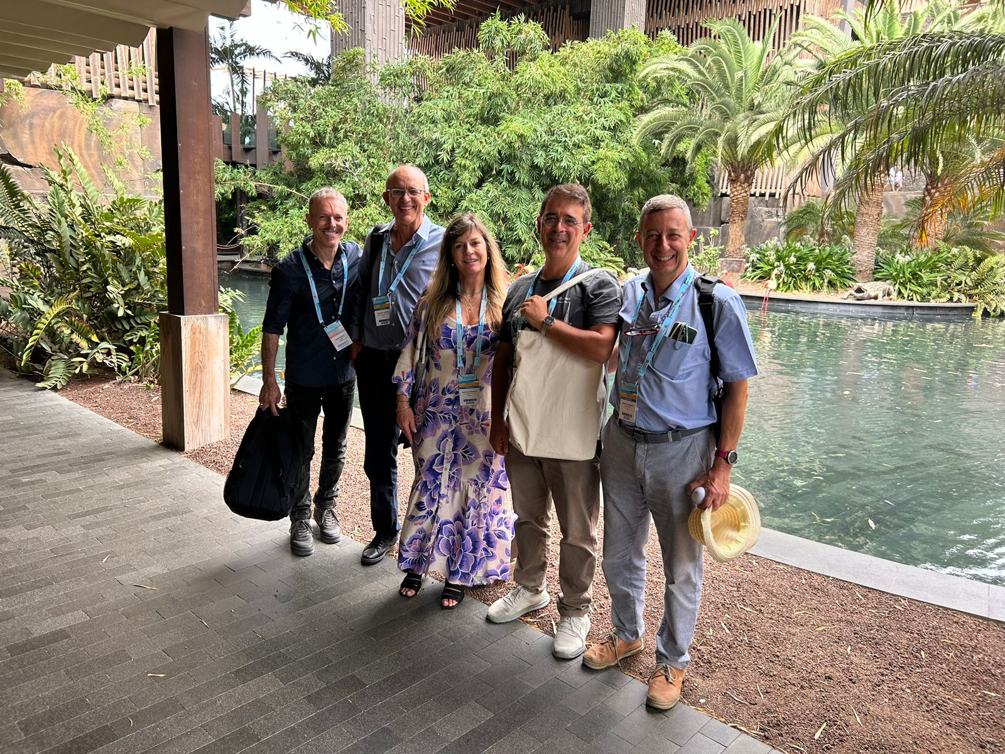
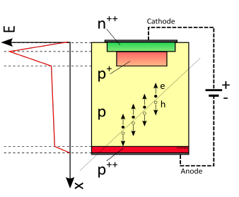
Motivation
Introduction
Dra. Marcilei Guazzelli
Thalia Alves da Silva
Dr. Rogelio. Palomo
Thalia A. Silva - 3rd DRD3 week
4

Slide 5


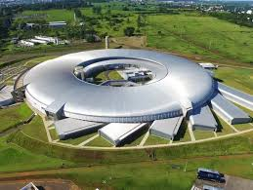

Motivation
SIRIUS Synchrotron (BRAZIL)
ESRF Synchrotron (EU)
Category | Sirius (Brazil) | ESRF (EU)
Facility Type | 4th-gen. synchrotron | 4th-gen. synchrotron
Location | São Paulo, Brazil | Grenoble, France
Beam Energy | 3 GeV | 6 GeV
Beam Current | Up to 350 mA | ~200 mA
Natural Emittance | 0.28 nm·rad | 0.15 nm·rad
RF Frequency | 500 MHz | 352 MHz
Circumference | ~518 meters | ~844 meters
Radiation & Optics | Sirius | ESRF
Spectral Brightness | > 10²¹ photons/s/mm²/mrad²/0.1%BW | > 10²² photons/s/mm²/mrad²/0.1%BW
Photon Energy Range | Infrared to ~40 keV | Soft to hard X-rays (~0.1 keV to 100 keV)
Spectral Range | IR to hard X-rays | EUV to hard X-rays
Beam Focus | Nanofocus capability (e.g., Carnaúba beamline) | Ultra-nanofocus (e.g., ID16B beamline)
Operating Modes | Multi-bunch (future single-bunch capability) | Multi-bunch, hybrid, and single-bunch modes
5
Projeto Sirius – a Nova fonte sincrotron do Brasil

Slide 6
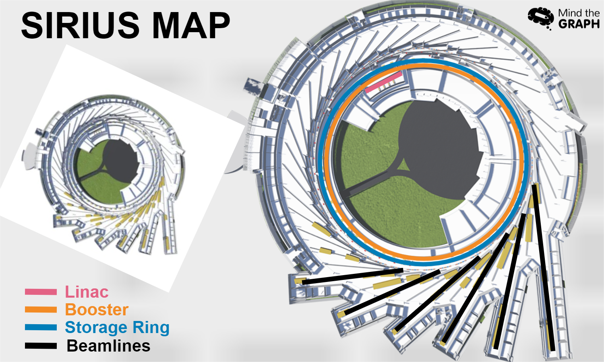
Motivation
Importance of Low Gain Avalanche Detector (LGAD)to Synchrotrons
The ideal detector for beamline experiments requires reach of fs. A good candidate to high temporal and spatial efficiency currently is the LGAD with ps.
Technological relevance for advanced facilities:
LGADs offer high-performance detection solutions suitable Sirius Synchrotron .
Potential for innovation and strategic use:
The possible integration of LGADs into Sirius beamlines has the potential to enhance the quality of experiments and promote the use of next-generation detection technologies in national strategic infrastructures like CNPEM.
Thalia A. Silva – 3rd DRD3 week
6
Notes:
LGADs are important in Brazil because they offer advanced solutions to meet some of the technological demands of facilities like Sirius. Just like the ESRF in France, Sirius operates with ultra-high brightness X-ray beams, which are essential for cutting-edge research in areas such as nanotechnology, biosciences, and applied physics. These experiments require detectors capable of withstanding extreme environments without performance loss — precisely the kind of performance LGADs provide. Therefore, developing and applying this technology in Brazil strengthens national scientific autonomy and drives innovation in strategic centers like CNPEM.

Slide 7
2
Methodology
Thalia A. Silva - 3rd DRD3 week
7

Slide 8
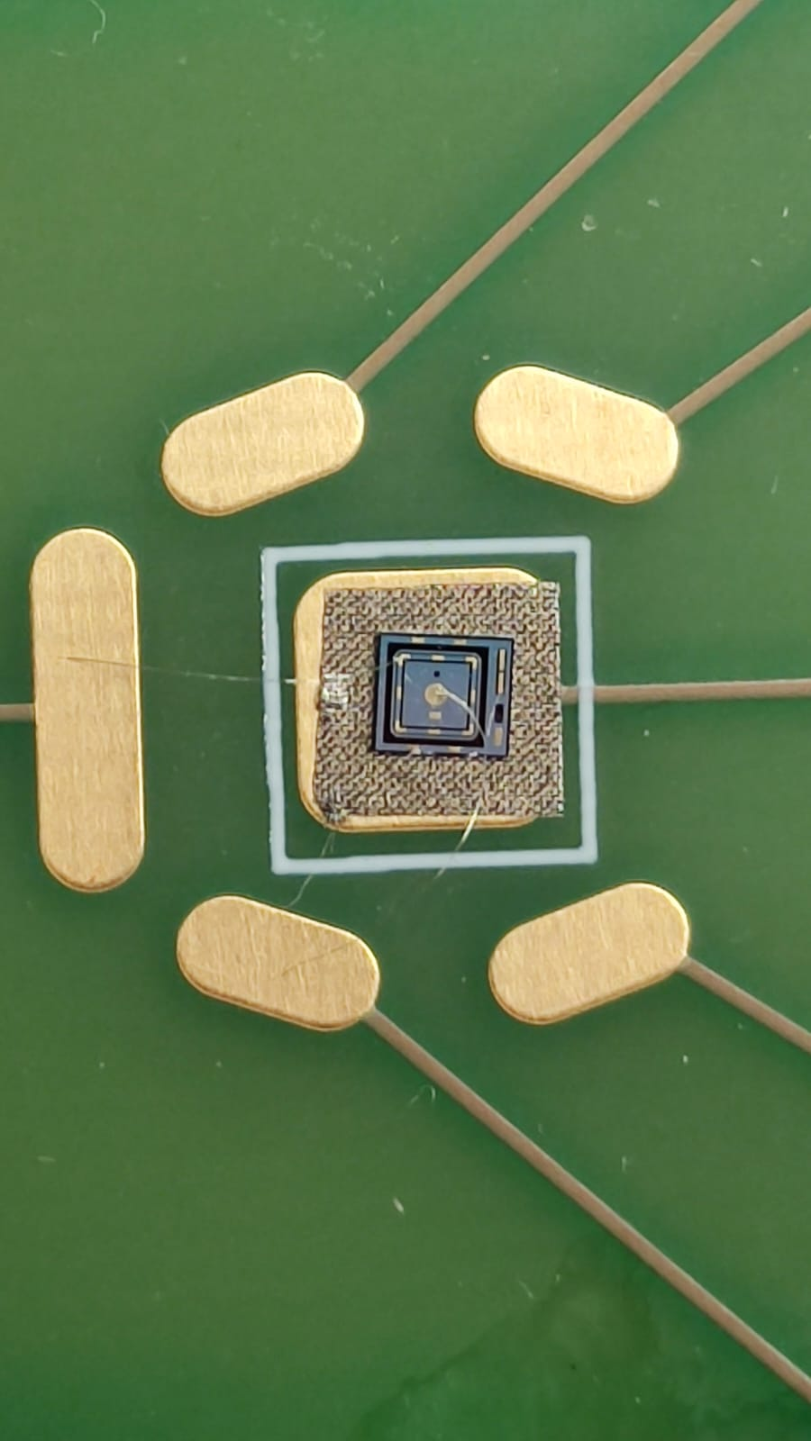
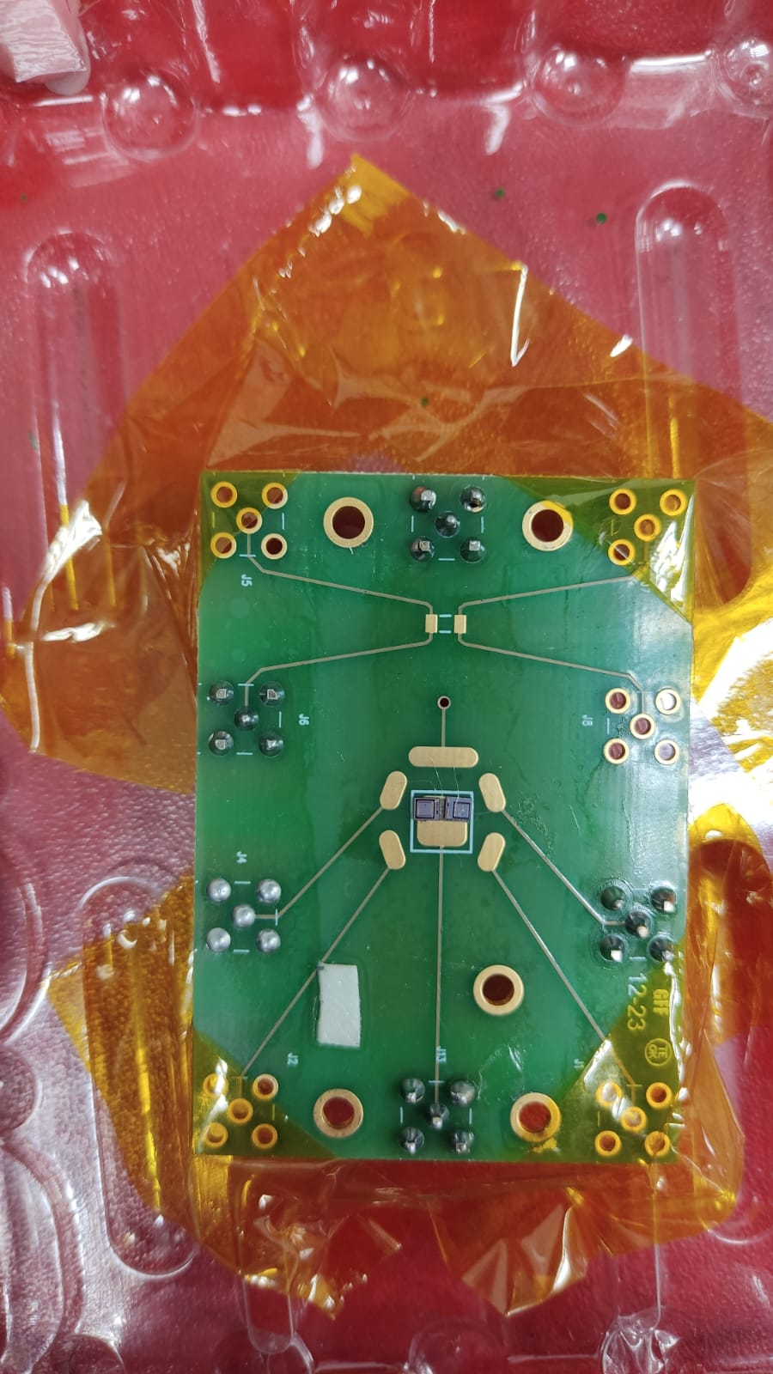
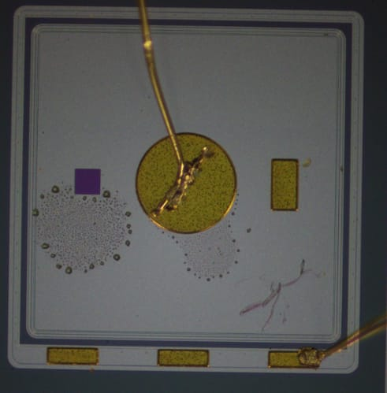
Methodology
This study investigated TID effects on LGADs through 10 keV X-ray exposure, with a focus on I–V and C–V curves measured before, during and after irradiation at varying radiation doses.
LGAD HPK 3.2 Single Pad
  Active area: 1.3 × 1.3 mm
  Active depth: 50 µm
  Gain layer: 2.2 µm
  Internal gain: 20
  Electric field: ~300 kV/cm
Thalia A. Silva - 3rd DRD3 week
8
A. Moreno

Slide 9
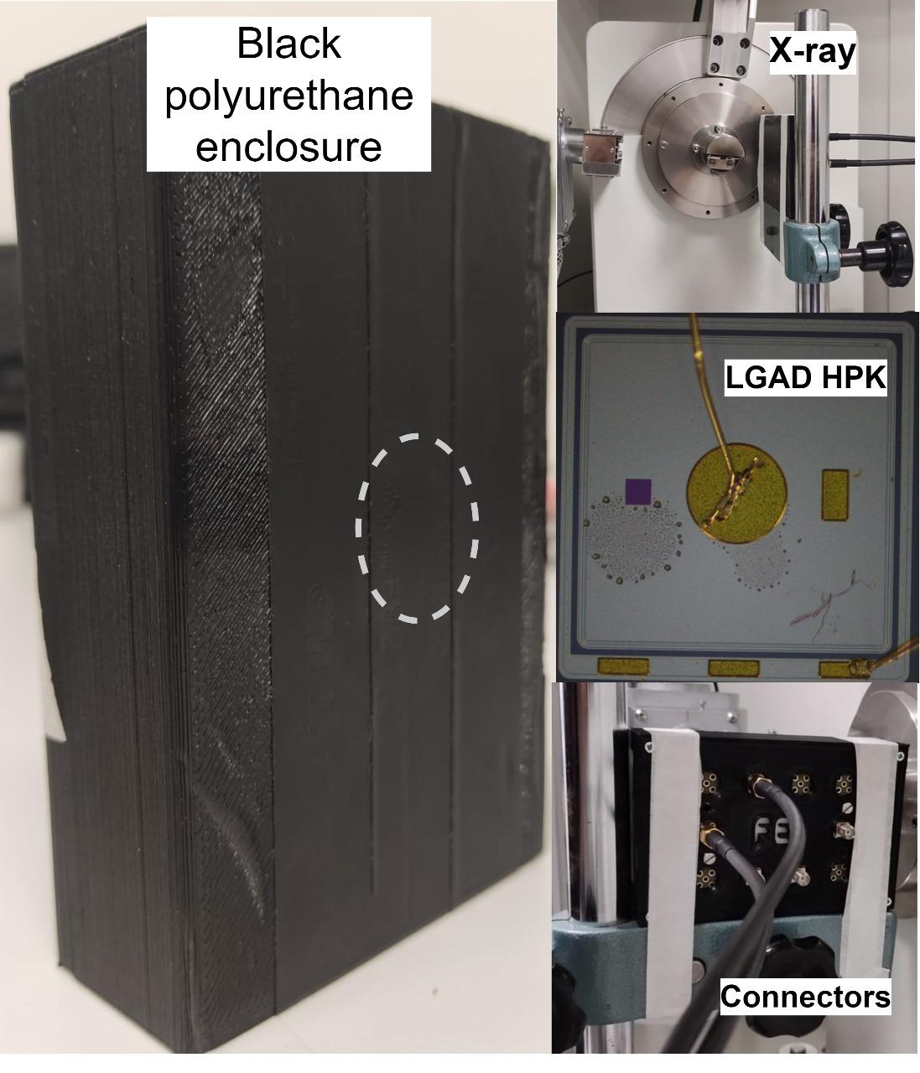
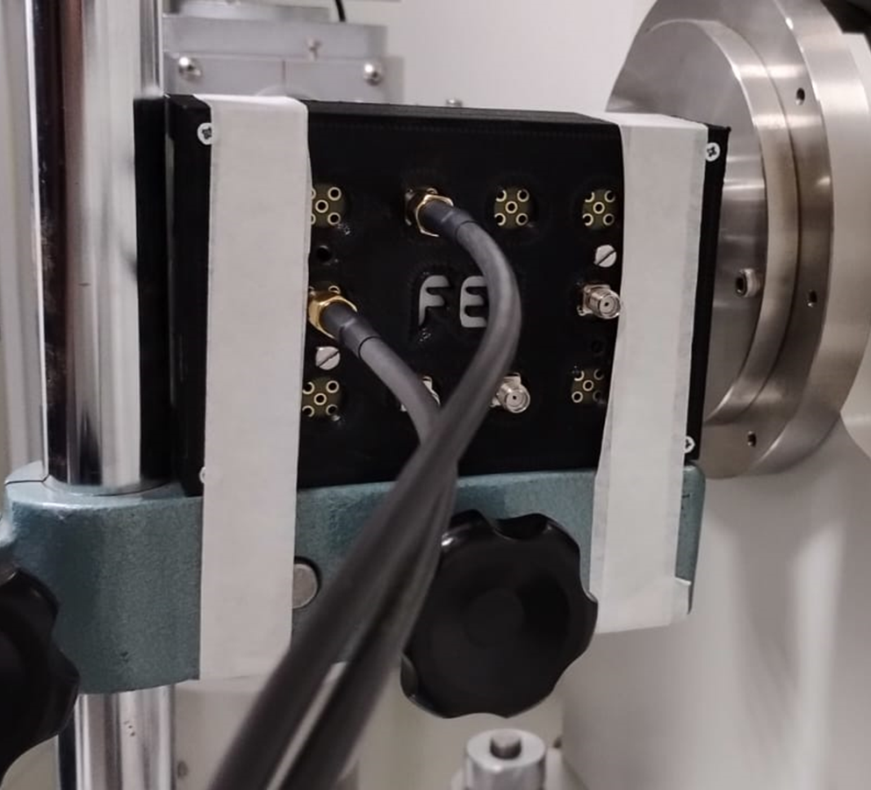
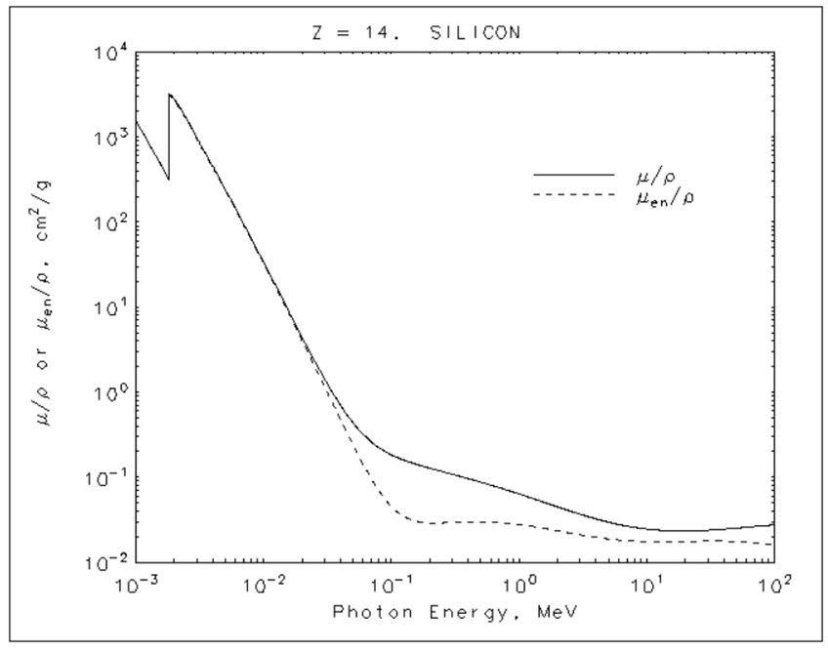
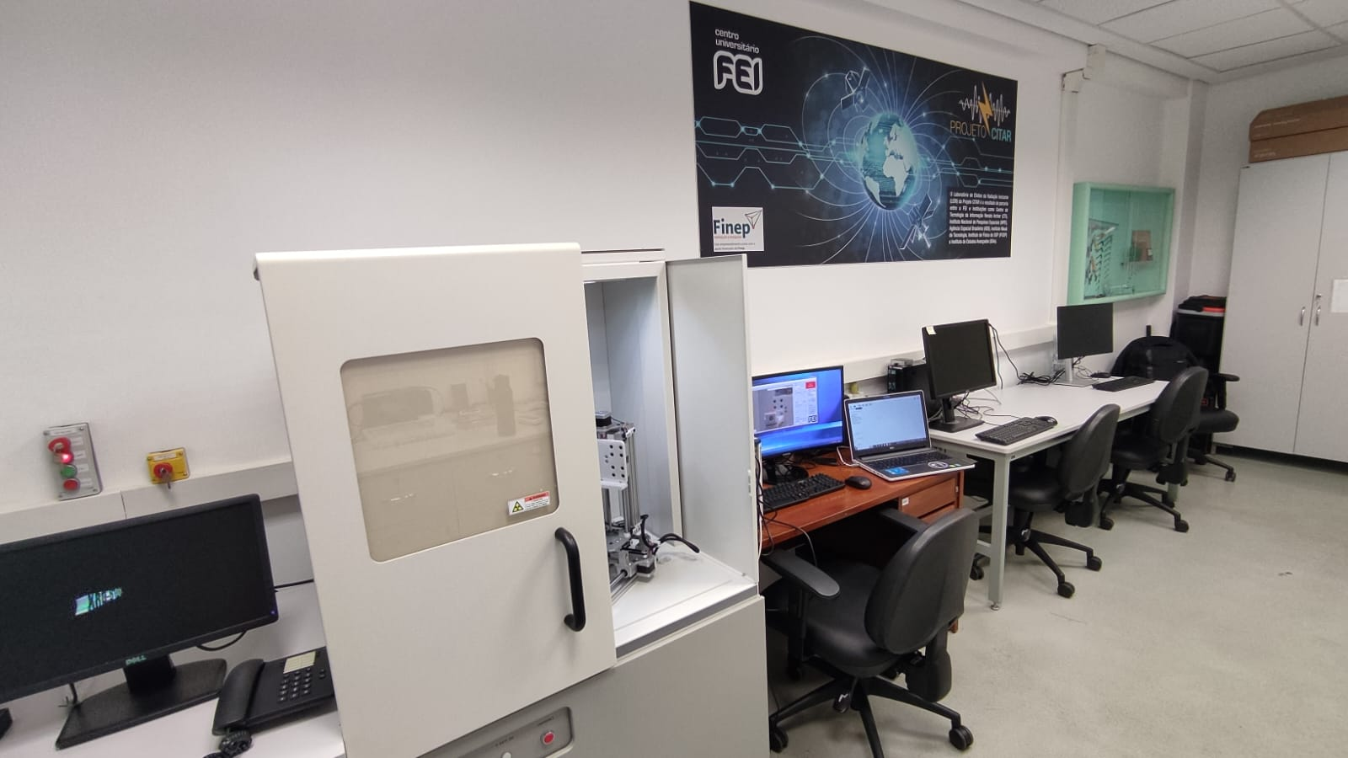
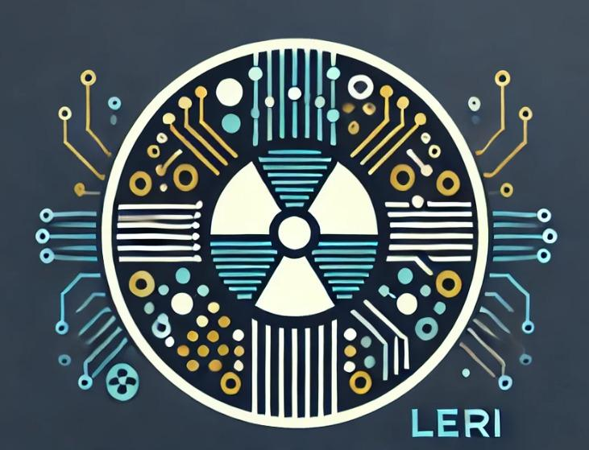
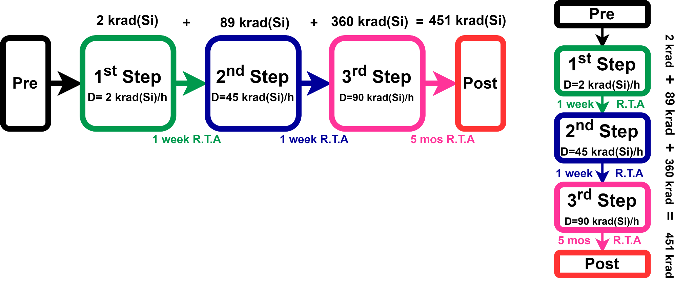
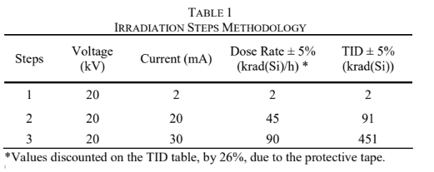
Methodology
X-RAY facility
10 keV X-ray
LERI
DUT distance = 15 cm
Thalia A. Silva - 3rd DRD3 week
9

Slide 10
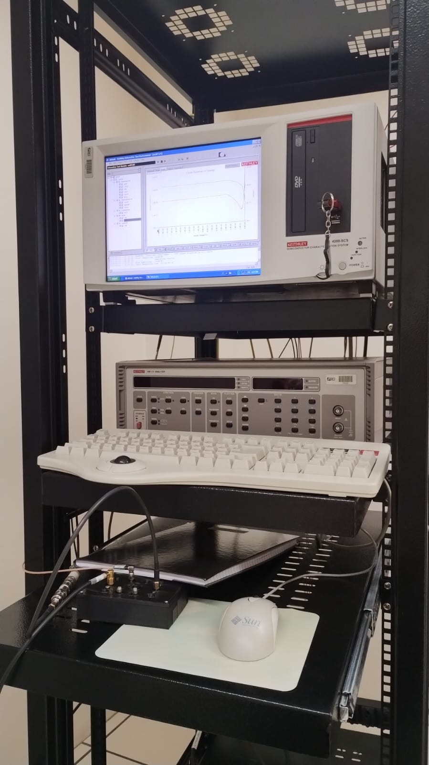
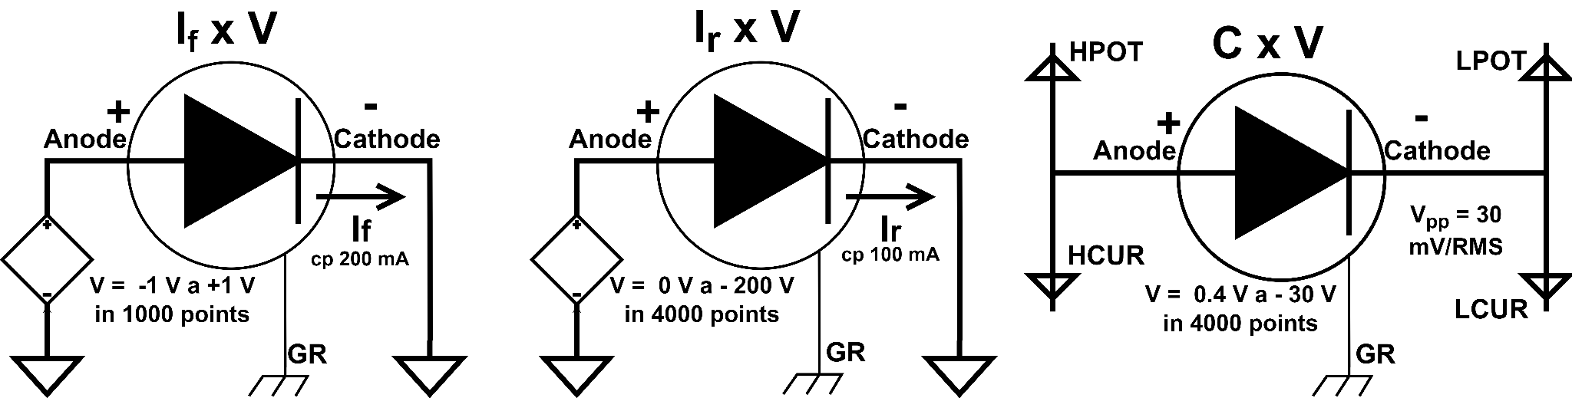
Methodology
Electrical characterization setup
Keithley 4200 SCS
For If x V measurements were voltages ranging from -1 to 1 V, with 200 mA current compliance, and 1000 points.
For Irev x V measurements were voltages ranging from 0 to -200 V, with 100 mA current compliance, and 4000 points
CxV : Vpp = 30 mV/RMS and VD = 0.4 to -30 V and two distinct frequencies: 1 MHz and 3 MHz..
Thalia A. Silva – 3rd DRD3 week
10

Slide 11
3
Results
Thalia A. Silva - 3rd DRD3 week
11

Slide 12
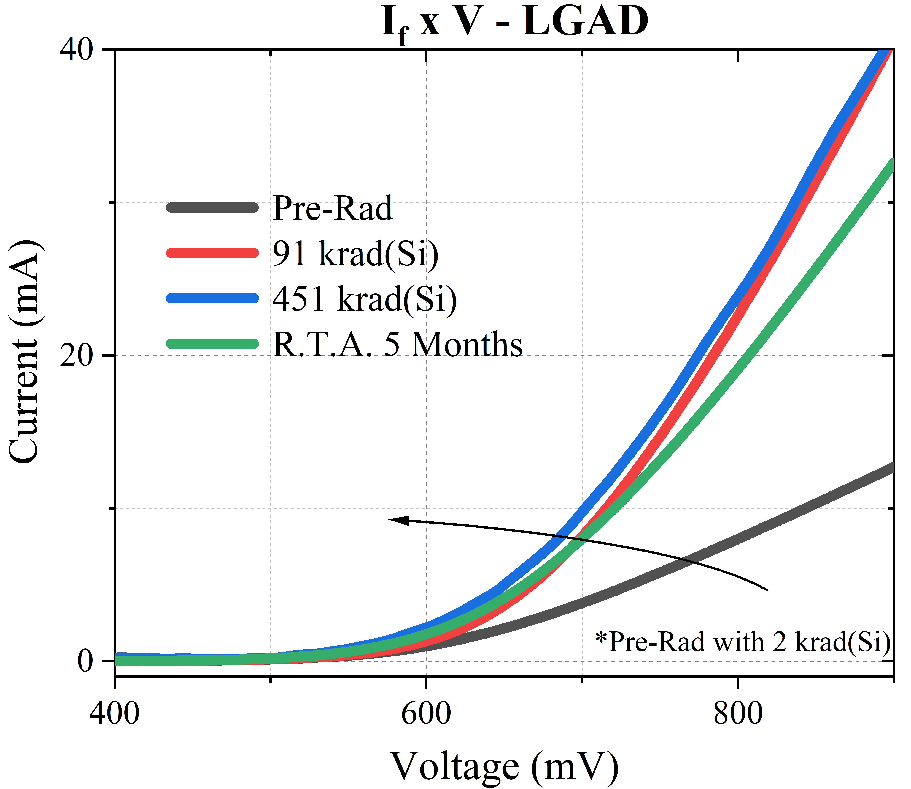
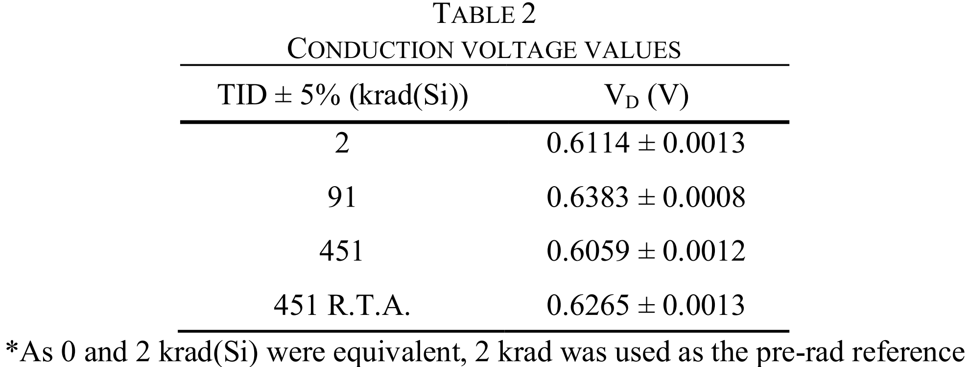
Results
Forward current vs Voltage (I_{f} x V)
It is known that the LGAD was not designed to operate under forward bias, as its functionality relies on carrier multiplication through impact ionization. This physical effect occurs under reverse current and for applied high electric fields. However, to understand the physical mechanisms that affect the functionality of this device under the TID effects, it is interesting to analyze its behavior under forward bias conditions.
Thalia A. Silva – 3rd DRD3 week
12

Slide 13
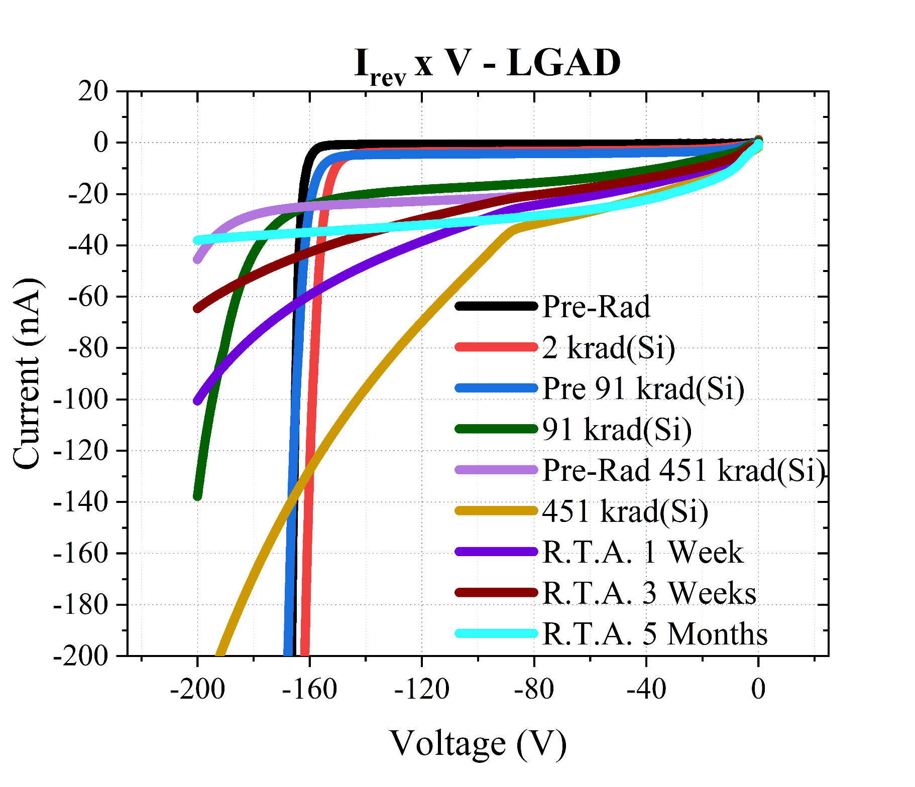
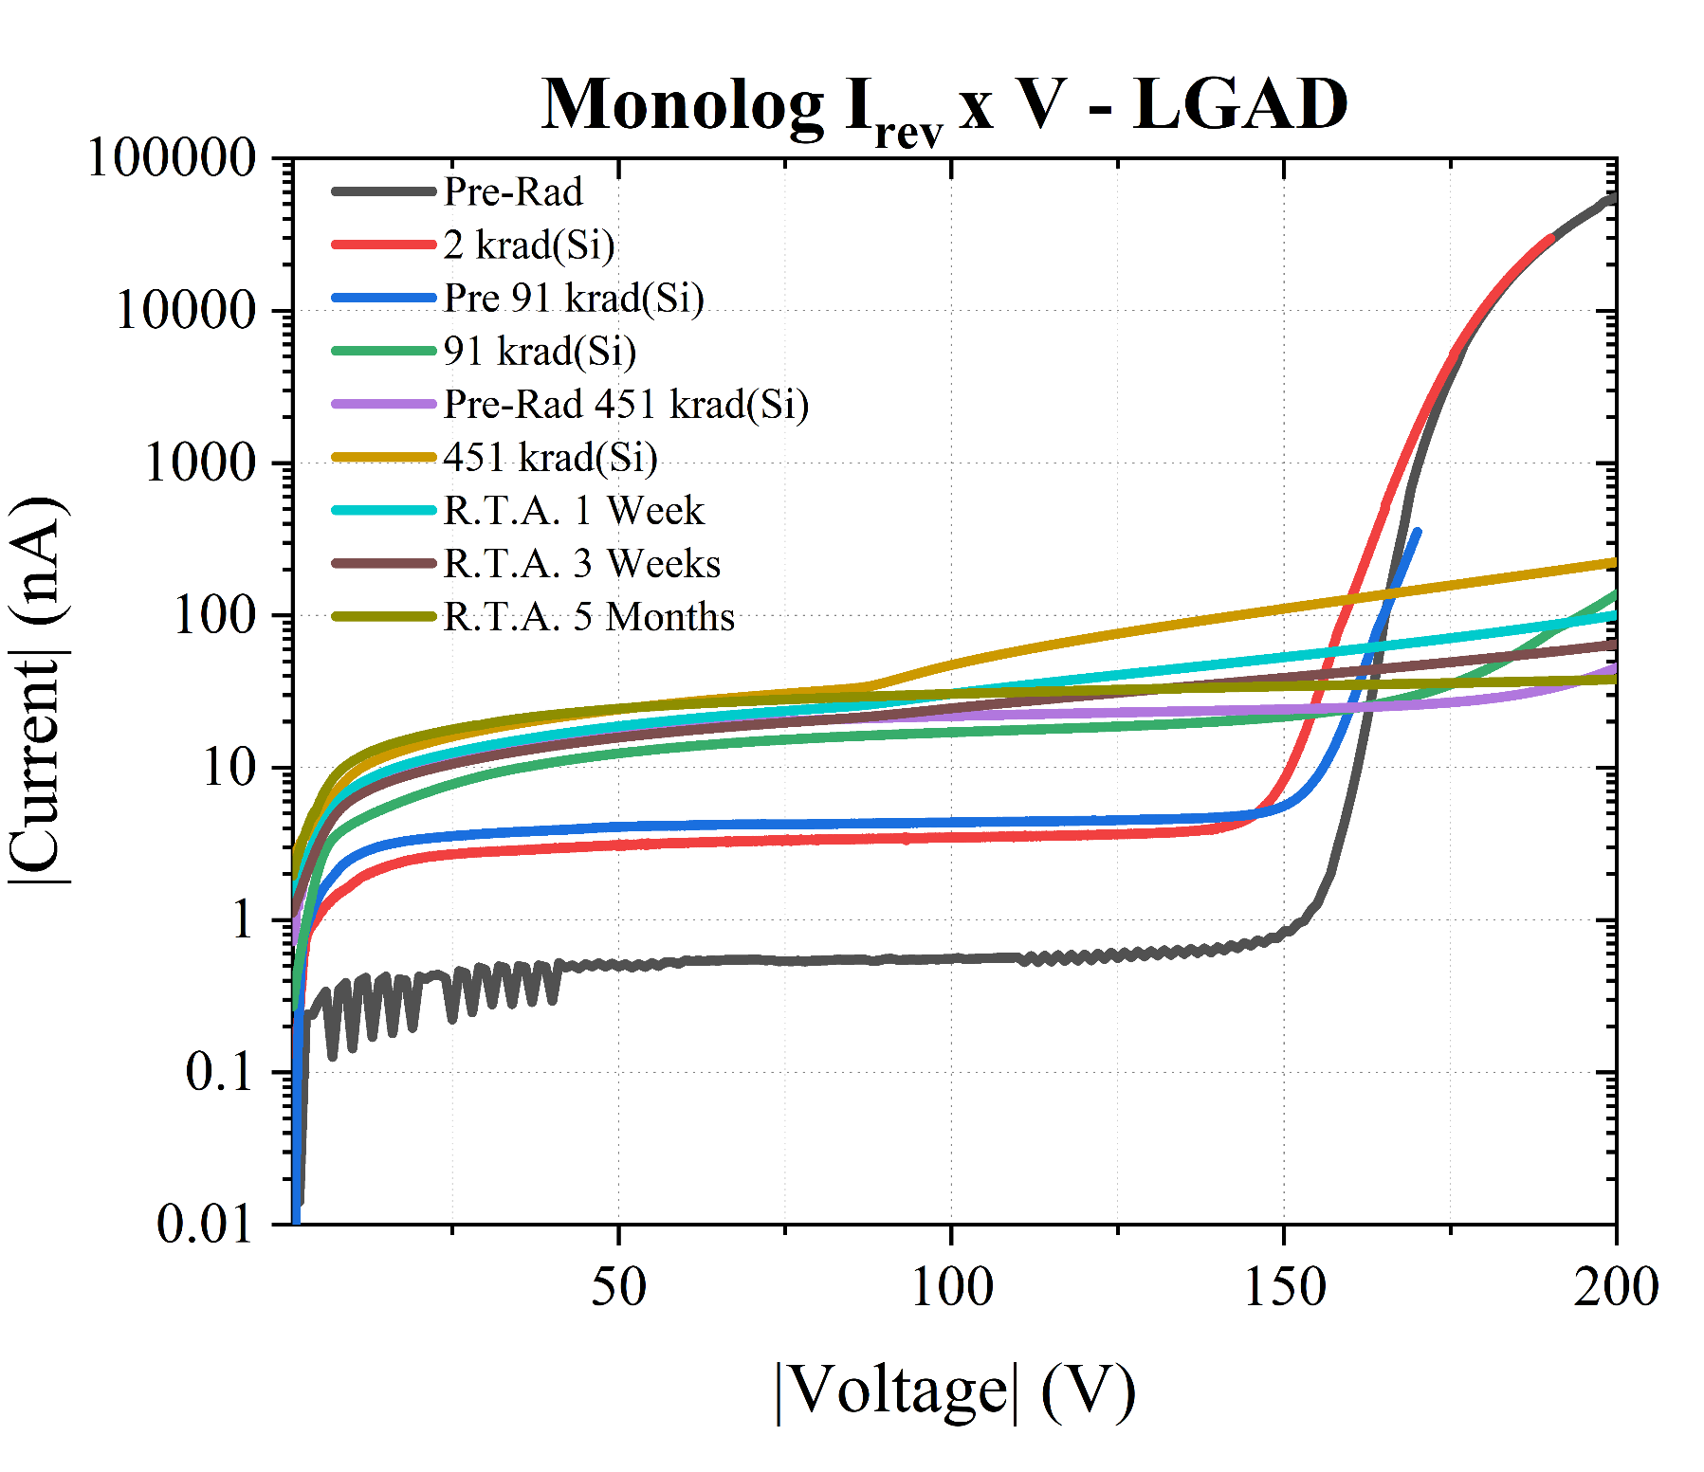
Results
Reverse current vs Voltage (I_{r} x V) and Breakdown Voltage (V_{B})
Breakdown voltage degradation is due to TID-induced damage in the passivation oxides, especially in the oxides located over the Junction Terminal Extensions (JTEs).
Thalia A. Silva – 3rd DRD3 week
13

Slide 14
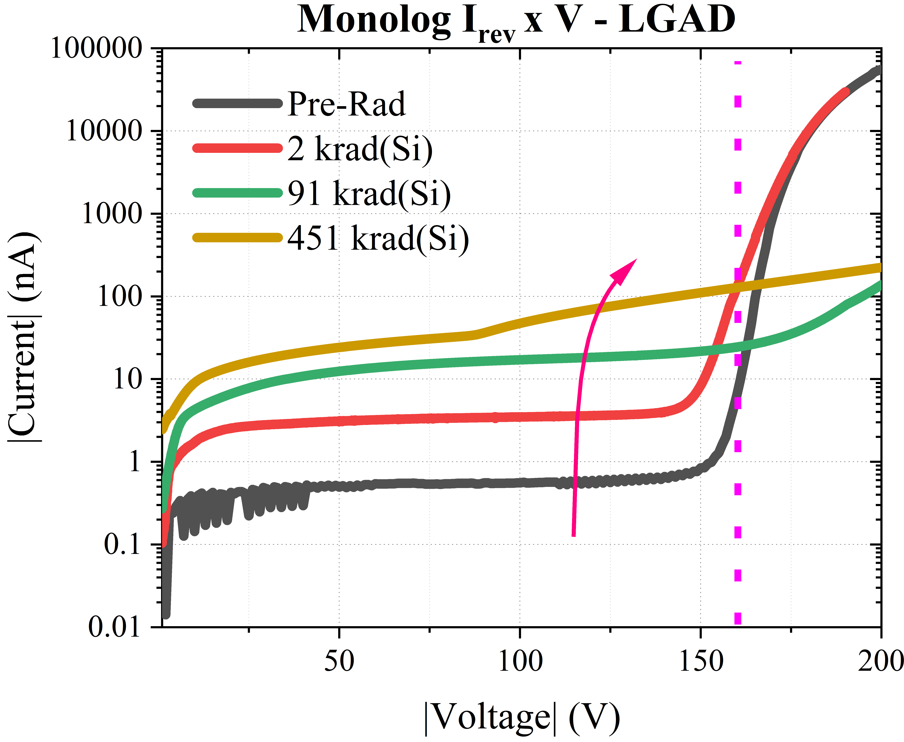
Results
Reverse current vs Voltage (I_{r} x V) and Breakdown Voltage (V_{B})
Breakdown voltage degradation is due to TID-induced damage in the passivation oxides, especially in the oxides located over the Junction Terminal Extensions (JTEs).
Thalia A. Silva – 3rd DRD3 week
13

Slide 15
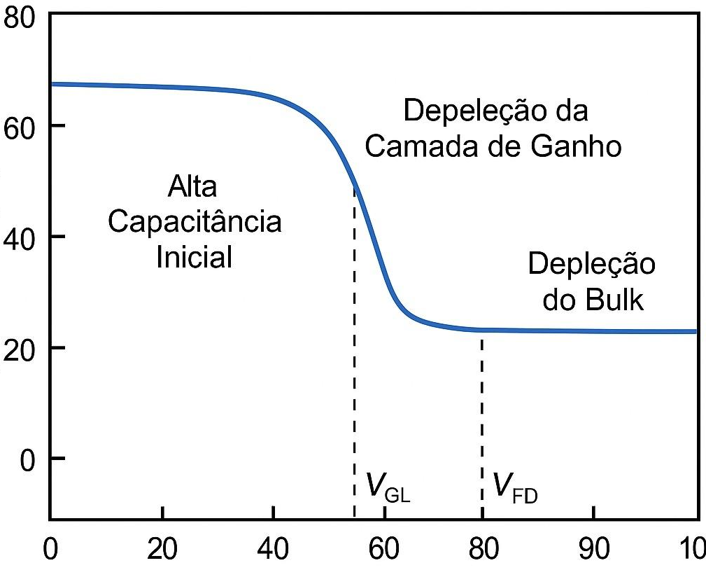
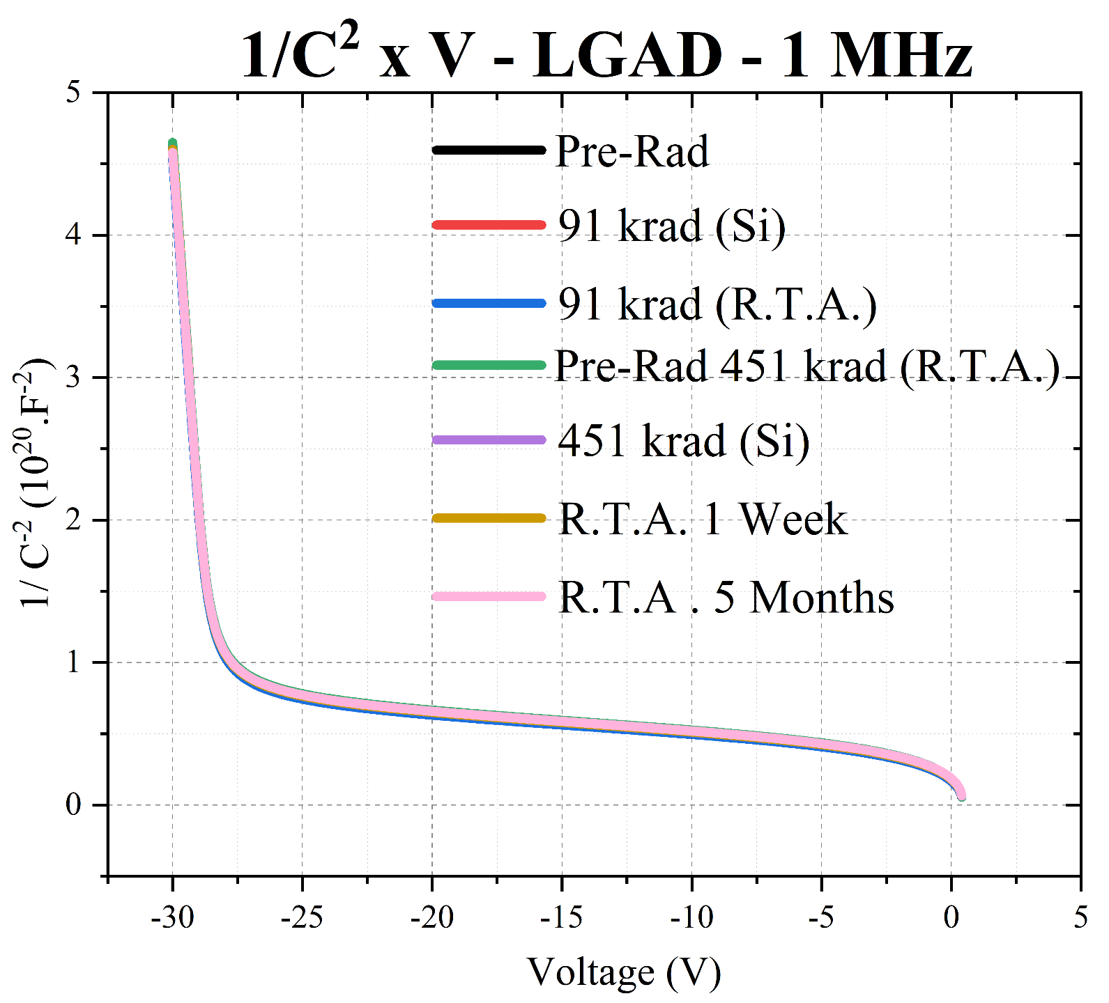
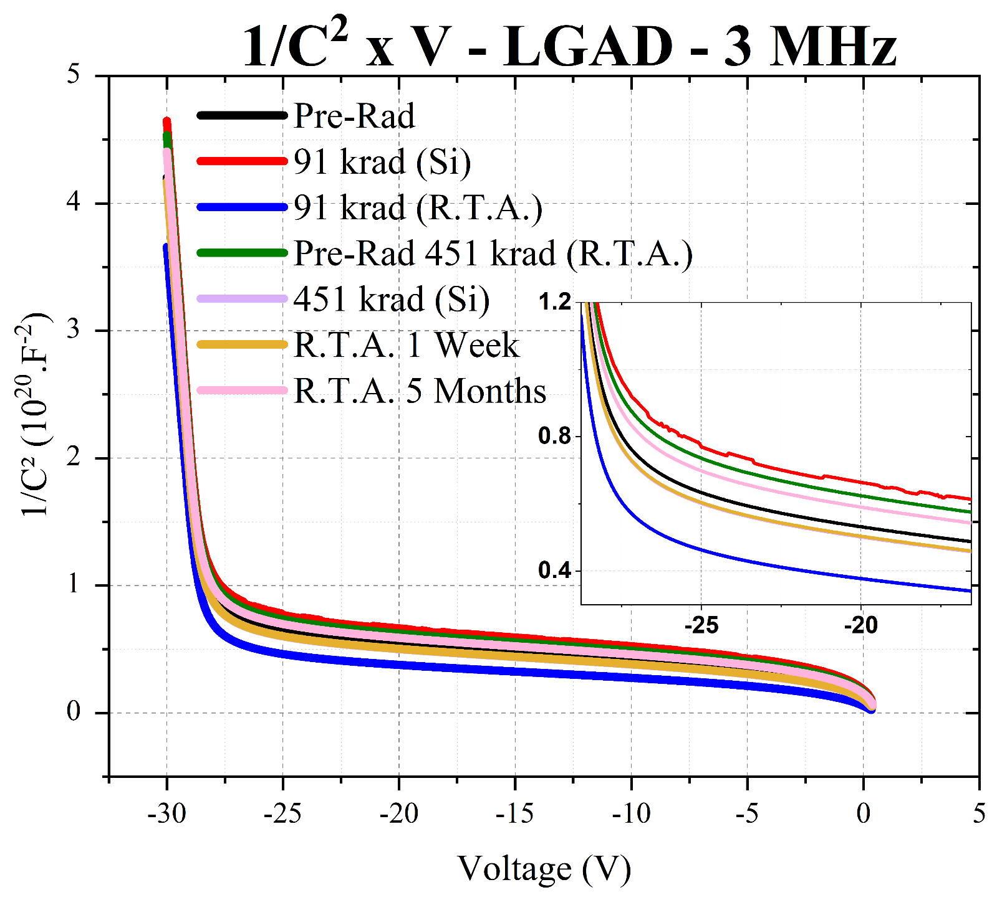
Results
Capacitance vs Voltage (C x V) and 1/C² vs Voltage
Gain layer depletion
Initial High Capacitance
Capcitance (nF)
Full depletion
Voltage (V)
A. Moreno
The behavior observed in the capacitance curve measured at 3 MHz can be attributed to the release of radiation-induced charge carriers previously trapped in defect states. This process alters the effective charge density at the device junction, directly impacting the capacitance value.
V_{GL} = -28.8 V
V_{GL}
For the measurements is possible to acquire the Gain layer depletion (V_{GL}), through the second derivative.
Thalia A. Silva – 3rd DRD3 week
14

Slide 16
4
Conclusions
Thalia A. Silva - 3rd DRD3 week
15

Slide 17
Conclusions
Numeric overview of the results
 | Pre-rad | 2 krad(Si) | 91 krad(Si) | 451 krad(Si) | Post-R.T.A.
VD (V) |  | 0.611 | 0.638 | 0.606 | 0.626
VB (V) | -166 | -159 | -195 | -143±50 | Undefinable
VGL (V) | -28.80 | -28.80 | -28.80 | -28.80 | -28.80
VGL (V) | -28.85 | -28.85 | -28.80 | -28.85 | -28.85
I_{f} x V
0.611
I_{r} x V
1 MHz 1/C² x V
3 MHz 1/C² x V
Thalia A. Silva – 3rd DRD3 week
16

Slide 18
Conclusions
There was a significant variation observed in device electrical characteristics during irradiation, particularly evident in I x V curves with decreased conduction voltage and degradation in avalanche region.
There was not a total recovery of electrical properties observed within a week of Room Temperature Annealing between irradiation steps.
Compromise of its original function in high-energy particle detection due to observed changes.
The degradation is due to TID-induced damage in the passivation oxides, especially in the oxides located over the Junction Terminal Extensions (JTEs).
Thalia A. Silva – 3rd DRD3 week
17

Slide 19
5
Future Steps
Thalia A. Silva - 3rd DRD3 week
18

Slide 20

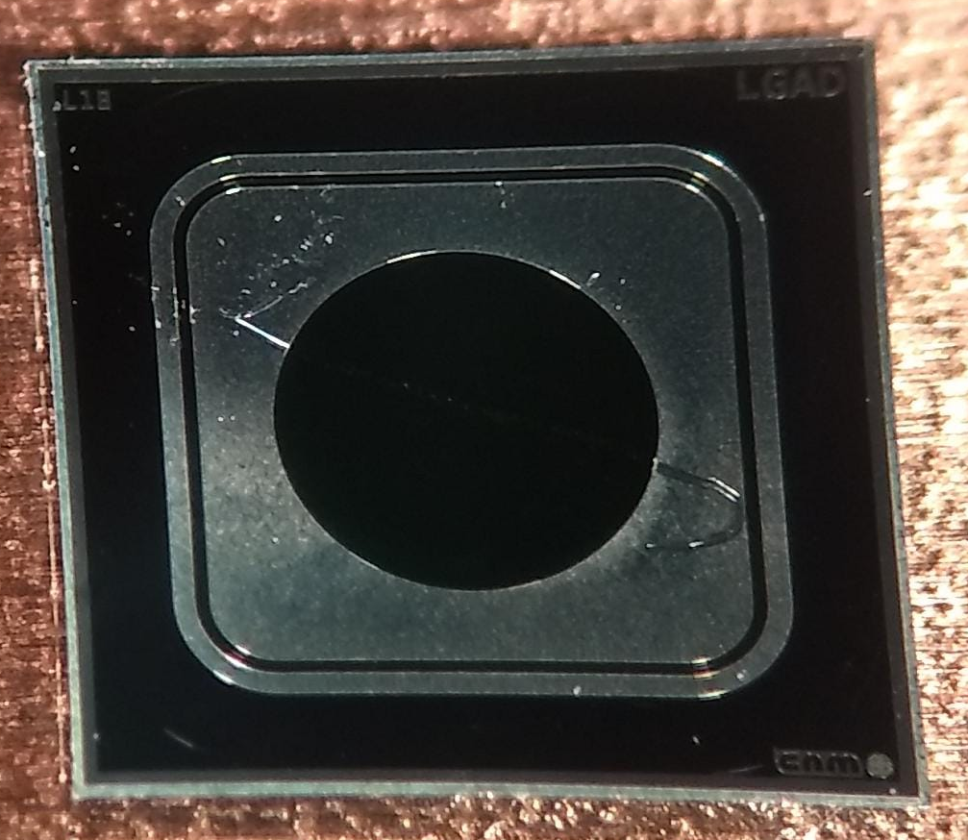
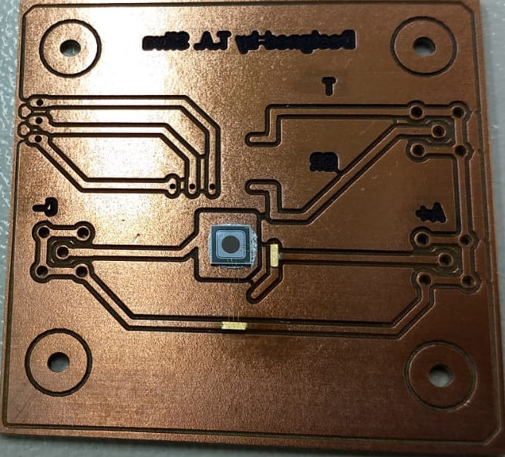
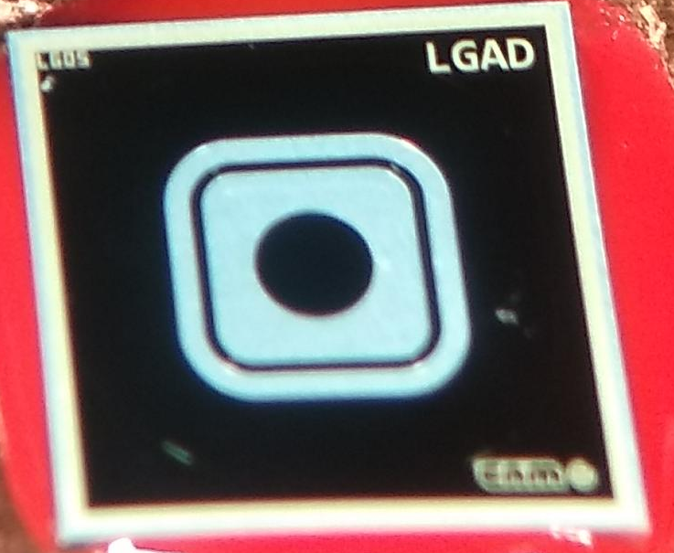
Future Steps
Collaboration with
LGAD CNM
Future steps aim to study surface damage caused by Total Ionizing Dose (TID) using LGAD, nLGAD, and PIN diodes from IMB-CNM.
These initial tests helped setup a more efficient methodology for this type of device
This study will also consider temperature variations, monitored using a thermopar, the extraction of the gain, to enable a comparative analysis of the three types of diodes.
Thermopar
Anode
Cathode
nLGAD CNM
Guard Ring
Thalia A. Silva – 3rd DRD3 week
19

Slide 21


Thank you!
E-mail : thalisilva@fei.edu.br
Orcid: 0009-0002-0508-7937
20

