Slide 1
Double Beam TCT (DB-TCT)
New laser method for high rate sensor tests
Bojan Hiti (JSI Ljubljana)
3rd DRD3 Collaboration Week, Amsterdam
6 June 2025

Slide 2
Motivation
Resistive Silicon Detectors (RSD) have sparse channels and rely on signal sharing to achieve a high spatial resolution
Sparse channels lead to higher channel occupancy at a given rate
  Signal sharing not necessarily limited to electrodes surrounding hit cell (DC discharge)
We are developing a lab method to test signal properties depending on relative position and time of two coincident hits
  Current options for rate tests:
    High rate testbeam – complex
    Laser with two time delayed pulses – time dependence only
Double Beam TCT (DB-TCT)
  Use two separate laser beams – position and time adjustable
AC strips
Hit 1
Hit 2 (+ few ns)
What is the signal from Hit 2 like?

Slide 3
DB-TCT considerations
Focused infrared laser (1064 nm)
  Spot size ≈ 10 µm, penetration depth 1 mm, top side injection
Two beams generated via beam splitter
  No variations in relative time of arrival
  Time profile of both pulses is identical
  Relative delay by adjusting path lengths
Two optical focusing systems required
  Spatial constraint – beams inclined to each other
  Favorable refraction on air-silicon boundary
    n_{Si} ≈ 3.5 → inclination in silicon 3x smaller than incident angle
  Challenging alignment of both beams (3 dimensions)
Independent translation of one optical branch
Laser source
scanning
Sample (not to scale)

Slide 4
DB-TCT setup schematics
z
Laser source
1064 nm, 300 ps,
1 kHz repetition rate
y
Standard Particulars TCT system upgraded for two beams:
  2 manual stages to adjust Branch 2 in y, z
  1 motorized stage to scan Branch 2 in x (X2)
  XYZ motorized stages remain
    Z stage replaced after finding focus with X2
New mechanics for focusing optics
  Focal distance 7 cm, lens mounting radius 3 cm
  Minimal achievable angle between beams ≈ 50°
  In silicon half-angle between beams α = 7° (refraction)
    In 50 µm thick sensors this means displacement of 6 µm from vertical
    This is less than beam spot size
Beam splitter + beam fibers
  Delay between both lines can adjusted in steps of 5 ns (1 m fiber)
Standard single channel & multi channel readout
x
  50:50 beam splitter
Branch 2
Branch 1
scanning
3 cm
DRS 4
700 MHz, 5 GS/s
7 cm
Amplifier
Particulars 53 dB, 2.5 GHz
or
Chubut 2 (4 ch.) 40 dB, 4 GHz
Sample (not to scale)
α ≈ 7°

Slide 5
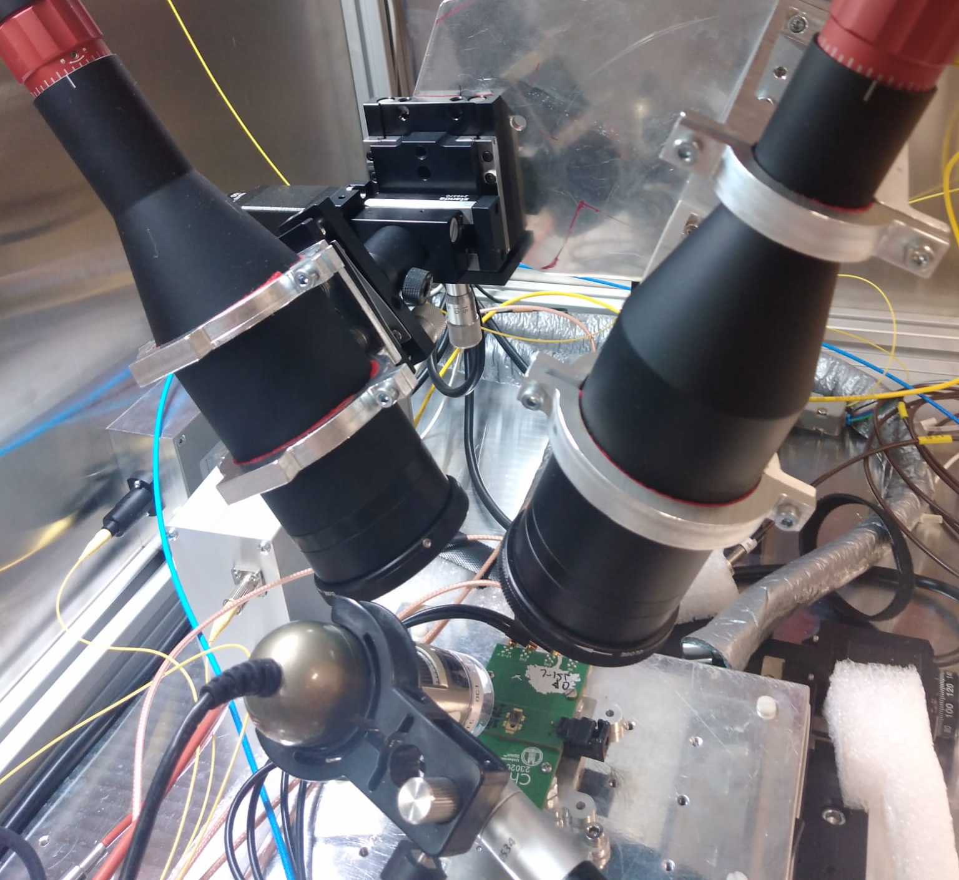
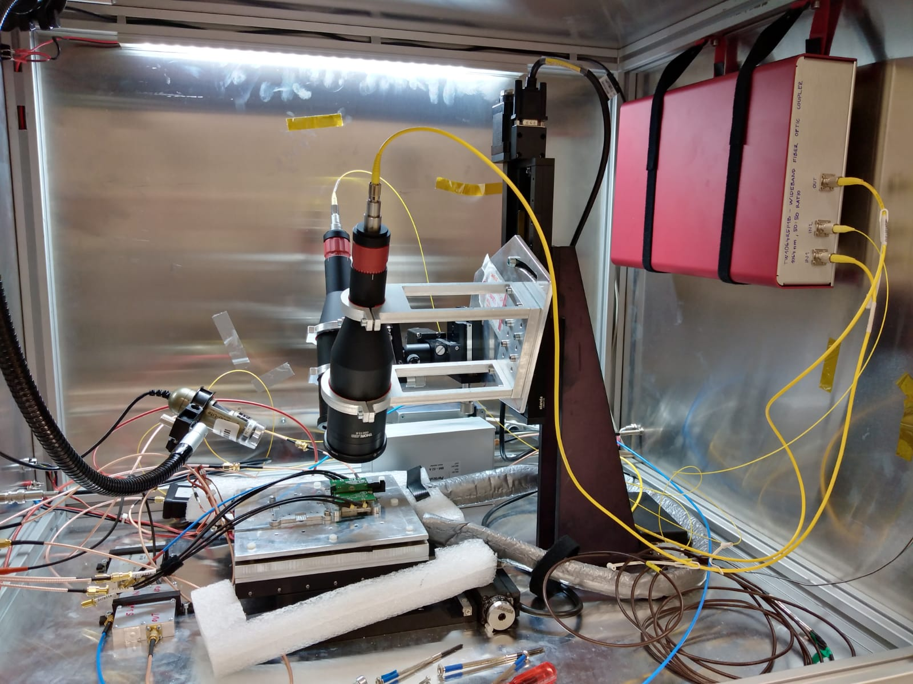
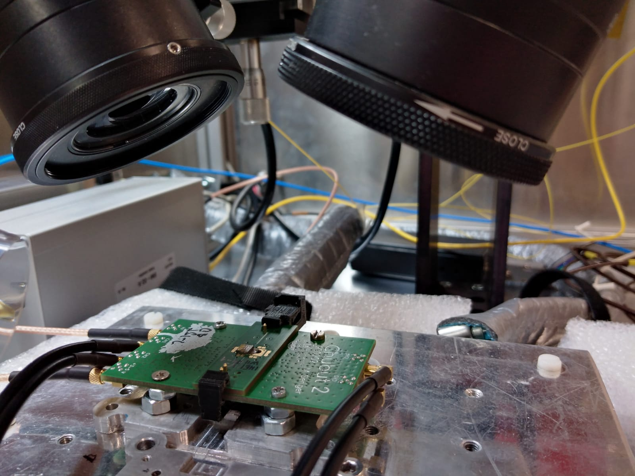
DB-TCT setup
Beam splitter
Branch 2
Branch 1
Sample with PCB
(Chubut 2)

Slide 6
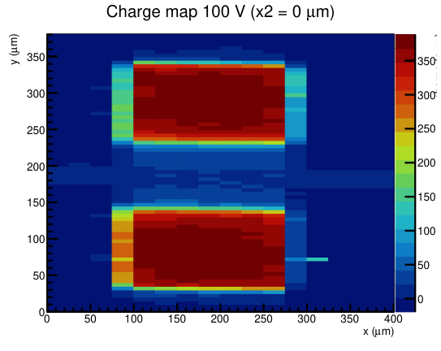
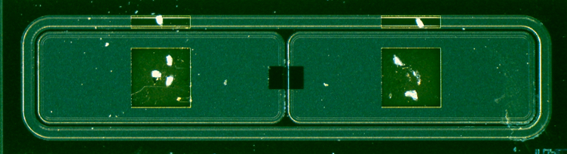
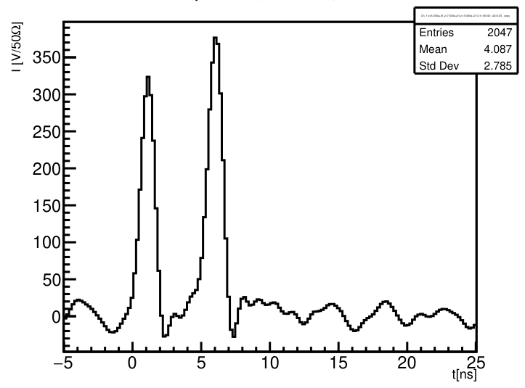
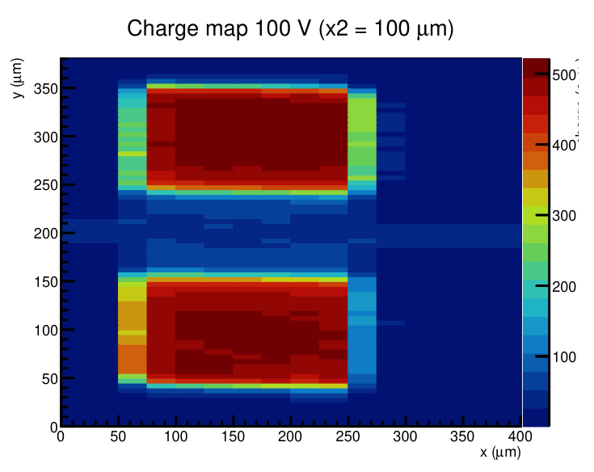
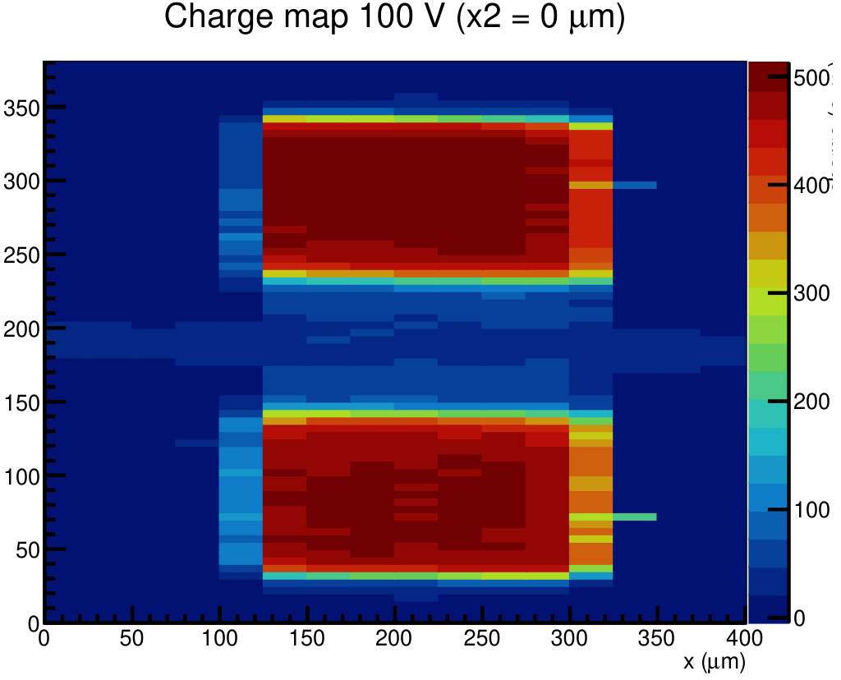
DB-TCT Commissioning
First tests of beam alignment and focusing carried out with ATLAS-HGTD LGADs
  Fast signals < 3 ns → no rate effects
  2 LGADs separated by inactive region (both connected together to same readout channel)
  5 ns delay between branches
    Define collected charge as integral of 3 ns around pulse peak
LGAD 1
optical window for laser injection
Hit 1
Hit 2
Signal 1
LGAD 2
Results:
  Successful alignment of both beams
  Measured beam spot size FWHM 9 µm (in x), 8 µm (in y)
  Hit 2 has consistently 40 % more charge (pulse energy difference between branches)
Signal 2 (two different positions)

Slide 7
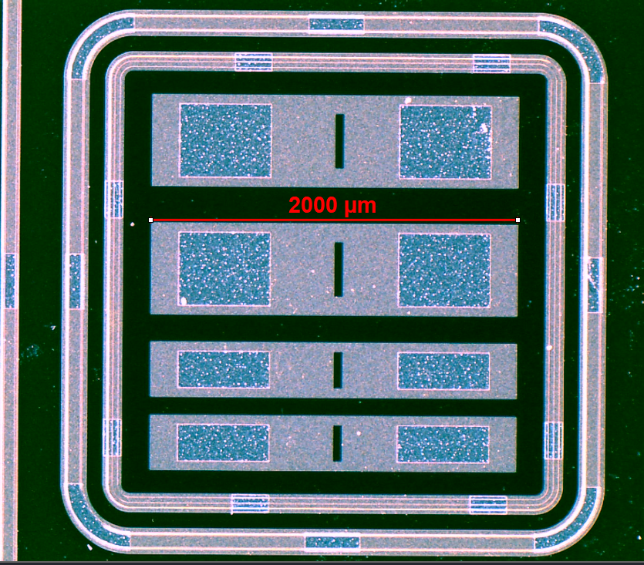
AC-LGAD: First measurements
IHEP-IME AC-LGAD sensor prototype
  For DRD3 project LGAD based timing tracker development for future colliders, also simulation
  4 AC pads, 50 µm thick active layer, biased to 140 V
Mounted on 4-channel Chubut2 Front End Board
Read out with DRS4 digitizer (3 channels connected)
Two data taking runs:
  Single beam (Branch 1)
  Double beam
    Branch 2 delayed by 5 ns w.r.t. Branch 1
    6 spatial separation steps (0 µm, 100 µm, …, 500 µm)
Goal is to study signal shapes
  Very preliminary study!
DC ring
Ch 3
Ch 2
Ch 1
Scan area

Slide 8
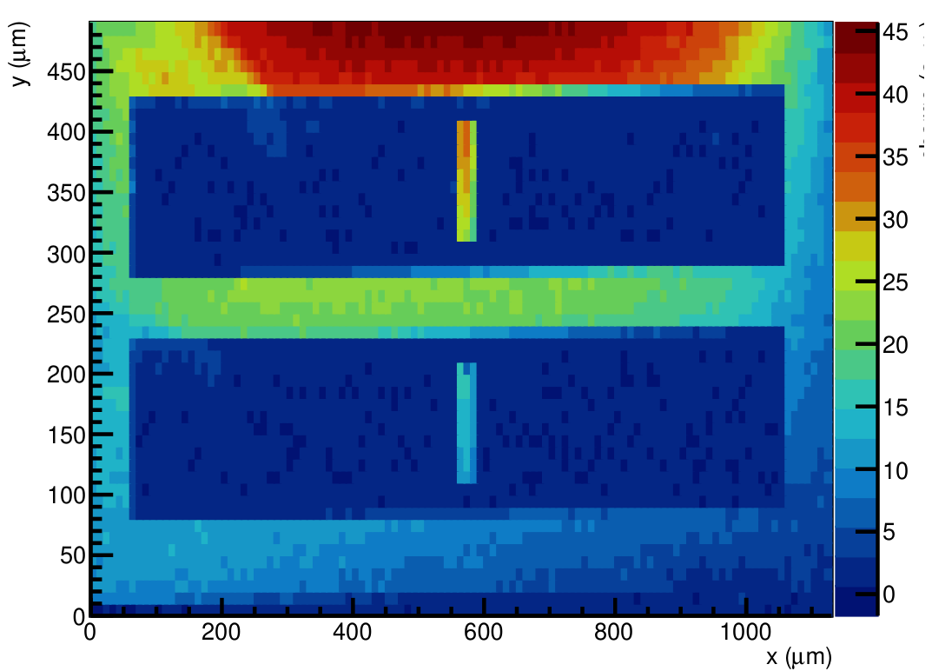
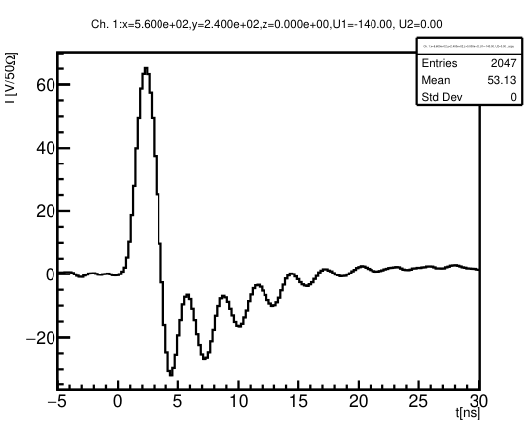
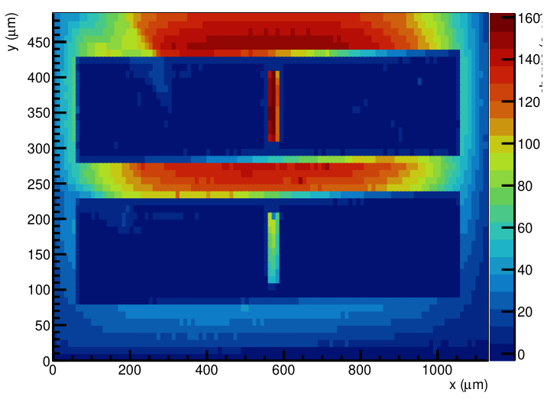
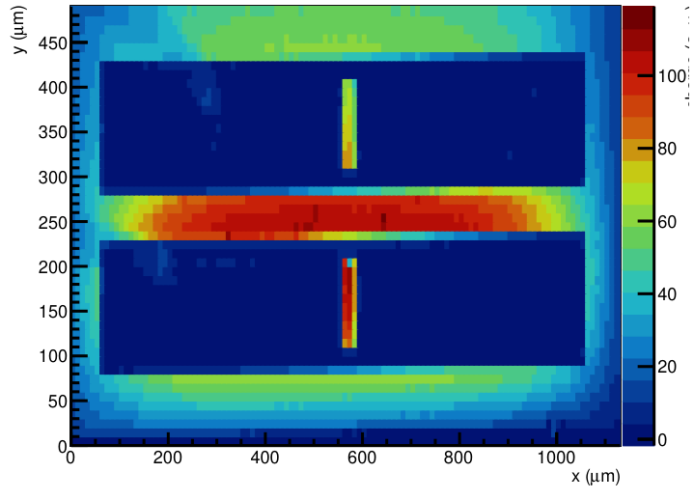
Single Beam signals
Ch 3
DC ring
1
z scale not
the same
Ch 3
Ch 2
2
Ch 1
Scan area
Ch 2
Signal analysis:
Collected charge:
  Multiplication & AC charge collection
    Collected charge defined as integral over 3 ns window
  “Slow” DC discharge
    Oscillations under investigation, electronics related
  Charge not confined only to nearest cell
  Towards edges significant share collected directly by DC ring (no gain)
Ch 1

Slide 9
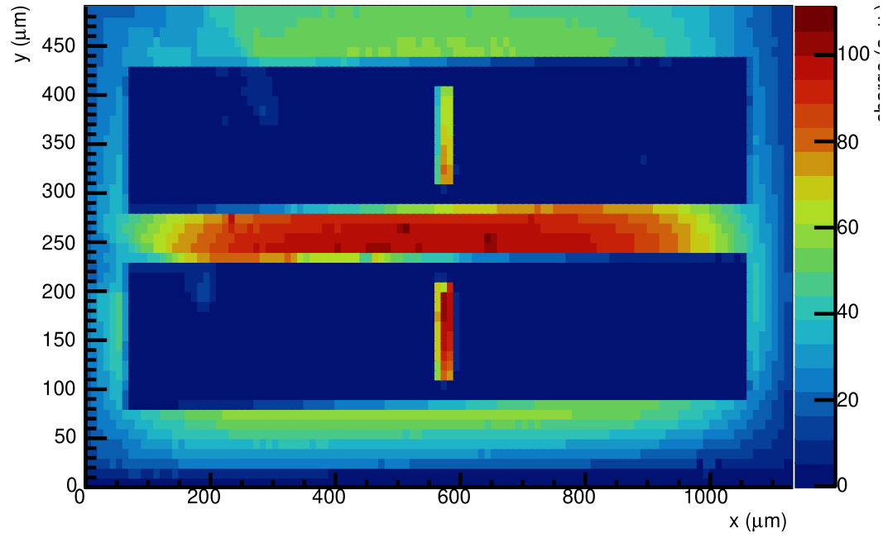
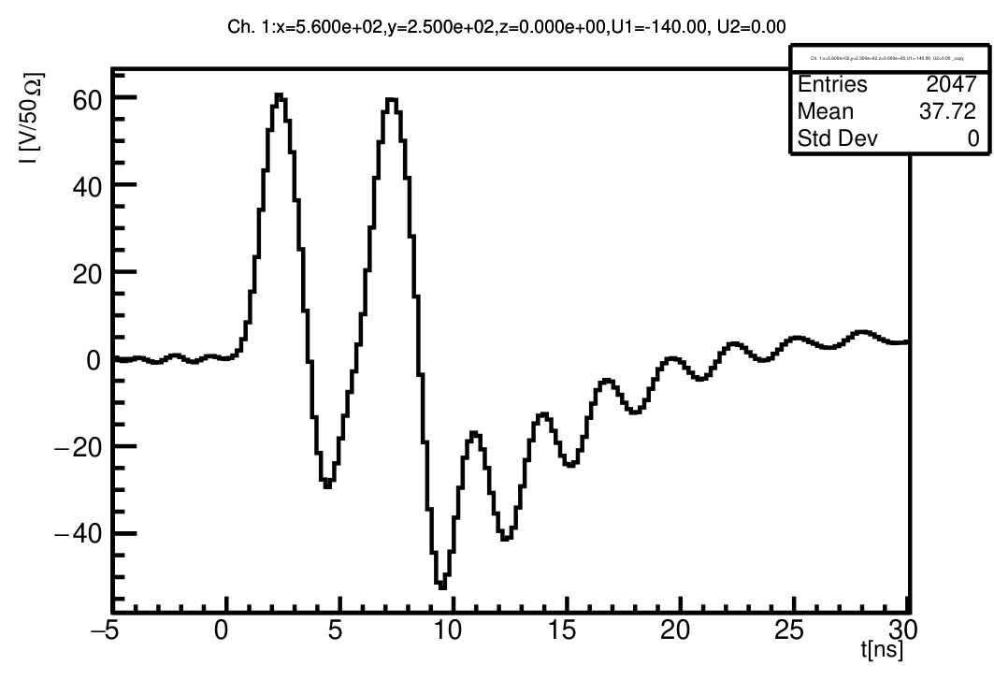
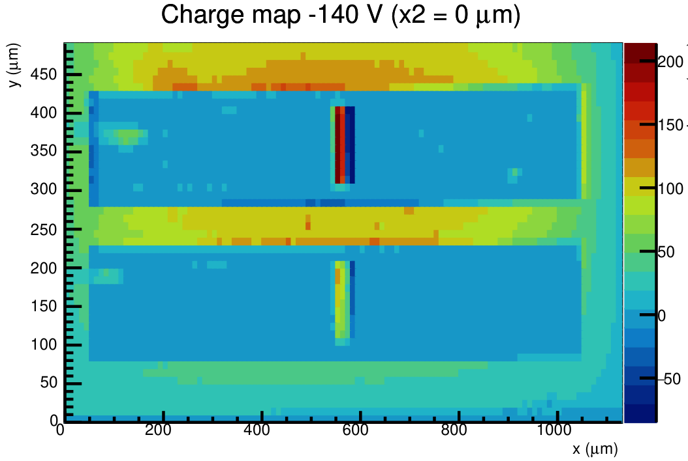
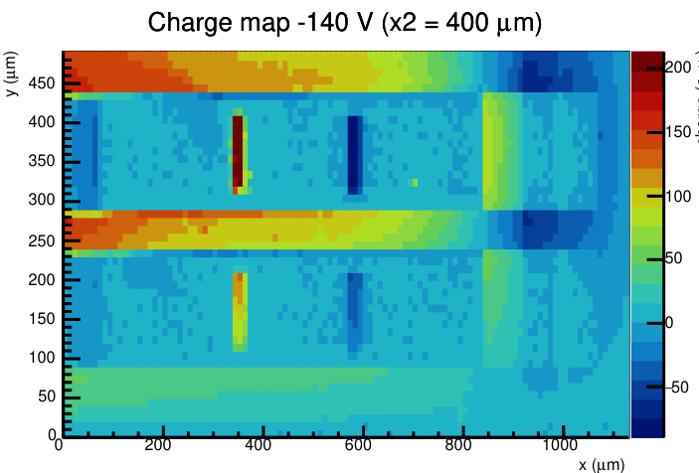
Double Beam signals
Charge 1
Hit 1
Hit 2
Charge 2 (no spatial offset)
z scale not
the same
  Signal is a superposition of signals from Hit 1 and Hit 2
  Hit 1 clearly affects collected charge from Hit 2
    5 ns delay not sufficient to reset the sensor
  Demonstration of scanning capability for Branch 2
    More detailed scans required (offset in different direction etc.)
Charge 2 (200 µm spatial offset)

Slide 10
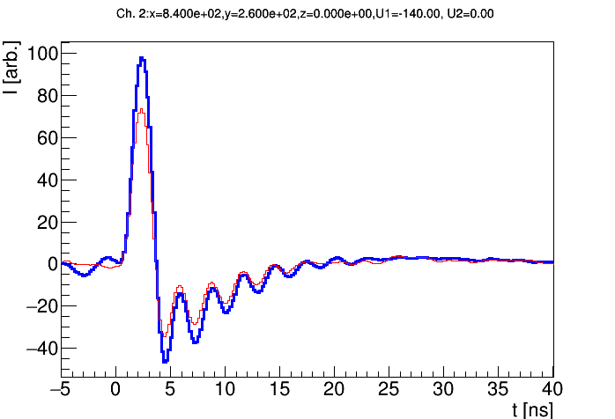

Signal superposition study
Is signal from the delayed pulse affected by the preceding pulse?
${{Signal}_{2}=Signal}_{1+2}−{Signal}_{1}$ ?
Both beams hitting the same point
Blue – Signal 2 (shifted 5 ns)
Red – Signal 1
from
Double beam signal
(run 2)
subtract
Single beam signal
(run 1)
shift by
5 ns delay
Signal 2 has exactly the same shape as Signal 1
  Amplitude is 40 % higher (Branch 2 has higher pulse energy) – consistently across entire sample
  If scaled by factor 1.4 signals match perfectly
Signal superposition works as expected

Slide 11
Summary and outlook
Double Beam TCT (DB-TCT) is a new method aiming for characterization of high rate effects in sensors
  Two spatially and time separated beams
  Challenges related to spatial alignment, but feasible
Analysis tools for processing two pulses in single waveform being developed
  One focus is mitigation of electronics related oscillations (hardware or offline fix)
First measurements with (IHEP-IME) AC-LGAD presented
  Observed signal sharing across multiple strips
  Signals superimposed on each other
  Signal shape not affected by preceding pulse (same injection point, 5 ns delay)
Many more tests with AC-LGADs to be done

