Slide 1
Design and characterization of CASSIA monolithic pixel sensors with gain
¹P. Bartulović, I. Berdalović, M. Jugović, B. Požar, T. Suligoj
²S. Haberl, A. Kotsokechagia, J. Lunde, H. Pernegger, C. Solans Sanchez

Slide 2
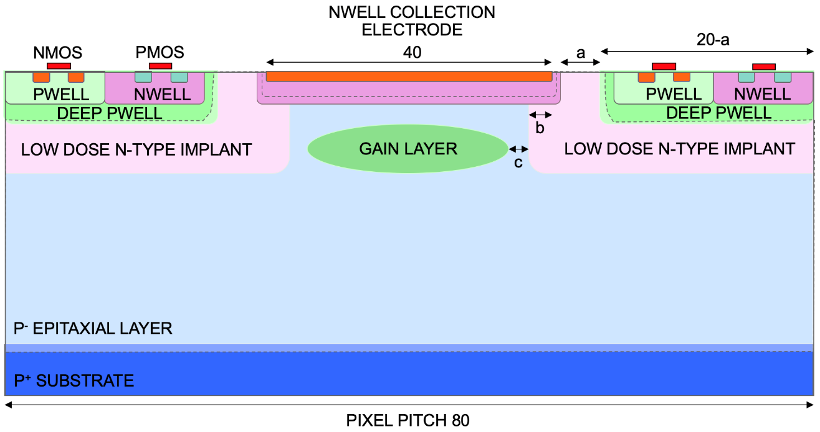
CASSIA (CMOS Active SenSor with Internal Amplification)
goal – implement active sensors with internal gain in foundry CMOS process in order to:
① simplify in-pixel electronics due to higher input
signals (e.g. reduce power consumption)
② improve timing resolution and response time
(e.g. for future 4D tracking)
③ improve signal-to-noise ratio (e.g. for improved
radiation hardness)
implementation – add gain layer underneath collection electrode in modified Tower 180 nm process – allows for in-pixel integration of sensor with gain and analog/digital readout electronics
choice of gain layer allows for breakdown voltage engineering
choice of reverse bias allows for operation in either low-gain (LGAD) or high-gain (SPAD) mode

Slide 3
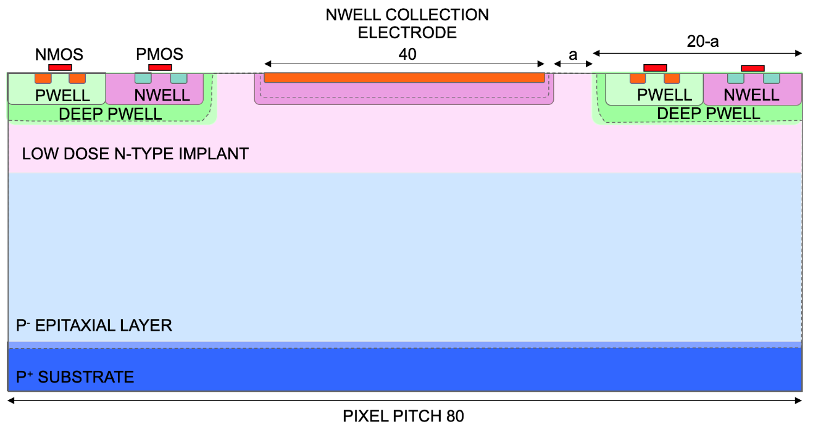
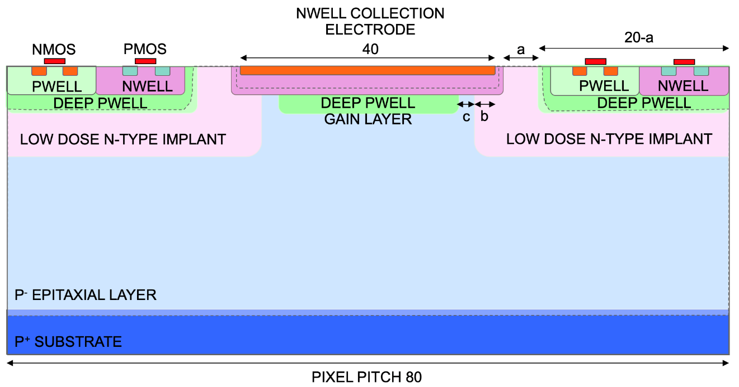
CASSIA1 sensor cross-sections (M1 and M2)
standard Tower 180 nm process modified with low-dose n-type implant for full depletion of epitaxial layer (used in MALTA prototypes)
deep p-wells housing in-pixel electronics
gap in n– implant under n-well collection electrode, added deep p-well as gain layer
b/c spacings acting as explicit/implicit guard rings against edge breakdown
M1
M2

Slide 4
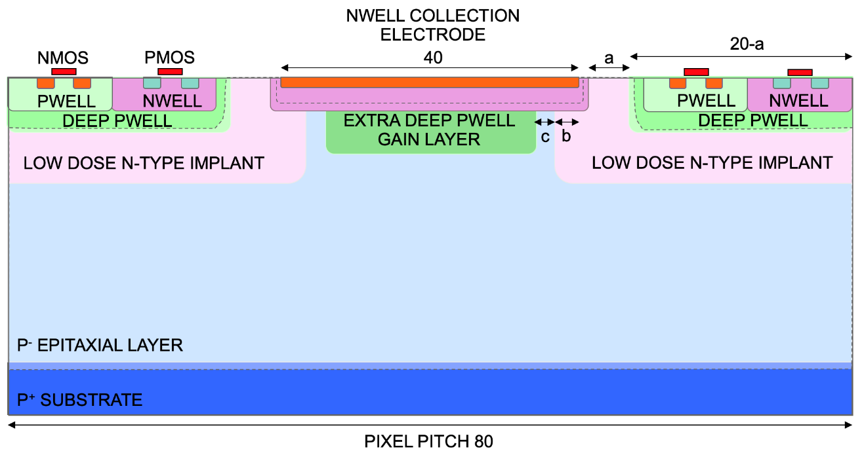
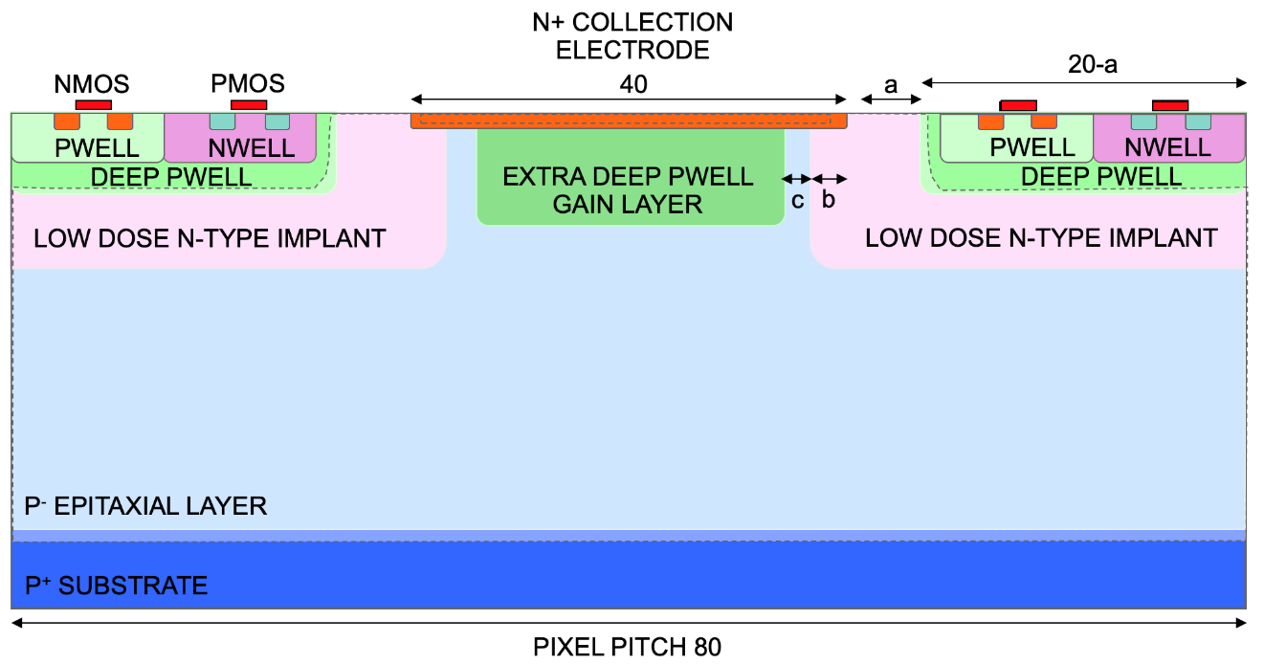
CASSIA1 sensor cross-sections (M3 and M4)
gain layer implemented using extra-deep p-well (used in miniMALTA prototypes) instead of standard deep p-well
extra deep p-well used as gain layer, but collection electrode implemented using only n+ implant without n-well
M3
M4

Slide 5
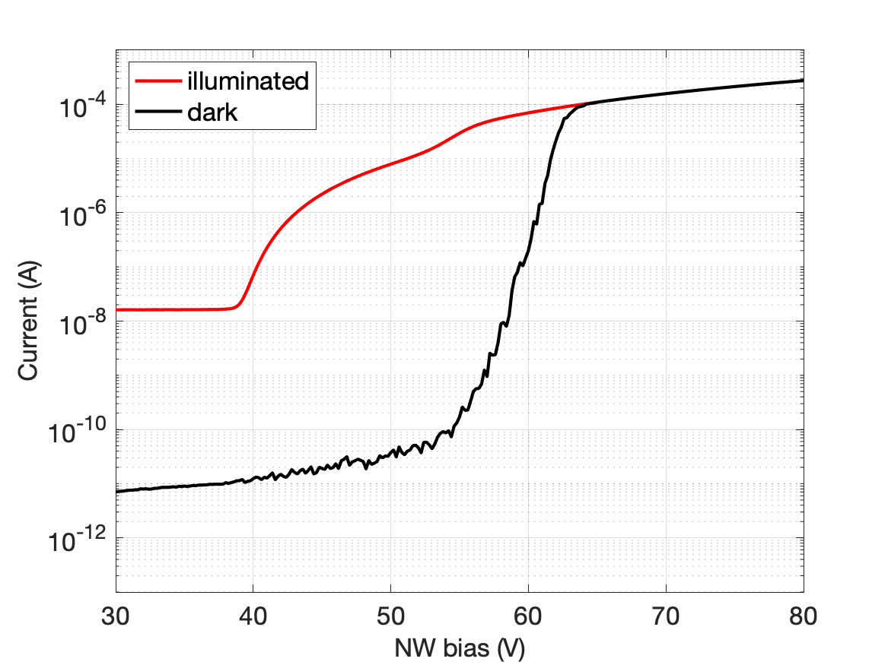
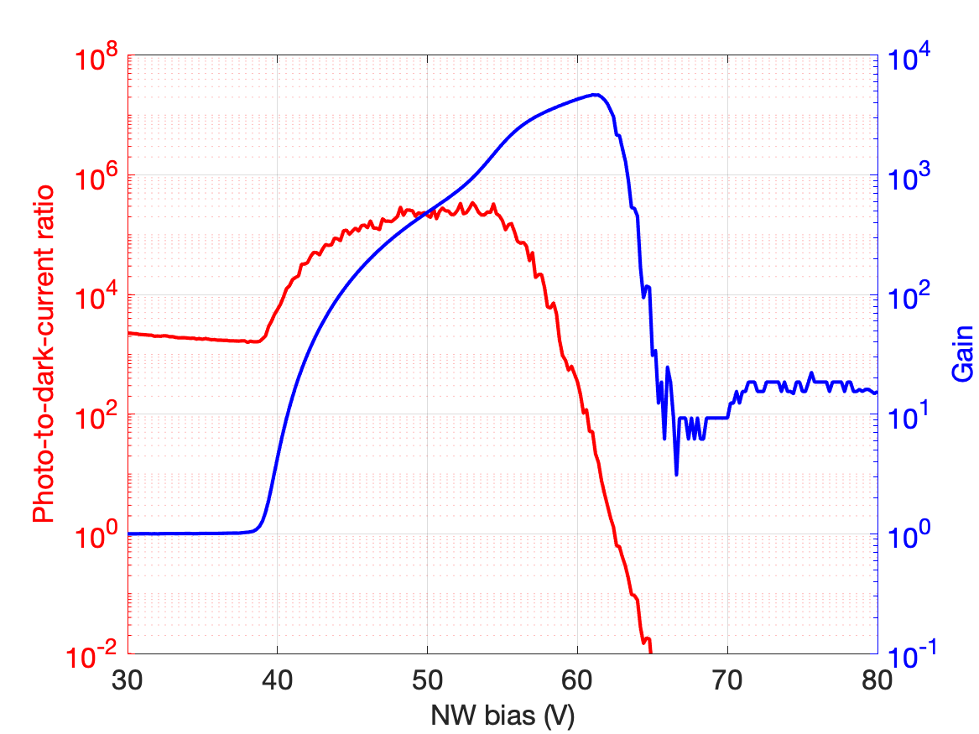
M2 I-V curves under illumination
SPAD mode
gain
illuminated
current
NW sweep
SUB = 0 V
DPW = 0 V
PDCR
dark current
LGAD mode
no-gain mode
avalanche multiplication of photogenerated carriers starts at bias of ~40 V
abrupt breakdown at bias of ~60 V
photo-to-dark-current ratio (PDCR) up to >10⁵
gain reaching values >5000
gain tuning by reverse voltage in range of >20 V

Slide 6
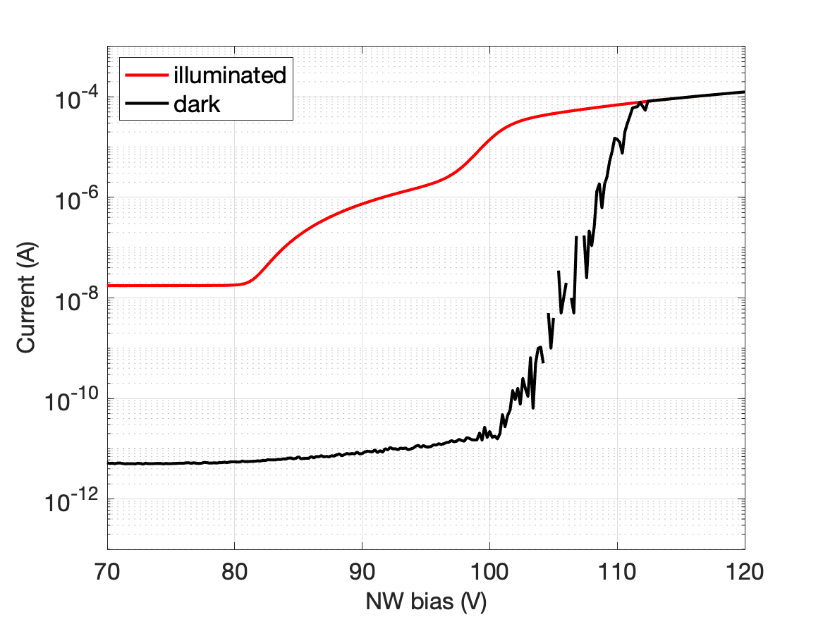
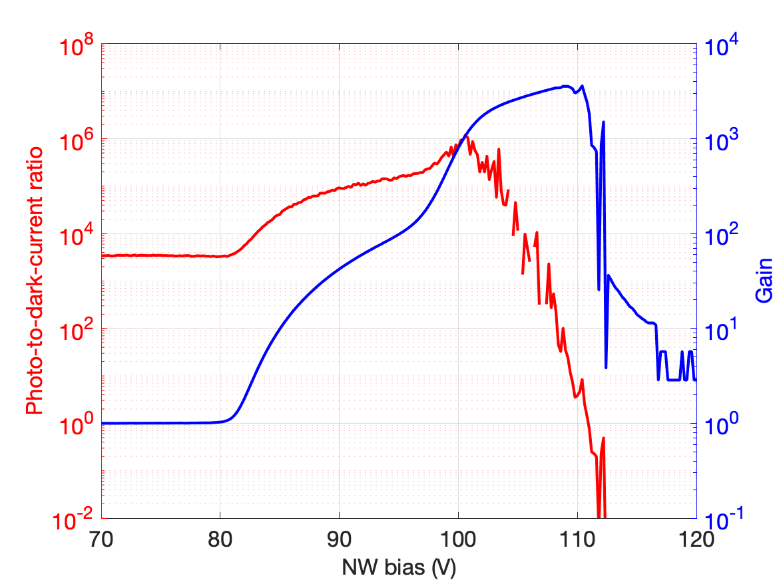
M3 I-V curves under illumination
gain
illuminated
current
NW sweep
SUB = 0 V
DPW = 0 V
PDCR
dark current
avalanche multiplication of photogenerated carriers starts at bias of ~80 V
abrupt breakdown at bias of ~110 V
photo-to-dark-current ratio (PDCR) up to >10⁶
gain reaching values >4000
gain tuning by reverse voltage in range of >30 V

Slide 7
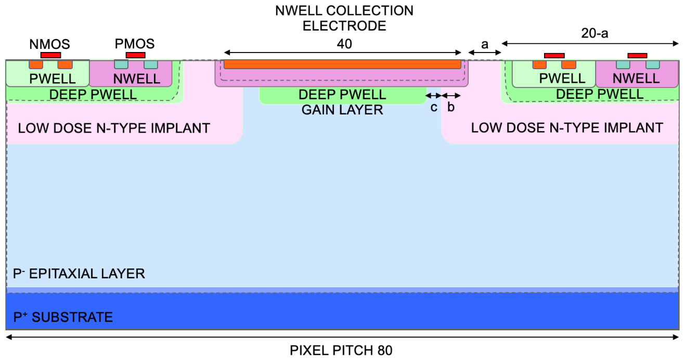
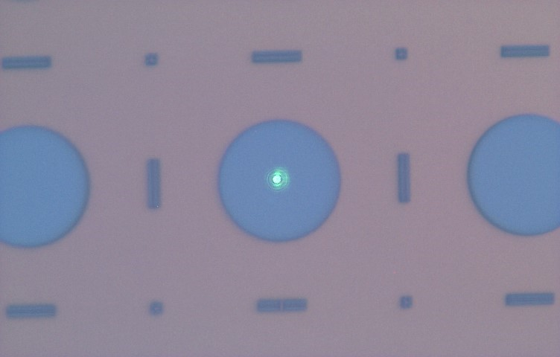
In-pixel gain measurement setup
532 nm/785 nm
FWHM ~2 um
continuous-wave front-side illumination of pixel with 532 nm/785 nm focused laser beam
NW
DPW
W3
metal
SUB
40 um electrode
performing x-y scan of photocurrent over the pixel area with a resolution of ~1 um
bias voltage adjusted to obtain gains of M = 1, 10, 100 and 1000 with laser beam centered above NW collection electrode

Slide 8
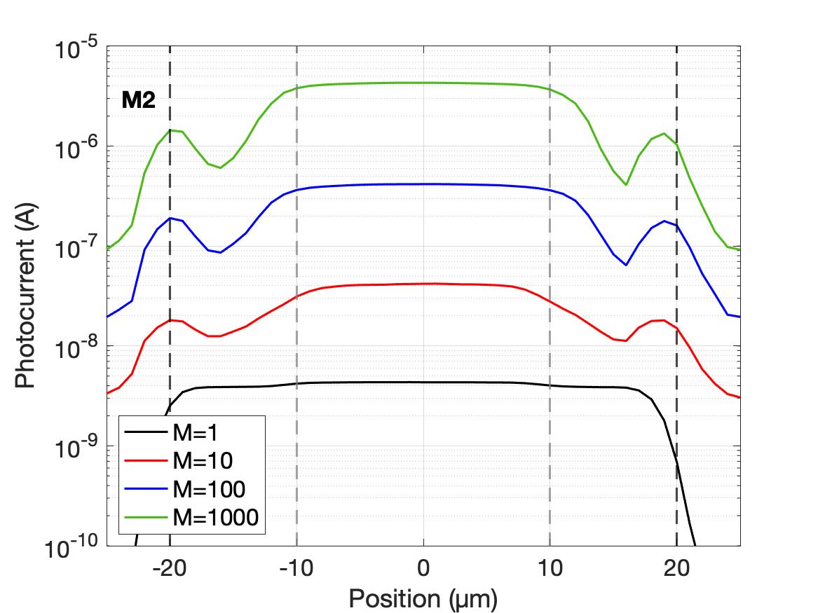
M2 in-pixel photocurrent (785 nm)
DPW gain layer diameter of 20 um, photocurrent ~4 nA within gain layer area at M = 1 (V_{BIAS} = 30 V)
NW
DPW
W3
SUB
V_{BIAS} adjusted to 39.4 V, 41.1 V and 45.1 V to achieve gains of M = 10, 100 and 1000 in pixel center, respectively
noticeable drop of photocurrent outside gain layer, but still much higher than unmultiplied current
light reflection from metal or field peak near NW edge?

Slide 9
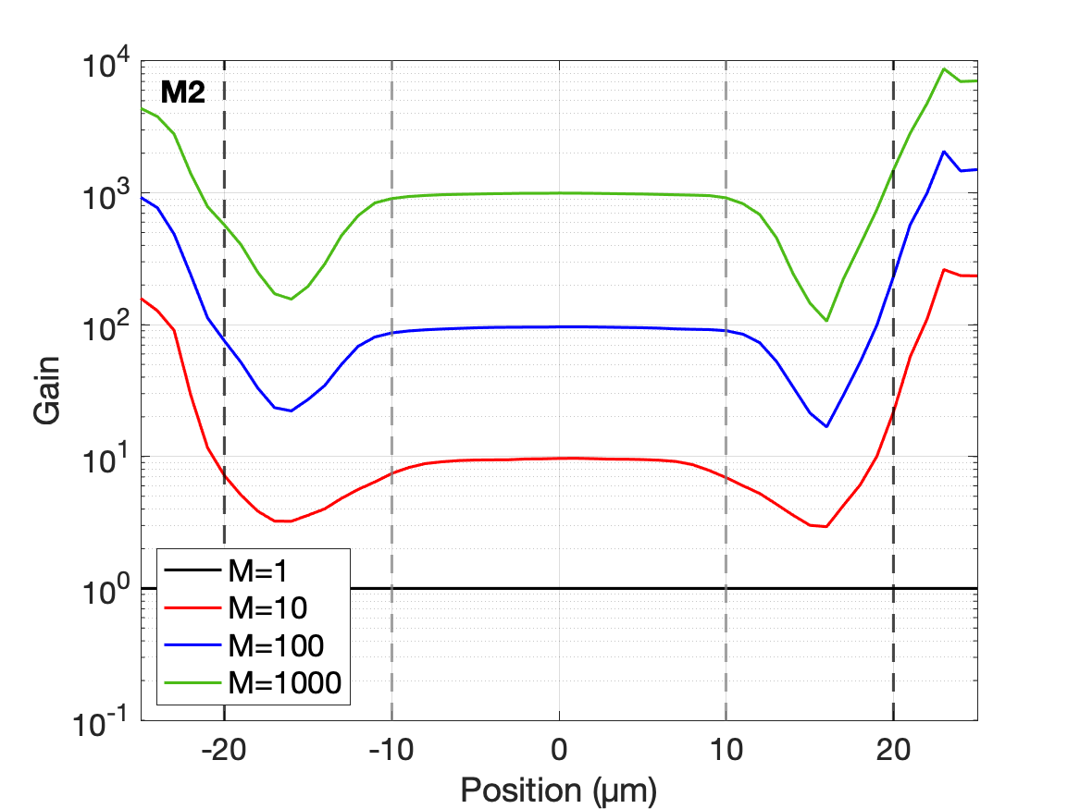
M2 in-pixel gain (785 nm)
DPW gain layer diameter of 20 um, gain constant only within gain layer area
NW
DPW
W3
SUB
drop of photocurrent corresponds to decrease of gain outside gain layer area
decrease of gain towards electrode edge mitigated somewhat by increasing reverse bias (still >100 for M = 1000)
artefact due to extremely low photocurrent at M = 1

Slide 10
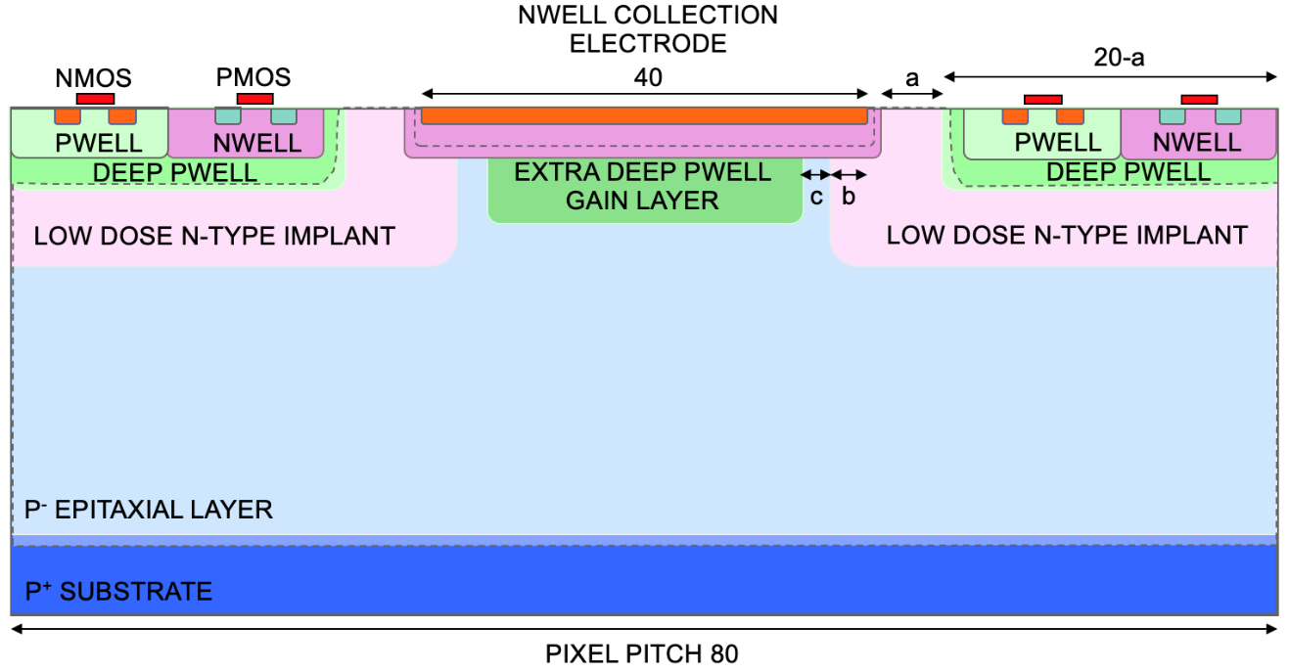
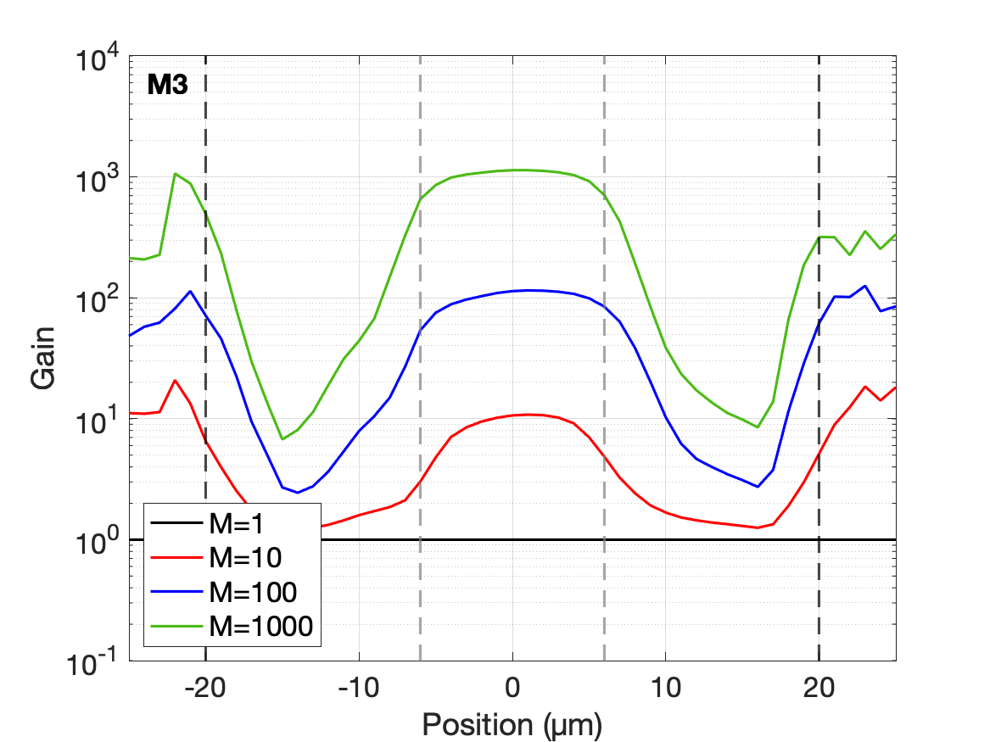
M3 in-pixel gain (785 nm)
XDPW gain layer diameter of 12 um, gain close to constant only within gain layer area
NW
DPW
W3
SUB
decrease of gain towards electrode edge more prominent compared to M2, mitigated somewhat by increasing reverse bias (still >5 for M = 1000)
artefact due to extremely low photocurrent at M = 1

Slide 11
IR pulsed laser measurements (1060 nm)
laser pulses of 1060 nm photons at 100 kHz
uniform illumination over entire pixel area
I-V curves with laser ON/OFF correspond well with curves under continuous illumination
scope
NW
DPW
W3
M2
⊕⊖
LGAD
SPAD
SUB
ON
biasing collection electrode of all pixels in 3x3 matrix, reading out signals from central pixel using a CIVIDEC Cx amplifier
OFF

Slide 12
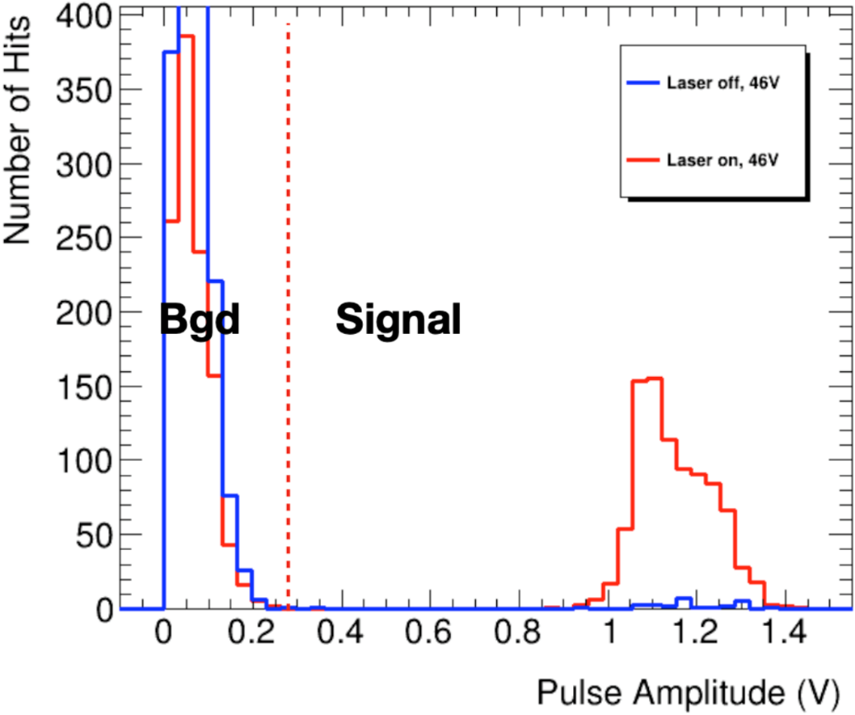
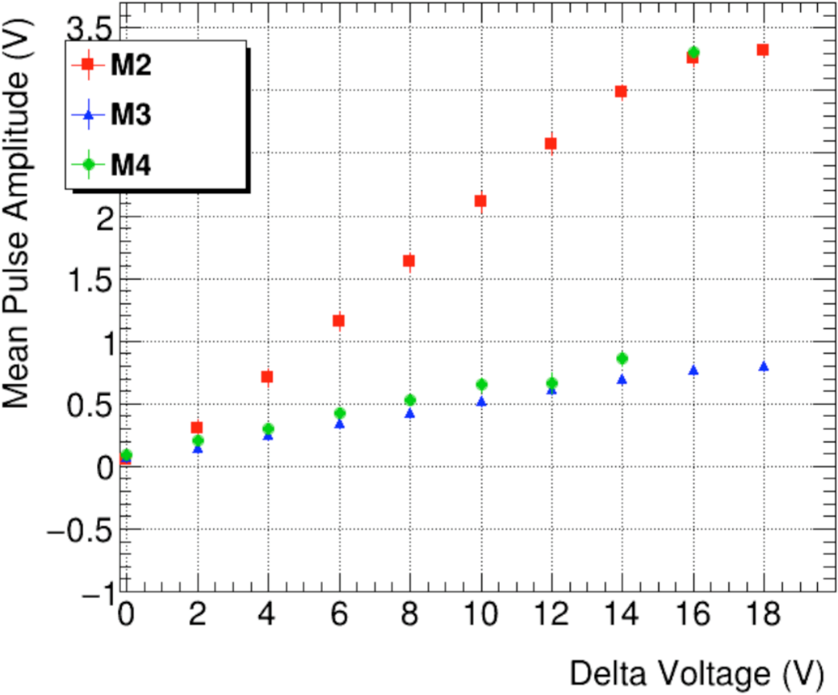
IR pulsed laser measurements (1060 nm)
collecting signals at amplifier output and analyzing pulse amplitude distribution
M3 and M4 show comparable amplitudes, higher amplitudes for M2 with wider gain layer (signal ratio similar to gain layer area ratio)
M2, V_{BIAS} = 46 V
LGAD mode

Slide 13
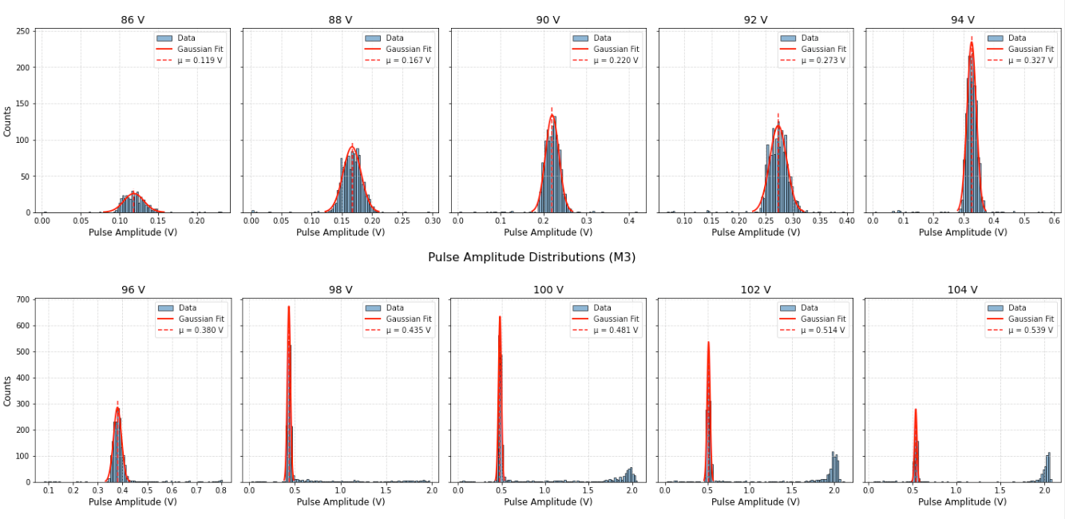
IR pulsed laser measurements (1060 nm)
LGAD mode operation from 86-98 V
parallel LGAD and SPAD response in transition region (100-104 V), then SPAD mode
approximate linear increase of gain with voltage
LGAD peak
M3 (preliminary)
LGAD peak
LGAD peak
LGAD peak
SPAD peak
SPAD peak
SPAD peak

Slide 14
Goals after CASSIA1
CASSIA1 contains only 3x3 sensor matrices and single pixels without in-pixel electronics – test vehicle for sensor optimization
Goals with CASSIA2:
  include in-pixel electronics (front-end amplifier + discriminator) for operating 5x5 sensor matrices in LGAD mode
  include in-pixel electronics (quenching circuit) for operating 4x4 sensor matrices in SPAD mode
  include a simple but scalable digital readout architecture for reading out pixel addresses in 4x4 matrices
  explore new sensor concepts for further improvement in performance

Slide 15
CASSIA2 layout
6x5 mm² chip area divided into 3 parts:
  CASSIA2A – 5x5 analog pixel matrices with in-pixel front-end + 4x4 digital pixel matrices with front-end and readout architecture for operation in LGAD mode
  CASSIA2B – 3x3 sensor matrices and single pixels (similar to CASSIA1) with new sensor concepts
  CASSIA2C – 4x4 pixel matrices with in-pixel quenching circuits and readout architecture for operation in SPAD mode
CASSIA2A
CASSIA2B
CASSIA2C
4x4 digital matrices
5x5 analog matrices
4x4 nQC matrices
4x4 aQC matrices

Slide 16
CASSIA2A 2.1x5 mm² (left chip)
use cascoded front-end amplifier known from miniMALTA, adapted for LGAD-mode sensor
AC-coupling capacitor required due to high collection electrode voltages
≈
SENSOR
collection electrode
metal-to-metal capacitor
discriminator
front-end w/o discriminator implemented in 5x5 analog matrices (OUTA signal buffered to pads)
front-end w/ discriminator implemented in 4x4 digital matrices (incl. simple readout architecture)
to FE input

Slide 17
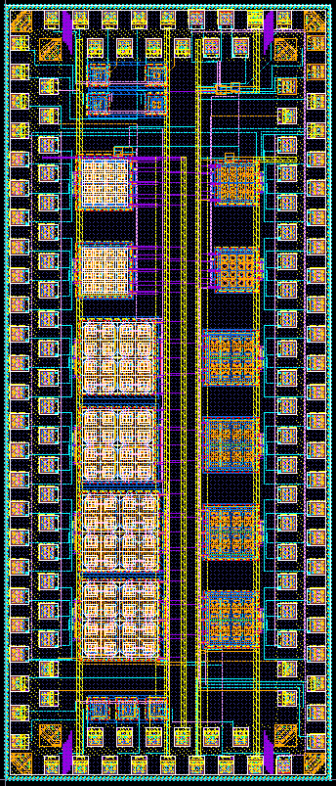
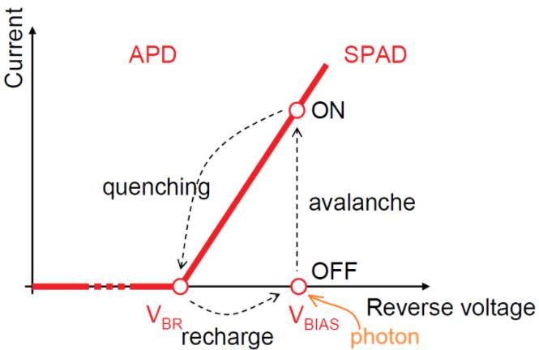
CASSIA2C 2.1x5 mm² (right chip)
PMOS quenching
circuit
6 4x4 matrices with NMOS-input quenching (i.e. connecting to SPAD anode) and digital readout
6 4x4 matrices with AC-coupled quenching (connecting to SPAD cathode, i.e. collection electrode) and digital readout
1 PMOS-input quenching circuit (can be bonded to collection electrode of single pixels on other chips)
several single pixels with passive quenching resistor and other test structures
in SPAD mode, quenching circuit required to stop the avalanche after detection and restore bias voltage to its initial value above breakdown
NMOS quenching
4x4 matrices
6
6
5
5
4
4
3
3
2
2
AC-coupled
quenching
4x4 matrices
1
1
passive quenching
single pixels

Slide 18

Quenching circuits and readout architecture
NMOS-input quenching to sense avalanche current from anode side (common SUB in Tower 180 nm)
preferable to quench avalanche from the cathode side (AC-coupled and PMOS-input quenching)
readout architecture transmits quenching circuit output signal asynchronously over high-speed buses to matrix periphery (similar to MALTA)
$$I_{aval}$$
GRP 00
GRP 10
0
1
2
3
2
3
0
1
1
0
3
2
GRP 01
GRP 11
3
2
1
0
PIX 0
PIX 1
…

Slide 19
Summary
CASSIA1 prototype implements 4 versions (M1-M4) of 3x3 mini-matrices containing sensors with gain
I-V curves of M2 and M3 show good response to illumination and a wide voltage range for gain tuning
in-pixel gain scans show uniform gain over the gain layer area, with gradual drop of gain outside GL area
pulsed laser measurements show comparable response in LGAD mode for all mini-matrices
CASSIA2 builds on the sensor structures with gain demonstrated in CASSIA1 by:
  integrating them with an analog front-end + discriminator (LGAD mode)
  integrating them with various quenching circuits (SPAD mode)
  implementing a simple readout architecture for reading out small pixel matrices
tape-out imminent, diced chips expected to be back for testing in Q4 2025

Slide 20
Thank you for your attention!
¹tomislav.suligoj@fer.hr, ivan.berdalovic@fer.hr
²heinz.pernegger@cern.ch

Slide 21
Backup – M2 light emission test
NW
DPW
W3
40 μm electrode
SUB
light emission test to confirm that avalanche multiplication takes place at electrode/gain layer active junction
SPAD biased well above breakdown, looking for secondary light emission from avalanche

Slide 22
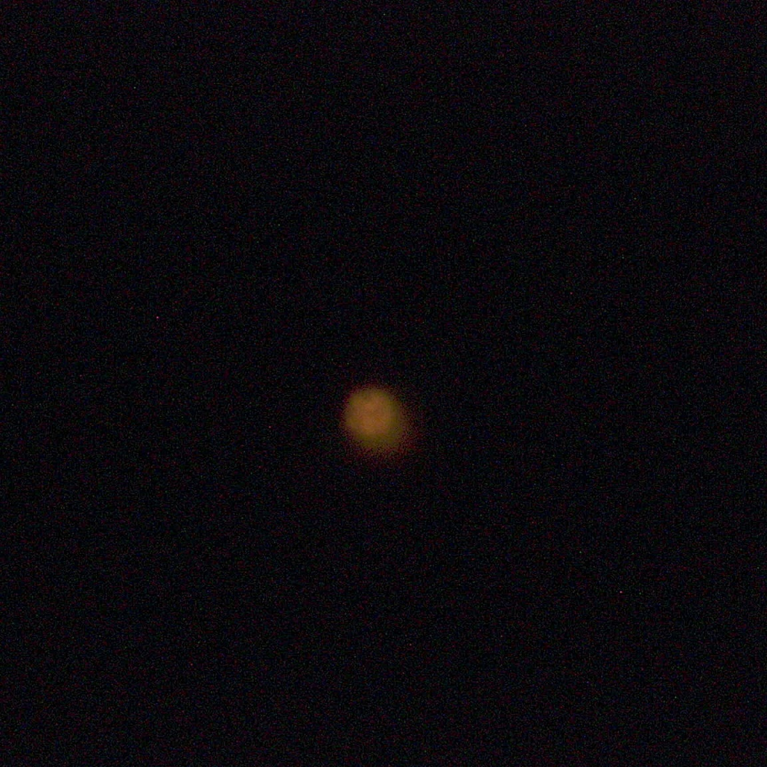
Backup – M2 light emission test
NW
DPW
W3
40 μm electrode
SUB
light emission in central region observed at avalanche current of 500 μA (reverse bias of 94 V)
full circular shape of emitted light ⇒ uniform breakdown at the 20 μm active junction, area of emitted light corresponds to gain layer area
20 μm gain layer

Slide 23
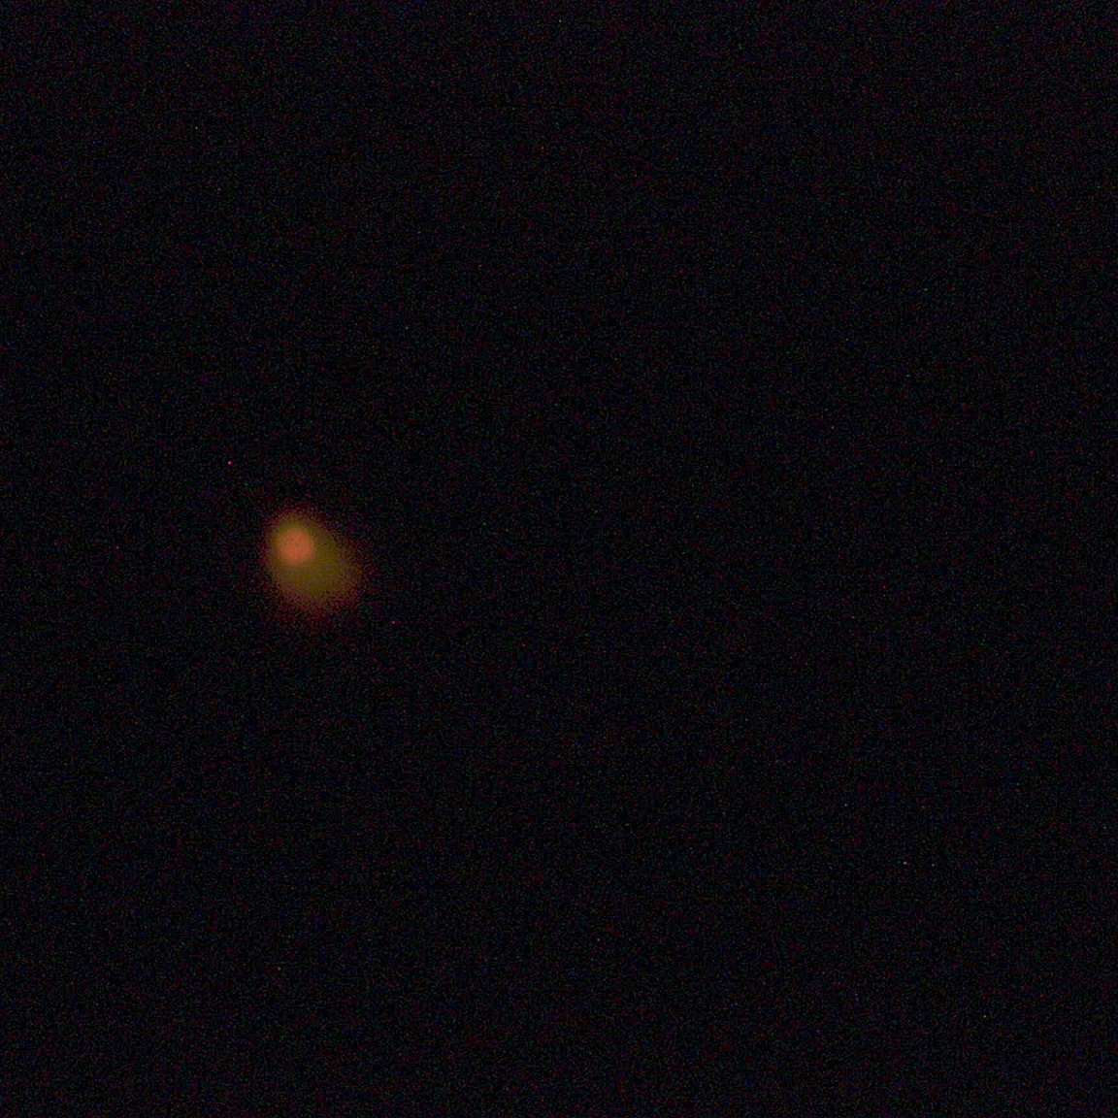
Backup – M3 light emission test
NW
DPW
W3
40 μm electrode
SUB
12 μm gain layer
area of emitted light at 500 μA (160 V of reverse bias) smaller compared to M2 (larger spacing c ⇒ smaller active junction diameter of 12 μm)
breakdown still contained within central region (same holds for all measured structures)

Slide 24
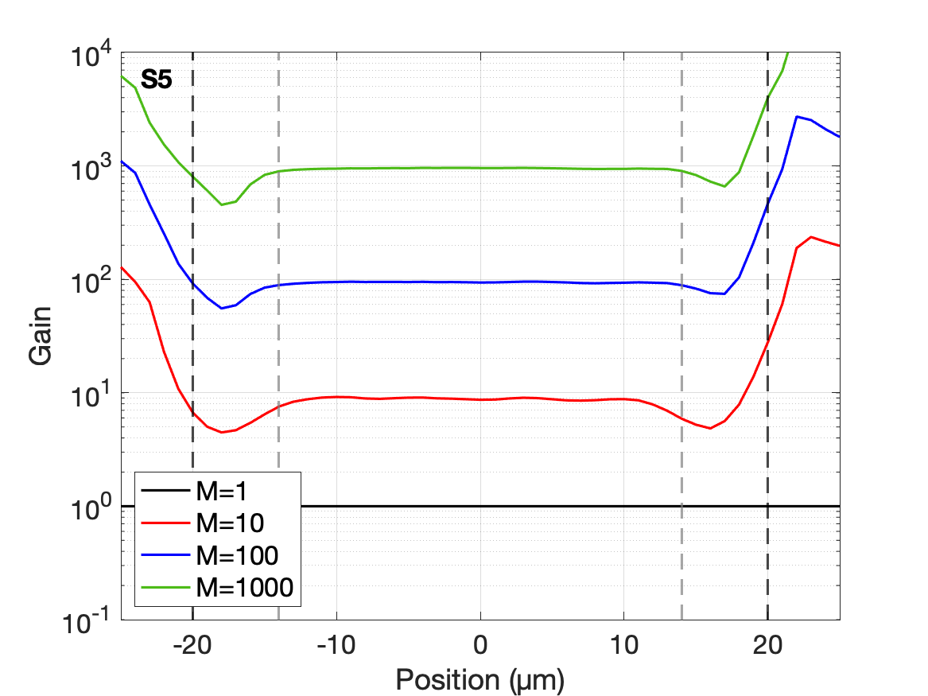
Backup – S5 in-pixel gain (785 nm)
S5 has same gain layer design as M2, but with gain layer diameter of 28 um
NW
DPW
W3
SUB
V_{BIAS} adjusted to 30.5 V, 31.8 V and 34.7 V to achieve central gains of M = 10, 100 and 1000
only slight drop of photocurrent outside gain layer area – higher fill factor
artefact due to extremely low photocurrent at M = 1

Slide 25
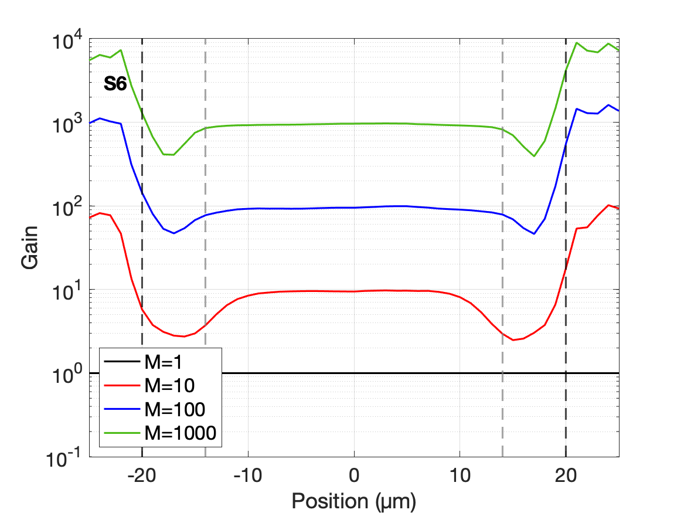
Backup – S6 in-pixel gain (785 nm)
S6 has same gain layer design as M3, but with gain layer diameter of 28 um
NW
DPW
W3
SUB
only slight drop of photocurrent outside gain layer area – higher fill factor
artefact due to extremely low photocurrent at M = 1

Slide 26
Backup – Analog front-end simulation
front-end output signal reduced due to AC-coupling (capacitor of ~600 fF)
1500 e⁻ (MIP signal)
gain of 10
15000 e⁻
a.u.
varying sensor capacitance
a.u.

Slide 27
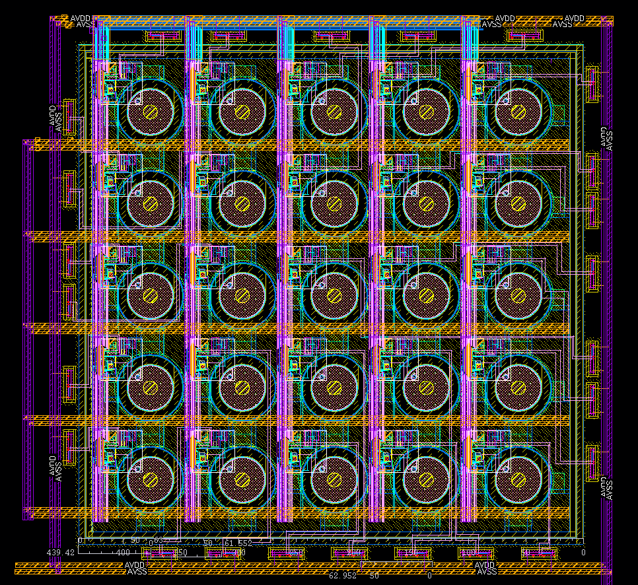
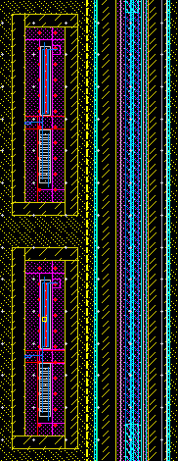
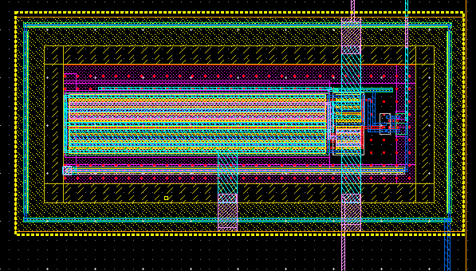
Backup – Analog LGAD matrix layout
front-end w/o discriminator from (mini)MALTA
pixel pitch of 72.8 um consistent with CASSIA2C
NMOS buffering stage outside of matrix
25 pixels with 16 output pads (switches to choose between monitored pixels)
NMOS buffer
PAD
guard ring

Slide 28


Backup – AC-coupled quenching schematic
$$≈1\text{00 }\text{V}$$
$$≈1.5 \text{V}$$
quenching resistor
baseline holder
current-starved inverter delay block
coupling capacitor
starts active quenching phase
resets flip-flop (ends detection)
starts active reset phase
active quenching and reset switches

Slide 29
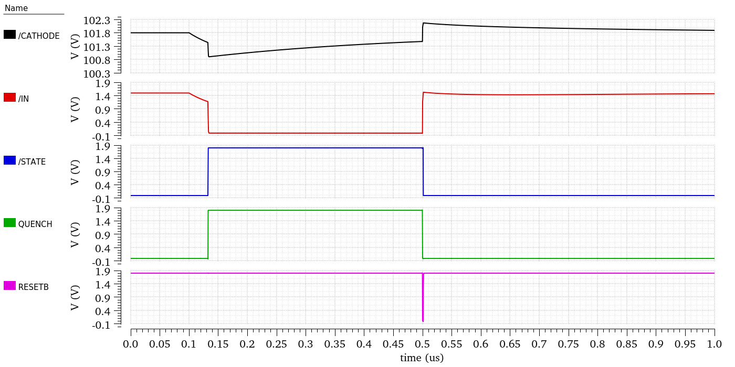
Backup – AC-coupled quenching simulation
passive quenching through R_{Q}
passive reset through R_{Q}
active quenching through C_{C}
active reset after hold-off delay
output signal going to digital R/O

Slide 30
Backup – AC-coupled quenching layout
digital readout architecture
collection electrode
AC-coupling capacitor
quenching circuit
incl. digital logic
72.8 µm
Quenching circuit fits comfortably into predefined pixel pitch of 72.8 um (most of the area taken up by large quenching resistor)
quenching resistor

