Slide 1
Status of the
Versatile MAPS project
J. Baudot, M. Deveaux, A. Maire
on behalf of the project partners

Slide 2
















Who we are…
Participating and interested institutes (in random order, interest still on very different levels)
 | Institute (in random order) | City | Country | Contact person
1 | Institut de Physique des 2 Infinis | Lyon | France | Didier Contardo
2 | University Bergamo | Bergamo | Italy | Gianluca Traversi
3 | University Barcelona | Barcelone | Spain | Raimon Casanova Mohr
4 | Instituto de Fisica Corpuscular | Valencia | Italy | Carlos Marinas
5 | Instituto Galego de Física de Altas Enerxías | Santiago | Spain | Abraham Gallas
6 | University and INFN Pisa | Pisa | Italy | Francesco Forti
7 | Das Institut für Hochenergiephysik (HEPHY) | Vienna | Austria | Thomas Bergauer
8 | University Pavia | Pavia | Italy | Lodovico Ratti
9 | Universität Bonn | Bonn | Germany | Bernhard Ketzer
10 | University Münster | Münster | Germany | Denise Moreira de Godoy
11 | GSI | Darmstadt | Germany | Michael Deveaux
12 | Stanford Linear Acceleartor Center | Menlo Park | USA | Catarina Vernieri
13 | IPHC Strasbourg | Strasbourg | France | Jerome Baudot, Antonin Maire
14 | Institut de recherche sur les lois fondamentales de l'Univers | Saclay | France | Fabrice Guilloux
15 | Laboratoire de physique nucléaire et des hautes énergies | Paris | France | Giovanni Calderini
16 | University Pusan | Busan | South Korea | Sanghoon Lim
3rd DRD3 week, NIKHEF Amsterdam, 2-6 June 2025

Slide 3


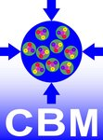


What are our collaborations and applications
ALICE3 outer tracker
Belle II tracker
CBM silicon upgrade
LHCb
FCC_{ee} tracking and PID
3rd DRD3 week, NIKHEF Amsterdam, 2-6 June 2025

Slide 4
Mission statement
 | Spat. res. | Time res. | Power [mW/cm²] | Rate [MHz/cm²] | Rad. hard
ALICE3 | 10 µm | 100 ns | ~20 | < 2 | 1e14 n/cm² + 50 kGy
BelleII Trk | 15 µm | ~1 ns | 50 | < 1 | 1e11 n/cm² + 10 kGy
CBM | 5 µm | ~25 ns | ~50 | < 180 | 3e14 n/cm² + 500 kGy
FCCee Trk | 10 µm | ~1 ns | ~20 | < 10 | ?
LHCb UT | 10 µm | 20-1k ns | 100 | < 160 | 3e15 n/cm² + 2400 kGy
FCC-ee PID layer | ≲10 µm | 100 ps | tbd | < 1 (tbc) | low
The Versatile MAPS project was started in response to the needs of several collaborations for a high performance ultra-low power MAPS detector for tracking applications.
It pursues the vision of covering the different requirements with one single sensor hardware, which may be configured to different use cases by means of slow control.
3rd DRD3 week, NIKHEF Amsterdam, 2-6 June 2025

Slide 5
What is the best choice for 2025-2030?
The dream: More power may buy everything but…
Today:
More sensitivity (low power)
Power vs. Performance: Hardwired
More statistics (high power)
What is the best choice for Sensor 403 in run 52?
2030:
Versatile sensor
Statistics Sensitivity
3rd DRD3 week, NIKHEF Amsterdam, 2-6 June 2025

Slide 6
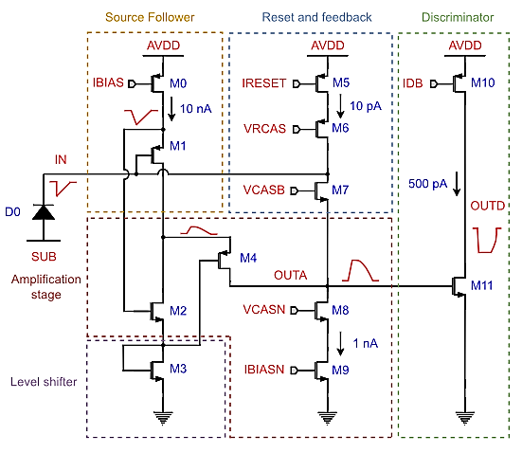
Considerations on a versatile pixel
?
Speed Low power
!
Important: Anything introduced is subject to replacement by better ideas!
!
3rd DRD3 week, NIKHEF Amsterdam, 2-6 June 2025

Slide 7
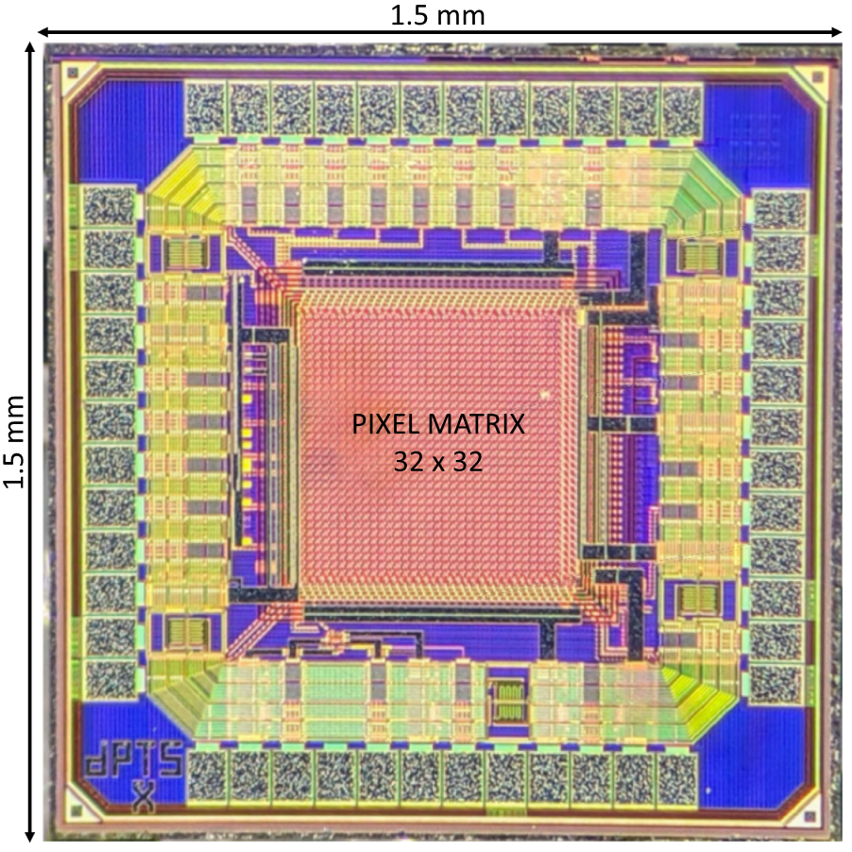
How could a versatile sensor look like (1 out of 1000 ways)?
Let’s start with the DPTS (F. Piro et al., IEEE TNS, VOL. 70, NO. 9, SEPT 2023)
Tuned by slow
control.
Technology: TPSCo 65nm
Pixel pitch: 15x15µm², 32 x 32 pixels
3rd DRD3 week, NIKHEF Amsterdam, 2-6 June 2025

Slide 8
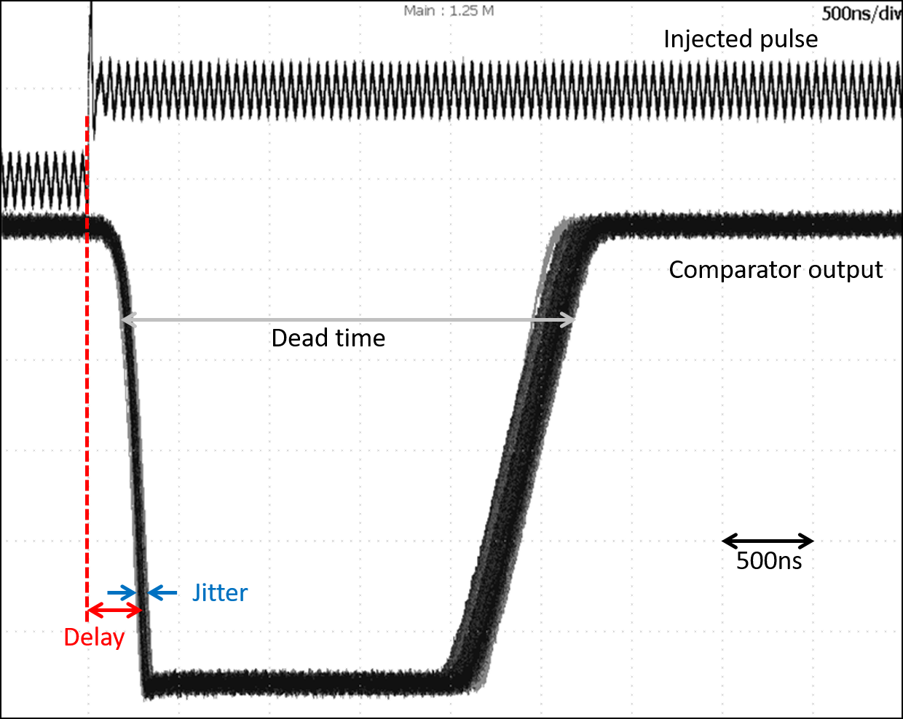
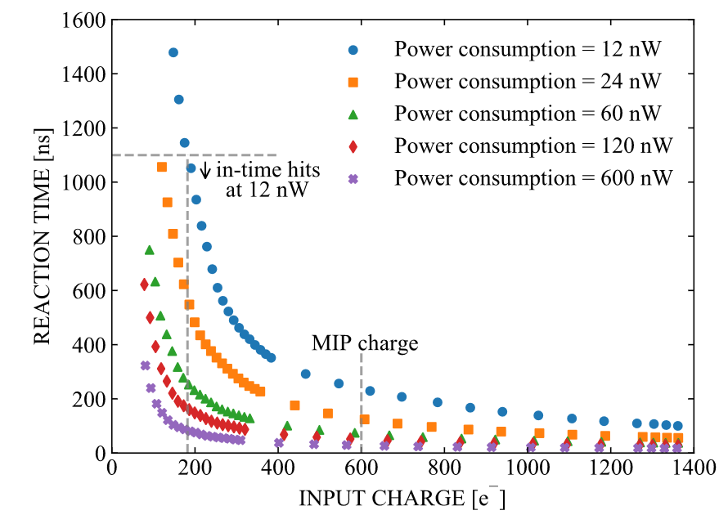
Relation of time walk and power
Time walk as extracted from plot
IEEE TRANSACTIONS ON NUCLEAR SCIENCE, VOL. 70, NO. 9, SEPT. 2023
Time walk

Slide 9
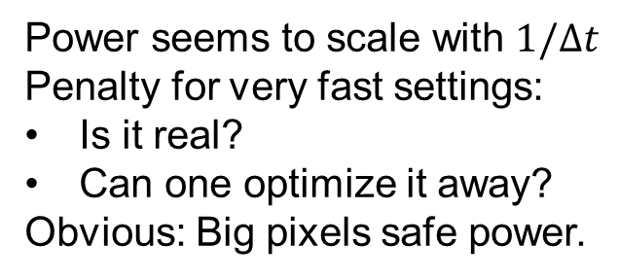

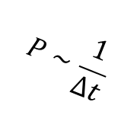
Pixel powering options
DPTS
Power seems to scale with $1/Δt$
Penalty for very fast settings:
Is it real?
Can one optimize it away?
Obvious: Big pixels safe power.
~3x
$$P∼\frac{1}{Δt}$$
$$P\sim \frac{1}{p^{2}}$$
pitch
3rd DRD3 week, NIKHEF Amsterdam, 2-6 June 2025

Slide 10
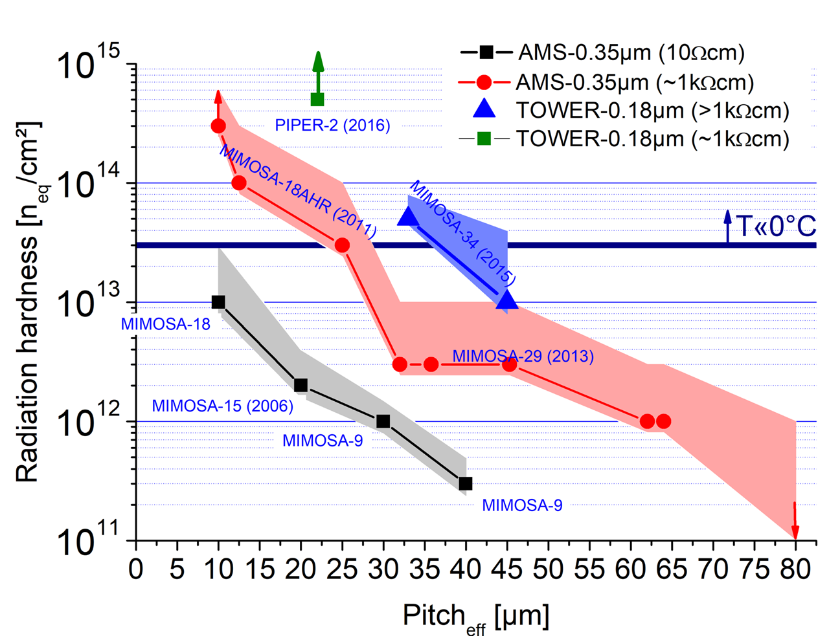
Radiation tolerance vs. pitch
DPTS
MIMOSIS
TOWER–0.18µm, p-stop (MIMOSIS-1)
TPSCo 65 nm (DPTS)
Using too big pixels will likely compromise rad. tolerance.
=> Must stay power efficient.
DPTS: G. A. Rinella et al., arXiv:2212.08621v4
MIMOSIS-1: H. Darwish et al, proceedings of 20thTrento workshop (2025), under preparation
Others: M. Deveaux, 2019 JINST 14 R11001
3rd DRD3 week, NIKHEF Amsterdam, 2-6 June 2025

Slide 11
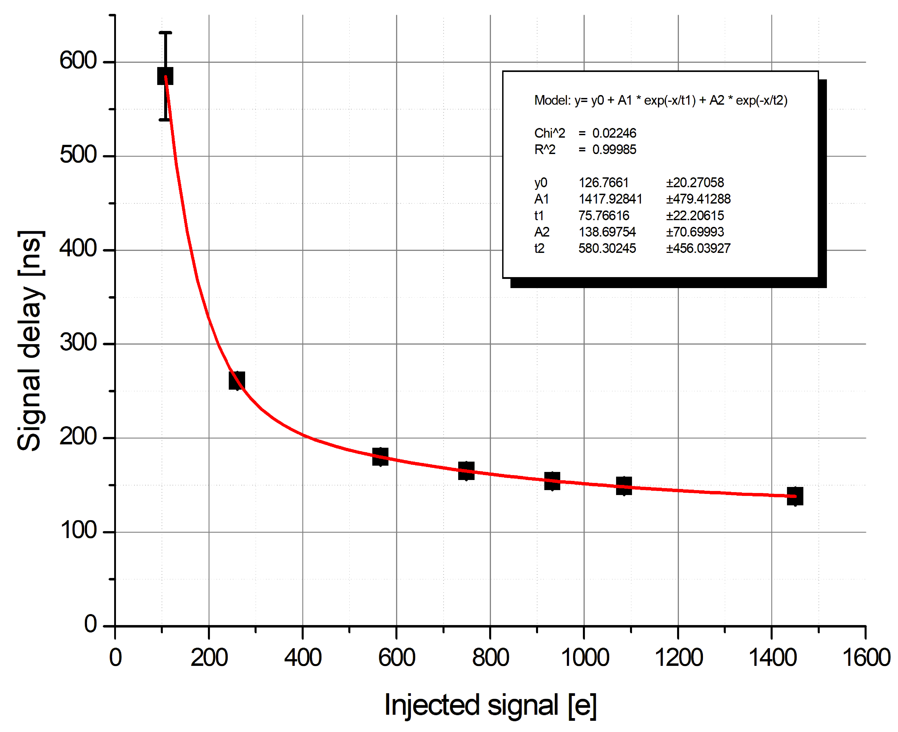
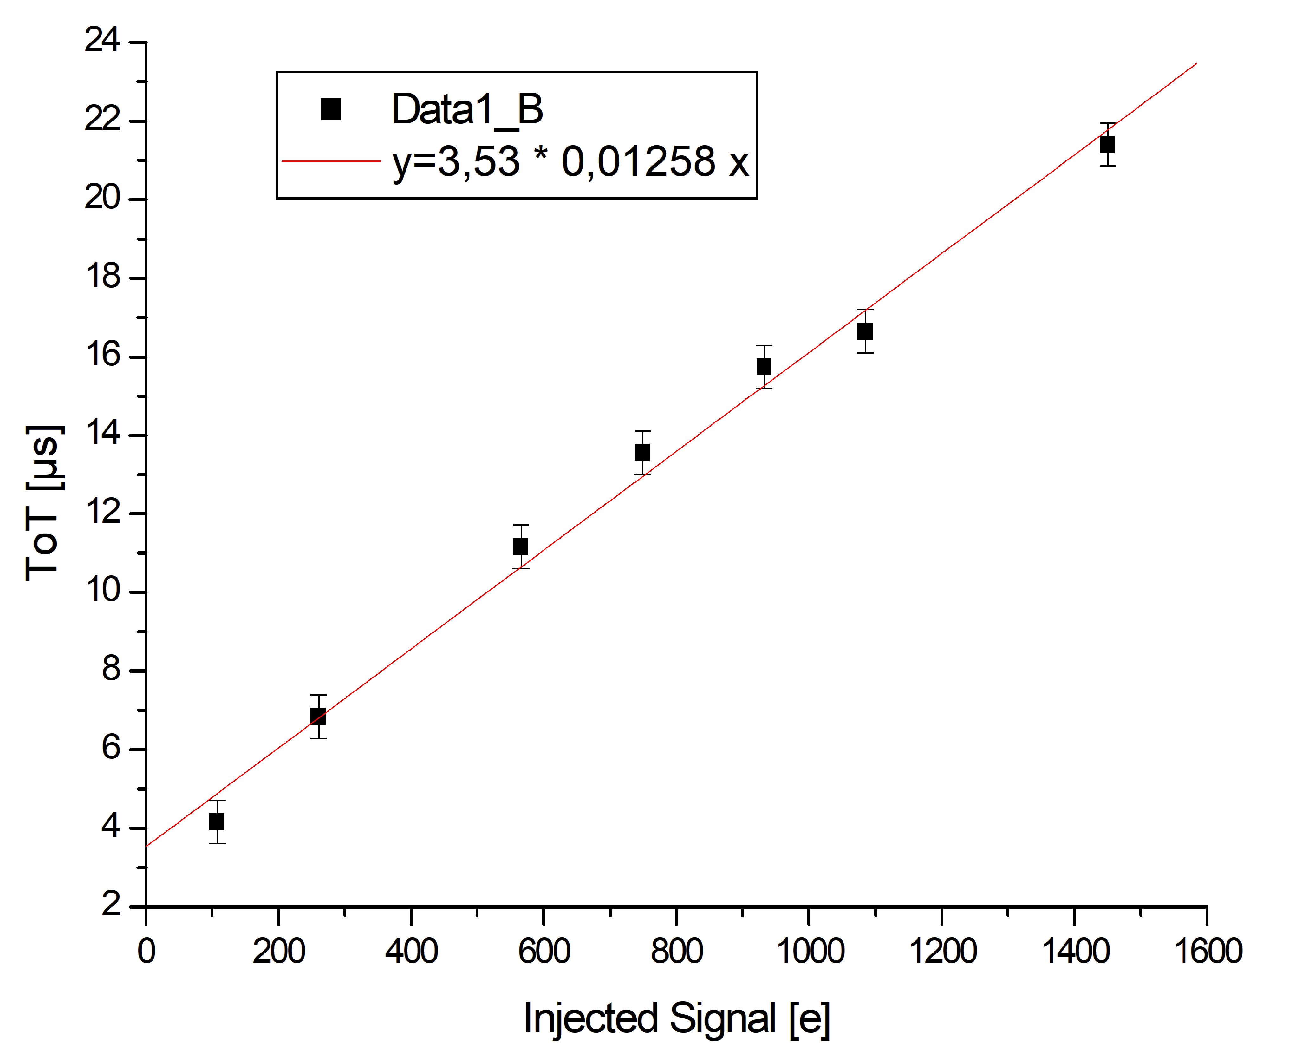
Time walk correction: Use Time Over Threshold
Time walk correction (example: MIMOSIS-0):
Measure signal amplitude – correct for average delay.
Signal measurement by ADC impossible, what about Time-over-Threshold (ToT)?
Inspired by G.A.Rinella et al.,
NIM-A Vol. 1056 (2023) p. 168589
B. Arnoldi-Meadows
ToT at proprtional seetings: Resolution 42 e
ToT may
be switched
on and of.
MIMOSIS-0 (24mW/cm²)
Limit for
100 MHz
Minimum ToT @ high speed settings: ~3µs
Different setting than previous slide
MIMOSIS-0 can be tuned for ToT measurement (analog output). Reported first by A. Dorokhov (IPHC).
Pulse length can be tuned to optimize ToT accuracy vs. rate capability (details yet to be studied).
Holds certainly for DPTS (to be confirmed)

Slide 12
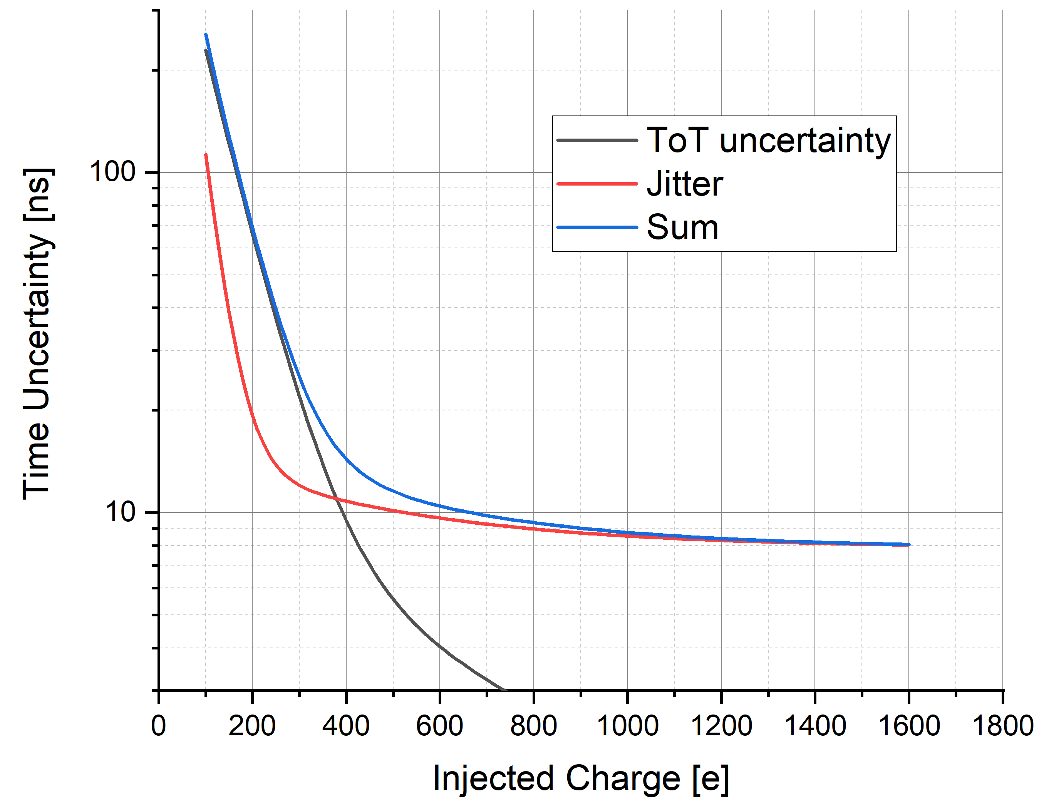
ToT based on time walk correction
Time walk correction
Uncertainties considered:
Jitter, ToT uncertainty of 44 e
Disclaimer: Pixel-to-pixel
variation not accounted for.
Signal 65nm (?)
Signal 180nm (?)
25 ns
M. Deveaux,
rough estimate
Time walk correction with ToT may buy ~10x time stamping without direct power penalty.
Implementation: Send information on falling edge.
+ Easy to implement in pixel (compact, energy efficient).
+ Fine time information.
Double data rate.
Need to sort/process data externally.
ALICE3 Meeting, IPHC, 9th Jan 2024

Slide 13
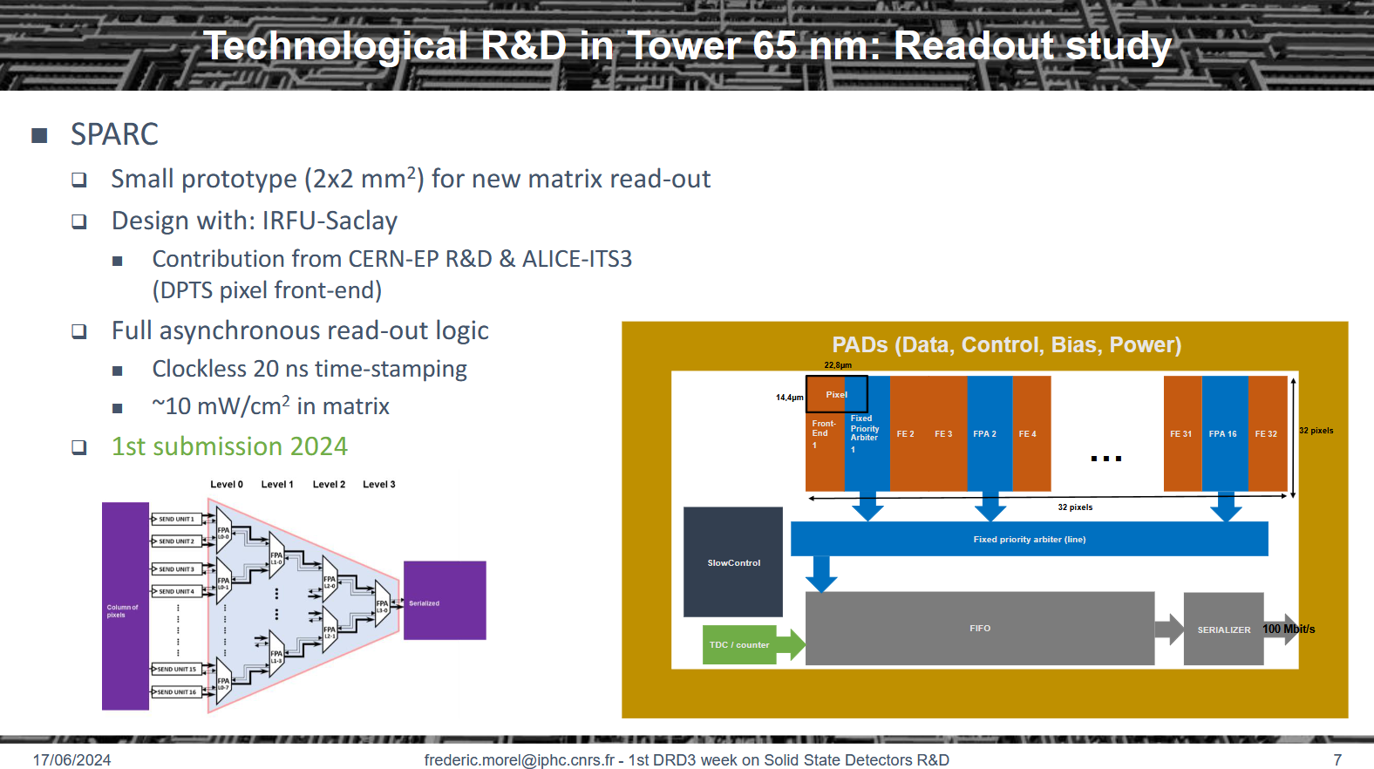
OCTOPUS: Smallest pitch, time stamping secondary (though important).
Versatile MAPS: Best time stamping, pitch secondary.
3rd DRD3 week, NIKHEF Amsterdam, 2-6 June 2025

Slide 14
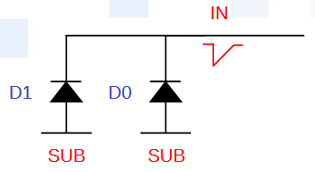
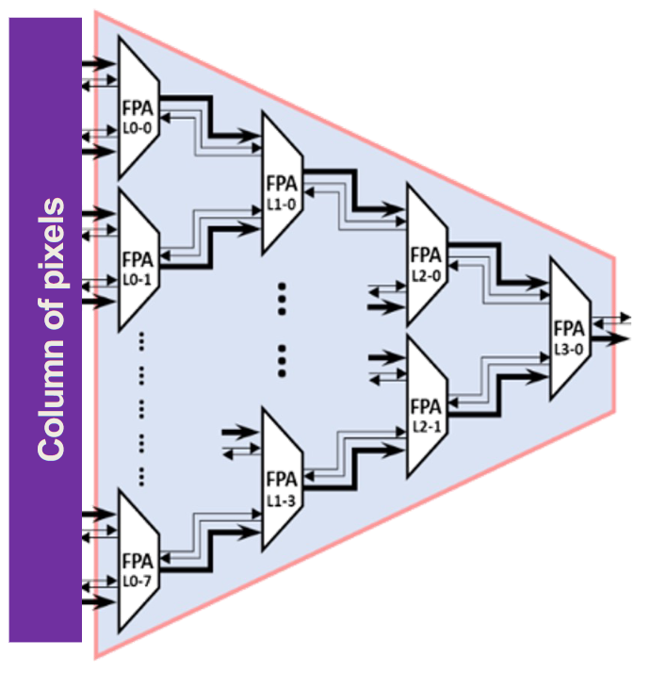
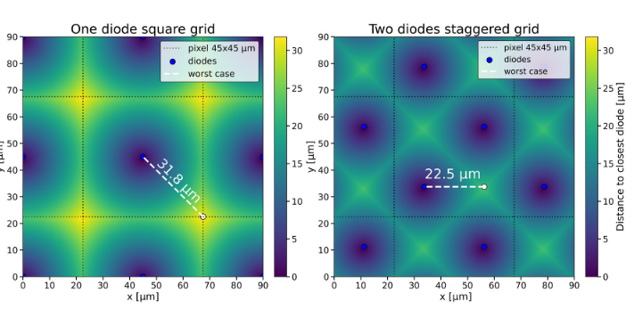
Particular issues on tracking sensors toward 1 ns
1 diode/pixel
2 diode/pixel
End of col. (?)
Fine TDC
Johannes Hensler, ALICE3 week May 2025,
https://indico.cern.ch/event/1533693/#49-ot-sensor-pixel-grouping-at
Need to optimize arbiter tree for small jitter.
Need fine TDC (variable number of bits?)
+ Accelerates charge collection time/efficiency.
- Increases pixel capacity.
=> Need to find best trade off

Slide 15
Versatile in readout (priority encoder)
Digital power of a 180nm sensor (symbolic picture):
Digital readout consumes power:
On data transport (scales with data)
Idle => Offset.
  Leakage of transistors.
  Transmission of “idle-bits”
Powering/clocking down unnecessary
resources helps
=> Foresee this from the start.
[a.u.]
Data cost [power/hit]
Irrad.
Switch off unnecessary
drivers.
Offset

Slide 16
Scientific questions and work packages…
WP1: How to build pixels with sizeable (>20µm) pitch in TPSCo 65 nm?
  Current assumption: Need pixel grouping.
  Preparatory work:
      Design sensors with single diode pixels up to 50µm (ALICE/ALICE3).
      Simulations on multi-diode pixels (J. Hensler, IPHC, Heidelberg).
      Results on AMS 0.35µm pixels (IPHC, CBM), old but still interesting(?).
WP2: How to build a fast front-end with adjustable power budget and time walk correction?
  Current assumption: Exploit silicon proven front-ends, add suited data concentrator.
  Preparatory work:
      DPTS front-end (CERN-EP, ALICE), NAPA front-end (SLAC).
      Fixed tree arbiter, SPARC prototype (IPHC).
WP3: How to build a versatile backend?
  Current assumption: Start somewhat on the scratch based on experience from MIMOSIS(IPHC, CBM)
        and ALICE-ITS2/3…
WP4: Design a prototype system.
WP5: Test infrastructure.
3rd DRD3 week, NIKHEF Amsterdam, 2-6 June 2025

Slide 17

Status of the project
Participants:
So far 16 interested institutes (at very different levels).
Still collecting declarations of interest.
Further participation most welcome.
Resources:
So far ~10 FTE, resource planning only started.
Nest steps:
Scrutinize technological approach and deliverables
      => coordinate with OCTOPUS.
Find additional resources (write proposals for EU-grants?).
Complete proposal toward DRD3.
Status of the
Versatile MAPS project
Interested to join?
Join CERN e-group: drd3-project-versatile-interest
Drop a mail to: J. Baudot, A. Maire or M. Deveaux (m.deveaux@gsi.de)
Watch past meetings: https://indico.cern.ch/event/1535625/ and following
          PassCode: VersatileMaps
Groups without secured funding/without experience are welcome.
3rd DRD3 week, NIKHEF Amsterdam, 2-6 June 2025

Slide 18
Summary and conclusion
The Versatile MAPS project:
Aims to build a versatile MAPS for multiple tracking applications in TPSCo 65nm.
Vision: Configure common hardware for different applications.
Targeted performances: ~10µm, ~1-100ns, 2-200 MHz/cm², 20-100mW/cm², >10¹⁴n_{eq}/cm²
        => Consider <1ns in consecutive stage
(see next talk by Caterina Vernieri and Didier Claude Contardo).
Synergies with OCTOPUS.
Participants:
16 interested institutes.
5 targeted applications.
~10 FTE so far.
Status of the project:
Kick-off meeting done.
Technical meetings being initiated.
Project structure being defined.
Proposal draft to be scrutinized.
…
3rd DRD3 week, NIKHEF Amsterdam, 2-6 June 2025

