Slide 1
3th DRD3 Week:
Introduction to WG5 session
Characterization techniques, facilities
Bojan Hiti (JSI Ljubljana)
Ivan Vila (IFCA Santander)
3th DRD3 Week (CERN)
6 June 2025

Slide 2
News & Announcements
Preparation of a 2nd TCT school at CERN.
DRD3 test beam at SPS
SiC TPA-TCT characterization campaign at Bilbao
Ultra high-fluence Irradiation campaign at JSI.
New TAMDEM facility
Today’s agenda

Slide 3
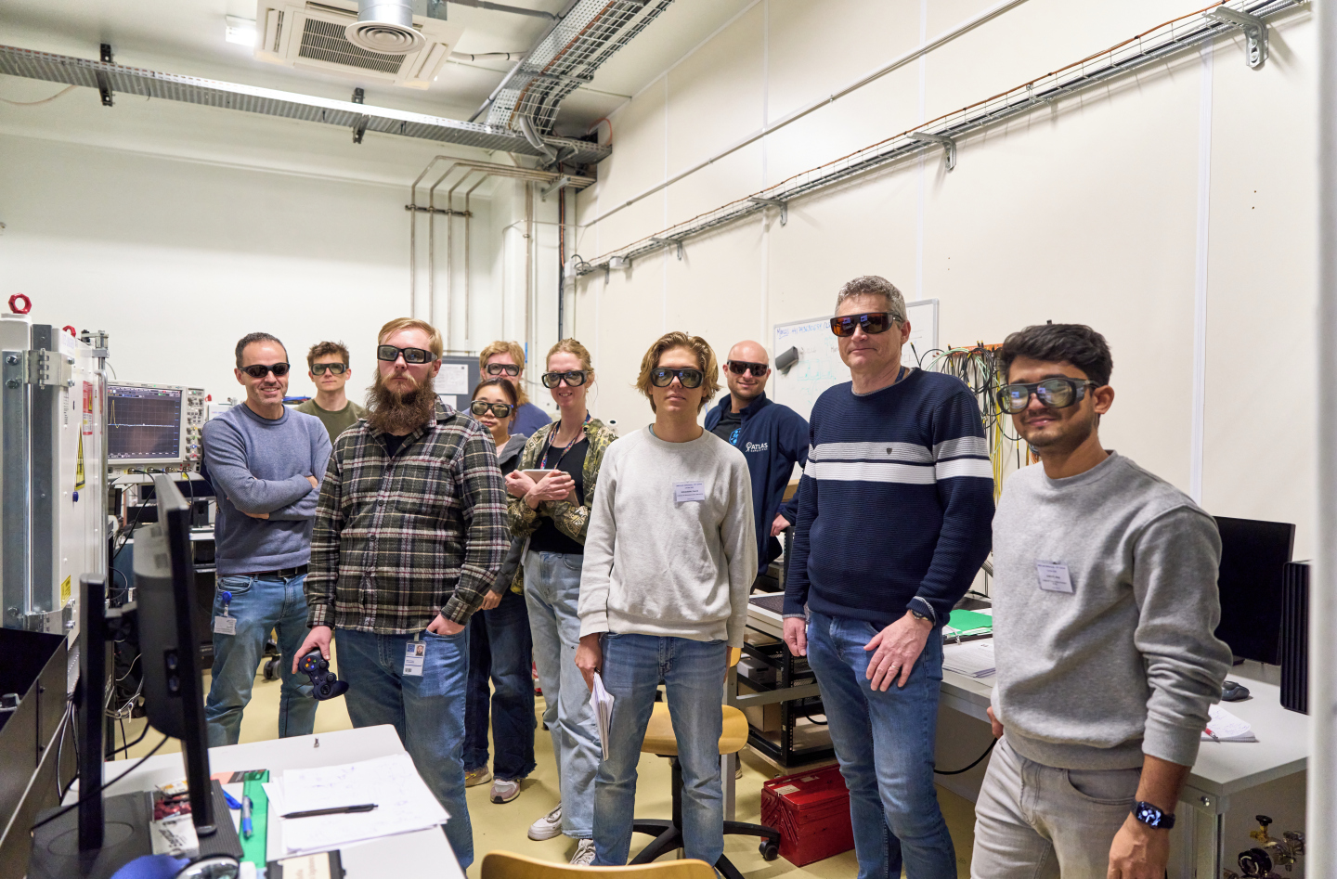

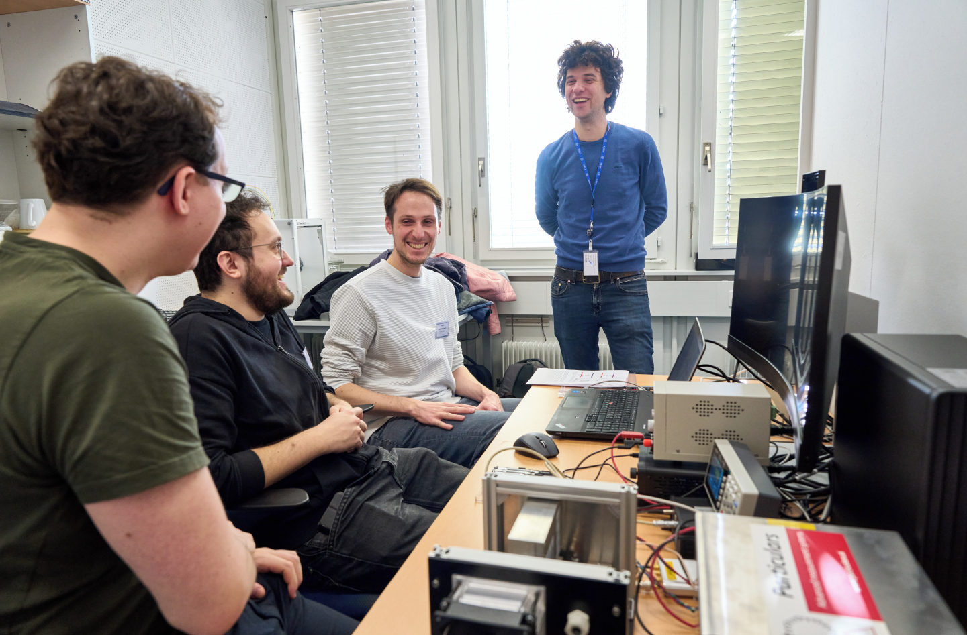
DRD3 TCT School
TCT School organized by DRD3 and AIDAInnova took place at CERN on 4-6 March 2025.
About 18 PhD students and postdocs attended it.
Very comprehensive TCT introduction.
In addition to a dedicated session to present participant research projects.
THE TCT SQUAD

Slide 4
2nd DRD3 TCT School
2nd DRD3 TCT school is being organized to address TCT training
  1st TCT School took place in March 2025 at CERN (18 participants, 50+ applications) – positive feedback from participants
  DRD3 Organizing Groups (contacts):
    CERN, Michael Moll, michael.moll@cern.ch
    CSIC Santander, Ivan Vila, ivan.vila@csic.es
    INFN Torino, Marco Mandurrino, marco.mandurrino@cern.ch
    JSI Ljubljana, Bojan Hiti, bojan.hiti@cern.ch
Experts/Demonstrators from 1st TCT School
Leena Diehl (CERN)
Marcos Fernandez Garcia (CSIC/CERN)
Raul Montero Santos (EHU Bilbao)
Marie Muehlnikel (Heidelberg/CERN)
Moritz Wiehe (CERN)
Planned to be held in Fall 2025, at CERN
  Announcement & Participant selection by July
Duration of 2.5 days
  0.5 day theoretical session
    Expert talks covering theoretical TCT background, lasers+optics and simulations
  1.5 day hands on lab session (3 parallel lab exercises of 0.5 day)
    SPA-TCT, TPA-TCT, Signal Formation courses
  0.5 day wrap up, Q&A session
  Social program – coffee breaks and dinner
15–18 participant places
  Aimed mainly at PhD students/postdocs (beginners and experienced users)
  Selection based on letter of motivation, one-person-per-institute rule
+

Slide 5
SPS test beam in 2025
CERN SPS test beam allocated time in 2025 for DRD3 was two weeks
  From May 28th through June 19th
  From Oct 1st through Oct 15th
As requested the H6b area was allocated for the test beam (AIDA telescope infrastructure)
Preparing for the May-June test beam was kind of a challenge given the short notice time between the granting of the time and the start date.
Three different WG2 sensor technologies are to be tested during this test beam: DC-RSD and (irradiated) TI-LGAD from FBK; and AC-LGADs from BNL. (See next slides).
For the October test beam we will issue a call for test beam to propose characterization activities next week

Slide 6
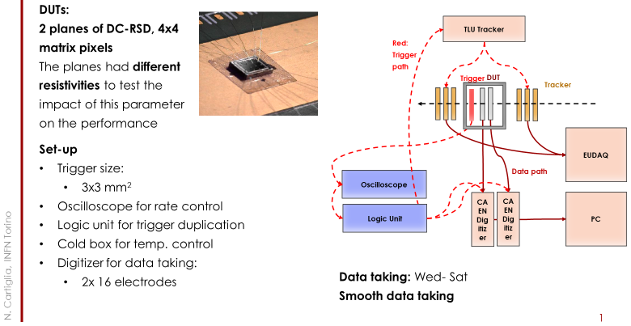
SPS test beam in 2025: DC – RSD

Slide 7
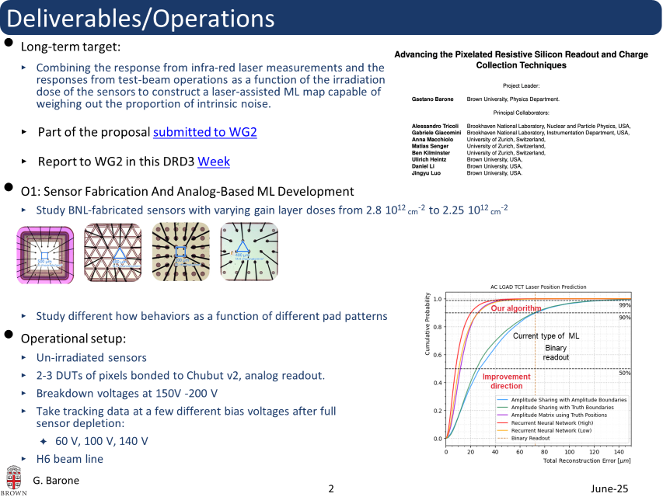



SPS test beam: AC-LGD

Slide 8

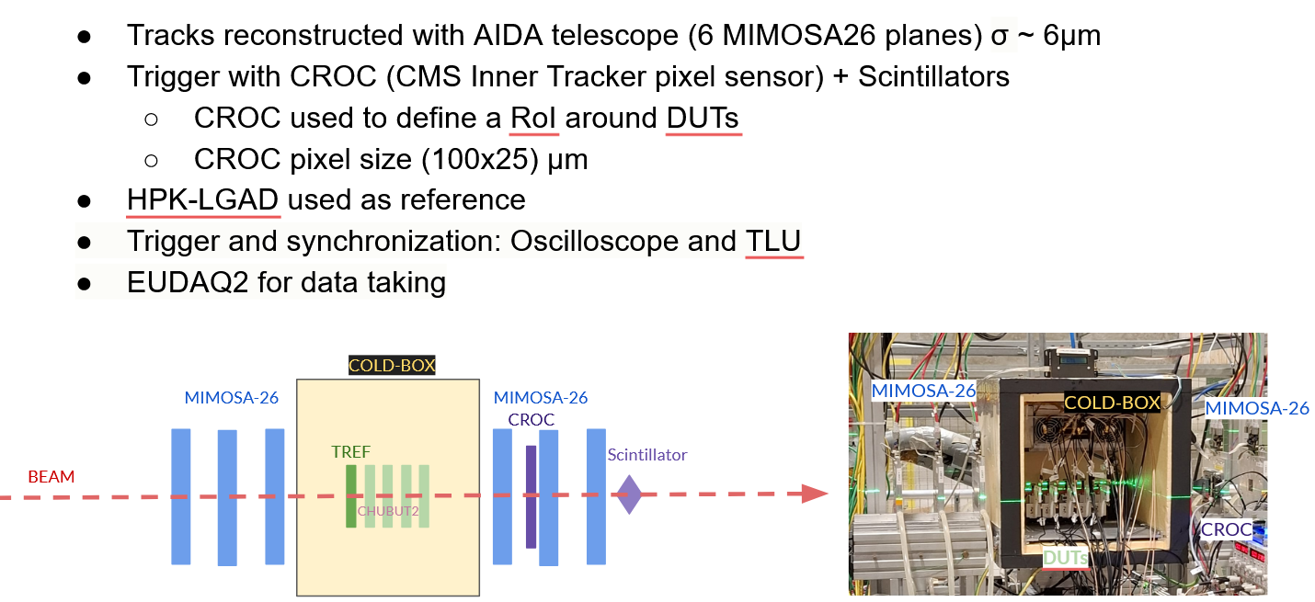
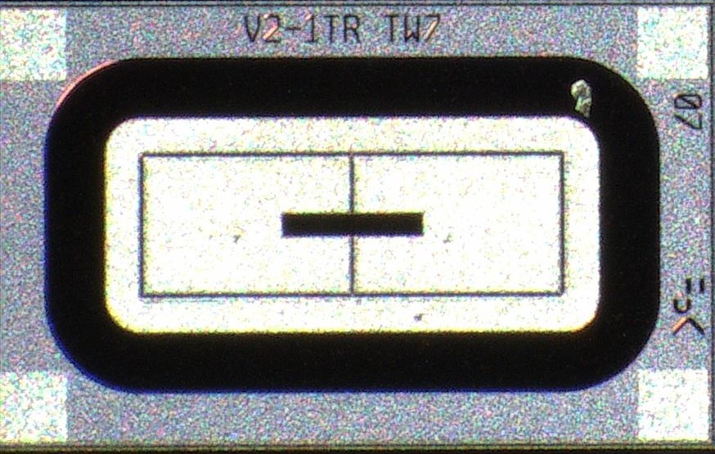





SPS test beam: TI -LGAD

Slide 9
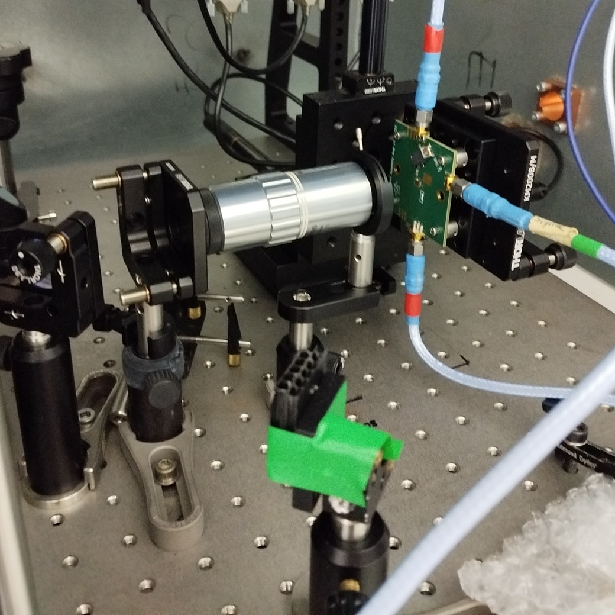
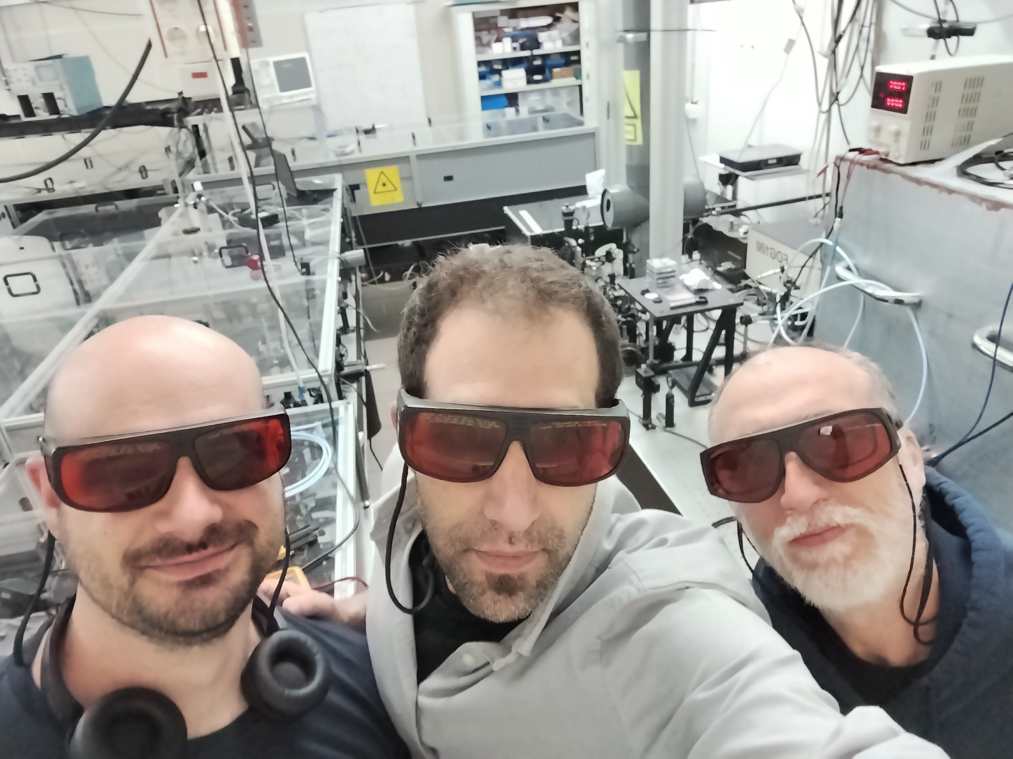
TPA-TCT campaign for SiC devices
From June 2 to June 13, TPA-TCT characterization campaign at the UPV/EHU femto laser facility in Bilbao
SiC PIN and LGAD devices from IHEP (2 PIN), IMB-CNM (one fresh and one irradiated PIN) and OnSemi. (PIN + LGAD)
Devices read out with HF amplifiers (HEPHY and UCSC ) and “convencional” CIVIDEC current amplifiers.
THE TPA-TCT GANG

Slide 10
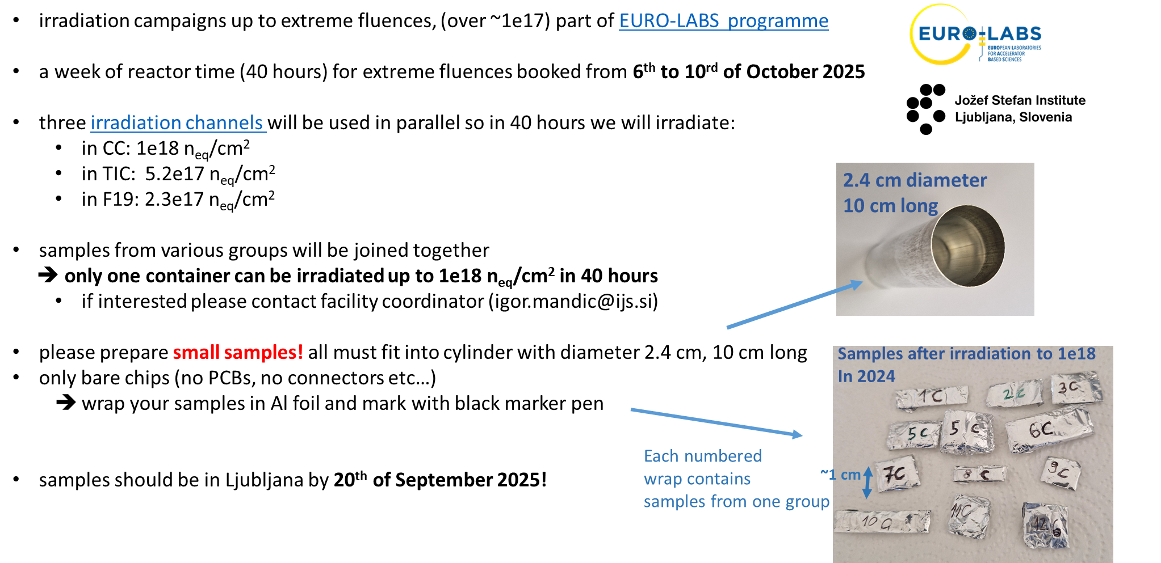
Irradiation to Extreme Fluences in 2025
Contact igor.mandic@ijs.si

Slide 11
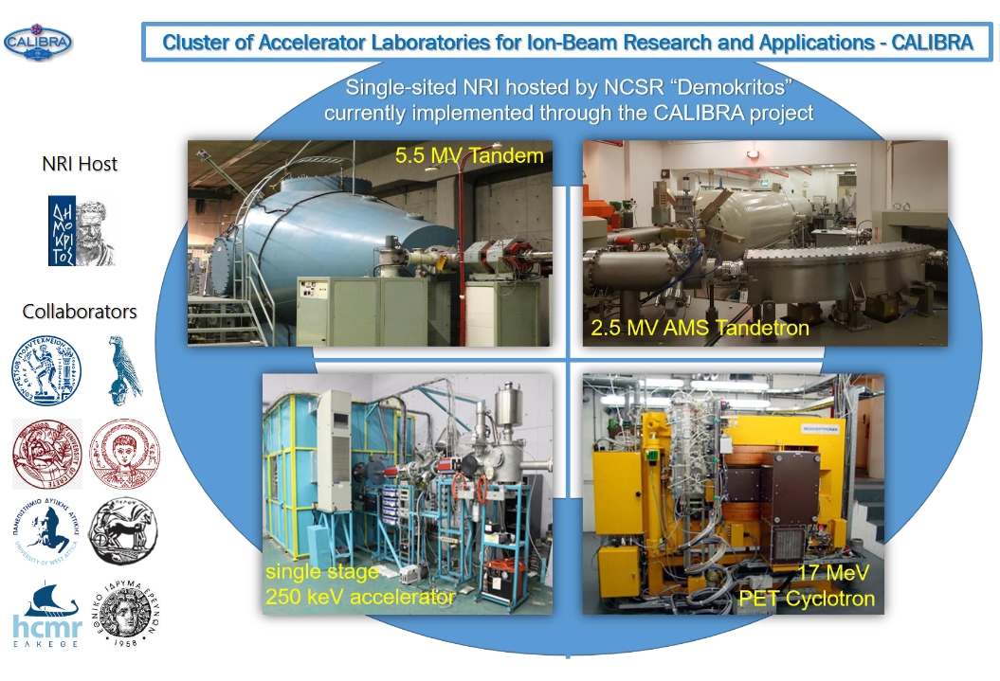

Introducing DEMOKRITOS Ion-beam facilities
Detailed description
Contact Aristoteles Kyriakis
<Aristoteles.Kyriakis@cern.ch>

Slide 12
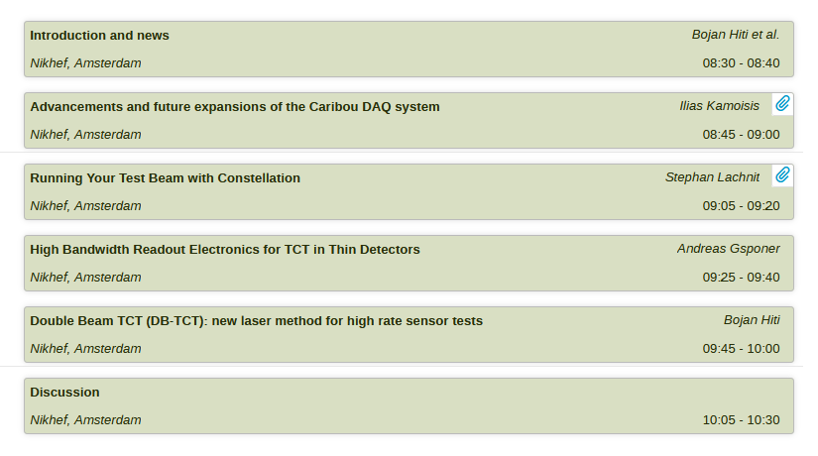
Agenda for today

