Slide 1
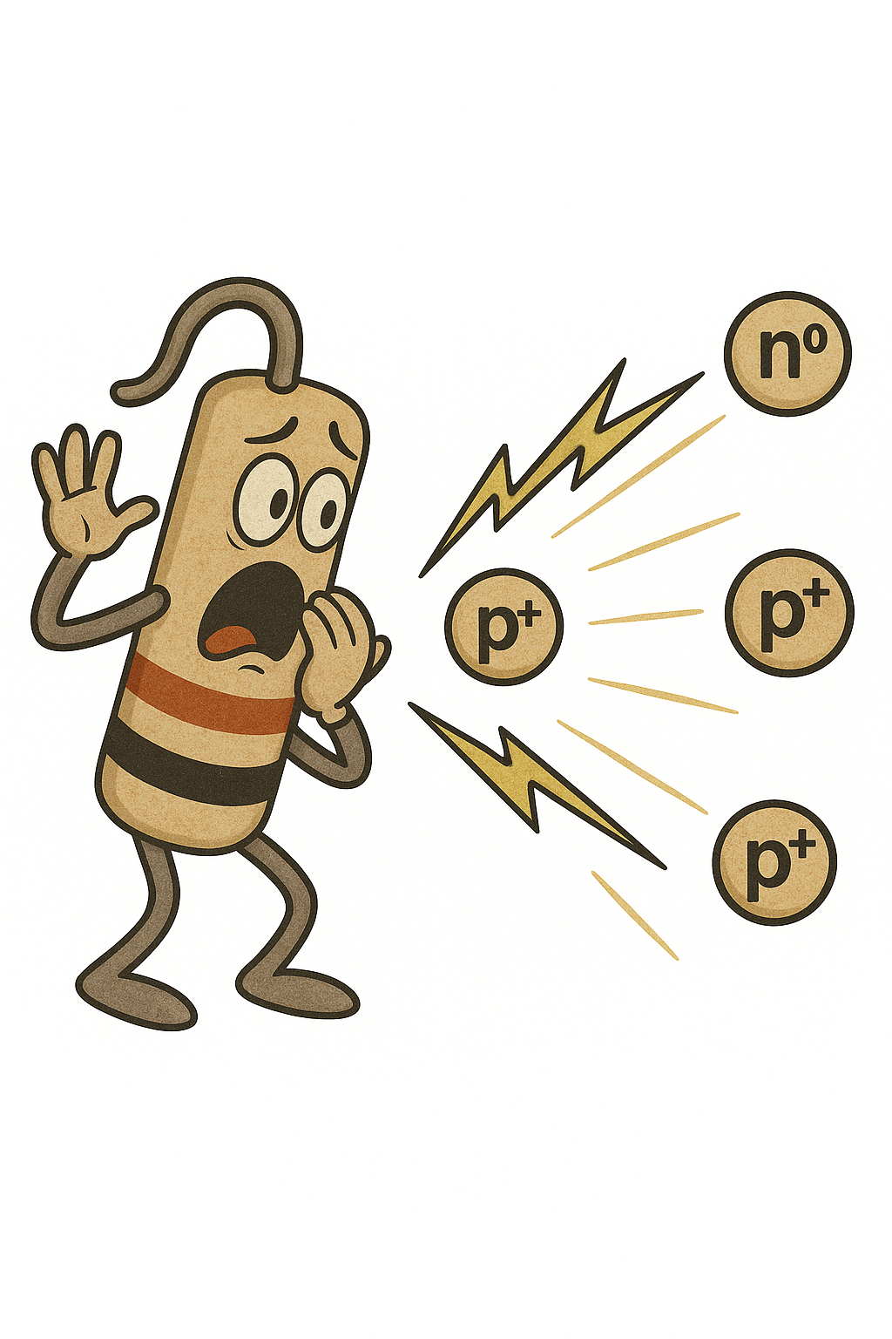







From Van der Pauw Test Structures to Compensated LGADs: A Simulation–Measurement Synergy to Quantify Donor Removal
A. Fondacci, A. R. Altamura, R. Arcidiacono, M. Boscardin, N. Cartiglia, T. Croci, M. Centis Vignali, M. Ferrero, A. Morozzi, F. Moscatelli, D. Passeri, G. Paternoster, B. Regnery, V. Sola, R. S. White
3rd DRD3 week on Solid State Detectors R&D

Slide 2
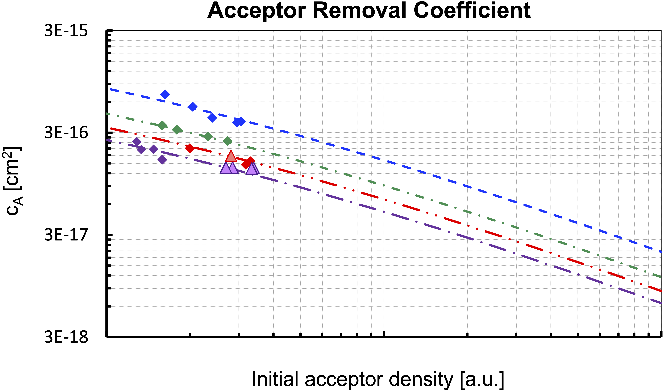

Defining the Challenge, Designing the Approach
Acceptor removal has been studied in detail for many years and is at the core of the LGADs' radiation hardness.
NO Carbon
CHBL / CHBH (0.4, 2, 3, 5)
CHBL / CHBH (0.8 - 1)
CBL / CBH (0.6 - 1)
Donor removal is now becoming very interesting as it plays a crucial role in the functioning of resistive LGADs and compensated LGADs.
A. Fondacci et al.
3rd DRD3 week on Solid State Detectors R&D

Slide 3
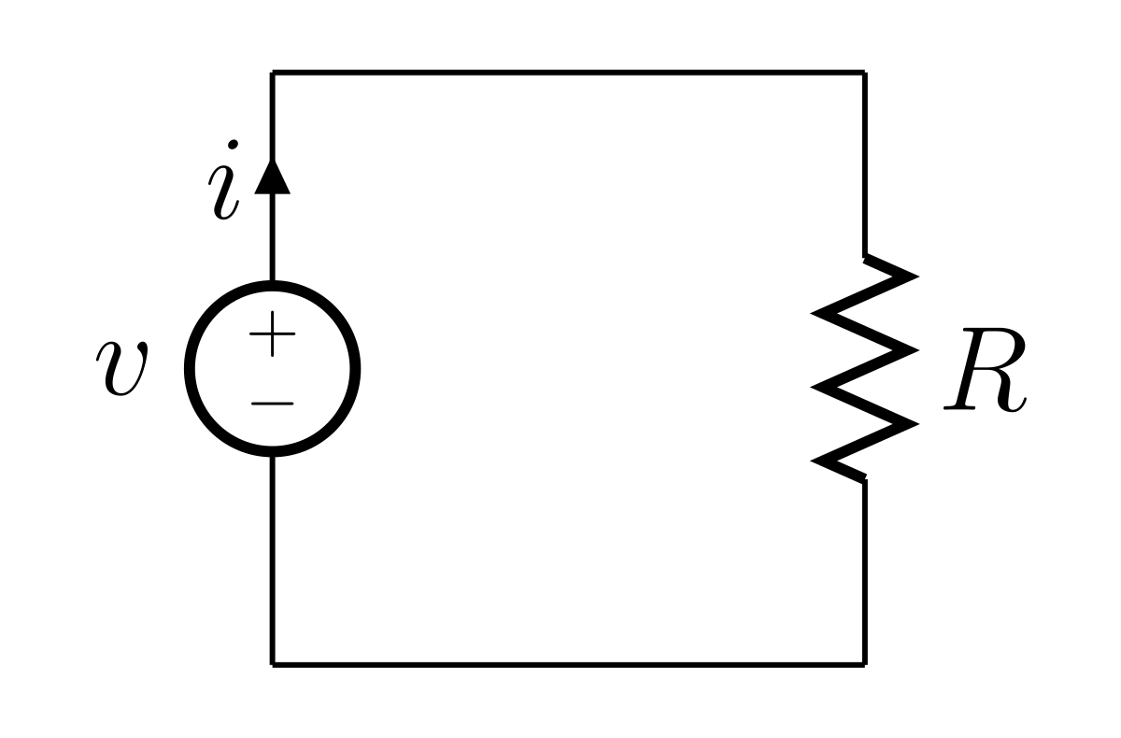
Defining the Challenge, Designing the Approach
Acceptor removal has been studied in detail for many years and is at the core of the LGADs' radiation hardness.
Donor removal is now becoming very interesting as it plays a crucial role in the functioning of resistive LGADs and compensated LGADs.
Resistive LGADs
Compensated LGADs
NO Carbon
CHBL / CHBH (0.4, 2, 3, 5)
CHBL / CHBH (0.8 - 1)
CBL / CBH (0.6 - 1)
n⁺⁺
p⁺
-
+
p⁺
-
+
-
+
-
+
p
p⁺⁺
A. Fondacci et al.
3rd DRD3 week on Solid State Detectors R&D

Slide 4
Defining the Challenge, Designing the Approach
Donor removal is now becoming very interesting as it plays a crucial role in the functioning of resistive LGADs and compensated LGADs.
A Simulation–Measurement Synergy to Quantify Donor Removal at high initial concentrations (N_{D} > 10¹⁵ atoms/cm³)
Resistive LGADs
Compensated LGADs
Van der Pauw test structures
  Clean environment (a dedicated test structure for each implant under study) to investigate donor removal by examining the change in sheet resistance with irradiation.
  RSD2 batch NPLUS test structures (TS) irradiated and analysed; DC-RSD1 batch NPLUS TS are under irradiation; NLGAD batch NGAIN TS will be analysed once FBK realises the batch.
n⁺⁺
p⁺
-
+
p⁺
-
+
Compensated LGADs
  EXFLU1 batch samples offer an opportunity to study donor removal to further initial donor concentrations than those of the previously mentioned samples by reproducing in simulation the capacitance variation with irradiation.
  These samples will also enable us to begin examining the interplay between donor removal and acceptor removal (Do acceptor and donor removals behave similarly together or alone?).
-
+
-
+
p
p⁺⁺
A. Fondacci et al.
3rd DRD3 week on Solid State Detectors R&D

Slide 5

Van der Pauw test structure
3rd DRD3 week on Solid State Detectors R&D
A. Fondacci et al.

Slide 6
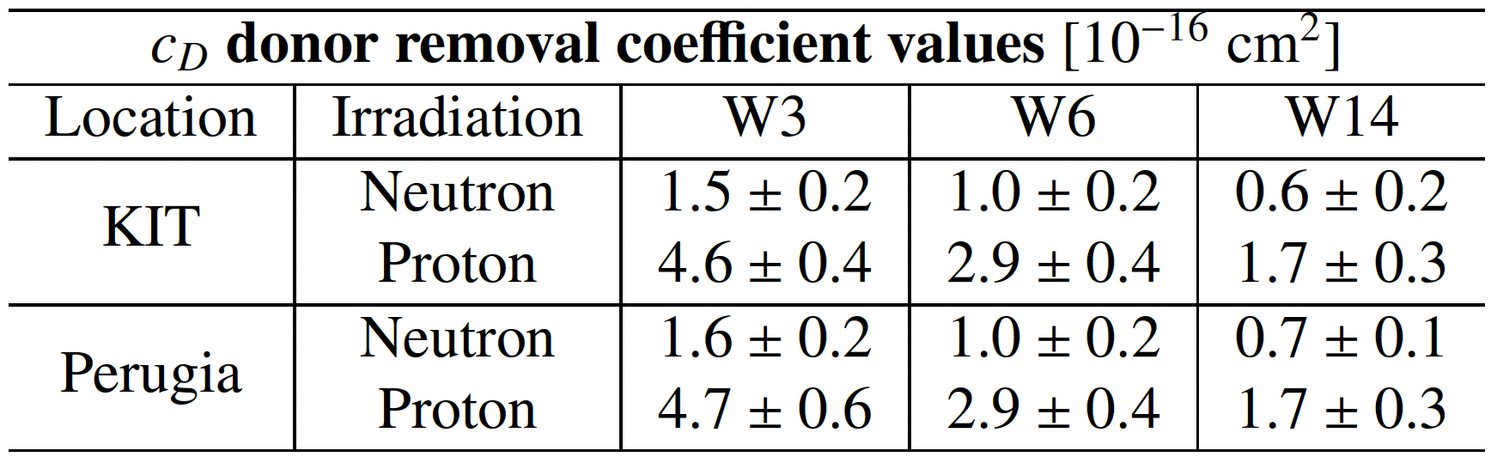
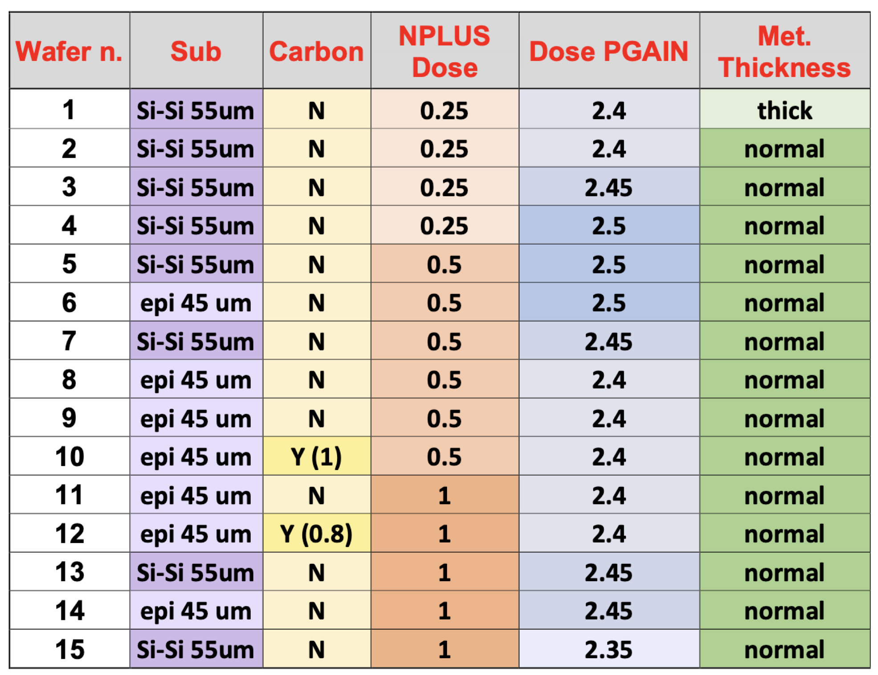
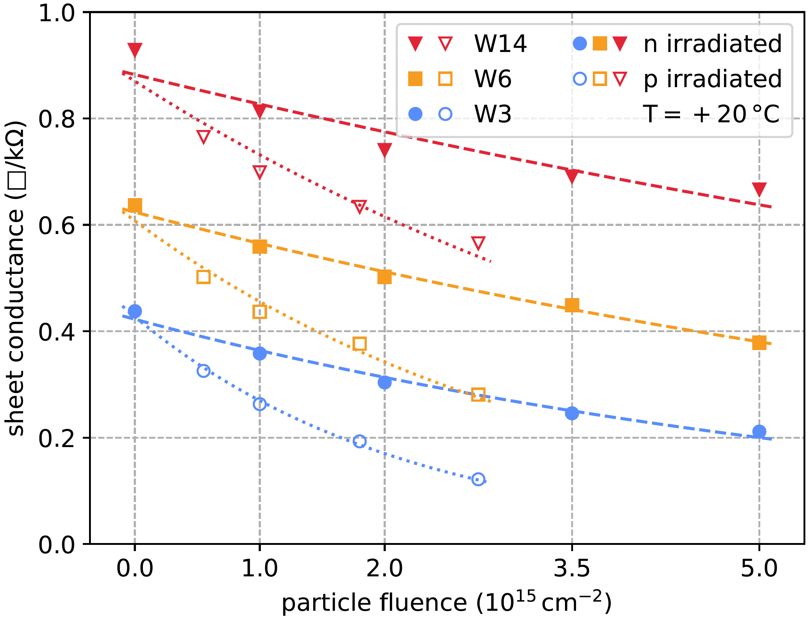

RSD2 batch — NPLUS
3rd DRD3 week on Solid State Detectors R&D
A. Fondacci et al.

Slide 7
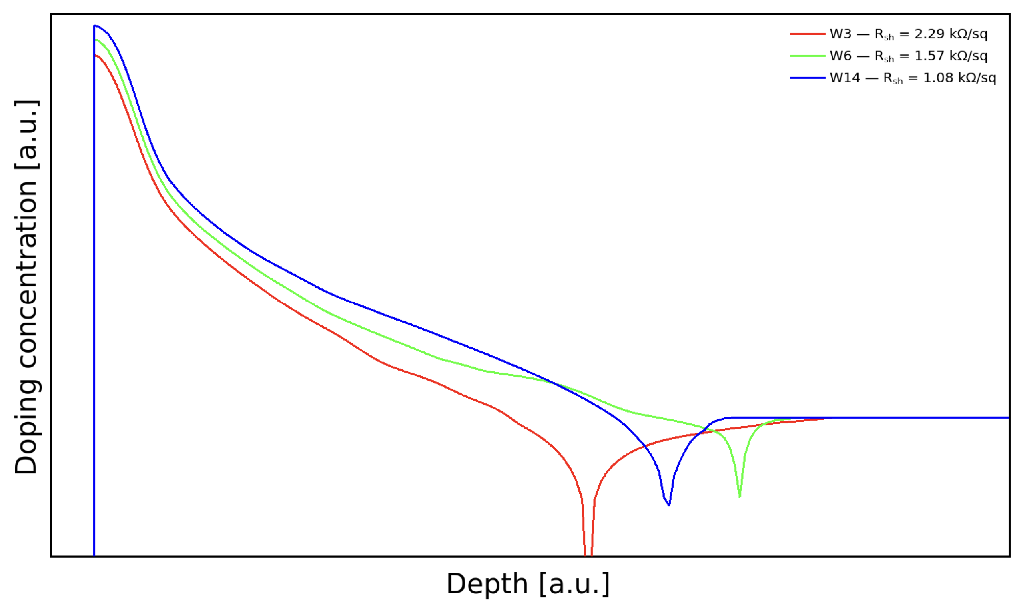

NPLUS profiles before irradiation
3rd DRD3 week on Solid State Detectors R&D
A. Fondacci et al.

Slide 8
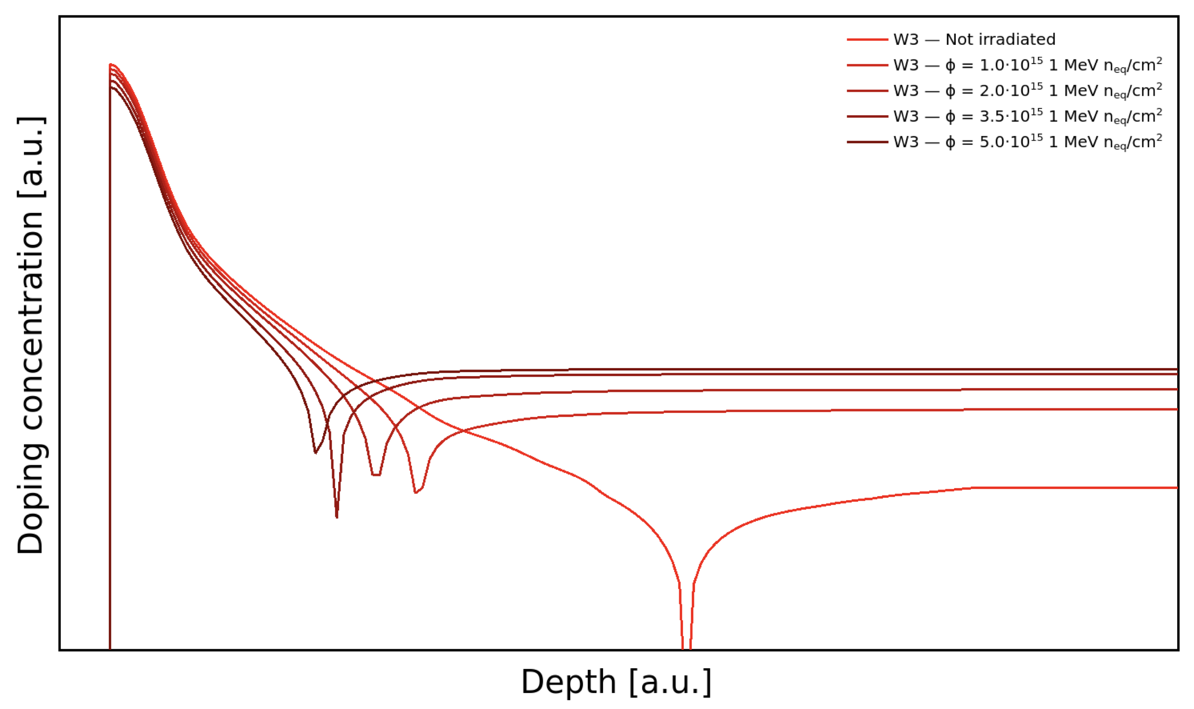
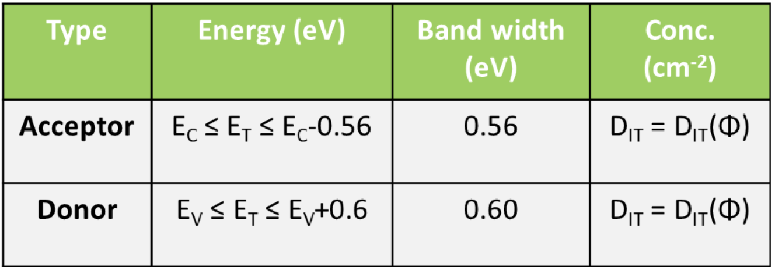
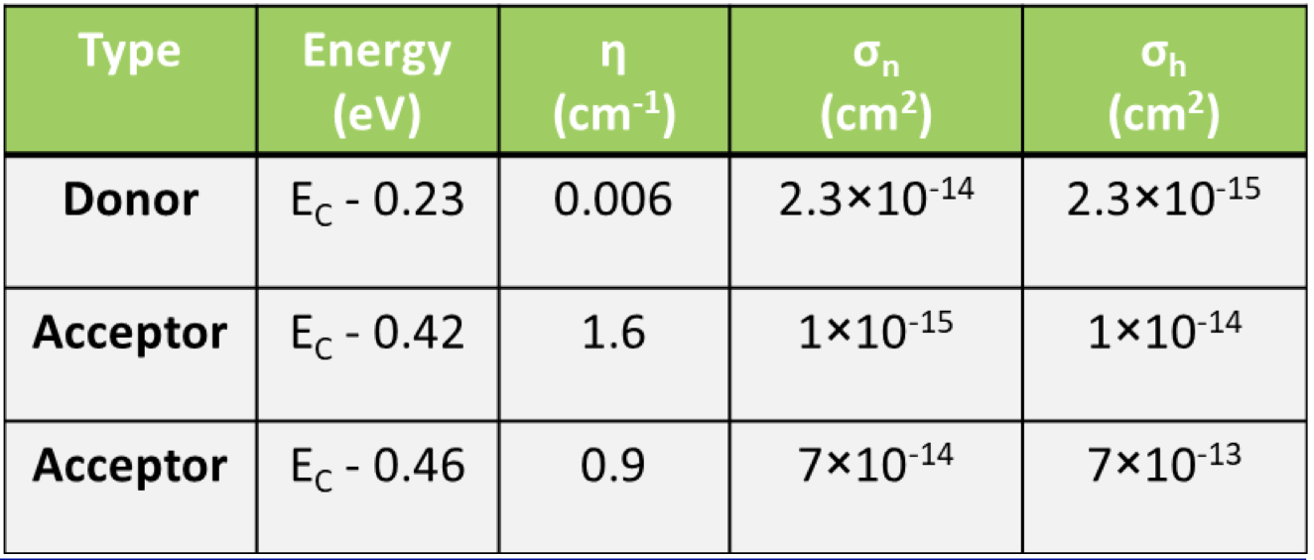

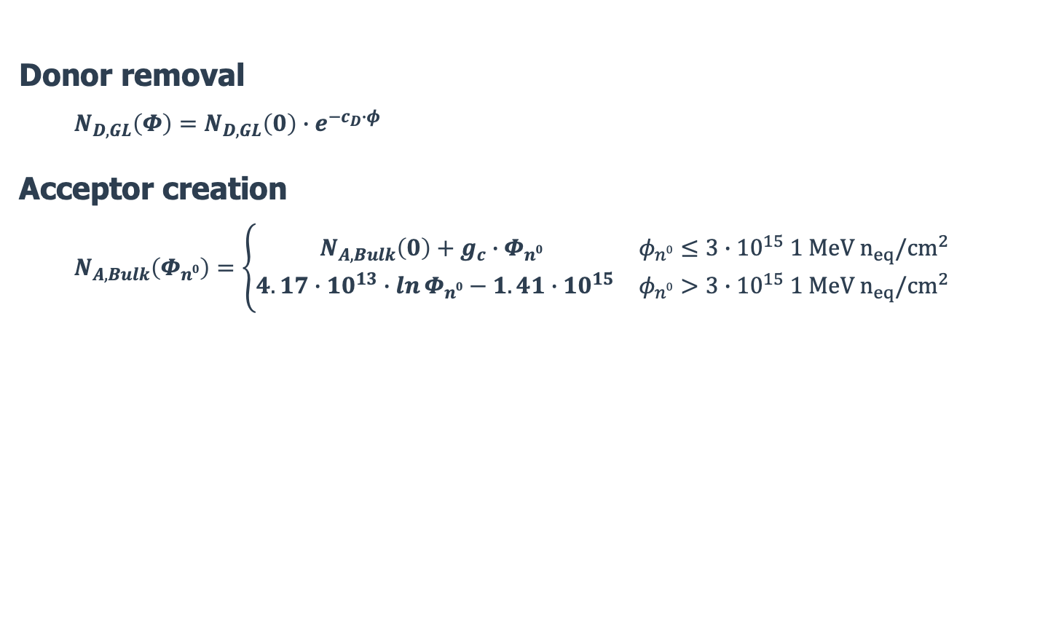
New University of Perugia radiation damage model
Doping analytical parameterisation
Traps in the bandgap
Surface damage (+Q_{ox})
Donor removal
Acceptor creation
Bulk damage
Donor removal
  $$N_{D,GL}\left(Φ\right)=N_{D,GL}\left(0\right)∙e^{−c_{D}∙φ}$$
Acceptor creation
  $$N_{A,Bulk}\left(Φ_{n0}\right)=\left\{\begin{matrix}N_{A,Bulk}\left(0\right)+g_{c}∙Φ_{n0} & φ_{n0}≤3∙{10}^{15} {1 MeV n}_{eq}/cm^{2} \\ 4.17∙{10}^{13}∙\ln{Φ_{n0}}−1.41∙{10}^{15} & φ_{n0}>3∙{10}^{15} {1 MeV n}_{eq}/cm^{2}\end{matrix}\right.$$
$$Φ_{n0} \left[1 MeV n_{eq}/cm^{2}\right]=2∙Φ_{p^{+}} \left[23 MeV p^{+}/cm^{2}\right]$$
https://www.etp.kit.edu/english/1669.php
3rd DRD3 week on Solid State Detectors R&D
A. Fondacci et al.

Slide 9

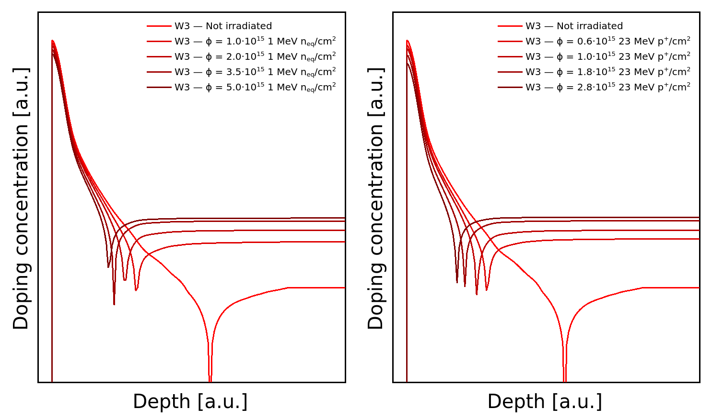








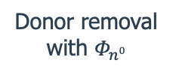
RSD2 NPLUS W3 — Neutron Proton
$$1.2∙{10}^{15} {1 MeV n}_{eq}/cm^{2}$$
$$2.0∙{10}^{15} {1 MeV n}_{eq}/cm^{2}$$
$$3.6∙{10}^{15} {1 MeV n}_{eq}/cm^{2}$$
$$5.6∙{10}^{15} {1 MeV n}_{eq}/cm^{2}$$
Donor removal with $Φ_{n0}$
Donor removal with $Φ_{p^{+}}$
Acceptor creation with $Φ_{n0}$
Acceptor creation with $Φ_{n0}$
3rd DRD3 week on Solid State Detectors R&D
A. Fondacci et al.

Slide 10
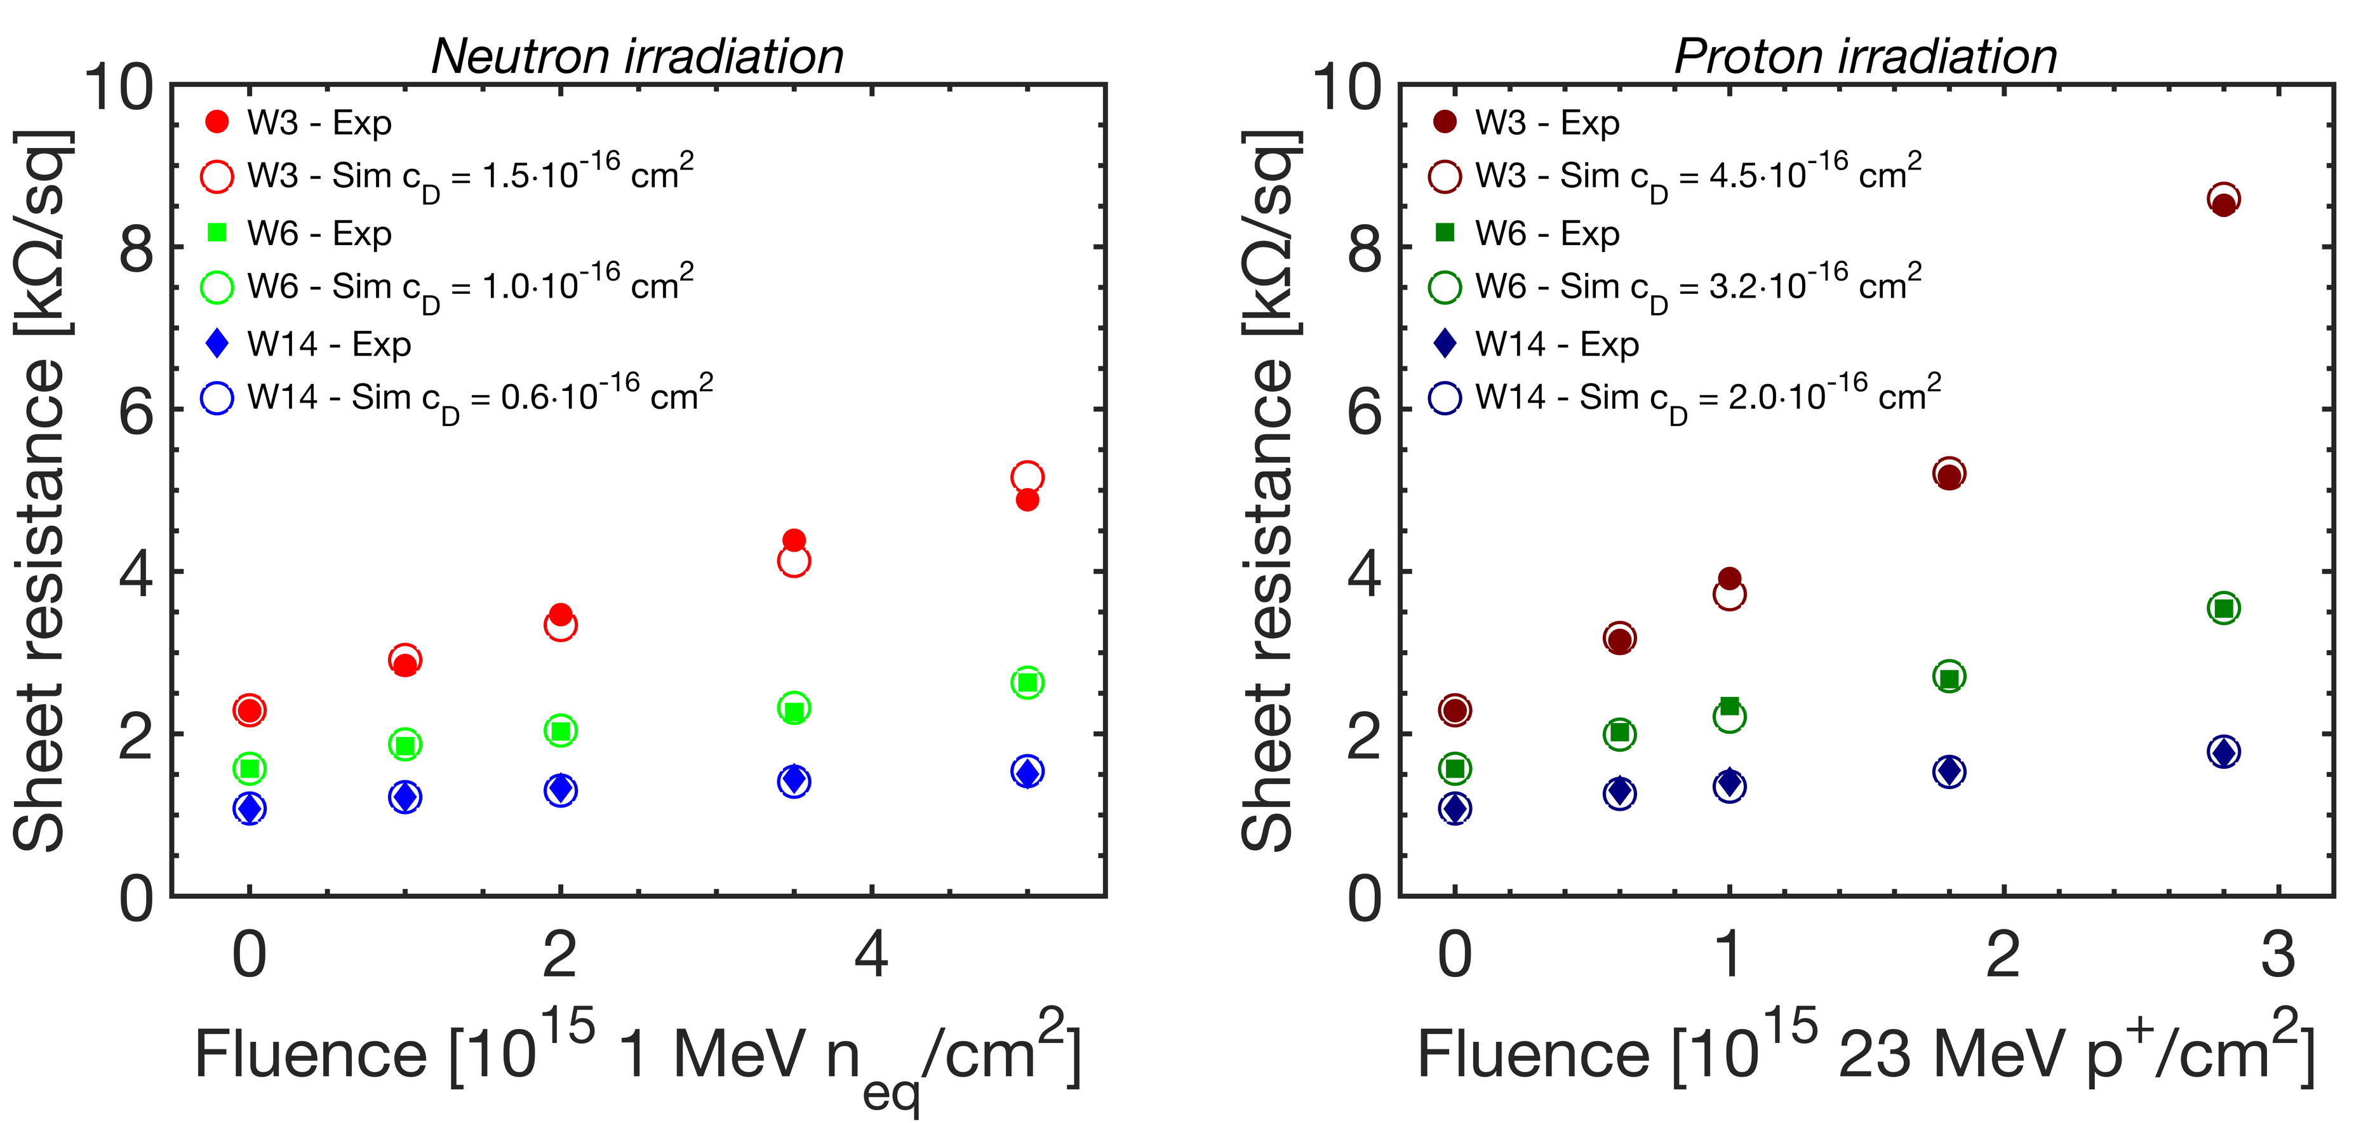

RSD2 batch — NPLUS — TCAD Measurements
3rd DRD3 week on Solid State Detectors R&D
A. Fondacci et al.

Slide 11
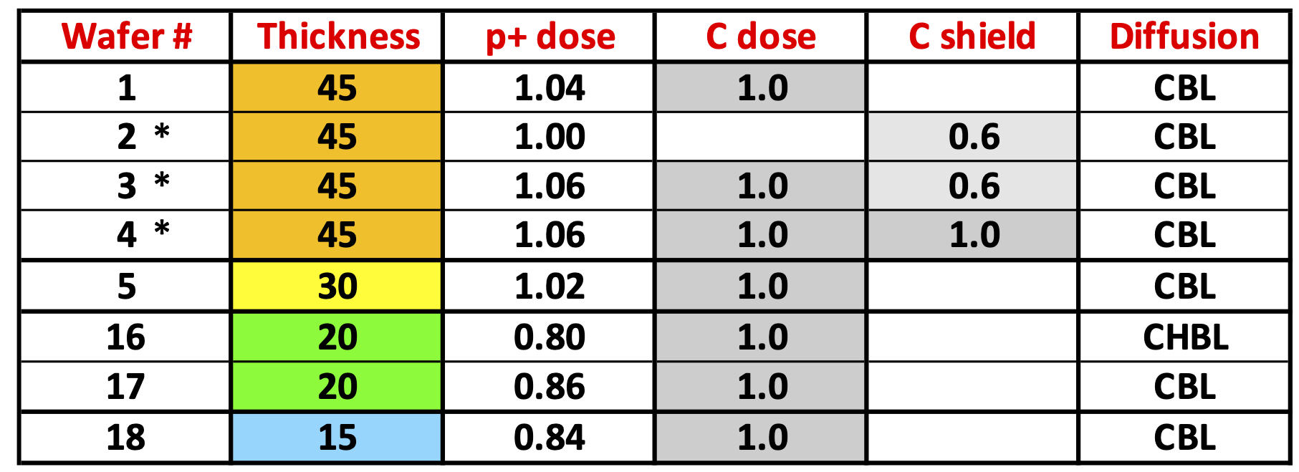
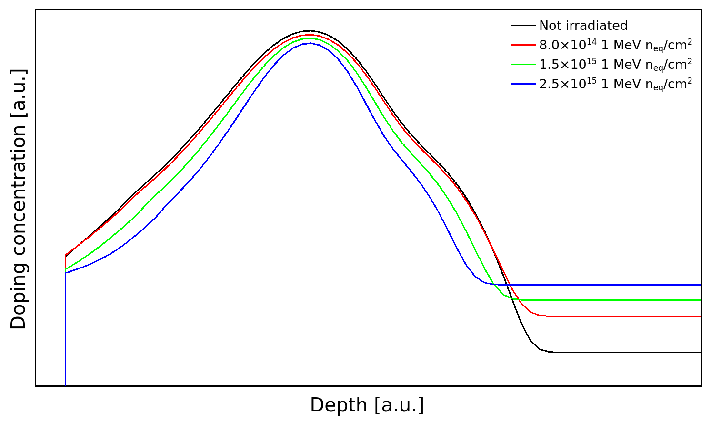

EXFLU1 batch - PGAIN
Acceptor removal
Acceptor removal
Acceptor removal
Acceptor creation
3rd DRD3 week on Solid State Detectors R&D
A. Fondacci et al.

Slide 12
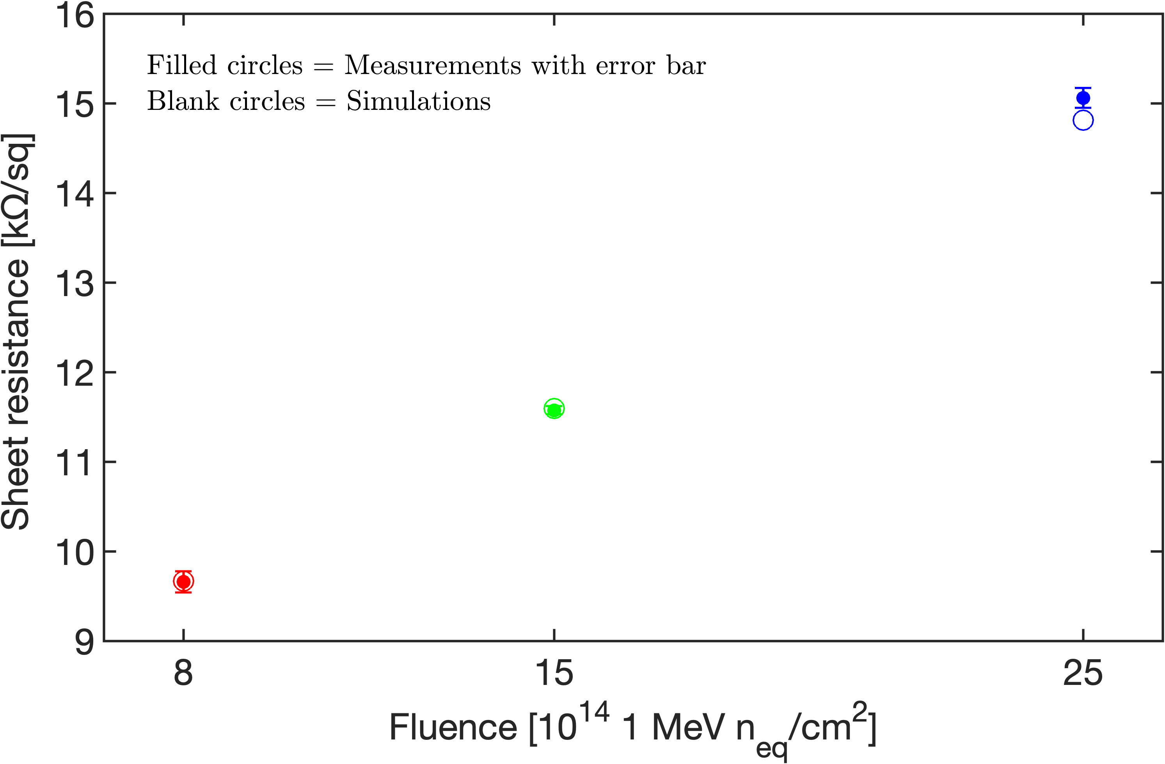

EXFLU1 batch — PGAIN — TCAD Measurements
3rd DRD3 week on Solid State Detectors R&D
A. Fondacci et al.

Slide 13

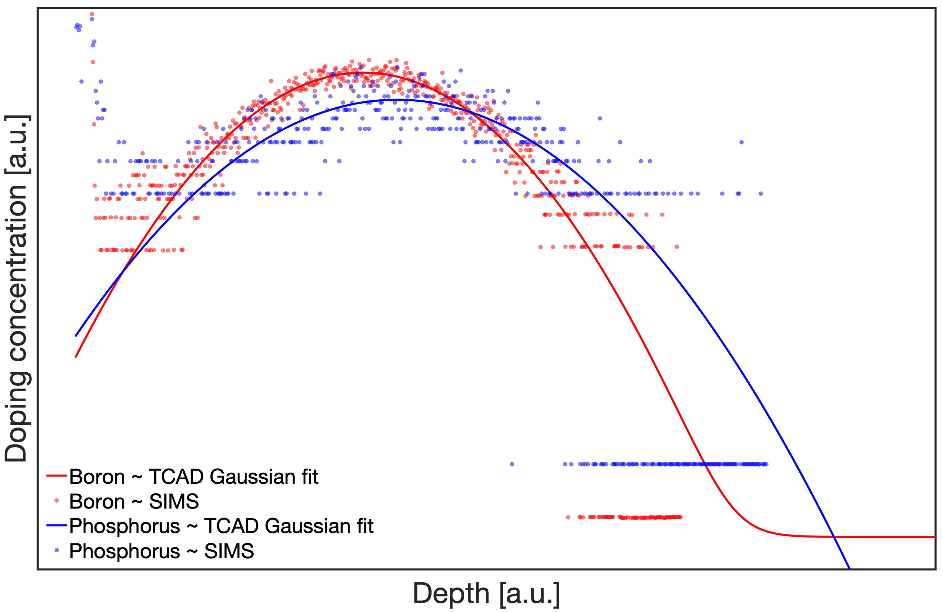


EXFLU1 batch – Compensated LGADs
Acceptor removal
Donor removal - Change c_{D} until experimental C-Vs are reproduced!
Single pad Compensated LGAD
3rd DRD3 week on Solid State Detectors R&D
A. Fondacci et al.

Slide 14
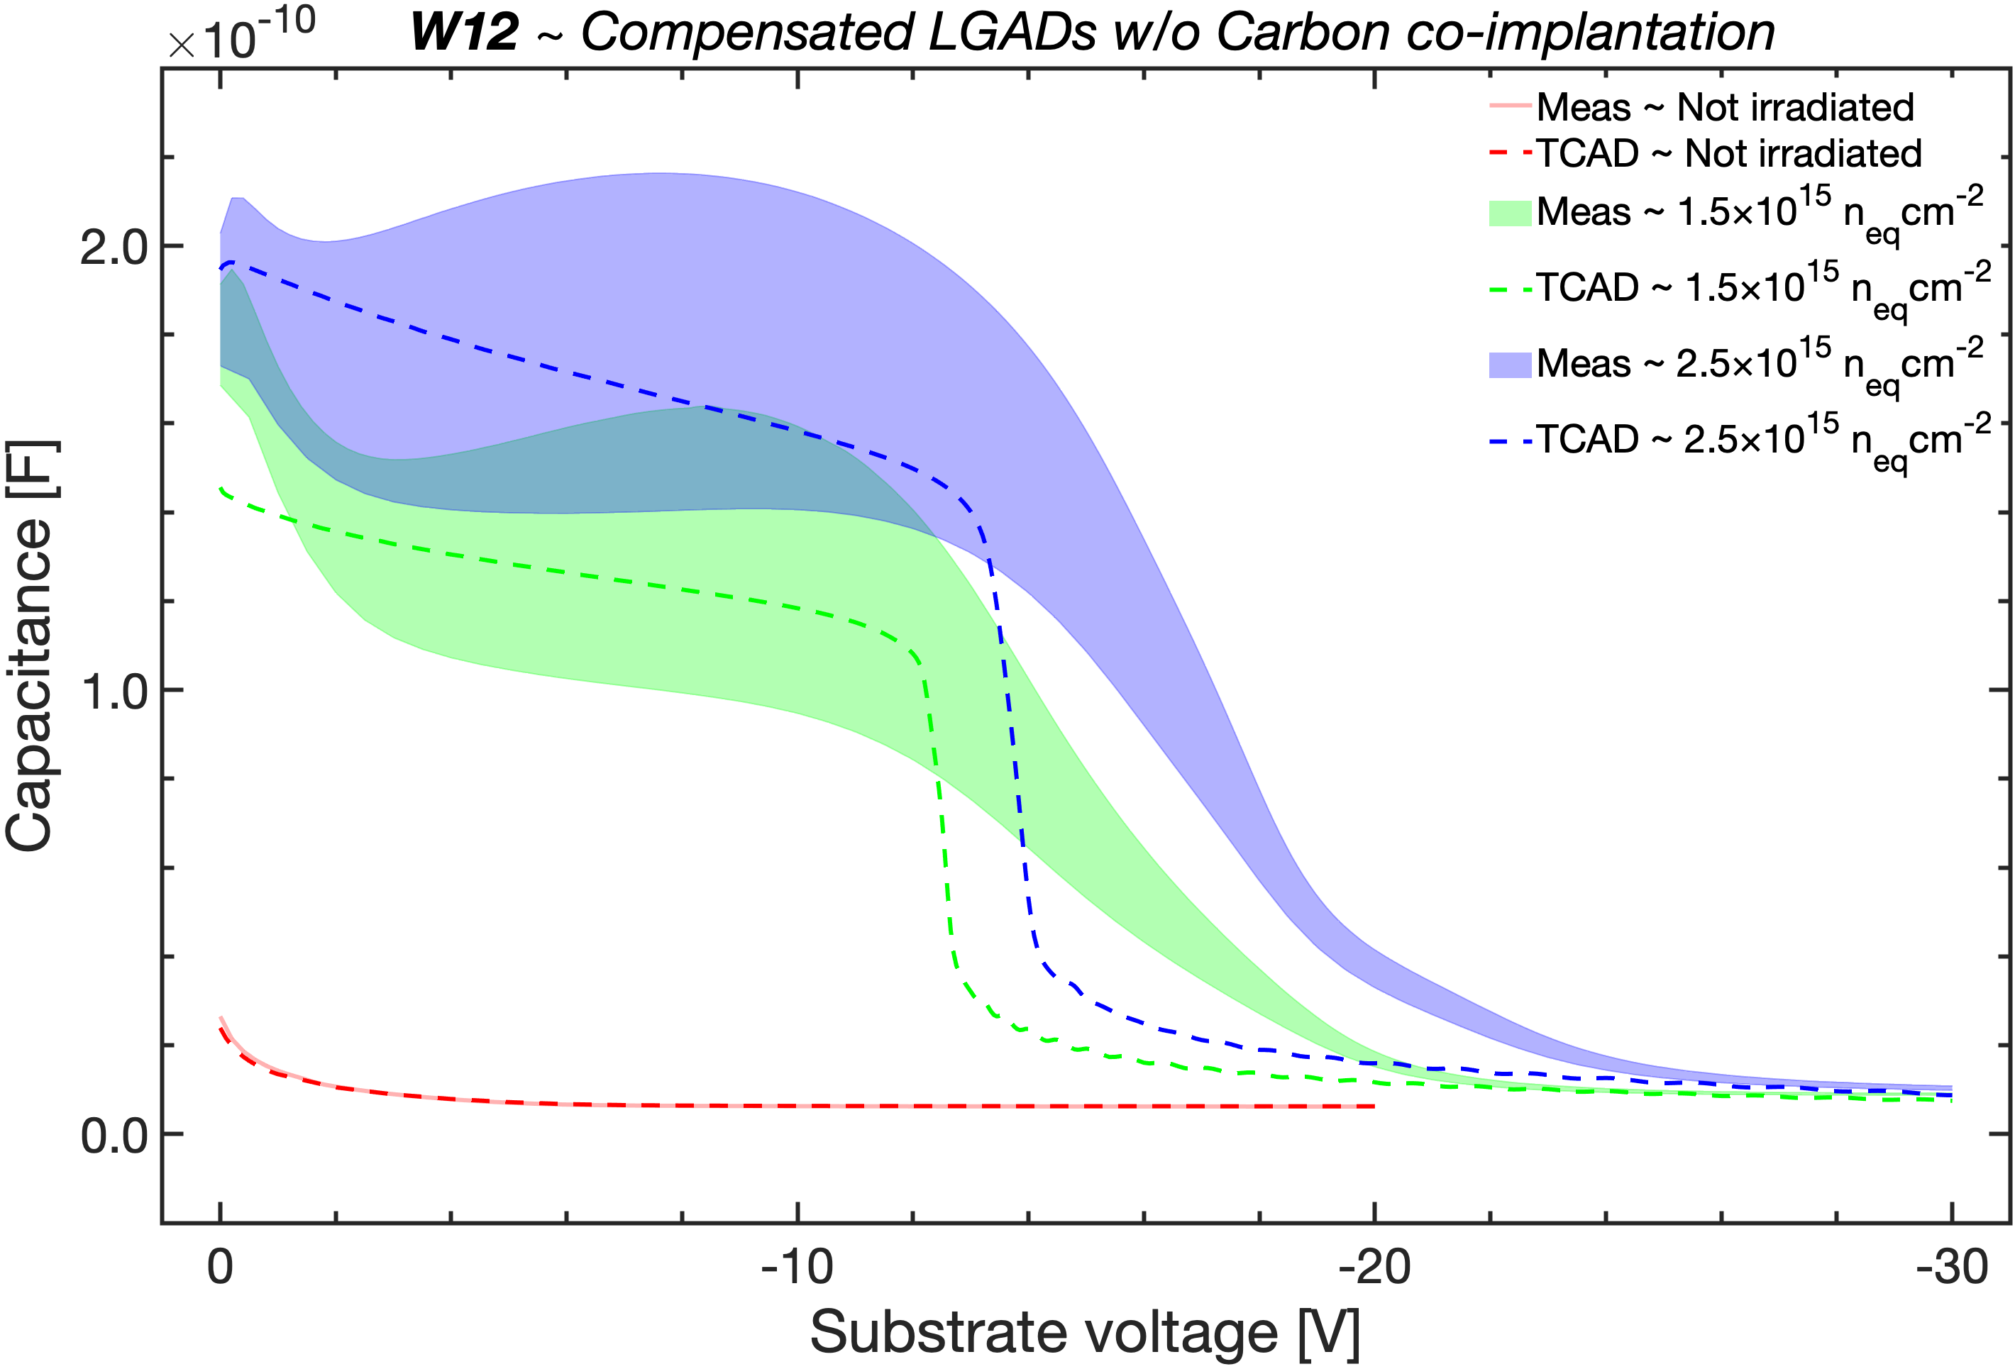
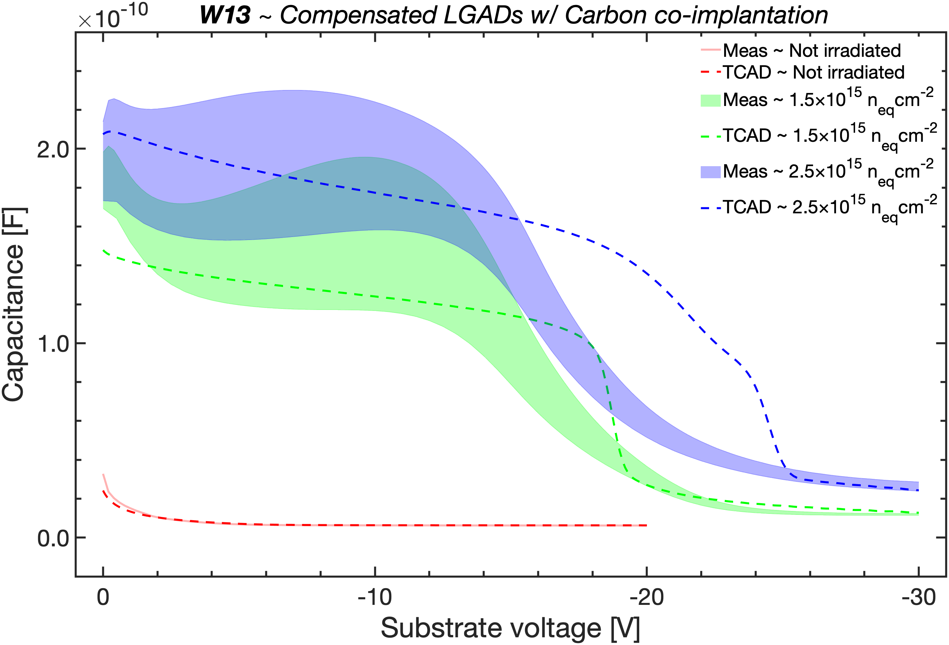

EXFLU1 batch – Compensated LGADs
By exploiting the experimental acceptor removal coefficient c_{A} = 2.50⋅10⁻¹⁶ cm², agreement with C-V measurements is achieved using a donor removal coefficient c_{D} = 6.50⋅10⁻¹⁶ cm².
Assuming the same dependence on the initial doping density and considering the different concentrations of implanted boron and phosphorus atoms, it results that c_{D} ~ 2⋅c_{A}.
By exploiting the extracted c_{D} (6.50⋅10⁻¹⁶ cm²) and the experimental c_{A} = 8.26 · 10⁻¹⁷ cm² for the carbonated gain implant, a good agreement between measurements and simulations was achieved.
The latter c_{A}, being one third of the former, confirms that carbon slows acceptor removal in the same way as in standard LGADs, even in the presence of phosphorus in the gain implant region.
3rd DRD3 week on Solid State Detectors R&D
A. Fondacci et al.

Slide 15
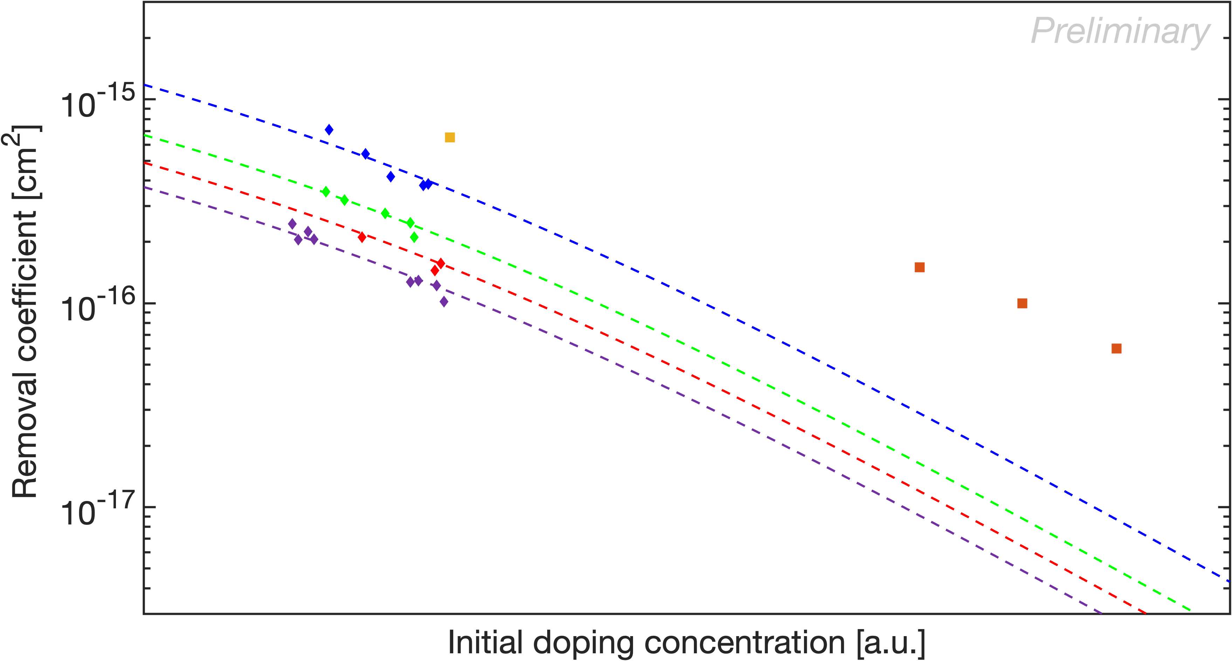

Preliminary c_{D} at high initial donor concentrations
EXFLU1
RSD2
NO Carbon
CHBL / CHBH (0.4, 2, 3, 5)
CHBL / CHBH (0.8 - 1)
CBL / CBH (0.6 - 1)
Diamonds = Acceptor removal
Squares = Donor removal
3rd DRD3 week on Solid State Detectors R&D
A. Fondacci et al.

Slide 16
Conclusion
Doping removal can be estimated via changes in sheet resistance under irradiation:
For surface implants of opposite conductivity to the substrate: van der Pauw measurements alone are sufficient;
For deep and/or same conductivity type implants: simulation is required to interpret van der Pauw measurements.
Preliminary analyses indicate:
Correlation between C-V and van der Pauw extracted removal coefficients;
A more pronounced donor removal than acceptor removal.
New analyses (EXFLU1, RSD2, DC-RSD1, NLGAD) aim to strengthen and validate these results.
Thank you for your attention!
A. Fondacci (alessandro.fondacci@pg.infn.it), A. R. Altamura, R. Arcidiacono, M. Boscardin, N. Cartiglia, T. Croci, M. Centis Vignali, M. Ferrero, A. Morozzi, F. Moscatelli, D. Passeri, G. Paternoster, B. Regnery, V. Sola, R. S. White

