Slide 1
Tracking and PID readout architecture with fine TDC in TPSCo 65 nm
Status of NAPA and TDC developments at SLAC
G. Boudoul, J. Daniel, L. Caponetto, X. Chen, D. Contardo, M Dahoumane, B. Nodari, (IP2I)
Christos Bakalis, Martin Breidenbach, Angelo Dragone, Christopher Kenney, Bojan Markovis, Lorenzo Rota Julie Segal, Alexandre, Mirella Vassilev, Caterina Vernieri C. Young (SLAC)

Slide 2
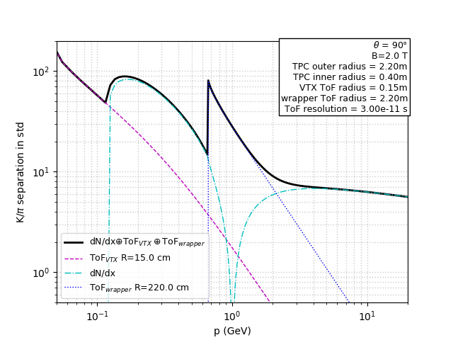
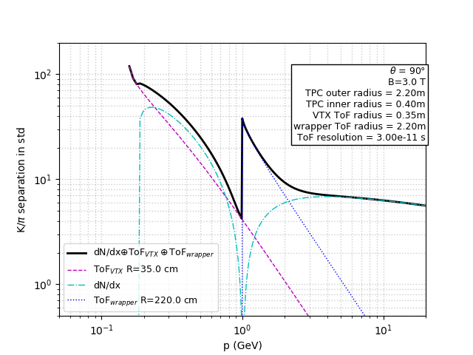
Motivation for tracking architectures with 1 ns to 100 ps precision
≃ 1 ns for background suppression & pile-up mitigation at e-e and h-h colliders
≲ 100 ps ToF Particle ID to complete Large Gas Volume Detector at e-e colliders
Tracking with both position and timing precision at low X/X₀
Si/W calorimetry with 5D high granularity first layers (possibly digital)
power consumption will drive granularity/timing compromise as a function of layer radius
ex. PID w/ ToF of 30 ps precision at inner and outer LGVD radius
extend low-P range at 2T B-field
enable PID at 3T B-field

Slide 3
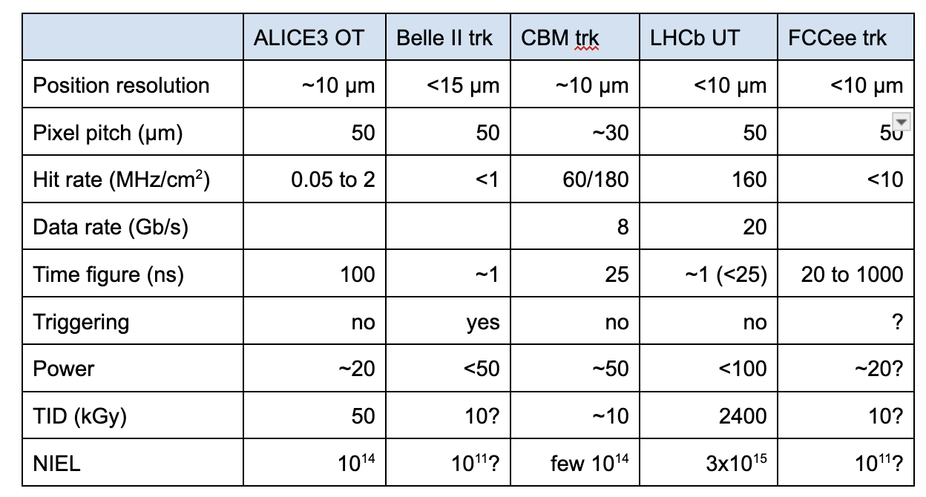
Tracking requirements of strategic experimental projects
Versatile Tracker*
+ PMaTT
FCCee trk & PID
≲ 10 μm
≃ 15
low*
≲ 100 ps
no
tbd
low
low
require fine TDC
(compared to timestamp)
TPSCo 65 nm offers the highest granularity potential at low power consumption
65 ps precision measured w/ TPSCo modified process at 10 μm pitch
* Projects submitted to DRD3 WP1, Versatile Tracker see talk of M. Deveaux

Slide 4
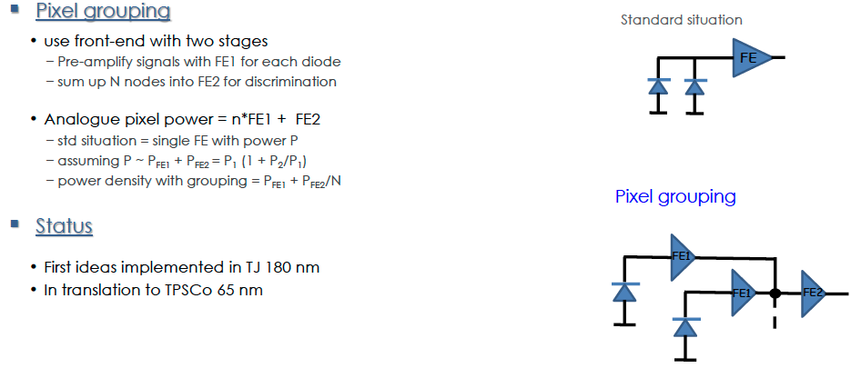
Possible specifications for analog sensor and Front-End
Diode pitch 15 μm* for time resolution ≃ 100 ps
2 (row) x 2 (col.) diodes grouped at FE = 1 pixel
  binary position resolution 30 / √12 ≃ 9 μm (cluster size 1)
  1- 2 stages FE as in Tracker Versatile grouping proposal
    NAPA SLAC-like FE, σ_{jit} ≃ 400 ps
    DPTS CERN DPTS-like, σ_{jit} ≃ 6 ns
Allpix2 + Cadence simulation can guide choice of pitch and grouping of diodes
* Pitch also considered in Octopus

Slide 5
Architecture (asynchronous) options for fine TDC implementation*
TDC at End of Column - no clock in matrix
  Dedicated line(s) to TDC (different from address readout), with pixels grouping depending on rates (radius…)
    FE in current mode to minimize components between discriminator and TDC
    FE in voltage mode require buffering of discriminator output
  Pixels grouped with Versatile Tracker/Octopus tree arbiter toward TDC
    more logics in timing path ≃ 6 ns precision in current SPARC design
TDC in matrix per pixel or group of pixels – need clock in matrix
  require buffering and calibration of clock in column and rows
Vernier delay line TDC (DRD7) - ToA on Leading Edge, ToT on Trailing Edge
SLAC, IP2I/CPPM developments (possible variants w/ - w/o ring oscillator)
* at IP2I expertise (RH available) in Cadence, RTL, UVM, DoT chip design, experience of complete MCOS design in TJ 180 nm and readout chain w/ precision timing in TSMC 130 nm

Slide 6
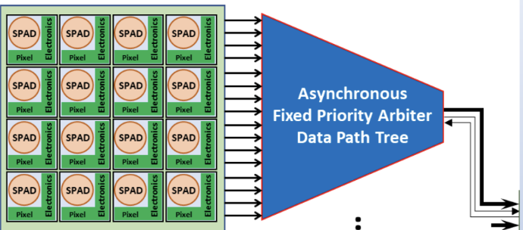
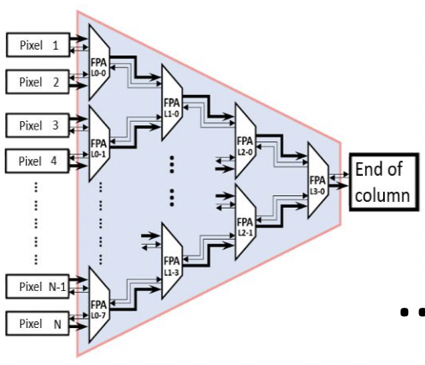
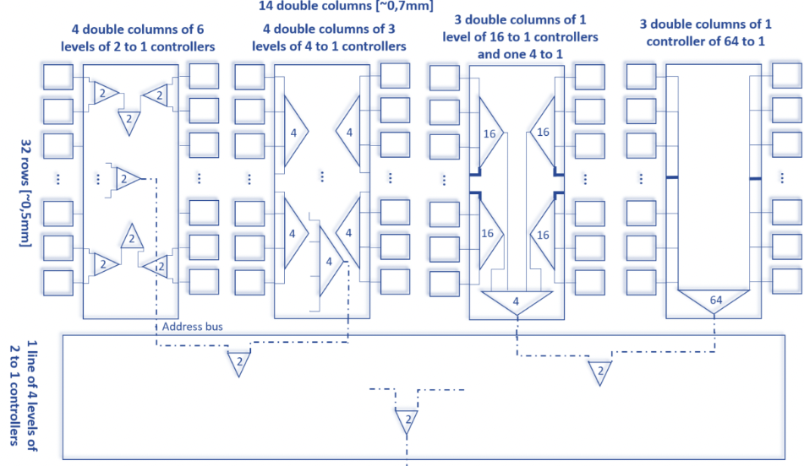
Architecture (asynchronous) options for address Read-Out and periphery
Fixed Priority Arbiter
Address Read-Out
  32 rows (of pixels = 2 x 2 diodes FE) - precision ≃ 9(300) μm //( ⊥)
  Versatile Tracker tree arbiter multiplexing levels TBD
Periphery w/ Versatile Tracker configurability
  DAC, Slow Control
  data format w/ some sepcific for precision timing
  multiplexing and output
Cadence – PIXESL simulations to guide choice of variants
Tree of FPA
SPARC (IPHC) ER2

Slide 7
Deployment in DRD3 - DRD7 framework and planning
Assuming two Multi Project Runs with 18 months cycle, reticle size 32.5 x 25.5 mm²
use length for ≃ 1024 pixels, share n columns (tbd) in Versatile Tracker + PMATT variants
1st submission :
  demonstrate Read-Out architecture w/ fine TDC implementation of precision < 50 ps
  demonstrate ≃ 1 ns hit precision (sensor + RO)
2nd submission :
  new FE and/or sensor gain (CASSIA see talk of I. Berdalovik) to demonstrate precision ≲ 100 ps
  improve power consumption
Second R&D phase
  Stitched sensors
  3D wafer stacking
Prepare to start desing in September for submission in ?
  define specifications for few architecture variants and identify contributors to tasks list in common w/ Versatile Tracker

Slide 8
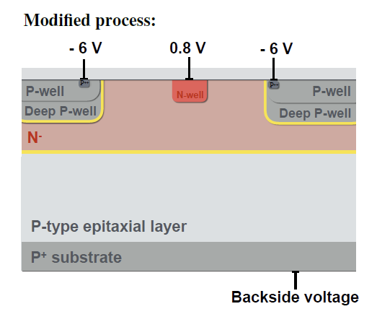
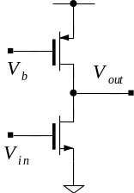
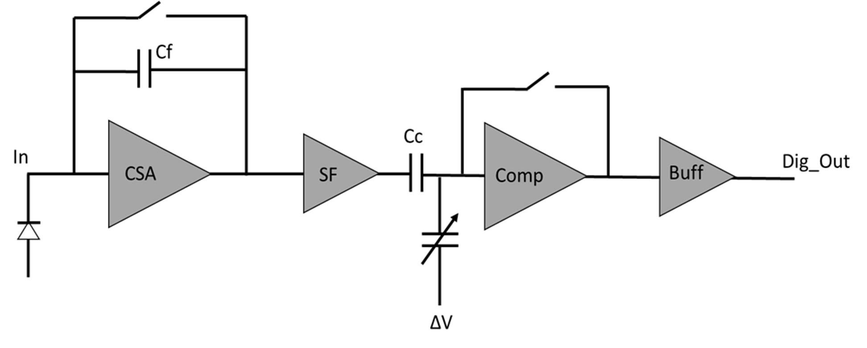
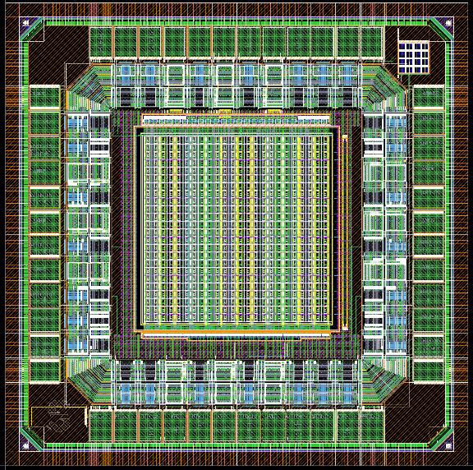
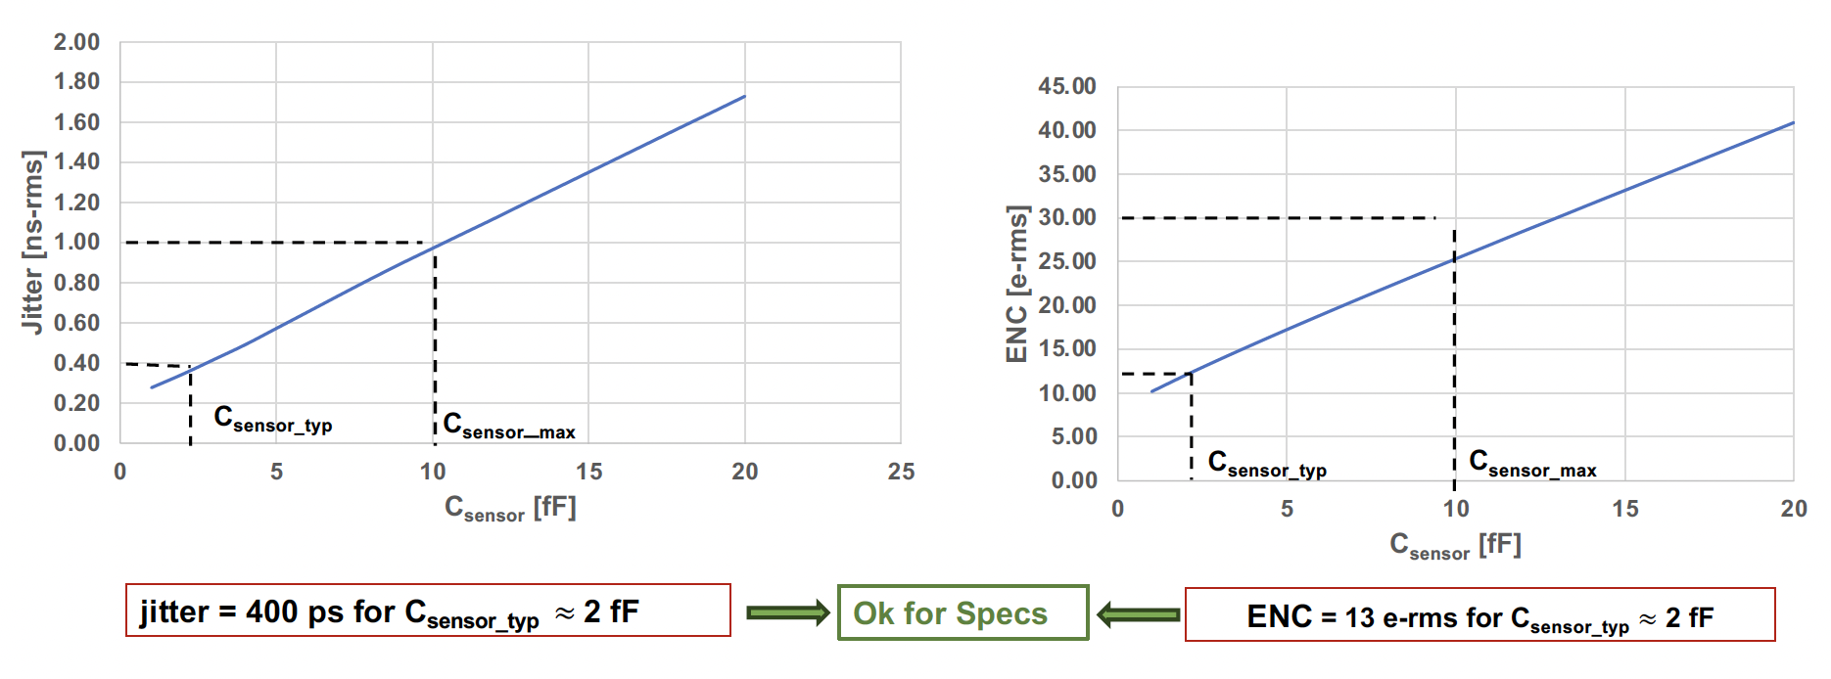
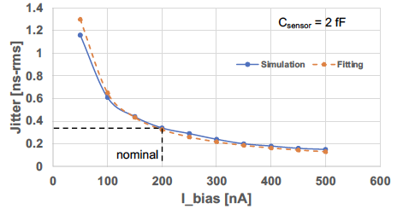
Status of NAPA and TDC TPSCo development at SLAC
NAnosecond Pixel for large Area MCMOS Front-End
  1 ns timing precision at low power consumption and fault tolerance for large size wafers (stitching)
1st NAPA proto. in TPSCo 65 nm in shared CERN WP1.2 ER1
  Common Source Architecture amplifier, variant with DC current feedback
pixel mask from CERN
layout of NAPA1
5 x 5 mm², ≃ 500 pixels with 25 μm pitch

Slide 9
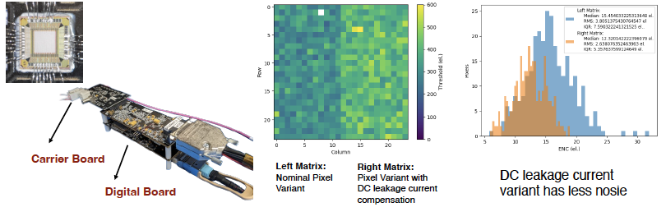
NAPA 1 characterization
Chips received in September 2023
  carrier board developed at SLAC
  wire bonding at SLAC
  digital board with FPGA and DACs
Laser acquired for timing characterisation

Slide 10
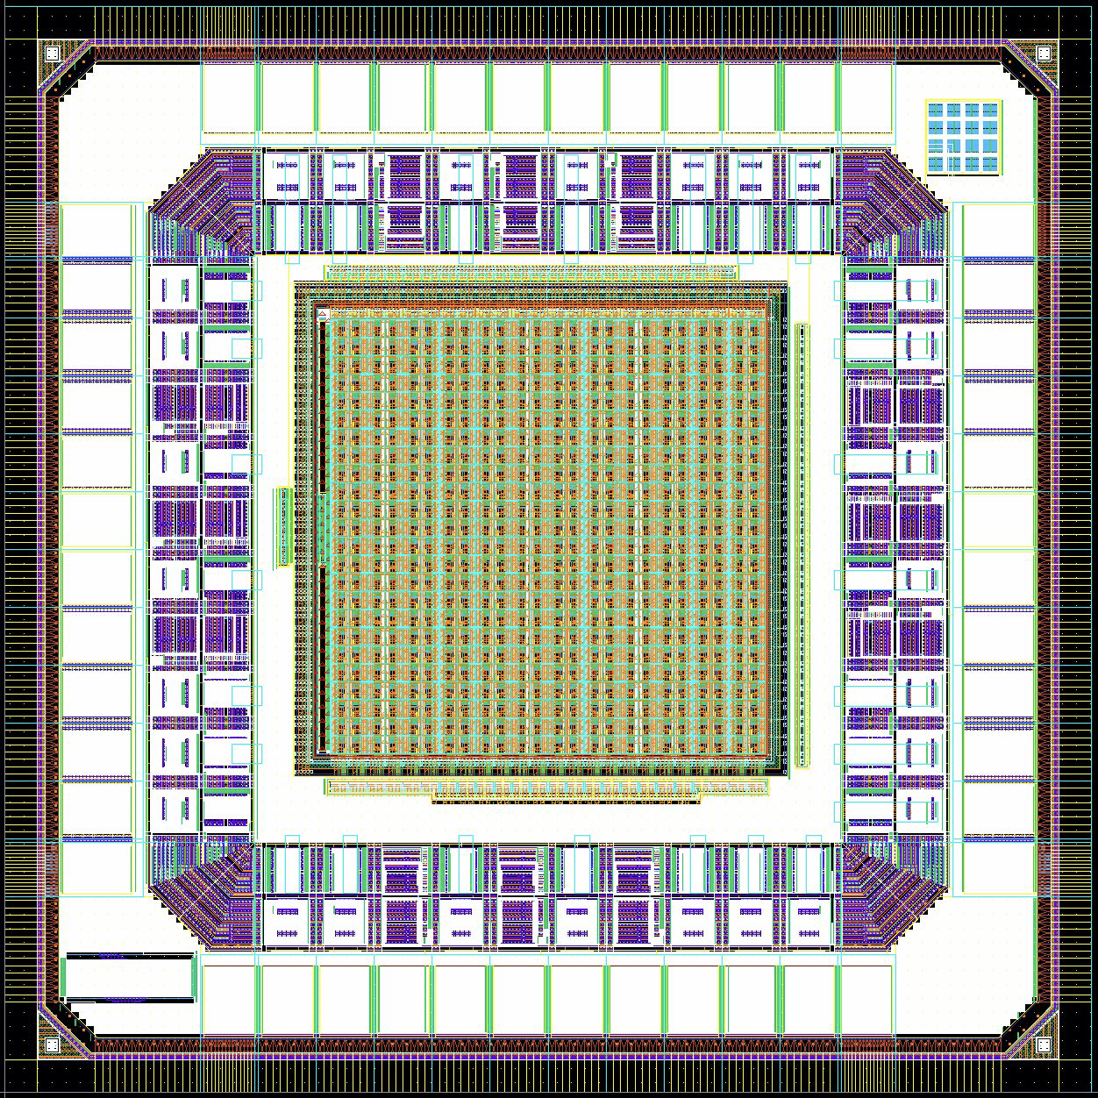
NAPA 2 and TDC design at SLAC
Further improve timing resolution & power trade-off:
  goal to achieve x10 improvement over current state-of-the-art
Design of compact, low-power Time-to-Digital Converter (TDC)
  low power vernier delay line w/ programmable time resolution ≲ 20 ps
NAPA 2 submission in CERN WP1.2 ER2 (June?)
layout of NAPA2
TDC as part of DRD7.3/6 submission in CERN WP1.2 ER2 (June?)

Slide 11
Outlook
Precision timing is a goal of several developments in DRD3
  w/ several technology options
    LGADs, MCMOS, w/ small/large electrodes or pads, w/ or w/o amplification…
  w/ common requirements toward low power, low X/X₀, monolithic integration, large size…
TPSCo 65 nm is an interesting option
  demonstrating 100 ps will need a proper FE on longer term
  exploring digital architecture options can be rather generic and start now
  the Versatile Tracker proposal is well adapted to gather projects and the related communities to share components and work on several aspects (w/ specifications that can be adapted)

