Slide 1
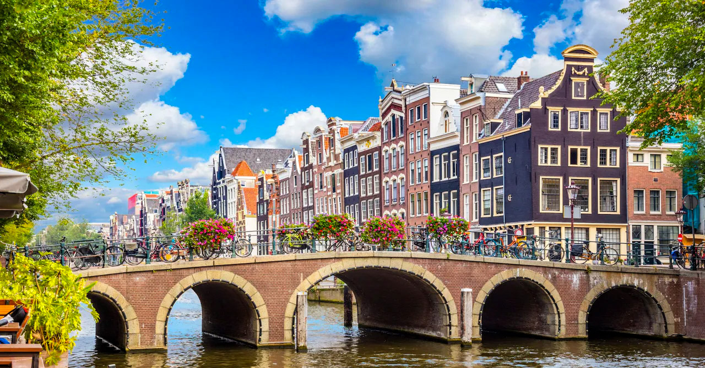
3rd DRD3 collaboration meeting
Welcome to Amsterdam!

Slide 2
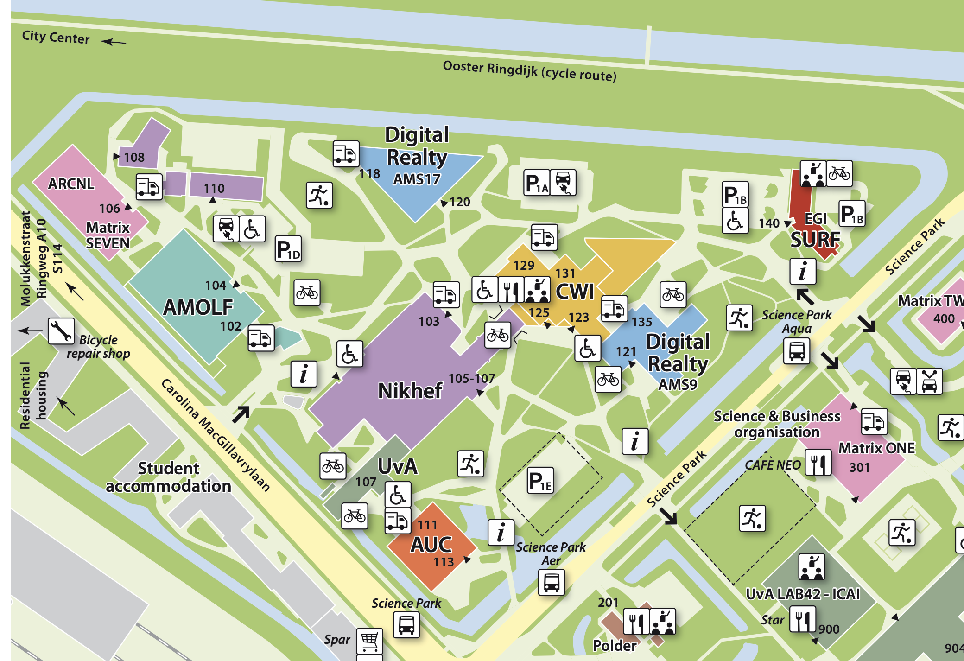
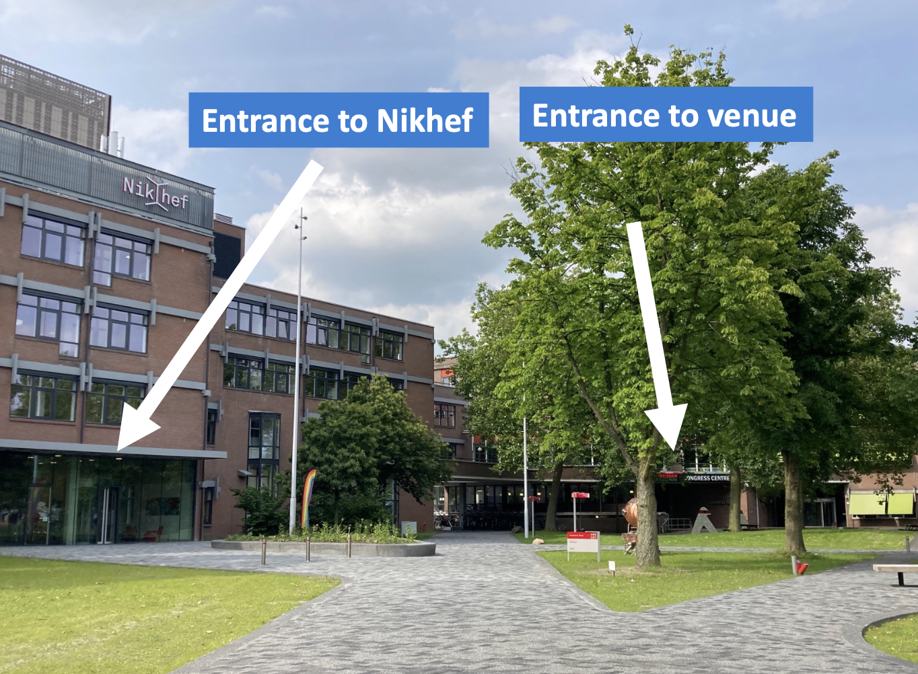
Venue at Amsterdam Science Park
Wireless:
  Eduroam
  Amsterdam Science Park

Slide 3
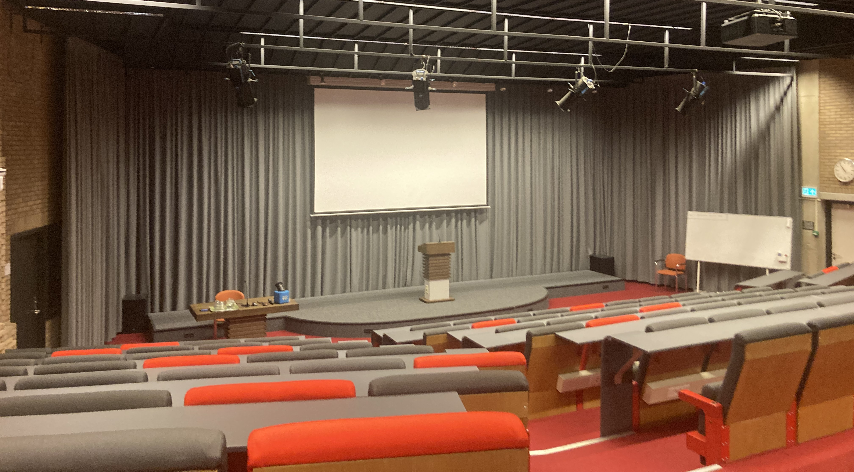
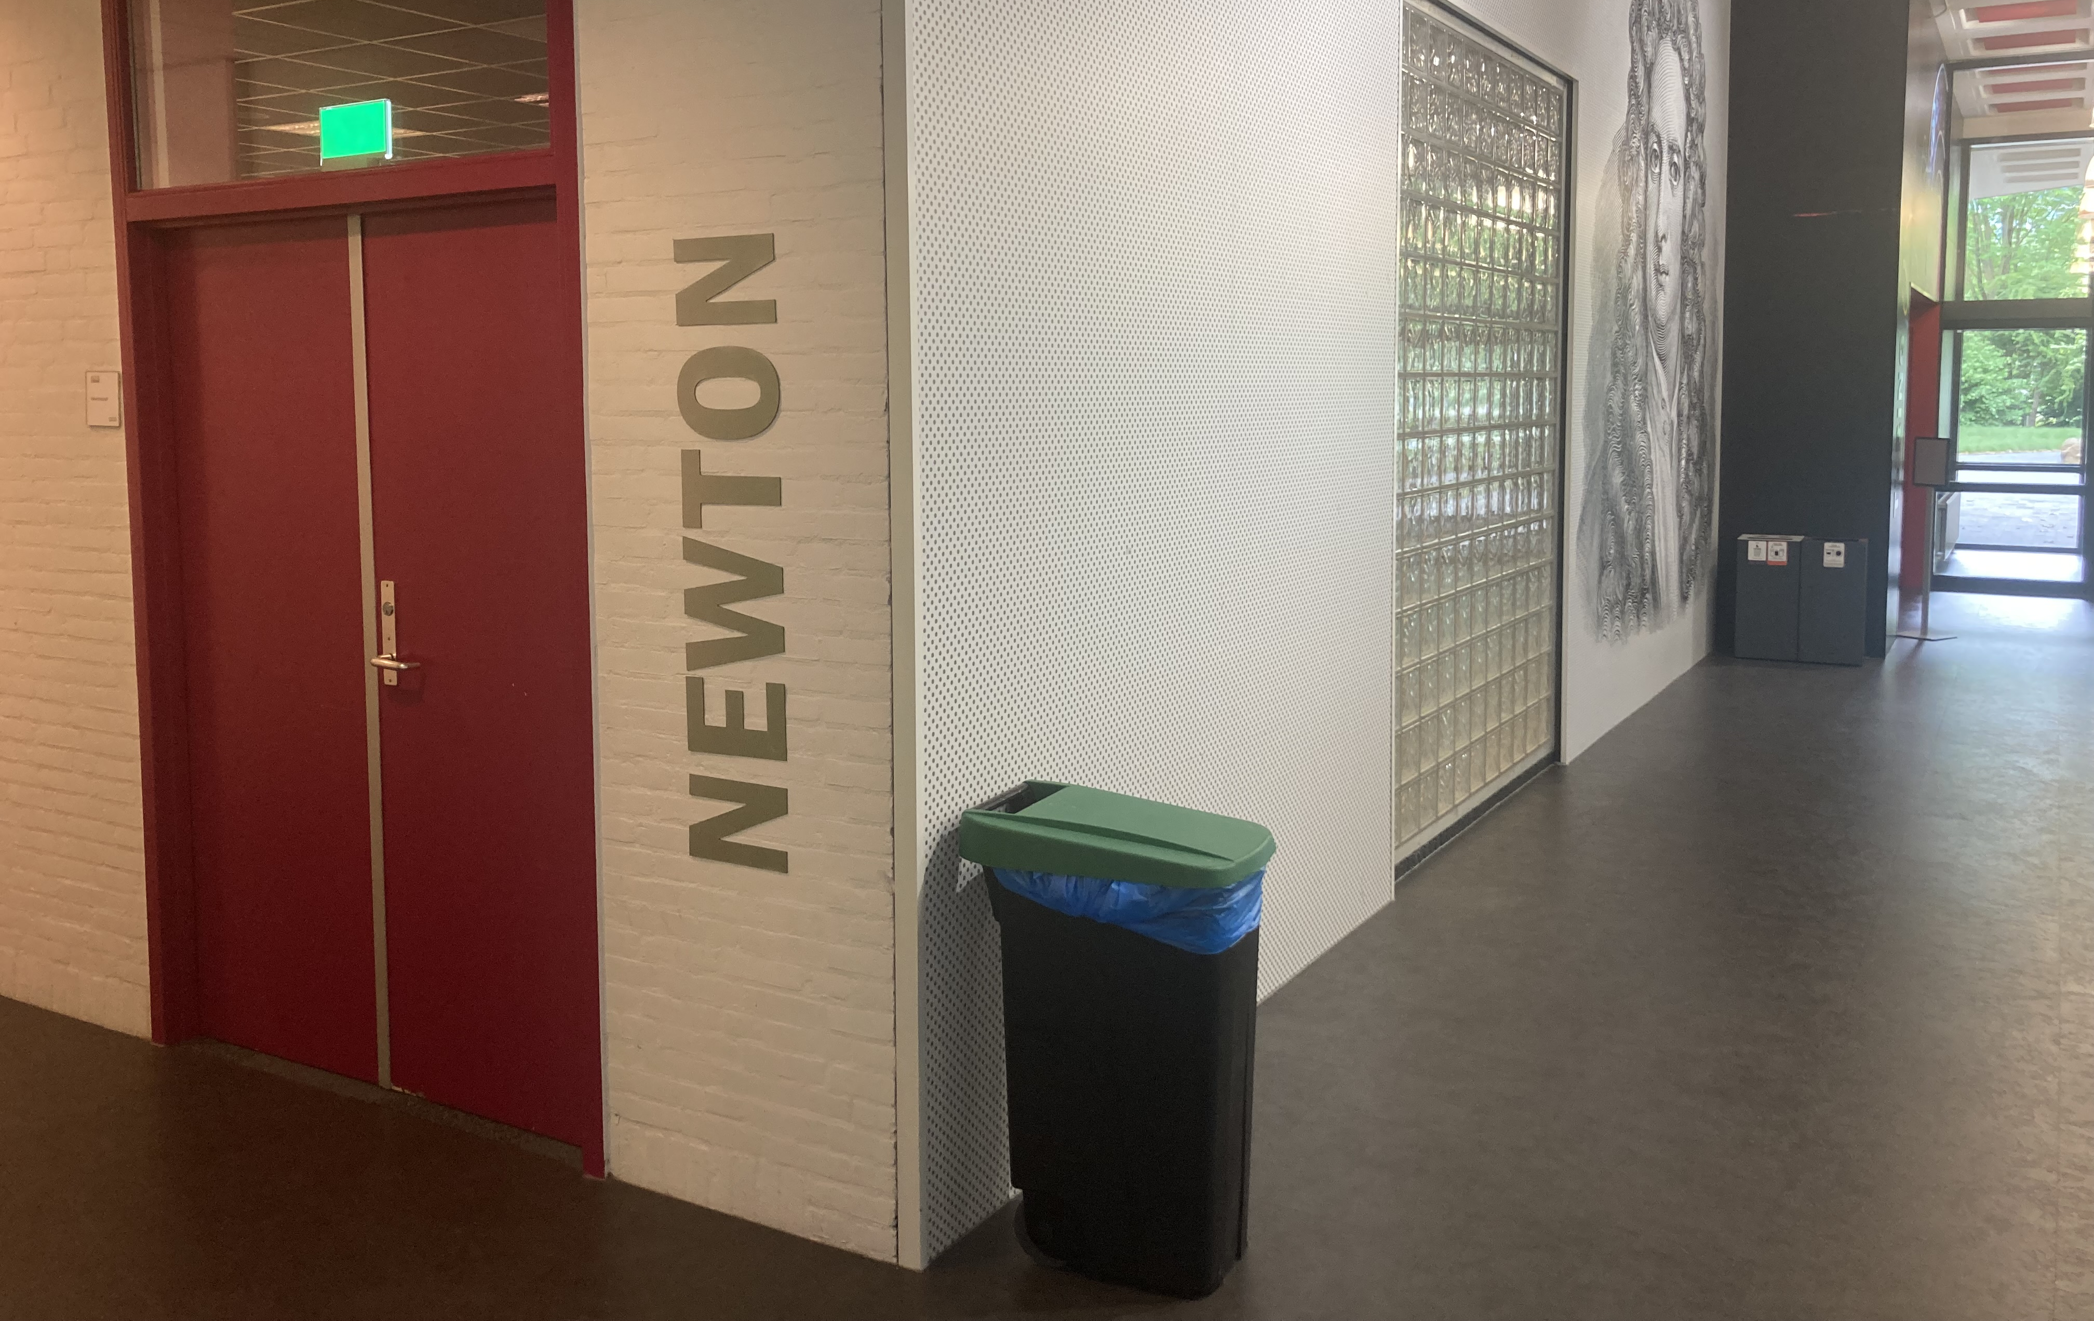
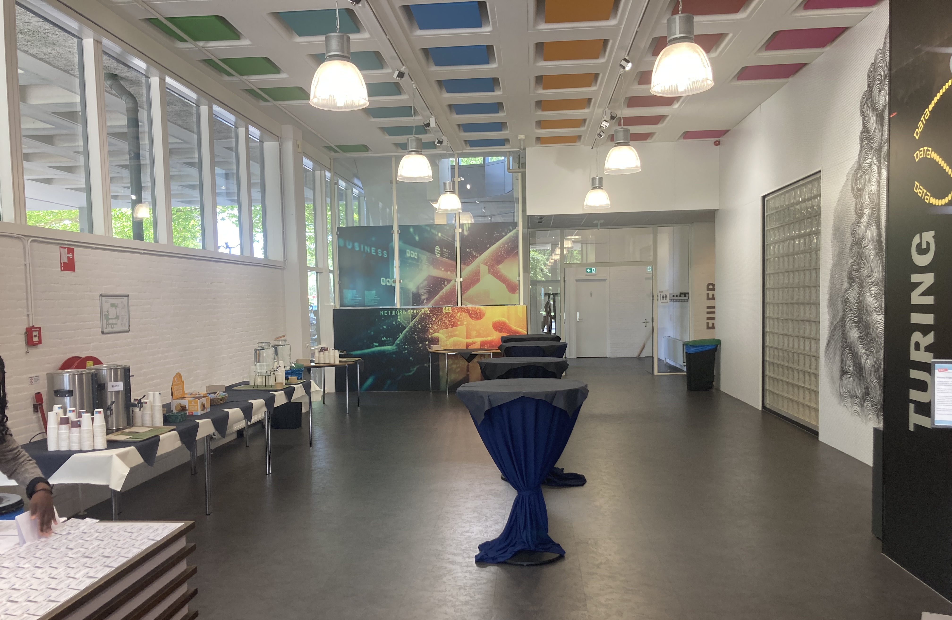
Coffee and lunches, and welcome drink
﻿﻿The Nikhef director Jorgen D'Hondt will welcome you at the start of the welcome drink at ~18:00 today (in the Foyer)
From Tuesday to Thursday lunches are served in the Newton room (next to the meeting room) at about 13:00
Please let us know if you have dietary requirements
On Friday we provide lunch bags for interested people. Please let us know if you would like a lunch bag, just to make sure we have enough.
Coffee is served in the Foyer (outside of room)
Turing room
Foyer

Slide 4

Group photo
First attempt for a group photo on Wednesday at 12:55, just before lunch
﻿﻿We gather outside of the conference centre

Slide 5
Collaboration board meeting
The collaboration board meeting is on Wednesday evening
The meeting with be in the Nikhef building next door
﻿﻿Either in the Veltman center (3rd floor) or in Vertex (ground floor)
  Depends on the number of in-person CB members

Slide 6
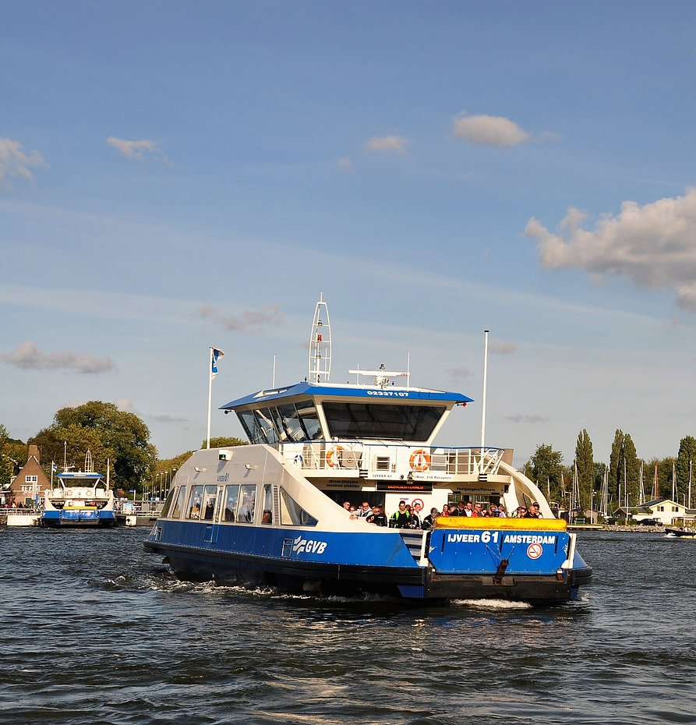
Social dinner
When: Thursday at 19:30
﻿﻿Where: restaurant Tolhuistuin room Zonzij
﻿﻿How to get there:
﻿﻿Go to the back of the Central Station via the ‘ijpassage' (shopping mall connecting both sides of the station)
﻿﻿Take ferry (F3) to Buiksloterweg
﻿﻿Ferry is free, and leaves every 4 minutes (until midnight, and every 6-12 minutes all night), the transfer takes 3-4 minutes
﻿﻿The restaurant is 100 meters from the ferry
﻿﻿Train from Science Park to Central station
  ~10 min by train (2 stops), 4 per hour
  One can check in / out with most debit and credit cards or with your phone

Slide 7
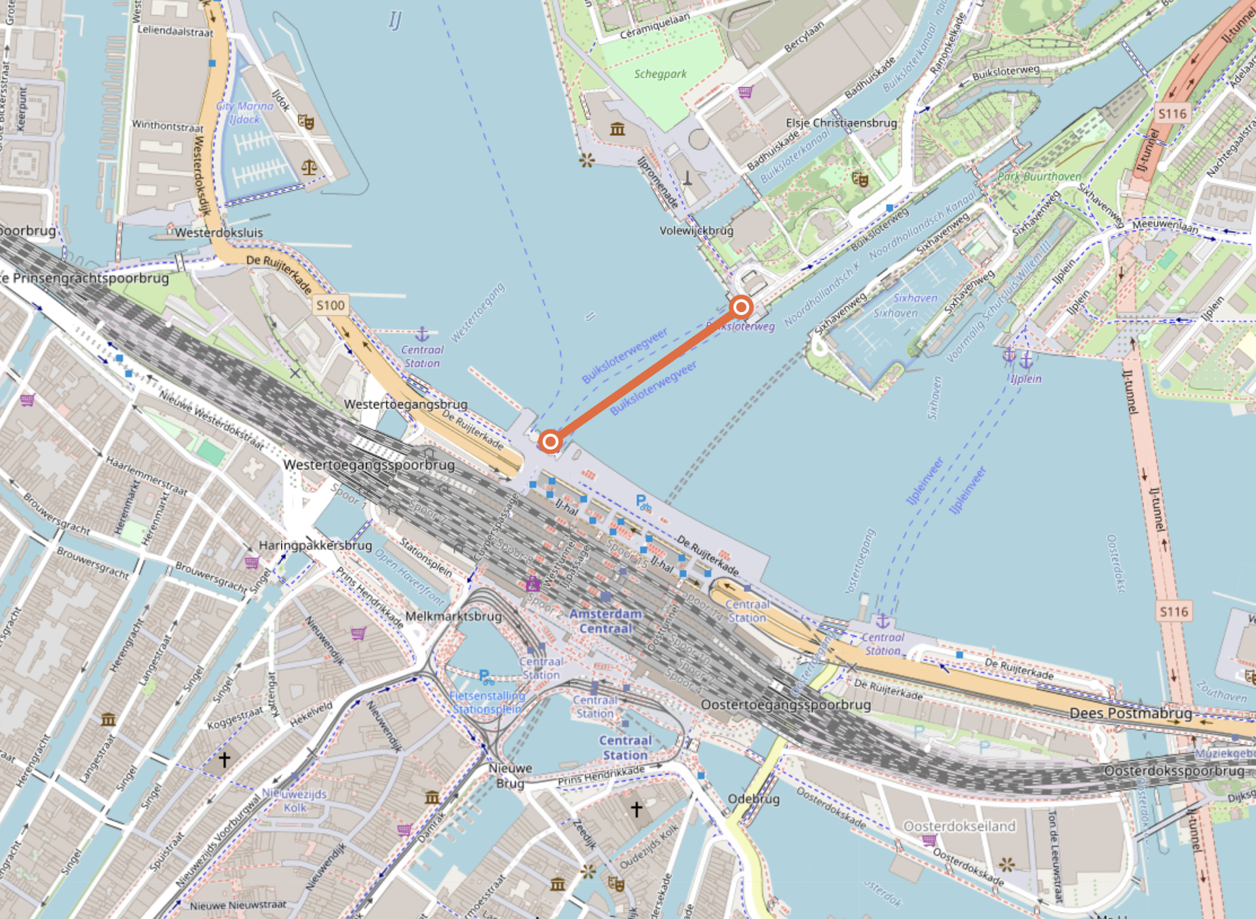

Slide 8
To all speakers:
Please upload your slides (well) in advance of the session

Slide 9
We wish you a productive and enjoyable week!

