Slide 1
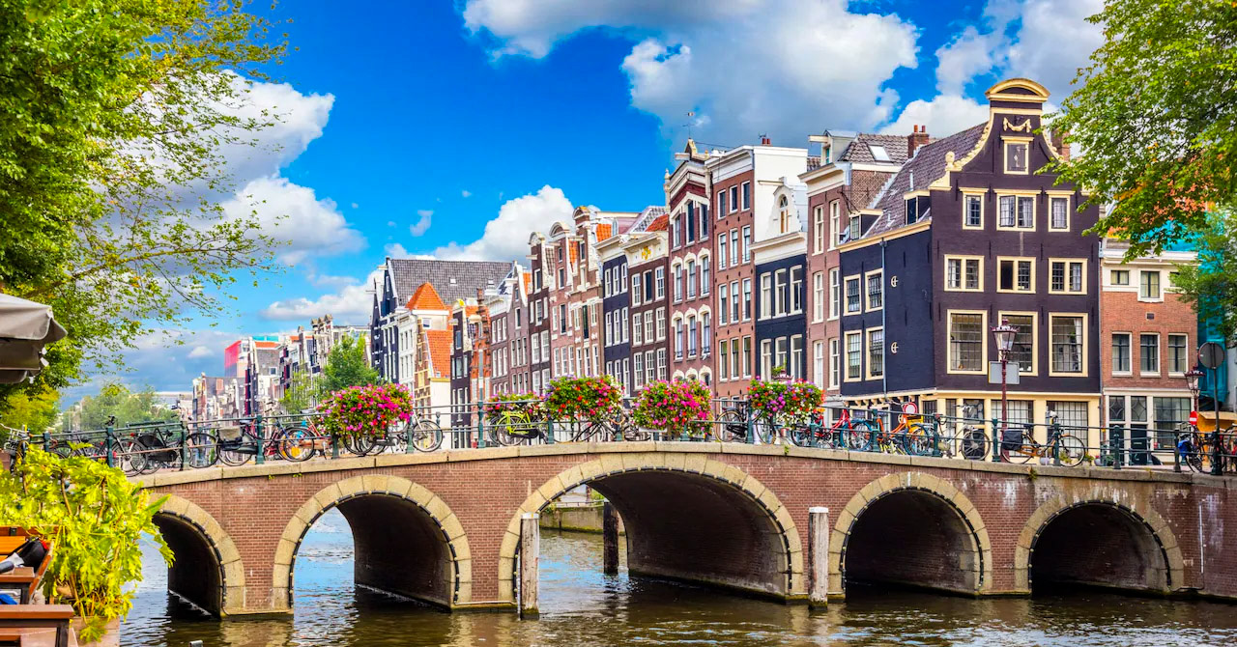
3rd DRD3 collaboration meeting Welcome to Amsterdam!

Slide 2
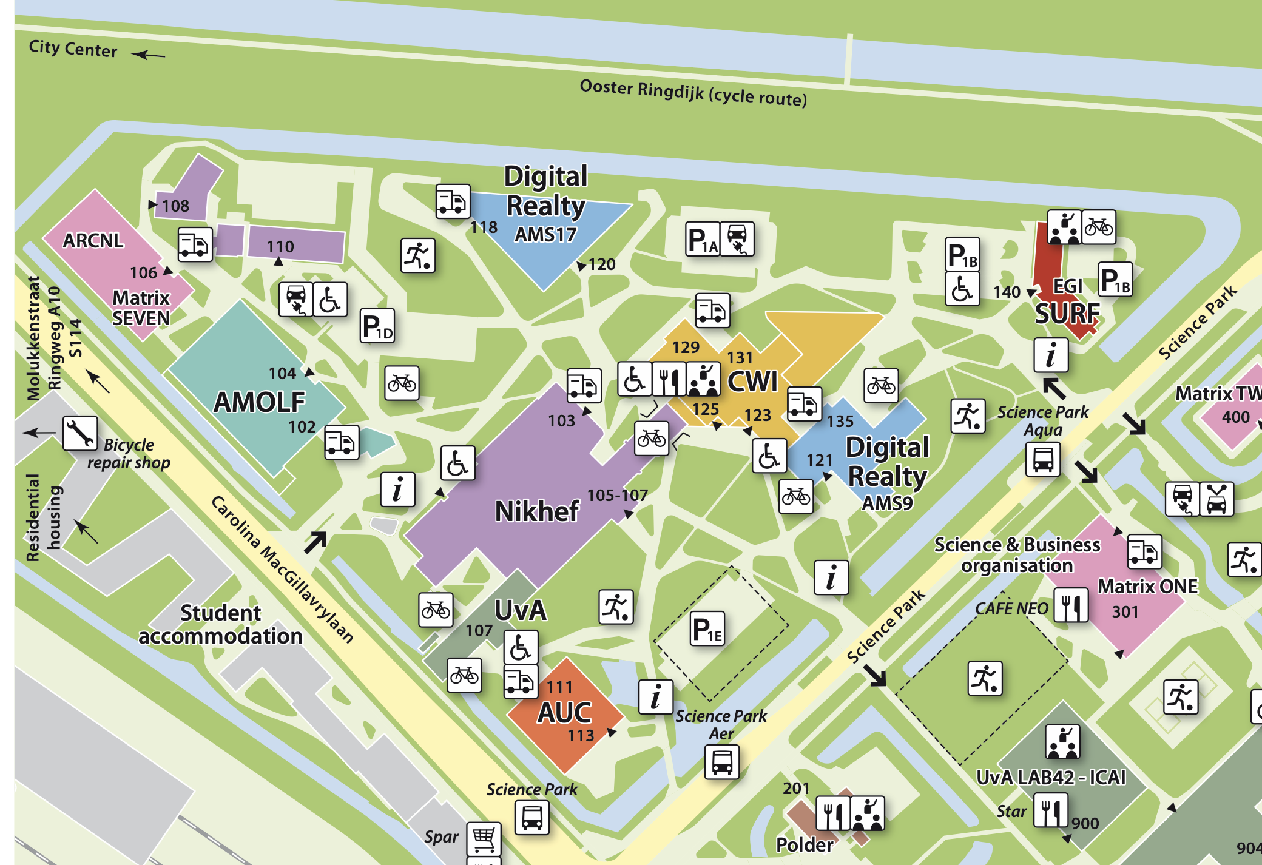
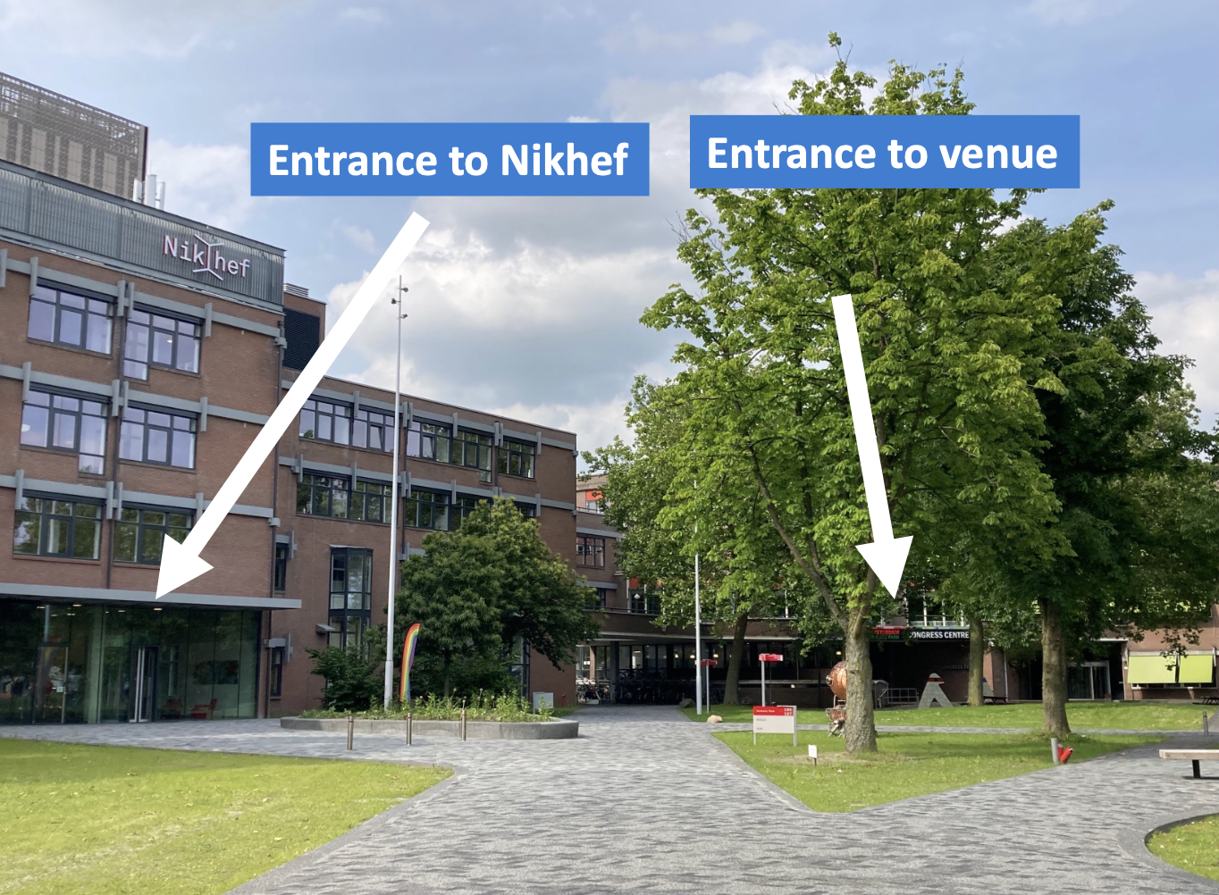
Venue at Amsterdam Science Park
Wireless:
Eduroam
Amsterdam Science Park

Slide 3
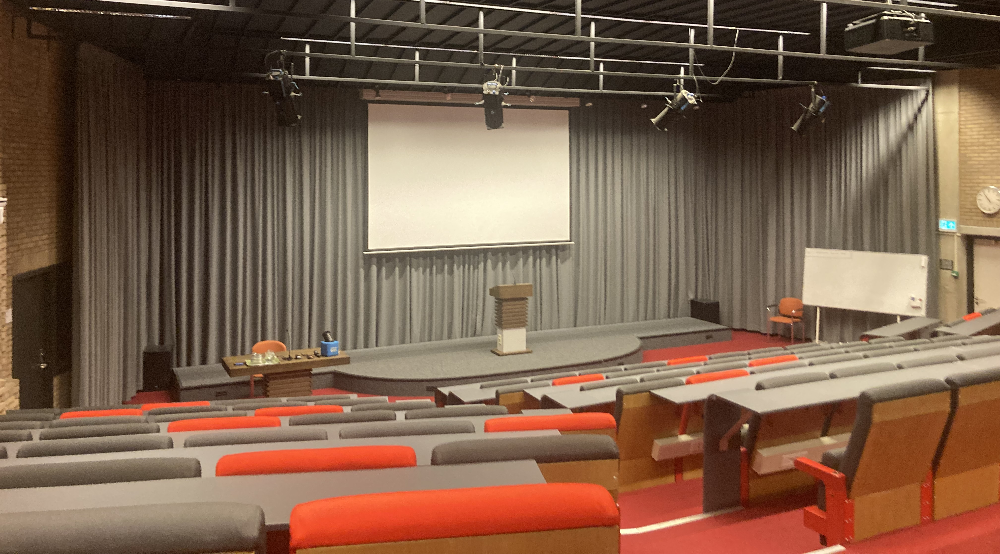
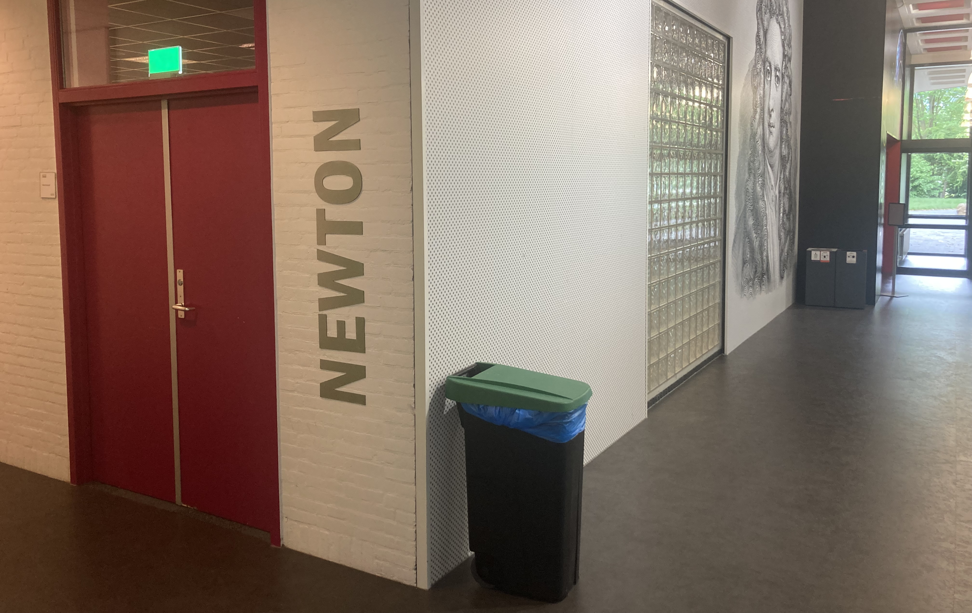
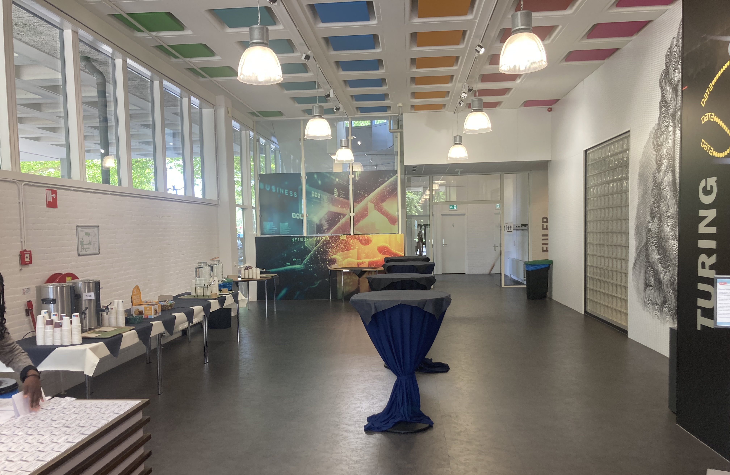
Coffee and lunches, and welcome drink
﻿﻿The Nikhef director Jorgen D'Hondt will welcome you at the start of the welcome drink at ~18:00 today (in the Foyer)
From Tuesday to Thursday lunches are served in the Newton room (next to the meeting room) at about 13:00
Please let us know if you have dietary requirements
On Friday we provide lunch bags for interested people. Please let us know if you would like a lunch bag, just to make sure we have enough.
Add your name to the list on the reception desk (by Tue evening)
Coffee is served in the Foyer (outside of room)
Turing room
Foyer

Slide 4

Group photo
First attempt for a group photo on Wednesday at 12:55, just before lunch
﻿﻿We gather outside of the conference centre

Slide 5
Collaboration board meeting
The collaboration board meeting is on Wednesday evening
The meeting with be in the Nikhef building next door
﻿﻿Either in the Veltman center (3rd floor) or in Vertex (ground floor)
Depends on the number of in-person CB members

Slide 6
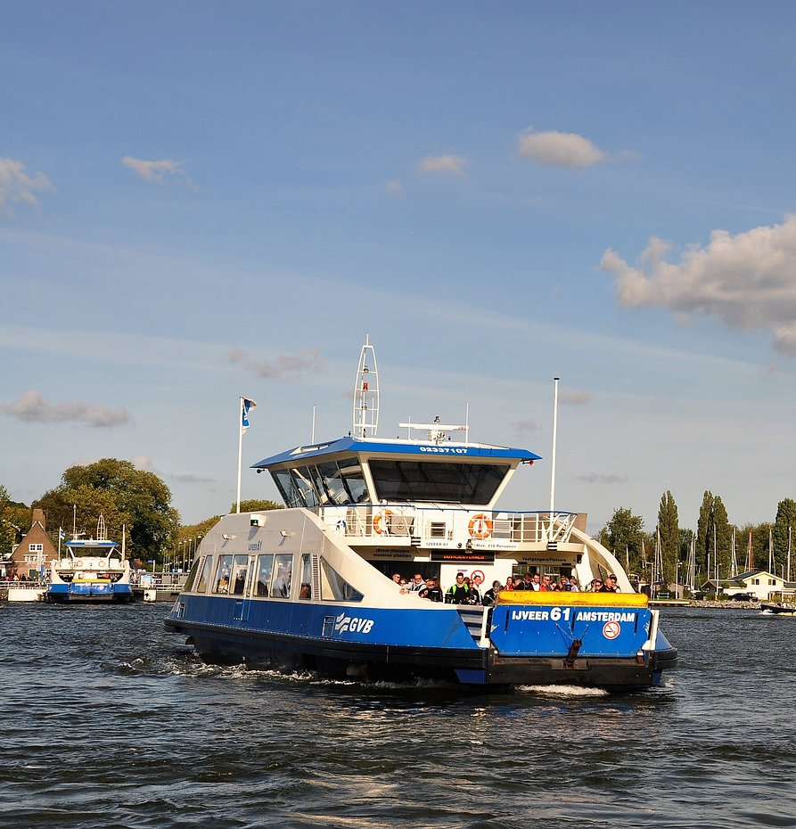
Social dinner
When: Thursday at 19:30
﻿﻿Where: restaurant Tolhuistuin room Zonzij
﻿﻿How to get there:
﻿﻿Go to the back of the Central Station via the ‘ijpassage' (shopping mall connecting both sides of the station)
﻿﻿Take ferry (F3) to Buiksloterweg
﻿﻿Ferry is free, and leaves every 4 minutes (until midnight, and every 6-12 minutes all night), the transfer takes 3-4 minutes
﻿﻿The restaurant is 100 meters from the ferry
﻿﻿Train from Science Park to Central station
~10 min by train (2 stops), 4 per hour
One can check in / out with most debit and credit cards or with your phone

Slide 7
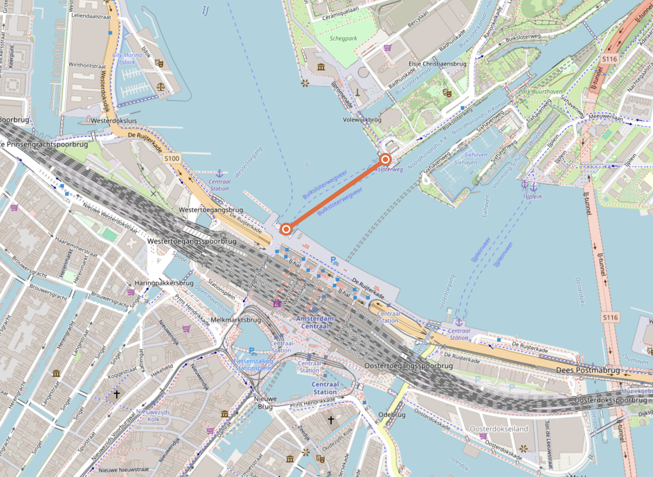

Slide 8
To all speakers: Please upload your slides (well) in advance of the session

Slide 9
We wish you a productive and enjoyable week!

