Slide 1
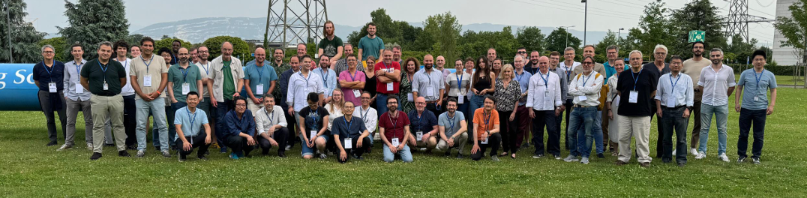
Welcome to the 3rd DRD3 collaboration week from CERN to Amsterdam, 2.-6. June 2025
NIKHEF organizing team (Joan, Martin)
DRD3 management (Ingrid, Sally, Michael, Gregor, Giulio, Roberta, Daniel)
WG/WP conveners
Picture from the 1st workshop a year ago

Slide 2
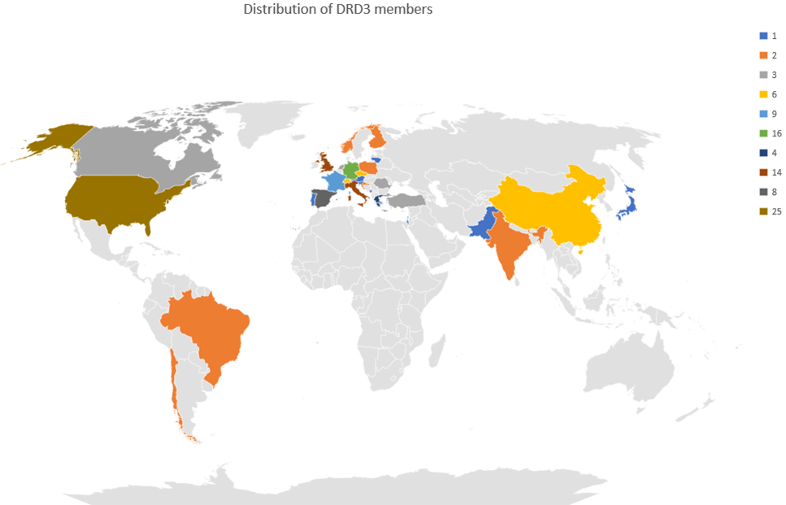
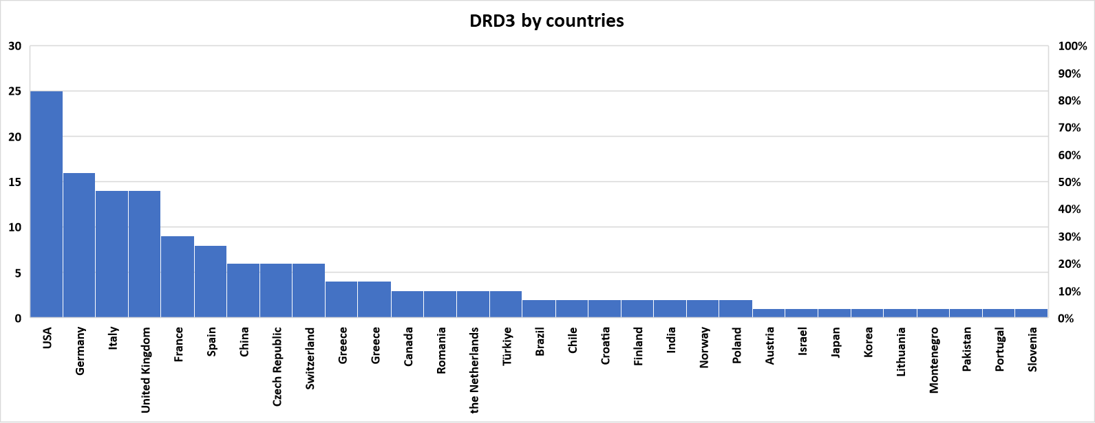
DRD3 collaboration
146 institutions / 700++ people in the community e-group
Main events since the last DRD3 week:
Lots of scientific meeting across many WGs
Preparation of WP projects – first “set” of projects is ready for approval at the CB
MoU is in the final stages of preparation
  gathered final information and confirmation on how the groups will participate
  Already confirming first WP projects
This year we had a first DRDC review
We have New institutes wanting to join us.
R&D work is ongoing in spite of large commitment of many groups to HL-LHC. The activities here are

Slide 3
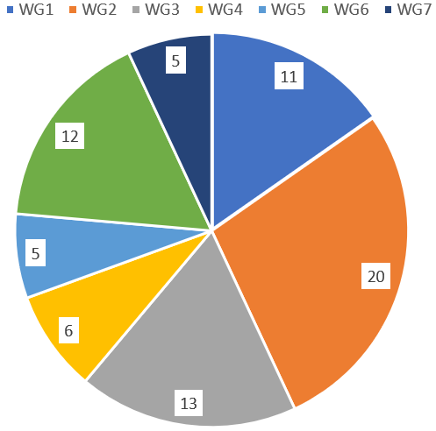
Organization of the 3rd DRD3 week
Monday [Main Auditorium]
  afternoon: WG1 – Hybrid technologies
Tuesday [Main Auditorium]
  Morning: WG1
  Afternoon: WG3
Wednesday [Main Auditorium]
  All day: WG2
  Evening: CB meeting (restricted to CB members);
  before it – status of collaboration
Thursday
  Early Morning: WG2, WG8 status
  Morning: WG4
  Afternoon: WG6
  Evening - dinner
Friday [Main Auditorium]
  Early Morning: WG5
  Late Morning: WG7
  Lunch time - Goodbye
Statistics:
86 – contributions / 72 abstracts
  8 project proposals
  64 scientific results
255 – registrants
145 - online
100 – in person
DRD3 week dinner:
Thursday 19:30 at → see Martin’s slides

Slide 4
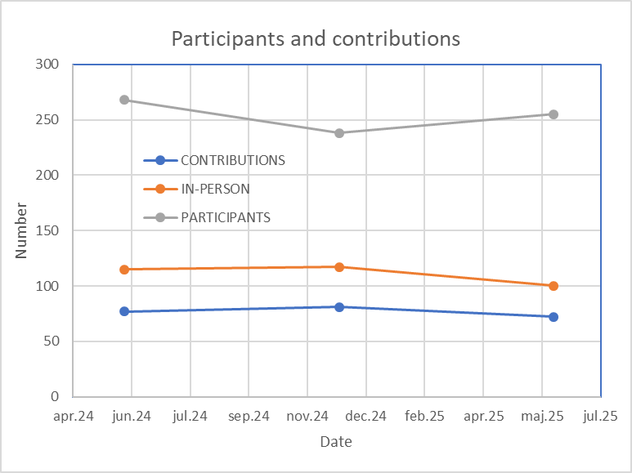
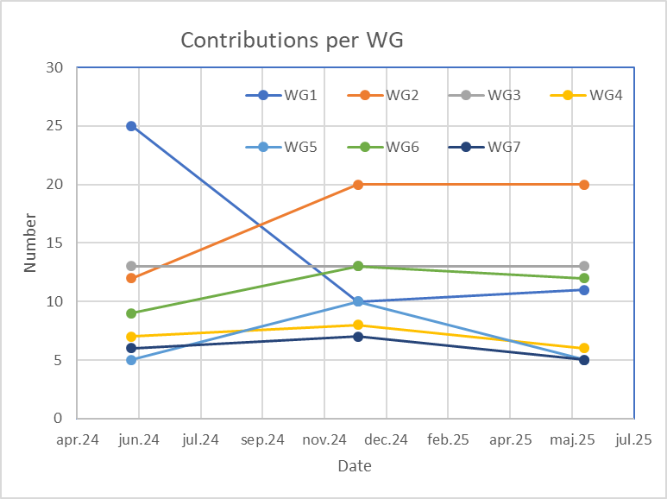
Presentations – Projects/Scientific
slight decrease of contributions and in-person attendance, and some slight increase of total attendence
an increase of WG1 contributions!
we decided to shuffle the WG/WPs around the week for democratic reasons.
CERN
CERN
AMSTERDAM

Slide 5
Many thanks to….
Local organizers for making it possible (visa, dinner, coffee breaks, social events, registration of participants, fee invoicing, remote connection …):
Joan Berger, Martin van Beuzekom, Frank Filthaut, Kevin Heijhoff, Uwe Krämer, Clara Nellist, Hella Snoek, Raimond Snellings, Jory Sonneveld, Mengqing Wu – THANK YOU
Session Chairs - WG conveners for organizing their sessions
All of you for attending the DRD3 week…
I wish all of us a very productive and successful week!

