Slide 1
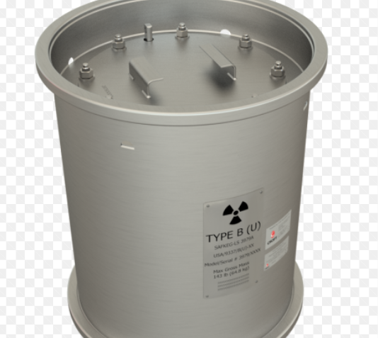
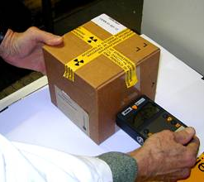
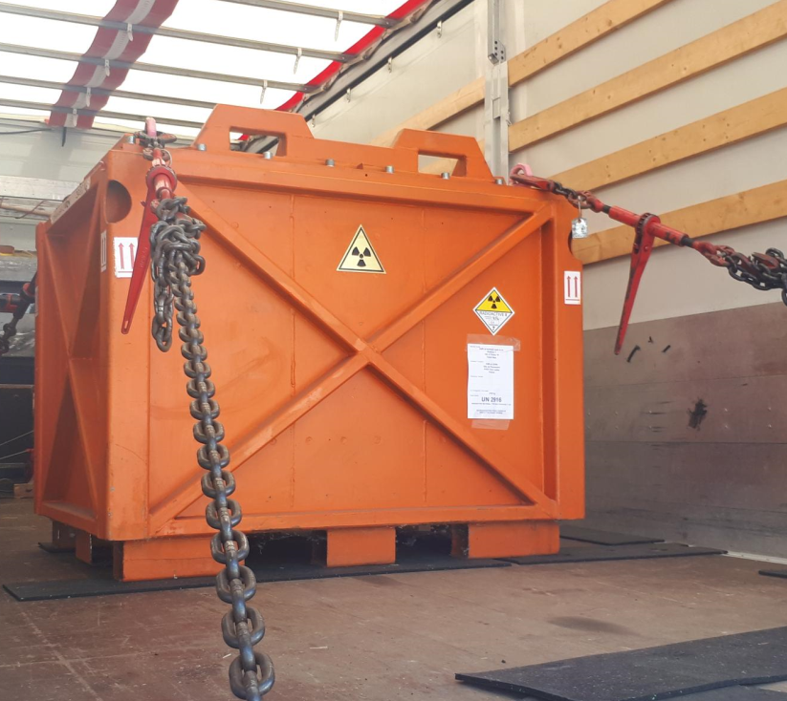
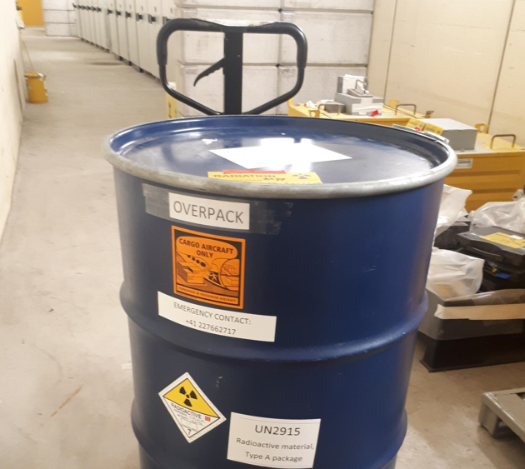
Radioactive shipping

Slide 2

The Radiation Protection Group assists the Logistic Services in organising the shipping of all radioactive material from CERN to other institutes or external organisations
The Radiation Protection Group also assists the Logistic Services to check on reception all radioactive materials that arrive on CERN’s sites from external organisations. Any person wishing to ship or import radioactive materials must contact the Radiation Protection Service RP beforehand, as well as the Logistic Services for urgent requests.

Slide 3
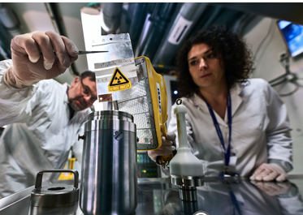
OUR MAIN CLIENTS:
MEDICIS : CERN’s MEDICIS facility contributes to medical research by producing novel radioisotopes. These radioisotopes not only help diagnose cancers and other diseases but can also deliver precise radiation doses to treat diseased cells without destroying the surrounding healthy tissue.
RWM : Radioactive Waste Management
https://indico.cern.ch/event/1460737/contributions/6166145/attachments/2949621/5184439/20241017_ARRAD-GT1-RW-Management.pdf
Export formalities for ANDRA shipments
OTHER INSTITUTES : irradiated equipement at/to CERN for analysis

Slide 4
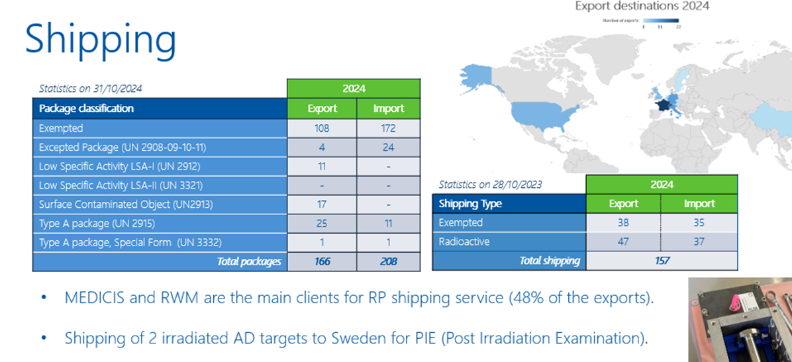

Slide 5
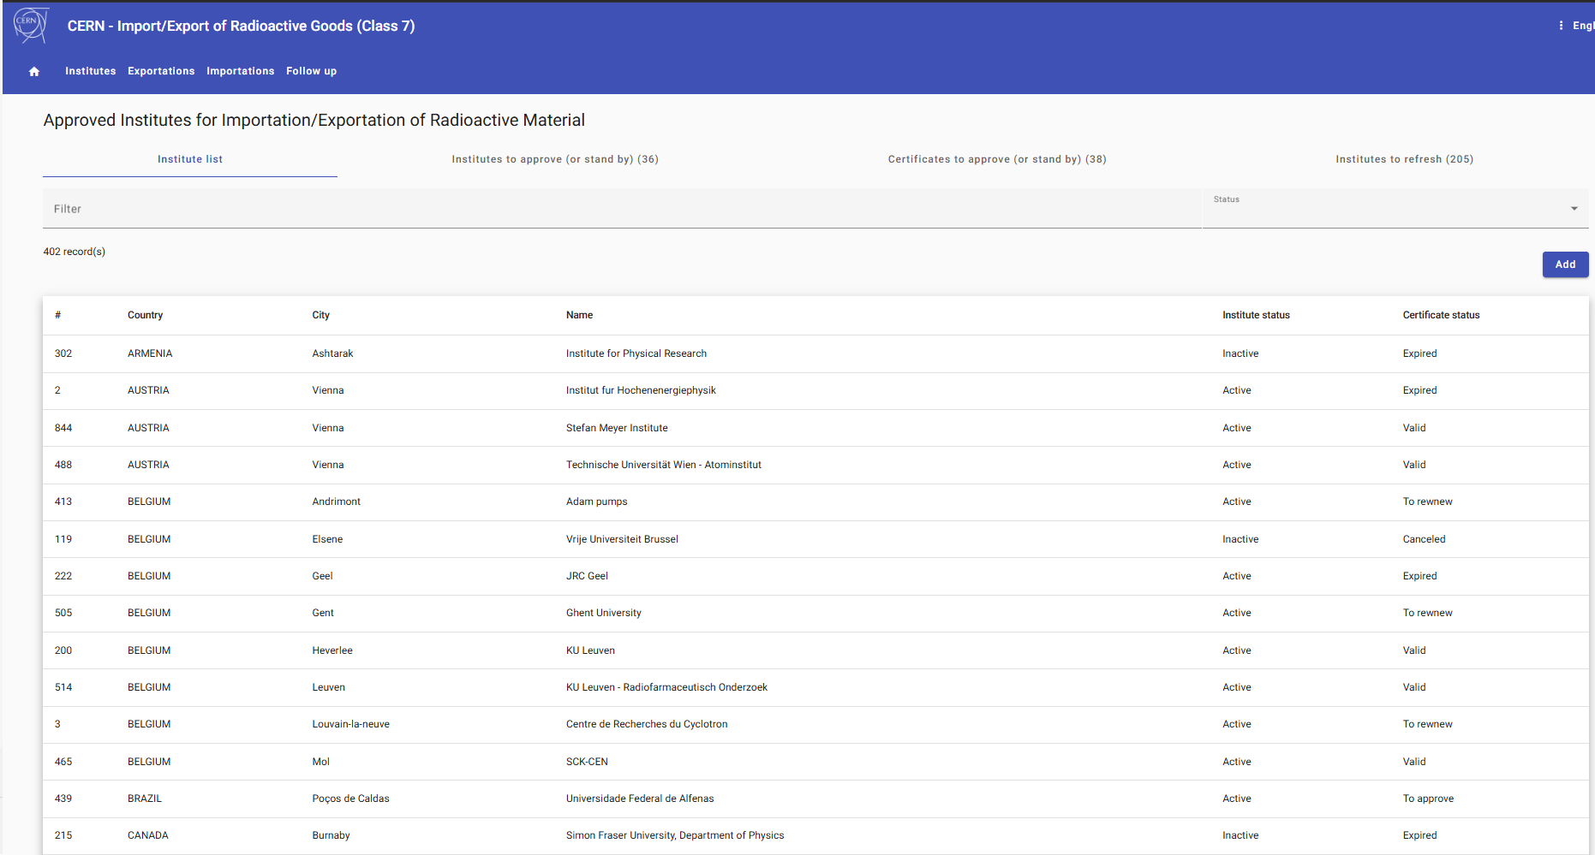
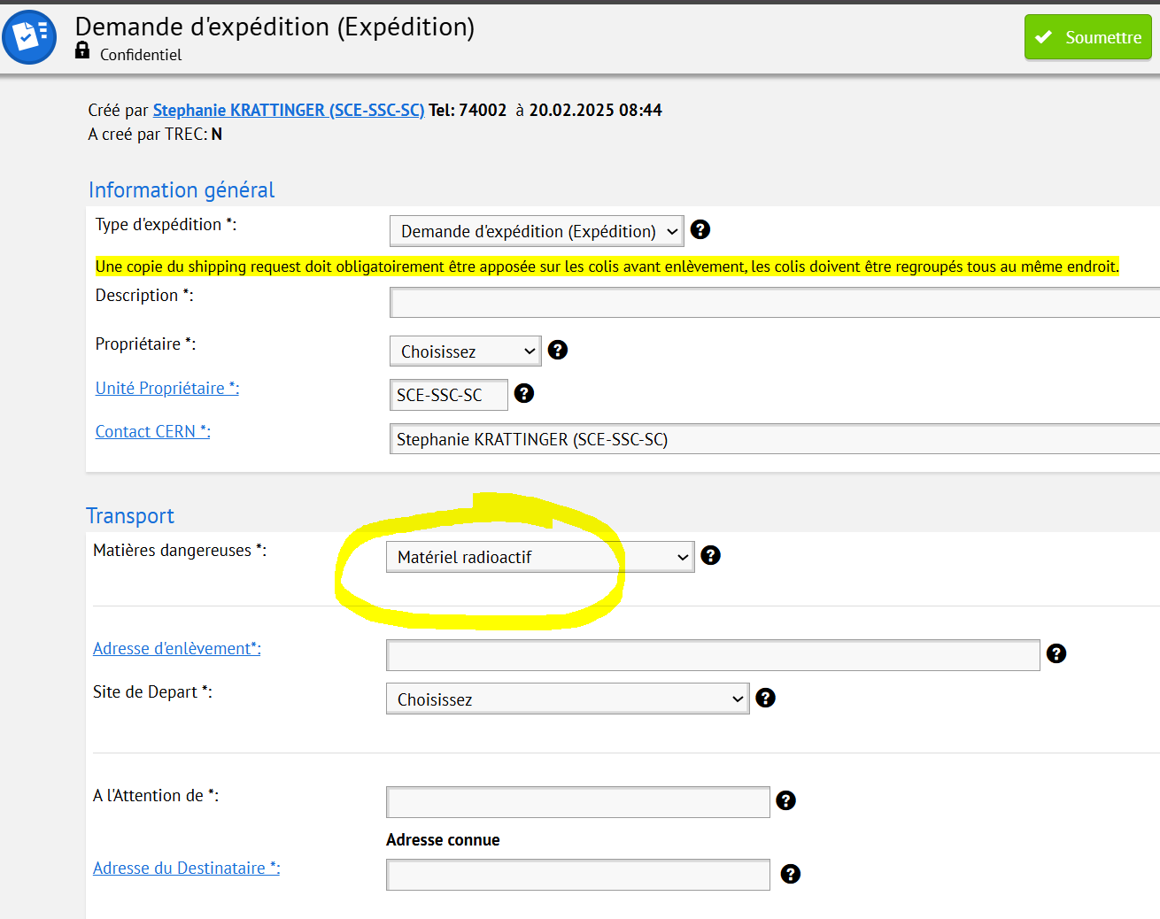
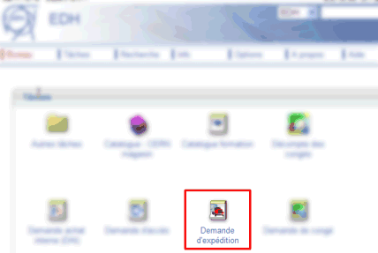
For all shipping of radioactive material, the addressee institute or organisation must be authorised to receive and handle radioactive materials. The applicant must make sure that the Radioprotection Group is in possession of the "licence to use radioactive substances". This document must be up-to-date. The details of a contact person who is responsible for radiation protection matters (Officer for Radiation Protection Safety: RSO) must also be known.
Check that the institute is listed in the database.
Then create shipping request in EDH selecting “radioactive”
danger

Slide 6
Until a reply is received by CERN’s Radiation Protection Service (Radioactive Shipping Service), the material cannot leave CERN.
Once the results of the gamma spectrometry is known, an email is sent by our Service to the addressee institute’s Radiation Protection Safety Officer (RSO), who must give his/her approval for receiving the material.
Once the reply is received, the parcel (according to the size of the material) is brought to goods reception, and shipping can be done
Shipping are done under CERN responsibility in agreement with ADR/IATA/IMDG regulations. For this reason, only entitled carrier and commissioned by CERN are authorised (no institute/private car allowed).

Slide 7
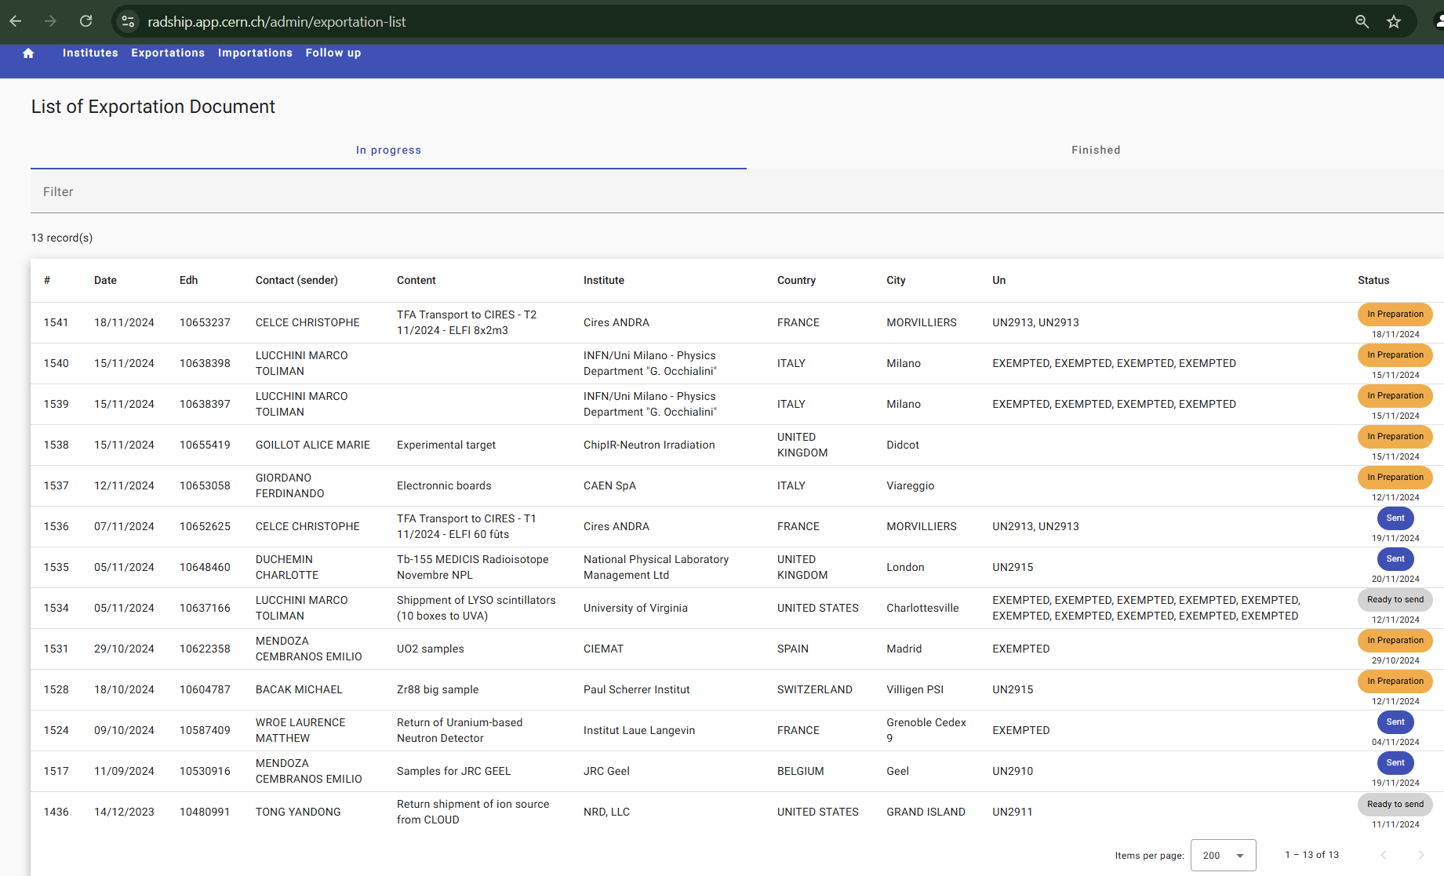

Slide 8
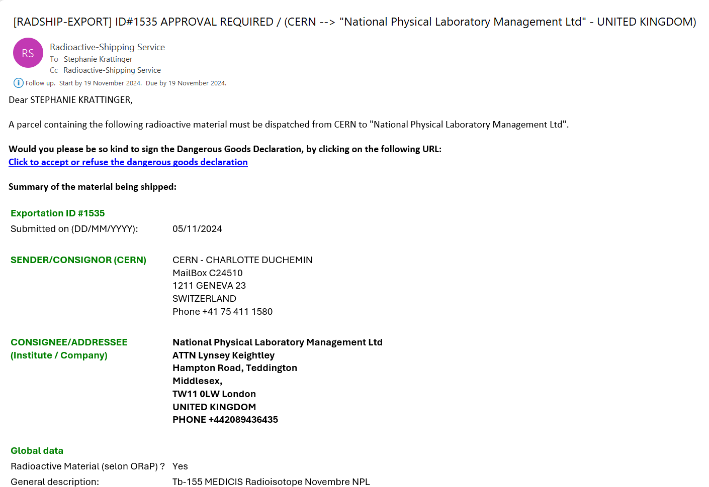

Slide 9
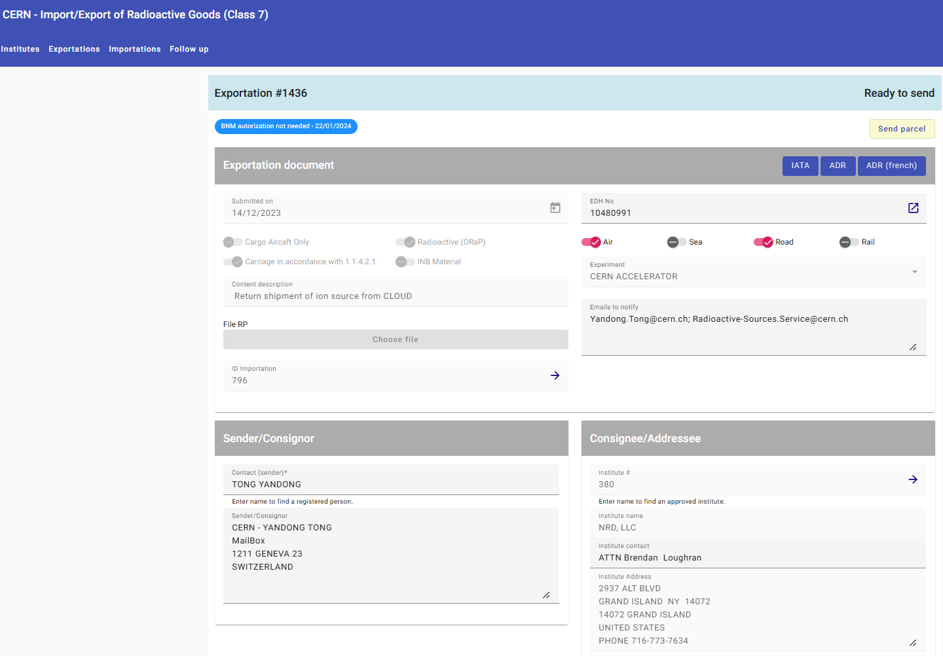
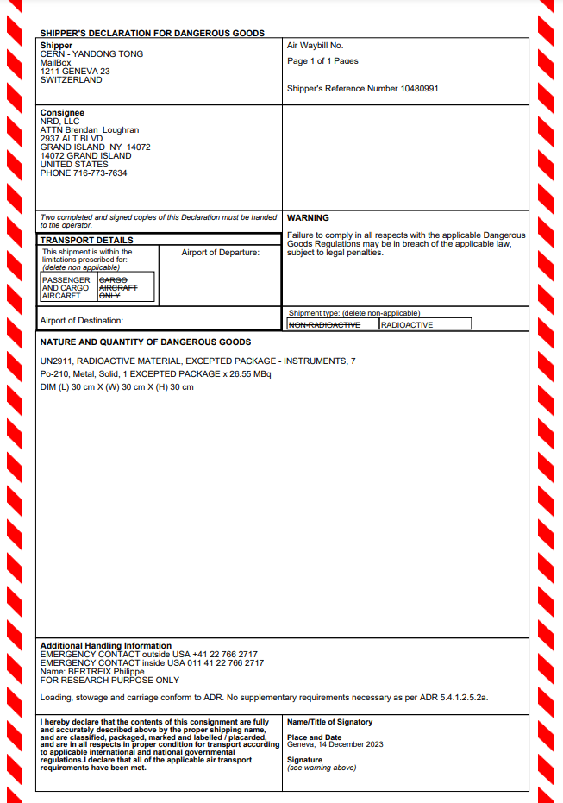


Slide 10
Pain points:
- few carriers in Switzerland : SAR, A7, Weggmuller, Indermuhle
-2 Freight forwarders only at GVA Airport
-CERN is no longer «shipper’s known»

