Slide 1
Services & Supply Chain
March 2025
Group Meeting
Cédric Garino
27-Mar-2025

Slide 2
Agenda
20 mn: CERN O2 Project 5000 Trees and much more… (Fred Magnin)
15 mn: SSC and SCE news (Cédric)
5mn: SCE-DOD news (Isabelle)
15mn: Locks and keys (Diana)
5mn: AOB (Cédric)

Slide 3
Safety - General
10904358: XXX manipulait une tôle avec la ventouse lors qu'il s'est rendu compte qu'il y avait du sang sur celle-ci. Il a vu à ce moment là qu'il s'était coupé sur le dessus de l'index de la main gauche. Cet incident a nécessité la pose de points de suture. réalisés à l'hôpital de la Tour. Il sera en arrêt de travail jusqu'au 23 mars inclus.
10909706: I opened a fridge door at the kitchen in B38 and it removed the nail of my big left toe. That fridge is located as 2nd at the far right corner of the kitchen. That corner is quite narrow, and the fridge base is not elevated, that's why it could reach my toe.
10893159: Ma collègue Madame Madalena Miranda Ribeiro a fait une crise d'angoisse + de tétanie

Slide 4
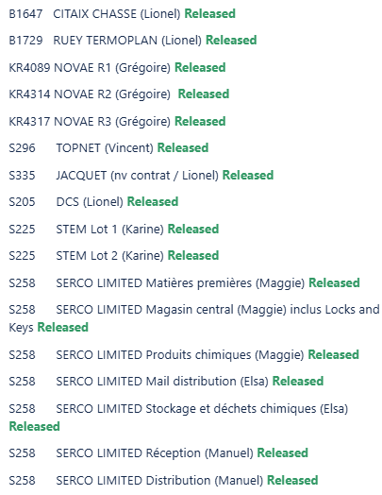
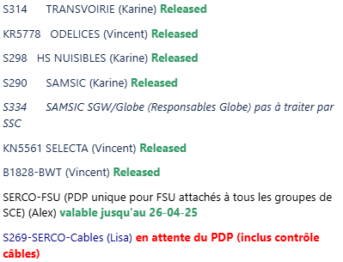
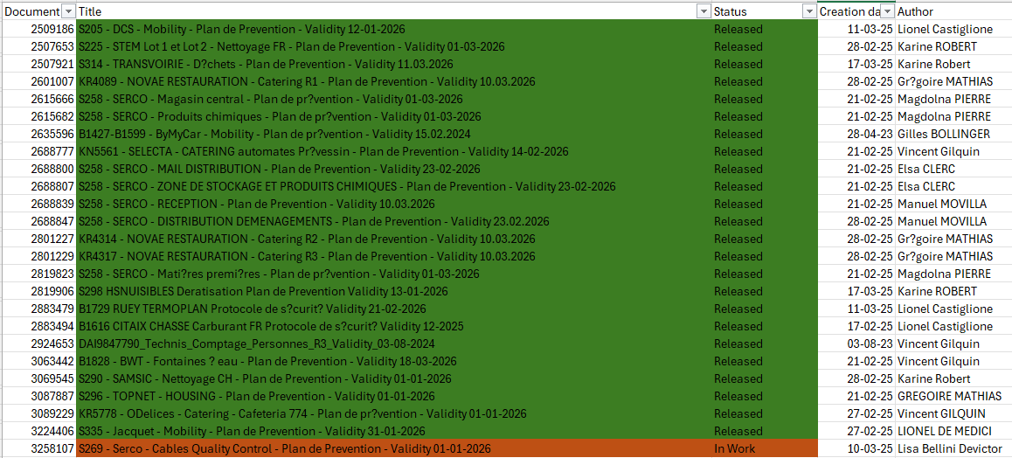
Safety – General. PdP status

Slide 5
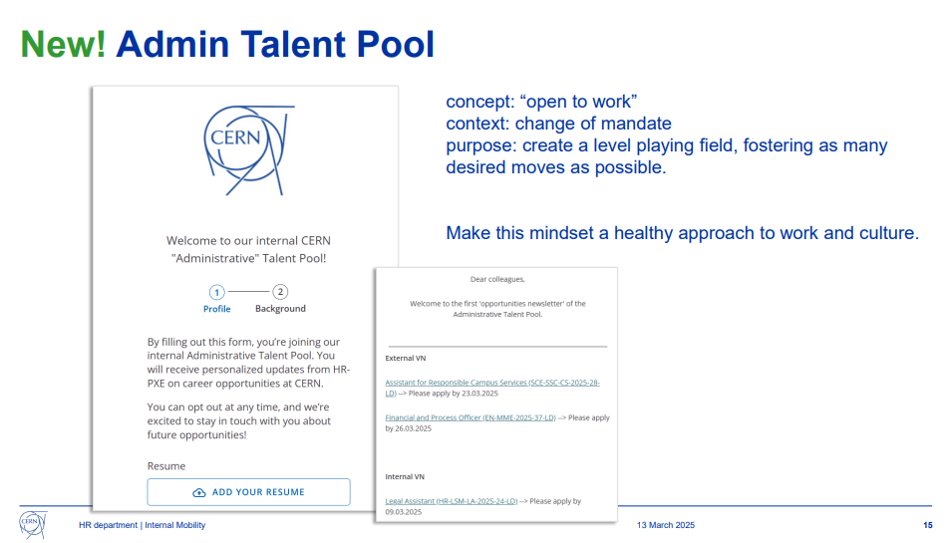
Internal Mobility HR webinar
https://indico.cern.ch/event/1517670/
Administrative Talent Pool
Internal mobility page

Slide 6

Diversity Dashboard
https://cern.ch/recruitment-diversity-dashboard

Slide 7
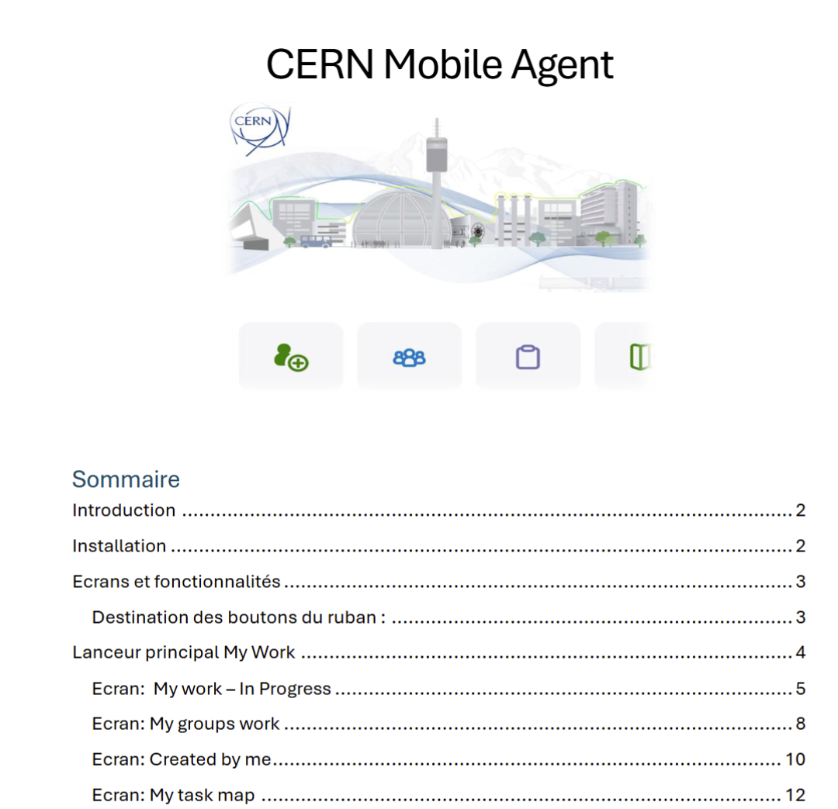

ServiceNow Agent
User Manuel for Mobile Agent app ServiceNow

Slide 8
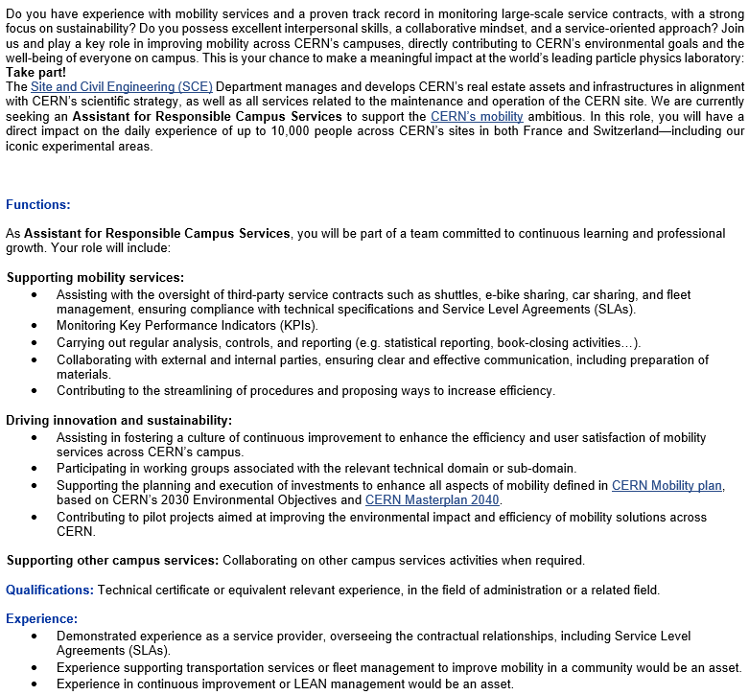
Personnel
Open position:
Assistant for Responsible Campus Services

Slide 9
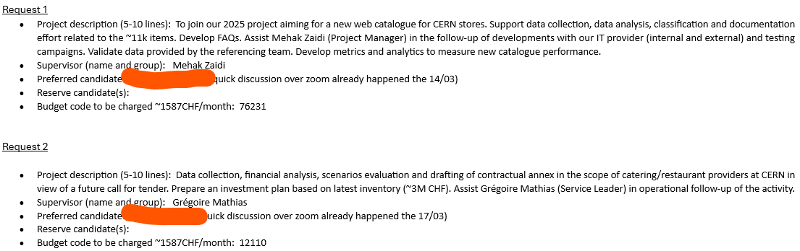
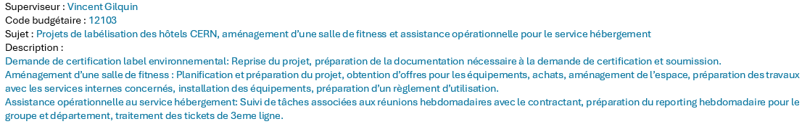
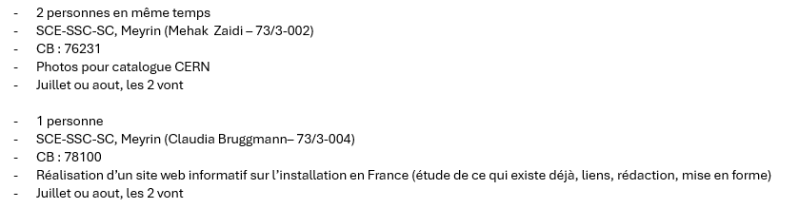
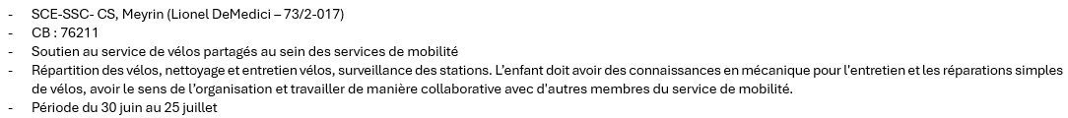
Personnel
Internships x 3
Summer work for children of members of the personnel x 4

Slide 10
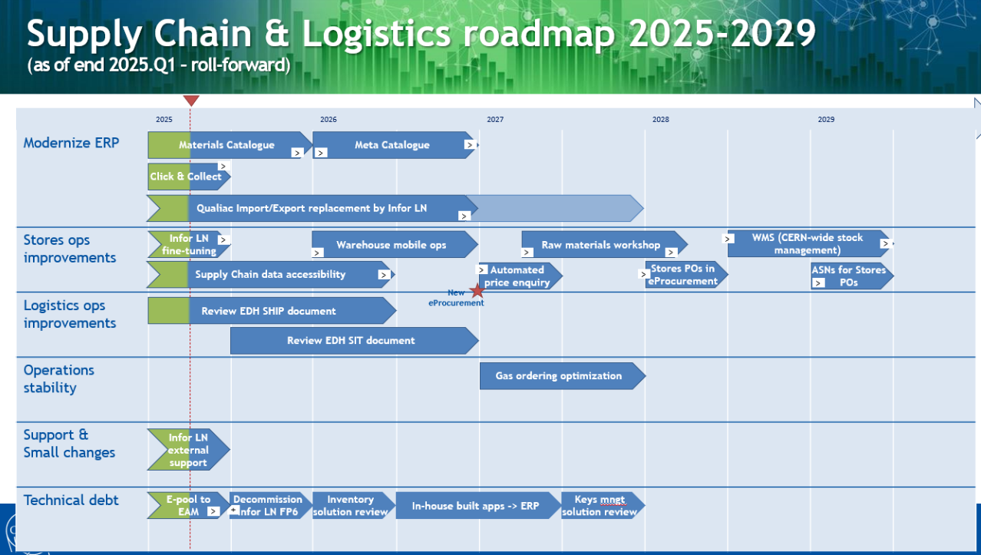
Postponed from +6m to +1.5y

Slide 11
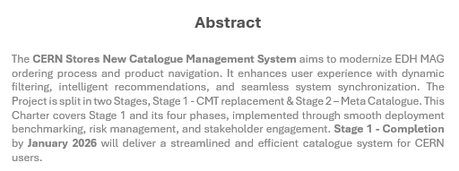
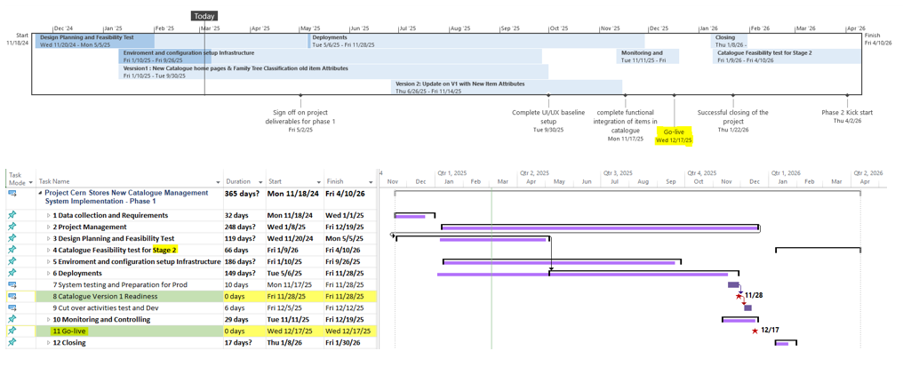
Highlight: Catalogue Project Charter (Mehak)
https://edms.cern.ch/document/3254478

Slide 12
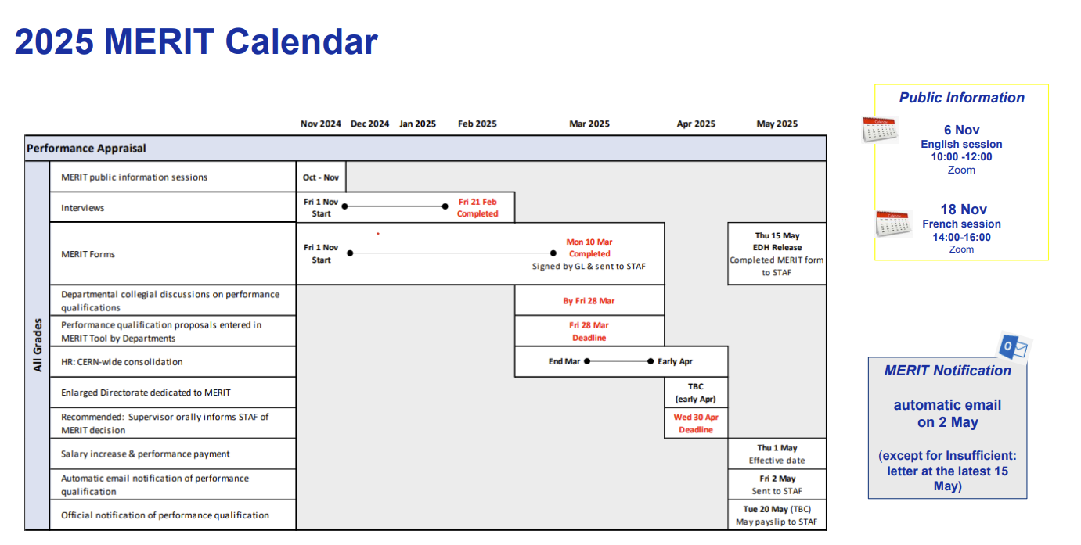

MERIT Deadlines

Slide 13
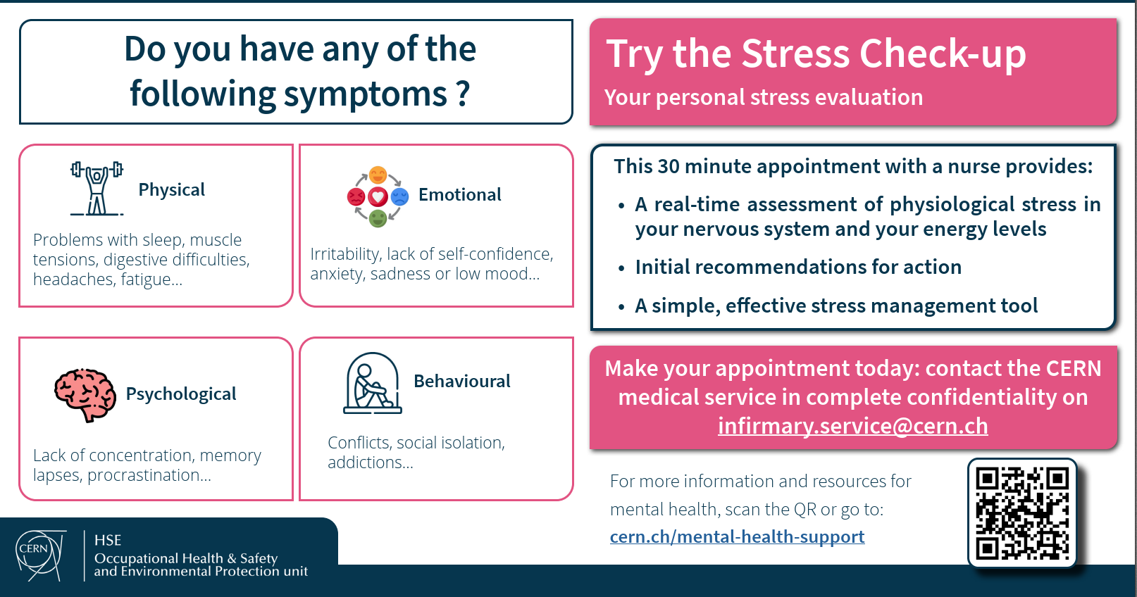

Slide 14
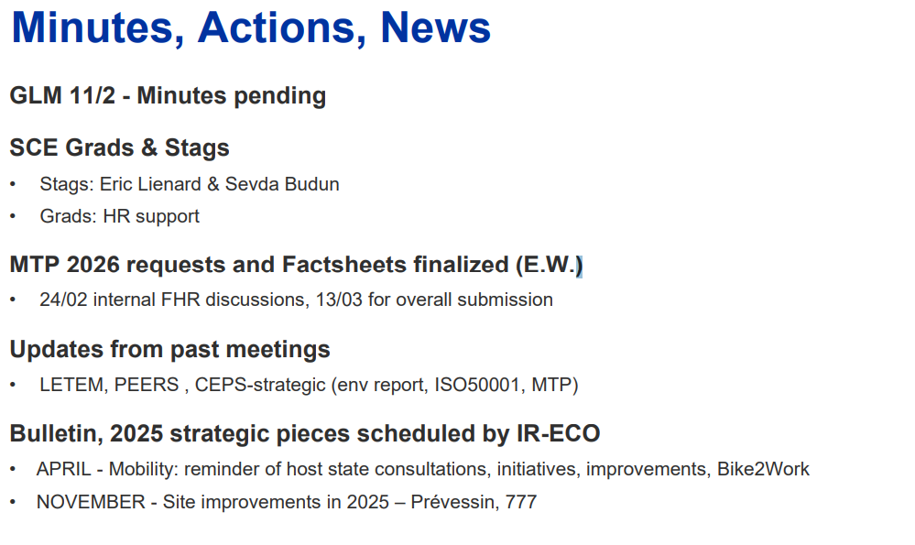
GLM 20250225

Slide 15
SCE Crisis Management
GLM 20250310
Changes:
Gyorgy and Emeline to Joined Silver Team
Fred to replace Gyorgy as SCE Silver Lead backup
Maria L. to replace Emeline as Log Keeper, Maria K. as backup
David to replace Laetitia for Site Services backup
Eric to replace Gyorgy as Snow/HelpDesk lead, and Flavio as backup
Ressources:
https://confluence.cern.ch/display/ISPUB/SCE+Crisis+Management, https://edms.cern.ch/project/CERN-0000235163, https://edms.cern.ch/project/CERN-0000235491, https://cern.sharepoint.com/sites/sce/DOD/Crisis_exercise/?CID=fc2ee2b9-53bc-493d-b5ba-c1cfc6043e2a
On-going action: Maria L. to publish resources in EDMS and close the SharePoint. Only a few pages in Confluence with links for navigation through EDMS resources.

Slide 16
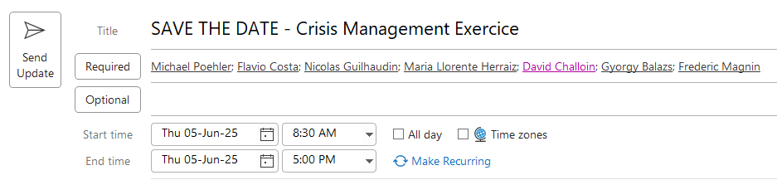
SCE Crisis Management
GLM 20250310
Next CERN exercise: 05th of June
Team: Alternates from 2024 exercise and new members
Adhoc SCE training + exercise to be organized with Didier (April or May)

Slide 17
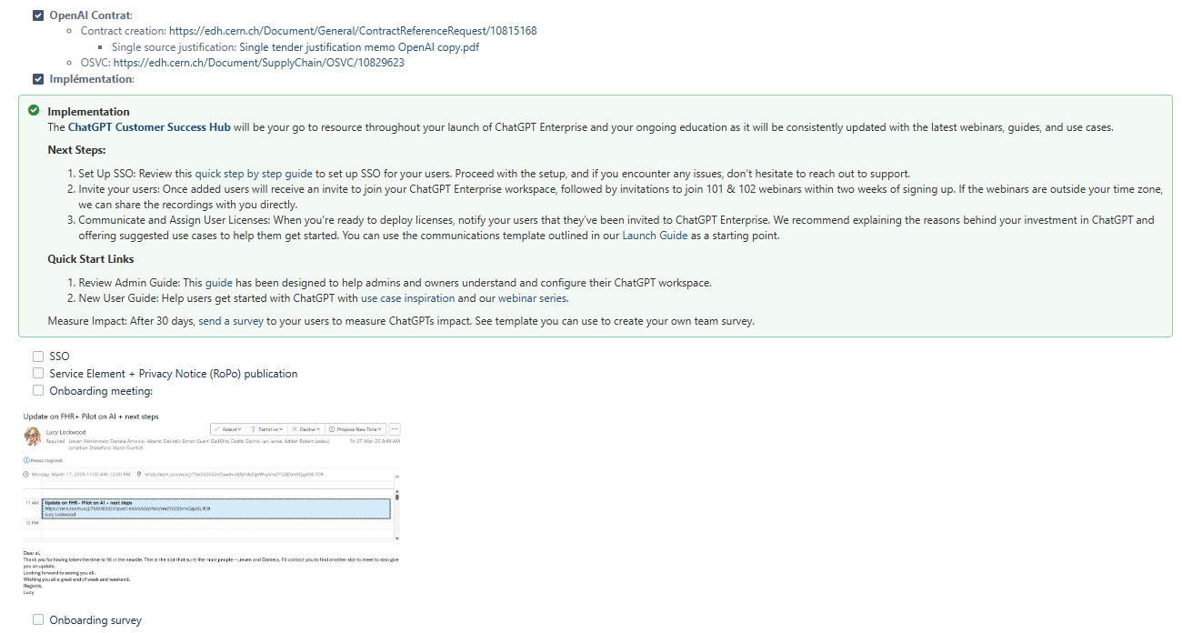
AI FHR+ Pilot Update
GLM 20250310
New Confluence Space: https://confluence.cern.ch/display/FHR/FHR+Sector+Home
ChatGPT

Slide 18

Generative AI in FHR+ Sector
GLM 20250310
Study and FHR+ Generative AI Strategy document by Lucy

Slide 19
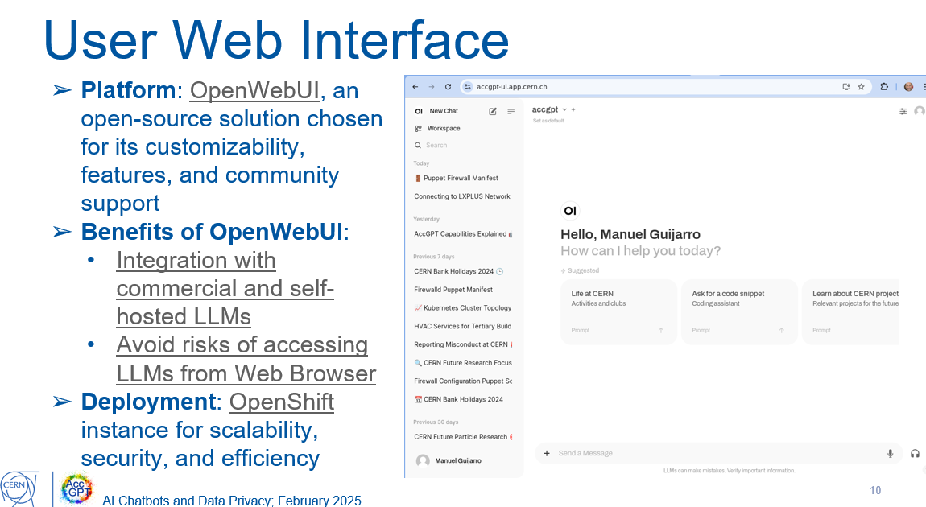
AI FHR+ Pilot Update
GLM 20250310
AI Steering Commitee Proposal (approved at ED of Feb 2025)
AccGPT (pilot phase 2)

Slide 20
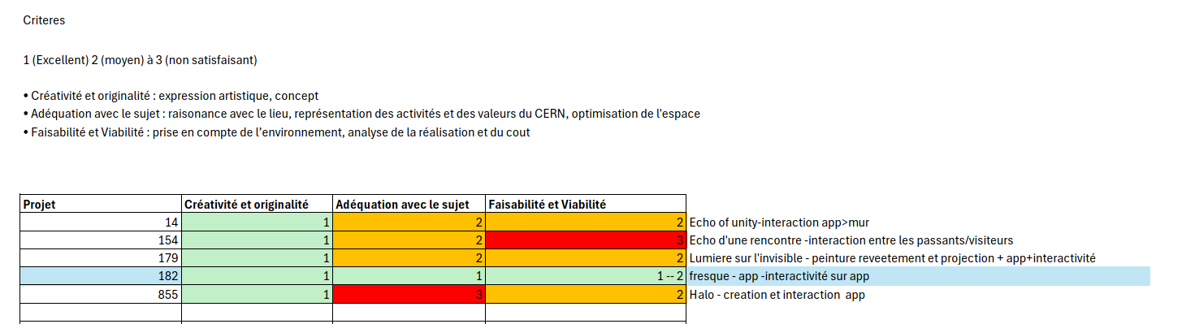
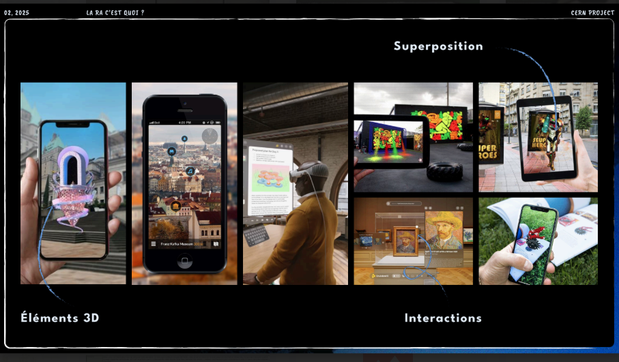
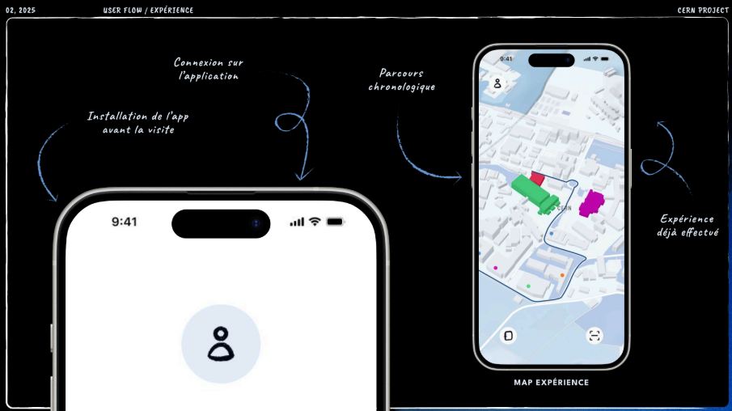
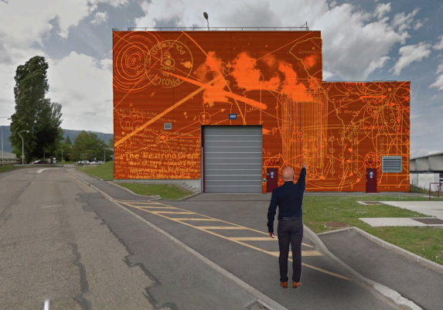
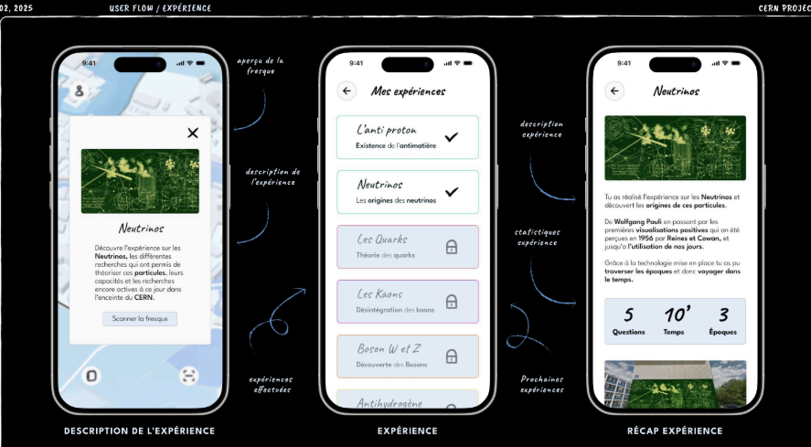
Murals update
GLM 20250310
Gobelins outcome (project 182)
Follow-up to be discussed with the school in next 2 weeks

Slide 21
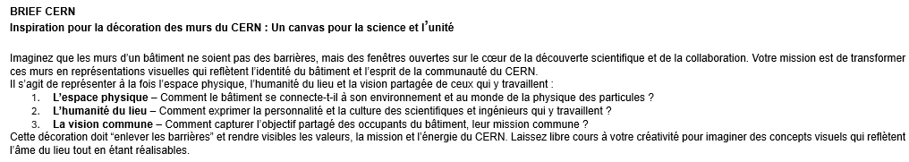
Murals update
GLM 20250310
04/03: Visit of “Département Instruction Publique”, arts teacher
  Project foreseen in 2027
  1 teacher proposed a free mural: https://www.mans1.ch/murals. To be explored
05/03: Visit of IPAC Design School with Araceli and Teresa
  New walls identified (mostly Democrite road)
  Next step: Extra data to be provided (ex: which department/group use the building), intermediate proposals from the school and then selection
Q3: Internal contest to beautify 1 gallery -> http://borderline.mit.edu/

Slide 22
LS3 Space
GLM 20250310
When the Flex building was constructed for LS2, it was foreseen to be fully available for LS3 activities.
More than a year before LS3 starts, the Flex exceeds its full capacity. Space planning for HL-LHC has not been properly addressed, and since LS2 ended, the Flex space has been used to quickly put remedy to space requests and space exchanges, linked to HL-LHC and other activities.
Despite the Storage Space Task Force efforts, as of March 2025 only 300 m² (~11% of the Task Force’s target) have been cleared from the Flex and Central Storage buildings, with just 30 m² in the Flex.
Given the slow progress and increasing congestion, meeting the TF targets on time is not viable.

Slide 23
LS3 Space – Management decisions
GLM 20250310
Proceed with the construction of a temporary storage tent on a new slab outside the Flex.
Estimated cost: 1.6–1.8 MCHF.
The tent will be rented and available just during LS3’s peak storage congestion phase.
SCE will make all efforts to deliver it by September 2025.
LS3 coordination must urgently inform SCE of the end date, recalculating the availability of square meters in Flex based on the ongoing clearing campaign and the forecasted movements in Flex at LS3’s start.
The tent’s technical specifications, timeline, and ATS funding source will be documented in a IRP, subject to ATS Dir approval.
LS3 coord. will manage the Flex and the temporary tent, with ATS covering the additional logistics resources to operate them.
Proceed to install a 600 m² metallo-textile tent requested and funded by the BE and EP Departments for temporary storage and assembly for ECN3 in the northeast of B920.
Estimated cost: 770k CHF.
The IRP document (EDMS 3235927) already exists.
Furniture, installation, maintenance will be under the BE Department’s responsibility for the tent’s entire lifespan.
Given the high volume of storage space requests (other six ongoing projects) the SCE DH will consult with the ATS Director to prioritize all these requests.

Slide 24
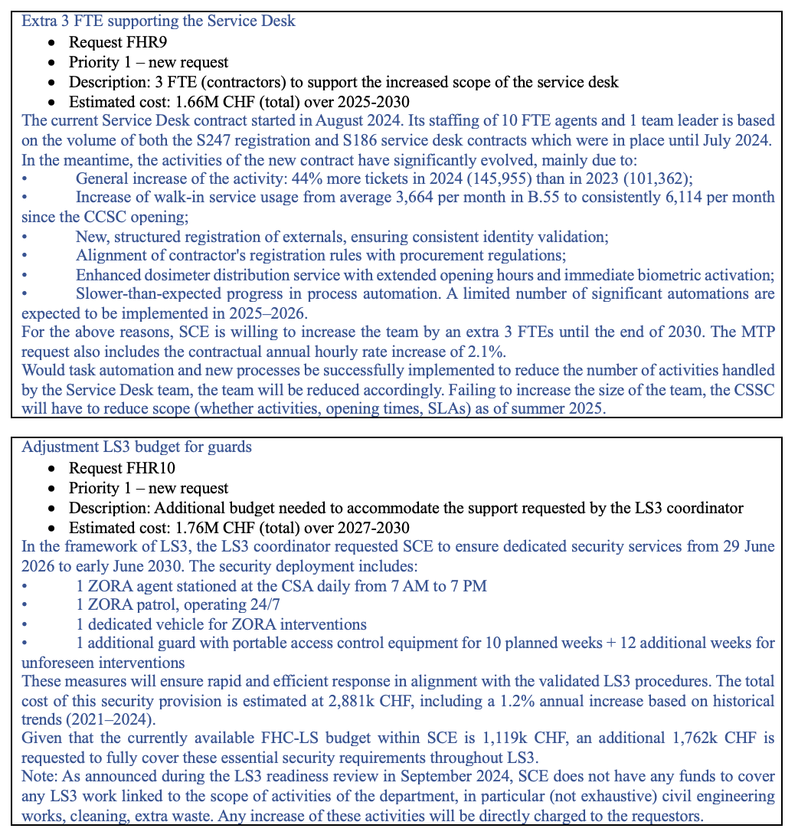
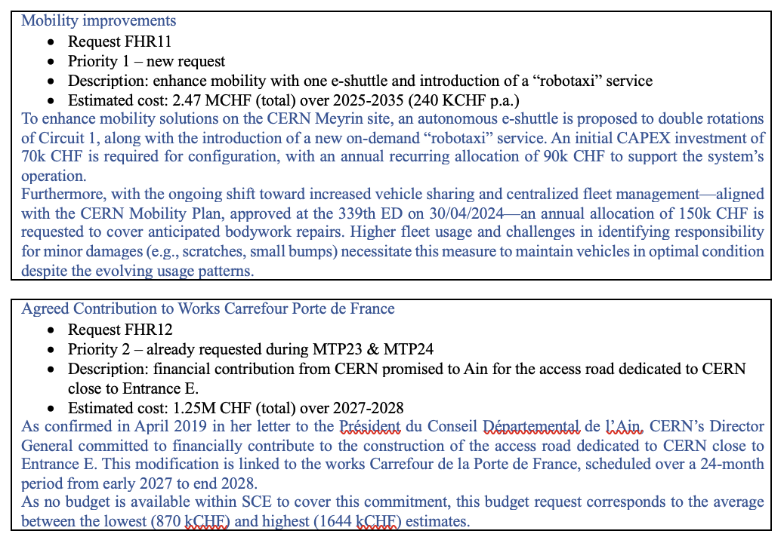
MTP – sector discussion on 7/3/25
GLM 20250310
SCE OPEX

Slide 25
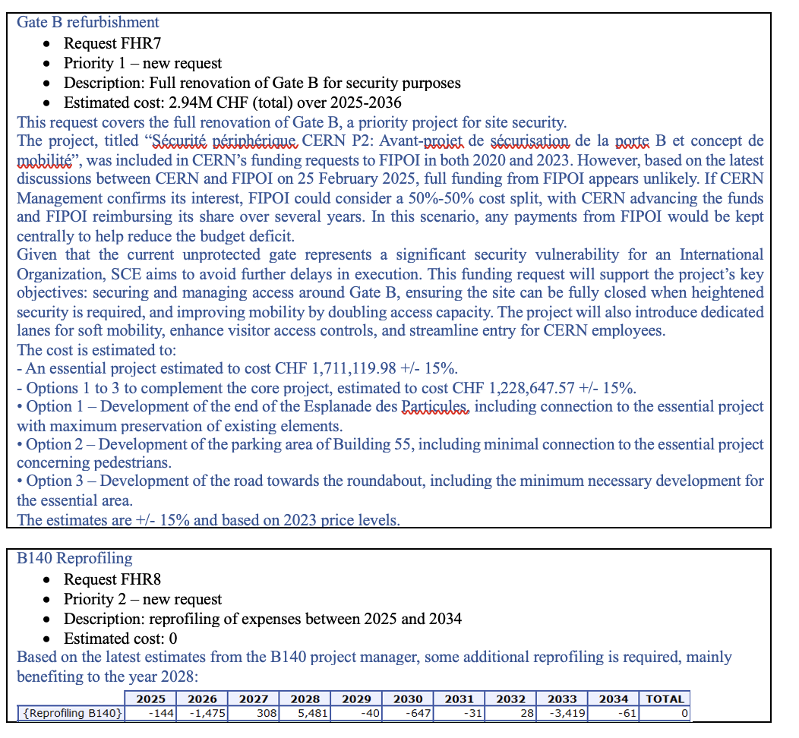
MTP – sector discussion on 7/3/25
GLM 20250310
SCE CAPEX

Slide 26
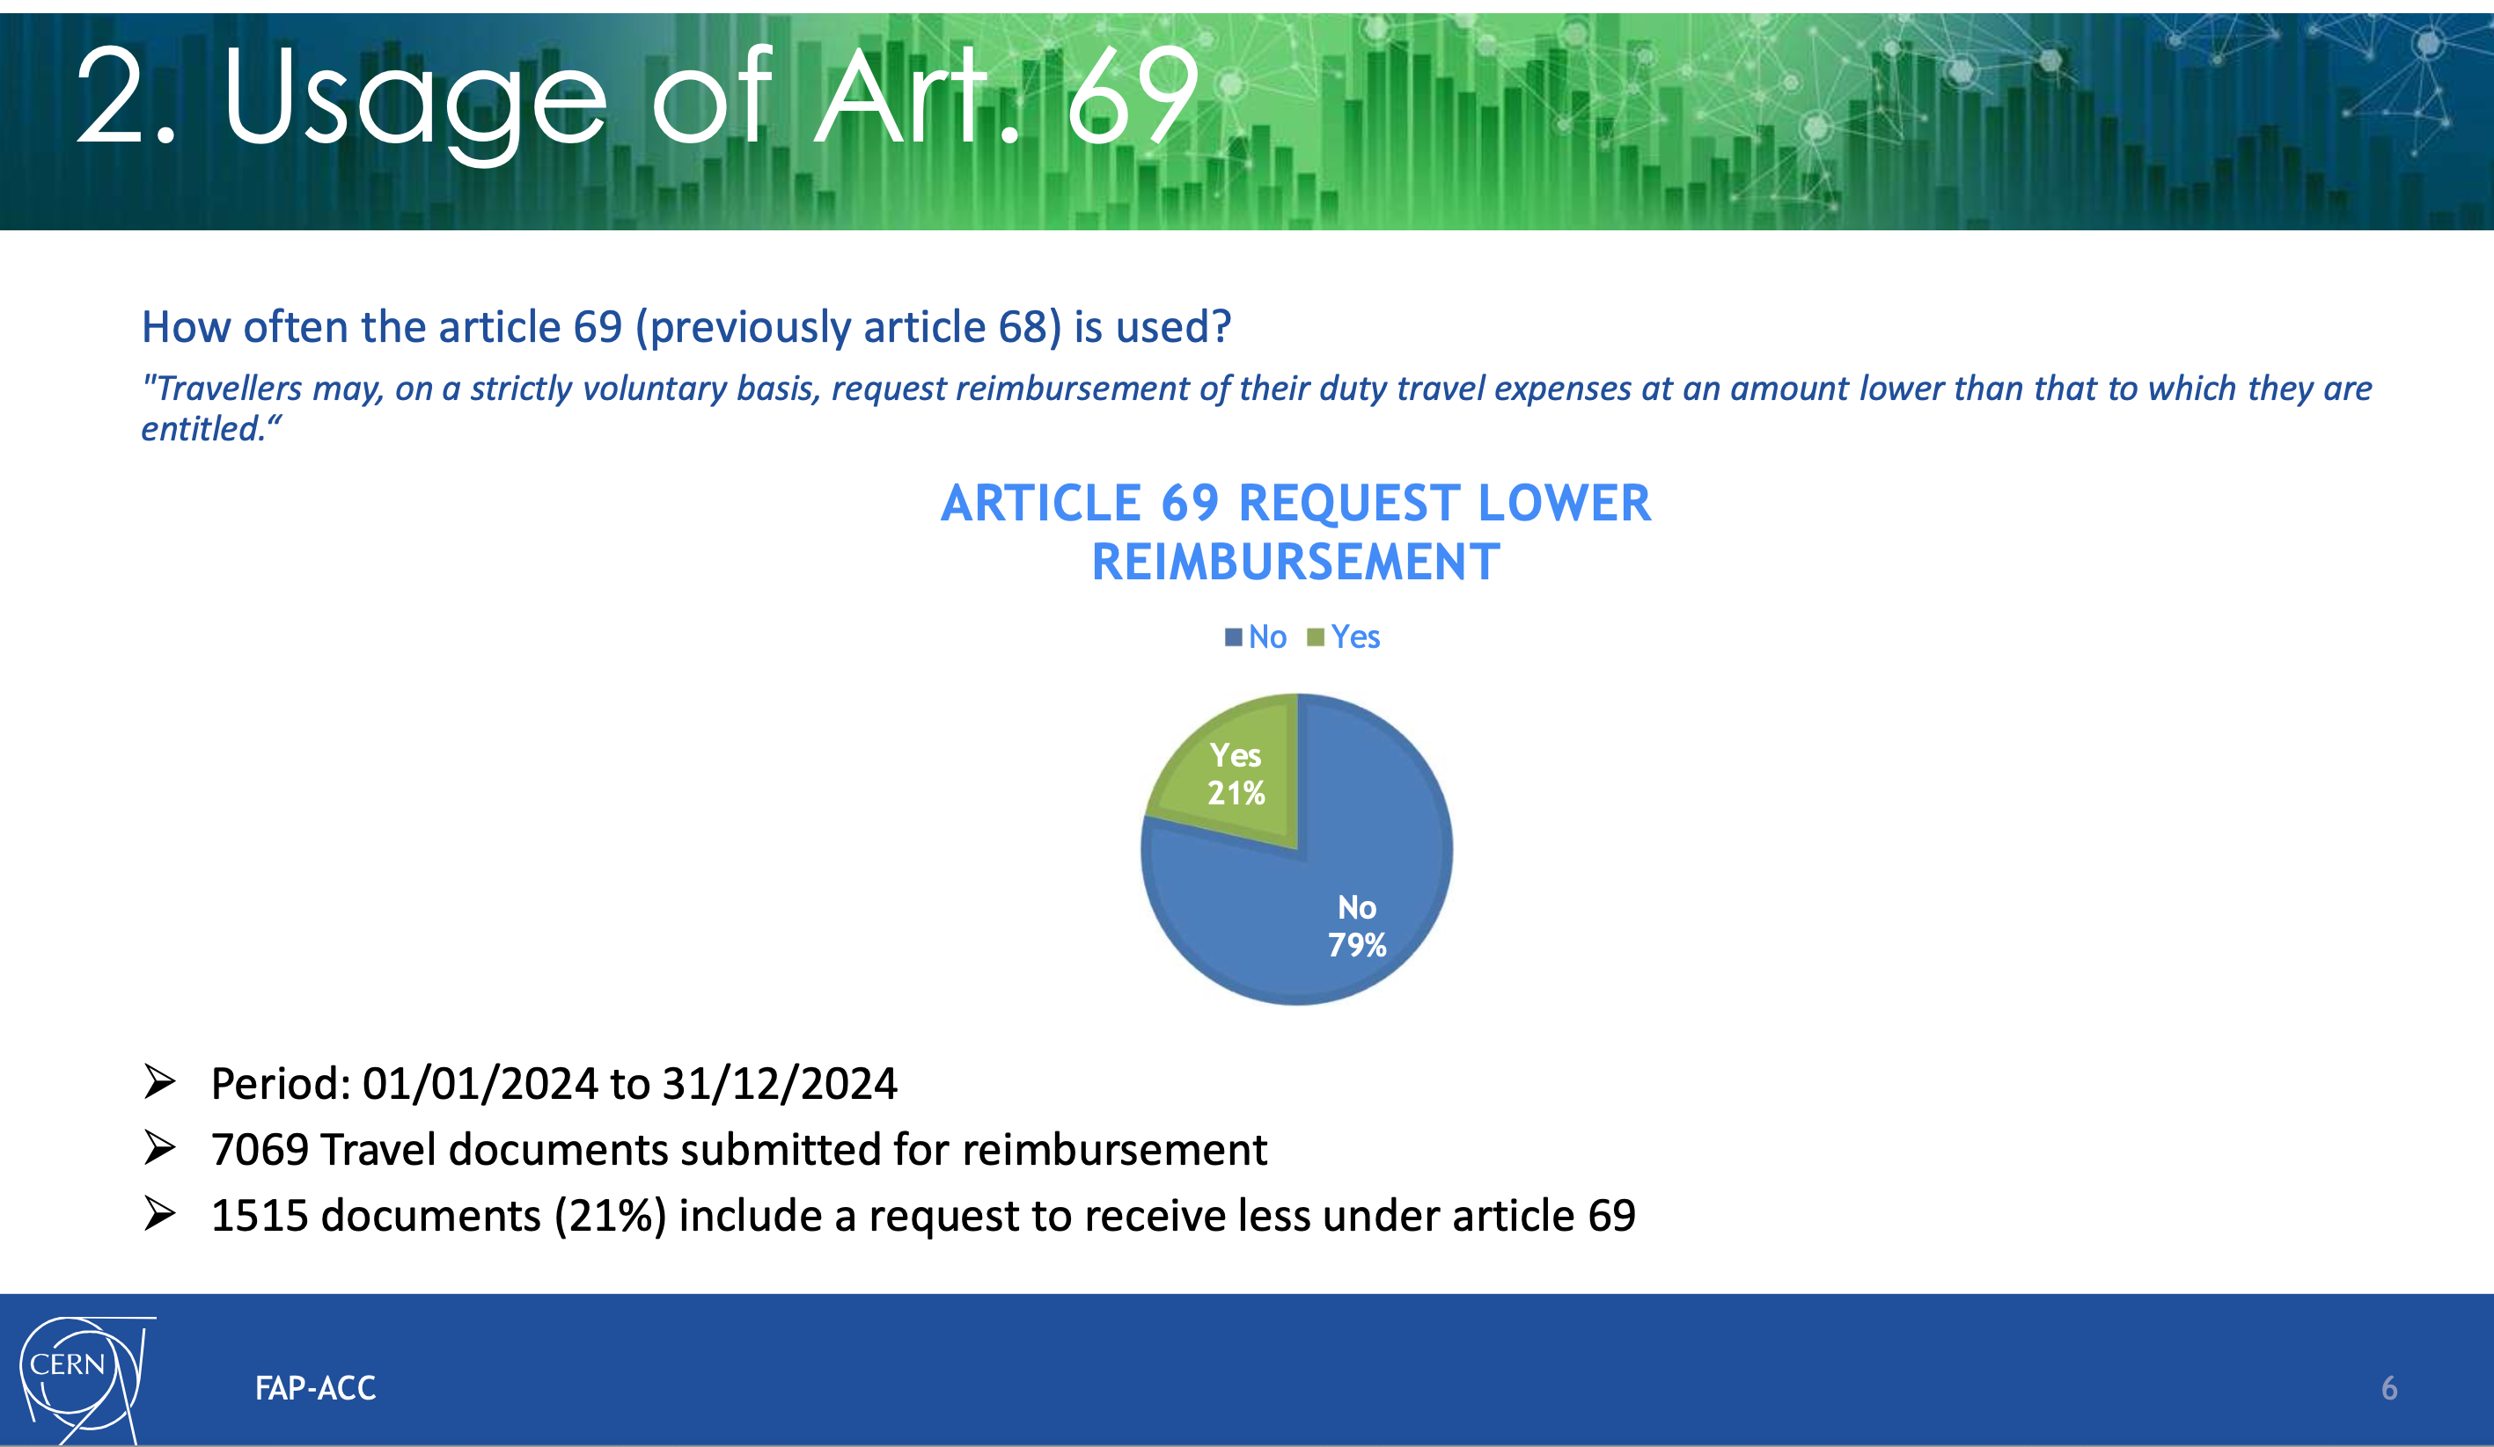
Annual travelling statistics by FAP
GLM 20250310

Slide 27
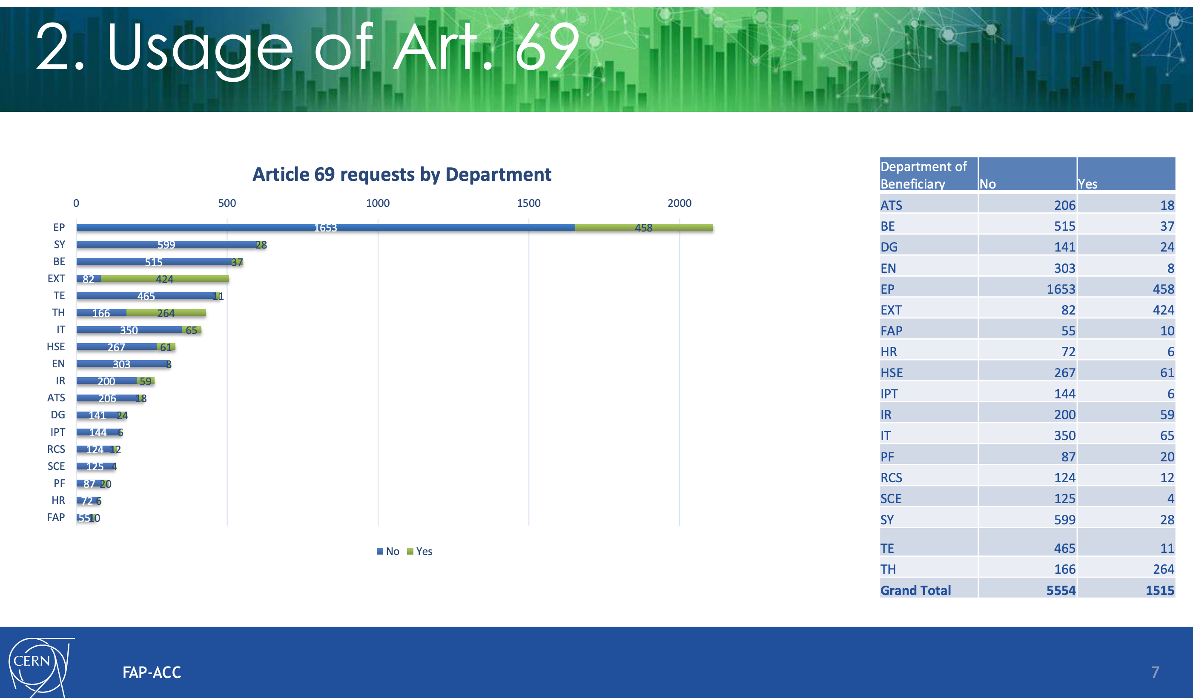
Annual travelling statistics by FAP
GLM 20250310

Slide 28
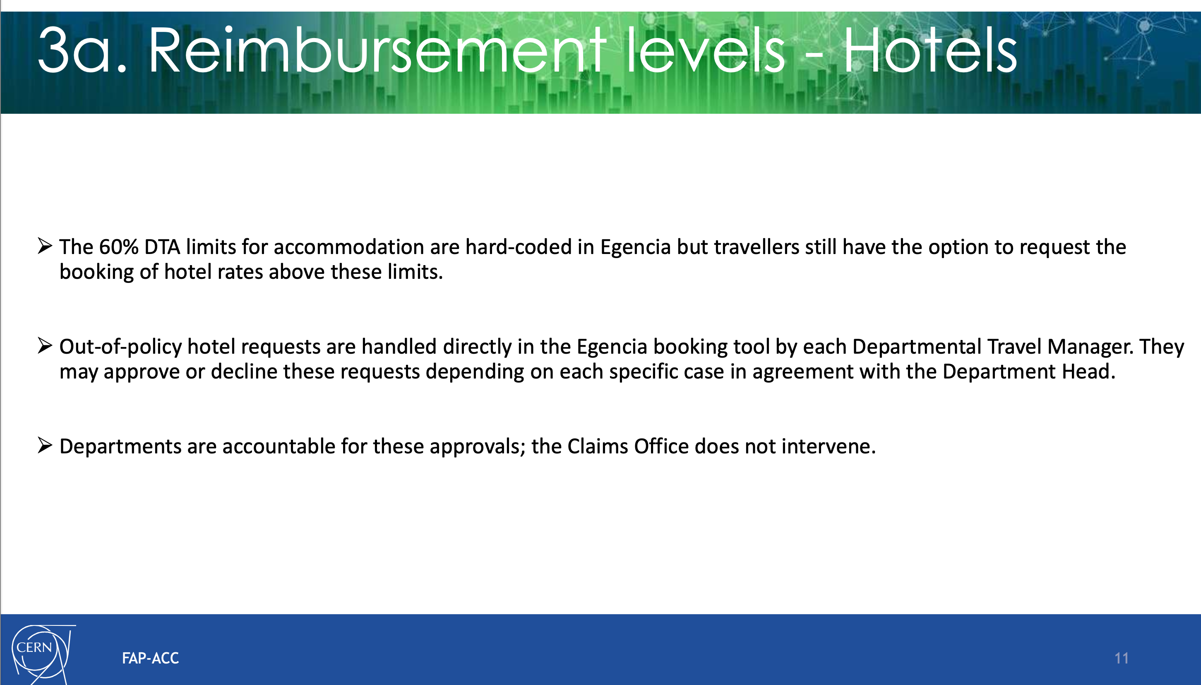
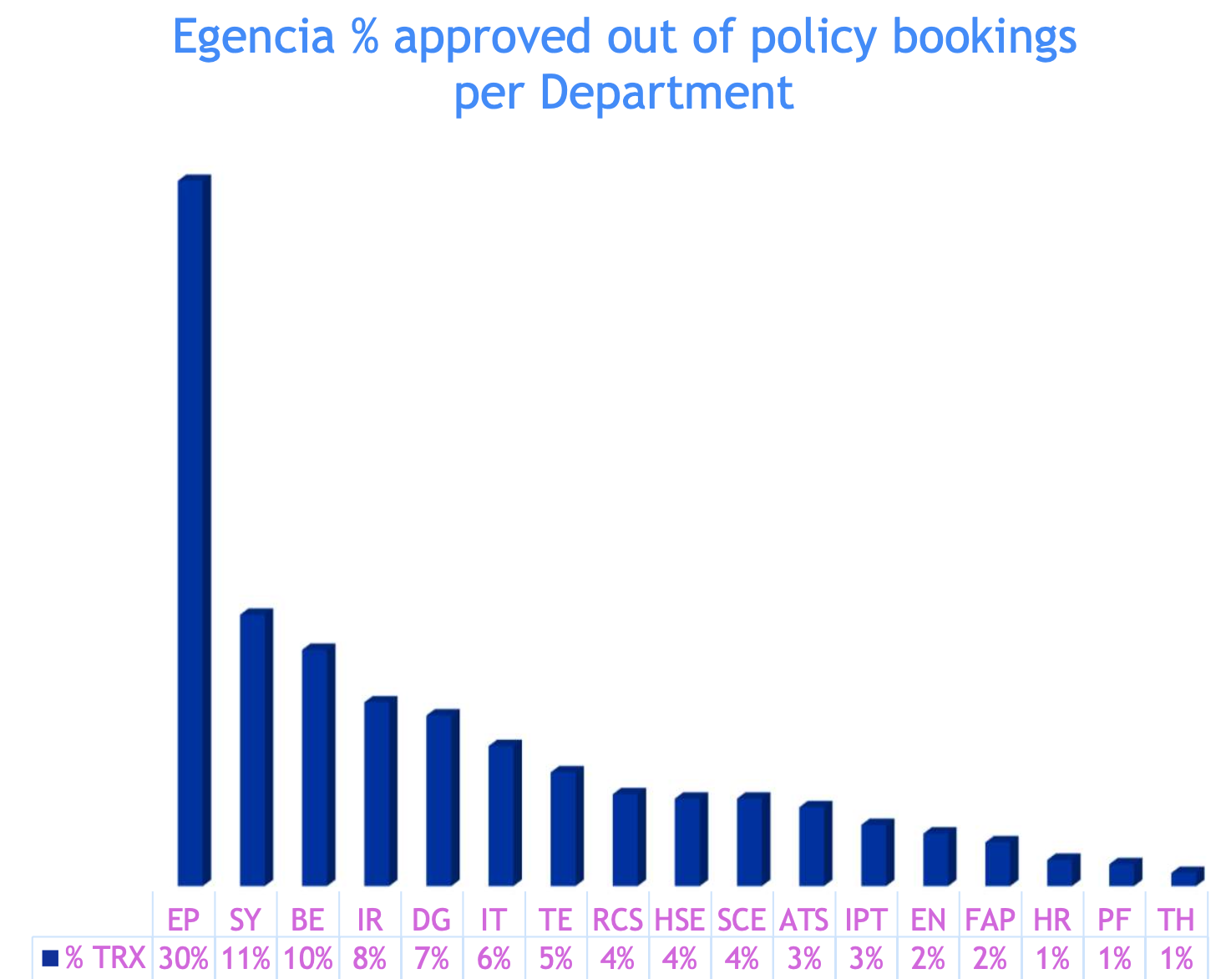
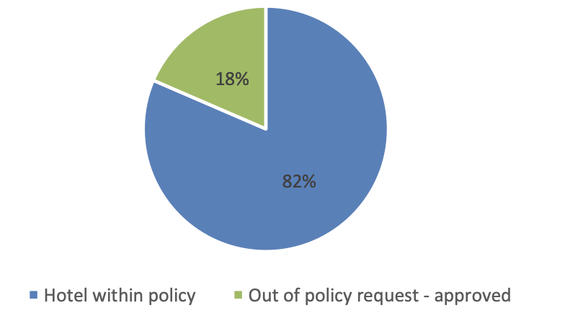
Annual travelling statistics by FAP
GLM 20250310

Slide 29
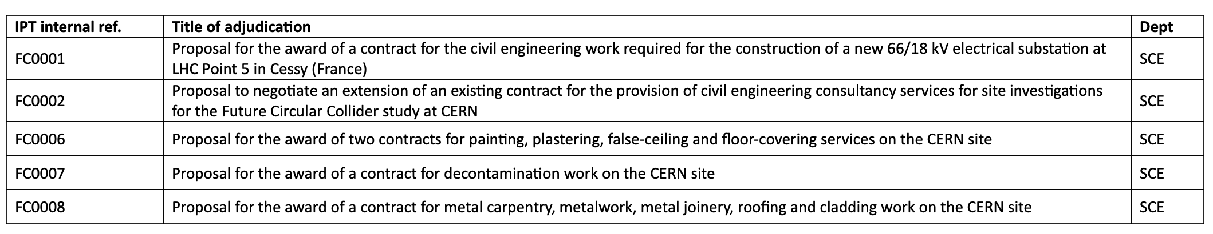
Other news
GLM 20250310
LS3: Veronique Sogno appointed SCE coordinator for SCE LS3 commitments. Schedule and work plan will be discussed in the weekly IRP meetings. Mandate under preparation.
Merit: Today 10/3 is the deadline for Merits, last day to sign forms by GL and sent.
Ongoing IA: insurances, LS3 preparations
Council week 24-28/3:
Proposed Management Structure of CERN for the Years 2026 to 2030 by the Director-General Designate in the SPC restricted session 25/3
Management proposal to FC - Associate Member States: possible measures in the event of contribution arrears → Restrictions on future personnel appointments and industrial contract awards possible.
SCE adjudications submitted to FC approval:

