Slide 1
Spectrometer Magnet Status A. Ballarino³, L. Baudin³, P. Borges de Sousa¹, N. Bourcey³, A. Devred², D. Duarte Ramos³, S. Izquierdo-Bermudez³, T. Koettig¹, F. Mangiarotti³, A. Milanese³, M. Pentella³, C. Petrone³, O. Pirotte¹, R. Van Weelderen¹, and G. Willering³ ¹CERN/TE-CRG, ²CERN/TE-HDO, ³CERN/TE-MSC
18 December 2024
31th SHiP Collaboration Meeting

Slide 2
Outlook
Proposal:
Use the MgB₂ cable, originally developed for superconducting links in the HL-LHC Work Package 6a, to design the large aperture SHiP hidden sector spectrometer magnet, aiming to reduce electrical consumption.
Demonstrator:
Develop a proof-of-principle demonstrator with scalable design and assembly processes for large, iron-dominated magnets in physics experiments. Phase 1 (test in a cryogenic test station with LHe at 4.5 K) and Phase 2 (test in a cryogenic test station with GHe at 20- 30 K) were successful. See more details in the presentation given at the 28th Collaboration meeting.
Update on demonstrator, Energy-Efficient Superferric Dipole Phase 3:
Status
Timeline
Conceptual design of SHiP superconducting spectrometer magnet:
Status of the electromagnetical design
Prototyping and test campaign, construction strategy
Update on quench protection

Slide 3
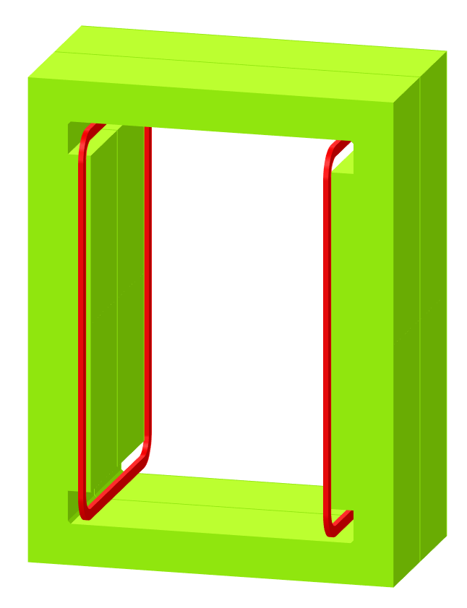
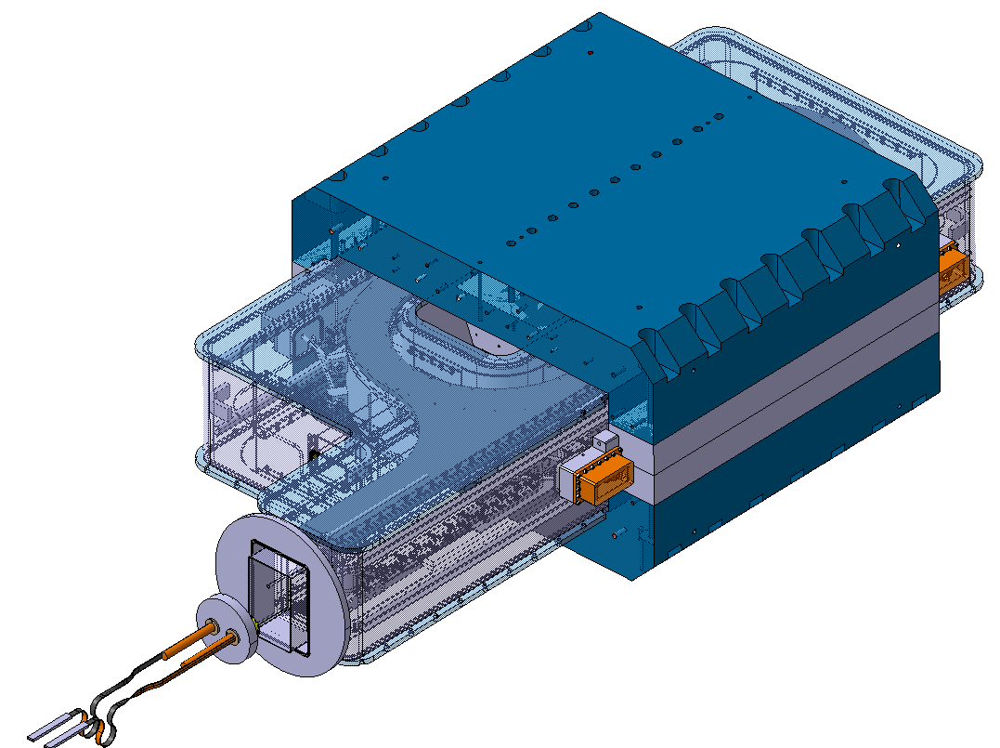

Nota
SHiP spectrometer magnet is something else…
compensation of staff resources in case TE shall continue with the detailed design, construction, testing and installation of the SHiP spectrometer (including its full-scale prototype coil) has been requested to the project
EESD (with its several phases) is an (agnostic) R&D initiative of TE

Slide 4
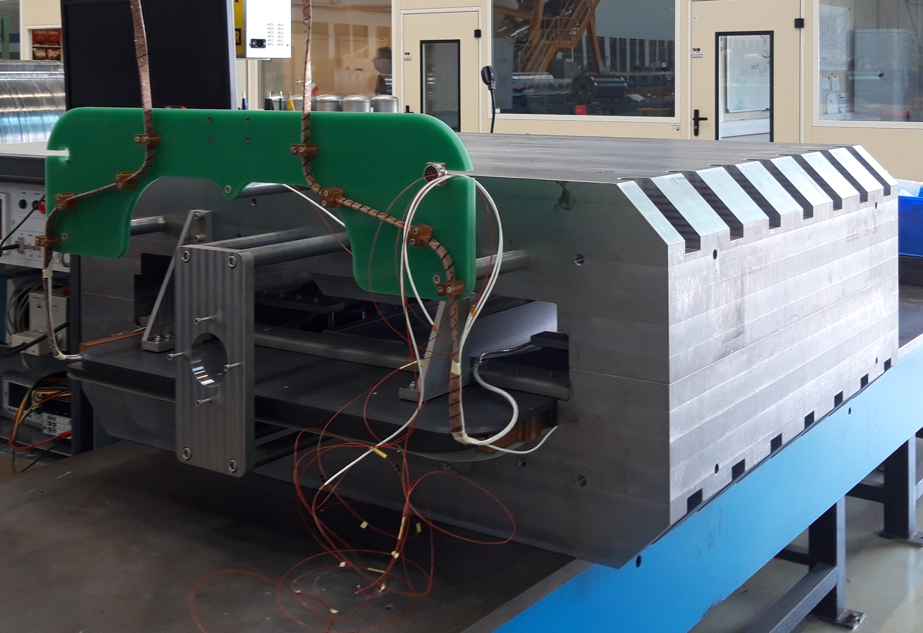
Energy-Efficient Superferric Dipole: Phase 3 Indirect cooling of the coils at 20 K
Assembly planned for Q2 2025
Objective: To cool superconducting coils made of MgB₂, efficiently by circulating Gaseous Helium (GHe) through capillaries within a dedicated cryostat, keeping the yoke warm
Phase 1
Iron yoke
Integration of the cryostat:
Vacuum vessel
Thermal shield
Cooling circuit
Pole gap
Superconducting coil
Courtesy of N. Bourcey, C. Chatron, and
D. Duarte Ramos
(CERN TE-MSC)

Slide 5
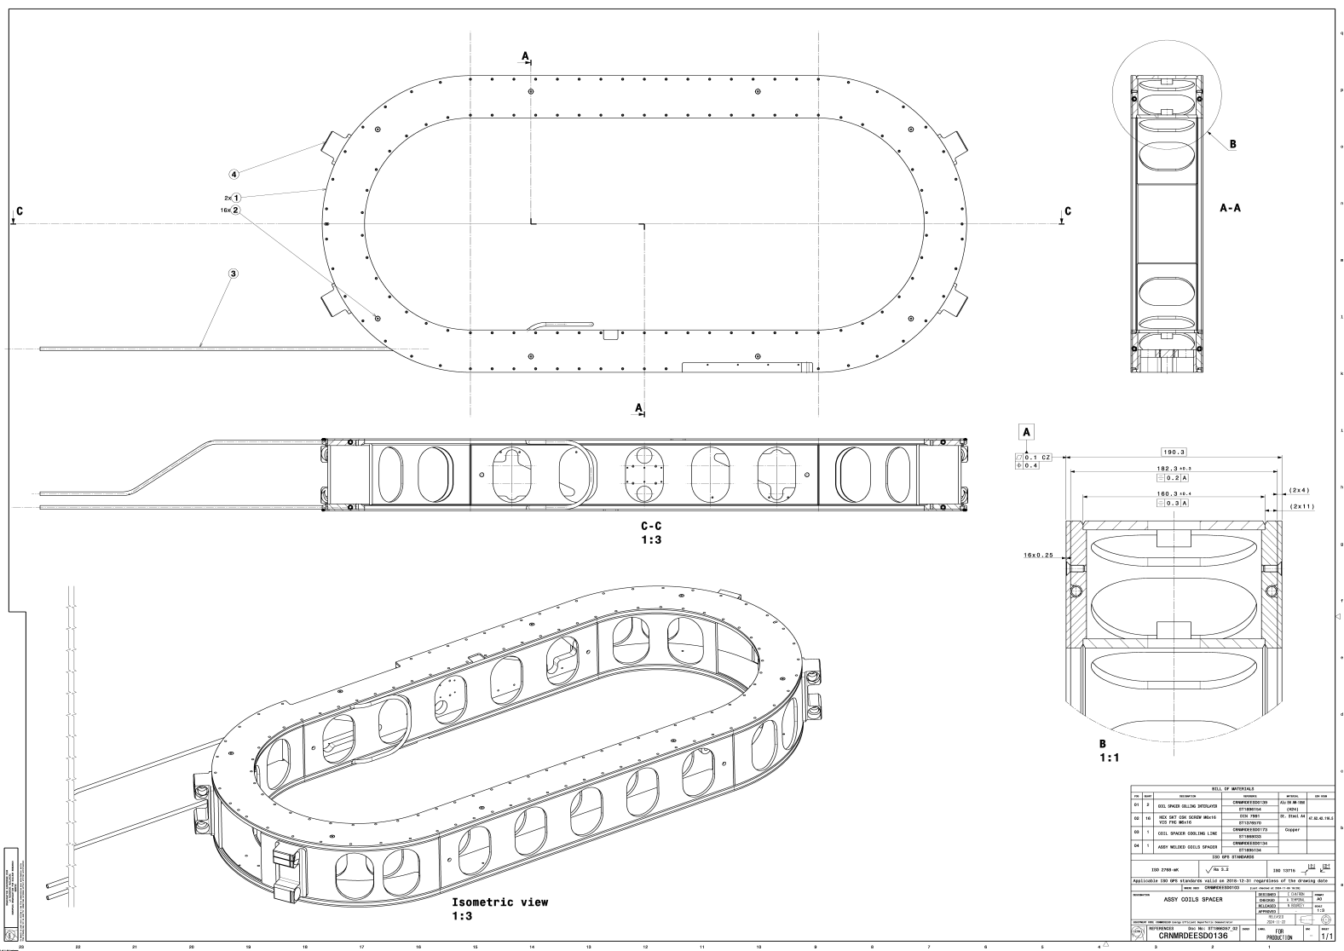
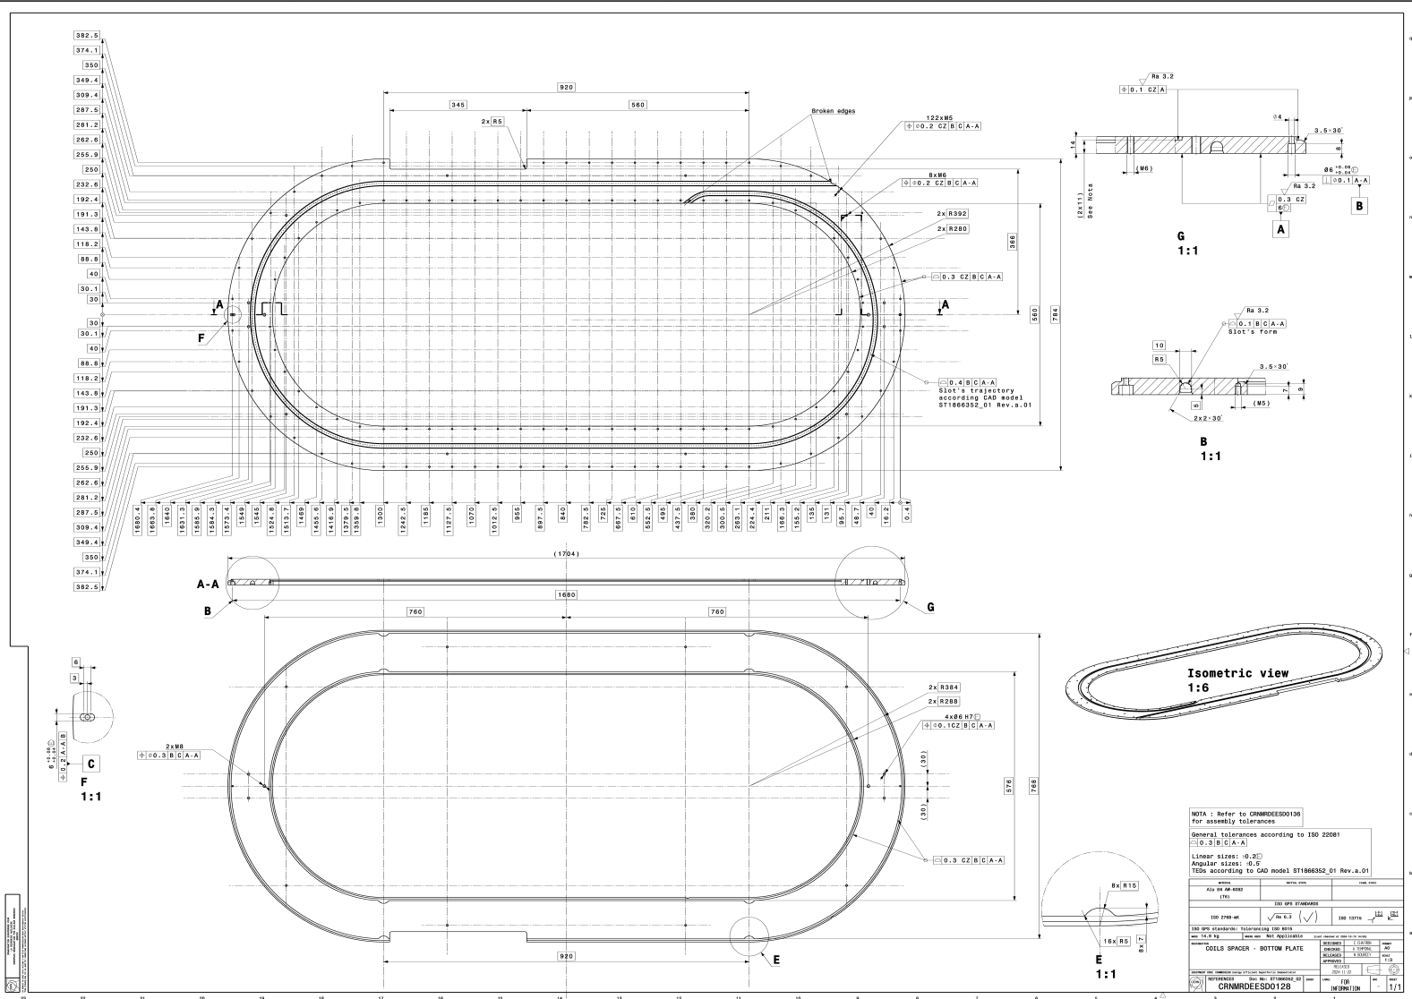
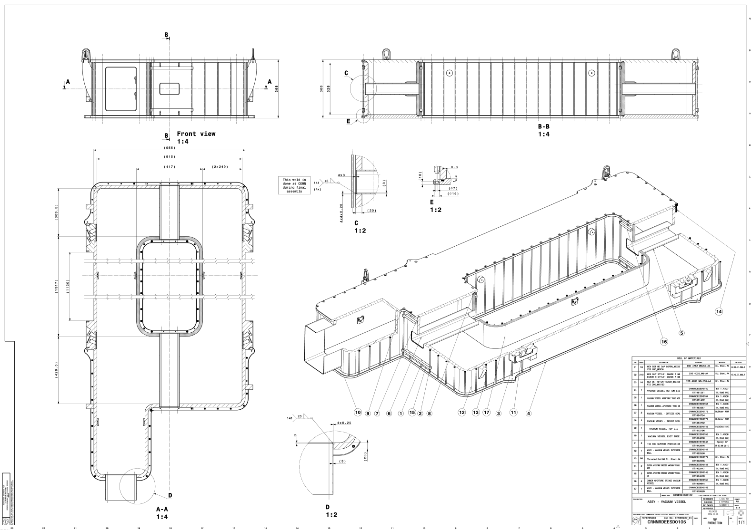
EESD Phase 3
Procurement of mechanical components of the EESD phase 3: on going
(Outsourcing followed by
CERN EN/MME)
Manufacturing of Magnet Components
Courtesy of N. Bourcey, C. Chatron, and D. Duarte Ramos
(CERN TE-MSC)

Slide 6
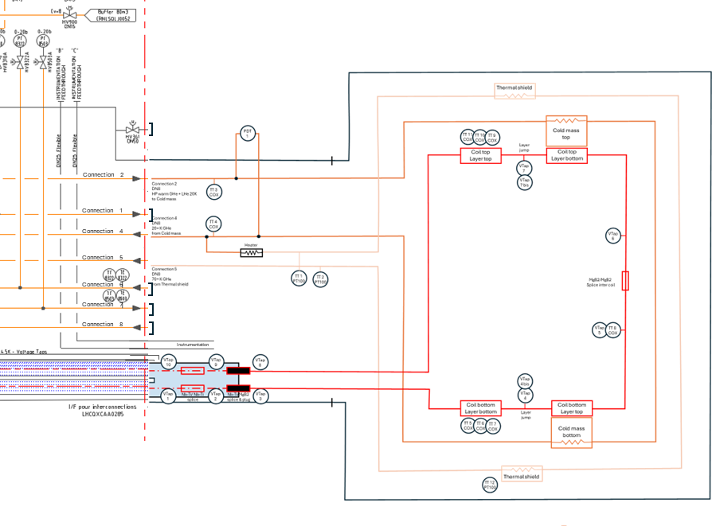
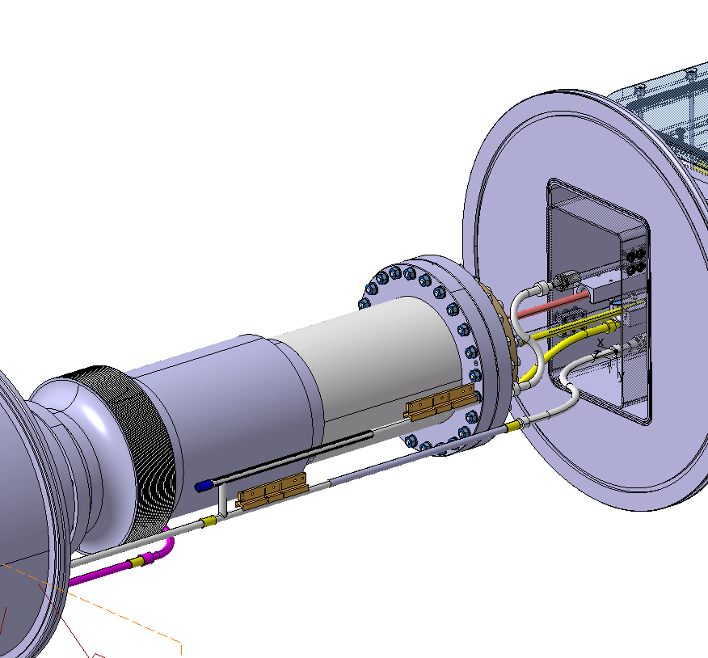
EESD Phase 3
Interconnection assembly
Connection to Cluster G
Test of EESD phase 3 Q3 2025
Design of interconnection module to SM18 test station
Courtesy of N. Bourcey, C. Chatron (CERN TE-MSC)

Slide 7
Timeline for EESD demonstrator Phase 3
Jan. 2025
3D CAD mechanical design ready
Interconnection area
Feb. 2024 Start of the Phase 3 mechanical design
April 2025
2D drawings
Tooling
July 2025
Winding
Magnet assembly
Sep. 2024
Assy. procedure
2024
2025
Aug. 2024
3D CAD mechanical design ready
Coil
Coldmass
Thermal shield
Vacuum vessel
Oct. 2024
2D drawings
Coil
Coldmass
Thermal shield
Vacuum vessel
Start of procurement
Feb. 2025
3D CAD mechanical design ready
Tooling
June 2025
Reception and control of components
Sept. 2025
Interconnection assembly
Connection to Cluster G
Test of EESD phase 3
Today
Validation of the technology choice Q3 2025:
use of MgB₂ cable developed for WP6a
winding in grooves machined in a radial plate
cooled by indirect cooling

Slide 8
Outlook
Proposal:
Use the MgB₂ cable, originally developed for superconducting links in the HL-LHC Work Package 6a, to design the large aperture SHiP hidden sector spectrometer magnet, aiming to reduce electrical consumption.
Demonstrator:
Develop a proof-of-principle demonstrator with scalable design and assembly processes for large, iron-dominated magnets in physics experiments. Phase 1 (test in a cryogenic test station with LHe at 4.5 K) and Phase 2 (test in a cryogenic test station with GHe at 20- 30 K) were successful. See more details in the presentation given at the 28th Collaboration meeting.
Update on demonstrator, Energy-Efficient Superferric Dipole Phase 3:
Status
Timeline
Conceptual design of SHiP superconducting spectrometer magnet:
Status of the electromagnetical design
Prototyping and test campaign, manufacturing strategy
Update on quench protection

Slide 9
Conceptual design of the SHiP Spectrometer Magnet
Main design concepts/parameters of the electromagnetic design are:
H-type iron yoke; Superferric = iron dominated magnet;
2 symmetric coils;
double-pancake, racetrack-type coils = flat coils;
pole gap: 6000 x 4000 mm;
target central field: 0.15 T
What will be validated by EESD phase 3:
use of MgB₂ cable developed for WP6a
winding in grooves machined in a radial plate
cooled by indirect cooling
What still needs to be validated:
electro-mechanical design needs to compatible with the requirements for physics (Integrated field strength, Field homogeneity,…)
independent cooling architecture based on cryocoolers;
current leads specifically tailored for this application;
extrapolation of the radial plate and cryostat design to larger scale assemblies
3.5 m
4 m
Main dipole field
6 m
Can be assed on EESD phase 4
Prototype will be a full scale cryostated coil

Slide 10
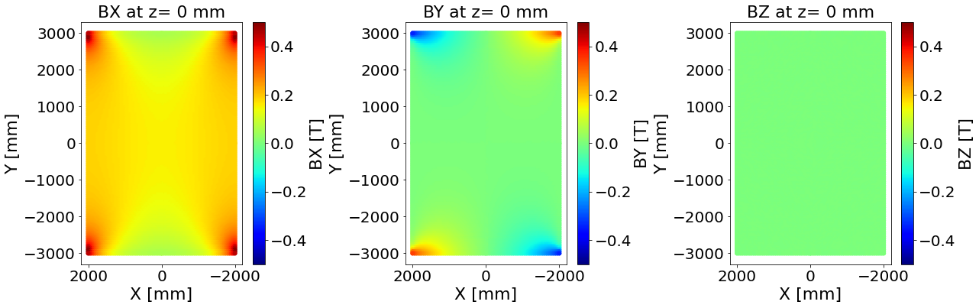
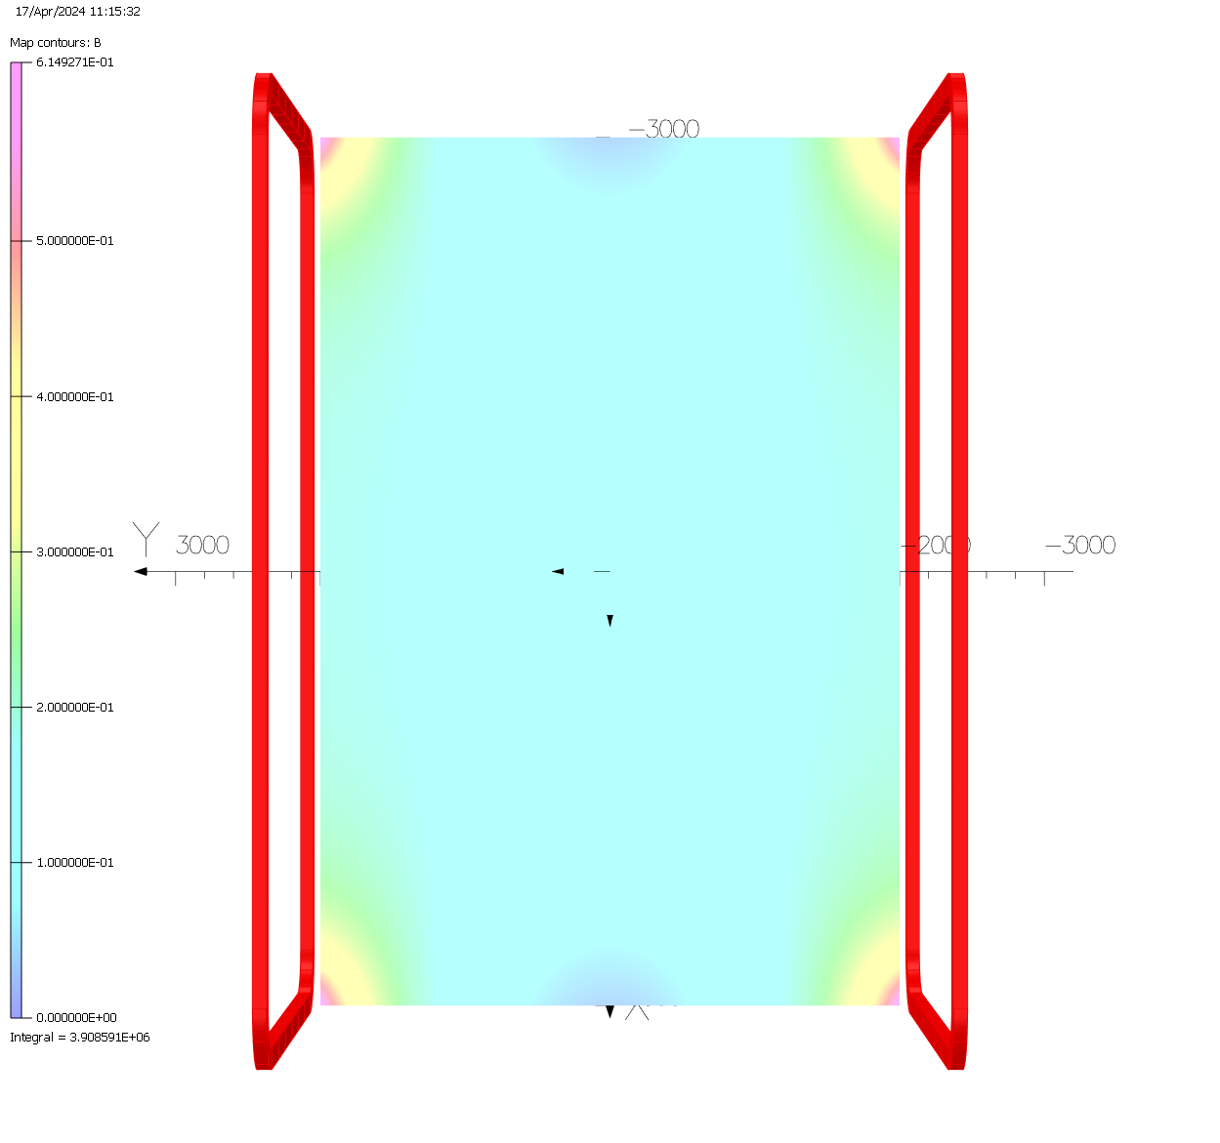
Preliminary electromechanical design
3 double pancakes per coil,
16 turns per layer
3 kA per turn
B₀ = 0.154 T
Field maps in the magnet aperture in vertical plan in the center of the magnet
The three components are shown.
Field maps are available in EDMS 3168589
Main parameters of the electromechanical design
The baseline magnetic design is under evaluation by the SHiP team
Need to quantify field uniformity with parameters to drive the coil and yoke optimization
B_{p} = 1 T
Int B.dl [-2.5 m; 2.5m] = 0.630 T.m
Stored energy: ~ 2.75 MJ
Main parameters of the electromechanical design V01

Slide 11
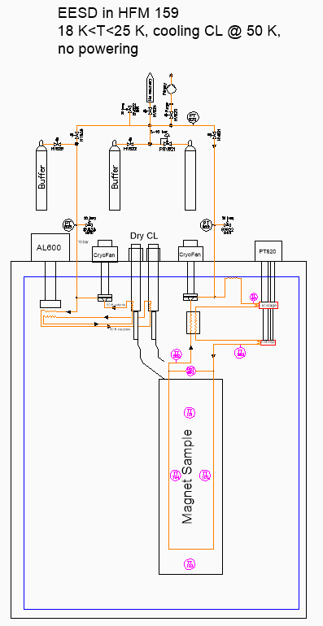
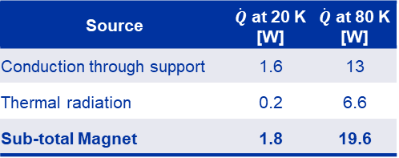
EESD Phase 4a – Cooling architecture
Phase 4 – 2025 Q3/Q4
Courtesy of P. Borges de Sousa, T. Koettig (CERN TE-CRG)
Test of the cooling architecture with cryocoolers in HFM test station in CRG Cryolab (HFM 159 building):
Cryocoolers
CryoFan
Membrane pump
Synergies with HFM WP 4.6: cryogenic study of novel cooling schemes (application for other projects like EuroSIG, CHiC)
Test is designed to evaluate the magnet cooling circuit efficiency. Heat loads will be simulated with electrical heaters.
Magnet will not be powered for lack of current leads; current leads and protection scheme could be added in a Phase 4b of the demonstrator.
Only added in phase 4b
Source | $\dot{Q}$ at 20 K [W] | $\dot{Q}$ at 80 K [W]
Conduction through support | 1.6 | 13
Thermal radiation | 0.2 | 6.6
Sub-total Magnet | 1.8 | 19.6

Slide 12
Tentative timeline
Today
Key milestones:
Test of the first prototype coil: Q4 2028
Test of the series coils Q4 2030
Assembly of the Spectrometer system at the surface : Q3 2031
System commissioning in the ECN3 cavern: Q2 2032
No time to lose: engineering design to start spring 2025 (i.e., main parameters must be fixed Q1 2025)
High co activities with HL-LHC installation during LS3 for most of the teams involved in SHiP project

Slide 13
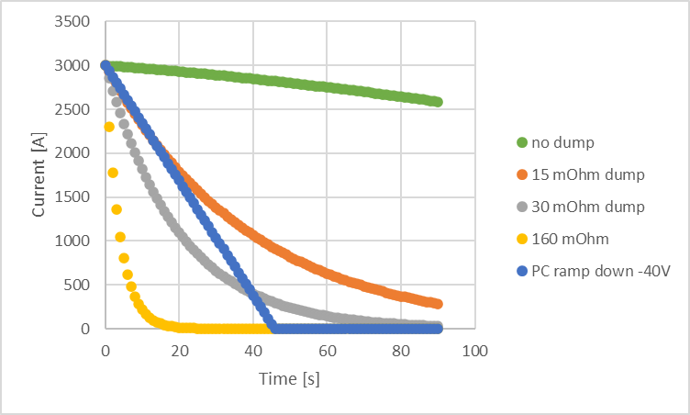
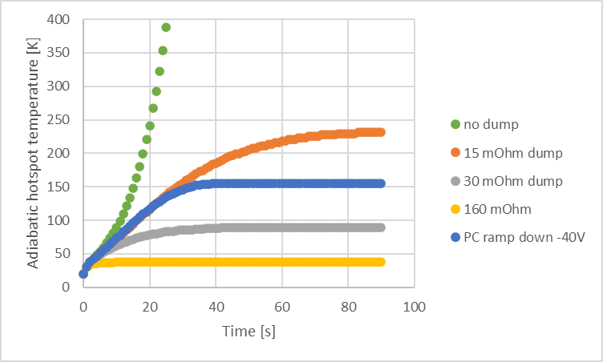
Protection
The magnet can be protected with a dump
A 160 mΩ allows for a peak voltage < 500 V a Thot < 50 K, with enough margin to design leads that can be protected/operated (< 200 K hot spot, < 5 W per lead)
Other options being explored (power converter ramp down in case of quench, or cold dump for a faster discharge of the current leads)
Detection, based on EESD experience is not a problem. Nevertheless, co-wound cable for quench detection will be tested in EESD phase 3.

Slide 14
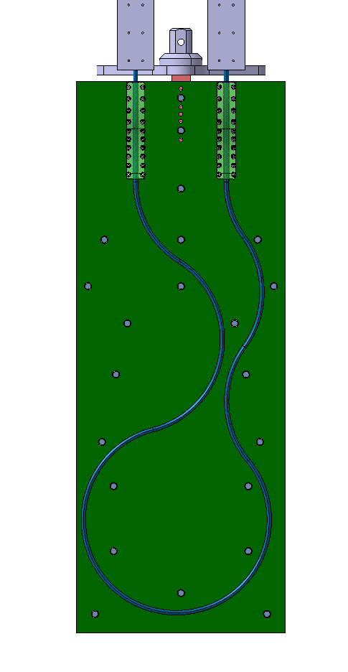
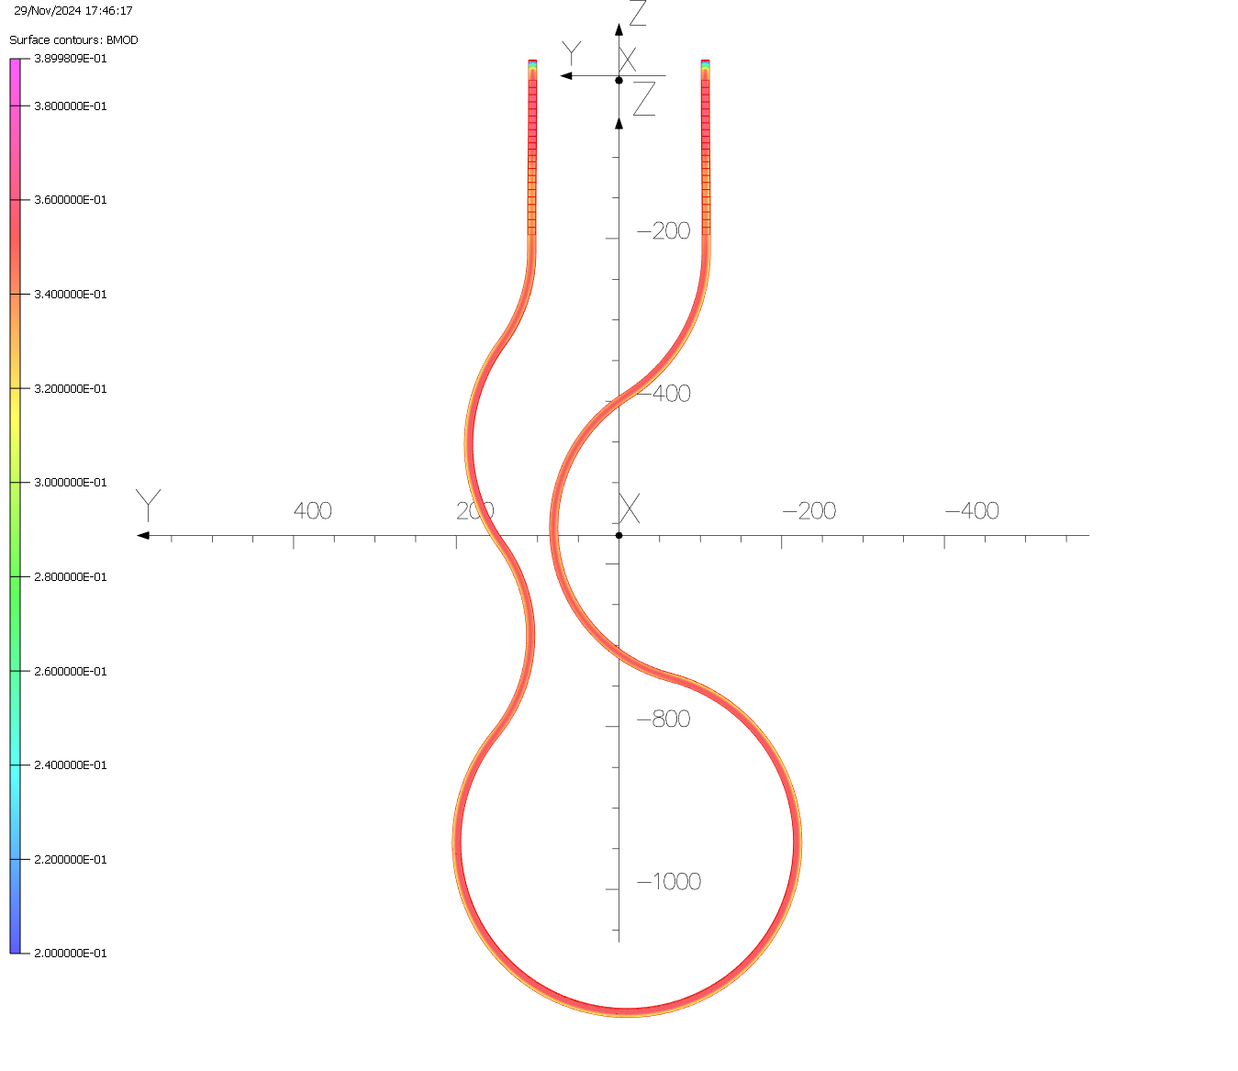
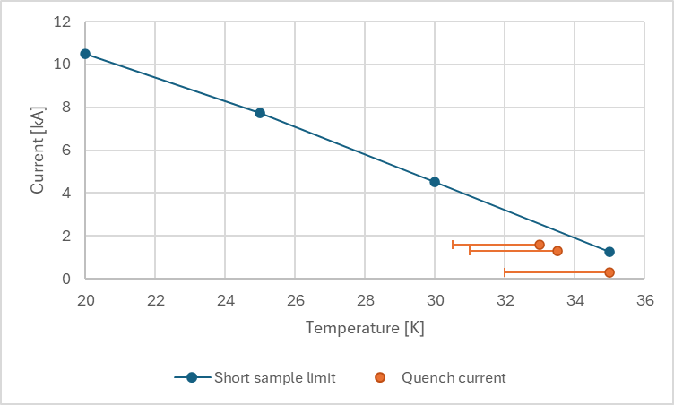
Technology development
Cable test for bending radius of 200 mm
Characterizing the cable with a bending radius of 200 mm, instead of the 300 mm used so far in the EESD demonstrator, would enable a more compact design for the SHiP spectrometer magnet coil and allow for more efficient routing of cables in the cold box or distribution box
View of the CAD 3 model and results of magnetic simulations
Test on the Diode test station:
Up to 35 K;
without background B field.
Testing was initiated but interrupted due to technical issues with the leads and expected discrepancies between the two temperature measurements.
First test results have been done
The test setup requires further improvements.
This is part of an ongoing learning process
aimed at better characterizing the behavior of the MgB₂ cable within the radial plate.
Courtesy of N. Bourcey, C. Chatron, and F. Mangiarotti
(CERN TE-MSC)
Courtesy of F. Mangiarotti (CERN TE-MSC)

Slide 15
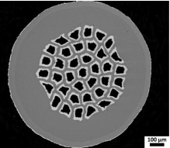
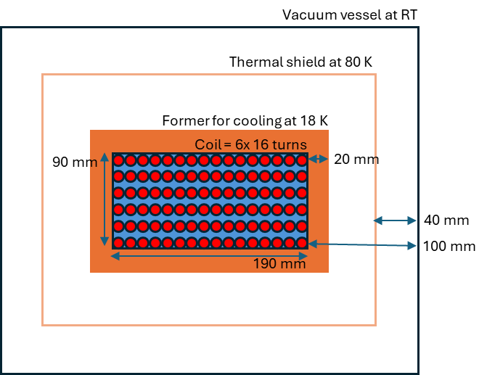
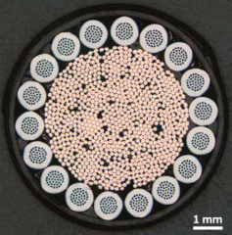
Procurement of MgB₂ strands
Estimation of the cable and strands needs for the project based on conceptual electromagnetic design V01:
Hypothesis for the calculation of the cable unit length:
Estimation of cable length for one coil based on current 3D magnetic simulations: 2200 m
2 +1 spare coils
1 double pancake (1/3 of coil) for prototyping margin
Must include winding margin
+ 10% twist pitch
+ 10% losses during cable production
18 strands per cable
The 28 km of strand has been ordered
MgB₂ wire for HL-LHC
superconducting link
(over 1000 km produced)
Unit length one coil for one double pancake | 750 | m
Number of double pancake : Three coils (2+1) x 3 + 1 prototype | 10
+ 10% twist pitch | 1.1
+ 10% cable prod. losses | 1.1
18 strands/cable | 18
Total | 162 | km
MgB₂ cable made from
18 MgB₂ strands twisted
around braided copper
core (available in
kilometric unit length)
Courtesy of A. Ballarino (CERN TE-MSC)
Simplified cross section of the coil and the cryostat

Slide 16
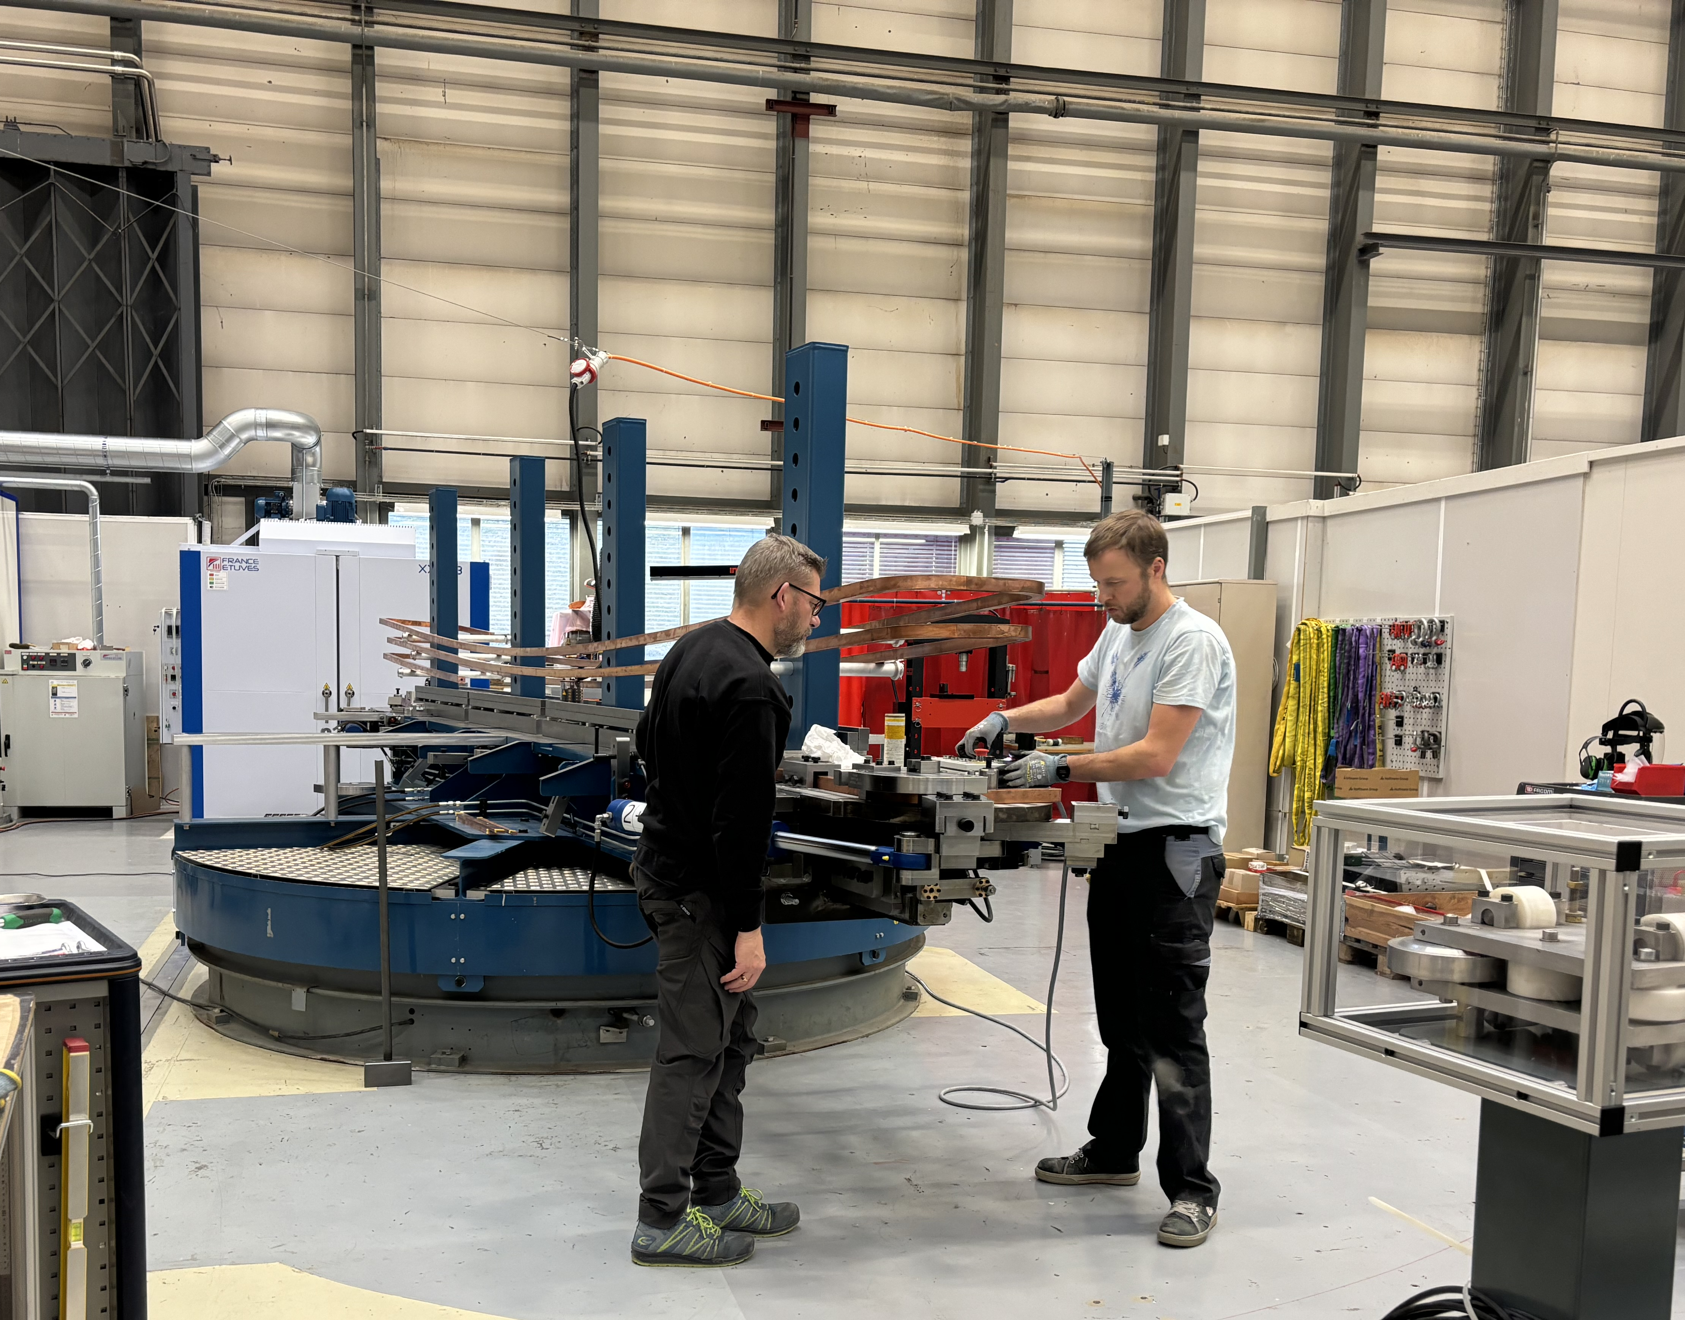
Construction strategy – first thoughts
Technology and Practical Feasibility
We are confident in our ability to manufacture the coil and magnet, benefiting from the knowledge, expertise, and support from CERN’s teams (MSC, EP experts, MME, Transport).
Participation from industry in the engineering design phase, including development of dedicated tooling, can be an option
Key Next Steps: Identify a suitable location for:
Coil winding
Cryostat assembly
Test bench installation
Preassembly of the full-scale system at the surface
Qualification campaign and production of the full-scale will be done at CERN
Winding machine operated in building 181, by TE/MSC-NCM, for the manufacturing of the resistive coils of the SPS MBB magnets (coil are 6.5 m long)

Slide 17
Conclusion on SHiP spectrometer magnet
Demonstrator:
Development a proof-of-principle demonstrator with scalable design and assembly processes for large, iron-dominated magnets in physics experiments ongoing:
Phase 1 (test in a cryogenic test station with LHe at 4.5 K) and Phase 2 (test in a cryogenic test station with GHe at 20-30 K) were successful. See more details in the presentation given at the 28th Collaboration meeting.
Phase 3 (test of indirect cooling using GHe circulating in capillaries with warm yoke, on the SM18 test station) Procurement of the mechanical components: on going Test expected in Q3 2025
Phase 4a (cooling by cryocoolers) to qualify a cooling architecture which will have to be extended to SHiP-size projects Phase 4b (powering as stand-alone by current leads) to qualify which will need to be specifically tailored for this application Tests expected in 2025-2026
Ongoing work on SHiP spectrometer magnet:
Conceptual design of SHiP hidden sector spectrometer magnet in progress: First iteration of electromagnetic design under verification by SHiP teams (Physics & technical infrastructures)
Prototype and full-scale system construction strategy is being established at CERN. No showstopper identified so far, however the two first years are critical: engineering design must progress efficiently in parallel with HL-LHC activities. Requirements and main parameters must be frozen Q1 2025.
The prototype will be a full scale cryostated coil which will be cooled done and powered as stand-alone on a test bench

Slide 19
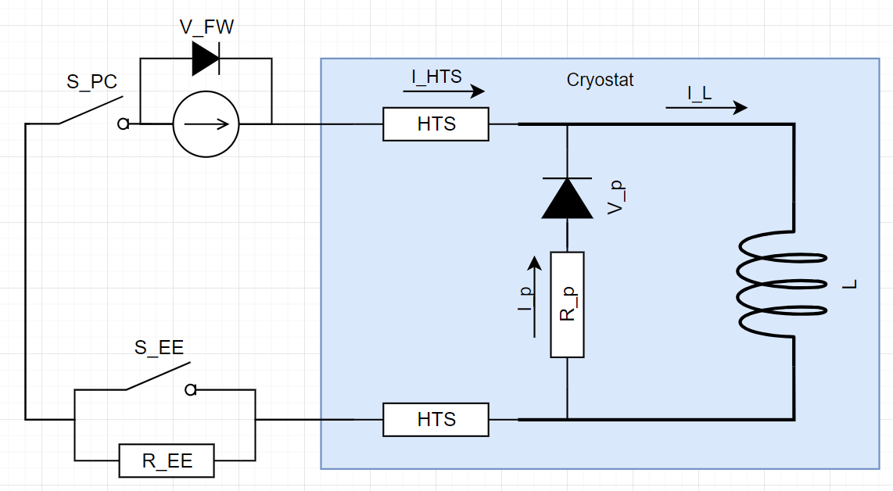
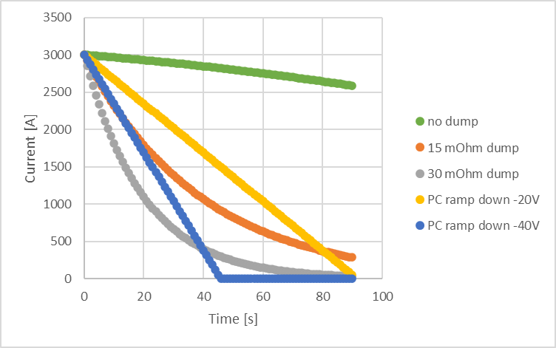
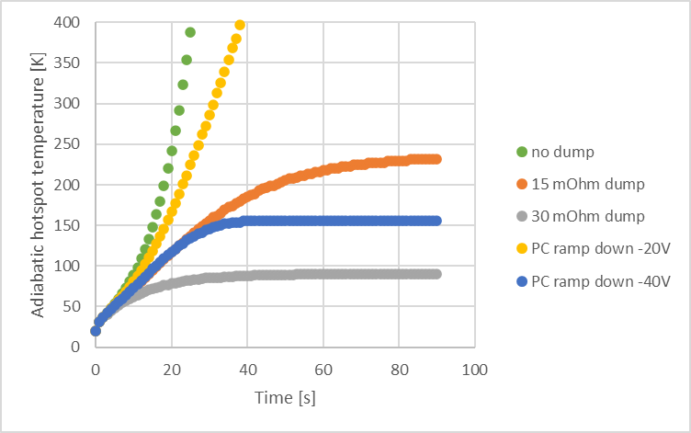
Magnetic design – Fist consideration on magnet protection
Courtesy of F. Mangiarotti (CERN TE-MSC)
SHiP spectrometer magnet protection
Thoughts about protection of HTS leads
The quench behavior of the EESD demonstrator has been analyzed and described (EDMS 2939340)
Quench protection studies based on the conceptual design of the SHiP spectrometer magnet are ongoing
Cold energy dump for protection of the HTS leads
Parameters:
R_EE = 30 mOhm
R_p = 100 mOhm
 | Magnet quench | HTS quench
max V_{L} | 70 V | 300 V
E_{dis} | 630 kJ (24%) | 2750 kJ (100%)
E_{ext} | 2100 kJ (76 %) | 0
T_{hotspot} | 120 K | 45 K
SHiP can not be self protected
but a ~30 mOhm dump seems enough (<100 K hotspot temperature)
To investigate: PC ramp down instead of dump (recover energy)
If the magnet quenches: open S_EE, extract most of the energy.
If the HTS leads quench: open S_PC, let the parallel resistor dissipate the magnet energy.
Quench detection
Co-winded cable for quench detection, already implemented in FCM magnet. It helps compensating for induce inductive voltage , so we can lower the detection threshold.
It will be tested in EESD phase 3.
No showstopper identified from the point of view of the protection of the system (magnet+ leads)
Feasibility of the cold dump to be checked
Quench propagation simulations

Slide 20
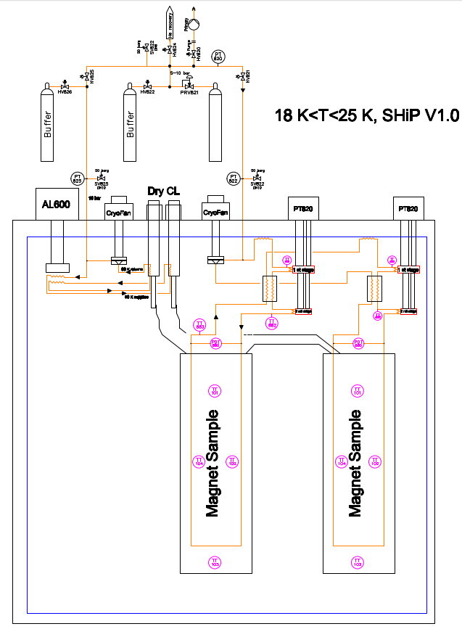
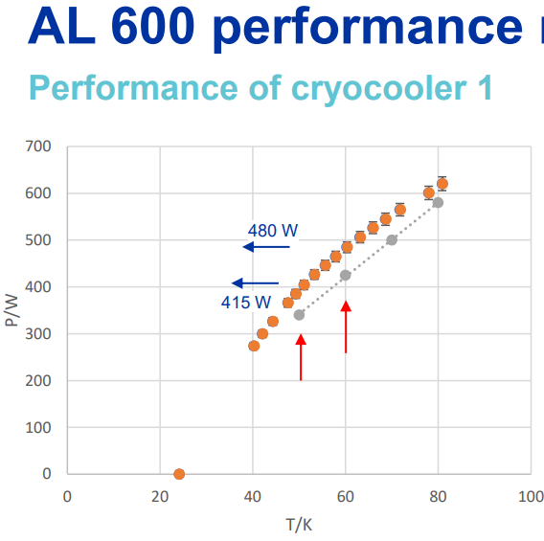
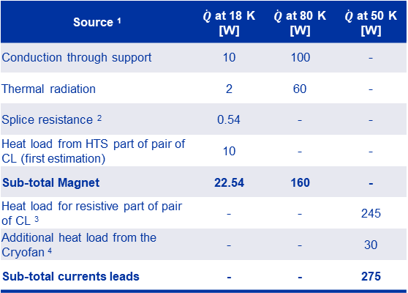
Cooling architecture by cryocoolers
Courtesy of P. Borges de Sousa,
T. Koettig (CERN TE-CRG)
Cryogenic study of novel cooling schemes: Updated values
Two separate circuits: Current leads & magnet
Highly efficient heat exchangers are been developed to be used in fluid circulation loop cooling of the current leads
Requirements for temperature of the magnet coldmass: 18 K (to keep a margin on the temperature of the cable expecting a gradient on such large coil)
Source ¹ | $\dot{Q}$ at 18 K [W] | $\dot{Q}$ at 80 K [W] | $\dot{Q}$ at 50 K [W]
Conduction through support | 10 | 100 | -
Thermal radiation | 2 | 60 | -
Splice resistance ² | 0.54 | - | -
Heat load from HTS part of pair of CL (first estimation) | 10 | - | -
Sub-total Magnet | 22.54 | 160 | -
Heat load for resistive part of pair of CL ³ | - | - | 245
Additional heat load from the Cryofan ⁴ | - | - | 30
Sub-total currents leads | - | - | 275
Preliminary hypothesis:
¹ Dynamic Heat Loads (beam induced effects + particle showers) not included
² 5 splices during winding 5x12 nOhm, at I= 3 kA
³ Pair of resistive CL Brass Cu60Zn40+ ReBCO, at I= 3 kA, Tcold= 60 K
⁴ High helium pressure loop with cold circulator (10 bars), 5 g/s
Several cooling architectures will be tested.
First estimations of heat loads seems compatible with the use of dry cooling by cryocoolers
Cryocooler AL600 tested in Cryolab
(would fit the needs for cooling of the current leads)
Cryocoolers that could be possibly used: 1 AL600 for current leads, electrical consumption: 13 kW
2 PT420 for cold mass and thermal shield: electrical consumption: 2x11 kW
Total electricity consumption: 35 kW

