Slide 1
DRD 8 WP1 status and plans
C. Gargiulo (CERN)
F. Palla (INFN Pisa)
DRD8 kick-off meeting
CERN, 31 January 2025

Slide 2
Two projects
The Vertex Region of Future Particle Physics Experiments
  Development of the next generation mechanics for advanced vertex layouts, including
    Curved and tilted silicon sensors
    Low radii vertex and retractable detectors
    Ultra-light, high-vacuum leak tight beam pipes and vessels
    Low mass hardware alignment systems for future vertex detectors
    Machine Detector Interface and impact on Detector
Robots in the HEP Experimental Caverns
  Development of robotic systems for future high energy physics experiments for inspection monitoring and first intervention for particle detectors even during the operation of beams
    Legged ground robotic platform in experimental cavern
    Aerial robotic platform in experimental cavern
    Mini-robots swarm and mobile mesh network

Slide 3
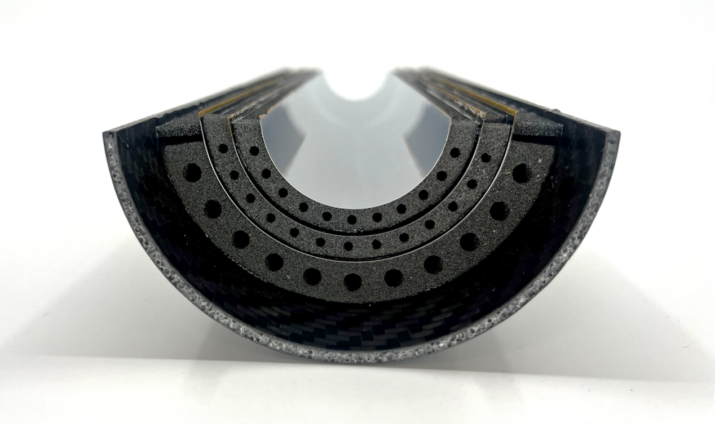
WP 1.1
Curved Sensors
Develop new wafer-scale curved silicon pixel chips to surround the beampipe and their carbon foam mechanical support. This concept has the potential to reduce the material budget and to bring the first detection layer closer to the interaction point.
Expertise at CERN within the context of the ALICE ITS3, and Strasbourg
Composite structures expertise (among others) in Bristol, Geneva, Liverpool and Oxford
Air-cooling integration is needed
Non-planar wire-bonding is required
Potential experiments: ALICE, FCC-ee, CEPC, EIC vertex detectors

Slide 4
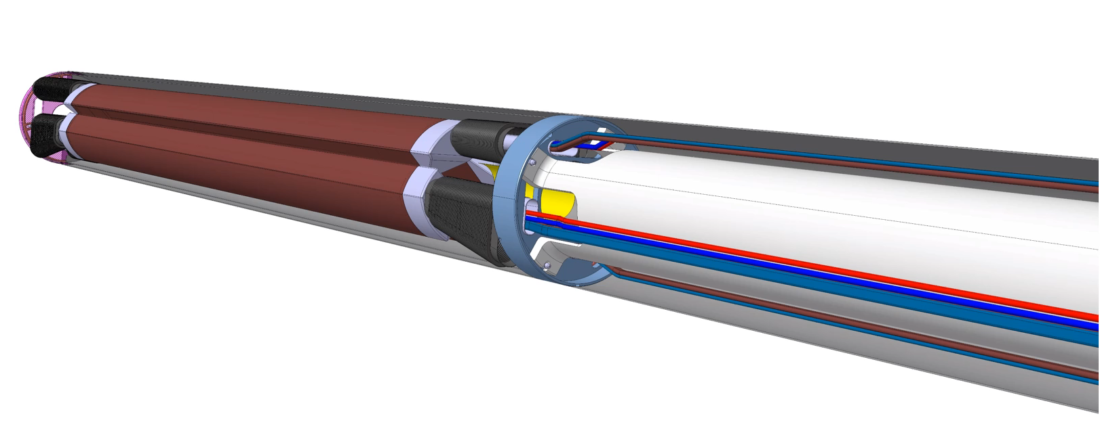
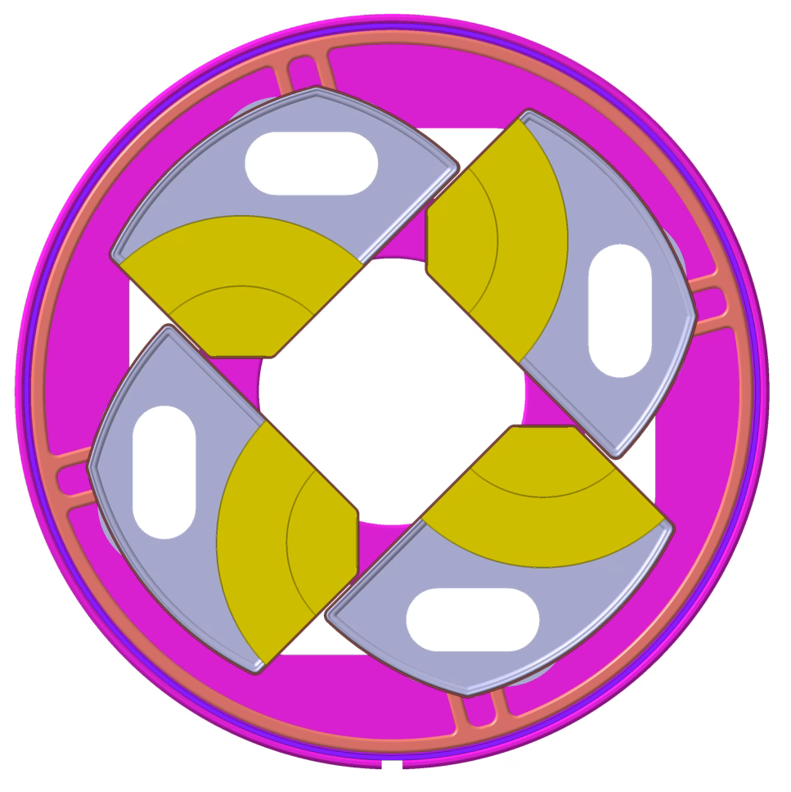
WP 1.1
Retractable Detectors
Development of a retractable Vertex Detector, inside the beampipe, positioning the first sensor layer as close as possible to the interaction point. Apertures, impedance and vacuum stability are key beam parametres and the Vertex detector petals has a direct impact on them.
Expertise at CERN within the context of the ALICE3
Nikhef with UHV
Accelerator experts feedbacks mandatory
Conductive cooling needed
Potential experiments: ALICE3, FCC-ee vertex detectors

Slide 5
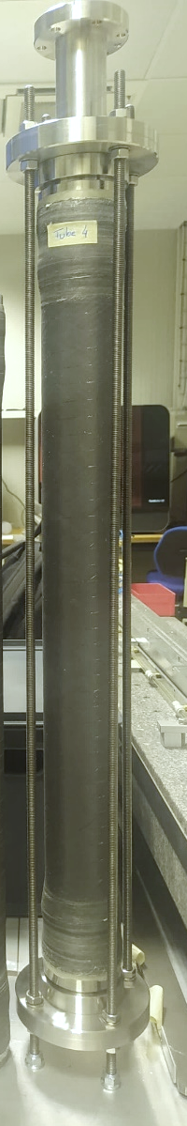
WP 1.1
Decrease material budget. Next CERN beryllium beampipe of a 16 mm inner radius and 0.5 mm wall thickness. Under study for FCC-ee one a 20 mm diameter and a double layer of 0.35 mm thick beryllium walls for cooling purposes. Retractable Vertex detector as well RICH detectors could also require ultrathin vacuum tight wall cases. To achieve wall impermeability R&D will focus on material like beryllium alloy, AlBeMet, and carbon composite.
Thin Beam Pipe
Expertise at CERN, Frascati and IHEP
Accelerator experts feedbacks mandatory
Cooling integration
Potential experiments: ALICE, FCC-ee, CEPC, EIC

Slide 6
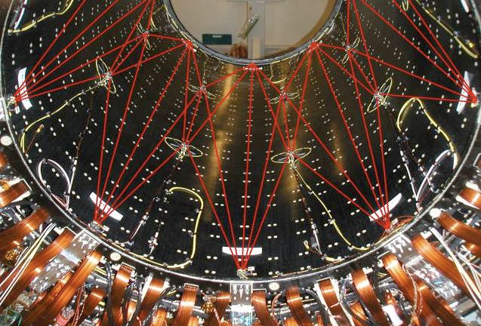
WP 1.1
Achieving the ultimate performance of a tracking detector ultimately often depends on the quality of its alignment. Especially weak degrees of freedom, often linked to the direction through the sensor thickness, can be limiting factors. Develop a solution to provide information that is complementary to that available through track-based alignment algorithms and that is low mass and radiation-hard.
Low mass hardware alignment systems for future vertex detectors
Expertise at CERN, Freiburg, GSI, IHEP
Potential experiments: ALICE, FCC-ee, CEPC, EIC

Slide 7
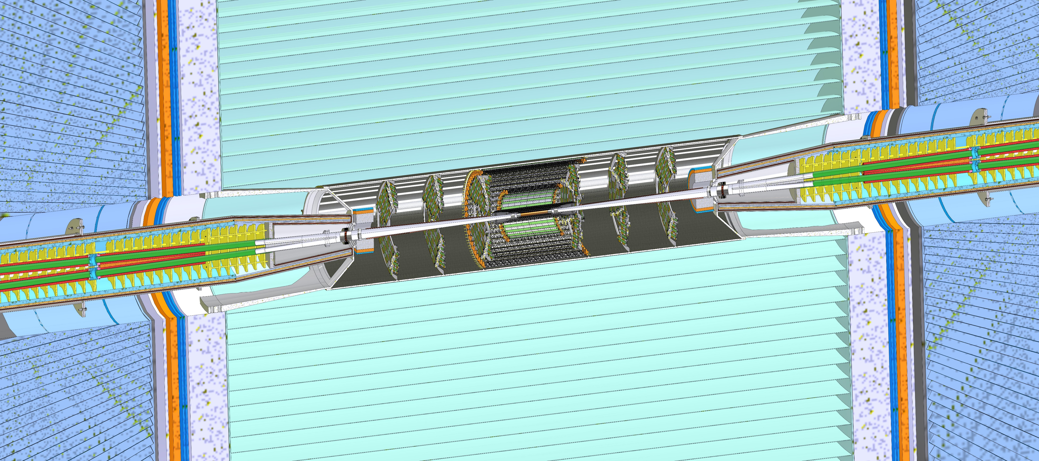
WP 1.1
Accelerator and Vertex Detectors Integration
Complex optics very close to the IR are needed to focalize the beam and achieve the high luminosity of the FCC-ee. The assembly of the detector must cope with tight requirements and allow the operations and maintenance.
Expertise widespread
Accelerator experts feedbacks mandatory – Frascati, CERN, IHEP
Potential experiments: ALICE, FCC-ee, CEPC, EIC

Slide 8
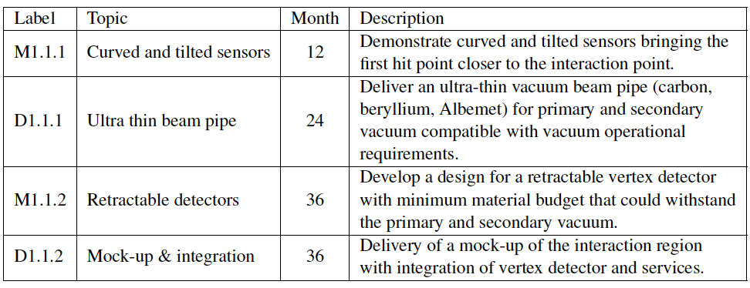
WP 1.1 – deliverables and milestones
Need to discuss who is contributing – intermediate check points?

Slide 9
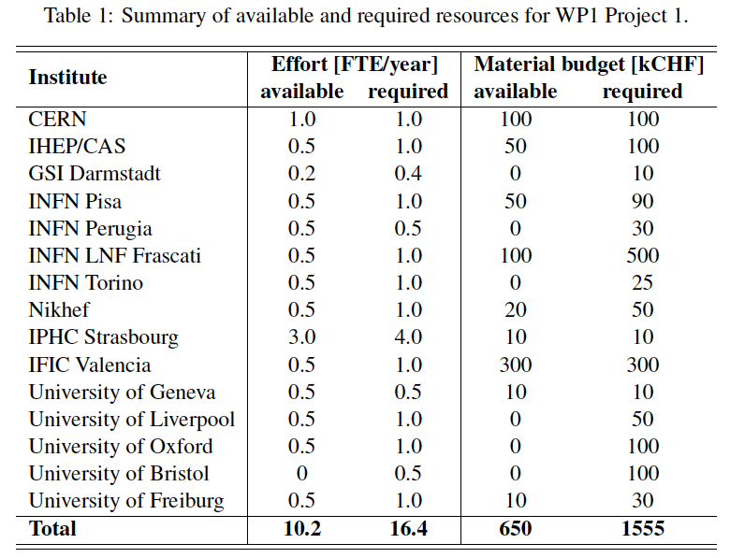
WP 1.1 – Resources
Need to be revisited by the Institutes contact persons
Needs 60% more FTE and 140% more material budget to accomplish the tasks

Slide 10

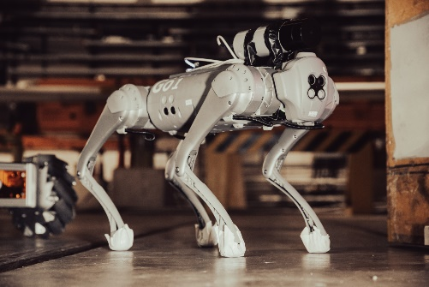

WP 1.2
Develop legged ground robotic platforms for the autonomous and on-demand inspection, patrolling all the walkable areas. These robots are characterized by a high payload, allowing them to be equipped with a wide variety of sensors, and an enhanced mobility, which makes them suitable to operate inside detector cavern.
Legged Ground Robotic Platform
Expertise at CERN, Rome, Arizona U.
Magnetic shielding of actuators
Simulation of virtual environment

Slide 11
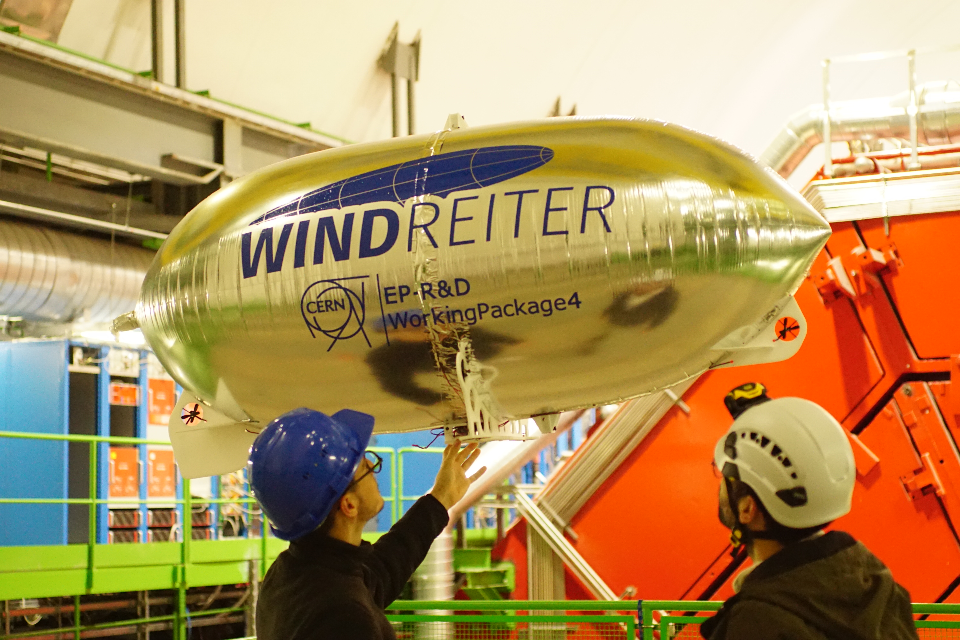
WP 1.2
Robotic Airship
Develop Lighter than Air Unmanned Aerial Vehicles (LtA UAV), such as blimps, to provide a 3D environmental mapping of the background magnetic field and radiation dose of the whole cavern volume by employing a custom lightweight payload. Blimps are harmless solutions for the detector equipment in case of failure.
Expertise at CERN, Rome, Arizona U.
Magnetic shielding of actuators
Simulation of virtual environment

Slide 12

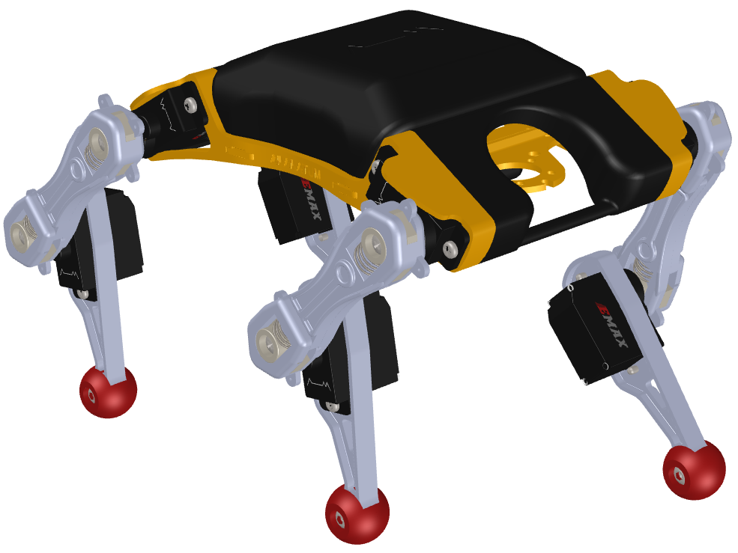



WP 1.2
Mobile Mesh Network
Investigates the use of a swarm of mini robots to inspect tight and cluttered confined spaces, spotting leaks and anomalies among the intricate detector services. A mobile ad-hoc mesh network that guarantees an uninterrupted communication within the swarm has to be developed to ensure that information originating from the deepest robot inside the experiment can reach the external one.
Client
Node
Gateway Node
Expertise at CERN, Rome, Arizona U.
Magnetic shielding of actuators

Slide 13
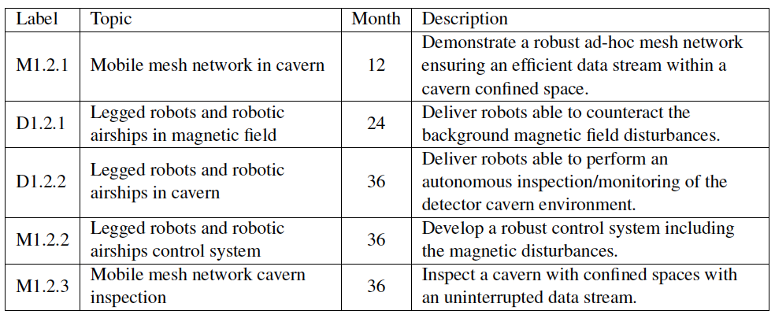
WP 1.2 – deliverables and milestones
Need to discuss who is contributing – intermediate check points?

Slide 14
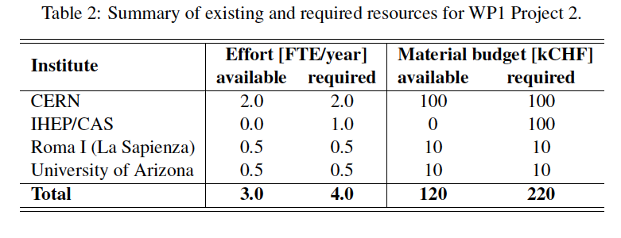
WP 1.2 – Resources
Need to be revisited by the Institutes contact persons
Needs 30% more FTE and 80% more material budget to accomplish the task

Slide 15
How to move forward?
March/ April – Organize a first meeting to establish a strategy for success based on:
  Status of already running activities at different Institutes
  Institute commitment in the different activities
    Consider to setup working groups
  Feedbacks on Institutes requests to the FA
  Assessment on the need to increase the FTE and material budget to accomplish the tasks
    May need to have in place the MoU?
  Assessment, alternatively, which activities can be pursued and what is the descoping strategy (if needed)?
June - Finalize a credible plan with clear commitment of the different Institutes in each WP to be presented at Bristol Forum
Follow up meetings every ~6 months.

