Slide 1
Kick-off meeting
DRD8 Collaboration
January 31, 2025
Burkhard Schmidt and Georg Viehhauser

Slide 2
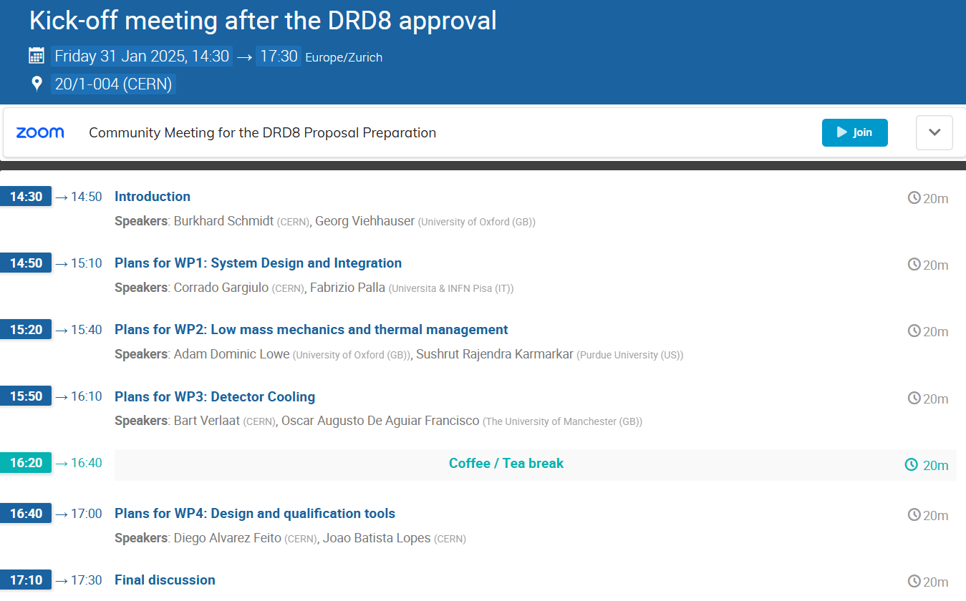

Slide 3
Introduction - DRD8 Collaboration
The DRD8 Proposal on Mechanics & Cooling for Future Vertex and Tracking Systems has been approved by the CERN Research Board on December 4.
Following the approval, DRD8 is now appearing in the Greybook for the CERN Experimental Programme, which simplifies affiliation of collaborators to CERN: https://greybook.cern.ch/researchProgram/detail?id=R%26D.
An Indico category has been created: https://indico.cern.ch/category/19408/, in which we will have sub-categories for the different Work Packages of DRD8 etc., so that all the information is centrally available.
The web-page for DRD8 has as well been created: https://drd8.web.cern.ch/. Feedback is welcome! Write access will be given to the WP conveners to add information for their Work Package as desired.
The next major task is the preparation of the Memorandum of Understanding for DRD8.

Slide 4
DRD8 Work Packages
Proposed Work Packages:
WP1: Global system design and integration
  Project 1.1: The Vertex Region of Future Particle Physics Experiments
  Project 1.2: Robots in the HEP Experimental Caverns
WP2: Low-mass mechanics and thermal management
  Project 2.1: Advanced Mechanical Tracker Structures
  Project 2.2: Characterisation of Material Properties and Database Development
WP3: Detector cooling
  Project 3.1: New Evaporative Cooling Fluids and Systems
  Project 3.2: Microchannel Cooling Substrates
WP4: Design and qualification tools
  Project 4.1: Extended Reality (XR) Development
  Project 4.2: Connection of Engineering Design Tools with Physics Simulation Software

Slide 5
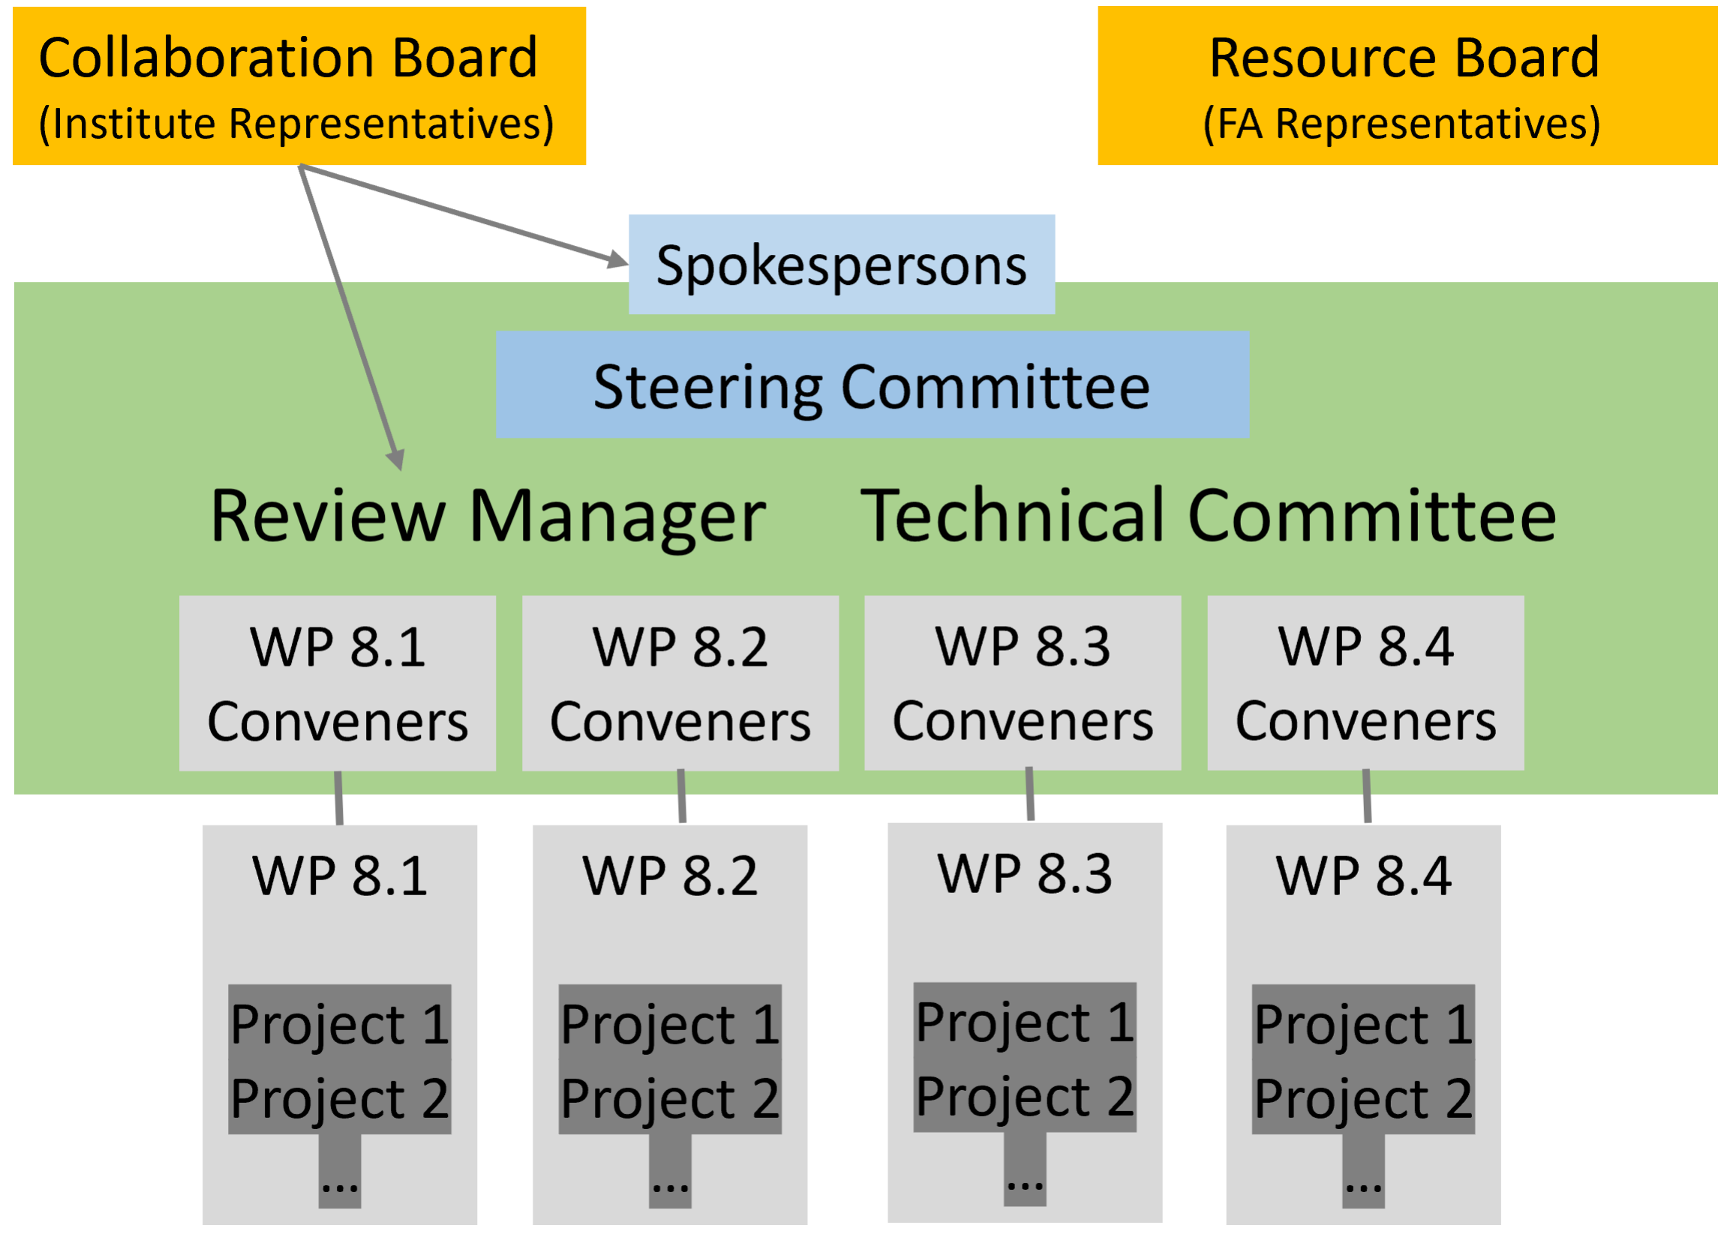
DRD8 Technical Committee
Endorsed Work Package Conveners:
WP1: Global system design and integration
  Corrado Gargiulo (CERN)
  Fabrizio Palla (Universita & INFN Pisa (IT))
WP2: Low-mass mechanics and thermal management
  Adam Dominic Lowe (University of Oxford (GB))
  Sushrut Karmarkar (Purdue University (US))
WP3: Detector cooling
  Bart Verlaat (CERN)
  Oscar Augusto De Aguiar Francisco (Manchester (GB))
WP4: Design and qualification tools
  Diego Alvarez Feito (CERN)
  Joao Batista Lopes (CERN)
We will soon start to meet as Technical Committee, also in view of the Collaboration week in June

Slide 6
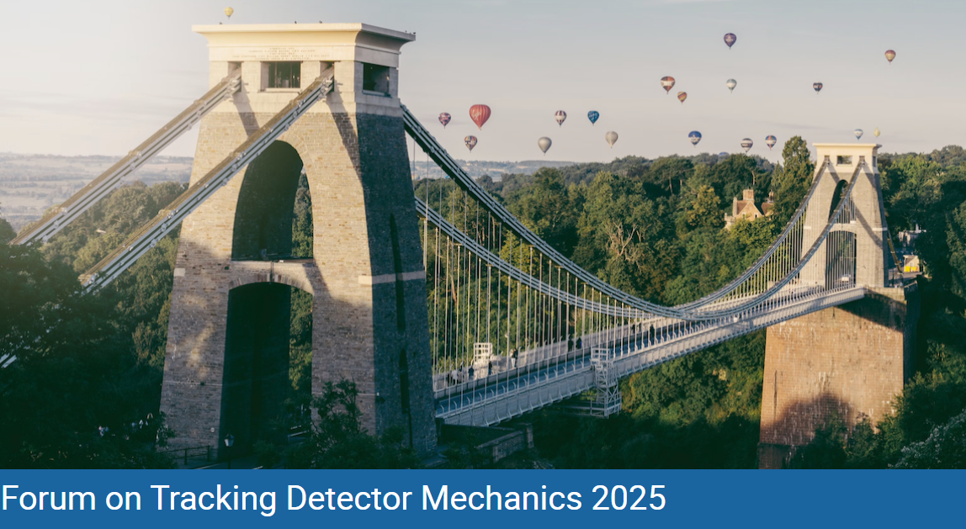
DRD8 Collaboration Week 2025
16-20 June 2025, University of Bristol
https://indico.cern.ch/event/1482847/

Slide 7
DRD8 Collaboration Week 2025
16-20 June 2025, University of Bristol
https://indico.cern.ch/event/1482847/
The week will start with the Forum on Tracking Detector Mechanics (Monday to Wednesday), including (composite) lab visits on Wednesday afternoon, followed by the DRD collaboration meeting (on Thursday and Friday).
We consider to have both Plenary and Parallel Sessions for the DRD8 meetings to give more time for discussion among the people active in each Work Package.
We plan to have a few invited speakers.

Slide 8
Memorandum of Understanding (MoU) for the DRD collaborations
MoU Core Part → Common to all DRDs
  This part is (still) being finalized by Helge Meinhard from CERN, taking into account the feedback received from some of the large national Funding Agencies. It underwent several iterations since June 2024.
MoU Annexes → Specific of each DRD
  This part should be prepared by us in the coming weeks, so that the approval process can be launched in the coming months.

Slide 9
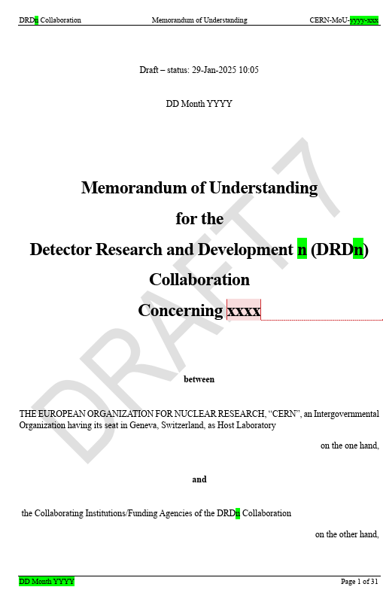
List of Articles (Core part)
Article 1 Purpose of the MoU
Article 2 Parties to the MoU
Article 3 Obligations of CERN as Host Laboratory
Article 4 Obligations of the Collaborating Institutions
Article 5 Equipment
Article 6 Structure of the Collaboration
Article 7 Collaboration Accounts
Article 8 Work Packages, Working Groups and other Work Entities
Article 9 Theses, Publications and Conference Contributions
Article 10 Intellectual Property
Article 11 Compliance with Export Control and Sanctions
Article 12 Conflicts of Interest
Article 13 Industrial Partners
Article 14 Observance of the MoU and the General Conditions
Article 15 Duration of Validity of the MoU and its Extension
Article 16 Withdrawal and Termination of Participation of Funding Agencies or Collaborating Institutions
Article 17 Participation of Additional Institutions
Article 18 Amendments and Annexes
Draft 7 was released yesterday with very minor changes in the Core part

Slide 10
List of Annexes
Annex 1 Collaborating Institutions and their Contact Persons
Annex 2 Funding Agencies and their Representatives
Annex 3 Sub-Detector Structure and Technical Participation of the Collaborating Institutions
Annex 4 The Organisational Structure of the Collaboration
Annex 5 Overview of the Financial Participation of the Funding Agencies
Annex 6 Specific Obligations and Responsibilities of CERN as the Host Laboratory of the DRDn Collaboration
Annex 7 Work Packages
Annex 8 Working Groups
Annex 9 Other Work Entities
Annex 10 Included Background IP
Annex 11 Conflict of Interest Disclosure Form
Annex 12 CERN General Conditions Applicable to Experiments

Slide 11
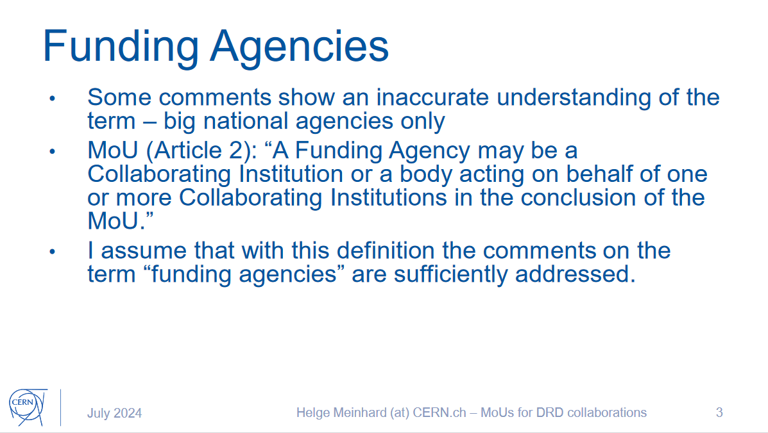
Annex 2: Funding Agencies and their Representatives
Funding Agencies signing the MoU are not necessarily the same as the Funding Agencies listed in the Work Packages.
The list of those FAs signing the MoU needs to be established.
It would be important to start contacting the FAs and ask for the required financial support!

Slide 12

Annex 5: Overview of the Financial Participation of the FAs
This Annex does not concern Work Package resources – only Common Fund
At this stage, DRD8 doesn’t foresee to have a Common Fund.
However, we are open for discussion on this point.
Examples for the use of Common Funds:
Support for Collaboration Meetings
Common Projects
Investment in common activities
Support for Common Facilities (Laboratories)
…

Slide 13
Annex 6: Specific Obligations and Responsibilities of CERN as the Host Laboratory of the DRDn Collaboration
  6.1 Irradiation Facilities
Access for members of the DRD8 Collaboration to CERN irradiation facilities.
  6.2 Laboratories
Access for members of the DRD8 Collaboration to laboratories at CERN such as Metrology, Composite Lab is possible. However, most of the CERN services are subject to a fee and access to the facilities is limited.
  6.3 Computing Resources
Access for members of the DRD8 Collaboration to CERN Computing resources in terms of processing, storage and software.

Slide 14
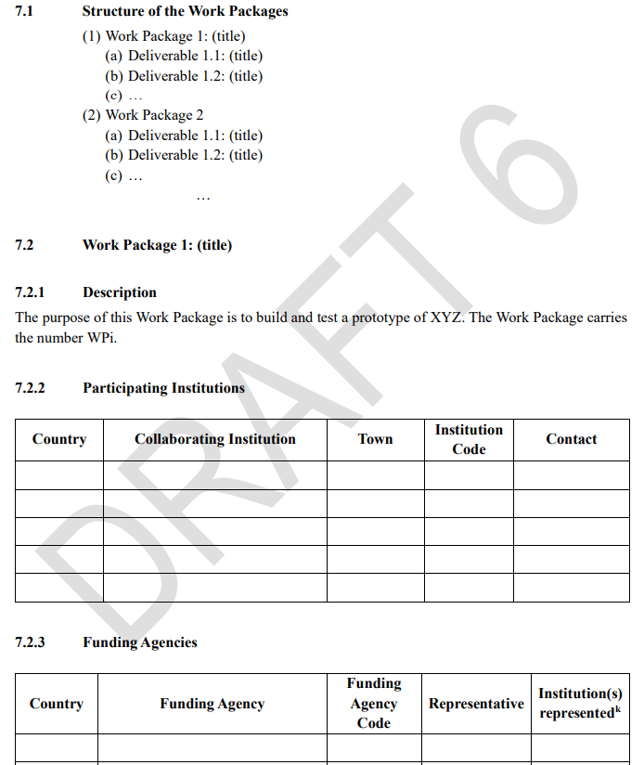
Annex 7 : Work Packages
Annex 7 with the description of the DRD
specific WPs and related Deliverables is
the most important Annex of the MoU.

Slide 15
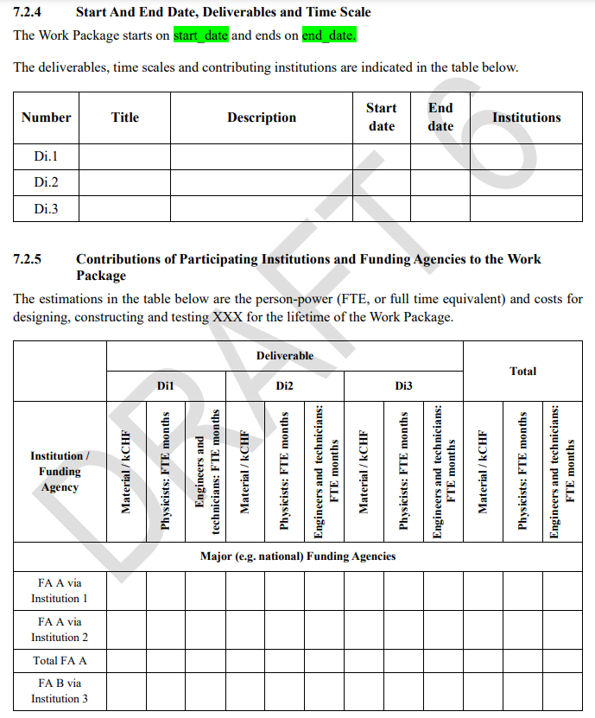
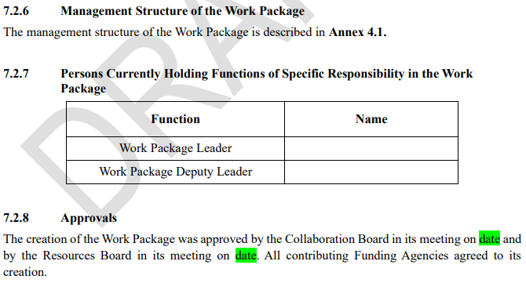
Annex 7: Work Packages
To some extent it is up to us to decide which
level of information we include in Annex 7.
We should avoid to complicate/delay the signature of the MoU.
Can be changed
Can be changed

Slide 16
Annex 8: Working Groups
DRD8 has a present no Working Groups
However, should the resources to realize the Work Packages not
become available at the required level, we might transform a
Work Package into a Working Group.

Slide 17
Summary and timeline
Core MoU:
  To be released soon…
  CERN and ECFA Detector Panel are working on it
  It is not clear whether there will be another DRD Managers Forum (DRDs SPs, ECFA Detector Panel, CERN) before the Core MoU will be released.
Annexes:
  A version of the DRD8 Annexes, in particular Annex 7, will be prepared in the coming weeks to be discussed in a CB meeting early March.

