Slide 1
IUPAP - Commission 11
Particles and Fields
Marcelo Munhoz
Universidade de São Paulo
Brazil

Slide 2
International Union of Pure and Applied Physics
IUPAP is the only International Scientific Union dedicated to all areas of physics
  It is run by physicists from all fields and continents
  The union is a network of networks, a network of communities
Mission: To assist in the worldwide development of physics, to foster international cooperation in physics, and to help in the application of physics toward solving problems of concern to humanity
Created in 1922 with 13 country members (Belgium, Canada, Denmark, France, Holland, Japan, Norway, Poland, Spain, Switzerland, UK, USA, South Africa), it now has about 60 territorial members representing identified physics communities from all regions

Slide 3
Members
Territorial Members
  IUPAP territorial members are representatives of identified physics communities across the world. There are currently 60 territorial members.
Corporate Associate Members
  They are commercial companies or international research organizations that have a special relationship with the field of physics or scientific research
Associate Territorial Members
  Relatively small national physics communities from developing territories. This category is established to facilitate a first step towards full territorial membership. Associate Territorial Members must commit to grow its physics activities and community. IUPAP will monitor this progress over a three-year period, renewable for however long it takes to bring the territory to a level where it can realistically join IUPAP as a regular Territory Member
Personal Members
  These are Ex-Officio members comprising only the Chairs of IUPAP Commissions or Affiliated Commissions

Slide 4
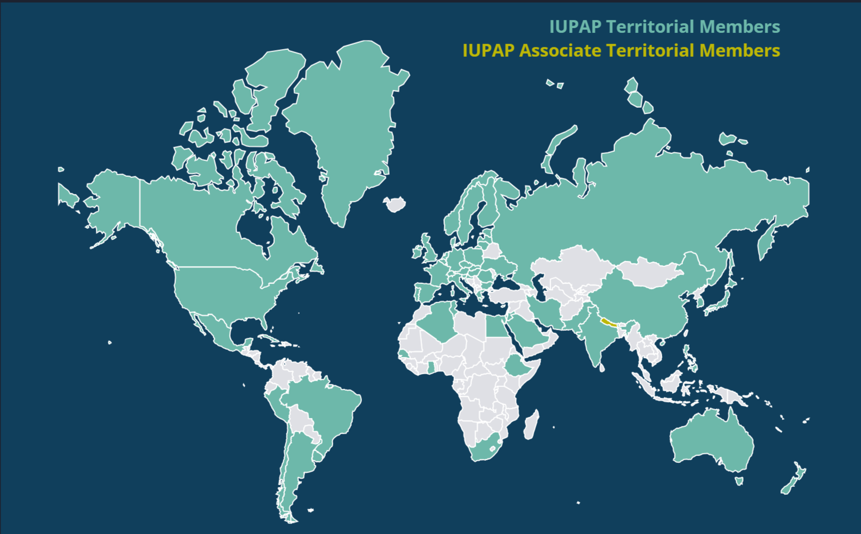
Members

Slide 5
Internal Organization
The Union is governed by its General Assembly which meets every three years
The Council is its top executive body, supervising the activities of specialized International Commissions, Affiliated Commissions and Working Groups.

Slide 6
General Assembly
Liaison Committees (representing territorial members)
  Voting rights that depend on the number of units they pay
  National Academies of Sciences (typical of oldest IUPAP members)
  National Physical Societies
Corporate Associate Members
  No voting rights but pay units
Chairs of Commissions and Affiliated Commissions
  Voting rights
Official Observers
  Strengthen our liaisons with regional physical societies and other international scientific organizations

Slide 7
Executive Council
An Executive Council (the Council) oversees and administers the activities of the Union between General Assembly meetings
  It normally meets at least once per year and every three years for the General Assembly.
The Council is composed of the President, President-Designate, ten Vice-Presidents, the Secretary-General and the Associate Secretary-General, all elected by the General Assembly, plus the immediate Past President
  At least one of the members shall be from a developing country
  The term of office of Councillors normally begins and ends at the end of each General Assembly
  Five of the Vice-Presidents shall be elected at large and five Vice-Presidents shall be elected from among the Chairs of the Commissions.

Slide 8
Commissions
C1: Policy & Finance
C2: Symbols, Units, Nomenclature, Atomic Masses and Fundamental Constants
C3: Statistical Physics
C4: Astroparticle Physics
C5: Low Temperature Physics
C6: Biological Physics
C8: Semiconductors
C9: Magnetism
C10: Structure and Dynamics of Condensed Matter
C11: Particles and Fields
C12: Nuclear Physics
C13: Physics for Development
C14: Physics Education
C15: Atomic, Molecular, and Optical Physics
C16: Plasma Physics
C17: Laser Physics and Photonics
C18: Mathematical Physics
C19: Astrophysics
C20: Computational Physics

Slide 9
Affiliated Commissions
AC1: International Commission for Optics
AC2: Iternationnal Commission on General Relativity and Gravitation
AC3: International Commission for Acoustics
AC4: International Commission on Medical Physics
AC5: Affiliated Commission of Physics Students
AC6: Affiliated Commission on the History and Philosophy of Physics

Slide 10
Working Groups
WG1: International Committee for Future Accelerators
WG5: Women in Physics
WG7: International Committee on UH Intensity Lasers
WG9: International Cooperation in Nuclear Physics
WG11: Gravitational Wave International Committee
WG13: Newtonian Constant of Gravitation
WG14: Accelerator Science
WG15: Soft Matter
WG16: Physics and Industry
WG17: IUPAP’s Centenary
WG18: Ethics
WG19: Quantum Science and Technology
WG20: Open Science
WG21: Physics for Climate Change Action and Sustainability

Slide 11
IUPAP Aims
Assist in the worldwide development of physics and promote physics as an essential tool for development and sustainability;
Engage in the strengthening and improvement of physics education, particularly in developing countries;
Increase diversity and inclusion in physics, enhancing the participation and recognition of women and of people from underrepresented groups;
Foster international cooperation and sponsor suitable international physics meetings;
Promote the free circulation of scientists and the open access to data;
Enhance the vital role of early career physicists and physics students;
Strengthen the links with physicists working outside academia and with other scientific communities;
Uphold openness, honesty and integrity in the practice, application and promotion of physics;
Promote international agreements on symbols, units, nomenclature and standards

Slide 12
IUPAP Aims
It is not possible to advance all of them equally well given our current structure and budget. This is one of the reasons why the EC decided to start a process that hopefully will lead to the rejuvenation of the Union, to increase its visibility and the impact of its actions
How do we relate with individual physicists?
  This is a challenge: there might be too many layers between IUPAP and individual physicists
Very hard to reach out to physicists outside academic or research institutions (the Corp Associate Member category was created to increase these relations)
Commissions, ACs and WGs are key to relate to physicists. They mainly do it through the activities they supervise/organize: international conferences and awards. Hopefully you will get involved in other activities as well!

Slide 13
C11 - Mission
Article 1
To promote the exchange of information and views among the members of the international scientific community in the general field of Particles and Fields including:
  The theory and experiment concerned with the nature and properties of the fundamental constituents of matter and the forces acting between these constituents;
  The maintaining of liaison with ICFA;
  The accelerators, detectors and techniques used in these investigations;
  The industrial applications of relevant technologies.
Article 2
To recommend for Union sponsorship international conferences which qualify for support under Union regulations.
To initiate such conferences as their need arises from the evolution of the Commission field.
To assist in the organization of such conferences when practical. To ensure the compatibility of international conferences in its field and to discourage clashes and incompatibility of dates.
Article 3
To promote the free circulation of scientists; to assist conference organizers in ensuring such free circulation and in resolving potential infringements

Slide 14
C11 - Mission
Article 4
To organize where feasible the award of medals or other testimonials of excellence in its field.
Article 5
To publish where feasible newsletters, circulars, occasional books, journals or handbooks in its area.
Article 6
To maintain liaison with other IUPAP Commissions, with the Commissions or Committees of other Unions or of the International Council of Scientific Unions (ICSU) or other scientific organizations, with a view to collaborating and cooperating in sponsoring joint conferences and to participating in joint projects when need arises.
In particular to maintain close liaison with the General Commissions of IUPAP (SUNAMCO, Physics Education and Development), so as to ensure suitable input from its field into these physics-wide activities.
Article 7
To make available to each General Assembly of the Union a summary of activities and progress in its field since the previous Assembly.

Slide 15
C11 - Members
Officers
Chair: Marcelo Gameiro Munhoz
Vice–Chair: Isabell Melzer-Pellmann
Secretary: Liangjian Wen
Associate Members
Deepak Kar
Deywis Moreno
Oliver Stelzer-Chilton
Members
Nicole Bell
Barbara Clerbaux
Jana Bielčíková
Shaaban Khalil
Lydia Iconomidou-Fayard
Sandip Trivedi
Atsuko Ichikawa
Roman Pasechnik
Franz Muheim
Joel N. Butler
Richard Lednicky

Slide 16
What is expected from the people serving on the various structures of IUPAP?
Help the Union by carrying out the usual tasks
Contribute to enhance the impact and visibility of IUPAP collaborating with other efforts, e.g., outreach, communication and initiatives such as the International Year of Quantum Science and Technology and the International Decade of Sciences for Sustainable Development.
IUPAP has been doing a great effort to liaise with physicists outside academia and with companies. Helping with these efforts would be most valuable!
Contacting new possible IUPAP members or engage members that lately have been less active would be very valuable as well.
Nurturing/promoting the sense of community belonging is very important.
Participating in the processes to define the creation of new Commissions or Working Groups or redefine existing ones.
Helping us explore possibilities of obtaining additional funding that would allow us to expand our support staff would be very desirable.
Finally, bringing in new ideas or giving input to advance with the rejuvenation process is more than welcome!

Slide 17
C11 - Proposed Organization for this mandate
Make sure all our responsibilities are fulfilled making then very clear
  Definition of C11 areas of responsibility
Assignment of a C11 member to take care of each of these responsibilities
Administration:
  Mailing list: IUPAP-C11-Members@cern.ch
  Repository: https://cernbox.cern.ch/s/ajjONueJOOFJ4wm
Regular meetings
  Remote (every 3 months?)
  Hybrid (LP-Madison in 2025, ICHEP-Brazil in 2026 and LP-Shangai in 2027)

Slide 18
C11 - Responsibilities
Conferences
Awards
Reports
Fundamental Particle Physics
  Theory
  Experimental
Instrumentation
Future accelerators
Industrial applications
IUPAP Commissions Liaison
Free Circulation
Communication
Regional Particle Physics Associations Liaisons
  Western Europe
  Eastern Europe
  North America
  Latin America
  Sub Saharan Africa
  Middle East and North Africa
  East Asia
  South and South East Asia
  Oceania

Slide 19
C11 - Responsibilities
Conferences: Categories
Amount granted:
  Type A: CHF 8,500.00
  Type B: CHF 6,000.00

Slide 20
C11 - Responsibilities
Conferences: Selection Criteria
Scientific Value and Composition of Organizing Committee:
  Justification to continue a series and, for new conferences, a clear statement of purpose on the relationship with existing conferences. Advisory and Program Committee members should be experts.
International Character and Accessibility:
  Only international conferences are considered for sponsorship. They must have a fairly representative international advisory committee. If a series, the conference must move amongst countries and continents. Participation should be genuinely international.
Free Circulation of Scientists:
  The free circulation of scientists for scientific purposes is a major piece of IUPAP policy. The principle of the Universality of Science is fundamental to scientific progress. This principle embodies freedom of movement, association, expression and communication for scientists, as well as equitable access to data, information and research materials.

Slide 21
C11 - Responsibilities
Conferences: Selection Criteria
Inclusion of Women:
  It is the policy of IUPAP that all IUPAP sponsored conferences must include women on the organizing and program committees and as invited speakers. The application should include a list of the program committee with evidence that women are included, and the numbers of women invited speakers should be recorded in the conference report.
Encourage Conferences to have Affordable Category of Registration Fee:
  Recommended affordable registration fee for 2025: 300 CHF
Harassment
  IUPAP insists that all participants at IUPAP conferences should be able to enjoy the conference and its benefits free of discrimination and harassment. To emphasize this policy and to indicate that remedies are available to those who are harassed or discriminated against, all IUPAP supported conferences are required to publish the following statement on their website and in all publications related to the Conference.

Slide 22
C11 - Responsibilities
Conferences: Rules
IUPAP Conferences are supported either by Financial sponsorship, or through Endorsement
To ensure that a conference is considered for IUPAP sponsorship in time, requests must be made before June 1 of the year preceding the date of the proposed conference. The request must include all required information as indicated on the application form
Physical Locations within IUPAP member nations to be given priority as conference hosts. Online and internet-based platforms should be fairly accessible to the wider community
IUPAP support to be given to best and most deserving conferences, previous funding not a guarantee for future support
Conference fees should be stated, requested amount should not exceed IUPAP limit
Travel grants should be used to support physicists from developing countries
Presence of women on LOCs and as invited speakers a condition for IUPAP support (10% Minimum)

Slide 23
C11 - Responsibilities
Conferences: C11 (2025)
Type A
  32nd International Symposium on Lepton Photon Interactions at High Energies (ISLPIHE-2025)
Type B
  International Conference on Large Hadron Collider Physics (LHCP25)
Type C
  Higgs Hunting 2025 (Higgs-2025)
  European Physical Society Conference on High Energy Physics (EPS-HEP-2025)

Slide 24
C11 - Responsibilities
Conferences: C11 (beyond 2025)
Type A
  43th International Conference on High Energy Physics (ICHEP2026), July-August, 2026, Natal, Brazil
  32th International Symposium on Lepton Photon Interactions at High Energies (LP2027), Shanghai, China
  44th International Conference on High Energy Physics (ICHEP2028), Bangkok, Thailand
  Start discussions about LP 2029?
Type B
  International Conference on Technology and Instrumentation in Particle Physics (TIPP-2026), Mumbai, India
Type C
  We should encourage for applications, mainly regional Particle Physics conferences

Slide 25
C11 - Responsibilities
Awards
Early Career Scientist (former Young Scientist) Prizes
Recognize the contributions of early career physicists within the subfields of each Commission.
Successful candidates will have up to 8 years of research experience following Ph.D. (excluding career interruptions).
C11 give two awards every two years
The award consists of a certificate, medal and a monetary amount
A presentation by the awardees will take place at an international conference sponsored through the commission
Always aim for an inclusive process
We need to organize the 2026 ECSP starting this year

Slide 26
C11 - Responsibilities
Reports
  Chair (with your help)
Fundamental Particle Physics, Instrumentation and Industrial applications
  Produce very brief reports on these subjects indicating documents that describe the nature, aim and status of these activities in Particle Physics
  Other ideas?
Future accelerators
  Liaison with ICFA

Slide 27
C11 - Responsibilities
IUPAP Commissions Liaison
  Make sure we keep contact with relevant (for us) commissions
    C4: Astroparticle Physics
    C12: Nuclear Physics
    C13: Physics for Development
    C14: Physics Education
    C20: Computational Physics
    Others?
Free Circulation
  Watch for this aspect mainly in C11 supported conferences
  Other ideas?

Slide 28
C11 - Responsibilities
Communication
  We should assume the role of IUPAP ambassadors
  Seek for possibilities to advertise IUPAP during conferences you attend
  Approach organizers of regional or national general conferences to include IUPAP advertisement
  Other ideas?
Regional Particle Physics Associations Liaisons
  Effort to reach Particle Physicists directly (one of IUPAP challenges)
  Appoint at least one C11 member as the contact person in each global region
  Promote activities with regional or national organizations to improve the communication between Particle Physicists and IUPAP (C11)

Slide 29
C11 - Responsibilities
Regional Particle Physics Associations Liaisons
  Western Europe
  Eastern Europe
  North America
  Latin America
  Sub Saharan Africa
  Middle East and North Africa
  East Asia
  South and South East Asia
  Oceania

Slide 30
C11 - First demands to discuss
Support letter on behalf of the HEP information infrastructure for the ESPP
  First discussion with CERN Library Service people
  Deadline in March
  Volunteers to help?
Provide support for WG-1 (ICFA)
  It is requested that WG1, WG7, WG9, WG11, WG14, WG18 and WG21 consider the recommendations, considerations and suggestions included in the external and internal evaluation reports and in the supplementary material of this resolution and present by May 31st, 2025, a proposal to the Executive Council with a recommendation of how the activities of the Working Group should continue. To this end they should liaise with relevant IUPAP Commissions as needed.

Slide 31
C11 - First demands to discuss
Request for endorsement of the International Particle Accelerator Conference (IPAC-26) which is to scheduled to be held on 17 - 22 May 2026 in Deauville France, with Dr Hanna Franberg Delahaye as the designated organizer.
  https://cernbox.cern.ch/s/lqnCtlsfl4EDbRT
  IPAC conference series is one of the conferences that are regularly supported under C11 Commission

Slide 32
Final Considerations
IUPAP has several challenges for this mandate and it needs our help to reach its goals
I wish for a productive and enjoyable mandate!
Thank you for attending the meeting!

