Slide 1
Administrative obligations
9th GENERAL ASSEMBLY MEETING
Science and Technology Park of Montenegro Podgorica and Online
Angelica Facoetti
General Assembly – March 26th, 2025

Slide 2
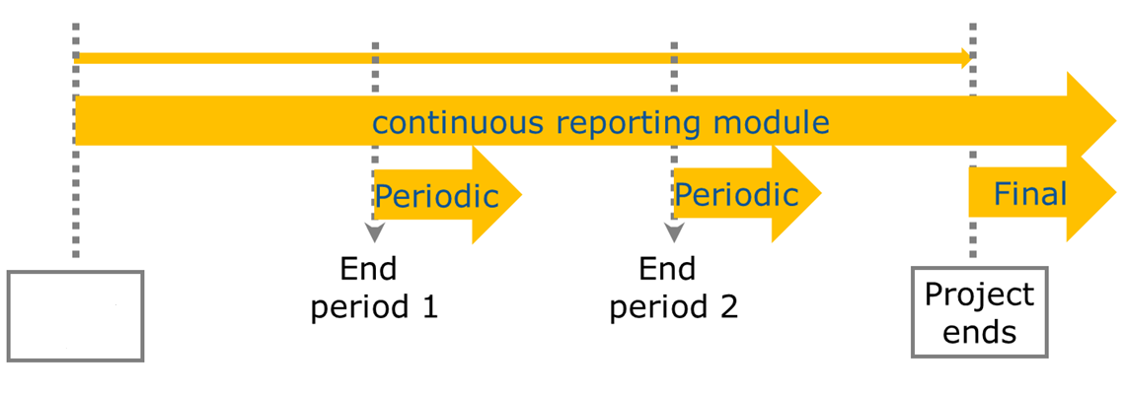

Where are we?
31 March 2026
1 April 2021
30 September 2025
Month 18
Month 36
Project starts
Project ends
30 September 2022
31 March 2024
March 2025

Slide 3
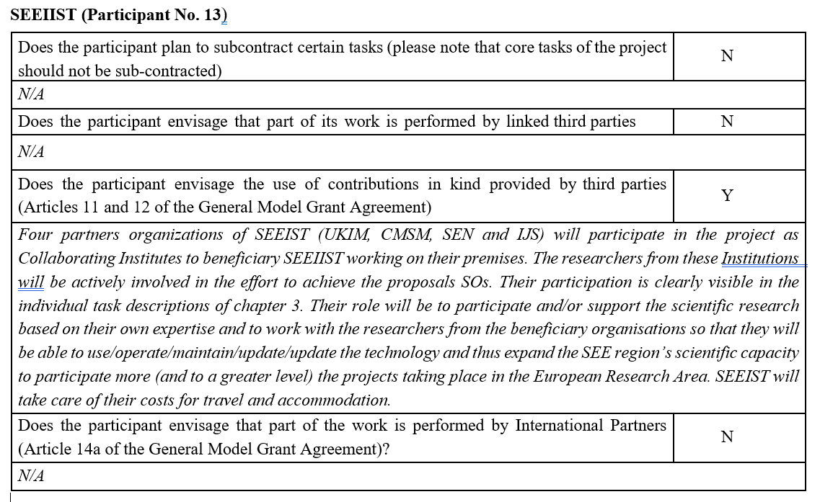

Amendment request
Annex1 - PartB
“Five partners organizations of SEEIST (UKIM, CMSM, SEN, IJS and TeraCare) will participate in the project as Collaborating Institutes to beneficiary SEEIIST working on their premises. The researchers from these Institutions will be actively involved in the effort to achieve the proposals SOs. Their participation is clearly visible in the individual task descriptions of chapter 3. Their role will be to participate and/or support the scientific research based on their own expertise and to work with the researchers from the beneficiary organisations so that they will be able to use/operate/maintain/update/update the technology and thus expand the SEE region’s scientific capacity to participate more (and to a greater level) the projects taking place in the European Research Area. SEEIST will take care of costs for travel and accommodation for UKIM, CMSM, SEN and IJS”

Slide 4
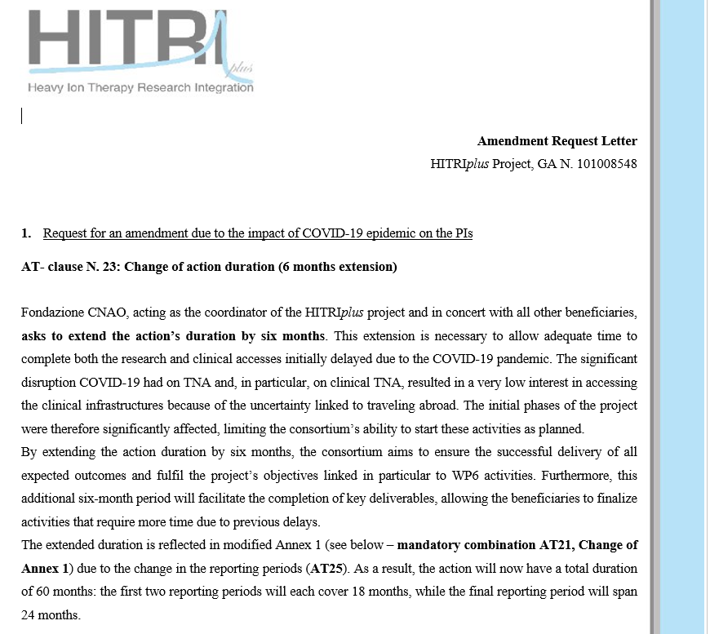

Slide 5
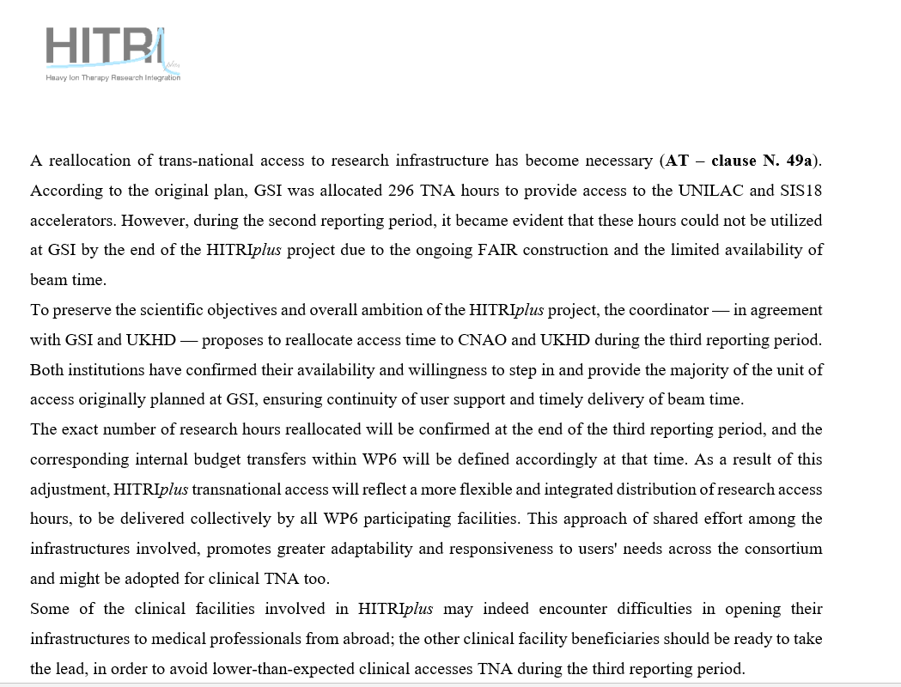

Slide 6
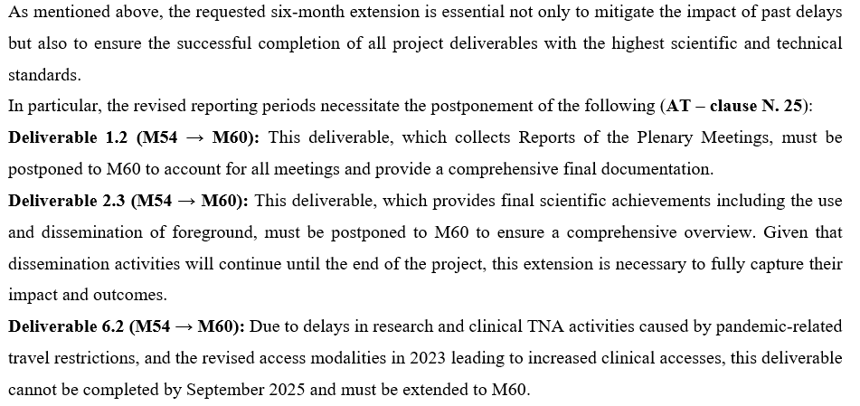

Slide 7
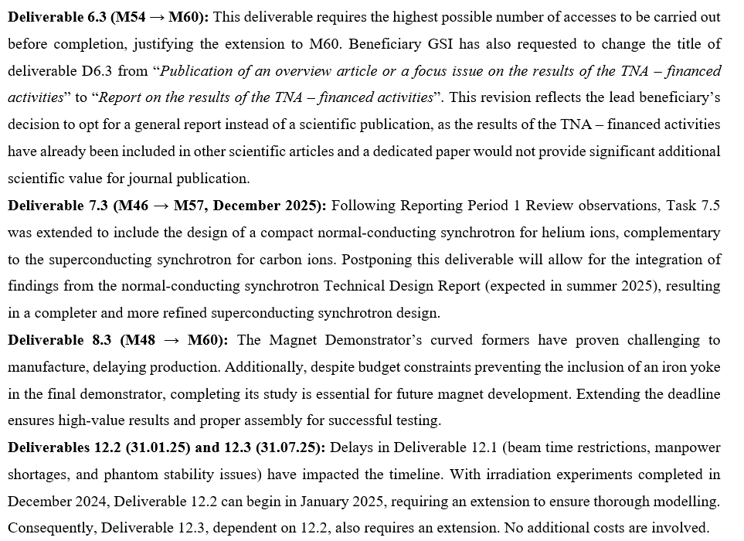

Slide 8
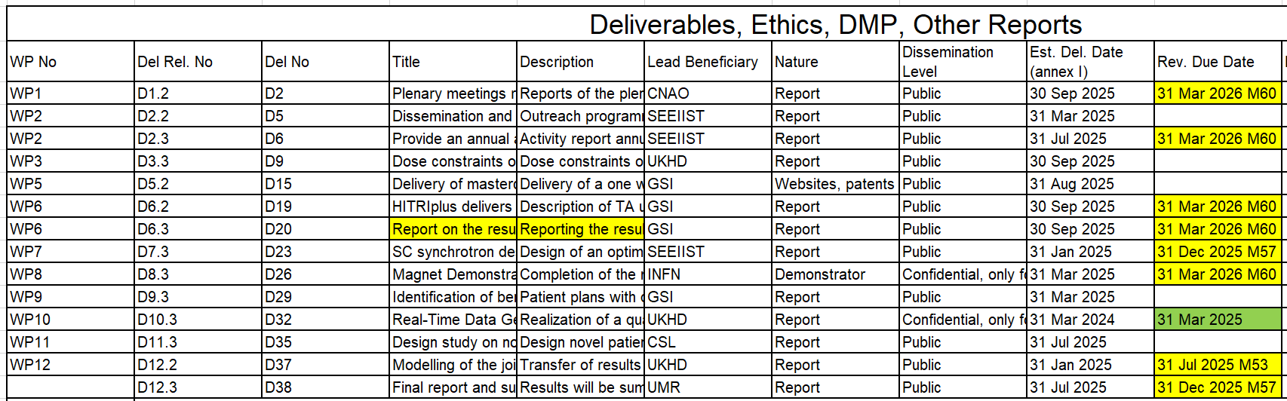
Amendment - contents

Slide 9
Amendment - contents
The duration of all WPs will be extended until the new project end date (March 2026)
Meetings, dissemination
N.B.: Last project meeting in March (?) 2026

Slide 10
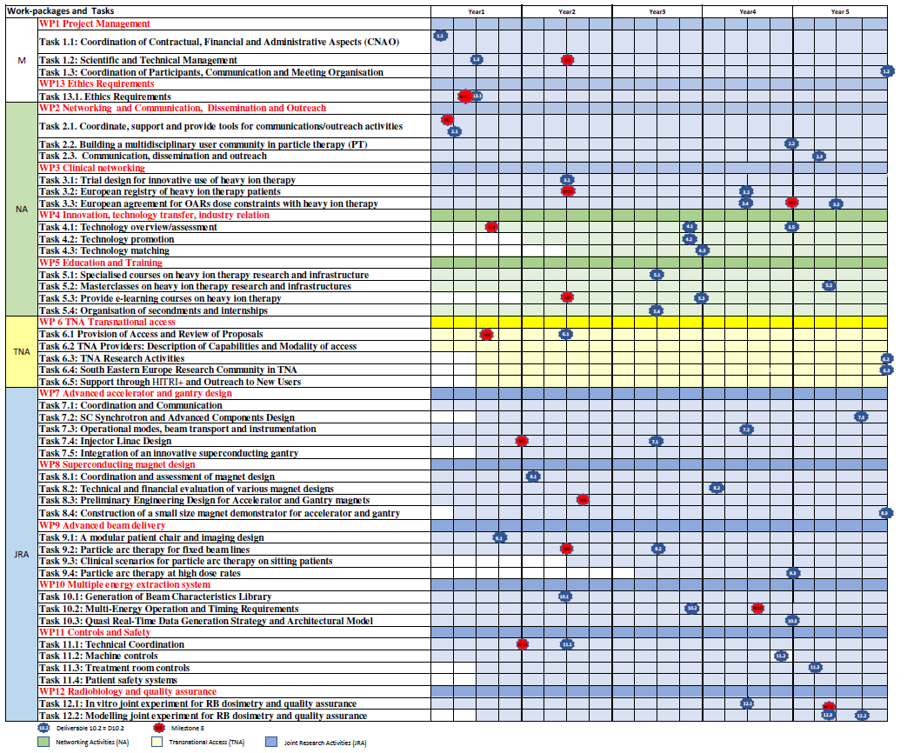

Slide 11





Publications
Please refer to our project as “HITRIplus”
Publish,
Acknowledge EU,
Inform WP1
ACKNOWLEDGEMENTS!!!!!
“This project/research/study was (partially) supported by the European Union’s Horizon 2020 research and innovation programme under grant agreement no. 101008548 (HITRIplus)”
Please, take record also of talks, seminars, poster (and send me)

Slide 12
Next meetings
Next General Assembly meeting in October 2025 (Online)
FINAL project meeting March 2026 (CNAO?)

Slide 13

THANK YOU!
https://www.hitriplus.eu/

