Slide 1
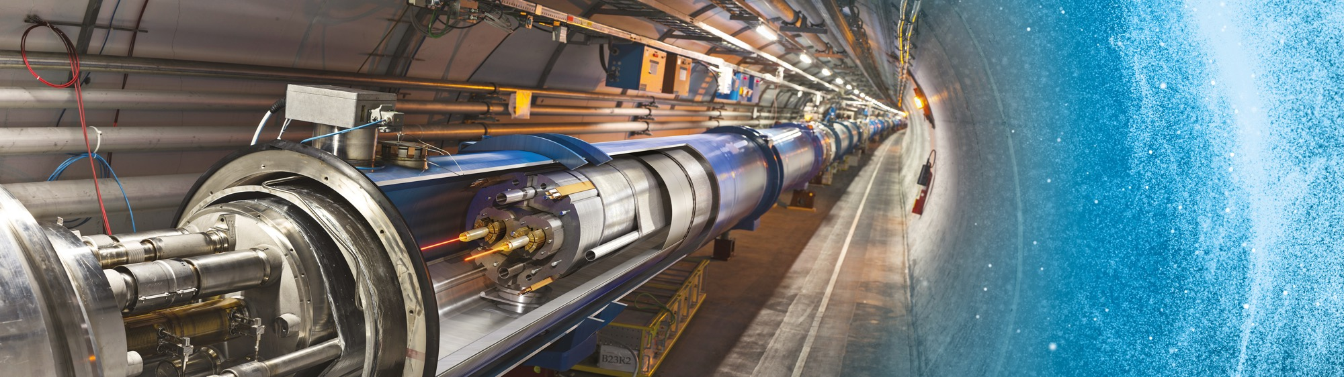
Doing Business with CERN
FCC Week – CERN Industry & Technology Day
Adam Horridge
21 May 2025

Slide 2
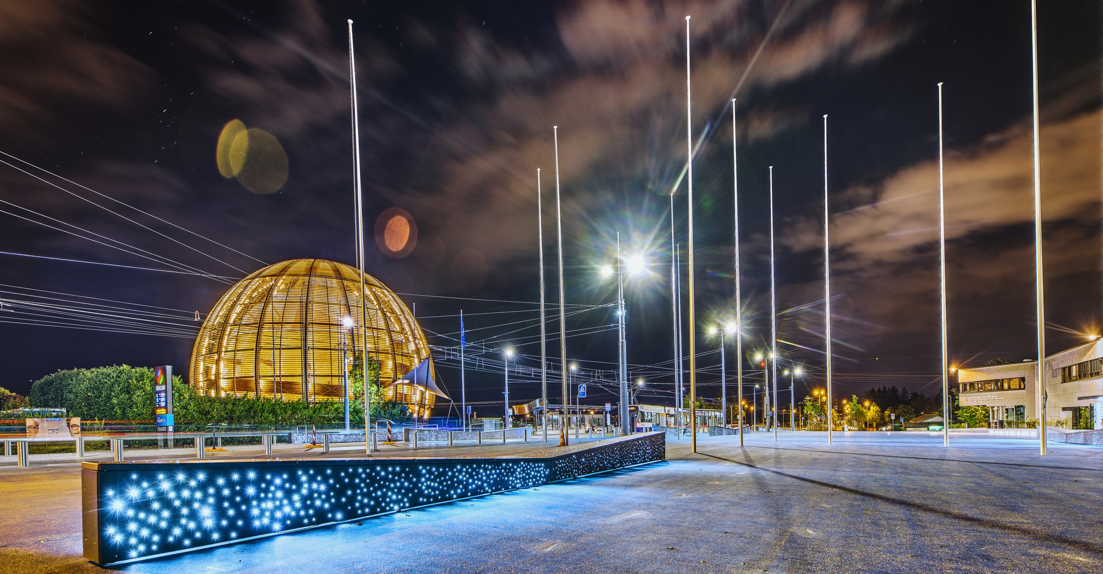
AGENDA
Introduction
Statistics
Procurement @ CERN - the rules
Procurement website and info resources
Forthcoming Needs
Recent CERN-Austria Success Stories

Slide 3

Introduction

Slide 4

CERN - the world’s biggest laboratory for particle physics.
International Organization
established on 1 July 1953 -
“Science for Peace”.
Immunity of jurisdiction
and execution.
Notes:
This slide addresses two questions:
“Where are we?”
Use the map to indicate the location of CERN, headquartered in Geneva, straddling the Franco-Swiss border
“What is CERN?”
CERN is one of the world’s leading laboratories for particle physics
CERN’s vision (long-term goal) is to understand the fundamental particles and laws of the Universe (This is the Vision statement that features in CERN’s communication strategy)
Thus, CERN is first and foremost a research laboratory

Slide 5

CERN is entitled to establish its own internal rules necessary for its proper functioning, including:
Procurement Rules
Safety Rules
Staff Regulation of its own personnel

Slide 6

In 1954 CERN had 12 Member States
Today CERN has 24 Member States
24 Member States
2 Associate Member States in the pre-stage to membership
8 Associate Member States
4 Observers
Geographical & cultural diversity
110 nationalities,
from 77 countries
~ 2,676 Staff members
~ 2,000 contractors’ employees
~ 13,000 physicists /users
Yearly budget ~ 1300 MCHF
Notes:
The speaker can highlight CERN’s second mission as stated when it was established: to foster peaceful collaborations between nations that had recently been at war.
This slide will have information on the country of the visiting delegation:
Location on the world map
Date of accession (if Member State or Associate Member State)
For information:
Member States – Austria, Belgium, Bulgaria, Czech Republic, Denmark, Estonia, Finland, France, Germany, Greece, Hungary, Israel, Italy, Netherlands, Norway, Poland, Portugal, Romania, Serbia, Slovak Republic, Spain, Sweden, Switzerland, United Kingdom
Associate Member States in the pre-stage to membership – Cyprus, Slovenia
Associate Member States – Croatia, India, Latvia, Lithuania, Pakistan, Turkey, Ukraine
Observers – USA, Russia (SUSPENDED), Japan, (EU, JINR, UNESCO)

Slide 7


































Yearly Budget (contributions 2025)*
Country | Percentage | Amount (CHF)
Germany | 20.10% | 254 713 750
United Kingdom | 14.63% | 185 443 700
France | 12.38% | 156 880 600
Italy | 9.43% | 119 487 150
Spain | 6.62% | 83 864 950
Netherlands | 4.72% | 59 771 700
Switzerland | 3.72% | 47 108 400
Poland | 3.09% | 39 196 050
Belgium | .2.71% | 34 355 300
Sweden | 2.61% | 33 069 950
Norway | 2.43% | 30 748 450
Israel | 2.28% | 28 901 850
Austria | 2.15% | 27 217 900
Denmark | 1.87% | 23 653 250
India | 1.45% | 18 348 250
Romania | 1.32% | 16 710 000
Finland | 1.29% | 16 346 850
Country | Percentage | Amount (CHF)
Czech Republic | 1.17% | 14 807 450
Portugal | 1.06% | 13 424 700
Greece | 0.97% | 12 225 600
Brazil | 0.81% | 10 232 950
Hungary | 0.71% | 8 982 550
Slovak Republic | 0.52% | 6 552 450
Türkiye | 0.39% | 4 955 250
Bulgaria | 0.39% | 4 888 400
Serbia | 0.28% | 3 596 450
Slovenia | 0.21% | 2 654 050
Pakistan | 0.16% | 2 053 850
Estonia | 0.16% | 2 045 150
Cyprus | 0.09% | 1 119 450
Latvia | 0.08% | 1 066 250
Ukraine | 0.08% | 1 034 000
Croatia | 0.08% | 1 000 000
Lithuania | 0.08% | 1 000 000

Slide 8

Statistics

Slide 9
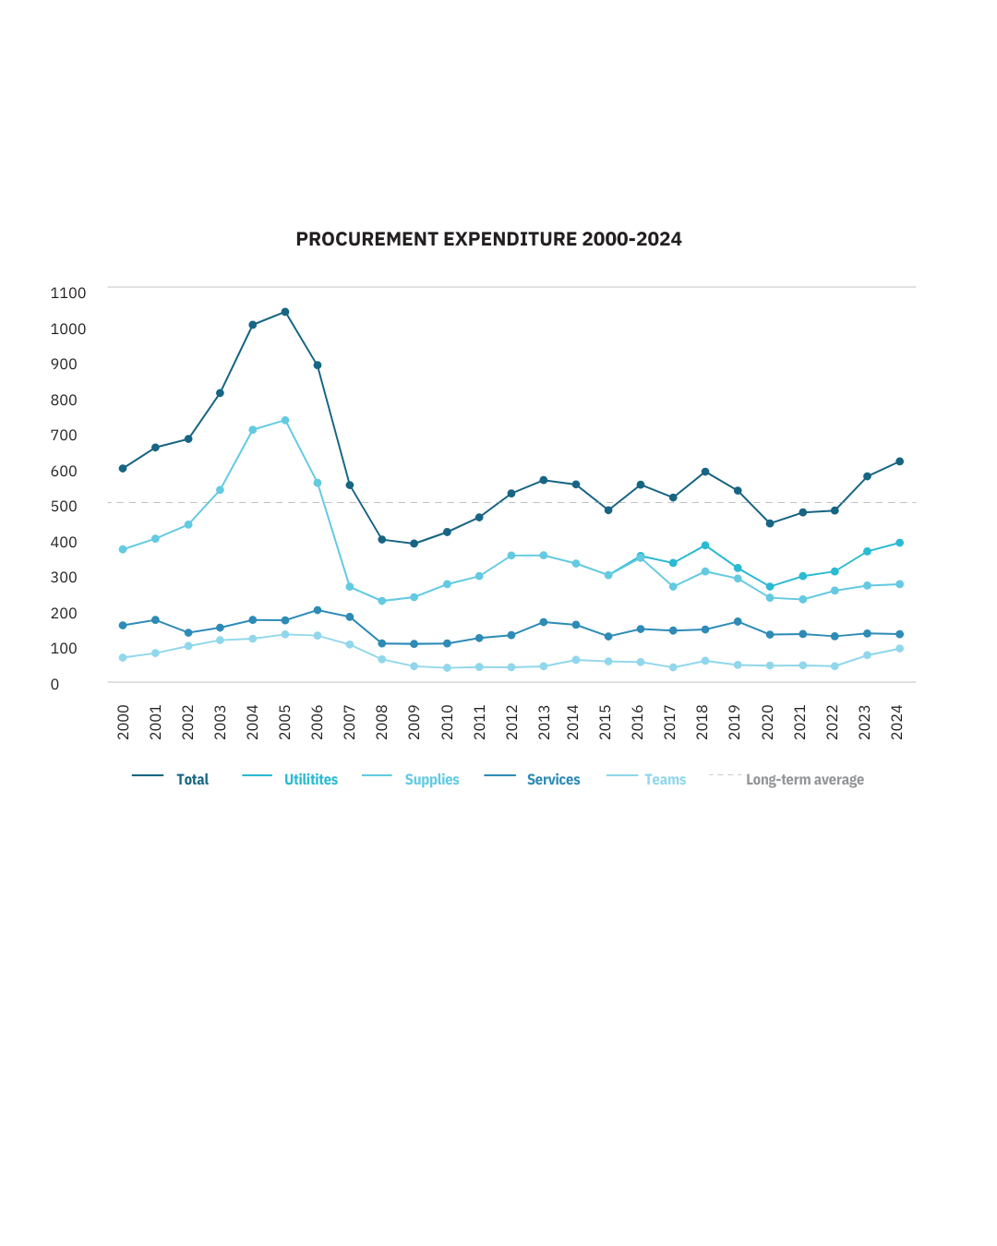
Procurement Expenditure
613MCHF

Slide 10
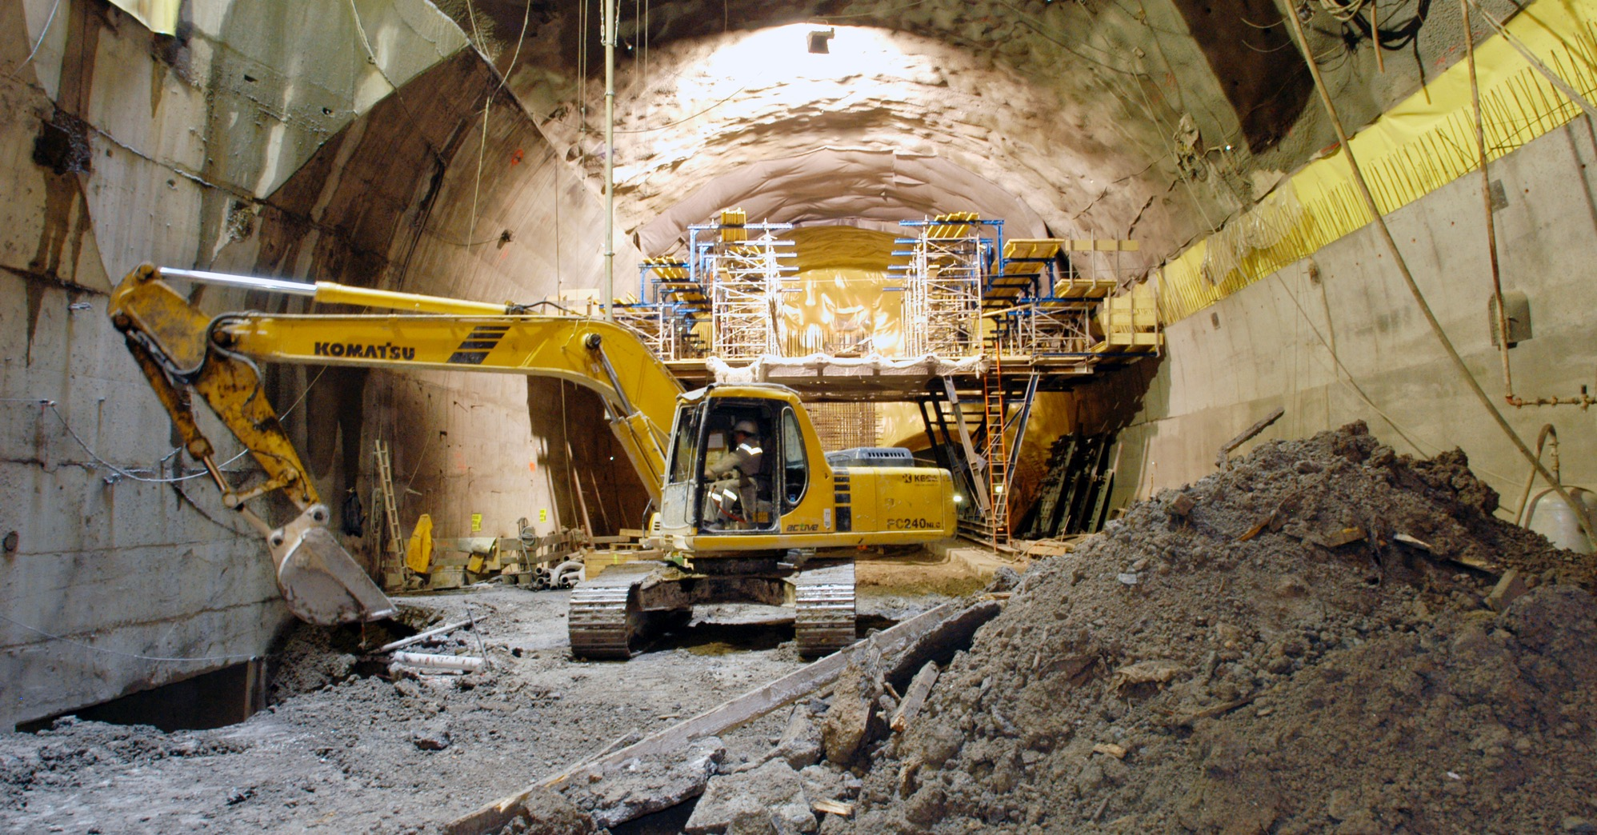
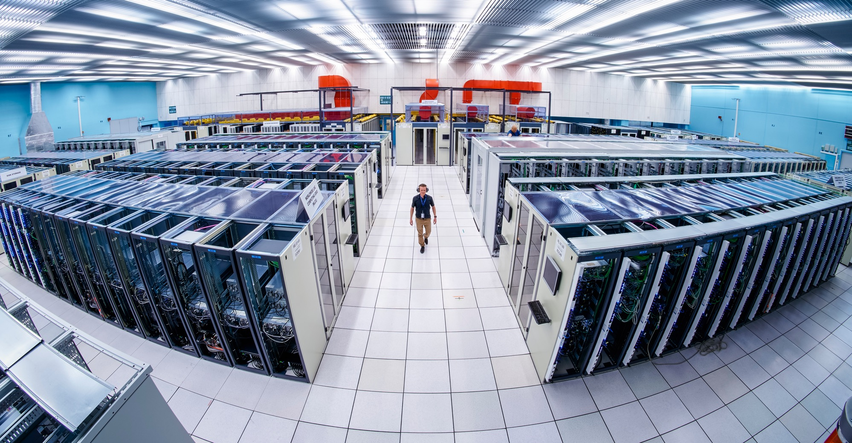
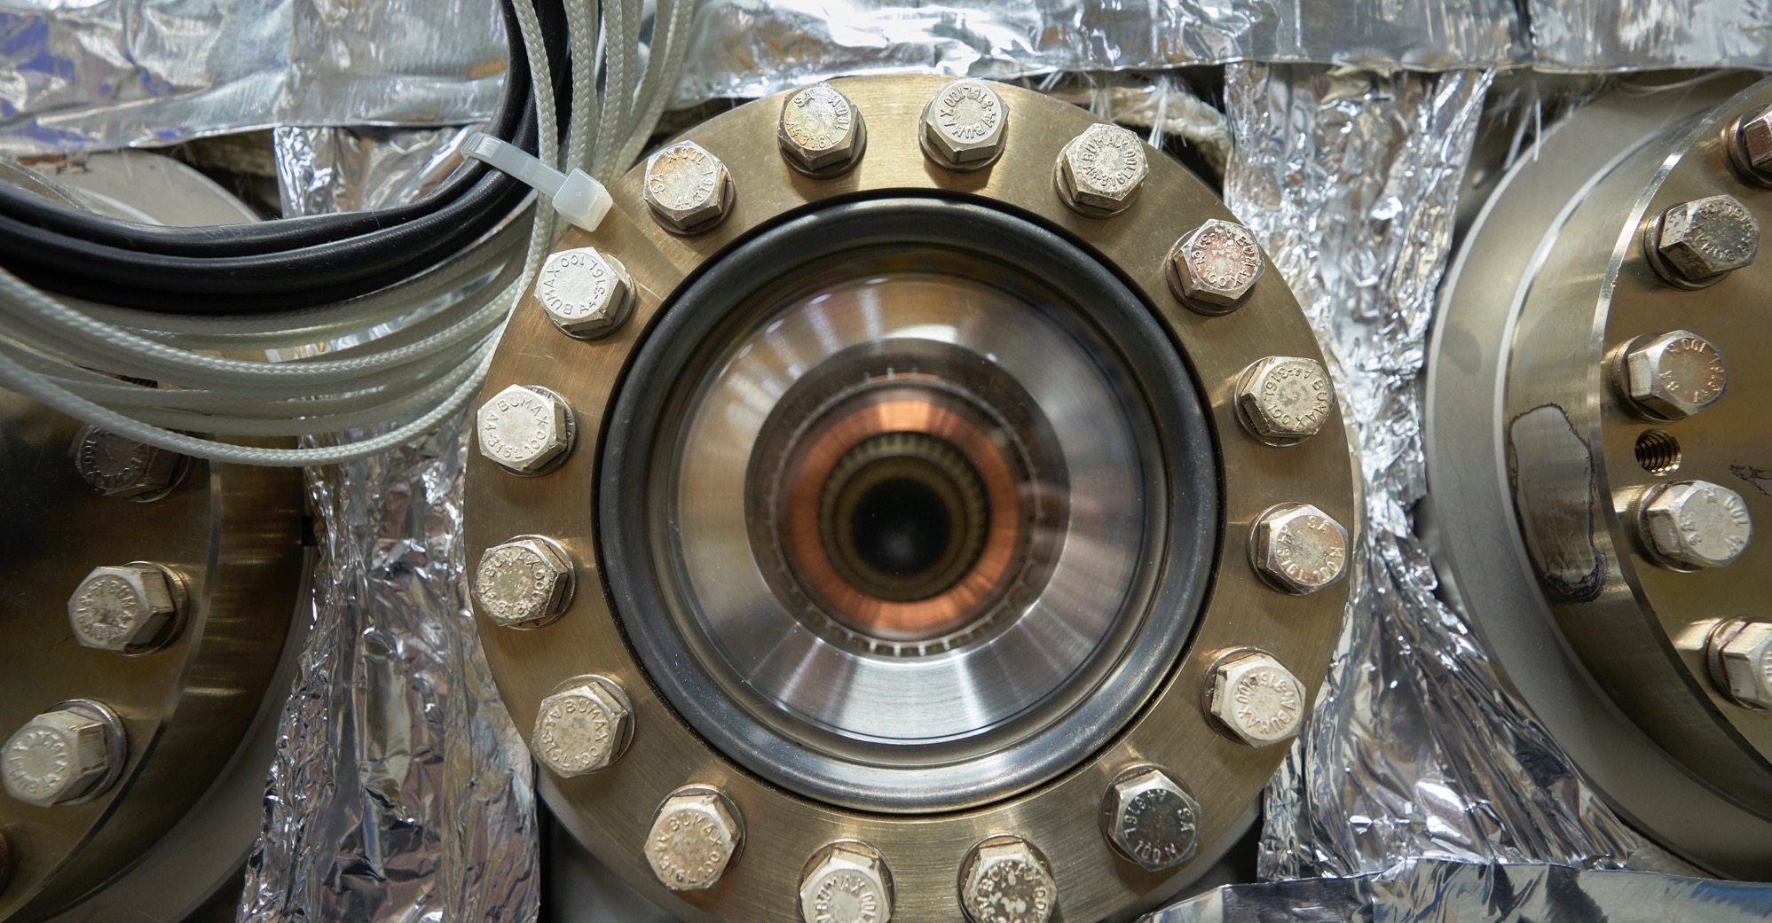
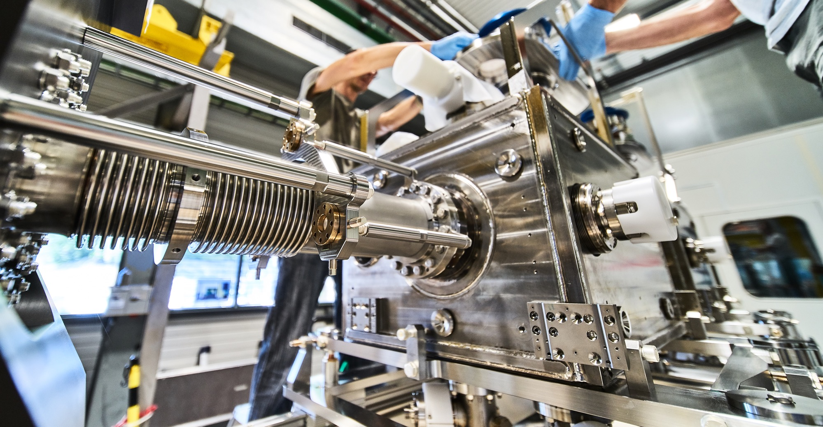
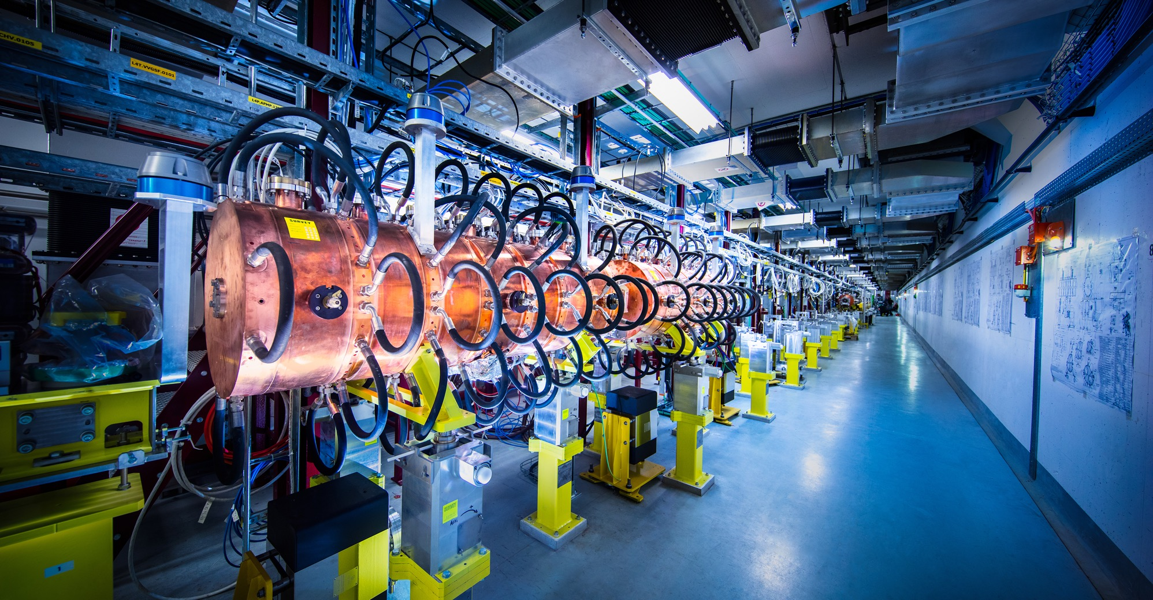
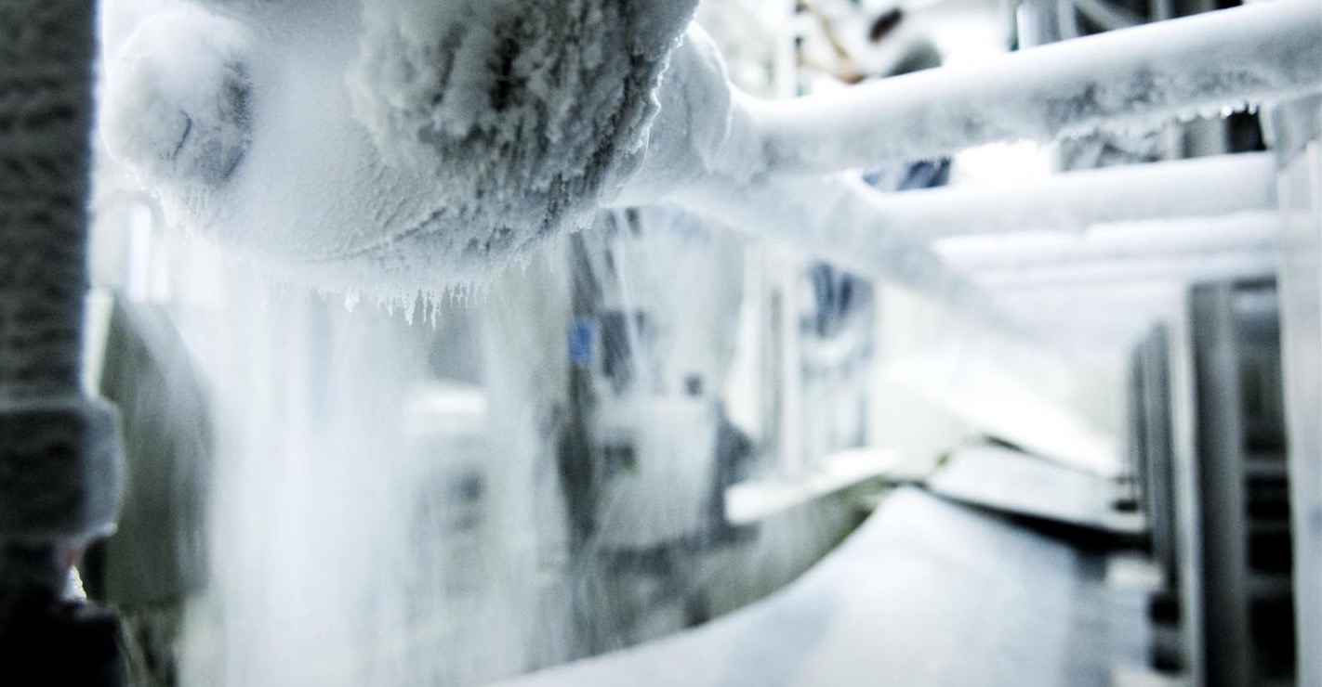
What do we buy?
Civil engineering
Cooling and ventilation
Electrical engineering and magnets
Information Technology
Mechanical engineering and raw materials
Electronics and radiofrequency
  Cryogenic and vacuum equipment
  Health and safety equipment,
  Transport and handling equipment
  Office supply, furniture
  Industrial services on the CERN site

Slide 11
Supplies (279MCHF spent in 2024 – CERN budget only*)
*Excluding visiting research teams and collaborations

Slide 12
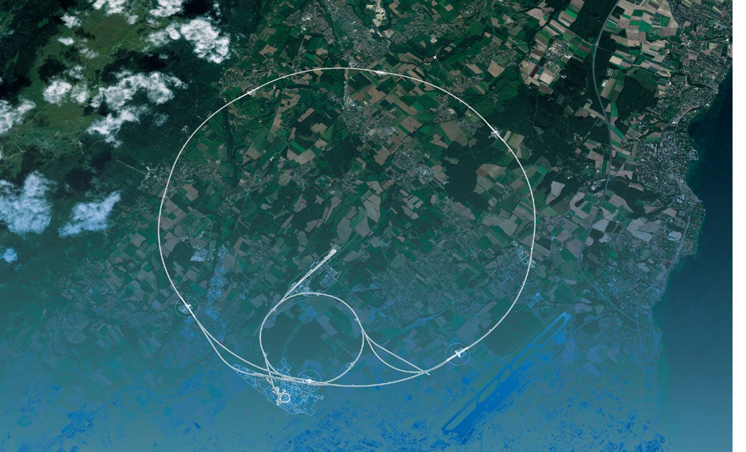
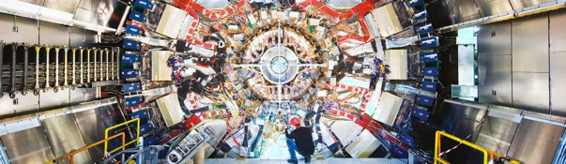
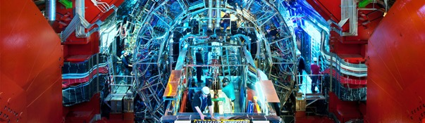
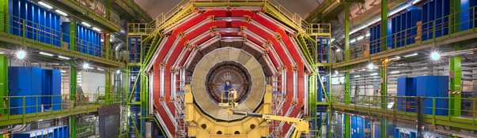
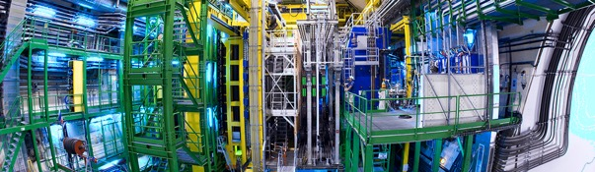
We also buy for the LHC experiments
CMS
ALICE
ATLAS
LHCb

Slide 13
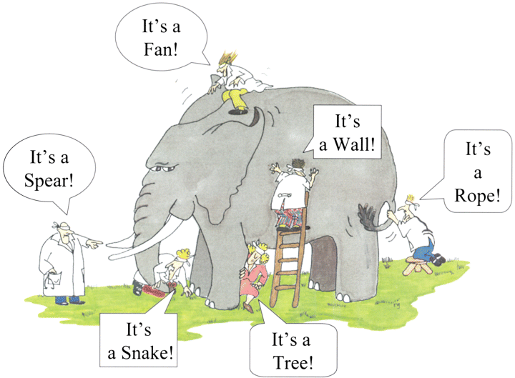

How do we buy?
  Off-the shelf or non-standard products which can be produced with existing manufacturing techniques or technologies:
  Functional specification
  Non-standard products where industry has neither the required know-how nor the interest to develop and design the products:
  Build-to-Print specification
Prototypes and or Pre-series might be required.

Slide 14


Procurement @CERN - Rules

Slide 15
The Procurement Service
Mission
The Procurement Service (PS) procures all supplies and services for CERN
Meeting the specified and financial, technical, environmental and delivery requirements
Keep overall costs for CERN as low as possible and to ensure the most advantageous use of CERN’s resources
While achieving balanced industrial return for CERN Member States
Respecting CERN
Procurement Rules

Slide 16
Principles of the Procurement Rules (1/4)
1
Transparency and Impartiality
2
Tenders open to Member States only
3
Objectivity and equal treatment: tendering packages are objective and impartial

Slide 17
Principles of the Procurement Rules (2/4)
Selective tendering procedures: CERN’s tendering procedures are not open to any interested firms
Confidentiality: Opening and evaluation of bids as well as negotiations are not public

Slide 18
Principles of the Procurement Rules (3/4)
Award for on Lowest compliant bid basis
Most commonly for Supply contracts
Technical
Financial
2
Delivery

Slide 19
Principles of the Procurement Rules (4/4)
Award on Best Value For Money basis
Most commonly used for industrial service contracts
2

Slide 20

Enquiries between 10,000 and 400,000 CHF
“Price enquiry” (Demande d’Offre - DO)
Submission deadline: 4-6 weeks from date of dispatch;
All price enquiries above 50,000 CHF are also sent to the
Industrial Liaison Officers (ILOs) for information;
Price enquiries consist of:
  Technical specification and annexes;
  Tender form (and a technical annex - optional);
  CERN’s General Conditions (contracts, invitations to tender, safety, etc.)
Price enquiries between 200,000 – 400,000 CHF announced on CERN’s procurement website, see
“Business Opportunities”

Slide 21

Enquiries exceeding 400’000 CHF (1/2)
“Market Survey” (MS)
Prior announcement on CERN’s procurement website, see
“Business Opportunities”
  At this stage, interested firms are encouraged to contact CERN in
  order to have a clear understanding of the requirement, allowing
  them to begin their organization ahead of the tendering process.
Market surveys consist of:
  “Technical Description” and;
  “Qualification Questionnaire” (financial and technical).
Submission deadline: 4 weeks, or more if the MS is still online.

Slide 22

Enquiries exceeding 400’000 CHF (2/2)
“Invitation to tender” (IT)
Sent to qualified and selected firms only;
Submission deadline: 4 weeks from date of dispatch (with a longer period for more complex requirements);
Firms shall ask all necessary questions in writing to understand all requirements and prepare a bid that best matches CERN’s needs;
All invitations to tender are sent to the Industrial Liaison Officers (ILOs) for information;
Bids shall be submitted via CERN’s e-tendering application.
Notes:
Invitations to tender consist of:
Technical specification and annexes;
Tender form (and a technical annex - optional);
General Conditions of CERN (contracts, invitations to tender, Safety, etc.)

Slide 23

Country of origin – Why do we need to know?
Industrial Return to our Member States and Associate Member States is a key organisational objective and therefore we need to record this in order to better manage our efforts to achieve our goals in this respect

Slide 24
Country of origin
SUPPLIES
“Country(ies) where the supplies (including their components and sub-assemblies) are manufactured or undergo the last major transformation by the contractor or its sub-contractor”
SERVICES
“Country(ies) in which the bidder is established.”

Slide 25

Industrial return coefficient
Industrial return
coefficient
Over a 4-year period:
Poorly balanced (PB) : < 1
Well balanced (WB): ≥ 1
For Supply contracts and for a
12-month period starting on
1st March, defined as:
“The ratio between a Member State's percentage share of the value of all Supply contracts and that Member State's percentage contribution to the CERN Budget over the same period”.
Status definition
% expenditure in the MS
Return Coef.=
% contribution to CERN budget for this MS

Slide 26
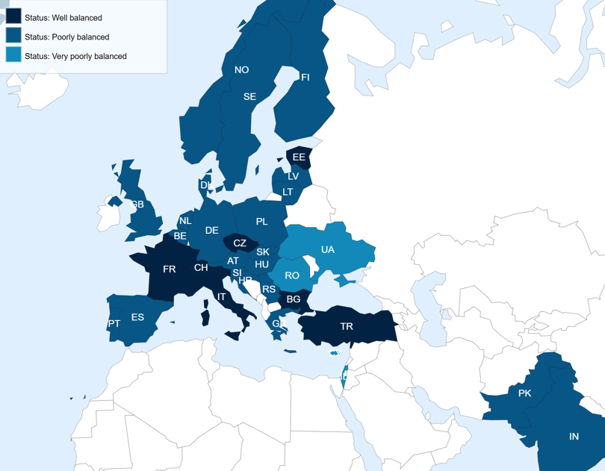
Poorly balanced Member States (Supplies)
(1st March 2025 – 28 February 2026, based on the previous 4 calendar years):
Well Balanced (≥1) | Poorly Balanced (< 1)
Bulgaria Croatia* Czech Republic Estonia France Italy Pakistan* Switzerland Türkiye* Ukraine* | Austria Belgium Brazil* Cyprus* Denmark Finland Germany Greece Hungary India Israel Latvia* Lithuania* Netherlands Norway Poland Portugal Romania Serbia* Slovak Republic | Slovenia* Spain Sweden United Kingdom
*Associate Member States

Slide 27
Alignment rule
Applicable for:
1
Contracts awarded on the lowest
compliant basis (mainly supply contracts)
2
With a total amount exceeding
100’000 CHF.
Under certain conditions as defined in CERN Procurement Rules, a bidder offering goods originating* in poorly balanced Member States is allowed to align his price to that of the
lowest bidder and thereby be awarded the contract.
RULE
* At least 60% for supply contracts or; at least 40% for service contracts awarded on the lowest compliant basis.

Slide 28
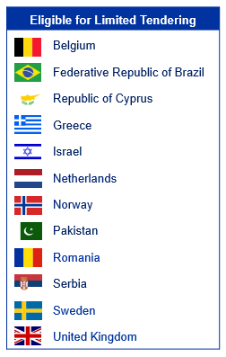
Limited Tendering
«Limited tendering is foreseen by the CERN Procurement Rules to improve the industrial return of the 12 most poorly balanced Member States»
Conditions
Twelve Member States with the lowest industrial Return Coefficient for Supply Contracts
Used in case where there is sufficient competition;
ILO can ask to add firms, provided they are established in one of the eligible countries.
Bids shall only be considered where a minimum of 60% of their value originates in any combination of the twelve Member States communicated by CERN

Slide 29

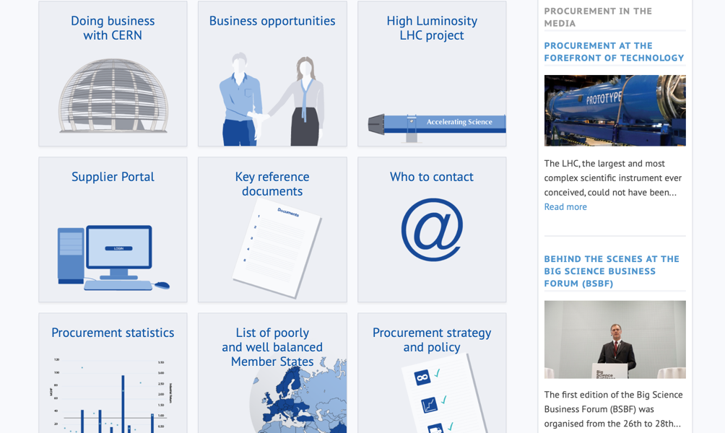
Procurement
website

Slide 30
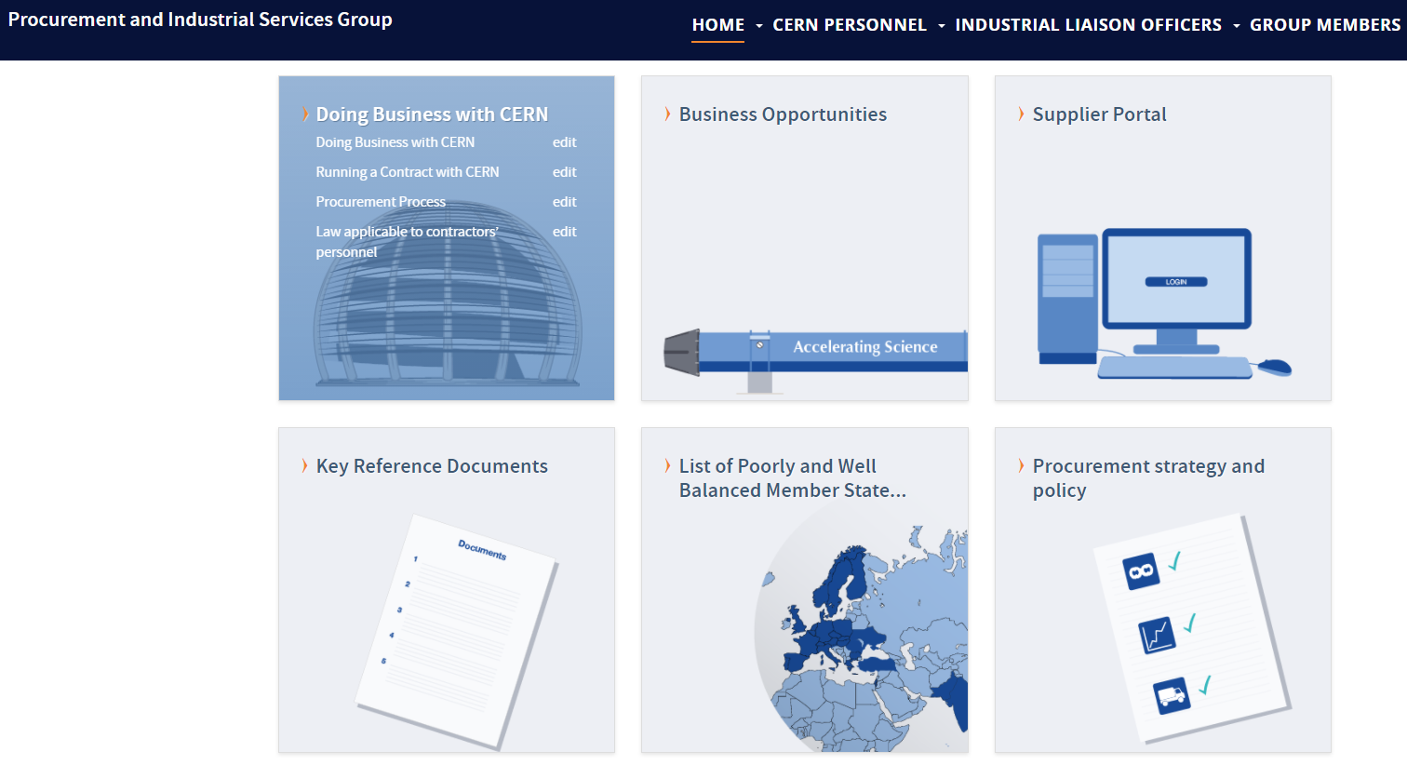
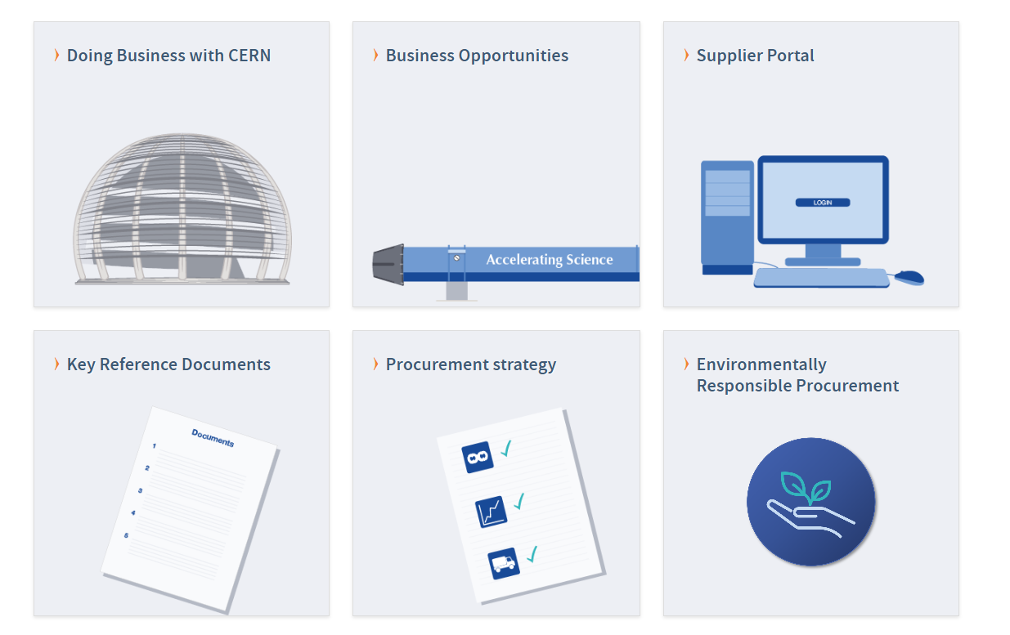
Website of the Procurement Service
http://procurement.web.cern.ch

Slide 31
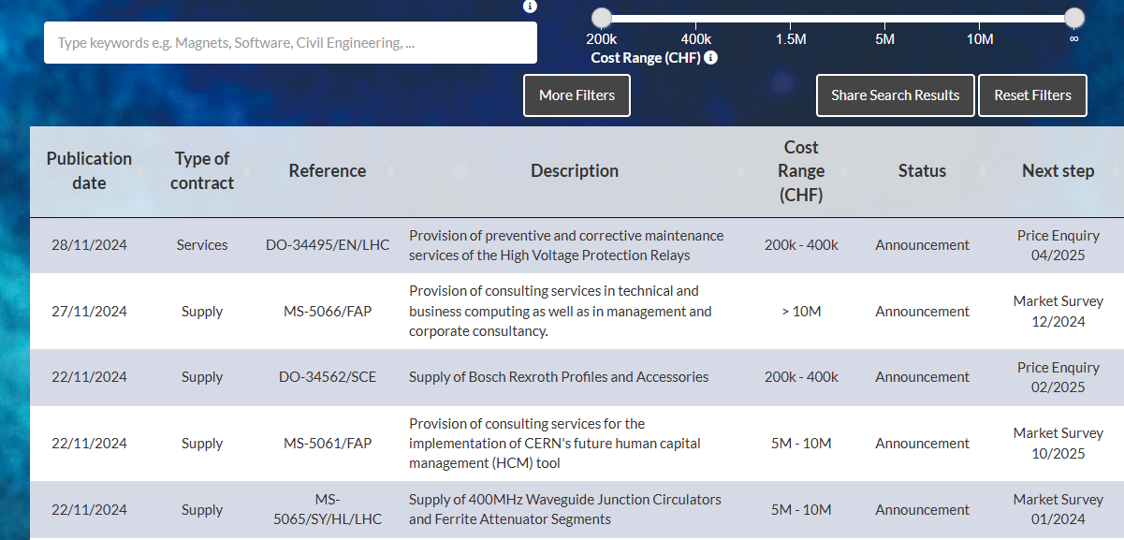
CERN Shopping List
https://forthcoming-ms.app.cern.ch/#!/

Slide 32
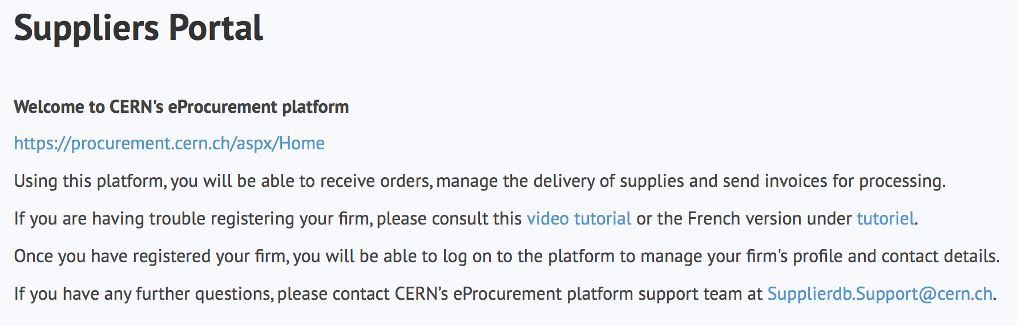
Register in the Suppliers Portal
for all exchanges with CERN, in particular to:
Be visible for future opportunities
(with the procurement codes you have indicated),
Receive and follow-up orders,
Send invoices.
MANDATORY

Slide 33
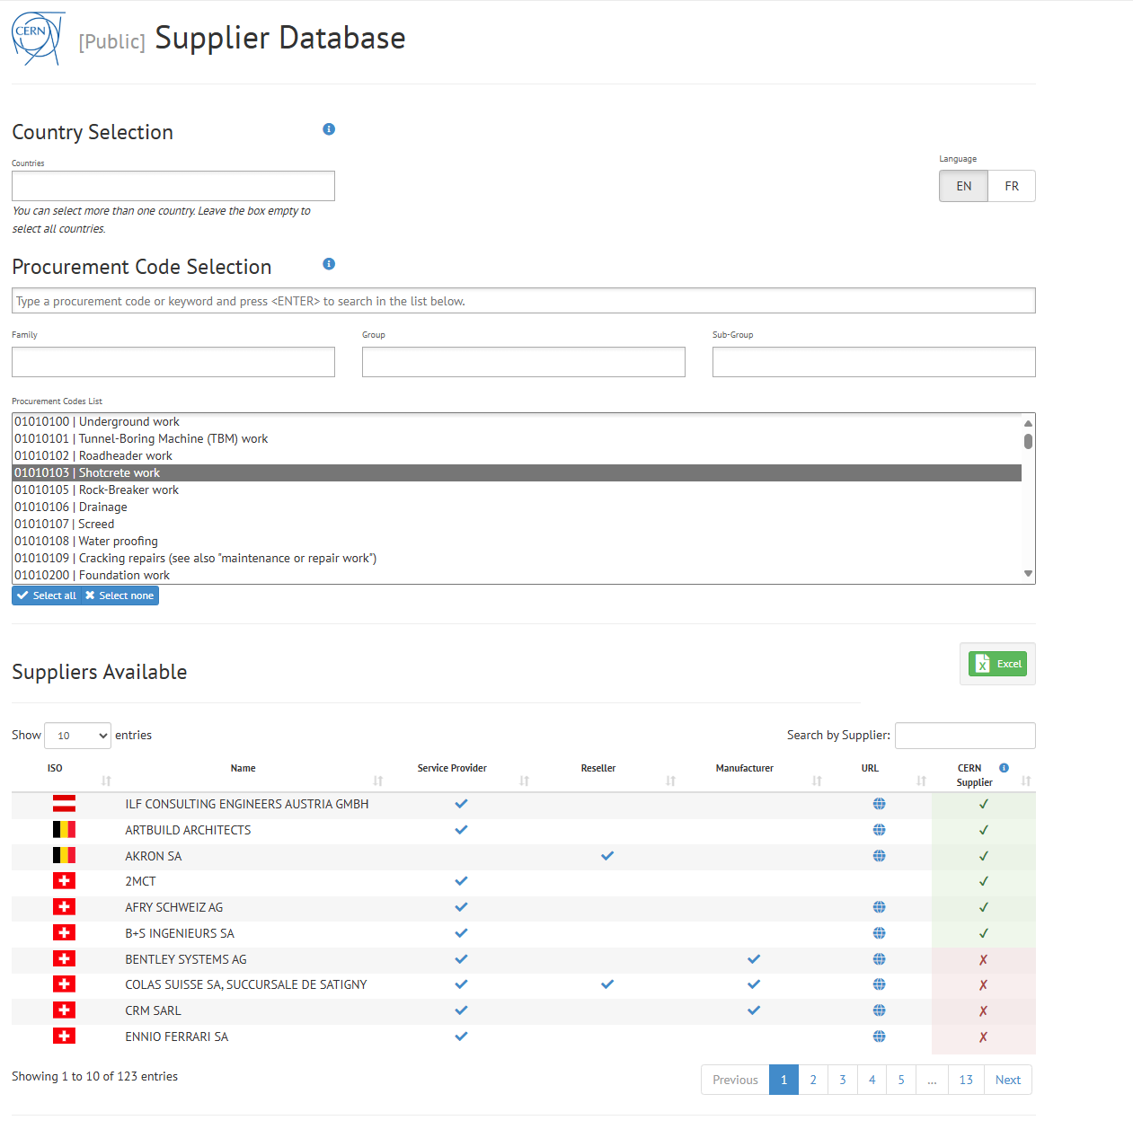
Look for potential partners
https://dir-ext-prod.cern.ch/pentaho/api/repos/%3Apublic%3ASupplier%20Database%3ADashboard.wcdf/generatedContent

Slide 34
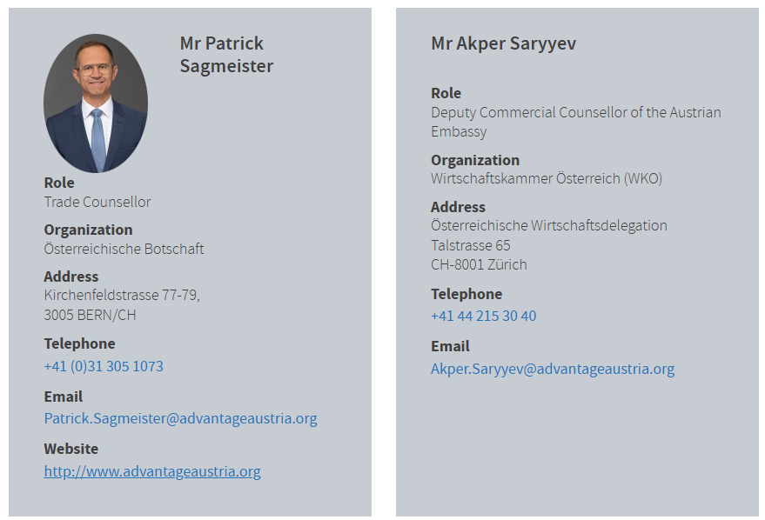
Contact in your country
ILO: Industrial Liaison Officer
Who to contact in your Country
    Industrial Liaison Officers (ILO's) are appointed by CERN's Member States to facilitate the flow of communication between CERN and its suppliers. ILO's can provide advice on the opportunities available for doing business with CERN and the support available to firms
    in their local regions.

Slide 35

Follow us on LinkedIn – ‘Business with CERN’
Selected forthcoming opportunities
News on events and webinars
Tips on how to engage with CERN
Success stories

Slide 36

Forthcoming Needs at CERN

Slide 37
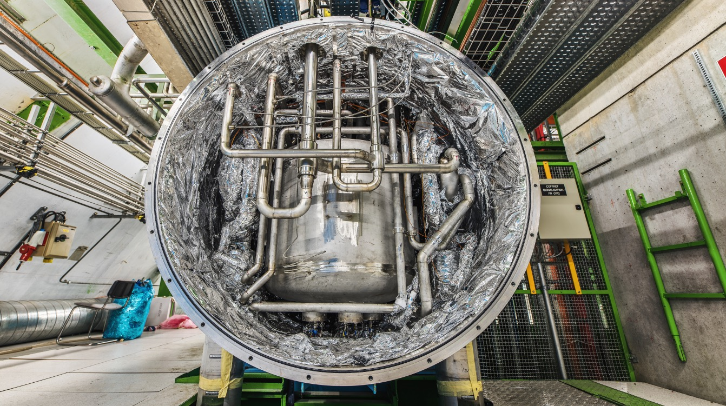
Cooling & Ventilation,
Cryogenics

Slide 38
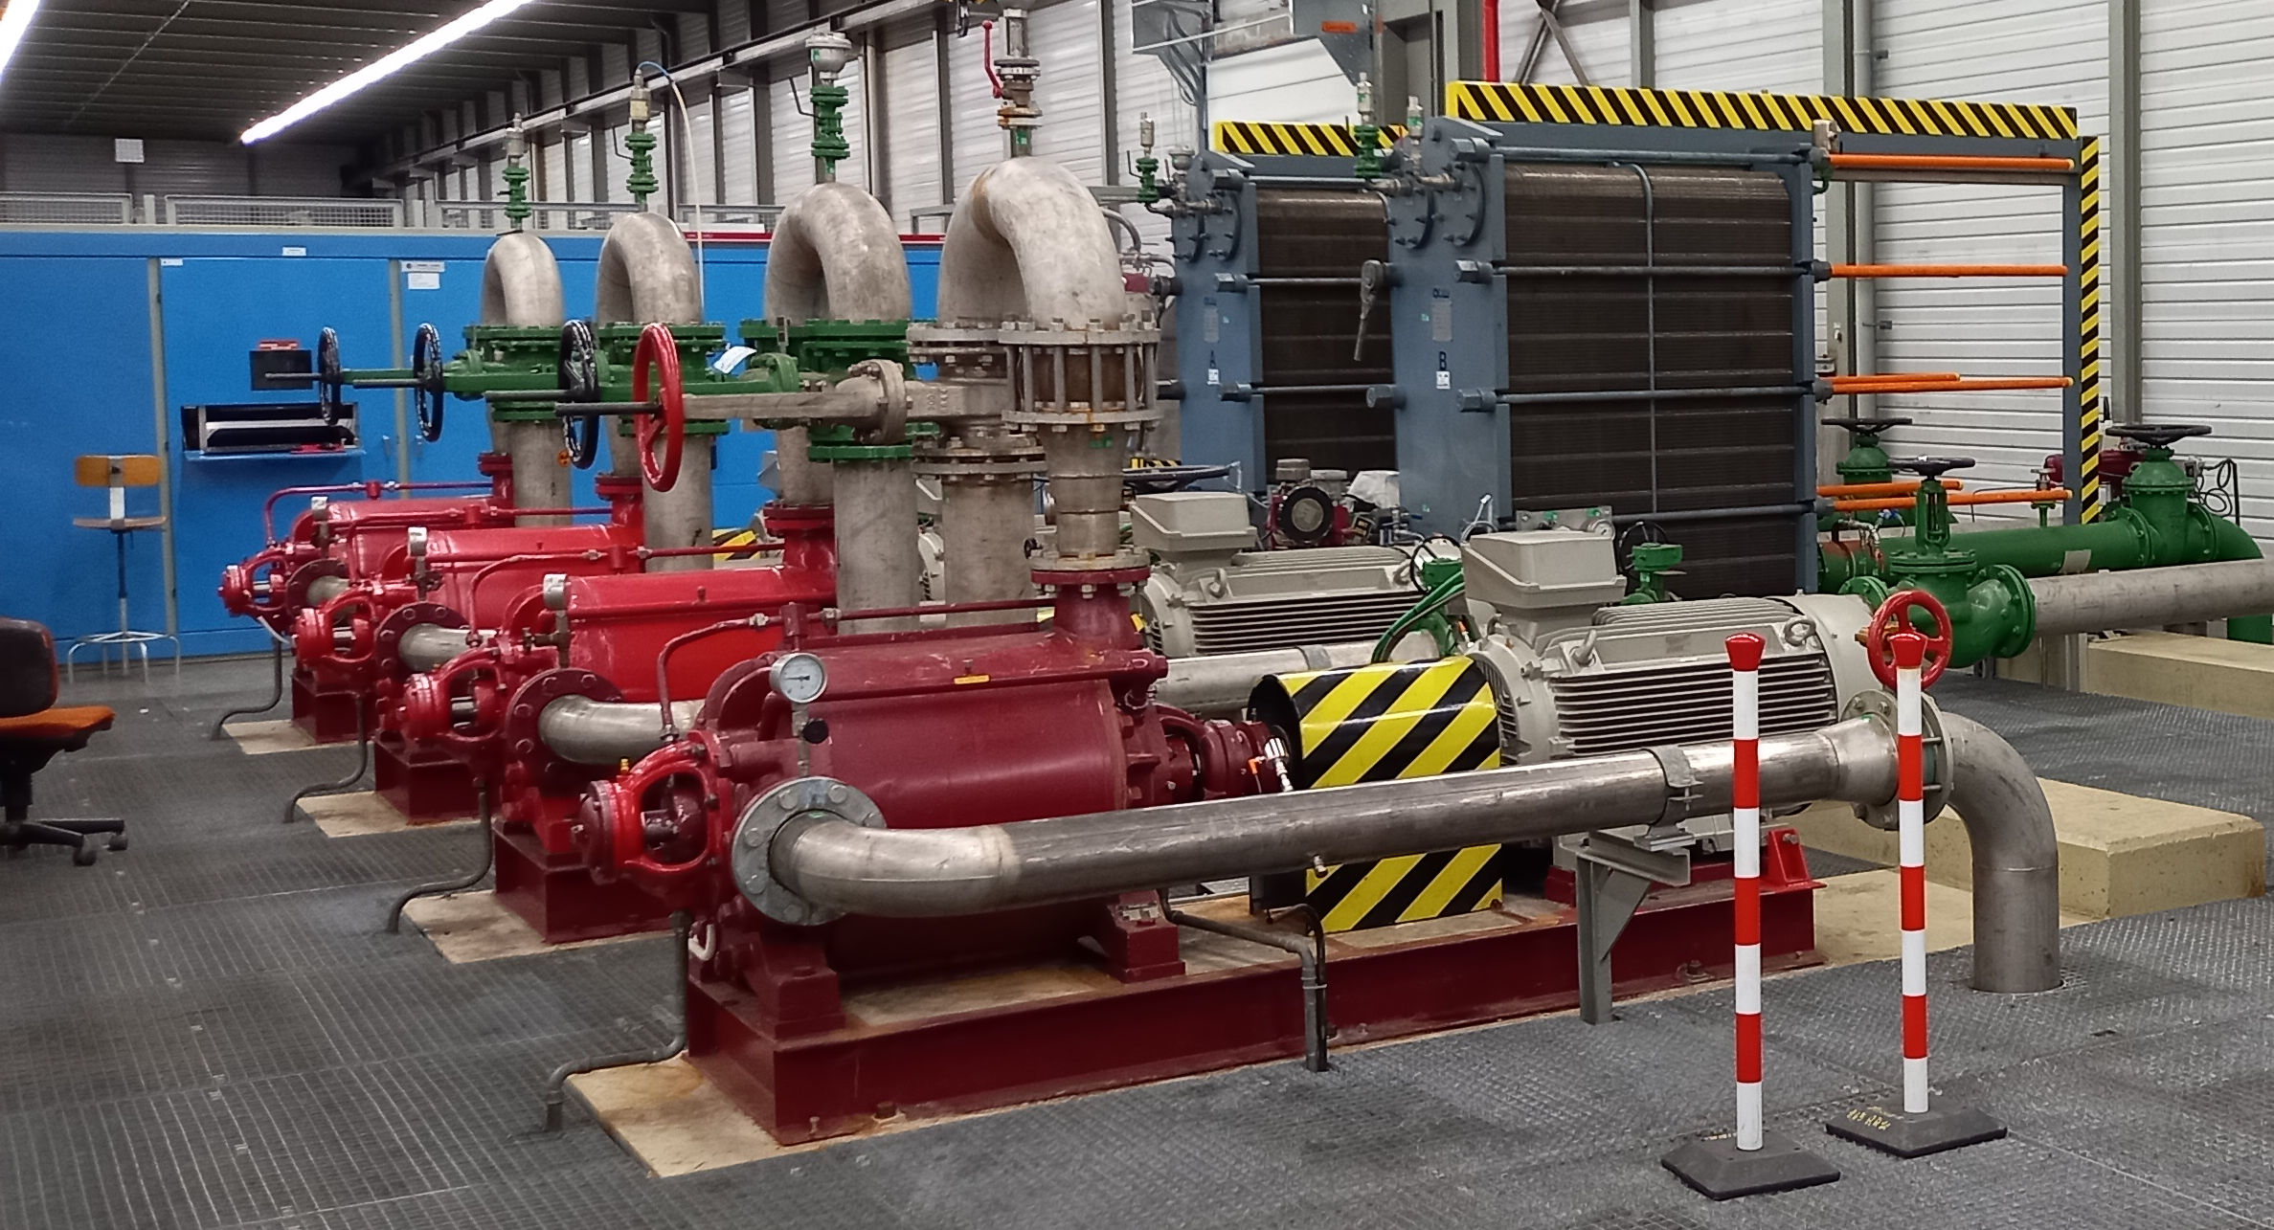
NA-CONS: BA80 cooling station consolidation and upgrade
Description & Specific Condition :
Design, dismantling when applicable, supply, installation and commissioning of turnkey new or partially renovated cooling systems for the demineralised water cooling station and water distribution network in BA80.
In order to improve the operability, reliability, availability, maintainability and safety, the demineralised water cooling plant in North Area building BA80 will be subject to consolidation by replacing the aging mechanical equipment. At the same time, the cooling plant capacity will be increased to cope with the additional load required by the new water-cooled Power Converters that will be installed as part of NA-CONS Phase 1 project.
Start of the Contract: Q4 2025
Procurement Code: 01 03 03 00
Cost Range : 1.5MCHF ⬄ 5 MCHF
Planning: MS: MS-5058 published
IT: Q3 2025
Contact: laurentiu.vlasceanu@cern.ch

Slide 39
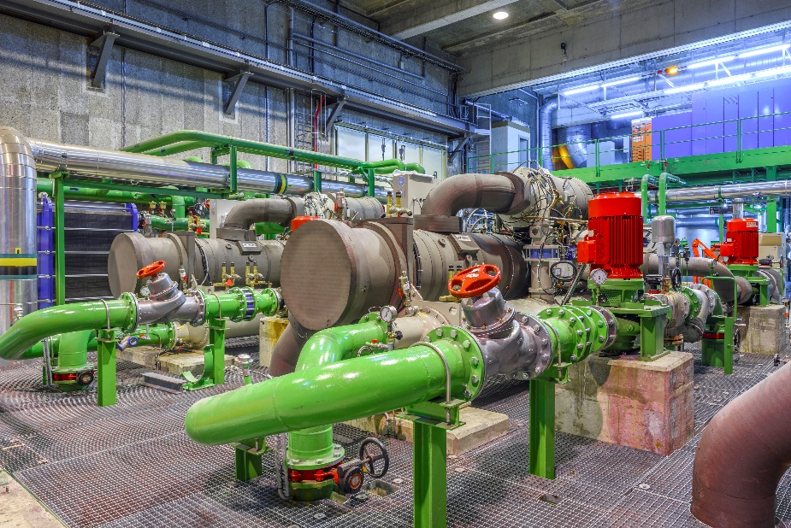
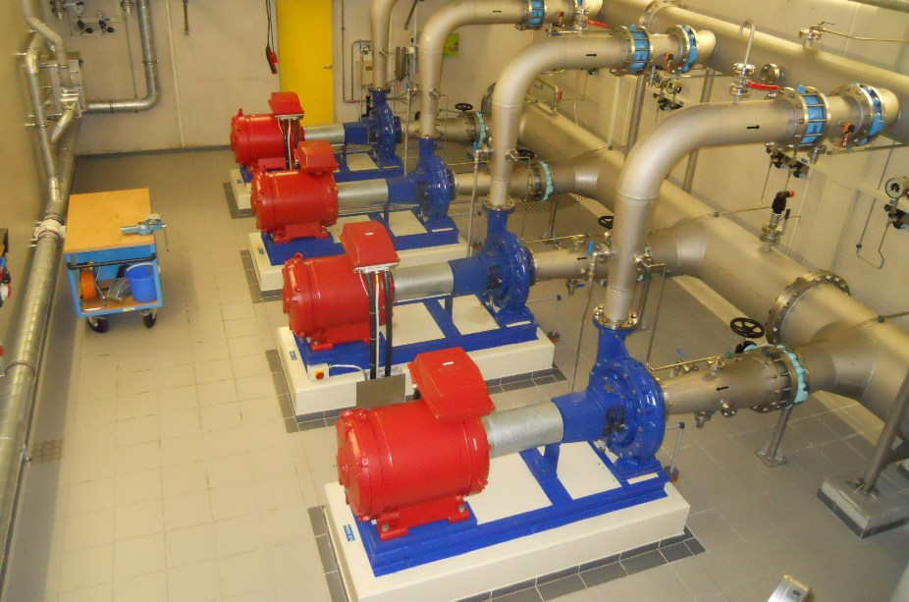
Cooling system Blanket Purchase Contracts
Description & Specific Condition :
5+1+1 years blanket purchase contract.
Design, supply and installation, test and commissioning of cooling systems on the CERN Site.
Several cooling plants will be consolidated or newly installed during and after Long Shutdown 3 both at the level of LHC, HL-LHC and Experiments.
Projects will range from small to medium and large sizes
All components shall comply with the technical prescriptions
Start of the Contract: December 2025
Procurement Code: 01 03 03 00
Cost Range : >10MCHF
Planning: MS: MS-5058 IT: Q3 2025
Contact: francesco.dragoni@cern.ch
39

Slide 40
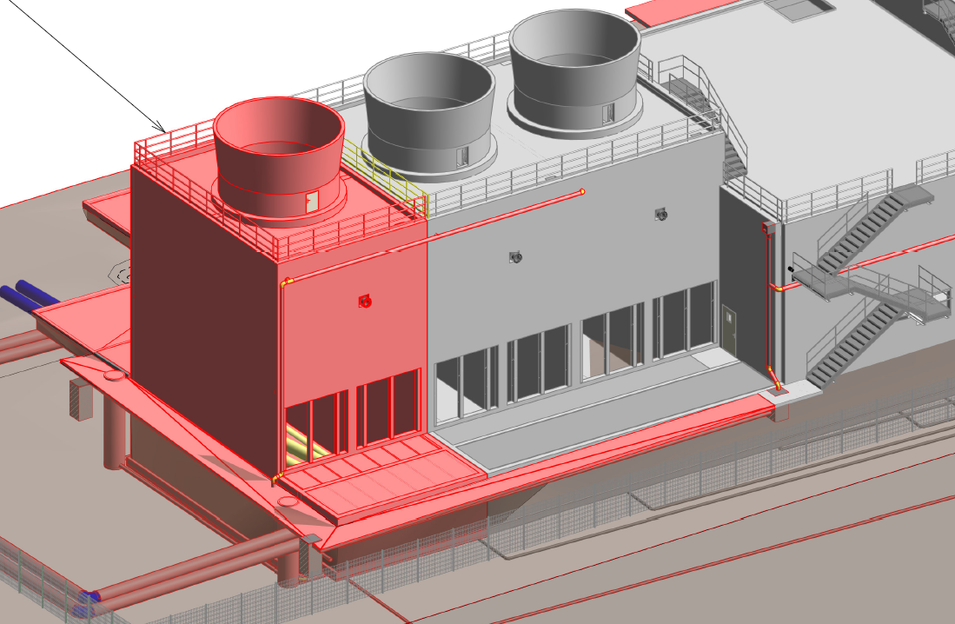
NA-CONS: CT2 cooling upgrade and consolidation
Description & Specific Condition :
Design, supply, installation, testing and commissioning of the 5th cooling tower cell in CT2.
To meet the requirements of the additional load required by the new users that will be installed as part of the NA-CONS project, a 5th cooling tower cell will be added to CT2. This Invitation to Tender will cover the equipment to be installed in the cell, as well as consolidation works to the pumping station.
Start of the Contract: Q2 2027
Procurement Code: 01 03 03 00
Cost Range : 400k - 1.5M CHF
Planning: MS: Q4 2026
IT: Q1 2027
Contact: laurentiu.vlasceanu@cern.ch

Slide 41
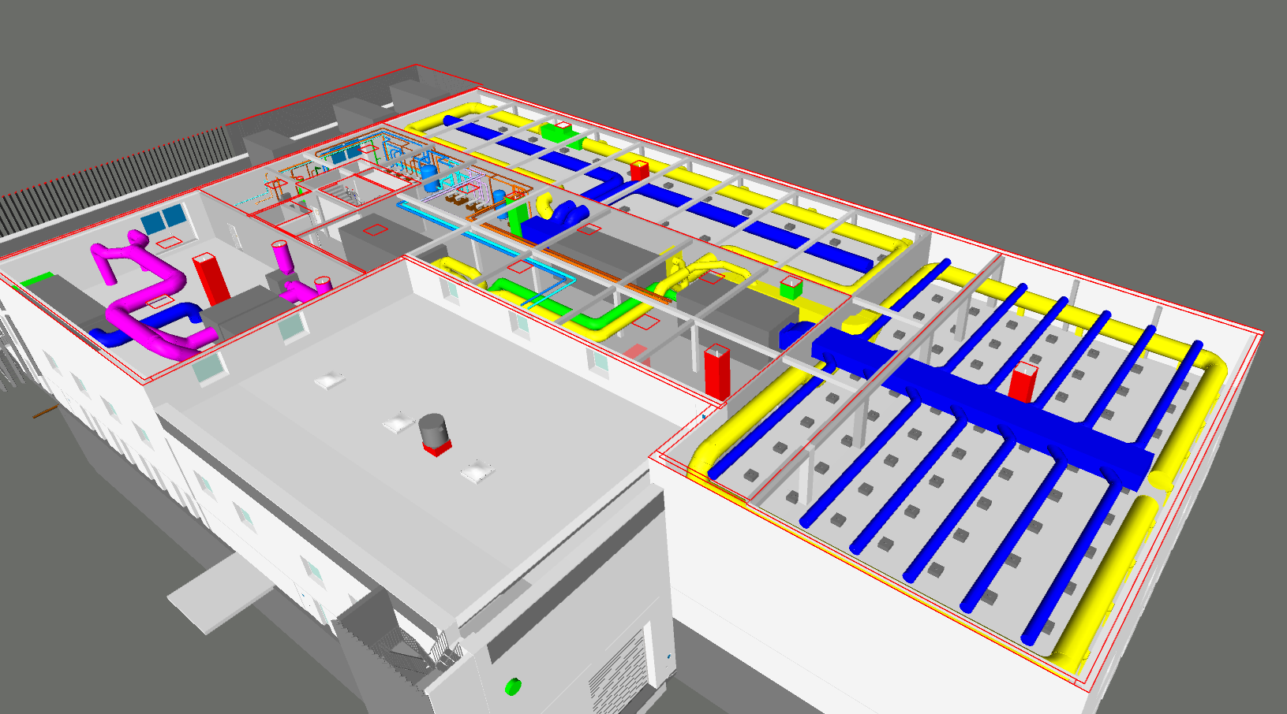
SRF/SA18 Cooling and ventilation systems
Description & Specific Condition :
Design, supply, installation, test and commissioning of all the HVAC systems and the air treatment system in the new building SA18 at Point 1.8 of the LHC.
Key conditions:
Experience in the installation of HVAC systems of similar size and complexity.
Experience in the installation of air treatment systems with wet scrubbers.
Experience in the execution of similar projects in accordance with applicable regulations.
Start of the Contract: Q2 2026
Procurement Code: 01 03 00 00
Cost Range : 5 MCHF ⬄ 10 MCHF
Planning: MS: Q2 2025
IT: Q4 2025
Contact: theodoros.aivaliotis@cern.ch

Slide 42
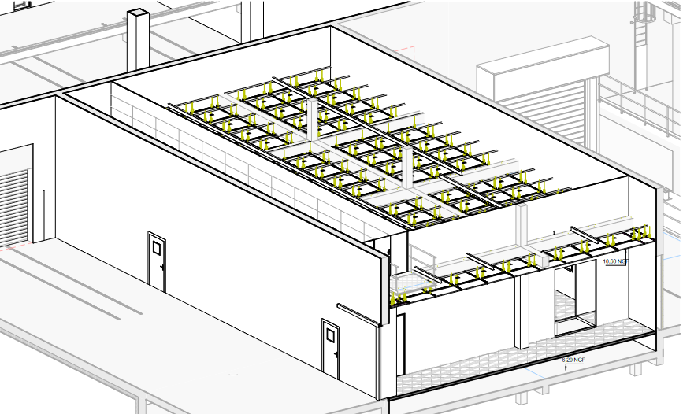
SRF/SA18 Cleanrooms construction
Description & Specific Condition :
Design, supply, construction, test and commissioning of all the cleanrooms and their associated HVAC systems in the new building SA18 at Point 1.8 of the LHC.
Key conditions:
Experience in the construction of laminar flow ISO Class 4 cleanrooms and mixed flow ISO 8 cleanrooms of similar size and complexity.
Experience in the execution of similar projects in accordance with the applicable regulations.
Start of the Contract: Q3 2026
Procurement Code: 01 03 00 00
Cost Range : 5 MCHF ⬄ 10 MCHF
Planning: MS: Q2 2025
IT: Q1 2026
Contact: theodoros.aivaliotis@cern.ch

Slide 43
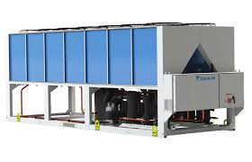
SRF/SA18 Natural refrigerant heat pumps/chillers
Description & Specific Condition :
Supply of the Air Source Heat Pumps (ASHPs), which will generate heating and cooling water for the new building SA18 at Point 1.8 of the LHC.
Key conditions:
Experience in the supply of units of similar cooling and heating capacities.
Utilisation of a natural refrigerant with very low GWP.
Energy performance validated in accordance to EN14511.
Start of the Contract: Q3 2026
Procurement Code: 01 03 01 03
Cost Range : 400k - 1.5M CHF
Planning: MS: Q3 2025
IT: Q1 2026
Contact: theodoros.aivaliotis@cern.ch

Slide 44
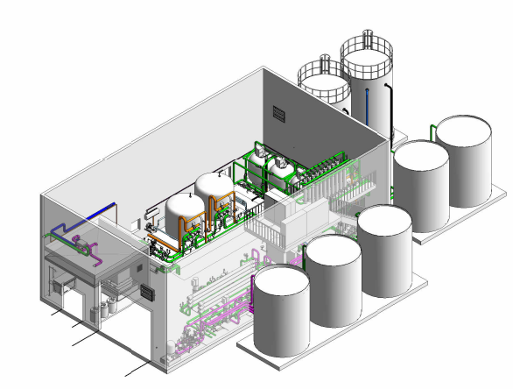
Water treatment plant in point 1
Description & Specific Condition :
Design, supply, installation, test and commissioning of a water treatment plant including :
Filtration: multimedia filters, ultrafiltration.
Softeners.
Reverse osmosis.
Tanks and piping.
Power and control cubicles.
Cost Range : 1.5 MCHF ⬄ 5 MCHF
Planning: MS: Q1 2027 IT: Q3 2027
Contact: serge.deleval@cern.ch
44

Slide 45
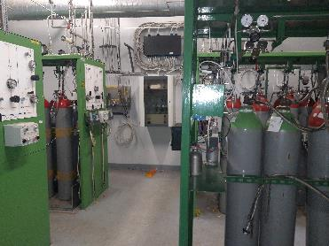
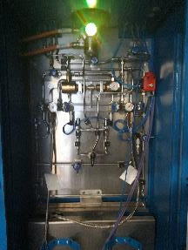
Gas supply infrastructure consolidation
Procurement Code: 13 02 08 00
Cost Range : 400kCHF ⬄ 1.5MCHF
Planning: MS: MS-5037 published
IT: Q2 2025
Contact: David.Jaillet@cern.ch
Description & Specific Condition :
Design, manufacturing of distribution panels and ATEX cabinets, dismantling of old pipes and racks, installation of distribution panels and ATEX cabinets, modification and update of the cabling, testing and commissioning.
Key requirements:
- Have a proven experience and competence in applying the norm EN 13480,
- Have welders with valid qualifications from 10mm to DN25
- Be able to provide a complete welding book with pipe inspection report
- Have at least 10 years of experience in the field of the installation of gas distribution systems, high purity gas
- Already have prepared a pressure test qualification
- Be able to work in near or in ATEX area and have the associated training
Start of the Contract: Q4 2025
Installation and commissioning to be completed by end 2027
Notes:
ATEX = explosive atmosphere hazard

Slide 46
Electrical Engineering, Electronics, Radiofrequency

Slide 47
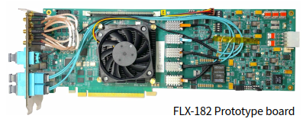
Custom designed PCIe based fibre optics I/O cards (MS-5040/EP)
Procurement Code: 03 04 09 00 (PCI, PCIe modular electronic boards)
Cost Range : 400 K – 1.5 M CHF
Planning: MS : Q4 2024 - published
IT: Q2 2025
Scope:
Assembly and testing of approx. 800 PCBs
Versal Prime VP1552 FPGA
PCIe Gen5 x16
Up to 52 optical links, link speed up to 25 Gb/s
Overall PCB dimensions: 311.99 x 106.65 m
24 layers and a thickness of (3.00 ± 0.28) mm
PCB material is EM980K
Duration: Production over 12 months
Eligible Firm Profile: Interested firms shall have proven experience and competence in assembly and test of PCBs of the complexity required. At least 50% shall originate in FR, DE, IL, IT, NL, RO, CH, US.
© CERN
Contact: Carlo.Alberto.Gottardo@cern.ch

Slide 48
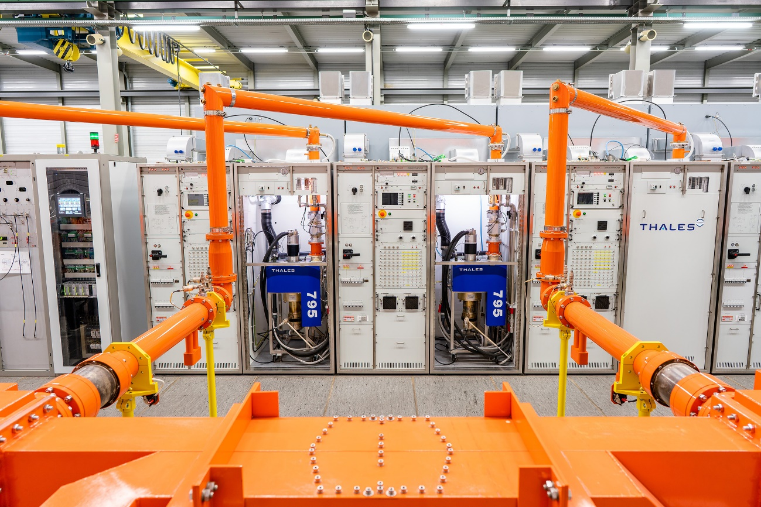
HL-LHC Crab cavities HPRF stations (MS-5024/SY/HL/LHC)
Description & Specific Condition :
Supply of 18 HPRF stations (High Power Radio Frequency station) powering IOTs for the HL-LHC Crab cavities.
Key conditions:
• Design and Manufacturing expertise in HPRF equipment
• Capacity to produce the systems in the required timeframe; delivery in batches over 2 years from the start of the contract. Commissioning foreseen in Q2 2027
Start of the Contract: Q4 2025
Procurement Code: 03 06 01 00
Cost Range : 5 MCHF ⬄ 10 MCHF
Planning: MS: published
IT: Q2 2025
Contact: gino.cipolla@cern.ch

Slide 49
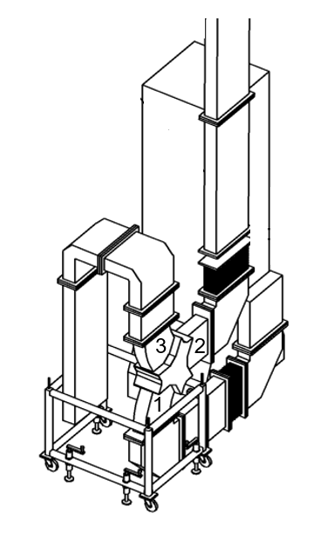
400.8MHz Waveguide Junction Circulators and Ferrite Loads for HL-LHC (MS-5065/SY/RF)
Description & Specific Condition :
Supply of 20x 400MHz Waveguide Junction Circulators and Ferrite Attenuator Segments
Key conditions:
Design expertise in high-power microwave ferrites devices
Manufacturing and testing of high-power microwave ferrite devices, including circulators and loads.
In-house manufacturing facilities
Capacity to manufacture 10 high power RF components per year over the last three years
Start of the Contract: Q4 2025
Procurement Code: 03 02 13 00
Cost Range : 5 MCHF ⬄ 10 MCHF
Planning: MS: published
IT: Q2 2025
Contact: chiara.marrelli@cern.ch

Slide 50
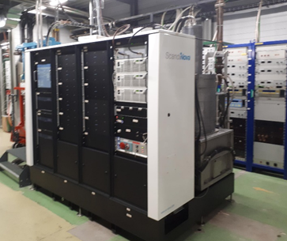
Turnkey High-Power RF-Systems for AWAKE (MS-5089/SY/RF)
Description & Specific Condition :
Supply, installation and maintenance of Turnkey High-Power RF Systems, including:
Full turnkey 45MW S-band;
Full turnkey 25MW X-band;
Fully equipped equipped HV modulator capable of powering a 50 MW X-band klystron.
The installation is expected to take place during Summer 2027 (in France)
Key conditions: Experience and competence in designing and manufacturing Turnkey High-Power RF Systems.
Start of the Contract: September 2025
Procurement Code: 03 06 01 00
Cost Range : 1.5 MCHF ⬄ 5 MCHF
Planning: MS: Published
IT: Q2 2025
Contact: steffen.doebert@cern.ch

Slide 51
Mechanical Engineering, Raw Materials

Slide 52
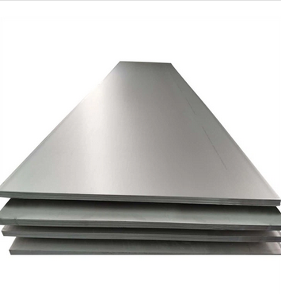
Stainless-steel sheets and plates EN 1.4429 AISI 316LN for Ultra-High Vacuum applications (MS-5056/SCE)
Procurement Code: 05 01 01 02 (Stainless Steel)
Cost Range : 1,5M – 5M CHF
Planning: MS : published
IT: Q2 2025
Contract start: 1 October 2025
Scope:
Supply of 80T stainless steel sheets and plates;
EN 1.4429 AISI 316LN (Electroslag Remelting ESR)
Duration: 5 years
Eligible Firm Profile: Interested firms shall have proven experience and competence in metallurgy, manufacturing, forging and testing of the above-mentioned material.
Contact: Leila.akhouay@cern.ch

Slide 53
Stainless-steel sheets and plates EN 1.4306 AISI 304L for High Vacuum applications (MS-5054/SCE)
Procurement Code: 05 01 01 02 (Stainless Steel)
Cost Range : 400K – 1,5M CHF
Planning: MS : Q2 2025
IT: Q3 2025
Contract start: 1 October 2025
Scope:
Supply of 70T stainless steel sheets and plates;
EN 1.4306 AISI 304L
Duration: 5 years
Eligible Firm Profile: Interested firms shall have proven experience and competence in metallurgy, manufacturing, forging and testing of the above-mentioned material.
Contact: Leila.akhouay@cern.ch

Slide 54
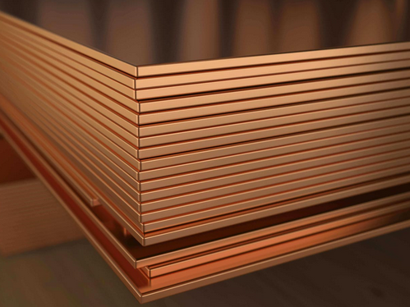
Cu-OFE (Oxygen-Free Copper) sheets and plates for Ultra-High Vacuum applications (MS-5057/SCE)
Procurement Code: 05 01 01 03 (Copper)
Cost Range : 400K – 1,5M CHF
Planning: MS : Q2 2025
IT: Q3 2025
Contract start: 1 October 2025
Scope:
Supply of 50T Oxygen- Free Electronic copper (UNS C10100) Grade 1, according to ASTM B224 with a maximum oxygen content of 5ppm
Duration: 5 years
Eligible Firm Profile: Interested firms shall have proven experience and competence in metallurgy, manufacturing, forging and testing of the above-mentioned material.
Contact: Leila.akhouay@cern.ch

Slide 55
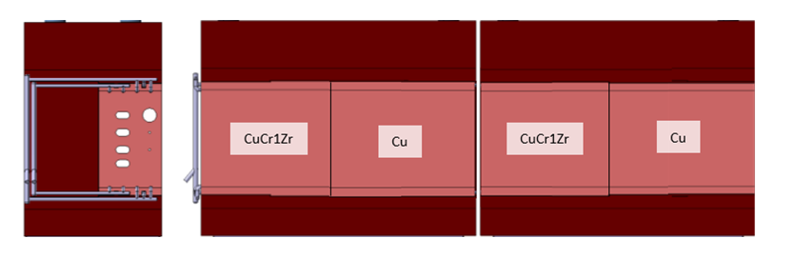
CuCr1Zr blanks for XTAX (MS-5074/BE)
Procurement Code: 05 01 03 03 (Copper, copper alloys)
Cost Range : 400K – 1,5M CHF
Planning: MS : Q2 2025
IT: Q3 2025
Contract start: Q4 2025
Scope:
Supply of forged CuCr1Zr blanks in various shapes and sizes
Material: CuCr1Zr CW106C according to EN 12420, multi-directional forged, solution annealed, and precipitation hardened. Delivered in temper H120 (according to EN 12167).
Overall tolerances: ISO2768 – cL
Delivery by July 2026
Eligible Firm Profile:
Interested firms shall have proven experience and competence in forging, machining, and material testing and certification.
6x DIMENSIONS : 300x810x420 mm³
2x DIMENSIONS : 800x810x420mm³
1x DIMENSIONS : 300x800x170mm³
Contact: miguel.lino@cern.ch

Slide 56

Cast Iron for XTAX (MS-5075/BE)
Procurement Code: 05 01 04 01 (Cast iron, steel)
Cost Range : 1,5M CHF – 10M CHF
Planning: MS : Q3 2025
IT: Q1 2026
Contract start: Q3 2026
Delivery by end 2027
Scope:
Supply of 410 T of Cast Iron Blocks machined in various shapes and sizes.
Main materials: Nodular Iron GJS – 400-18U-RT, acc. to EN 1563
Paint: Primer anti-radiation: Inorganic zinc silicate; 2nd layer epoxy coat; (3rd layer red 3005)
Overall tolerances: ISO2768 - cL
Eligible Firm Profile:
Interested firms shall have proven experience and competence in casting, machining, and material testing and certification.
20x DIMENSIONS : 500x380x2100 mm³
20x DIMENSIONS : 500x820x2100 mm³
14x DIMENSIONS : 500x785x2100 mm³
7x DIMENSIONS : 3200x1600x800 mm
1x DIMENSIONS : 490x3230x657 mm³
1x DIMENSIONS : 300x3230x440 mm³
Contact: miguel.lino@cern.ch

Slide 57
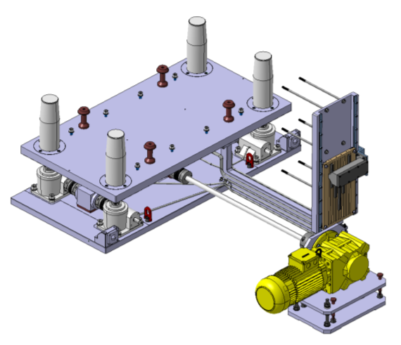
Tables for XTAX (MS-5076/BE)
Procurement Code: 05 01 01 04 (Aluminium, aluminium alloys)
05 01 01 02 (Stainless steel)
Cost Range : 400K – 1,5M CHF
Planning: MS : Q1 2026
IT: Q2 2026
Contract start: Q3 2026, delivery by May 2027
QTY: 8; DIMENSIONS: 1616 x 780 x 832 mm³
QTY: 1; DIMENSIONS: 3200 x 780 x 832 mm³ (non motorized)
Scope:
Supply of alignment tables which are a Z displacement (300 mm) device, designed to support and lift 15T of operational load with all controls and driving systems placed outside the table footprint.
Stroke: +/-150 mm; Operational Load 12 T; Speed: 100 mm/min
Each table is equipped with a manual alignment system on its base providing 5 DOF with the following specifications:
Resolution: 0.1mm; Stroke: y: +/- 5 mm; Z: +/- 3mm; Rx: +/- 7 mrad; Ry: +/- 7 mrad; Rz: +/- 7 mrad
Main materials: AL EN AW6082, Stainless Steel A4, Stainless Steel 304
General machining tolerances ISO2768 – mk
All commercial components must be radiation hard > 100kGy in 20 Yrs.
Eligible Firm Profile
Interested firms shall have proven experience and competence in machining, precision assembly, and metrology and material testing and certification.
Contact: miguel.lino@cern.ch

Slide 58

Information Technology

Slide 59

Human Capital Management (HCM) Implementation Services
(MS-5061/FAP)
Procurement Code: 04900200 (Software Development Consultants)
Cost Range : 400k – 5M CHF
Planning: MS : Q3 2025
IT: Q4 2025
Contract start: 1 May 2026
Scope:
Provision of agile HCM Suite implementation services (tool vendor to be determined in preceding tendering procedure).
Duration: 3 years
Eligible Firm Profile:
Interested firms shall have proven competence and experience in implementing HCM/ERP solutions in replacement of an existing system.
They shall be certified implementation partners for the HCM solutions they wish to be considered for.
Contact: Oana.Liteanu@cern.ch, Jan.Janke@cern.ch

Slide 60
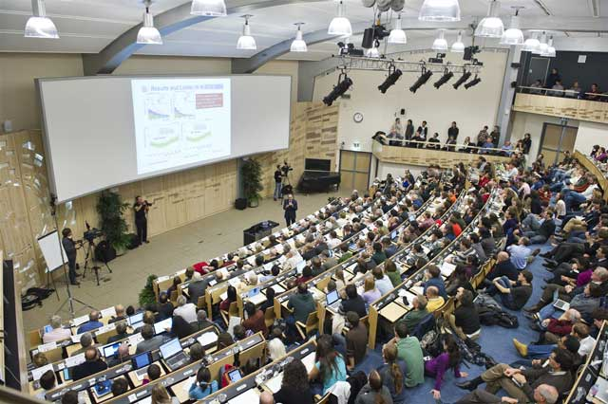
Supply and installation of audio-visual equipment
Procurement Code: 04040000
Cost Range : 1.5M – 5M CHF
Planning: MS : Q2 2025
IT: Q3 2025
Contract start: 1 January 2026
Scope:
Supply and installation of equipment for around 75 conference rooms including three auditoriums
Includes system schematics, rack layouts, cabling schedules, room layouts
Duration: 3 years, blanket purchase contract
Eligible Firm Profile:
Interested firms shall have proven competence and experience in supplying AV and videoconferencing equipment
Contact: Olof.Barring@cern.ch

Slide 61
Construction,
Onsite & Offsite Services

Slide 62
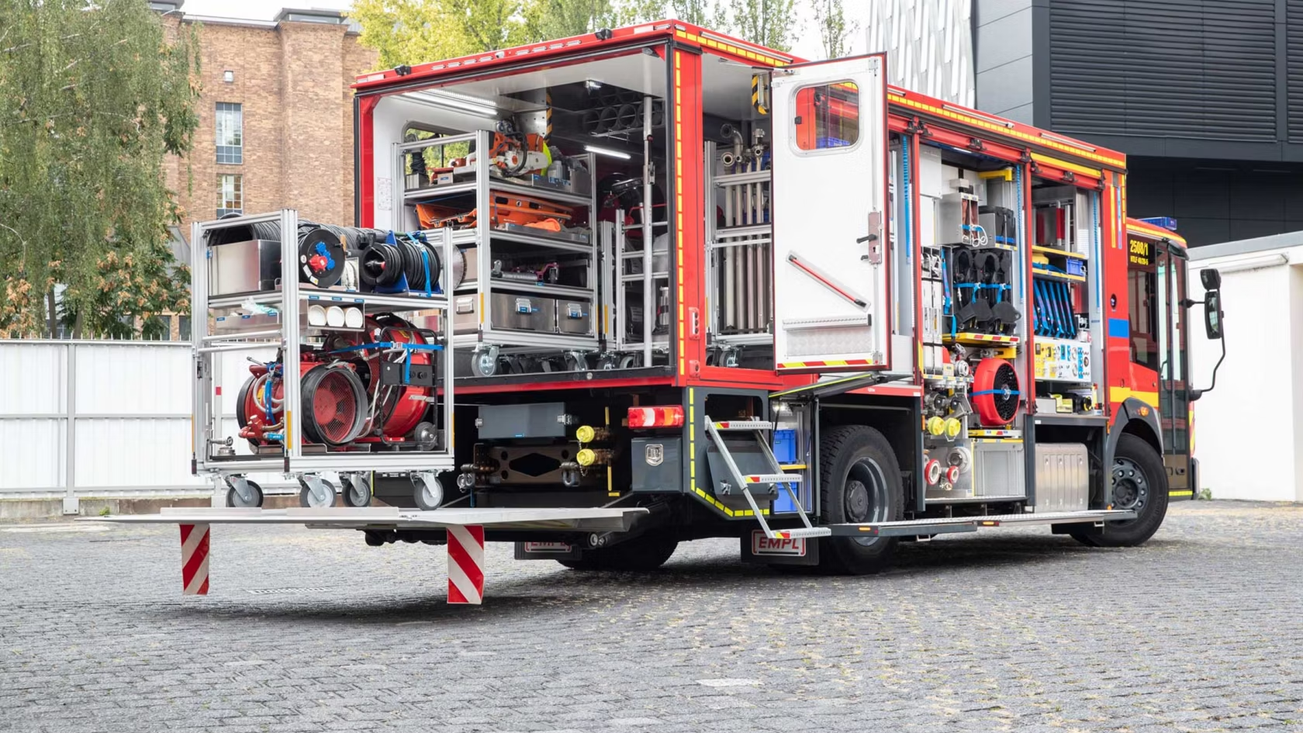
Supply of three utility vehicles (MS-5083/HSE)
Description & Specific Condition :
Three utility vehicles to be delivered over a three- year period (2026-2028)
  1x Flexi Unit in 2026
  1x Officer unit in 2027
  1x Flexi unit in 2028
Vehicles must be suited to transport fire and rescue equipment
Be equipped with an automatic gearbox
Procurement Code: 11 01 04 01 (Fire engines)
Cost Range : 400 kCHF - 1.5 MCHF
Planning: MS: Q2 2025 IT: Q3/4 2024
Contact: Miikka.Leinonen@cern.ch

Slide 63
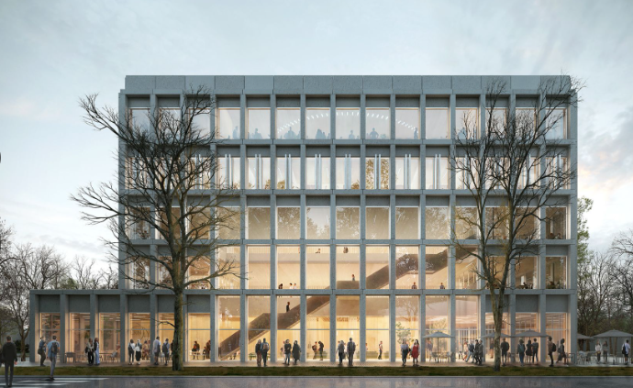
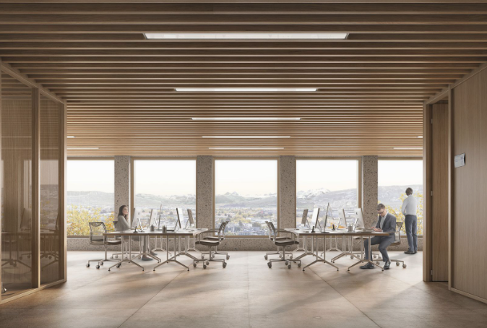
Construction of new Building 140
Description & Specific Conditions :
General contractor to construct new Building 140 on CERN’s Meyrin site in Switzerland.
Highly-performing mechanical, electrical, plumbing (MEP) and façade system to achieve recognised sustainability accreditation.
The building will provide a new council meeting room, EP workshops, a learning centre and media facilities and will be constructed in two phases
Procurement code: 01 02 01 00/ 01/ 02
Cost Range : > 10M CHF
Planning: MS Q3 2025 / IT Q1 2026
Contact: baptiste.mercier@cern.ch

Slide 64

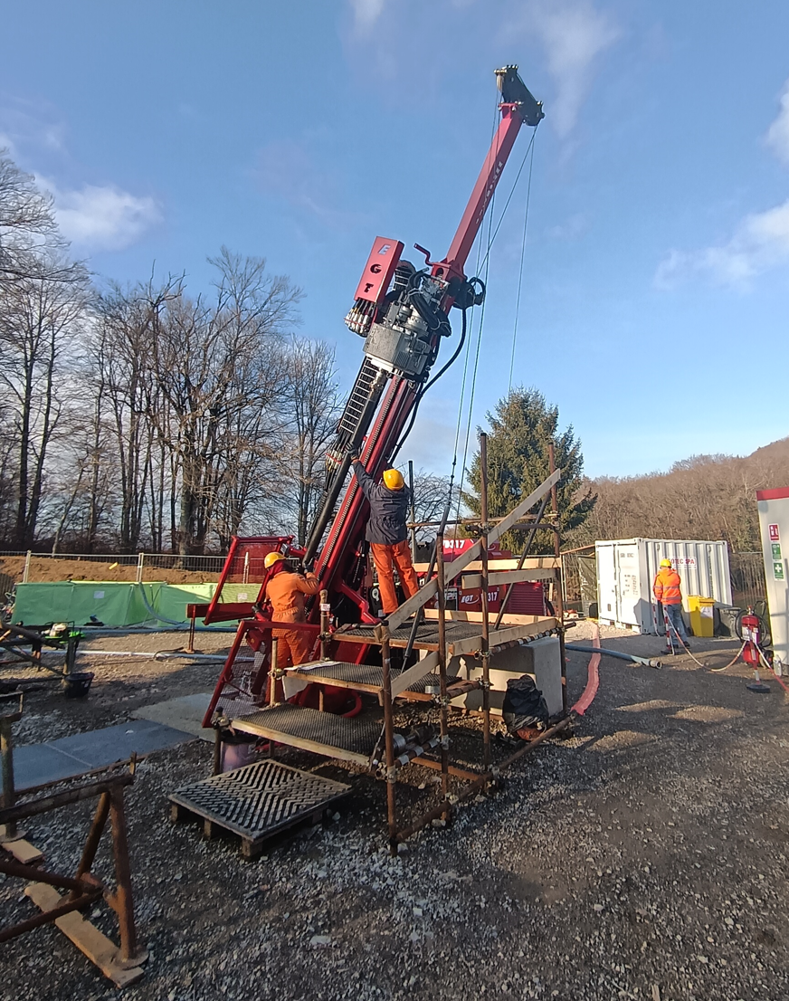
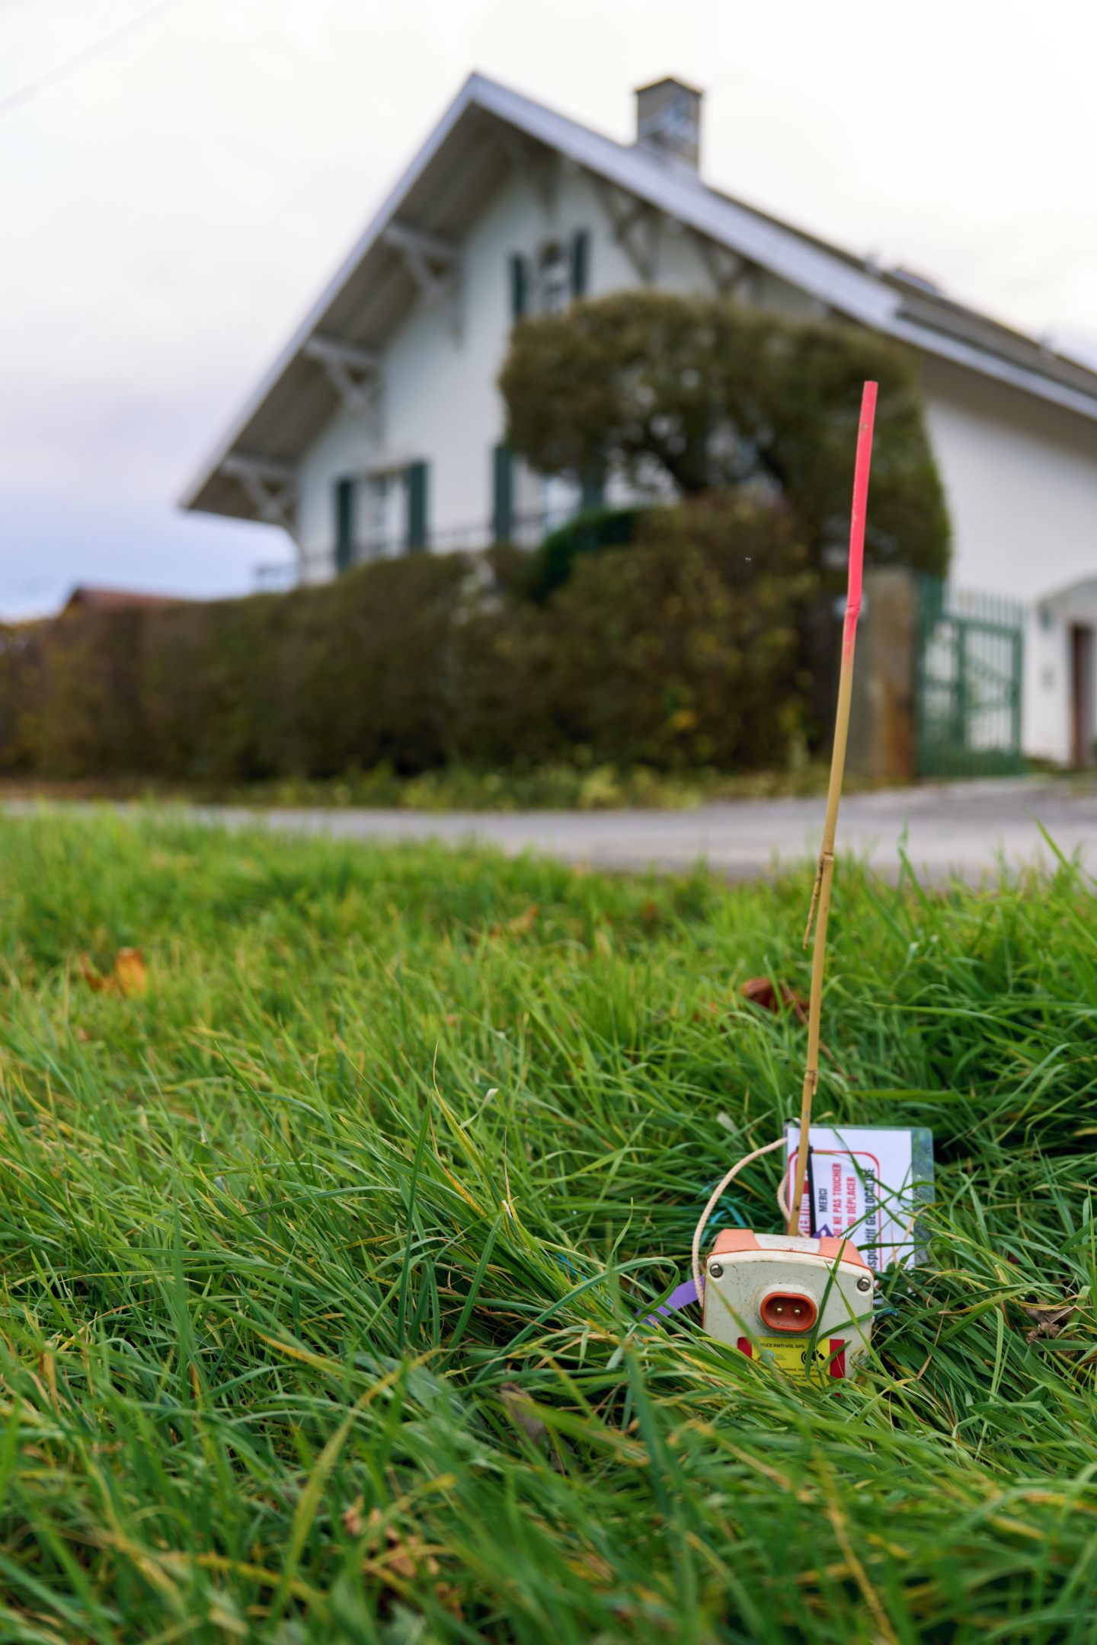
Consulting engineering services for FCC Site Investigations
Description & Specific Conditions :
Appointment of a consultant for the provision of engineering services to prepare design and specifications in readiness for the potential second phase of FCC site investigations
Scope of services includes geotechnical and civil engineering as well as environmental and permitting aspects and associated reporting
Procurement code: 01 01 01 00; 01 90 04 03; 01 90 01 02
Cost Range : 5M – 10M CHF
Planning: MS Q2 2025 Open Now (MS-5095) / IT Q2 2025
Contact: Roderick.cunnigham@cern.ch

Slide 65
CERN – Austria Success Stories

Slide 66

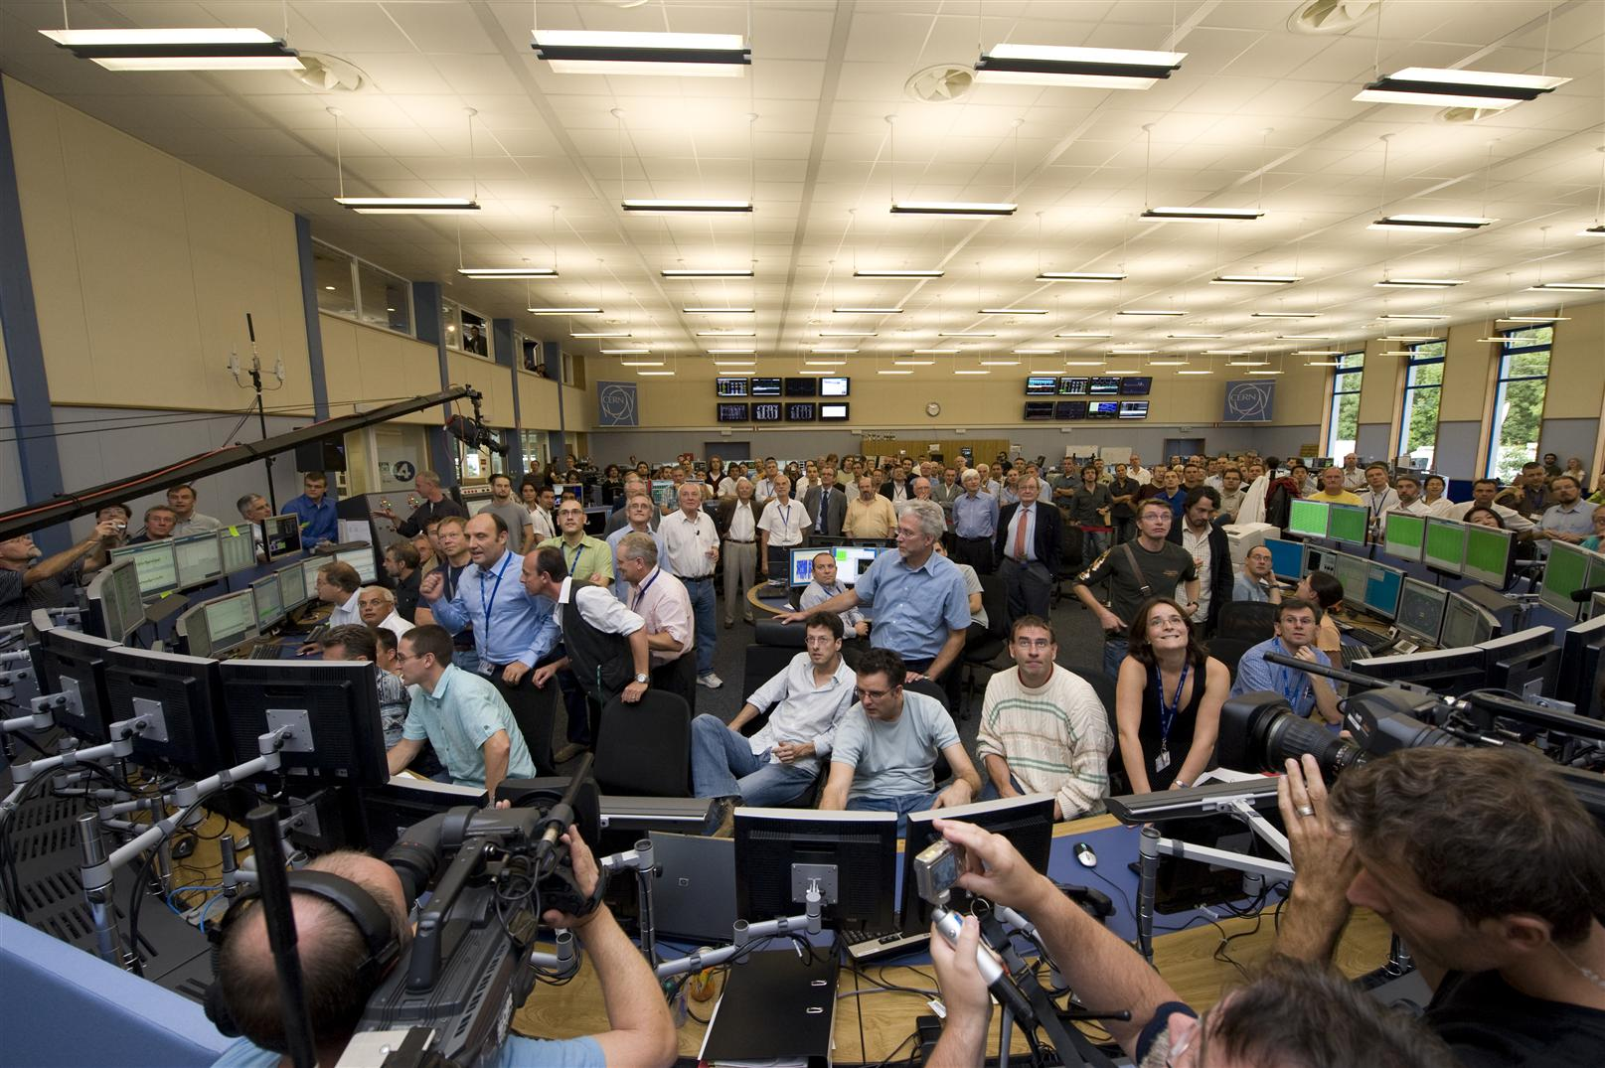
ETM Professional Control – Contract X089
Long standing contract for the development and provision of an integrated control system for the LHC and associated infrastructures
Example of co-development between CERN and high-tech Austrian company who have become long term partner
Initially a small company, they have grown during the lifecycle of the contract and have been acquired by Siemens as a wholly owned subsidiary

Slide 67


HMF Smart Solutions – Contract B1342
Design, supply, installation, commissioning and maintenance of a digital radio communication system
Critical digital system, based on the TETRA (Terrestrial Trunked Radio) standard for use by emergency authorities which provides very high reliability, availability and full coverage of all the CERN sites in order to fulfil the
outdoor, indoor and underground communication needs (voice and data) of CERN’s Fire Brigade.
It guarantees independent communication channels for the French and Swiss authorities, as well as for guards and safety, security and maintenance teams.

Slide 68


Trench Austria – Contract B1582
Supply of Harmonic Filter Reactor (HFR) coils for Static Var Compensators (SVCs) under a blanket purchase contract
Critical and highly technically specialised components for high-voltage installations used for stabilising and filtering the electrical network voltage, as well as for compensating the reactive power consumed by the electrical loads of CERN’s particle accelerators.

Slide 69


TU Wien – Collaboration Agreement
Collaboration agreement for the characterisation of HTS REBCO tape for the CERN HFM R&D programme
FCC-hh requires the development of superconducting magnets that produce magnetic fields beyond those that will be attained by the High-Luminosity LHC
(HL-LHC). CERN is collaborating with European institutes on the development of
superconducting magnets, as set out in the HFM R&D roadmap.
TU Wien has a specialised neutron irradiation facility and extensive expertise in this domain to support these R&D efforts

Slide 70


ILF Consulting Engineers
Provision of engineering consultancy services for several studies related to the FCC Feasibility Study including:
High level cost and schedule development updated in keeping with development of the alignment and design changes
Early identification of areas of highest geological uncertainty in support for the eventual tendering for the site investigation campaign currently underway
Partnered with Swiss office and local geological consultants

Slide 71

Doing business with CERN: the facts
Supplier Survey (500+ respondents in 34 countries, 2024)
4.53/5
average rating
98%
of suppliers would recommend CERN as a client
1 out of 4
hired new personnel
71%
had positive impact on their sales
63%
used CERN as a marketing reference
66%
improved products or services
47%
developed new products
70%
improved technical knowledge in their field
52%
found or opened a new market to address
Notes:
The key message here is that CERN is an open institution: open to its neighbours, and open to citizens from across the globe. We welcome them to CERN and go out to meet them
This slides summarises the outreach activities carried out by CERN.
It also includes a mention of CERN’s fundraising activities, for projects that are not part of CERN’s core activity. These fall into three categories: education & outreach, culture and creativity, innovation and knowledge exchange

Slide 72

Doing business with CERN: the facts
Using CERN as a marketing reference has a positive
reputational effect for our suppliers

Slide 73

Thank you
Thank you

