Slide 1


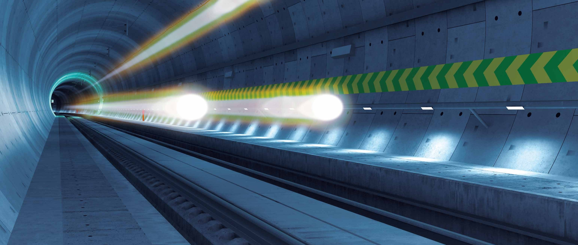

Cross-Border Collaboration:
Challenges and Insights from Brenner Base Tunnel
Matthias Hofmann
© BBT / All Rights Reserved

Slide 2

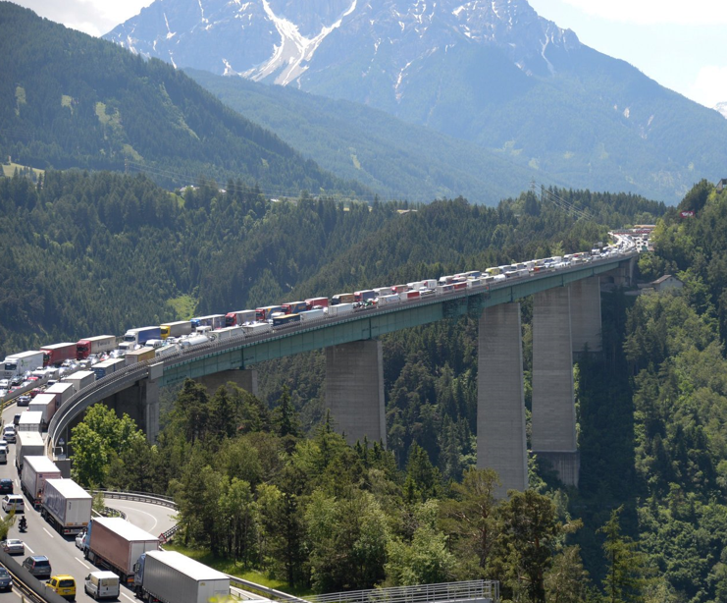
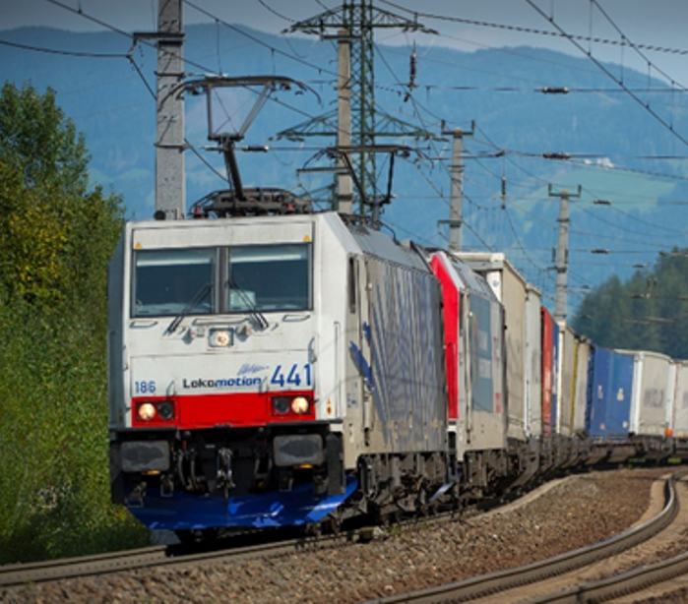
Short overview of Brenner Base Tunnel (BBT) project
BBT / BRENNER BASISTUNNEL GALLERIA DI BASE DEL BRENNERO
Transport volume Brenner Pass
(2019)
52.7m t
Modal share
of ROAD
38,8m t (73,5%)
Modal share of RAIL
13.9m t (26,5%)

Slide 3
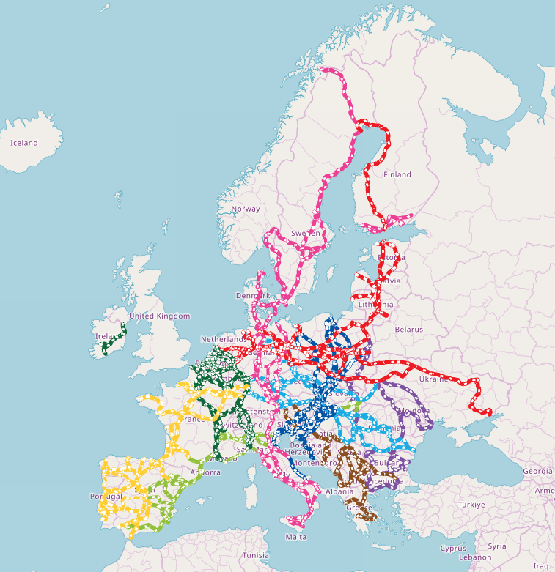
BBT / BRENNER BASISTUNNEL GALLERIA DI BASE DEL BRENNERO
ScanMed Korridor
Trans-European-Network
Transport
© TENtec Map EC

Slide 4
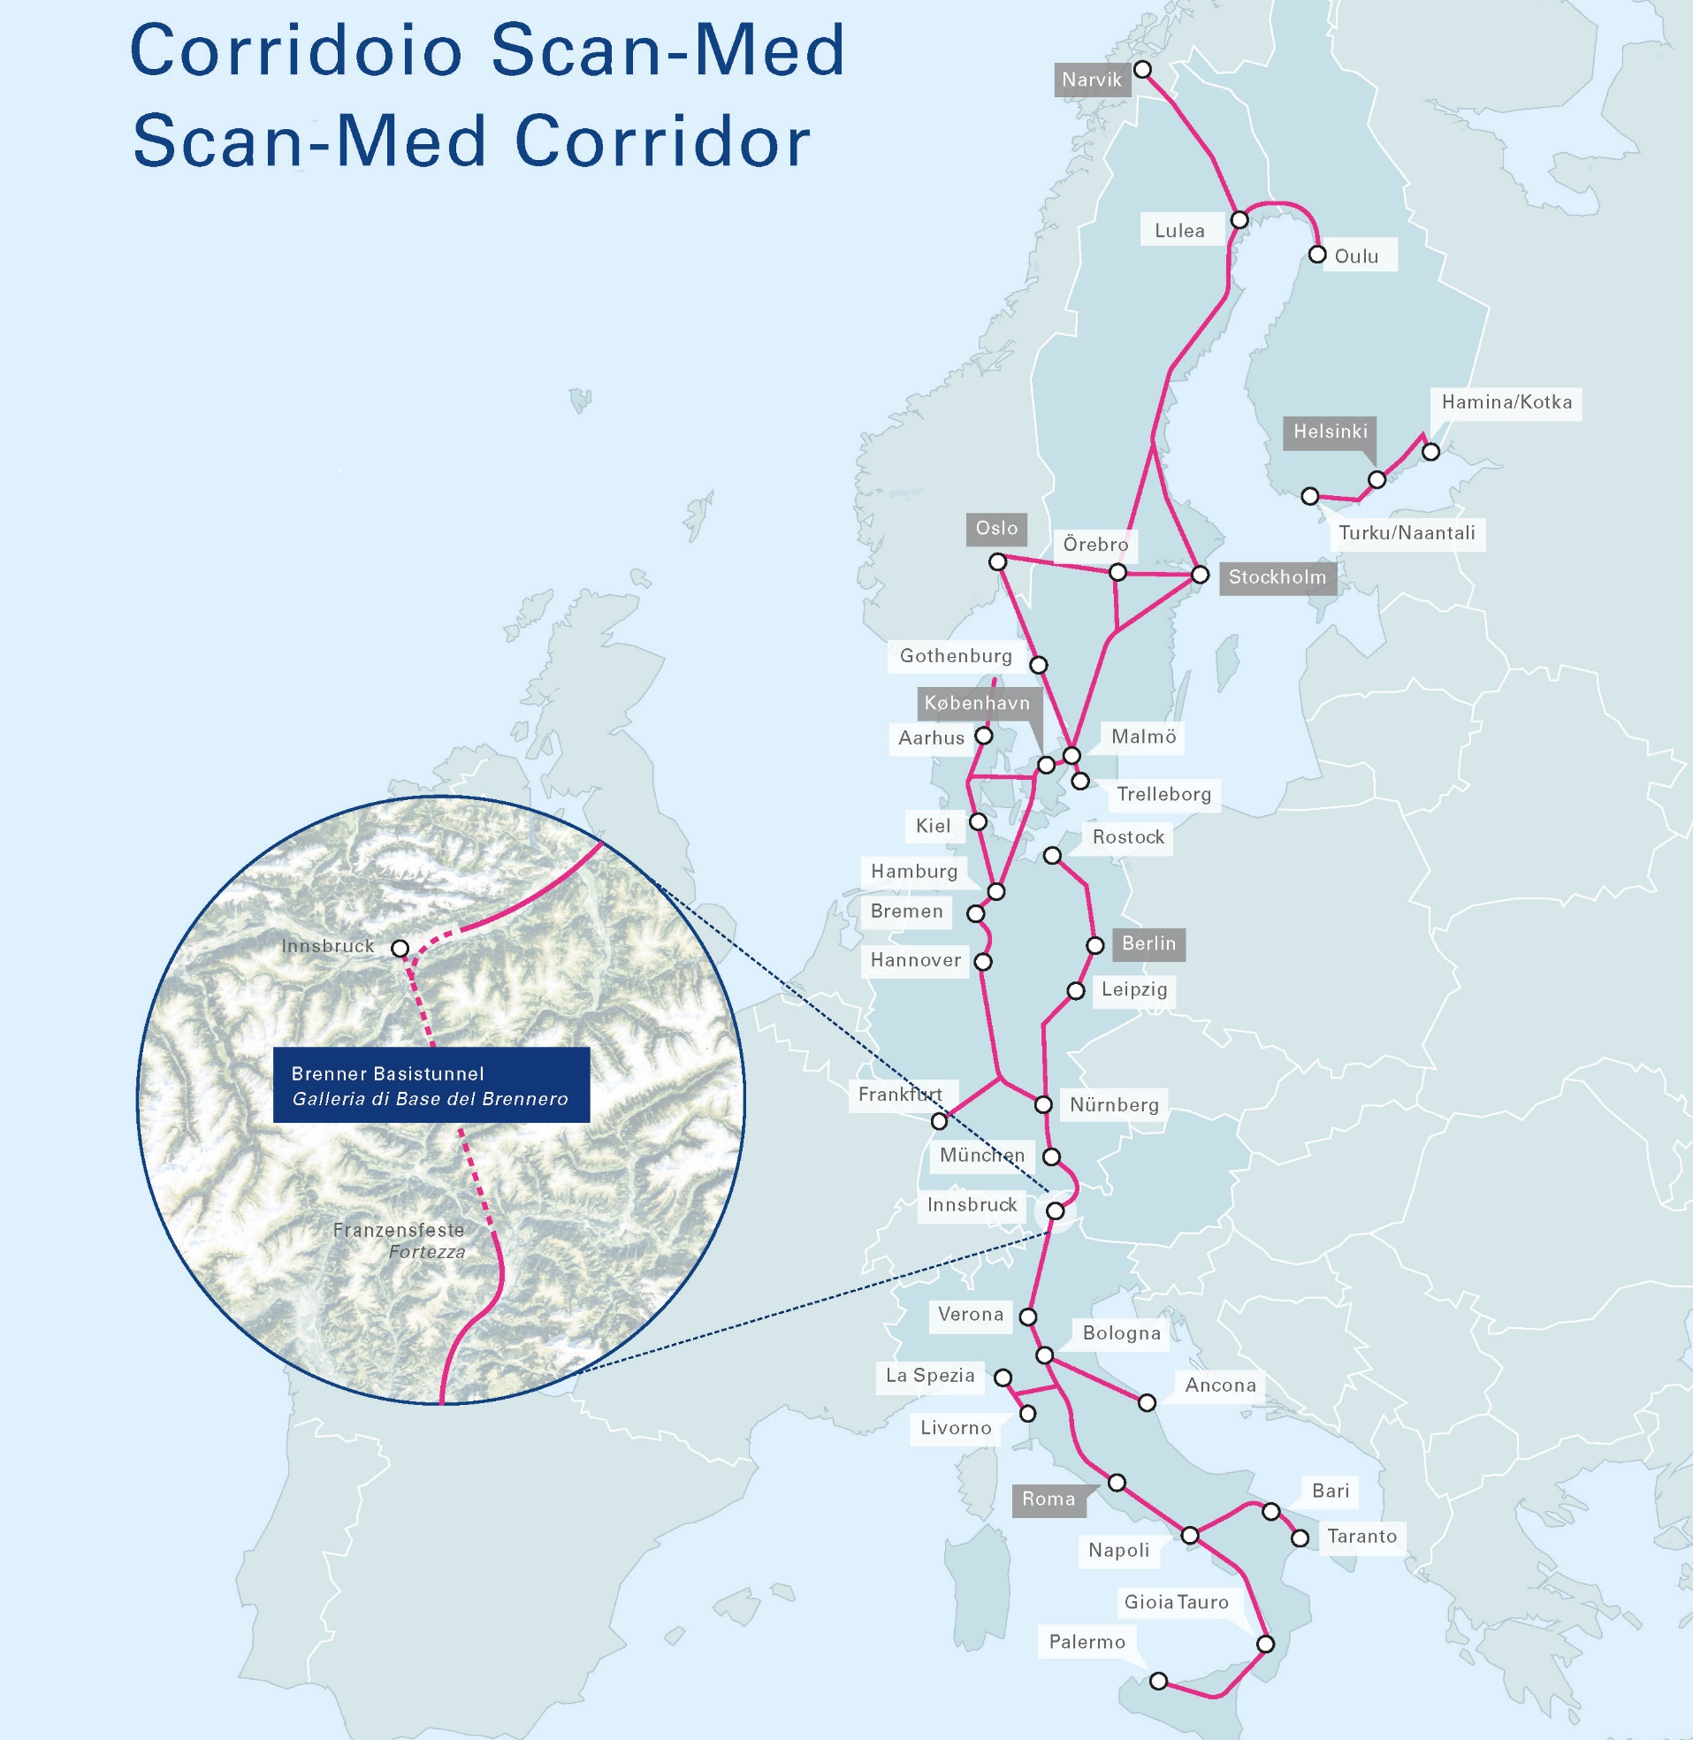

BBT / BRENNER BASISTUNNEL GALLERIA DI BASE DEL BRENNERO
Scan-Med Corridor
BBT as the centrepiece
• Approx. 9,400 km railway line
• 8 countries
• 110 million people

Slide 5
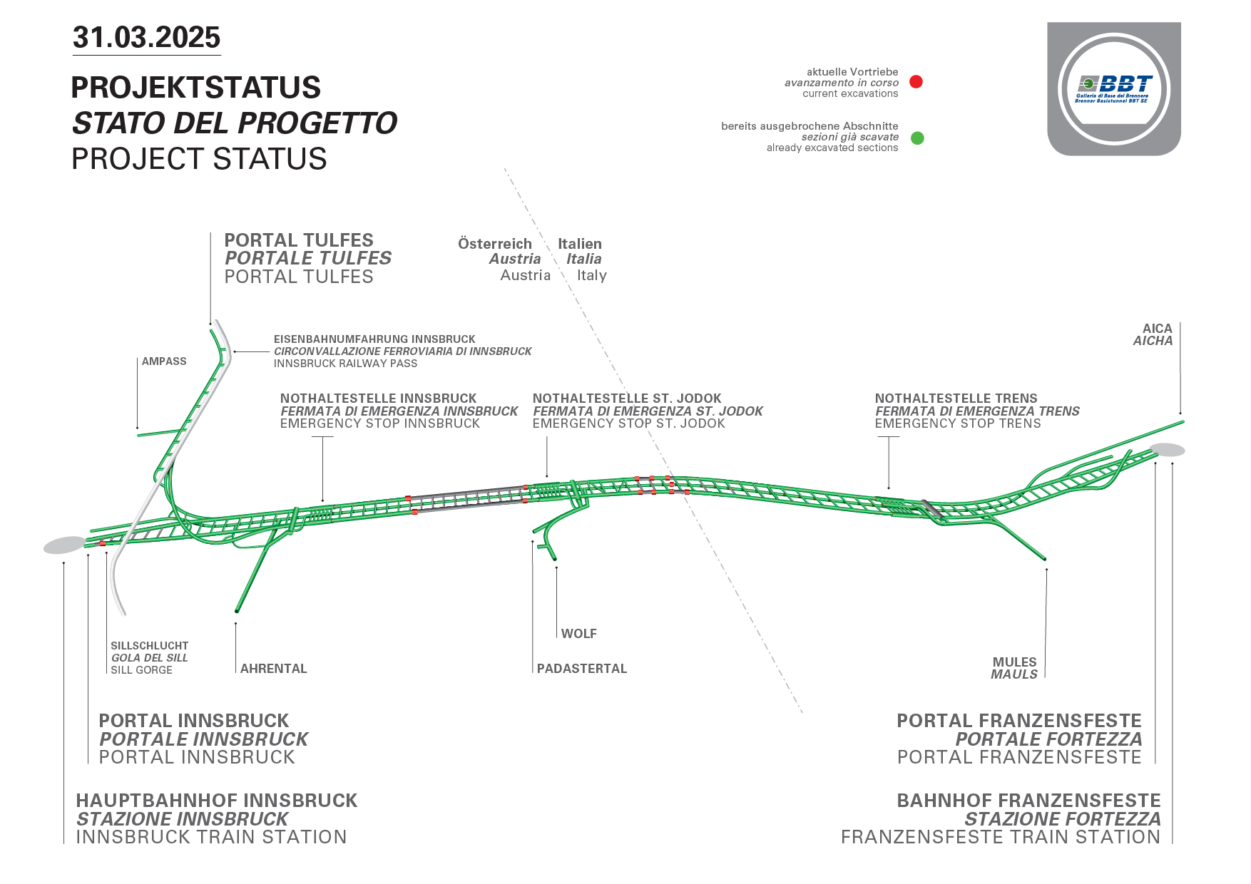
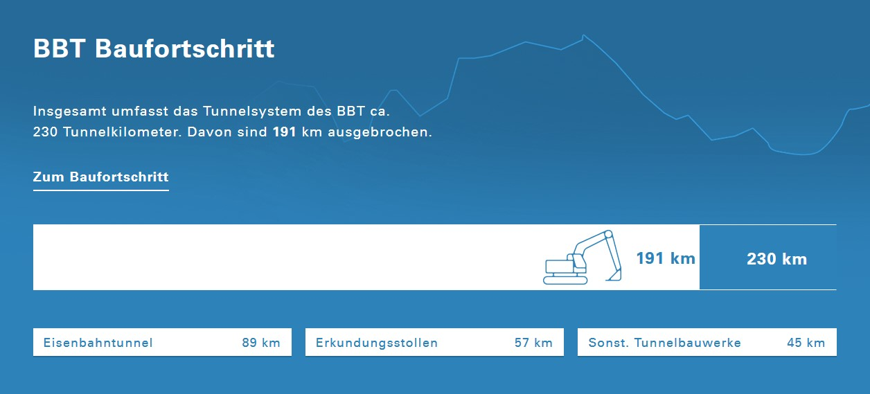

Slide 6
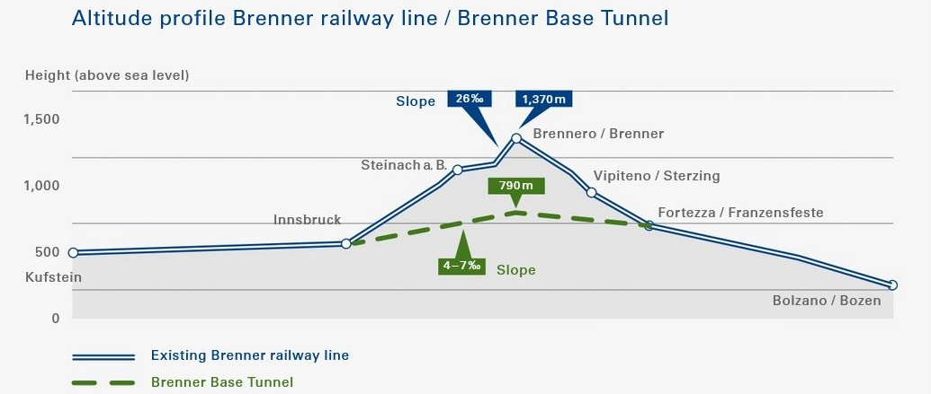
BBT / BRENNER BASISTUNNEL GALLERIA DI BASE DEL BRENNERO
Advantages of a flat railway line
6
6

Slide 7
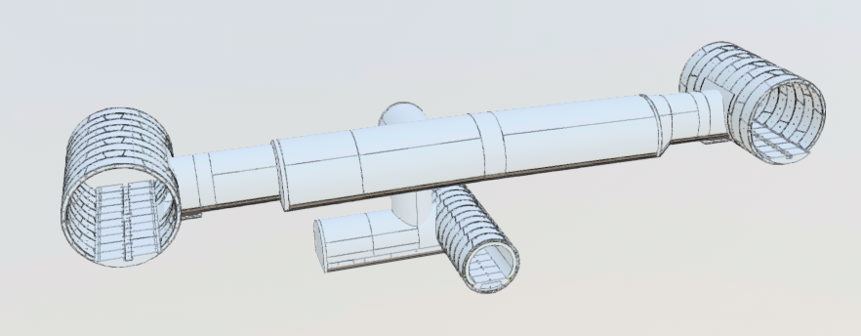
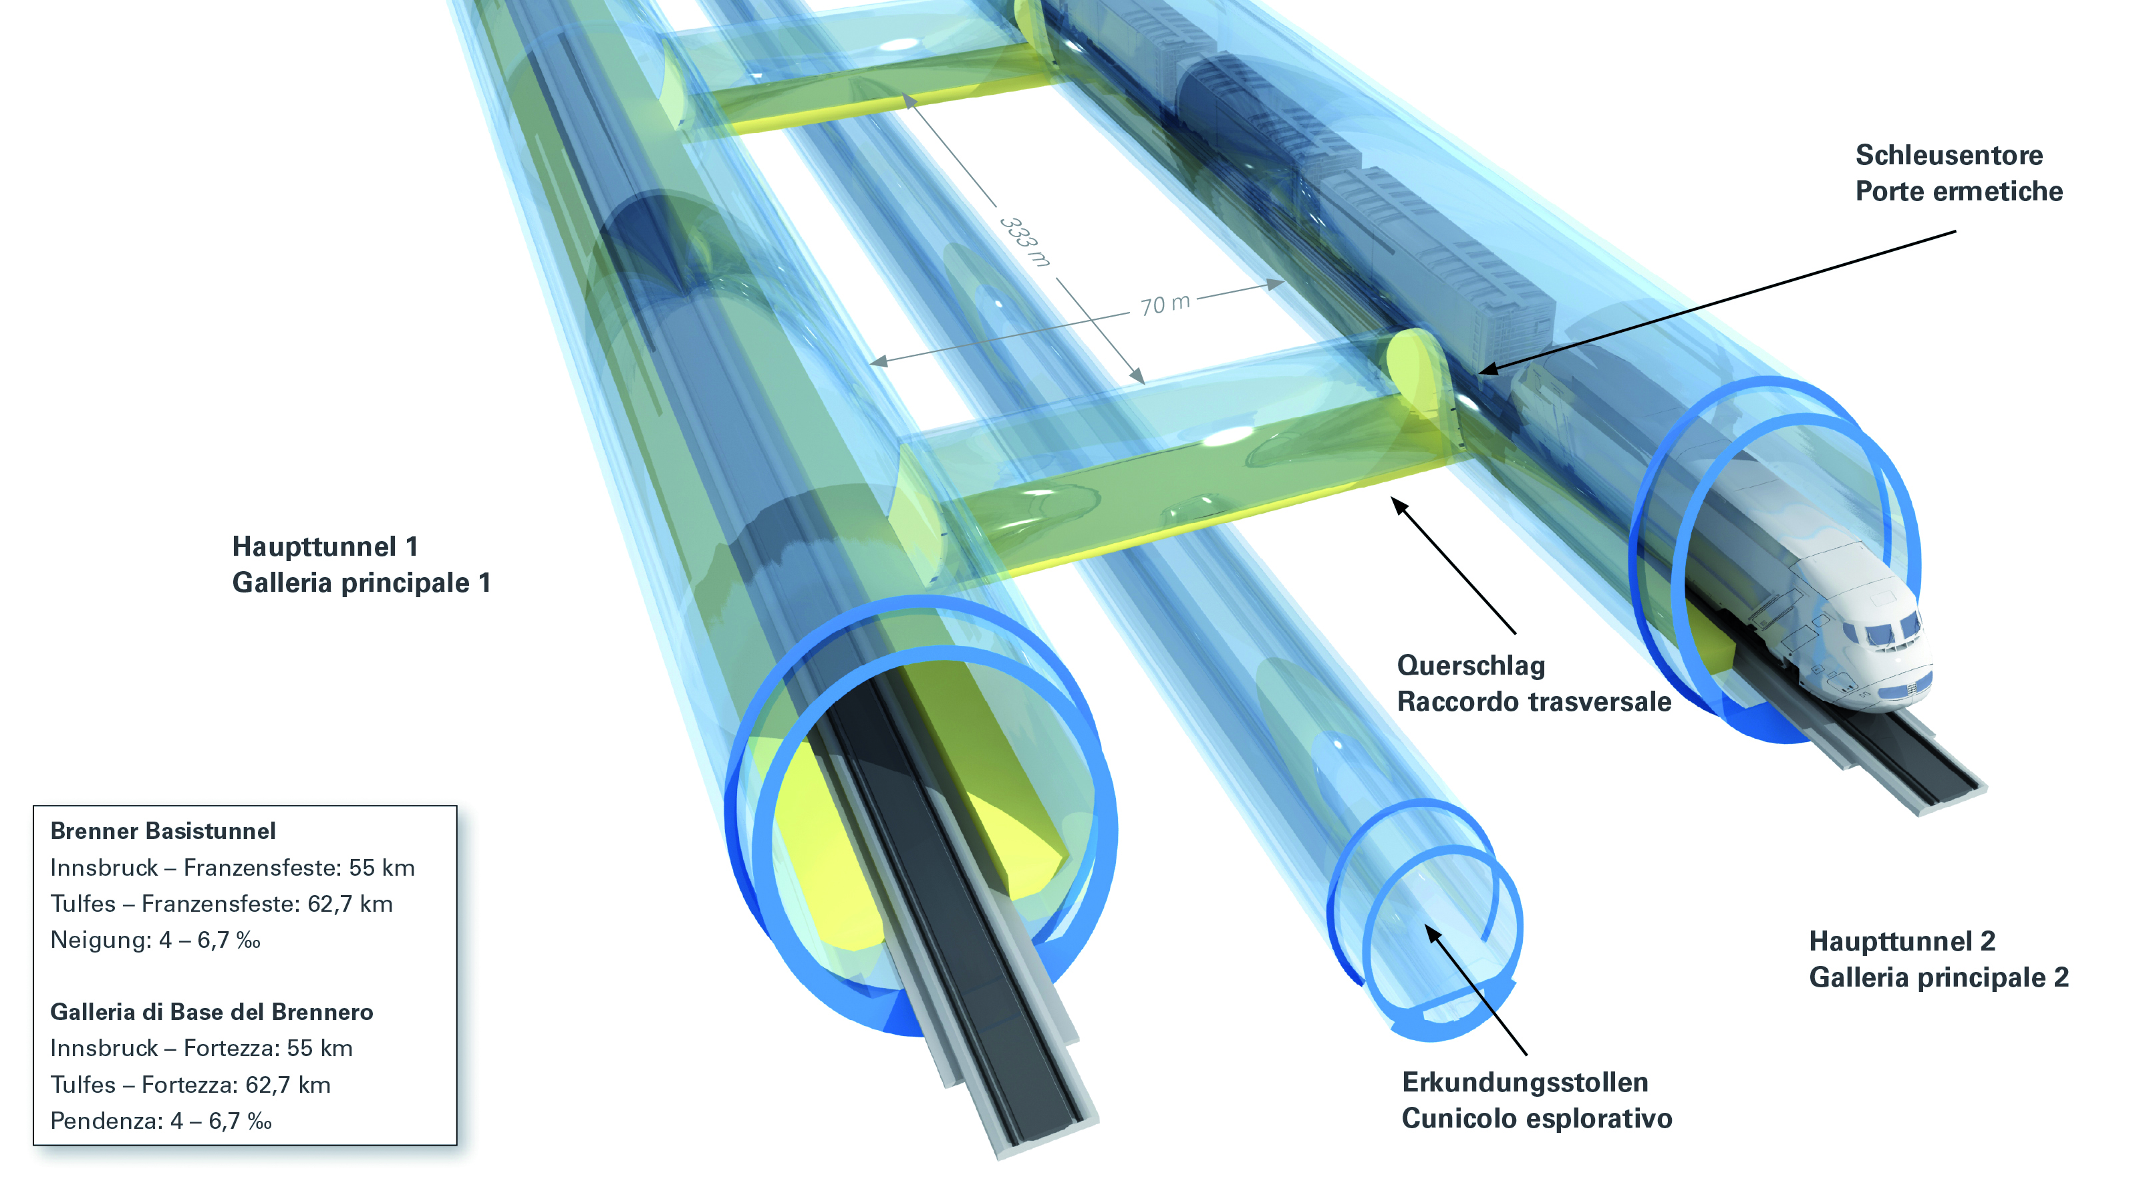
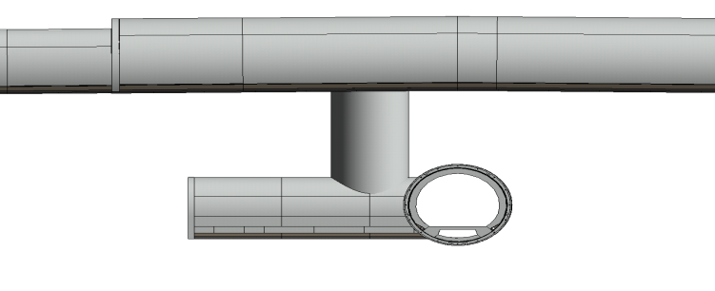
BBT / BRENNER BASISTUNNEL GALLERIA DI BASE DEL BRENNERO
Speciality of BBT: Exploratory Tunnel

Slide 8
BBT / BRENNER BASISTUNNEL GALLERIA DI BASE DEL BRENNERO
Main info
Length of the BBT | Innsbruck-Fortezza 55 km / Tulfes-Fortezza 64 km
Maximum overburden | approx.1,720 m
Total length of the tunnel system | approx. 230 km
Spoil | approx. 21.5 Mio. m³
Design speed | Freight trains up to 160 km/h, passenger trains up to 250 km/h

Slide 9
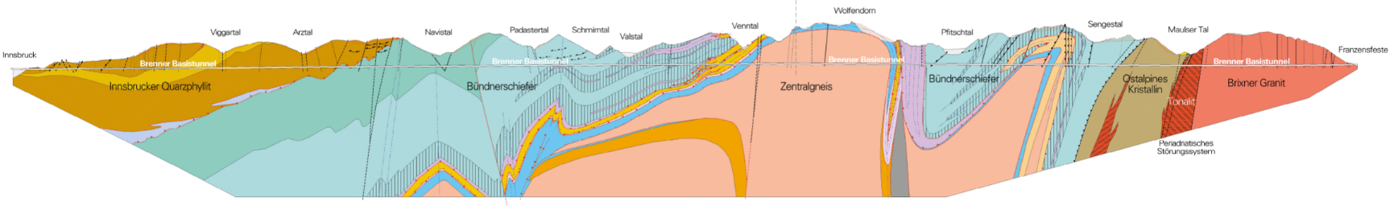
Cross-Border Collaboration: Challenges
BBT / BRENNER BASISTUNNEL GALLERIA DI BASE DEL BRENNERO
Dimension
Duration of the project
3. National border

Slide 10
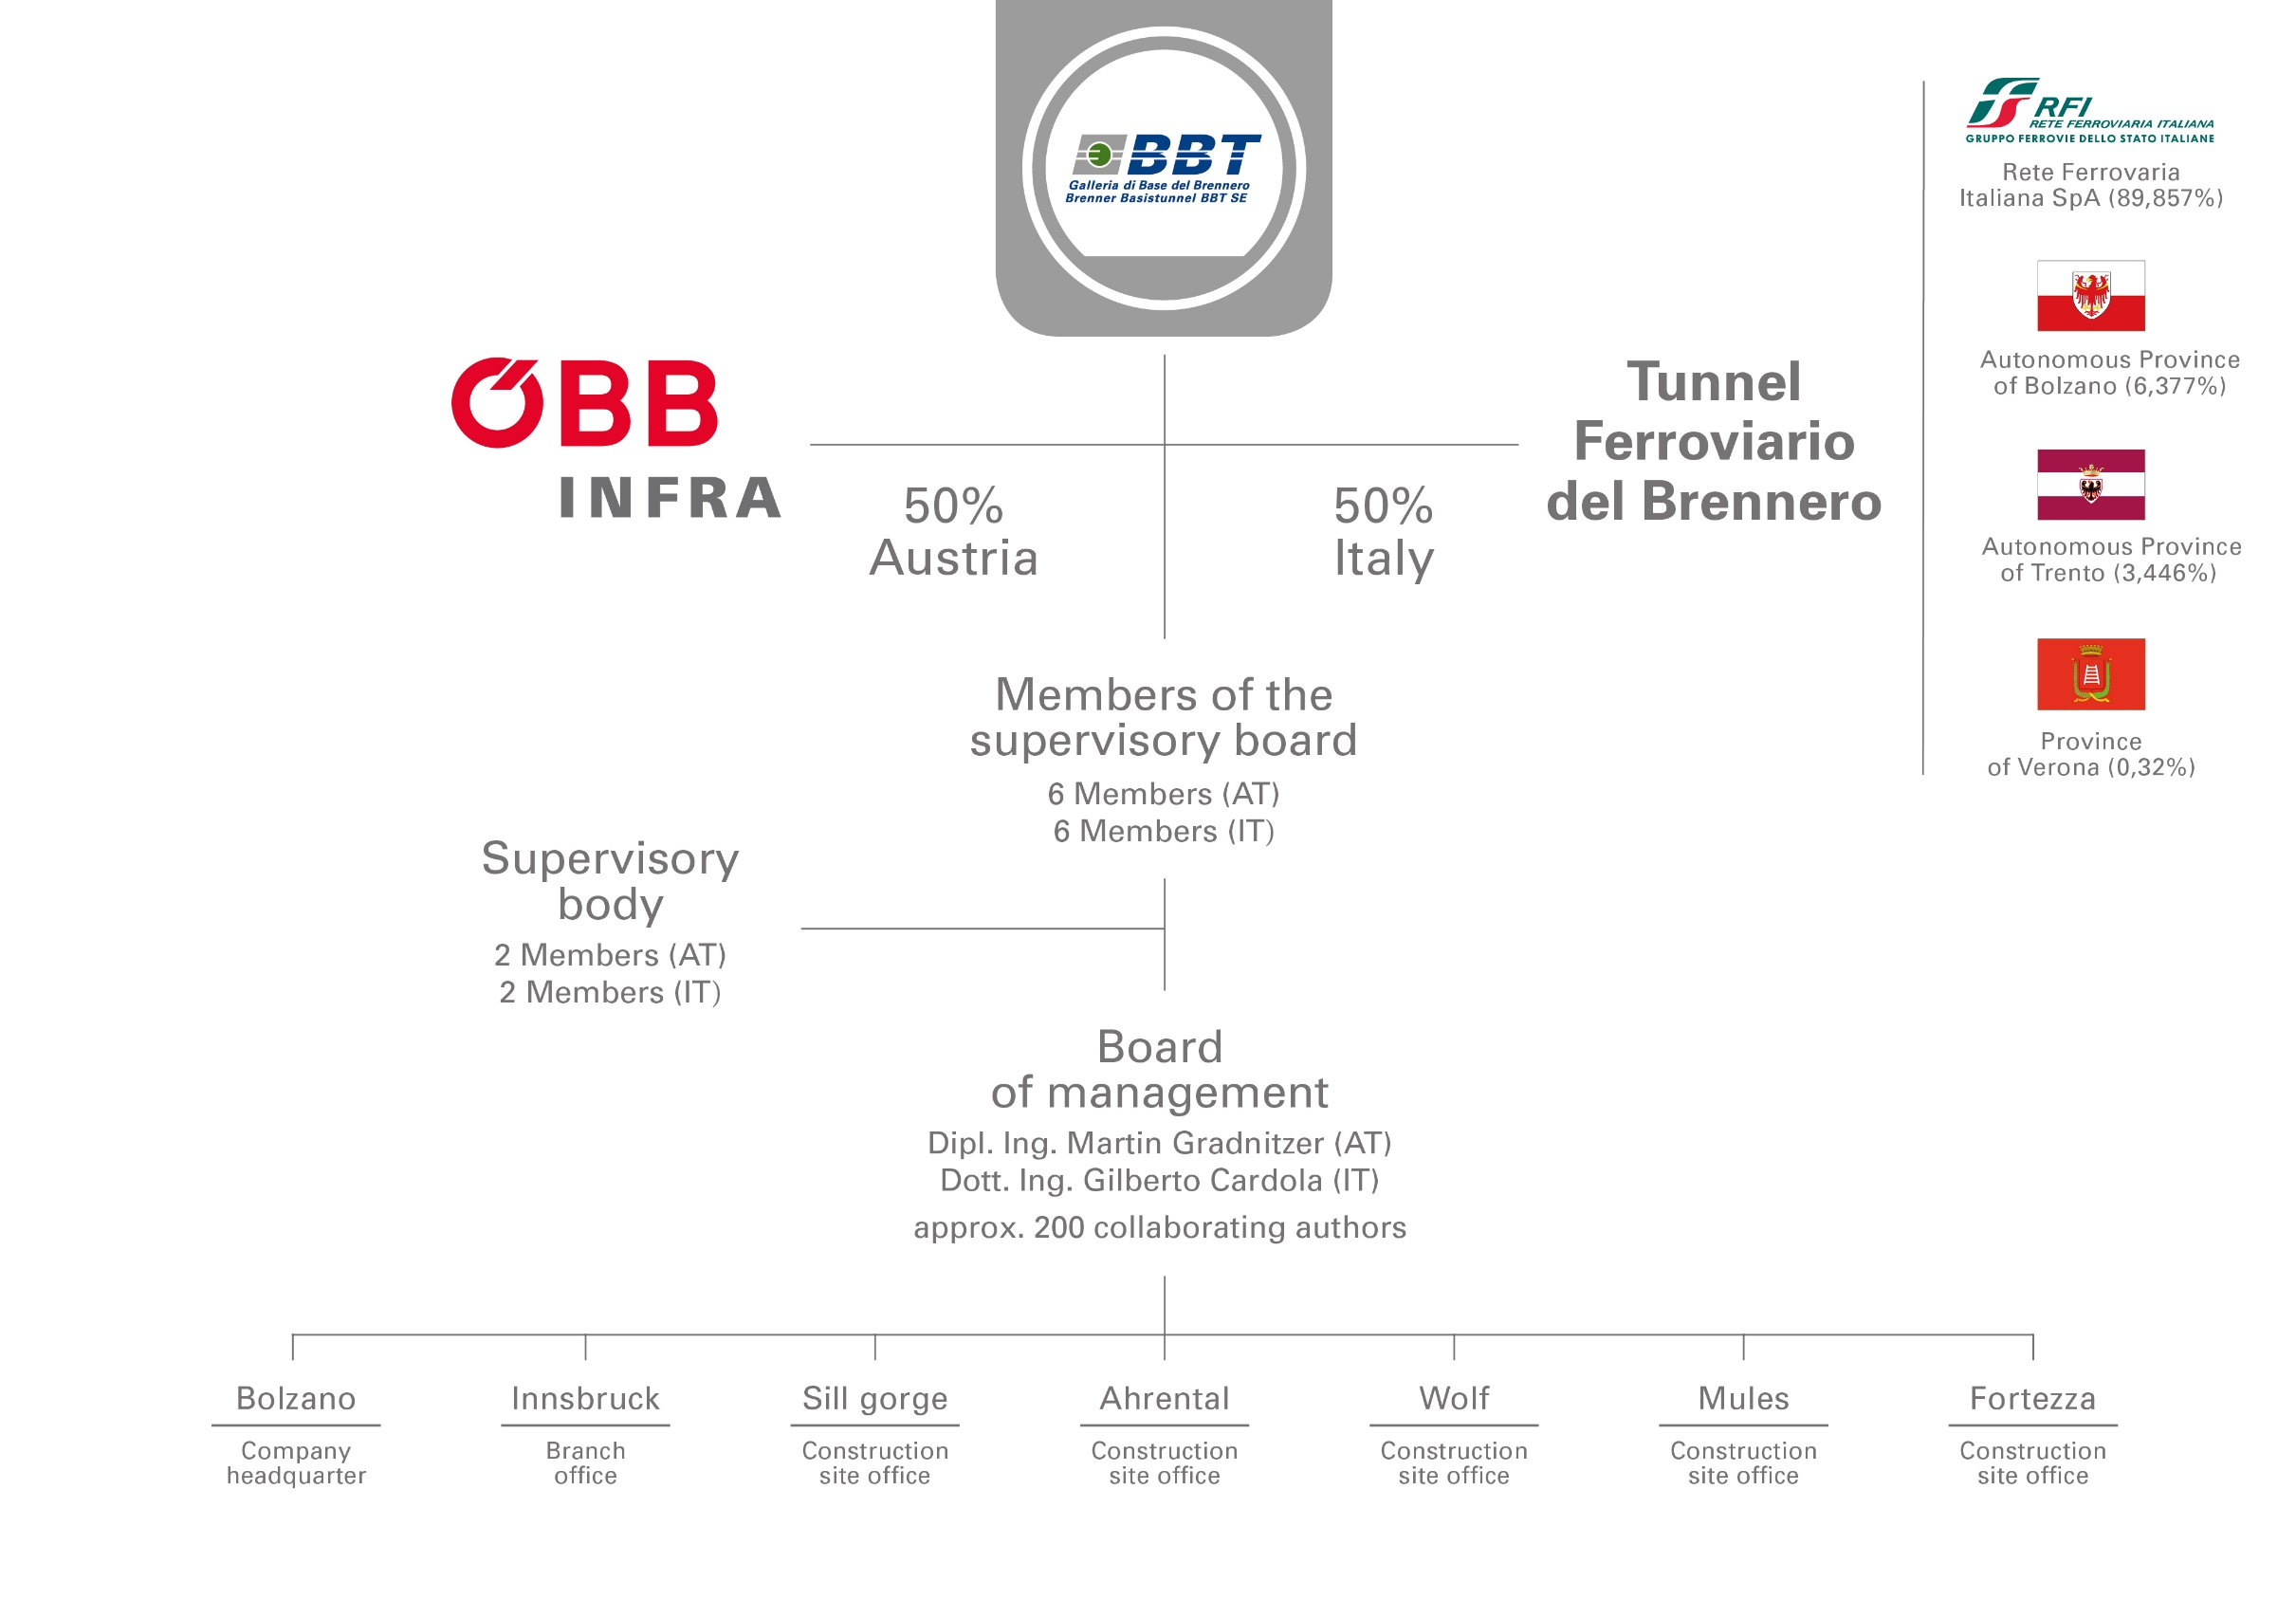
BBT / BRENNER BASISTUNNEL GALLERIA DI BASE DEL BRENNERO
Challenge: Cross border project company
10

Slide 11
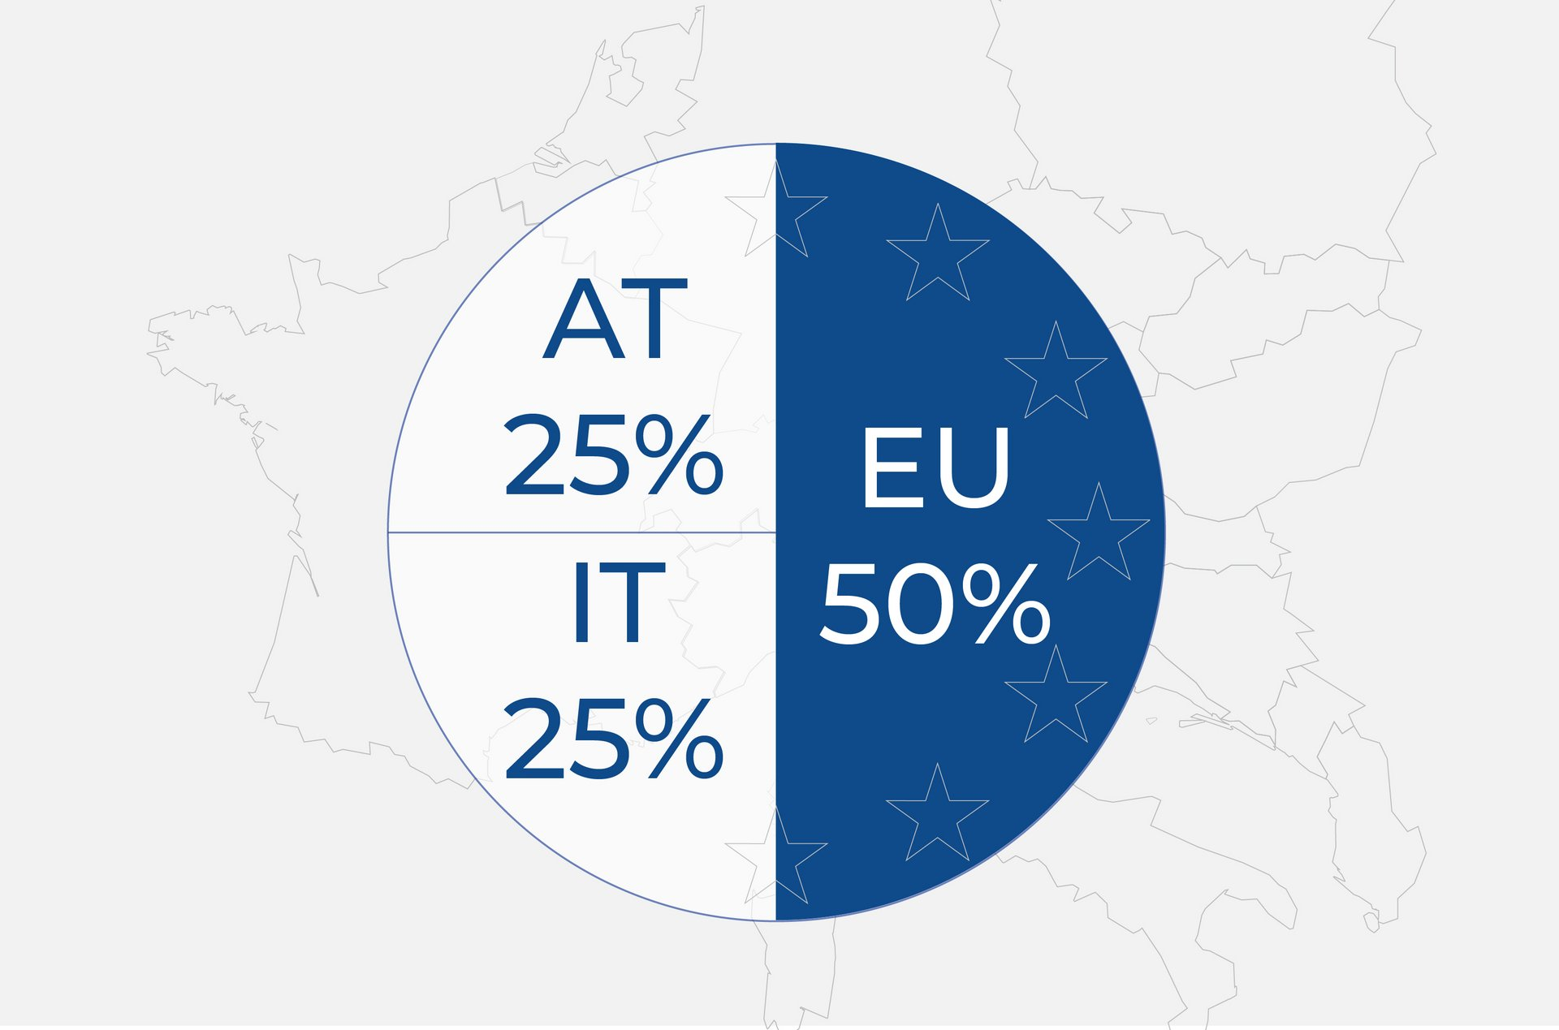



BBT / BRENNER BASISTUNNEL GALLERIA DI BASE DEL BRENNERO
Challenge: Cross border financing
11

Slide 12



Challenge: Cross border project management
BBT / BRENNER BASISTUNNEL GALLERIA DI BASE DEL BRENNERO
Differences in:
Understanding of project management
Legal framework conditions
Authorisation procedure
Standards and guidelines
Calculation methods for project financing

Slide 13
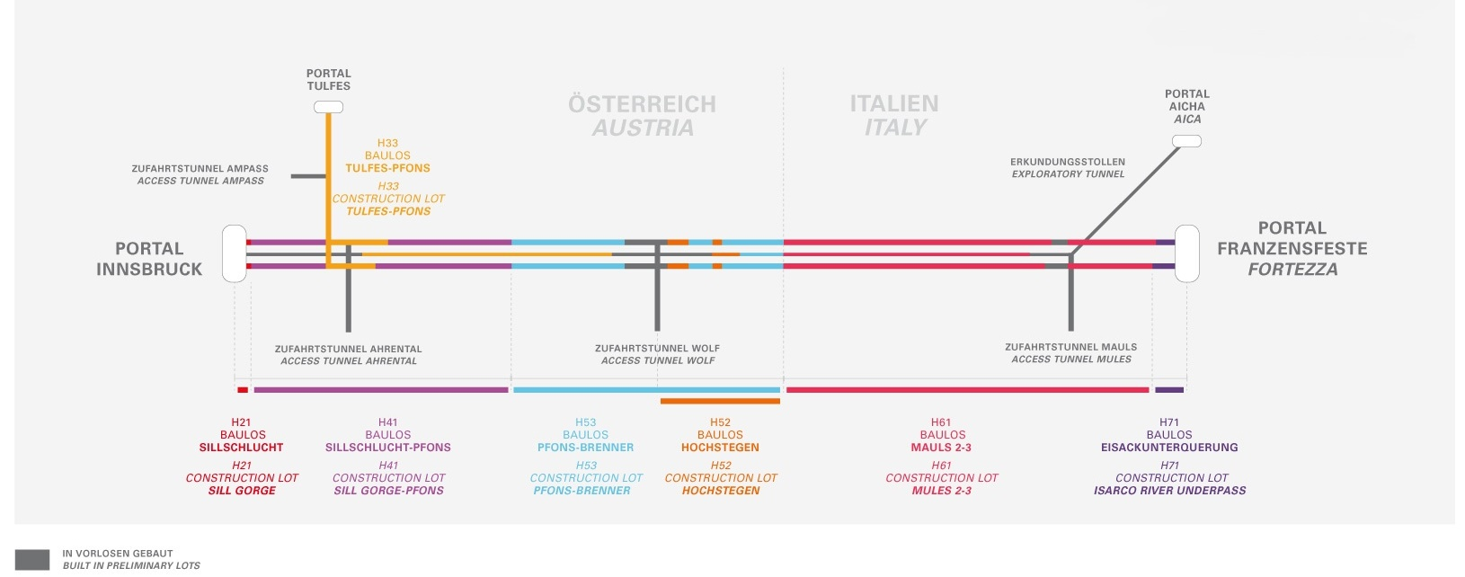
Challenge: Construction lots (not cross border)
BBT / BRENNER BASISTUNNEL GALLERIA DI BASE DEL BRENNERO
completed
completed
in progress
in progress
completed
completed
completed

Slide 14
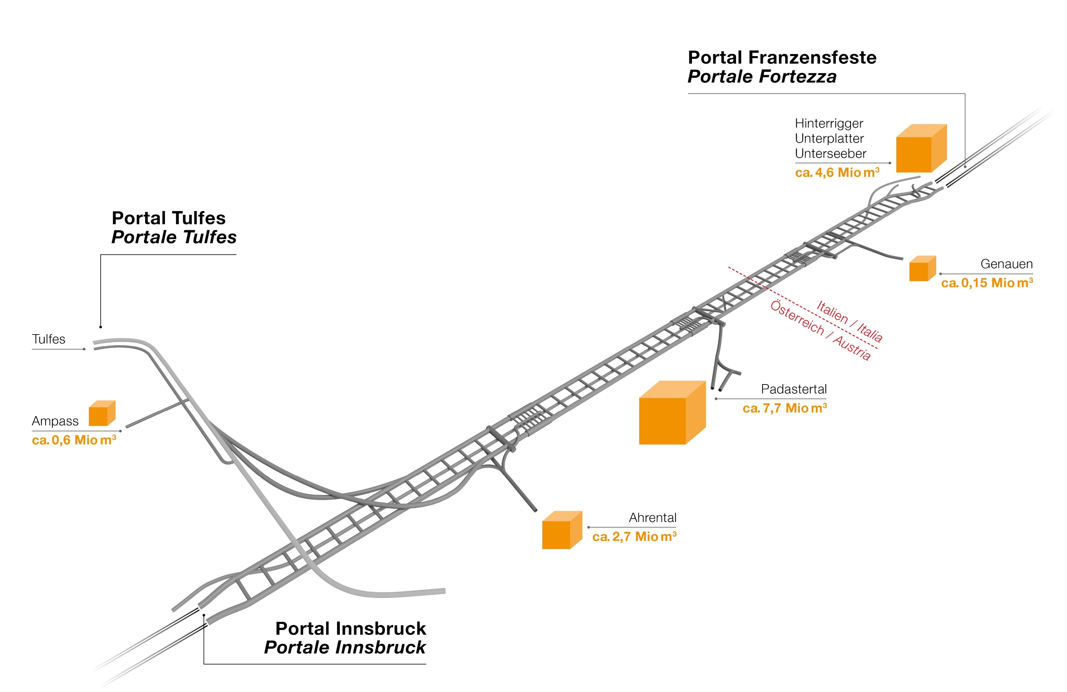
Challenge: Disposal sites (not cross border)
BBT / BRENNER BASISTUNNEL GALLERIA DI BASE DEL BRENNERO

Slide 15
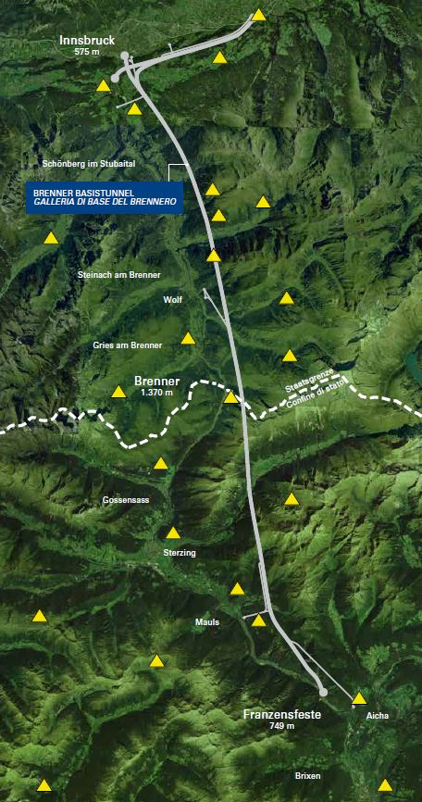
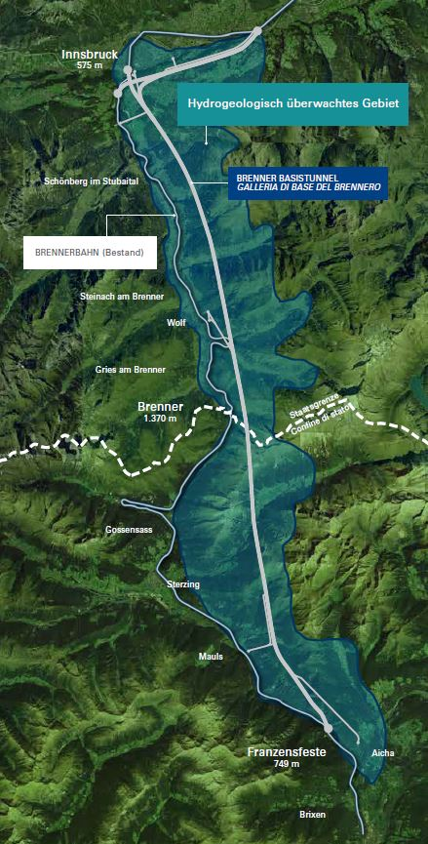
BBT / BRENNER BASISTUNNEL GALLERIA DI BASE DEL BRENNERO
Challenge: Cross border tunnel survey & water monitoring
water monitoring
  area of 70km x 20km
  Up to 1250 measuring points
  (springs and groundwater)
  Preservation of evidence
  long before and after execution
    in total longer than 30 years
tunnel surveying
    considering non-constant earth gravitational field
    project specific cross border
  coordinate system
15

Slide 16
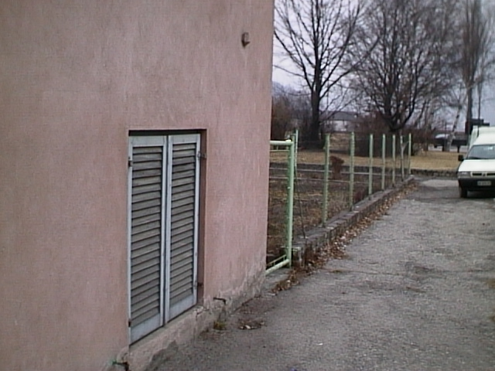
BBT / BRENNER BASISTUNNEL GALLERIA DI BASE DEL BRENNERO
Challenge: Cross border tunnel survey
Fixpunkt
I.G.M.
EUROPA U.E.L.N.:
Q = m.945,360
Italia/Italien:
Q = m. 945,586
MAREOGRAFO DI RIFERIMENTO / REFERENZPEGEL:
Austria/Österreich:
Q = m. 945,464
U.E.L.N. : AMSTERDAM
Austria/Österreich: TRIESTE/TRIEST
  22 cm
  12 cm
Italia/Italien: GENOVA/GENUA

Slide 17

BRENNER BASISTUNNEL BBT SE
Amraser Straße 8
A-6020 Innsbruck
T. + 43 512 4030
F. + 43 512 4030 110
bbt@bbt-se.com
www.bbt-se.com
GALLERIA DI BASE DEL BRENNERO
Piazza Stazione, 1
I-39100 Bolzano
T. + 39 0471 0622 10
F. + 39 0471 0622 11
bbt@bbt-se.com
www.bbt-se.com
Glück Auf!

