Slide 1
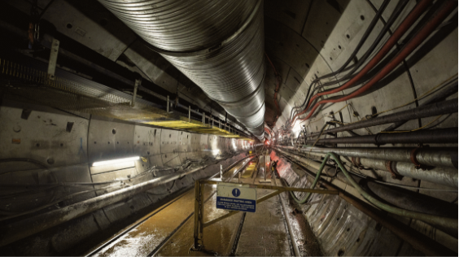
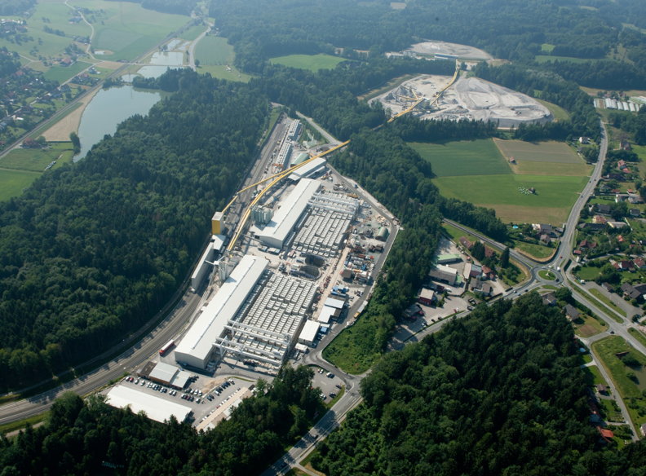
Execution of large- scale projects in regards to logistic potentials
DI(FH) Robert Goliasch
Business Unit Manager Plant & Equipment
© STRABAG, MAY 2025

Slide 2
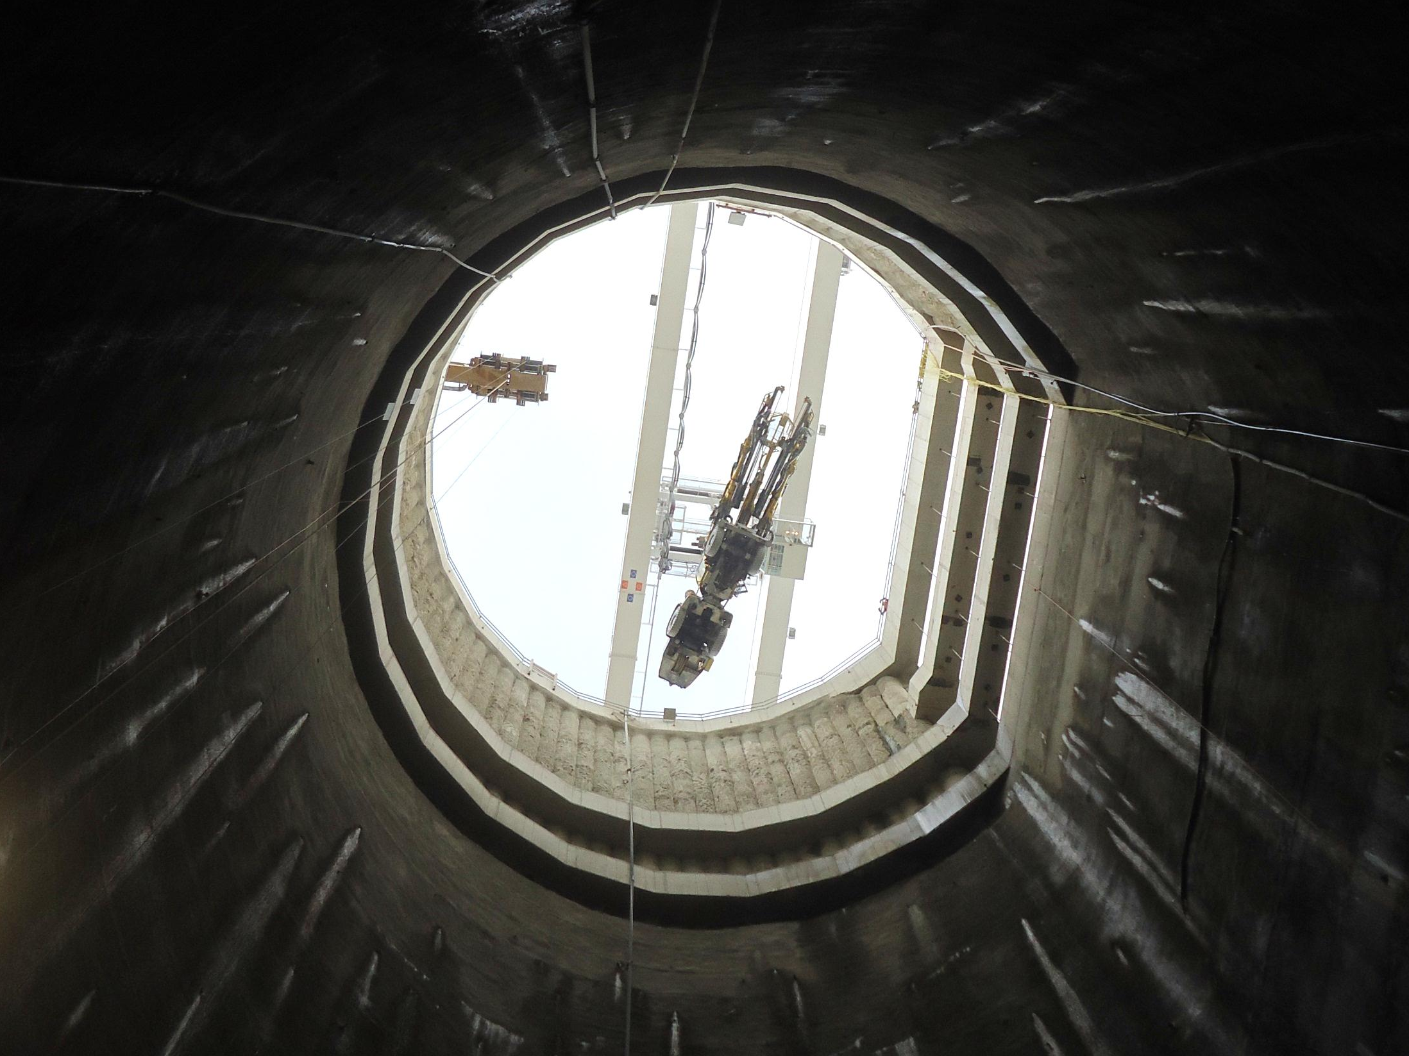
Content
  Project Overview
  North Yorkshire Polyhalite Project
  Rail-bounded Logistic
  Conveyor System
  Shaft System
  Koralm Tunnel LOT 2
  Shaft Logistic
  Conveyor System
  Logistic Concept
  Material Processing
  Summary

Slide 3
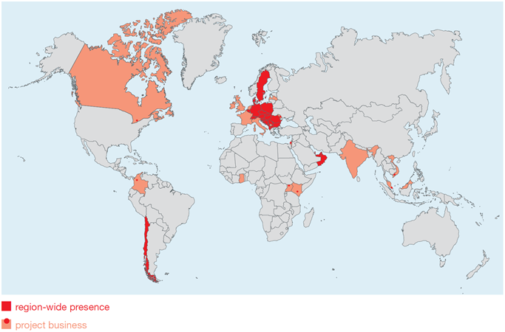
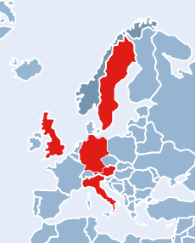
Projects of STRABAG – ZÜBLIN; Division 3I
  Division 3I Tunnel Construction & International:
  Austria/ Germany/ Switzerland
  Canada
  International Projects
  Membrane Department
  600+ colleagues
York Potash - UK
Koralm Tunnel - AT
  Highlights:
  50+ years of experience
  worldwide projects
  sustainable
  innovative spirit
  trust & respect

Slide 4
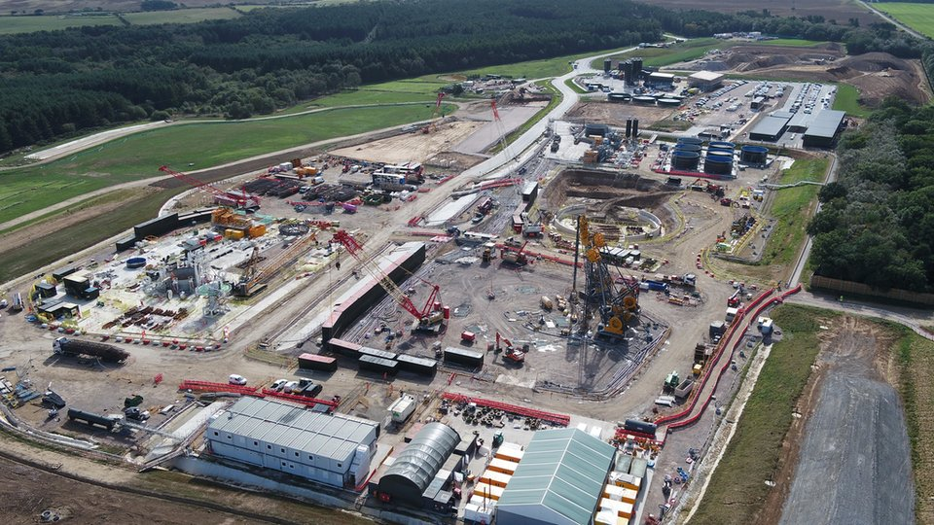
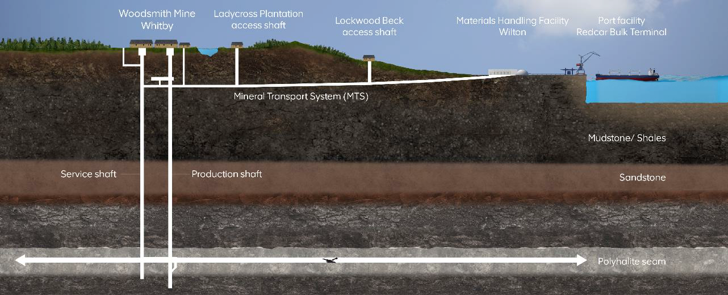
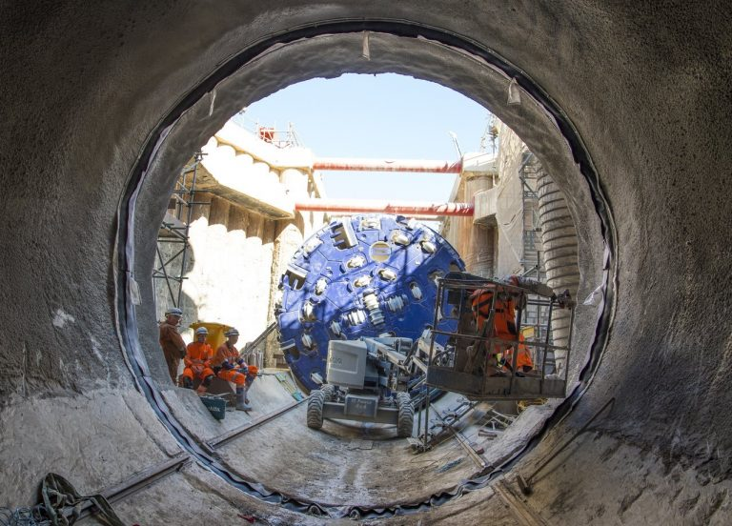
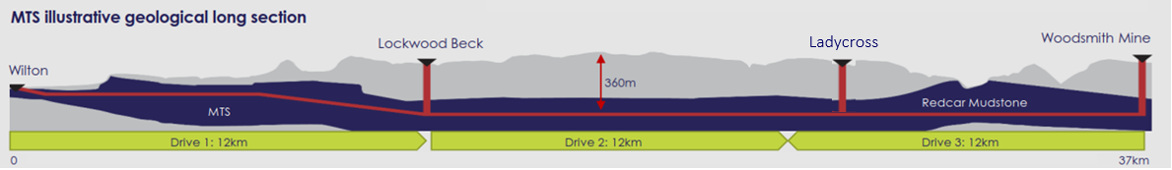

North Yorkshire Polyhalite Project
  Project Data:
  Mining the largest polyhalite deposit to produce fertilizer
  2018 – ongoing
  37km long segment lined tunnel
  6m TBM cutting diameter
  service – to deliver polyhalite from the mine to port facility
  Most Significant Challenges:
  geotechnically – 4 intersecting faults
  groundwater flows
  environmental sensitivity – Border of National Park, groundwater connection to local beck
  Tunnel logistic - from one portal and through shaft structures

Slide 5
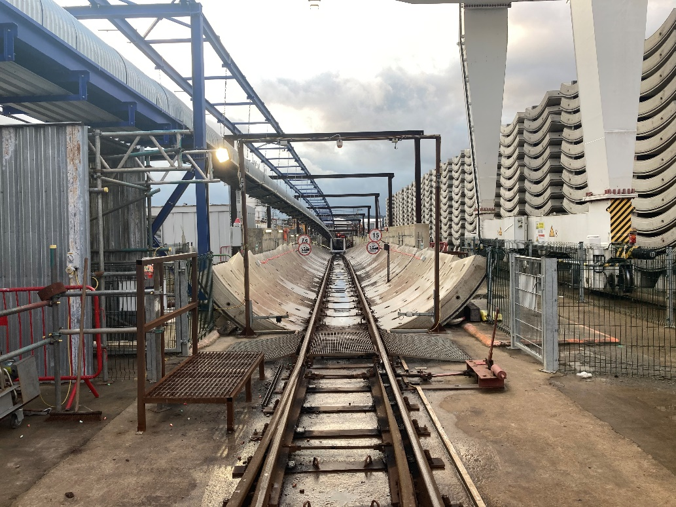
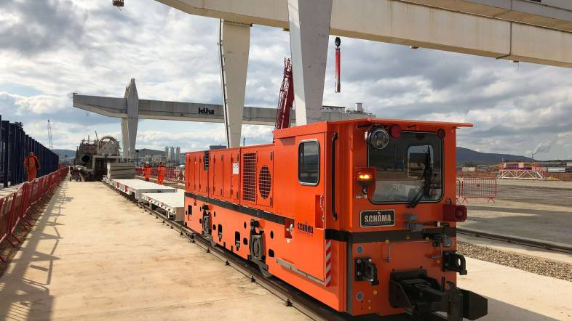
Rail-bounded logistic for 37km TBM-Tunnel
  Rail-bounded Logistic:
  37km long
  up to 4% gradient
  900mm track gauge
  One train about 180ton gross weight, rail-bounded with best resistance
  services – transport of segments, rail sets, consumables and staff
  Highlights:
  Use of California Crossings – for train crossings in single-lane tunnel
  Battery & plug-in-hybrid Loco’s - with recuperation while downhill drive
  Optimised ventilation – due to use of battery driven equipment
  Rescue train - parked on California-crossing at the rear end of the TBM
  Cycle times – every train is timed after TBM-production

Slide 6
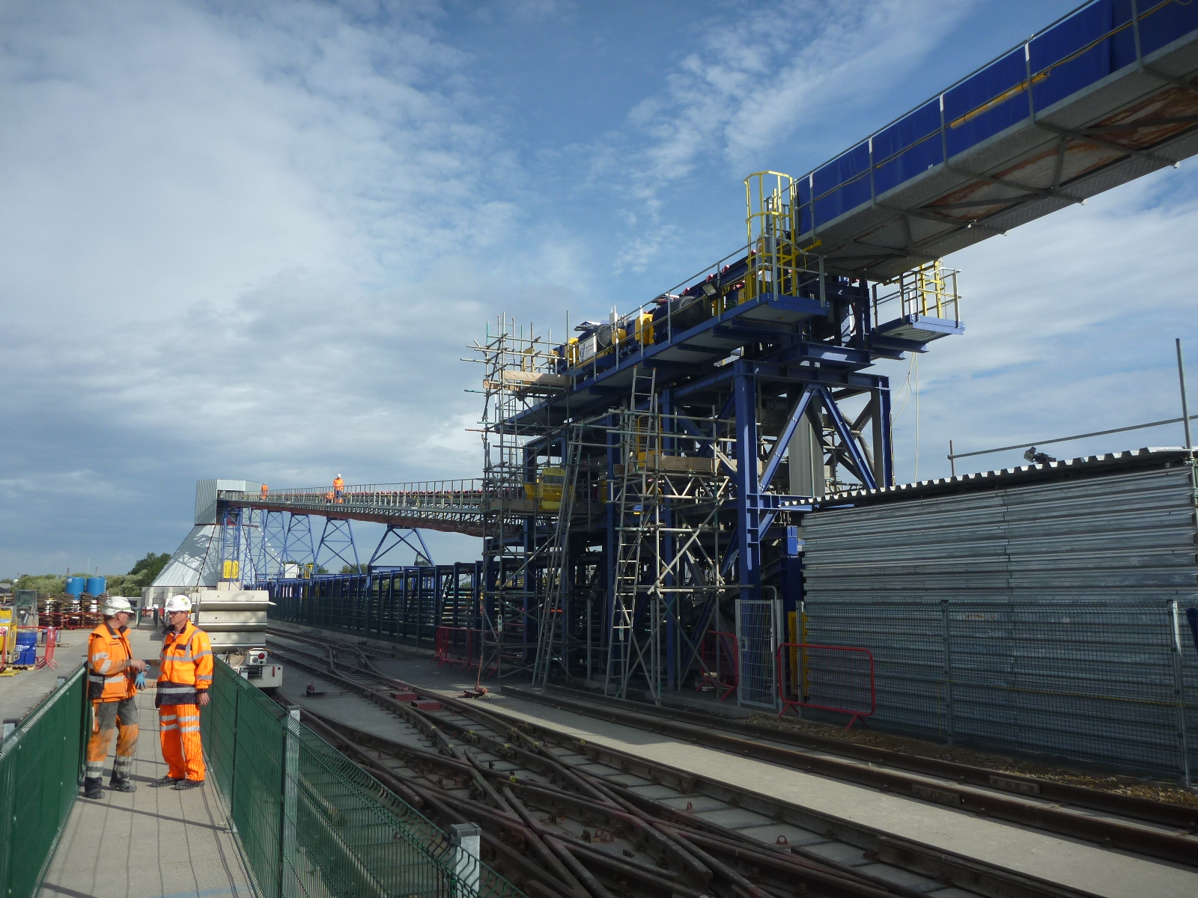
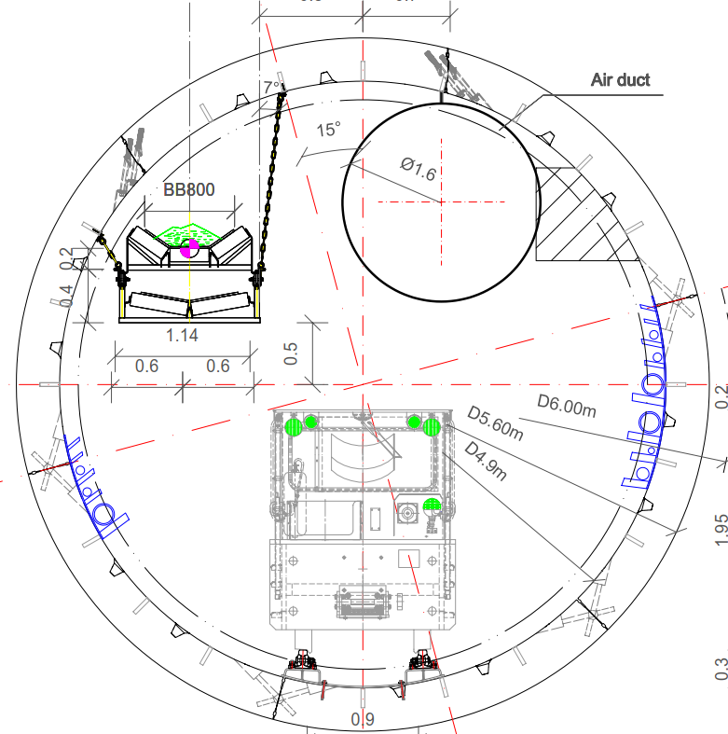
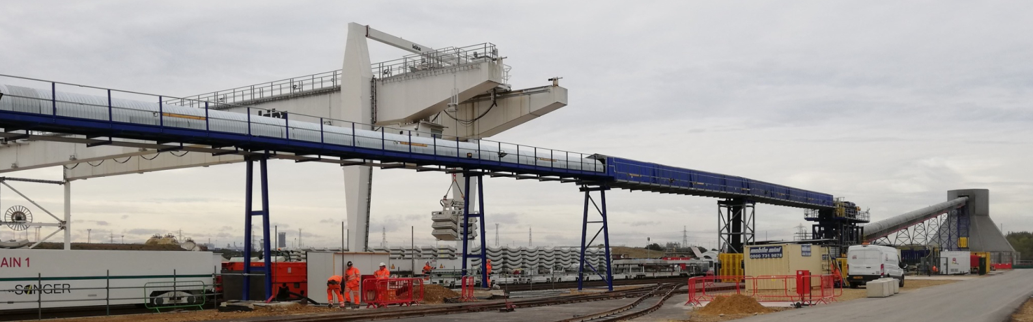
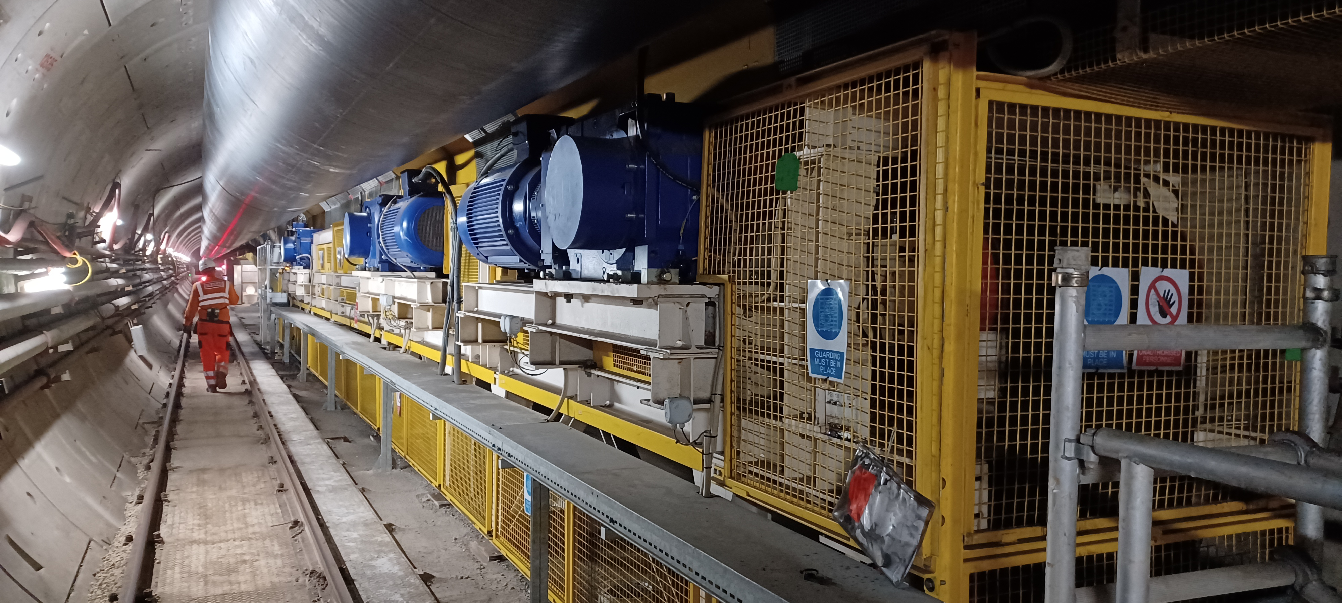
Conveyor System for 37km TBM-Tunnel
  Conveyor System:
  37km long
  208m height difference
  services – excavation material transport
  Most Significant Challenges:
  length & height – 4 booster stations needed
  space – little space to ventilation, train, survey window
  belt tension – complex measuring and adjustment

Slide 7
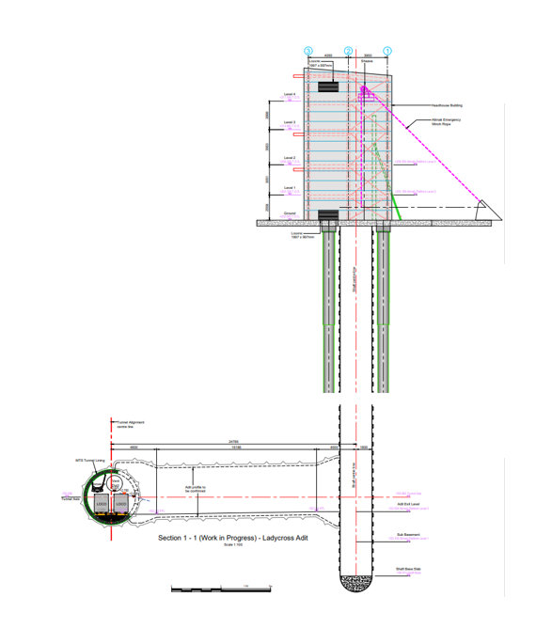
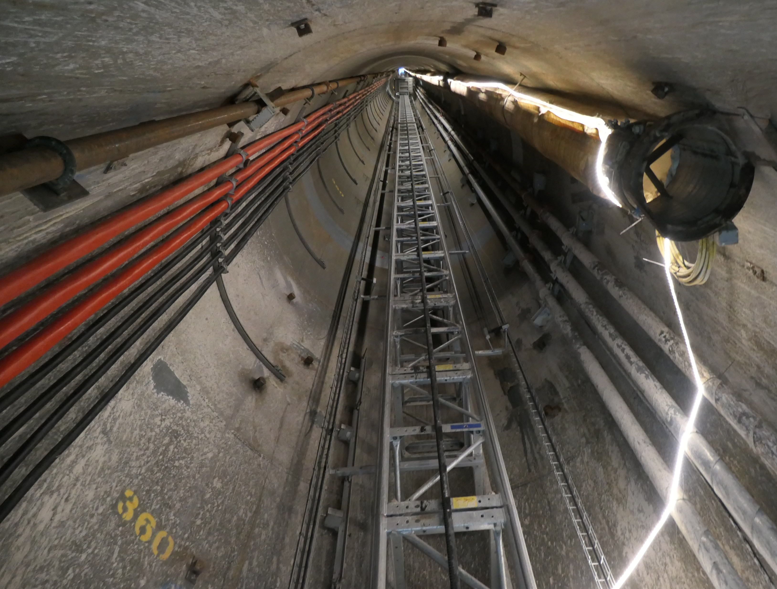
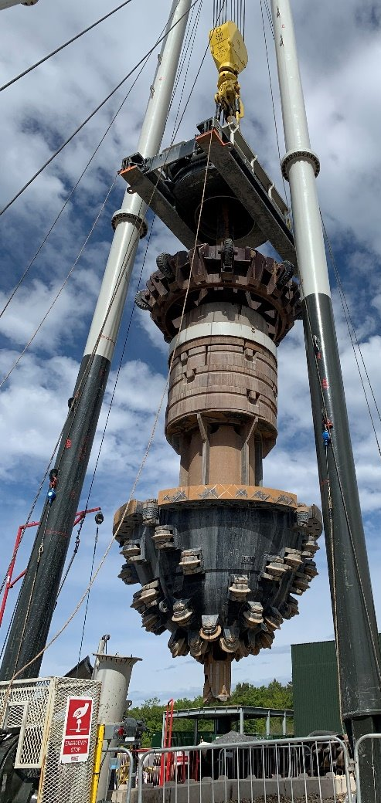
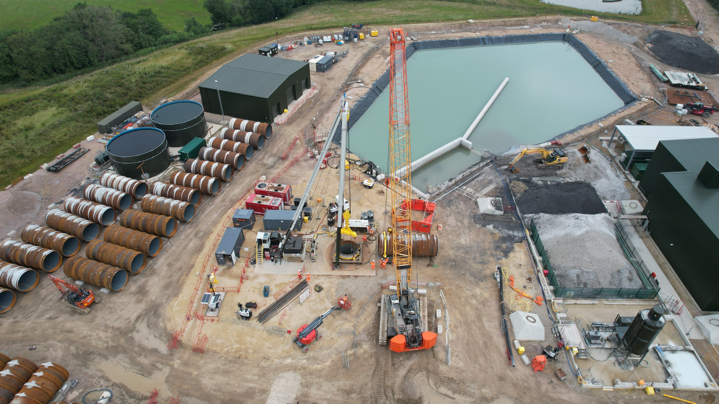
INTERMEDiATE Shaft aditS
  Completed Shaft via Blind Boring:
  380m deep
  3.2m diameter
  services - ventilation, grout, power, water, elevator
  access - 12.8km/ 23km from tunnel entry point
  Most Significant Challenges:
  schedule – ventilation and power supply on TBM critical path
  groundwater flows – 2 unsuccessful grouting programmes previously
  connection tunnels – with drill and blast method

Slide 8
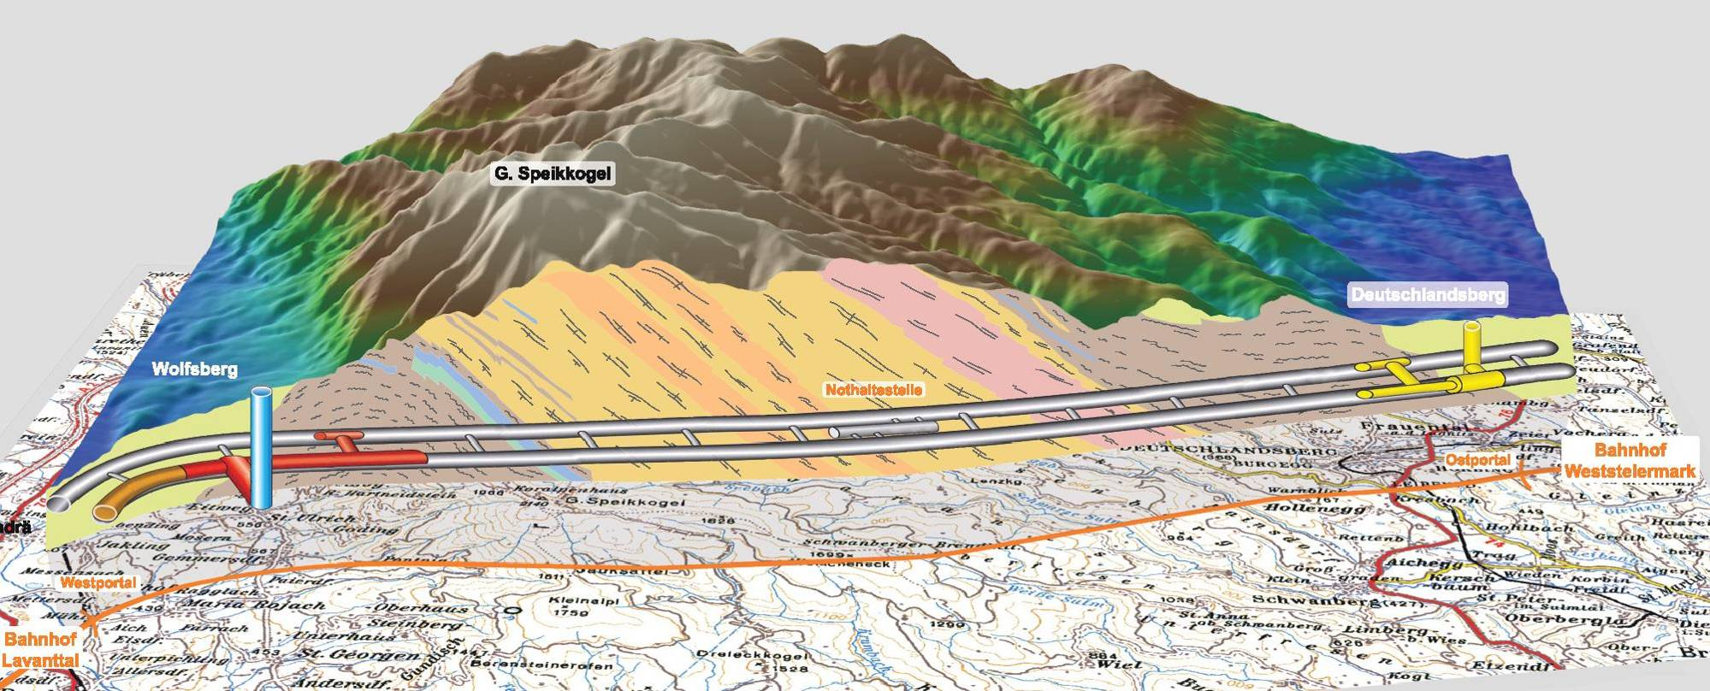
Koralm tunnel Lot 2
  Project Data:
  Project of ÖBB Infrastructure, Twin Tunnel for High Speed Rail in Austria
  2011- 2021 – construction period Lot 2 - operation will start in Q4.2025
  2 x 32,9km lined tunnel – 2 x 19km Lot 2 executed by JV STRABAG-Jäger Bau
  8,6mio ton excavation material
Weststyria neogene
Lavanttal neogene
Lavanttal fault
Crystalline
Wolfsberg
Deutschlandsberg
Max. overburden: 1200 m (3937 ft)

Slide 9
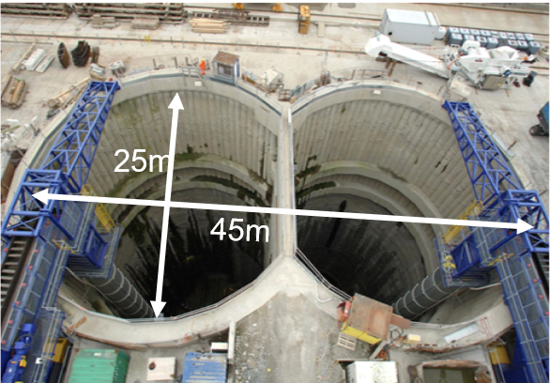
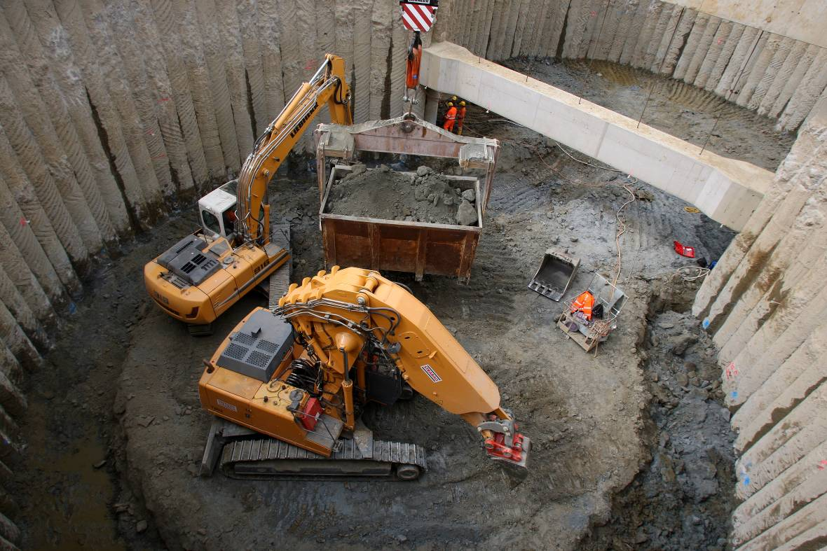
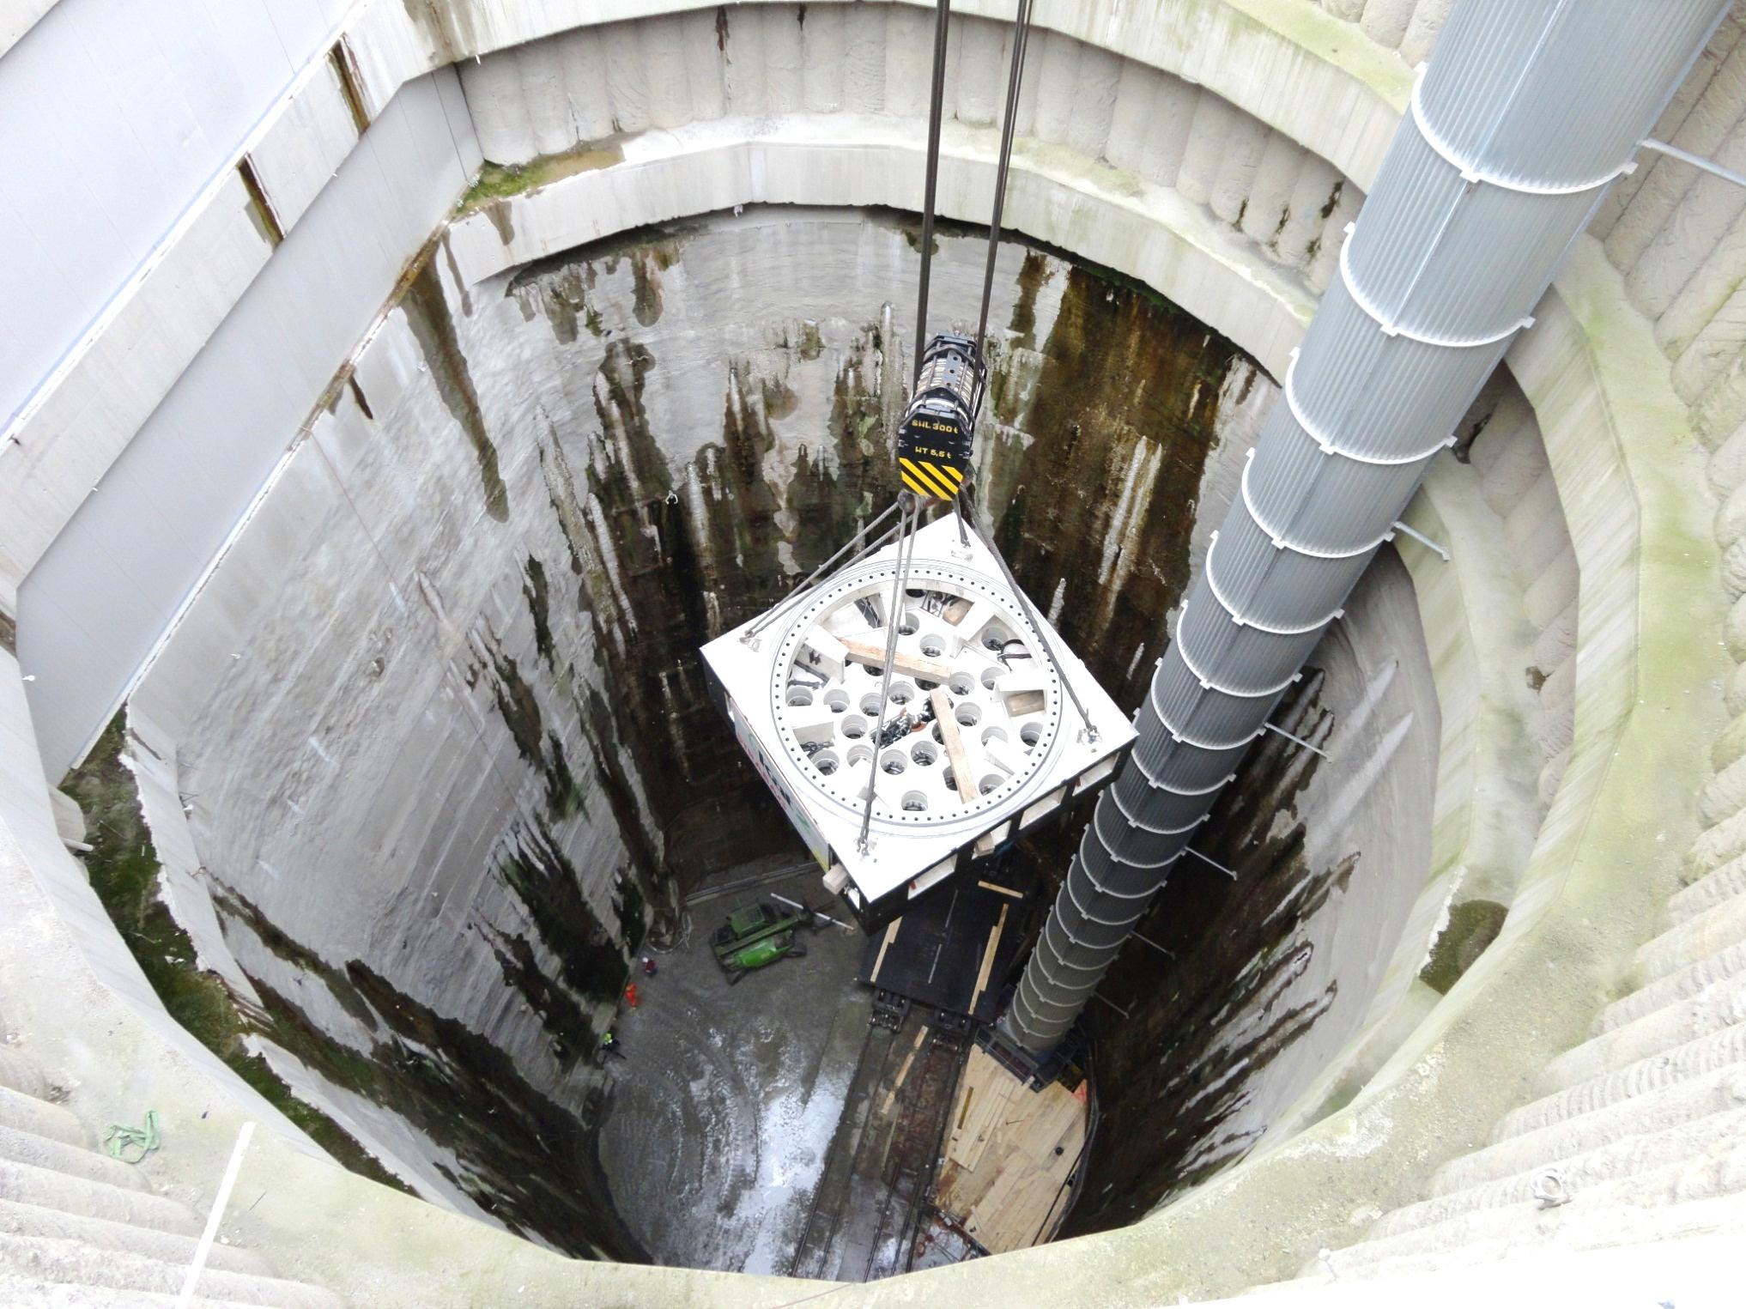
Shaft logistic
  Shaft structure, Conventional Excavation:
  60m deep
  700m² outbreak area of twin shaft structure
  services - ventilation, grout, cables, concrete, vertical conveyor with excavation material and segments
  Most Significant Challenges:
  sequence – of gantry cranes for TBM, D&B, concrete operations
  gantry cranes – 2 x 60ton + 2 x 35ton gantry cranes with recuperation
  vertical conveyor – 2 x vertical conveyors for TBM muck transport 1000ton/h

Slide 10
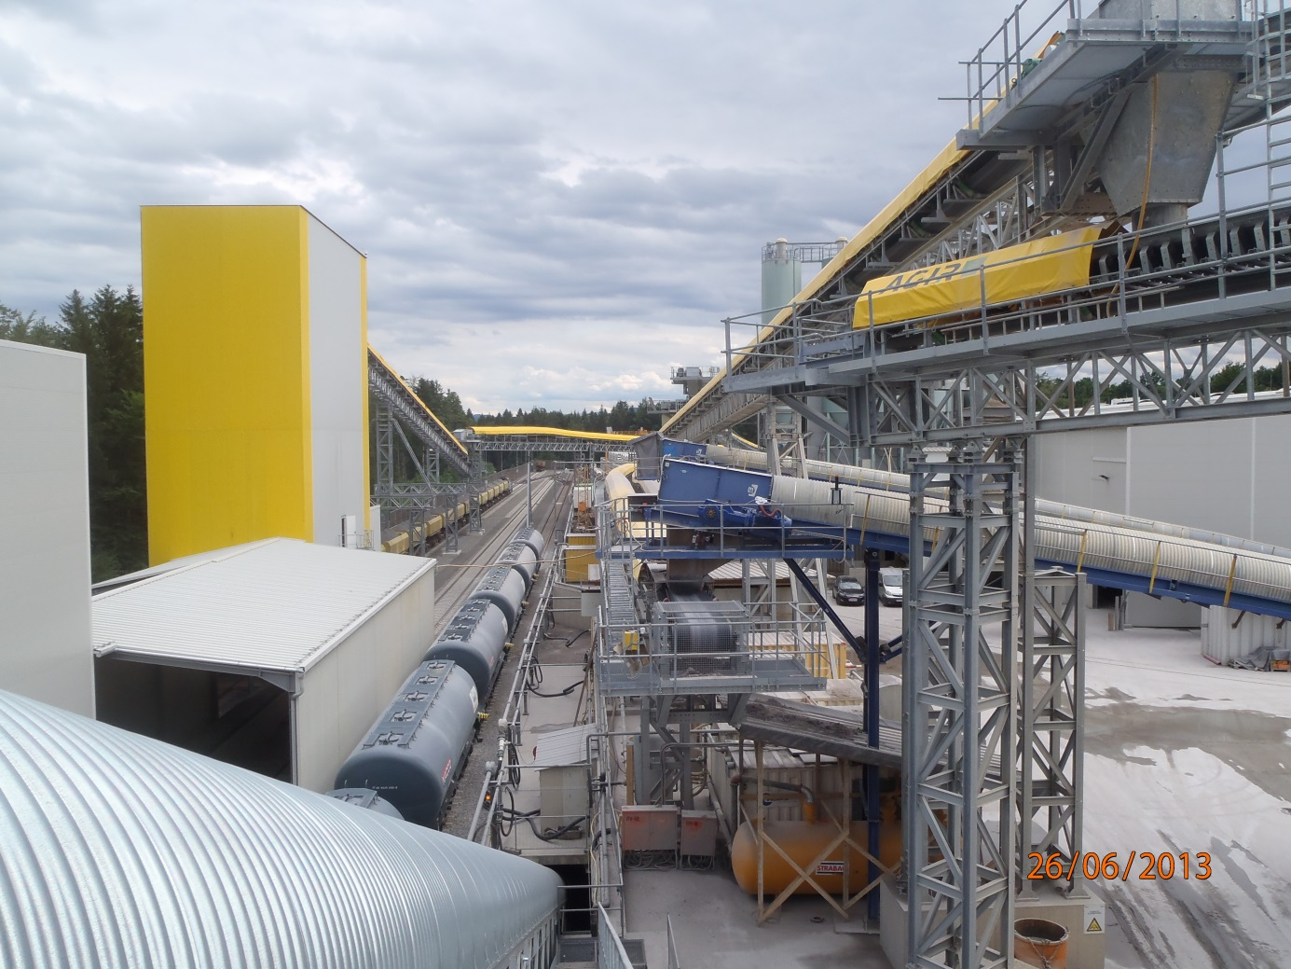
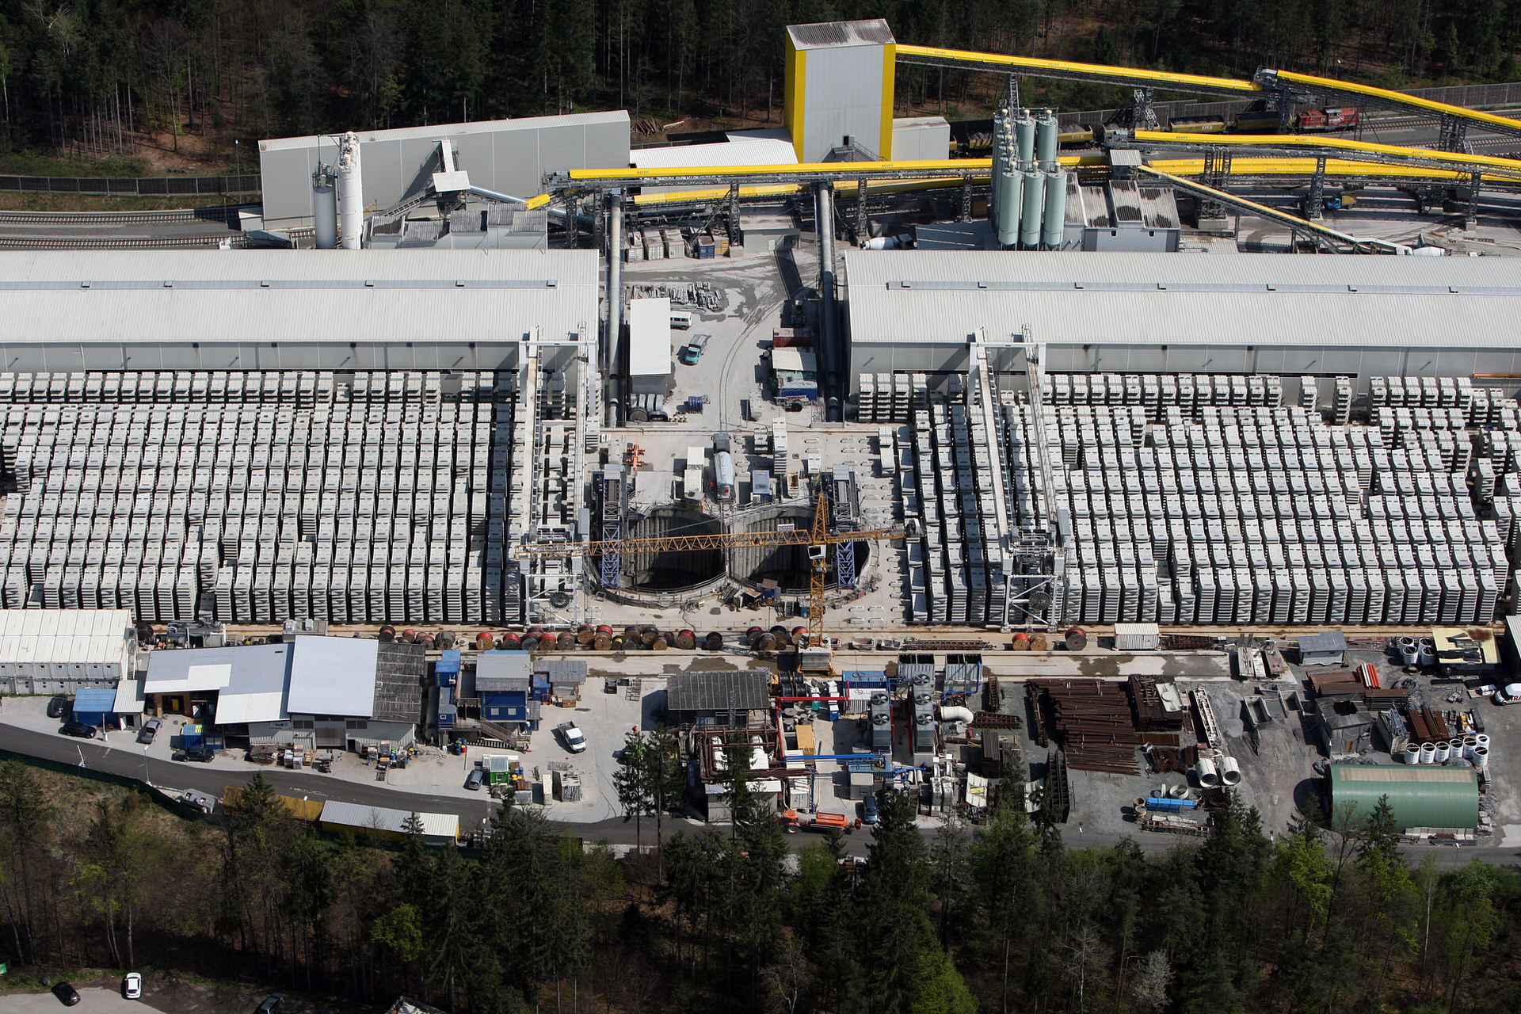
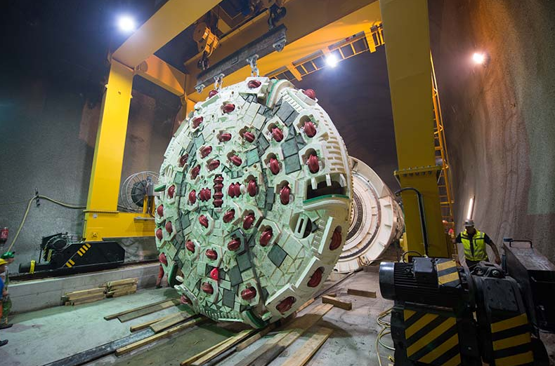
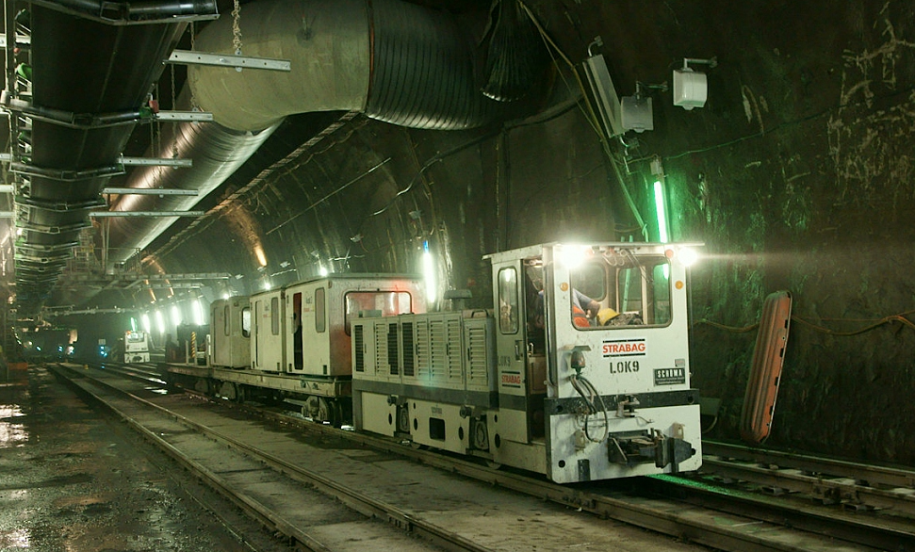
Logistic Concept
  Logistic Concept:
  national train connection – for cement, pea gravel and excavation material
  tunnel train – transport of segments, back filling, consumables and staff
  gantry cranes – transport trough the shaft into the tunnel and on surface
  Highlights:
  75km – of railbounded logistic – 2 rails per tunnel
  120.500 – segments fabricated on site
  1,2mio ton - excavation material transported by train according to contract
  75% - of cement and pea gravel to be delivered by national train system

Slide 11
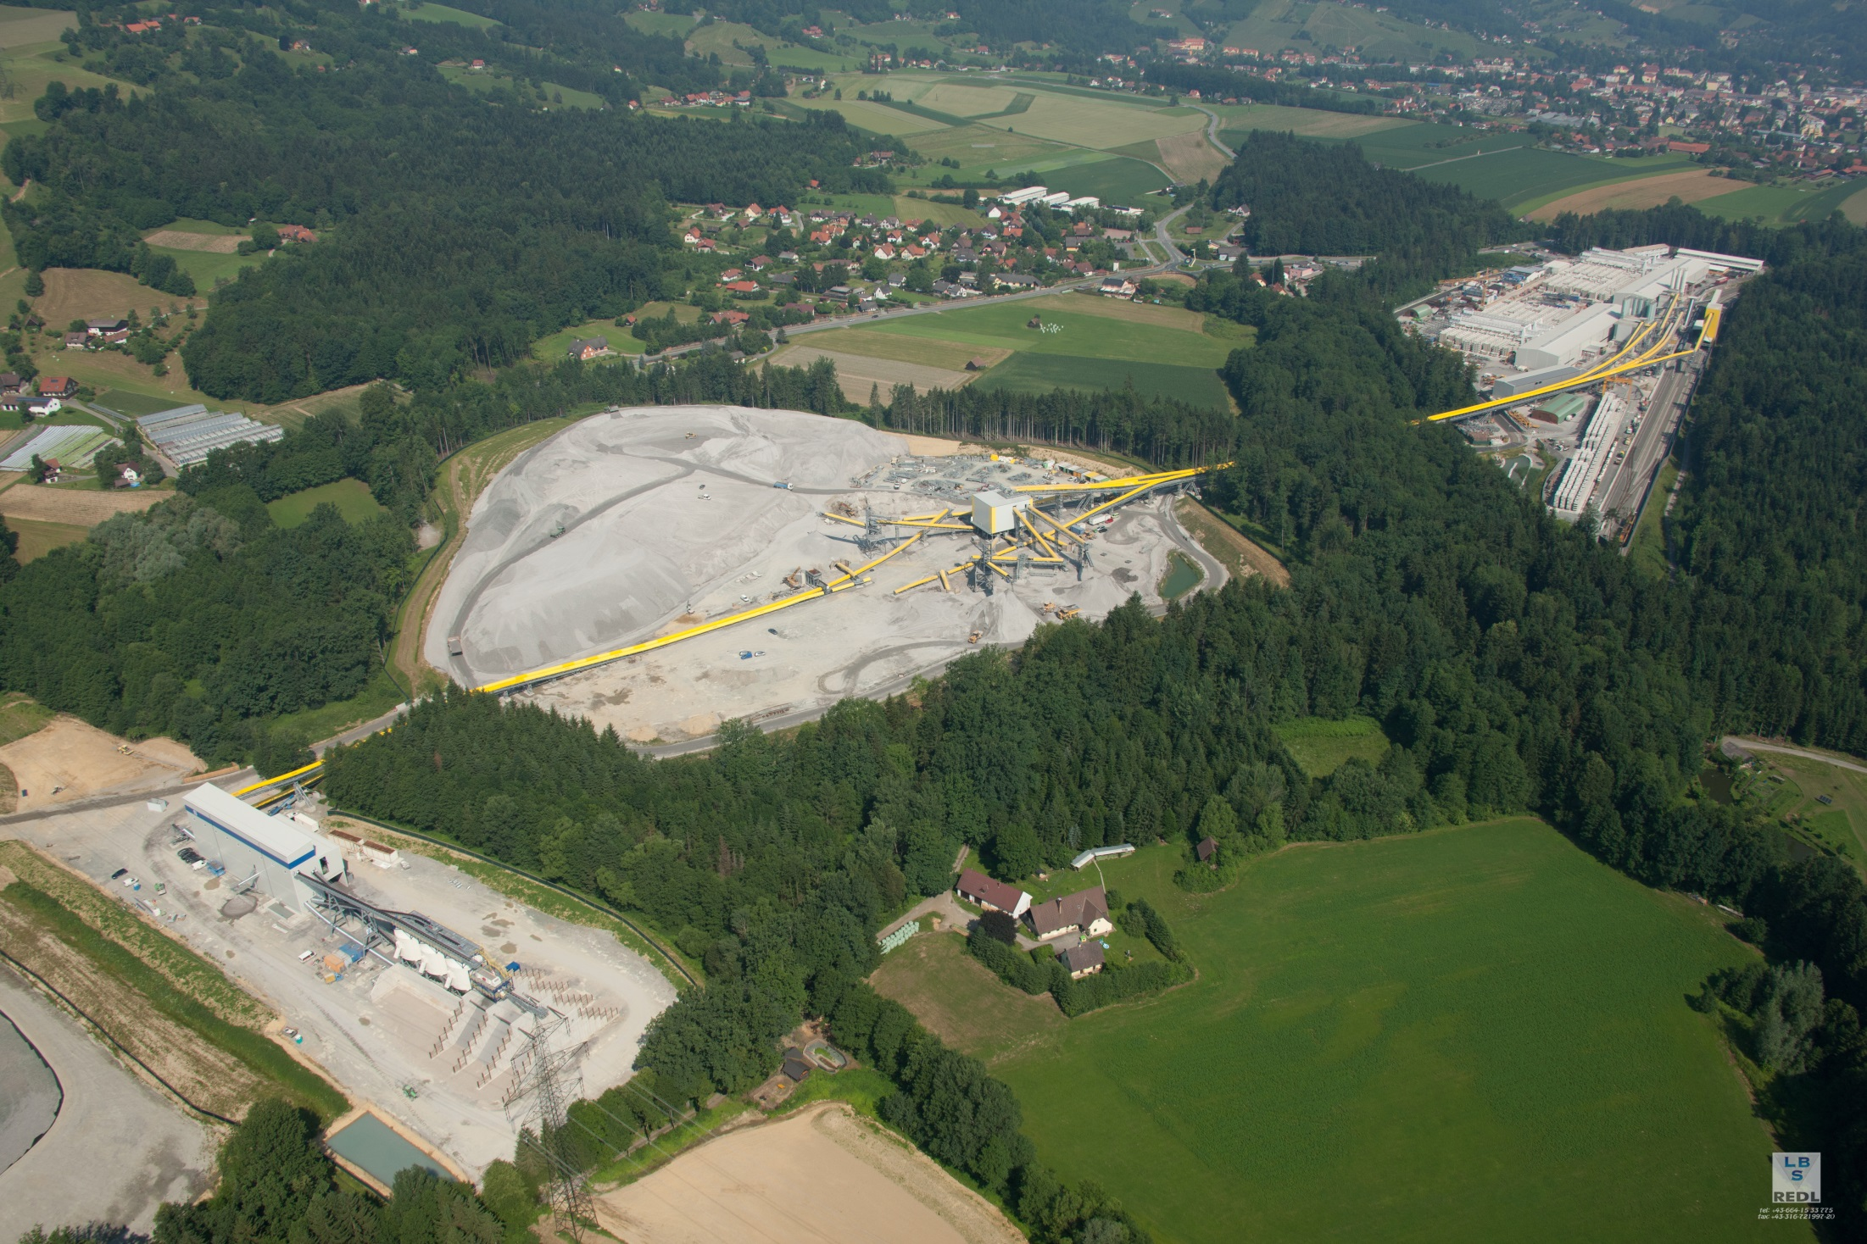
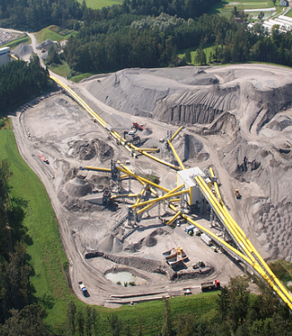
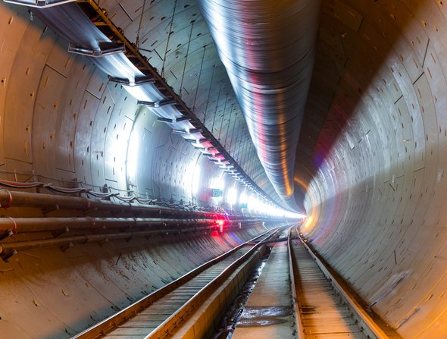
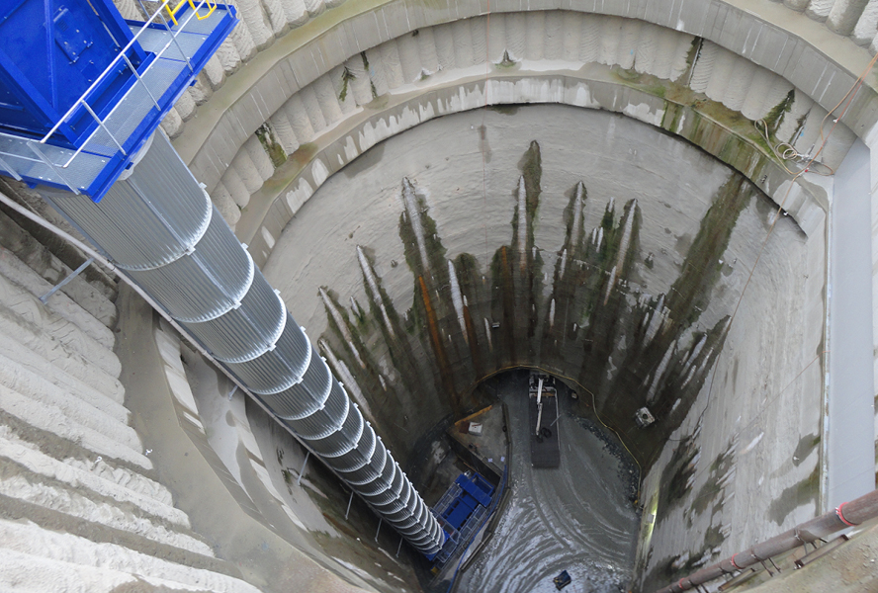
Conveyor System
  Conveyor system:
  44km long
  1000ton/h / 2000ton/h design capacity
  services – excavation material transport
  Highlights:
  2 x vertical conveyor – in shaft
  belt scales – no. 15 scales used to record all material flows just in time
  dispose – of material flow from central control room
  sustainability – very economic and efficient way of mass transport

Slide 12
Material processing – overall flow chart
railway loading facility
batch plants/ segment production
TBM drive
gravel storage/ crushing plant
external peagravel delivery
screening plant

Slide 13
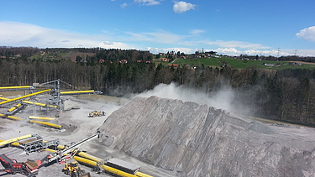
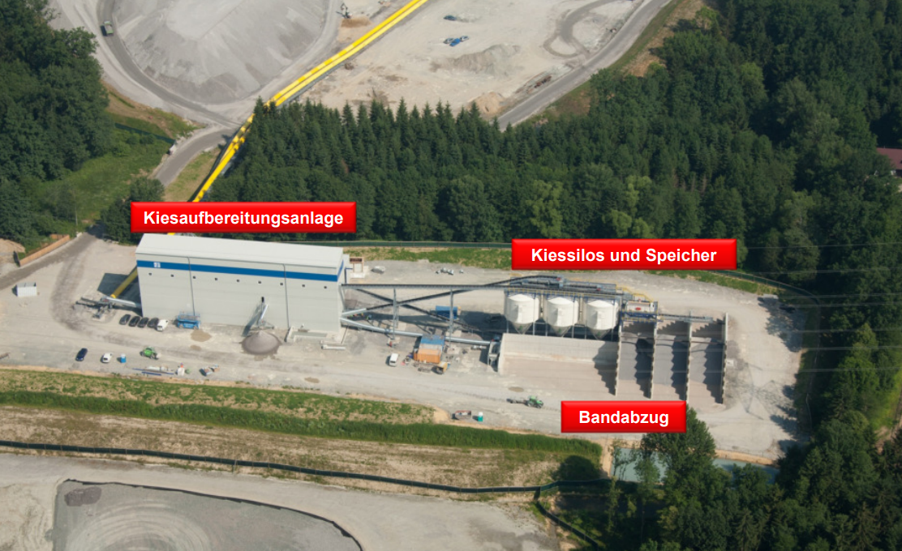
Material processing – Crushing process, plant overview
  Highlights:
  300 ton/hr – plant production capacity
  550.000 ton excavation material – reused in 3 years for segment production
  app. 600.000 ton excavation material – reused in 4 years for concrete lining
  Material Crushing Process:
  pre-screening plant – integrated in conveyor system
  aggregate processing plant – just in time production of concrete aggregates from TBM excavation material
  three stage crushing plant and wet sieving process due to challenging crystalline geology
aggregate processing plant
aggregate silo and storage
Transfer to batch plant

Slide 14

Summary
Sustainable Concepts – Locos & Gantry Cranes
Focus on Logistic Tasks
Supply Shafts
Challenging Interface TBM drive and D&B method
Ventilation
Complex Conveyor Systems
Muck Material Processing
Focus on Site Process Sequence
Power and Water supply for Construction Phase

Slide 15


