Slide 1

The White Rabbit Collaboration
Javier Serrano
CERN BE-CEM

Slide 2
Outline
A tale of two mandates
The original vision for White Rabbit (WR)
What happened in reality
The White Rabbit Collaboration (WRC)
Closing remarks

Slide 3
Outline
A tale of two mandates
The original vision for White Rabbit (WR)
What happened in reality
The White Rabbit Collaboration (WRC)
Closing remarks

Slide 4
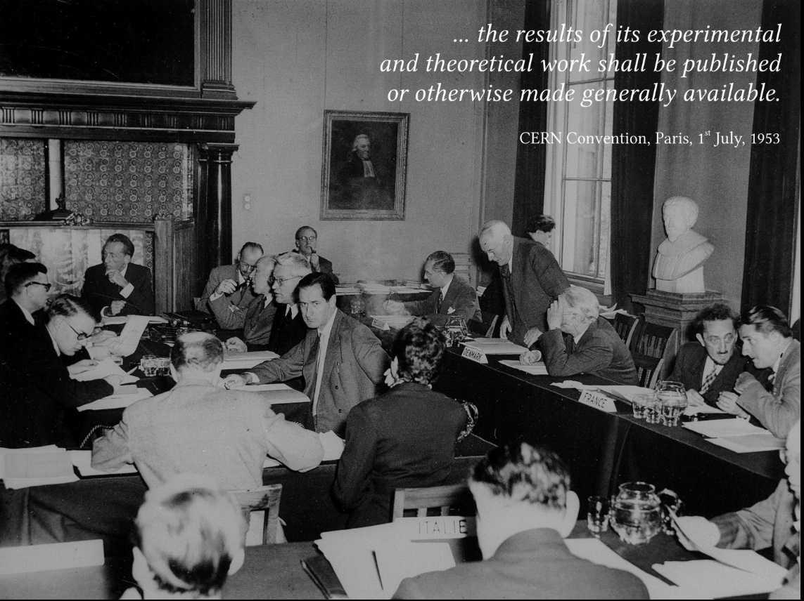
The CERN Convention

Slide 5
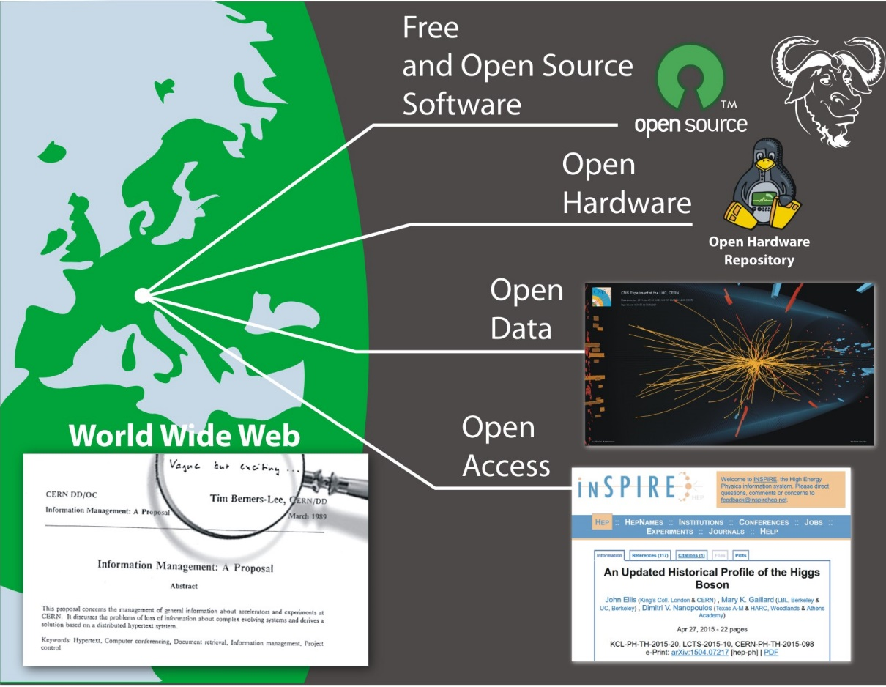
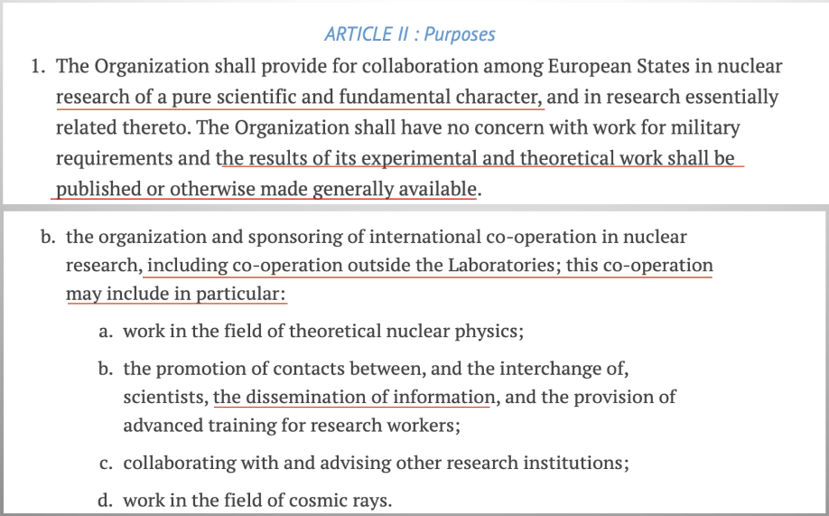
The Dissemination Mandate
See also https://openscience.cern/

Slide 6



The Knowledge Transfer Mandate
Ensure that the technology and expertise developed at CERN can have an impact on society, in particular through Member States industry
Promote CERN as an innovation partner for industry
Demonstrate the importance and impact of fundamental research investments

Slide 7

Can these mandates by combined in a harmonious way?

Slide 8
Outline
A tale of two mandates
The original vision for White Rabbit (WR)
What happened in reality
The White Rabbit Collaboration (WRC)
Closing remarks

Slide 9
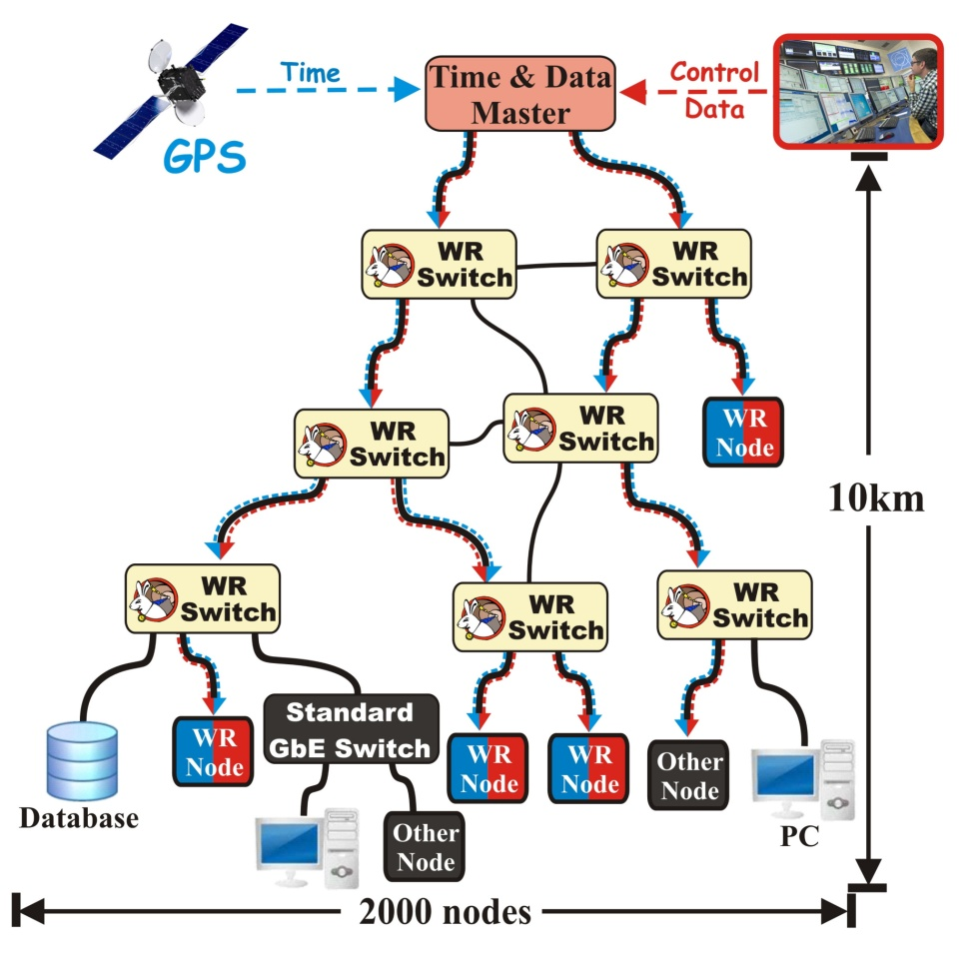
What is White Rabbit trying to solve?
Distributed, hard real-time controls and data acquisition
Based on well-established standards
  Ethernet (IEEE 802.3)
  Bridged Local Area Network (IEEE 802.1Q)
  Precision Time Protocol (IEEE 1588)
Extending standards to provide
  Sub-ns synchronisation
  Deterministic data transfer
Initial specs: 10km links and up to 2000 nodes
Plug and play
Open source and commercially available

Slide 10
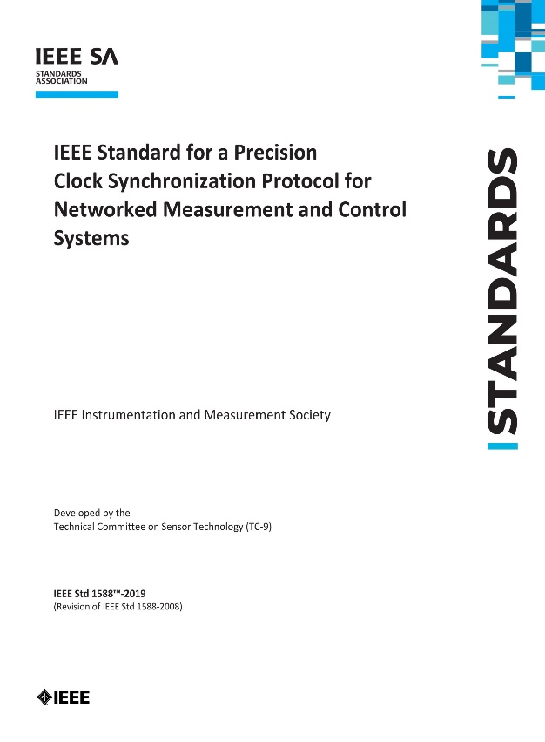
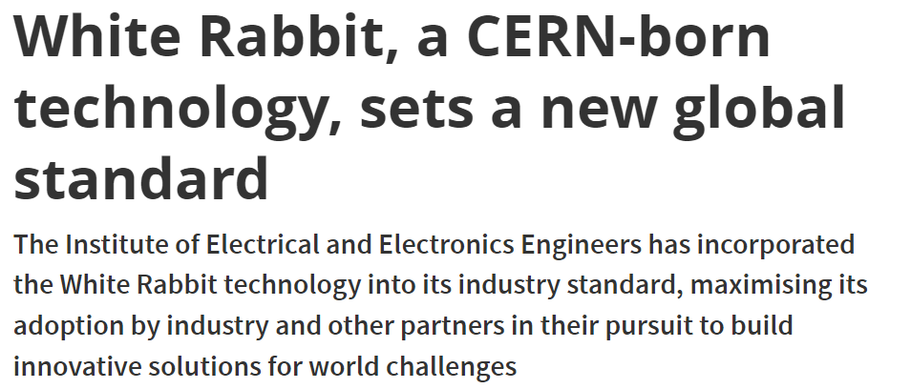
The price to pay: enlarging scope
https://home.cern/news/news/knowledge-sharing/white-rabbit-cern-born-technology-sets-new-global-standard
www.white-rabbit.tech/ieee1588-standard/

Slide 11
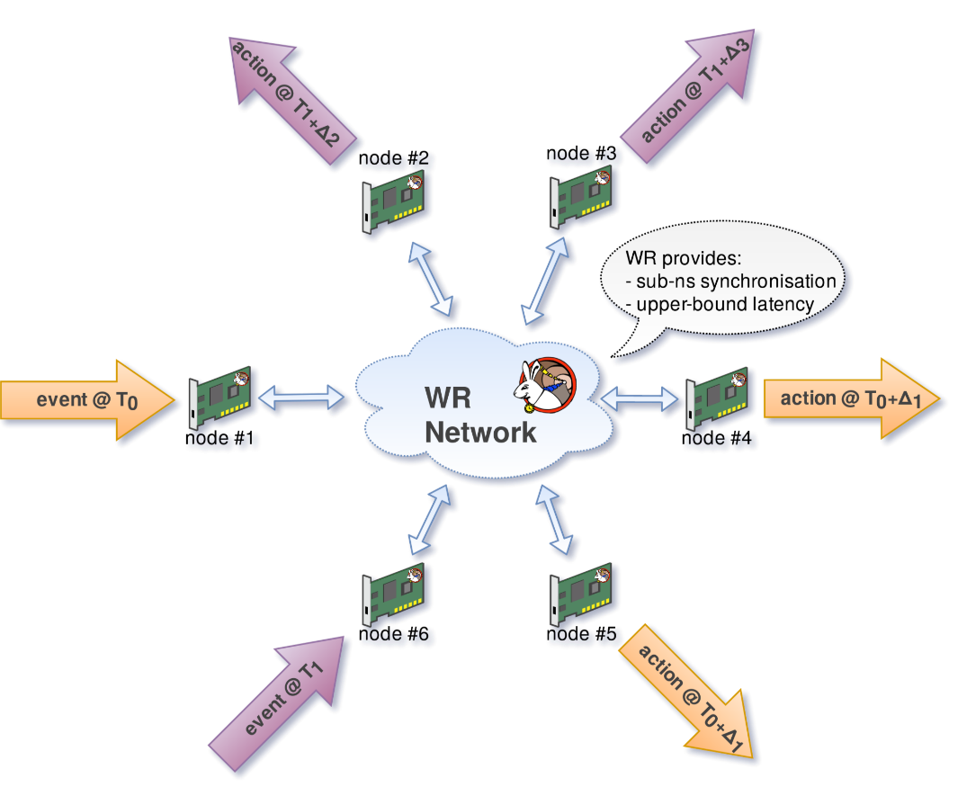
Why?
Our mandate!
Practical reasons:
  Missing piece in our kit of distributed controls and data acquisition
  Avoid proliferation of ad-hoc solutions
  Avoid vendor lock-in and cater for the extremely long lifetime of our deployments
  Improve talent acquisition, retention and replacement

Slide 12
Outline
A tale of two mandates
The original vision for White Rabbit (WR)
What happened in reality
The White Rabbit Collaboration (WRC)
Closing remarks

Slide 13
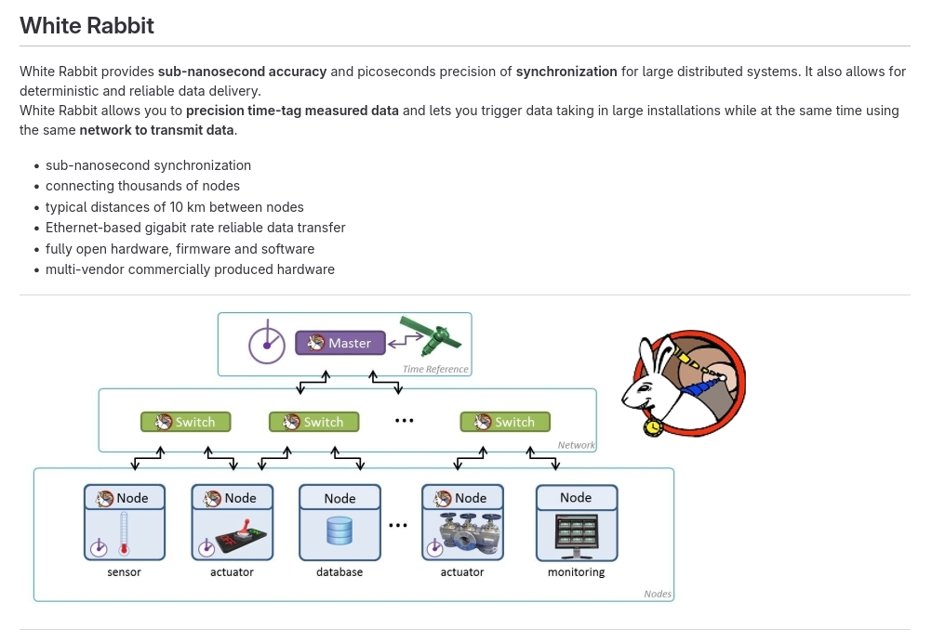
Challenges in Open Hardware: a “forge” to collaborate on HW design
  See White Rabbit in the Open Hardware Repository: https://ohwr.org/project/white-rabbit/wiki

Slide 14
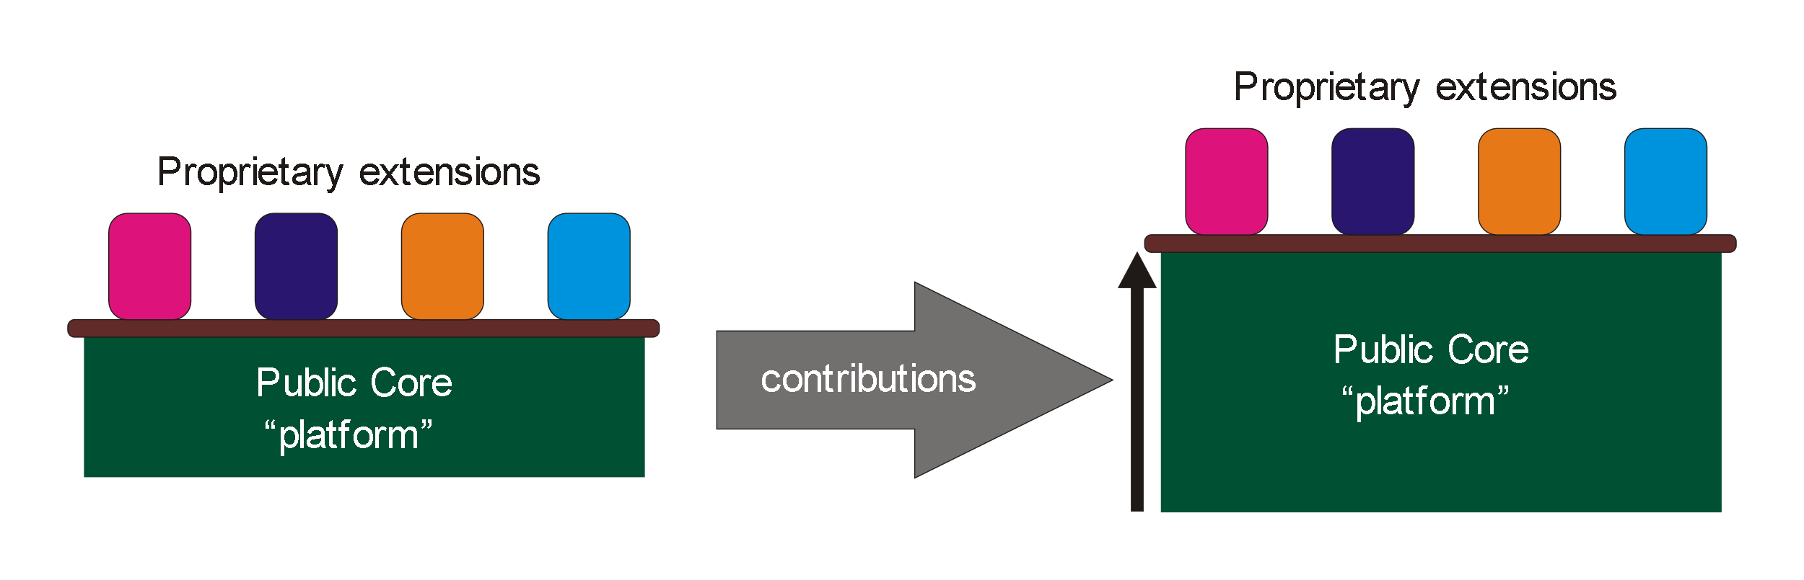
Challenges in Open Hardware: business models

Slide 15
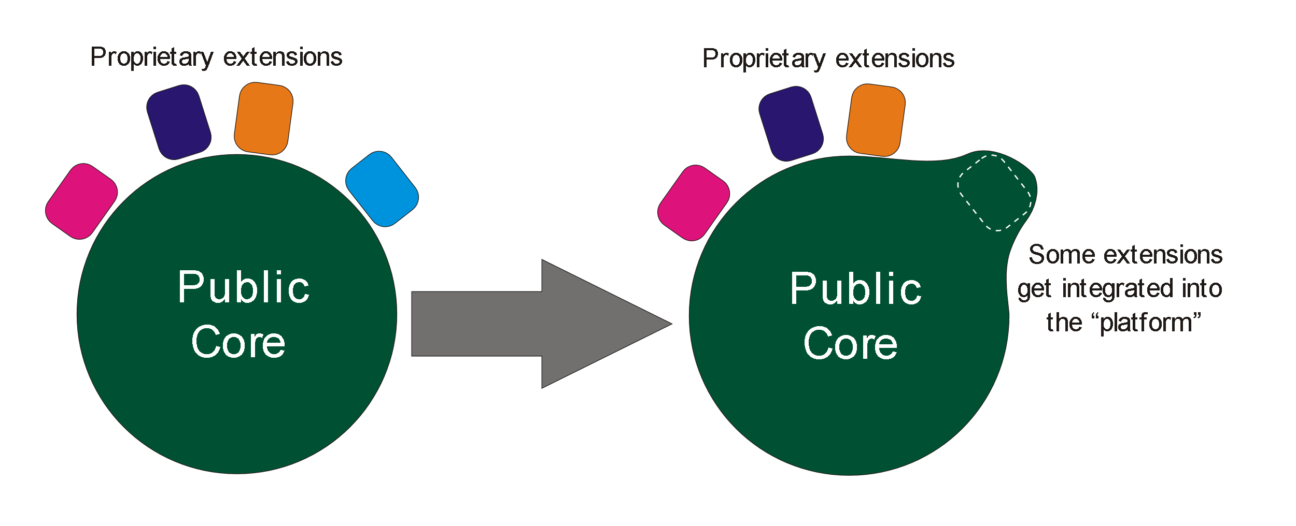
Challenges in Open Hardware: the time dimension in business models

Slide 16
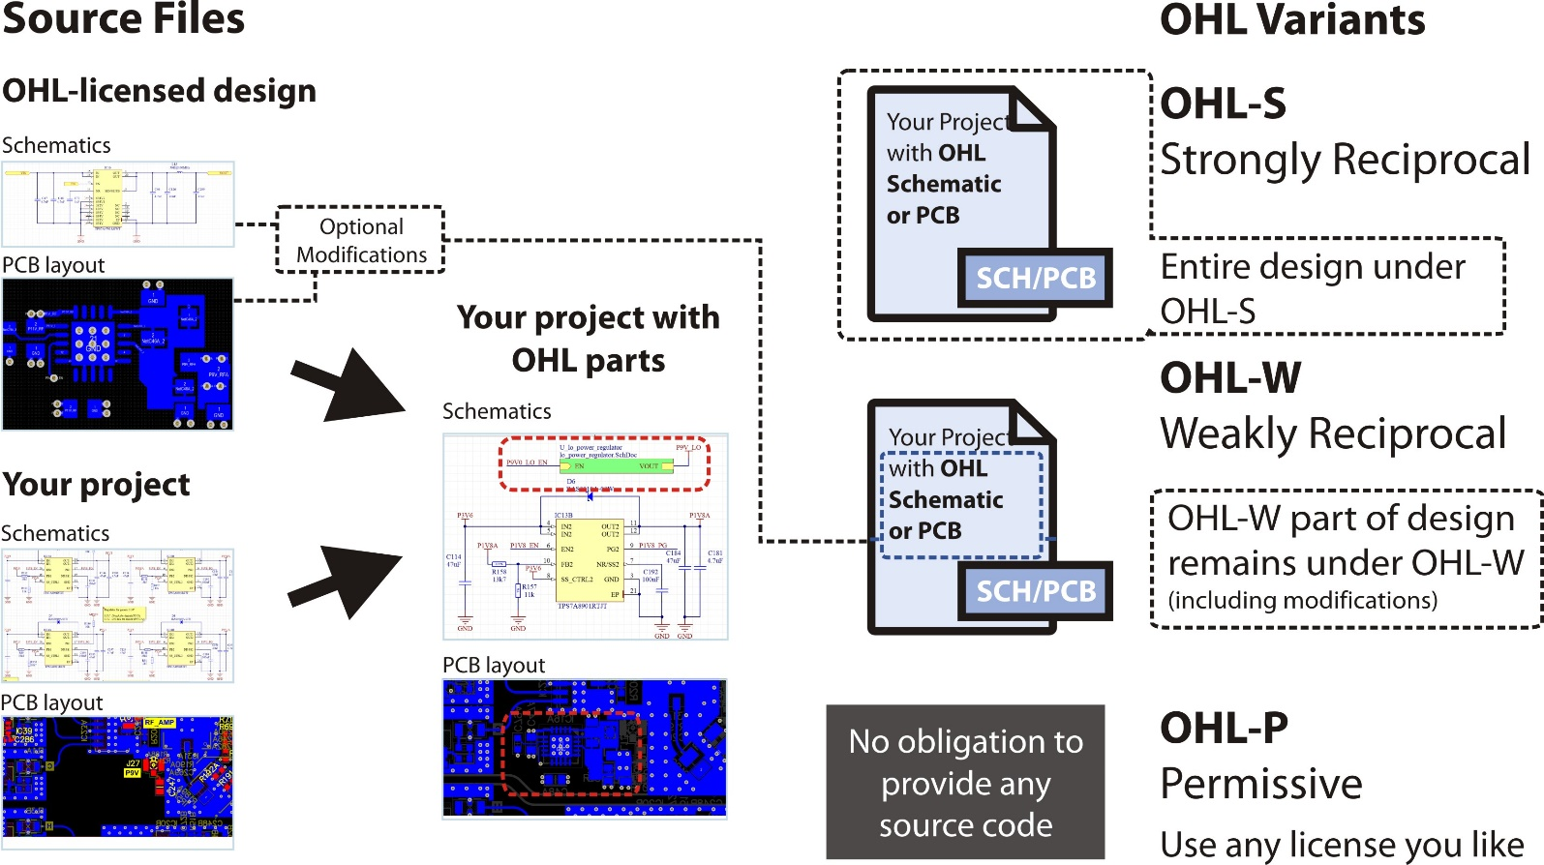
Challenges in Open Hardware: licensing for PCBs
Great collaboration with CERN KT. See https://cern-ohl.web.cern.ch/

Slide 17
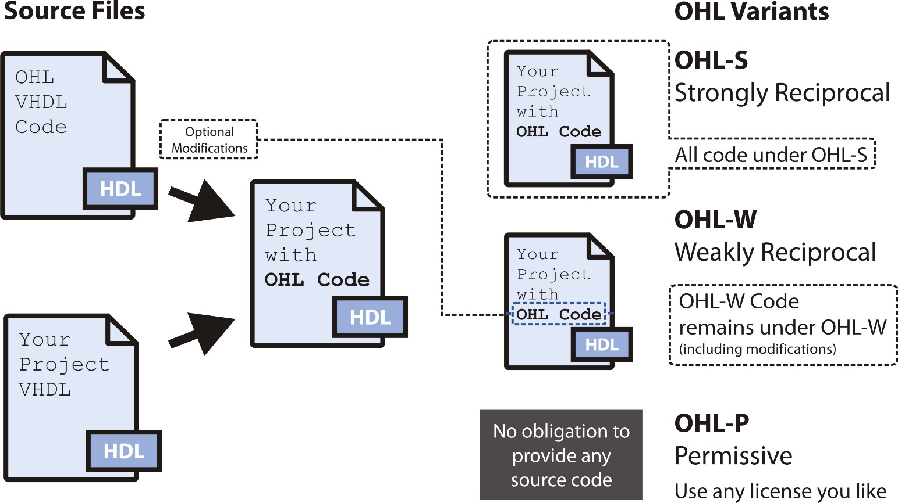
Challenges in Open Hardware: licensing for HDL
Great collaboration with CERN KT. See https://cern-ohl.web.cern.ch/

Slide 18
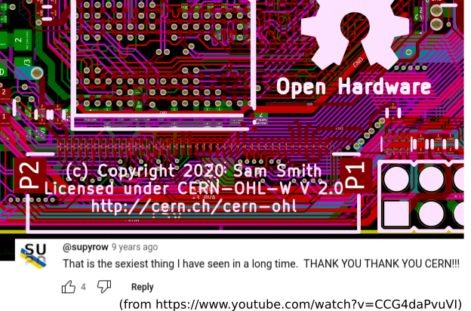
Challenges in Open Hardware: the tools
CERN contribution to KiCad development in collaboration with the CERN & Society Foundation:
https://cernandsocietyfoundation.cern/news/significant-milestone-regarding-cerns-involvement-development-kicad

Slide 19
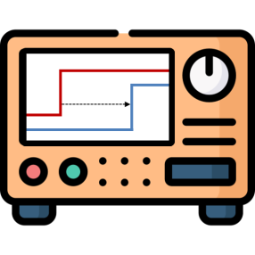
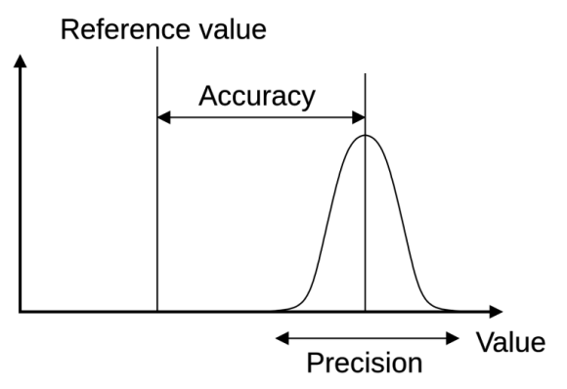
Basics of WR: accuracy and precision
11h50m00s
11h50m01s
Network
PPS
PPS

Slide 20
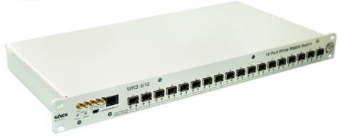
White Rabbit operation in a nutshell
White Rabbit = PTP + L1 syntonisation + phase detection + asymmetry correction
11h50m00s000000000.000ns
11h50m00s000000000.010ns
t₁
Precision Time Protocol
(PTP, IEEE 1588)
PTP limitations:
Free-running oscillators
Timestamp resolution
Symmetry assumption of
medium & hardware
t₂
(t₄ – t₁) – (t₃ – t₂)
2
t₃
Time_correction = + asym
t₄
t
Ethernet
t
Frequency
transfer
Common frequency
makes task of PTP easier
Enhance
timestamp precision to ps level
by using phase detection techniques
Phase
detection
Phase offset with ps precision
Single bidirectional fiber
Link delay model
Calibration
Enhance
time correction accuracy
by automatic medium asymmetry calculation and calibration of hardware delays
Asymmetry
corrections

Slide 21

White Rabbit Switch Overview
Central element of WR network
1U height
1 management port (100Mbit/s)
USB Serial console for management
18 GbE (1 Gbit/s) SFP ports with
White Rabbit support
5 clock connectors

Slide 22
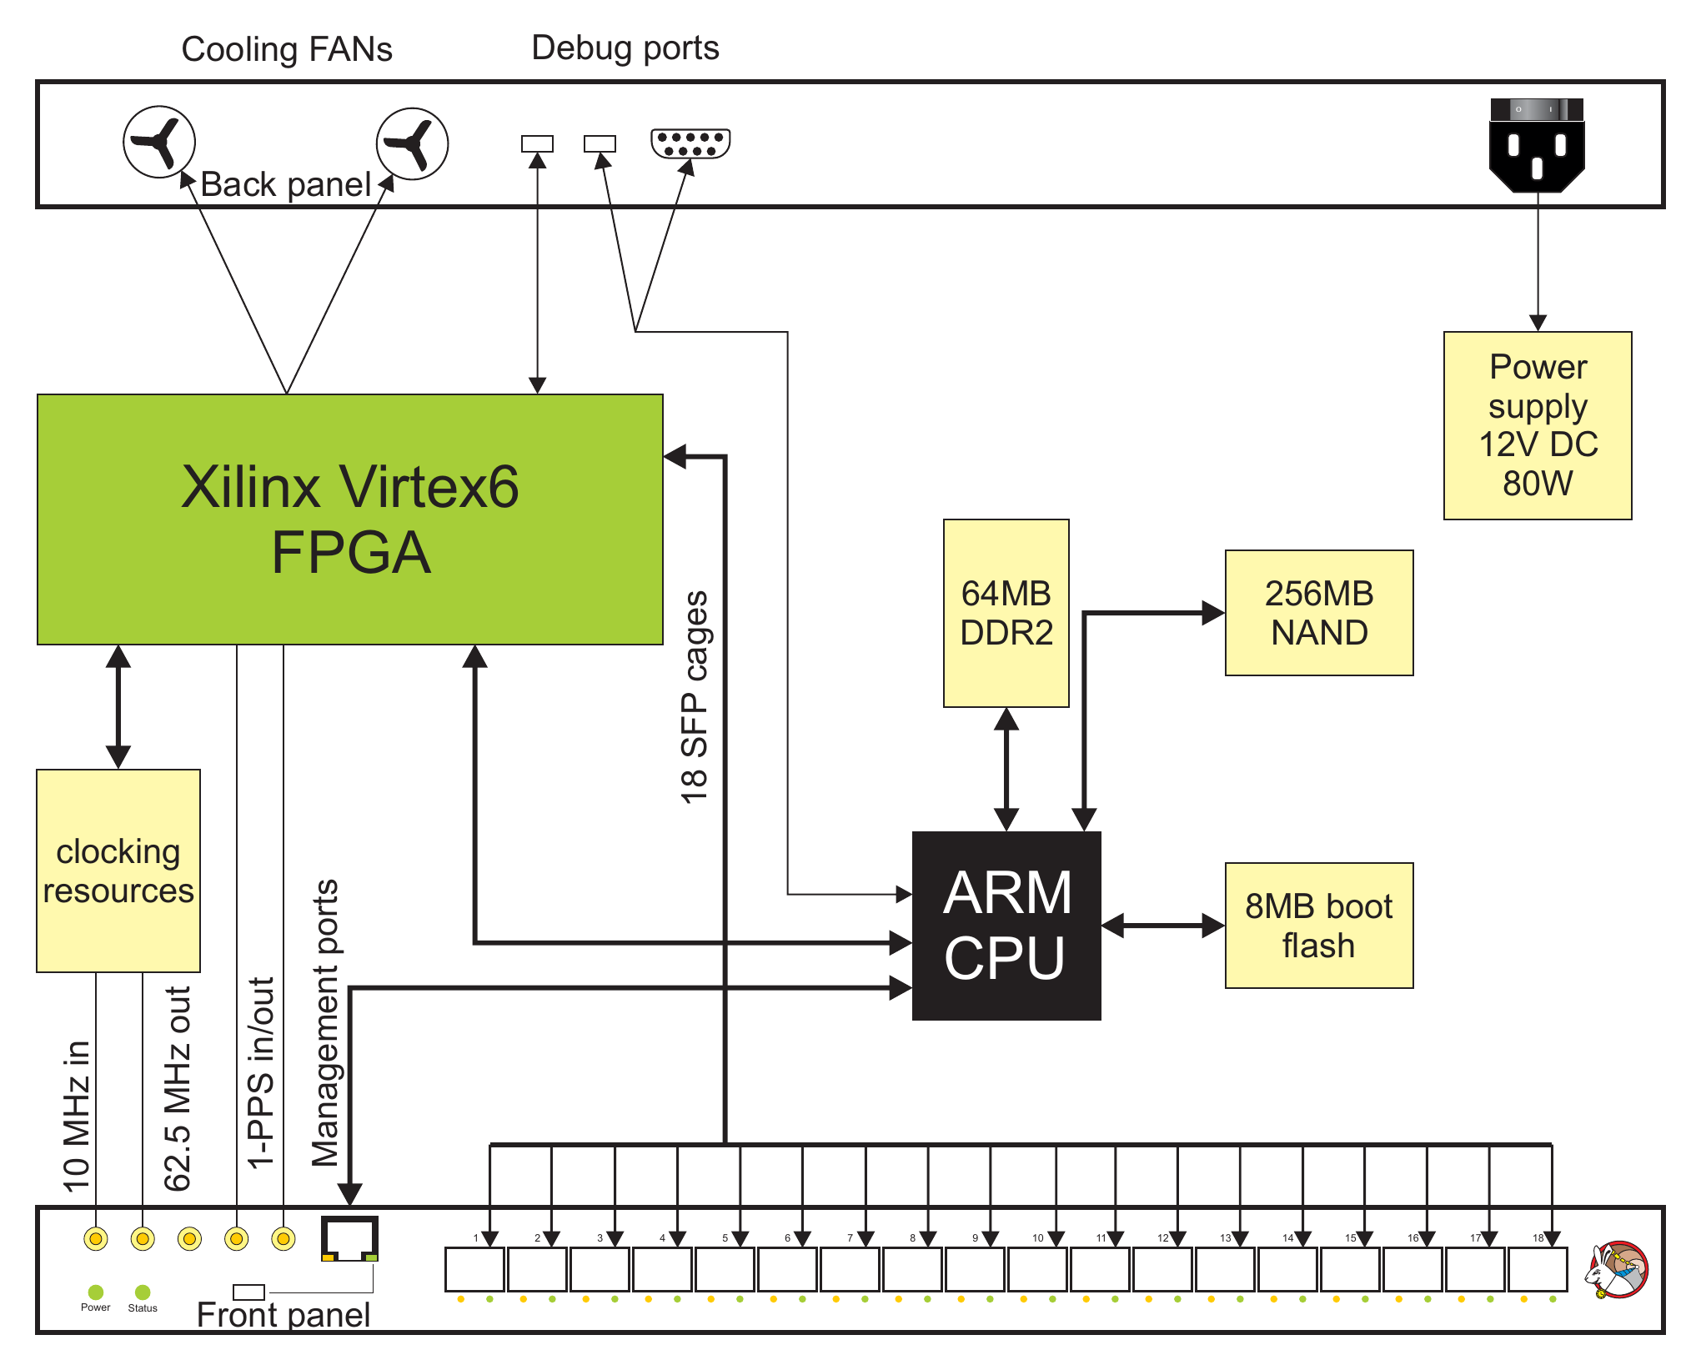
White Rabbit Switch Inside
ARM CPU
  Runs Linux
  Implements PTP
  Handles switch management
FPGA
  Frame forwarding between ports
  Timestamping of PTP messages
  Resources for clock signal manipulation

Slide 23
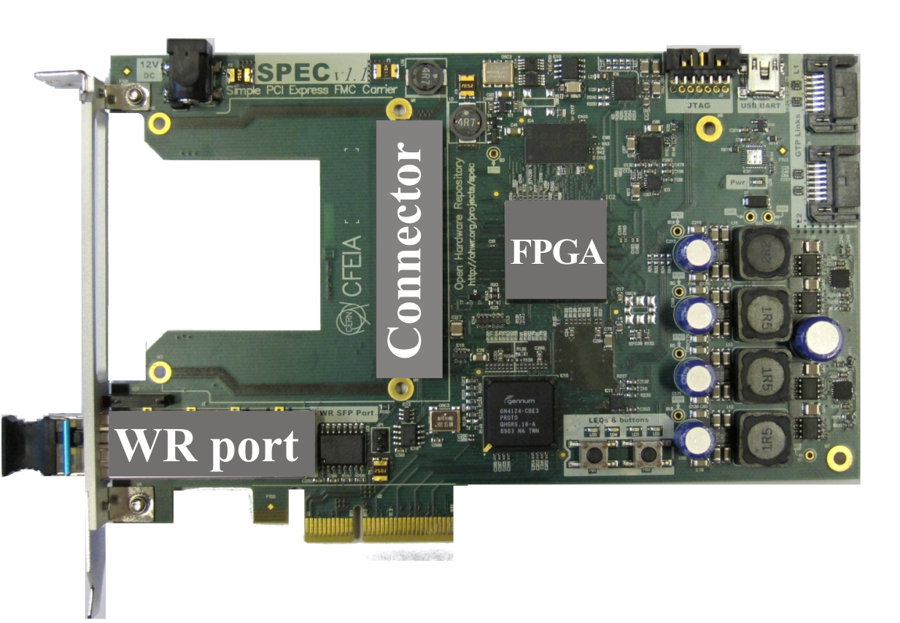







WR Node = WR PTP Core + hardware
FPGA
WR PTP Core
WR PTP Core
(WRPC)
Hardware with WR support
source
sink
Simple PCIe FMC carrier (SPEC)
Simple VME FMC carrier (SVEC)
PCI eXtensions for Instr. (PXI) module
FPGA Mezzanine Card (FMC) module
CompactRIO White Rabbit
Mini-WR to WR-enable carrier
Tx
Ethernet
Rx
MAC I/F
PHY
Serdes
CLK_{REF}
CLK_{DMTD}
adjust
I2C
User Data
1-PPS
timecode
frequency
Peripheral
CPU/registers
External oscillators
timing I/F
Aux diags
Control/status
EEPROM
Pipelined WB
Slave I/F

Slide 24
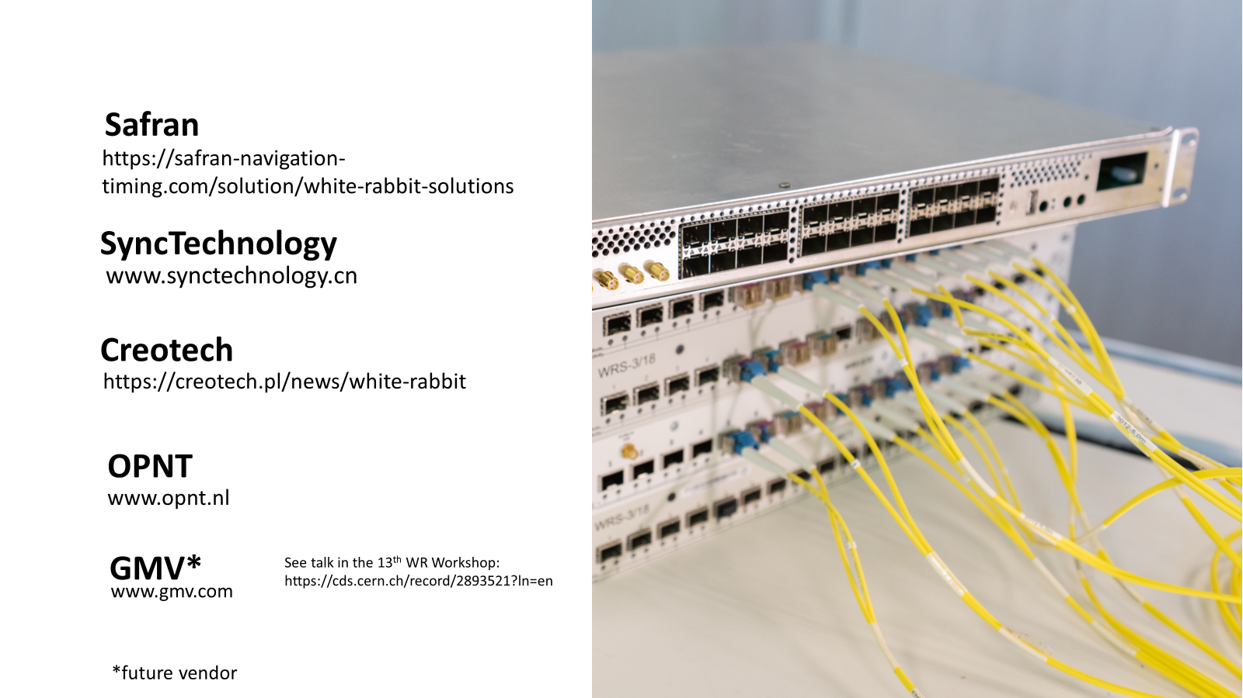
The WR HW/GW/FW/SW ecosystem

Slide 25
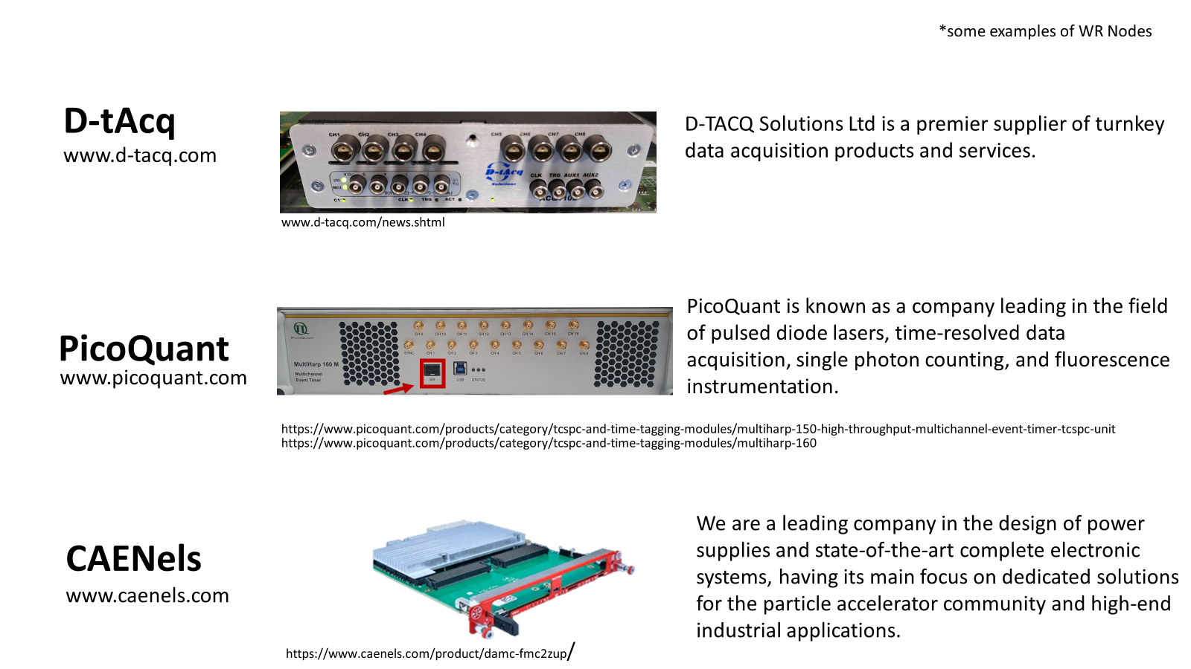
The WR HW/GW/FW/SW ecosystem

Slide 26
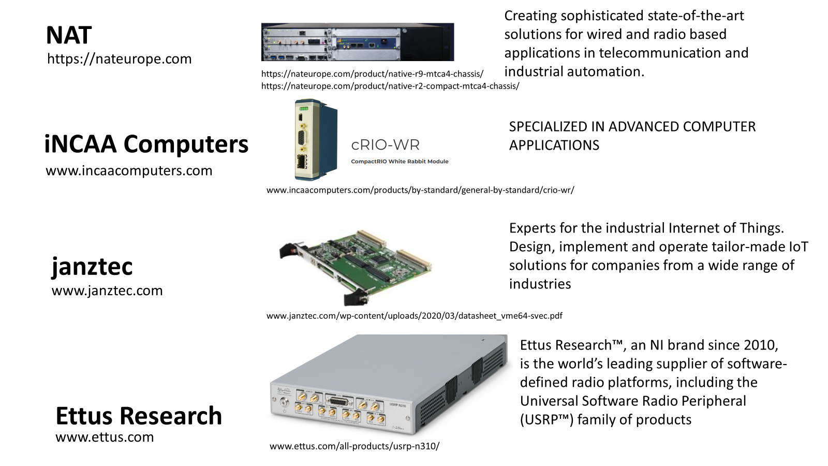
The WR HW/GW/FW/SW ecosystem

Slide 27
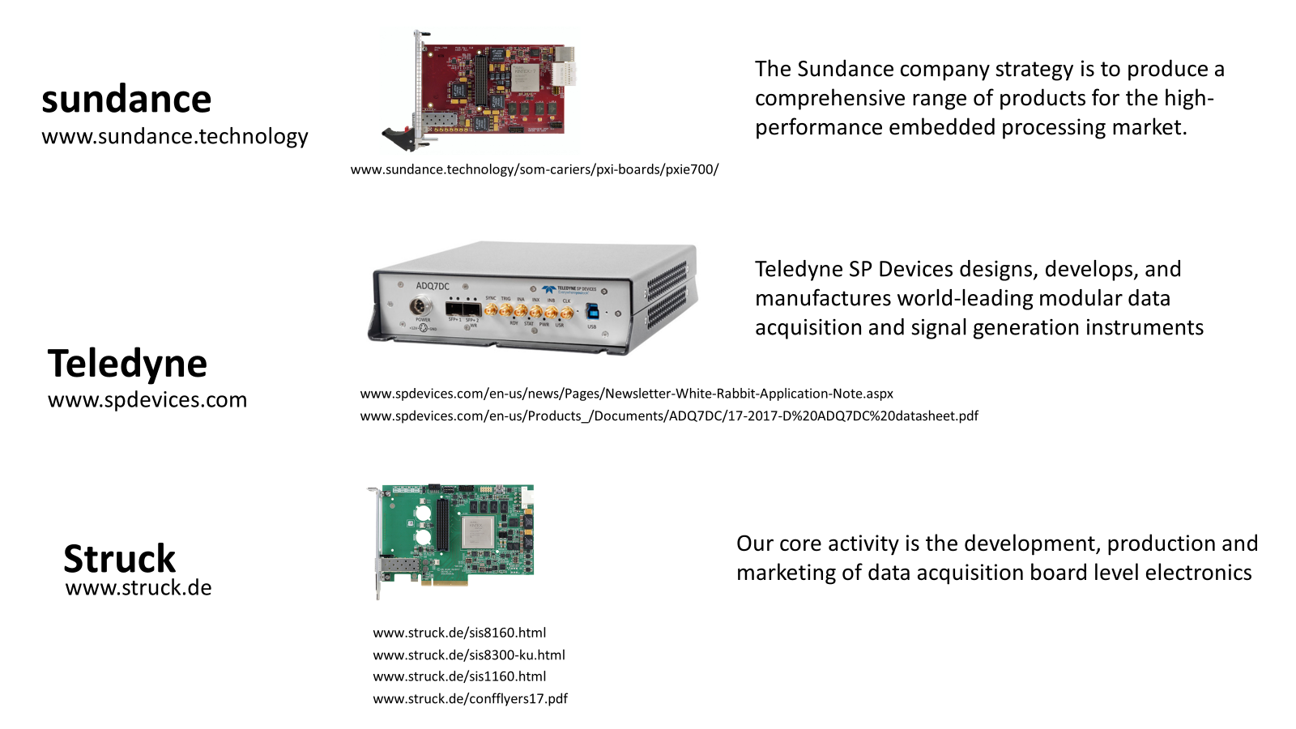
The WR HW/GW/FW/SW ecosystem

Slide 28
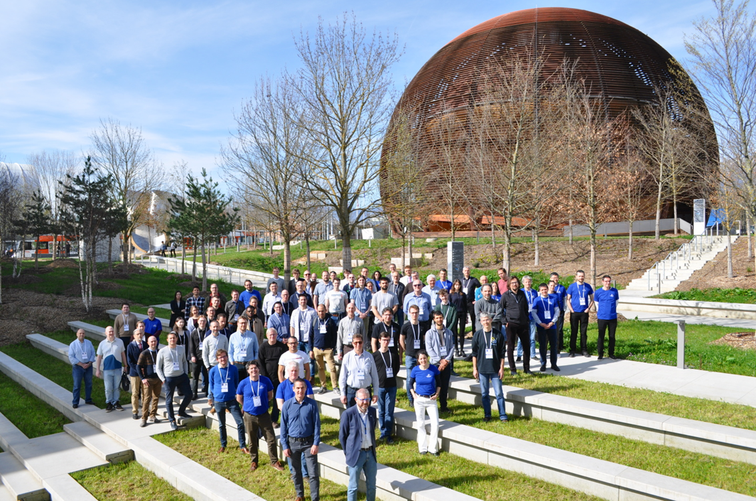
The WR Community and open source

Slide 29
Outline
A tale of two mandates
The original vision for White Rabbit (WR)
What happened in reality
The White Rabbit Collaboration (WRC)
Closing remarks

Slide 30
A short history of White Rabbit
2008: first meeting at CERN
2009: first switch prototype
2010: Spanish government grant
2012: first COTS switch available (open-source hardware, gateware, firmware, software)
2012: first operational deployment of WR (Gran Sasso National Lab)
2013-2018: WR concepts standardised within IEEE 1588
2024: creation of the WR Collaboration
See https://www.white-rabbit.tech/wr-history/ for more details

Slide 31

Bringing of all stakeholders
of the technology together
Companies
  End users
  Positioning, Navigation and Timing (PNT) providers
  Measurement instrumentation
National Metrology Institutes
Universities
Research institutes/laboratories

Slide 32

WR
To maintain a
high-performance
open-source core
for the benefit of all

Slide 33
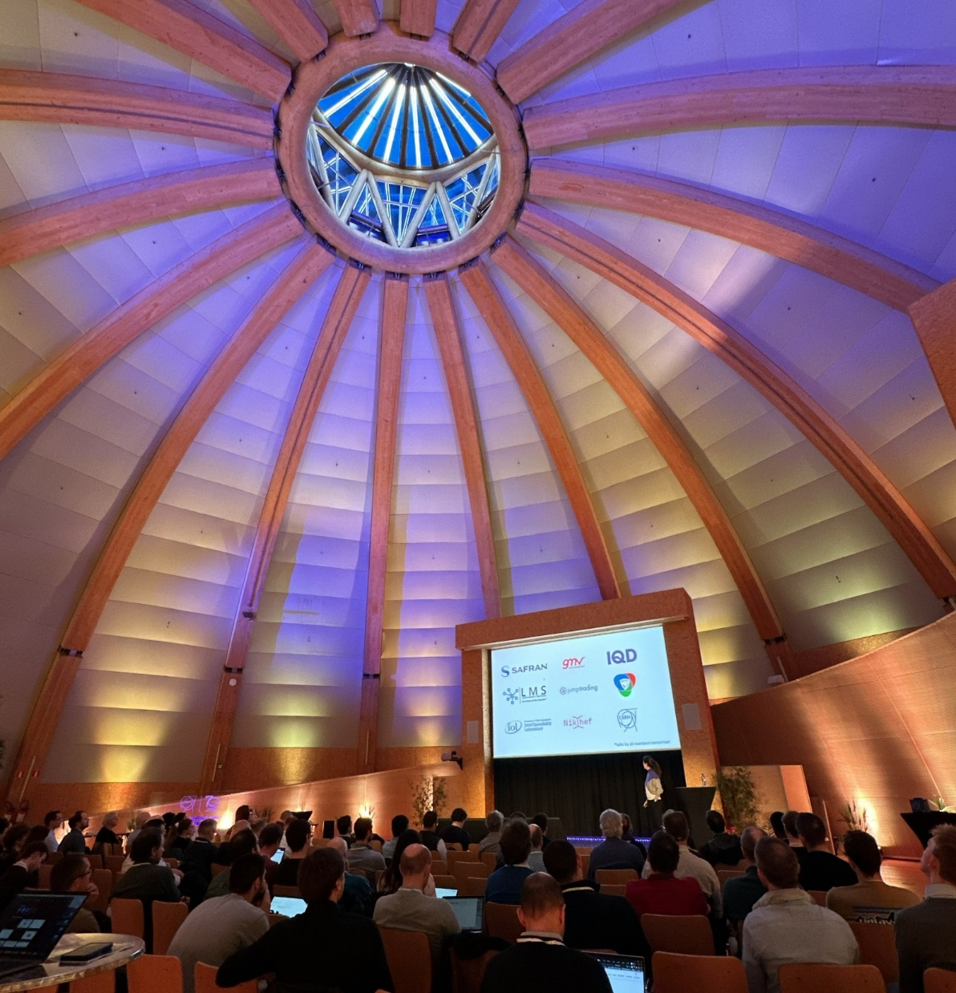
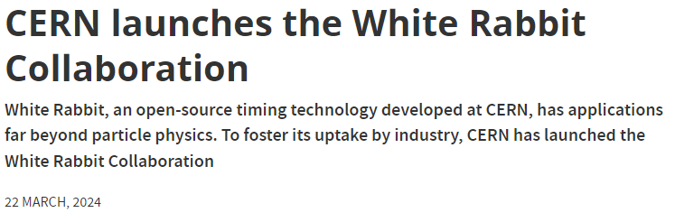
https://home.cern/news/news/knowledge-sharing/cern-launches-white-rabbit-collaboration
Listen to the talks of the event here:
https://www.white-rabbit.tech/13th_WR_workshop/

Slide 34
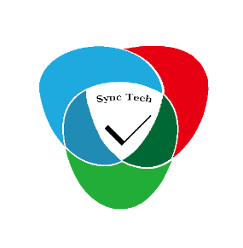

















Slide 35
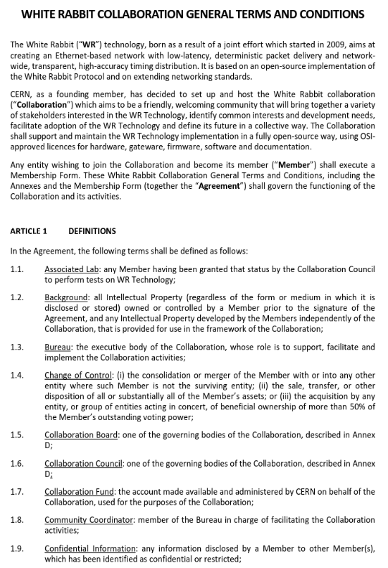
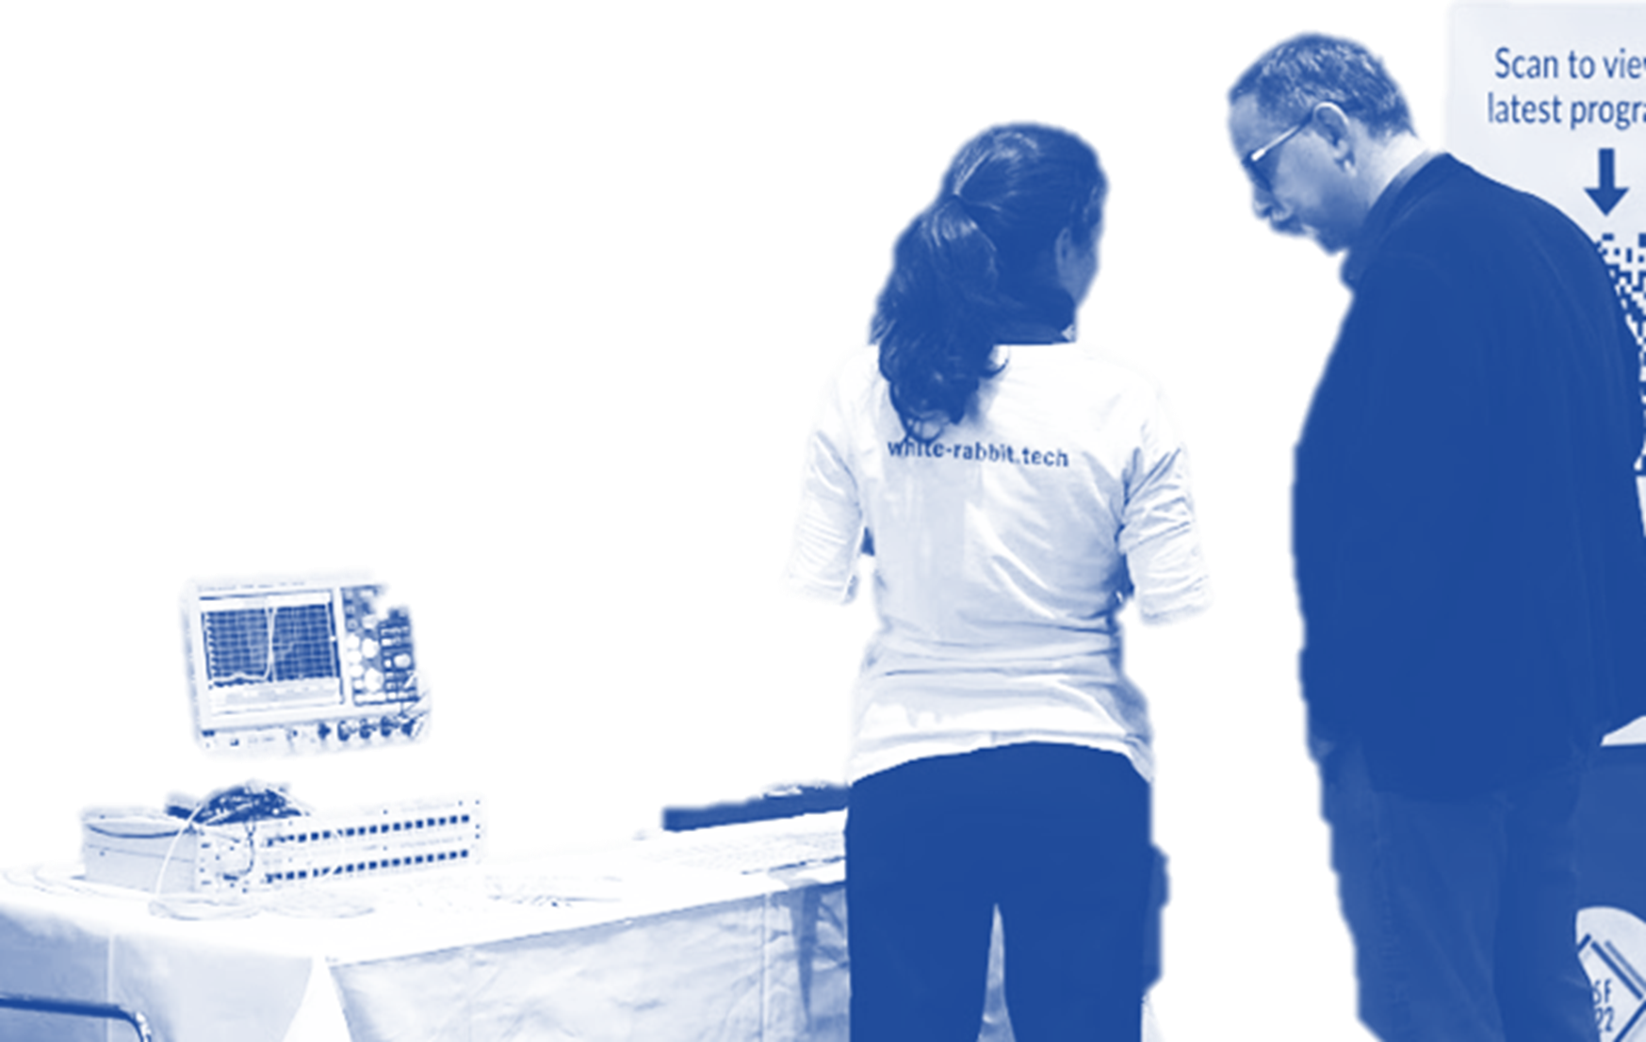
Collaboration with KT
WRC community coordinator
An experiment in public-private partnerships: getting the best of both worlds

Slide 36
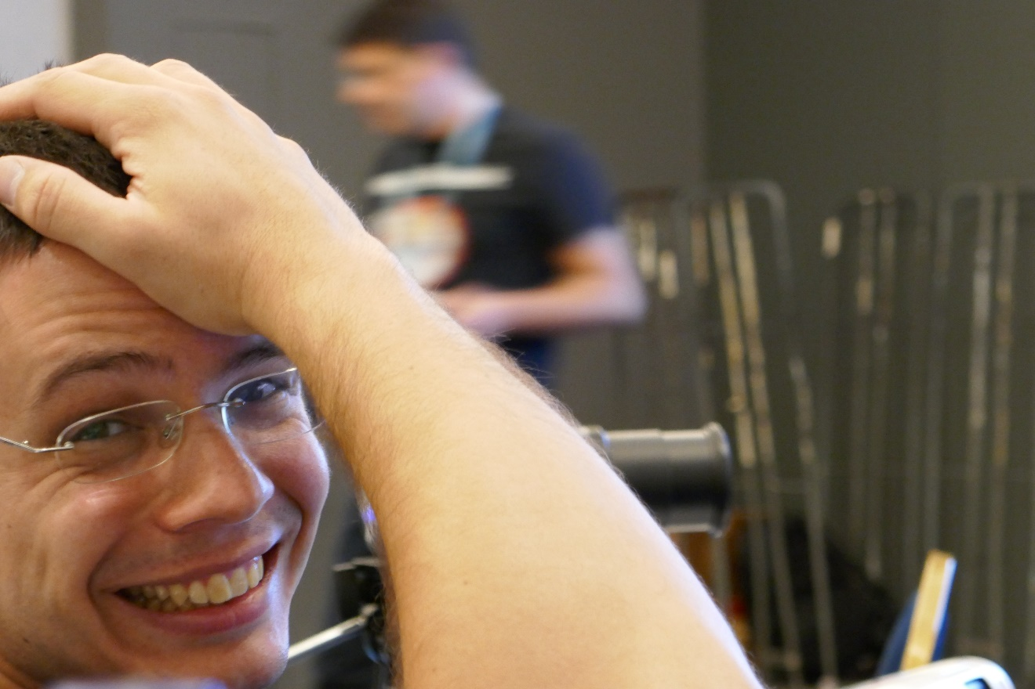
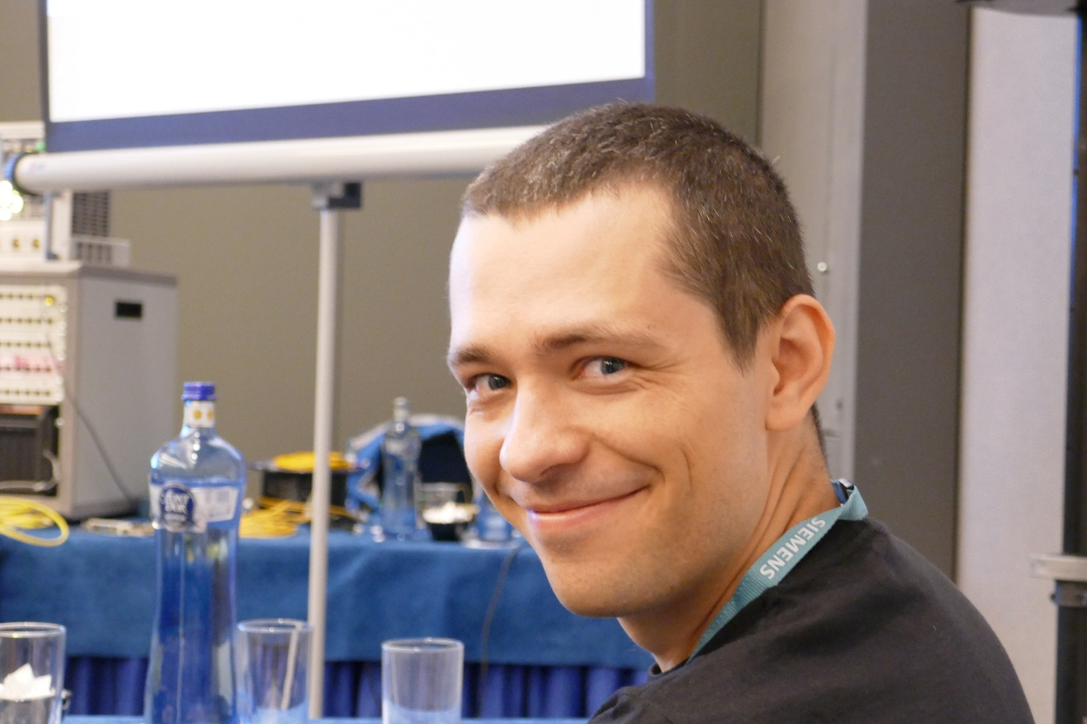
Benefits of WRC membership: support

Slide 37
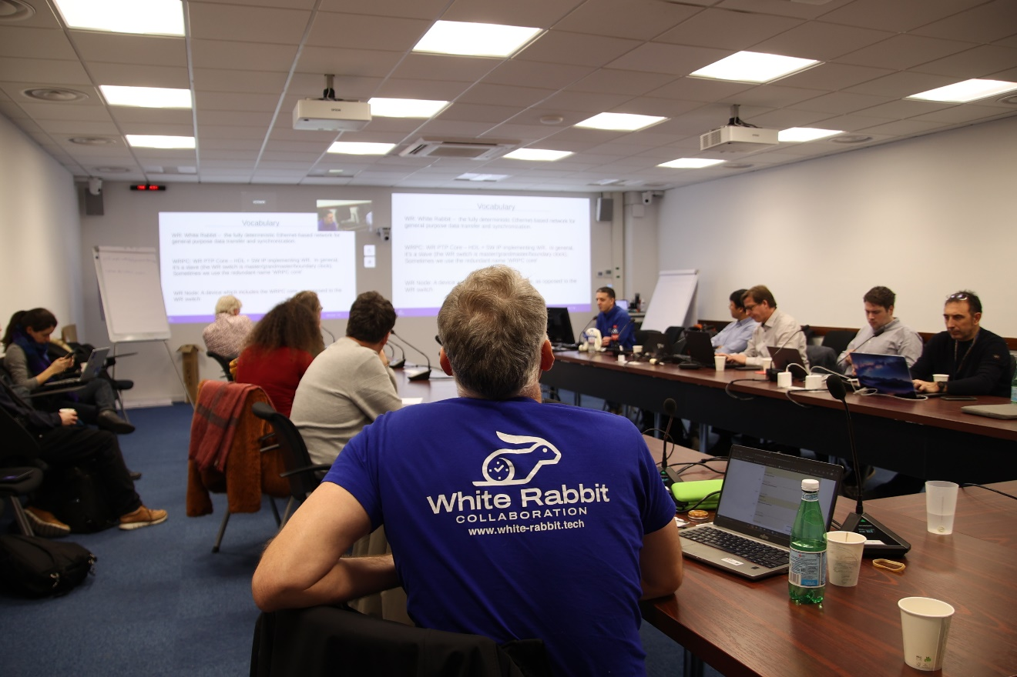
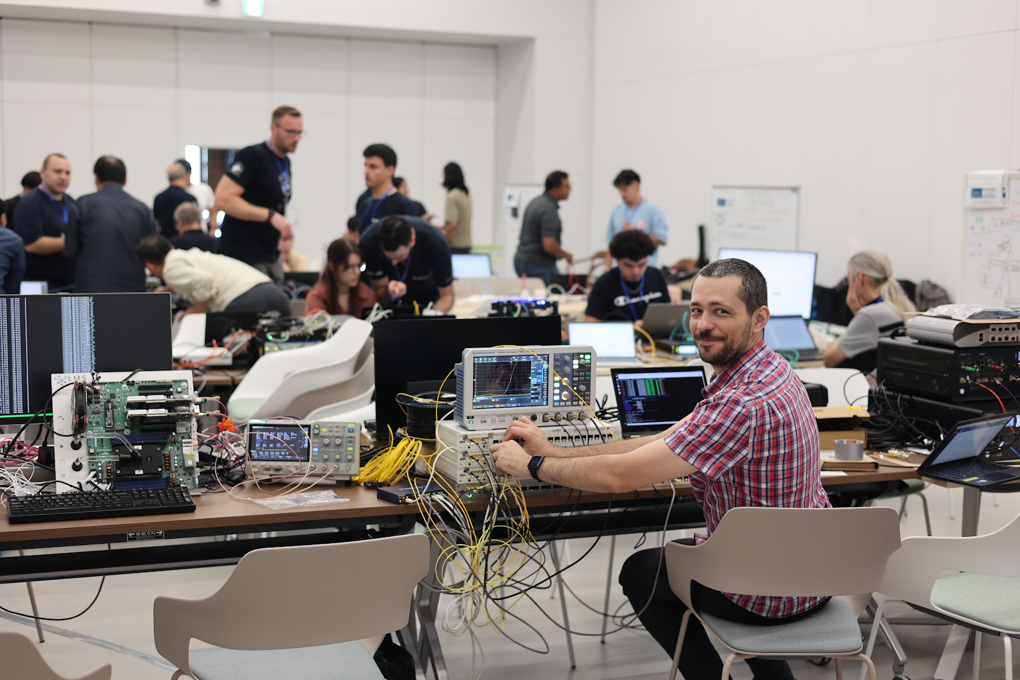
Benefits of WRC membership: training

Slide 38
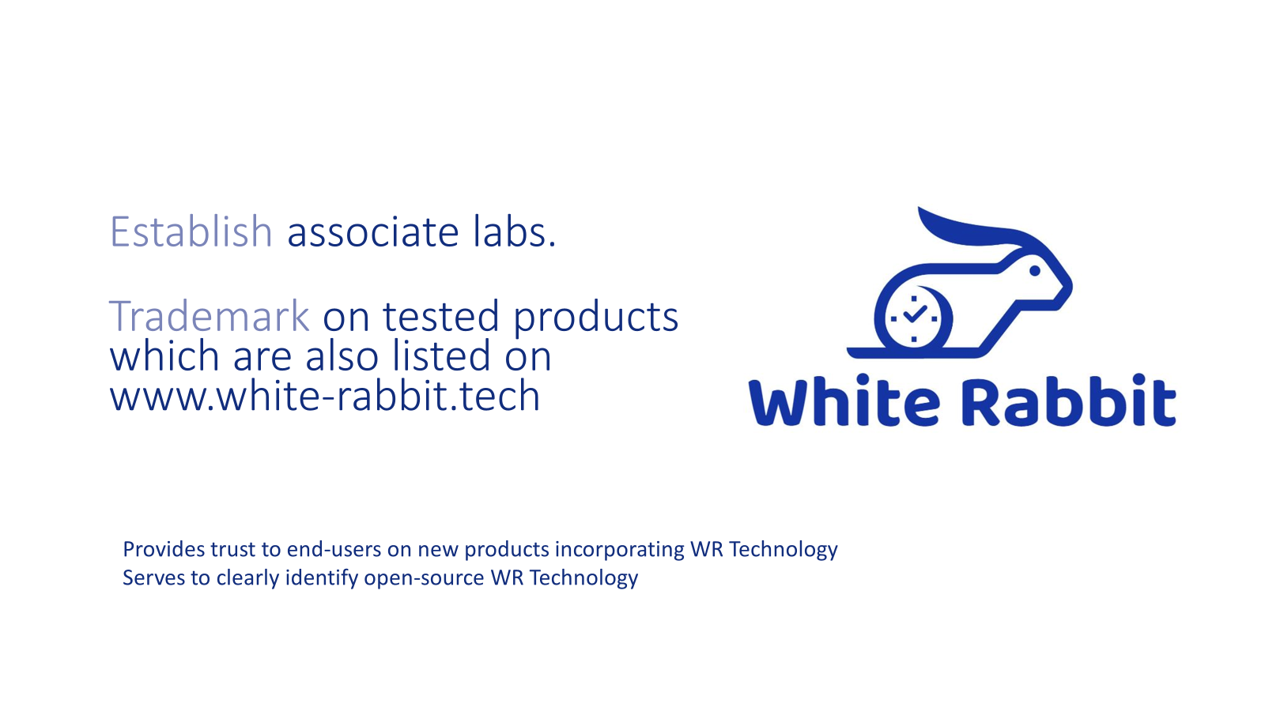
Benefits of WRC membership: qualification
The WRC logo and trademark: our only bit of “artificial scarcity”

Slide 39
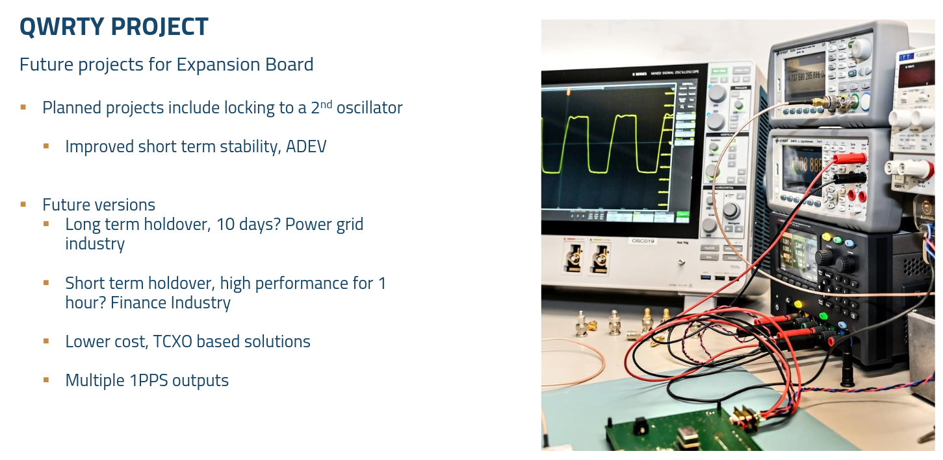
Benefits of WRC membership: projects
Courtesy Nick Amey, IQD

Slide 40
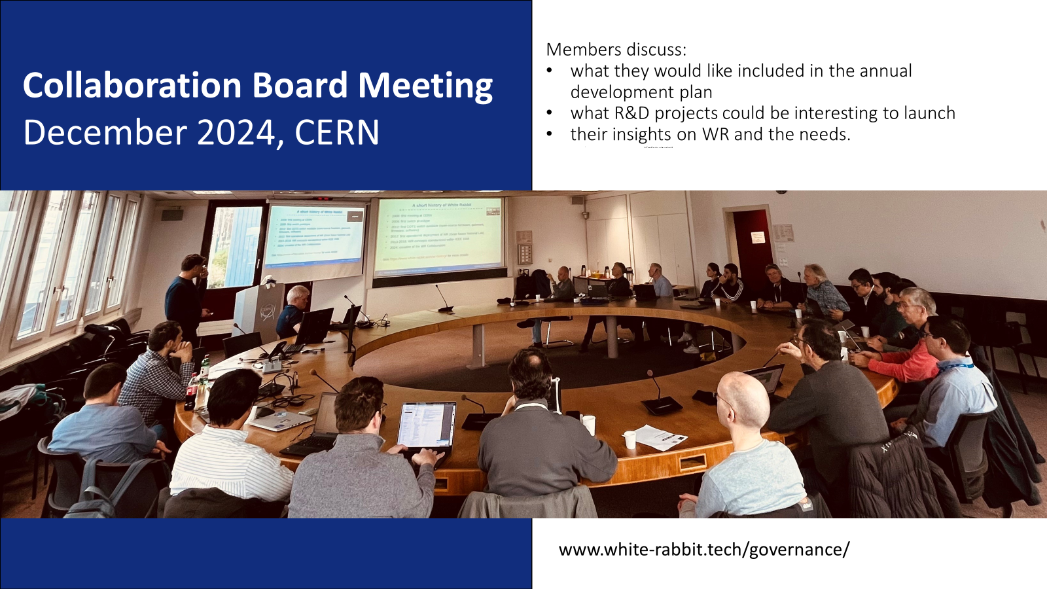
Governance: the WRC Board

Slide 41
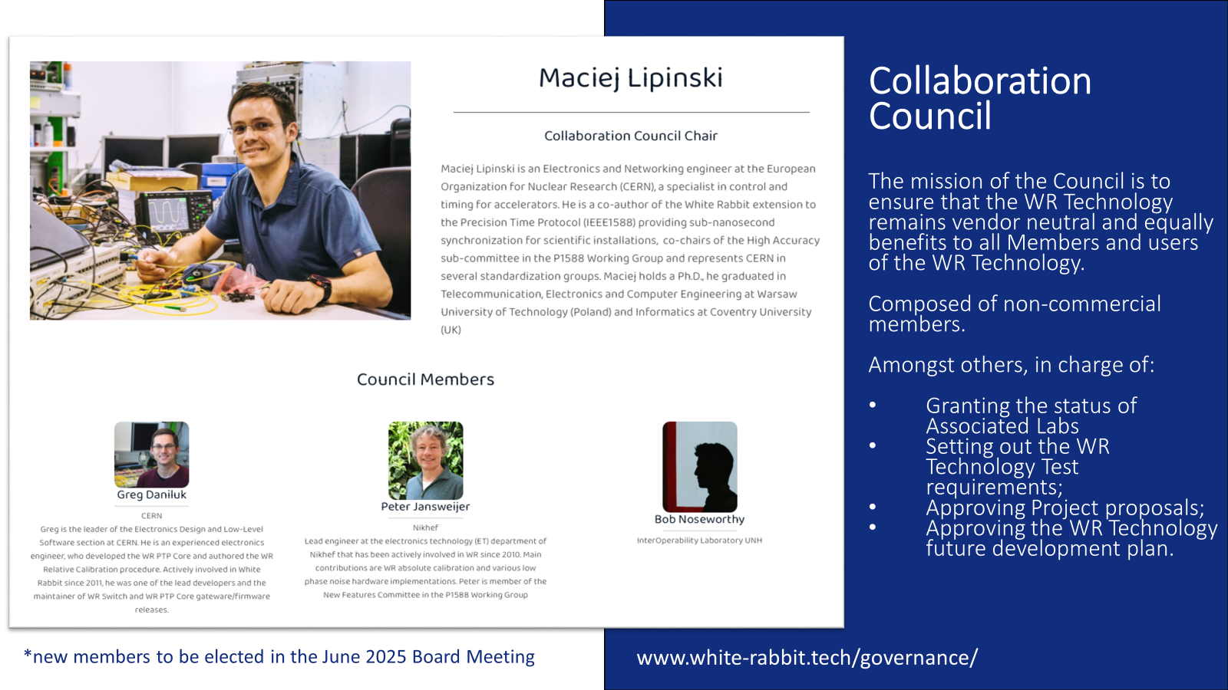
Governance: the WRC Council

Slide 42
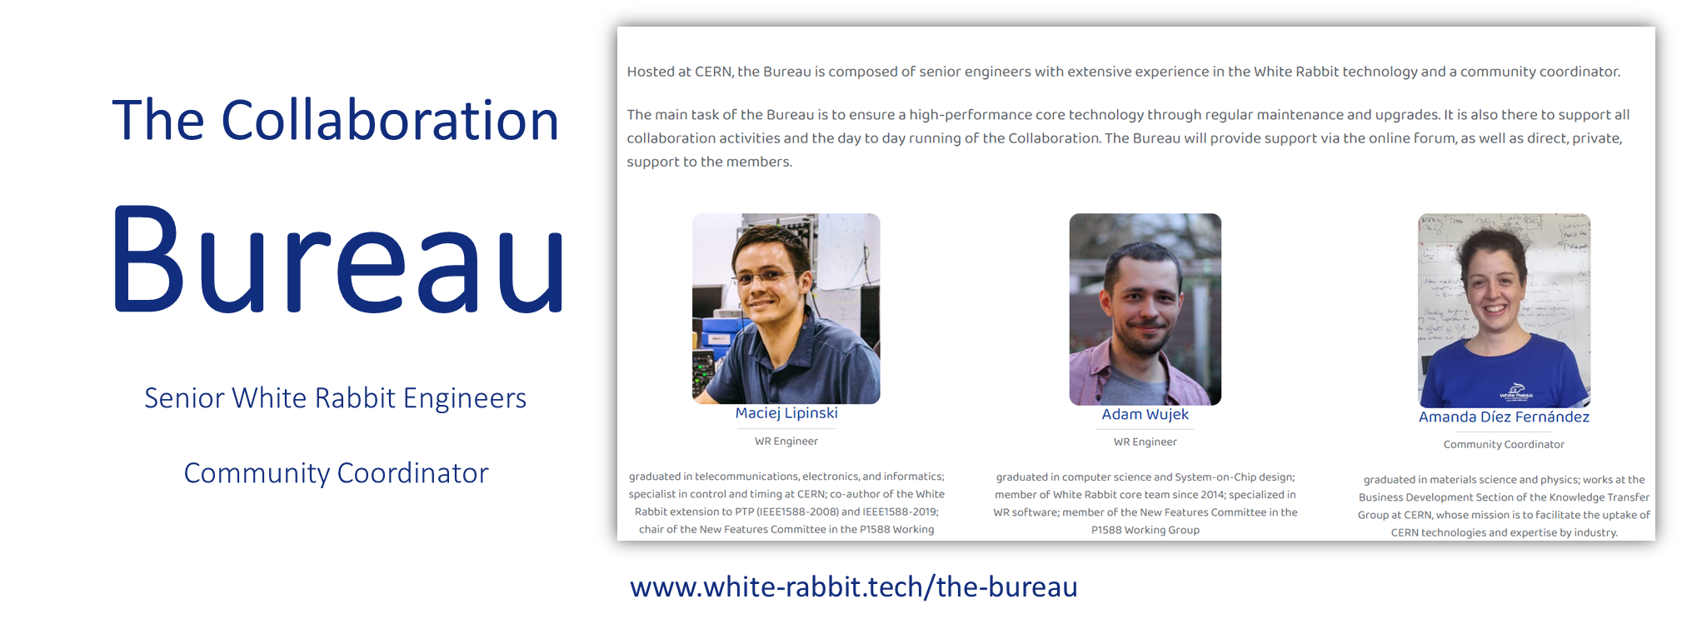
Governance: the WRC Bureau

Slide 43
Outline
A tale of two mandates
The original vision for White Rabbit (WR)
What happened in reality
The White Rabbit Collaboration (WRC)
Closing remarks

Slide 44
The WRC one year in
Things to work on (still learning!):
  Remain inclusive while providing added value to members
  Scale the Bureau in the medium term while ensuring economic sustainability
Things we are happy with (see next slides):
  Many new improvements and applications of WR technology
  Prospects of even more impact to come
  Steady flow of new companies and institutes expressing interest in membership

Slide 45
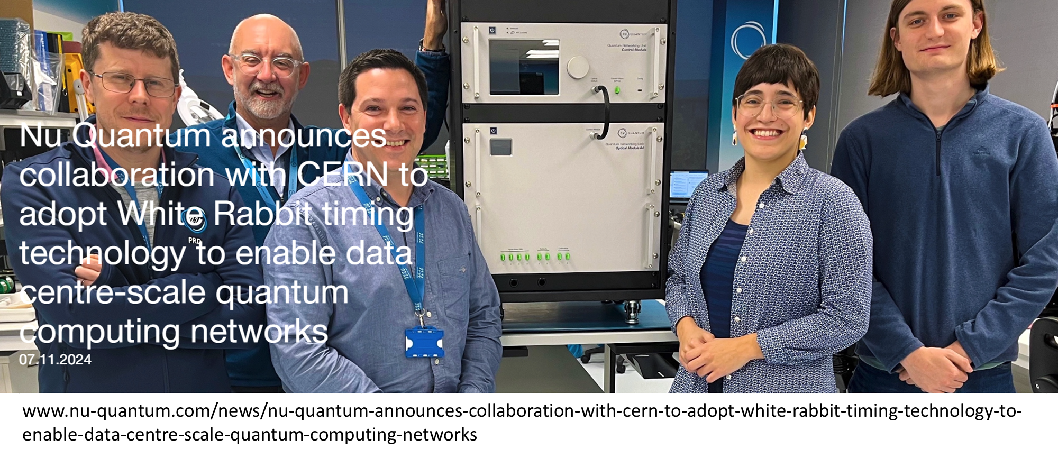
The WRC one year in

Slide 46
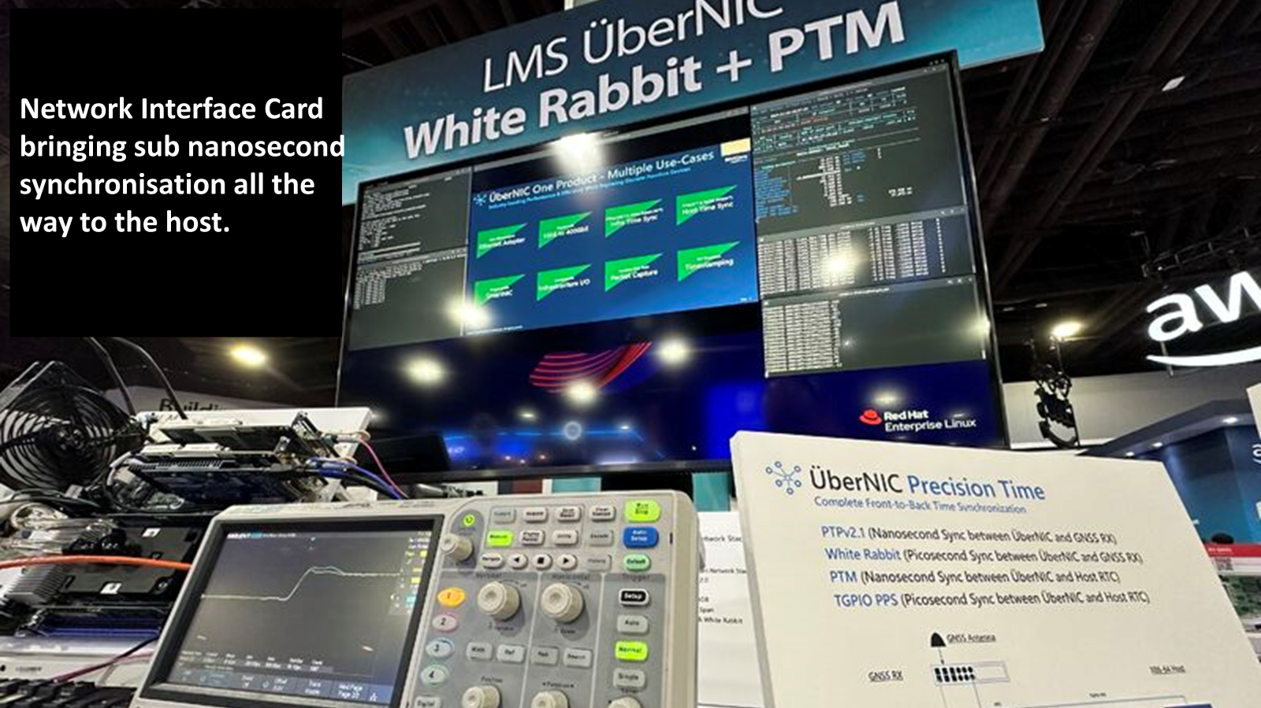
The WRC one year in

Slide 47

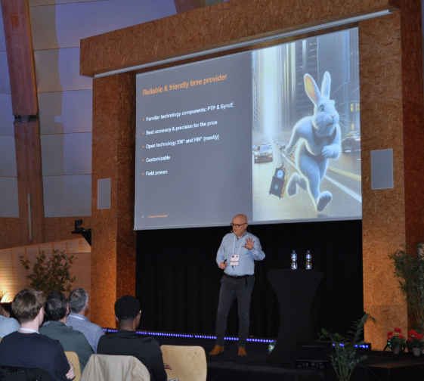
Towards Carrier Grade
White Rabbit
Marek Brawanski, Orange Poland
www.white-rabbit.tech/13th_WR_workshop

Slide 48
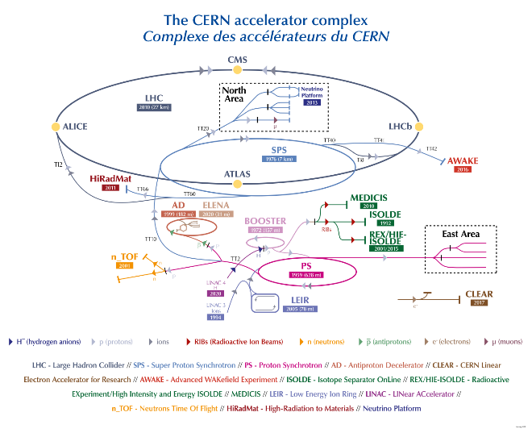
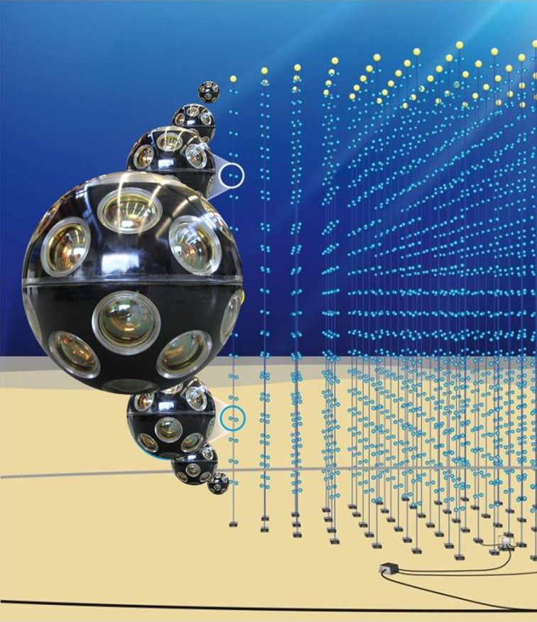
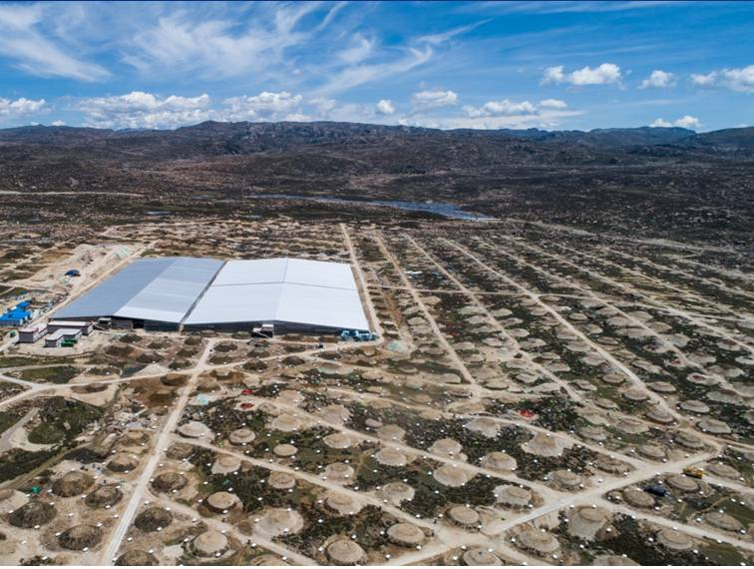
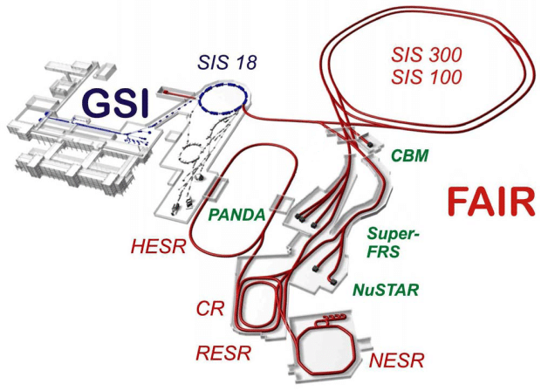
Scientific facilities

Slide 49
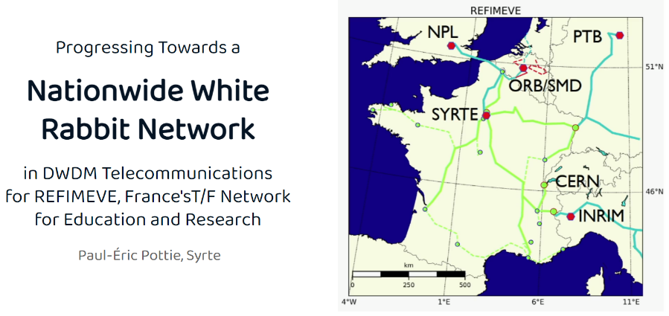
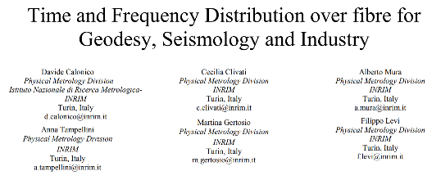
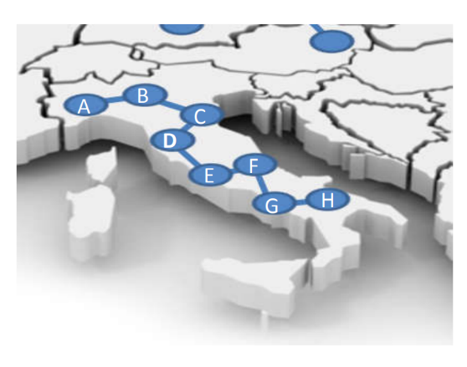
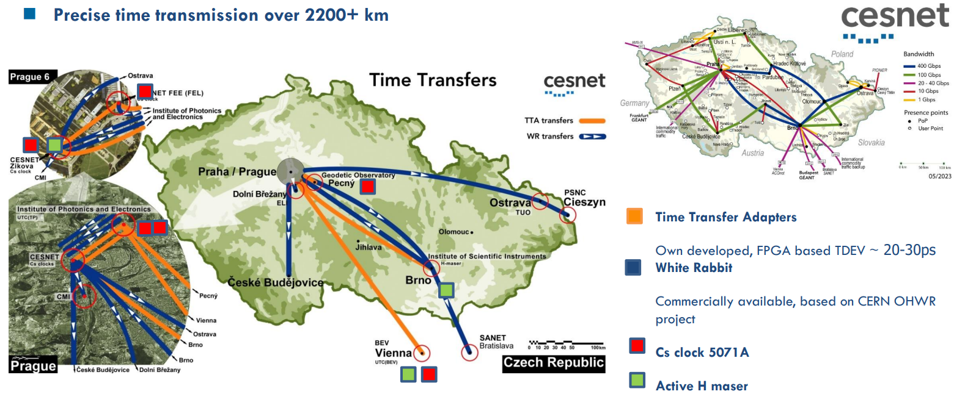

Long distance WR examples
Presently, we implemented the coherent frequency transfer on all the 1830 km, and we are upgrading the optical infrastructure to embed the White Rabbit PTP on all the backbone, too.
A WR-PTP implementation is already operational on a separate fibre from Torino to Milano.
Netnod’s White Rabbit implementation achieves sub-nanosecond accuracy in live Swedish network
https://www.netnod.se/time-and-frequency/netnods-white-rabbit-implementation-achieves-sub-nanosecond-accuracy-in-live-swedish-network
https://www.slideshare.net/slideshow/surf-hoe-laat-is-het-sander-klemann-nwd23/258638391
https://events.geant.org/event/1581/sessions/770/attachments/940/1400/Cntr_wide_WR.pdf
Notes:
Ask Amanda for two slides on EU plans

Slide 50

The WRC one year in

Slide 51
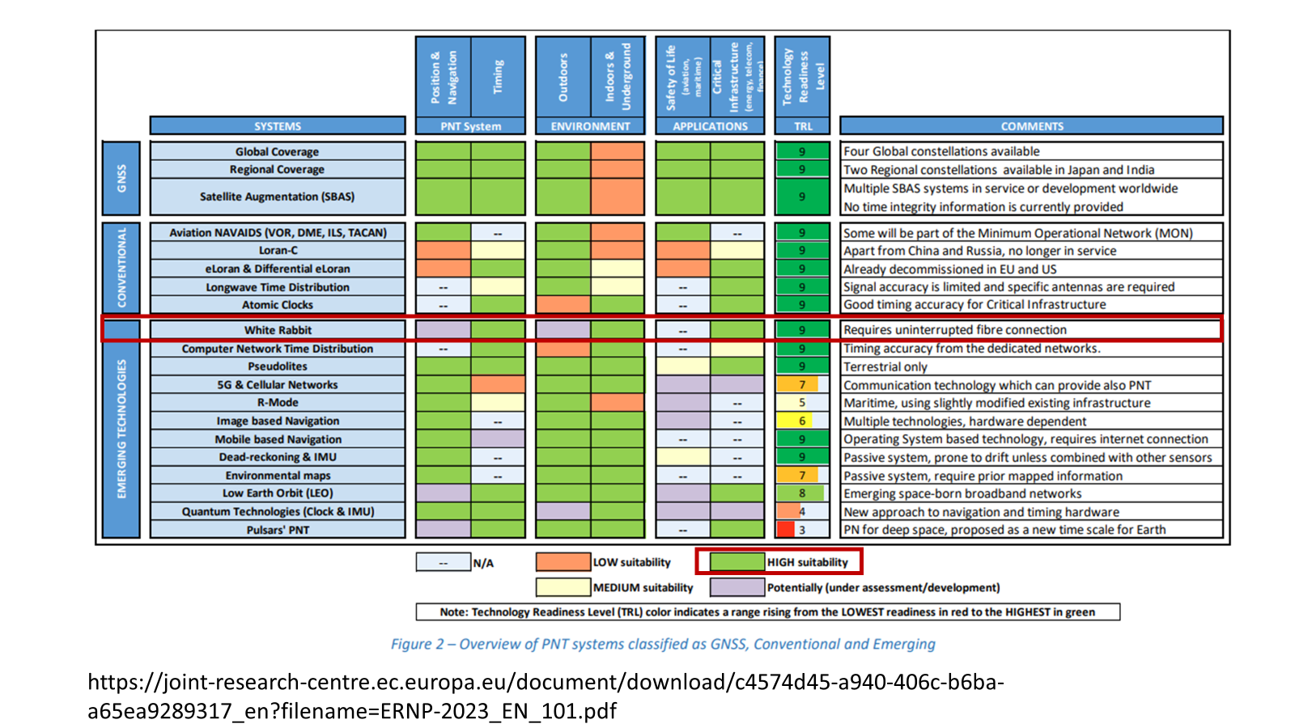
The WRC one year in

Slide 52
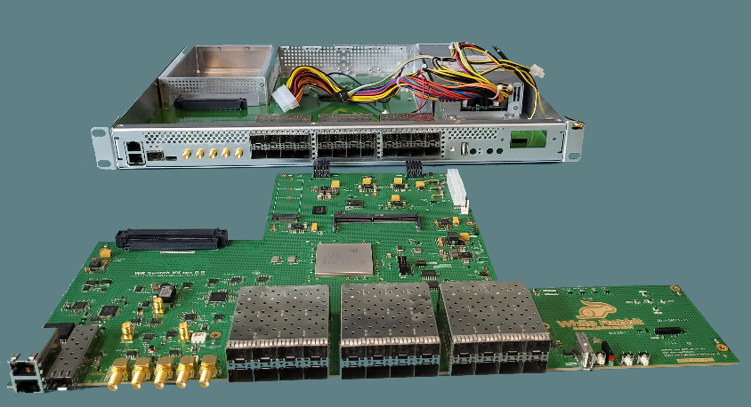


WR plans
Technical
  New WR components: switch v4 and nodes
  R&D: long distance, high precision and accuracy
  More automation, including absolute and in-situ calibration
  Projects: holdover, clock ensemble, event system…
Organisational
  Evolution of WR Collaboration
  European time and frequency transfer network
  Definition of testing and qualification in collaboration with commercial and non-commercial partners

Slide 53
Can these mandates by combined in a harmonious way?
Yes.
We are combining open-source dissemination with
sustainability and impact,
solving a long-standing problem (lack of
time to do KT and open-sourcing in technical groups)
through a
membership-based scheme
which can become a template for other
projects at CERN and elsewhere.

Slide 54
Acknowledgments
Many thanks to:
WR Collaboration Bureau: Amanda Díez, Maciej Lipiński, Adam Wujek
WR Team at CERN: Quentin Genoud Duvillaret, Tristan Gingold, Eva Gousiou, Harvey Leicester, María Murillo, Paul Peronnard
The WR Community at large

Slide 55
References
WR project: https://white-rabbit.web.cern.ch/
WR Collaboration: https://www.white-rabbit.tech/
WR training slides and videos: https://indico.cern.ch/event/1480226/
WR dev forum: https://forums.ohwr.org/c/white-rabbit-dev

