Slide 1
CoARA at CERN
21 Feb 2025

Slide 2
2
Research
Asessment
Recognize the diversity of contributions to, and careers in, research in accordance with the needs and nature of the research.
Base research assessment primarily on qualitative evaluation for which peer review is central, supported
by responsible use of quantitative indicators.
Abandon inappropriate uses in research assessment of journal and publication-based metrics, in particular inappropriate uses of Journal Impact Factor (JIF)
and h-index.
Avoid the use of rankings of research organizations
in research assessment.”
CoARA

Slide 3
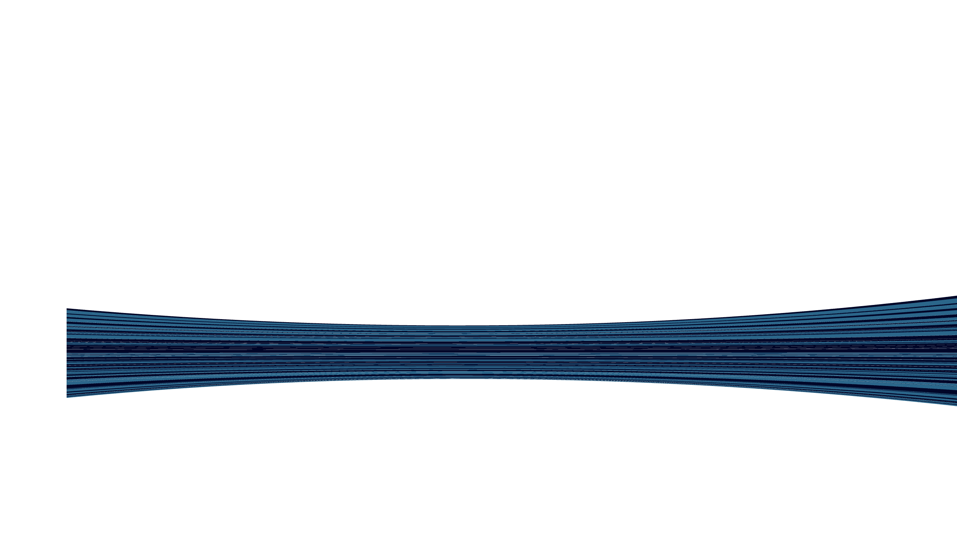
CoARA timeline
so far
2024
Preliminary CoARA Action Plan released
2022
CERN Signs CoARA Agreement

Slide 4
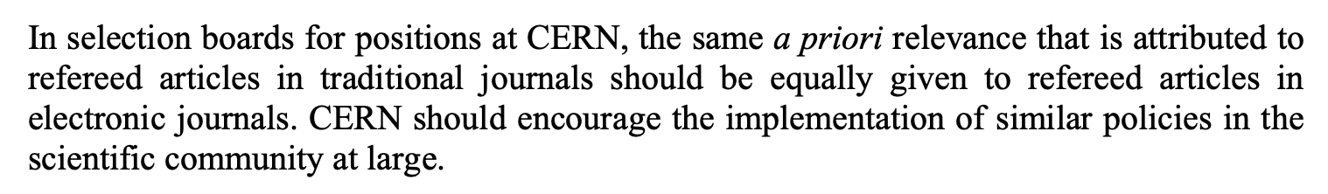
CoARA at CERN
The CoARA principles are well aligned with CERN Values and established particles physics practices.
To further enhance this alignment, the following actions will be taken in the next 5 years:
Action Plan
Conclude organisation-wide assessment of current practices (interviews)
Develop educational material and training to create awareness of CoARA principles
Promote open science, teaching and outreach activities by acknowledging them in relevant guidelines.
If a change of practices is required (depending on the assessment outcome), implement such changes
Already 2003 the Scientific Information Policy Board approved
the ‘CERN Electronic Publishing Policy’ aligned with CoARA:
https://cds.cern.ch/record/828991/files/open-2005-006.pdf

Slide 5
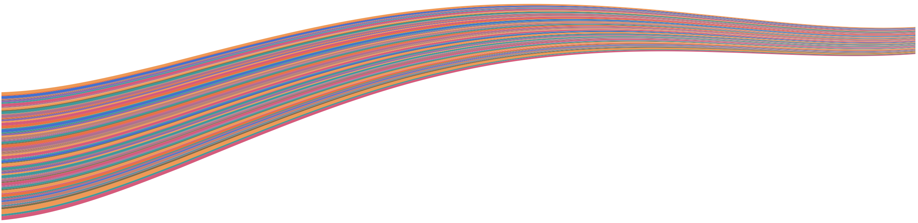
CoARA Action Plan
Timeline
2026
Implement recommendations.
2029
Test and revise implemented changes.
2025
Review of official documentation on assessment.
2028
Device recommendations in line with the CoARA principles.
2027
Testing effect
of implemented changes
2025
Overview of Project proposal assessment practices.
2025
Overview of individual research practices.
http://dx.doi.org/10.5281/zenodo.14334818

