Slide 1
Update on D5.3:
Performance of neutrino interaction cross-section measurement
George Fanourakis, Ioannis Karakoulias, Spyros Tzamarias
Aristotle University of Thessaloniki – Demokritos
At the University of Cukurova, Adana, 4-May-2025

Slide 2
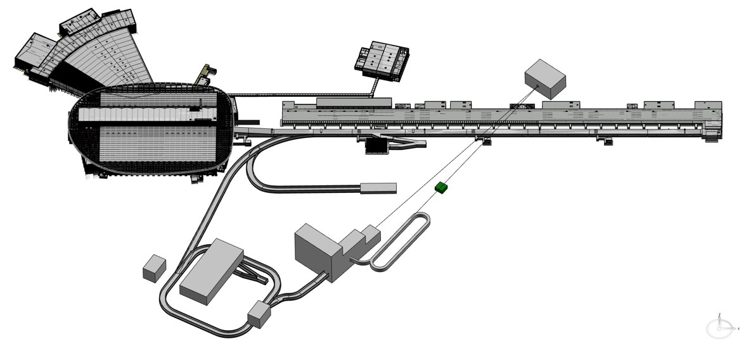
Why measure the muon and electron (anti)neutrino cross sections?
The precision of the (anti)neutrino cross-section knowledge is crucial for the accurate determination of the neutrino oscillation parameters. It is the second important factor, after the detector calibration, of the systematics of these measurements.
There are limited precision or no (anti)neutrino cross-section measurements in the energy range of ESSnuSB.
The precise measurement of the neutrino and antineutrino cross sections is the main reason for introducing the two facilities (LEnuSTORM and LEMNB) in the ESSnuSB+ project, together with the near-near water Cherenkov detector (LEMMOND).
J.A. Formaggio, G.P. Zeller, From eV to EeV: Neutrino cross sections across energy scales. Rev. Mod. Phys. 84, 1307 (2012)

Slide 3
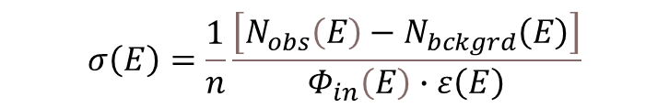
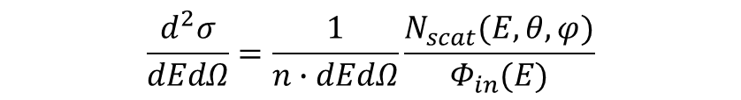
cross sections types?
Total/inclusive cross section
Differential cross sections
Double differential cross sections
$$σ\left(Ε\right)=\frac{1}{n}\frac{\left[N_{obs}\left(E\right)−N_{bckgrd}\left(E\right)\right]}{Φ_{in}\left(E\right)∙ε\left(Ε\right)}$$
N_{scat}(E,θ,φ)= [N_{obs}(E,θ,φ)-N_{bckgrnd}(E,θ,φ)]×ε(E,θ,φ)
$$\frac{d^{2}σ}{dEdΩ}=\frac{1}{n∙dEdΩ}\frac{N_{scat}(E,θ,φ)}{Φ_{in}(E)}$$
Data are now classified in terms of final state particles, such as “1 muon 0 pion and any number of protons”, the so-called zero-pion CC (0p-CC) events which include also the 1p-CC vertex contribution if the final pion is not detected.

Slide 4
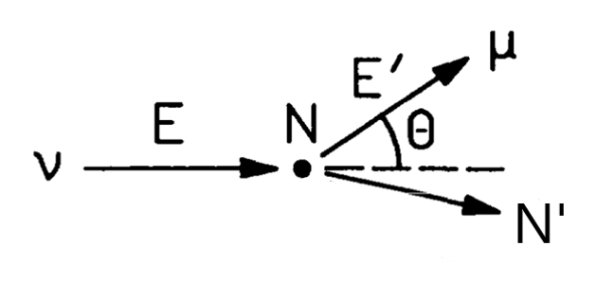
cross section measurements needs of ESSnuSB
For the evaluation of the migration matrices ESSnuSB will need cross sections for specific type events as a function of Energy
In particular: Charged Current Quasi Elastic (CCQE) neutrino - nucleon interactions
However, ESSnuSB will be able to identify more complicated final state events, as exemplified in the reconstruction methodologies and this will be of great value to the verification of nuclear models.

Slide 5
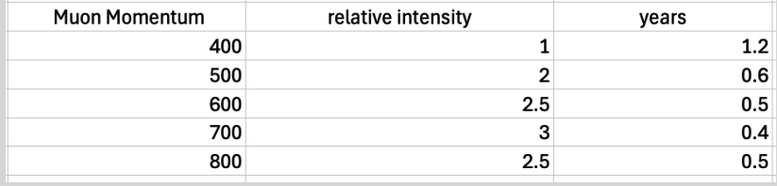
Event statistics from LEnuSTORM
For the determination of the required dimensions and capacity of LEMMOND, we have assumed that 10¹⁷ muons, with energy 600MeV, will be available for decaying and producing a sufficient (anti)neutrino flux by the Low Energy neutrinos from Stored Muons (LEnuSTORM) facility. For the current design of LEMMOND (a cylindrical water Cherenkov of 2.5m radius and 10m length) we would expect the following number of events (see table 1 and the Milestone MS3 documentation).
Table1. The number of Charged Current Quasi Elastic (CCQE) neutrino interactions (events)
from the ν-flux expected from 10¹⁷ 600 MeV/c muons or anti-muons.
Muon momentum (MeV/c) | ν_{μ} events | anti-ν_{e} events | ν_{e} events | anti-ν_{μ} events
600 | 5,200 | 1,479 | 4,633 | 1,610
Table 2. Muon momenta for muons of various momenta in the LEnuSTORM ring, their relative (to 400 MeV muons) intensity and the running time in years for 10¹⁷ muon decays.

Slide 6
Event statistics from LEMNB
To estimate the expected number of neutrino interactions, in the LEMMOND detector, due to the neutrino flux by the Low Energy Monitored Neutrino Beam (LEMNB), we assumed the decay of 10¹⁷ pions in the instrumented decay tunnel (length=40m long, radius=50cm). As seen in the Milestone MS3 documentation and in table 3 there is a sufficient number of events expected from neutrinos coming off positive or negative pion decays.
Table 3. Neutrino CCQE interactions from neutrinos coming from pion decays.
Pion momentum (MeV/c) | ν_{μ} events | anti-ν_{μ} events
1000 | 6,038 | 1,928
According to preliminary results of the design of the LENMB instrumented tunnel we expect about 3x10¹⁸ 1GeV (±10%) pion decays with uniform distribution (8x8 cm² at tunnel entrance with 4 mrad divergence) in a year.

Slide 7
Preliminary estimation of the total cross section precision
The statistical error for the determination of the total cross section mainly comes from the total number of observed events and the (via Monte Carlo) estimated number of background events. It is a type √N error and depends on the binning of the energy range.
For all energies, in the case of the LEnuSTORM facility (neutrinos of 150-600MeV), assuming a perfect muon-electron separation (misidentification rates are of the order of 1% according to ESSnuSB CDR) the statistical error is seen in table 5. In the case of LENMB facility (neutrinos of 300-500MeV), for 10¹⁷ 1GeV pion decays, the statistical error for muon-neutrino interactions is also inn table 5.
Table 5. Percent statistical errors for CCQE total neutrino cross sections.
Facility | LEnuSTORM |  |  |  | LENMB
Neutrino beam | ν_{μ} | anti-ν_{e} | anti-ν_{μ} | ν_{e} | ν_{μ} | anti-ν_{μ}
% statistical error | 1.4 | 2.6 | 2.5 | 1.5 | 1.3 | 2.3
For discussion of the systematics and the error on the efficiency see slide further below

Slide 8
Preliminary estimation of the differential cross section precision
If we assume that we have 10 equally populated energy bins and ignore any bin-to-bin correlations (of course this assumed a very good neutrino energy determination which is extremely difficult at this energy range due mainly to nuclear effects), the statistical errors per energy bin will be as seen in table 5. The combined relative statistical error from both facilities for (anti) neutrino interactions is also shown.
Table 5. Percent statistical errors for energy dependent CCQE neutrino cross sections (10 energy bins) and combined from both facilities.
Facility | LEnuSTORM |  |  |  | LENMB
Neutrino beam | ν_{μ} | anti-ν_{e} | anti-ν_{μ} | ν_{e} | ν_{μ} | anti-ν_{μ}
% statistical error | 4.4 | 8.2 | 7.9 | 4.7 | 4.1 | 7.2
% combined stat. error from both | 3 | - | 5.3 | - | - | -
For discussion of the systematics and the error on the efficiency see slide further below

Slide 9
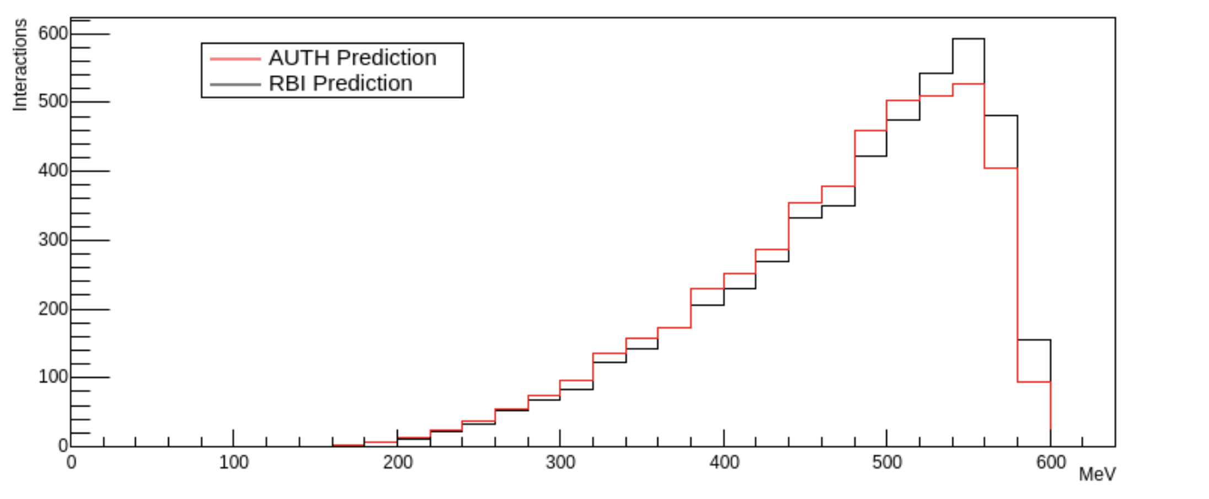
Systematics for the cross-section measurement precision
The neutrino flux for each type of neutrino beam is assumed to be precisely known by the two facilities. LEnuSTORM neutrinos are produced by a well-defined muon beam, of a 10% momentum bite, and the resulting neutrino fluxes are accurately predicted by Monte Carlo calculations. The systematics of the neutrino fluxes can be estimated from the systematics of the muon flux, and this is controlled by the knowledge of the ring parameters and their monitoring.
Figure 1. The energy spectrum of the detected muon neutrinos produced by a 600MeV muon beam with LEnuSTORM. The black line does not take into account the crossing length of the neutrinos (it assumes they cross the whole detector length).

Slide 10
The case of the LEMNB neutrino and antineutrino fluxes is also exceptional. Here we have exactly measured incoming (anti)neutrino fluxes because of the available information from the instrumented decay tunnel. By measuring the energy and direction of the muon from the pion decays we have exact measurements of the (anti)neutrino fluxes.
Figure 2. Muon neutrino energy distribution from the Low Energy Neutrino Monitored Beam.
The systematics of the neutrino flux in this case also depends on the systematics of the creation of the pion beam and the monitoring of the decays.

Slide 11
The effect of ε for the cross-section measurement precision
The cross-section estimation is subject to how precise we estimate the incoming neutrino energy and the reconstruction efficiency as a function of the neutrino energy. Assuming that the neutrinos arrive in the LEMMOND parallel to the detector axis we have to know the charged lepton reconstruction capability of the detector and to model precisely the effect of the nuclear structure to the interaction kinematics. Both the above issues are currently under study.

