Slide 1
Review of Cross-Section measurement
George Fanourakis, Ioannis Karakoulias, Spyros Tzamarias
Aristotle University of Thessaloniki – Demokritos
At the Çukurova University, Adana, 4-May-2025

Slide 2
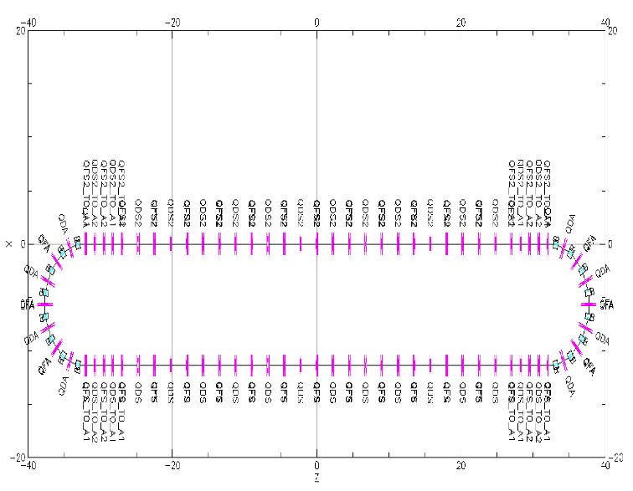
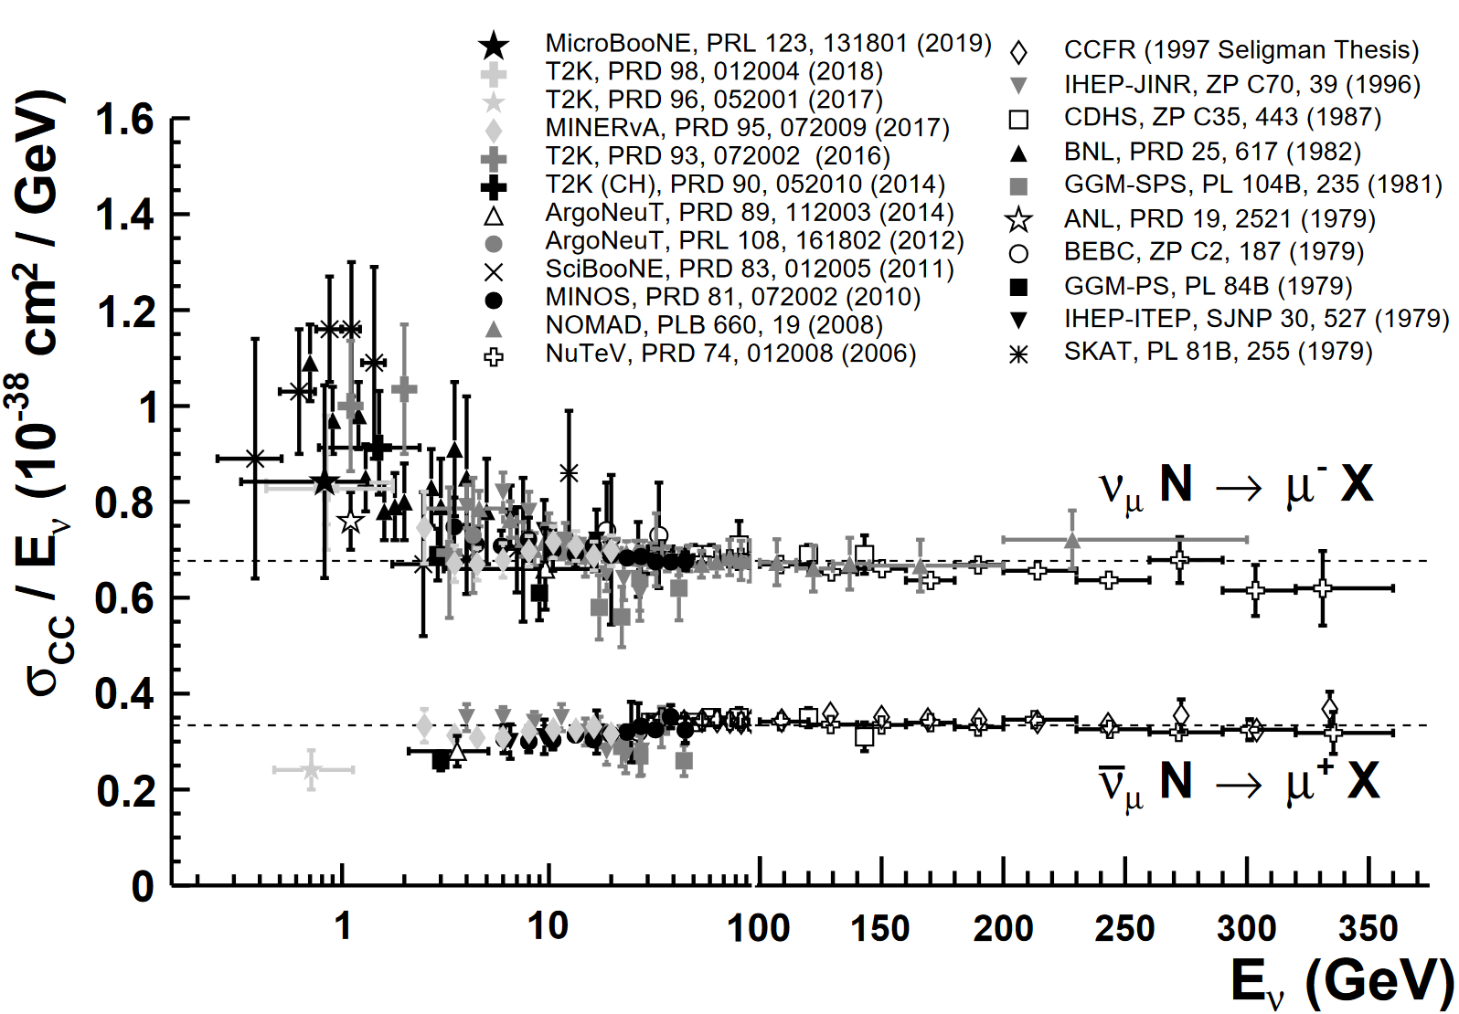
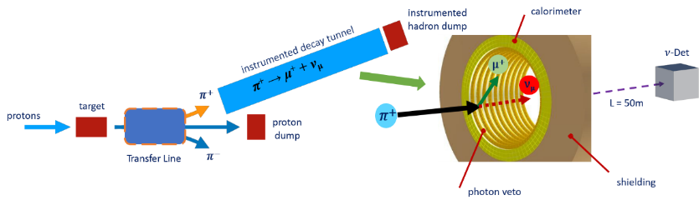
The facilities to measure (anti)neutrino cross-sections
Two facilities are being designed, within the ESSnuSB+ project, with the purpose to be used for a precise measurement of the neutrino and antineutrino cross sections. The Low Energy neutrinos from STORed Muons (LEnuSTORM) and the Low Energy Monitored Neutrino Beam (LEMNB) facilities, together with a near-near water Cherenkov detector the Low Energy neutrinos from stored Muons and from the MOnitored Neutrino beam Detector (LEMMOND).
https://pdg.lbl.gov/2022/reviews/rpp2022-rev-nu-cross-sections.pdf
Low Energy neutrinos from Stored Muons
Low Energy Monitored neutrino Beam
Missing measurements at the ESSnuSB region: below 600 MeV
LEMMOND

Slide 3
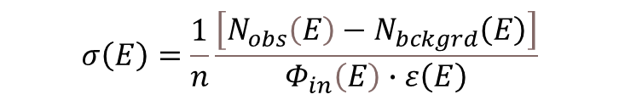
The cross section as a function of energy for neutrino CCQE interactions
$$σ\left(Ε\right)=\frac{1}{n}\frac{\left[N_{obs}\left(E\right)−N_{bckgrd}\left(E\right)\right]}{Φ_{in}\left(E\right)∙ε\left(Ε\right)}$$
The incoming flux (# beam particles/cm²) will be given by the LEnuSTORM and LENMB facilities. n is the number of target particles (protons or neutrons or electrons).
For an inclusive cross section, N_{obs}(E) is the number of observed single muon interactions + any secondaries. If strictly 1μ final state events are recorded we refer to 1μ 0π cross section (an exclusive interaction)… and so on for specific final states (CC interactions).
The Background interactions are interactions which contain more final state particles, but they are not identified or NC interactions with a final state particle mimicking e or μ etc… They will be evaluated within the design of LEMMOND.
The efficiency ε is to be evaluated within the current work on simulation and reconstruction with LEMMOND.
The procedure will be to generate events using Genie, simulate the response of LEMMOND and reconstruct them with the methodology currently being developed.

Slide 4
Lessons from the experiments with nuclei targets and modelling
In long-baseline accelerator-based neutrino oscillation experiments, neutrino beams are produced with energies in the range of few hundreds of MeV to a few GeV. The produced neutrinos interact then with the bound nucleons of nuclei in the detectors via reactions such as quasielastic scattering (QE), resonant production (RES), and deep inelastic scattering (DIS). A precise measurement of the oscillation parameters relies on the understanding of the incoming neutrino beam flux, of the scattering of neutrinos with nucleons, and of the nuclear medium effects in the nucleus.
Due to intranuclear hadron rescattering and the effects of correlations between target nucleons, additional particles may be ejected in the final state; hence, a QE interaction on a nuclear target does not necessarily imply the ejection of a lepton and a single nucleon. One therefore needs to take care in defining what one means by neutrino QE scattering when scattering off targets heavier than hydrogen or deuterium. Because of this, modern experiments tend to instead report cross sections for processes involving pionless (e.g., nucleon-only) final states, often referred to as CC 0π or QE-like reactions in recent literature:
Many modern experiments have also the last years opted to report nucleon-only cross sections as a function of observed final state particle kinematics. Such measurements can be more difficult to directly compare between experiments but have the advantage of being much less model-dependent and provide more stringent tests of the theory than historical cross sections as a function of derived quantities such as neutrino energy (E_{ν}) or 4-momentum transfer (Q²).
Neutrino oscillation experiments could reduce systematics by using the same active material for the near and far detectors.
R.L. Workman et al. (Particle Data Group), Prog. Theor. Exp. Phys. 2022, 083C01 (2022)

Slide 5
Current performance results
See talk by Yannis Karakoulias on Wednesday
With the flat Toy Detector (reported in D5.1)
With the cylindrical geometry, using the realistic charge distributions due to photoelectrons recorded

Slide 6
Event statistics from LEnuSTORM and LEMNB
The number of Charged Current Quasi Elastic (CCQE) neutrino interactions (events) from the ν-flux expected from 10¹⁷ 600 MeV/c muons or anti-muon decays in LEnuSTORM.
Muon momentum (MeV/c) | ν_{μ} events | anti-ν_{e} events | ν_{e} events | anti-ν_{μ} events
600 | 5,200 | 1,479 | 4,633 | 1,610
Neutrino CCQE interactions from neutrinos coming from 10¹⁷ pion decays in LEMNB.
Pion momentum (MeV/c) | ν_{μ} events | anti-ν_{μ} events
1000 | 6,038 | 1,928
The above numbers will be finalized with the completion of the LEnuSTORM and LEMNB design.
They were evaluated using a linear dependence of CCQE cross section with Energy.

