Slide 1

Follow-up on
IT STRING lessons learned #1, #2 and #3
ATS-DO, HL-LHC WP15 Integration
Miguel Navarro Baeza
Francesca Paola Nicoletti
Darshana Ramrekha
31/01/2025

Slide 2
Context
Davide Bozzini (WP16) has presented the lessons learned on the IT String relevant for HL-LHC installation on
  31/05/2024 (Indico).
  13/09/2024 (Indico).
  13/12/2024 (Indico).
WP15 followed-up on the 13/09/2024 (Indico) the relevant pending points to be implemented or considered in HL-LHC integration or installation.
Today WP15 is following-up the last two presentations from WP16.
WP15 will continue reviewing the status of the pending actions. Additionally, WP15 will maintain the following SharePoint site dedicated to tracking and following up on these items: IT String Lessons Learned SharePoint
WP16 will present the 4th round around March 2025.

Slide 3
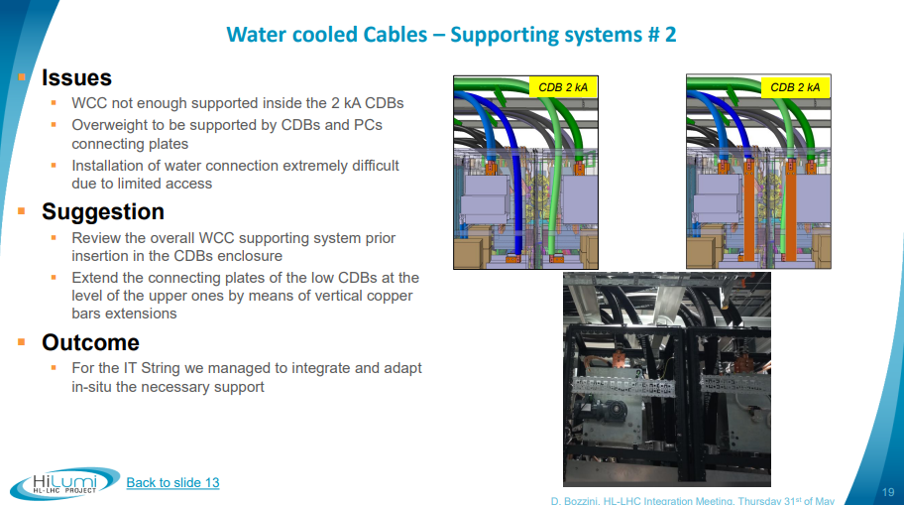
Water Cooled Cables supporting systems
EN-EL
COMPLETED
A request of an extension of the connecting plates for the 2kA CDBs was made, but the CDB design was already fixed.
In order to reduce the weight of the WCC section in the CDB, EN-EL has delivered a solution that has been validated by WP6B.
The detailed integration of the WCC water hoses has been completed by EN-CV. EN-CV is currently reviewing with WP6B the water hoses interfaces with the PCs.
As planned, the WCCs pulling in the UR55 Left will start in February 2025. The installation will be carried out using the already produced mock-ups of the PCs.

Slide 4
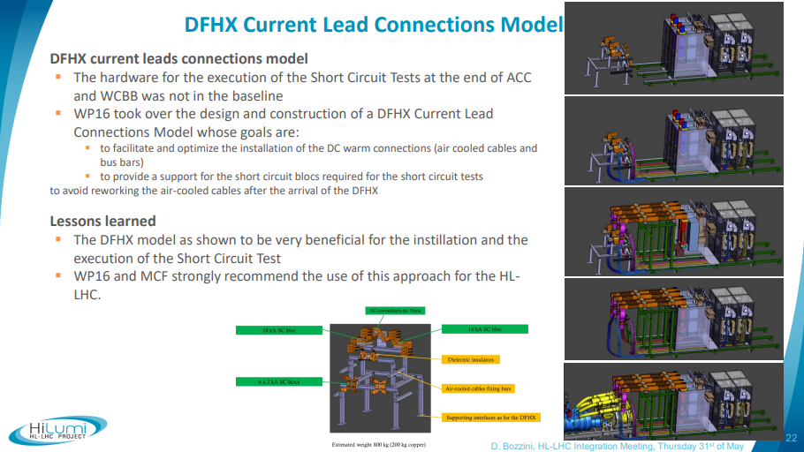
DFHM Current Lead Connections model
WP6B, WP6A, WP15
UNDER REVIEW
If deemed useful, a mock-up will also need to be built for the DFHM.
The DFHX/M and WCBB installation phases will vary across the different IP sides. For the short circuit test, the use of a mock-up, similar to the one used for the IT STRING, cannot be automatically applied due to the timing of the DFHX/M installation.
Actions being followed:
  Review the schedule for the 4 IP sides to assess the situation in the 8 installation cases.
  Determine if a modified design, adapted from the IT STRING model, could be used to accommodate all configurations.
  Identify the responsibility for the mock-up construction for the new underground installation and test phases.

Slide 5
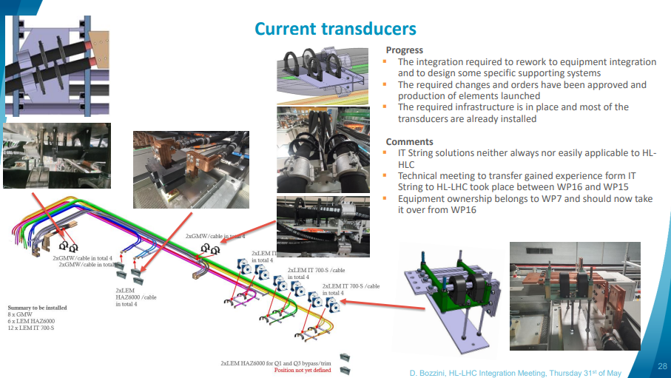
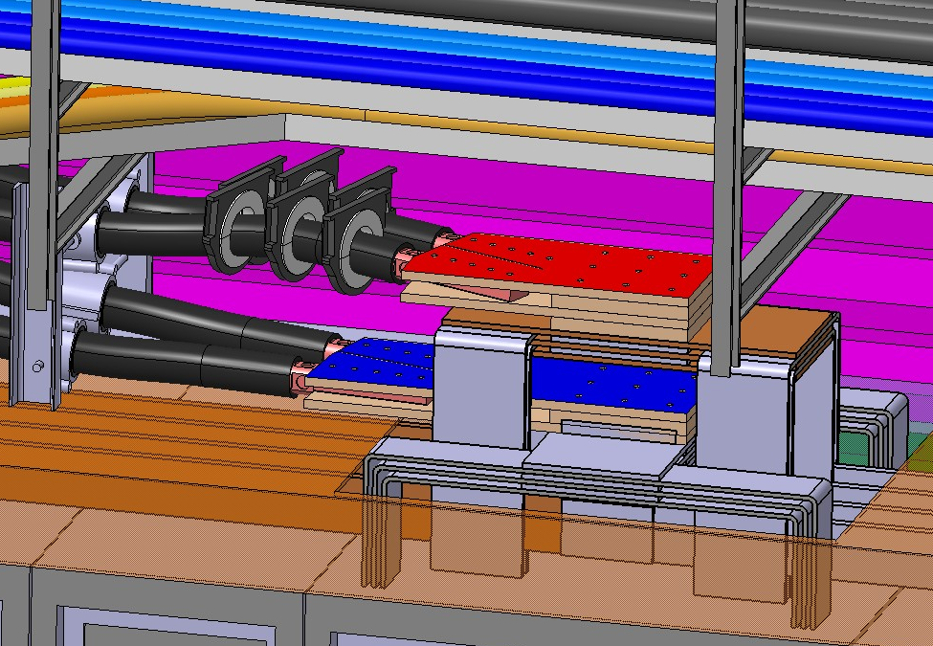
Current transducers
WP7
COMPLETED
A third sensor has been added in UR and integration is complete.
The integration is not the same for UR. Note that, in the UR, the entire size of the system must fit over the racks and are not mechanically supported.
Update in UR integration model to be done by WP15 after the current transducers 3D model is fixed.
Current transducers integration in UR15

Slide 6
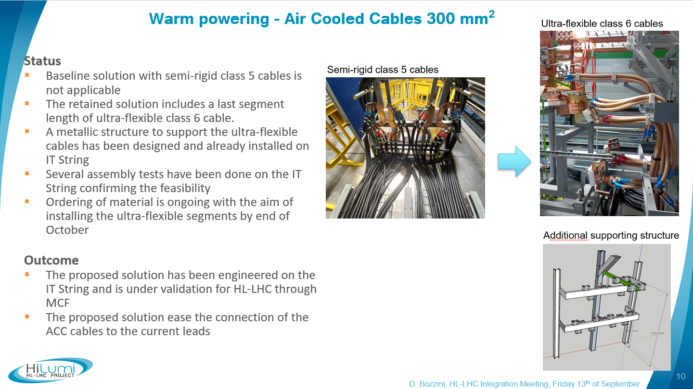
Warm powering - Air Cooled Cables
EN-EL, WP6B
UNDER REVIEW
Air cooled cables 3D model has been received and integration is validated.
UR15/55 final integration is still to be validated. Discussions are being held offline between EN-EL, WP6A, WP6B and WP15.
ECR will be produced by WP17.

Slide 7
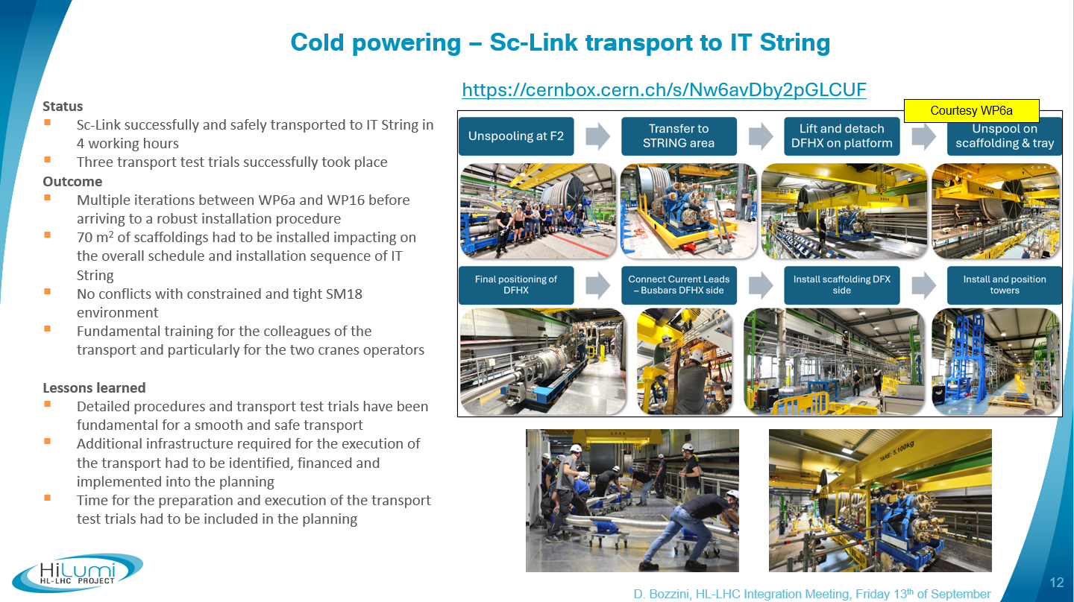
Cold powering – Sc-Link transport
WP6A
UNDER REVIEW
SC Link installation sequence and transport constraints are being discussed offline between WP6A, WP15, WP17 and EN-HE.
As soon as transport study is finished (expected next week), WP15 will host a presentation for explaining the installation procedure of SC Link and DFHX/M in UR15/55.

Slide 8
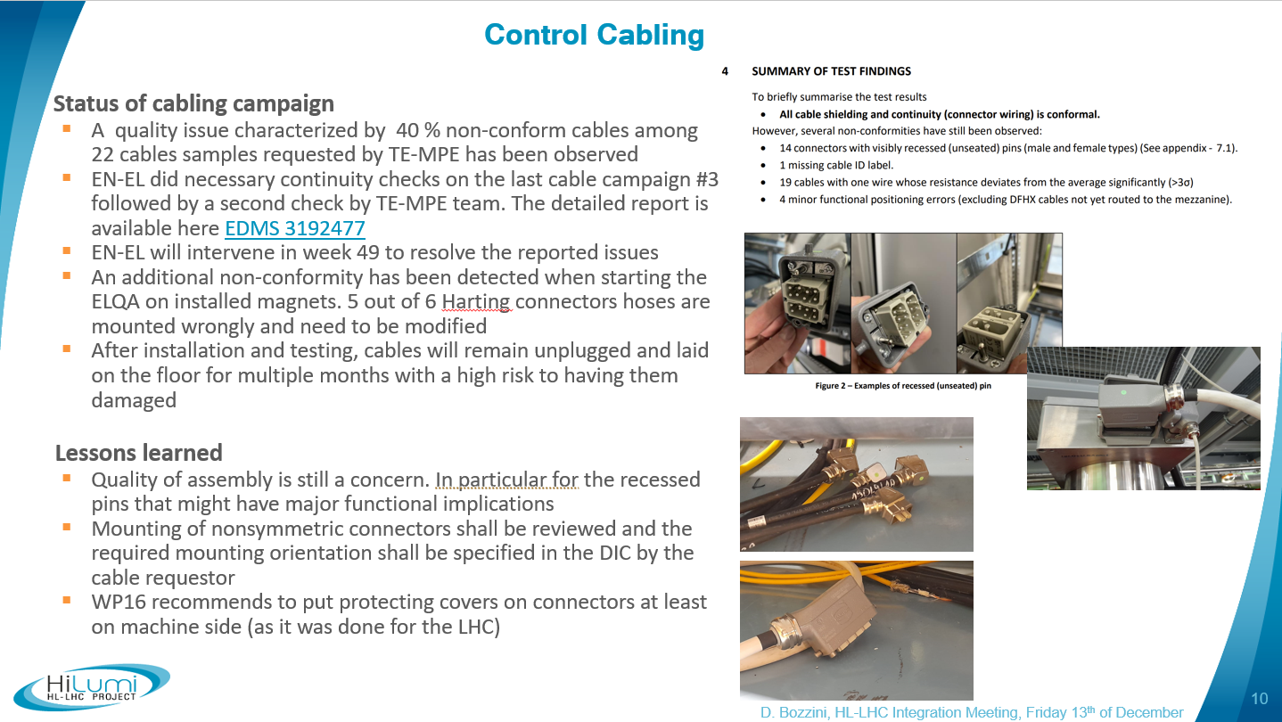
Control cabling and connectors
EN-EL
UNDER REVIEW
G. Girardot will follow up with key points from the cabling campaign.
It was confirmed that the factor 3 budget increase was not solely due to EN-EL's estimates but also impacted by other suppliers.
EN-EL subcontractors will redo quality checks, though the issue is considered minor.
Presentation during Friday Integration Meetings from G. Girardot, M. Parodi (EN-EL) after YETS 24-25 detailing actions taken and the reasons for confidence in LS3 planning.
Cable/connector issues were also escalated to CSTSC Standardization committee, and the issue will be discussed at the incoming meetings.

Slide 9
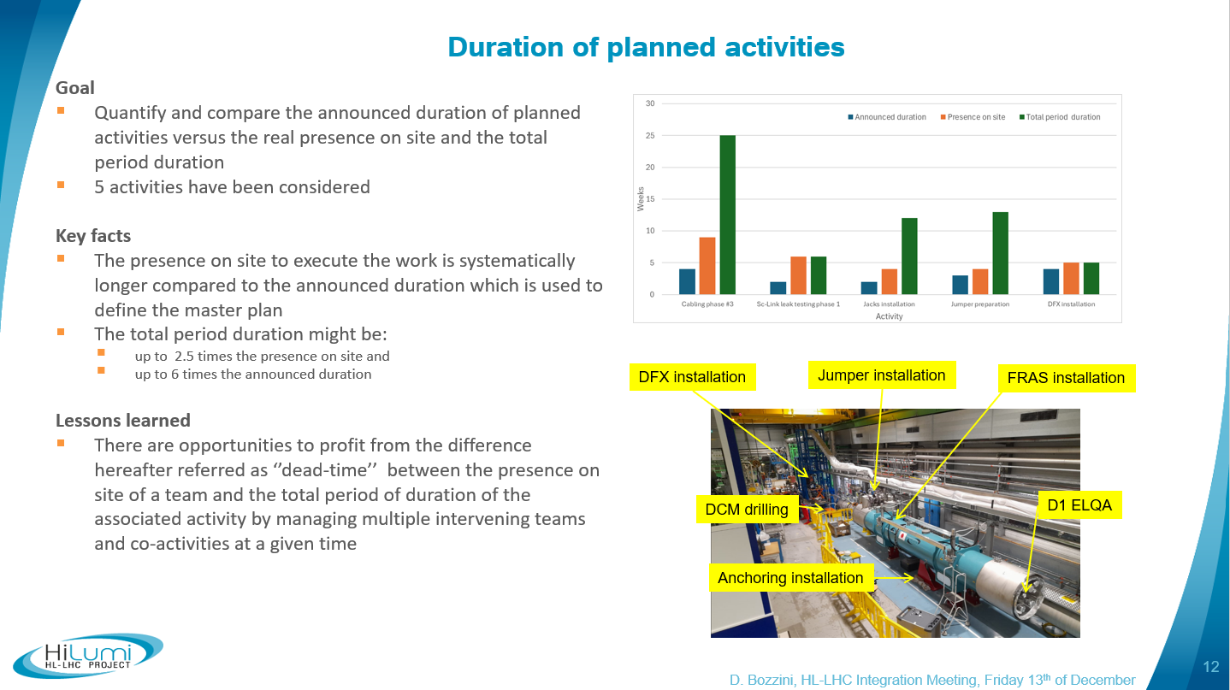
Duration of planned activities
WP15 / EN-ACE
UNDER REVIEW
Before the planning readiness review foreseen in June, WP15 to host a discussion with E. Vergara (EN-ACE) and D. Bozzini (WP16) to evaluate whether any feedback from WP16 could be useful, particularly if certain aspects can be reviewed following IT string experience.

Slide 10
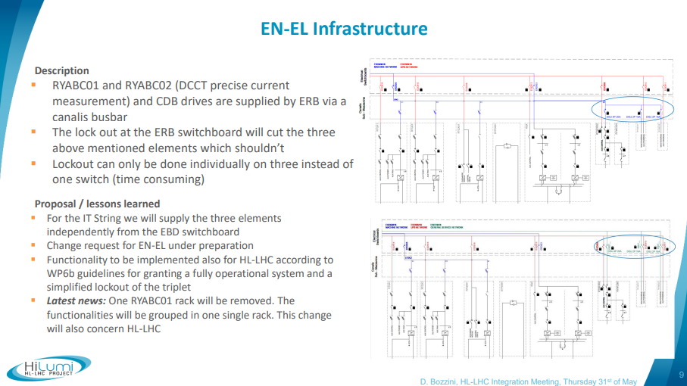
Powering precise measurement racks and CDB
EN-EL, WP6B
UNDER REVIEW
The identified problem is relevant also for the HL-LHC machine powering scheme.
Unfortunately, the solution identified in the IT string cannot be deployed in the UR.
EN-EL and SY-EPC are discussing an updated new proposal and new meeting will be held on 5th of February.

Slide 11
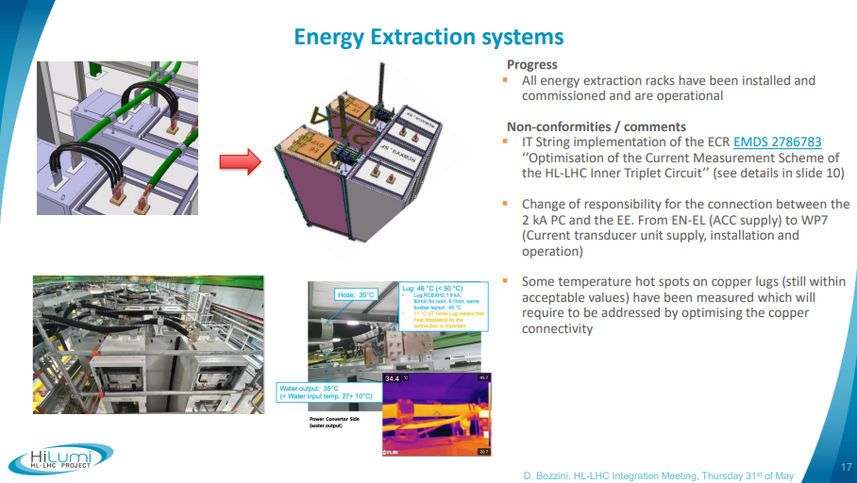
Energy Extraction cable connections
WP7
COMPLETED
The temperatures in hotspots measured in the IT-String are within acceptable values. In addition, the electrical current used in HL-LHC will be lower than in these tests. Therefore, no further actions needed.
Feedback on Energy Extraction has been acknowledged from IT-String by WP7 and will be considered for HL-LHC.

Slide 12
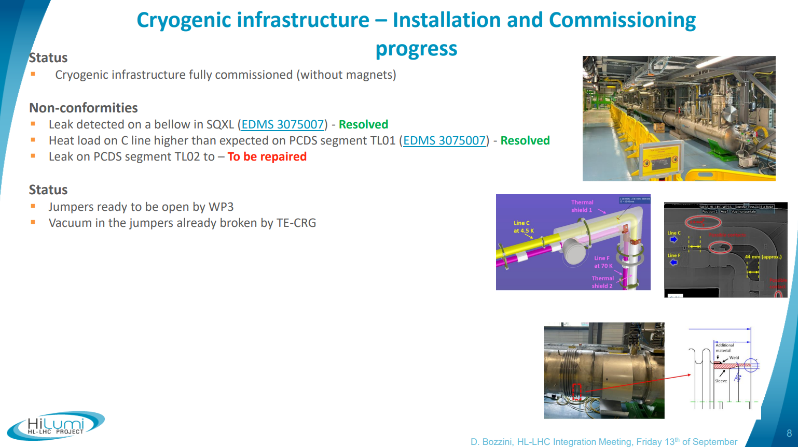
Installation and commissioning of cryogenic infrastructure
WP3, WP9
UNDER REVIEW
Presented by WP3 and WP9 24th January 2025 (INDICO).

Slide 13
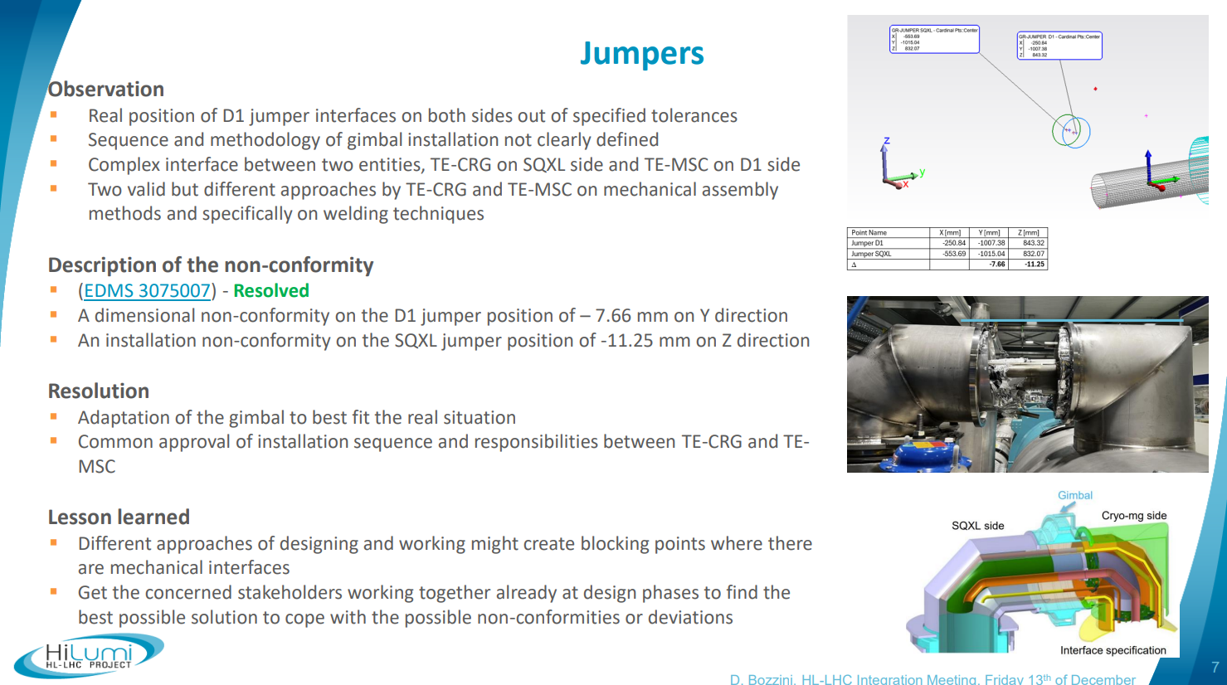
Jumpers
WP3, WP9
UNDER REVIEW
Presented by WP3 and WP9 24th January 2025 (INDICO).

Slide 14
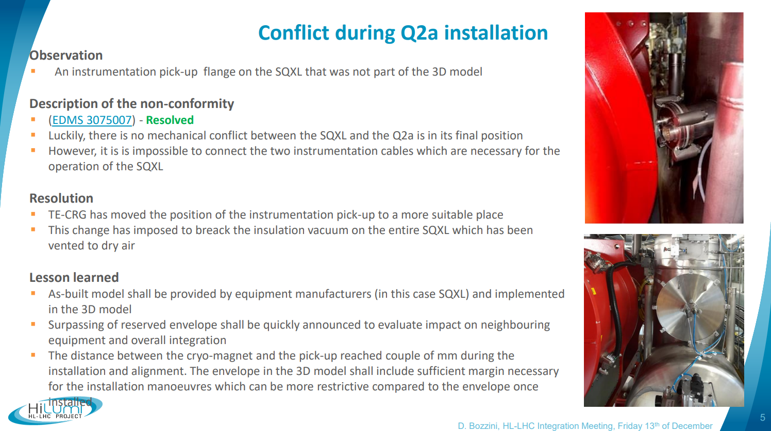
Conflict during Q2a installation
WP9
COMPLETED
TE-CRG commits to respect their equipment volumes defined in the HL integration 3D models.
The installation and transport volumes defined in the HL integration 3D models take into account all the installation steps.
Integration is monitored and discussed on a weekly basis by WP15 and all stakeholders to ensure no interferences.

Slide 15
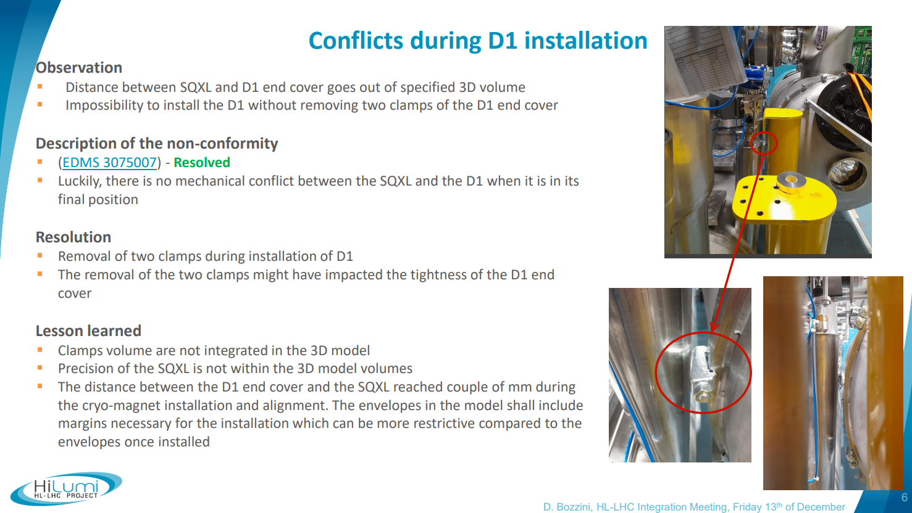
Conflict during D1 installation
WP9, WP3
COMPLETED
TE-CRG commits to respect their equipment volumes defined in the HL integration 3D models.
Clamps volume are present in HL integration 3D models.
HL-LHC tunnel volumes include safety margins.
Reasonable distance is let between all elements and volumes.

Slide 16
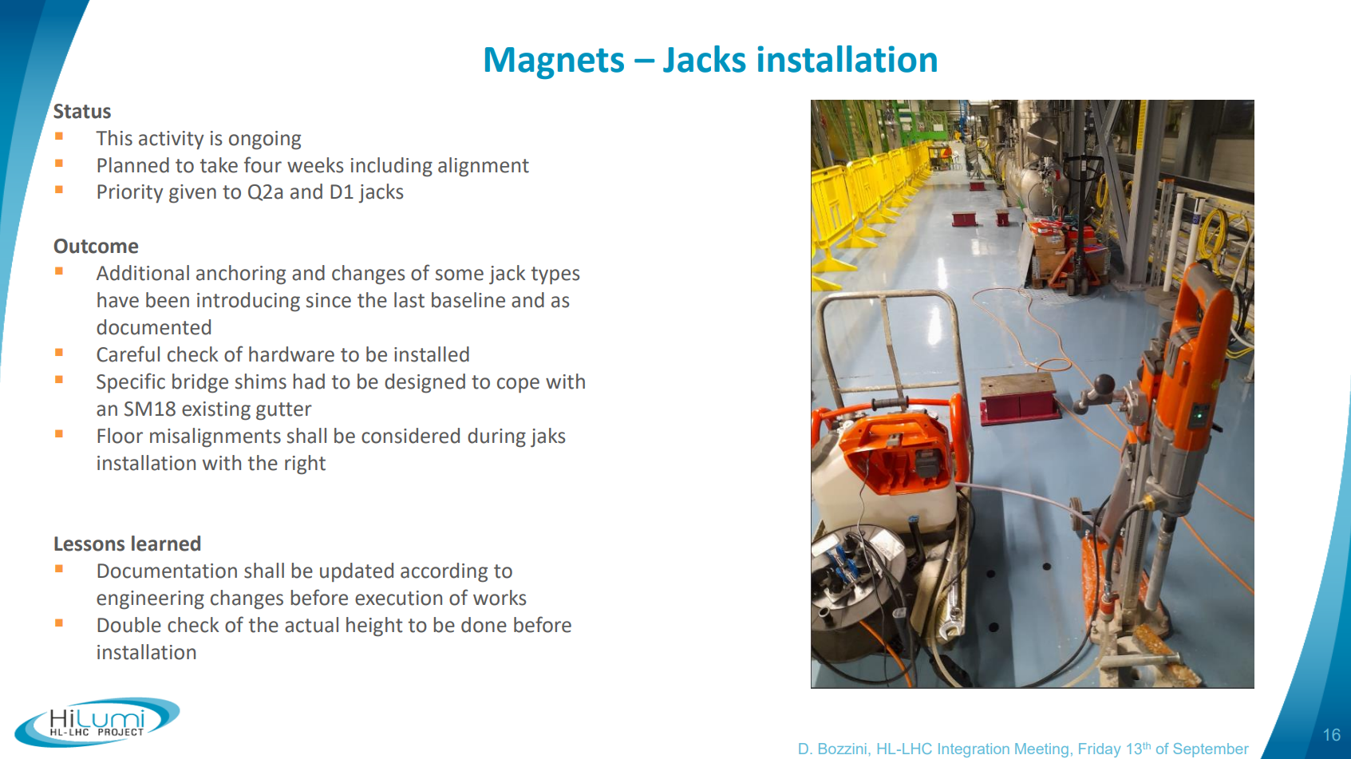
Jacks installation
WP3
UNDER REVIEW
In order to prepare a correct and smooth jacks installation phase in LS3, WP15 with EN-MME and EN-ACE is analyzing the reality of IP5 and IP1 LSSs floor height under each HL jack, based on scans and on-site measurements, to determine the proper ground preparation (grinding) and additional pieces to be produced (shims).
The results of this study will be traced in an upcoming EDMS document.

Slide 17
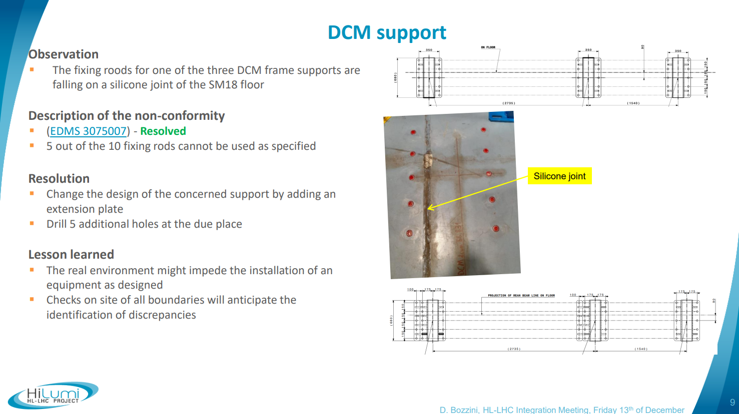
DCM support
WP3
UNDER REVIEW
WP15 together with EN-MME and SCE is studying the LHC infrastructure real environment on which all major supports will fall, especially HL jacks.
Particular attention is paid to concrete joints, concrete cracks, supports close to the trench and falling onto the rails.
SCE drawings are been searched but seem not always available. Therefore, on-site inspections are ongoing.
Specific supports will be designed accordingly, if needed.
The results of this study will be traced in an EDMS document.

Slide 18
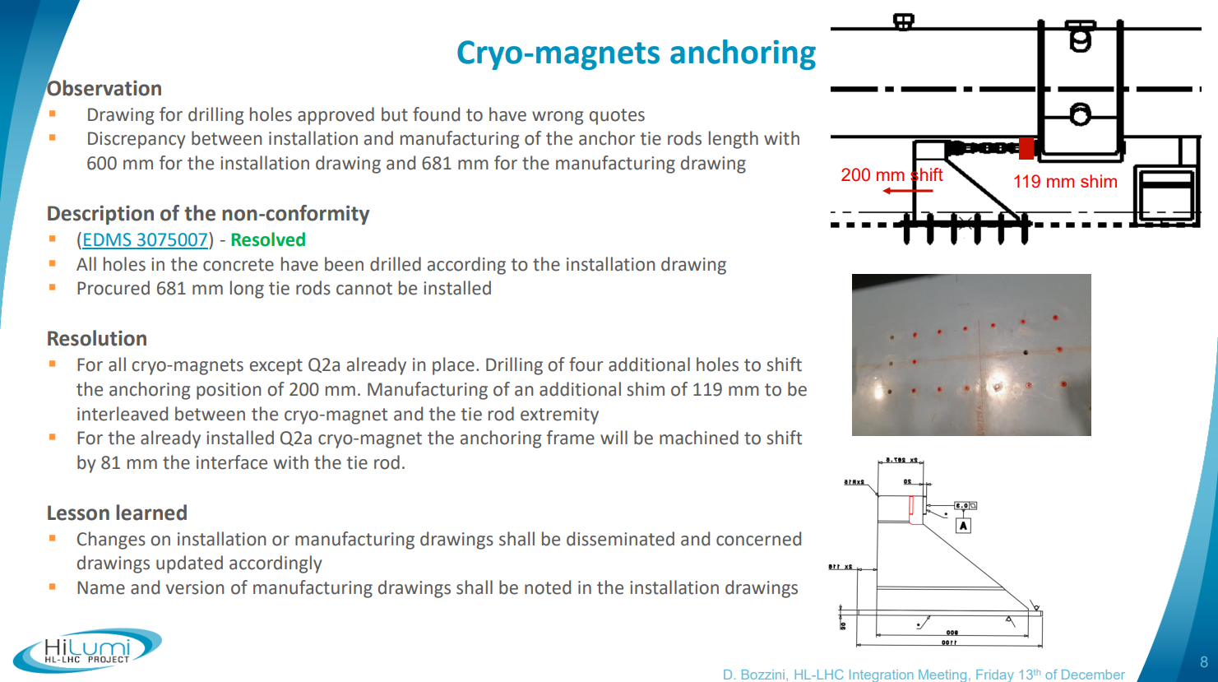
Cryo-magnets anchoring
WP3
COMPLETED
Any changes to installation or manufacturing drawings must be communicated, and the relevant drawings should be updated accordingly.
Specificity on anchors design location-dependent are under evaluation by EN-MME and will be tracked in an EDMS document.
The name and version of the manufacturing drawings must be documented in the installation drawings.

Slide 19
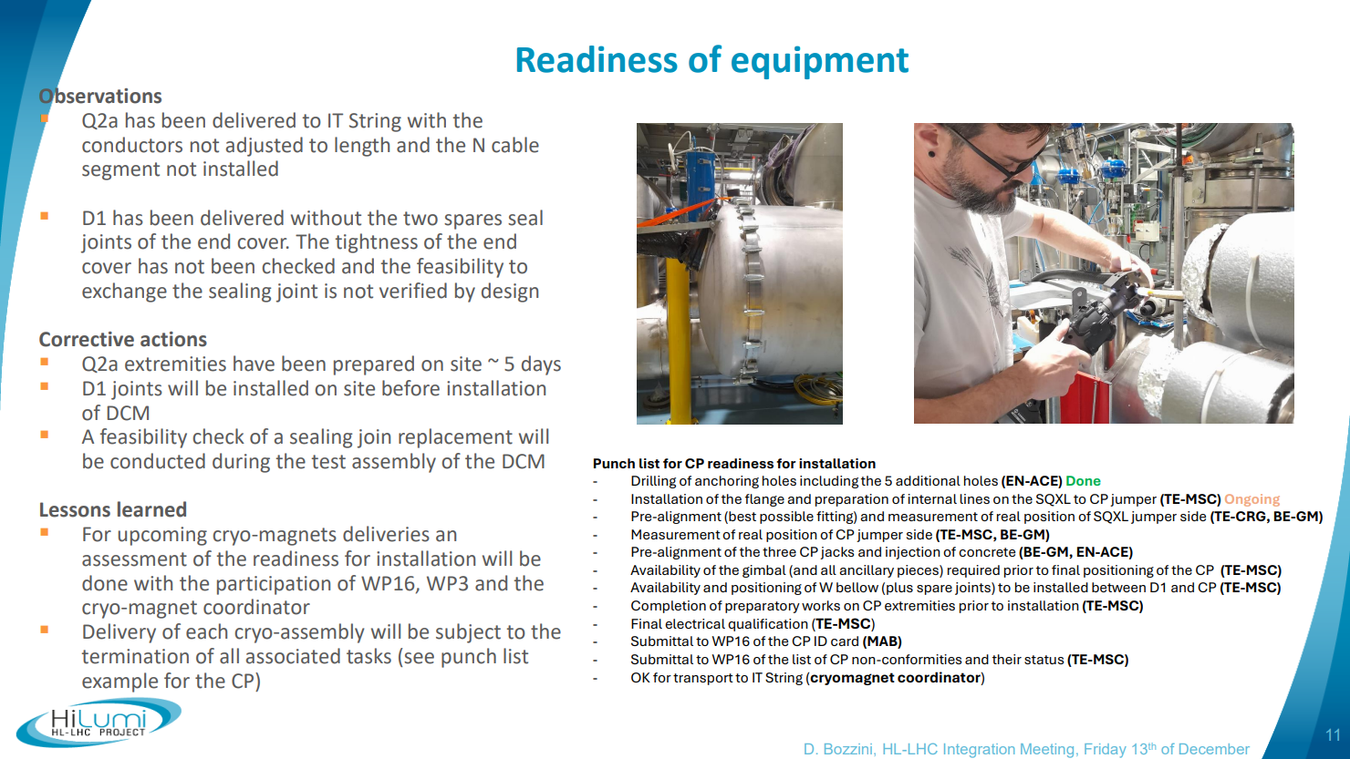
Readiness of equipment
All equipment owners
COMPLETED
A checklist by each team will need to be provided and included in the readiness review for installation to be set up by the project.
This checklist should be revised and updated if needed later, to ensure that it is as complete as possible at the time of installation.

Slide 20
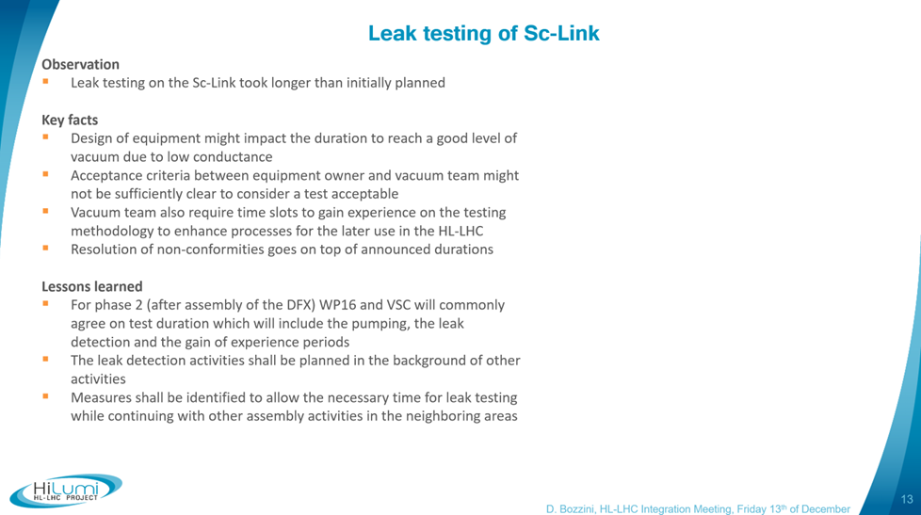
Leak testing of SC-Link
WP6A
UNDER REVIEW
After WP16 and TE-VSC have commonly agreed on the specifics of the leak tests of the SC-Link assembly, communicate it to HL-LHC in order to allocate the necessary time for this activity.
Discussions are ongoing with WP6A.

Slide 21
Thank you for your attention and help !
Any questions ?

