Slide 2
High Field Magnet Programme
E. Todesco, HFM programme leader
B. Auchmann, HFM programme co-leader
On behalf of HFM collaboration
With feedbacks from A. Milanese, A. Ballarino, S. Izquierdo Bermudez,
G. Willering, D. Delikaris, M. Jimenez, M. Benedikt
30 January 2025, Chamonix

Slide 3
HFM steering board
M. Lamont (chair)
P. Vedrine (co-chair)
HFM collaboration board
C. Senatore (chair)
TBD (deputy)
High Field Magnet Programme
E. Todesco (Leader), B. Auchmann (Co-leader)
Programme office
G. Riddone
RD2:HTS conductor+magnets
RD2 coord: A. Ballarino (CERN)
RD3: Nb₃Sn magnets
RD3 line coordinators:
F. Toral (CIEMAT)
Haziot, A. Foussat (CERN)
RD4: Integration,
sustainability
RD4 line coordinator:
P. Borges de Sousa (CERN)
RD5: Infrastructures
2.1 REBCO development
B. Holzapfel (KIT)
3.1 12 T cosθ CERN
A. Foussat (CERN)
5.1 Test
F. Mangiarotti (CERN)
4.3 Insulation and HV
R. Piccin (CERN)
RD1: Nb₃Sn conductor
RD1 line coordinators:
T. Boutboul (CERN)
C. Senatore (UniGe)
2.2 REBCO conductor
A. Ballarino (CERN)
3.2 12 T cosθ INFN
S. Farinon (INFN)
5.2 Conductors, cables
J. Fleiter (CERN)
1.1 Nb₃Sn wire and cable
T. Boutboul (CERN)
4.5 Quench D+P
M. Wozniak (CERN)
2.5 Demonstrator DI coils
A. Ballarino (CERN)
3.4 Technology development
A. Haziot (CERN)
5.4 Manufacturing
J. Axensalva (CERN)
1.3 Internal oxidation wires
C. Senatore (UniGe)
4.6 Cryogenics, thermal
P. Borges de Sousa (CERN)
2.6 Solenoids and MuC
L. Bottura (CERN)
3.5 14 T Block dipole BOND
J. C. Perez (CERN)
5.5 MM, modelling
L. Fiscarelli (CERN)
1.15 Nb₃Sn development
M. Sugano (KEK)
2.11 Demonstrator MI coil
T. Lecrevisse (CEA)
3.3 5-m-long block
S. Izquierdo Bermudez(CERN)
5.7 CIEMAT lab
C. Martins (CIEMAT)
1.18 Internal oxid. studies
A. Leineweber (BAF)
2.15 IBS development
A. Malagoli (CNR-SPIN)
3.6, 3.12 Block dipole F2D2
E. Rochepault (CEA)
2.16 HTS laboratory
A. Ballarino (CERN)
2.17 REBCO development
Y. Yang (SOTON)
3.7 Common coil DAISY
F. Toral (CIEMAT)
1.19 Nb₃Sn characterization
C. Senatore (UniGe)
2.18 HTS 10 T dipole
M. Statera (INFN)
3.11 14 T Cosθ
M. Sorbi (INFN)
6.1 Societal impact
E. Chesta (CERN)
2.19 REBCO racetrack
D. M. Araujo (PSI)
3.14 CC stress managed
D. M. Araujo (PSI)
2.20 REBCO characteriz.
M. Eisterer (TUWien)
Collaboration WPs
January 2025
Note: completed WP
not shown
CERN WPs

Slide 4
Contents
Baseline for FCC, options and timeline
Status of Nb₃Sn and recent results
HTS hopes and challenges
Appendix: news from US and China, magnet design, HFM organization

Slide 5
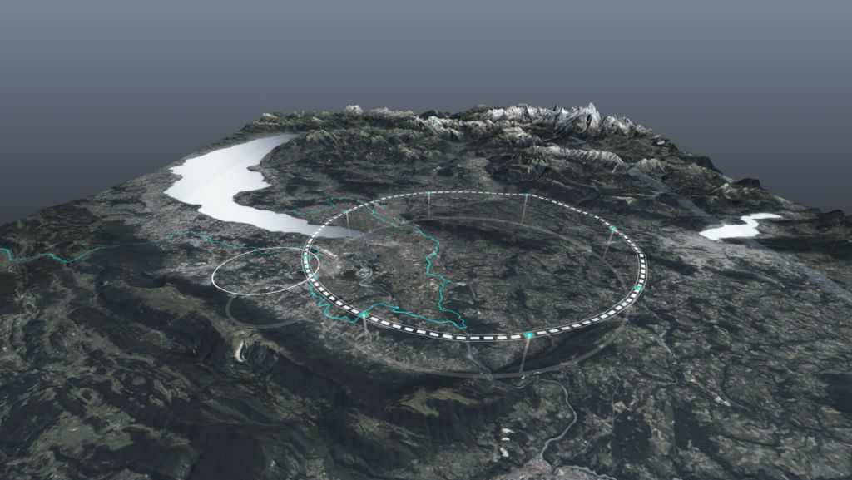
FCC-hh baseline
The new targets for FCC-hh in Nb₃Sn allow reaching 85 TeV with 83% filling factor, and improved HL-LHC conductor
  The magnet is at 80% of short sample, and this gives more margin, allowing ease several aspects (stress limits can be set at 150 MPa rather than 200 MPa, protection is less demanding, conductor is available today)
  Further improvement of filling factor could allow 90 TeV c.o.m
FCC-hh parameters | CDR 2019 | 2024-Nb₃Sn | 2024-HTS
Dipole field (T) | 16.0 | 14.0 | 14-20
Temperature (K) | 1.9 | 1.9 | 4.5-20
Tunnel length (km) | 100 | 90.7 | 90.7
Arc length (km) | 82.0 | 76.9 | 76.9
Arc filling factor (adim) | 0.80 | 0.83 | 0.83
Energy c.o.m (TeV) | 100 | 85 | 85-120
Non Cu jc 16 T 4.2 K | 1500 | 1200 | TBD
Loadline margin | 86% | 80% | TBD
FCC layout and evolution of parameters

Slide 6
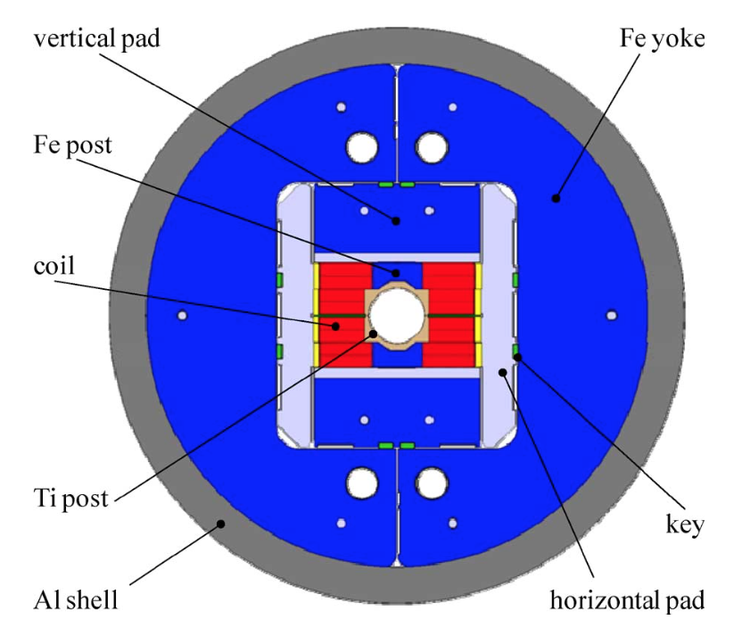
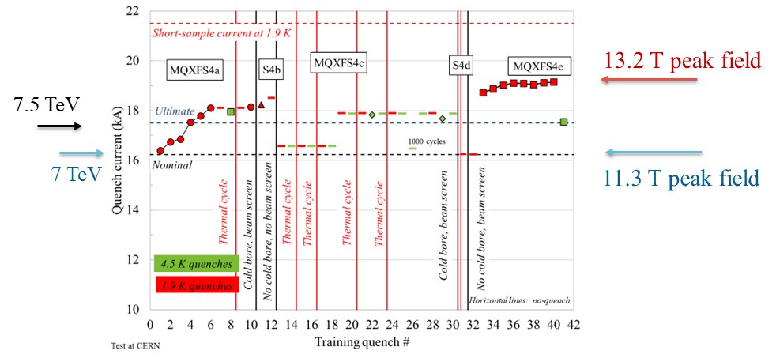
Feedback from HL-LHC
14 T operational field → short models shall reach 15-15.5 T
  Do not make confusion between operational and achieved field: LHC dipoles reached 9.5 T, but they operate in the LHC slightly above 8.0 T
14 T shall be reached also at 4.5 K
    In HL-LHC MQXF operational field is also achieved at 4.5 K, without retraining
  Record of achieved field in accelerator dipoles
    13.8 T at 4.5 K (HD2, 2005)
    14.5 T at 1.9 K, 13.8 T at 4.5 K (Fresca2, 2019)
    14.1 T at 4.5 K (MDPCT1, 2020)
Sketch of Fresca2 cross-section
[A. Milanese, P. Ferracin, et al.]
MQXFS4 test results [S. Izquierdo Bermudez, J. C. Perez, P. Ferracin, F. Mangiarotti, et al.]

Slide 7
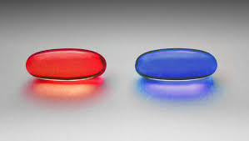
Options to the FCC baseline
We are exploring the following options
  12 T magnet and 77 TeV (15-20% cheaper magnet, for 10% less energy)
  Operation at 4.5 K with the same magnet (significant reduction of power consumption of cryogenics)
  Hybrid Nb₃Sn/Nb-Ti (large reduction in the mass of Nb₃Sn conductor, even more at 12 T, significant cost reduction)
  20-m-long magnets (25% less magnets to produce, plus a few more TeV or a bit more margin, an a bit cheaper magnet)
  Combined function options was studied but for the moment is not pursued
HTS long-term goal in the 14-20 T range, giving 85-120 TeV
All this is in the FCC-FS, chapter on magnets (see talk today by M. Benedikt)
Please don’t think that Nb₃Sn and HTS are in competition!
  This is not a blue pill/red pill story …
Wachowski broth., “Matrix” (1999, Warner Bros.)

Slide 8
Timeline for FCC-hh baseline
Select the design by the end of LS3 (we should start having some indications from tests in 2026-2027)
Have a full short model program as MQXF during RunIV
Scaling in length in two steps
(but we are already anticipating)
15 m long prototypes (>5 of each type)
5 m long prototypes of one selected design
(>5 of each type)
Short model program on two selected designs
(>5 of each type)
Ongoing 12 T and 14 T short models (seven designs, 1 or 2 of each type)
Selection of final design
to start long magnets
2024
2025
2026
2027
2028
2029
2030
2031
2032
2033
2034
2035
2036
2037
2038
2039
2040
2041
LHC RunIII
HL-LHC RunIV
HL-LHC RunV

Slide 9
Roadmap for Nb₃Sn
This is rather a conservative roadmap, and could be shortened by 5-10 years (with more risk and cost) having less staggered phases and with earlier involvement of the industry
Installation and commissioning
Production and test
Industrialization (pre-series magnets)
Tender for the series
2040
2041
2042
2043
2044
2045
2046
2047
2048
2049
2050
2051
2052
2053
2054
2055
2056
2057
LHC RunV

Slide 10
Table of contents
Baseline for FCC, options and timeline
Status and results of Nb₃Sn
HTS hopes and challenges
Appendix: news from US and China, magnet design, HFM organization

Slide 11
Conductor status and R&D
Conductor development for Nb₃Sn follows two main guidelines
  Have more providers (today there is only one fully qualifed industry)
  Decrease the cost: this is only possible with prolonged investements on amid term plan as done in the US with CDP at the beginning of the 00’s
Plus
  Increase the performance: FCC targets fixed in 2015 (50% more critical current at 16 T (L. Bottura, A. Ballarino, IEEE TAS) reached in laboratories, but not in industrial production – this would allow to have 30% reduction of conductor for the 14 T
  Improve resilience to stress (efforts ongoing in KEK)
APC (artificial pinning center) opportunities: more j_{c}, less hysteresis losses
  Works in HFM on going in University of Geneva, BAF
  Synergies with activities in FNAL (X. Xu et al, SUST )
In fall 2024 we made an order to have a strategic reserve of Nb₃Sn conductor (1 ton) for the mid-term needs

Slide 12


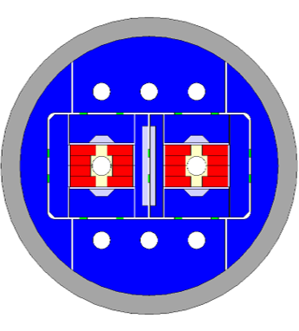


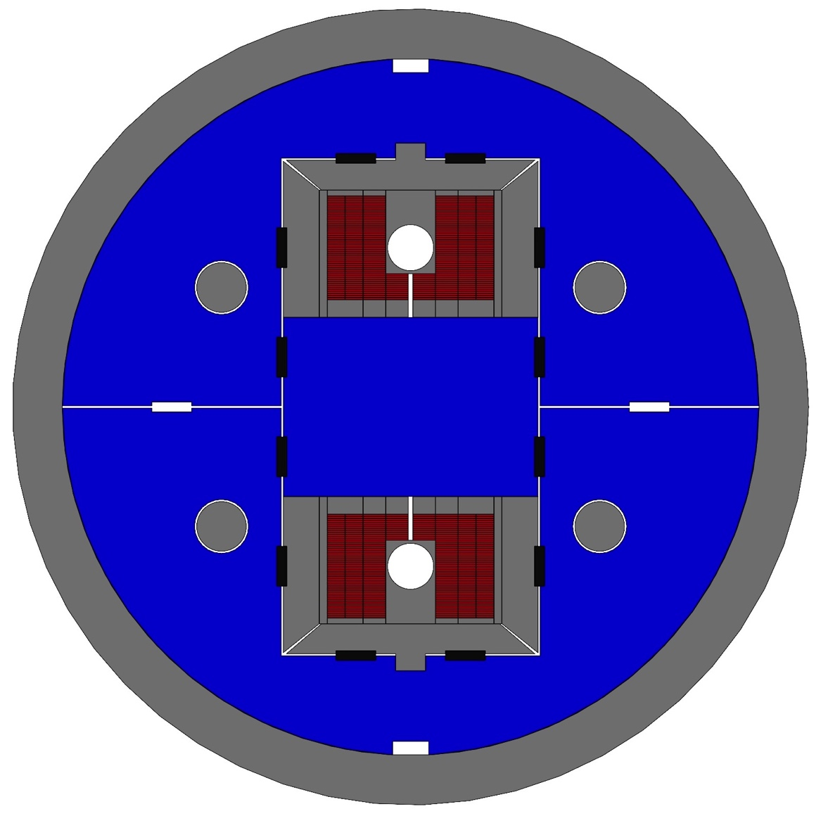
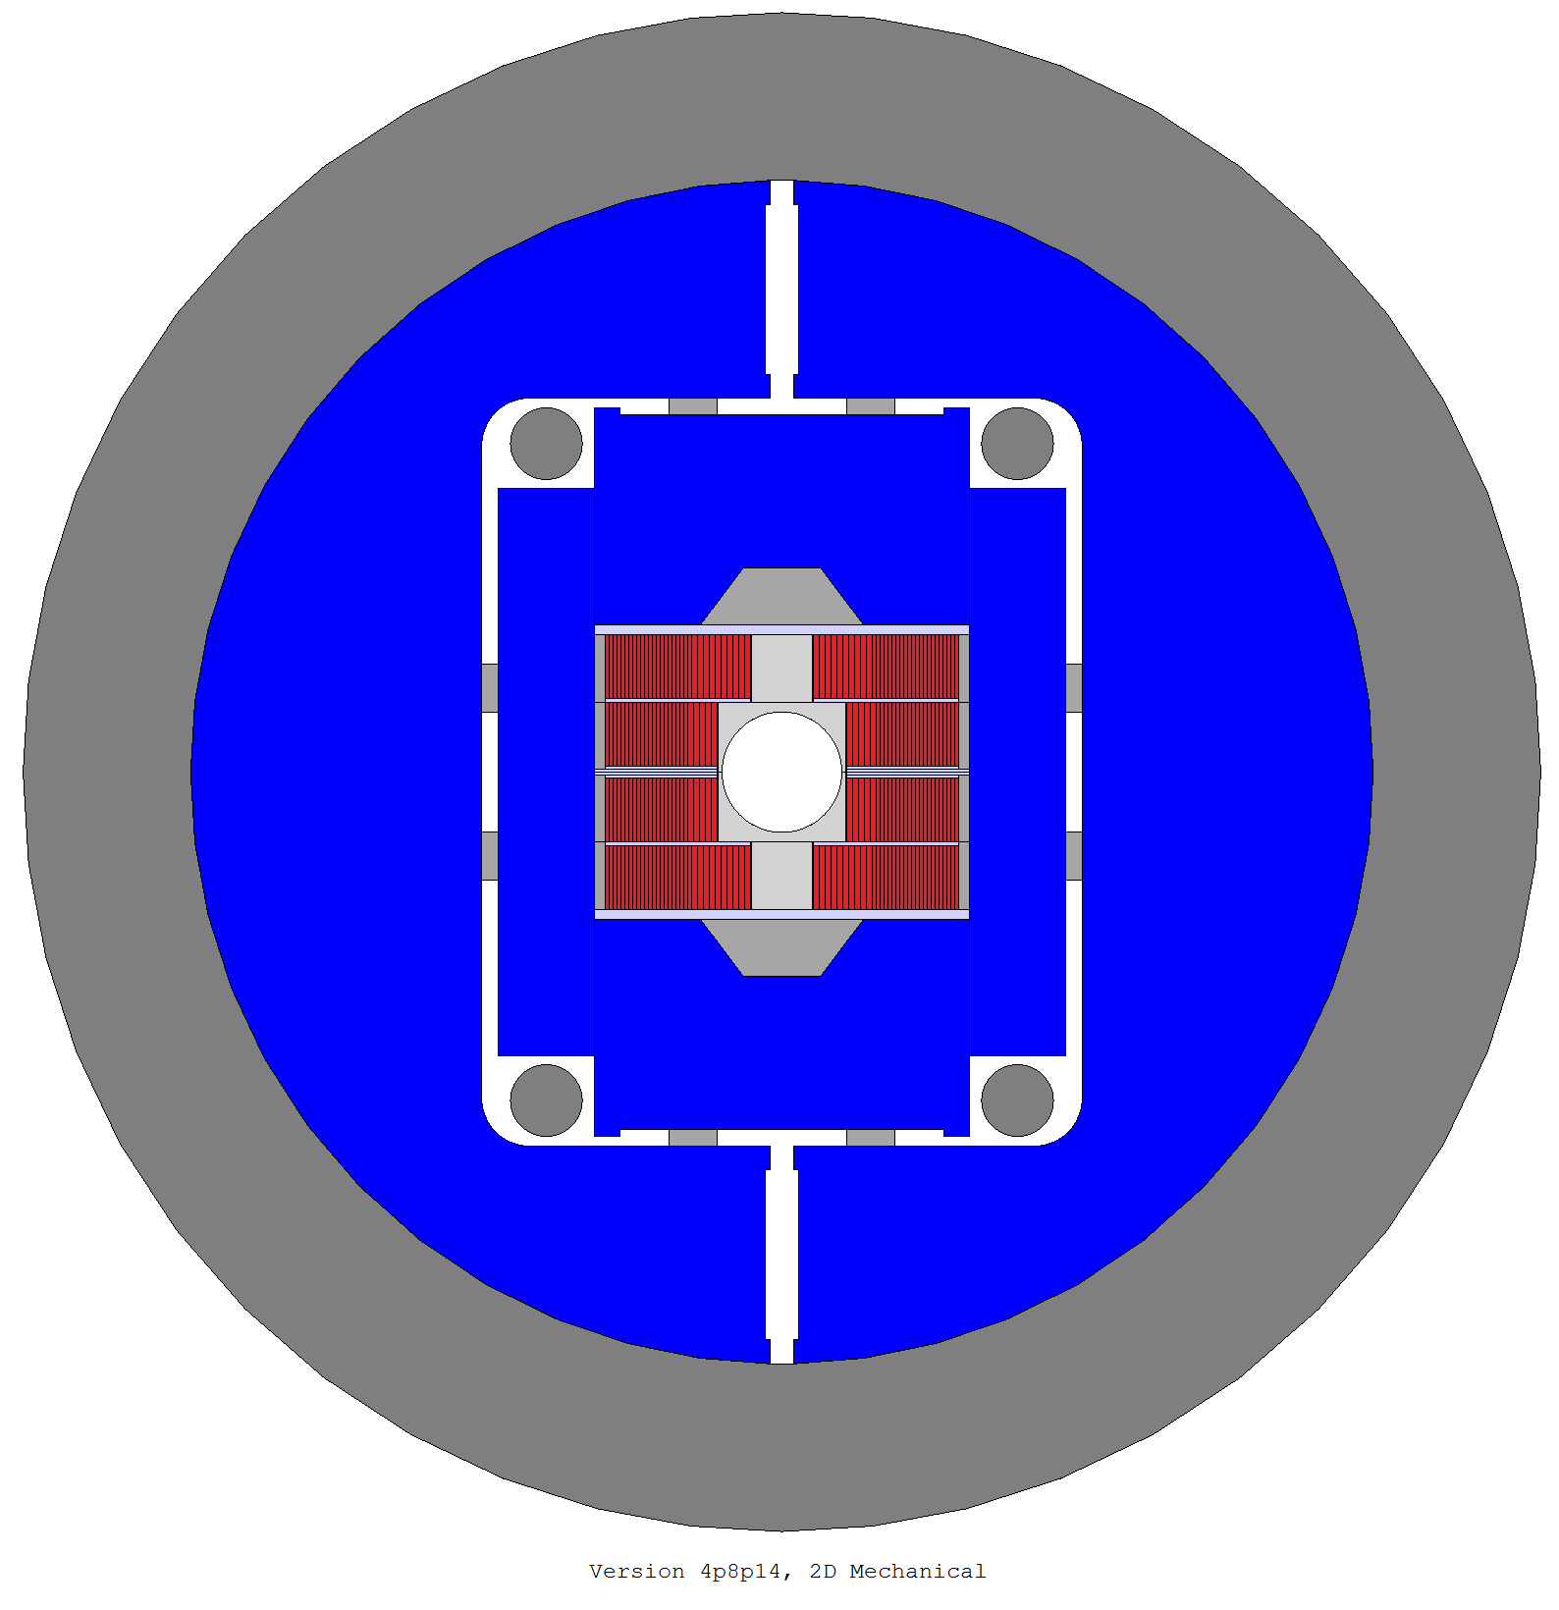
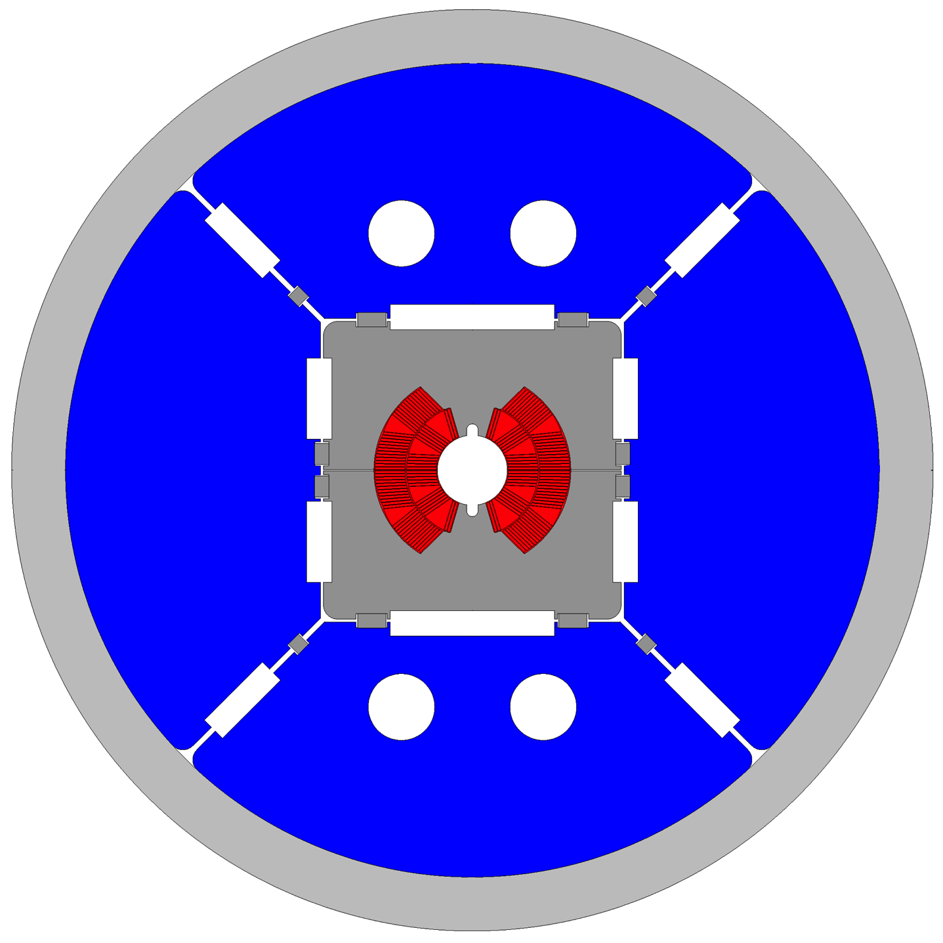
Nb₃Sn magnet design
The block option: this design has the world record
  HD2 reached 13.8 T at 4.2 K, Fresca2 reached 14.6 T at 1.9 K
  BOND (no grading) test in 2026, F2D2 (grading) test in 2028
The common coil design: a simpler path ?
  The IHEP program reached 12.5 T at 4.5 K (LFP1)
  CIEMAT is planning to build a common coil, test in 2027/8
Cosθ option: MDPCT1 reached 14 T at 4.5 K in the US, 11 T reached 12.5 T at 1.9 K
  Two layer magnet in INFN and CERN, winding started, test in 2026
FalconD cross-section
[S. Farinon, M .Sorbi,
A. Foussat et al.]
14 T block dipole
[J. C. Perez, et al.]
14 T block dipole F2D2
[E. Rochepault, et al.]
DAISY cross-section
[F. Toral, et al.]

Slide 13
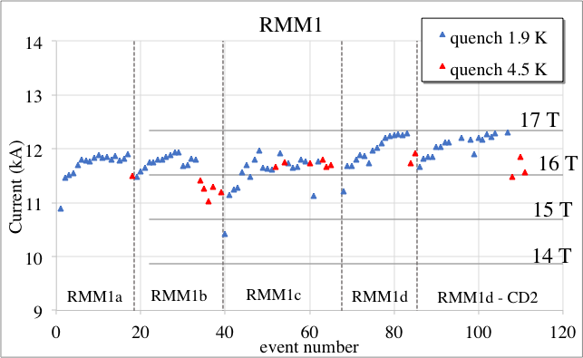
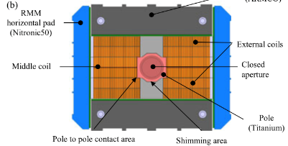
Recent results: Nb₃Sn magnets
Demonstrator: RMM, large width block coil (100 mm) without flared ends launched by EuroCirCol
  RMM reached 16.4 T in a 50 mm bore in 2022
  Test of reproducibility of the assembly in 2024: 16.9 T achieved, and 15.7 T for long flattops
Test of reproducibility of manufacturing (new set of coils) in 2025
Cross-section of RMM [J. C. Perez, et al.]

Slide 14

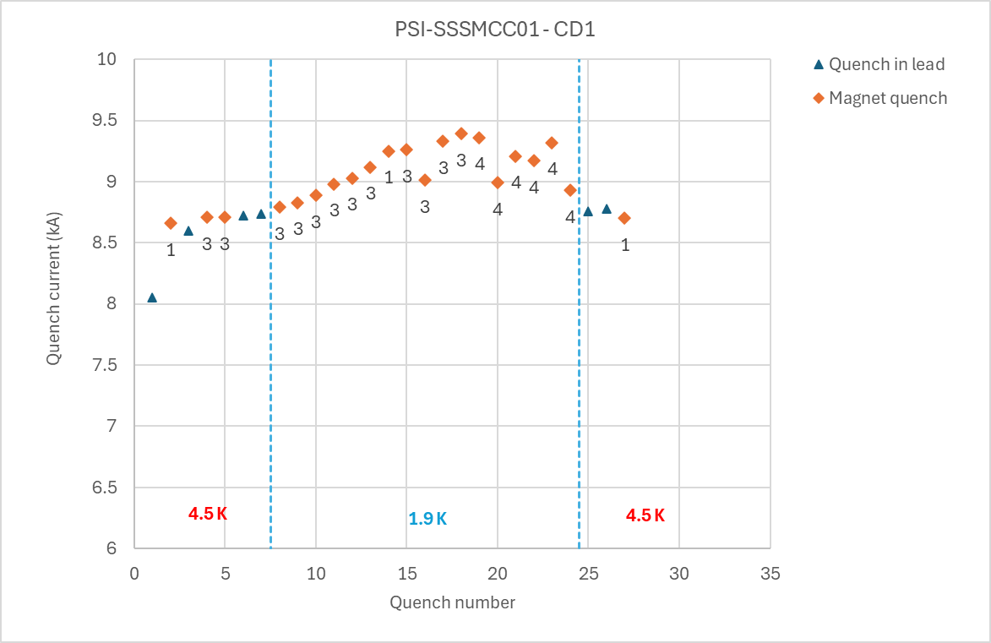
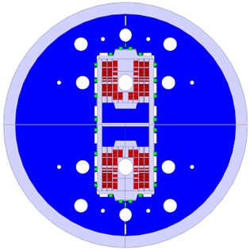

Nb₃Sn program: stress management
Stress management consists in mixing the structure and the coil
  Mandatory for 20 T, and MDP is investing only in this direction
    CCT5: 8 T reached (LBNL), CD1: 10 T (PSI) reached with 17 mm width coil
PSI manufactured a subscale stress managed common coil, with CERN support for parts of coil manufacturing and test
  Peak field in the coil of 6.5 T reached >5 T in in the centre (June 2024)
SMACC1 is a common coil stress managed, 12 T target, test in 2026
Short sample 1.9 K
Short sample 4.5 K
Design of 12 T SMACC1
(D. Araujo, B. Auchmann, et al.)
Test of SSSMCC in SM18 (D. Araujo, G. Willering, et al.)

Slide 15
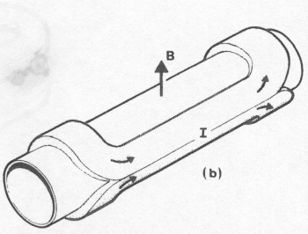
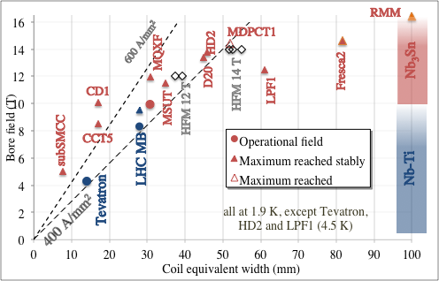
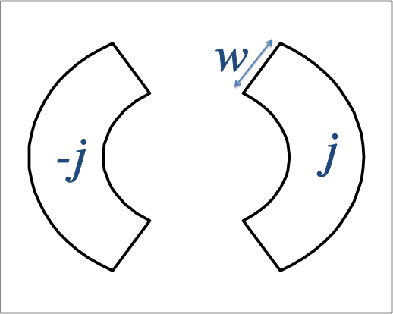
What are we building
Demonstrators
μ₀/2

Slide 16
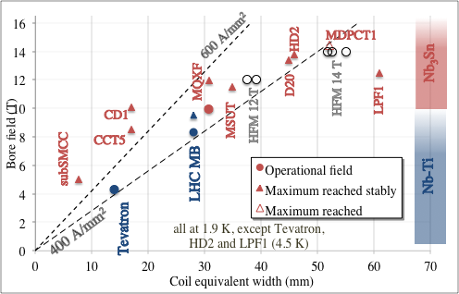
What are we building
Stress managed
μ₀/2

Slide 17
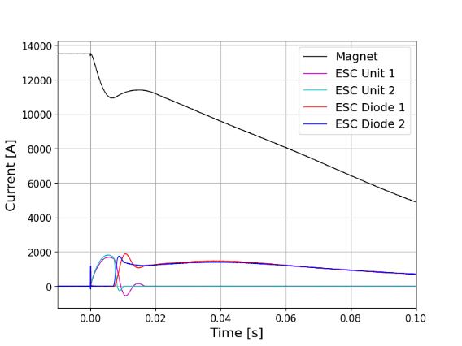
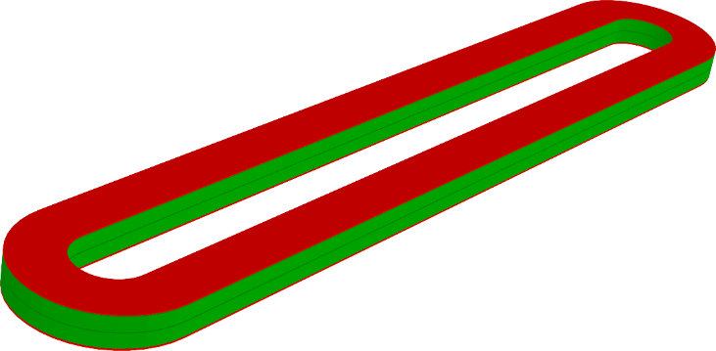
2024 results: novel protection schemes
Larger current density → more compact and cheaper magnets
  One of the limits to the design is the protection – all energy has to be dumped in the coil
  Novel method proposed (E. Ravaioli et al.) and has been tested at CERN on a SMC to allow a part of energy extraction, and fast quenching
  Second novel method (eCLIQ) is to be tested in the coming weeks
Copper coil and SC coil in ESC, and quench protection (E. Ravaioli, J. C. Perez, et al.)

Slide 18
Table of contents
Baseline for FCC, options and timeline
Status and results of Nb₃Sn
HTS hopes and challenges
Appendix: news from US and China, magnet design, HFM organization

Slide 19
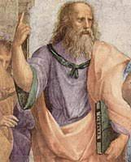
HTS: the ideal superconductor?
… a critical current that does not decrease with field
… a critical current that does not increase at lower fields (to reduce hysteresis, persistent currents)
… 10³ to 10⁴ A/mm² (just what is needed, nothing more) at 70 K
Ideal superconductor,
at temperatures >> 70 K
[Raffaello et al., The School of Athens,
detail, Musei Vaticani (1510)]
… and
Cheap: 5 $/(kA m)
Stress resistent at least up to 200 MPa
Available in long (km) lengths

Slide 20
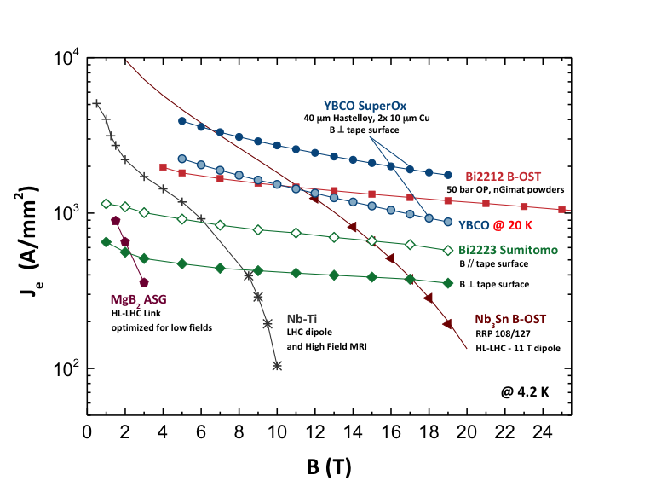
HTS: the ideal superconductor?
… a critical current that does not decrease with field
… a critical current that does not increase at lower fields (to reduce hysteresis, persistent currents)
… 10³ to 10⁴ A/mm² (just what is needed, nothing more) at 70 K
[Raffaello et al., The School of Athens,
detail, Musei Vaticani (1510)]
… and
Cheap: 5 $/(kA m)
Stress resistent at least up to 200 MPa
Available in long (km) lengths
Jeng vs B, all at 4.2 K (courtesy of A. Ballarino)

Slide 21
Three paths for HTS
BSSCO (commercially available, mainly used in the US)
    Available in round strand, dipoles reaching 1.5 T have been done (LBNL)
    Expensive, complicated manufacturing process (more than Nb₃Sn)
    No activities foreseen in HFM
REBCO (commercially available, strong impluse from fusion investments of order of BCHF)
    Recently, large reduction of cost, but still 5-10 larger than what needed in the unfavorable direction, and with limited lengths
    Available in tape, cable geometries being considered (Roebel, Corc®, Star ®)
    Hysteresis losses can be a showstopper: the filament is the tape width
    Workhorse for HFM – to be used, could be necessary renegotiating requirements
    IBS (not comercially available, strong impulse from China)
    Critical current is improving, but not as expected (see appendix)
    Potentially cheaper than REBCO
    One WP in HFM

Slide 22
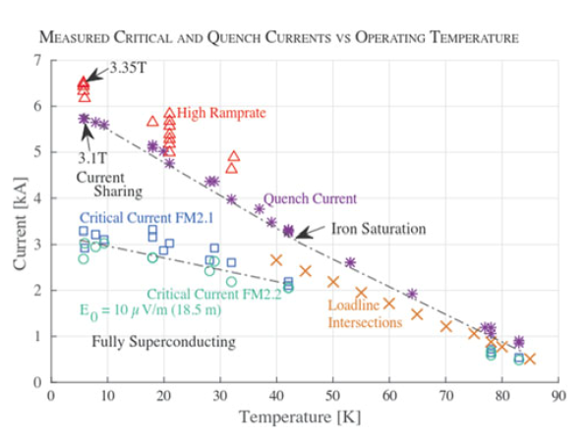
The challenge of hysteresis losses
The larger temperature margin and lower j at low field, allows stability with very large filaments in one direction (up to 12 mm)
Hysteretic losses, that are today critical for the FCC-hh (target of 10 kJ/m per cycle is given), can be a showstopper in this case
  In case of HTS insert, both common coil and cosθ have the cables perpendicular to the field: the ideal is the block, where they are parallel
Feather magnet tested in 2017, REBCO, block aligned: it reached 4.5 T, but did not prove all accelerator features
L. Rossi, et al, Instruments 5 (2021) ]
Is the REBCO tape used in fusion a viable
conductor for HEP main dipole magnets ?
Question still open today

Slide 23
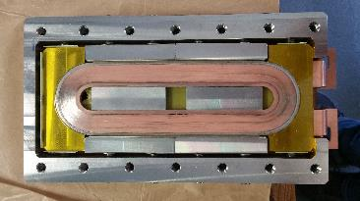
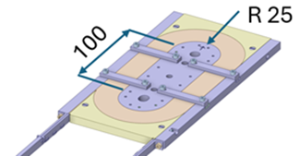
HTS results in 2024
Production line in KIT commissioned (B. Holzapfel et al.) in March 2024
At CERN, racetrack wound with dielectric insulated (DI) REBCO and went through preliminary tested at 77 K
A research line of MI (Metal Insulated) is also active in HFM (CEA) – 2.7 T at 4.2 K reached in fall 2024 (but half of the field w.r.t. model !)
  Remember that all magnets for fusion are NI (Non Insulated) – this design does not fit our requirements
  Protection is still challenge far to be solved …. Many coil lost, in all fields
[A. Ballarino, et al., HFM TE day https://indico.cern.ch/event/1425262/ ]
MI racetrack coil [T. Lecrevisse, et al. ]

Slide 24
Never forget the specificity of accelerator magnets
First: An accelerator dipole is not a solenoid !!
  Field is not parallel to the wire, forces are not perpendicular to the wire, stresses are 50% larger than magnet pressure
Second: Overall current densities of ∼500 A/mm² are a peculiar feature/challenge for accelerator magnets
  One order of magnitude above HEP detector magnets or fusion magnets
Third: magnet operational range is not a single point, but a whole set of currents (from injection to high field)
 | Overall current density (A/mm²) | Non-Cu current density (A/mm²) | Ramp rate (mT/s) | Field in conductor (T)
Tevatron dipole | 360 | 1550 | ∼4 | 4.7
LHC dipole | 360/440 | 1260/1820 | ∼8 | 8.6
ATLAS BCT | 30 | 950 | ∼0.8 | 3.9
ITER (TF & CS) | 20 to 40 | 150 | ∼400 | 5 to 13
HL-LHC SC link | 17 | 1450 | ∼8 | Self field (<1 T)

Slide 25
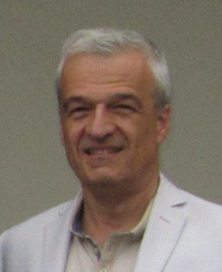
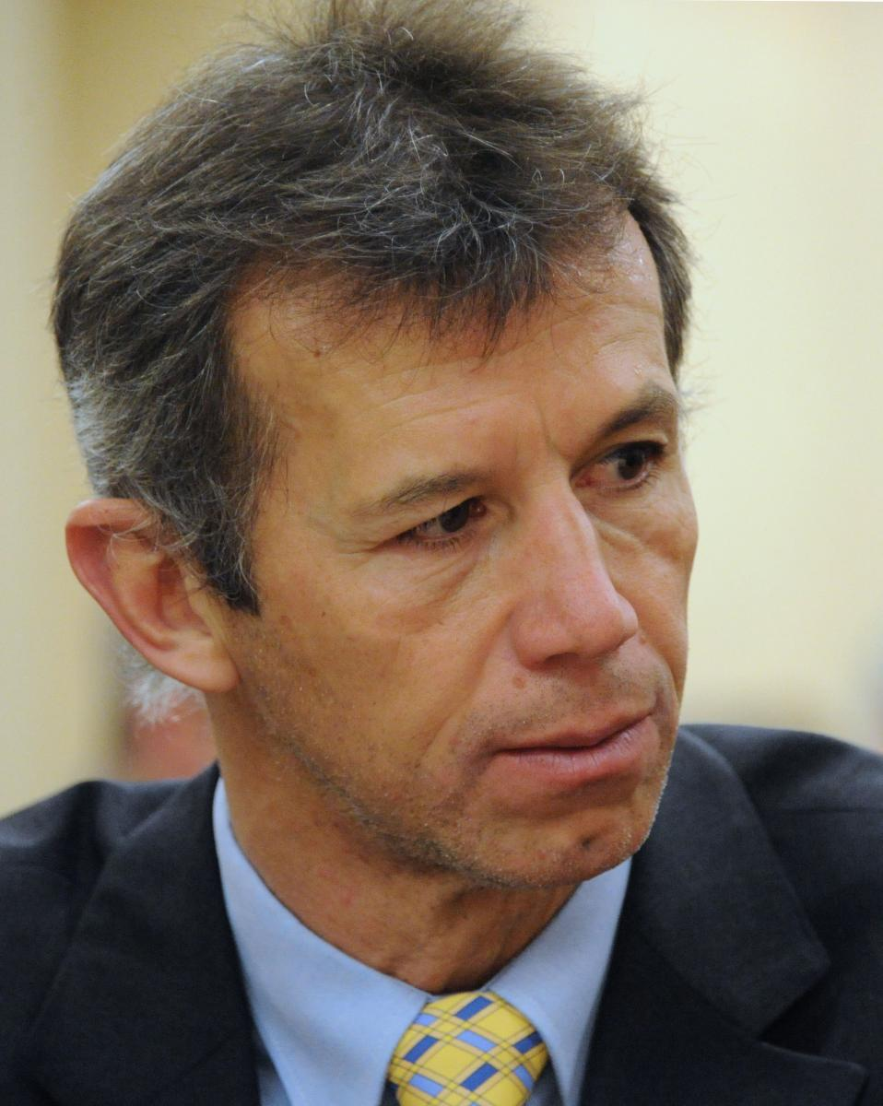
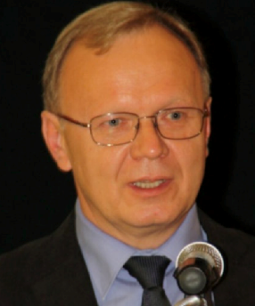
A big thanks to our predecessors
D. Tommasini, leading
EuroCirCol studies 2014-2020
Luca Bottura, leading
HFM program 2020-2021
Andrzej Siemko, leading
HFM program 2022-2023

Slide 27
Appendix
News from China
News from the US
HFM structure and organization

Slide 28

SPPC
Comparison between FCC-hh and SPPC
  As FCC-hh, SPPC went through a modification of parameters
  Today it relies on 20 T magnet, with 100 km tunnel, and 125 TeV c.o.m.
  The 20 T are given by 13 T in Nb₃Sn and 7 T in HTS
    It will probably be lowered in the near future
  Machine works at 4.5 K
FCC-hh parameters | CDR 2019 | 2024-Nb₃Sn | 2024-HTS
Dipole field (T) | 16.0 | 14.0 | 14-20
Tunnel length (km) | 100 | 90.7 | 90.7
Arc length (km) | 82.0 | 76.9 | 76.9
Arc filling factor (adim) | 0.80 | 0.83 | 0.83
Energy c.o.m (TeV) | 100 | 85 | 85-120
Loadline margin | 86% | 80% | TBD
SPPC parameters | Nb₃Sn (2019) | HTS (2019) | Nb₃Sn/HTS (2023)
Dipole field (T) | 12.0 | 20-24 | 20 (13+7)
Tunnel length (km) | 100 | 100 | 100
Arc length (km) | 81.8 | 81.8 | 81.8
Arc filling factor (adim) | 0.79 | 0.79 | 0.79
Energy c.o.m (TeV) | 75 | 125-150 | 125

Slide 29

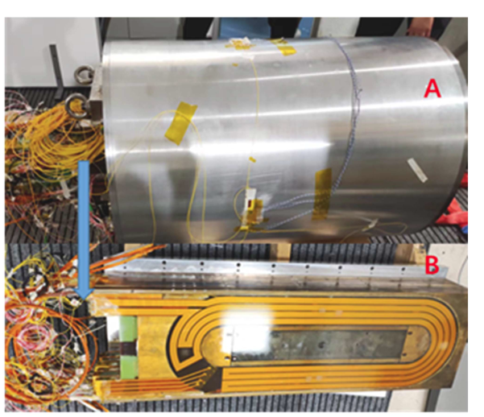
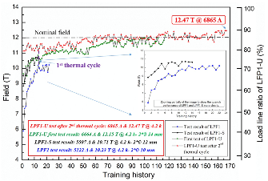
SPPC magnets
IHEP has selected the common coil design
  Steps aiming at 20 T increasing field and aperture
  2018-2023: LFP1 Nb₃Sn magnet reached 12.5 T in 14 mm aperture after very long training
    Configuration based on flat racetrack, without field quality
  LFP3 construction ongoing since two years, aiming at 13 T with Nb₃Sn plus 3 T with HTS
    Nb₃Sn coils limited at 11 T, HTS reached 3 T, then two coils lost during tests
    New set of coils being manufactured, test in 2025
LFP3 magnet [J. Shi, Q. Xu, et al., IEEE TAS 34 (2024) 4701405]
    LPF1 training [C. Wang, et al., SUST 36 (2023) 065006]

Slide 30
IBS
The common coil shall contain a part (7 T) in HTS
  China is investing on IBS since many years – solenoids successfully built
  Considerable progress in critical current in the past years, but still far from target (a factor 4 missing)
IBS target 2025
IBS achieved 2022
IBS achieved 2019
IBS achieved 2016
Improvement in IBS [see talk by Q. Xu, in Marseille, 2024 https://indico.in2p3.fr/event/20053/ ]

Slide 31
Appendix
News from China
News from the US
HFM structure and organization

Slide 32
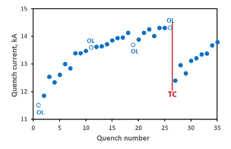
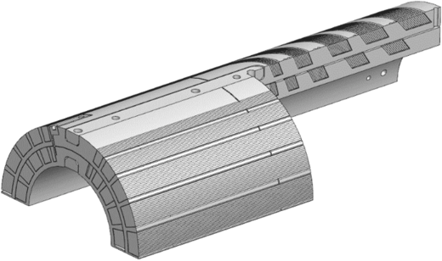
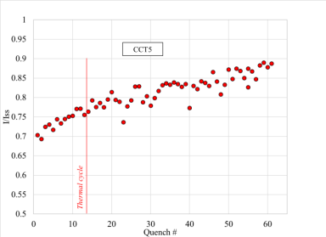
US magnet development program (MDP)
MDP aims at reaching 20 T with an hybrid magnet
  To reach 20 T the stress management is mandatory
  Two paths: CCT and Cosθ
Cosθ from FNAL: 12.7 T but in mirror
CCT from LBNL: 8.5 T in 90 mm aperture
HTS:
  Bin5, made with BSSCO reached 1.6 T in 35 mm aperture
  CCT with REBCO corc® cable reached 2.9 T in 65 mm aperture
  Record of 4.5 T still dates back to 6 years ago (Feather2)
12.7 T peak field
10.0 T peak field

Slide 33
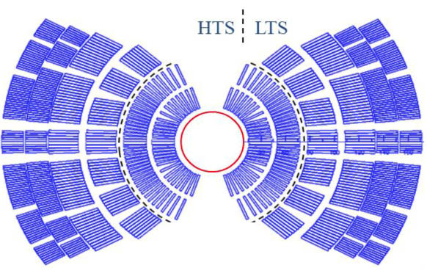
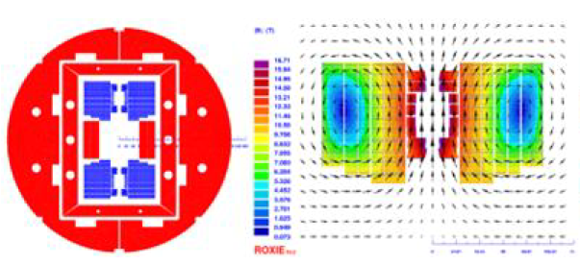
Hybrid or all HTS ?
All-HTS coil open the possibility of 20 K operation, which could consume less energy
  Beware of drawing « easy » conclusions on sustainability … it is a very complex computation that is not intuitive – 20 K operation today requires 3 times conductor
«Hybrid» makes use of HTS in higher field regions, and of cheaper Nb₃Sn up to 13-15 T
  This option is being developed in the US by MDP, and in China by IHEP
HFM has not yet taken any decision on this
Hybrid design for 20 T magnet
[P. Ferracin, et al, IEEE TAS 33 (2023) 4002007
and 4LOr1B-01]
Hybrid design for 20 T magnet
[Q. Xu, et al, CEPC design report, pg 749]

Slide 34
Appendix
News from China
News from the US
HFM structure and organization

Slide 35
HFM structure and organization
33 WPs, 17 from CERN and 16 from collaborations
  Since early 2024 reduction of WP number (20% less)
Having a unique forum to share results
  Since March 2024, 17 meetings, with average 50 colleagues
MDP systematically invited to HFM forum, 4 joint meetings with the US in the afternoon
7 working groups established since 2024
  Block coil – Common coil
  BOX program - Composite WG - insulation
  HTS modeling – Quench and transients
More information on https://hfm.web.cern.ch/

Slide 36
HFM steering board
M. Lamont (chair)
P. Vedrine (co-chair)
HFM collaboration board
C. Senatore (chair)
TBD (deputy)
High Field Magnet Programme
E. Todesco (Leader), B. Auchmann (Co-leader)
Programme office
G. Riddone
RD2:HTS conductor+magnets
RD2 coord: A. Ballarino (CERN)
RD3: Nb₃Sn magnets
RD3 line coordinators:
F. Toral (CIEMAT)
Haziot, A. Foussat (CERN)
RD4: Integration,
sustainability
RD4 line coordinator:
P. Borges de Sousa (CERN)
RD5: Infrastructures
2.1 REBCO development
B. Holzapfel (KIT)
3.1 12 T cosθ CERN
A. Foussat (CERN)
5.1 Test
F. Mangiarotti (CERN)
4.3 Insulation and HV
R. Piccin (CERN)
RD1: Nb₃Sn conductor
RD1 line coordinators:
T. Boutboul (CERN)
C. Senatore (UniGe)
2.2 REBCO conductor
A. Ballarino (CERN)
3.2 12 T cosθ INFN
S. Farinon (INFN)
5.2 Conductors, cables
J. Fleiter (CERN)
1.1 Nb₃Sn wire and cable
T. Boutboul (CERN)
4.5 Quench D+P
M. Wozniak (CERN)
2.5 Demonstrator DI coils
A. Ballarino (CERN)
3.4 Technology development
A. Haziot (CERN)
5.4 Manufacturing
J. Axensalva (CERN)
1.3 Internal oxidation wires
C. Senatore (UniGe)
4.6 Cryogenics, thermal
P. Borges de Sousa (CERN)
2.6 Solenoids and MuC
L. Bottura (CERN)
3.5 14 T Block dipole BOND
J. C. Perez (CERN)
5.5 MM, modelling
L. Fiscarelli (CERN)
1.15 Nb₃Sn development
M. Sugano (KEK)
2.11 Demonstrator MI coil
T. Lecrevisse (CEA)
3.3 5-m-long block
S. Izquierdo Bermudez(CERN)
5.7 CIEMAT lab
C. Martins (CIEMAT)
1.18 Internal oxid. studies
A. Leineweber (BAF)
2.15 IBS development
A. Malagoli (CNR-SPIN)
3.6, 3.12 Block dipole F2D2
E. Rochepault (CEA)
2.16 HTS laboratory
A. Ballarino (CERN)
2.17 REBCO development
Y. Yang (SOTON)
3.7 Common coil DAISY
F. Toral (CIEMAT)
1.19 Nb₃Sn characterization
C. Senatore (UniGe)
2.18 HTS 10 T dipole
M. Statera (INFN)
3.11 14 T Cosθ
M. Sorbi (INFN)
6.1 Societal impact
E. Chesta (CERN)
2.19 REBCO racetrack
D. M. Araujo (PSI)
3.14 CC stress managed
D. M. Araujo (PSI)
2.20 REBCO characteriz.
M. Eisterer (TUWien)
Collaboration WPs
January 2025
Note: completed WP
not shown
CERN WPs

Slide 37
Appendix
News from China
News from the US
HFM structure and organization
More about magnet design

Slide 38
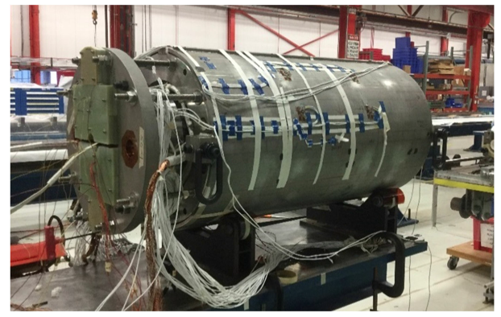
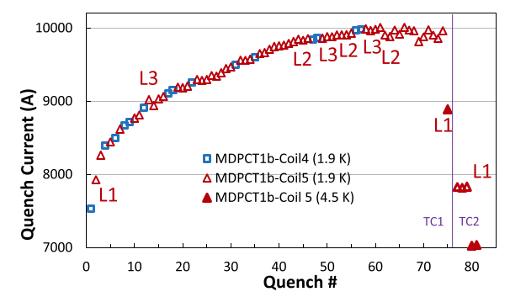

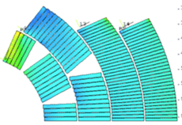
Nb₃Sn program for 14 T
The cosθ option: the more classical path
  MDPCT1: four layer cos theta made in FNAL reached 14.5 T at 4.2 K but degraded
    This path was abandoned by MDP
  INFN is proposing to have a 4 layer cosθ (discussions on scope ongoing)
    Test in 2029 at earliest
Power tests of MDPCT1 [S. Stoynev, et al. IEEE TAS 32 (2022) 4000705]

Slide 39
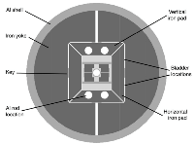
Nb₃Sn program for 14 T
The block option: this design has the world record
  Advantage: no stress accumulation in the midplane
  HD2 reached 13.8 T at 4.2 K
  Two options:
    CERN (no grading) – test in 2026
    CEA (with grading) – test in 2028
[G. L. Sabbi, et al. IEEE TAS 15 (2005) 1128]
14 T block dipole (J. C. Perez, et al.)
14 T block dipole F2D2 (E. Rochepault, et al.)

Slide 40
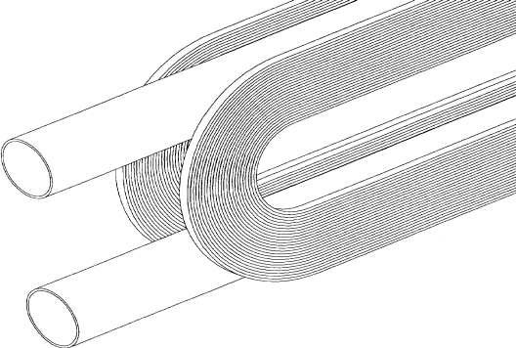
Nb₃Sn program for 14 T
The common coil design: a simpler path ?
  Racetrack coils are easier to manufacture
  The IHEP program reached 12.5 T with Nb₃Sn, but with small aperture (14 mm and no field quality, see appendix)
  CIEMAT is planning to build a common coil, test in 2027/8
Common coil design
[R. Gupta, IPAC 1997 3344]
DAISY cross-section [F. Toral, et al.]
    LPF1 training [C. Wang, et al., SUST 36 (2023) 065006]

