Slide 1
CERN Summer Student Lecture - 2025
Accelerator Technology Challenges:
Superconducting magnets (1/2)
Susana Izquierdo Bermudez
(susana.Izquierdo.Bermudez@cern.ch)
European Organization for Nuclear Research (CERN)

Slide 2
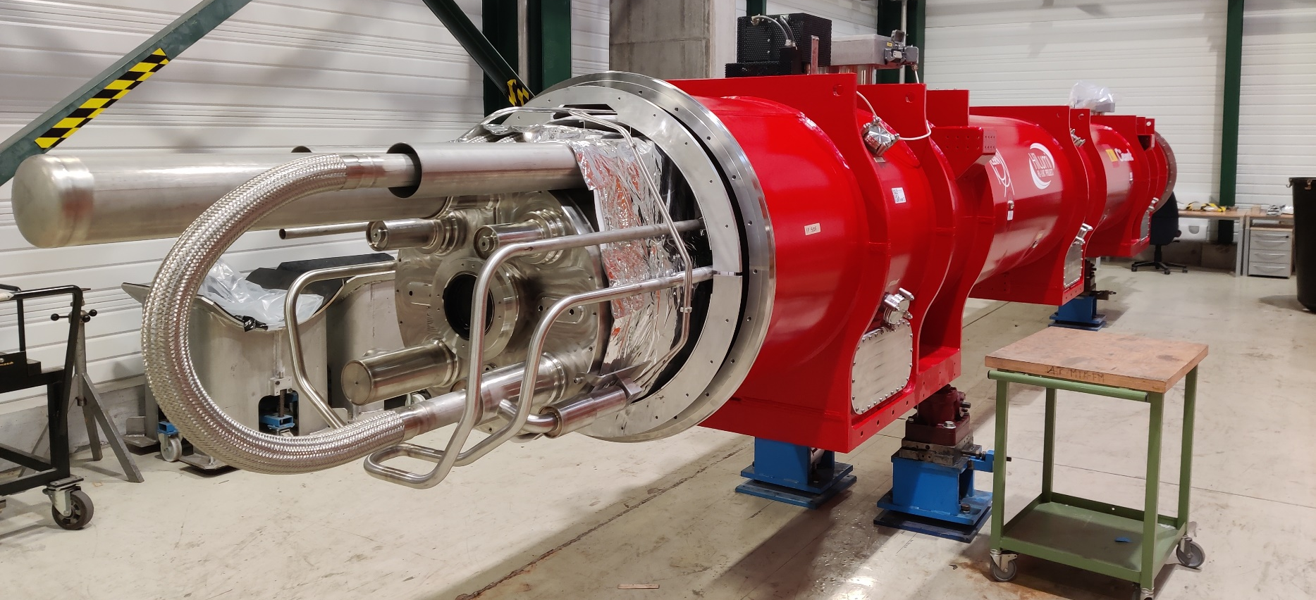
Superconducting magnet in a nutshell
A superconducting magnet is an exciting, fancy and dirty mixture of physics, engineering, and chemistry

Slide 3
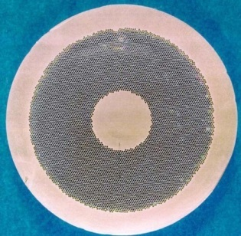
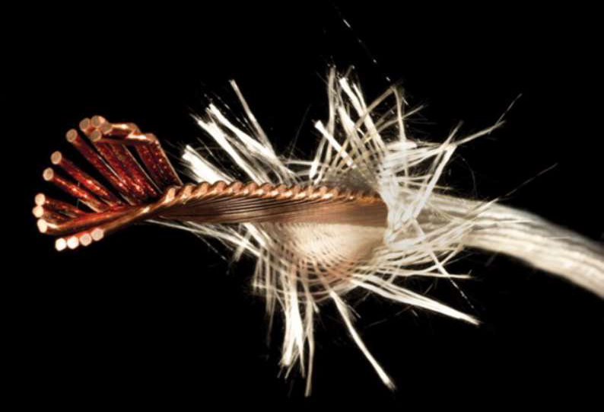
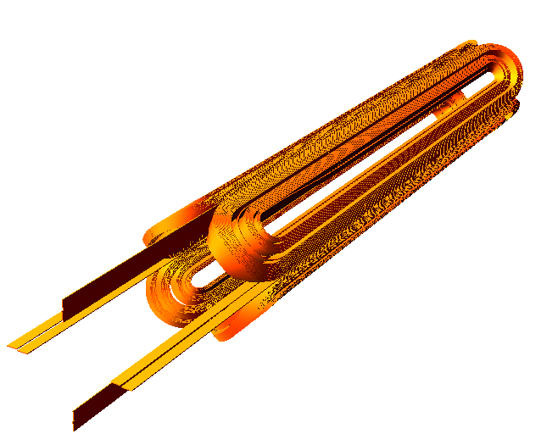
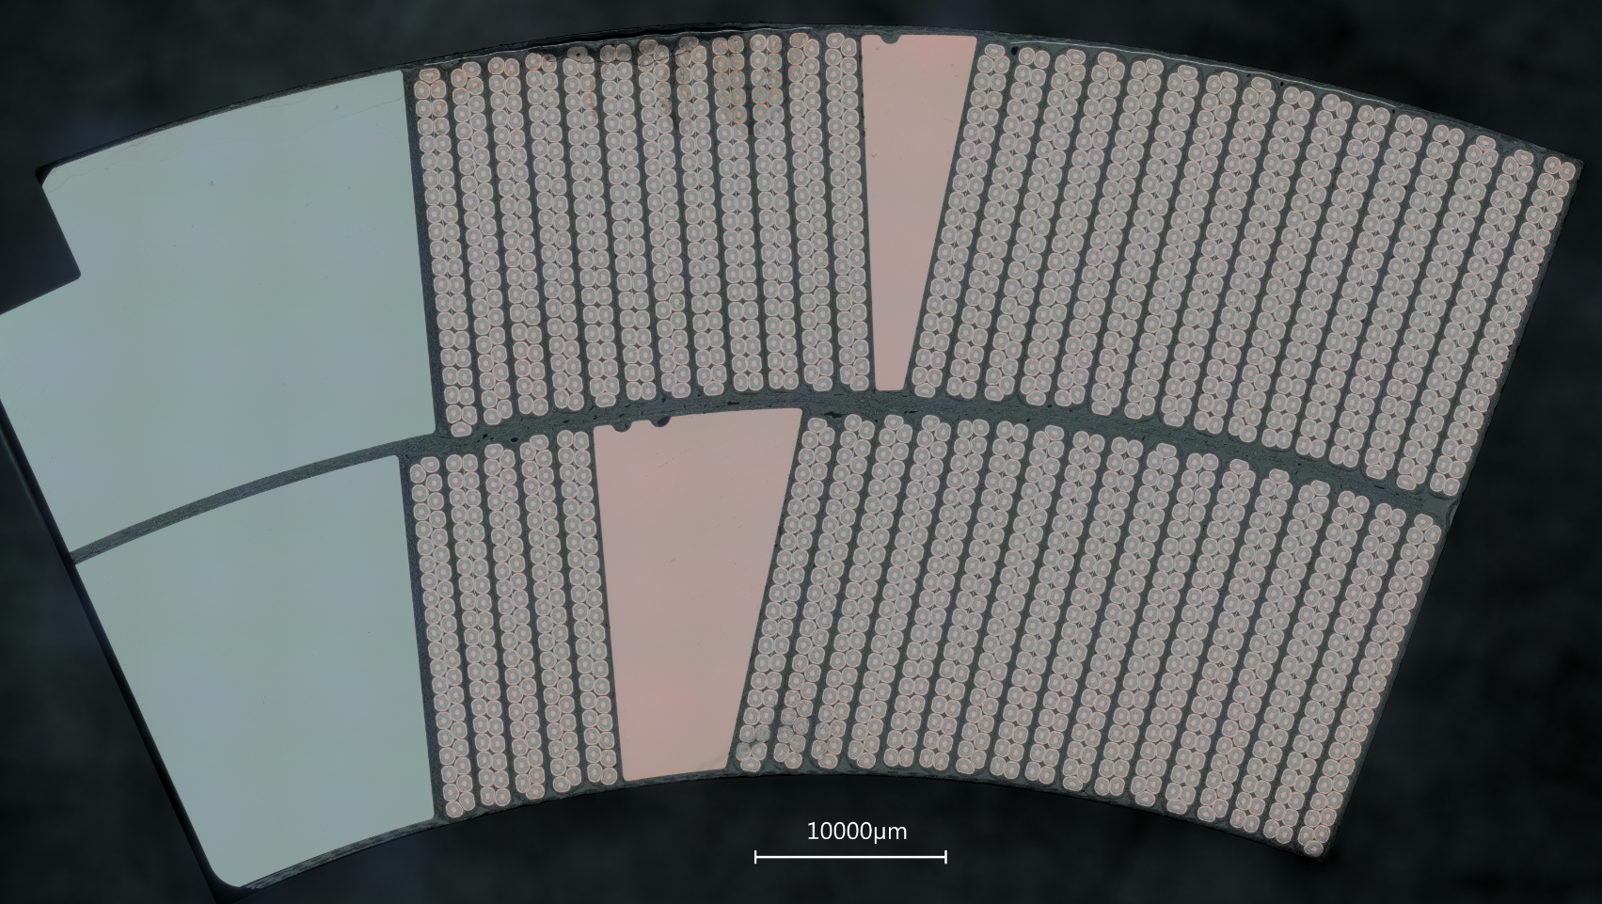
Superconducting magnet in a nutshell
A superconducting magnet is an exciting, fancy and dirty mixture of physics, engineering, and chemistry
Quantum physics:
Superconductivity
Material science
Superconducting materials
Strand
Cable
Coil

Slide 4
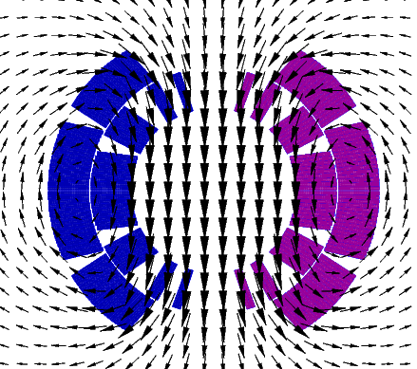
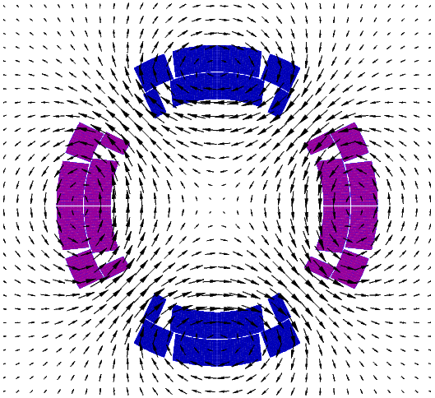
Superconducting magnet in a nutshell
A superconducting magnet is an exciting, fancy and dirty mixture of physics, engineering, and chemistry
Quantum physics:
Superconductivity
Material science
Superconducting materials
Classical electrodynamics
Magnet design

Slide 5
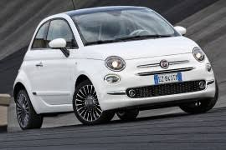
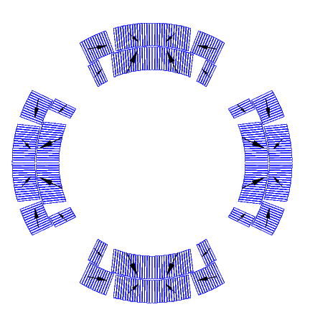
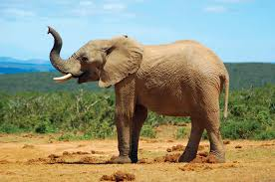
Superconducting magnet in a nutshell
A superconducting magnet is an exciting, fancy and dirty mixture of physics, engineering, and chemistry
Quantum physics:
Superconductivity
Lifting every meter 1360 x
Material science
Superconducting materials
HL-LHC MQXF
Nb₃Sn, B_{p} = 11.3 T
F_{x} = 6.8 MN/m
σ_{θ,em} = 100-110 MPa
F_{z} = 1200 kN
Classical electrodynamics
Magnet design
F_{z}
Mechanical engineering:
Handling of the Lorentz forces
Lifting 25 x

Slide 6
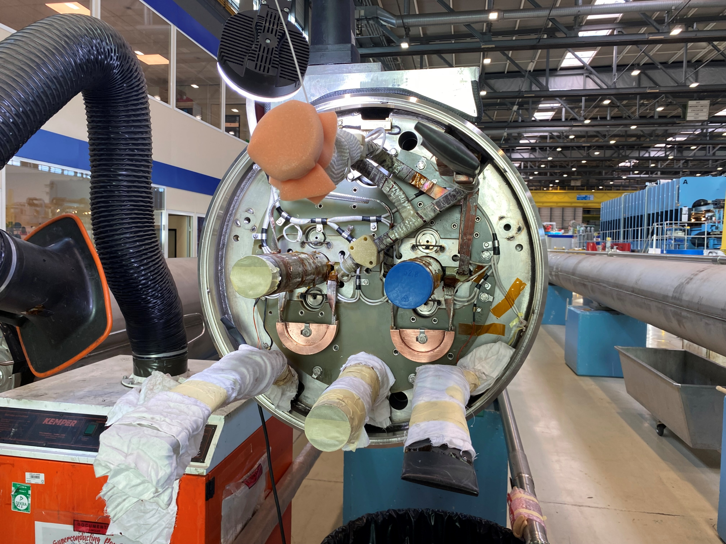
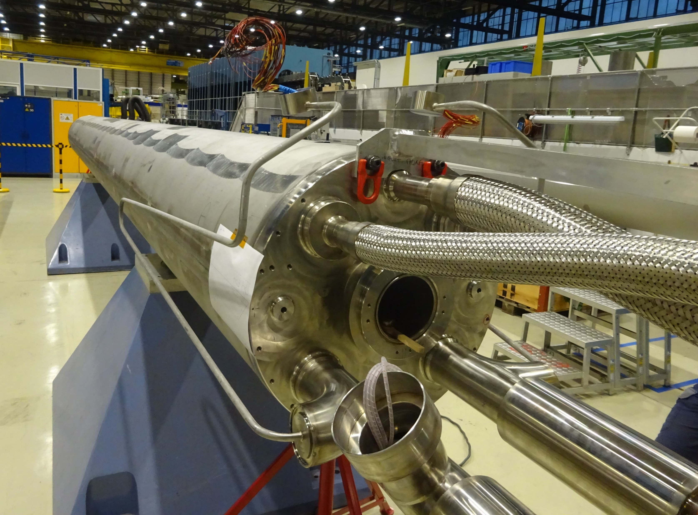
Superconducting magnet in a nutshell
A superconducting magnet is an exciting, fancy and dirty mixture of physics, engineering, and chemistry
Quantum physics:
Superconductivity
Material science
Superconducting materials
Classical electrodynamics
Magnet design
Electrical engineering:
power and protect
Mechanical engineering:
Handling of the Lorentz forces

Slide 7
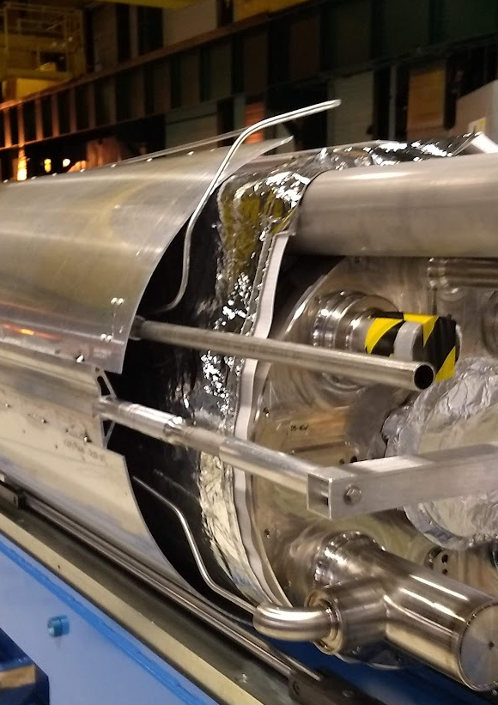
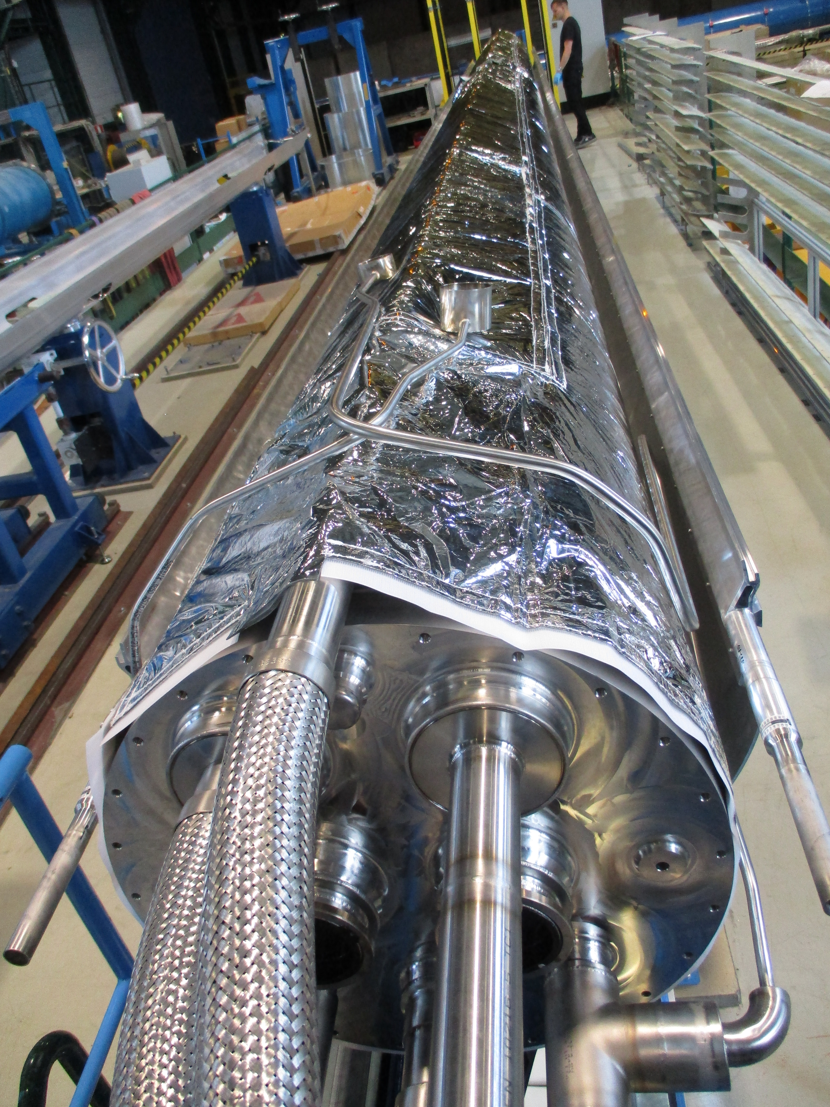
Superconducting magnet in a nutshell
A superconducting magnet is an exciting, fancy and dirty mixture of physics, engineering, and chemistry
Quantum physics:
Superconductivity
Material science
Superconducting materials
Cryogenics:
keep them cool
Classical electrodynamics
Magnet design
Electrical engineering:
power and protect
Mechanical engineering:
Handling of the Lorentz forces

Slide 8
Superconducting magnet in a nutshell
A superconducting magnet is an exciting, fancy and dirty mixture of physics, engineering, and chemistry
Quantum physics:
Superconductivity
Cost!
Material science
Superconducting materials
Cryogenics:
keep them cool
Classical electrodynamics
Magnet design
Electrical engineering:
power and protect
Mechanical engineering:
Handling of the Lorentz forces

Slide 9
Superconducting magnet in a nutshell
A superconducting magnet is an exciting, fancy and dirty mixture of physics, engineering, and chemistry
Quantum physics:
Superconductivity
Cost!
Material science
Superconducting materials
Goal: Provide an overview of superconducting magnets for particle accelerators
Disclaimer: Superconducting magnets for particle accelerators are a vast domain. This lecture will be especially focused on magnets for colliders, with a special eye on the CERN high energy infrastructures (LHC and HL-LHC).
Cryogenics:
keep them cool
Classical electrodynamics
Magnet design
Electrical engineering:
power and protect
Mechanical engineering:
Handling of the Lorentz forces

Slide 10
Outline
Part I
  Particle accelerators, magnets and the need of superconductors
  Magnetic design and coil fabrication
Part II
  Mechanical design and assembly
  Quench, training and protection
  Outlook, what brings the future

Slide 11
Outline
Part I
  Particle accelerators, magnets and the need of superconductors
  Magnetic design and coil fabrication
Part II
  Mechanical design and assembly
  Quench, training and protection
  Outlook, what brings the future

Slide 12
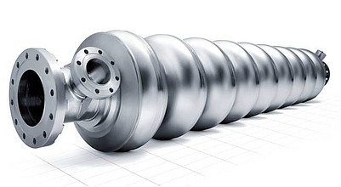
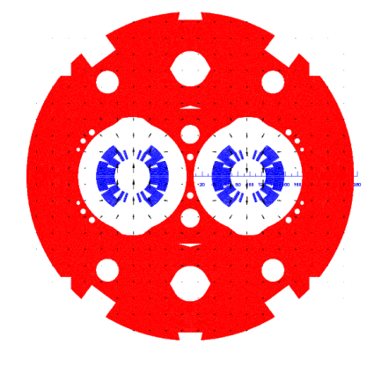
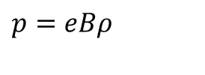


Particle accelerators
Principle of synchrotrons:
  Driving particles in the same accelerating structure several times.
Electro-magnetic field accelerates particles
Magnetic field steers the particles in a ∼ circular orbit
Particle accelerated → energy increased → magnetic field increased (“synchro”) to keep the particles on the same orbit of curvature ρ
$$\vec{F}=e\vec{E}$$
$$\vec{F}=e\vec{v}×\vec{B}$$
B
$$p=eBρ$$
Constant

Slide 13


Particle accelerators and magnets
How do we keep the particles in a cycle? MAGNETS!
  Dipole magnets provide a constant field, to be increased with time to follow the particle acceleration, steering (bends) the particles in ≈ circular orbit
  Quadrupole magnets keep the particles in the orbit, providing a linear force that keep them focused acting as a spring. They provide a field
    Equal to zero in the center
    Increasing linearly with the radius
$$B_{y}=B_{1}$$
$$B_{x}=0$$
$$B_{y}=Gx$$
$$B_{x}=Gy$$

Slide 14
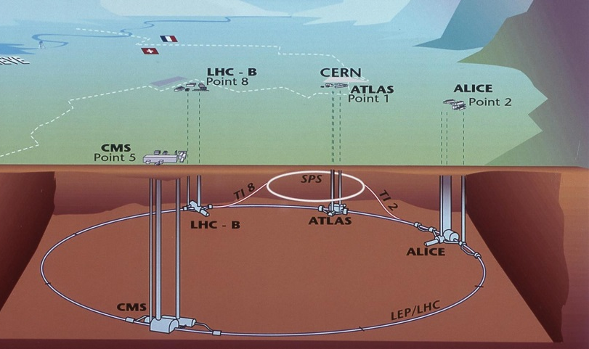
Particle accelerators: the LHC
“The Arc (20.7 km)”
Dipoles: magnetic field steers (bends) the particles in a ∼circular orbit
Quadrupoles: magnetic field provides the force necessary to stabilize linear motion.
  They act as a spring: focus the beam
  Prevent protons from falling to the bottom of the aperture due to the gravitational force (it would happen in less than 60 ms!)
Correctors
“Long straight sections (7.2 km)”
Interaction regions (IR) where the experiments are housed
  Quadrupoles for strong focusing in interaction point
  Dipoles for beam crossing in two-ring machines
Regions for other services
  Beam injection (dipole kickers)
  Accelerating structure (RF cavities)
  Beam dump (dipole kickers)
  Beam cleaning (collimators)

Slide 15


Electromagnets
Dipoles: the larger B, the larger the energy ($p=eBρ$)
Quadrupoles: the larger B, the larger the focusing strength ($G=B/r$)
For an electro-magnet, the larger B, the larger must be J
In normal conducting magnets, J ~ 5 A/mm²
In superconducting magnets, J_{e} ~ 600-700 A/mm²
$$G=−\frac{μ_{0}J_{0}}{2}ln\frac{r_{out}}{r_{in}}$$
w
If we want magnets with B>2T and a reasonable size (and energy consumptions), superconductors are needed

Slide 16
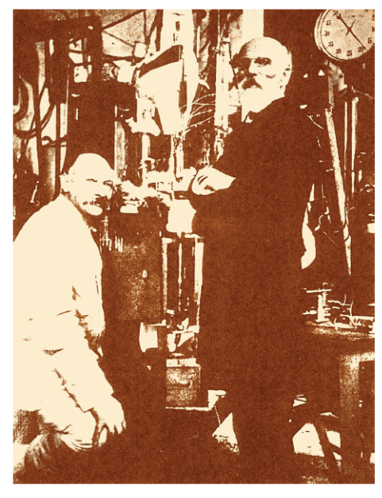
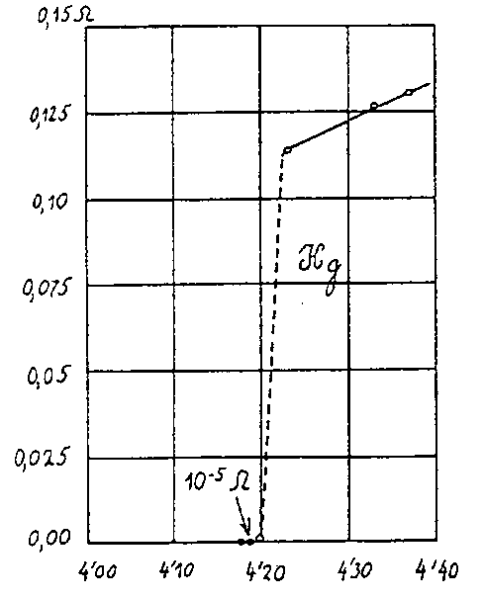
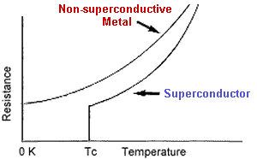
Superconductivity
In 1911, Kammerling-Onnes, discovered superconductivity (ZERO resistance of mercury wire at 4.2 K)
The temperature at which the transition takes place is called critical temperature T_{c}
Observed in may materials
  but not in the typical best conductors (Cu, Ag, Au)
At T > T_{c} , superconductor very poor conductor

Slide 17
Superconductivity
For 40-50 years, only “Type I” superconductors were known.
by L. Bottura
B
B
  Perfect diamagnetism. With T<T_{c} magnetic field is expelled
  But, the B must be < critical field B_{c}. Otherwise, superconductivity is lost
  Unfortunately, B_{c} very low (≤ 0.1 T), not practical for electro-magnets
Increase of field
Cool-down
Superconducting state
Normal state
Then, in the 50’s, “Type II” superconductors
by L. Bottura
  Between B_{c1} and B_{c2} : mixed phase
      B penetrates as flux tubes: fluxoids
Much higher fields and link between T_{c} and B_{c2}
B<B_{c1}
B_{c1}<B<B_{c2}

Slide 18
Practical Superconductors for particle accelerators:
All accelerator magnets installed up to now in an accelerator are using NbTi as superconductor:
Nb and Ti (1961) → ductile alloy
  Extrusion + drawing
  T_{c} is ~ 9.2 K at 0 T
  B_{C2} is ~ 14.5 T at 0 K
  ~50-200 US$ per kg of wire
  (1 euro per m)
In HL-LHC, Nb₃Sn magnets will be installed for first time in an accelerator:
Nb and Sn (1954) → intermetallic compound
  Brittle, strain sensitive, formed at ~650-700°C
  T_{C} is ~ 18 K at 0 T
  B_{C2} is ~ 28 T at 0 K
  ~700-1500 US$ per kg of wire
(5 euro per m)
New materials are emerging (the so-called High Temperature Superconductors), and R&D is in progress to engineer the technology for particle accelerators
Critical surface for Nb-Ti and Nb₃Sn

Slide 19
Practical superconductors
Typical operation parameters
(for a 0.85 mm diameter strand)
By P. Ferracin
Cu
Nb-Ti
Nb₃Sn
J_{e} ~ 5 A/mm²
I ~ 3 A
B = 2 T
J_{e} ~ 600-700 A/mm²
I ~ 300-400 A
B = 8-9 T
J_{e} ~ 600-700 A/mm²
I ~ 300-400 A
B = 12-13 T

Slide 20
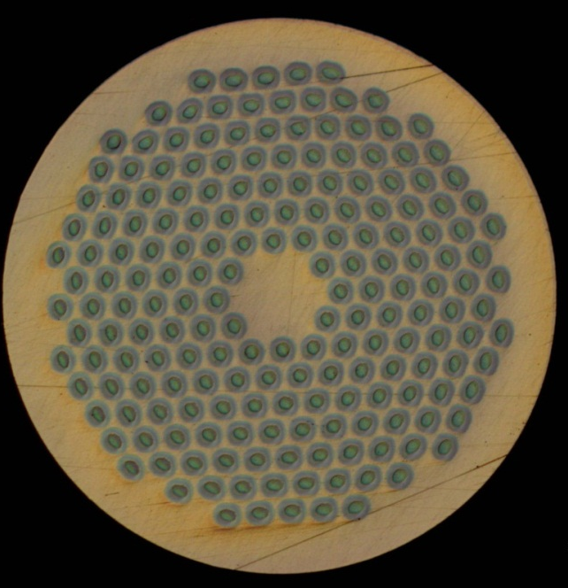

Practical superconductors
Typical operation parameters
(for a 0.85 mm diameter strand)
By P. Ferracin
Cu
Nb-Ti
Nb₃Sn
J_{e} ~ 5 A/mm²
I ~ 3 A
B = 2 T
J_{e} ~ 600-700 A/mm²
I ~ 300-400 A
B = 8-9 T
J_{e} ~ 600-700 A/mm²
I ~ 300-400 A
B = 12-13 T

Slide 21
Strand: multifilament wire
Superconducting materials are produced in small filaments and surrounded by a stabilizer (typically copper) to form a “multi-filament wire” o “strand”
Why small filaments are needed?
  Stability (flux jumps)
  Magnetic field quality
    Persistent currents
    Inter-filament coupling currents
Why are they embedded in a copper matrix?
  Protection, to redistribute the current in case of quench

Slide 22
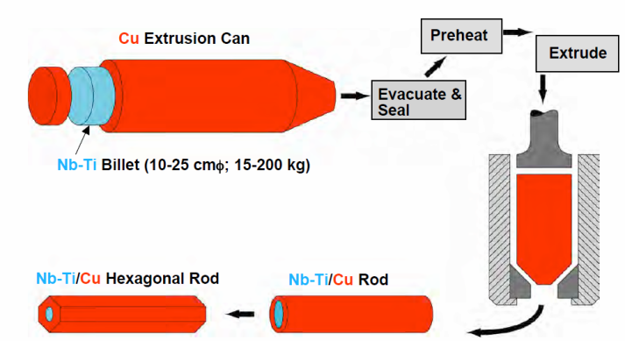
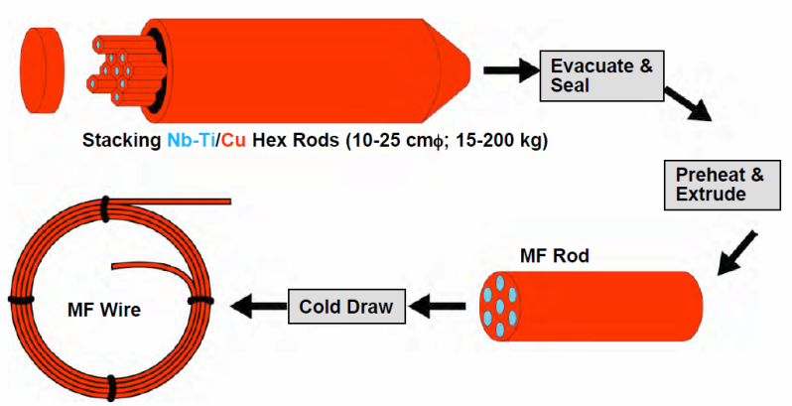
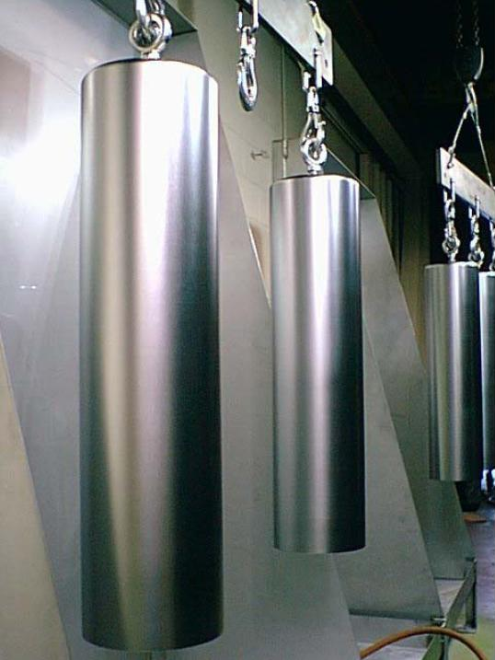
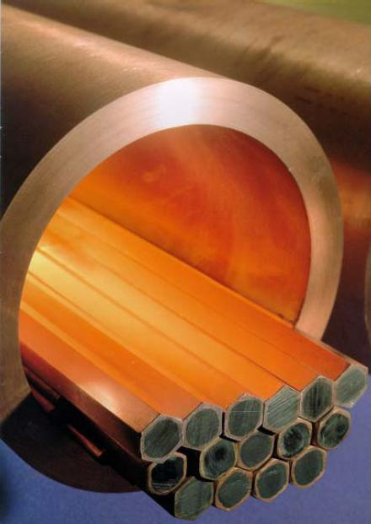
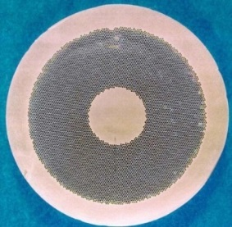
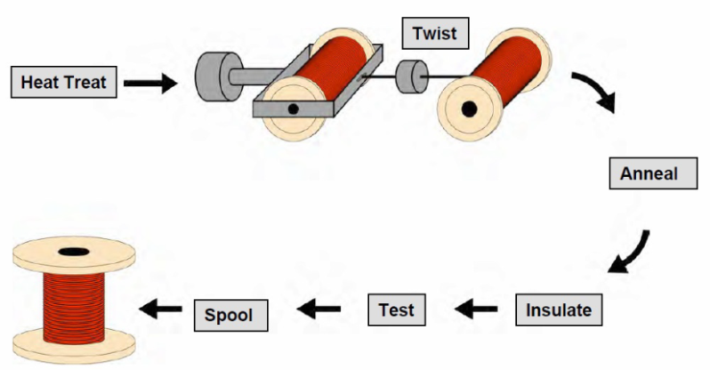
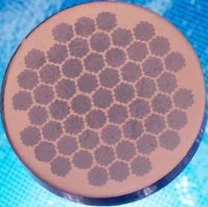
Strand: Manufacturing process (NbTi)
Nb-Ti ingots
  200 mm ∅, 750 mm long
Monofilament rods are stacked to form a multifilament billet
  then extruded and drawn down
  can be re-stacked: double-stacking process

Slide 23
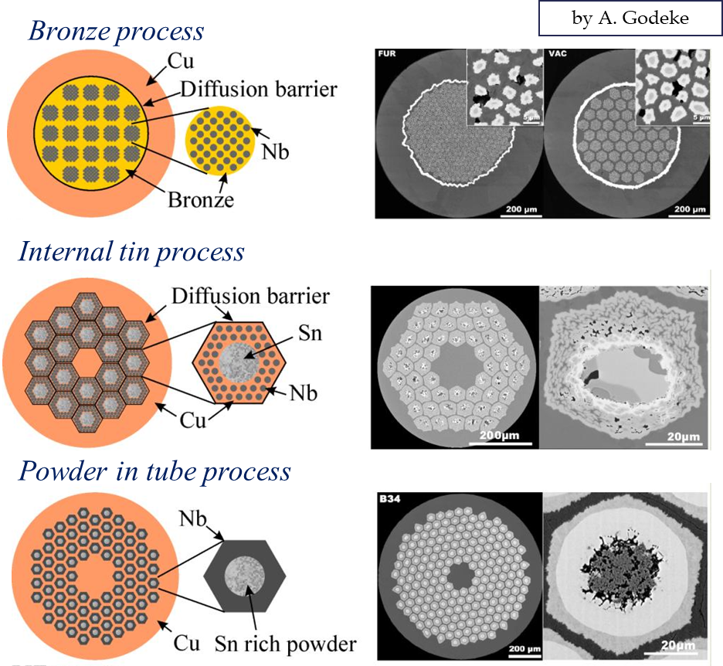
Strand: Manufacturing process (Nb₃Sn)
Since Nb₃Sn is brittle
  It cannot be extruded and drawn like Nb-Ti. It must be formed at the end of the fabrication of the cable (or the coil).
Process in several steps
  Fabrication of the wire, assembling multifilament billets from with Nb and Sn separated. Different processes tried in industrial scale (bronze process, internal tin process, powder in tube process)
  Fabrication of the cable
  Fabrication of the coil. Two different techniques:
      Wind & react” (more common). First coil winding and then formation of Nb₃Sn
      “React & wind”. First formation of Nb₃Sn and then coil winding
  Reaction. Heating to about 600-700 C in vacuum or inert gas (argon) atmosphere, and the Sn diffuses in Nb and reacts to form Nb₃Sn.

Slide 24
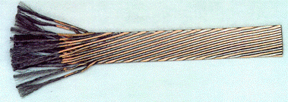
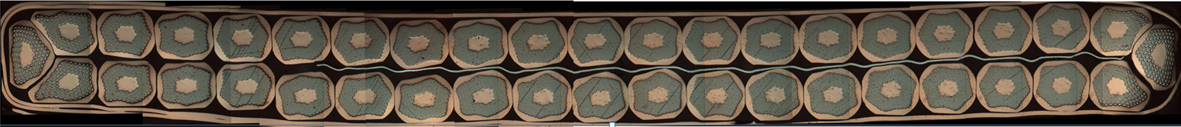
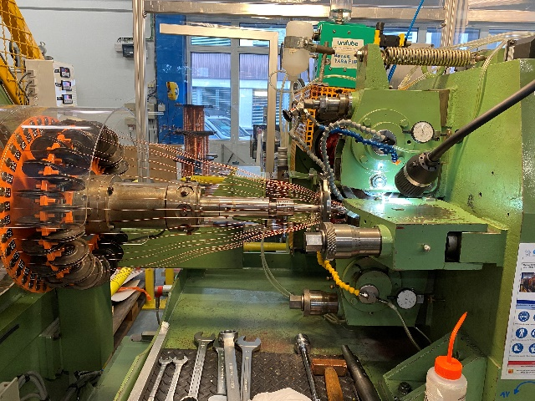
The cable
Most of the superconducting coils for particle accelerators wound from a multi-strand cable (Rutherford cable). The strands are twisted to
  Reduce inter-strand coupling currents
    Losses and field distortions.
  Provide more mechanical stability
  Current redistribution (in case a defect in one strand)
  Reduction the number of turns (easier winding, lower inductance)
  Reduction strand piece length
Strands wound on spools mounted on a rotating drum
Strands twisted around a conical mandrel into rolls
The rolls compact the cable and provide the final shape

Slide 25
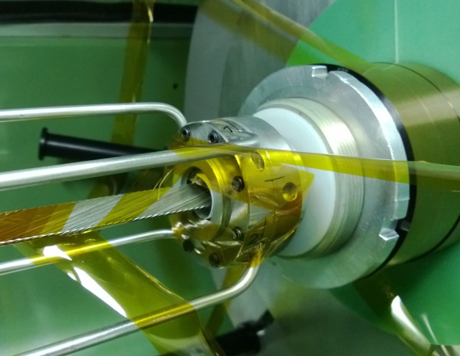
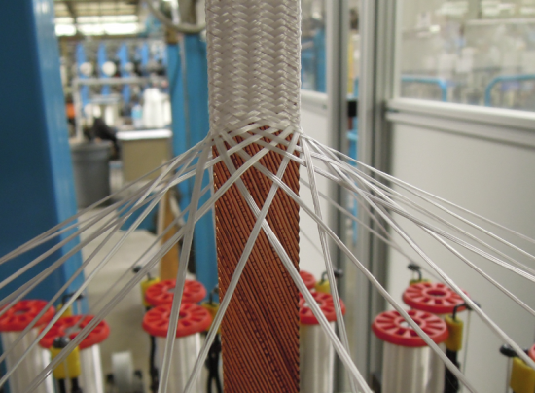
The cable insulation
The cable insulation must feature
  Good electrical properties to withstand turn-to-turn V after a quench
  Good mechanical properties to withstand high pressure conditions
  Porosity to allow penetration of helium (or epoxy)
  Radiation hardness
Polyimide insulation for Nb-Ti
Fiber glass insulation for Nb₃Sn

Slide 26
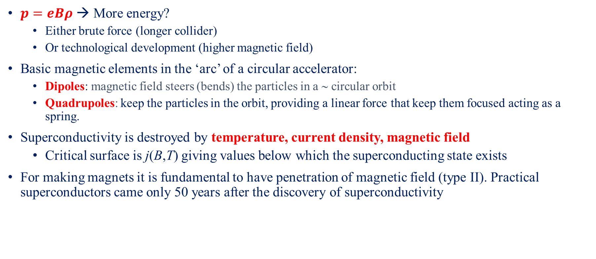
Summary
$p=eBρ$ → More energy?
  Either brute force (longer collider)
  Or technological development (higher magnetic field)
Basic magnetic elements in the ‘arc’ of a circular accelerator:
  Dipoles: magnetic field steers (bends) the particles in a ∼ circular orbit
  Quadrupoles: keep the particles in the orbit, providing a linear force that keep them focused acting as a spring.
Superconductivity is destroyed by temperature, current density, magnetic field
  Critical surface is j(B,T) giving values below which the superconducting state exists
For making magnets it is fundamental to have penetration of magnetic field (type II). Practical superconductors came only 50 years after the discovery of superconductivity

Slide 27
Summary
Strand made from twisted filaments in a stabilizing matrix (stability, protection, field quality)
Cable is insulated (dielectric strength, mechanical robustness)
Cable made from twisted wires (stability, protection, field quality)

Slide 28
References
K.-H. Mess, P. Schmuser, S. Wolff, “Superconducting accelerator magnets”, Singapore: World Scientific, 1996.
Martin N. Wilson, "Superconducting Magnets", 1983.
Fred M. Asner, "High Field Superconducting Magnets", 1999.
P. Ferracin, E. Todesco, S. Prestemon, “Superconducting accelerator magnets”, US Particle Accelerator School, www.uspas.fnal.gov.
E. Todesco, “Masterclass -Design of superconducting magnets for particle accelerators”, https://indico.cern.ch/category/12408/
A. Devred, “Practical low-temperature superconductors for electromagnets”, CERN-2004-006, 2006.
Presentations from Luca Bottura and Martin Wilson

Slide 29
Outline
Part I
  Particle accelerators, magnets and the need of superconductors
  Magnetic design and coil fabrication
Part II
  Mechanical design and assembly
  Quench, training and protection
  Outlook, what brings the future

Slide 30
Introduction
The magnetic design is one of the first steps in the design of a superconducting magnet development
It starts from the requirements(from accelerator physicists, researchers, medical doctors…others)
A field shape: Dipole, quadrupole, etc
A field magnitude usually with low temperature superconductors from 5 to 20 T
A field homogeneity, uniformity inside a solenoid, harmonics in a accelerator magnet
A given aperture (and volume), some cm diameter for accelerator magnets, much more for detectors and fusion magnets

Slide 31
Magnetic design and coil
How do we create a perfect field?
How do we express field and its “imperfections”?
How do we design a coil to minimize field errors?

Slide 32

How to create a dipole field?
Perfect dipole: intercepting circle/ellipses
Within a cylinder carrying j₀, the field is perpendicular to the radial direction and proportional to the distance to the centre r:
Combining the effect of two intersecting cylinders
-J₀
+J₀
-J₀
+J₀
$$B_{y}=\frac{μ_{0}j_{0}r}{2}\left\{−r_{1}\cos{θ_{1}}+r_{2}\cos{θ_{2}}\right\}=−\frac{μ_{0}j_{0}}{2}w$$
But…
The aperture is not circular
Not easy to simulate with a flat cable
Similar proof for intercepting ellipses

Slide 33
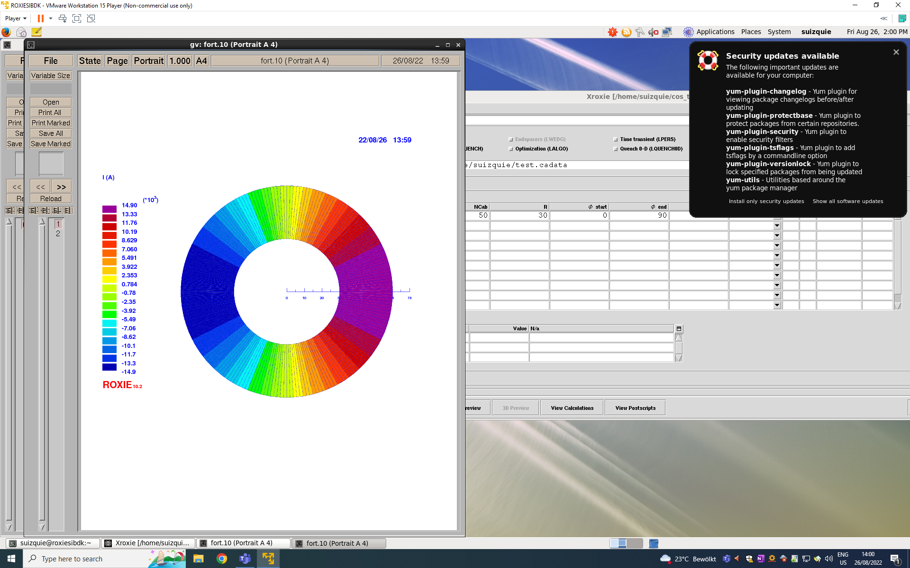
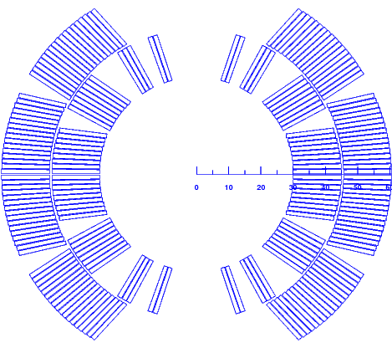
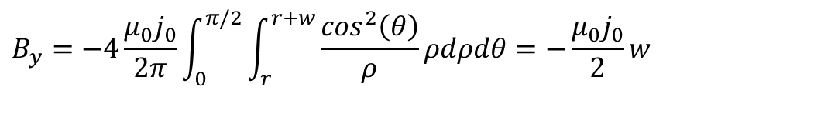

How to create a dipole field?
Perfect dipole: thick shell with cosθ current distribution
If we assume a current distribution proportional to the angle
j₀
r
w
$$j\left(θ\right)=j_{0}cos\left(θ\right)$$
0
The generated dipole field is
$$B_{y}=−4\frac{μ_{0}j_{0}}{2π}\int_{0}^{π/2}{\int_{r}^{r+w}{\frac{\cos^{2}\left(θ\right)}{ρ}}}ρdρdθ=−\frac{μ_{0}j_{0}}{2}w$$
-j₀
From ideal to practical configuration
In a dipole:
B ∝ current density (obvious)
B ∝ coil width w (less obvious)
B independent of the aperture r (surprising)
A bit easier to reproduce with a flat cable (Rectangular cross-section and constant J)
  More layers and wedges to reduce J towards the 90 degrees plane
  It will not be a perfect field…but it can be pretty close!

Slide 34
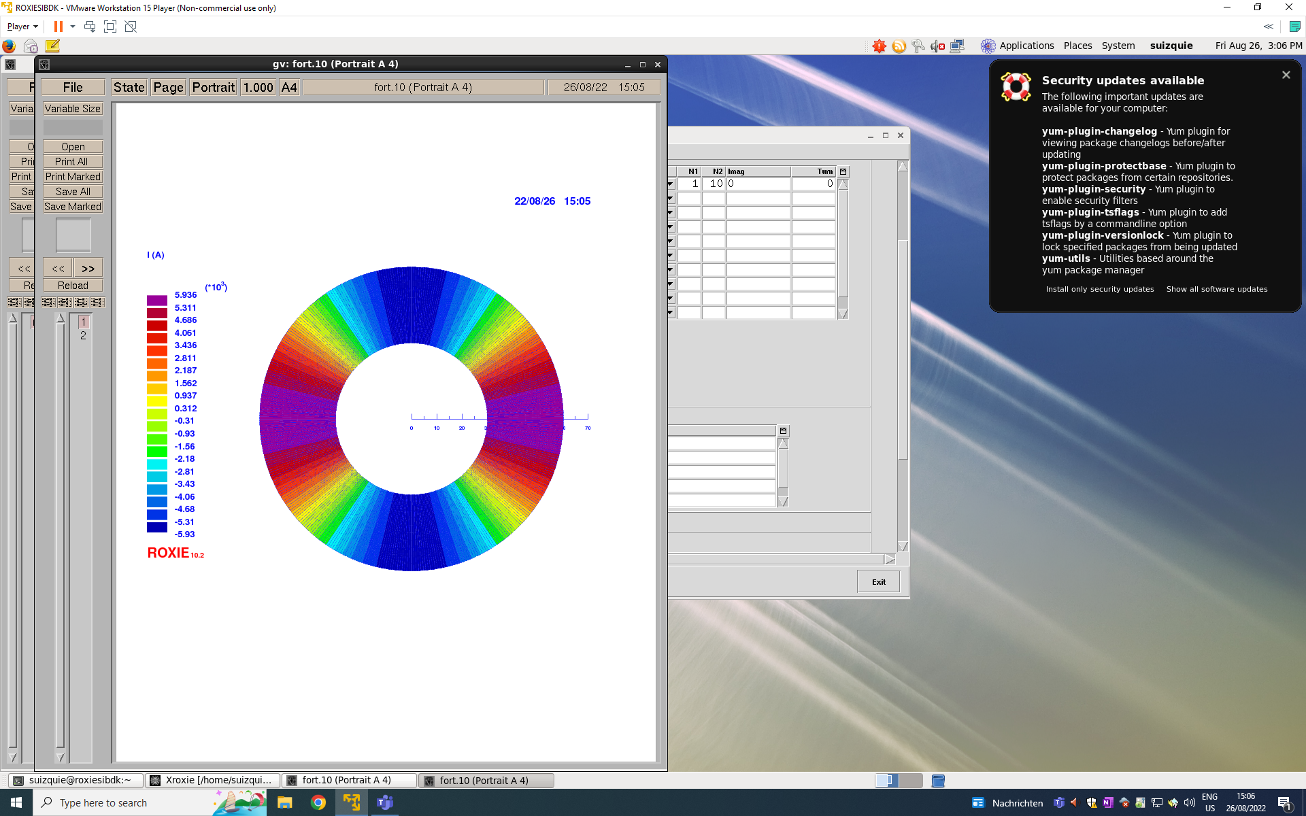
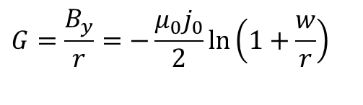
Perfect 2n-pole field
Four intercepting circles/ellipses and a cos2θ current distribution generate a perfect quadrupole field
j₀
$$G=\frac{B_{y}}{r}=−\frac{μ_{0}j_{0}}{2}ln⁡\left(1+\frac{w}{r}\right)$$
r
0
w
-j₀
And so on…
  Perfect sextupole: cos3θ or 3 intersecting ellipses
  Perfect 2n-poles: cos(nθ) or n intersecting ellipses

Slide 35
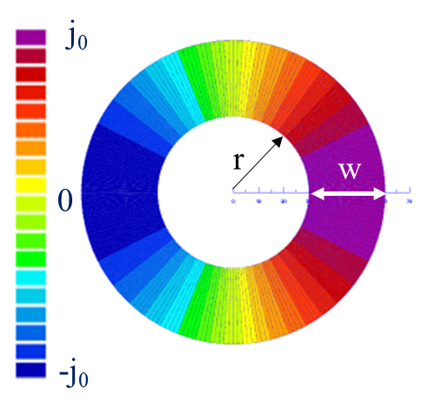
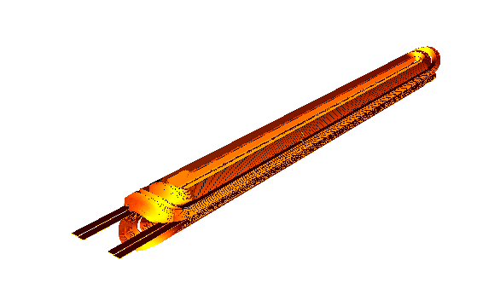
From ideal to real configurations
‘The solution’ to go from the ideal cosθ current distribution to a windable configuration → Approximation of the cos-theta layout by sectors with uniform current density
Now we can use the multipolar expansion to optimize our “practical” cross-section
  The first allowed harmonic in a dipole configuration is B₃
  The second allowed harmonic in a dipole configuration is B₅
  for α=π/3 (i.e. a 60° sector coil) one has B₃=0
  for α=π/5 (i.e. a 36° sector coil) or for α=2π/5 (i.e. a 72° sector coil)
  one has B₅=0

Slide 36

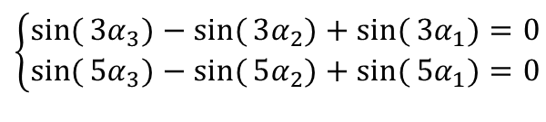


Dipole sector coils
With one sector, we can only set to zero one multipole
With two sectors, equations to set to zero B_{3,} B₅ and B₇
With three sectors, one can set to zero 5 multipoles
$$\left\{\begin{matrix}\sin{(}3α_{3})−\sin{(}3α_{2})+\sin{(}3α_{1})=0 \\ \sin{(}5α_{3})−\sin{(}5α_{2})+\sin{(}5α_{1})=0\end{matrix}\right.$$
$$α_{3}$$
  for instance (48°,60°,72°) or (36°,44°,64°) are solutions
$$α_{2}$$
$$α_{1}$$
~[0°-33.3°, 37.1°- 53.1°, 63.4°- 71.8°]

Slide 37
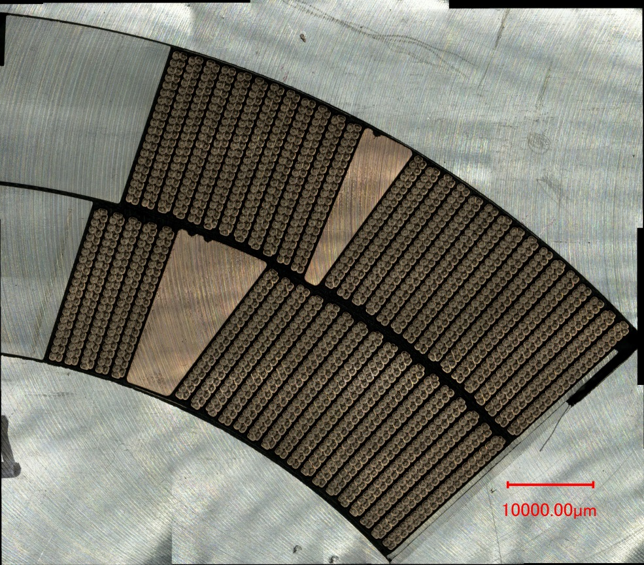
Coil fabrication
The coil: most critical component of a superconducting magnet
Cross-sectional accuracy of few tens of micrometers over ~15 m
Manufacturing tolerances (~30 µm on blocks position) are accounted as random components for field quality.
Cross section of a Nb₃Sn practice coil

Slide 38
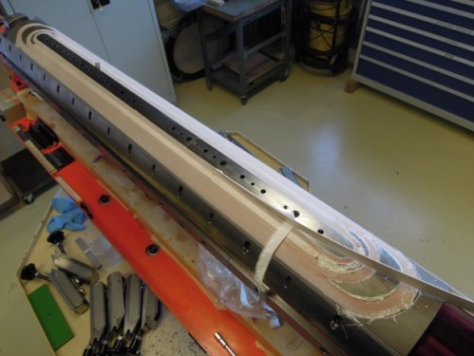
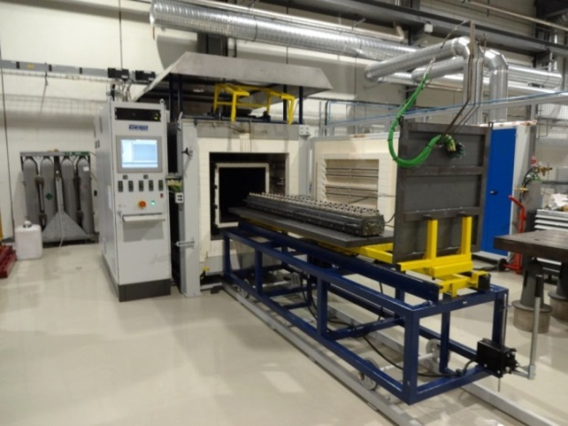

Coil fabrication (Nb₃Sn)
Winding & Curing
Reaction
Impregnation
The cable is wound around a pole on a mandrel.
A ceramic binder is applied and cured (T~ 150 C) to have a rigid body easy to manipulate.
Sn and Nb are heated to 650-700 C in vacuum or inert gas (argon) →Nb₃Sn
The cable becomes brittle
In order to have a solid block, the coil placed in a impregnation fixture
The fixture is inserted in a vacuum tank, evacuated → epoxy injected

Slide 39



Coil at different manufacturing steps
After curing
After reaction
After impregnation

Slide 40

The iron yoke
Keep the return magnetic flux close to the coils, thus avoiding fringe fields
In some cases the iron is partially or totally contributing to the mechanical structure
Considerably enhance the field for a given current density
The increase is relevant (10-30%), getting higher for thin coils
This allows using lower currents, easing the protection
11 T Double Aperture Magnet

Slide 41

Peak Field, Aperture Field and Margin
A material is superconducting below a given current, temperature and magnetic field, the so-called critical surface
The margin of a magnet is defined with respect to its weakest point, i.e. the peak field
What matters for the margin is the peak field in the coil, not the field in the aperture
B_{p} = 11.6 T
current density
(A/cm )
2
7
10
critical surface
6
10
10
5
4
B_{ap} = 11.2 T
10
3
5
10
5
10
T_{op}
10
15
15
20
20
Temperature
magnetic field
(K)
(T)

Slide 42
Margin
Among magnet engineers, a commonly used concept is the loadline margin
  The concept is always criticized (not physical) but never replaced: the success of a magnet judged on its ability of reaching the max performance
    LL_{margin} = 1−I_{𝑜𝑝}/I_{𝑆𝑆}
High field accelerator magnets typically are design to operate at ≈ 80% of the short sample level (20 % margin)
Operation point

Slide 43
Summary
B ∝ J∙w → Two ways to increase the field:
  Larger current density (up to a certain level, then hard limits in terms of stress and protection)
  Larger coils (cost)
The coil is most critical component of a superconducting magnet.
  Typically, 1/3 of the coil material is superconductor, 1/3 copper and 1/3 insulation/resin
The iron keeps the return magnetic flux and considerably enhances the field. In some cases it also has a mechanical function.
The margin of a magnet is defined with respect to its weakest point, i.e. the peak field

Slide 44
References
K.-H. Mess, P. Schmuser, S. Wolff, “Superconducting accelerator magnets”, Singapore: World Scientific, 1996.
Martin N. Wilson, "Superconducting Magnets", 1983.
Fred M. Asner, "High Field Superconducting Magnets", 1999.
S. Russenschuck, “Field computation for accelerator magnets”, J. Wiley & Sons (2010).
P. Ferracin, E. Todesco, S. Prestemon, “Superconducting accelerator magnets”, US Particle Accelerator School, www.uspas.fnal.gov.
E. Todesco, “Masterclass -Design of superconducting magnets for particle accelerators”, https://indico.cern.ch/category/12408/
A. Jain, “Basic theory of magnets”, CERN 98-05 (1998) 1-26
L. Rossi, E. Todesco, “Electromagnetic design of superconducting quadrupoles”, Phys. Rev. ST Accel. Beams 10 (2007) 112401.
L. Rossi and Ezio Todesco, “Electromagnetic design of superconducting dipoles based on sector coils”, Phys. Rev. ST Accel. Beams 9 (2006) 102401.
CAS 2023 on Normal and Superconducting Dipoles https://indico.cern.ch/event/1227234/

Slide 45
Thank you
For questions, don’t hesitate!
susana.izquierdo.bermudez@cern.ch

Slide 46
The strand: multifilament wire
WHY a multi-filament wire in a stabilizing matrix?
1. Flux jumps
Thermal disturbance → the local change in J_{c} → motion or “flux jump” → power dissipation
Stability criteria for a slab (adiabatic condition)
  a is the half-thickness of the slab
  j_{c} is the critical current density [A m⁻²]
  γ is the density [kg m⁻³]
  C is the specific heat [J kg⁻¹]
  θ_{c} is the critical temperature.
B_{c1}<B<B_{c2}
2. Quench protection
Superconductors have a very high normal state resistivity.
If quenched, could reach very high temperatures in few ms.
If embedded in a copper matrix, when a quench occurs, current redistributes in the low-resisitivity matrix → lower peak temperature
Cu
SC

Slide 47



The strand: multifilament wire
3. Persistent currents
When a filament is in a varying B_{ext}, its inner part is shielded by currents distribution in the filament periphery
They do not decay when B_{ex}is held constant → persistent currents
Strand magnetization
mT
by K.-H. Mess, et al.
External magnetic field
Tesla
These currents produce field errors that are particular important at low energy (when the beam is injected), which are proportional to the filament diameter (d_{sub}) and the current density.
$$M(B)∝d_{sub}{∙J}_{c}(B)$$
Allowable limits

Slide 48

The strand: multifilament wire
4. Inter-filament coupling
  When a multi-filamentary wire is subjected to a time varying magnetic field, current loops are generated between filaments.
  If filaments are straight, large loops with large currents → ac losses
  If the strands are magnetically coupled the effective filament size is larger → flux jumps
To reduce these effects, filaments are twisted
  twist pitch of the order of 20-30 times of the wire diameter.
by M. Wilson
by L. Bottura

Slide 49

Filling ratio and current density
Coil :
≈ 1/3 superconductor
≈ 1/3 copper
≈ 1/3 insulation
Engineering current density is the current divided by the strand area (Cu+sc)
Overall current density is the current divided by the total area (Cu+sc+ins)
Current density (A/mm²)
 | LHC-MB |  | 11 T DS
 | IL | OL
J_{sc} | 1259 | 1817 | 1655
J_{engineering} | 475 | 616 | 770
J_{overall} | 349 | 430 | 522

Slide 50
Maxwell equations
Maxwell equations for magnetic field
In absence of charge and magnetized material
  (inside a magnet)
If (constant longitudinal field), then
  x and y perpendicular to the beam (transverse coordinates), z along the beam

Slide 51
Analytic functions
If Maxwell gives
Cauchy-Riemann conditions
and therefore, the function B_{y}+iB_{x} is analytic
where C_{n} are complex coefficients
Advantage: we reduce the description of the field to a (simple) series of complex coefficients

Slide 52

Field harmonics
The field can be described as a (simple) series of complex coefficients, each coefficient corresponds to a “pure” multipolar field
Magnets usually aim at generating a single multipole
  Dipole, quadrupole, sextupole, octupole, decapole, dodecapole …
By K.-H. Mess et al.

Slide 53
Field harmonics
The field harmonics are rewritten as
  We factorize the main component (B₁ for dipoles, B₂ for quadrupoles)
  We introduce a reference radius R_{ref} to have dimensionless coefficients (usually chosen as 2/3 of the aperture radius)
  We factorize 10⁻⁴ since the deviations from ideal field in superconducting magnets for particle accelerators have to be ∼0.01%
The coefficients b_{n}, a_{n} are called normalized multipoles
  b_{n} are the normal, a_{n} are the skew (adimensional)

Slide 54

Considerations on margin
For Nb₃Sn and Nb-Ti the temperature margin depends only on the loadline margin and very weakly on the field.
For a given a material and an operational temperature, load line margin and temperature margin are equivalent
For a given LL margin, Nb₃Sn T margin is about 2.5 times greater than NbTi T margin
Temperature margins at 20% on loadline
Operational temperature | 1.9 K | 4.2 K
Nb-Ti | 2.1 K | 1.2 K
Nb₃Sn | 4.5 K | 3.0 K

Slide 55

Practical superconductors
Critical current density in the superconductor versus field for different materials at 4.2 K [P. J. Lee, et al]
https://nationalmaglab.org/images/magnet_development/asc/plots/JeChart041614-1022x741-pal.png

Slide 56











Notable Progress with REBCO
The late 2010s have seen key milestones reached with
REBCO high-field solenoids
  NHMFL 32 T hybrid solenoid, 32 mm aperture.
  Bruker BioSpin 1.2 Ghz NMR, 28.2 T
  hybrid solenoid 54 mm aperture.
  MIT/SUNAM/NHMFL, 26 T all-REBCO NI 35 mm apert.
REBCO magnets for commercial fusion
  MIT and Commonwealth Fusion Systems CFS
  all-REBCO Toroidal-Field Model Coil (TFMC),
  1.6x2.6 m, 20 T on conductor.
  lately, Central-Solenoid Model Coil (CSMC):
  windability and ramped operation, 1.2 m ID, 5.7 T.
Long-term operation still to prove: degradation on leads and
heaters in NHMFL magnet and a burn-out quench in TFMC

Slide 57





REBCO Market Growth
To date supply comes mostly from Asia, with only one supplier in Europe (Teva).
But the market is dynamic and new actors appear every year.
Citation from Faraday Factory talk at
CCA workshop
Fusion creates demand, promotes capacity; large volume drives the cost down.
HTS price halves with every 10-fold volume increase
Other applications will DO benefit
    [B. Song, et al., https://indico.cern.ch/event/1347361/ (2025)]
    [A. Molodyk, https://indico.cern.ch/event/1347361/ (2025)]

Slide 58







HTS R&D Directions
A. Conductor Choice:
  RD: Develop REBCO tape technology in view of accelerator needs.
  RD: Monitor developments in BSCCO technology closely in cooperation with US-MDP.
  RD: Study potential of IBS round wire conductor in
  view of competitive specifications and timeline.
B. HTS magnet specifications and requirements:
  RD: In an iterative process that involves all relevant subsystems (with particle physics, cryogenics, beam dynamics, feedback systems, powering/protection, instrumentation, vacuum, beam-induced losses, etc), determine HTS magnet specifications and requirements.
Value | Range (to be negotiated with …)
Main field | 14-20 T (cost, sync. rad., cryo, physics)
Operating temp | 4.2-20 K (cost, cryo)
Field quality (accuracy, stability, reproducibility) | Traditionally rel. errors 10⁻⁴ (beam-dynamics and feedback)
Ramp losses | 10-100 J/m.cycle? (cryo, sustainability)
Outer diam | 800 mm
Cryo interface | High-pressure, high-massflow supercritical He?
Vacuum interface | 4.5 K cryo-pumping liner for 20 K magnets?
Enthalpy Margin | 0.1-1 J/cm³ (cryo and beam-losses)
Protection | Max. temp. and volt. – or quench prevention?
Operating current | >10 kA? (powering and protection)

Slide 59





HTS R&D Directions
C. HTS magnet technology:
  RD: Develop and validate a cable for REBCO accelerator magnets.
  RD: Determine how to wind and insulate, mechanically load, cool, and protect REBCO dipoles.
  RD: Demonstrate accelerator quality at an intermediate field level and short length, before scaling up to nominal field.
WP Leader A. Ballarino
A. Baskys, D. Perini
Magnetic flux density [T]
Dipole demonstrator (no aperture) with 5.58 T central field with electrically insulated cable from REBCO tape-stack. Quenched with no degradation.

Slide 60



HTS R&D Directions
C. HTS magnet technology:
  RD: Develop and validate a cable for REBCO accelerator magnets.
  RD: Determine how to wind and insulate, mechanically load, cool, and protect REBCO dipoles.
  RD: Demonstrate accelerator quality at an intermediate field level and short length, before scaling up to nominal field.
WP Leader T. Lecrevisse
Metal-insulated double racetrack demonstrator (no aperture) magnet reached 5.1 T in 4.2 K and quenched without degradation.

Slide 61
Timeline for HTS
Target: 2035 a proof of a short model dipole with all features for FCC
  Aperture, field ≥14T, field quality, protection, …
Development of LTS and HTS technology in parallel at least until 2035.
Selection of cable and
insulation technology.
Partial demonstration
of accelerator specs.
FEASIBILITY
Reproducibility and first scaling in length
SCOPING
Short model ≥14 T
PROTOTYPING
PRE-SERIES
CANAVASSING
Demonstrators to select cable
and coil design
Proof of short model
with all requirements
Proof of reproducibility
and first long magnets
INDUSTRIALIZATION
`25
`26
`27
`28
`29
`30
`31
`32
`33
`34
`35
`36
`37
`38
`39
`40
`41
`42
`43
`44
`45
`46
`47
`48
`49
`50
`51
`52
`53
`54
RunIII
HL-LHC RunIV
HL-LHC RunV
HTS timeline for FCC-hh [FCC FS midterm report, August 2023, B. Auchmann, et al.]
23/06/2025
High Field Magnets – Open Symposium ESPP, Venice

Slide 62










IBS State of the Art
Iron-based superconductors (IBS) were discovered in 2008 in Japan. The Ba-122 variant was found shortly thereafter in Germany.
IBS Ba-122 is being developed towards and industrial product by the Chinese Academy of Science for SppC magnets. IBS status:
Bc2 ∼70 T @ 20 K, Tc ∼ 38 K
Lower Anisotropy than REBCO
Potentially low cost
Wind&react conductor
Performance increase x4 since 2016.
Another x3-4 from IBS@4.2 K to REBCO@20 K.
For the time being, IHEP (Beijing) develops hybrid accelerator magnets with Nb₃Sn and REBCO.
CNR-SPIN in the HFM Programme performs
R&D from powder synthesis to
multi-filamentary PIT wires.
IBS SotA:
420 A/mm²
@ 10 T, 4.2 K
[A. Ballarino, presented at the LDG Mtg and Acc. R&D Workshop at BNL, June 5, 2024]
[Q. Xu, High Performance and Cost-Effective Superconducting Accelerator Magnet R&D at IHEP, Submission 49 to ESPP]
[A. Ballarino, Progress towards HTS HFM Magnets and Conductor Strategy, https://indico.cern.ch/event/1408515/timetable/]
[A. Malagoli, Progress on development of iron based superconducting wire, https://indico.cern.ch/event/1471305/timetable/]

