Slide 1
CERN Summer Student Lecture - 2025
Accelerator Technology Challenges: Superconducting magnets (2/2)
Susana Izquierdo Bermudez
(susana.Izquierdo.Bermudez@cern.ch)
European Organization for Nuclear Research (CERN)

Slide 2
Outline
Part I
Particle accelerators, magnets and the need of superconductors
Magnetic design and coil fabrication
Part II
Mechanical design and assembly
Quench, training and protection
Outlook, what brings the future

Slide 3


Mechanical design
In the presence of a magnetic field B, an electric charged particle q in motion with a velocity v is acted on by a force F_{L} called electro-magnetic (Lorentz) force [N]:
A conductor element carrying current density J (A/mm²) is subjected to a force density f_{L} [N/m³]
Some examples (values per aperture):
$${\vec{F}}_{L}=q\vec{v}×\vec{B}$$
$${\vec{f}}_{L}=\vec{J}×\vec{B}$$
Nb-Ti LHC MB (8.3 T)
F_{x} = 340 t per meter
F_{z} = 27 t
Nb₃Sn DS dipole (11T)
F_{x} = 620 t per meter
F_{z} = 47 t

Slide 4
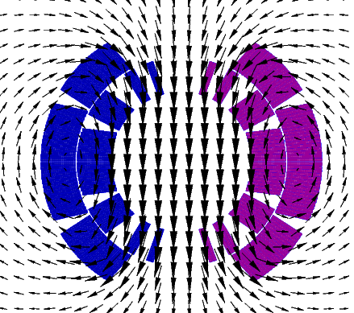
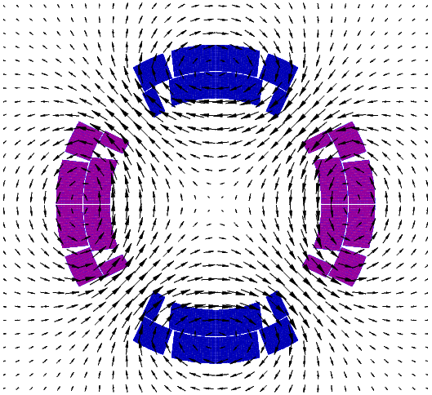
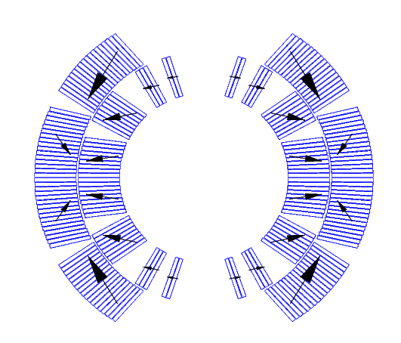
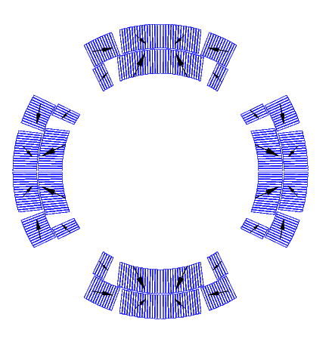
Electro-magnetic force
The e.m forces in a dipole/quadrupole magnet tend to push the coil
Towards the mid-plane in the azimuthal direction
Outwards on the radial direction.

Slide 5
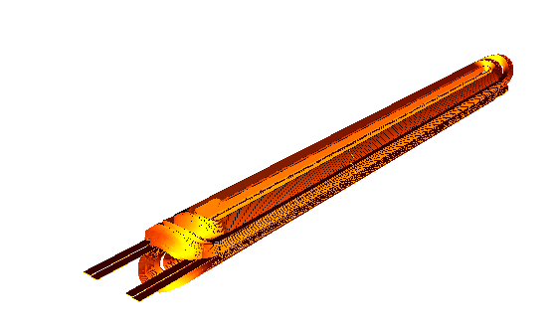
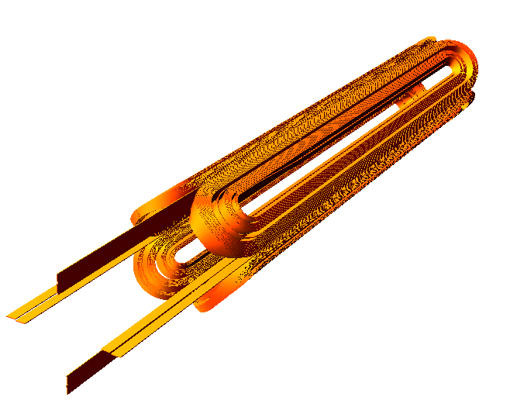
Electro-magnetic force
In the coil ends, the electromagnetic forces tend to push the coil outwards in the longitudinal direction (F_{z} > 0)
Fz
Fz
Fz
Fz
11 T dipole for HL-LHC
MQXF quadrupole for HL-LHC

Slide 6



Electro-magnetic force
The x/y e.m. force on a dipole coil varies
with the square of the bore field
Linearly with the bore radius (a)
The axial e.m. force on a dipole coil varies
with the square of the bore field
with the square of the bore radius
$$F_{x}=\frac{B_{y}^{2}}{2μ_{0}}\frac{4}{3}a$$
$$F_{y}=−\frac{B_{y}^{2}}{2μ_{0}}\frac{4}{3}a$$
Approximation of thin shell dipole, see how to derive the equations in [2]
$$F_{z}=\frac{B_{y}^{2}}{2μ_{0}}2πa^{2}$$
See how to derive the equation in [2]

Slide 7
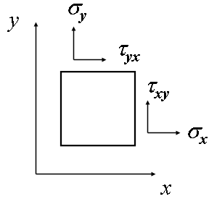
Stress and strain - definitions
A stress σ or τ [Pa] is an internal distribution of force [N] per unit area [m²].
When the forces are perpendicular to the plane the stress is called normal stress (σ) ; when the forces are parallel to the plane the stress is called shear stress (τ).
Stresses can be seen as way of a body to resist the action (compression, tension, sliding) of an external force.
A strain ε (δl/l₀) is a forced change dimension δl of a body whose initial dimension is l₀.
A stretch or a shortening are respectively a tensile or compressive strain; an angular distortion is a shear strain.

Slide 8
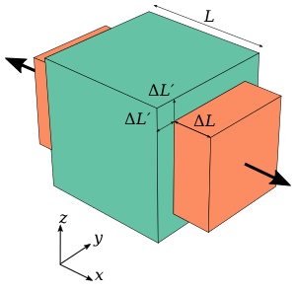
Stress and strain - definitions
The Elastic modulus (or Young modulus, or modulus of elasticity) E [Pa] is a parameter that defines the stiffness of a given material. It can be expressed as the rate of change in stress with respect to strain (Hook’s law):
The Poisson’s ratio ν is the ratio between “axial” to “transversal” strain. When a body is compressed in one direction, it tends to elongate in the other direction. Vice versa, when a body is elongated in one direction, it tends to get thinner in the other direction.
E = σ / ε
ν = -ε_{trans}/ ε_{axial}
A cube with a Poisson's ratio of 0.5, courtesy of Wikipedia

Slide 9
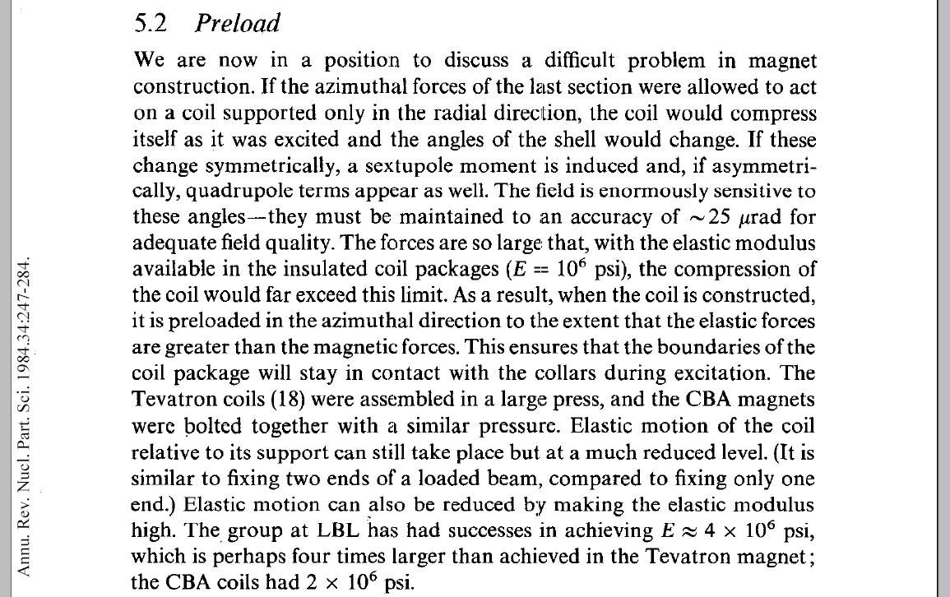
Pre-stress
The prestress paradigm is that coil should never be in tension but always precompressed (as reinforced concrete)
The initial reasons for this paradigm were field quality concerns: change of b₃ (A. Tollestrup, Ann. Rev. Sci. 1984, father of Tevatron magnets and collared structure)
Later, it was believed that the detachment provokes training – and this is what many of us think still today
The paradigm is always used in design and not always followed in reality
Typically, for the first models and prototypes one speaks of “conservative” loading, meaning that the preload is lower than what required to avoid pole unloading in operational conditions
The fear is to break something of degrade the conductor

Slide 10
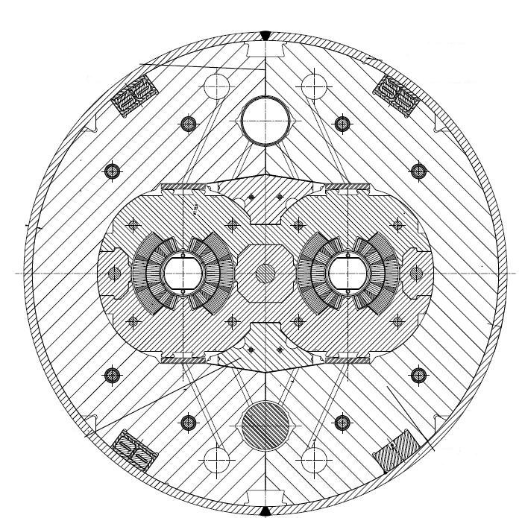
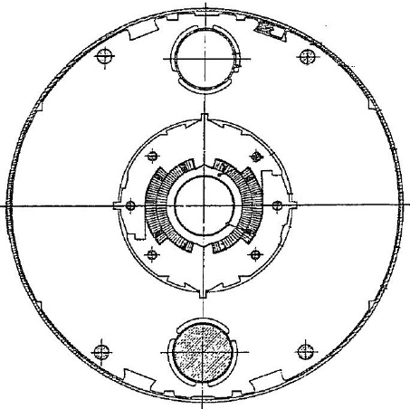
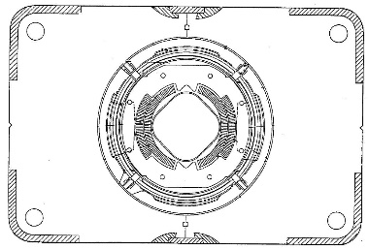
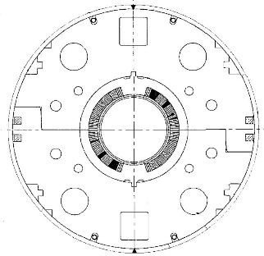
Superconducting dipoles (NbTi)
Tevatron
1983-2011
Bore: 76 mm
Field: 4.3 T
F_{x} = 0.5 MN/m
F_{z} = 78 kN
HERA
1991-2007
Bore: 75 mm
Field: 5.0 T
F_{x} = 0.6 MN/m
F_{z} = 87 kN
RHIC
2000-running
Bore: 80 mm
Field: 3.5 T
F_{x} = 0.3 MN/m
F_{z} = 48 kN
LHC
2008-running
Bore: 56 mm
Field: 8.3 T
F_{x} = 1.7 MN/m
F_{z} = 265 kN
F_{x} per quadrant/F_{z} per aperture

Slide 11
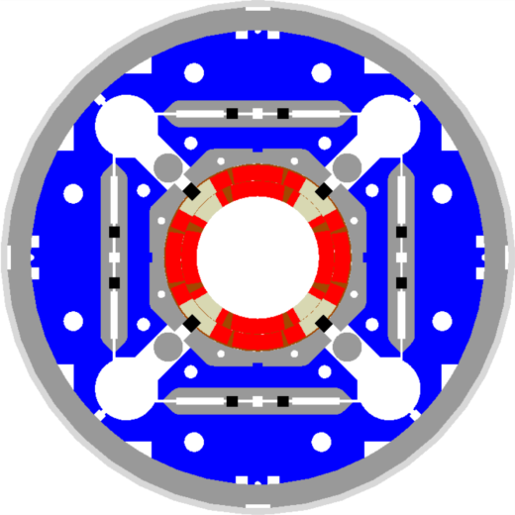
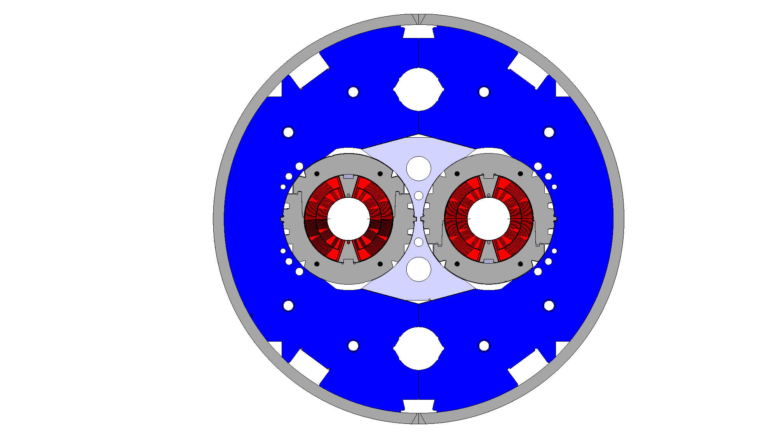
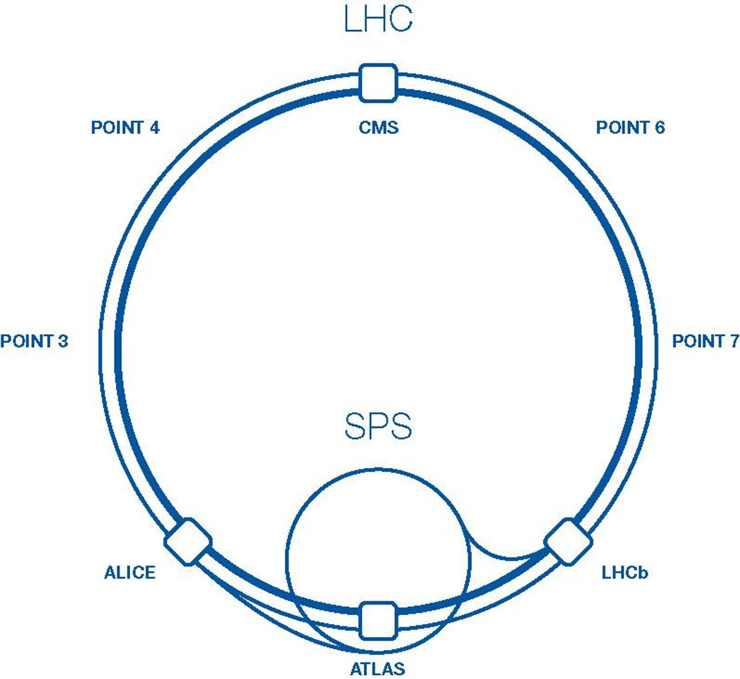
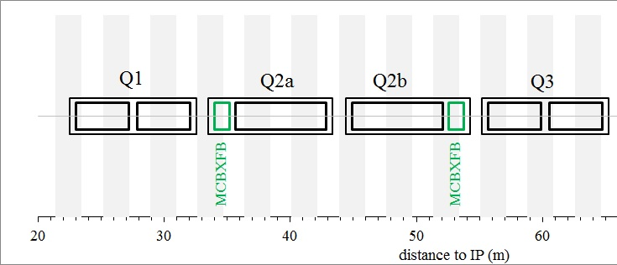
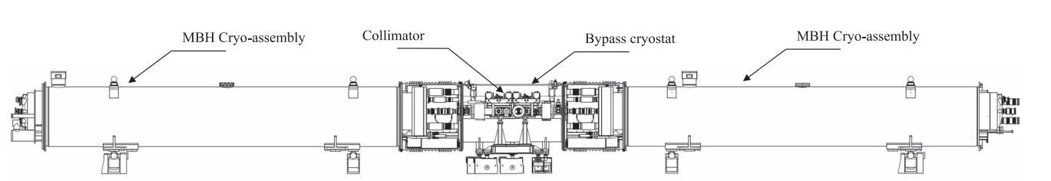
The HL-LHC Nb₃Sn magnets
MQXF
HL-LHC MBH 11 T
30 large aperture and more powerful quadrupoles around ATLAS and CMS to decrease the beam size and increase the integrated luminosity by a factor 10
Construction of pre-series and series magnets on-going, joint effort between CERN and US-AUP
4 pairs of shorter and more powerful dipole bending magnets to free up space for the new collimators (2x5.5 m length 11 T dipoles to replace 14.3-m-long LHC MB dipole)
Initially planned for 2020, now delayed
E. Todesco
F. Savary

Slide 12
The 12 T challenge – e. m. force
≈ 2 times more force/stress than in the LHC-MB dipoles, in a brittle conductor
LHC MB
NbTi, B_{p} = 8.6 T
F_{x} = 3.4 MN/m
σ_{θ,em} = 50-60 MPa
F_{z} = 265 kN
HL-LHC MBH 11 T
Nb₃Sn, B_{p} = 11.7 T
F_{x} = 7.2 MN/m
σ_{θ,em} = 100-110 MPa
F_{z} = 450 kN
HL-LHC MQXF
Nb₃Sn, B_{p} = 11.3 T
F_{x} = 6.8 MN/m
σ_{θ,em} = 100-110 MPa
F_{z} = 1200 kN
F_{x} per half magnet; F_{z} per aperture

Slide 13
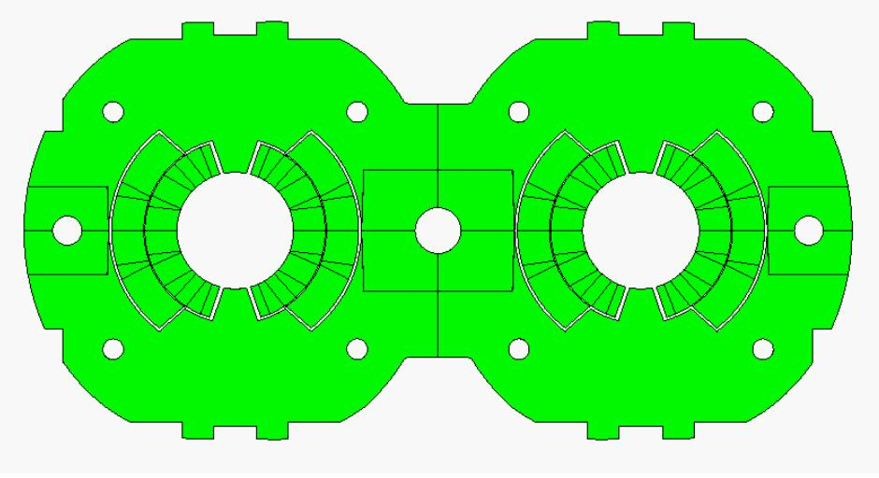
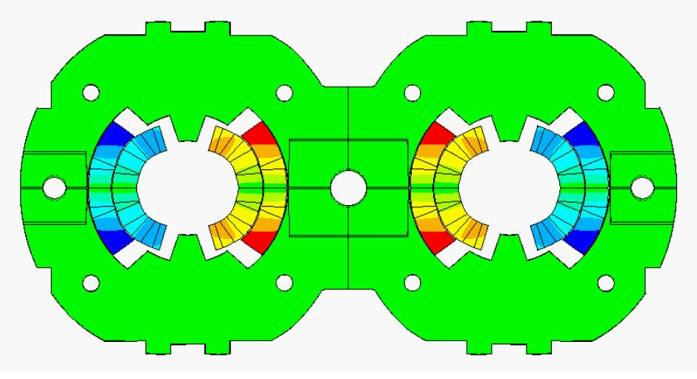
Deformation and stress
Effect of e.m forces
change in coil shape → effect on field quality
a displacement of the conductor → potential release of frictional energy
Nb-Ti magnets: possible damage of insulation at~150-200 MPa.
Nb₃Sn magnets: possible conductor degradation at about 150-200 MPa.
All the components must be below stress limits.
LHC dipole at 0 T
LHC dipole at 9 T
By P. Ferracin
Displacement scaling = 50

Slide 14
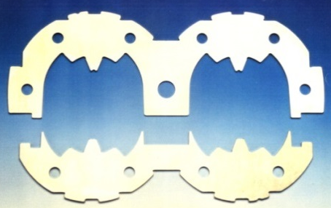
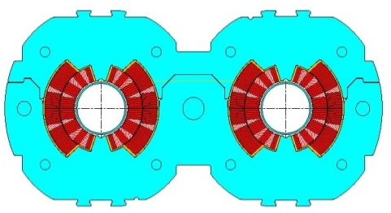
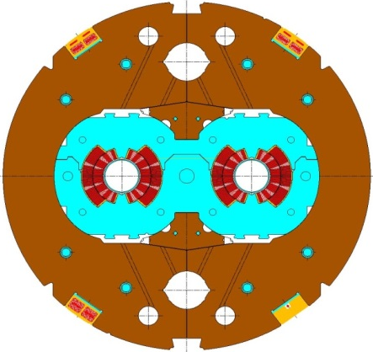
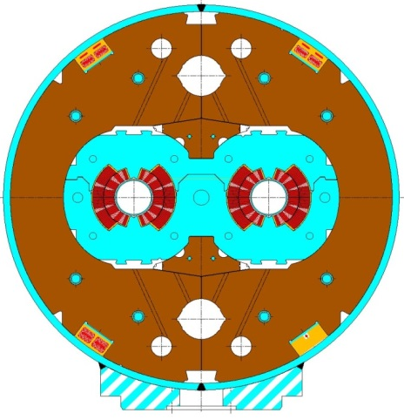
Overview of the coil stress
Collaring: By clamping the coils, the collars provide
coil pre-stressing;
rigid support against e.m. forces
precise cavity
Yoking: Ferromagnetic yoke around the collared coil provide
Magnetic function
Mechanical function (increase the rigidity of the coil support structure and limit radial displacement)
Alignment, assembly features…
Shell welding: two half shells welded around the coil to provide
Helium container
Additional rigidity
If necessary, the welding press can impose the desired curvature on the cold mass
By P. Ferracin

Slide 15
Overview of coil stress
4. Cool-down
Components shrink differently
Again, coil positioning within 20-50 μm
Significant variations of coil stress
5. Excitation
The pole region of the coil unloads
Depending on the pre-stress, at nominal field the coil may unload completely
All these contributions taken into account in the mechanical design:
Minimize coil motion (pre-stress)
Minimize cost and dimension of the structure
Maintain the maximum stress of the component below the plasticity limits
…and for (especially) Nb₃Sn coils, limit coil stress (150-200 MPa).

Slide 16
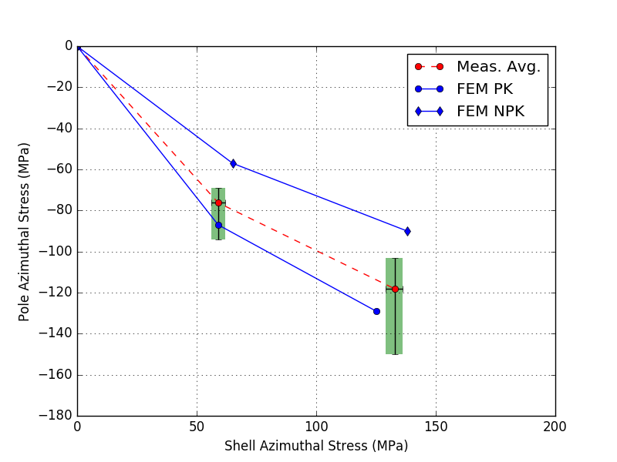
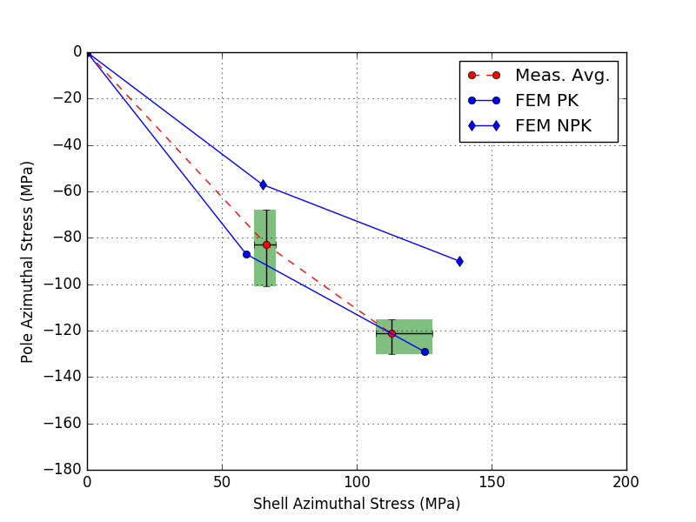
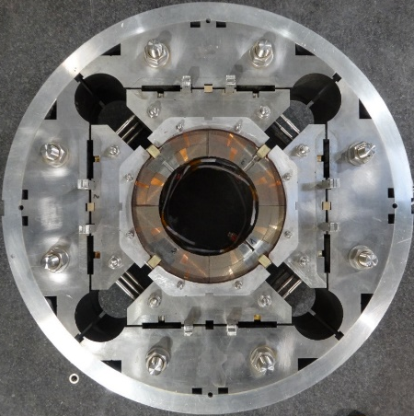
Al shell: MQXF in HL-LHC
Aluminum shell, bladder and key technology, prima for accelerators
During cool-down increase in coil/shell stress
Predictable stress variation → Capability to control final coil and shell stress
MQXFS4
MQXFS6

Slide 17
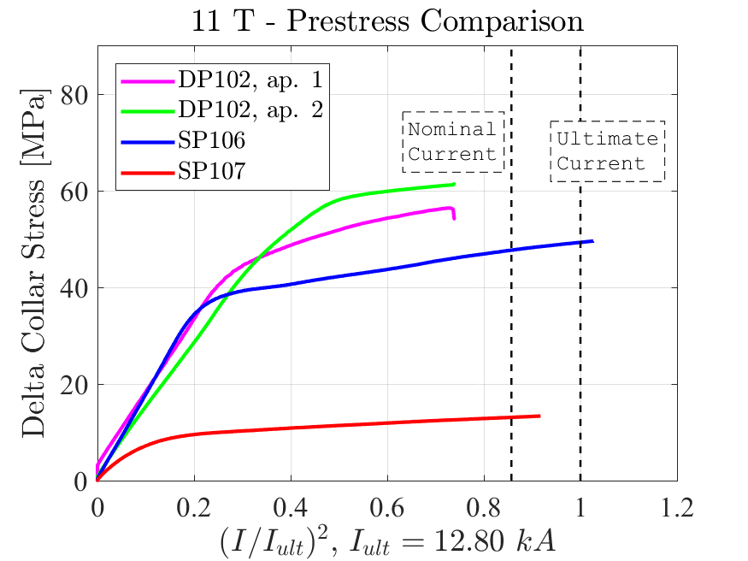
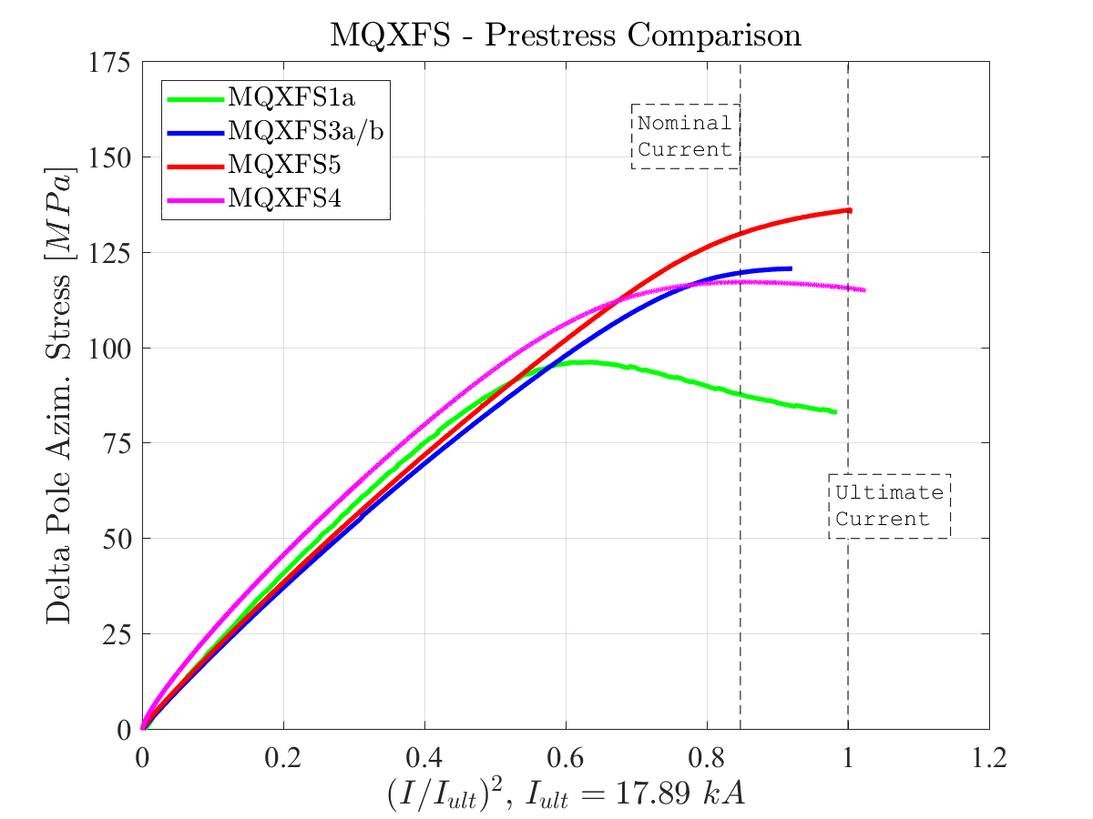
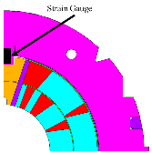
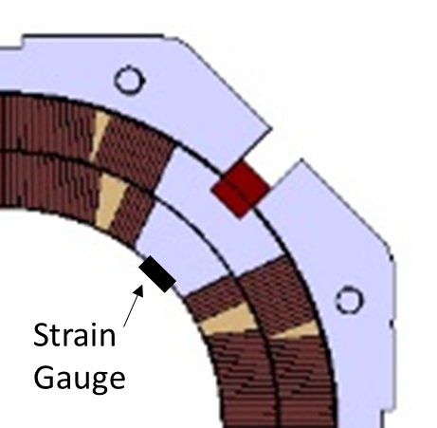
Pre-stress: HL-LHC Nb₃Sn magnets
This is the example of the MQXF and 11 T, the Nb₃Sn magnets for the HiLumi upgrade.
Strain gauges placed in the pole in MQXF, in the collar nose in 11 T. They allow seeing the pole unload
Estimated stress proportional to square of current (forces)
The end of the linear region implies a pole unloading, i.e. that the coil at the pole is not compressed any more
Reference pre-stress target for series magnets
Reference pre-stress target for series magnets

Slide 18
Pre-stress – MQXF example
MQXFS6b reached the MQXF record of 19.1 kA, 93% of short sample at 1.9 K
Reassembled with much lower preload
Nominal without training, ultimate reached after retraining, and kept after thermal cycle
Very good indication of wide preload window, reproducibility of performance after reassembly and thermal cycle
Apparent plateau above ultimate may indicate that larger preload is beneficial to reach 90% of short sample
Training of MQXFS6b&6c
Unloading during powering
of MQXFS6b&6c

Slide 19
Axial support
‘Two schools’ in terms of longitudinal support, with no consensus on the magnet community:
Limit the coil displacements due to electromagnetic forces by having a rigid structure in the longitudinal direction (LHC Dipole, MBH-11 T concept, end-plate welded to the shell)
Limit the coil displacements due to electromagnetic forces by having a rigid structure in the longitudinal direction and pre-load coil ends to compensate the axial forces and keep coil end turns under compression (MQXF, FRESCA2, concept, )

Slide 20
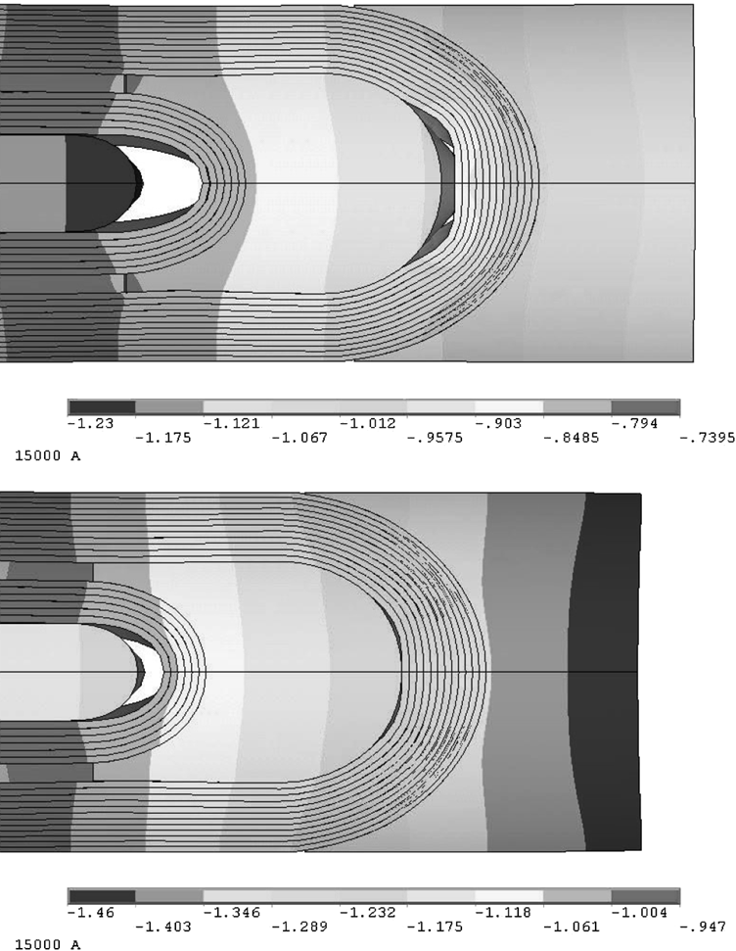
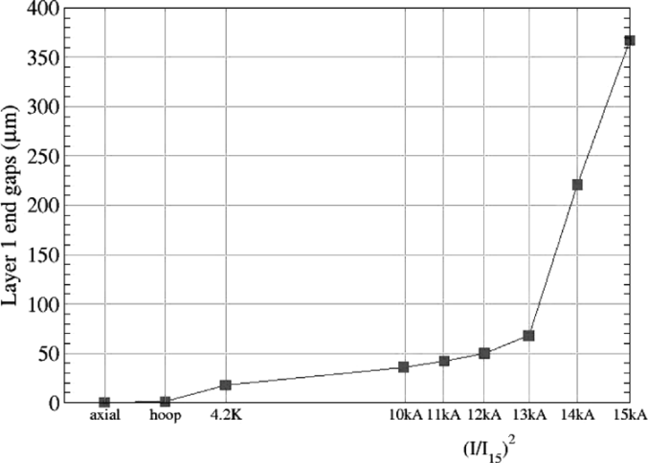
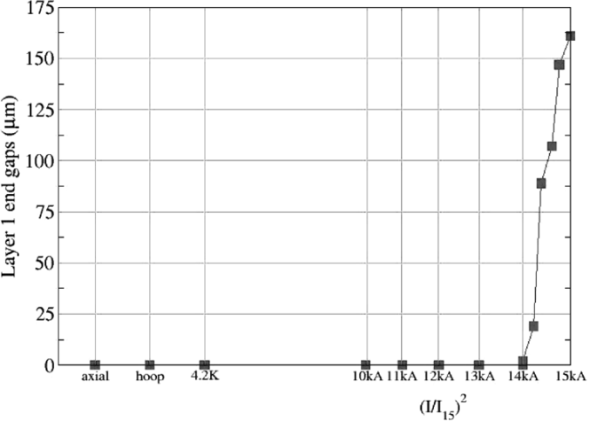
Axial support: force or not force?
Two type of axial displacements:
Relative movement of the coil with respect to the structure. It depends on the overall stiffness of the structure, i.e., independent of the level of pre-load in the ends.
Relative movement of the coil ends with respect to the pole. It depends on the level of pre-load.
This was extensively studied in LBNL, developing the rods - plate axial pre-load system we are currently using for MQXF
20
Axial displacements of inner layer’s (0.2 friction factor assumed).
Limited axial support (top) and full axial support (bottom).
S. Caspi, P. Ferracin., “Towards integrated design and modeling of high field accelerator magnets,” IEEE Trans. Appl. Supercond., vol. 16, no. 2, pp. 1298–1303, June 2006.

Slide 21
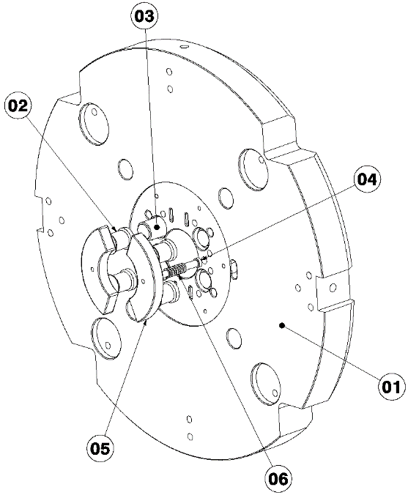
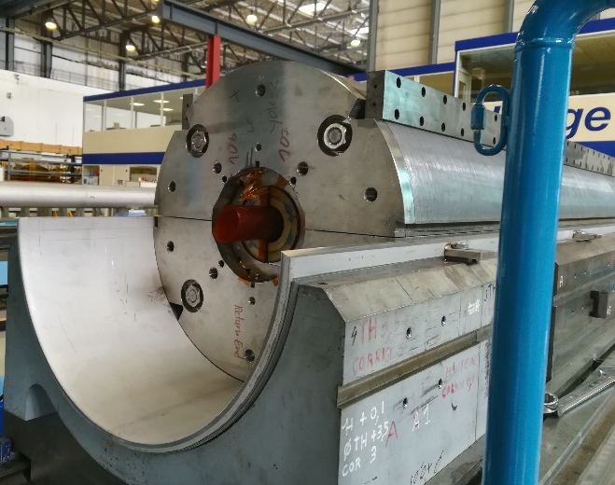
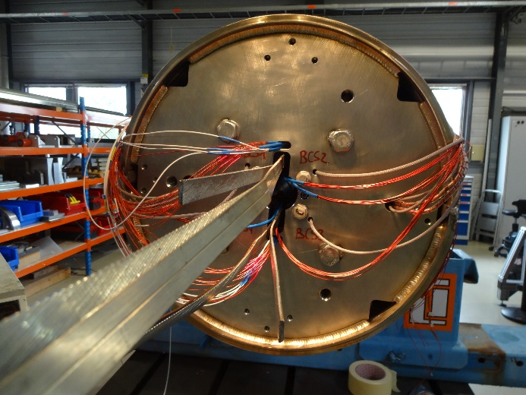
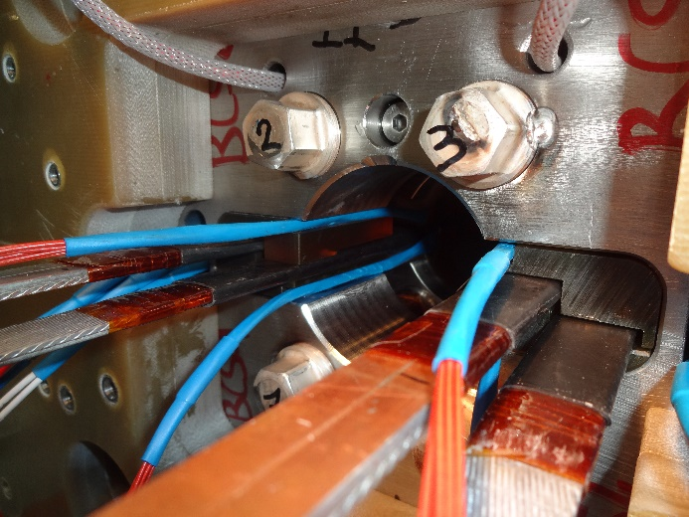
Axial support: welded end plate
We take as example the 11 T dipole for the HL-LHC
Slight pre-load at room temperature, to guarantee that there is still contact coil to end plate at 1.9 K.
Goal: limit the coil displacements providing a rigid lateral support
1in1 models:
43 mm thick end-plate, 12 mm stainless steel shell.
2in1 models:
75 mm thick end-plate, 15 mm stainless steel shell.

Slide 22
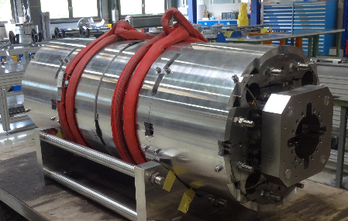
Axial support: rods and end-plate
We take as example the MQXF quadrupole for the HL-LHC
Direct connection between the motion of the rod and the one of the coil ends
Goal: keep the pole turn under compression during powering.
Short models (1.2 m):
Aluminum rods, 36 mm diameter
Nitronic 50 end plate, 75 mm thick
MQXFA (4.2 m):
Stainless steel rods, 32 mm diameter
Nitronic 50 end plate, 75 mm thick
MQXFB (7.15 m):
Stainless steel rods, 35 mm diameter
Nitronic 50 end plate, 75 mm thick
Measured delta in the rods during powering from 0 to I_{nom}
 | Rod Strain [µɛ] | Rod Stress [MPa] | Force [MN] | % of F_{em} at I_{nom} | Rod elongation [mm]
MQXFS | 75 | 6 | 0.02 | 2 | 0.12
MQXFA | 80 | 13 | 0.05 | 4 | 0.37
MQXFB | 80 | 16 | 0.06 | 5 | 0.60

Slide 23
Summary
We presented the force profiles in superconducting magnets. In dipole and quadrupole magnets, the forces are directed towards the mid-plane and outwardly.
They tend to separate the coil from the pole and compress the mid-plane region
Axially they tend to stretch the windings
The importance of the coil pre-stress has been pointed out, as a technique to minimize the conductor motion during excitation.
There are several ways of designing a support structure
The solution for a given magnet is not unique
Structures based on collars are the workhorse of Nb-Ti magnets
Guarantees adequate support to avoid deformation and allows giving azimuthal prestress
Aluminum shell structure guarantees that the peak pre-stress is reached in operational conditions
Introduced in LNBL, used in several Nb₃Sn. It has been scaled from 1-m-long to 3.4 m long magnets with LARP, and to 7.2 m long magnet in HL LHC MQXFB at CERN

Slide 24
References
[1] MJB Plus, Inc. “Superconducting Accelerator Magnets”, an interactive tutorial.
[2] Paolo Ferracin, USPAS - Superconducting Magnets for Particle Accelerators, Unit 10, 13 and 14 (available in https://indico.cern.ch/event/440690/ )
[3] Y. Iwasa, “Case studies in superconducting magnets”, New York, Plenum Press, 1994.
[4] M. Wilson, “Superconducting magnets”, Oxford UK: Clarendon Press, 1983.
[5] A.V. Tollestrup, “Superconducting magnet technology for accelerators”, Ann. Reo. Nucl. Part. Sci. 1984. 34, 247-84

Slide 25
Outline
Part I
Particle accelerators, magnets and the need of superconductors
Magnetic design and coil fabrication
Part II
Mechanical design and assembly
Quench, training and protection
Outlook, what brings the future

Slide 26
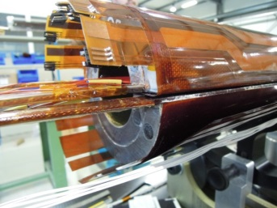

Quench definition
Quench = irreversible transition to normal state
Heat generation > cooling
Why do magnets quench?
Thermal energy released by
Mechanical events
Frictional motion
Epoxy cracking
Electromagnetic events
Flux-jumps ,AC loss
Thermal events
Degraded cooling
Nuclear events
Particle showers
What do we do when a magnet quenches?
thermal energy (redistribute the energy in the whole coil volume, joule heating)
Conversion magnetic energy
$$J^{2}η$$

Slide 27
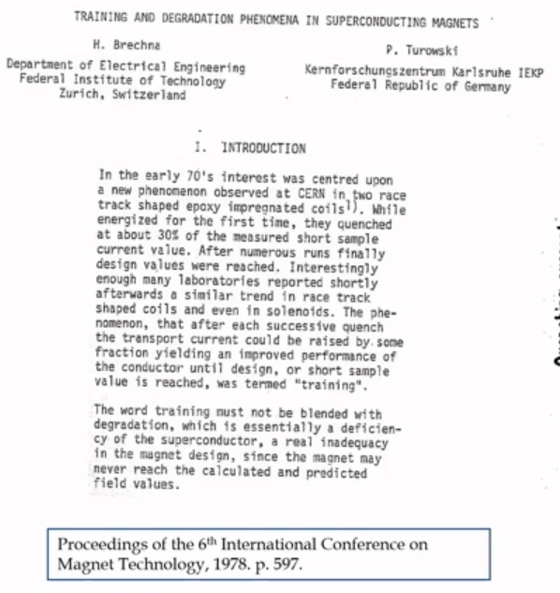
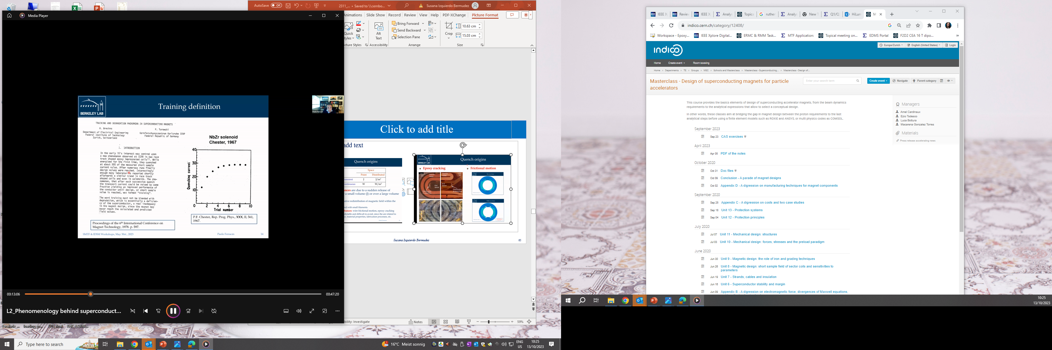
Training
Superconducting magnets typically quench before reaching their nominal performance, the so-called training
Training is characterized by two phenomena:
The occurrence of premature quenches
The progressive increase of the quench current
Irreversible change in the coil’s mechanical status
Somehow the magnet is ‘improving’ or getting better quench after quench
Mechanical induced quenches are considered the main causes of training in a superconducting magnet (frictional motion & epoxy failure)
Main features relevant for operation
The ability to reach the target current with adequate margin (virgin training)
The retraining expected during operation (i.e., memory after thermal cycle)

Slide 28
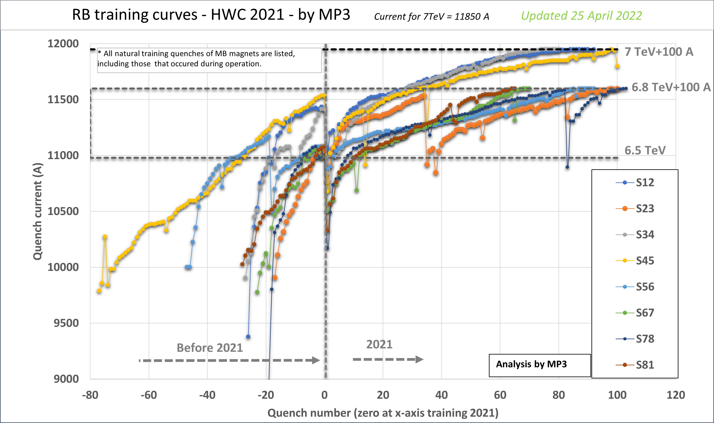
Training in the LHC
The LHC dipoles were assembled by three manufactures
All magnets tested at 1.9 K in SM18 before installation in the tunnel
All powered above nominal (11850 A, 7 TeV)
About 50 % powered to ultimate (8 % more than nominal, 12850 A)
Less than 10 % went through thermal cycle (biased sample)
Magnet not reaching 12850 A with 9 quenches were tested after thermal cycle
Bonus strategy: magnets reaching ‘rapidly’ ultimate were given a bonus
Training of LHC sectors to 6.5 TeV
Memory after cycle is important to avoid training in the accelerator (time consuming, i.e., $$$$).
In the LHC we have 1232 magnets, connected in series in 8 circuits (i.e., 154 magnets per circuit)
If every magnet needs to quench once to reach nominal → 154 quenches per sector, and we can do only 2-3 quenches per day → training in the machine is very expensive and that is why memory after thermal cycle is VERY important!
In general, memory is better in Nb₃Sn than in NbTi

Slide 29
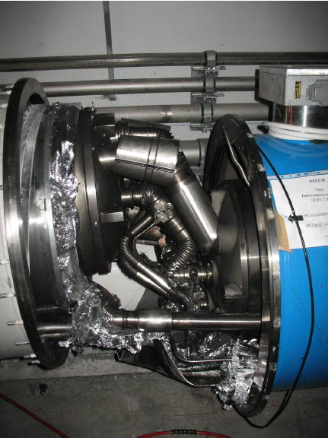
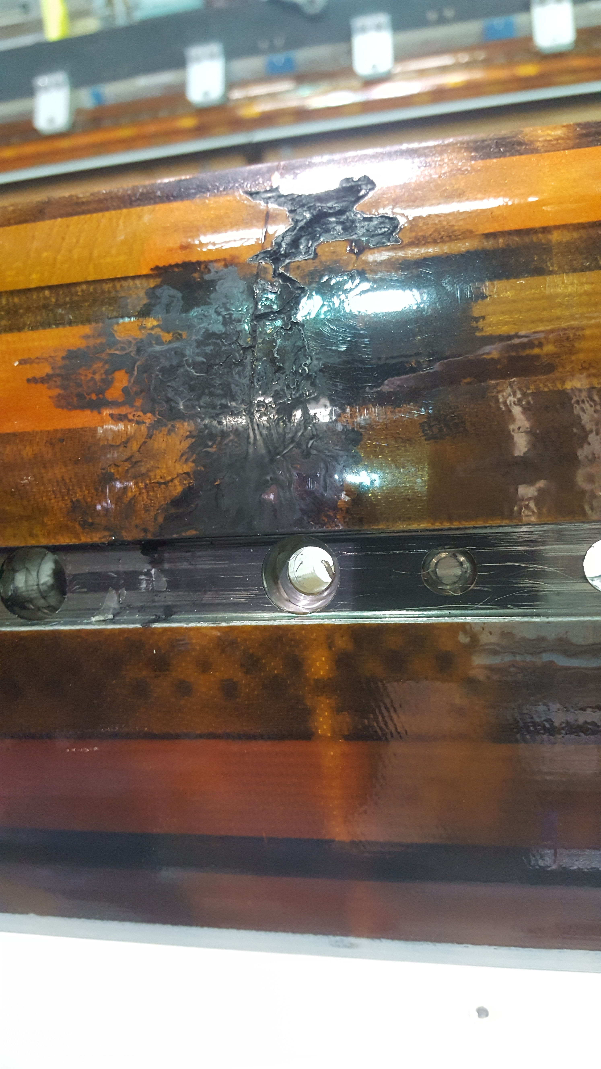
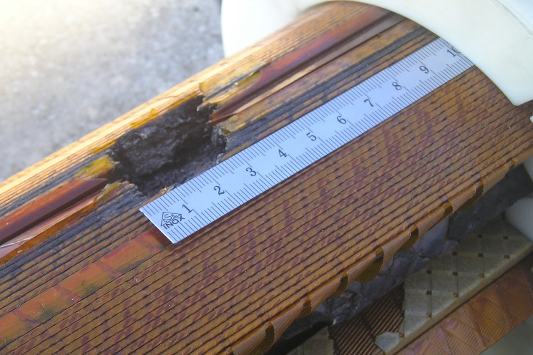
Quench: why it can be a problem ?
Quench is the result of the resistive transition, leading to appearance of voltage, temperature increase, thermal and electro-magnetic forces, and cryogen expulsion
If the process does not happen uniformly: as little as 1 % of the magnet mass may absorb the total energy – large damage potential !
Result of the chain of events triggered by a quench in an LHC bus-bar
Result of degradation due to local heating in a NbTi coil
Result of electrical short circuit quench heater to coil in a Nb₃Sn coil

Slide 30

Protection strategies
Two limiting cases in terms of magnet protection strategy:
External-dump: The magnet is dumped externally on a large resistance (R_{dump} >> R_{quench}) as soon as the quench is detected (e.g. ITER)
Self-dump: The circuit is on a short circuit and is dumped on its internal resistance (R_{dump} = 0) (e.g. LHC). Actually, external dump is not an option for a chain of accelerator magnets.
Typical J_{Cu} ≈ 1000…1250 (A/mm²)
Meaning dT/dt ≈ 1000…2000 (K/s)
We need to dump quickly! τ(300 K) ≈ 0.15…0.3 (s)
I_{op} ≈ 15 (kA)
E/l ≈ 1000 (kJ/m)
$$\frac{V}{l}≈\frac{{2E}/l}{τI_{op}}=500…1000 V/m$$

Slide 31
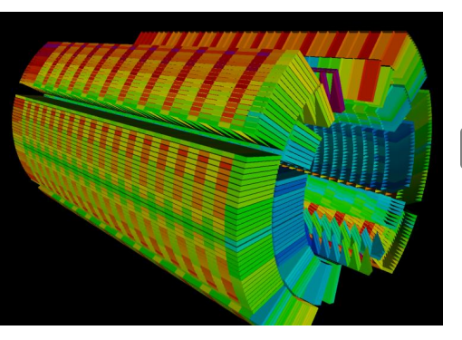

The quench event: summary
Quench starts
Thermal energy released by a precursor
Heaters effective
Distributed quench in the coil
Quench front propagates
Validation delay
Heater delay
Current decay due to the resistance growth in the coil
Quench detected
Quench validated
(power supply off, protection system fired)
Temperature rise in the conductor
Typical time scale:
From quench start to quench detected ~ 5 ms
Validation delay ~ 10 ms
Heater delay ~ 20 ms
Current decay ~ 100-200 ms
Maximum acceptable temperature: 350K

Slide 32
Protection strategy – External dump
The magnetic energy is extracted from the magnet and dissipated in an external resistor:
normal operation
quench
S₁
S₁
L
L
R_{dump}
R_{dump}
R = 0
R_{quench}

Slide 33
Protection strategy – Self dump
In the case of the LHC, the magnetic energy is completely dissipated in the internal resistance, which depends on the temperature and volume of the normal zone
(when increasing the temperature, the material becomes resistive→ resistance increase→ current decrease (fix voltage))
normal operation
quench
S₁
S₁
L
L
D
D
R = 0
R_{quench}

Slide 34
Protecting a magnet string
Magnet strings (e.g. accelerator magnets, fusion magnetic systems) have exceedingly large stored energy (10’s of GJ):
energy dump takes very long time (10…100 s)
the magnet string is subdivided and each magnet is by-passed by a diode (or thyristor)
the diode acts as a shunt during the discharge
M₁
M₂
M₃
M_{N}

Slide 35




Adiabatic heat balance
The simplest (and conservative) approximation for the evolution of the maximum temperature during a quench is to assume adiabatic behavior at the location of the hot-spot:
$\text{Average} \text{heat} \text{capacity}$: $\overline{C}\left(T\right)=\sum_{i}{f_{i}ρ_{i}}c_{i}$
$$A\overline{C}\frac{∂T_{cond}}{∂t}\text{=}\text{A}q_{joule}^{′′}→\overline{C}\frac{∂T_{cond}}{∂t}\text{=}η_{Cu}J^{2}$$
Electrical resistivity of the stabilizer (Cu):
$$η_{Cu}(B,RRR,T)$$
The circuit is a RL circuit
with the magnet inductance L
and a highly variable resistance R(t), growing with time
the higher the resistance, the faster the current dump, the lower hotspot
$$L\frac{∂I}{∂t}\text{+} R\text{I}\text{=}0$$

Slide 36


Hot spot temperature
Adiabatic conditions at the hot spot:
$$\overline{C}\frac{∂T_{cond}}{∂t}\text{=}η_{Cu}J^{2}$$
Can be integrated
$$\int_{T_{op}}^{T_{max}}{\frac{\overline{C}}{η_{Cu}}dT}=\int_{0}^{∞}{J^{2}dt}$$
Ability of the cable of « taking » the current (combination of enthalpy and resistivity): Quench capital (Γ)
Load due to the current decay, that should be made as fast as possible and is an observable: Quench tax

Slide 37



Protection limit
Ideal case: all magnet is quenched at the quench start
Assuming adiabatic conditions
$$\frac{E}{V}=\int_{T_{op}}^{T}{\overline{C}\left(T\right)dT}$$
Ultimate protection limit?
$$\frac{E}{V}$$
Magnet stored energy per unit volume.
HD2, 11T,
FRESCA2, RMM
LHC-MB
$$\overline{C}\left(T\right)=\sum_{i}{f_{i}ρ_{i}}c_{i}$$
HERA
Volumetric heat capacity of the cable
i = copper, superconductor and insulation.
Enthalpy of the strand volume (neglecting the insulation)
Reality: we need time to detect, validate and quench the magnet.

Slide 38



Detection and validation
The time needed to detect and validate a quench is very expensive in terms of temperature rise. And here is where current density become critical!
The detection threshold are defined through two parameters:
A voltage level (above the noise level) – typically 100 mV → 3-5 ms at nominal
A validation time (to reject spurious spikes in voltages) – typically 10 ms
Voltages staying above voltage level for a time longer than validation time are interpreted as a magnet quench, and activate the protection system
Therefore on the time needed to detect the voltage, one has to add the validation time ∼ 15 ms
$$\frac{dT_{hot}}{dt}=\frac{I^{2}}{\left(A_{Cu}+A_{SC}+A_{ins}\right)∙A_{Cu}∙Γ(T,B)}$$
$$Γ\left(T,B\right)=\frac{\overline{C}\left(T\right)}{η_{Cu}(T,B)}$$
Nominal
All coil quenched after 35 ms from quench start

Slide 39




Quench initiation: quench heaters
Principle: temperature rise in the conductor through the heating of metal strips attached to the coil.
They are typically installed in the outer surface of the coil
Time required to induce a quench at nominal ∿ 10 ms
11 T Heater Lay-Out (only outer layer heaters)
Outer layer heater design
OL - HF
Copper
Stainless Steel
OL - LF
MQXF Heater Lay-Out (heater in the inner and outer layers)
Outer layer heater design
OL - HF
Stainless Steel
Copper
Inner layer heater design
IL
OL - LF

Slide 40


Quench initiation: CLIQ
CLIQ (Coupling Losses Induced Quench)
This system is based on injecting in the magnet coils two opposite impulses of current via a capacitor
The mechanism is the heating due to interfilament coupling losses induced by the variation of the field
It has been developed at CERN and patented in 2014 (EP13174323.9)
Electrical scheme of CLIQ implementation in a dipole
G. Kirby, V. Datskov, E. Ravaioli et al. IEEE TAS 24 (2014) 0500905

Slide 41
The case of MQXF
The baseline protection scheme of the HL-LHC MQXF quadrupole relays on CLIQ + QH, a prima for accelerator magnets.
CLIQ + QH, provides a redundant protection system. In the case of MQXF, it reduces the quench load by 20 % at high current, decreasing the hot spot temperature by∼ 100 K (∼350 K QH only, ∼250 K QH+CLIQ).
Comparison of quench load in MQXF magnets when protected only with QH and QH+CLIQ
Current decay in MQXF for CLIQ + QH or QH only protection

Slide 42
Summary
Magnet protection concerns two different phenomena: increase of temperature (joule heating) and increase of voltage (transition to resistive state).
The two key parameters for the protection of a magnet are:
Current density in the copper (heating rate)
Energy density in the coil (needs to be dissipated in the coil enthalpy)
A resistor in series with the magnet allows to dump part of the energy, but it is not effective for long magnets or magnets in a string due to the voltage limitation.
For long and high current density, the protection relies on the induction of a rapid transition to resistive state in the full coil.
In the LHC-MB NbTi magnets, the time margin is ≈ 100 ms.
In the HL-LHC Nb₃Sn magnets, the time margin is ≈ 40 ms.
Two systems to induce a resistive transition in the full coil:
Quench heaters: temperature rise in the conductor through the heating of metal strips attached to the coil.
CLIQ: temperature rise in the conductor through the inter-filament coupling losses induced by the variation of the field.

Slide 43
References
General principles and equations:
M.K. Wilson, Superconducting Magnets, Oxford, Clarendon Press, 1983.
More on quench propagation and scaling :
A. Devred, General Formulas for the adiabatic propagation velocity of the normal zone, IEEE Trans on Magnetics, Vol. 25, No. 2, March 1989
E. Todesco, “Quench limits in the next generation of magnets” CERN Yellow Report 2013-006 10-16
S. Izquierdo Bermudez, et al., Analytical method for the prediction of quench initiation and development in accelerator magnets, Cryogenics, Volume 95, October 2018, Pages 102-109
U.S. Particle Accelerator School, lectures from Ezio Todesco, http://etodesco.web.cern.ch/etodesco/
Wide literature on specific results on magnets and outlook for future magnets, for instance
H. Felice, et al., “Instrumentation and quench protection for LARP Nb3Sn magnets” IEEE Trans. Appl. Supercond. 19 (2009) 2458-2462
S. Izquierdo Bermudez, et al., "Overview of the quench heater performance for MQXF, the Nb₃Sn low-beta quadrupole for the high-luminosity LHC" IEEE Trans. Appl. Supercond. 28 (2018) 4008406
T. Salmi, et al., “Quench protection analysis integrated in the design of dipoles for the Future Circular Collider” Phys. Rev. STAB 20 (2017)

Slide 44
Outline
Part I
Particle accelerators, magnets and the need of superconductors
Magnetic design and coil fabrication
Part II
Mechanical design and assembly
Quench, training and protection
Future outlook

Slide 45

HL-LHC
The IR LHC today:
The HL-LHC IR:

Slide 46


HL-LHC
A large variety of (fun) magnets
Challenge associated with the production of the first Nb₃Sn accelerator-ready magnets
The project is now in series production phase, with the first chain of magnet being assembled in the IT-String in SM18!

Slide 47









What is next?
From a magnet perspective,
explore the limits of Nb₃Sn and industrialize the technology.
develop high temperature superconductors (HTS)
High Field Magnet (HFM) program coordinates these efforts in Europe https://arxiv.org/pdf/2504.16885
Collaboration agreements between CERN and EU institutes to build demonstrators
CERN also working on small scale demonstrators to explore the limits
US Magnet Development Program (MDP), pushing magnets beyond the present state of the art (https://usmdp.lbl.gov/)
https://home.cern/science/cern/fcc-study-media-kit
Magnets under development in the High Field Magnet Program

Slide 48


What is next?
Other machines that also offer a great variety of challenges for magnet builders are also being explored, such as the muon collider
a) production solenoid;
b) 6D muon cooling solenoids:
c) final muon cooling system;
d) fust-cycling muon acceleration magnet;
e) collider ring magnets;
f) IR magnets.
See https://muoncollider.web.cern.ch/

Slide 49







Beyond LTS: the broad world of HTS
The broad world of HTS, opens the door to fields > 16 T
So far, most of the developments focused on HTS inside outsert coils made of Nb₃Sn or NbTi
EUCARD REBCO HST insert
FEATHER2 REBCO HST insert
CEA + CRNS Grenoble, J.M. Rey, F. Borgnolutti, M. Durante, CEA-Saclay
CERN, Gijs the Rijk, Glyn Kirby
Bi-2212 racetracks
Bi-2212 CCT
MDP, US
MDP, US

Slide 50
In conclusion
Magnet technology is a complex, but very exciting, business: are you convinced?
There is no magic technology, some are more mature than others.
There are remaining challenges to go to high field in a robust and reproducible manner.
The High Field Magnets Program is being launched to tackle these issues.
The magnet community will need to be creative and pragmatic.
We need bright minds!

Slide 51
Thank you
For questions, don’t hesitate!
susana.izquierdo.bermudez@cern.ch

