Slide 1



Accelerator Operation and Diagnostics
Federico Roncarolo
@CERN summer student lectures 2025
Part I

Slide 2
Introduction
Welcome to this two-part lecture series on "Beam Instrumentation for Accelerator Operation." These lectures will provide an overview of how beam diagnostics support particle accelerator facilities. It will be a 2 × 45-minute journey to explore the fundamental concepts, general principles, and some of the fascinating physics and engineering at the core of accelerator operation and beam diagnostics.
What is an accelerator and what it means to operate an accelerator complex
Essential beam parameters that must be measured
Various beam instrumentation technologies and their applications
While we'll discuss general concepts applicable to different accelerator types, specific examples of instrumentation technologies and implementations (mainly in Part II) will primarily focus on CERN's diagnostic systems, drawing from direct experience with these facilities.

Slide 3
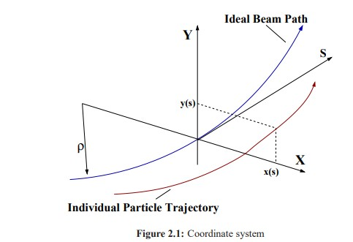
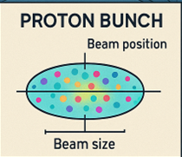
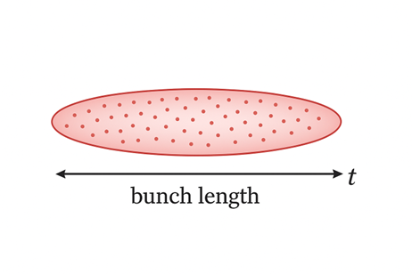
Glossary – to ensure there are no secrets or misunderstanding
Beam Diagnostics/Instrumentation: I'll use these terms interchangeably throughout the lectures
Bunch: refers to a collection of particles that are grouped together both spatially and temporally
X,Y → ‘transverse’ coordinates
s or t = ‘longitudinal’

Slide 4
References – Bibliography
(not exhaustive, I’ll update it and leave on indico)
Proceedings of the 2018 course on Beam Instrumentation (CAS)
https://cds.cern.ch/record/2625174?ln=en
M.Vretnar , Particle Accelerators in the 21st century
https://indico.cern.ch/event/1469325/contributions/6186031/
Peter Forck's Lectures at JUAS
Lecture Notes on Beam Instrumentation and Diagnostics (JUAS)
https://www-bd.gsi.de/conf/juas/juas_script.pdf

Slide 5



Contents
Part 1 (General)
Part 2 (Diagnostics use examples)
Introduction & Accelerator basics
Facility ‘Types’
Operation - Challenges
Beam Diagnostics
Introduction
Methods (examples)
LINAC4 Phasing
SPS-LHC Electron Cloud
LHC Beam Dump System
…
Wrap-up

Slide 6
Accelerator Basics
Quick facts and basic notions, you’’ll find much more:
Accelerators and Beam Dynamics
Speaker: Foteini Asvesta

Slide 7
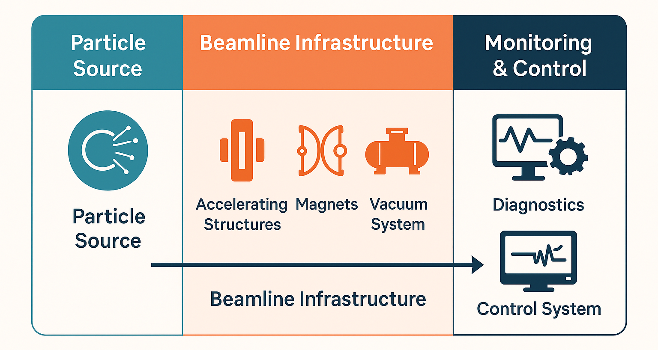
What is a particle accelerator
Definition
Building blocks (in short)
A particle accelerator is a machine that uses electromagnetic fields to propel charged particles—such as electrons or protons—to high speeds and contain them in well-defined beams.

Slide 8
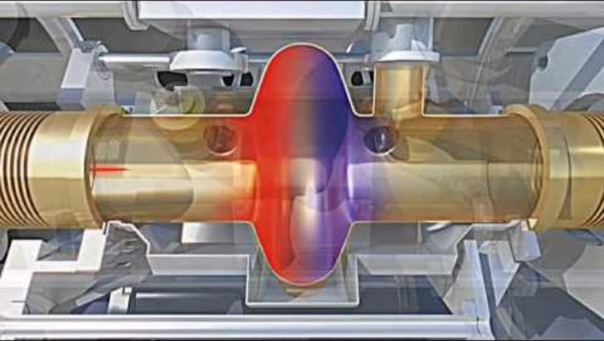
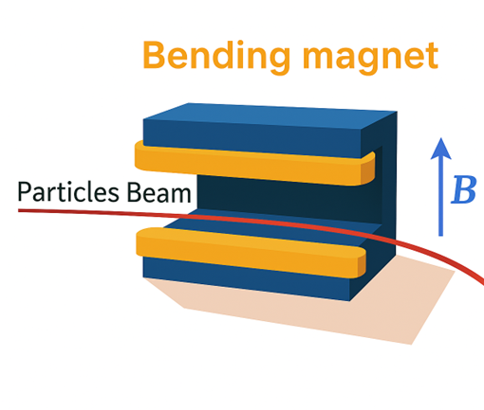
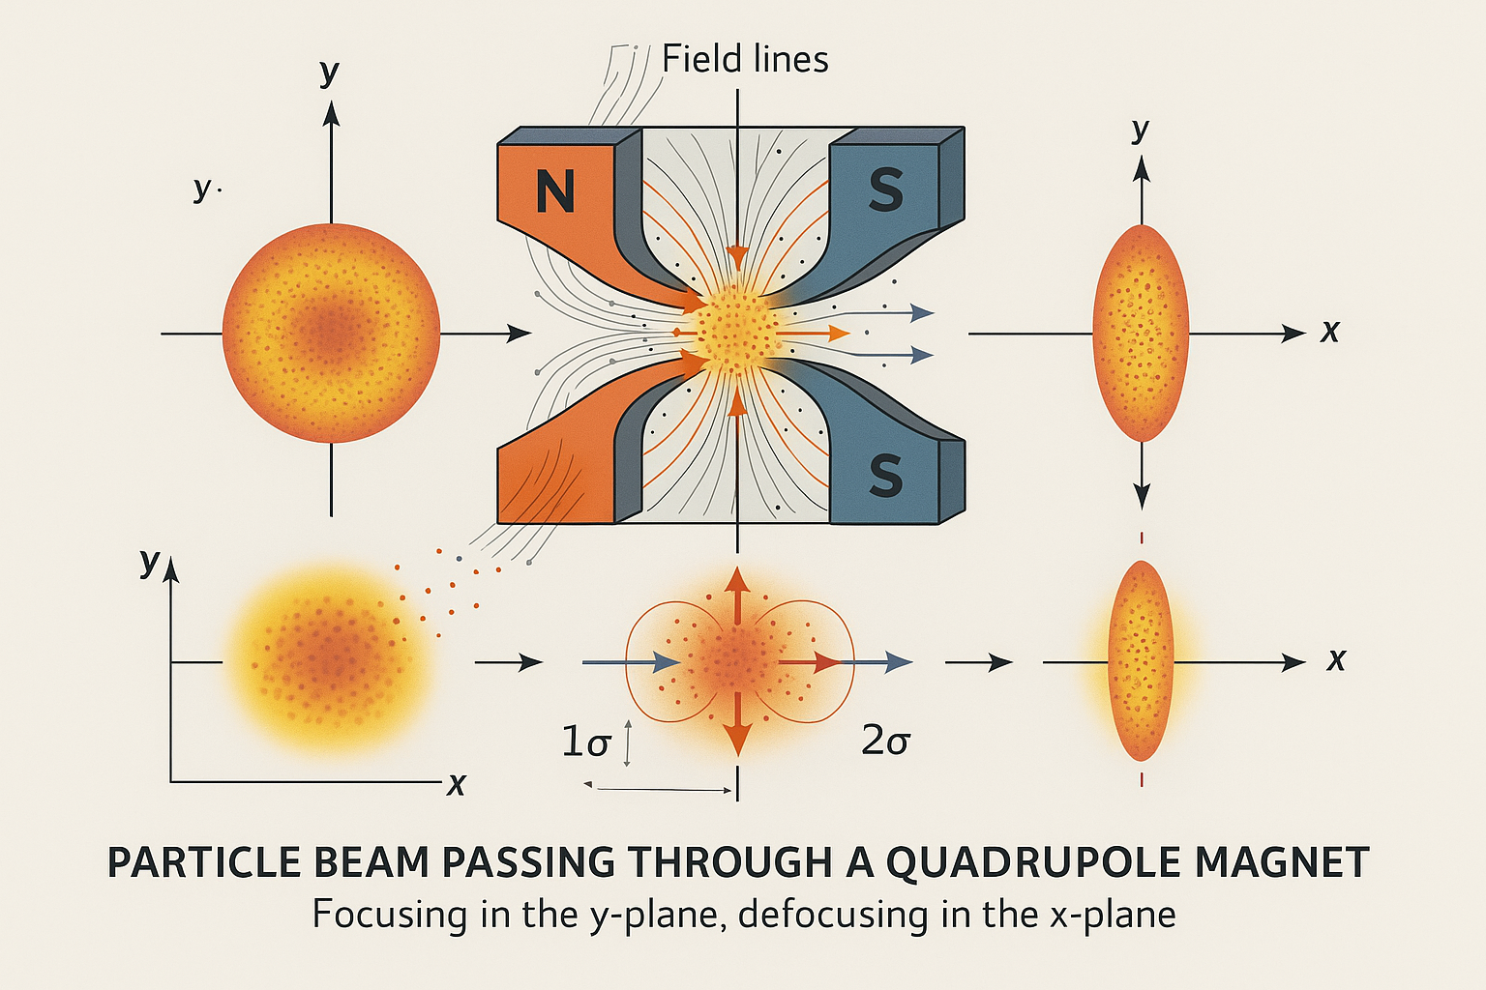
Basic concepts
CAVITIES for acceleration
Magnets for bending and focusing
Metallic chambers designed to resonate at specific frequencies (typically MHz to GHz)
Generate alternating electric fields along the beam axis
Particles gain energy when passing through at the correct phase
Dipole magnets: Bend particle trajectories (steering)
Quadrupole magnets: Focus beams (similar to optical lenses)
Sextupole/higher-order magnets: Correct optical aberrations
ΔE = qV₀T cos(φ)
Lorentz force: F = q(v × B)

Slide 9
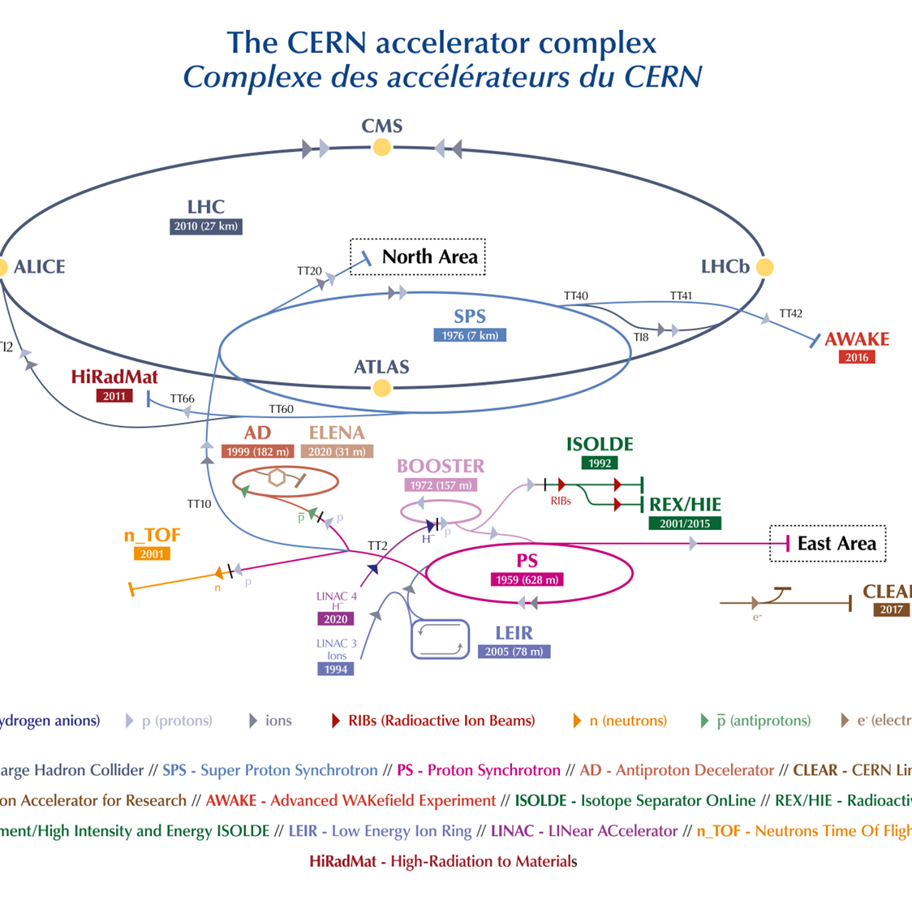
Very often we talk about Accelerator ‘Complex’
Particle Sources
Generate the initial beam of particles
Linear Accelerators (Linacs)
Accelerate particles in a straight line
Rings
Recirculate particles for further acceleration or storage
Transfer Lines
Connect different accelerator stages or deliver the beam to experiments
Each presents challenges for operation and diagnostics

Slide 10
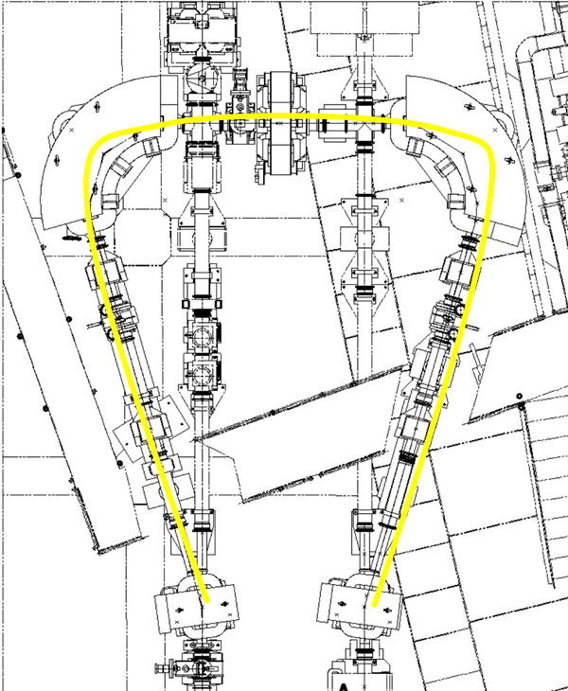
The CERN ITE Line
Example of peculiar transfer line bringing ions form LINAC3 to LEIR , part of the complex PS complex ‘switchyard’ zone

Slide 11
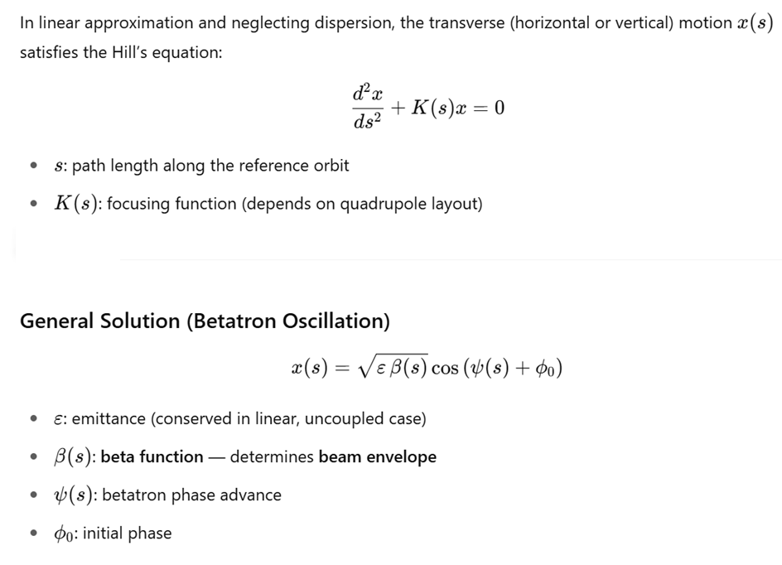
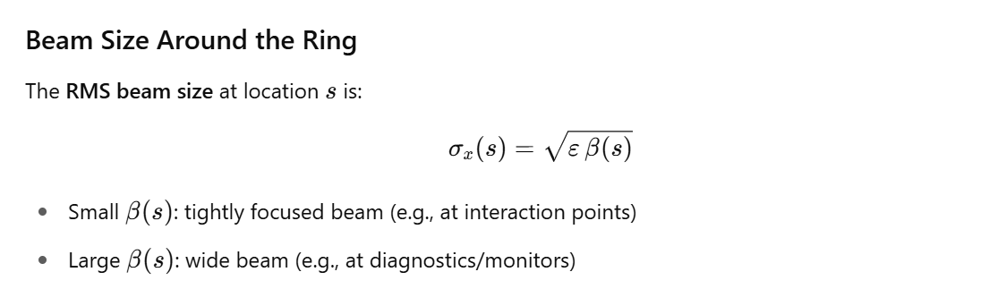
Basics of (transverse) beam dynamics
Transverse Beam Dynamics – Even in Idealized Simulations==by design
Key equations – see beam dynamics lectures
Particles do not follow exact lines or circles.
Their transverse positions oscillate around the design orbit: these are betatron oscillations.
The beam size varies (oscillates) due to the optical functions of the accelerator.

Slide 12
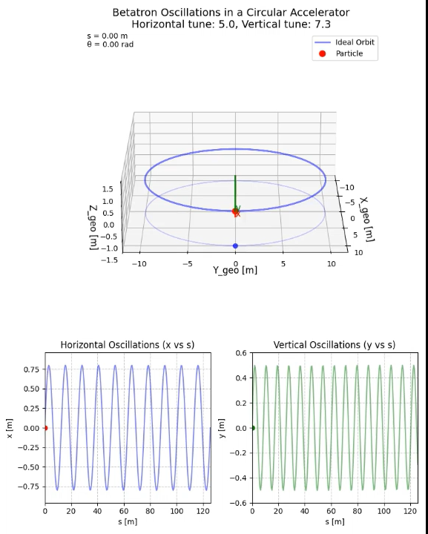
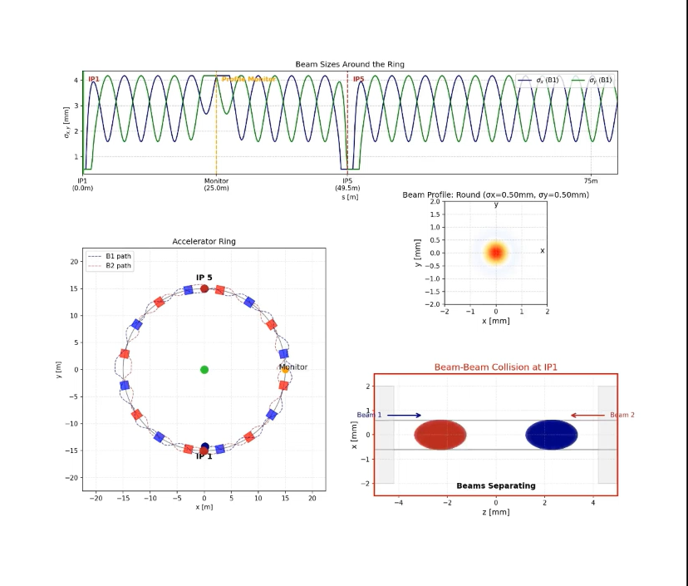
Particle’s behavior
Particles (transverse) dynamics in a storage ring at constant energy – only illustrative
BEAM POSITION
BEAM SIZE
#oscillaitons / turn = Tune (Q)

Slide 13
Accelerator facility ‘types’

Slide 14
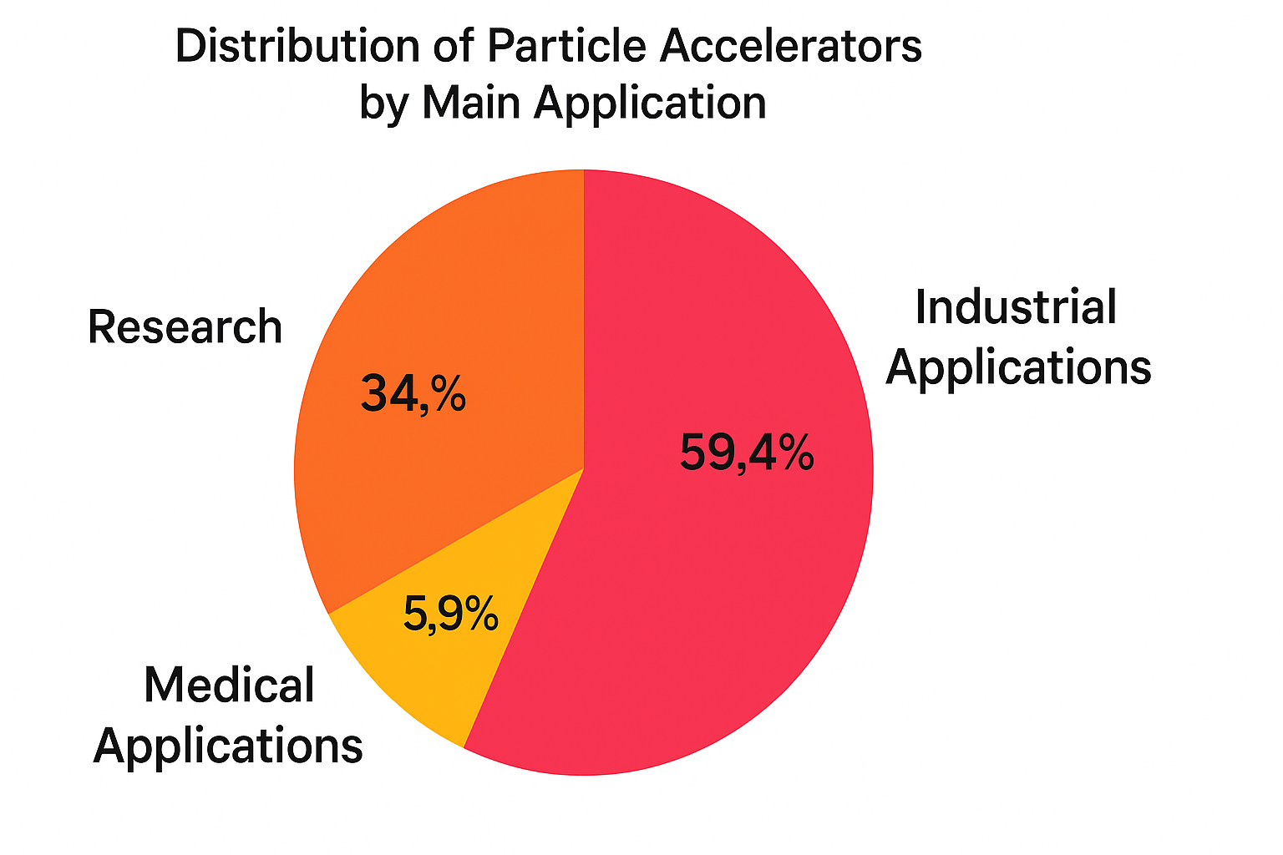
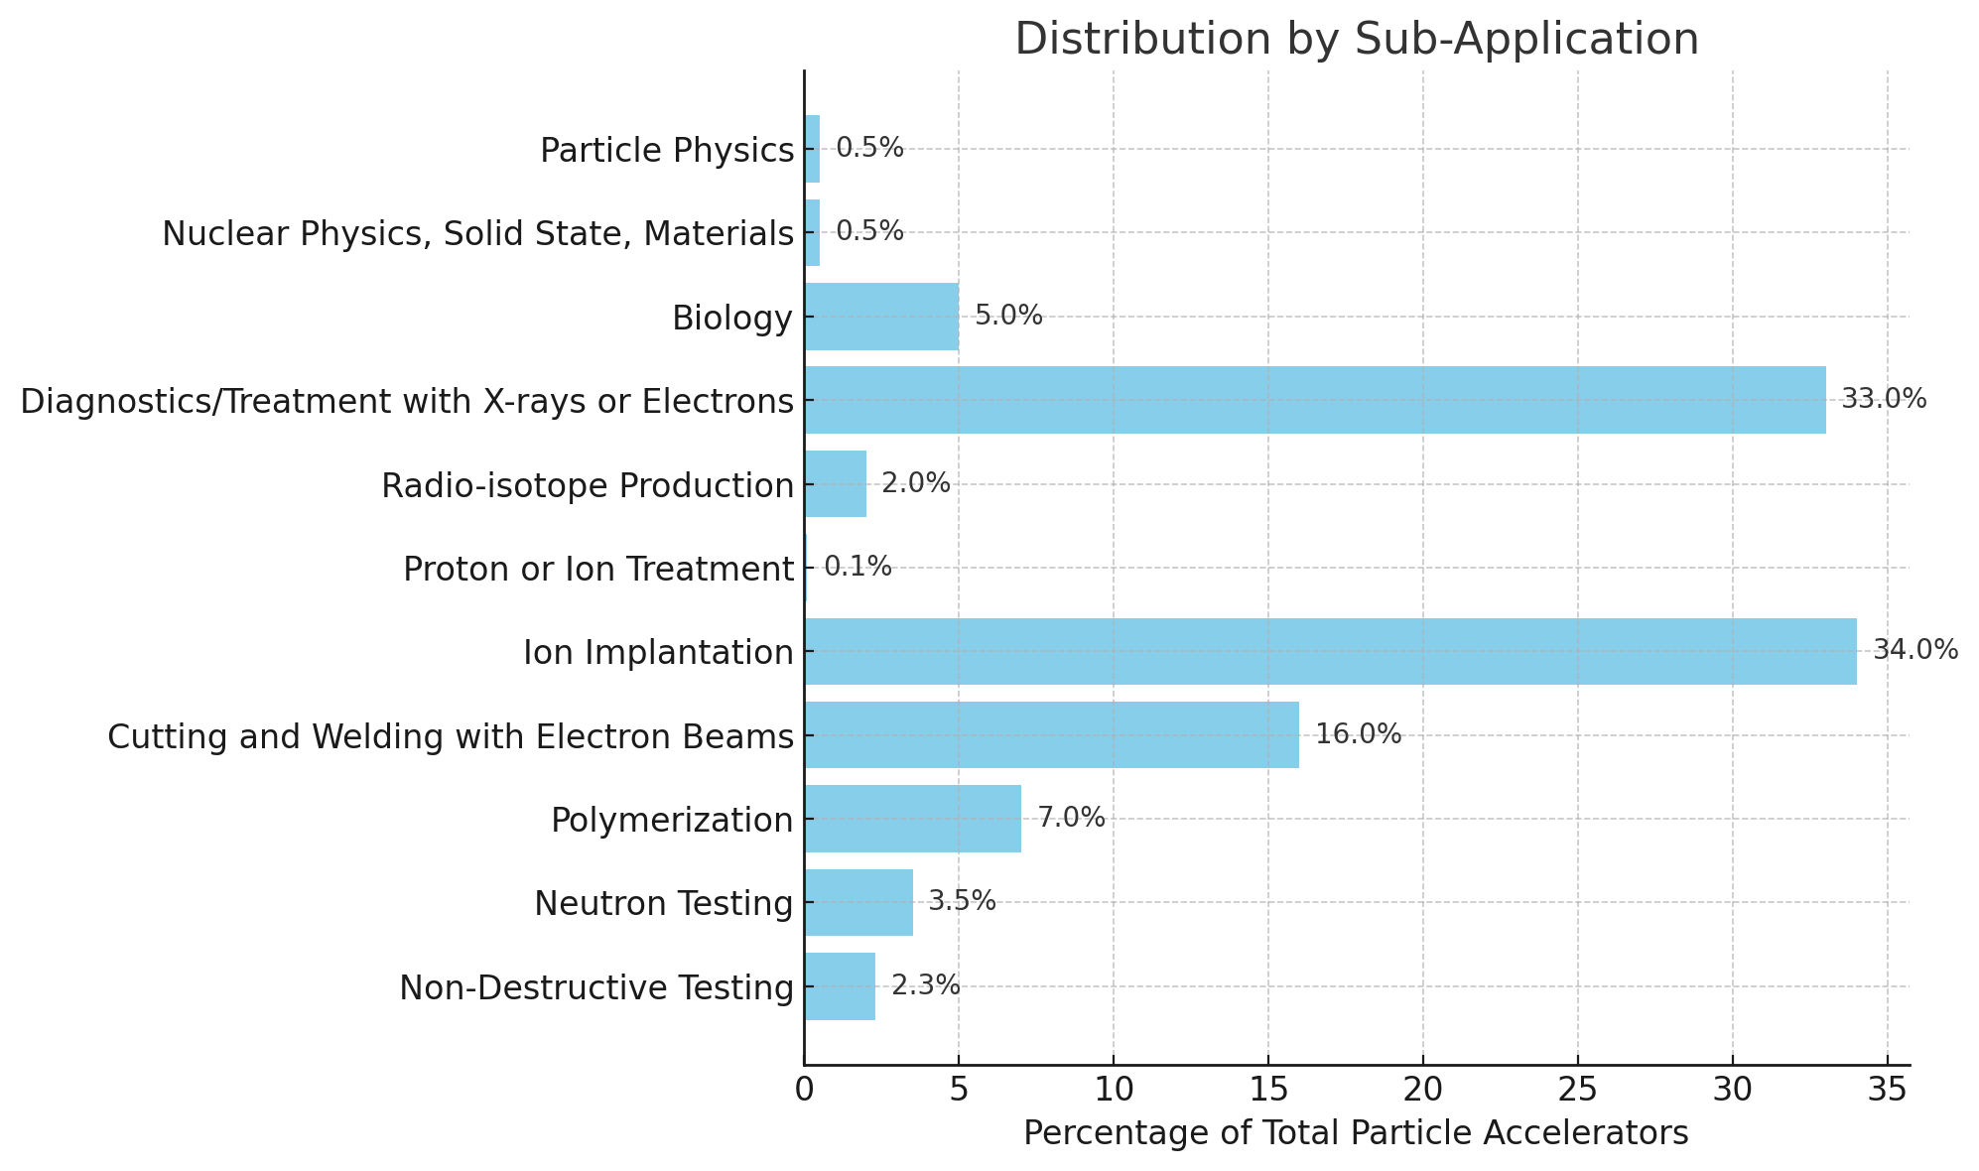
The world of Particle Accelerators
Most of these are compact ~low energy electron linac, not treated in these lectures
Source:
M.Vretnar , Particle Accelerators in the 21st century
https://indico.cern.ch/event/1469325/contributions/6186031/

Slide 15


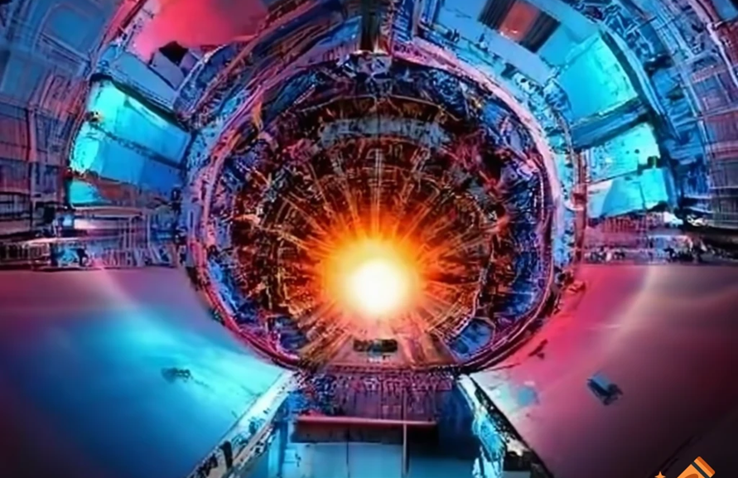
Research Facilities
Uncover fundamental particles
Colliders
Understanding universe origins, discovering new particles, testing Standard Model

Slide 16

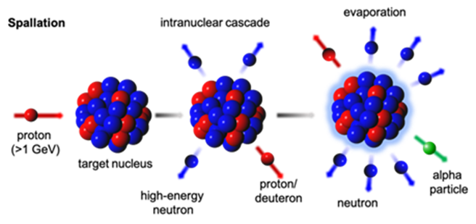
Research Facilities
Fixed Target
  Nuclear physics research, rare decay studies, neutrino production, neutron production, antimatter production

Slide 17
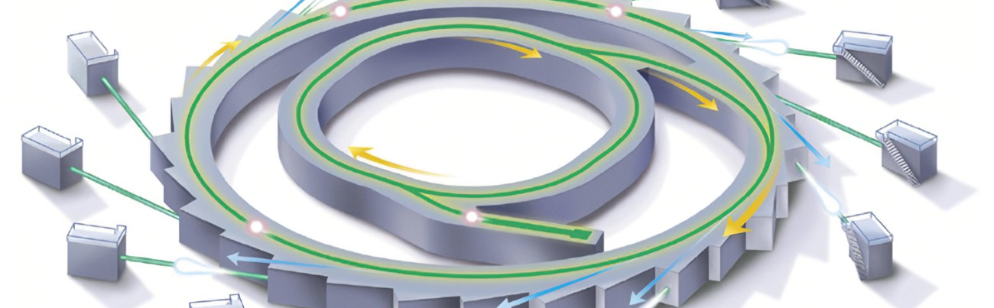
Synchrotron Radiation Facilities
Generate specialized light
  Material science, protein crystallography, pharmaceutical development, advanced imaging

Slide 18
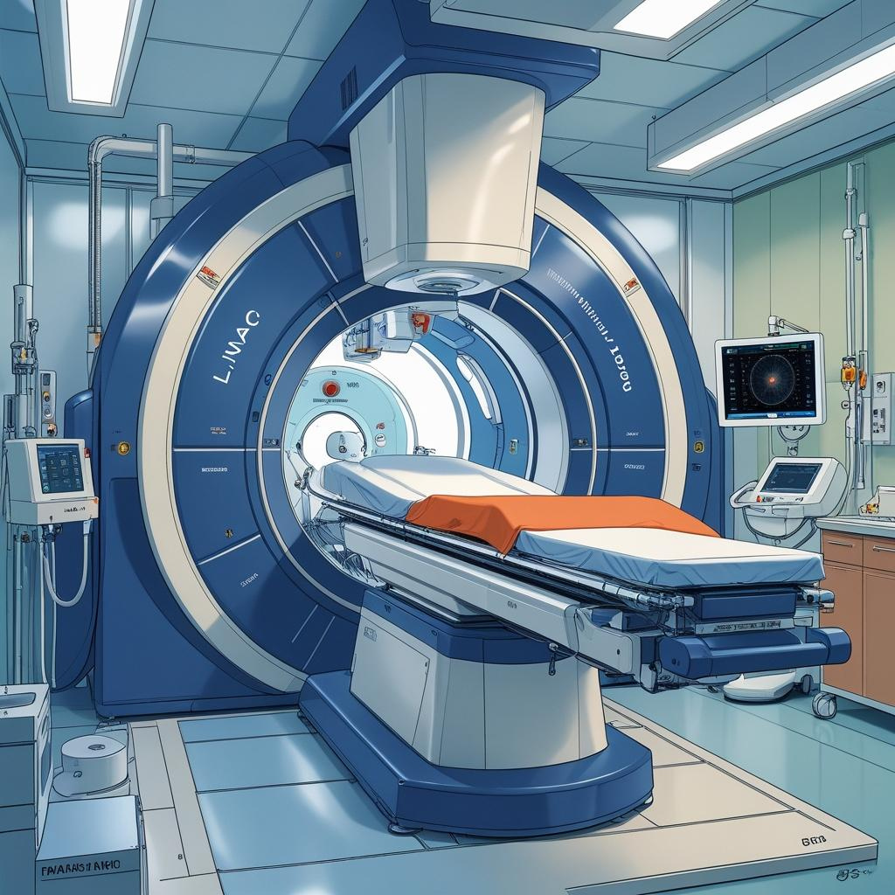
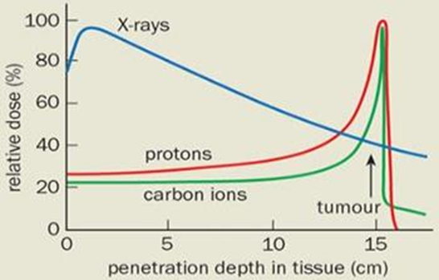
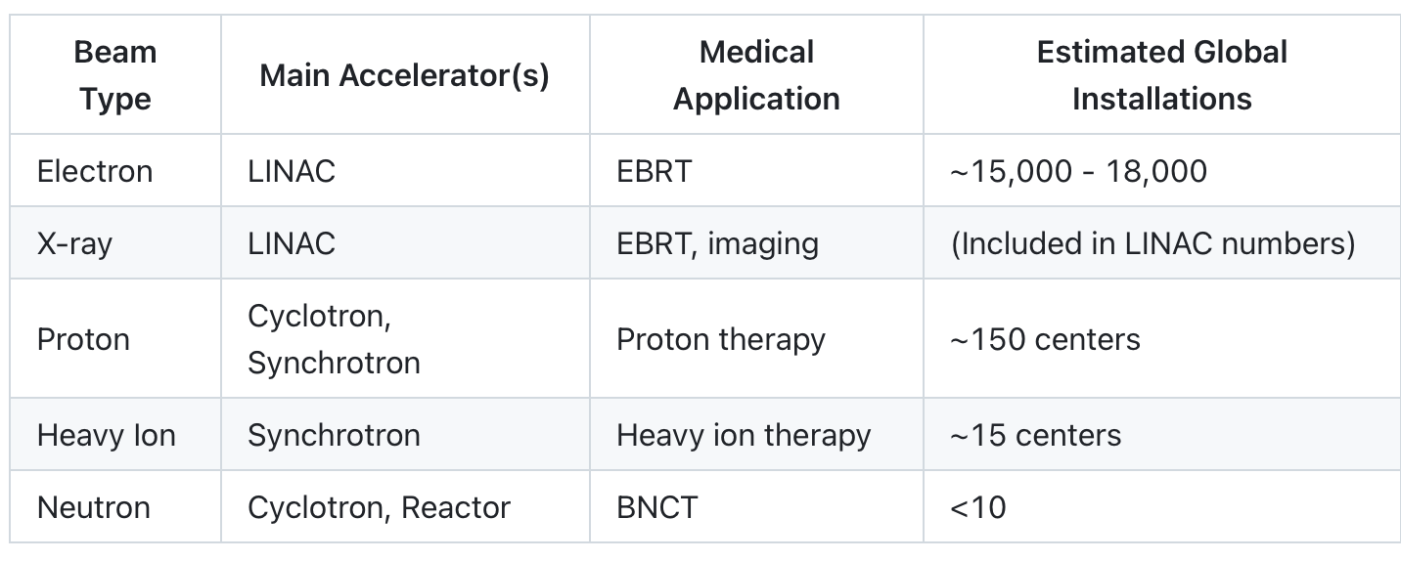
Medical Accelerators
Treat disease precisely
  Cancer therapy, medical imaging, targeted radiation treatment, minimizing healthy tissue damage

Slide 19

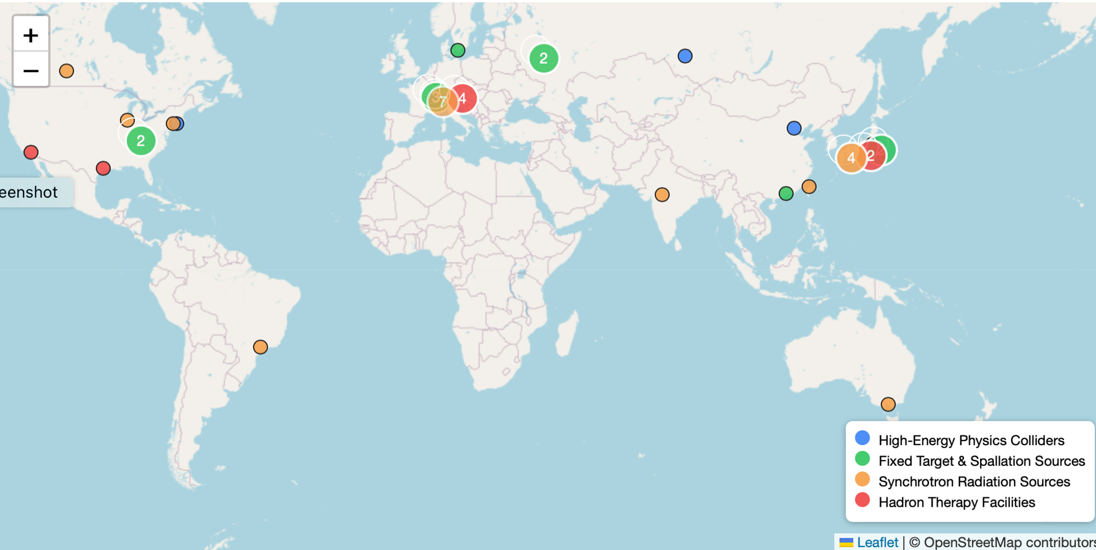
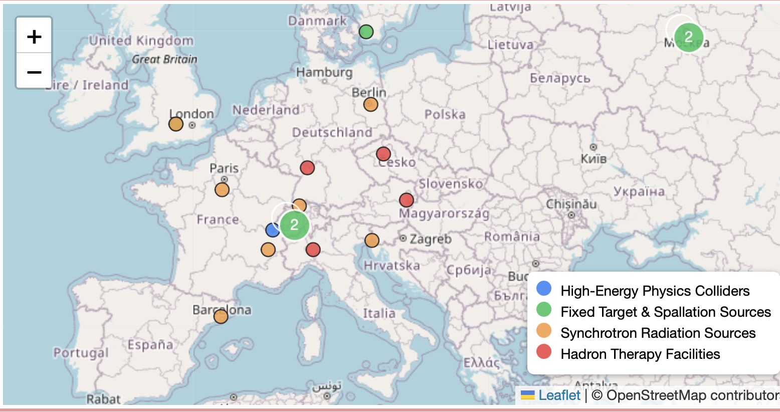
World Accelerators (some categories only)

Slide 20
Accelerators Operation

Slide 21
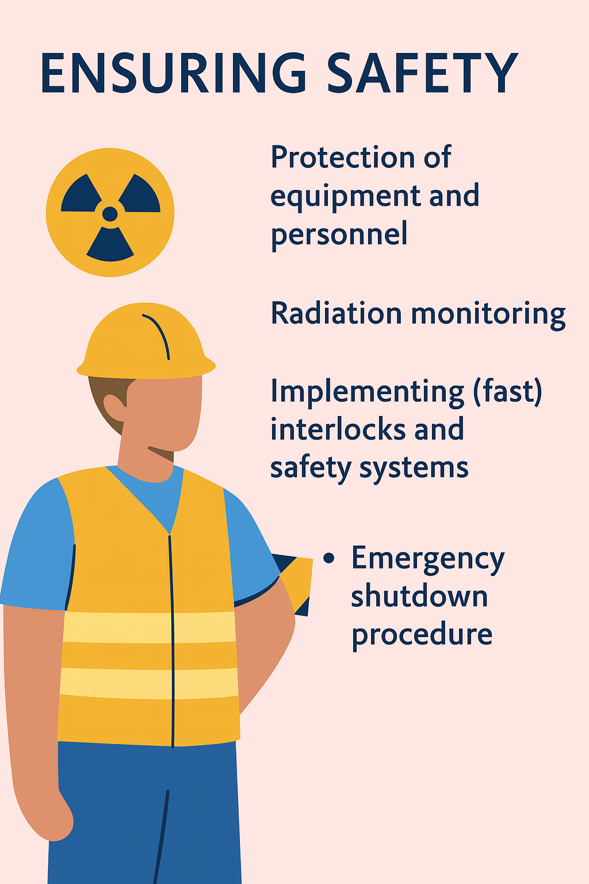
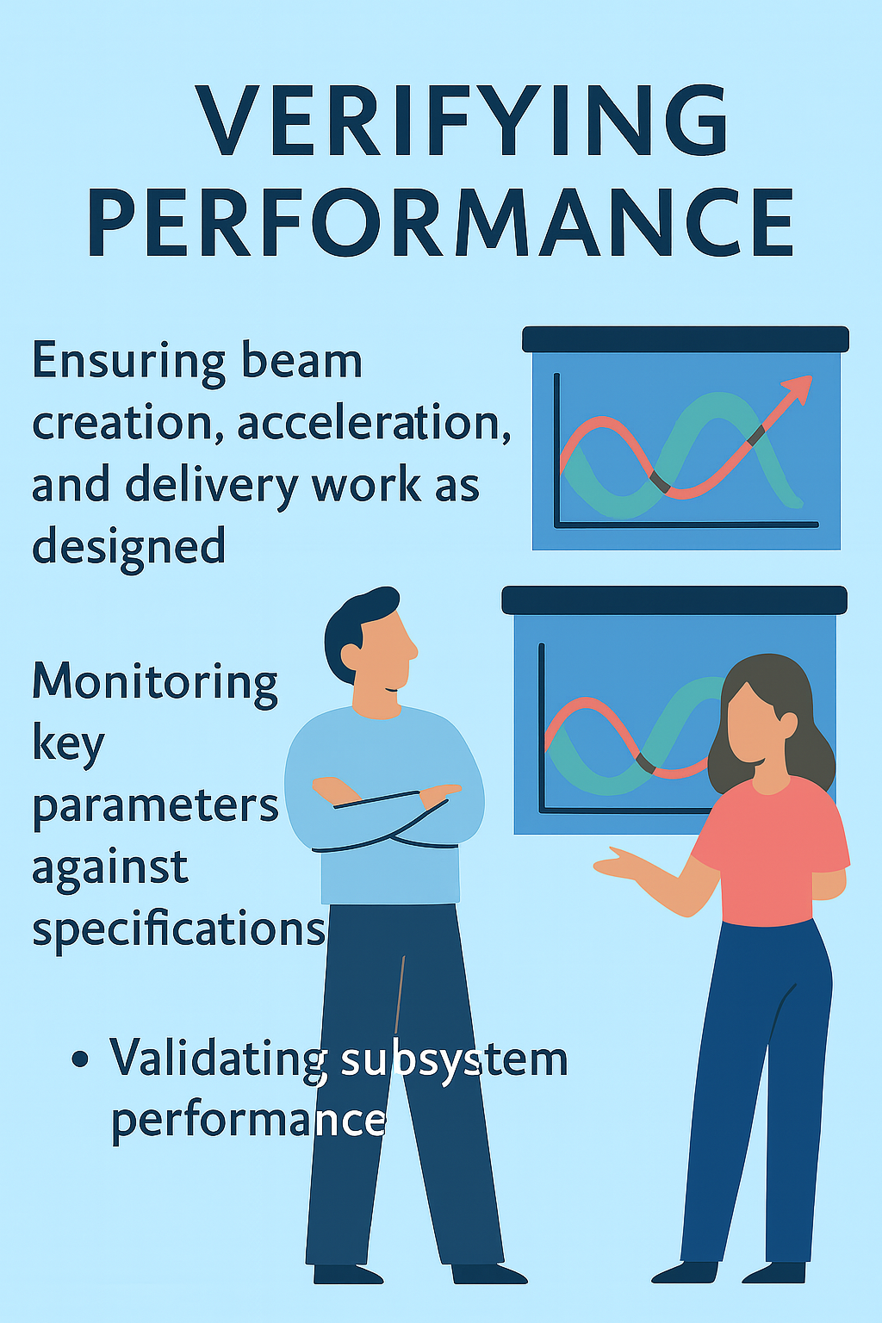
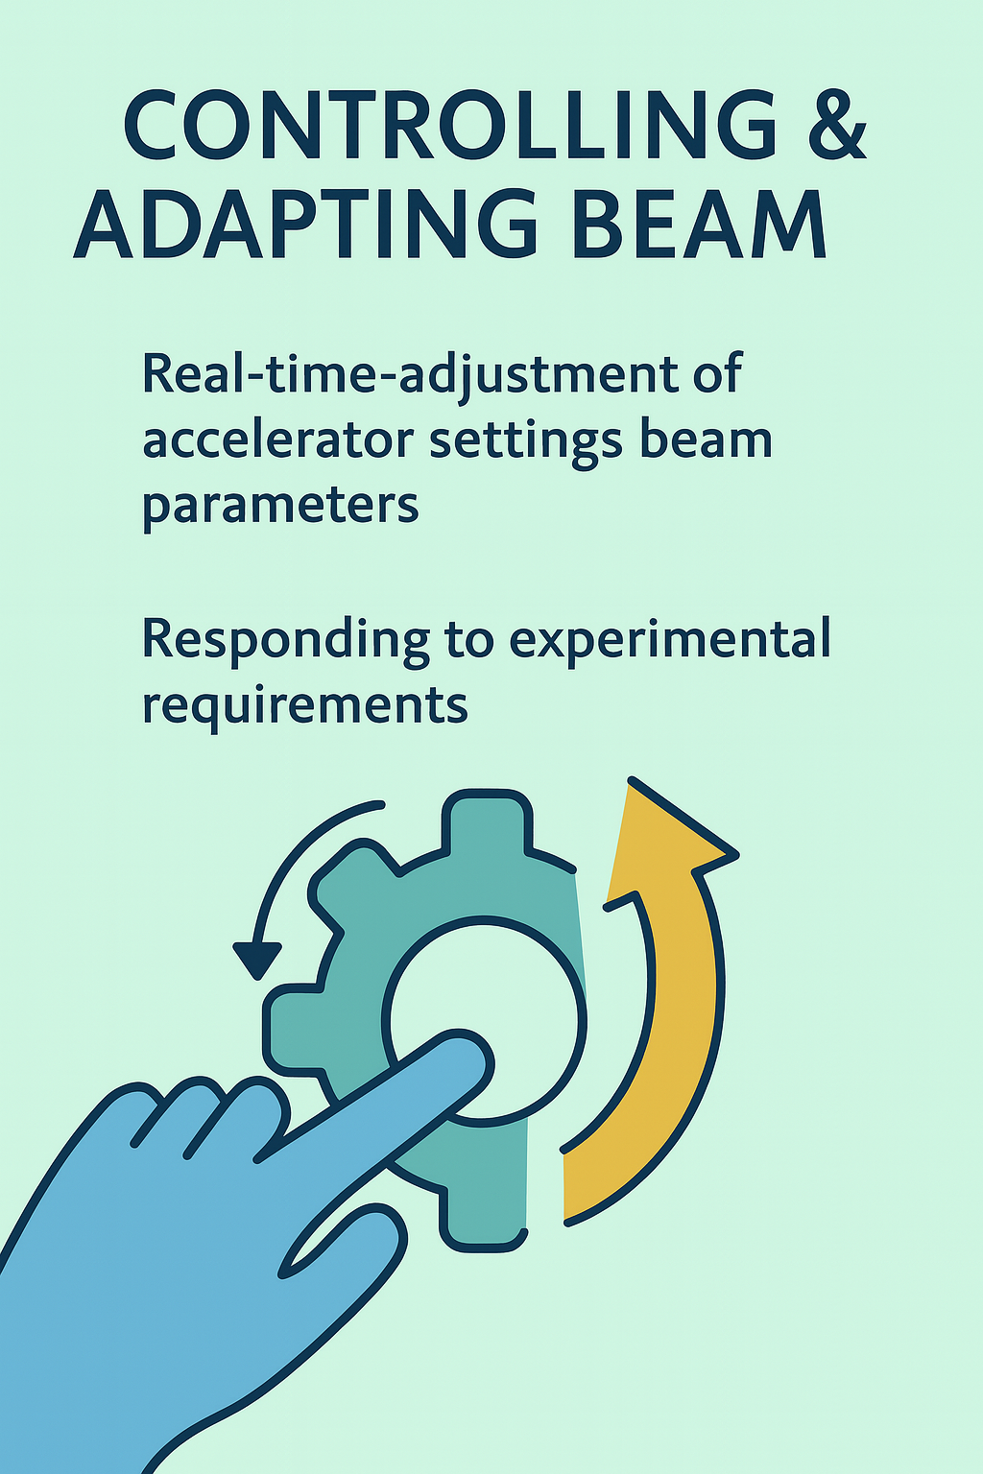
What Does It Mean to Operate an Accelerator Complex?
And ….

Slide 22
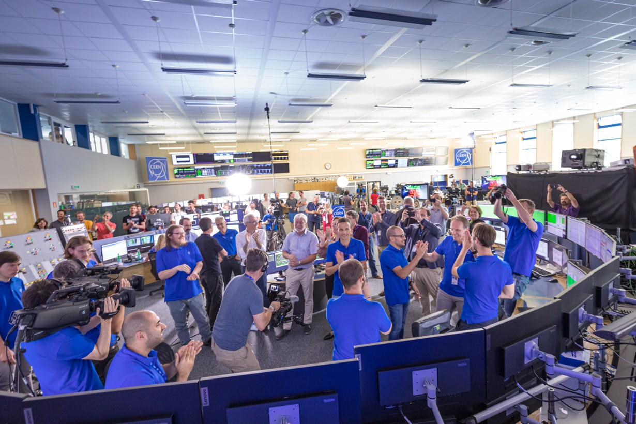
What Does It Mean to Operate an Accelerator Complex?
…. Celebrating !

Slide 23
Timeline of Accelerator Life Cycle
Day Zero –
First Beam
Initial beam creation and acceleration with safety verification
Commissioning phase
Extensive testing and validation for optimized functionality
Common challenges across all stages:
Safety system maintenance Equipment reliability
Beam quality monitoring
Documentation and logging
Beam delivery for experiments with real-time adjustment
Physics Operation
Machine Studies
Performance improvements and investigations into beam dynamics

Slide 24
When you enter an accelerator control room …

Slide 25
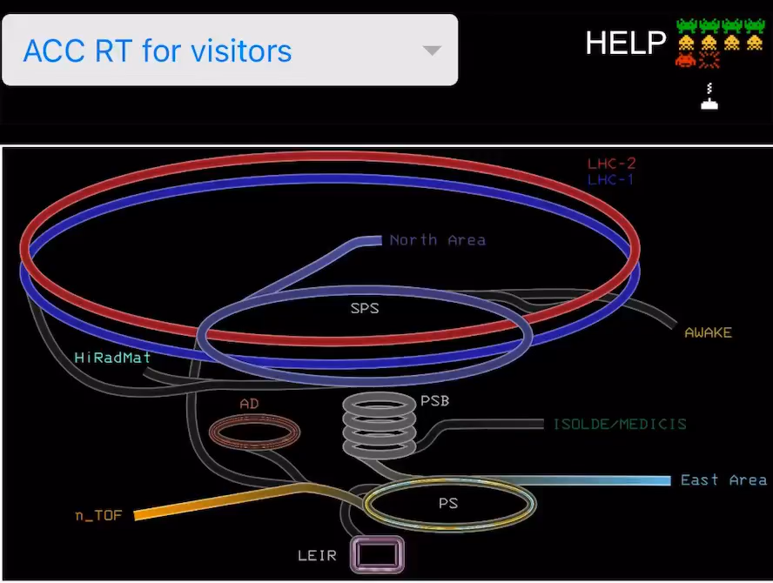
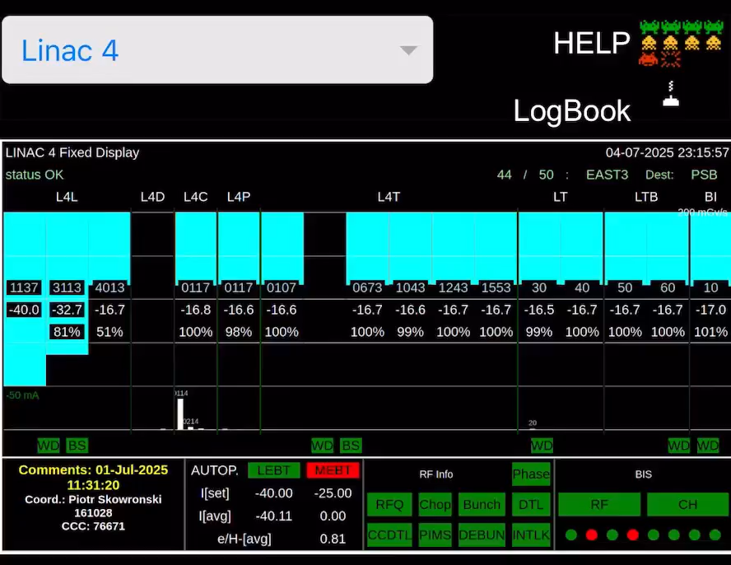
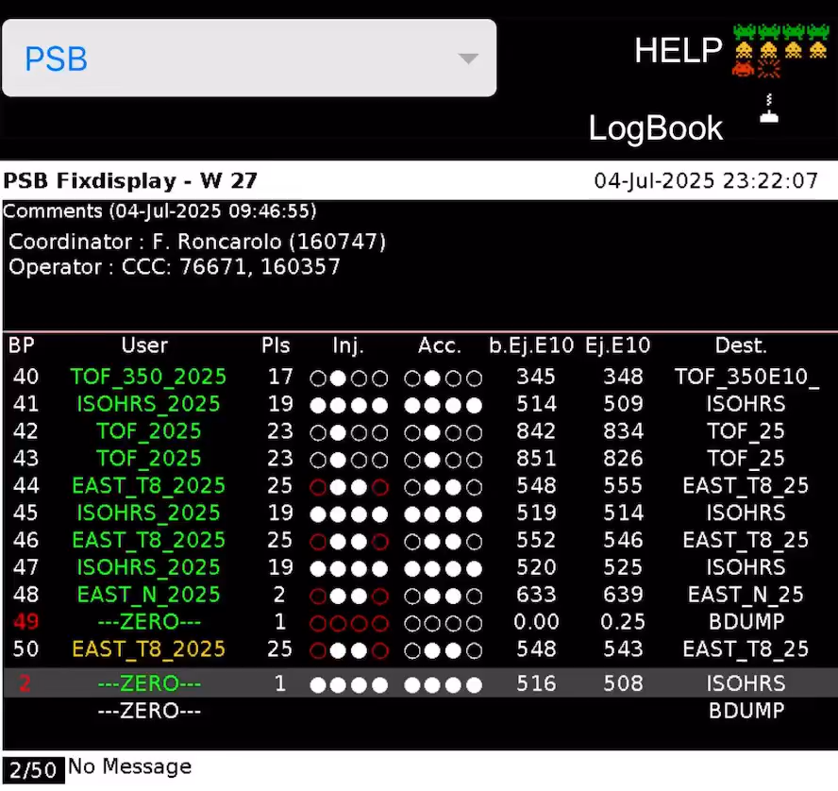
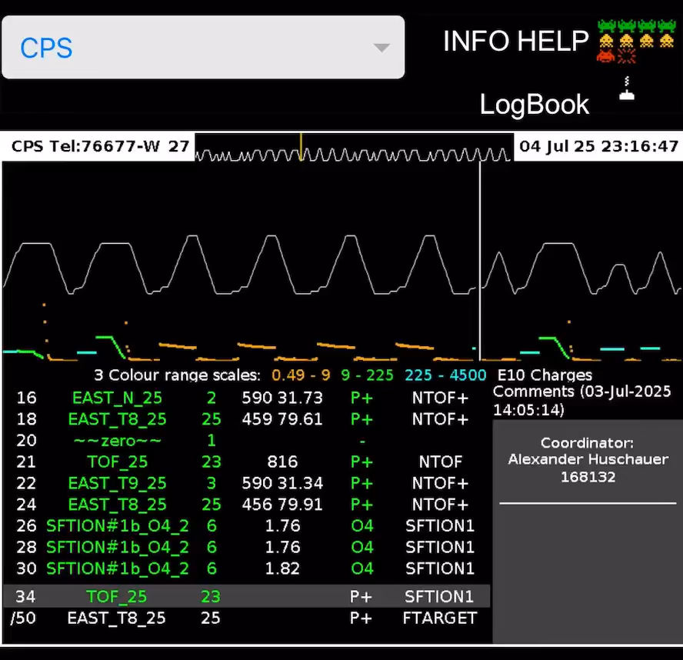
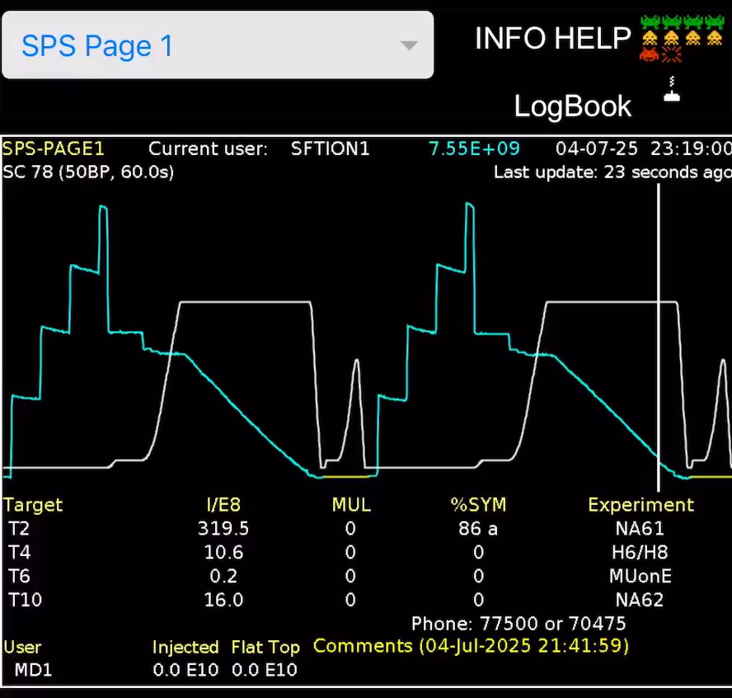
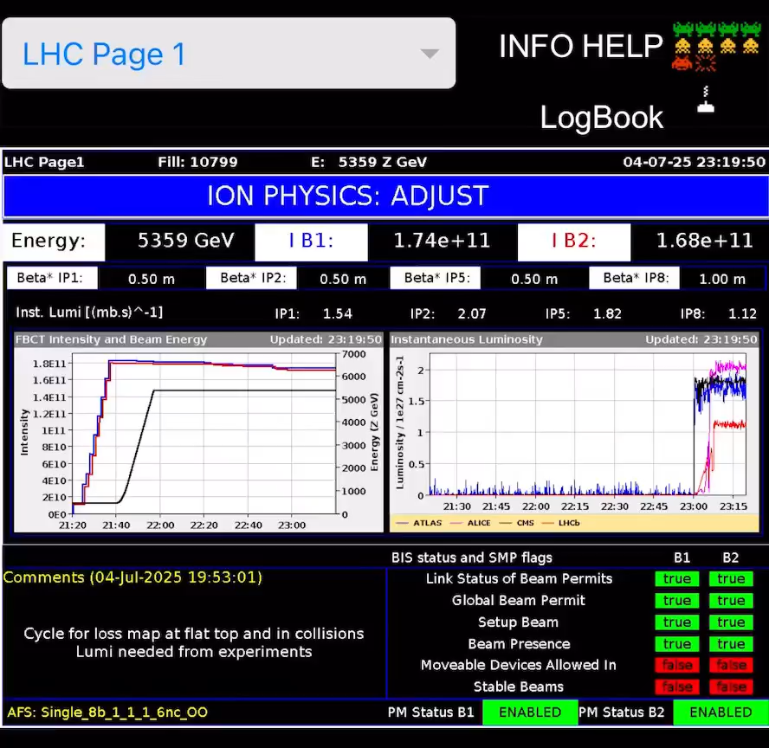

Slide 26

But don’t worry , you are not alone
There are always at least two persons present, as leaving only one is risky. ;-)

Slide 27
Beam Diagnostics

Slide 28

Why Beam Diagnostics ?
The Accelerator's Eyes
Beam instrumentation provides critical feedback to operators, allowing them to monitor and optimize particle beams.
Without it, operators would be "flying blind" when managing these complex systems.

Slide 29

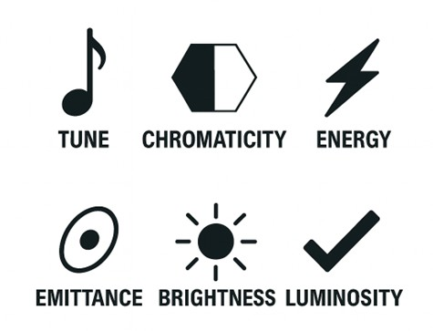
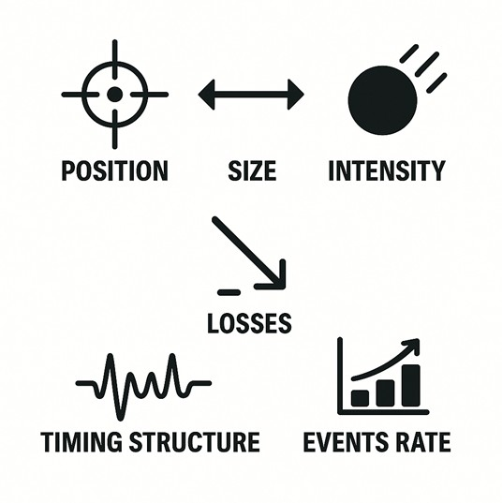

Which Beam Diagnostics ?
Direct measurements
Indirect measurement…
.. And Key performance indicators
Closely tied to beam observables →~intuitive
Less intuitive often require combination of monitors

Slide 30
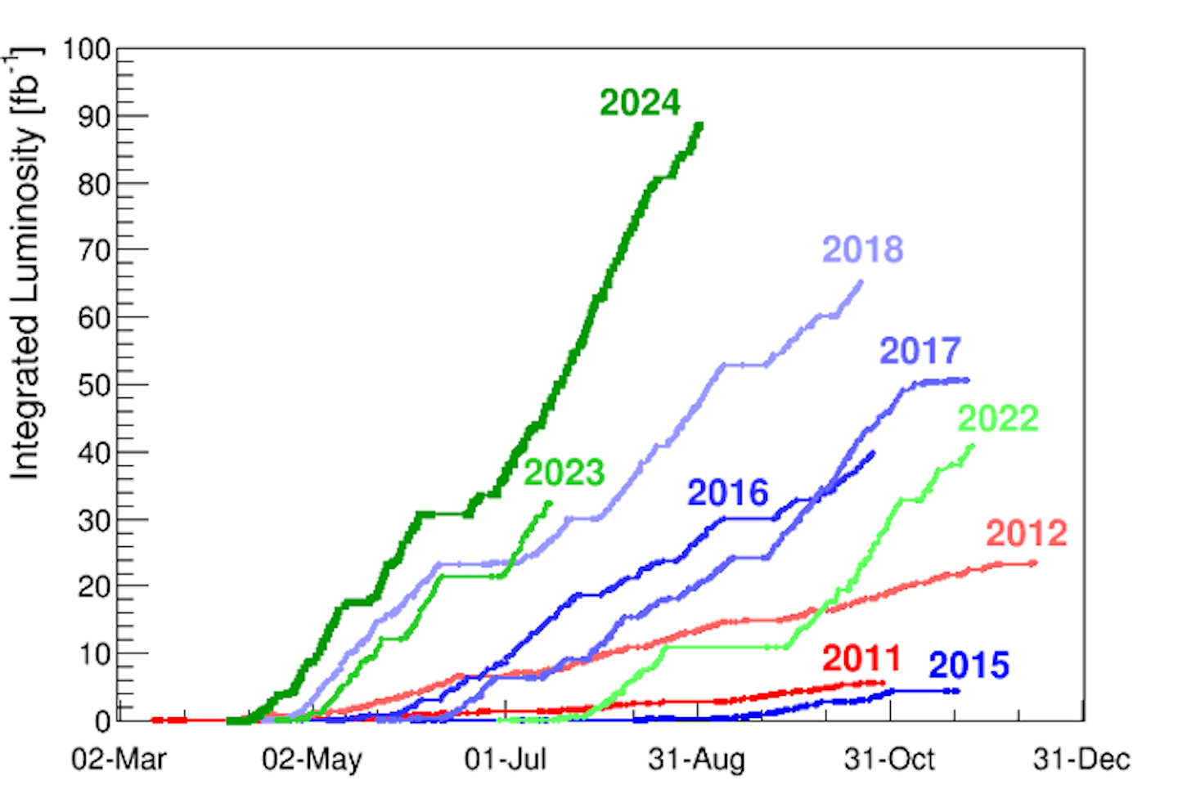
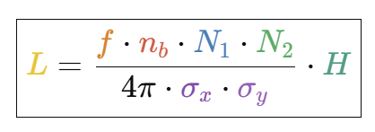
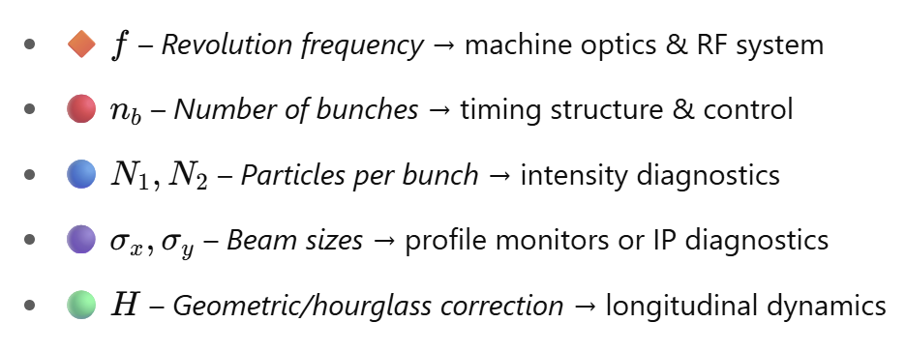
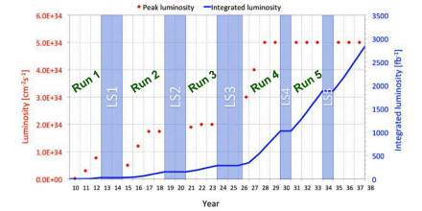
Luminosity
Essential for optimization, discovery, and control
A single illustrative case of the importance and complexity of beam monitoring
Concept & Basic definitions
Luminosity (L) is the key performance metric for colliders, measuring collision probability
It quantifies the event rate potential for a given physics process and is defined as:
LHC
High L means intense small beams colliding very frequently !
Each term comes from a different class of beam diagnostics, making luminosity a derived, cross-dependent observable that reflects both machine performance and diagnostic integration.
Direct luminosity measurements from LHC Experiments (absolute) and Machine Detetors (‘BRAN’, relative)
But Beam Current and Beam Size measurements essential to control and optimize luminosity

Slide 31
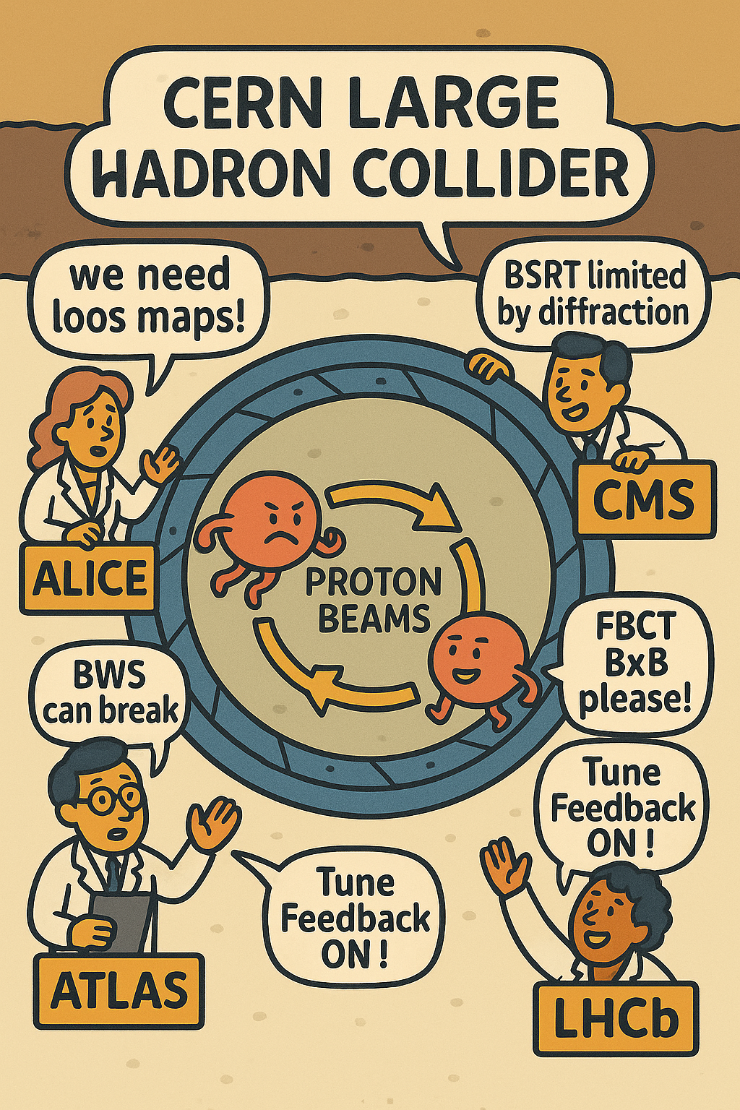
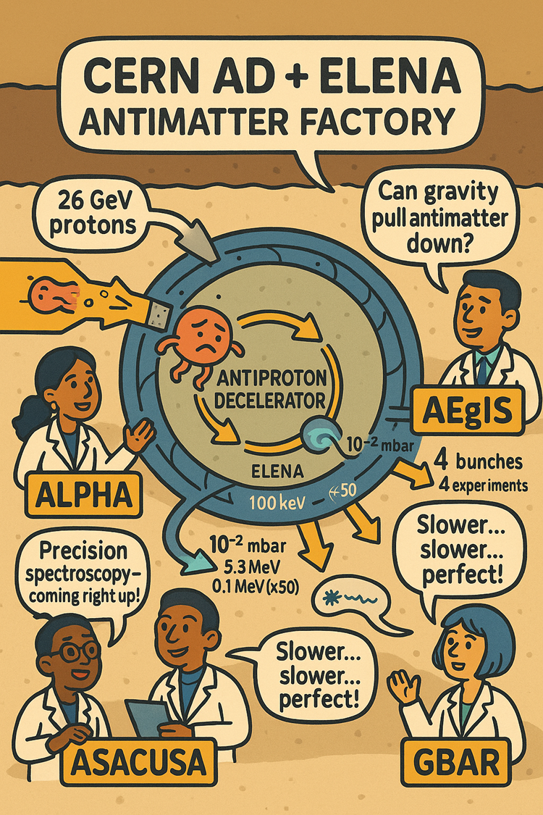
Spanning Extremes: The Range of Measurable Beam Parameters (at CERN)
LHC@Top Energy | Parameter | AD/ELENA
Protons (or heavy ions) | Particle | Antiprotons / Antihydrogen
6.8 TeV per beam | Energy | 5.3 MeV → 100 keV (ELENA)
~10¹¹ protons/bunch | Intensity | ~10⁷ antiprotons/cycle
Up to 2808 | Bunches | Single or few bunches
25 ns | Bunch Spacing | ms – s
<20 μm at IP (Interaction Point) | Beam Size | mm–cm range
High dynamic range, high resolution, radiation hard | Diagnostics Challenge | Ultra-sensitive, low-noise, single-particle capable

Slide 32
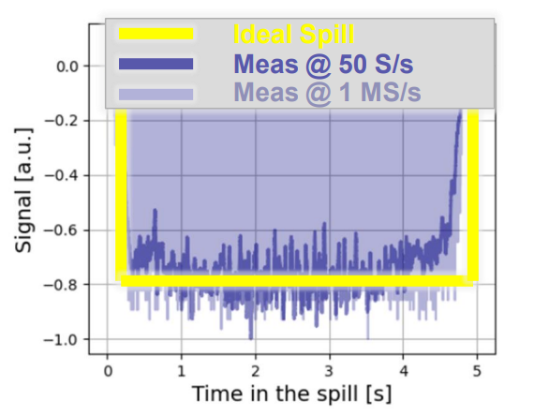
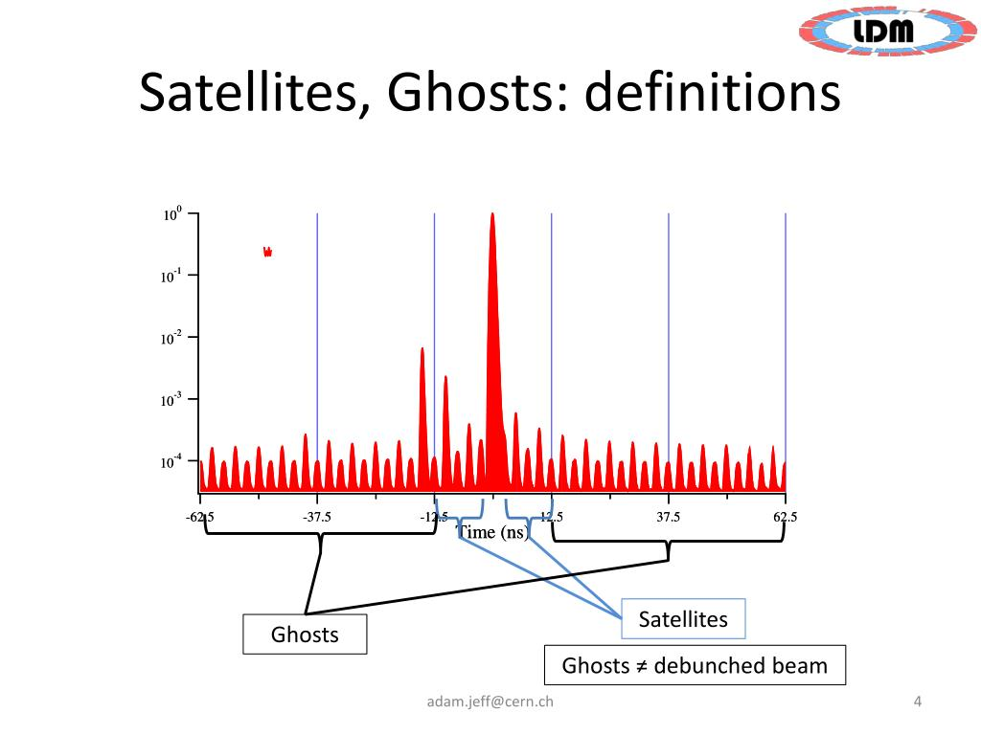
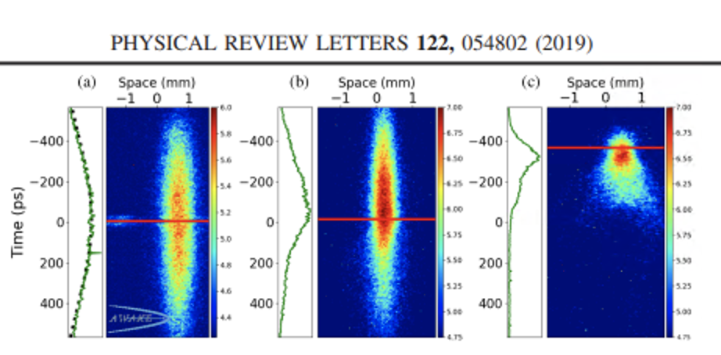


More on diagnostics diversity
SPS SPILL MONITORING
LHC LONGITUDINAL DENSITY MONITOR
AWAKE PROTON bunching PROBING
Provide constant proton flux to fixed target experiemnts
Check proton populating around main bunch
Measure long. profile of the proton bunch with/without plasma source
Resolve 50ps , takes 5 minutes to collect enough signal
Single shot lasts 5s, need to resolve 10s of ns
Resolution : ∼ 0.7 − 0.9 𝑝𝑠
Accuracy: ∼ 0. 17ps
F.R. et al. , 'Fast Spill Monitor Studies for the SPS Fixed Target Beams'
A. Jeff et . al - Longitudinal Density Monitor for the LHC
AWAKE collab., Experimental Observation of Proton Bunch Modulation in a Plasma
click
click
click

Slide 33
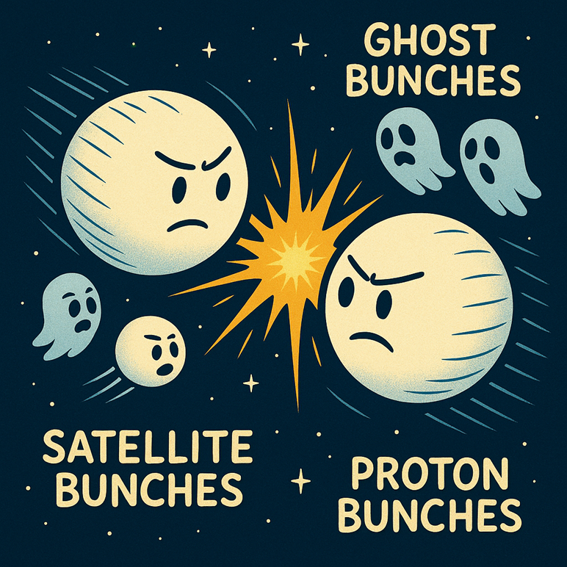
Key takeaway from the previous slide
We must measure Ghost and Satellite bunches

Slide 34
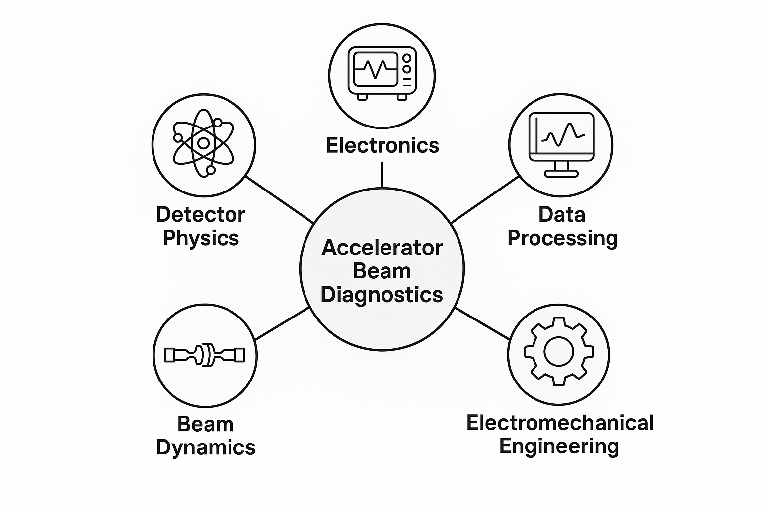
What is beam diagnostics
Developing diagnostics systems for particle accelerators is a complex and interdisciplinary field. It requires collaboration across a broad range of scientific and engineering domains:
Detector Physics & Design: Understanding particle interactions with matter, optics, and electromagnetism is fundamental to building accurate and sensitive detectors.
Electronics: Fast, high-resolution front-end and acquisition electronics are essential for capturing transient signals from particle beams.
Data Processing: Signal processing, real-time analysis, and advanced algorithms are needed to extract meaningful information from raw data.
Electromechanical Engineering: Precision mechanical systems ensure the stability, alignment, and integration of diagnostic devices in challenging environments.
Accelerator Physics & Beam Dynamics: In-depth knowledge of beam behavior is crucial to interpreting diagnostic signals and optimizing performance.
Simulations – Implementation – Data analysis, and much more

Slide 35
(~Standard) Diagnostic Toolkit
Particle interaction with matter
Electromagnetic coupling or radiation emission
Beam crosses (solid or gaseous) material
Electrical signal:
☢️ Faraday cups – direct charge collection
🔄 Secondary-emission foils – emit electrons
⚡ Gas-ionisation chambers – ion pair current
Photon emission:
✨ Scintillating screens – visible light emission
💡 Gas fluorescence monitors – UV/visible light
🔆 Optical Transition Radiation (OTR) screens
High energy secondary showers
➖Wire scanners – secondaries detected by out-of-vac detectors
Instrument placed around/near beam pipe
Signal produced by Electromagnetic coupling/image currents:
📡 Beam Position Monitors (BPMs) – image currents
🔁 Beam Current Transformers (BCTs) – inductive pickup
Radiation:
🌈 Synchrotron-light monitors – natural emission in magnets
Intrusive: may disturb / stop beam
Non-intrusive—beam remains undisturbed

Slide 36
Diagnostics reference table
Parameter | LINAC / Transfer Line | Synchrotron
Beam Quantity | Transformer (dc, pulsed), Faraday cup | Transformer (dc)
 | SEMs | Calibrated pick-up signal
Position | Pick-up (button, stripline) | Pick-up (button, stripline)
 | Screens, SEMs | Cavity excitation (e⁻)
Transverse Size | SEM-grid, wire scanner, screens | Beam gas monitor, synchrotron radiation, wire scanner
 | Grid with amplifier (MWPC) | —
Momentum p and Δp/p | Pick-up (TOF), magnetic spectrometer | Pick-up, tomography
 |  | Schottky noise pick-up
Bunch Length | Pick-up | Pick-up, wall current monitor, streak camera (e⁻)
DC Beams (FT) Longitudinal Structure | SEM, OTR screens
Tune, Chromaticity | n.a. | Exciter + pick-up (BTF), transverse Schottky pick-up
Beam Loss | Ionization chambers, scintillators, Secondary Emission monitors | Ionization chambers, scintillators, Secondary Emission monitors
Luminosity | n.a. | Scintillators, gas detectors
Much more details from accelerator schools
Comprehensive view surely here:
Peter Forck @ JUAS
Lecture Notes on Beam Instrumentation and Diagnostics
https://www-bd.gsi.de/conf/juas/juas_script.pdf

Slide 37
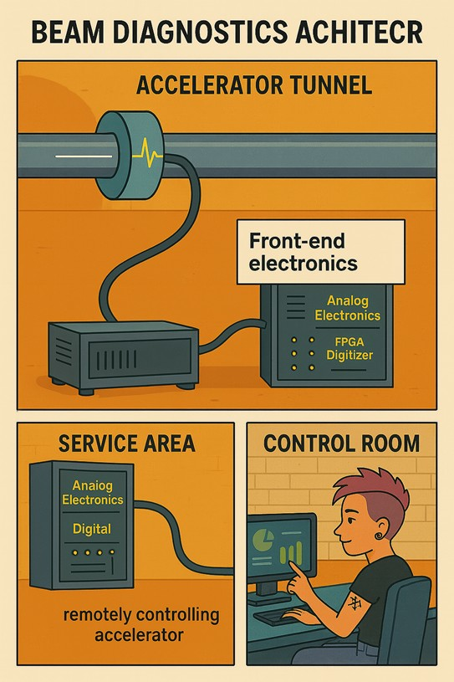
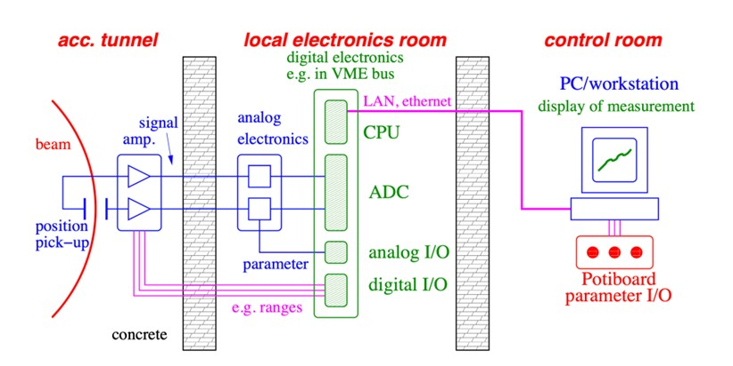
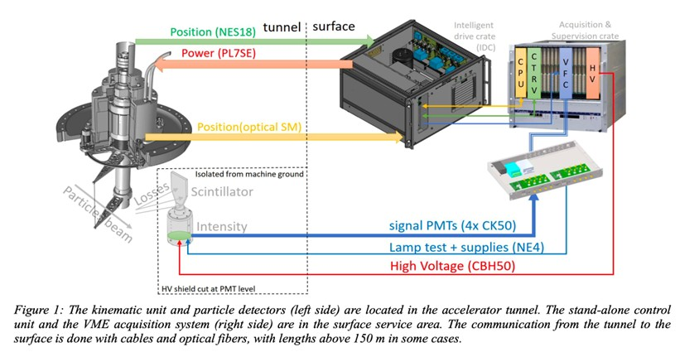
Typical Architecture of a BI system
Beam position monitor (~=typical)
Beam Wire Scanners (all LHC injectors)

Slide 38
Analog & Digital Electronics in Diagnostics
Particle beam instrumentation relies heavily on both analog and digital electronics to measure, monitor, and control beam parameters with high precision.
Aspect | Analog Electronics | Digital Electronics
Signal Type | Continuous | Discrete (binary)
Key Roles | - Signal conditioning - Pre-amplification - Filtering | - Data acquisition - Signal processing - Storage
Common Components | Op-amps, filters, ADCs (output stage), mixers | FPGAs, microcontrollers, DSPs, memory
Strengths | Low latency, high bandwidth, real-time behavior | Flexible, programmable, precise timing and logic operations
Challenges | Susceptible to noise, drift | Requires conversion (ADC/DAC), sometimes slower for real-time
Signal transmission: over copper cables or optical fibers, each with field of application, + pro and cons always to be considered when conceiving or upgrading diagnostics

Slide 39
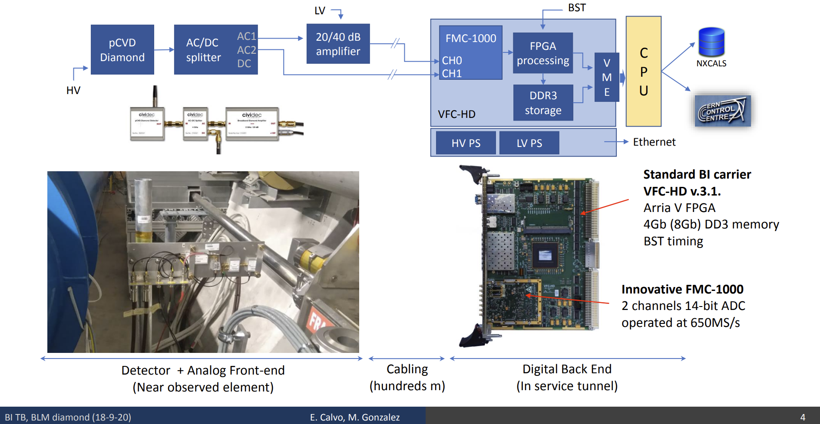
Takeway of this part
(while looking at a Diamond Beam Loss Monitors architecture)
Working with beam instrumentation systems offers unique and multidisciplinary opportunities, including:
The design, development, and testing of both analog and digital electronics
Real-time data acquisition and processing
Performance evaluation, requiring broad expertise — from detector physics to data analysis

Slide 40
Diagnostics methods basics (examples)

Slide 41






Beam Position Monitor - Concept
V1
Proportional to beam position in the pipe
V2
To be independent of beam intensity:
Need bunched beam

Slide 42


Beam Current Transformers
1️⃣ DC Beam Current Transformer (DCCT)
🧭 Measures the average (DC) beam current, even if it’s constant over time (e.g., in a storage ring).
🧪 Working Principle
Uses magnetic cores and zero-flux feedback techniques to detect a steady magnetic field caused by the beam current.
🔣 Key Concept
Ampère’s law (steady current):
The device cancels this magnetic field using a compensation winding carrying a current I​, and the value of I_feedback = -I_beam (see diagram)

Slide 43





Beam Current Transformers
2️⃣ Fast (AC) Beam Current Transformer (FBCT))
⚡ Measures the time-varying (AC) components of the beam current — e.g., fast pulses or individual bunches.
🧪 Working Principle
Based on a toroidal transformer: beam acts as a primary winding, inducing a voltage in a secondary coil proportional to dI/dt (change in current).
🔣 Key Concept
Faraday’s law:
- M is mutual inductance.
Ideal Case
Reality
Bandwidth matters !

Slide 44


Imaging Systems (Scintillation)
When a charged particle passes through a scintillator (like Chromox, which is Al₂O₃:Cr), it excites atoms in the material. As these atoms return to their ground state, they emit visible photons.
CAMERA
BEAM
SCREEN

Slide 45

Imaging Systems (OTR)
Optical Transition Radiation (OTR):
When a charged particle crosses the boundary between two media with different dielectric constants (e.g., vacuum to titanium), it emits OTR photons due to the sudden change in electromagnetic field configuration.
CAMERA
BEAM
SCREEN

Slide 46




Imaging Systems – Synchrotron Radiation
Physics:
When a charged particle (such as an electron or proton) moves at relativistic speeds and is accelerated (bent) by a magnetic field, it emits electromagnetic radiation known as synchrotron radiation. This can be collected and imaged, providing non-interceptive diagnostics of the beam’s size, shape, and position.
CAMERA
From photon energy to wavelength
In Part II: how it is used for ‘Abort Gap’ monitoring

Slide 47




LHC Synchrotron Radiation Monitor a.k.a. BSRT
Light Extraction tank
Front view
Beam
Light
Top view of table hosting optical lines and different detectors for imaging and counting
early LHC version, Illustrative != present version

Slide 48






Bonus Slide –Synchrotron Light at Hands
ALBA – (Barcelona, Spain) SR facility commissioning xx year ago
Courtesy of U.Iriso (all, apart form St.Thomas)

Slide 49




Bonus Slide – Beam Halo Monitor
WORK IN PROGRESS

Slide 50
Take-away Messages — Part 1: Diagnostics Foundations
👁️ Beam diagnostics are the accelerator’s eyes – without them, operators would be flying blind.
📈 A few essential observables drive performance: position, current, size, losses, longitudinal profile and, ultimately, luminosity.
⚙️ Intrusive (e.g. screens, wire-scanners) and non-intrusive (e.g. BPMs, BCTs, synchrotron-light) monitors are chosen according to beam power and required resolution.
💡 Accurate instrumentation needs multidisciplinary know-how: detector physics, fast electronics, real-time data processing and beam dynamics all meet here.
🛡️ Diagnostics integration lets CERN span many orders of magnitude in beam intensity, it still need to protect both people and hardware.
🔍 Next lecture (Part 2) will show real-world use-cases – LHC dump system, electron-cloud studies, LINAC4 phasing – where good BI is essential for operation.

