Slide 1



Accelerator Operation and Diagnostics
Federico Roncarolo
@CERN summer student lectures 2025
Part II

Slide 2



Contents
Part 1 (General)
Part 2 (Diagnostics use examples)
Introduction & Accelerator basics
Facility ‘Types’
Operation
Beam Diagnostics
Introduction
Methods (examples)
LINAC4 Phasing
LHC Threading
SPS-LHC Electron Cloud
LHC Beam Dump System
Some exotic/fun stuff

Slide 3

Take-away Messages — Part 1: Diagnostics Foundations
👁️ Beam diagnostics are the accelerator’s eyes – without them, operators would be flying blind.
📈 A few essential observables drive performance: position, current, size, losses, longitudinal profile and, ultimately, luminosity.
⚙️ Intrusive (e.g. screens, wire-scanners) and non-intrusive (e.g. BPMs, BCTs, synchrotron-light) monitors are chosen according to beam power and required resolution.
💡 Accurate instrumentation needs multidisciplinary know-how: detector physics, fast electronics, real-time data processing and beam dynamics all meet here.
🛡️ Diagnostics integration lets CERN span many orders of magnitude in beam intensity, it still need to protect both people and hardware.

Slide 4

Take-away Messages — Part 1: Celebrations

Slide 5
Use of beam instrumentation - Examples
LINAC trajectory and energy measurements via BPMs
LHC Threading
Electron Cloud
LHC Beam Dump System
Wrap up + Wire Grids for inspection on the desk)

Slide 6
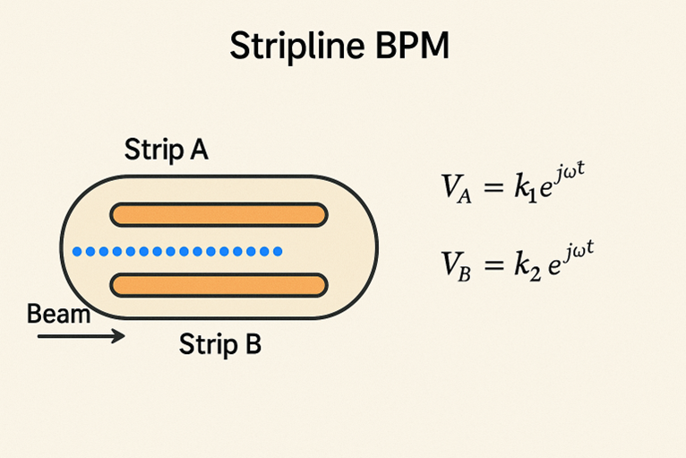
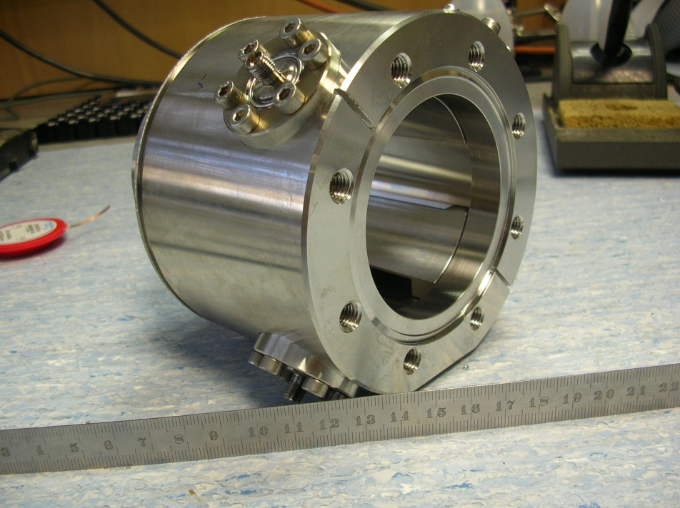
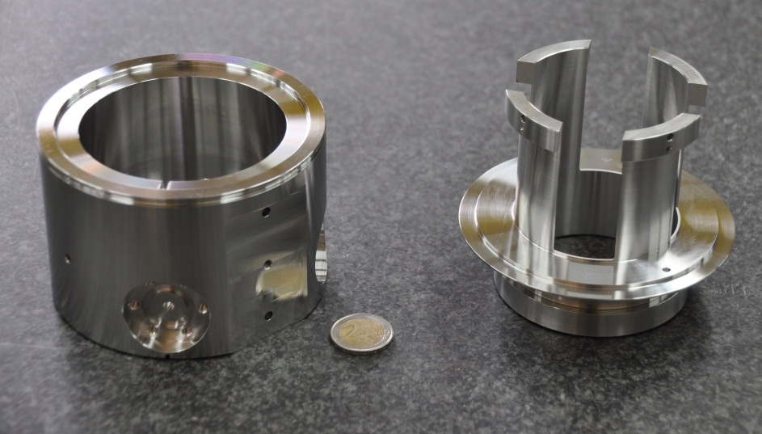
Stripline BPM
Electrostatic BPM (yesterday): Uses capacitive coupling between the beam and electrodes (typically 2 or 4 pickup electrodes).The beam induces an image charge on the electrodes; the voltage difference between electrodes is proportional to the beam's position.
Stripline BPM: Uses transmission lines (striplines) with matched impedance. The beam induces a traveling signal that propagates down the stripline and is picked up at the downstream end.
Position: x ∝ (Vₐ - Vᵦ) / (Vₐ + Vᵦ) — signal difference shows offset.
Phase: compare signal phase to RF reference → φ = φ_meas - φ_LO.
Time-of-Flight: compare phase at two BPMs → beam velocity → energy.

Slide 7
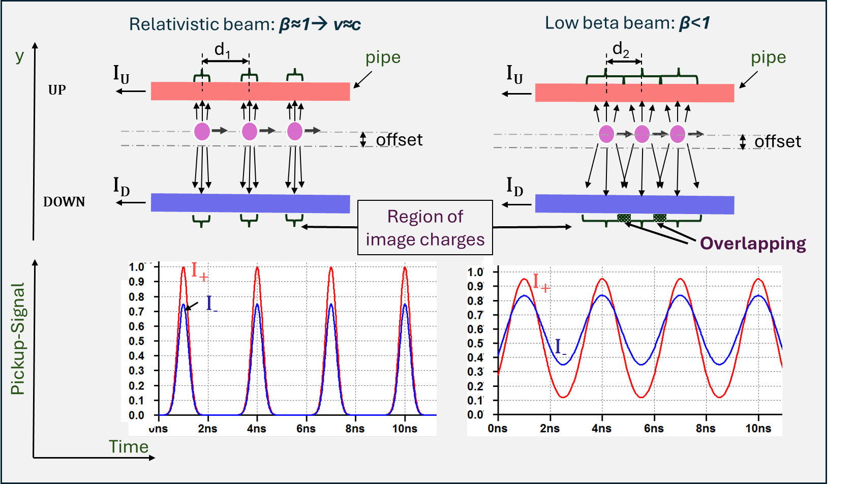


Signals induced on a stripline BPM
Intensity ${ \sim Σ=(I}_{U}+I_{D})$
Position $=\sim \frac{∆}{Σ}=\frac{I_{U}−I_{D}}{I_{U}+I_{D}}$

Slide 8
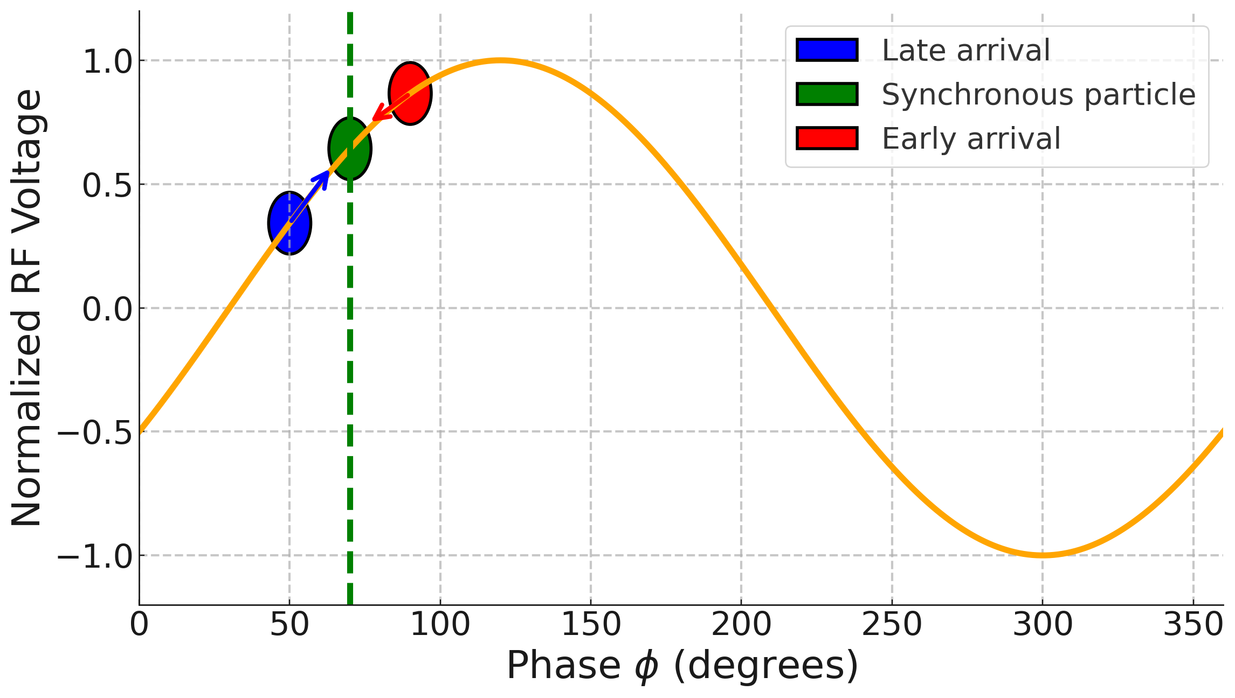
LINAC Acceleration and Cavity Phasing
RF Cavity and Acceleration - Reminder
The synchronous particle is accelerated at the nominal energy.
Particles arriving late relative to the synchronous phase receive a larger energy gain than the synchronous particle.
Particles arriving early receive a smaller energy gain than the synchronous particle.
→ This leads to acceleration and longitudinal focusing (bunching).
To set-up and check acceleration : Time of Flight (TOF) via Beam Position Monitors

Slide 9
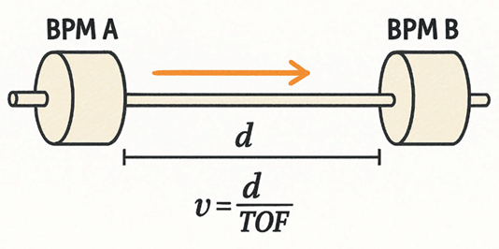

Energy measurement via Time Of Flight between BPMs
🧪 Inferring Beam Energy from Time of Flight (TOF)
By measuring how long a particle bunch takes to travel between two beam position monitors (BPMs) a known distance apart, we can calculate its velocity. Since velocity is directly related to energy, this Time-of-Flight method allows us to determine the beam energy without intercepting the beam.
Key idea:

Slide 10

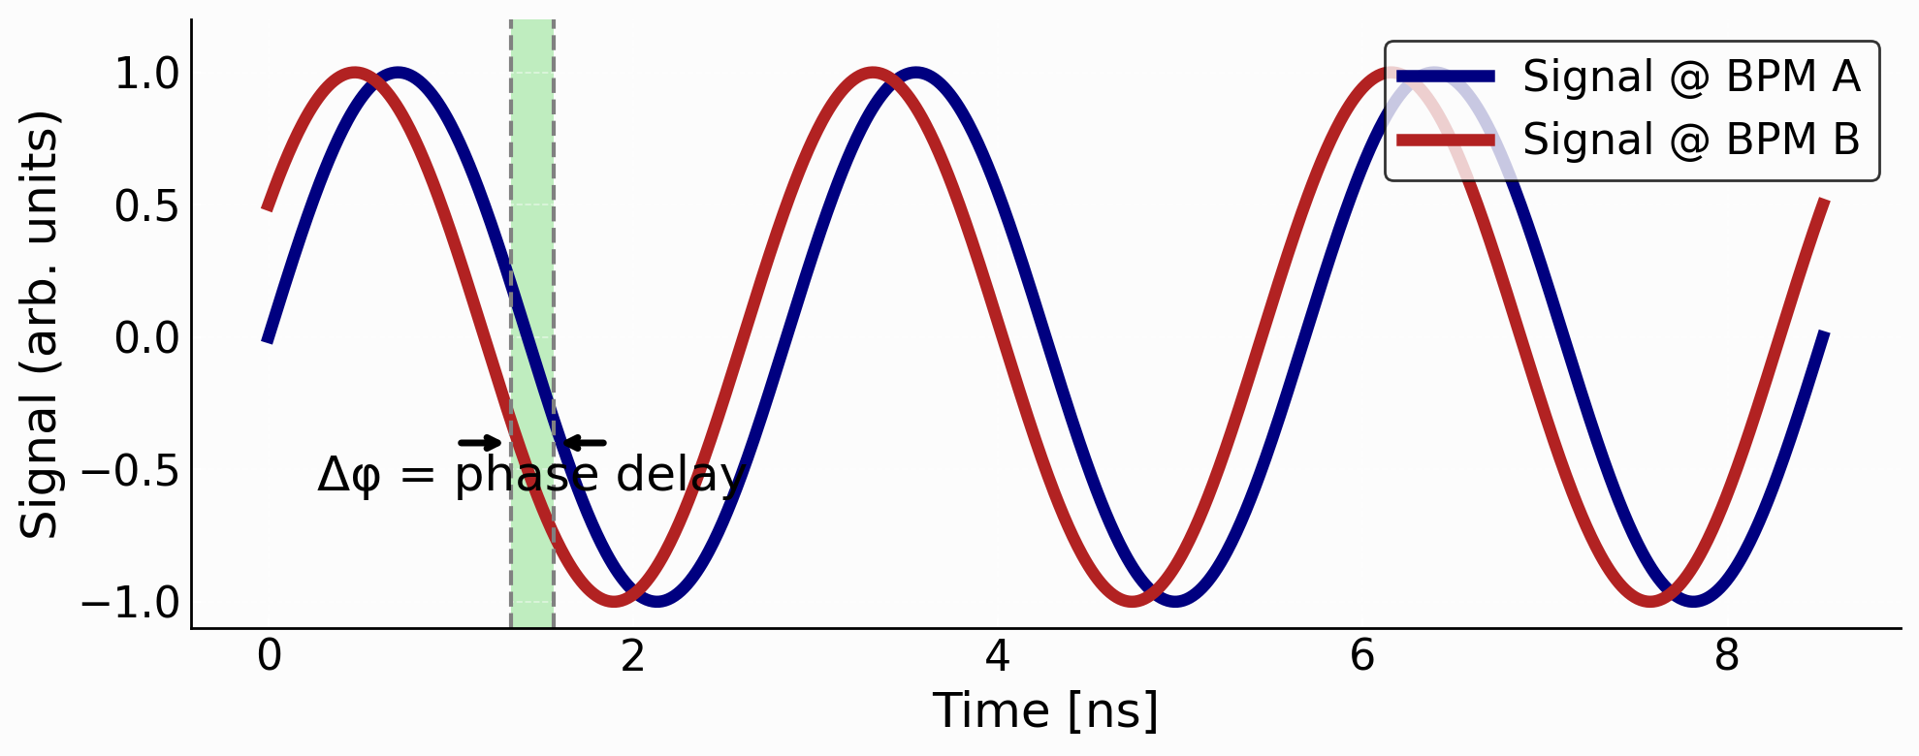

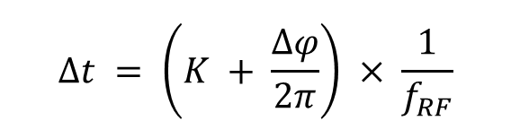
Energy measurement via Time Of Flight between BPMs
🧪 Setup:
Two BPM pick-ups (A & B) separated by a drift d ≈ 3 m
Beam velocity: v = d / Δt, where Δt is flight time
🕒 Method 1: Direct Time-Stamping
Electronics jitter: Δt_res ≈ 1 ns ⇒ Energy resolution: ΔE ≈ 1 MeV
✔ Too imprecise for cavity tuning
🔁 Method 2: RF-Phase Measurement (LINAC4: f_RF = 352 MHz)
Pick off 352 MHz phase at both BPMs → Phase resolution ≈ 5°
⇒ Δt_res ≈ (5°/360°) × (1/352 MHz) ≈ 40 ps
⇒ Energy resolution: ≈ 40 keV
🧩 Phase ambiguity:
Integer K = unknown number of full RF cycles (≈10–few 100)
Resolved via design estimates or iterative TOF scans
$$Δt = \left(K + \frac{Δφ}{2π}\right) × \frac{1}{f_{RF}}$$
Key take-aways
  • TOF converts timing into velocity β and therefore energy E.
  • RF-phase gives picosecond-level timing without ultra-fast digitisers.
  • Must keep track of the integer turn-count K to get the absolute energy.

Slide 11
RF Cavity Phasing - Procedure
📉 Measure baseline Time-of-Flight (ToF) with cavity OFF:
Turn off the RF field (or set it to a low reference value).
Measure the beam arrival times at both detectors: this gives a reference ToF and a baseline beam energy.
📈 Vary cavity RF phase:
Turn the cavity ON and sweep its RF phase over a range (typically ±30° to ±90°).
For each phase setting, measure the beam arrival times at the two detectors again.
📊 Compute ΔToF for each phase:
For each RF phase setting, compute the difference in arrival time (ΔToF) compared to the baseline.
This ΔToF reflects the change in beam velocity due to energy gain in the cavity.
Repeat for Multiple Amplitudes (Voltage Scan):
For each voltage setting (e.g., 80%, 90%, 100%, 110% of nominal), repeat the phase scan.
This gives a family of ToF vs phase curves.

Slide 12
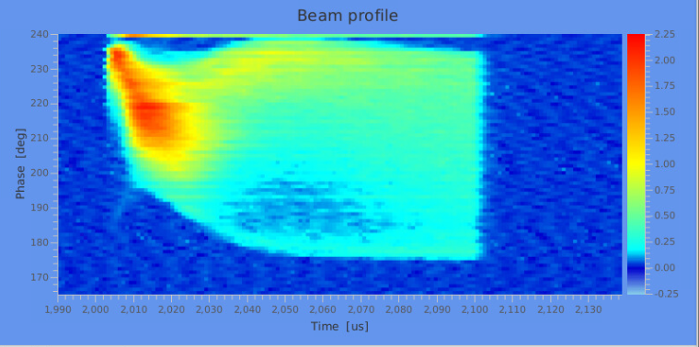
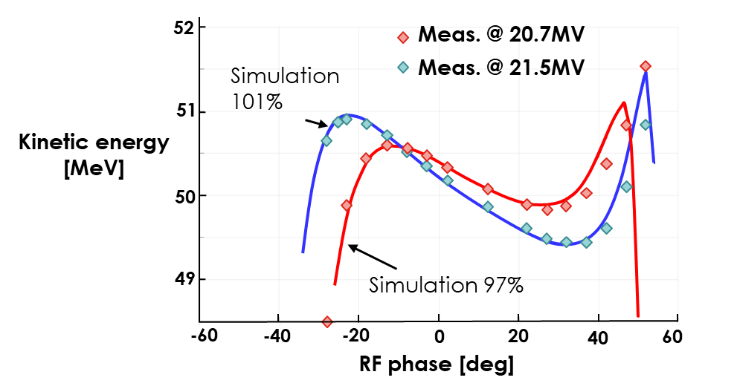
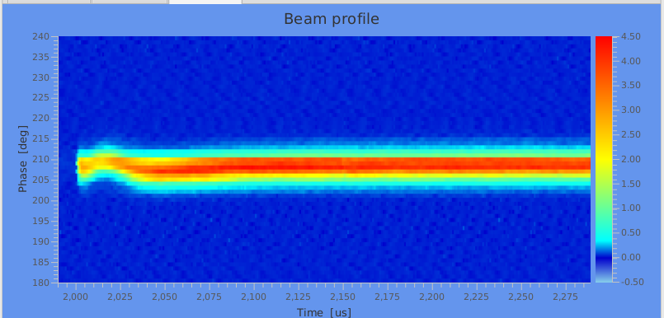
LINAC Energy Measurement -Results
Cavity setting with BPMs TOF
Bonus plots – Bunch length end energy measurements via bunch shape monitor **
RF cavity settings lost → un-bunched beam high energy spread
PHASE (→ENERGY)
Problem fixed, back to normal!
TIME
** phantastic-too-long to explain here monitor :
Feshenko, A.V., "Methods and instrumentation for bunch shape measurements," Proceedings of the 1999 IEEE Particle Accelerator Conference (Cat. No.99CH36366), 1999, pp. 1663-1665.

Slide 13
BPMs used to inject for the first time in the LHC

Slide 14

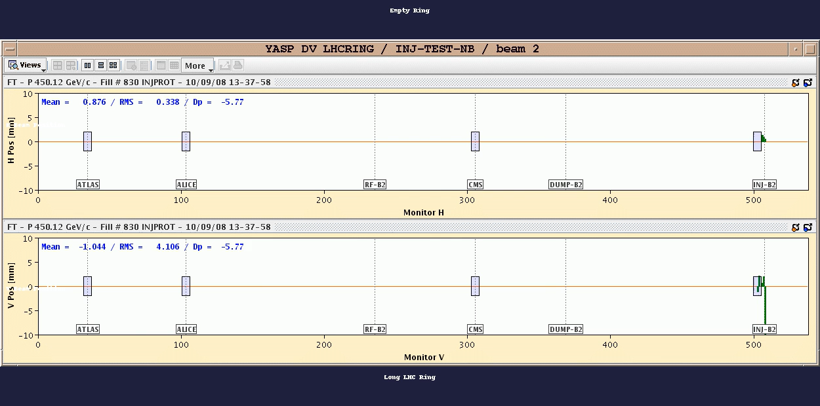
LHC Day 1: ‘Threading’

Slide 15
BPMs used to track the moon
Based on J. Wennninger’s studies, e.g. here

Slide 16
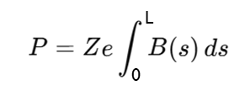
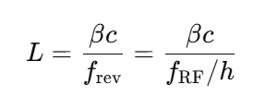
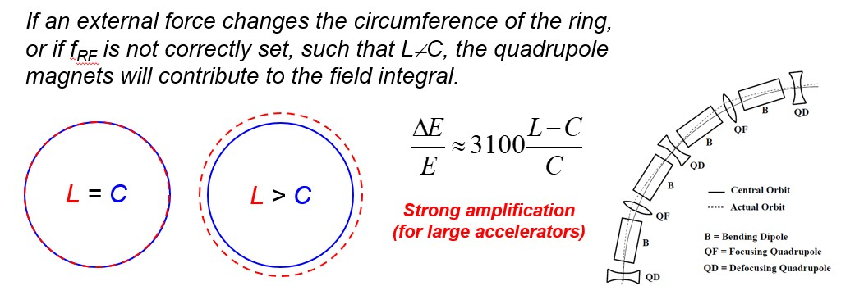
Knowing the LHC circumference for measuring beam energy
Key relationship
Why Circumference Matters
Beam momentum P is determined via the magnetic field integral
In the ideal case: L=C (magnet-defined circumference)
If 𝐿≠𝐶: quadrupoles and other magnets contribute to energy → measurement bias
Precise knowledge of circumference ensures accurate calibration of energy using magnetic model and RF system.

Slide 17
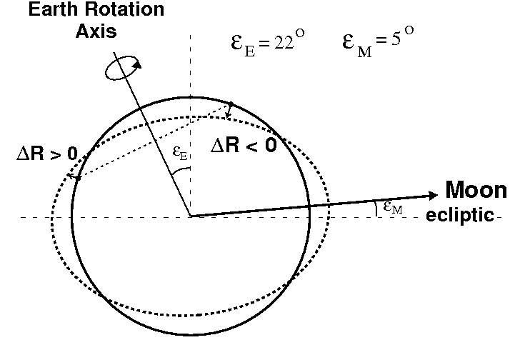
Tides Modulate LHC Circumference
Tidal Influence
Earth tides from Moon & Sun induce up to 1 mm peak-to-peak circumference changes.
Uncorrected, this leads to modulations up to ~1.4×10⁻⁴ in beam energy.
How effect Measured
With LHC BPMs and Orbit measurements
LHC’s orbit feedback system automatically adjusts for these changes
Residual impact on energy < 0.01%

Slide 18

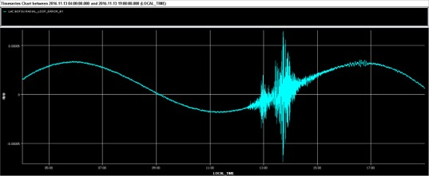
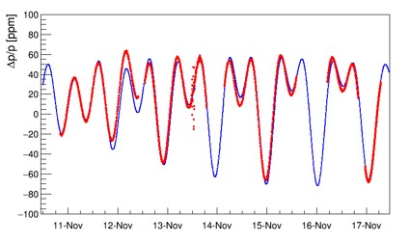
Tides (and not only) measurements
Orbit measurements vs model
Tide observations during the 2016 pPb run at 4 TeV
— MODEL
— ORBIT MEASUREMENT
Pressure waves reached the LHC → Cause transient deformations of the tunnel → Change in circumference → Measured by BPMs!

Slide 19

Electron Cloud

Slide 20
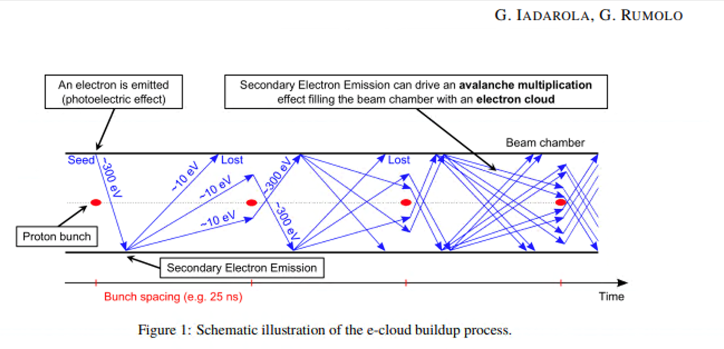
Electron Cloud
CONCEPT
Accumulation of free electrons in the accelerator beam pipe.
ORIGIN:
Ionization of residual gas → primary electrons
Synchrotron photons hitting walls → photoelectrons
Beam—wall interaction →secondary electrons
EFFECT ON BEAM
Beam instabilities (single & multi-bunch), instabilities that affect bunches differently along the train—typically degrading later bunches more severely
Emittance growth and losses
Thermal loads in cryo‑sections
Vacuum degradation
Multipacting

Slide 21
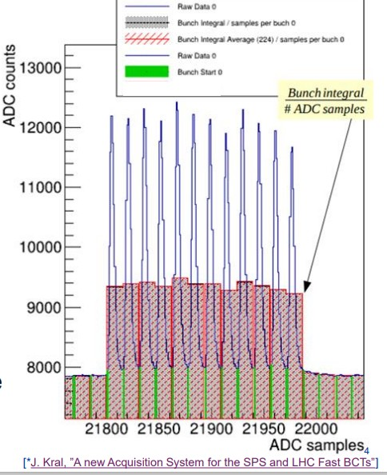
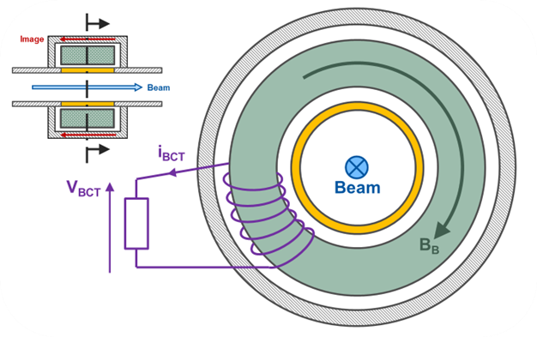
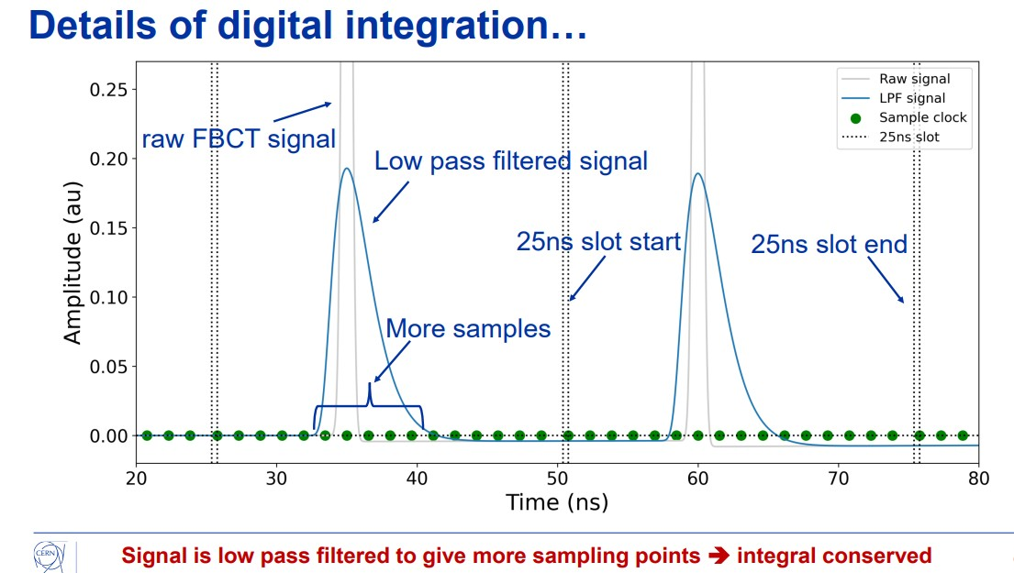
How we measure bunch per bunch intensity
Remember the FBCT ?
Simulation
measurement

Slide 22
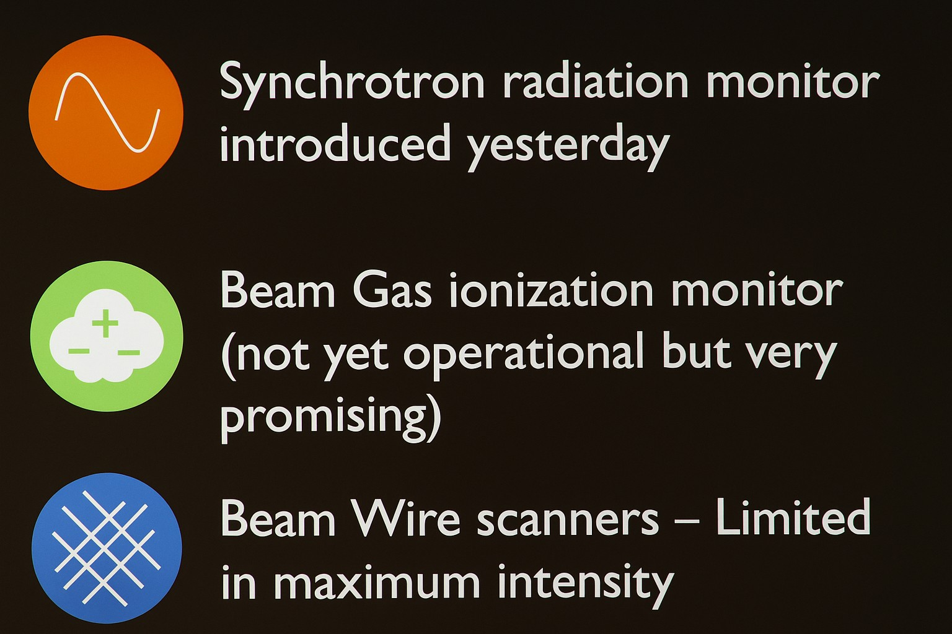
How we measure bunch per bunch beam size – e.g. to monitor e-cloud effects

Slide 23
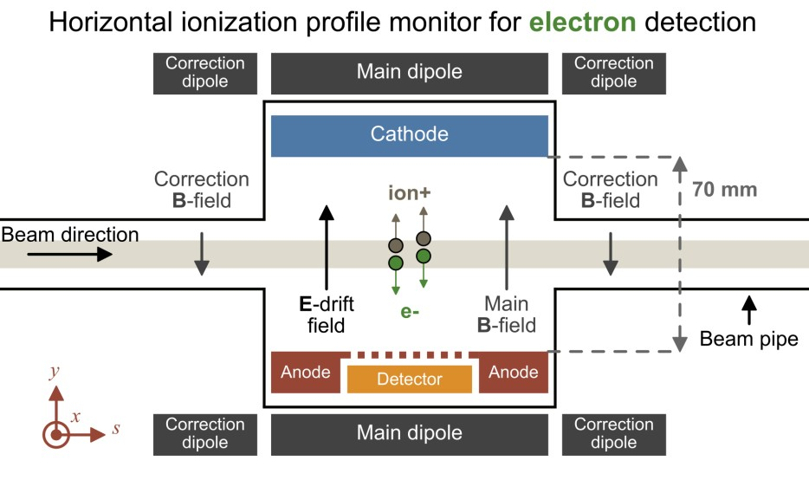
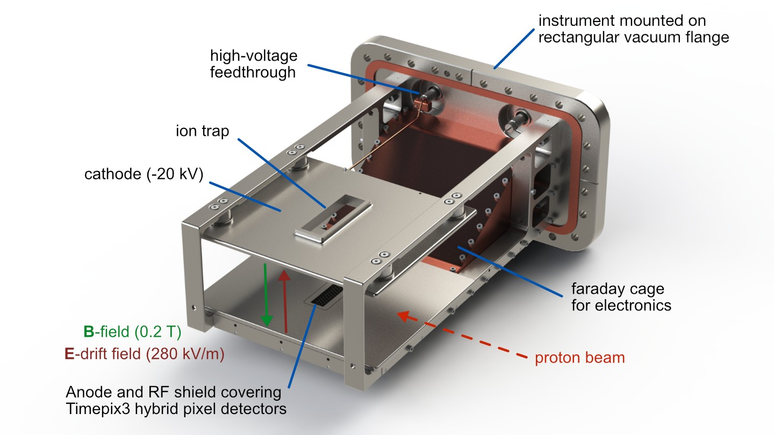
Beam Gas Ionization Monitor (BGI)
Recent version base on Timepix sensor
-in principle self calibrated , allows bunch per bunch
https://bgi.web.cern.ch/

Slide 24

BGI images during proton beam acceleration in PS
S
X

Slide 25
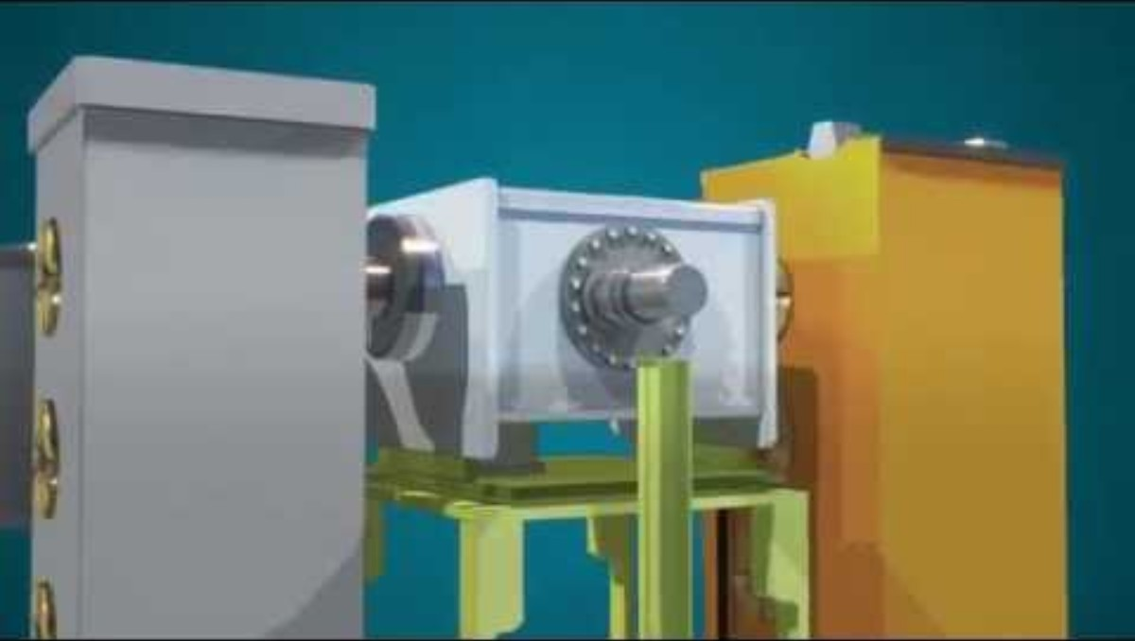
Beam Wire Scanners

Slide 26
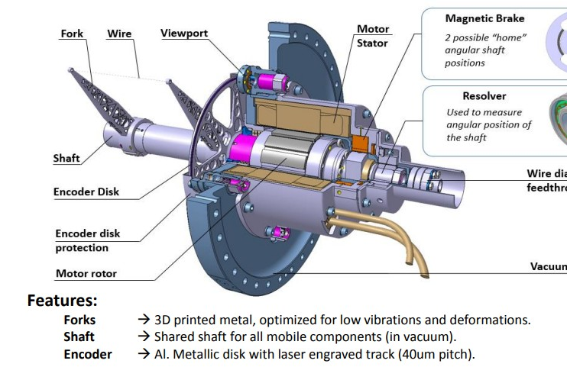
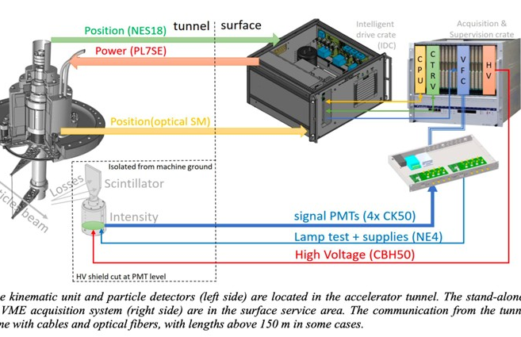
Beam Wire Scanners – Latest Generation
Kinematic unit
System architecture

Slide 27
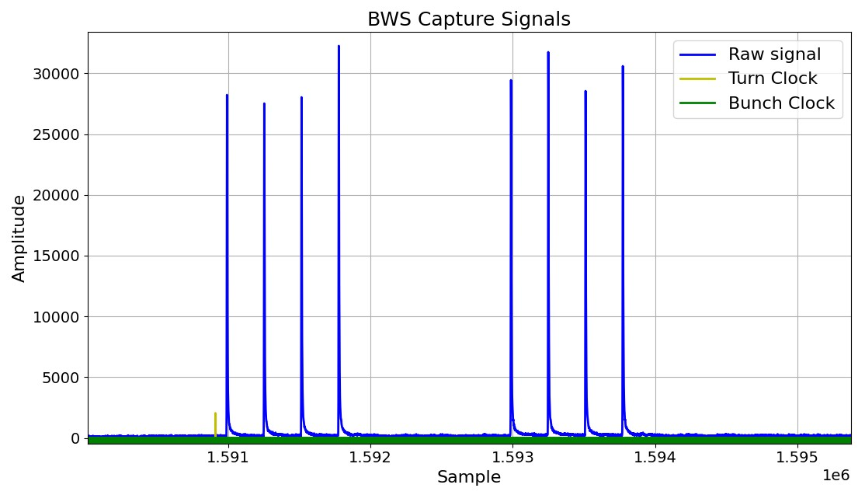
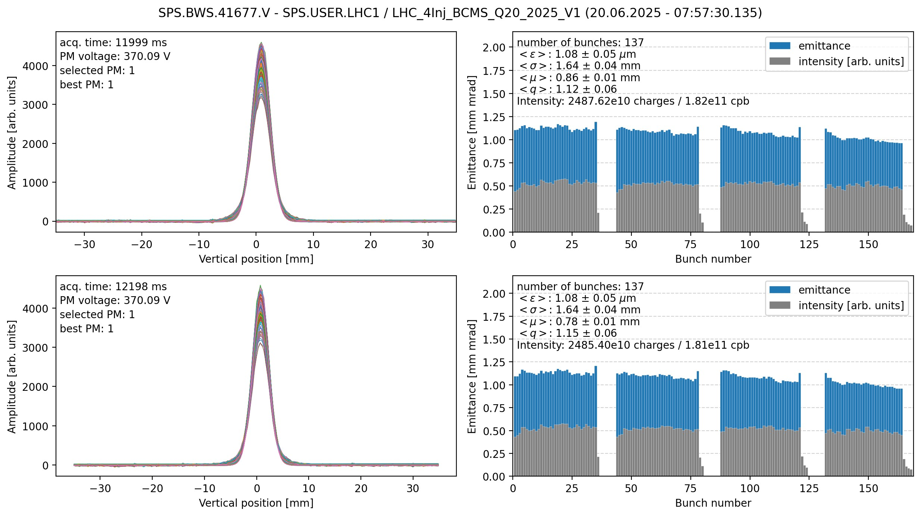
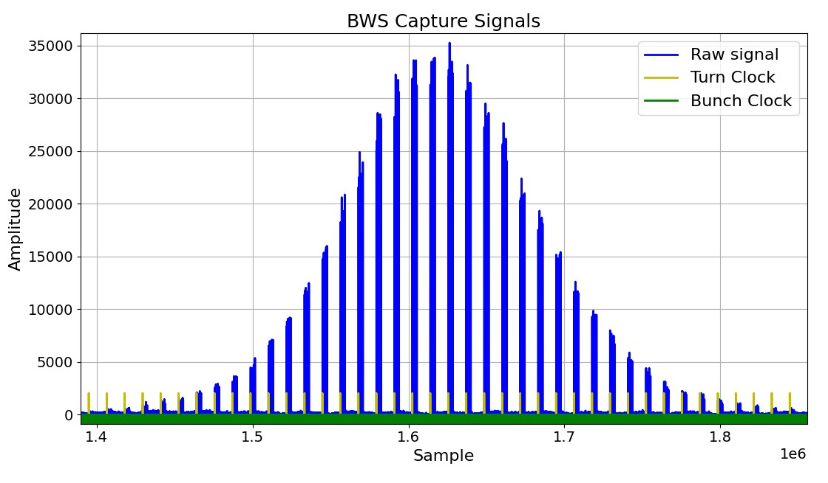
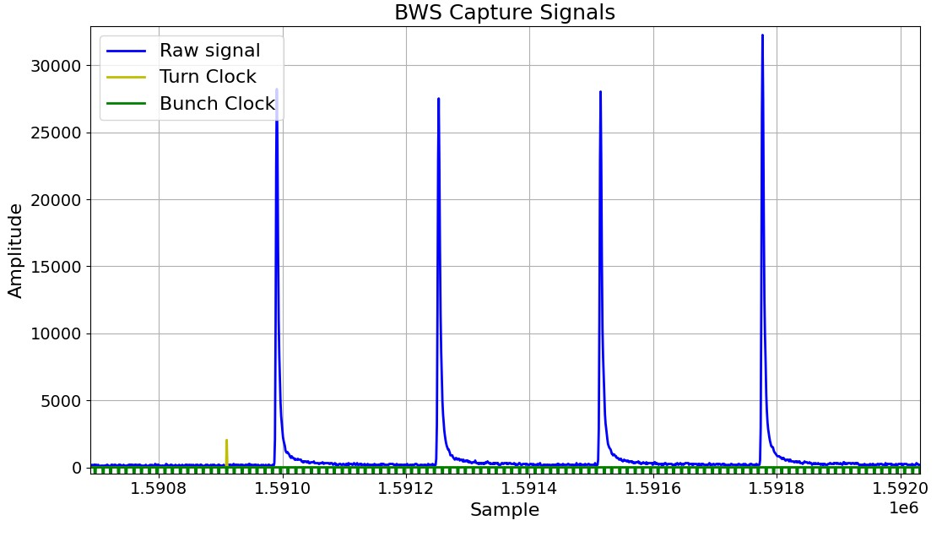
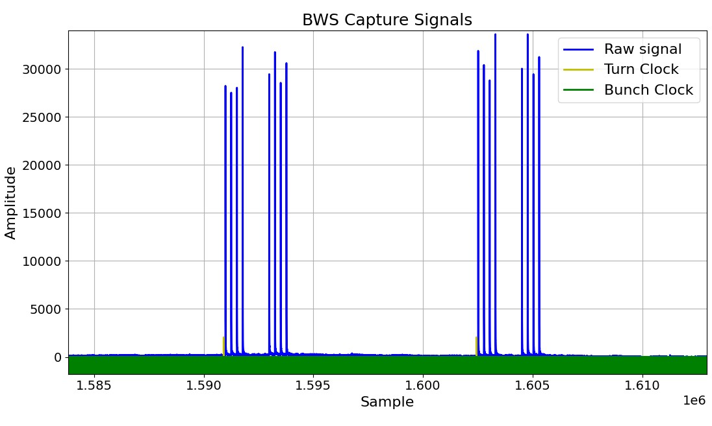
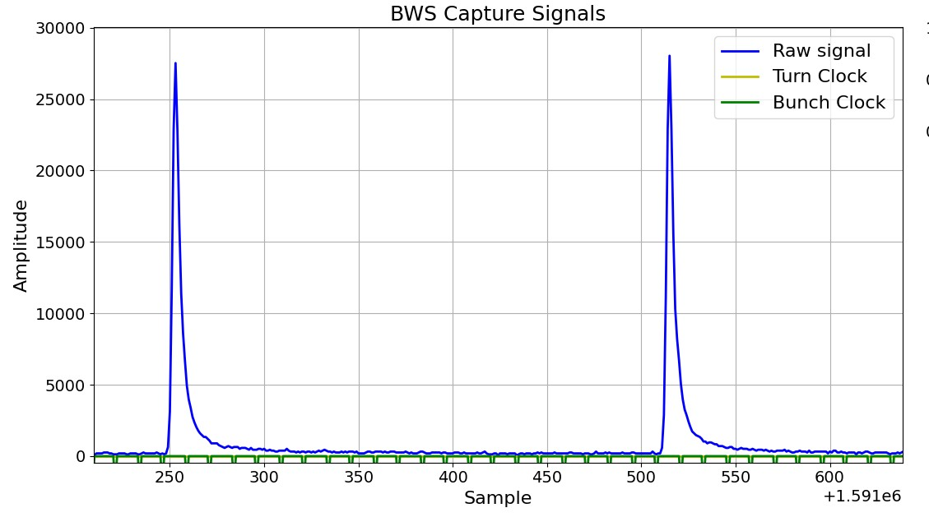

Beam Wire Scanners – BbB meas
PMT signal during wire flight: every turn wire intercepts N bunches (here = 8)
ZOOM
Wire fly direction
Electronics is integrating the signal for every bunch and publishing one amplitude and one wire position point per bunch per turn
At the end of the scan, N profiles (here 144)

Slide 28
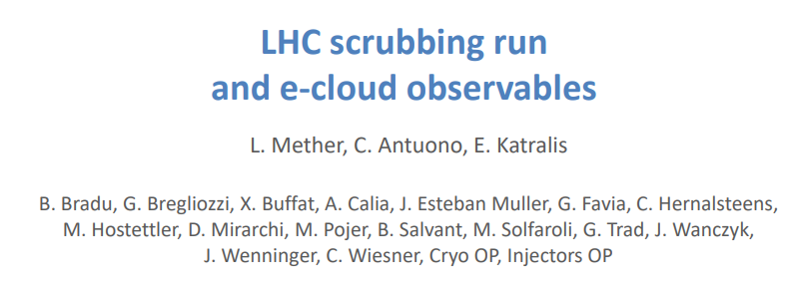
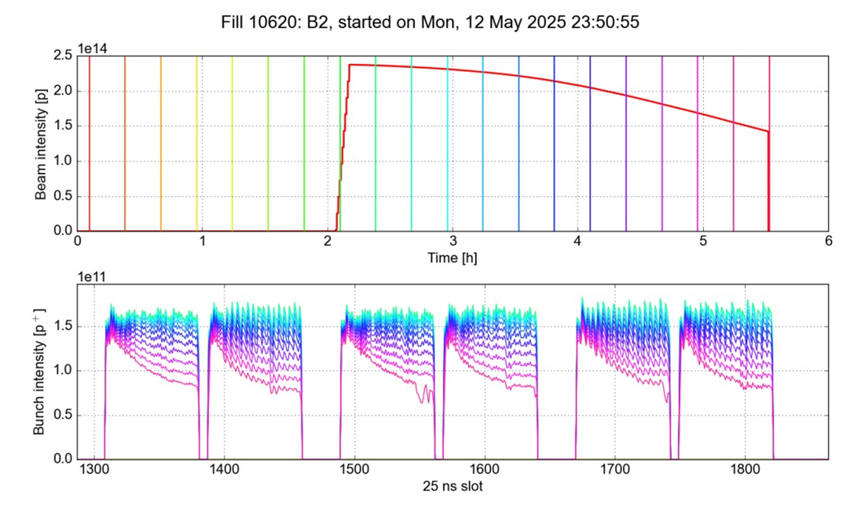
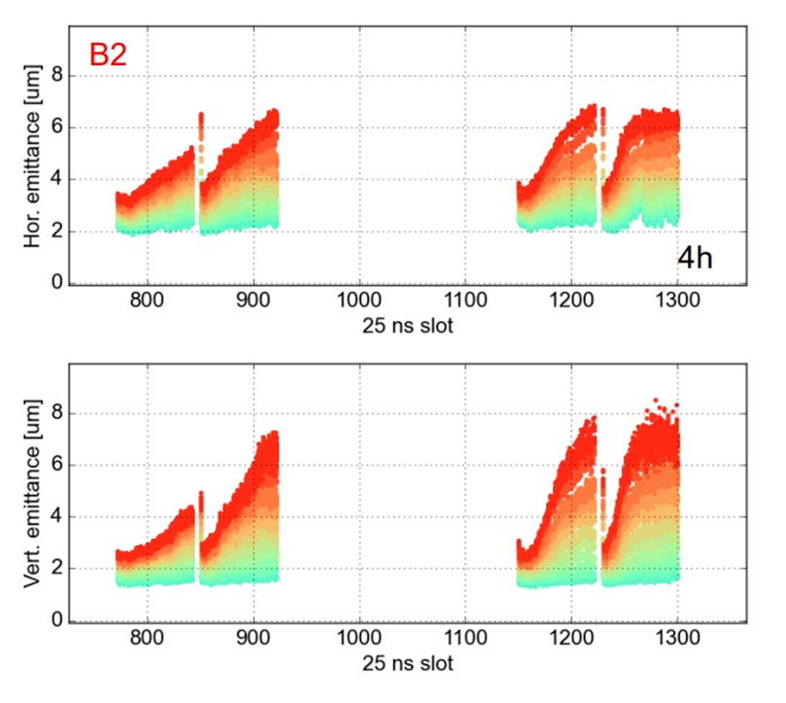
Effect of electron cloud – Real Measurements

Slide 29
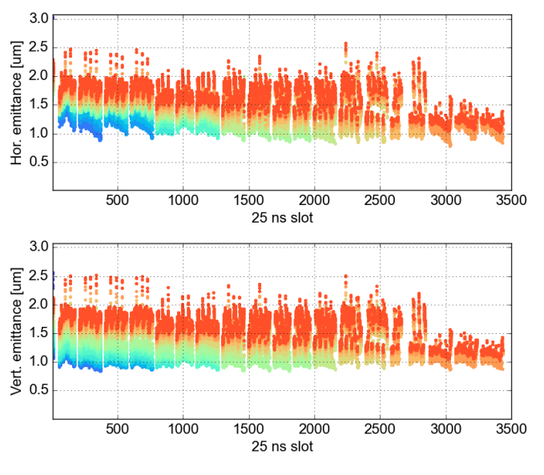
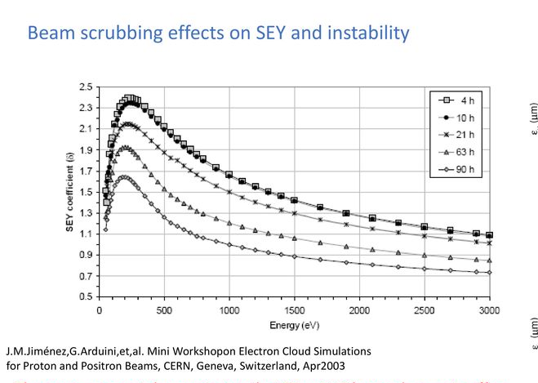
Scrubbing
Beam Size after scrubbing (-- after 2H → ok)
Scrubbing = Controlled beam-induced conditioning of vacuum chamber surfaces to reduce Secondary Electron Yield (SEY).

Slide 30

Dumping the Beams

Slide 31
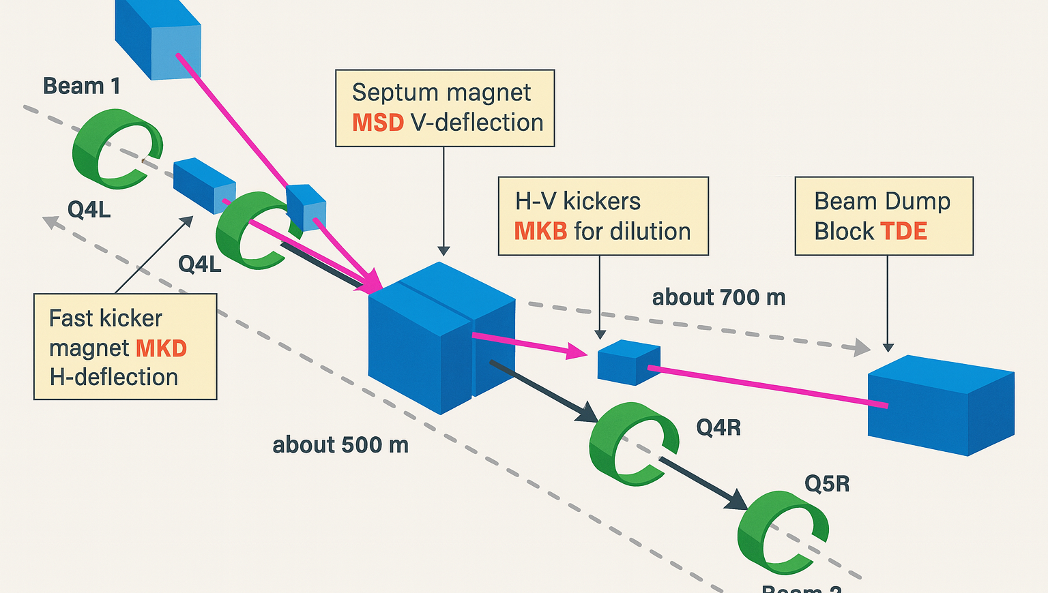
LHC Beam Dumping System
🔹 How does it work?
When a beam dump is triggered, fast kicker magnets (MKD) deflect the beam vertically into the extraction channel.
The beam is then passed through a dilution kicker system (MKB) that spreads the beam transversely in a spiral pattern.
Finally, it reaches the TDE (Target Dump External) – a graphite core dump block designed to absorb the energy safely.
🔹 Principle of Dilution
Without dilution, the energy would be deposited in a tiny area and destroy the dump block.
The dilution kickers oscillate in time to sweep the beam in a 2D spiral over the dump face, spreading energy deposition.
🔹 How is dilution measured?
Beam imaging monitors along the extraction line and at the dump measure the footprint.
The transverse sweep pattern is reconstructed from these diagnostics to verify the dilution amplitude and frequency.
Parameters like sweep radius, number of revolutions, and homogeneity are key metrics.
🔹 Why a Beam Dump System?
The LHC stores beams with hundreds of megajoules of energy. An uncontrolled loss could severely damage accelerator components. A reliable and safe dump system is essential.

Slide 32
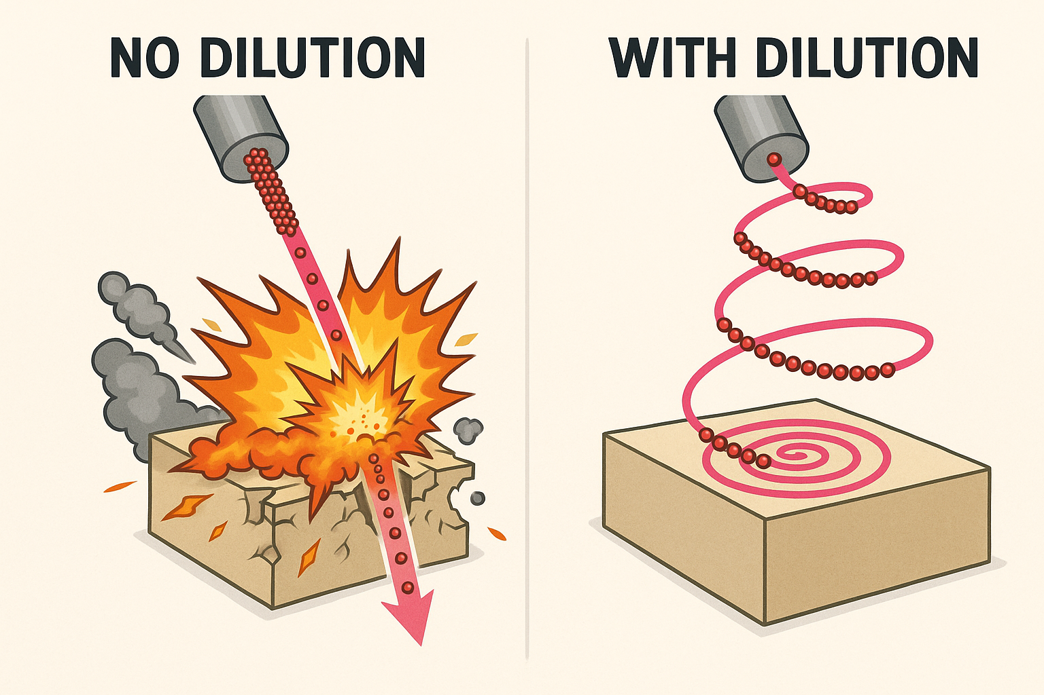
Takeaway from previous (too wordy) slide
We need to paint !

Slide 33
What is the Abort Gap?
The abort gap is a beam-free time window (~3 µs ) in the LHC beam structure.
It ensures the kicker magnets do not interact with any beam bunch during their rise time.
🔹 Why is it critical?
If particles are present in the abort gap, they get partially kicked and can hit sensitive components at high energy. → This can lead to quenches, damage, or uncontrolled beam losses.
🔹 How do we monitor it?
The Abort Gap Monitor uses synchrotron radiation to detect particles circulating in the abort gap.
A fast photomultiplier records the light intensity from gap regions
The monitor also provides: Threshold alarms when excessive charge is detected
Data helps operators trigger a beam dump before the situation becomes unsafe

Slide 34

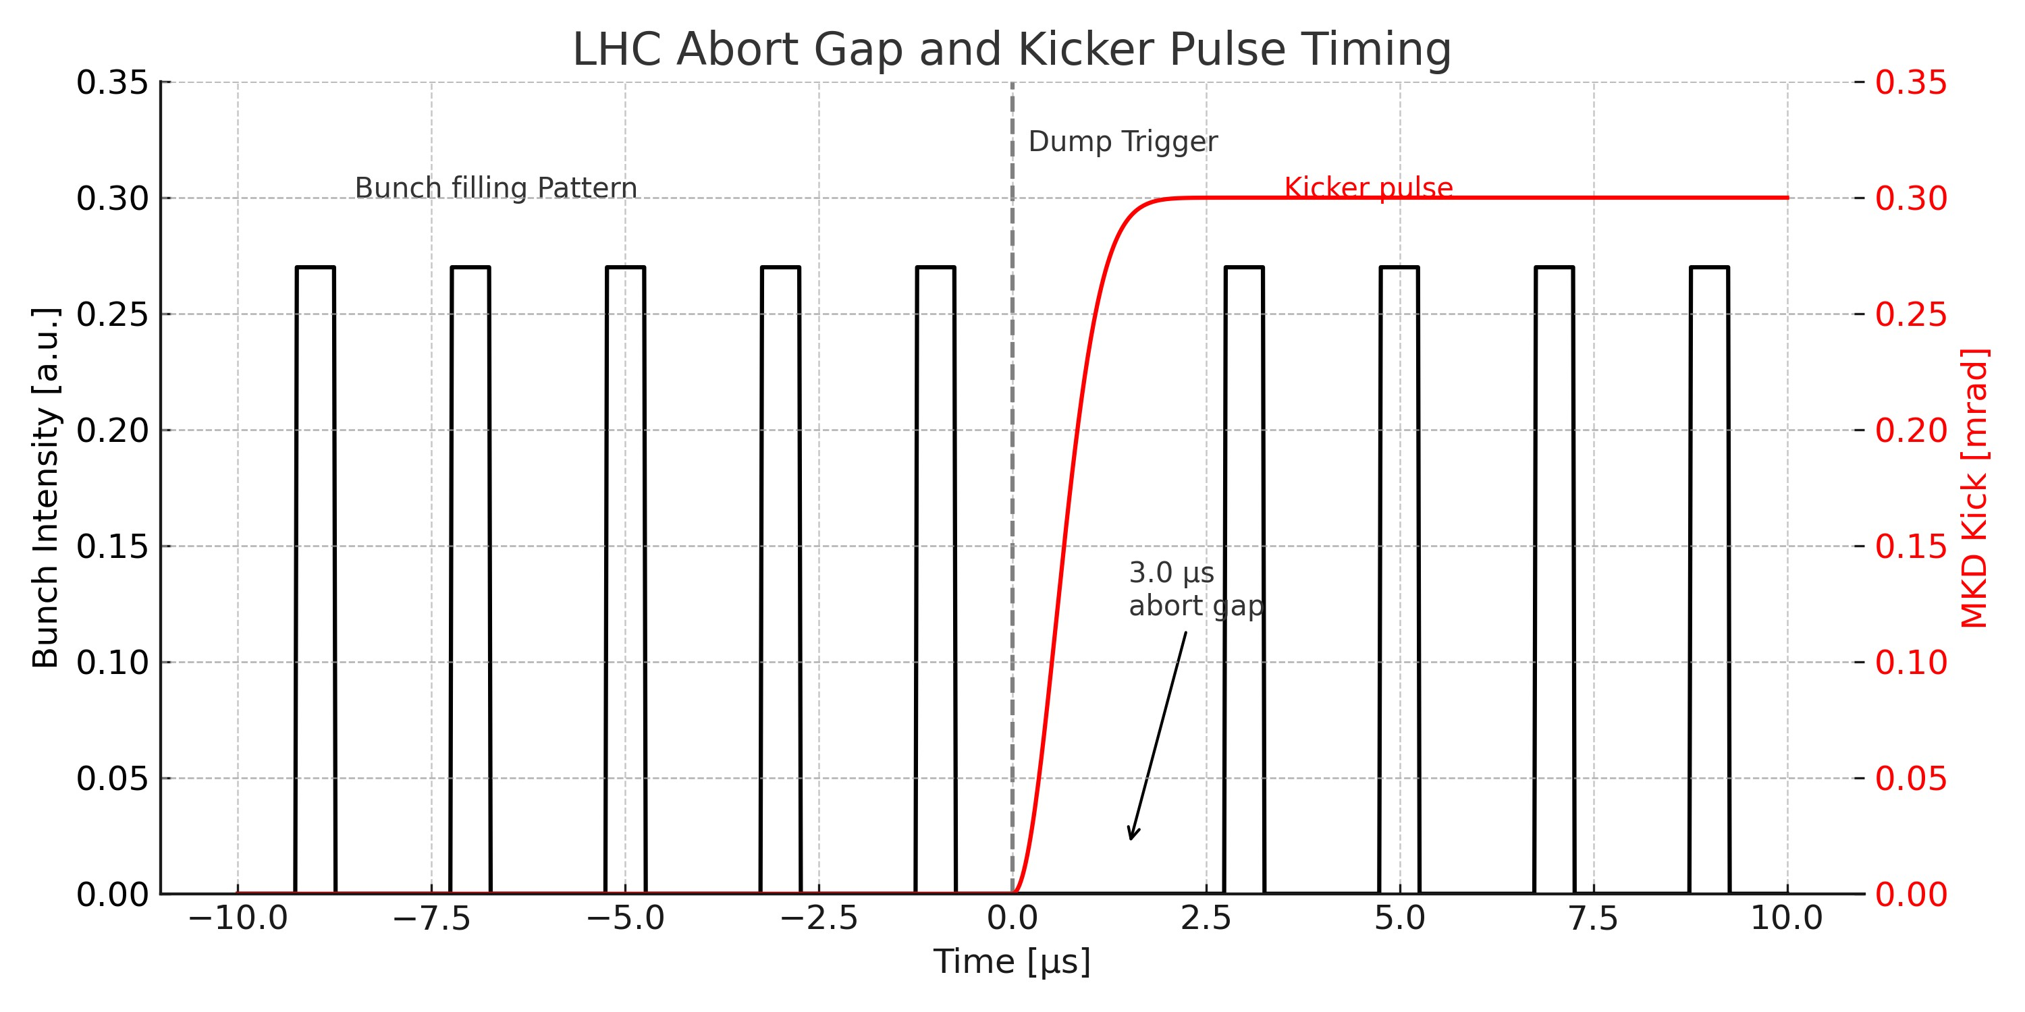
Takeaway from previous (too wordy) slide
We need a Gap !

Slide 35
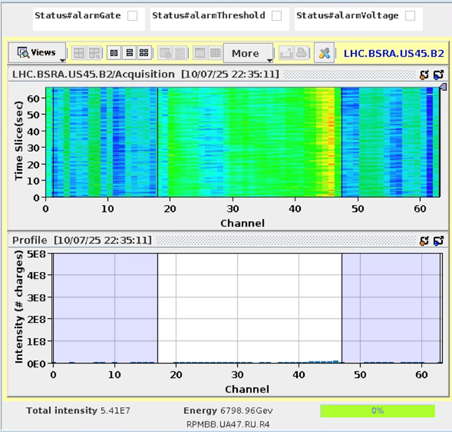
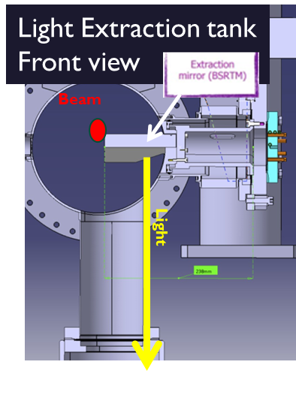
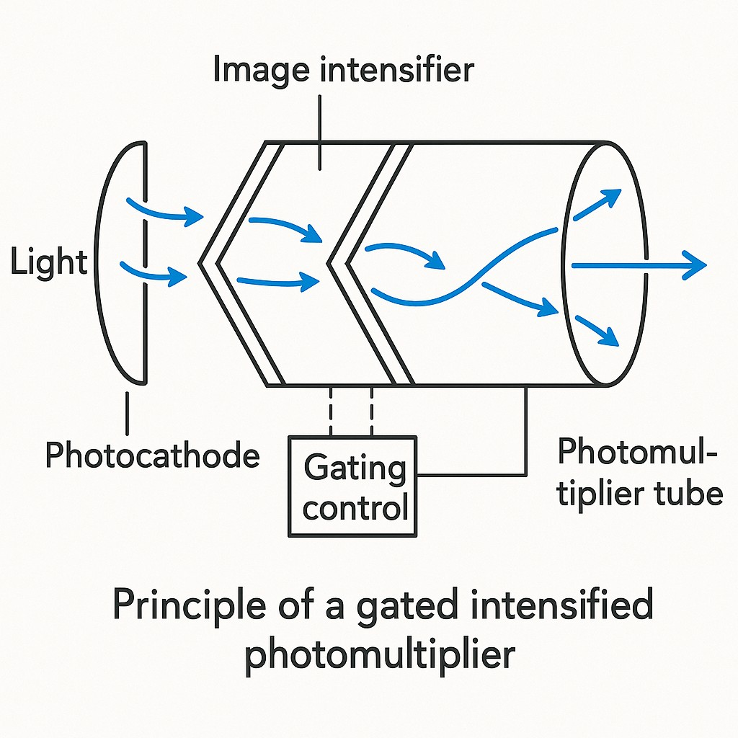
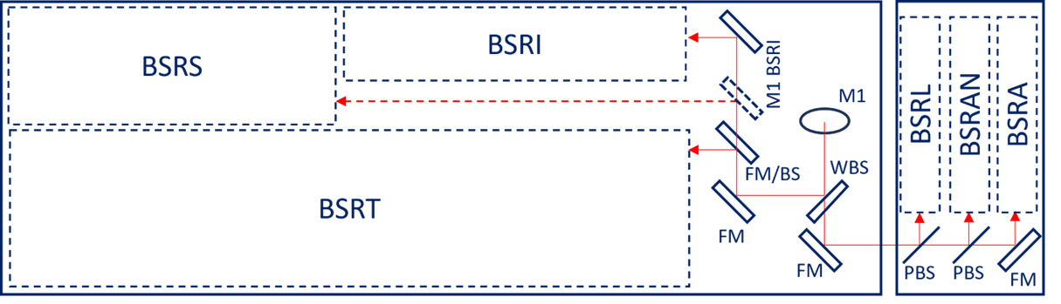
Beam Synchrotron Radiation for the Abort Gap Monitoring
Gated and Intensified Photo Multiplier
3us
5.4e7 p → we are safe!

Slide 36
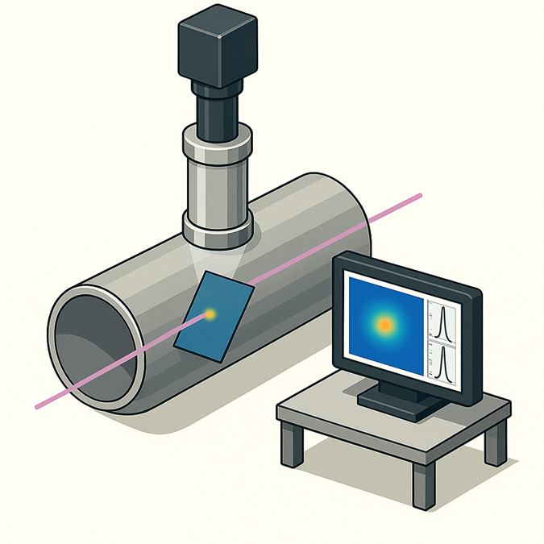
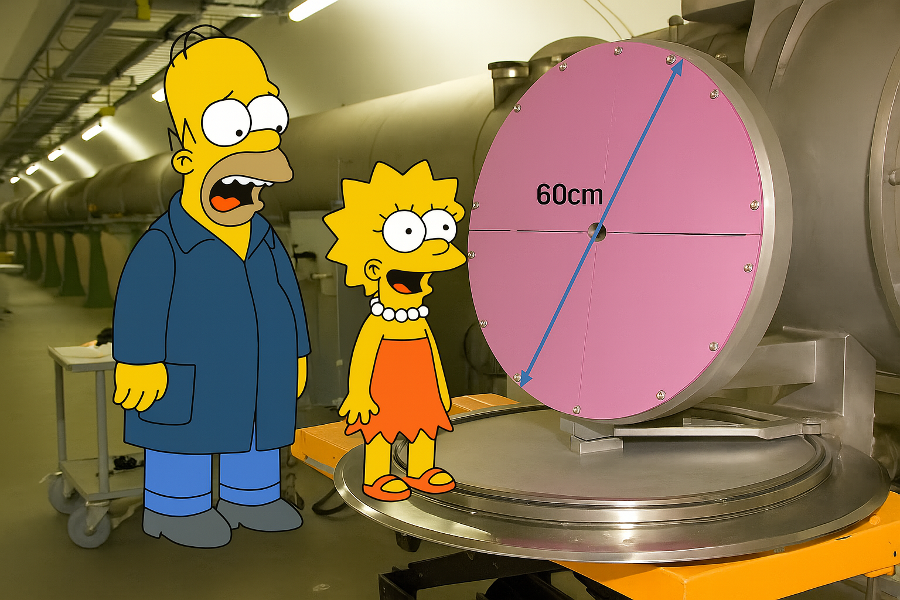
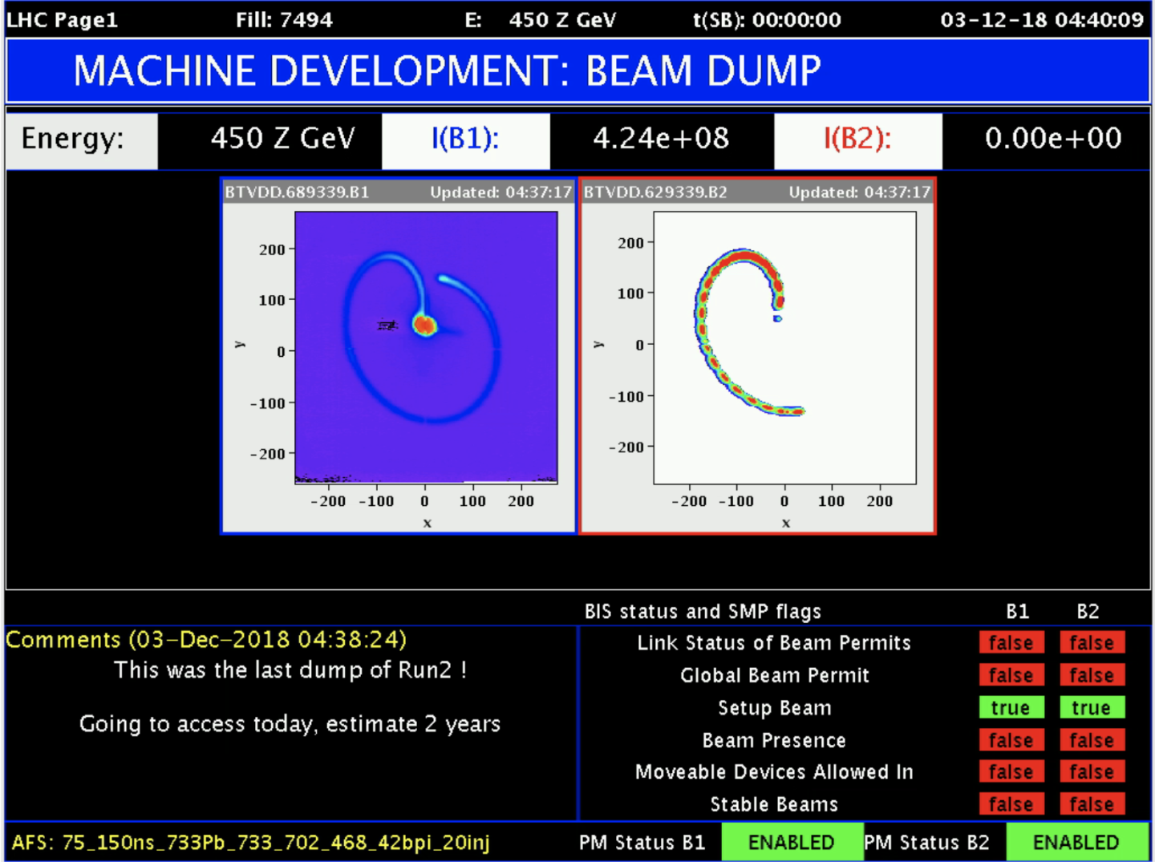
How do we measure the beam dilution
DO YOU REMEMBER the imaging systems ?
@LBDS WE put a big one
And it works !
CAMERA
BEAM
SCREEN

Slide 37
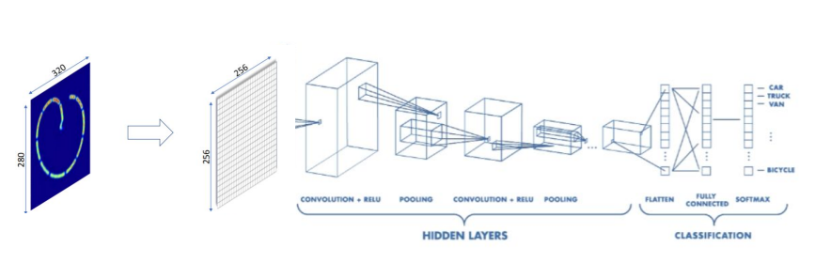

Bonus Slide – Machine Learning for LBDS
Train models to correlate BTVDD images to ‘normal’and ‘faulty’’ LBDS extraction and di;lution magnets system with the aim of anticipating future failure
-F.M.Velotti, B.Goddard

Slide 38

Bonus Slide: Imaging via single optical fiber assisted by machine learning
Motivation for Optical Fiber Imaging in Radiation-Harsh Environments
VIDICON & CCD cameras (used in CERN’s Beam TV) are being phased out → need for alternatives in high-radiation areas
Concept: Use radiation-tolerant optical fibers to transport images away from radiation zones
Tested: Fiber bundles → limited resolution (cross-talk) & high cost
Under study: Single-fiber imaging with neural networks / ML to reconstruct images

Slide 39


Slide 40
Wrap-Up & Final Thoughts
🔍 Diagnostics in Action
From LINAC4 phasing to LHC beam dumps and electron cloud mitigation, real-time instrumentation is vital to accelerator safety and performance.
💡 Instrumentation is Multidisciplinary
Detector physics, signal processing, accelerator physics, and systems engineering all play a role in successful beam diagnostics.
📊 From Theory to Reality
We’ve seen how Beam Position Monitors, Abort Gap Monitors, Wire Scanners, and BGIs translate physical processes into actionable operational data.
🚀 Looking Forward
New technologies like machine learning and radiation-tolerant imaging are shaping the future of diagnostics and control.

Slide 41

Thank You!
📬 Questions? Comments? Always welcome!
Now or @ 👨‍🏫 Federico.Roncarolo@cern.ch
Feel free to come here and see secondary
emission wire grids samples

