Slide 1
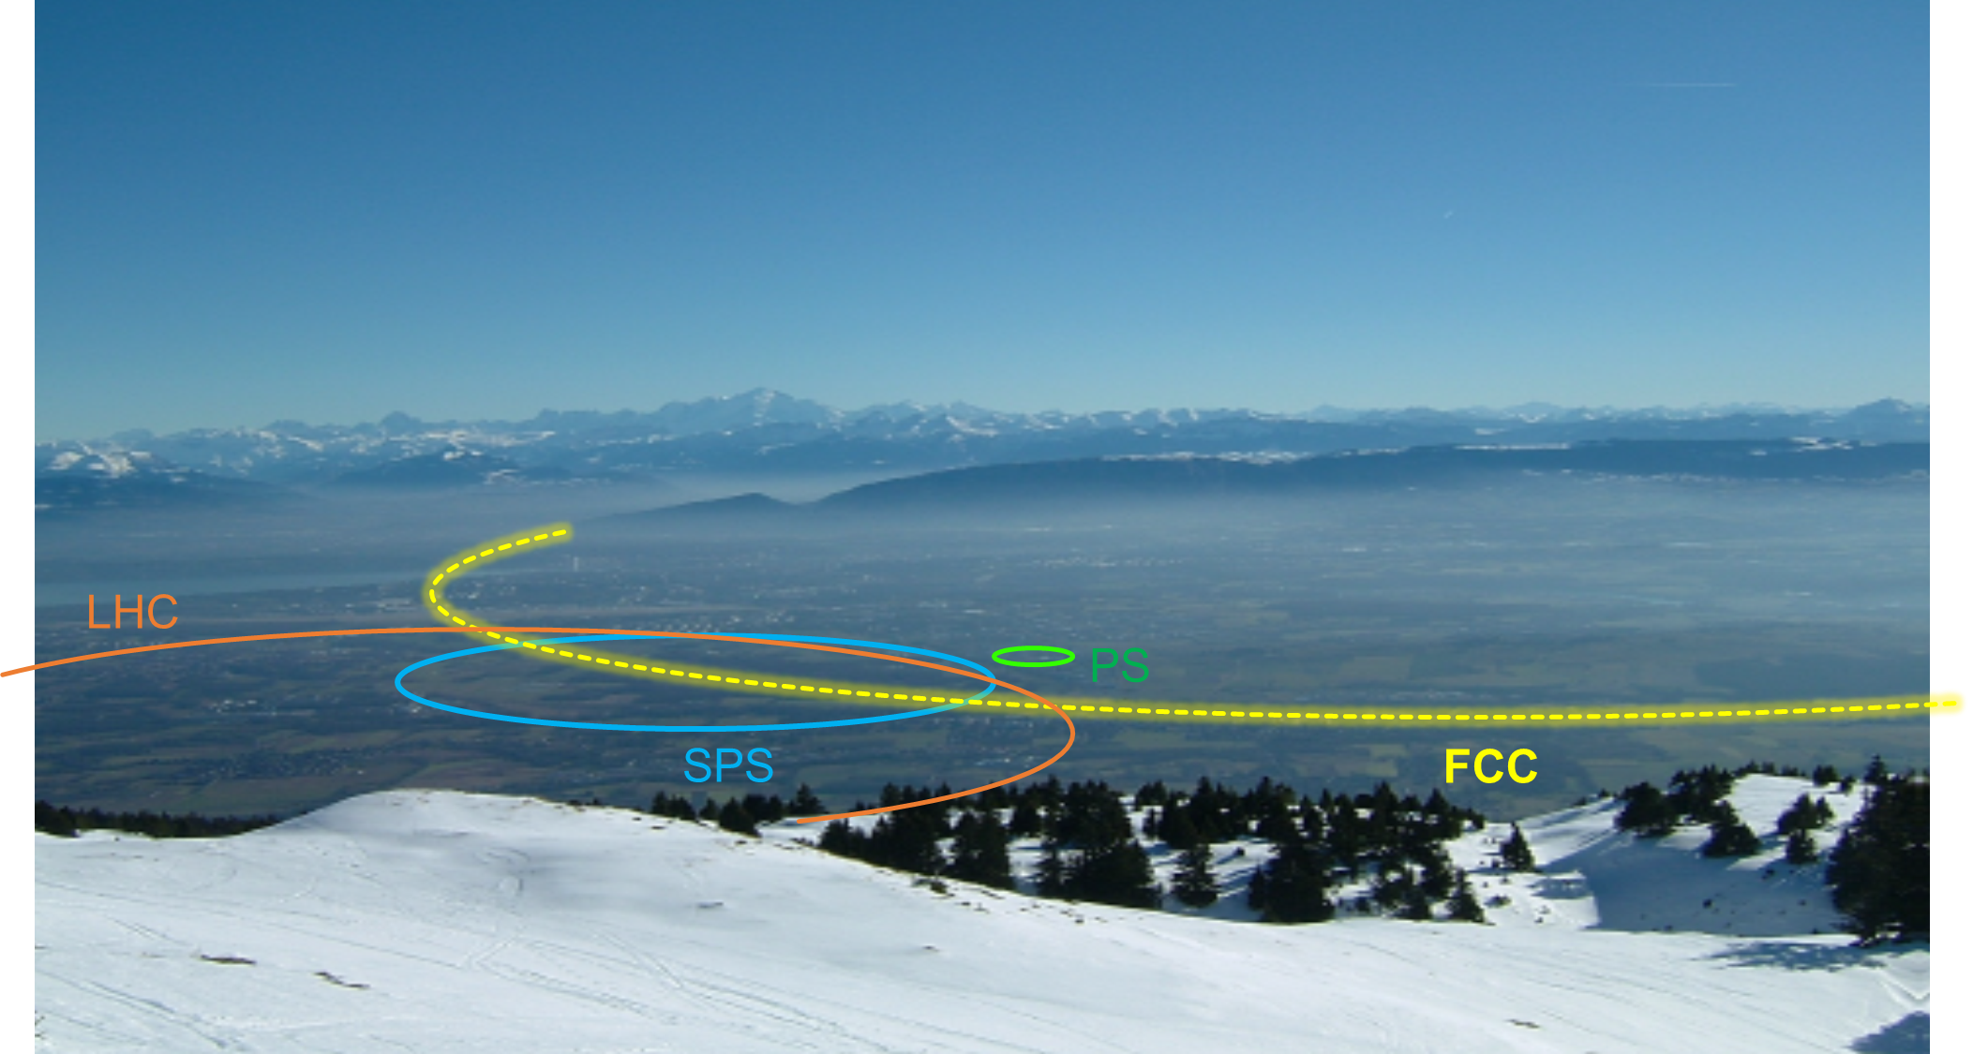
Future High-Energy Collider Projects
Part 2
Roderik Bruce

Slide 2
Outline
Introduction
Considerations for collider design: particle type, energy, circular/linear…
Limitations for future colliders
European strategy for particle physics
ILC (International Linear Collider)
CLIC (Compact Linear Collider)
HL-LHC (High-Luminosity Large Hadron Collider)
FCC-hh (Future Circular collider, hadrons)
FCC-ee (Future Circular collider, e+e-)
CEPC/SppC (Circular Electron-Positron Collider / Super proton-proton Collider)
Muon collider
First lecture
Linear
Second lecture
Circular

Slide 3
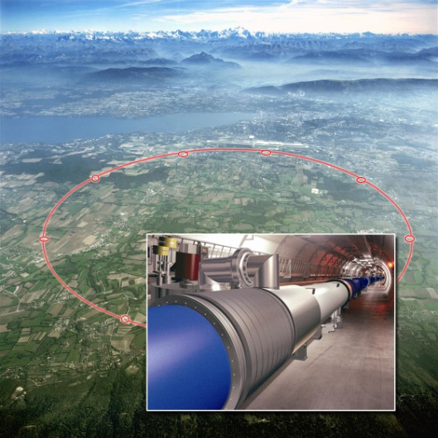
HL-LHC

Slide 4
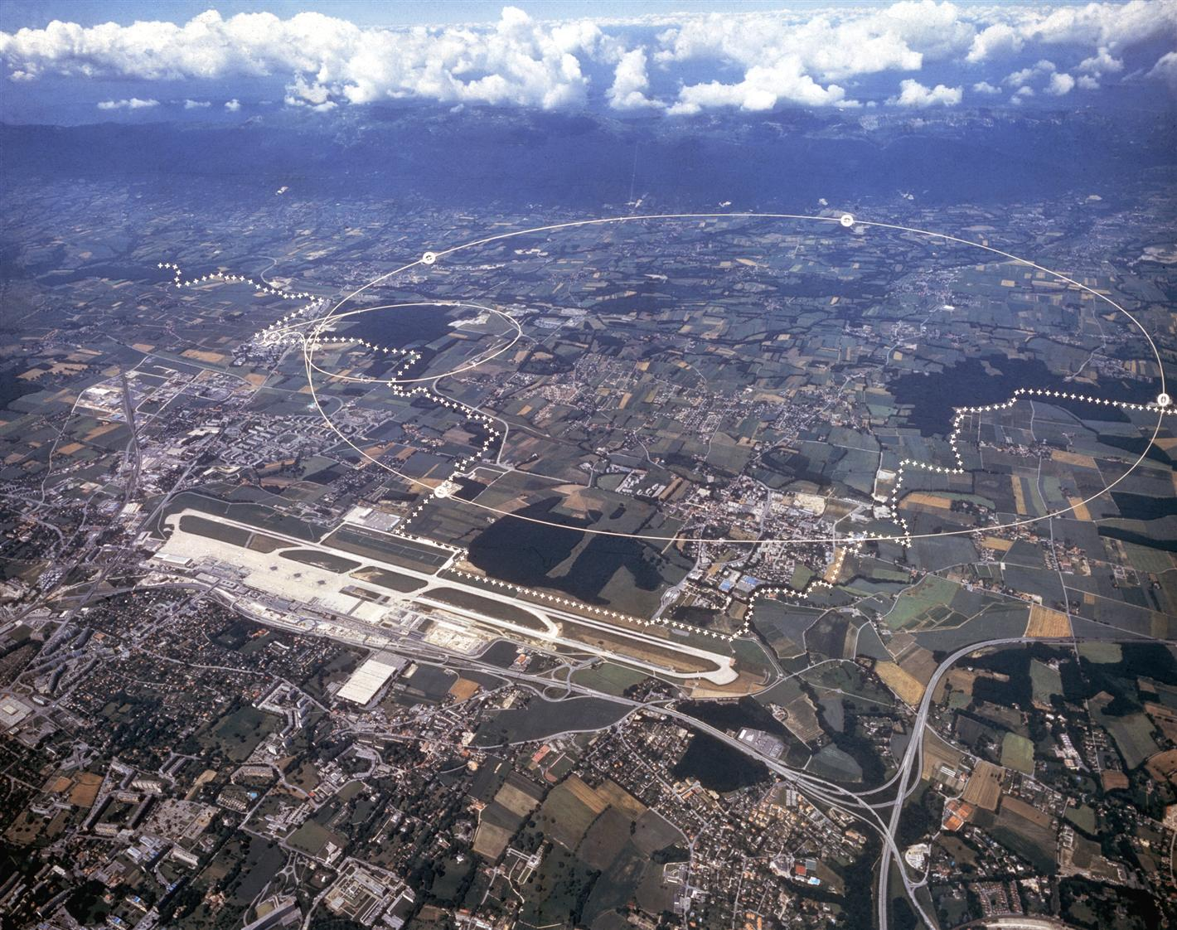
Reminder: LHC
27 km synchrotron, built to collide 7 TeV proton beams at 4 experiments
Largest collider and highest energy to date
About 1 month per year: heavy-ion collisions
About 1200 superconducting dipole magnets (NbTi) with 8.3 T field, operating at 1.9 K
In total, more than 9000 magnetic elements
LHC
France
ALICE
Switzerland
ATLAS
CMS
LHCb

Slide 5
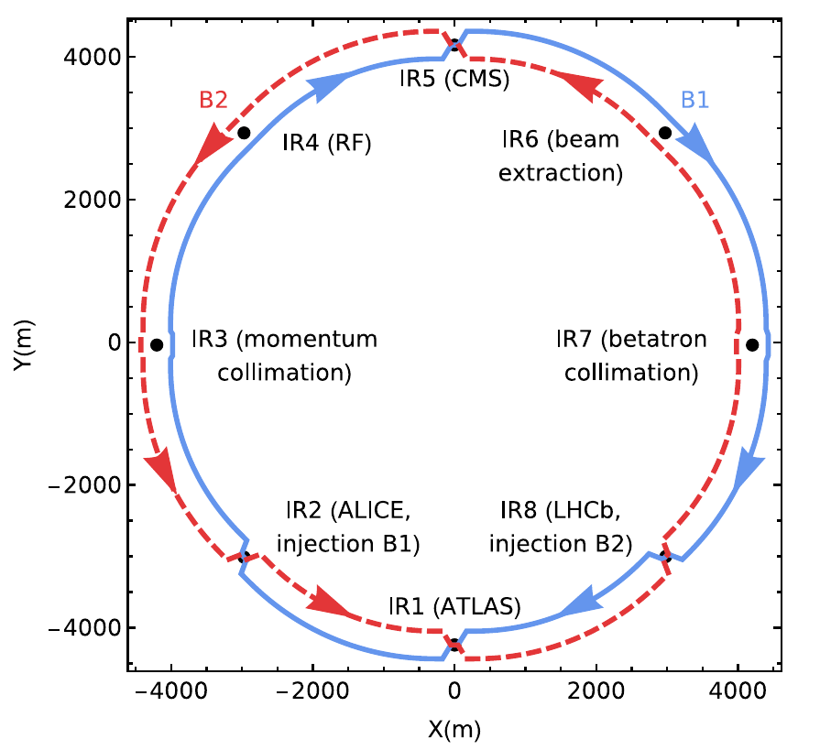
LHC layout
8 bent sections, arcs, and 8 straight sections, “insertion regions (IRs)”
4 experiments where beams collide (ATLAS – IR1, ALICE – IR2, CMS – IR5, LHCb – IR8)
2 IRs for beam cleaning (collimation), one for RF, one for beam extraction

Slide 6
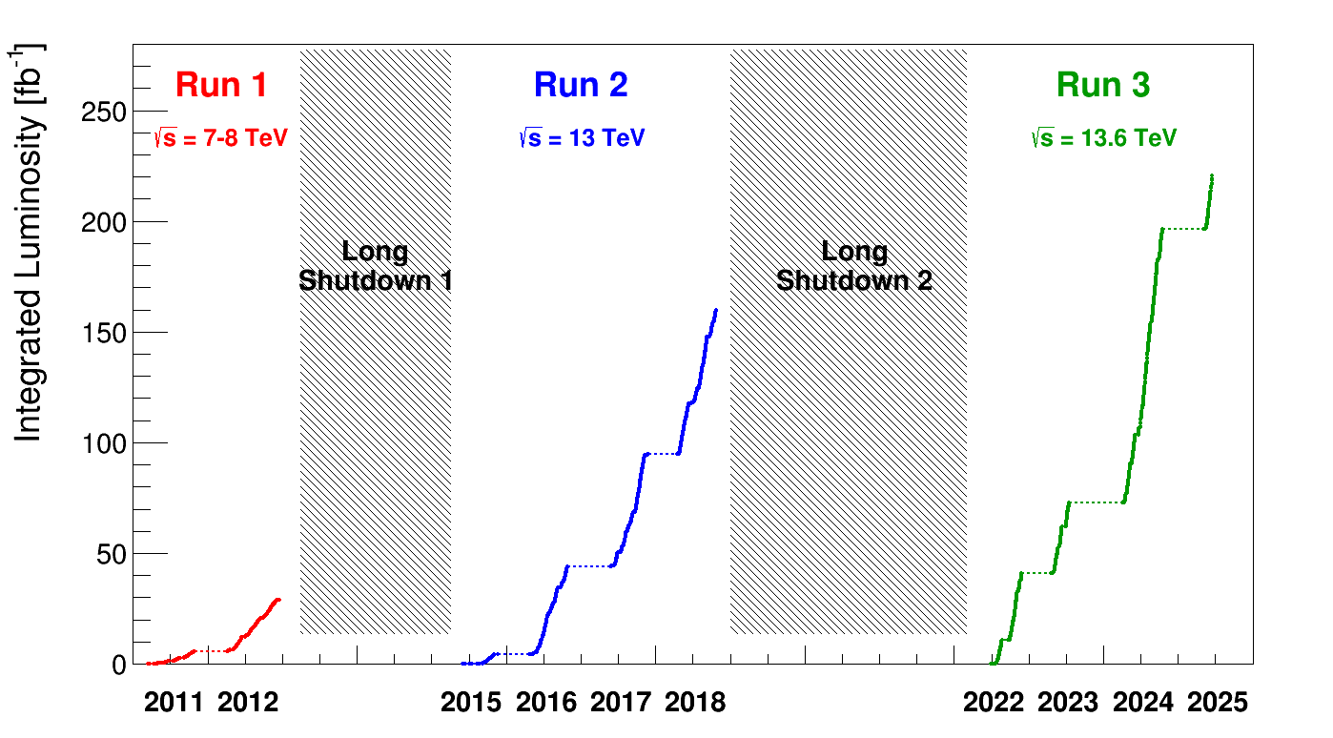

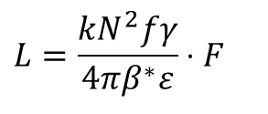
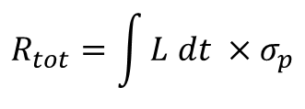
LHC main parameters
Parameter | 2025 | Design
Energy [TeV] | 6.8 | 7.0
No. of bunches | 2460 | 2808
p/bunch (typical value) [10¹¹] | 1.6 | 1.15
Max. stored energy per beam (MJ) | 410 | 362
β* [cm] | 60/18 | 55
Typical normalized emittance [μm] | ~1.6 | 3.75
Peak luminosity [10³⁴ cm⁻²s⁻¹] | 2.2 (lev.) | 1.0
year
$$L=\frac{kN^{2}fγ}{4πβ^{∗}ε}⋅F$$
$$R_{tot}=\int{L dt} ×σ_{p}$$
Tot. no. events
Design luminosity of 1×10³⁴ cm⁻²s⁻¹ surpassed by more than a factor 2
Collected in total more than 400 fb⁻¹ of integrated luminosity at the high-luminosity experiments (ATLAS, CMS)

Slide 7
HL-LHC
High-luminosity LHC: Major upgrade of the LHC
Main goals:
achieve a total integrated luminosity of 3000 fb⁻¹, a factor ~10 higher than what has been achieved so far since the start of the LHC
Target an integrated luminosity of ~250 fb⁻¹ per year
Prepare machine for operation from 2029 and into the 2040's
 | LHC 2025 | HL-LHC
Protons per bunch | 1.6 x 10¹¹ | 2.2 x 10¹¹
Number of bunches | 2460 | 2750
Normalized emittance | 1.6 micron | 2.5 micron
Beta* | 60/18 cm (flat) | 15 cm
Full crossing angle | 320 microrad | 500 microrad
Geometric reduction factor F | 0.6 | 0.35
“Virtual” luminosity | 4.2 x 10³⁴ cm⁻²s⁻¹ | 2.4 x 10³⁵ cm⁻²s⁻¹
Levelled luminosity | 2.1 x 10³⁴ cm⁻²s⁻¹ | 5 x 10³⁴ cm⁻²s⁻¹

Slide 8
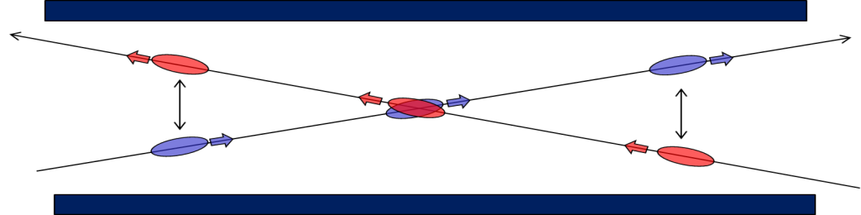
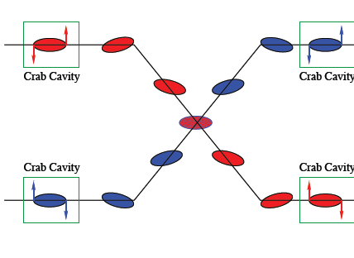
Compensation of geometric reduction factor
Bunches experience electromagnetic force from the opposing beam at the collision point (head-on beam-beam) or nearby in common beam pipe (long-range beam-beam)
Need crossing angle, not only to avoid parasitic collisions
Crossing angle at HL-LHC must be larger than at LHC, due to higher intensity
Would cause very large loss in luminosity: F≈0.35
To compensate: use “crab cavities” that tilt the bunches longitudinally and ensure overlap at the collision point
Long-range
Head-on

Slide 9
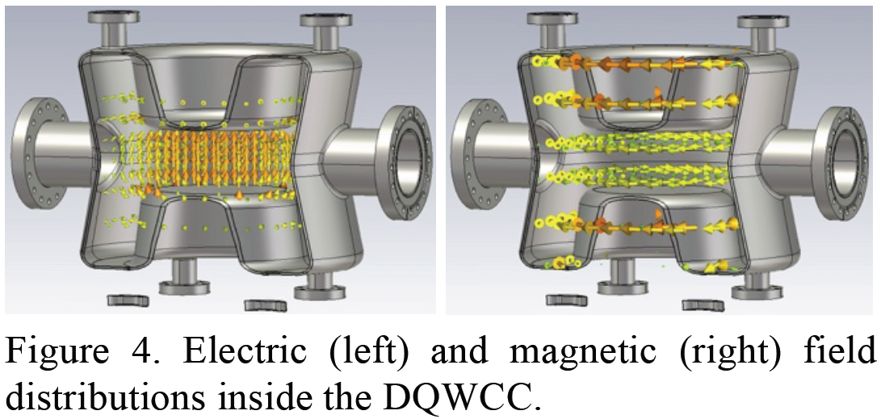
Crab cavities
Create a oscillating transverse electric field
Kick head and tail of the bunch in opposite directions

Slide 10
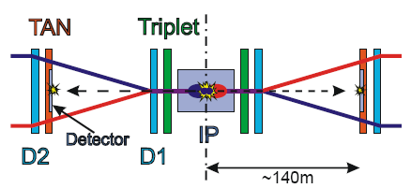
HL-LHC interaction region
For smaller β*: need new triplet
All magnets and other equipment in IR1 and IR5 to be completely exchanged for HL-LHC

Slide 11
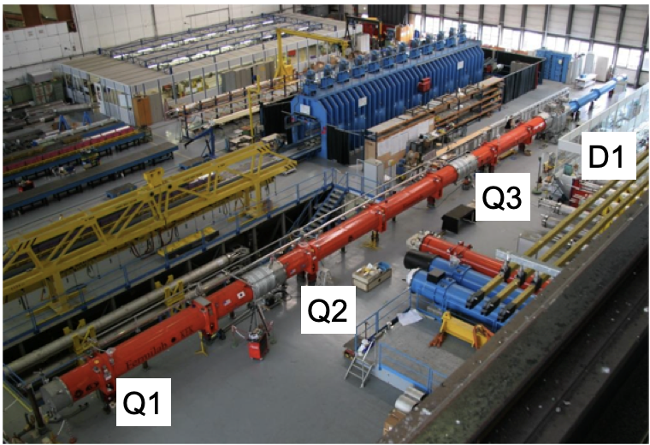
Comparison: LHC triplets

Slide 12
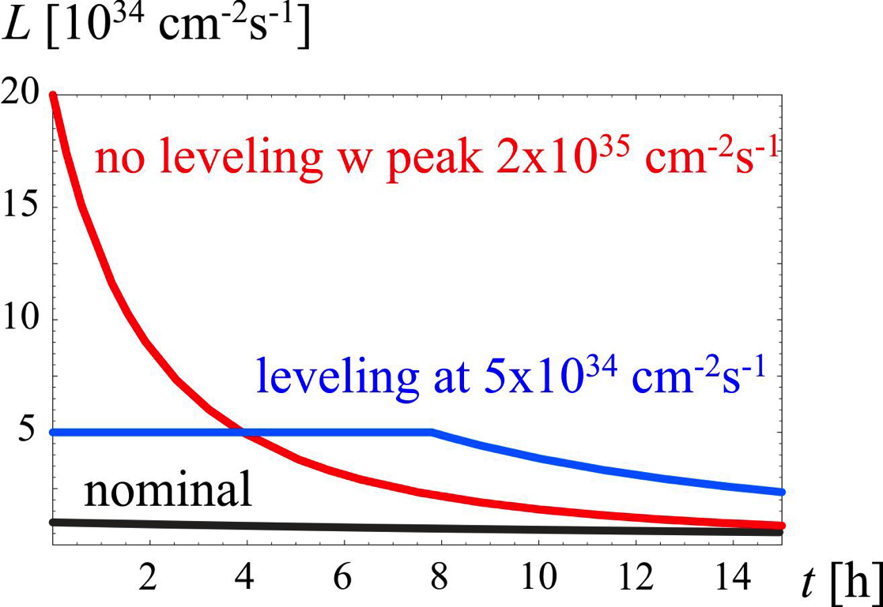
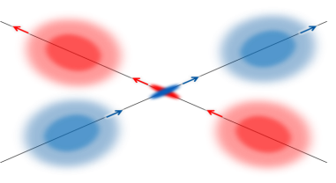
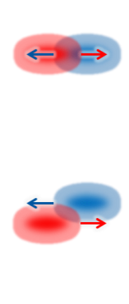
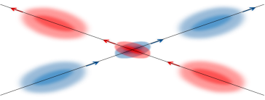
Luminosity leveling
Experiments can only cope with a certain maximum event rate before saturating
In LHC and HL-LHC, the achievable peak luminosity gives a significantly higher rate
Solution: artificially reduce luminosity to stay within limit of experiments – ”leveling”
Can be done by changing offset between beams, β* (beam size – chosen option in HL-LHC) or crossing angle
β*-leveling
Separation
leveling

Slide 13
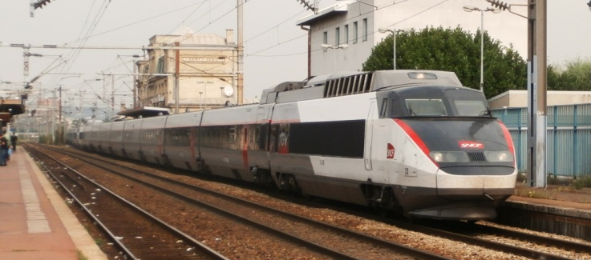
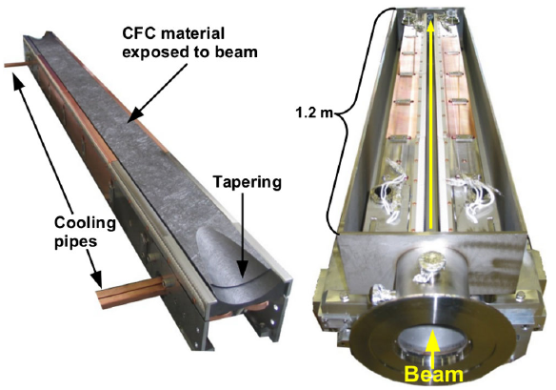
Collimation and machine protection
Losses from the beam are inevitable, and could cause magnet quenches or even damage
With higher intensity in the HL-LHC, need to enforce machine protection
New collimators to be installed to better protect the machine
680 MJ =
Total energy in one HL-LHC beam =
kinetic energy of TGV train at 215 km/h

Slide 14
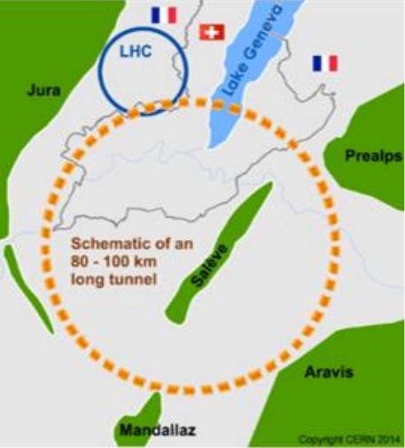
FCC-ee

Slide 15
Reminder: European strategy 2020
European strategy: “An electron-positron Higgs factory is the highest-priority next collider”
European strategy: “Europe, together with its international partners, should investigate the technical and financial feasibility of a future hadron collider at CERN with a centre-of-mass energy of at least 100 TeV and with an electron-positron Higgs and electroweak factory as a possible first stage. “

Slide 16
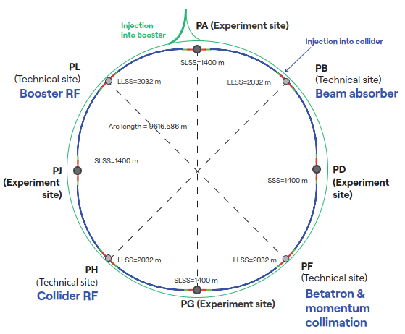
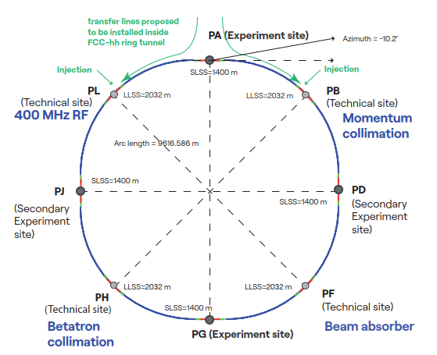
FCC integrated program
stage 1: FCC-ee circular e+e- collider Higgs factory, but several other operational energies for different physics programs
stage 2: FCC-hh circular hadron collider (~100 TeV) as natural continuation at energy frontier, proton and ion collisions
FCC-ee
FCC-hh
Re-use the same civil engineering, build on CERN’s existing infrastructure

Slide 17
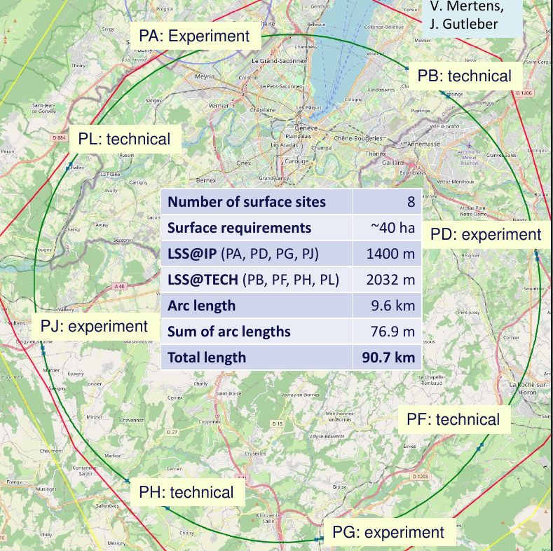
Current working hypothesis on FCC placement
Overall layout and placement optimisation process: Many options being studied
Current baseline position based on:
lowest risk for construction, fastest and cheapest construction
feasible positions for large span caverns (most challenging structures)
Total length is 90.7 km
8 surface sites with few ha area each

Slide 18
FCC-ee layout
Double ring collider with 8 straight sections
4 collision points
4 technical insertions for RF, beam dump, collimation
FCC-ee

Slide 19
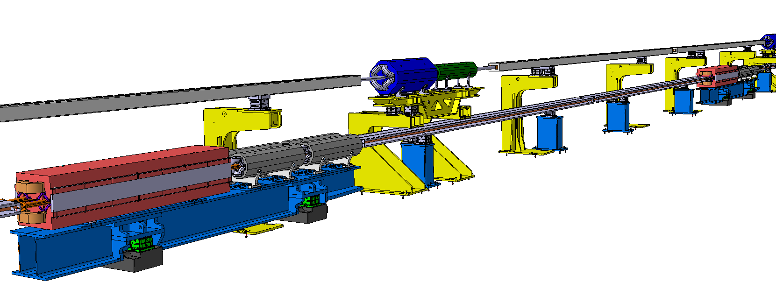
FCC-ee accelerator complex
Injector complex
Electron & positron source, linacs for e- and e+, damping ring, high-energy linac to 20 GeV.
On CERN Prevessin site
High Energy Booster (HEB)
Additional ring installed on top of the collider with same circumference, 1.03 m vertical separation.
Collider
Booster
2025 DESIGN
F. Carra et al.
Collider

Slide 20




FCC-ee operation modes
4 different operational energies are foreseen to perform precision measurements of Z, W and H bosons and the top quark
Z-pole: 45.6 GeV
WW pair production threshold: 80 GeV
ZH production peak: 120 GeV
ttbar production threshold: 182.5 GeV

Slide 21




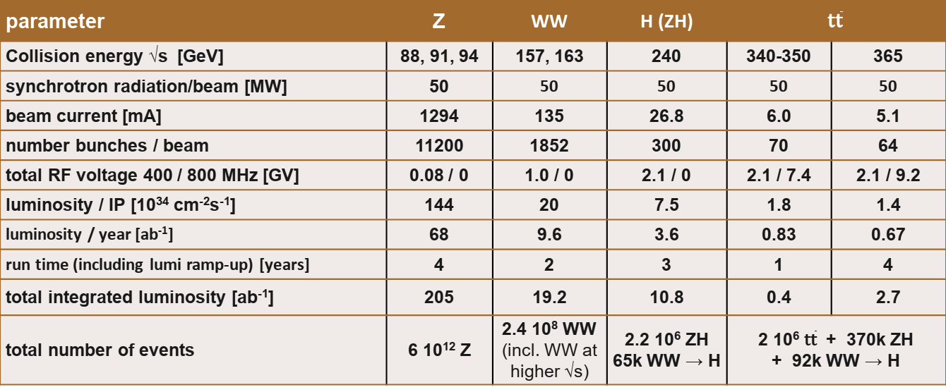
FCC-ee parameter table
parameter | Z | WW | H (ZH) | $$\text{t}\overline{\text{t}}$$
Collision energy √s [GeV] | 88, 91, 94 | 157, 163 | 240 | 340-350 | 365
synchrotron radiation/beam [MW] | 50 | 50 | 50 | 50 | 50
beam current [mA] | 1294 | 135 | 26.8 | 6.0 | 5.1
number bunches / beam | 11200 | 1852 | 300 | 70 | 64
total RF voltage 400 / 800 MHz [GV] | 0.08 / 0 | 1.0 / 0 | 2.1 / 0 | 2.1 / 7.4 | 2.1 / 9.2
luminosity / IP [10³⁴ cm⁻²s⁻¹] | 144 | 20 | 7.5 | 1.8 | 1.4
luminosity / year [ab⁻¹] | 68 | 9.6 | 3.6 | 0.83 | 0.67
run time (including lumi ramp-up) [years] | 4 | 2 | 3 | 1 | 4
total integrated luminosity [ab⁻¹] | 205 | 19.2 | 10.8 | 0.4 | 2.7
total number of events | 6 10¹² Z | 2.4 10⁸ WW (incl. WW at higher √s) | 2.2 10⁶ ZH 65k WW → H | 2 10⁶ $\text{t}\overline{\text{t}}$ + 370k ZH + 92k WW → H
M. Benedikt

Slide 22
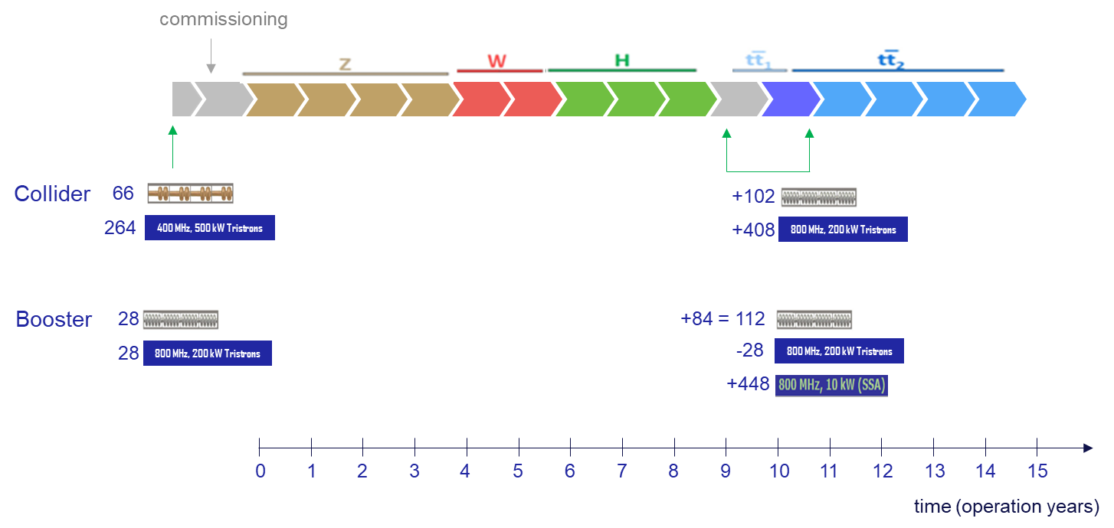
FCC-ee operational sequence
Flexible sequence Z – W - H

Slide 23
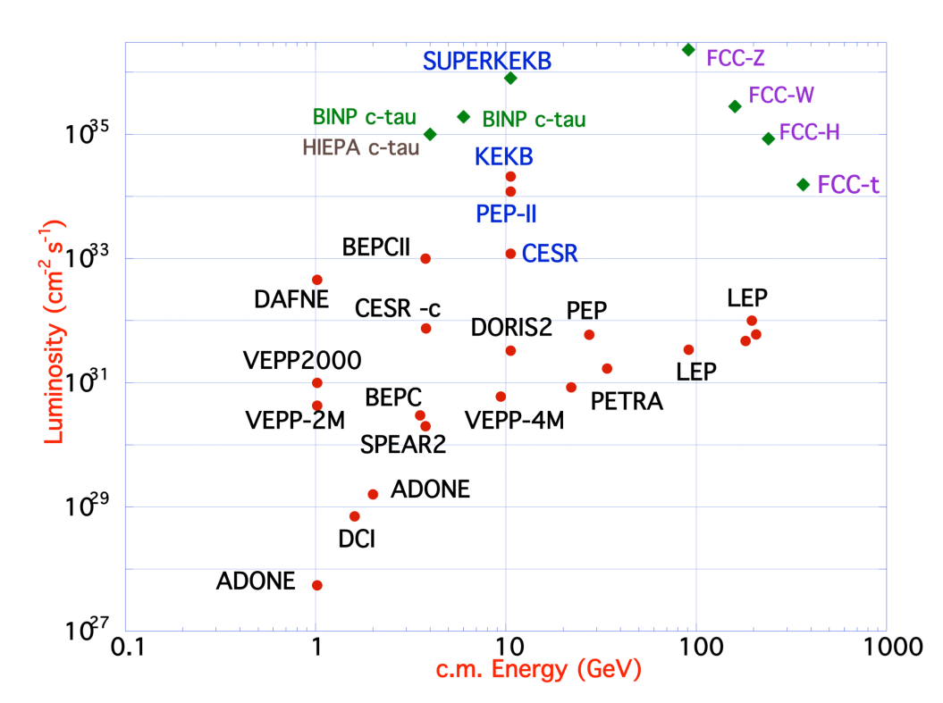
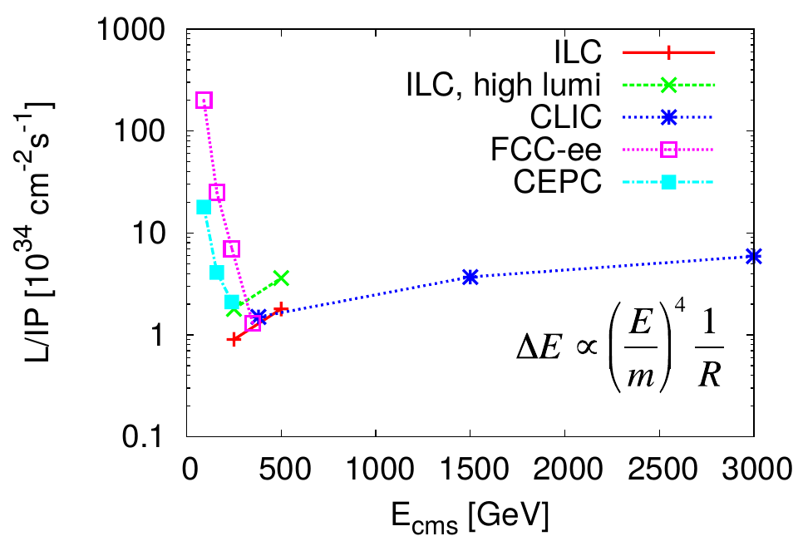
Luminosity comparison
To reach the physics goals, need to significantly increase luminosity w.r.t. previous lepton colliders
Can reach higher luminosity than linear colliders at lower energy
The higher the energy, the more severe limitations from synchrotron radiation

Slide 24
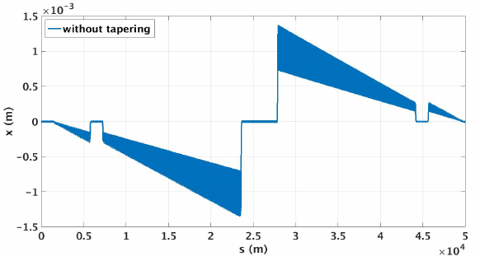
Synchrotron radiation in FCC-ee
Design choice: limit radiation power to 50 MW per beam (still huge!)
RF cavities have a certain (in)efficiency → total RF power consumption for both beams up to about 160 MW
Lower intensity at higher energy => lower luminosity
Not critical for cooling – normal-conducting magnets
At highest energy, 182.5 GeV, loss of 9 GeV or ~5% per turn
Also: particles that have lost energy are overbent by the dipoles => accumulate large transverse offsets, “saw tooth” orbit if nothing is done
Example horizontal orbit with radiation
B. Härer, A. Doblhammer, and B.J. Holzer, IPAC16, THPOR003

Slide 25
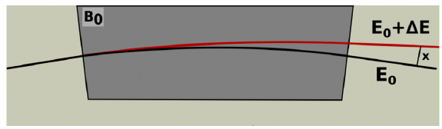
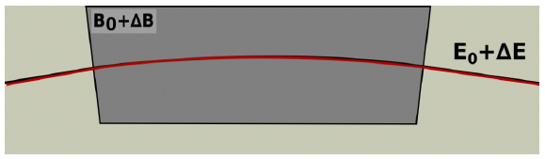
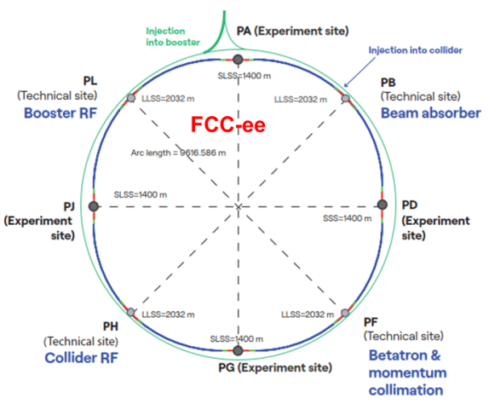
Tapering
To avoid large transverse offsets due to over-bending: “Tapering scheme”
Vary magnetic strengths along the ring, so that we always match the beam energy
No tapering (note: positive energy offset)
Tapering: adjusting magnetic field to beam energy
B. Härer, A. Doblhammer, and B.J. Holzer, IPAC16, THPOR003

Slide 26
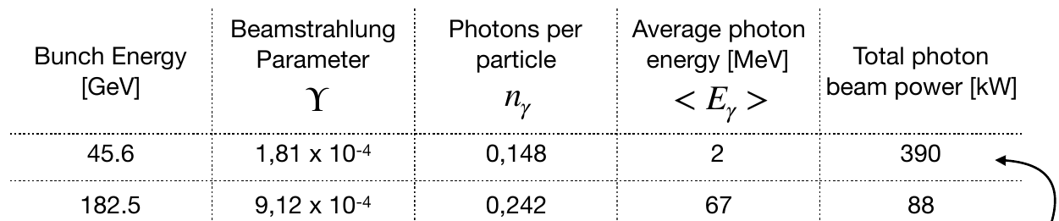
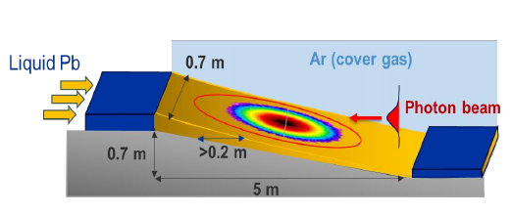
Beamstrahlung
Particles radiate not only in magnets, but also due to electromagnetic field of opposing beam: “beamstrahlung”
FCC-ee will be the first collider where beamstrahlung plays a significant role in beam dynamics
Collider must have sufficiently large momentum acceptance to hold a particle that loses its energy in a single photon emission due to beamstrahlung.
A particle with 2% momentum deviation must still stay within the beampipe without touching it
Power of radiated photons reaches almost 400 kW – big engineering challenge!
Photons hit downstream vacuum chamber in localized spot – engineering challenge to dispose of heat without material damage
Different solutions under study: solid graphite absorber (might break), absorber with flowing liquid Pb
`
M. Calviani et al.

Slide 27
FCC-ee power consumption
FCC-ee elecrtical energy consumption | Z | W | H | TT
Beam energy [GeV] | 45.6 | 80 | 120 | 182.5
Peak power during beam operation [MW] | 250 | 275 | 297 | 381
Total FCC-ee yearly consumption [TWh] | 1.2 | 1.3 | 1.4 | 1.85
Power consumption dominated by RF
Total increase of power usage compared to LHC
Load to be distributed on three main sub-stations – concept confirmed with French electricity grid operator
Notes:
Yearly consumption about 1.9 TWh (compare 1.2 TWh for CERN in 2016)

Slide 28
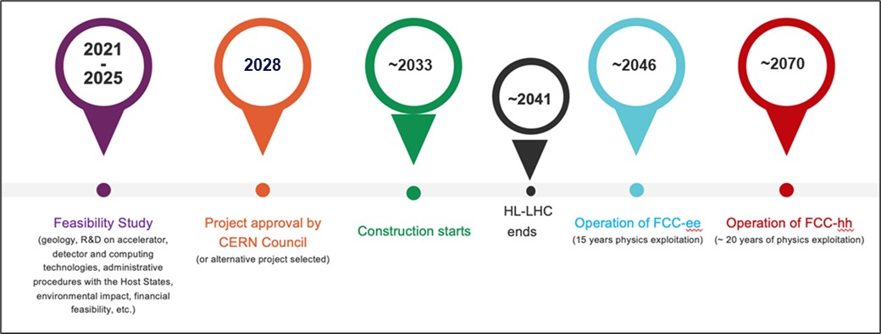
Overall FCC timeline
Foreseen FCC timeline spans several decades
Remember: it took ~25 years from the start of the LHC design to the start of operation
2100?

Slide 29

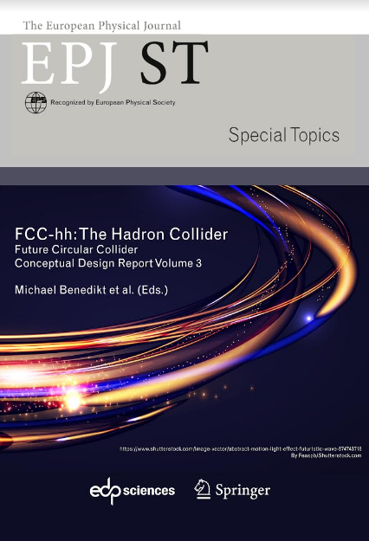
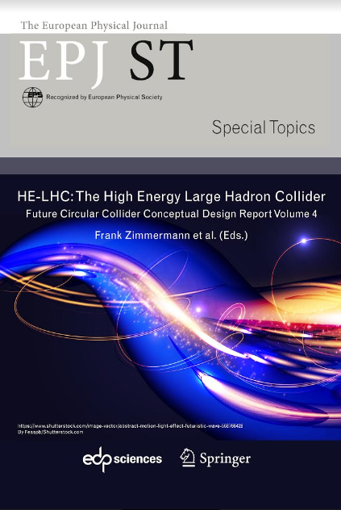
FCC documentation
FCC-Conceptual Design Reports (completed in 2018):
Vol 1 Physics, Vol 2 FCC-ee, Vol 3 FCC-hh, Vol 4 HE-LHC
EPJ C 79, 6 (2019) 474 , EPJ ST 228, 2 (2019) 261-623 , EPJ ST 228, 4 (2019) 755-1107 , EPJ ST 228, 5 (2019) 1109-1382
Feasibility study report prepared for 2025, as input to European strategy
Volume 1: Physics and Experiments is here
Volume 2: Accelerators, technical infrastructure and safety is here
Volume 3: Civil Engineering, Implementation and Sustainability is here

Slide 30
FCC-hh

Slide 31

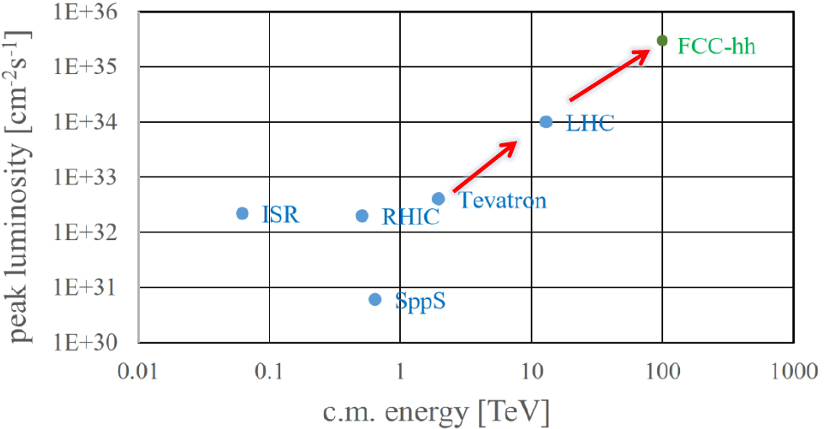
FCC-hh general goals
European strategy: “Europe, together with its international partners, should investigate the technical and financial feasibility of a future hadron collider at CERN with a centre-of-mass energy of at least 100 TeV and with an electron-positron Higgs and electroweak factory as a possible first stage. “
FCC-hh: collide 42 (or up to 60) TeV protons (or heavy ions of equivalent magnetic rigidity)
Factor ~6-8.5 higher energy than LHC, factor ~3 longer tunnel
International FCC collaboration (CERN as host lab)
More than an order of magnitude higher peak luminosity than LHC; factor 6 higher than HL-LHC
Goal: Achieve integrated luminosity of 20 000 fb⁻¹ per experiment collected over 25 years of operation (vs 3000 fb⁻¹ for HL-LHC)

Slide 32
FCC-hh layout
Insertions in FCC-hh
Two high-luminosity experiments (A and G)
Two other experiments (D and J)
Two collimation insertions (F and H)
One extraction insertion (B)
One RF insertion (H)
Considered injector options
New superconducting machine in the SPS tunnel
modified faster-ramping LHC
new 4 T machine in the LHC tunnel
new 2 T superferric machine in the LHC tunnel

Slide 33
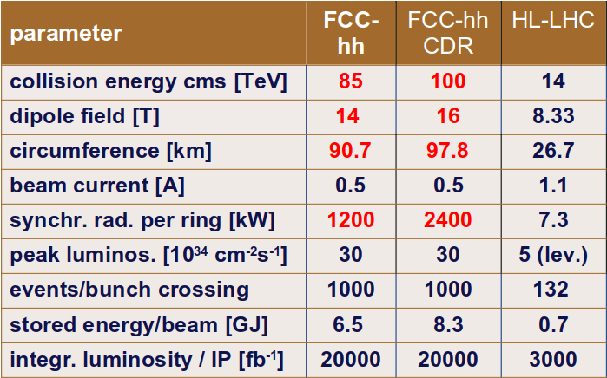
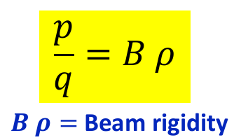
FCC-hh parameter comparison

Slide 34
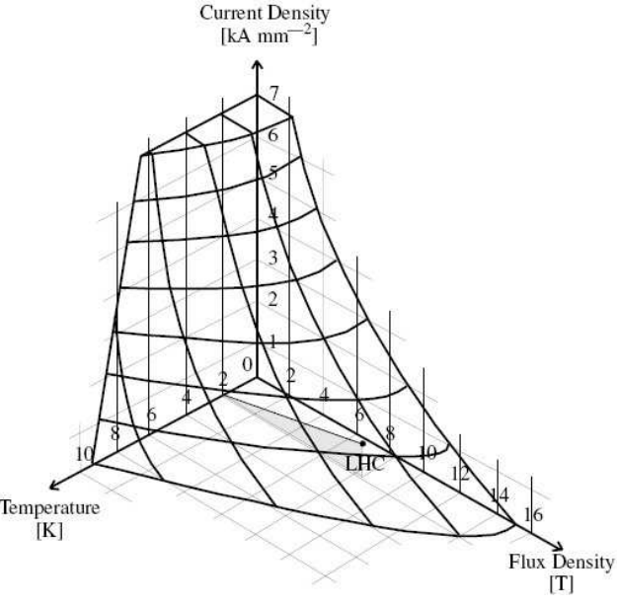
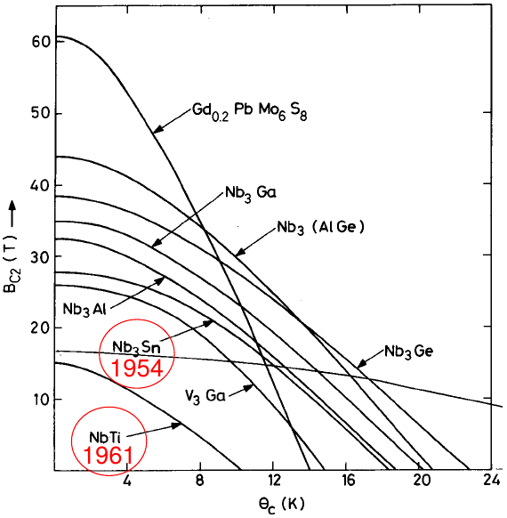
FCC-hh magnets
Need 14-20 T dipole magnets – not feasible with today’s technology → big challenge for technological development!
In LHC, 8.3 T, with NbTi superconductors
Cannot to much higher with NbTi: need working point below “critical surface”
Rely on future developments of Nb3Sn superconductor technology
Alternative: high-temperature superconductors
Could achieve higher fields and lower power consumption
Significant technology development and cost reduction needed
Critical surface
for NbTi

Slide 35
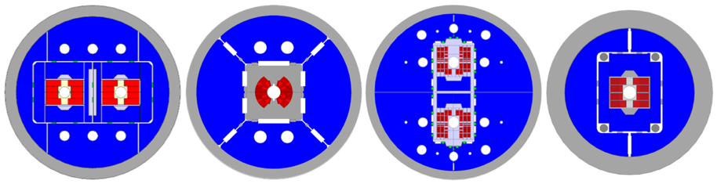
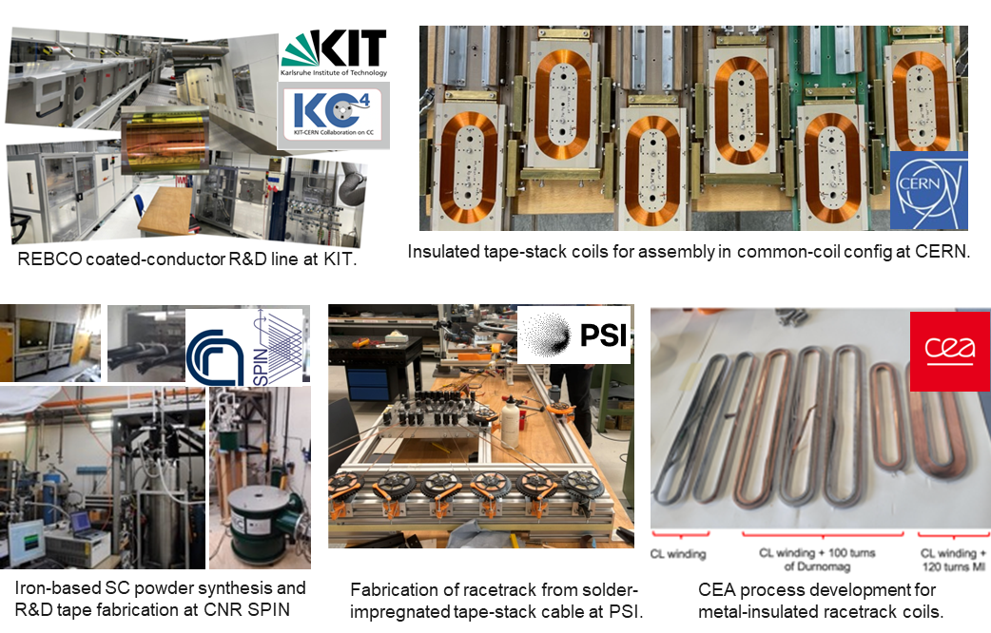


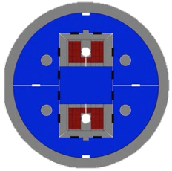



High-field magnet research
Nb₃Sn:
12- and 14-T short demonstrators
different coil geometries
tests scheduled for 2026
HTS R&D in various domains:
REBCO and IBS Conductor R&D
racetrack coil developments

Slide 36

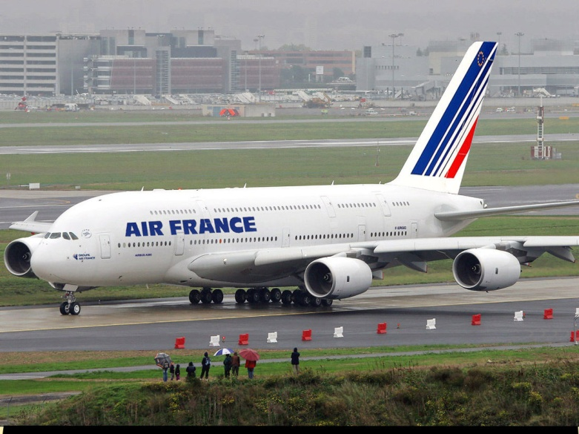
Next challenge: FCC-hh machine protection
HL-LHC: total stored energy of beam = 680 MJ = kinetic energy of TGV train cruising at 215 km/h
FCC-hh: : total stored energy of beam = 8.3 GJ = kinetic energy of Airbus A380 (empty) cruising at 880 km/h
Big challenge: Protect the machine against beam losses –
need very efficient collimation system

Slide 37
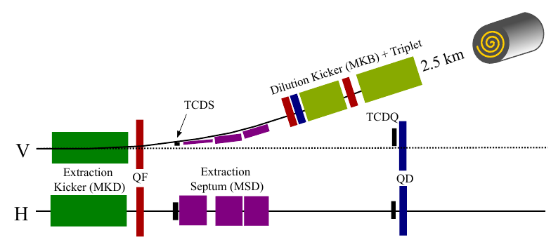
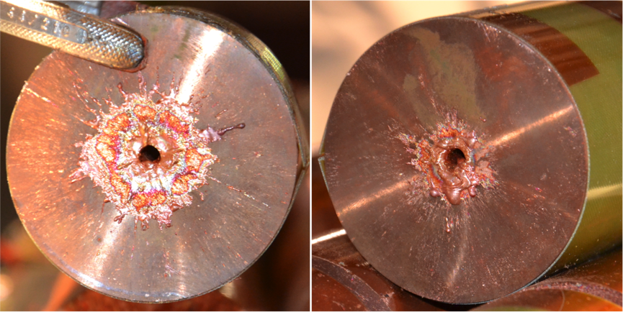
Beam dump
Need beam dump to safely extract and dispose of beam in case of any failure, or the remaining beam a the end of luminosity production
Extract beam in separate dump channel using very fast dipole magnets
Need to dispose of 8.3 GJ!
Enough to drill 300m long hole in copper
FCC-hh CDR

Slide 38
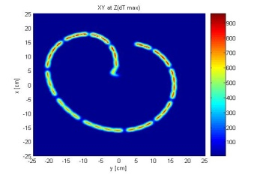
Beam dump
D. Schulte, W. Bartmann
Solution: as for LHC, distribute (“paint”) beam transversely, but over much larger surface than in LHC
Dynamically changing magnetic field while beam is passing
Beam-dump made of low-density graphite sheets, should not exceed 1500 deg C
1m
LHC pattern (same scale)

Slide 39
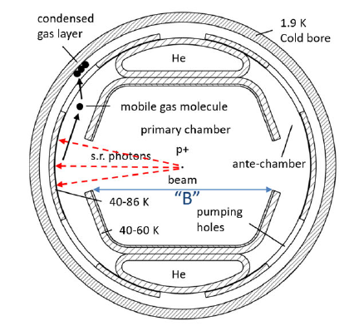
Synchrotron radiation in FCC-hh
FCC-hh first hadron collider where synchrotron radiation power has potentially limiting effects
About 5 MW power loss per beam, lost continuously around the ring!
Need about 12 MW of RF power per beam to replenish lost energy
Need to cool away the 5MW heating power of lost photons around the ring
Special beam screen design to intercept photons in a slit

Slide 40
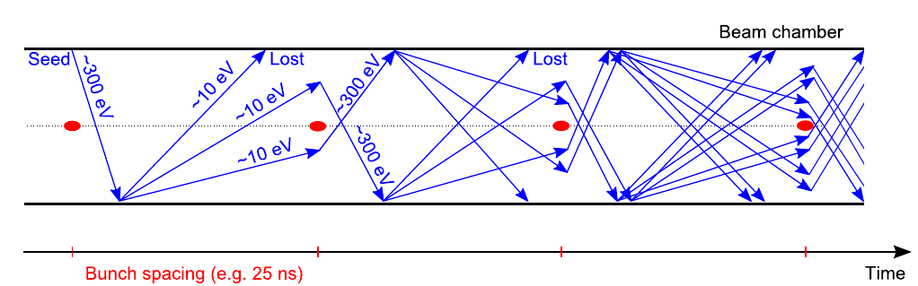


Electron cloud effects
Electrons inside vacuum chamber accelerated by field from passing bunch
Electrons hit inside of vacuum chamber, releasing more electrons, in turn accelerated => ever increasing cascasde of electrons
Causes heating, potential beam instabilities, worse vacuum...
Big challenge for LHC, even more for FCC-hh
Mitigations:
Beam screen design, surface treatment, coatings
If nothing else helps: increase spacing between bunches
G. Iadarola
LESS
a-C
Notes:
Laser ablation surface engineering (LASE), or laser-engineered surface structures (LESS) are techniques that can be applied to the beam-facing surfaces of the beamscreen in order to mitigate the electron cloud

Slide 41

CEPC / SppC

Slide 42

CEPC (Circular Electron Positron Collider)
Chinese proposal for e⁺e⁻ collider 90-240 GeV, 100 km ring
Four operation modes: H, Z, WW, ttbar
Two collision points, two RF insertions
Limit synchrotron radiation power to 30 MW per ring, option to go to 50 MW

Slide 43



CEPC parameter table
More details technical design report , 2023

Slide 44

SppC (Super proton-proton Collider)
100 km hadron collider to later be installed in the same tunnel as CEPC
Design report scenario:
use 12 T high-temperature iron-based superconductors for high field dipole magnets => centre of mass energy of 75 TeV
“ultimate” upgrade: 24T field, 150 TeV CMS energy
Operating at 4.2 K
Luminosity of 10³⁵ cm^{–2} s^{–1}
Baseline layout with 8 insertions for experiments, collimation, extraction, injection, RF
conceptual design report in 2018

Slide 45

Muon collider

Slide 46


Muon collider study
Could use heavier leptons than e+e- to minimize synchrotron radiation in a circular lepton collider
Could reach much higher energy than with e+e- for the same radius, still with “cleaner” collisions than protons
Or reach similar energies with a much smaller machine → cost- and energy-efficient
Use muons?
mass = 106 MeV/c² = 207 m_{e}
Challenge 1: Unstable, 2.2 μs mean lifetime
Need to very quickly accelerate them to high energy – with time dilation, factor γ longer lifetime
Challenge 2: experimental backgrounds due to e+ and e- from muon decay
Challenge 3: abundant neutrinos from muon decay could reach surface and interact, causing radiation
Production of muons – presently considered option:
Let high-power proton beam hit a target
Pions are produced, which later decay into muons
Muons have relatively large transverse momentum spread → need to very quickly "cool" them to achieve small beam size for higher luminosity
Challenge 4: very fast cooling of muon beam
protons
target
Many particles,
including π+, π-
Notes:
At 5 TeV, gamma = 47322, mean lifetime is 95 ms
Muons should last about 1000 turns in main ring, I.e. ~30 ms. Lifetime at top energy is 95 ms for 5 TeV beams (10 TeV CMS)

Slide 47

Muon collider concept
Muon collider design studies ongoing in international collaboration
A lot of advancement lately, many challenges remain
D. Schulte
Protons produce pions which decay into muons which are captured
Ionisation cooling of muon in matter
Acceleration to collision energy
Short, intense proton bunch
Collision

Slide 48
Summary
LHC will be upgraded to HL-LHC, and operate to ~2041
Future collider projects on the table, but no decision yet
Main projects studied at CERN
FCC-ee: circular e+e- collider
e+e- Higgs factory is highest priority it European strategy
Feasibility study report prepared as input to next European strategy
FCC-hh: circular pp collider with ion option
Second stage after FCC-ee
CLIC: Linear e+e- collider
Also fulfills priority on a Higgs factory in European strategy
Conceptual design report exists, technology and concept demonstrated
Muon collider: potential for high-energy circular lepton collider without radiation limitation, very challenging
Other projects: LEP3, LHeC, …
All machines have many interesting beam physics aspects and difficult challenges – I could cover only a few!
Initiatives in other parts of the world
ILC: Linear e+e- collider, possibly hosted by Japan
Mature design with technical design report; ready to be built. Awaiting political decisions
Alternative placement at CERN under study
CEPC / SppC: circular e+e- collider followed by hadron collider, Chinese initiative
Technical design report exists. China will decide
EIC: circular electron-ion collider, to be built in the US
Approved project with conceptual design report

Slide 49






Future colliders?
Particle collisions 50 years ago
Particle collisions today
Particle collisions in 50 years
574 TeV Pb beams colliding at ALICE, LHC
32 cm bubble chamber with liquid hydrogen, 16 GeV pion interacting with proton
We know only that we will need scientists and engineers to design, operate and optimize the machines, and to analyze the data
https://cds.cern.ch/record/39474

