Slide 1


About CERN openlab
Killian Verder, Mariana Velho, CERN openlab

Slide 2




About
CERN openlab
Collaboration is the core of CERN openlab, where industry and scientific researchers co-develop innovative solutions. Together, we embark on four primary missions:
Establishing strategic industry collaborations
For almost 25 years, CERN openlab has been the bedrock of partnership, providing a structured and collaborative framework for industry and research organisations to engage with CERN researchers.
Fuelling technological innovation
Exposing technology to researchers
Nurturing knowledge and growth in young STEM researchers
2

Slide 3
R&D Directions
Sustainable Infrastructures
Emerging Technologies
Projects within the CERN openlab framework are dedicated to accelerating computing for science, particularly under the R&D directions of ‘Sustainable Infrastructures’ and ‘Emerging Technologies’.
Heterogeneous Computing, Platforms and HPC systems
New Materials for
Long-Term Digital Storage
Advanced Storage, Data Management and Networks
Digital Twins
Strategic Objectives
Computing Architectures and Software Engineering
Pioneer sustainable and innovative computing and storage solutions
Leverage HPC infrastructures and AI techniques for sustainable science
Foster collaboration between industry and science in ICT technologies
Infrastructures and Techniques for Artificial Intelligence
Applications for Society and Environment
3

Slide 4


CERN openlab phase VIII
Implementation Model
The CERN openlab implementation model relies on two main approaches:
Establishing a managed portfolio of small to medium-size agile projects with technology providers with clear impact on the CERN IT Technology Roadmap.
Identifying a few collaborations, especially at the level of the computing infrastructures, of high potential impact and act as an incubator for strategic partnerships.
4

Slide 5
CERN openlab phase VIII
Stakeholders
CERN openlab’s primary role is to act as conduit and facilitator for collaboration in computing science and technology between two categories of stakeholders:
The science communities
(CERN departments and groups; R&D teams at CERN; Research centres)
Technology providers
(industry)
5

Slide 6





















Our members
We aim to enhance industry and research partnerships, in particular within Europe, leveraging on CERN ILOs.
Established Industry and Research Members
Industry and Research Members
in Pre-Agreement Stage
Prospective Industry and
Research Members
6

Slide 7
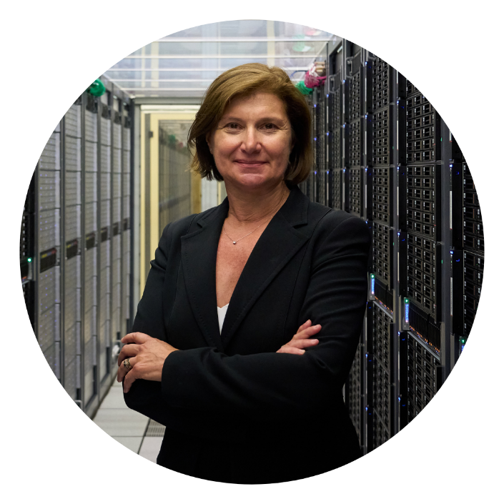
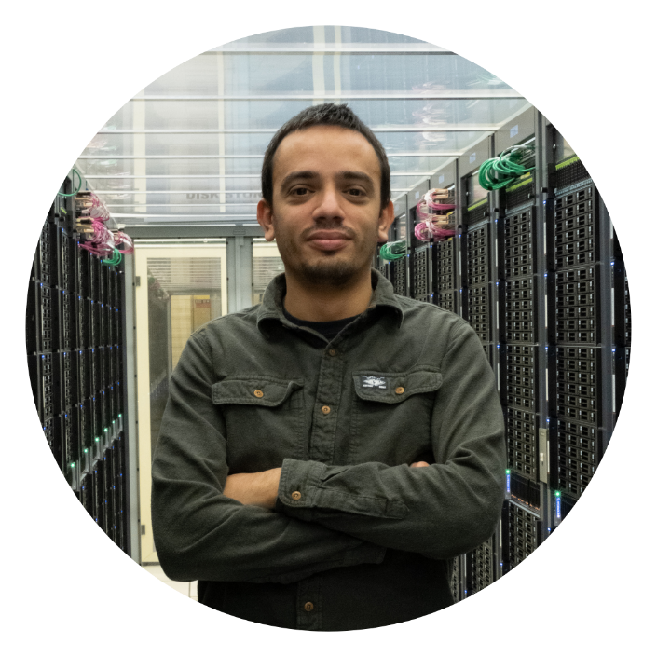
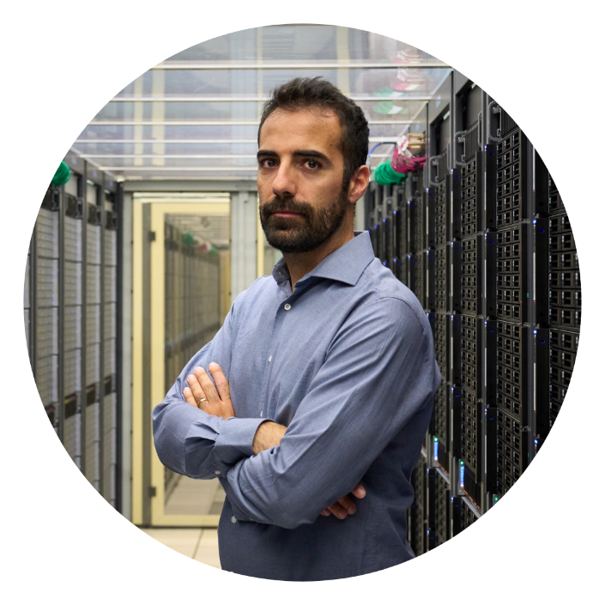
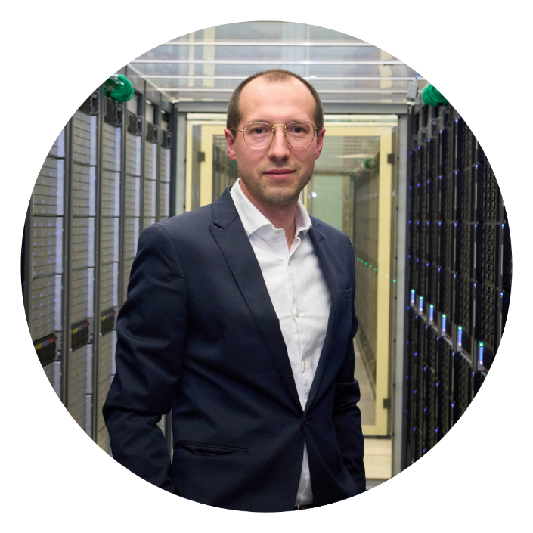
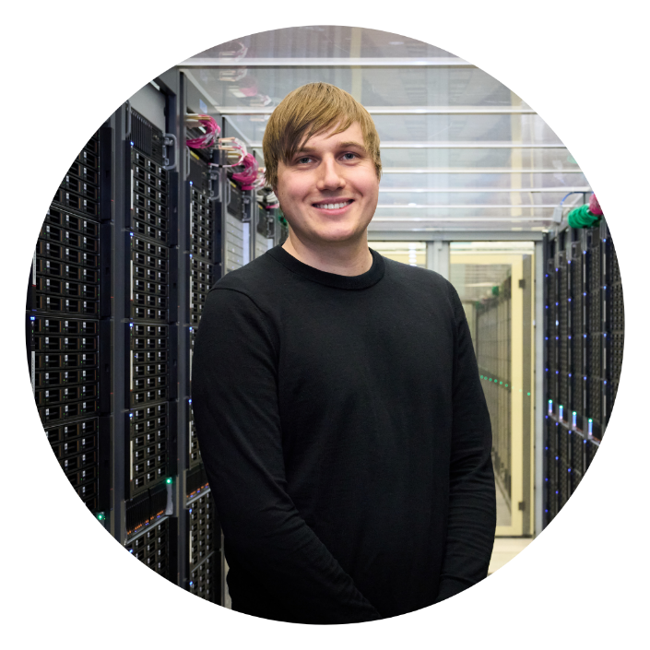
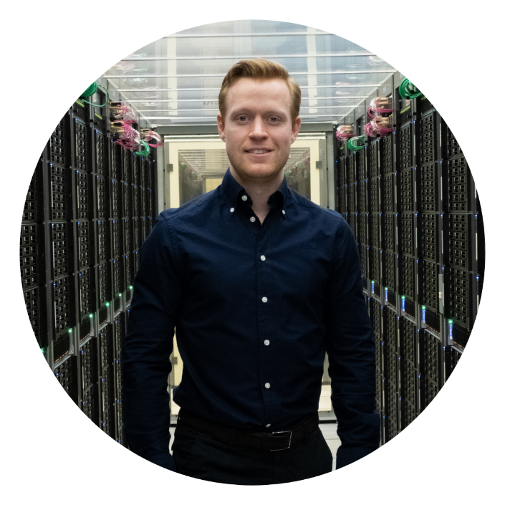
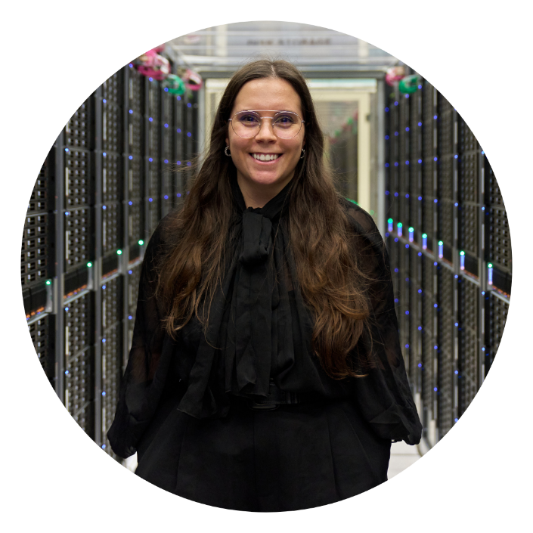
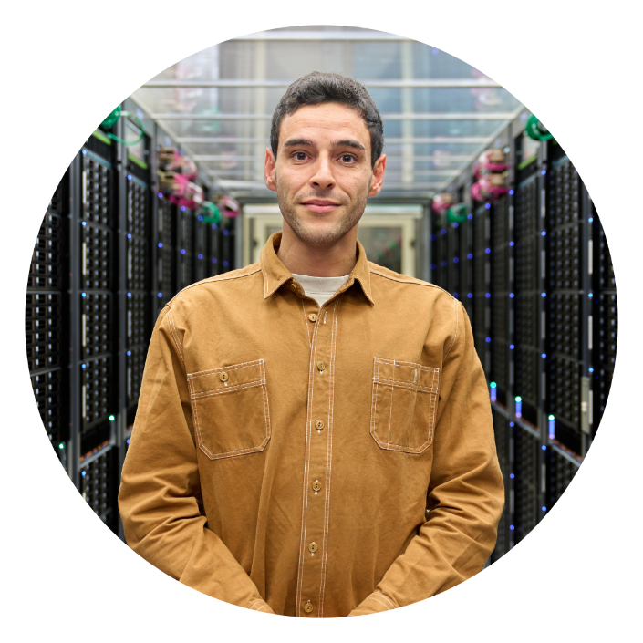
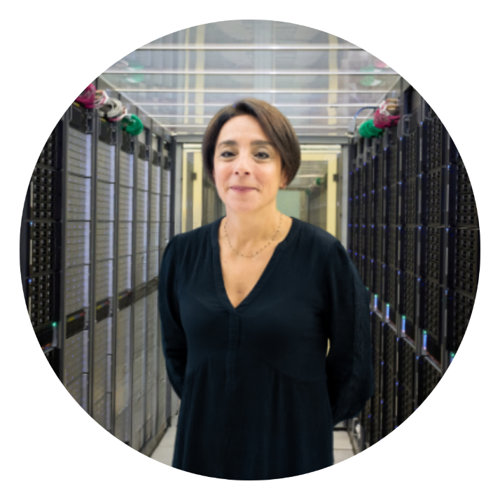
CERN openlab Team
Maria Girone
(Head of CERN openlab)
Luca Atzori
(CTO for Computing)
Antonio Nappi
(CTO for Platforms and Workflows)
Luca Mascetti
(CTO for Storage)
Thomas Owen James
(CTO for AI and Edge Devices)
Eric Wulff
(CTO for AI on HPC)
Mariana Velho
(Communication Manager)
Killian Verder
(CTO Office Administrative)
Valentina Clavel
(Finance Manager)
6

Slide 8
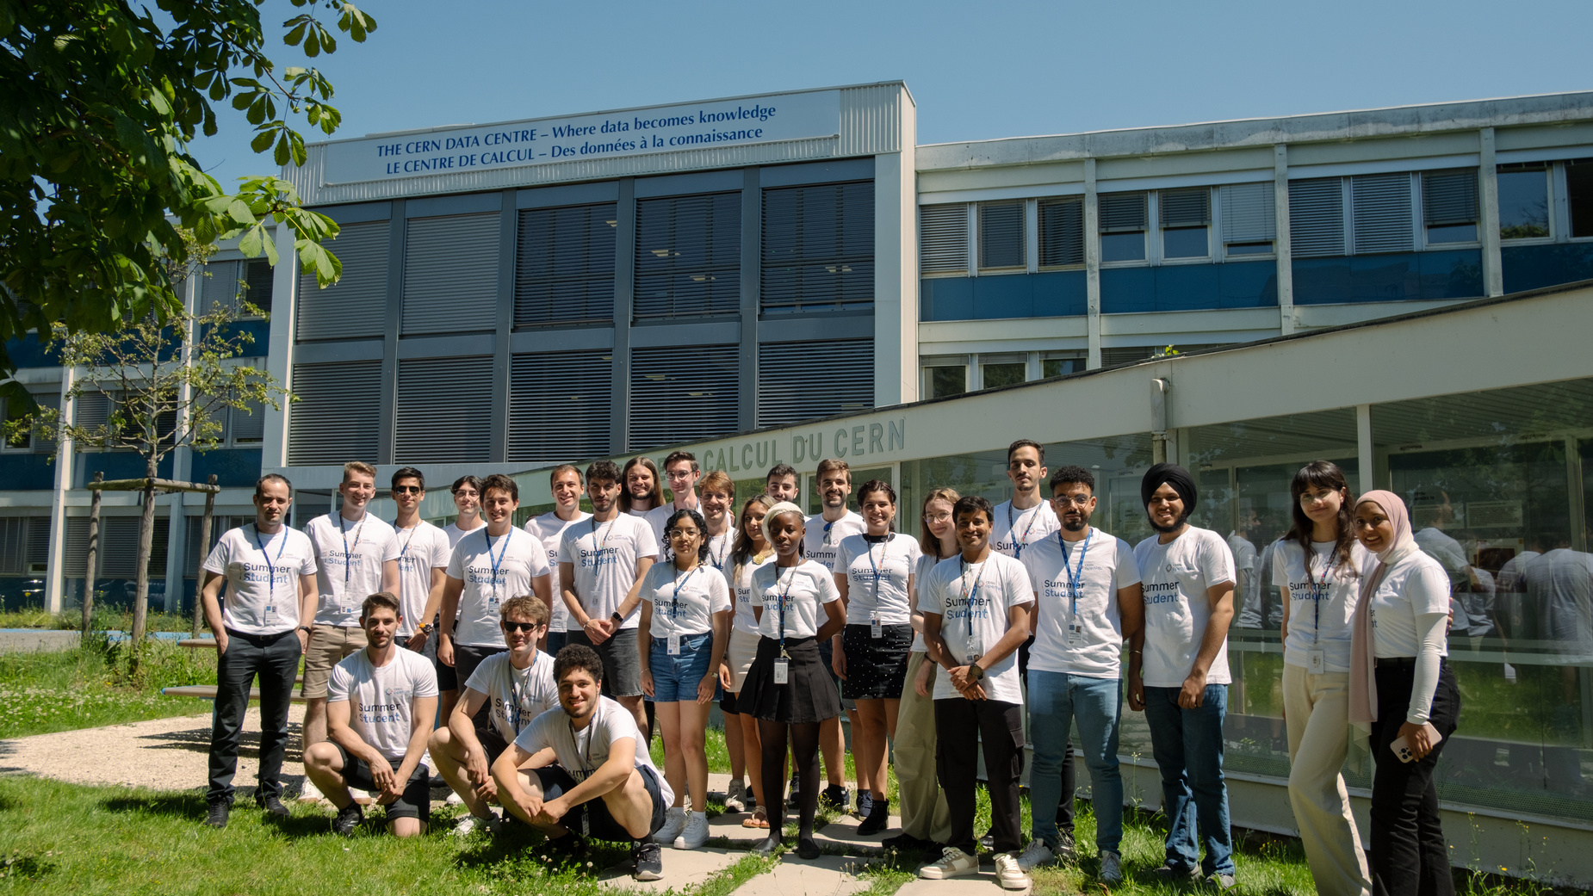
CERN openlab
Summer Student Programme
The CERN openlab summer student programme provides undergraduate and master’s level students with an opportunity to work on one of the R&D projects for nine weeks under experts’ supervision.
CERN openlab joined forces with ideas4HPC to sponsor a CERN openlab Summer Student, promoting the participation of women in high-performance computing research. CERN openlab is committed to improve girls’ participation in ICT and will continue championing for more women’s involvement in ICT.
7

Slide 9
CERN openlab
Summer Student Programme Lectures Programme
8

Slide 10

Workshops
Thursday
31/07
8h30 to 17h30
Wednesday
09/07
14h00 to 17h00
ROOT Workshop
NVIDIA Fundamentals of Deep Learning
Monday
14/07
13h30 to 16h30
FPGA Programming with LABview
NVIDIA Fundamentals of Accelerated Computing with CUDA
Wednesday
23/07
14h45 to 16h45
Wednesday
30/07
8h30 to 17h30
Best Practices of Writing Code
9

Slide 11
Computing Lectures
Tackling Computing Challenges at CERN
Data Centre Hardware
Computer Security: past, present, future
Data Storage at CERN
Best practices: the theoretical and practical underpinnings of writing code that is less bad
Data Centre Nightmares
DAQ-filtering data
GPU programming
Understanding containers and why they matter
Introduction to Quantum Computing
Always check the indico for the the most up to date information: https://indico.cern.ch/category/19808/
10

Slide 12

AI/ML Lectures
Council Chamber
503/1-001
Introduction to Machine Learning and Deep Learning
Introduction to Reinforcement Learning
Hyperparameter Optimisation for Deep Learning Models using HPC
ML for Trigger and Data Acquisition
interTwin: on distributed ML
Foundation Models
Nvidia Workshop: Fundamentals of Deep Learning
Always check the indico for the the most up to date information: https://indico.cern.ch/category/19808/
11

Slide 13
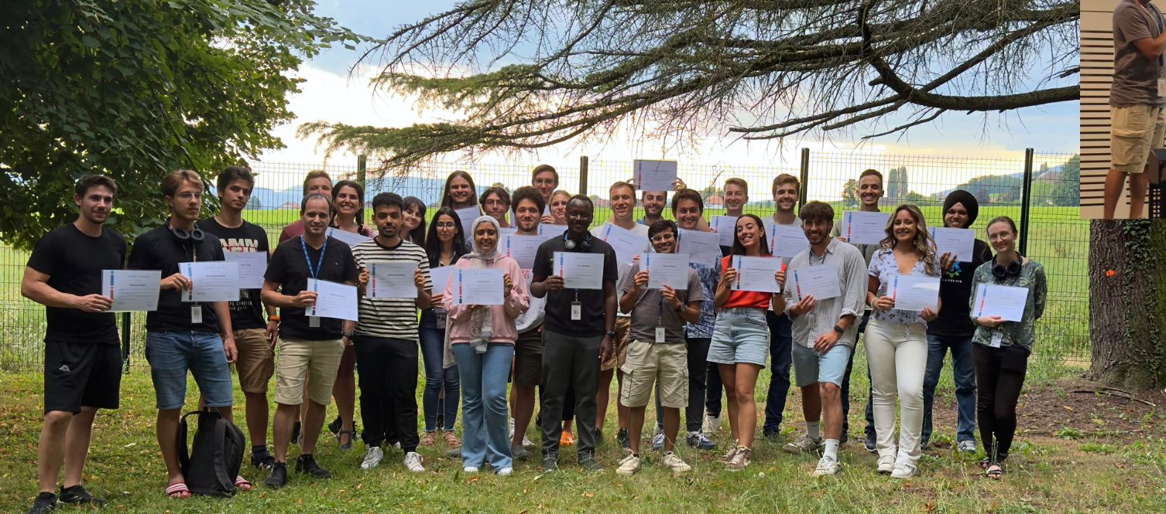
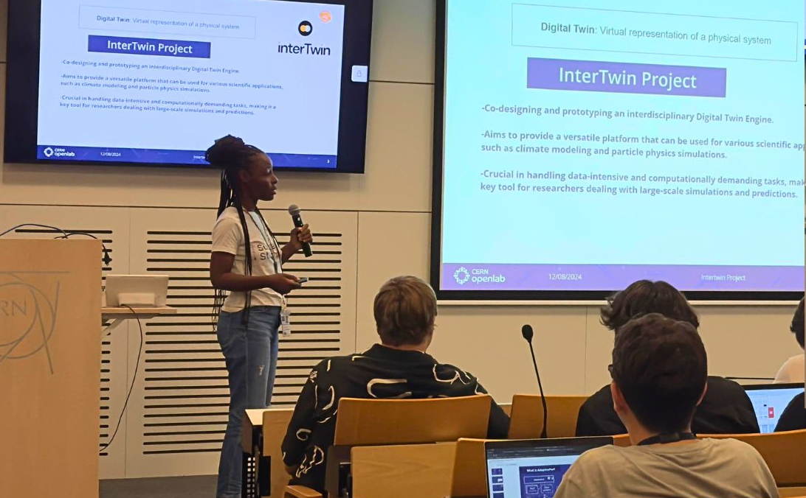
Lightning Talks
CERN openlab summer students present brief overviews of their projects in five-minute 'lightning talks' series explaining the challenges, problems and solutions they found during their work.
Lightning Talk 1
11th of August
Lightning Talk 2
12th of August
12

Slide 14


Movie Night
Tuesday
15/07
19h15 to 21h15
Particle Fever by
Marc Levinson
Always check the indico for the the most up to date information: https://indico.cern.ch/category/19125/
13

Slide 15



Thank you!
Email | openlab-communications@cern.ch
Website | openlab.cern
Lecture Programme | killian.verder@cern.ch
Indico | https://indico.cern.ch/category/19808/
Phase VIII Strategy
LinkedIn
2024 Annual Report

