Slide 1
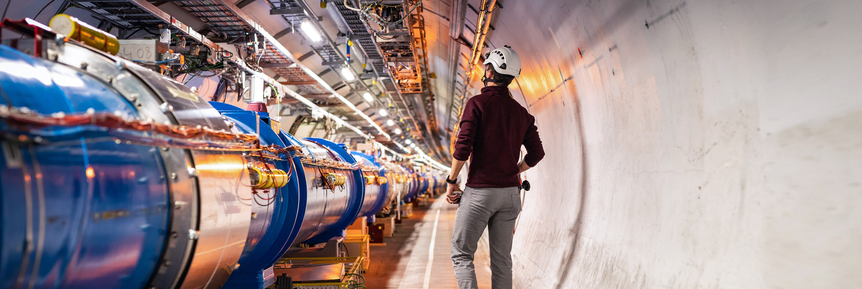
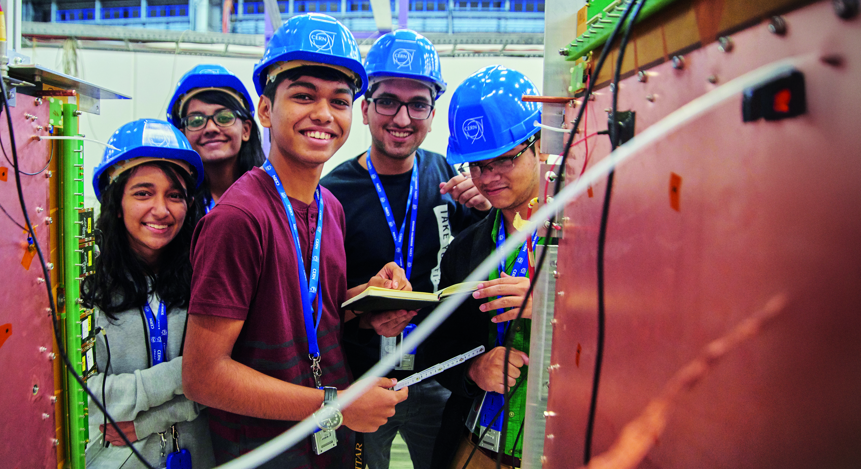
WELCOME TO CERN
Notes:
THE WELCOME SLIDE
With this slide the speaker:
Introduces him/herself
Describes how this brief presentation aims to give an overview of CERN, as an introduction to the visit that will follow.

Slide 2
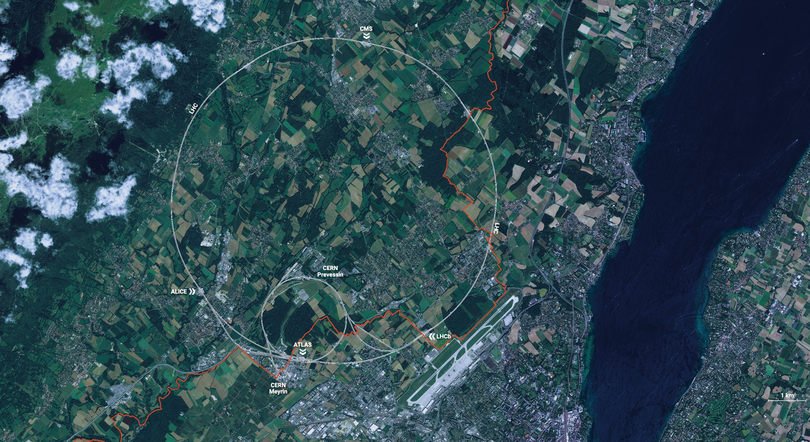
CERN is the world’s biggest laboratory
for particle physics.
Our goal is to understand the most fundamental particles and laws
of the universe.

Slide 3
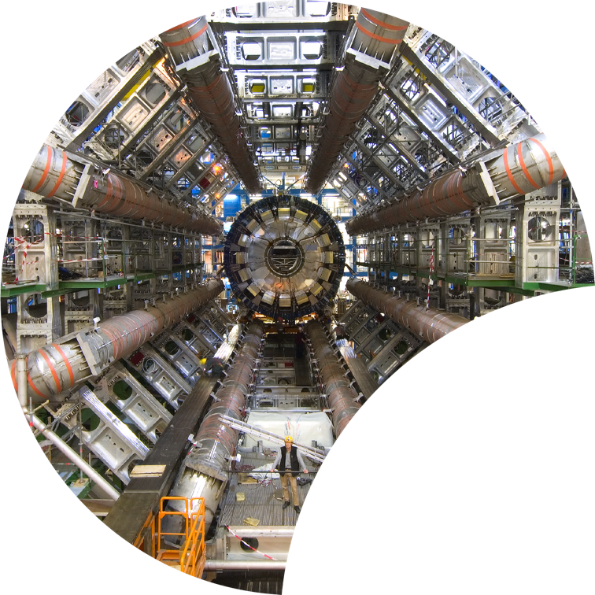
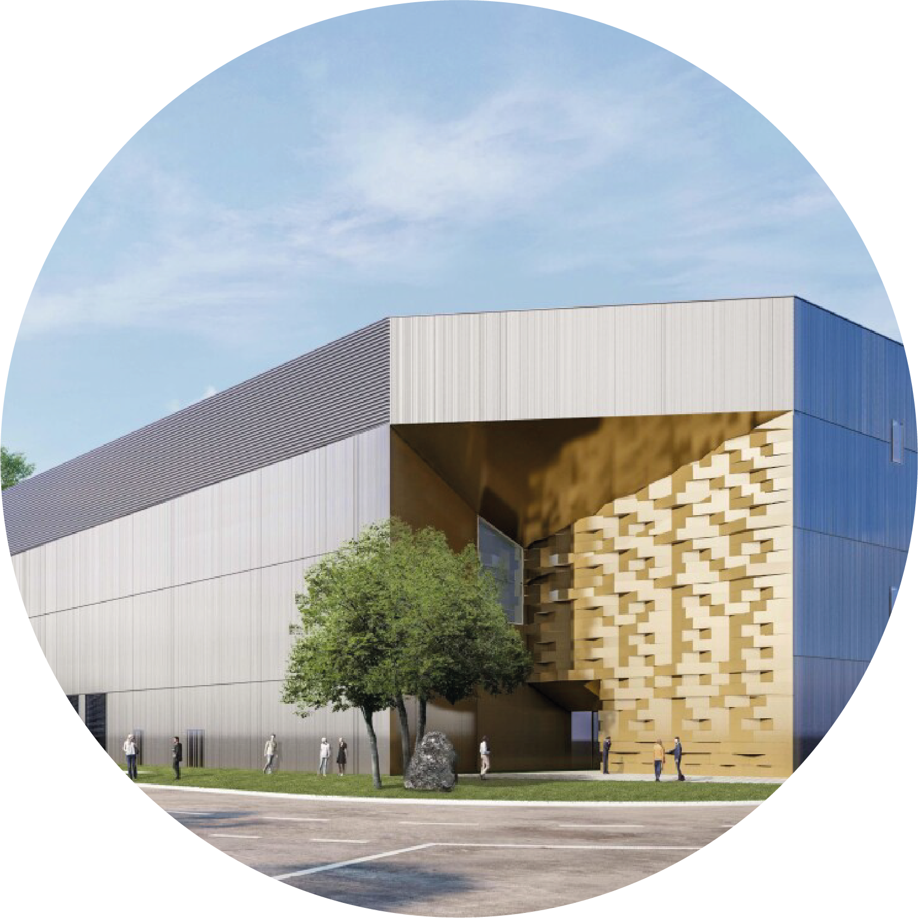
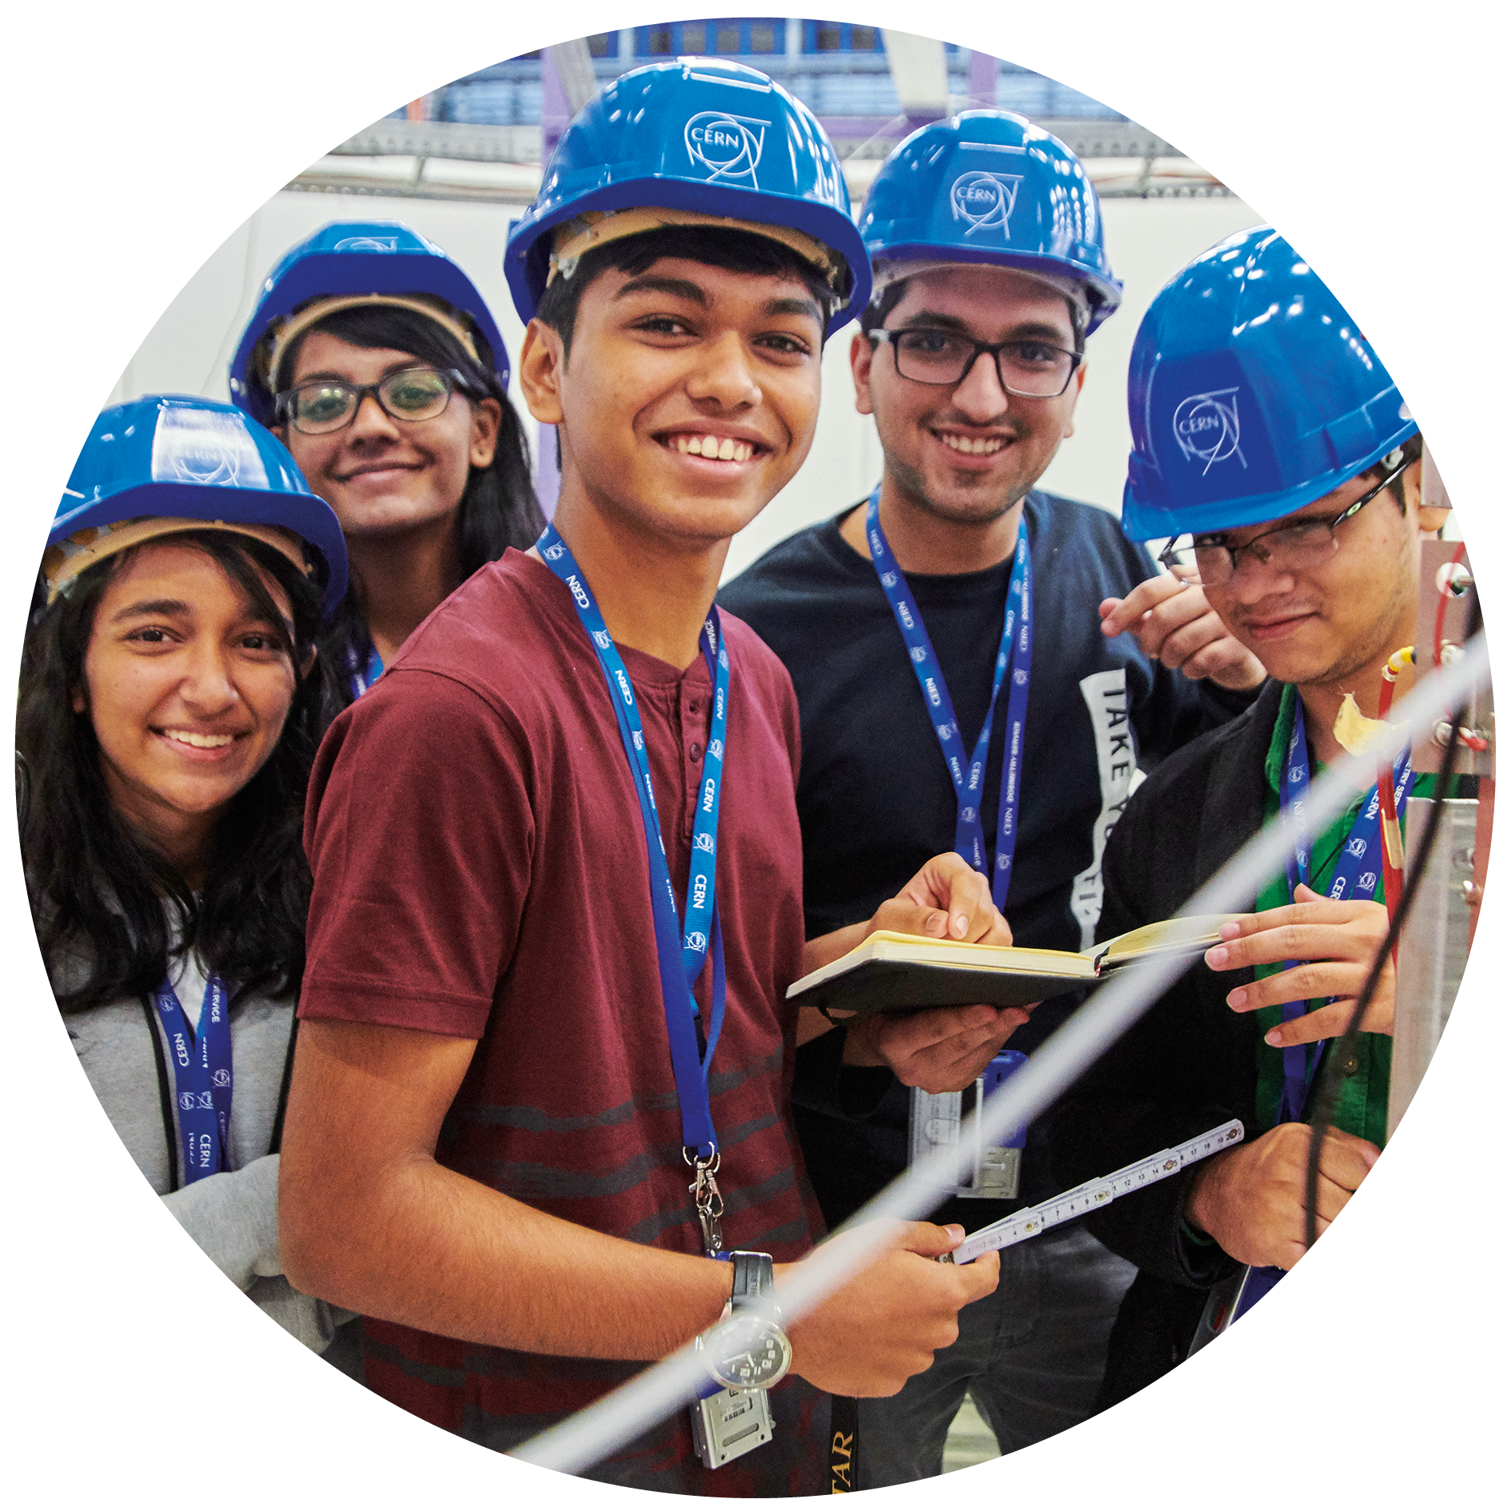

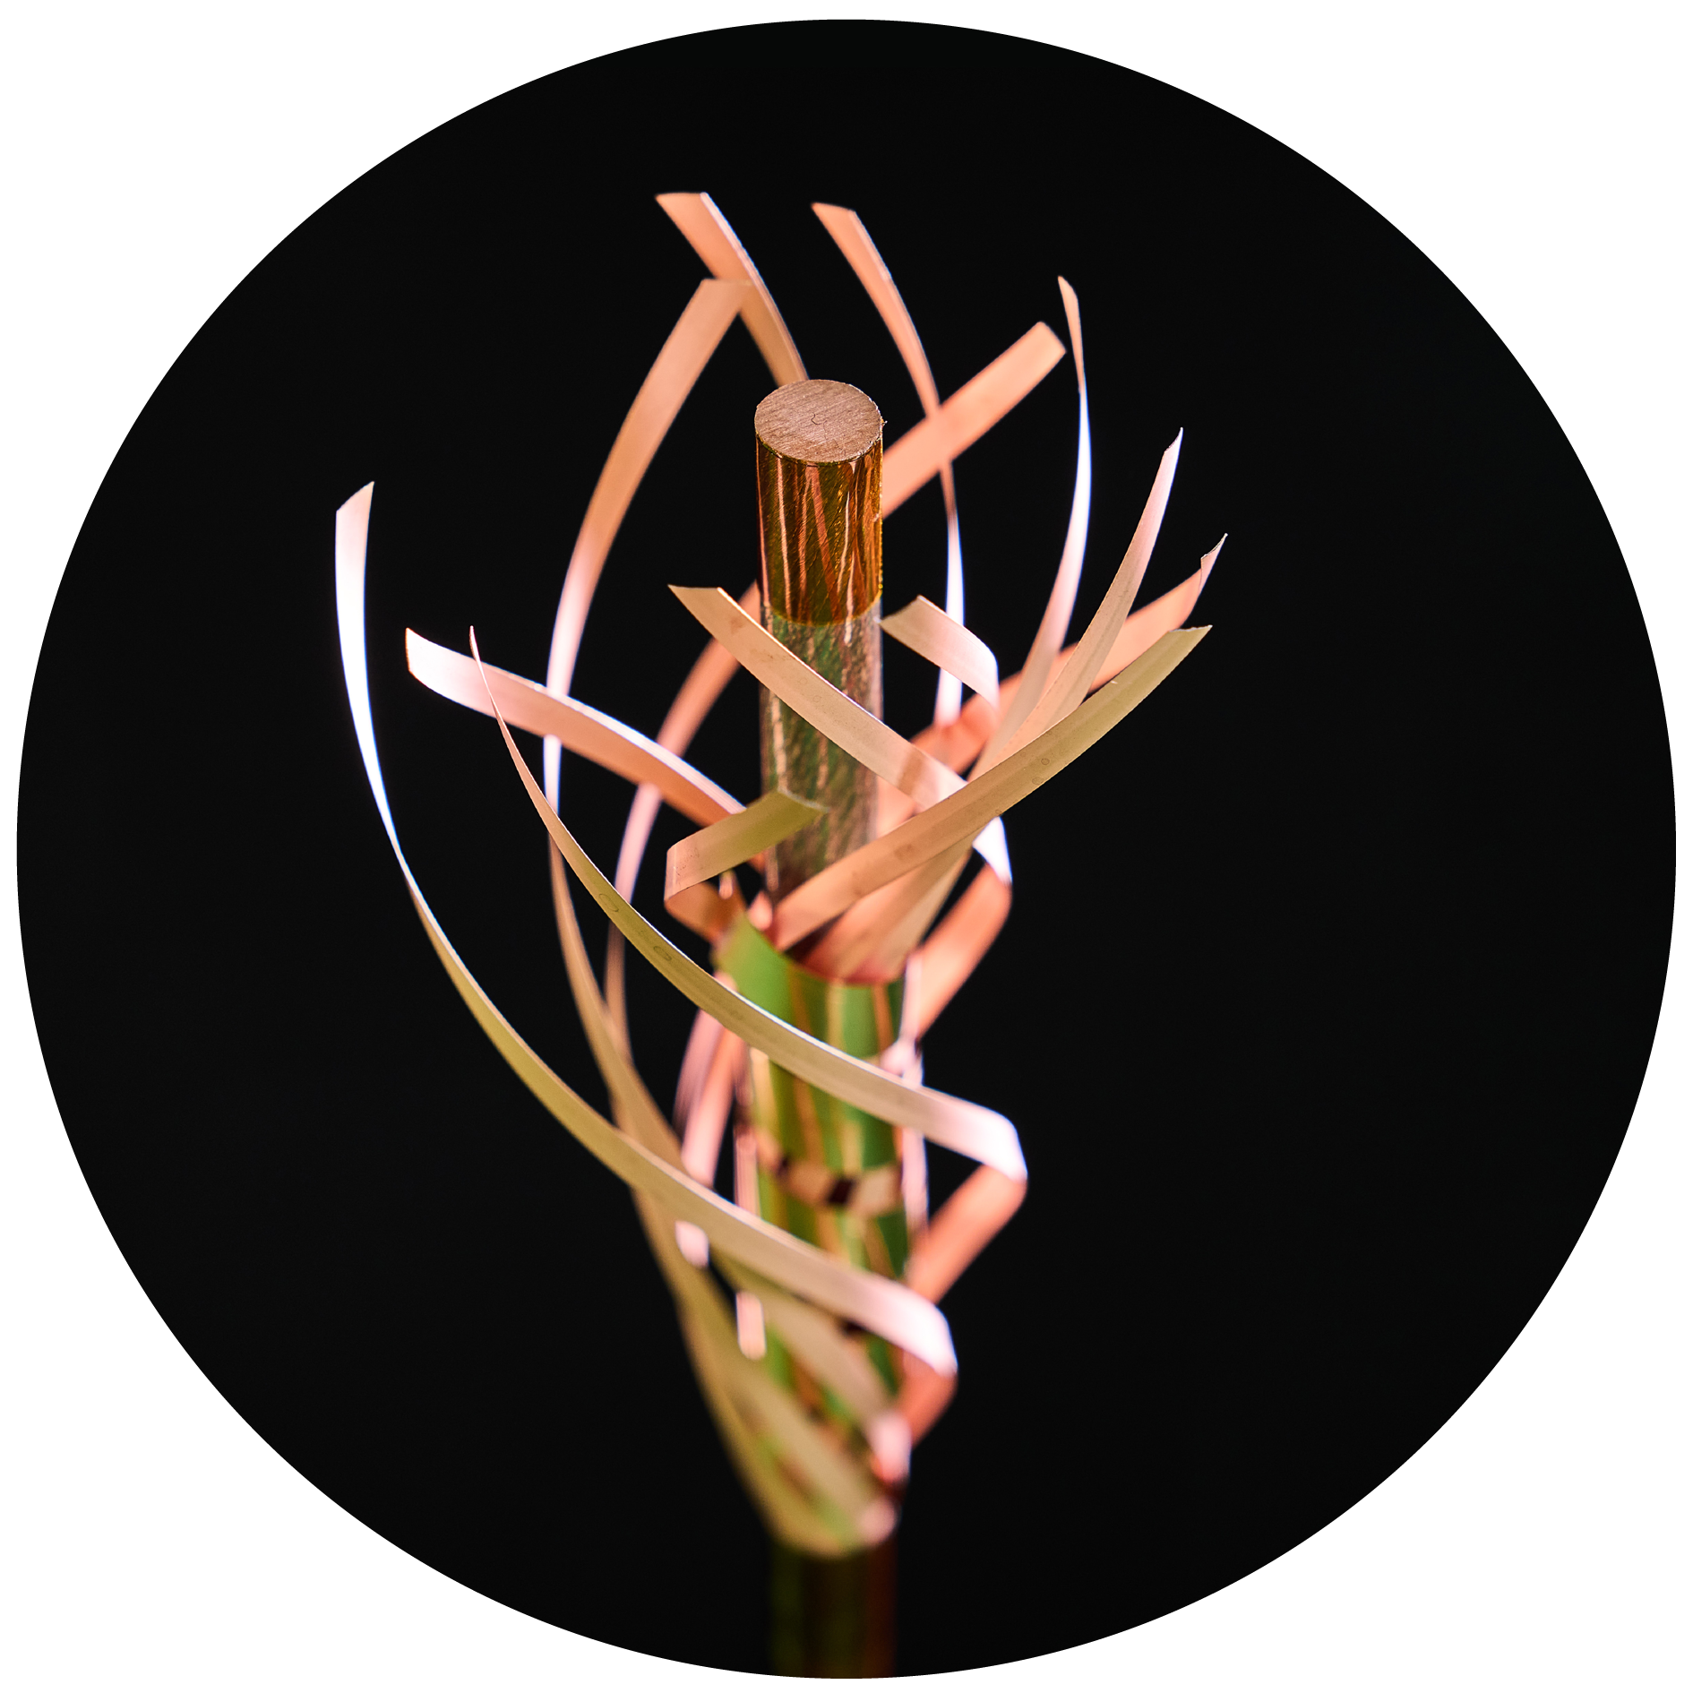

Four pillars underpin CERN’s mission
RESEARCH
EDUCATION
& TRAINING
COLLABORATION
TECHNOLOGY
& INNOVATION
Notes:
This slide introduces the four pillars that underpin CERN’s mission:
Research: To perform world-class research in experimental and theoretical particle physics; and to provide the particle physics community a range of accelerators that enable that research
Collaboration: To unite people from all over the world in the common goal of advancing the frontiers of human knowledge, in a spirit of equal collaboration and openness
Innovation: To push the technology underpinning accelerators, detectors and computing, to drive innovation in order to transfer knowledge to other scientific and technological areas, for the benefit of society
Education and Training: To train future physicists and engineers, to promote careers in science and engineering, and to foster citizens’ engagement in particle physics and in fundamental research.
FROM THIS POINT FORWARD, THE PRESENTATION IS DIVIDED INTO FOUR SECTIONS: ONE SECTION PER PILLAR

Slide 4
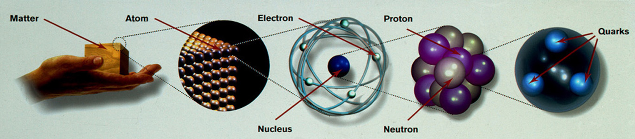
At CERN we study the elementary particles, i.e., the smallest constituents of matter and the universe, and the laws of physics at the most fundamental level
10⁻¹⁰ m
10⁻¹⁴ m
10⁻¹⁵ -10⁻¹⁸ m
The Large Hadron Collider (LHC) at CERN allows us to scrutinize matter down to scales of smaller than 10⁻¹⁸ m
→ provides insight also into the structure and evolution of the Universe
→ the very small to understand the very big …

Slide 5
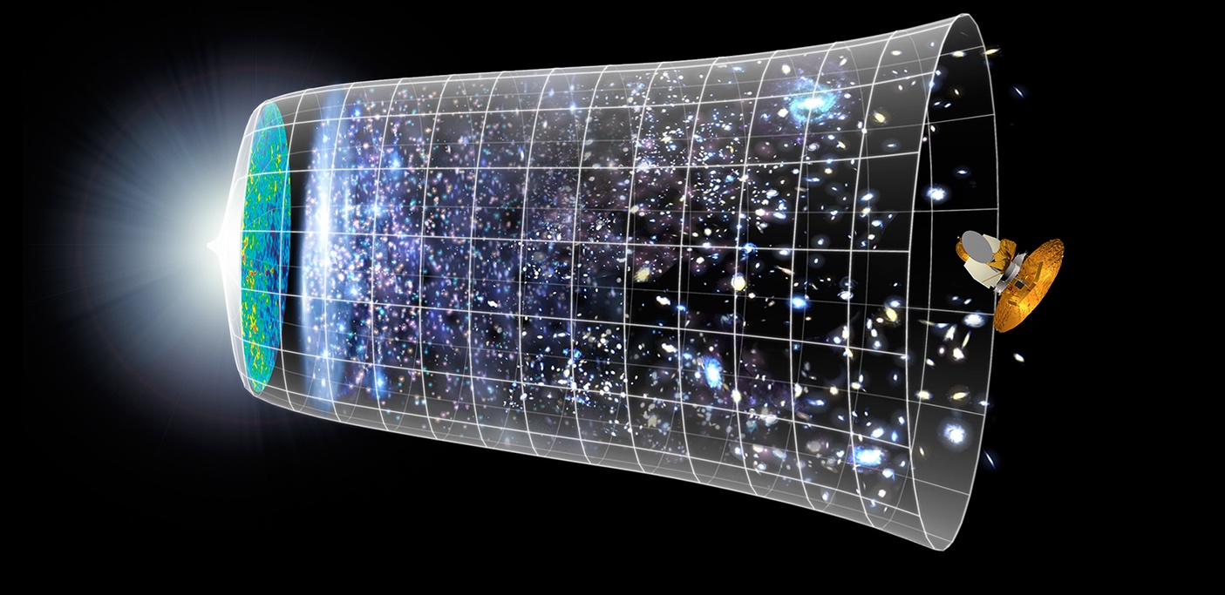
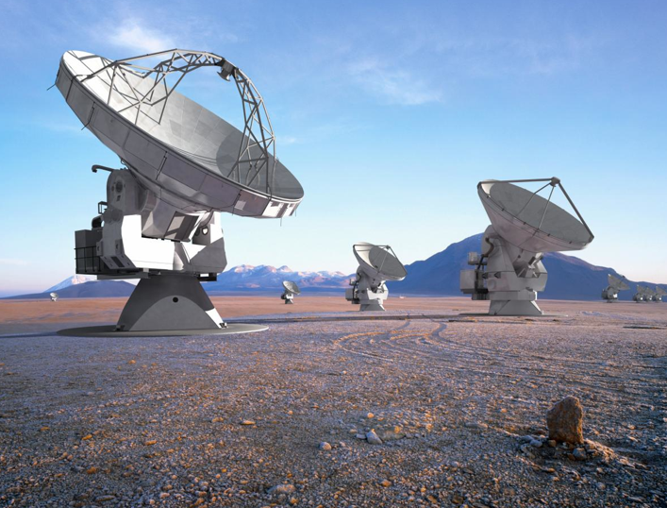

Evolution of the Universe
Telescopes
Big Bang
LHC
13.8 Billion Years
Explore the Universe back to 10⁻¹² s after the Big Bang
Today
10²⁸ cm

Slide 6
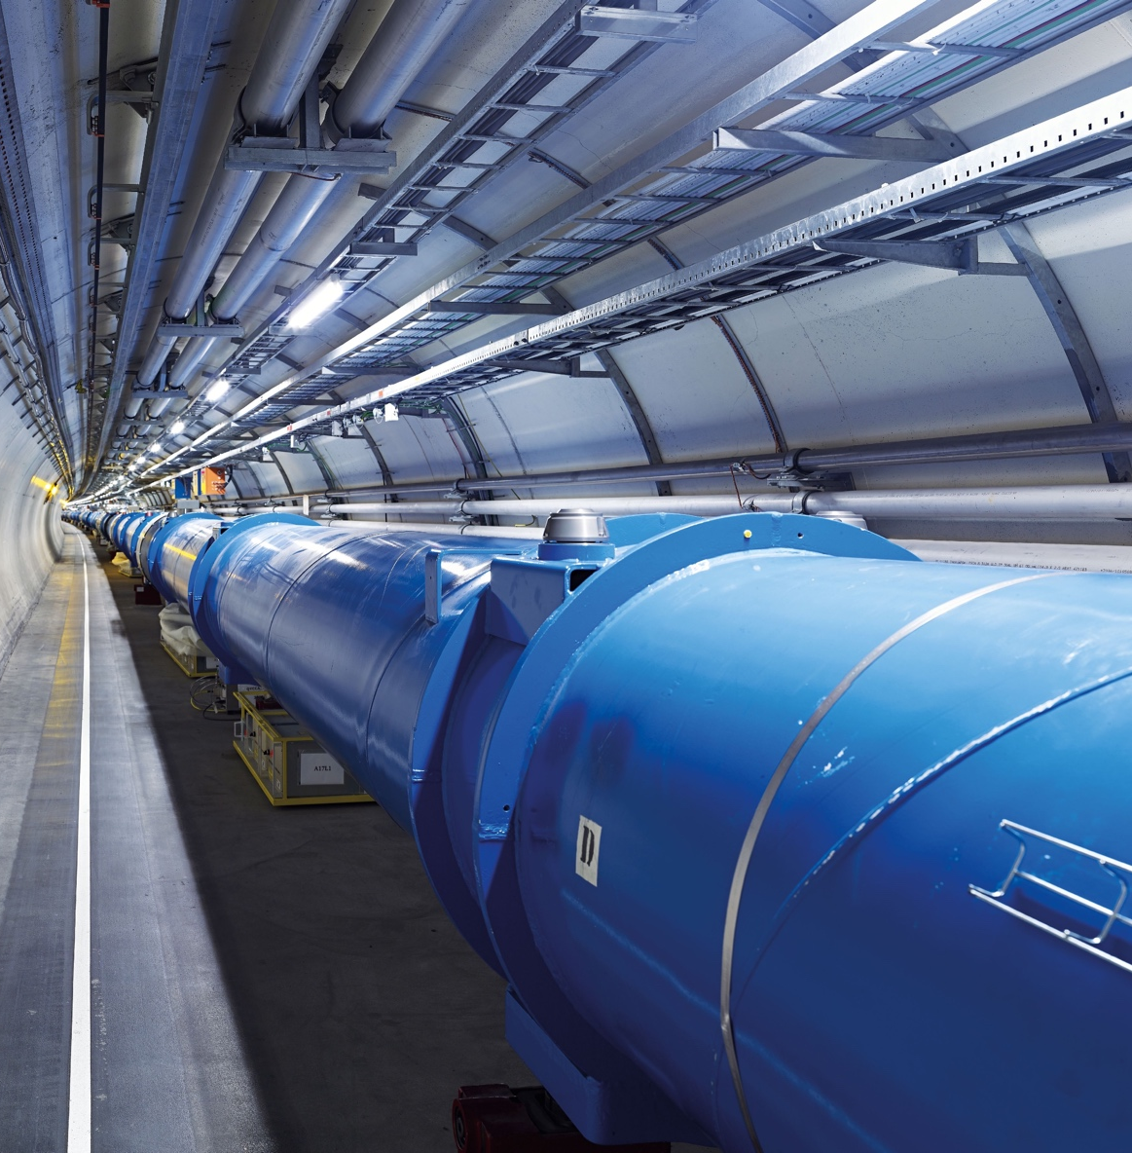
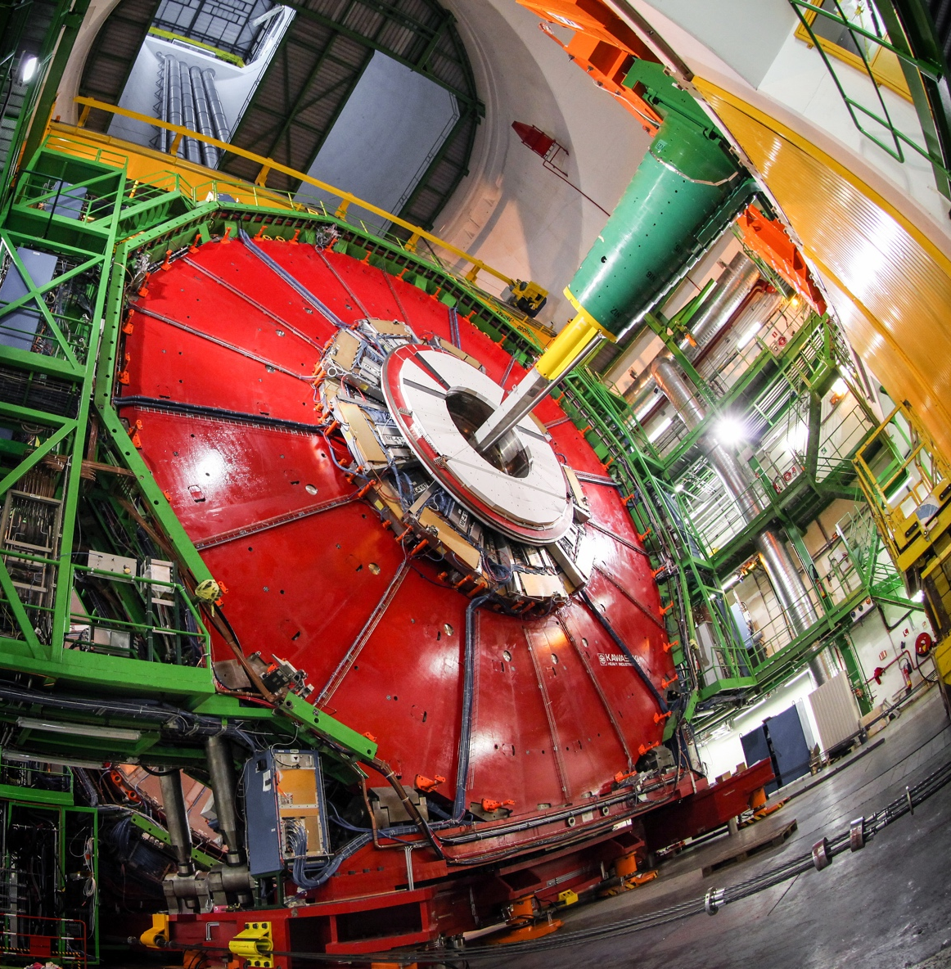
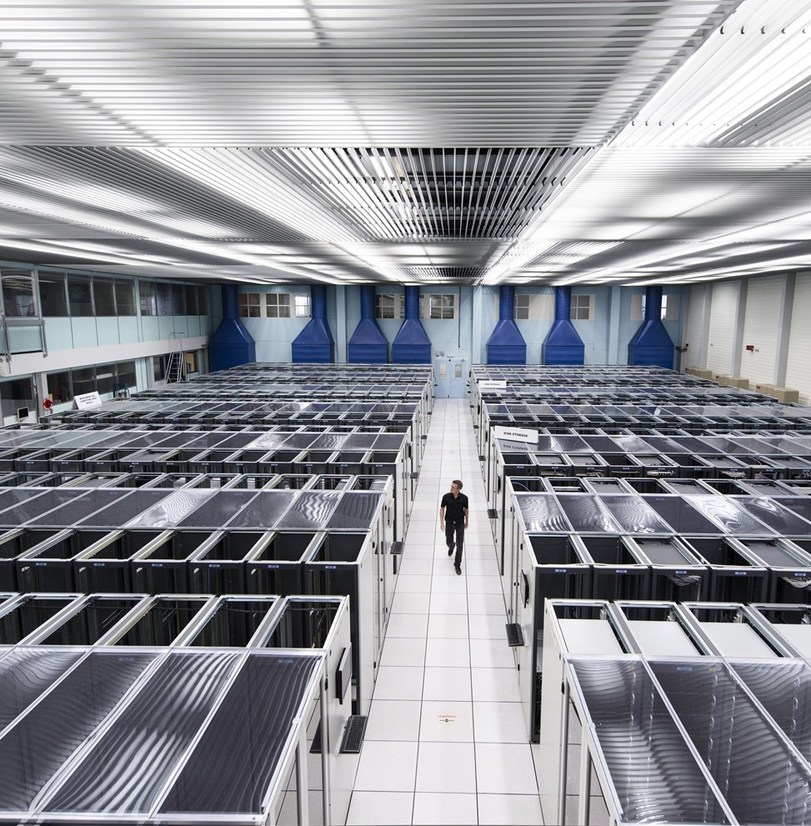
3 main instruments and a broad spectrum of advanced technologies are needed for our exploration
ACCELERATORS
DETECTORS
COMPUTING

Slide 7
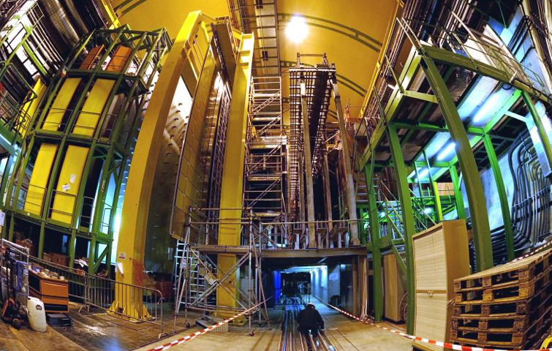



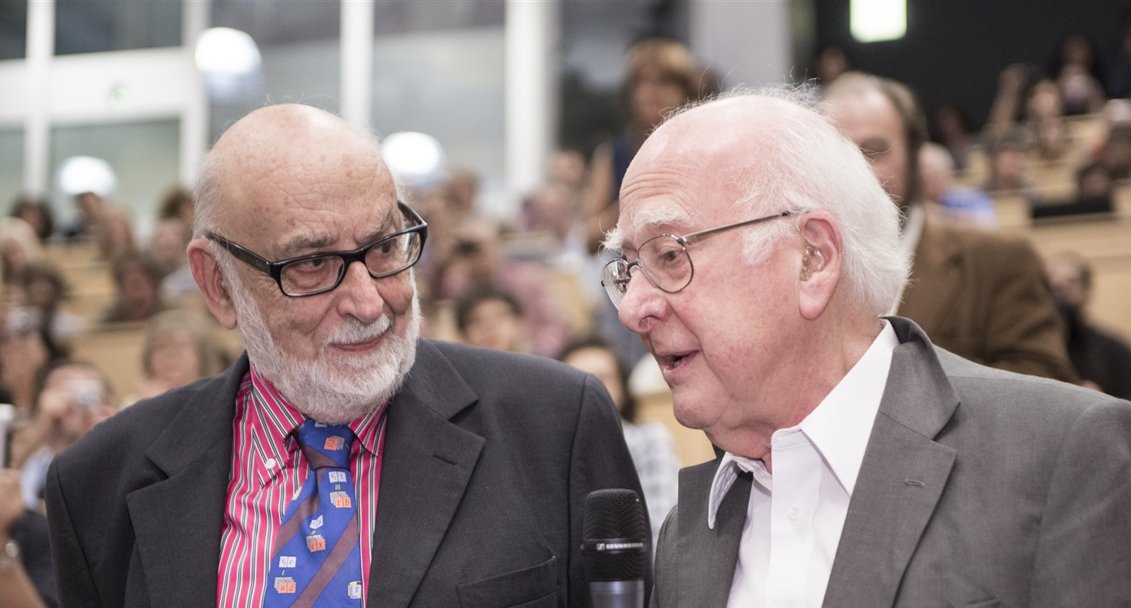
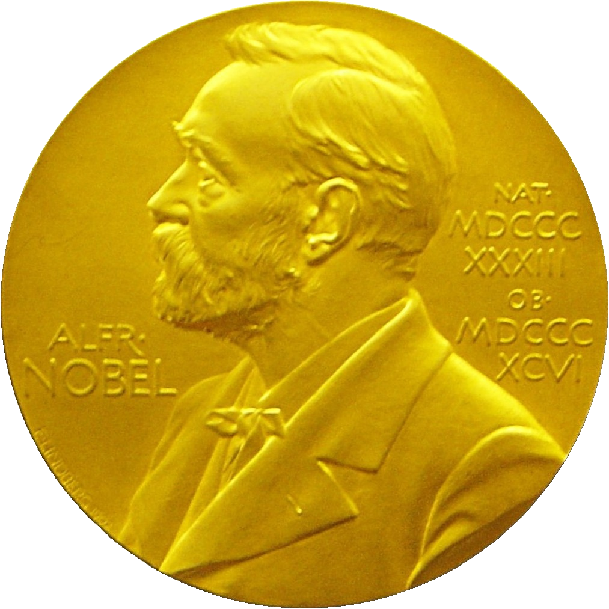
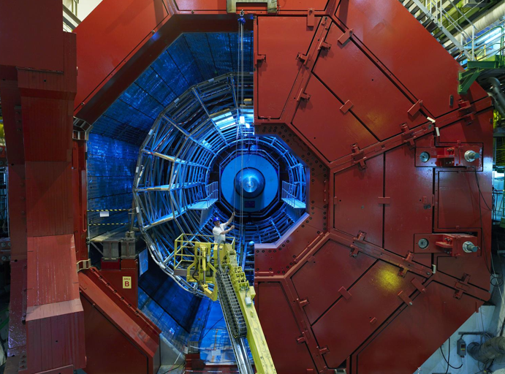
Large Hadron Collider - LHC: the most powerful accelerator ever
LHCb
ATLAS
27 km ring, 100 m underground Operation started in 2010 →
exploration of a new energy frontier
CMS
July 2012, ATLAS and CMS announced the discovery of a new (very special!) particle: the Higgs boson.
ALICE
Francois Englert and Peter Higgs Physics Nobel prize 2013

Slide 8
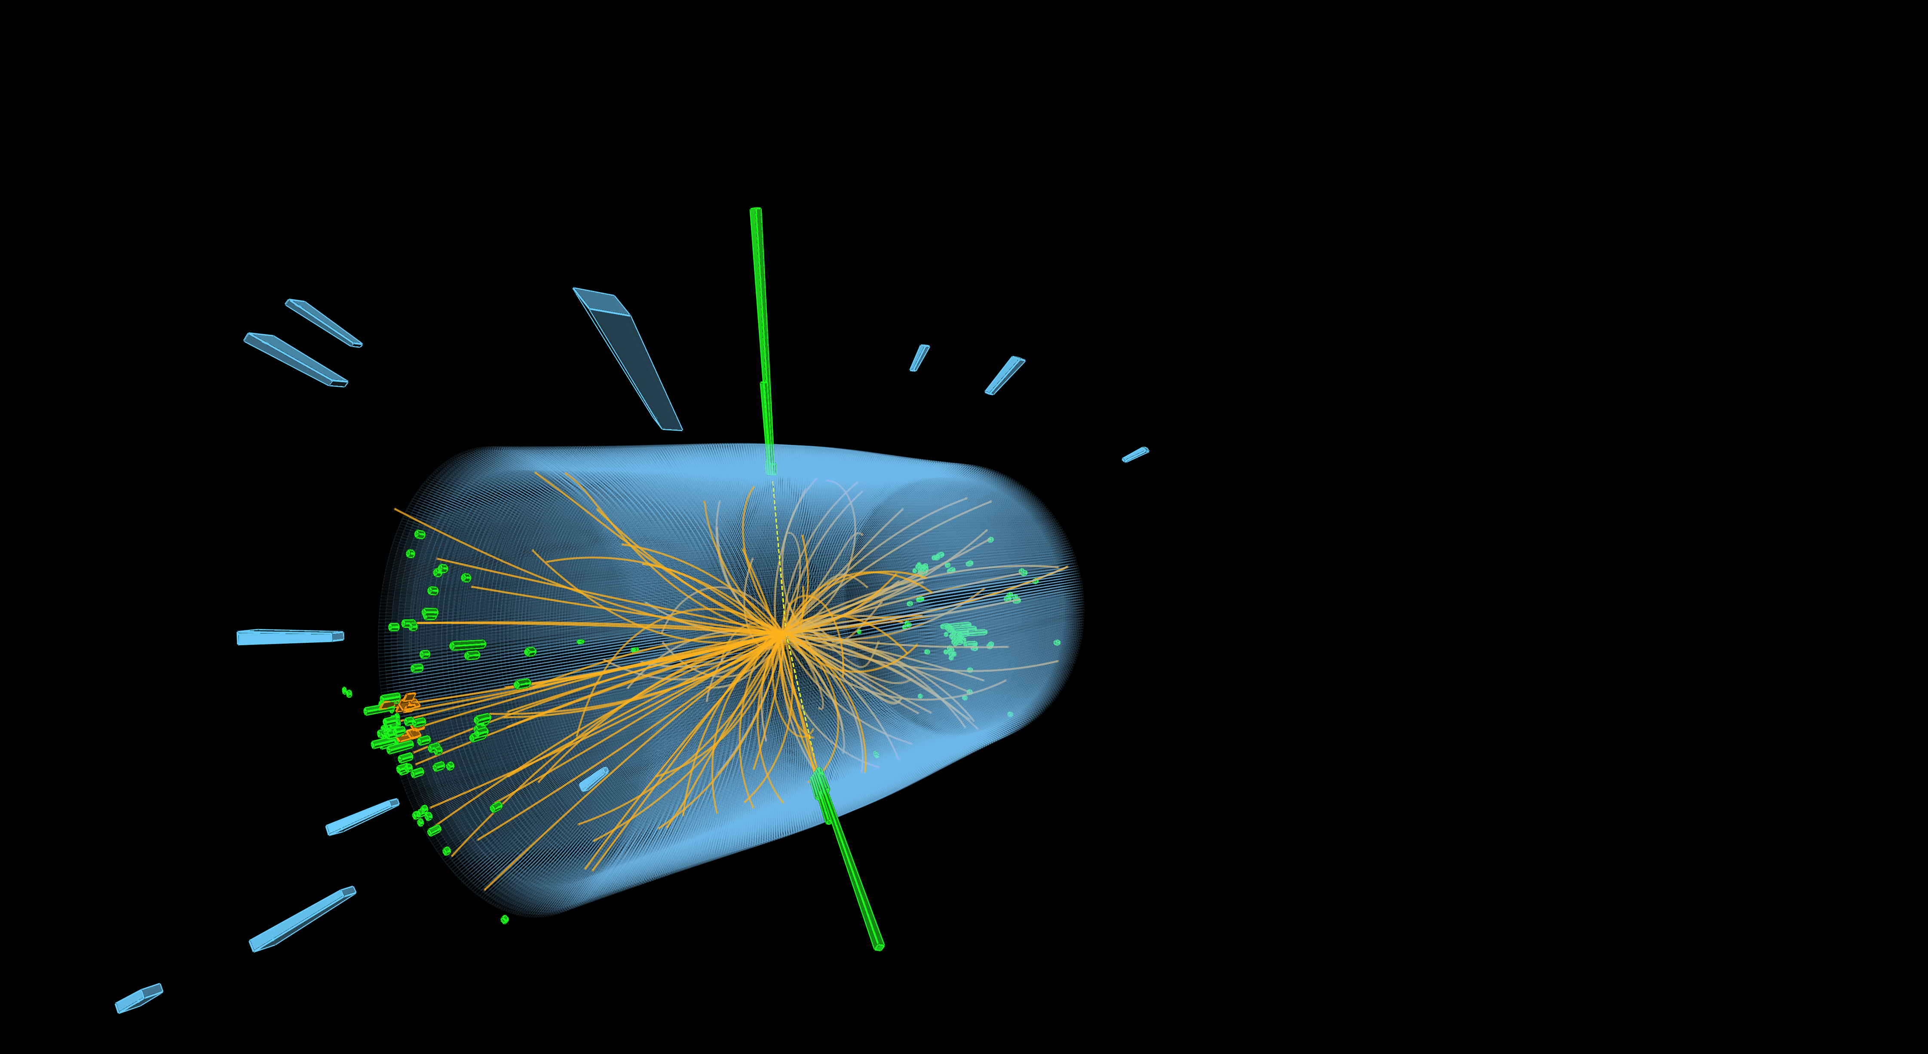
The LHC produces more than 1 billion particle collisions per second
The energy of the particles in collision is converted into new particles.
Notes:
Possible complementary information (TIME PERMITTING)
- At collision point, the energy density or temperature is equivalent to 10⁻¹²s after Big Bang (10¹⁶°C).
- The two proton beams collide at a combined energy of 13 TeV. A flying mosquito has about 4 trillion electronvolts of energy, so a collision in the LHC generates the energy of about 3 flying mosquitoes. But the energy is crammed into a space about 1 trillion times smaller across than the insect.
Nowhere else on Earth can we concentrate energy to that extent.

Slide 9
Key figures illustrating the technological challenges
1.9 K (-271° C)
The operating temperature
of the LHC magnets
(colder than outer space)
200 000 billion
The number of protons
per beam
11 000
The number of revolutions
of the 27 km ring made every second by the protons
40 million
The number of
beam-beam collisions in
the detectors per second
10¹⁶ K
(~ 100,000 billion times
room temperature):
the collision energy in the
LHC, corresponding to the temperature of the
Universe 10⁻¹² seconds
after the Big Bang
1500 million GB
The data from the
LHC experiments stored
around the world
400 MJ
The energy stored in
each of the LHC
beams (equivalent to an
Airbus 320 at 110 km/h)
3000 km
The length of cable needed to transmit signals
from the LHC detectors
to the control room

Slide 10
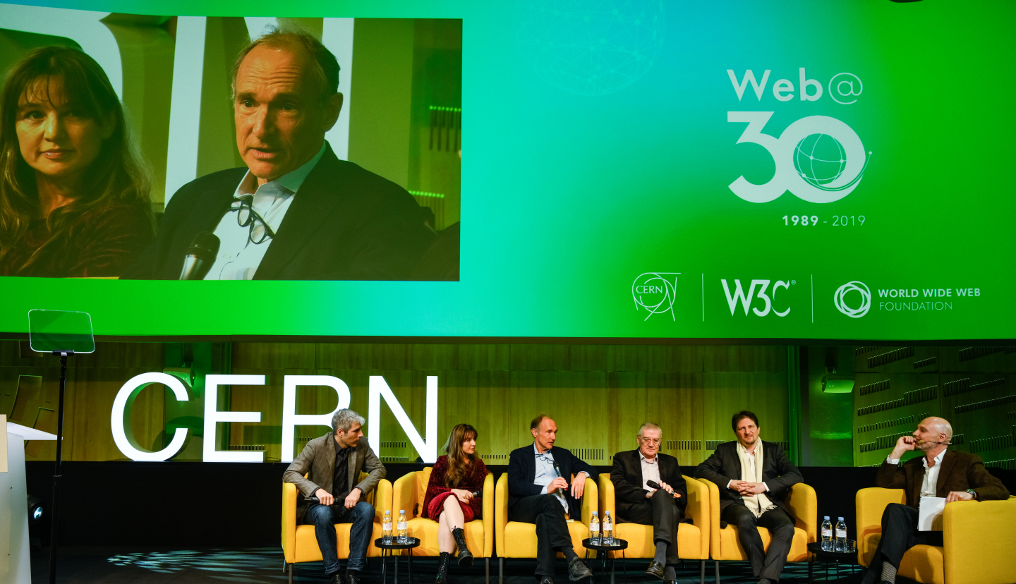
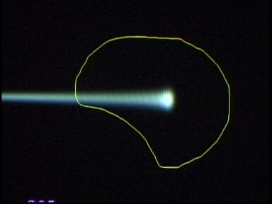
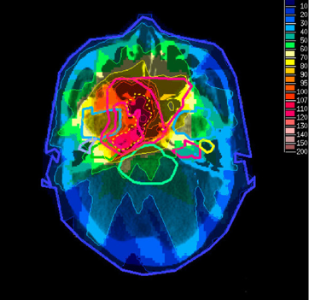
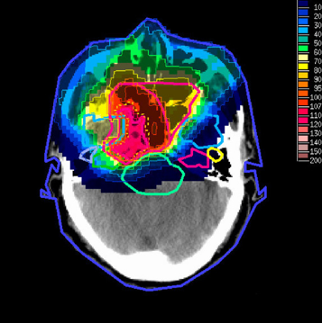
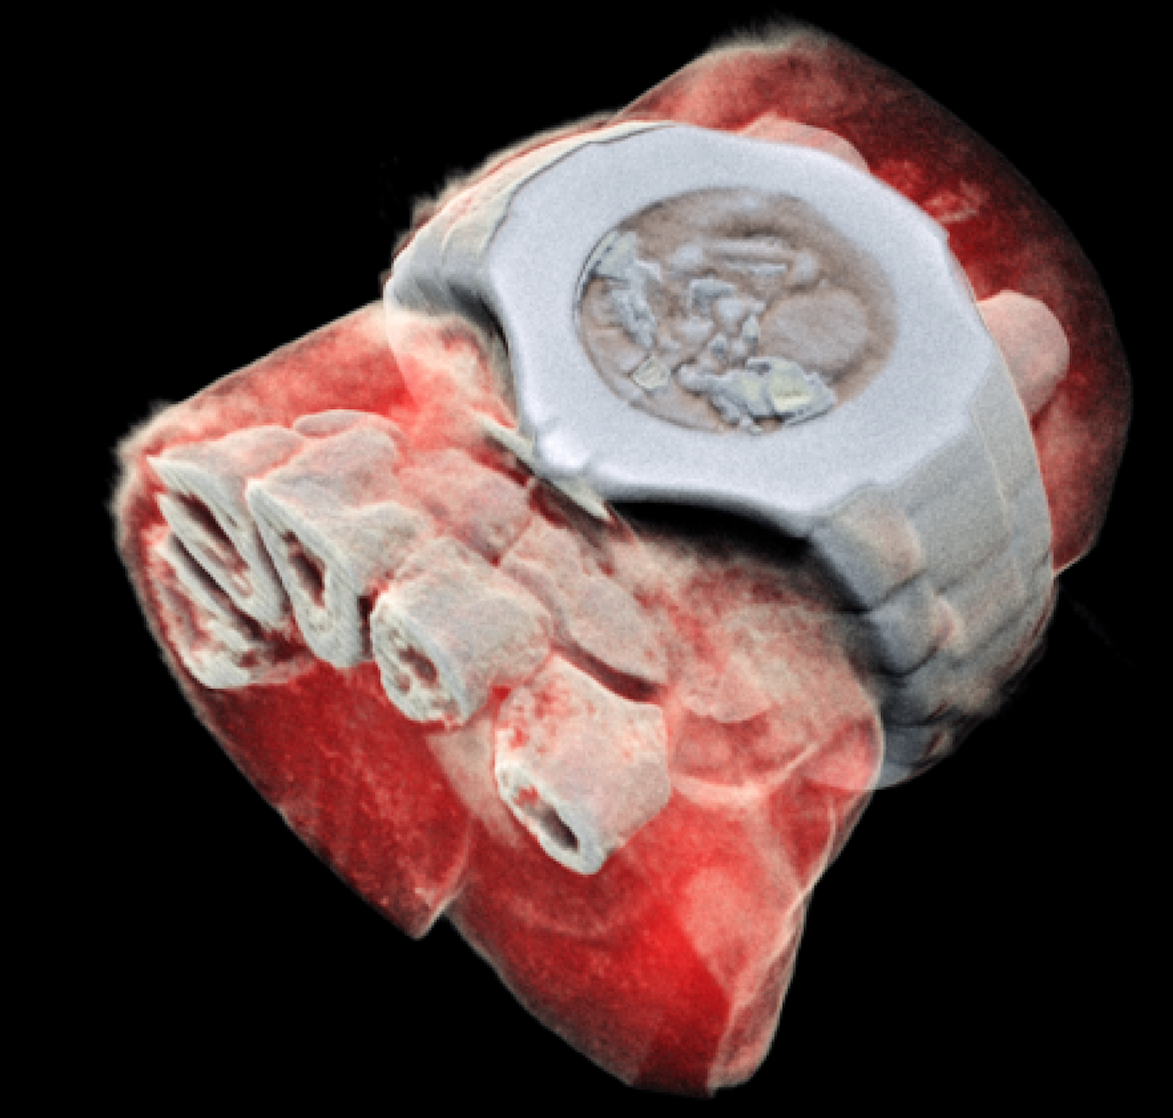

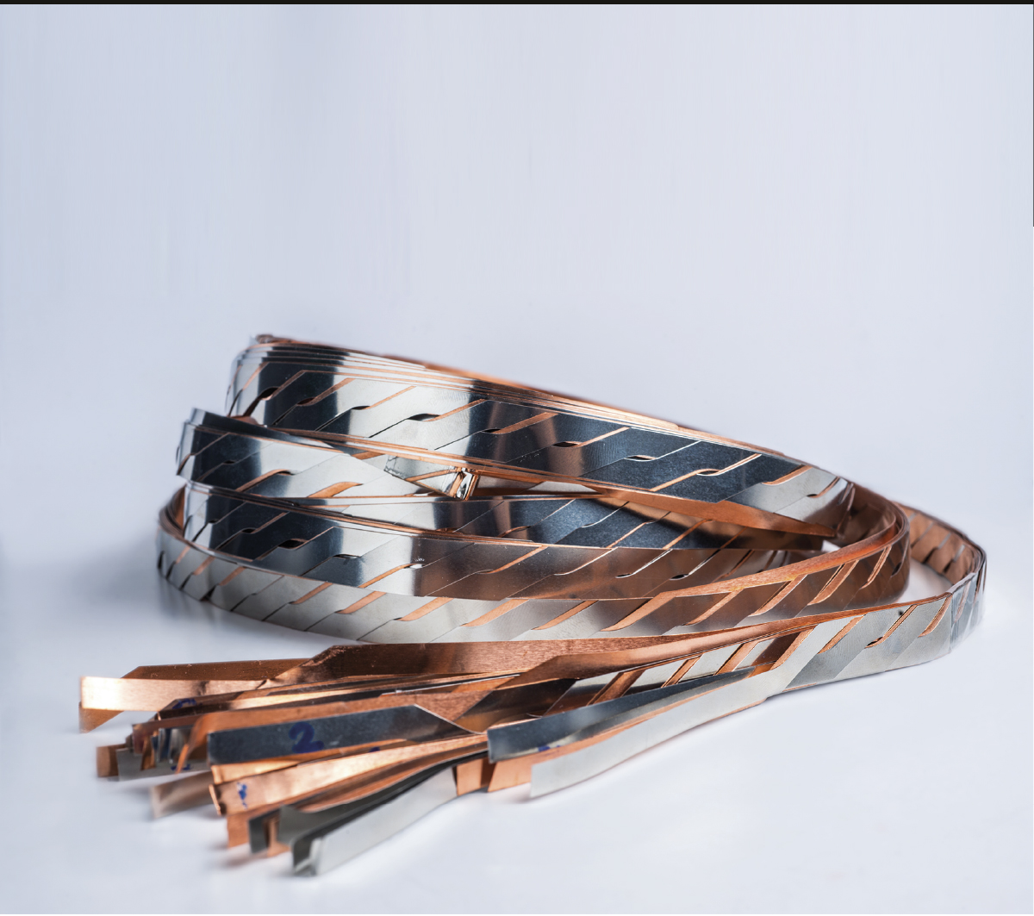
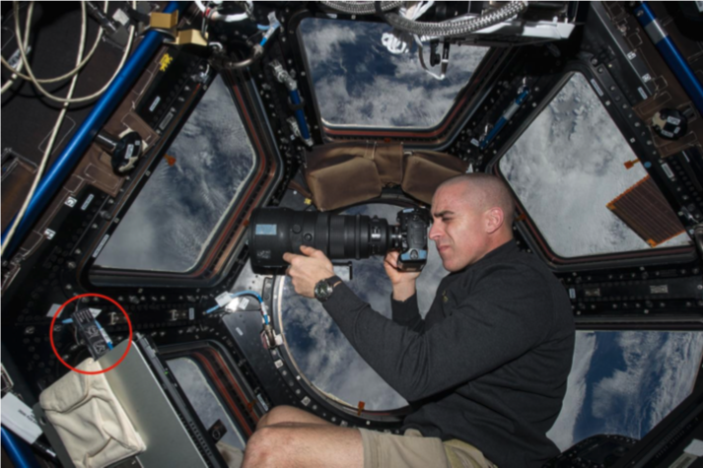
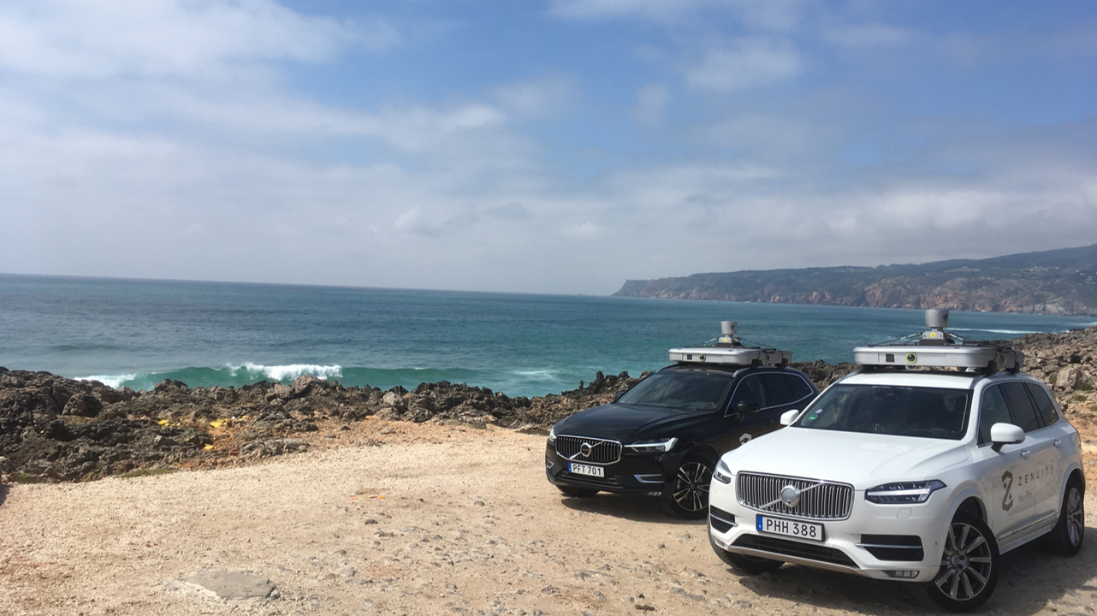
CERN’s frontier technologies and their impact on society: examples
Large variety of cutting-edge, multi-disciplinary technologies developed at CERN: superconducting magnets and materials, electronics, vacuum, cryogenics, robotics, instrumentation, big data, quantum computing and sensors, AI, etc.
Transferred to society at no cost (open science).
Medical imaging:
colour X-ray scanner
using CERN electronics
CERN is the birthplace of the World Wide Web
Hadron therapy
Tumour Target
Protons
light ions
X-ray
protons
Superconducting cables for loss-free transport of electricity (collaboration with Airbus)
Radiation dosimetry for space missions
Machine learning for self-driving cars (collaboration with Volvo)

Slide 11
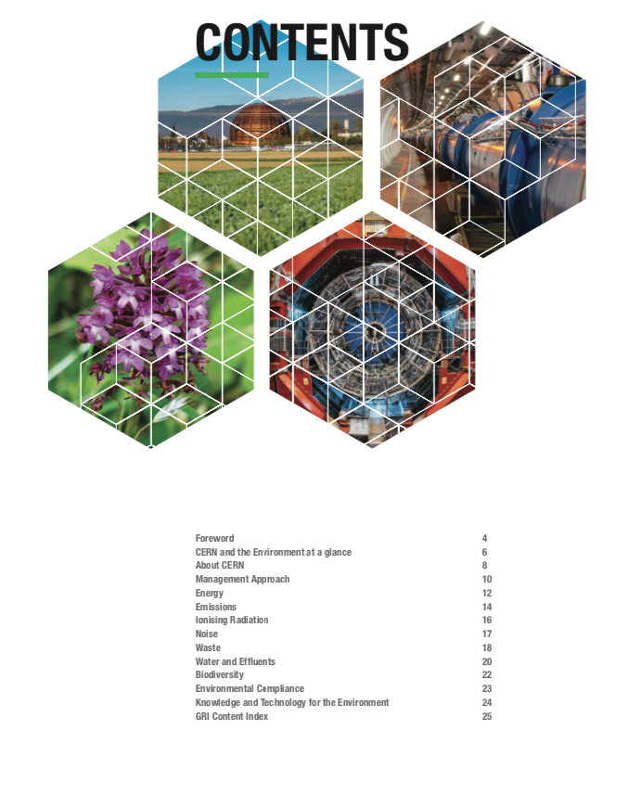
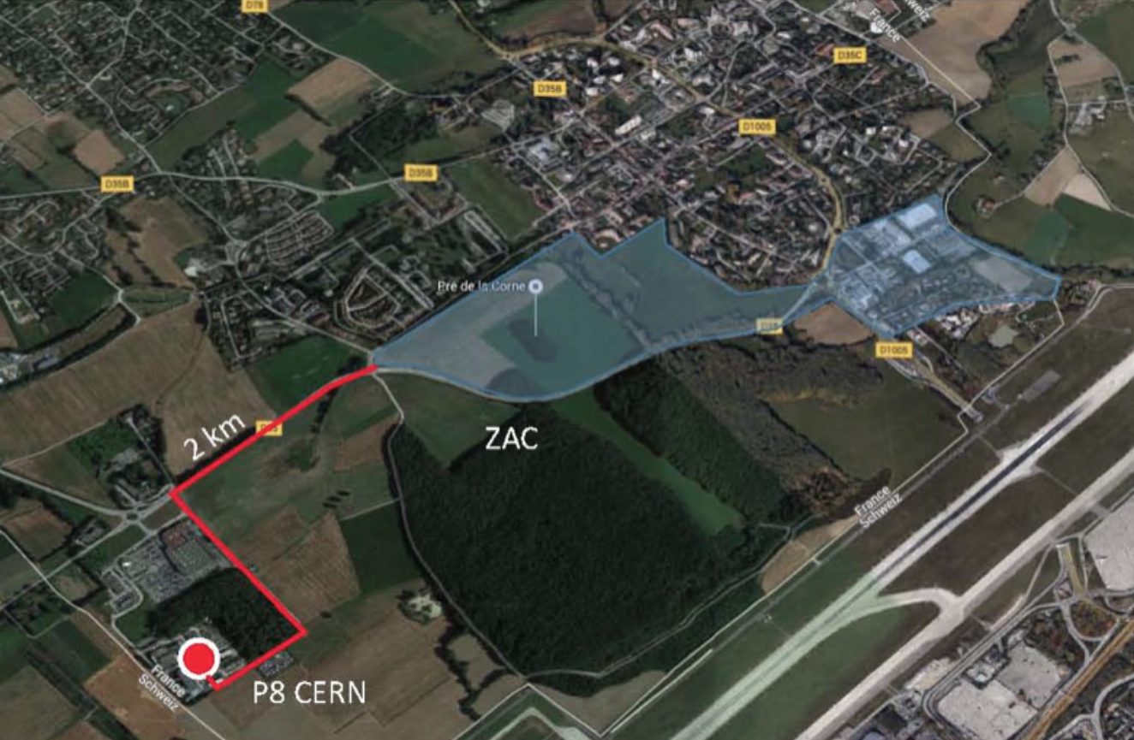
Sustainability and the environment at CERN (examples)
Three public environment reports published so far
Energy savings and recovery
CERN technologies for
loss-free transport of electricity
(collaboration with Airbus)
Ambitious objectives for the future:
e.g. reduce greenhouse gas emissions by ~ 50% by 2030
Heat from the LHC cooling towers is used to heat a nearby residential neighbourhood in Ferney-Voltaire (~ 8000 people)
Thanks to “high-temperature” superconducting materials

Slide 12

Science for peace
CERN was founded in 1954 with 12 European Member States
CERN’s annual budget
is 1200 MCHF (equivalent
to a medium-sized European university)
25 Member States
Austria – Belgium – Bulgaria – Czech Republic
Denmark – Estonia – Finland – France – Germany
Greece – Hungary – Israel – Italy – Netherlands
Norway – Poland – Portugal – Romania – Serbia - Slovenia
Slovakia – Spain – Sweden – Switzerland – United Kingdom
As of 31 December 2023
Employees:
2666 staff, 1002 graduates
Associates:
12 370 users, 1513 others
9 Associate Member States
Brazil – Croatia – Cyprus– India – Latvia – Lithuania Pakistan – Türkiye – Ukraine
4 Observers
Japan – USA – European Union – UNESCO
~ 50 Cooperation Agreements
Albania – Algeria – Argentina – Armenia – Australia – Azerbaijan – Bahrain – Bangladesh – Bolivia – Bosnia and Herzegovina
Canada – Chile – Colombia – Costa Rica – Ecuador – Egypt – Georgia – Honduras – Iceland – Iran – JINR – Jordan
Kazakhstan – Lebanon – Malta – Mexico – Mongolia – Montenegro – Morocco – Nepal – New Zealand
North Macedonia – Palestine – Paraguay – People's Republic of China – Peru – Philippines – Qatar – Republic of Korea
Saudi Arabia – South Africa – Sri Lanka – Thailand – Tunisia – United Arab Emirates – Uruguay – Vietnam
Notes:
The speaker can highlight CERN’s second mission as stated when it was established: to foster peaceful collaborations between nations that had recently been at war.
Additional information (OPTIONAL)
More than 40% of CERN’s budget is returned to industry through materials, utilities and services

Slide 13
A global laboratory: more than 17 000 people of 110 nationalities work at CERN from more than 600 universities/institutions
Distribution of all CERN users by the country of their home institutes as of 31 December 2023
(distributions below do not include CERN employees)
Geographical & cultural diversity
Users of 110 nationalities
24 % women
Member States (7493)
Austria 86 – Belgium 129 – Bulgaria 46 – Czech Republic 252
Denmark 47 – Estonia 29 – Finland 88 – France 842 – Germany 1296
Greece 112 – Hungary 80 – Israel 74 – Italy 1609 – Netherlands 167 Norway 77 – Poland 322 – Portugal 105 – Romania 113
Serbia 38 – Slovenia 26 - Slovakia 67 – Spain 413 – Sweden 106
Switzerland 419 – United Kingdom 950
Associate Member States (555)
Brazil 135 – Croatia 37 – Cyprus 14* – India 145 – Latvia 21
Lithuania 17 – Pakistan 30 – Türkiye 129 – Ukraine 27
Observers (2226)
Japan 219 – United States of America 2007
Cooperation Agreements (1596)
Algeria 2 – Argentina 16 – Armenia 16 – Australia 26 – Azerbaijan 3 – Bahrain 3 – Canada 206 – Chile 45
Colombia 24 – Costa Rica 3 – Cuba 3 – Ecuador 4 – Egypt 24 – Georgia 34 – Hong Kong 15 – Iceland 3 – Indonesia 7 Iran 14 – Ireland 4 – JINR 293 – Jordan 3 – Kazakhstan 3 – Kuwait 2 Lebanon 7 – Madagascar 1 – Malaysia 4
Malta 1 – Mexico 56 – Montenegro 3 – Morocco 18 – New Zealand 2 Nigeria 2 – Oman 1 – Palestine 1
People's Republic of China 414 – Peru 3 – Philippines 1 – Republic of Korea 168 – Saudi Arabia 6 – South Africa 61
Sri Lanka 10 – Taiwan 52 – Thailand 17 – Tunisia 4 – United Arab Emirates 10 – Vietnam 1
Notes:
THIS SLIDE WILL INCLUDE THE NUMBER OF MEMBERS OF PERSONNEL OF THE VISITORS’ COUNTRY OF ORIGIN

Slide 14
CERN trains people for career opportunities in society at large
Number
of Persons
27
19%
Other fields, including
government organisations
45%
Industry
67
36%
Academia or Research
age
100
Age distribution of CERN users
At any given time CERN is training ~ 5500 young people:
physicists, as well as engineers and technicians in a larger number of fields (mechanics, robotics, cryogenics, vacuum, electronics, superconducting materials, quantum/AI, civil engineering, etc.)
Only ~ 30% of them remain in particle physics.
Source: CERN Alumni survey (2014)
PhD and Technical students leaving CERN
Notes:
CERN opens a world of career opportunities
for 4 500 people?

Slide 15
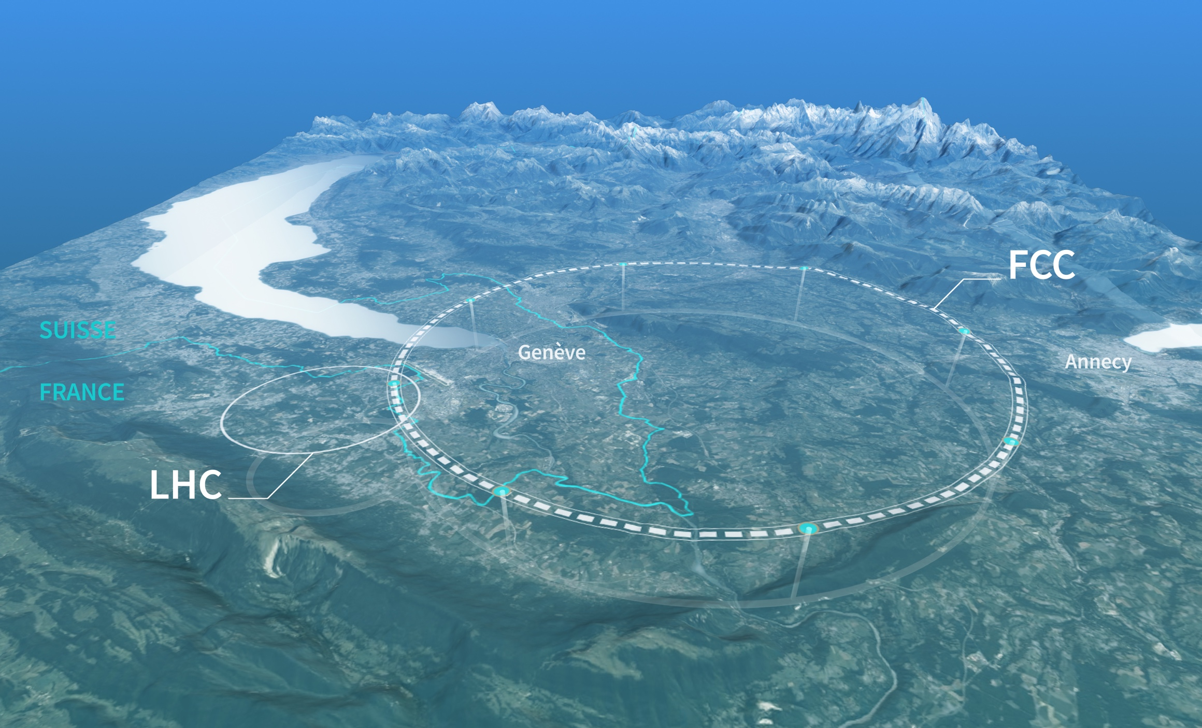
What’s next? CERN has recently completed the feasibility study of the Future Circular Collider (FCC)
Potentially the most extraordinary instrument ever built to study the laws of nature at the most fundamental level and address many of the oustanding questions about the Universe
Technologically very ambitious → will push innovation in many domains with applications for medicine, environment, nuclear energy, digital, material science, etc.
Tentative timescale:
project approval ~ 2028
construction start ~ 2033
first-stage operation (e⁺e⁻ Higgs factory) 2048-2062
FCC : ~ 90 km ring

Slide 16
JWST

