Slide 1

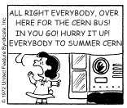
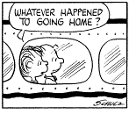
A short introduction to the
2025
Summer
Student
Labs
Niko Neufeld, CERN-EP/ July 1st, 2025
1
Notes:
1

Slide 2
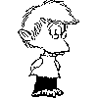


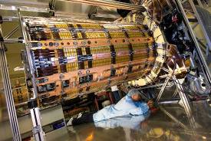
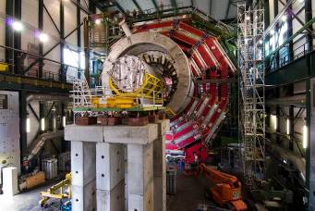
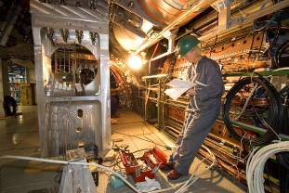
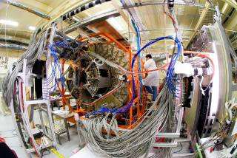
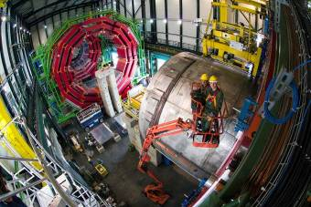
The Summer Student (Hardware) Labs
With the size of the experimental tools in high energy physics getting larger and more complicated, it is very hard in some short summer months to get a feeling of the different aspects of an experiment.
2

Slide 3












We would therefore like to invite you into some of our labs and try to show you in a few hours what we are doing there and why we are doing it.
Welcome!
3
Notes:
3

Slide 4
As a Menu, we can offer:
ROOT
Cloud chamber – for physicists and others
Characterization of a simple particle detector using cosmic particles
MADGraph
Introduction to Silicon Pixel Detectors
Silicon Sensors
Web Application Security Penetration Testing
Data Acquisition and Trigger
Micro Pattern Gas Detectors in the GDD laboratory
https://indico.cern.ch/category/6274/
4

Slide 5
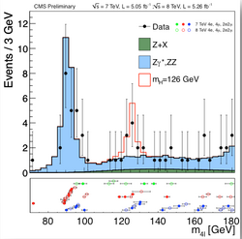
Root
Did you ever wonder how pictures like this one are created?
And more importantly – which are the tools for the data analysis resulting in these plots?
In HEP there is a single answer: ROOT
Learn about it from the ROOT developer team themselves!
You must bring your own laptop!
And if you have been wondering why we don’t use “R” – this is your occasion to ask and find out!
5

Slide 6
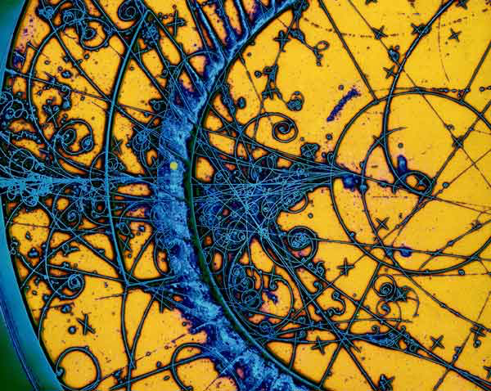
Cloud Chambers
A classical HEP detection technology
You can actually see the particles; It doesn’t get more direct than this in HEP
This is a very pedagogical workshop, and we have a version for physicists, as well as one for students without physics background
Where: 82/1-001B

Slide 7
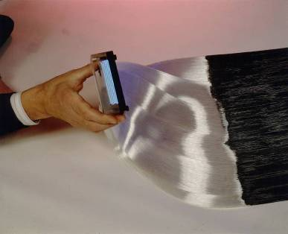
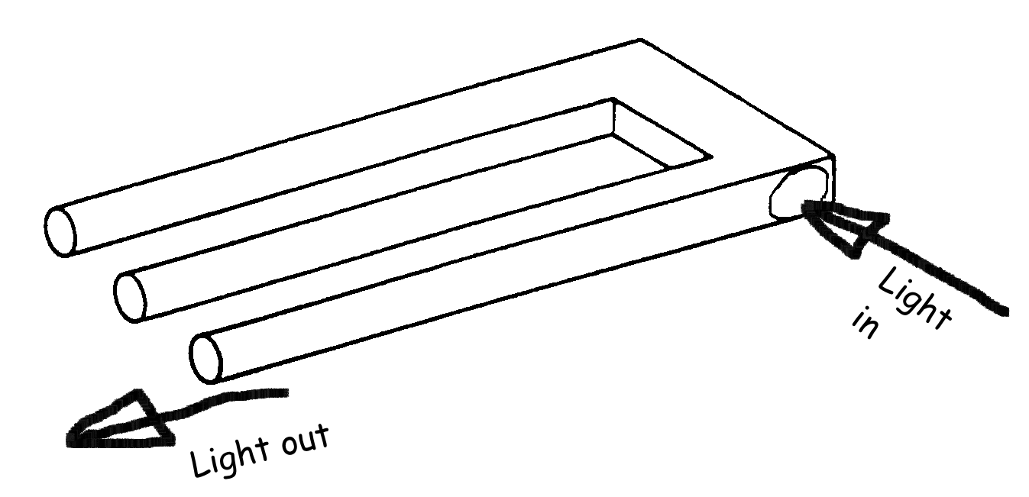
Characterization of a particle detector using cosmic particles
Contact: Sune Jakobsen
3 afternoons with 3 students.
When: TBC – check indico please
Where: Meeting room: 21-1-067
What: Hands-on experience with photomultipliers, oscilloscopes, scintillators, light guides, wavelength shifters and monochromators.
measure the photodetection efficiency (PDE) of a silicon photomultiplier (SiPM)
Learn from CERN’s detector-pros!
CERN photo CERN-EX-9201043
End part of the scintillating fibre detector of the CHORUS experiment. There are 1 million fibres and each fibre has a diameter of 500 .micron.m.
7

Slide 8

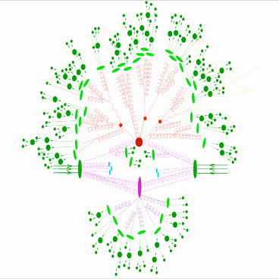
MADGraph
http://madgraph.phys.ucl.ac.be/
Contact Persons: Olivier Mattelaer
2 afternoons with up to 20 students each time.
Where: 6/2-024 BE Auditorium
When: Check out Indico
1. High-Q2 Scattering 2. Parton Shower
3. Hadronization 4. Underlying Event
In this workshop we will
Discuss the various aspects of a hard-hadronic collision using a FLASH simulation.
Develop cutting edge Monte Carlo techniques necessary for simulating these collisions.
Use MADEvent’s web-based capabilities to produce event simulations for processes important to LHC physics.

Slide 9
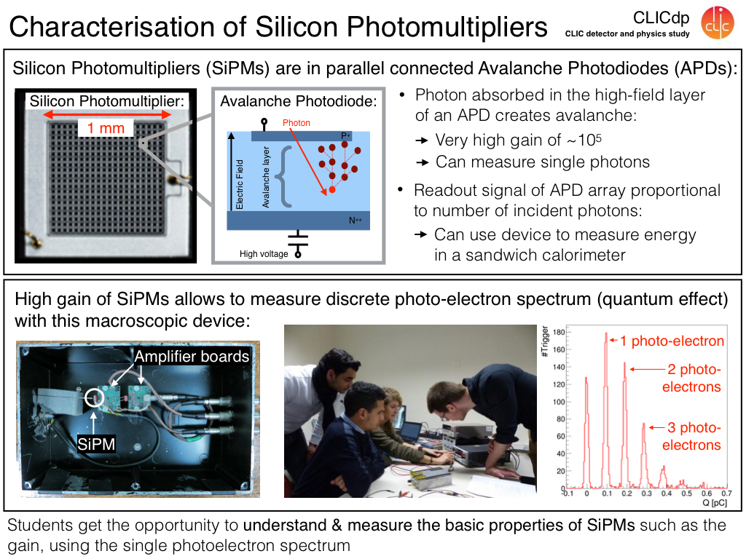
Introduction to silicon pixel detectors
Where: 1/1-015
When: TBC
Contact: Dominik
Dannheim
3 x 4 students
Short description: The students will learn about the basic principles of silicon detectors and perform
measurements with hybrid pixel-detector assemblies.
● An introduction part will discuss the use of segmented p-n junctions coupled to dedicated readout circuits
for the detection of ionising particles. The measurement programme includes electrical characterisations,
calibration of the energy response using radioactive photon sources, as well as detection of minimum-ionising
particles from cosmic rays and/or a radioactive electron source
For this lab you will need a dosimeter
9

Slide 10
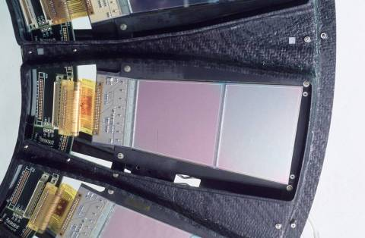
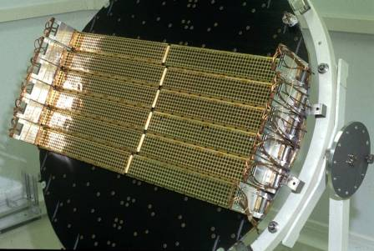
Silicon Sensors
Contacts: Michael Moll, Moritz Wiehe
2 afternoons with 6 students.
Where: Meeting room: 28/2-015
What: We will investigate how radiation damage is influencing the silicon tracking detectors in the LHC experiments. The following properties of irradiated and non-irradiated silicon detectors will be measured: Reverse current, detector capacitance, depletion voltage and charge collection efficiency. This will give you an impression on how much detectors in the LHC will suffer from radiation damage. In a concluding discussion we will look at some possibilities on how to make detectors radiation harder.

Slide 11

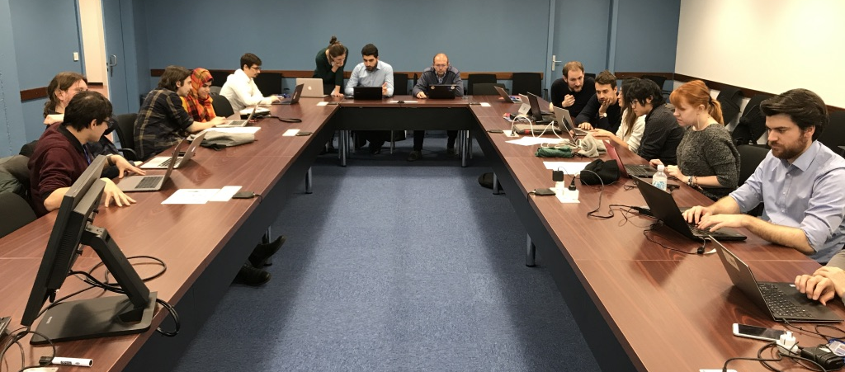
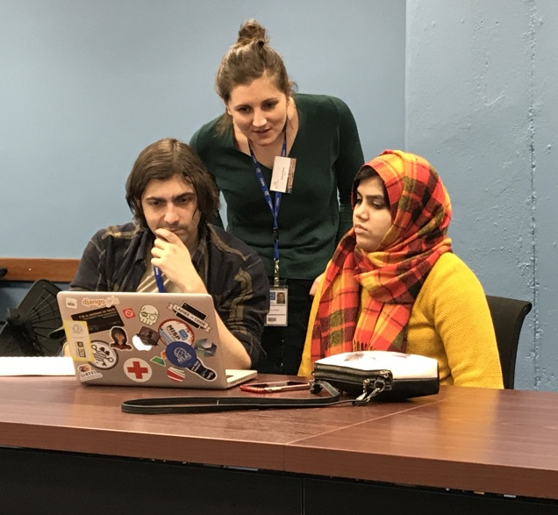
Web application
security penetration testing
Where: 513/1-024 35 places
When: 30 July, 2025
Who: Sebastian Lopienski
Bring your own laptop
And fix your passwords before !!
Become a White Hat hacker ☺
11

Slide 12
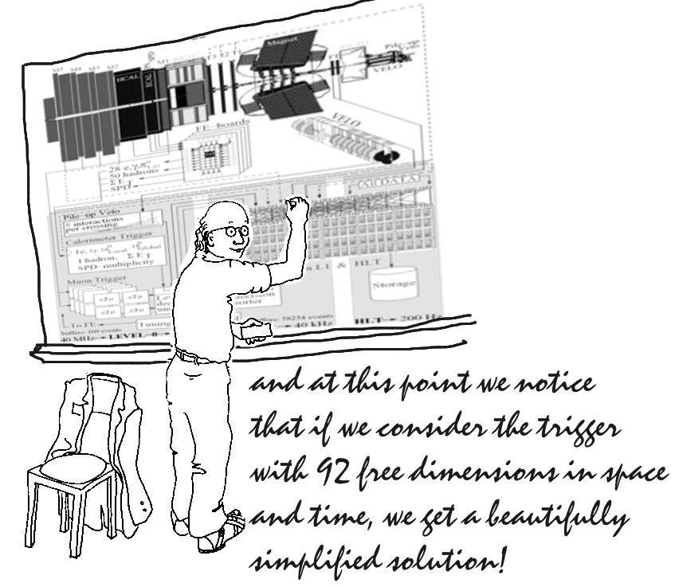
Data Acquisition (and fun with bits lost and found).
Contact persons: A. Karvelas, F. Pisani, P. Cifra
Requirements: Some basic programming experience
would be good - but that should not deter anyone.
4 sessions with 4 students
Time : one afternoon, 13:30 – 17:00
Dates : Check on indico
Place : Meeting at 13:30 in 2-R-004
Real data acquisition at 30 MHz.
Follow the data through LHCb and try not to lose a single bit!
From the front-end electronics, through the readout boards, the network, the farm to tape - and not back.
You’ll learn about a few key technical aspects of high speed DAQ systems
12

Slide 13
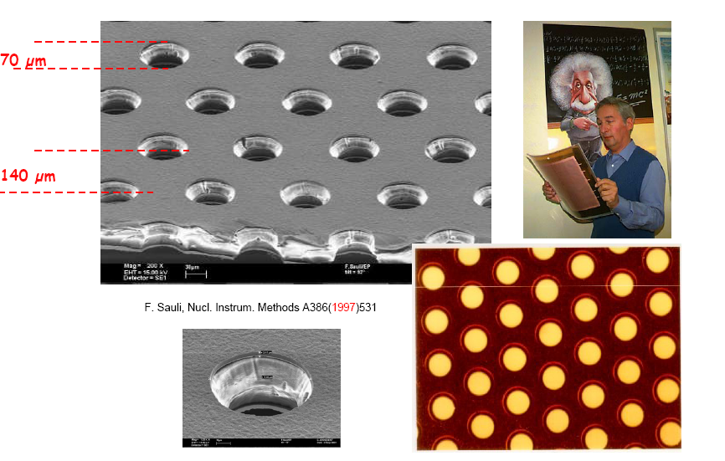
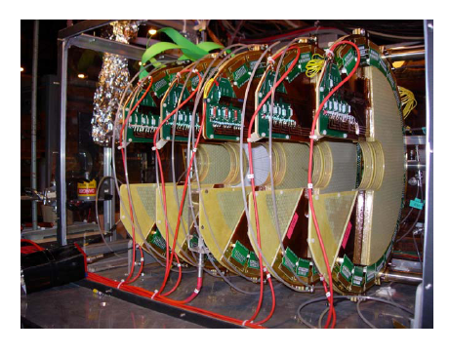
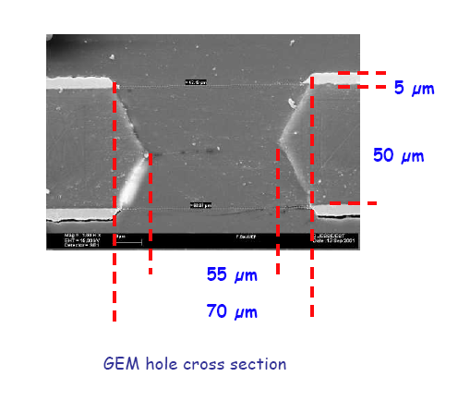
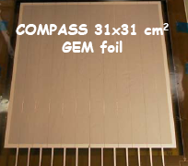
Micro Pattern Gas Detectors in the GDD laboratory
Contact Persons: Djunes Janssens
Requirements: Some Lab Experience, Dosimeter is mandatory
Time: One introductory lecture (common_
three afternoons, 14.00 – 17.30
three groups of 8 students
Dates: please check and register on indico
Place: 154/R-001
Please note that x-rays source and high voltages
are present on the set-up
You will work in the Gas Detectors Development Group (GDD), a PH-DT group created in the late sixties by Georges Charpak, inventor of the Multiwire Proportional Chamber and 1992 Nobel Laureate for Physics, that has been active in the development and applications of advanced detectors for particle physics.
Intro to gas detection and operate real R&D prototypes, built for the development and characterization of MPGDs detectors for LHC experiments upgrades. Basic understanding of gaseous particle detection, signal formation and processing will be reviewed

Slide 14

What you have to do :
①
Check and decide which are interesting for you:
https://indico.cern.ch/category/6274/
1) Watch out when the registration opens on indico
2) Register – note that you should only register for one workshop as we want to give everybody a chance. We reserve the right to cancel additional registrations
②
③
Try not to forget
your rendez-vous…,
Have fun!
14

