Slide 1
HEPSCORE and power measurements with AMD Bergamo
Validating IPMI power measurements
Max Efficiency vs Max Performance profiles
Simon George (RHUL)
5 Feb 2025
Notes:
Zen 4c (Bergamo)

Slide 2
Equipment
Lenovo ThinkSystem SR645 V3
  2x AMD EPYC 9754 128-Core Processor (512 threads) – “Bergamo”
    Base/Boost clock 2.25/3.1 GHz, 360W TDP
  2.3 TB memory (24 x 96 GB DDR5; 4.5 GB/thread)
  12 TB NVMe SSD
Also tested a similar system with
  2x AMD EPYC 9654 (384 threads) – “Genoa”
    Base/Boost clock 2.4/3.7 GHz, 360W TDP
APC AP8853 PDU
  230V x 32A Zero-U PDU

Slide 3
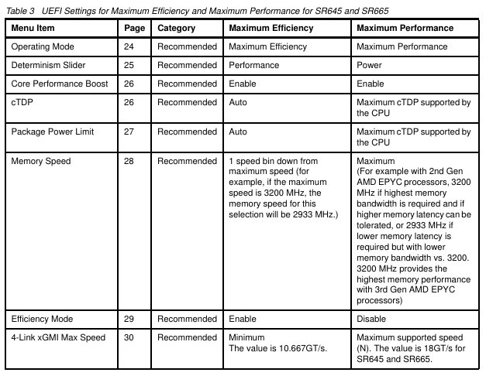
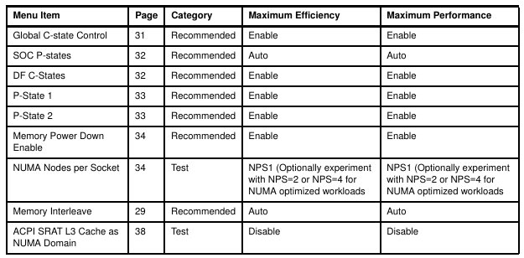
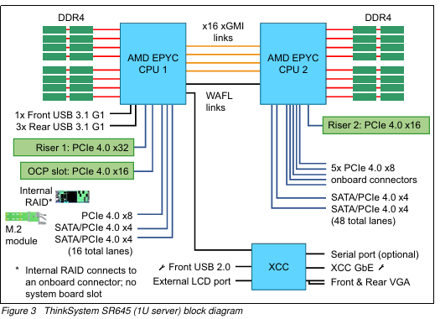









ThinkSystem SR645 V3
AMD Power profiles
UEFI provides selection between operating modes
https://lenovopress.lenovo.com/lp1267-tuning-uefi-settings-for-performance-and-energy-efficiency-on-amd-servers
Maximum Efficiency: Maximizes the performance / watt efficiency with a bias towards power savings.
Maximum Performance: Maximizes the absolute performance of the system without regard for power savings. Most power savings features are disabled, and additional memory power / performance settings are exposed.
Custom Mode: Allow user to customize the performance settings. Custom Mode will inherit the UEFI settings from the previous preset operating mode. For example, if the previous operating mode was the Maximum Performance operating mode and then Custom Mode was selected, all the settings from the Maximum Performance operating mode will be inherited.
Observed differences in CPU frequency and consequently HEPSCORE and power use

Slide 4
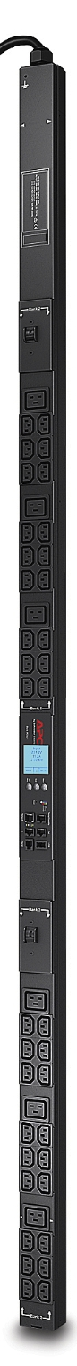
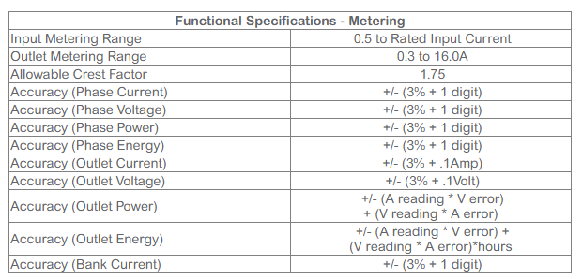
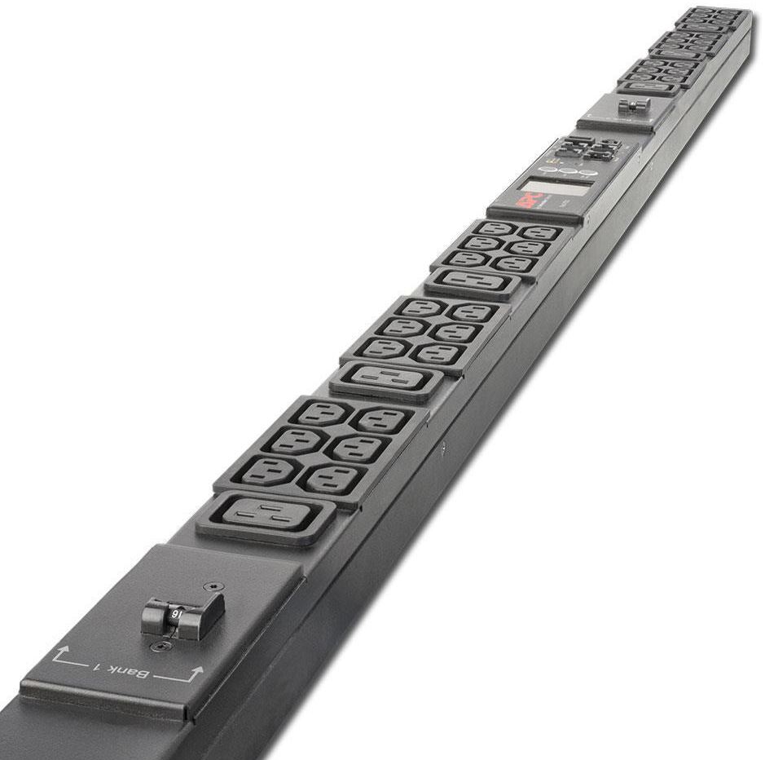
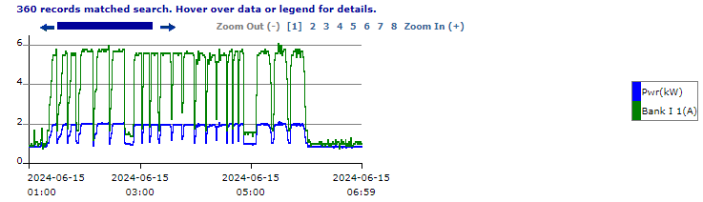
APC AP8853 PDU
Monitoring capability
  2 banks, each with 21 sockets max 16A
  Per-bank power monitoring (not per socket)
  Test server was the only connection to bank 1
  Configurable frequency of data logging, set to 1 minute
Accuracy
  "Rack PDUs (AP8XXX) have an accuracy of +/- 3% of reading, +/- 1 least significant digit across the entire power and temperature range.”
  “Note: Accuracy is not defined below 0.5A.“
  https://www.apc.com/uk/en/faqs/FA156074/
  Not clear if this is a statistical or systematic accuracy
Format and units
  Download text file at end of test
  Needs a little clean up before importing as a table e.g. into python/pandas
  Actually measures/reports current (A) but it also reports the input voltage (241.0V) and the overall PDU load (kW) and current (A) vs time so I can convert to power drawn in W.
    241 +/- 1 W from 281 measurements
Notes:
Overall PDU load and current: 281 measurement points each in test period.
From these the voltage is 241 +/- 1 W

Slide 5
Commands used to run benchmark
Download and run
  wget -O run_HEPscore.sh https://gitlab.cern.ch/hep-benchmarks/hep-benchmark-suite/-/raw/3.0rc11/examples/hepscore/run_HEPscore.sh?ref_type=tags
  chmod +x run_HEPscore.sh
  ./run_HEPscore.sh -v 3.0rc11 -b 'f,l,m,s,p' -s UKI-LT2-RHUL
This collects power data by periodically running
  ipmitool dcmi power reading
Notes:
-b plugin_keys Bundle time series plugins listed by key 'f,l,m,s,p' where
f enables cpu_frequency
l enables load
m enables memory usage
s enables memory swap
p power consumption

Slide 6
Results
Host | AMD CPU model | timestamp | Profile | HEPSCORE | CPU freq (GHz) q75 | CPU load q75 | Power (W) q75 | W/HS
node213 | 9654 | 2024-05-08T14:03 | Efficiency | 5807 | 2.60 | 384 | 1003 | 0.173
node213 | 9654 | 2024-05-03T10:57 | Efficiency | 5811 | 2.60 | 384 | 1006 | 0.173
node213 | 9654 | 2024-05-02T16:15 | Performance | 7192 | 3.69 | 384 | 1326 | 0.184
node221 | 9754 | 2025-01-27T22:30 | Efficiency | 6978 | 2.45 | 513 | 1022 | 0.146
node221 | 9754 | 2025-01-28T09:57 | Efficiency | 6967 | 2.45 | 513 | 1022 | 0.147
node214 | 9754 | 2024-05-16T09:39 | Efficiency | 7050 | 2.45 | 512 | 1015 | 0.144
node221 | 9754 | 2025-01-27T17:21 | Performance | 8130 | 3.10 | 512 | 1306 | 0.161
node221 | 9754 | 2024-06-15T01:17 | Performance | 8227 | 3.10 | 512 | 1309 | 0.159
node214 | 9754 | 2024-05-17T11:30 | Performance | 8341 | 3.10 | 512 | 1351 | 0.162
Notes:
Efficiency profile seems to run CPU freq just above the base clock, Performance profile hits the max boost clock.

Slide 7
Comparison with published data
Site | AMD CPU model | SMT/Ncores/RAM | # Meas | Profile | HEPSCORE (mean)
UKI-LT2-RHUL | 9654 | Enabled/384/1.5TiB | 2 | Efficiency | 5809
UKI-LT2-RHUL | 9654 | Enabled/384/1.5TiB | 1 | Performance | 7192
IHEP | 9654 | Enabled/384/1TiB | 26 | ? | 6001
JP-KEK-CRC-02 | 9654 | Enabled/384/820GiB | 3 | ? | 7268
UKI-LT2-RHUL | 9754 | Enabled/512/2.1TiB | 3 | Efficiency | 6998
UKI-LT2-RHUL | 9754 | Enabled/512/2.1TiB | 3 | Performance | 8232
UKI-SCOTGRID-GLASGOW | 9754 | Enabled/512/1TiB | 5 | ? | 7450
similar
?
Notes:
https://w3.hepix.org/benchmarking/scores_HS23.html

Slide 8
Power analysis
Data from PDU and IPMI recorded every minute
Checked clocks are correct on PDU and IPMI (ntp)
PDU measurement at 44 secs past each minute
IPMI measurement at 36 secs past each minute
These points were aligned to the same minute for plotting
Might expect a small lag in IPMI data during changes in power, but changes are so fast we don’t really see that, and the steady state power when each benchmark is running should not be affected
PDU bank 1 current transformed to power, using voltage calculated from total PDU power/current at the same time

Slide 9
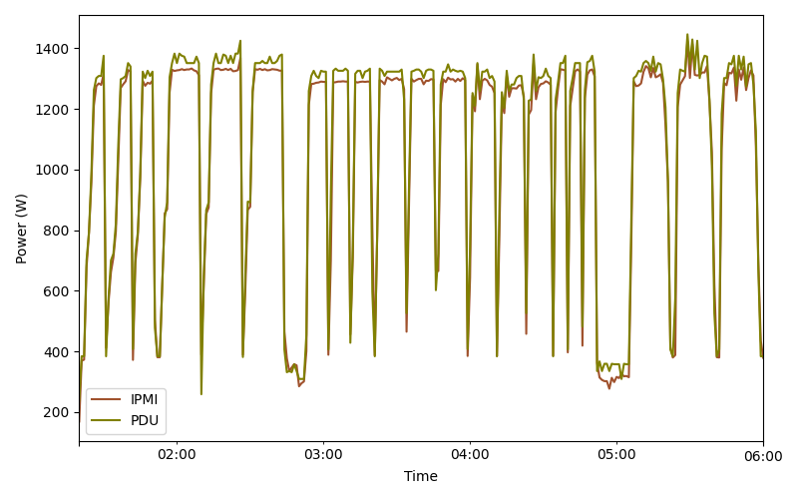
Power measurements PDU vs IPMI
Taken with
2x AMD 9754 (node221)
Each benchmark run is clear
Excellent correlation between PDU and IPMI
  Large rises and fall match
  PDU systematically slightly higher than IPMI in steady state

Slide 10
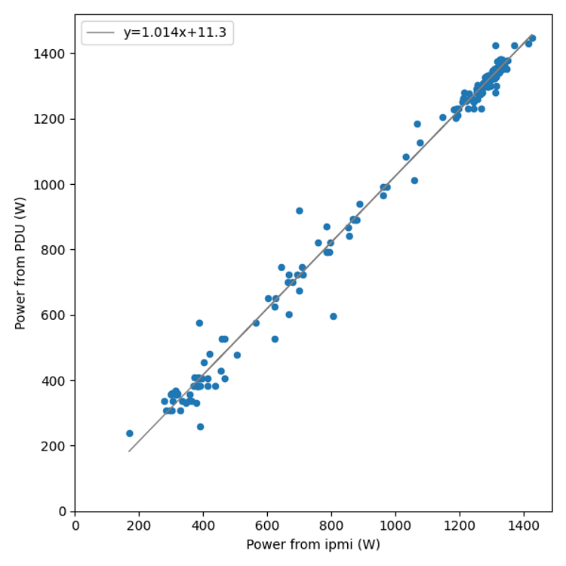
Correlation
Good correlation between PDU and IPMI, especially in the most relevant area of high power use
Mean of each PDU/IPMI ratio is 1.025

Slide 11
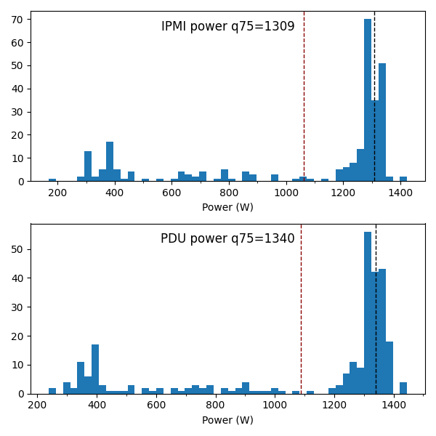
Power spectra
mean ----
75% quantile ----
q75 is a decent estimator of average power under load
Mean is not
PDU q75 2.3% higher than IPMI
This is within claimed 3% accuracy of PDU

Slide 12
Additional material

Slide 13
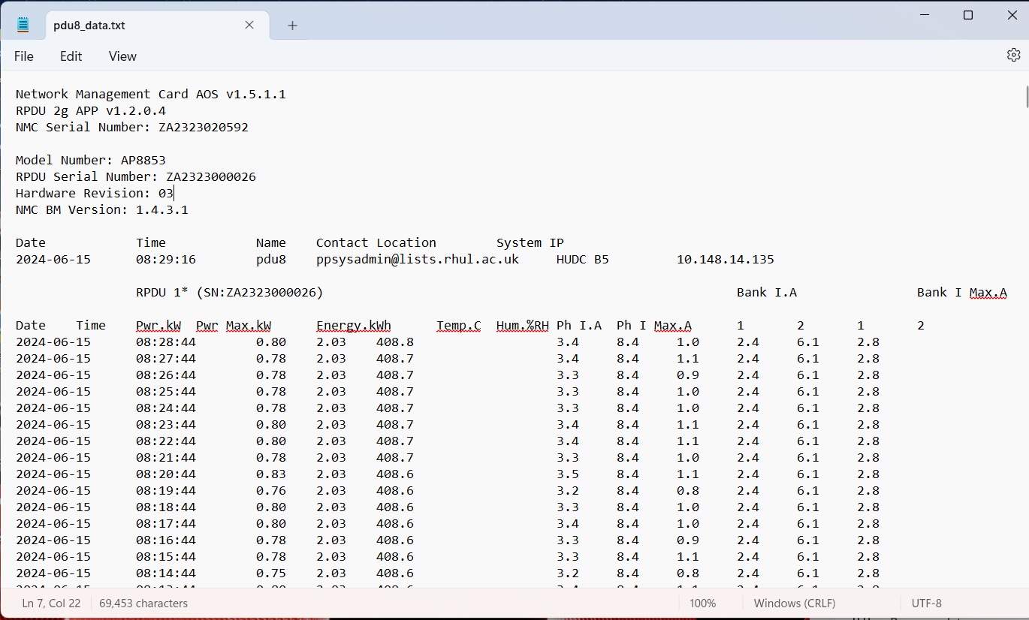
Format of data from PDU
Remove first 14 lines then it is a simple tab-separated table

Slide 14
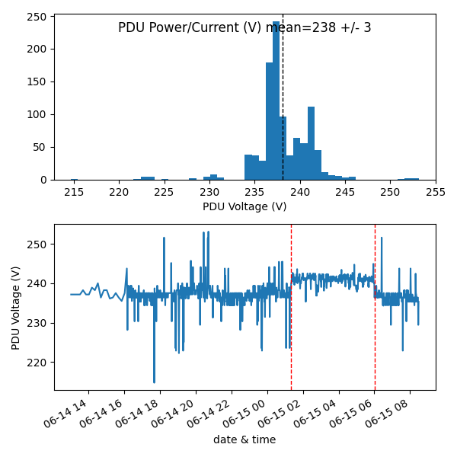
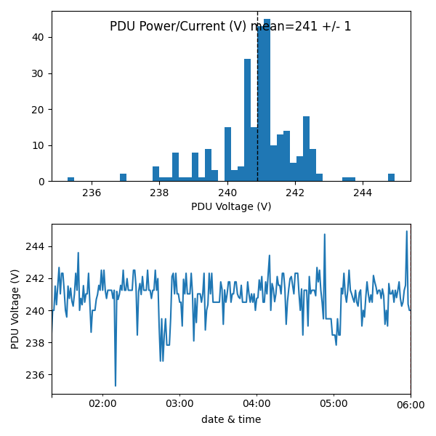
PDU voltage stability
Full PDU data range
HEPSCORE test data range
HEPSCORE test data range

