Slide 1
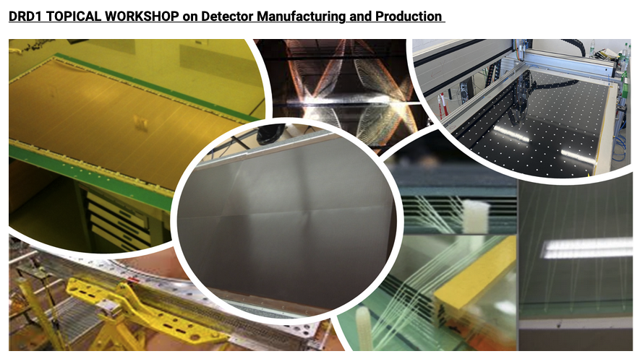
The industrial production of Micro Pattern Gaseous Detector: experience from the ATLAS Micromegas
Paolo Iengo (INFN), Fabien Jeanneau (CEA Saclay)
On behalf of the ATLAS Muon Spectrometer System

Slide 2
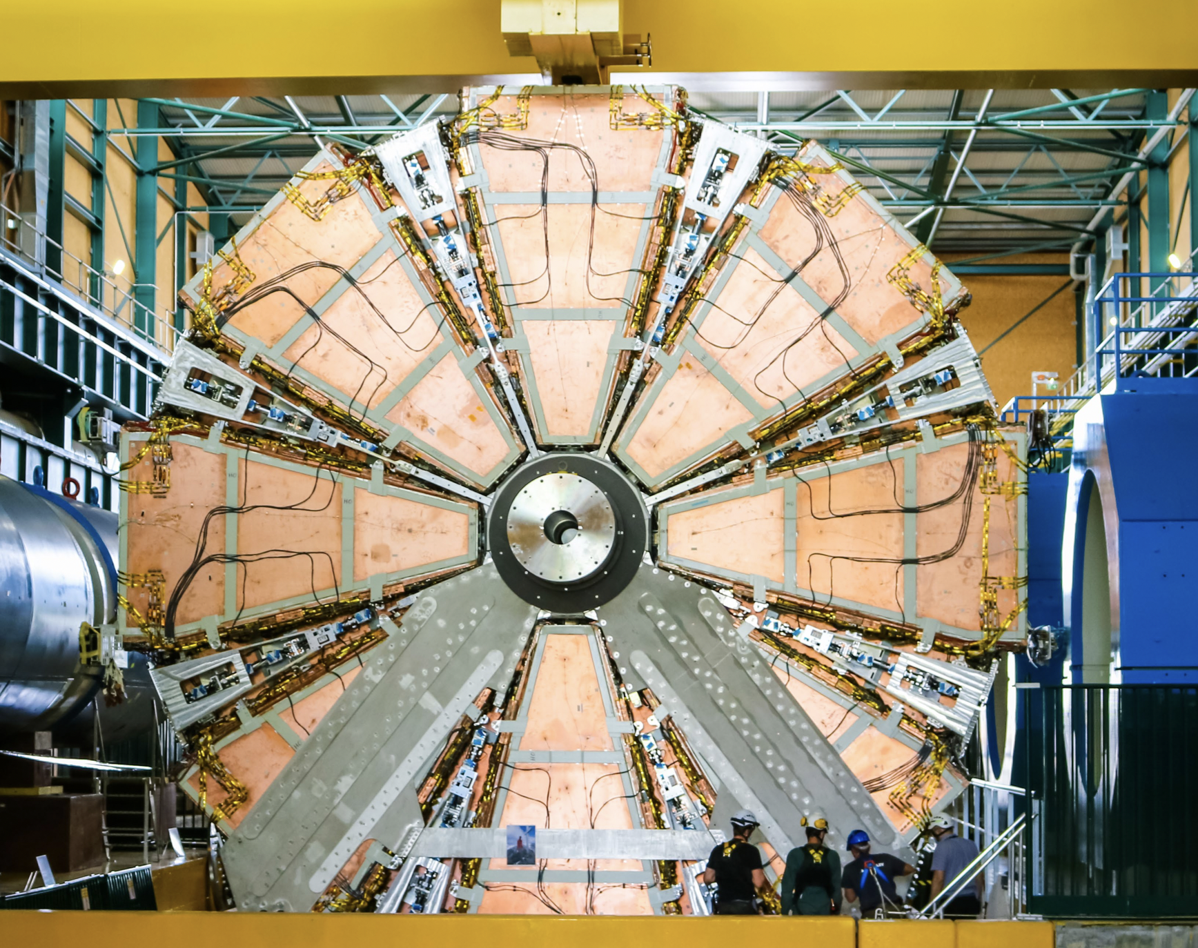
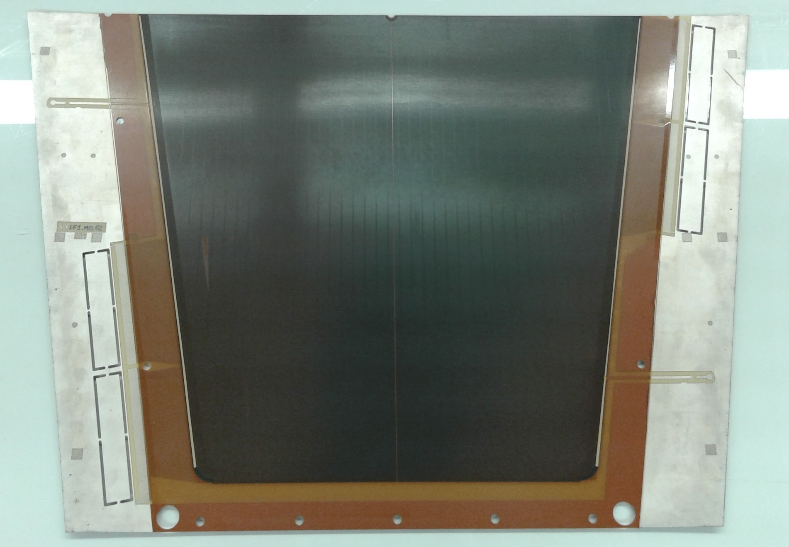
Introduction
ATLAS Micromegas is the largest MPGD-based system ever conceived and built
1280 m² active surface
2.1 M readout channels
128 detectors / 4 types
  4 layers
  2 to 3 m² area
  Mechanically floating mesh (no bulk)
The Micromegas anode board is the heart of the detector

Slide 3
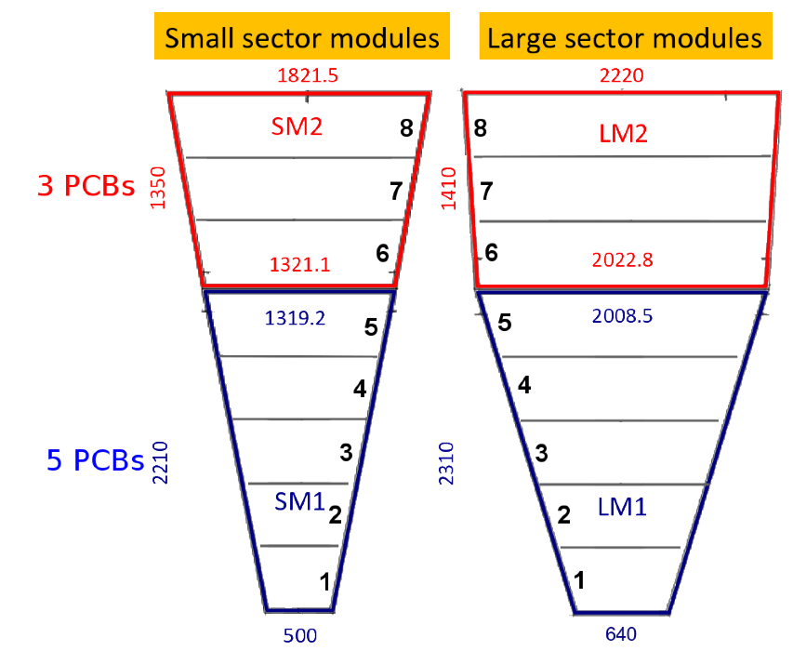
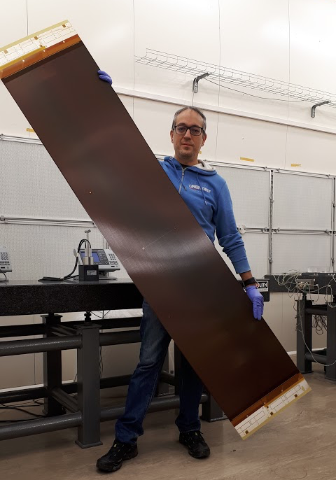


The production challenge
Mass production: 2800 boards / 32 different types
Unprecedented size: up to 45 x 220 cm²
Full production in industry
Technology breakthrough
→ Direct move from R&D to mass production
Two companies selected after tendering process and negotiations: ELVIA (FR), ELTOS (IT)

Slide 4
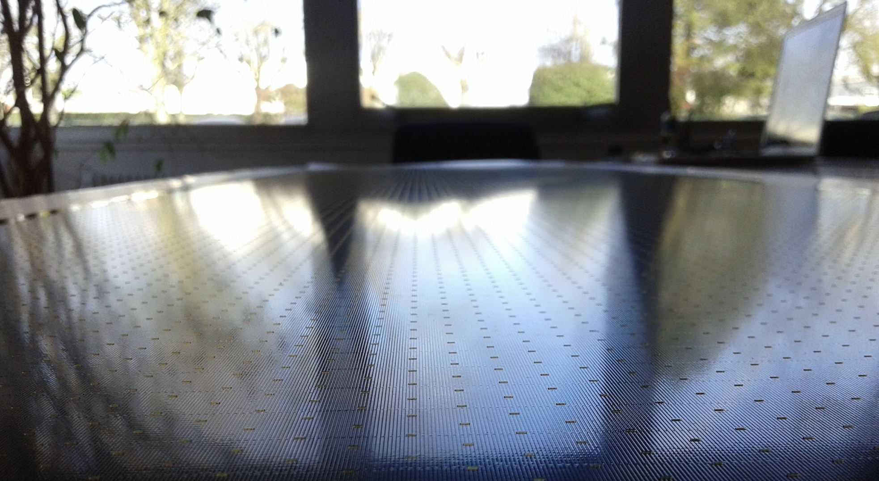
Generalities

Slide 5
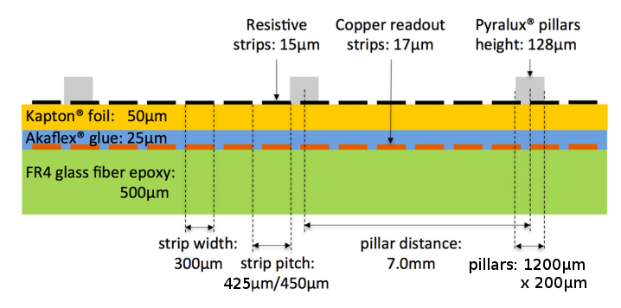
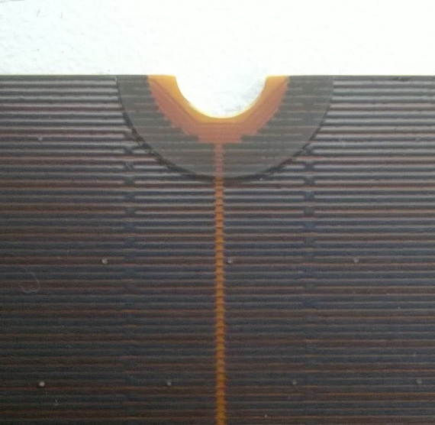
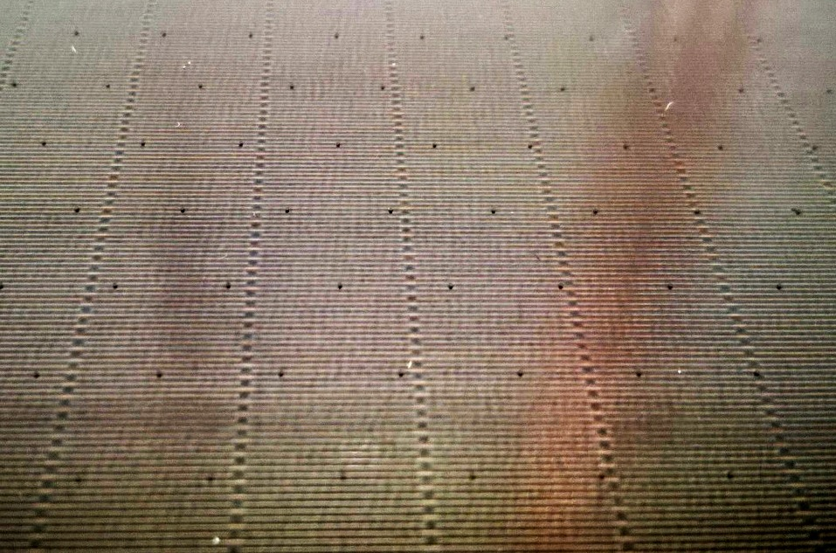
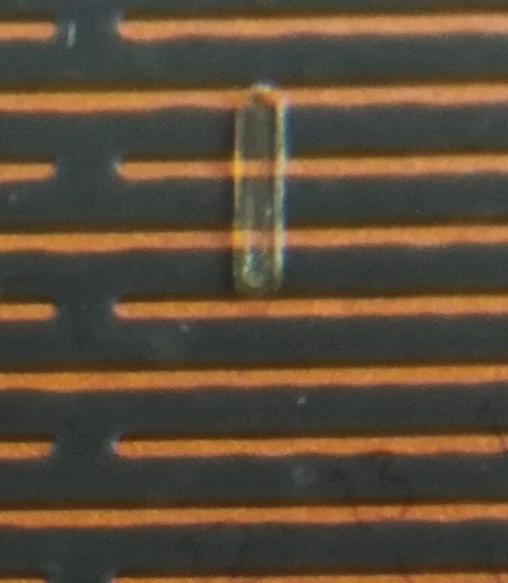
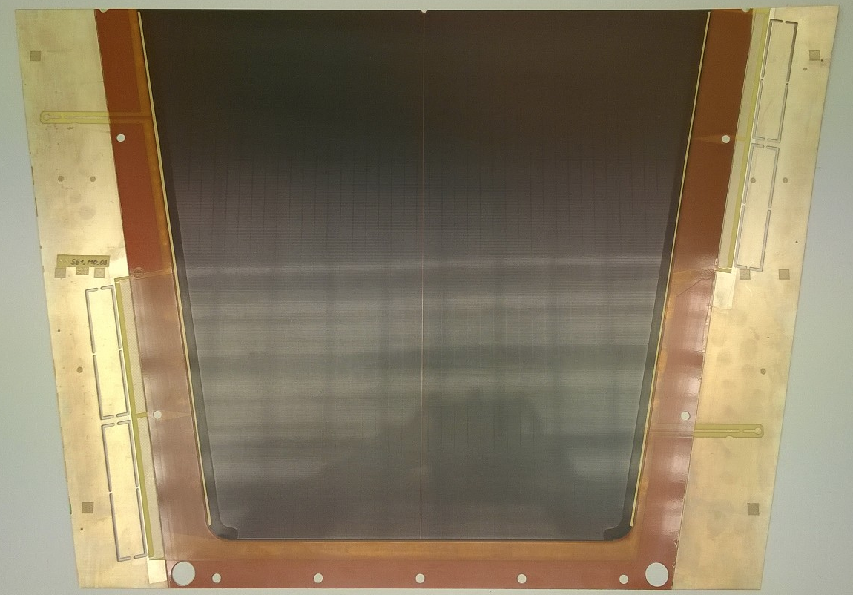
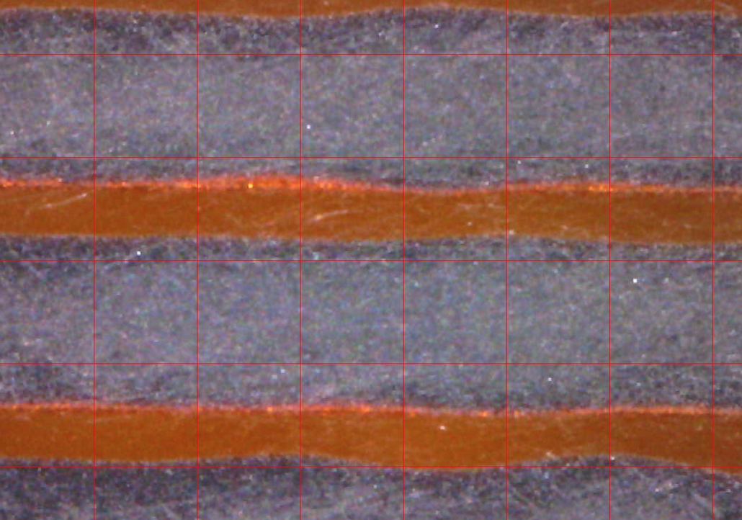
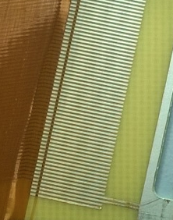
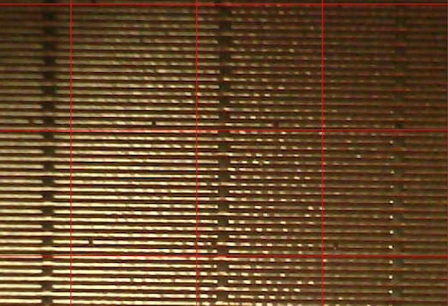
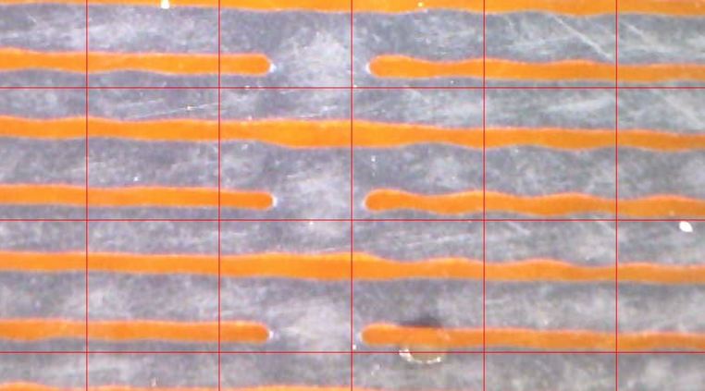
Anode Board Design
Surface structure of the board, with regular patterns of pillars and interconnections of resistive strips
Central upper hole for layer interconnection. Readout strips routed around the hole. Central separation of resistive pattern.
Example of NSW Micromegas readout board (smallest type)
Zoom of the board surface with a pillar
1022 strips/board
Readout strips: 300 µm width, 425 or 450µm pitch
Screen-printed resistive strip pattern with same pitch
Resistive strips interconnected; pattern interrupted in the center → two HV sections per board
HV supply via silver line from the side
Elongated pillars: 1200μm x 200μm
Readout strips routed to pads for elastomeric connectors (Zebra)
Pads for elastomeric connector (Zebra)
Zoom of the resistive strip interconnections

Slide 6
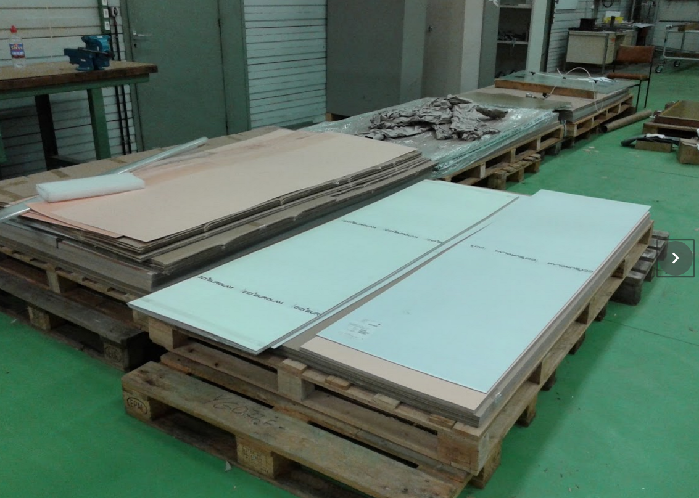
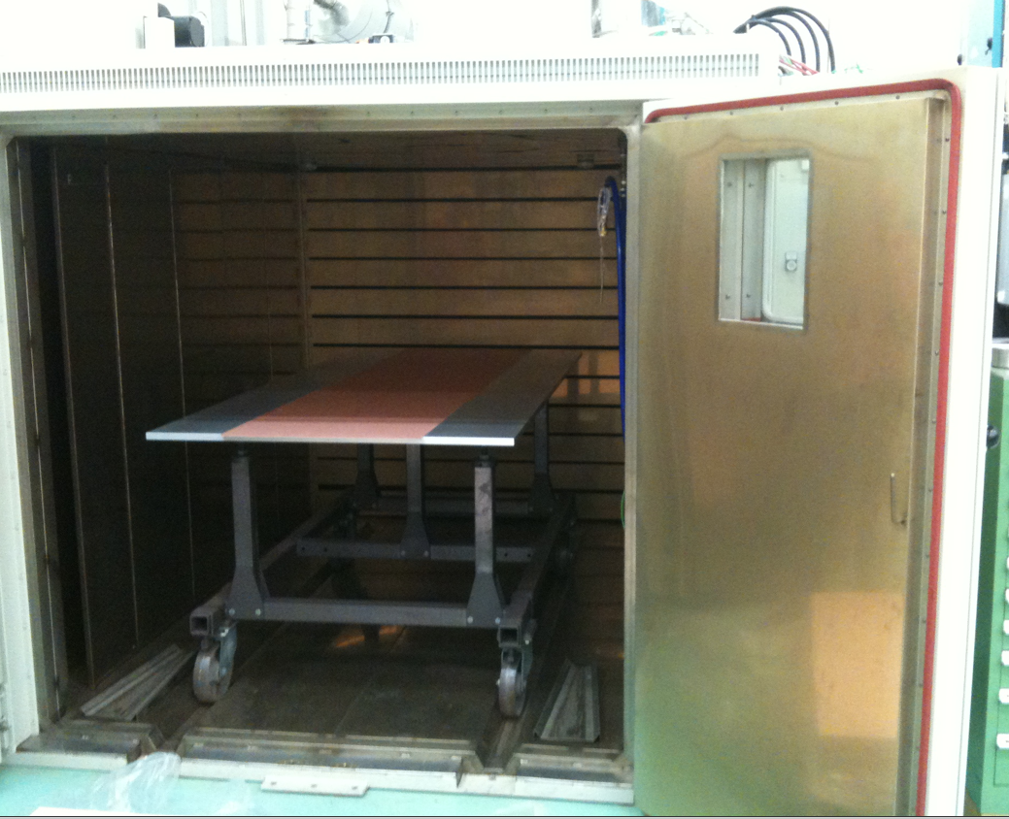
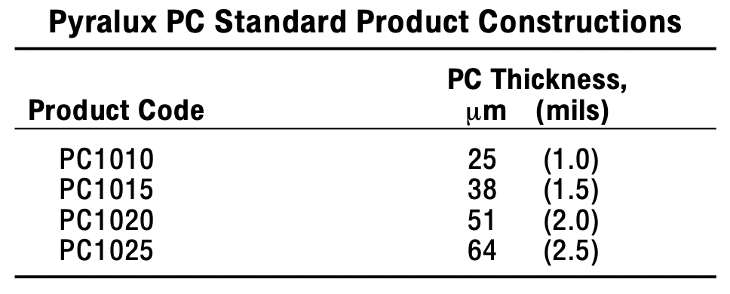
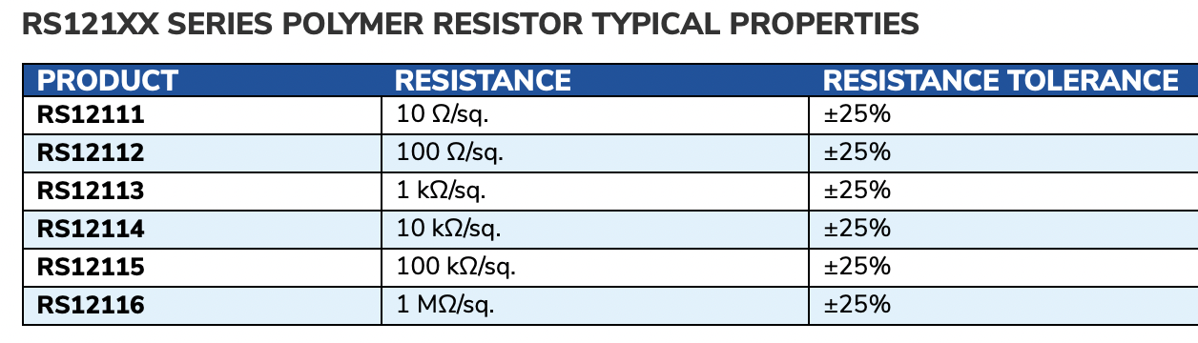
Material Procurement
Board components are procured centrally and delivered to manufacturers
  keep control of the procurement (avoid delays)
  save money
Base Cu-clad FR4 sheets, halogen free (0.5 mm thick, 2000x600 mm²)
  QC (thickness, uniformity, defects) and stabilisation (thermal treatment) at CERN
  Full quantity procured at at the beginning, delivered to companies in batches
Kapton (EN type) for resistive foils
Coverlay (Dupont Pyralux PC1025, 600 mm wide, 128 μm thick)
Resistive paste (RS12115 100 KΩ/square polymer resistor) for printing
Ag paste for electrical contact
Limited shelf-life

Slide 7

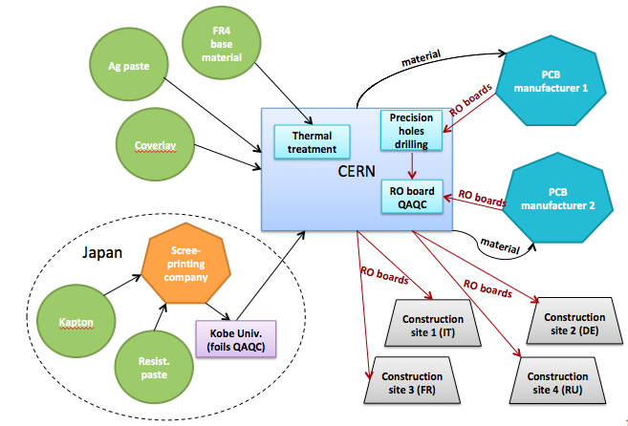
Logistic & organization
NSW stuff
Material for Micromegas

Slide 8
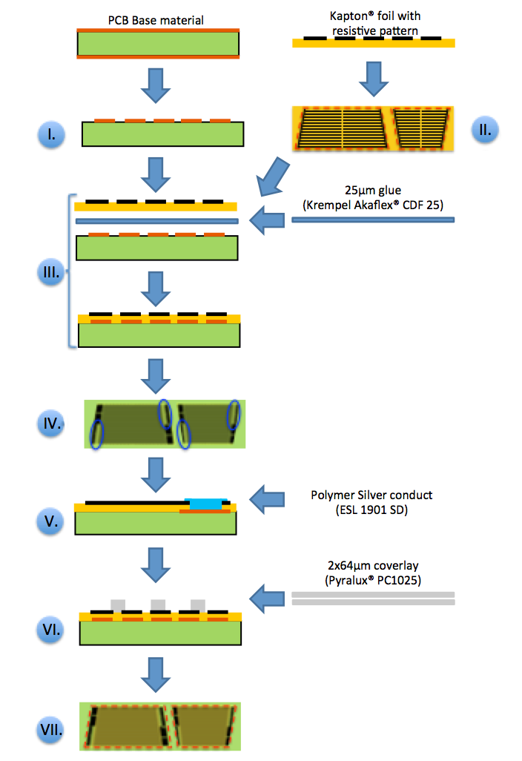
Board Production
Photolithographic creation of copper pattern
standard process.
complex due to: size of board, required precision & board elongation (humidity).
Cutting of Kapton foil with resistive pattern
non-standard but simple & required accuracy only ±1mm
Stacking and gluing at high P&T of Kapton foil, glue foil and board
standard process for small boards
complex due to: size of board & required cleanliness.
Chemical silver plating of copper pads
standard process
Screen-printing of silver paste
non-standard but rather simple & required accuracy only ± 1mm
Lamination of coverlay & pillar creation
standard process for small boards.
complex due to: size of boards, highly non-standard pattern, required flatness
Cutting of boards and drilling of non-precision holes
standard process on CNC machine.
complex due to size of boards, required cutting precision & board elongation (humidity).
Try to make all production steps as close as possible to standard processes in industry
waiting for board expansion (>20 days)

Slide 9
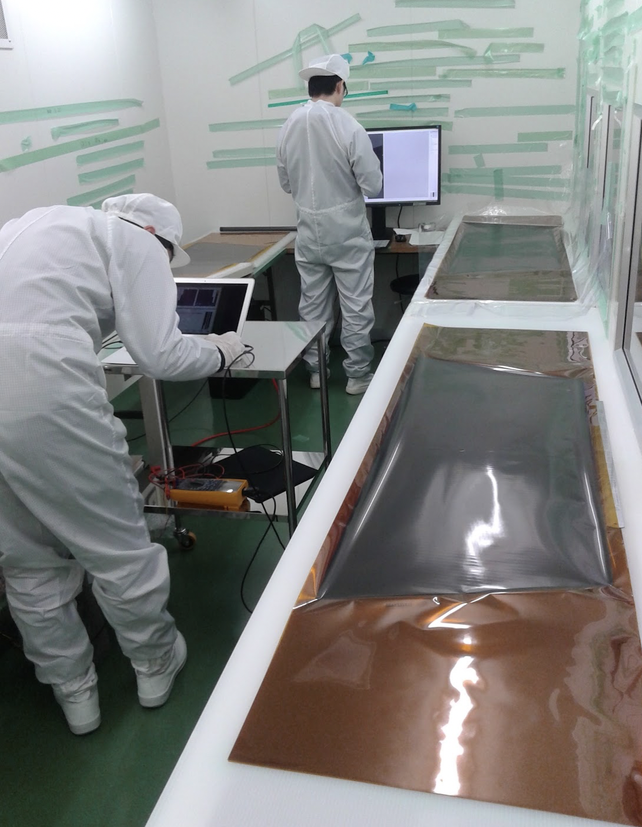
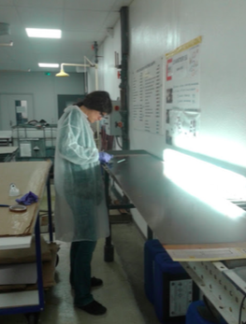
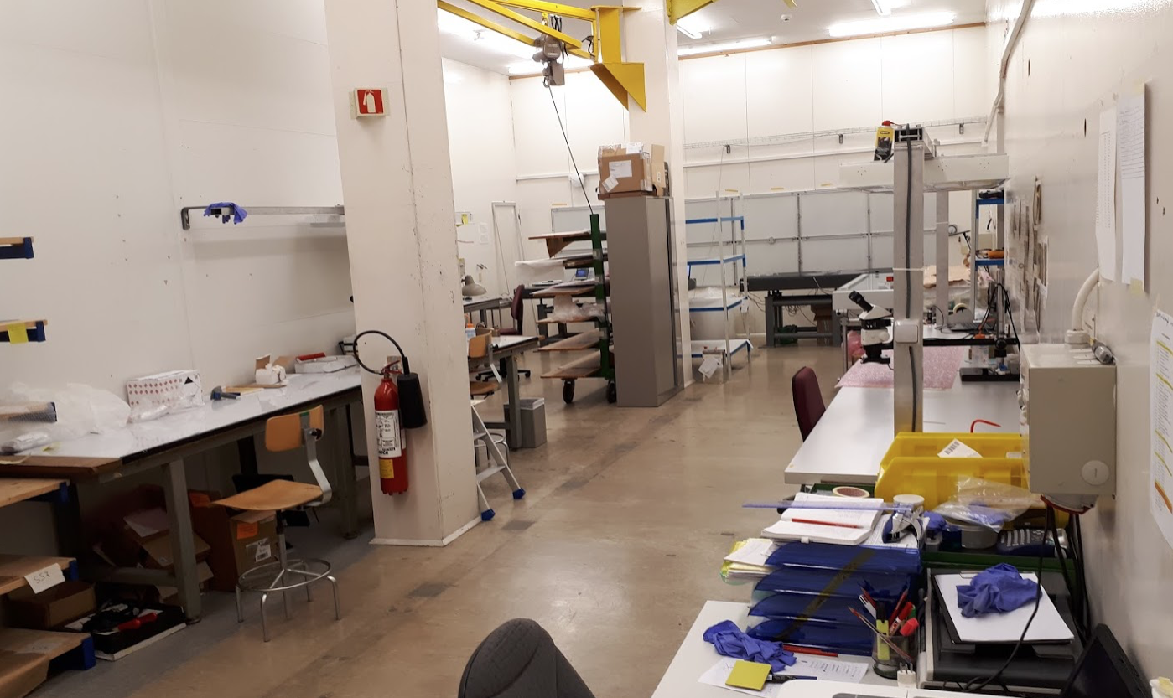
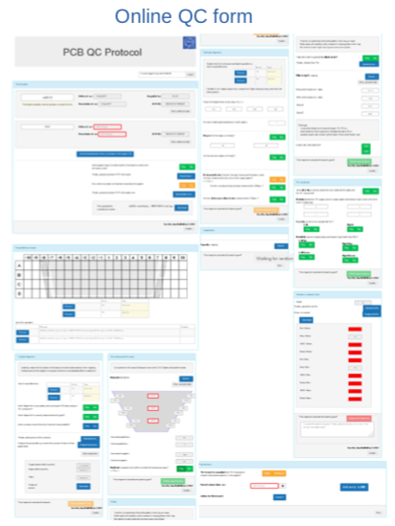
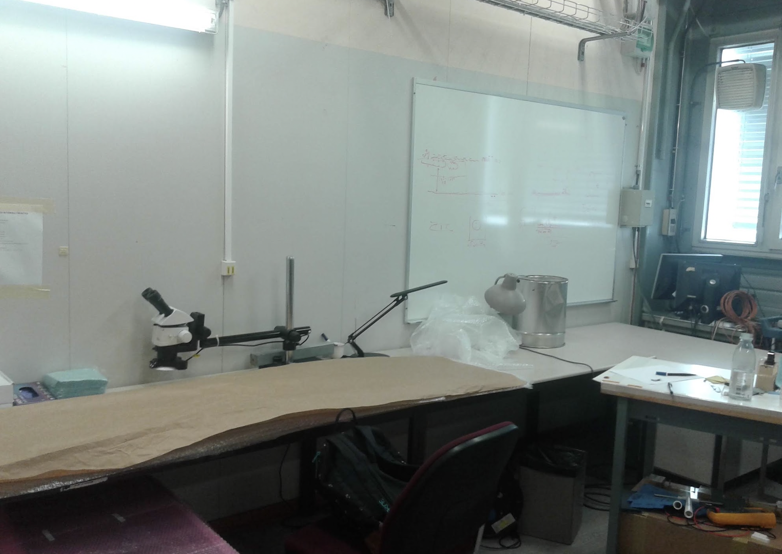
Quality Assurance / Quality Control
QA/QC lab for foils at Kobe
First QC at the manufacturer premises
Dedicated lab set-up at CERN
  7 test stations
  Each board tested according to QC protocol
  Online form interfaced with QC DB to guide through QC
Repair facility in a separate room
Foil QC at Kobe
Inspection at company
QC lab at CERN
Repair facility @ CERN
QC web form connected to DB

Slide 10
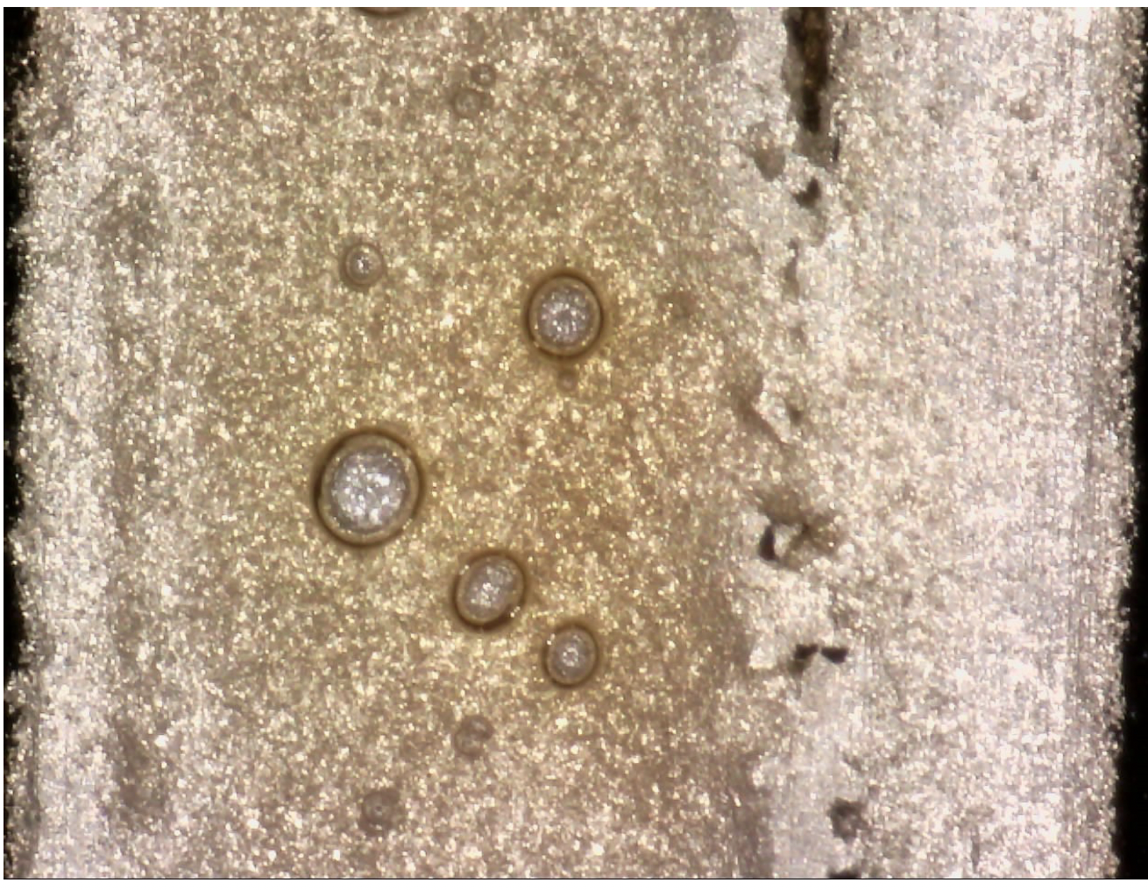
Selected list of production issues
Focus on some of the main issues encountered during the production, actions taken and adopted solutions

Slide 11
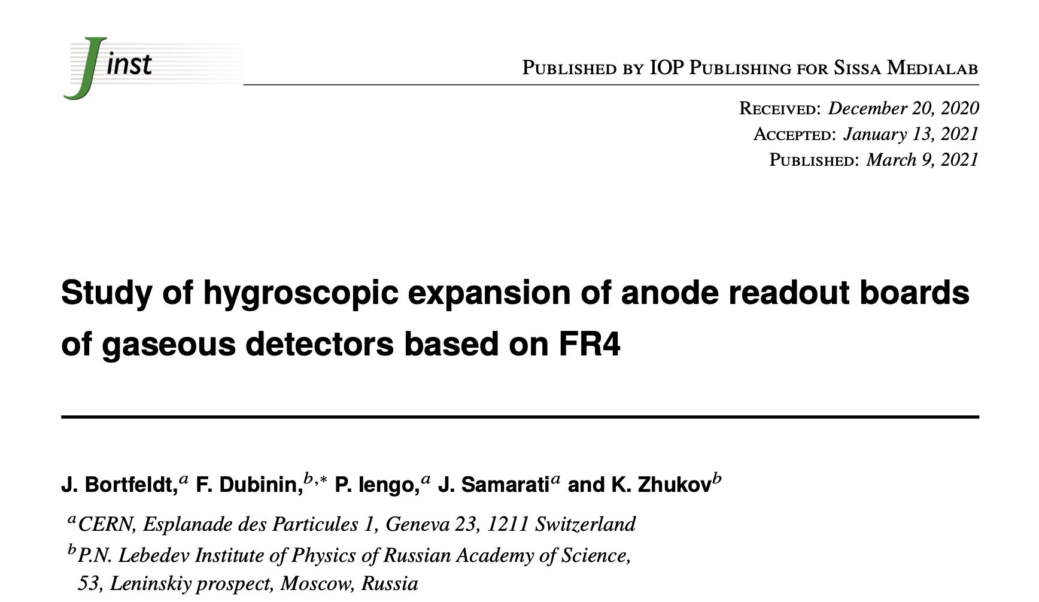
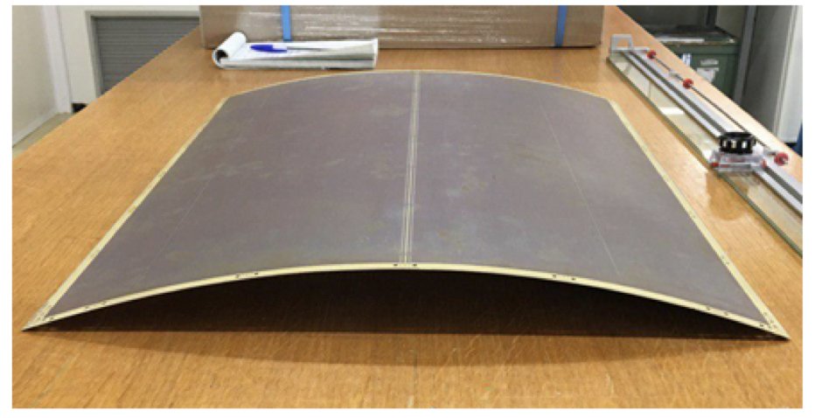
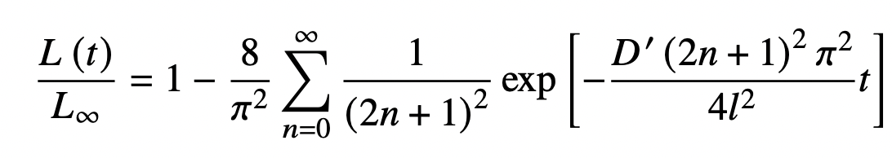
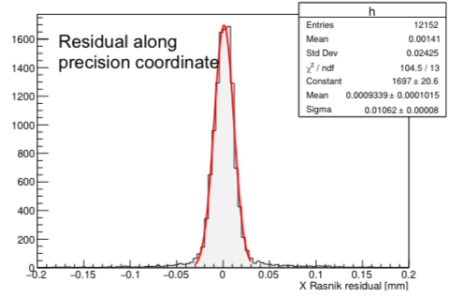
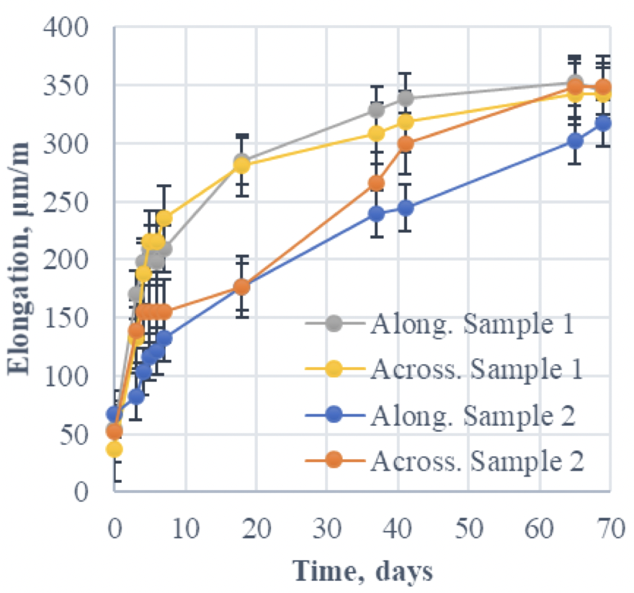
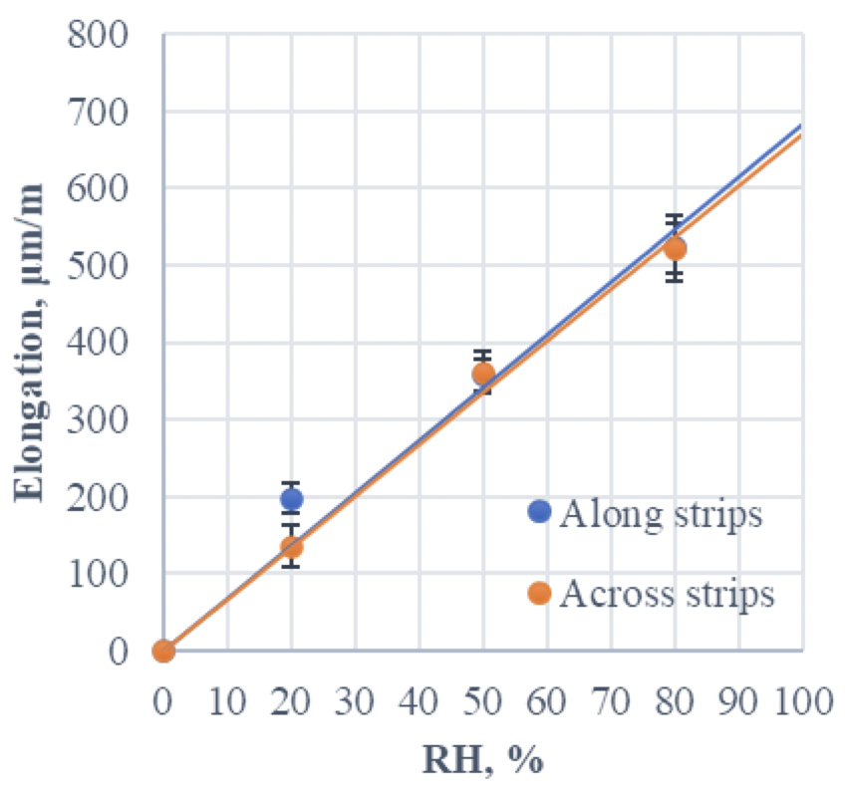
Board material expansion
Knowledge of the board dimension (strip position and deformation) crucial for precise tracking
  Copper pattern precision <30 μm
  Cutting and drilling precision <200 μm
FR4 subject to moisture uptake → expansion
  Described by Fick’s laws
  Made our own study
Expansion: ~400 μm/m at 21° and 50% RH to be accounted during production
  Cu pattern (masks) scaled accordingly to have the final desired dimensions
    Scale factors optimised for each company after dedicated studies
  After the production, the boards are stored for 4 weeks in RH controlled room
  before being cut/drilled → relaxation time to reach the final size
Panel deformation due to moisture absorption
JINST 16 (2021) 03, P03016
Residual after fitting PCB shape
Achieved precision ~10 um

Slide 12
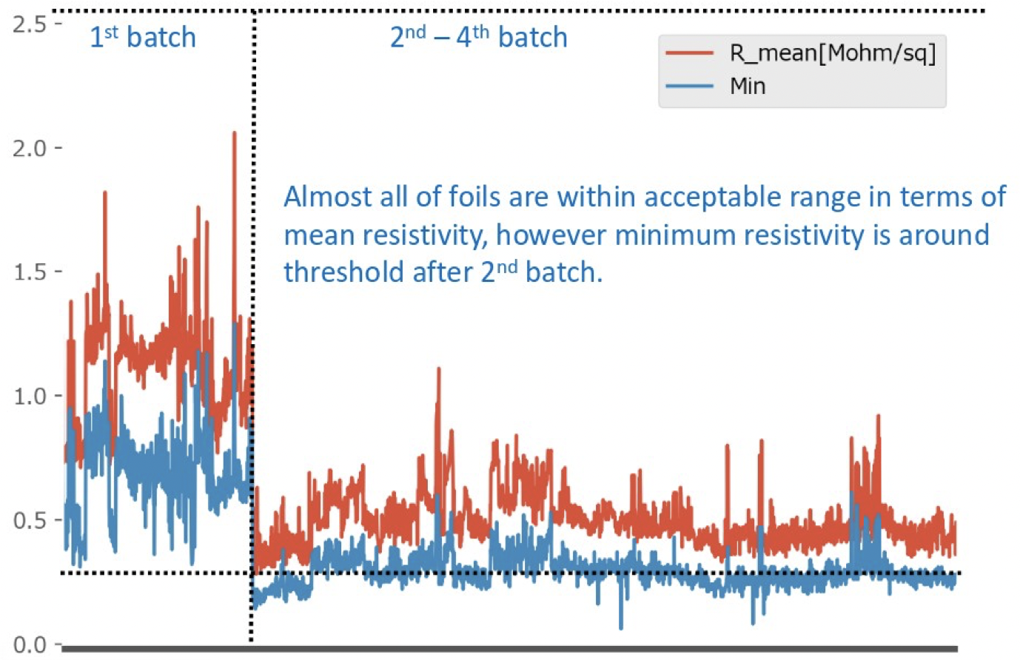
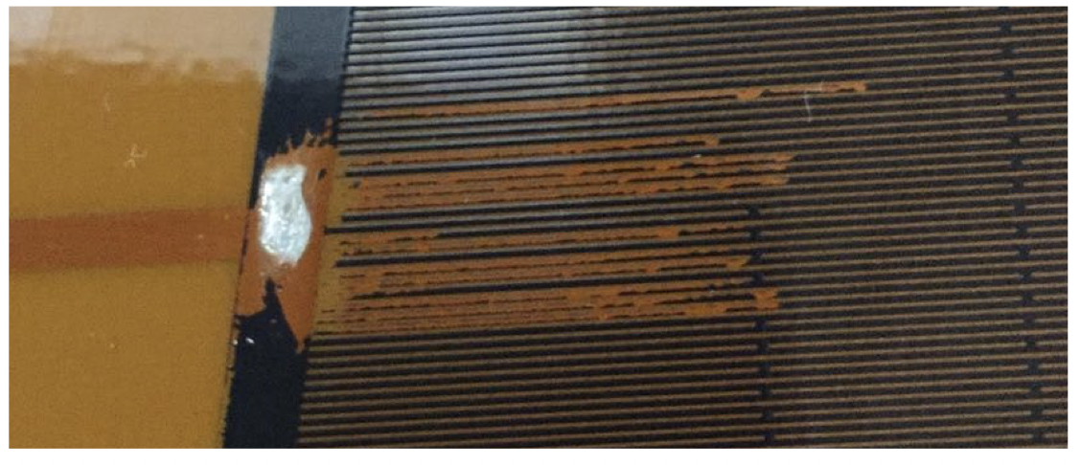
Resistive paste
MΩ/sq
Single provider: ESL(D), then Ferro (UK)
Final foil resistance driven by paste resistivity; curing conditions after printing; pressing conditions during board production
3 crisis related to resistive paste:
2016: Resistivity 10x higher then expected, finally understood in a change of solvent.
2016: Reported from PCB company low adhesion of resistive strips during PCB manufacturing. Reason found in insufficient curing at foil printing company (Matsuda, JP).
No information propagated to us →it took time to reconstruct the full story
2019: Paste production was moved from Germany to UK (after Ferro acquired ESL). Delivery of the last batch postponed for months.
Not able to produce usable paste.
Strong push from CERN to find a solution. Finally, the German expert was sent to UK to supervise the production. Costed months of delay and required tuning of the pressing condition at the PCB companies
Foil ID
Surface resistivity vs foil ID. Reduced resistivity correlated with the change of batch of resistive paste
Foil with resistive pattern partially removed

Slide 13
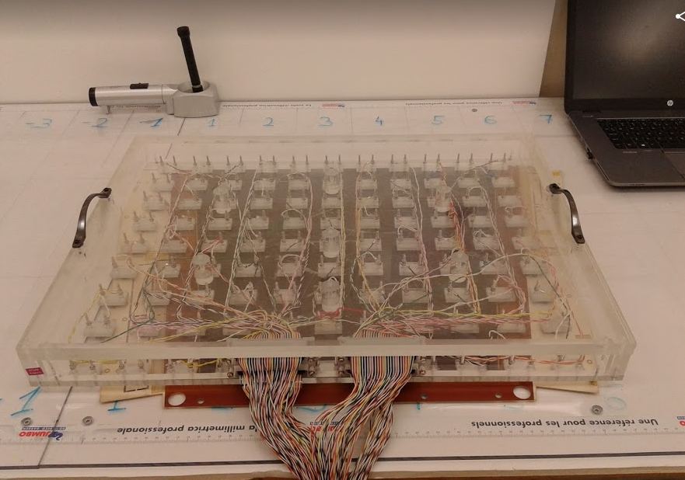
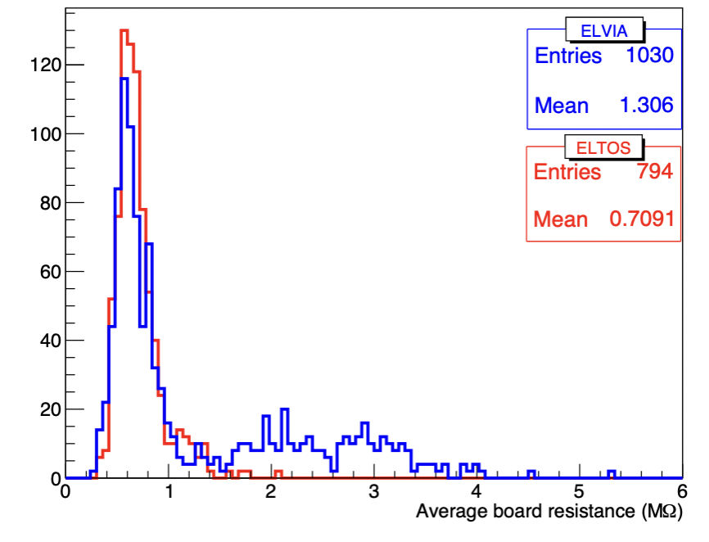
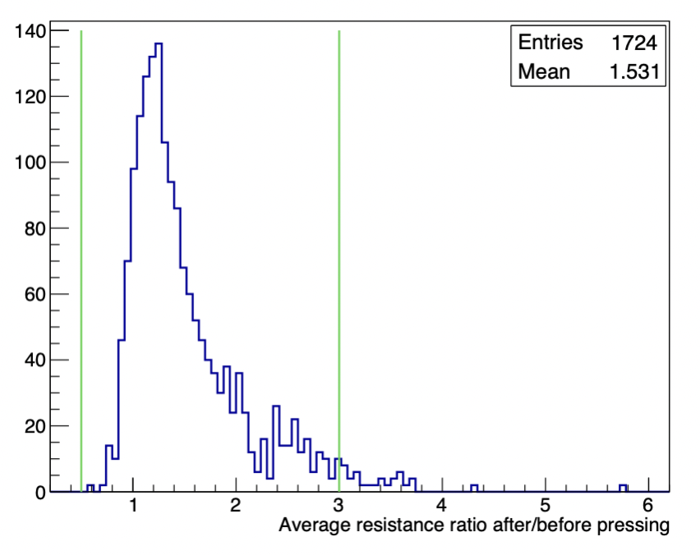
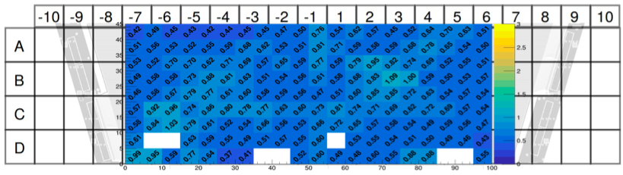
Surface resistance measurement
Resistivity foils measured at Kobe after production
Final resistivity of the boards measured at CERN
Resistivity map measured for each board
Comparison after/before board production
Dedicated tool developed and used in both sites
Surface resistivity measurement tool
Acceptance interval
Acceptance interval
Target value
Surface resistivity map of a board
/sq)
>98% of the foils used for production satisfy the acceptance criteria on resistivity
We now know that the lower limit (set on prototype detectors) was set too low, contributing to the detector HV instability

Slide 14
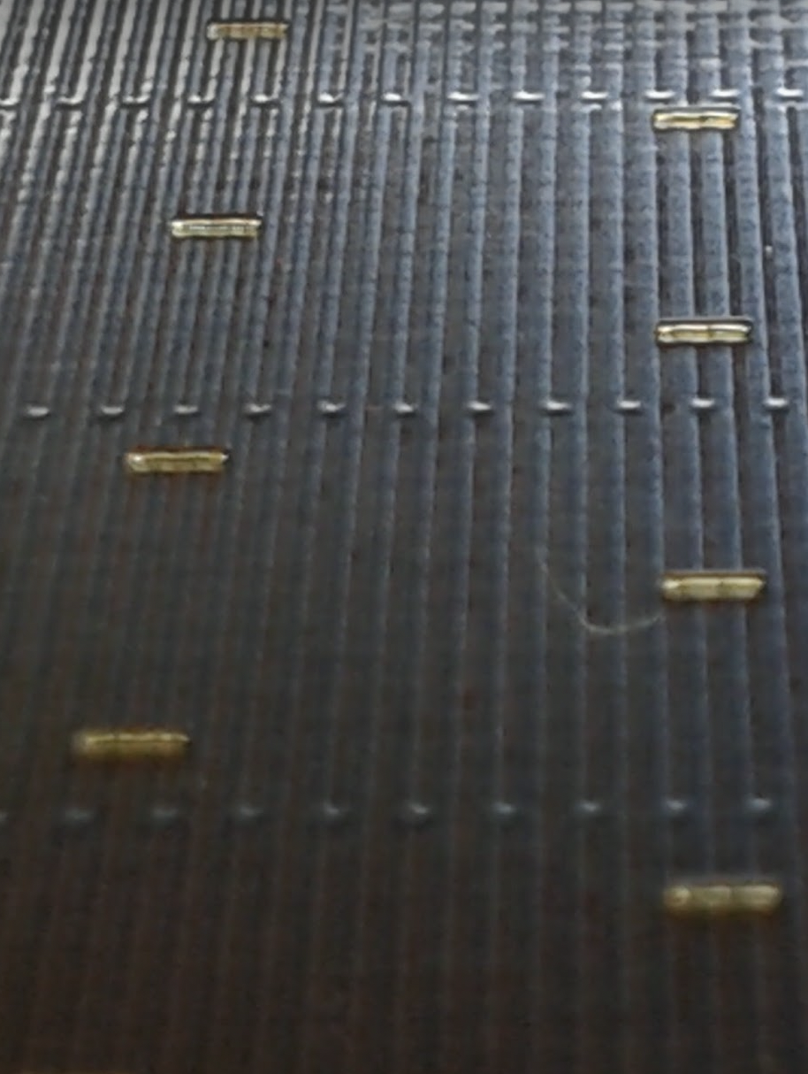
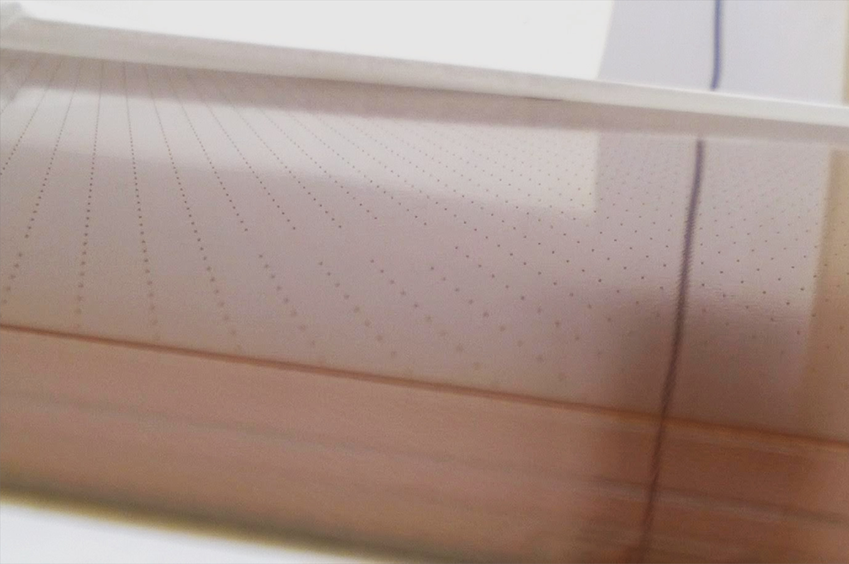
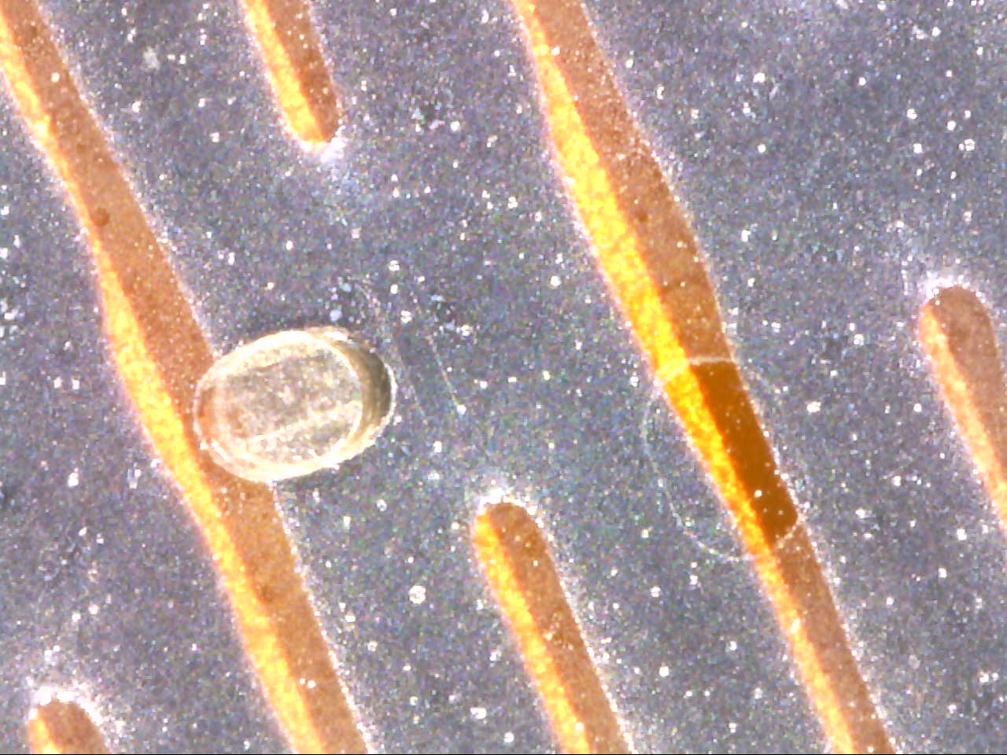
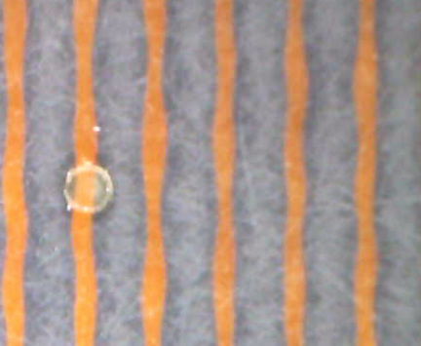
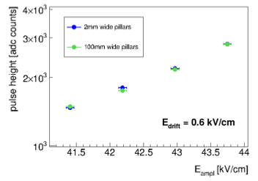
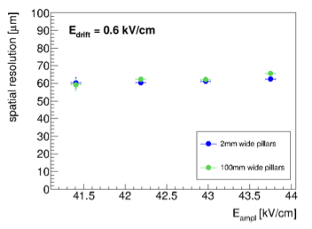
Pillar adhesion
Missing pillars
Detached pillars (oval)
Pre-series board: 2016
First step forward:
Correct surface polishing
& process optimization
round pillars well attached
(process improvement)
Second step forward:
long pillars well attached
(design improvement)
Module0 boards: 2015
Long pillars (1.2 mm x 0.2 mm) running parallel to the readout strips do not affect the detector performance, while ensuring larger attachment surface
Tested on 10x10 cm² bulk-MM built at CERN
Production board: 2017
JINST 12 (2017) 02, C02076
Mesh sagitta from simulation:
  between pillars: 2μm @ 600V & 10 N/cm
  if single pillar missing: 8μm @ 600V & 10 N/cm
→ individual missing pillars still tolerable

Slide 15
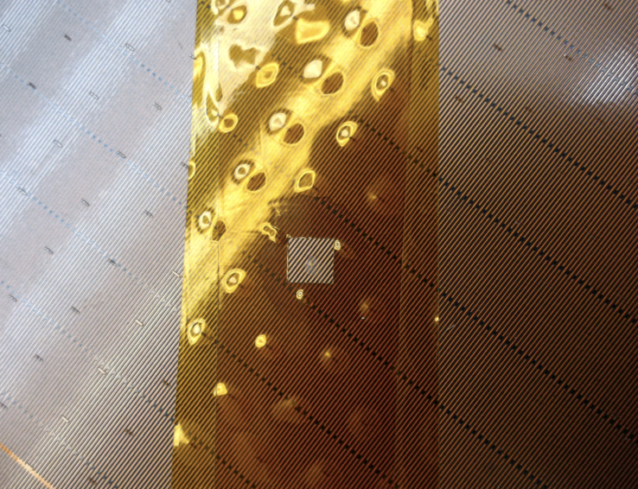
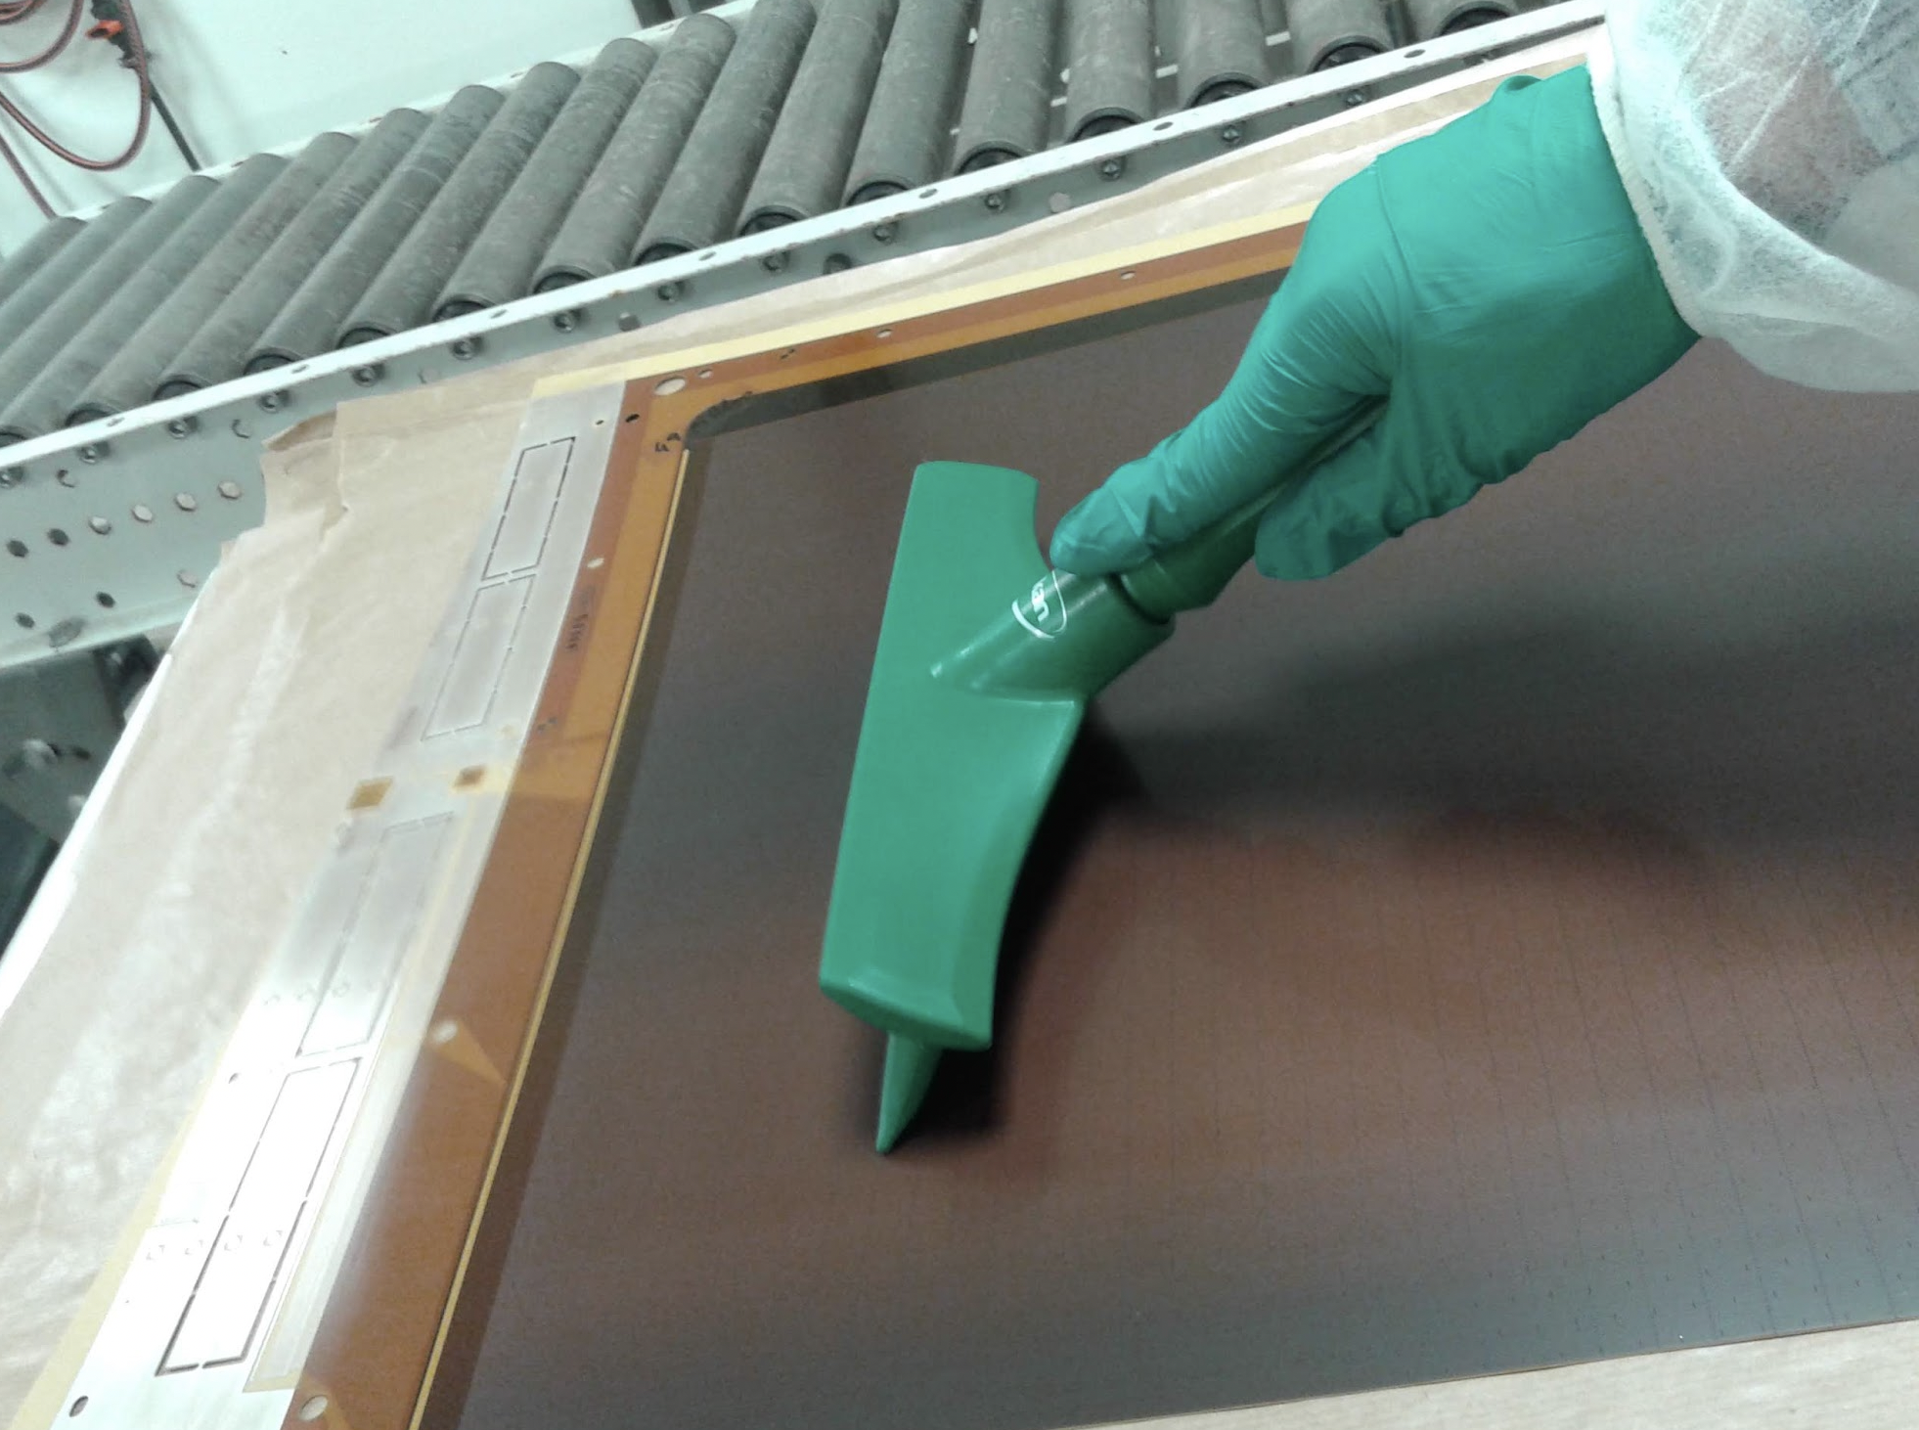
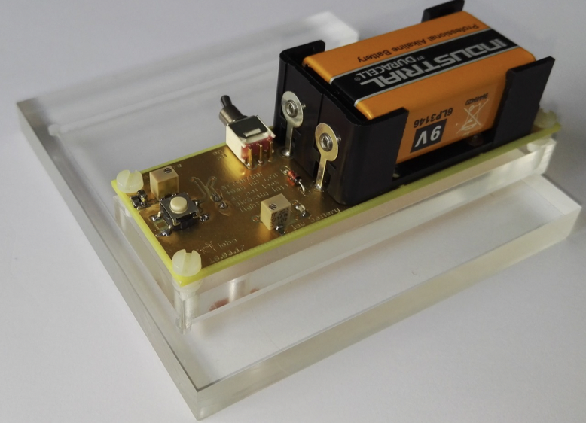
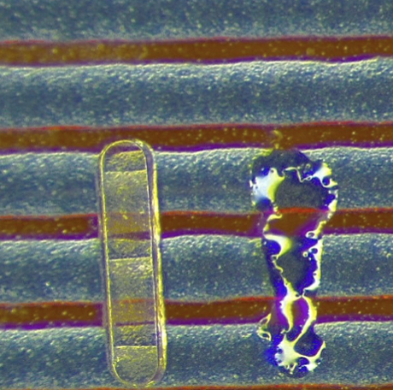
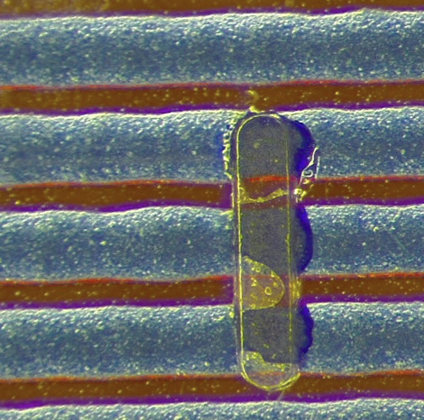
Pillar QC and repairs
New adhesion checks implemented
  ISO: removal with tape → only on limited area
  Use of window-cleaning tool (hard test)
Acceptance criteria
  single missing pillars < 8-10 (3.3k to 20k pillars on PCB)
  ≥ 2 neighbouring pillars missing
Reparation procedures developed to recover boards with
few missing or badly attached pillars (out of specs):
  At CERN: manual single pillar gluing with Araldite 2011
  At companies: local cleaning, re-lamination,
  development (UV tool developed), curing
ISO9000 protocol: tape test
Windows squeegee cleaning (raclette) test
UV spot lamp with single pillar mask (J. Bortfeldt)
Single pillar gluing (manual)

Slide 16





Pillar height measurement
Pillar height map measured for each board
Precision of the tool: 0.5 μm
Systematic difference (2 μm) between the two companies
RMS~ 2 μm; L/R asymmetry ~ 2 μm
Average value: 120 μm (expected 128 μm)
Pillar height measurement tool

Slide 17








Bumps & enclosures
Module0 boards: 2015
Great improvement thanks to:
Technology transfer
Procedure and work-flow optimization
Cleanliness during gluing
First production batch: 2016
Production board: 2017
Repair techniques & dedicate tools developed
Tool to measure height of bumps & enclosures
Before
After
Polishing of resistive surface
Passivation of bumps with coverlay disk

Slide 18








HV connection & edge cutting
Silver line HV connection
Non-standard manual procedure
Needed iterative TT
First step improvement
Second step improvement
OK
Third step improvement
Unusable
Usable after repair
Perfect!
Edge cutting
Pre-series board: 2016
CERN expert showing the HV connection technique to techs from production company
Great improvement:
Procedure and work-flow optimization
Design improvement: removed 1 strip to allow for larger safety margin
Module0 boards: 2015

Slide 19










Off topic / Hot topic
Design issue
Resistive interconnections extending to the edge: reduce R_{min} → Passivation
Mesh selection
The mesh used for ATLAS is the less performing for HV stability
Resistivity
Target value too low (optimised on small bulk prototypes with 18/45 mesh). Min resistance not enough to quench discharged close to the edge
→ Process optimisation (when possible) + passivation
Gas mixture
Baseline gas mixture Ar:CO₂ 93:7 ok for prototypes not for final detectors. Big improvement by adding 2% of iC₄H₁₀
→ Gas changed
ATLAS mesh (30/71)
Mesh of prototypes
(18/45)
Ar:CO₂ 93:7
OK
Ar:CO₂iC₄H₁₀ 93:5:2
NOT OK

Slide 20
Lessons learned
& Conclusions

Slide 21



Lessons learned - Generalities
Design
  For the design of the detector do not forget the global view of the project
  Select well your components: saving money is not always the solution. It can cost you more later.
  Don’t do mistakes in the design. Or reduce the risk by reducing the number of different items to design
From prototyping to final detector:
  Don’t extrapolate (too much) results from small prototypes to large detectors, in particular if they are built with different components
  If you identify a problem, don’t believe it is the only one until you prove
We always openly reported problems and shared experience with the community. Received interest and support from many, but… were taken as bad example by people who don’t know what building such a huge detector system means
  Don’t care about sterile criticisms, focus on work. And continue to share experience: the more a knowledge is diffused the best it is preserved
…which mesh?

Slide 22

Lessons learned - 1
Main criticalities
  Move from R&D to mass production. No time for real TT to the companies BEFORE the production (limitation also from the tendering procedure).
  Pre-production helped but most of the TT and process optimisation was done during the production
  Although most of the production steps were ~standard for specialised companies.
  Both manufacturer assumed the ATLAS production as an R&D expecting a yield <80%
  Time pressure and long production (>3 years): hard to keep expert manpower at CERN and at the companies
    Both companies replaced their production supervisor between the Mod0 and the series production
  Some unforeseen technical issues emerged during the production (e.g., strip etching, see backup slides)
  Problems in material procurement from single supplier (reproducibility among batches)

Slide 23

Lessons learned - 2
Main strong points
  Good choice to go to 2 companies: split production + continuous feedback from independent sources
  Establish good communication with both companies, especially with the technical personnel doing the work
  Good choice procure the material centrally by the collaboration. Some problem would have been spotted too late otherwise
  Huge effort to constantly follow the production at both companies from the same team. Yield went from 64% at the pre-production to >90% for the last batches, demonstrating the feasibility of the project
  Thorough and complete QA/QC on each single board
  Set-up of a repair facility to accept board with small, repairable defects

Slide 24


Conclusions
The industrial production of the first large-scale MPGD system has been successfully completed for ATLAS
Production span over 3.5 years 2017-2020
Many issues had to be addressed during the production phase, requiring close and constant follow-up
The transition from R&D to construction revealed unexpected problems… nevertheless:
We made it! Demonstrating the feasibility or large MPGD system for the next generation experiment
With the Micromegas for ATLAS the MPGD technology has entered the new era of mass production

Slide 25

Thank you!

Slide 26
Additional Material

Slide 27

Boards QA/QC
Dedicated lab set-up in 188
  7 test stations
  Each board tested according to QC protocol
  Shift work (2 FTE) + experts
  Online form interfaced with QC DB to guide shifters through QC
  Repair facility in a separate room

Slide 28




Board QC: resistivity
Resistivity foils measured in Japan after production
Final resistivity of the boards measured at CERN
Resistivity map measured for each board
Comparison after/before board production
Understood to be a critival parameter for HV stability

Slide 29



Board QC: dimensions
Knowledge of the board dimension (i.e. strip position and deformation) crucial for precise tracking
Boards are subject to expansion for moisture uptake
  Study of the expansion (result: ~400um/m)
  Rescaling of the dimension for the board production
  Waiting period of 4w at the company to let the boards expand before final cutting/drilling
  Dimension measurement on all the boards (contact CCD tool)
Raw measurements
Residual after fitting PCB shape
Achieved precision ~10 um

Slide 30




Strip etching
Unexpected problem observed at the pre-series boards Affecting some boards of both companies:
Cu lines cut at the edge of the kapton foils
(excess of micro-etching during Ag plating)
→ problem understood and solved
Capacitance between neighboring strips or strip and
HV line is a good indicator for interruptions and cuts
Automated tool developed for capacitance measurement
Strip capacity vs line number
Kapton
Cu
FR4
Strip capacity automatic measurement setup
Cu lines cut at the Kapton edge

Slide 31

Resistivity
Correlation between board resistivity and HV stability
Action taken:
  Process optimisation to increase resistivity during production
  Passivation to increase Rmin (DOCA)
But the produced boards are ~all within the acceptance interval for the resistivity…
…was the target value too low? Why?

Slide 32


The role of the mesh
…because it was optimized on bulk detector with 18/45 calendered mesh!
Test campaign in 2018 to evaluate the role of the mesh geometry on HV stability
Clear dependence of stability on geometry
  Smaller wires perform better
  Smaller openings give larger stability region (field uniformity)
  Calendered meshes perform better
Experimental results in agreement with prediction
NSW
Mod0
Prototypes
The mesh was selected considering mechanical/physics/cost aspects
The stability limit did not appear to be a problem
When the role of the mesh was clarified there was no consensus in the collaboration to go to the 18/45C mesh for the remaining to build detectors

Slide 33
Design mistake
Some boards type (of the 32 different ones) affected by a design issue:
Interconnections between resistive strips extending to the edge: reduce R_{min} → Passivation
OK
NOT OK
DOCA
DOCA
DOCA = Distance Of Closest Approach

Slide 34




Gas choice
ATLAS Micromegas were supposed to operate with Ar:CO2 93:7 mixture. The main reason for the original choice was to re-use the gas system for the MDT/CSC of the old wheel and save few kCHF
Not an optimal gas for a parallel single-sage amplification structure
All other MM system in use until then (e.g. COMPASS MM) used Ar-based with iC4H10
Small bulk prototypes with 18/45 mesh worked perfectly with Ar:CO2 93:7
Instabilities are largely mitigated with the addition of a small amount of stronger quencher
  Lower operating voltage / larger stability plateau / suppress events with larger charge (→ discharges)
Ref: JINST 18 (2023) 07, C07005
Ar:CO₂ 93:7
Ar:CO₂iC₄H₁₀ 93:5:2
HV stability improved by adding 2% of iC₄H₁₀

