Slide 1
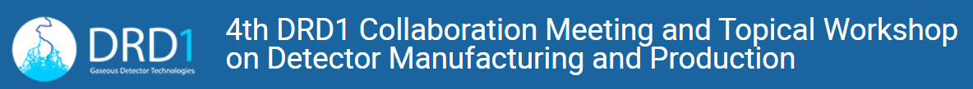
The manufacturing of HPL plates and gas volumes for RPCs
P. Camarri
University of Roma «Tor Vergata» and INFN
February 27th, 2025

Slide 2
Outline
The manufacturing of HPL plates for RPCs at Teknemika
The manufacturing of RPC gas volumes at General Tecnica Engineering

Slide 3
HPL plates @ Teknemika
T he site of Teknemika is at Cinisello Balsamo, north of Milano (Italy)
Teknemika specializes in the research and development, production, creation and distribution of high added value table tops
In addition, Teknemika can manufacture special plates with definite specifications for scientific and technological applications
One outstanding example of a special production is the manufacturing of HPL (High Pressure Laminates) for Resistive Plate Chambers

Slide 4
HPL manufacturing @ Teknemika (1)
Preparation of Raw Materials
• Media selection:
o Choice of decorative and core papers (e.g. kraft or reinforced paper).
• Impregnation with resins:
o Decorative paper treated with melamine resin for aesthetics and resistance.
o Core papers impregnated with phenolic resin for stability and strength.

Slide 5
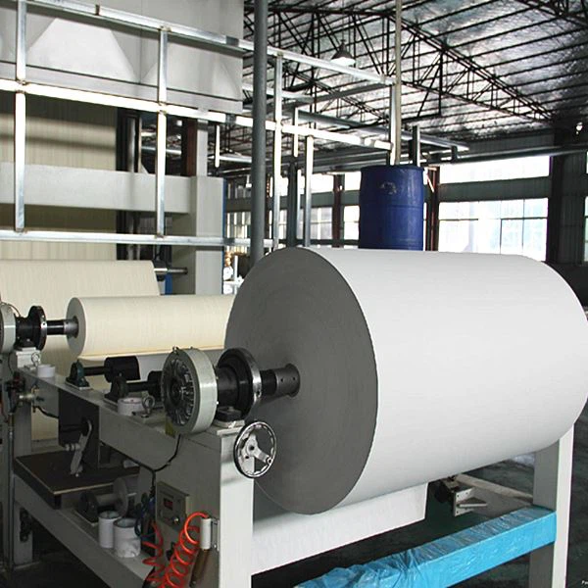
HPL manufacturing @ Teknemika (2)

Slide 6
HPL manufacturing @ Teknemika (3)
Assembly and Pressing
• Assembly of the layers:
o Overlaying sheets in definite order: decorative layer on the surface, followed by layers for the core and reinforcement.
• High temperature and pressure pressing:
o The stack is placed in a press (approx. 150–200 °C, 5–10 MPa).
o The resins polymerize, consolidating the layers and ensuring a homogeneous panel.

Slide 7
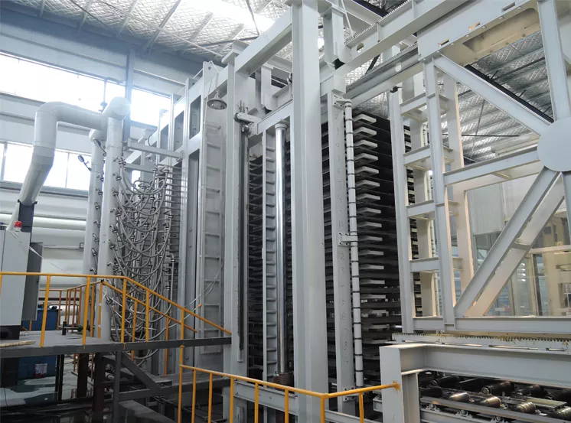
HPL manufacturing @ Teknemika (4)

Slide 8
HPL manufacturing @ Teknemika (5)
Cooling, Finishing and Quality Control
• Cooling:
o The panel is gradually cooled to stabilize the structure.
• Finishing and cutting:
o Cutting and trimming to obtain final dimensions.
• Quality control:
o Visual and instrumental verification to ensure homogeneity, resistance and compliance with standards.

Slide 9
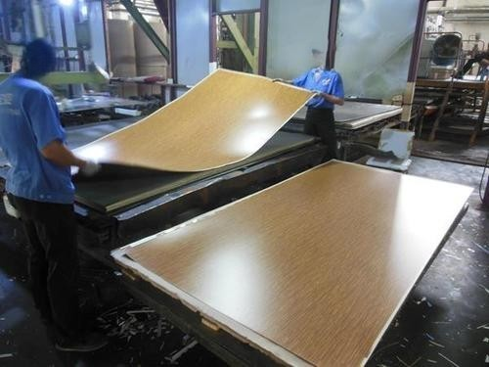
HPL manufacturing @ Teknemika (6)

Slide 10
HPL manufacturing @ Teknemika (7)
Resistivity measurement phase
Measurement of the resistivity of Bakelite HTRG sheets is carried out to evaluate their electrical properties, essential in antistatic or insulating applications.
The test is performed using a high impedance electrometer or ohmmeter, applying electrodes to the surface of the sample. The measurement can take place in surface configuration (surface resistivity) or in volume (bulk resistivity), depending on the intended use.
The values ​​obtained are compared with the reference standards or with the parameters requested by the customer (for example ATLAS) to guarantee the conformity of the material to the required standards.

Slide 11
HPL manufacturing @ Teknemika (8)
Slab cutting phase
The precision cutting of HPL sheets is performed using numerically controlled pantographs (CNC). This is a highly automated process that guarantees extremely accurate results, even for complex geometries, and can be summarized in 5 points
1. Design and Programming
o Creation of the digital design: We start with a CAD/CAM file that defines exactly the shape and dimensions to obtain.
o Tool path generation: The CAM software converts the drawing into a cutting path (usually in G-code language) that the CNC will follow, taking into account the tolerances and specifications of the HPL material.

Slide 12
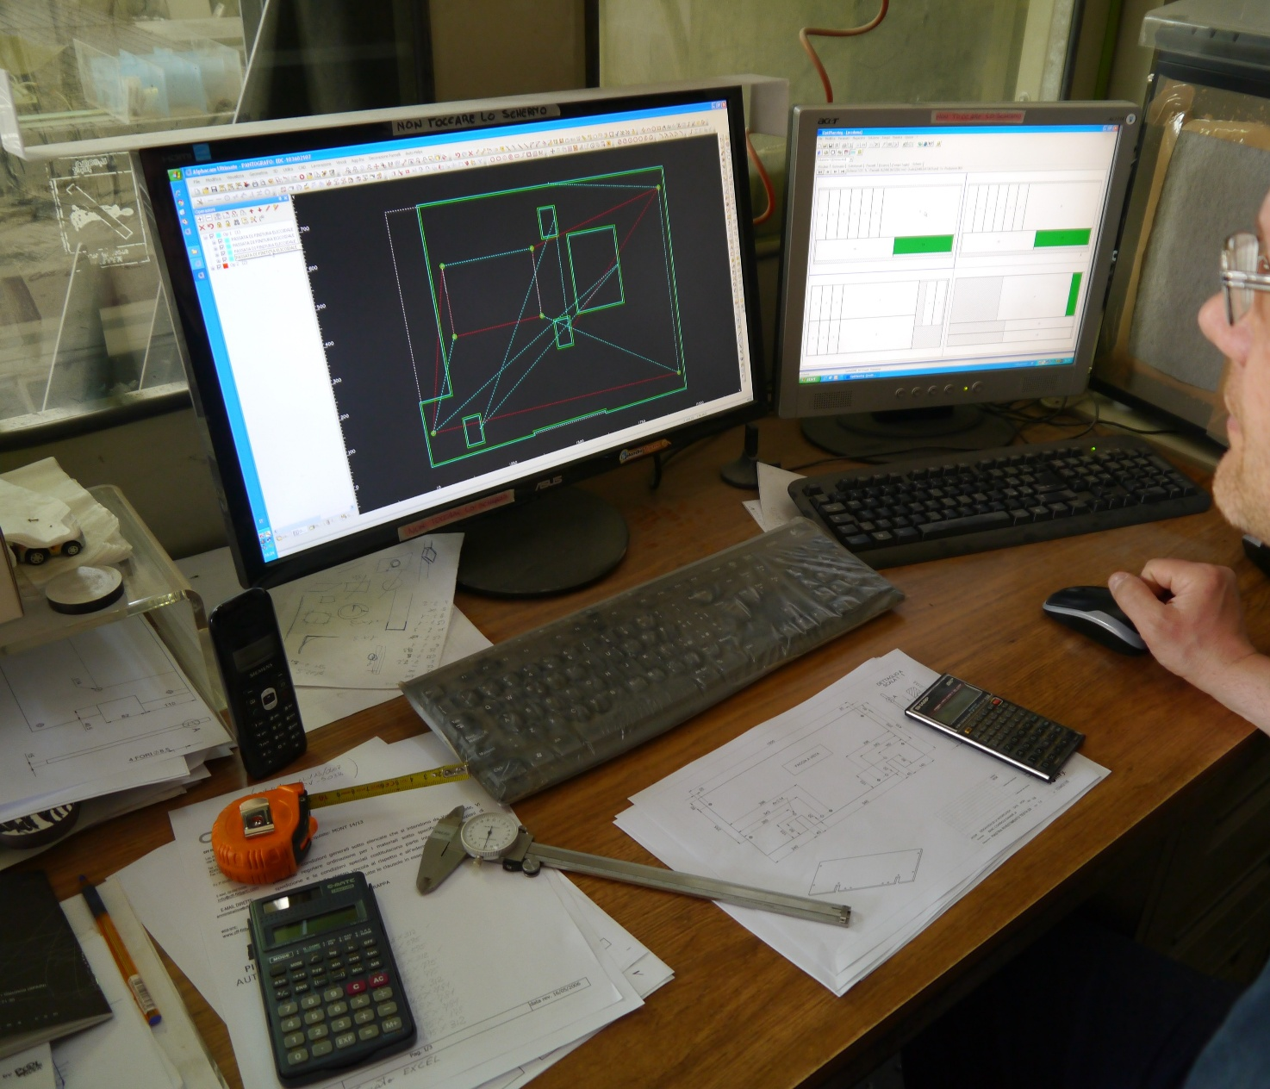
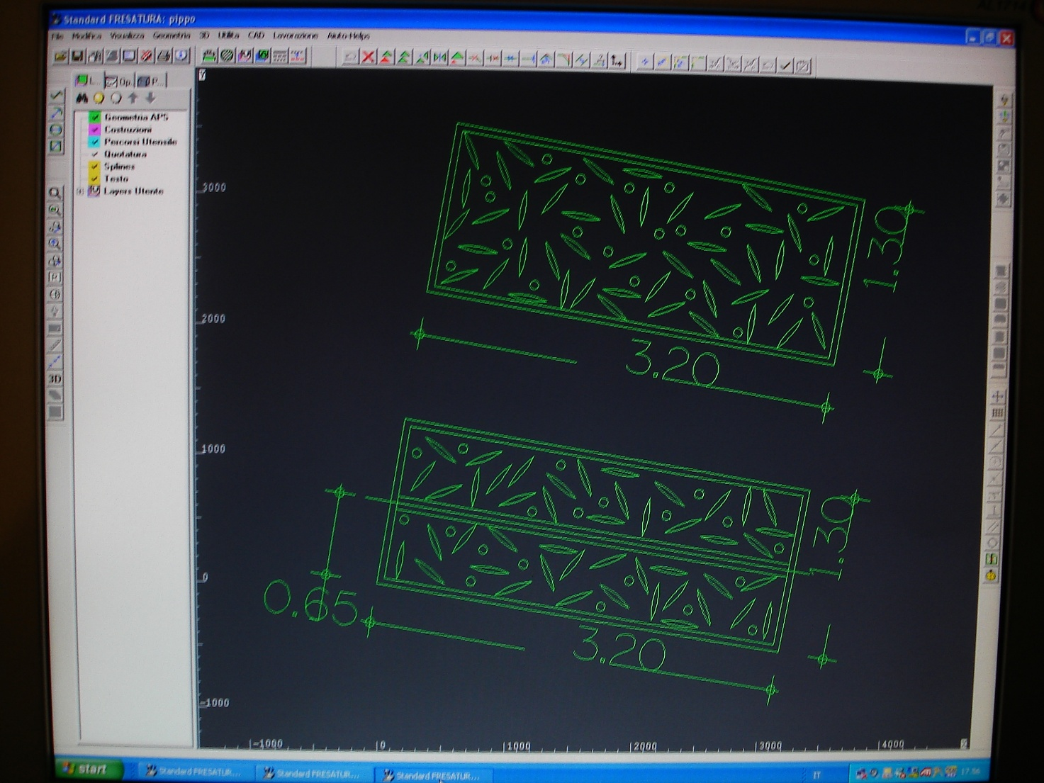
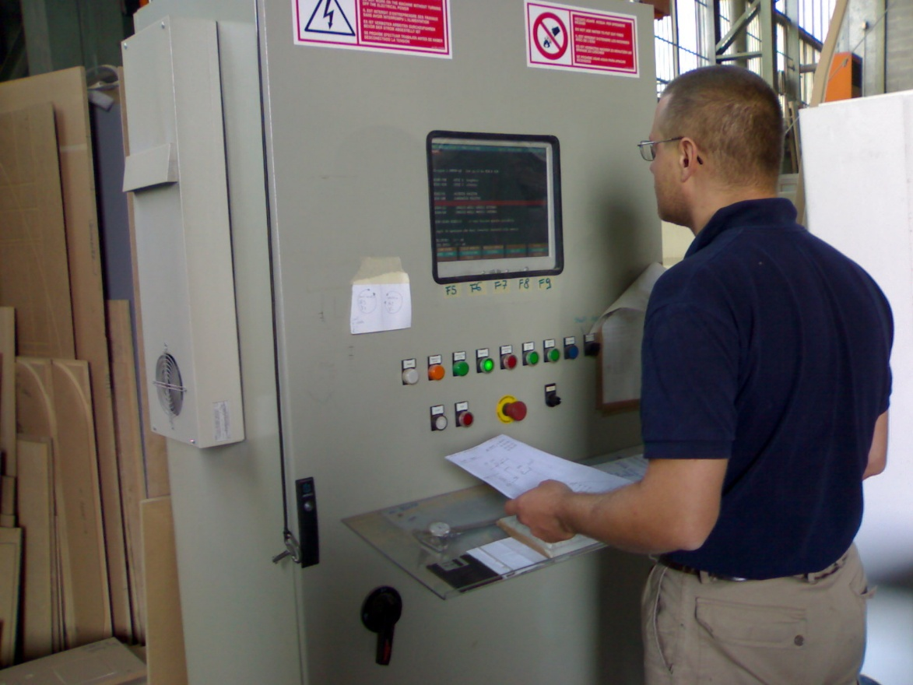
HPL manufacturing @ Teknemika (9)

Slide 13
HPL manufacturing @ Teknemika (10)
2. Preparation of the Machine and Material
o Positioning of the sheet: The HPL sheet is fixed on a specially prepared work table. Locking systems (such as clamps or vacuum-generating suction cups) prevent movement during cutting.
o Machine calibration: Before starting, the machine performs a calibration to define the zero point (origin) and the correct position of the plate, ensuring that the cutting depth and the alignment of the axes are perfectly set.

Slide 14
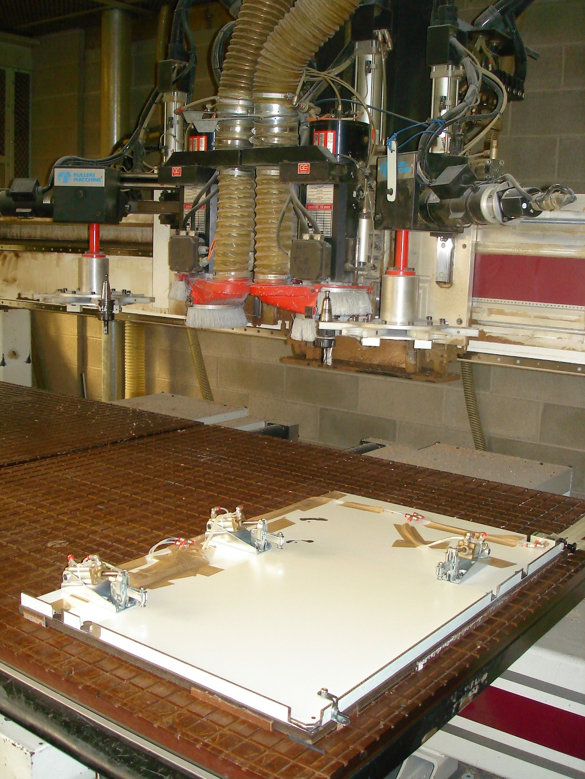
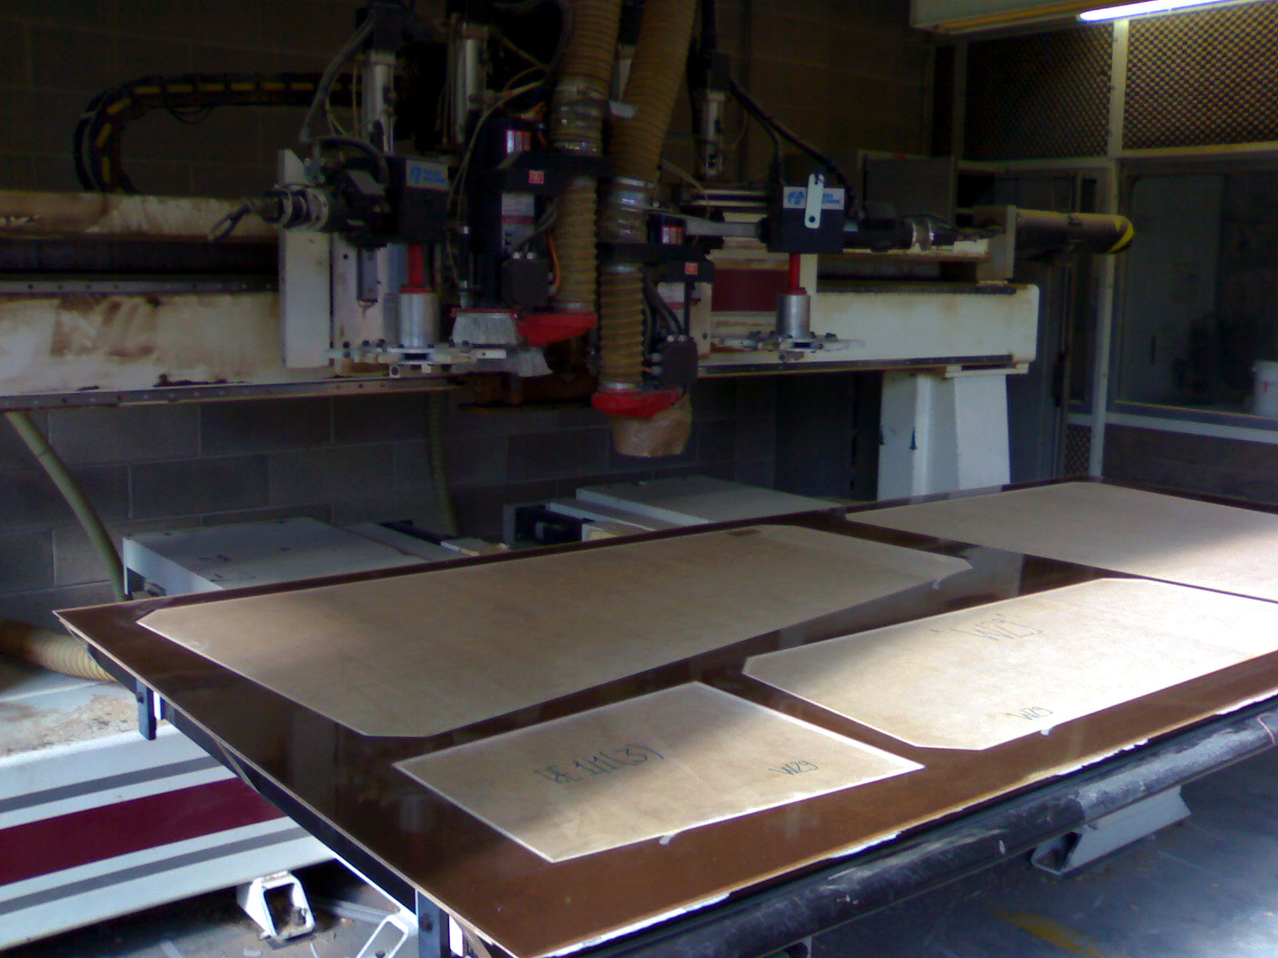
HPL manufacturing @ Teknemika (11)

Slide 15
HPL manufacturing @ Teknemika (12)
3. Setting the Cutting Parameters
o Choice of tool: The blade or tool suitable for cutting HPL is selected, capable of guaranteeing clean and perfectly machined edges.
o Parameter definition: The CNC software sets the feed speed, applied force and cutting depth, based on the specific characteristics of the HPL material.

Slide 16
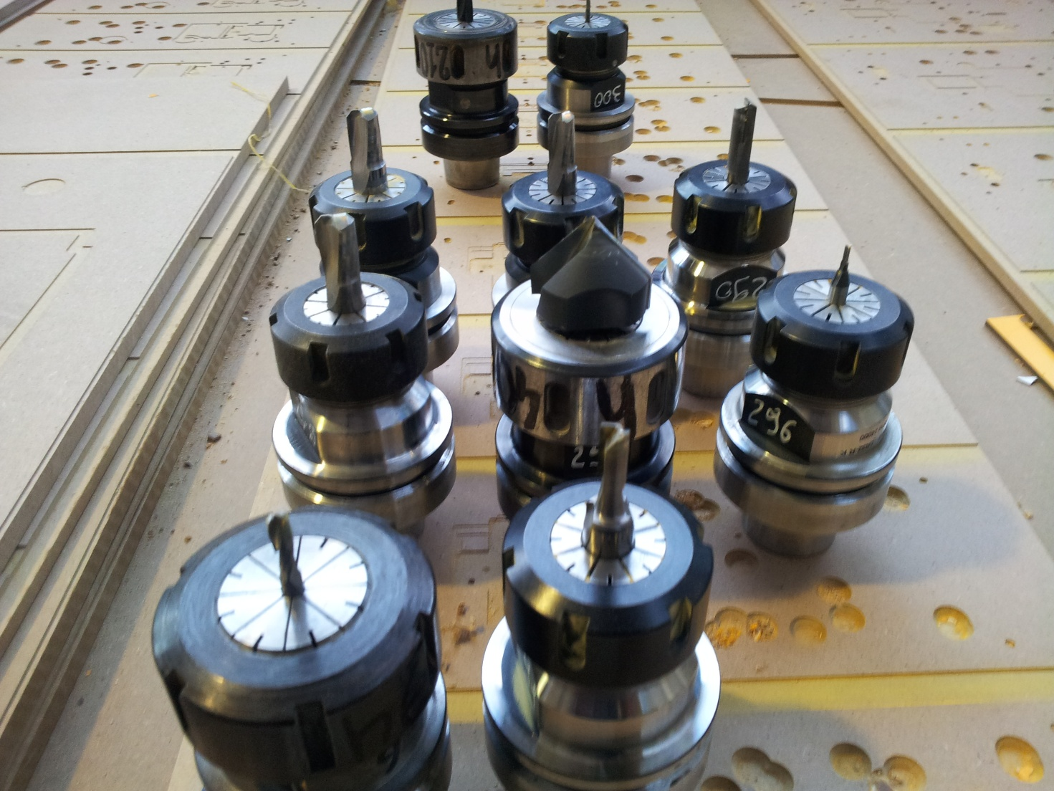
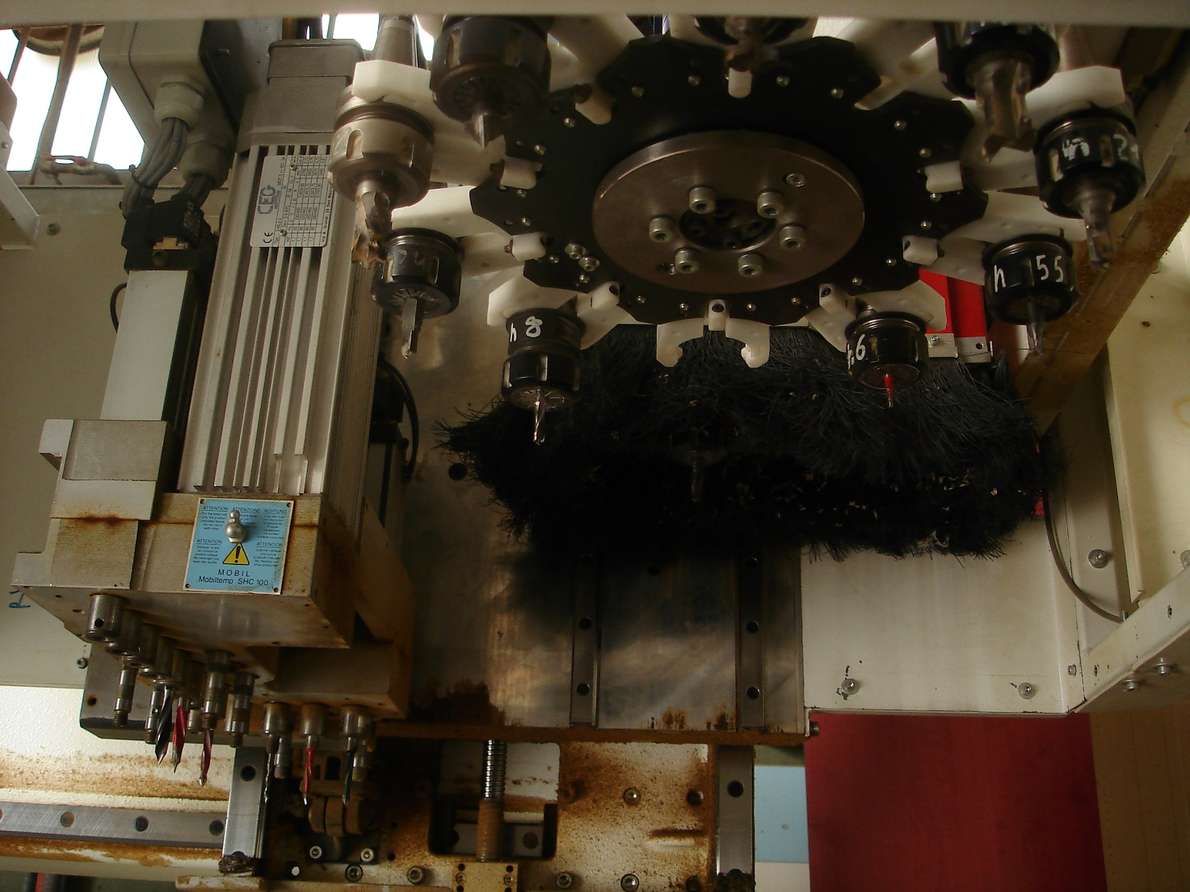
HPL manufacturing @ Teknemika (13)

Slide 17
HPL manufacturing @ Teknemika (14)
4. Execution of the Cut
o Controlled movements: The CNC pantograph, thanks to precision motors and guides, performs movements along the X, Y (and, if necessary, Z) axes exactly following the programmed path.
o Real cut: During cutting, the tool removes the material along the pre-established trajectory, ensuring a clean and precise cut. At this stage, sensors and feedback systems can monitor the process in real time, adjusting parameters as necessary to maintain accuracy.

Slide 18
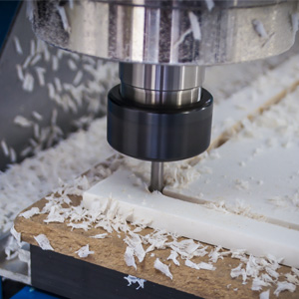
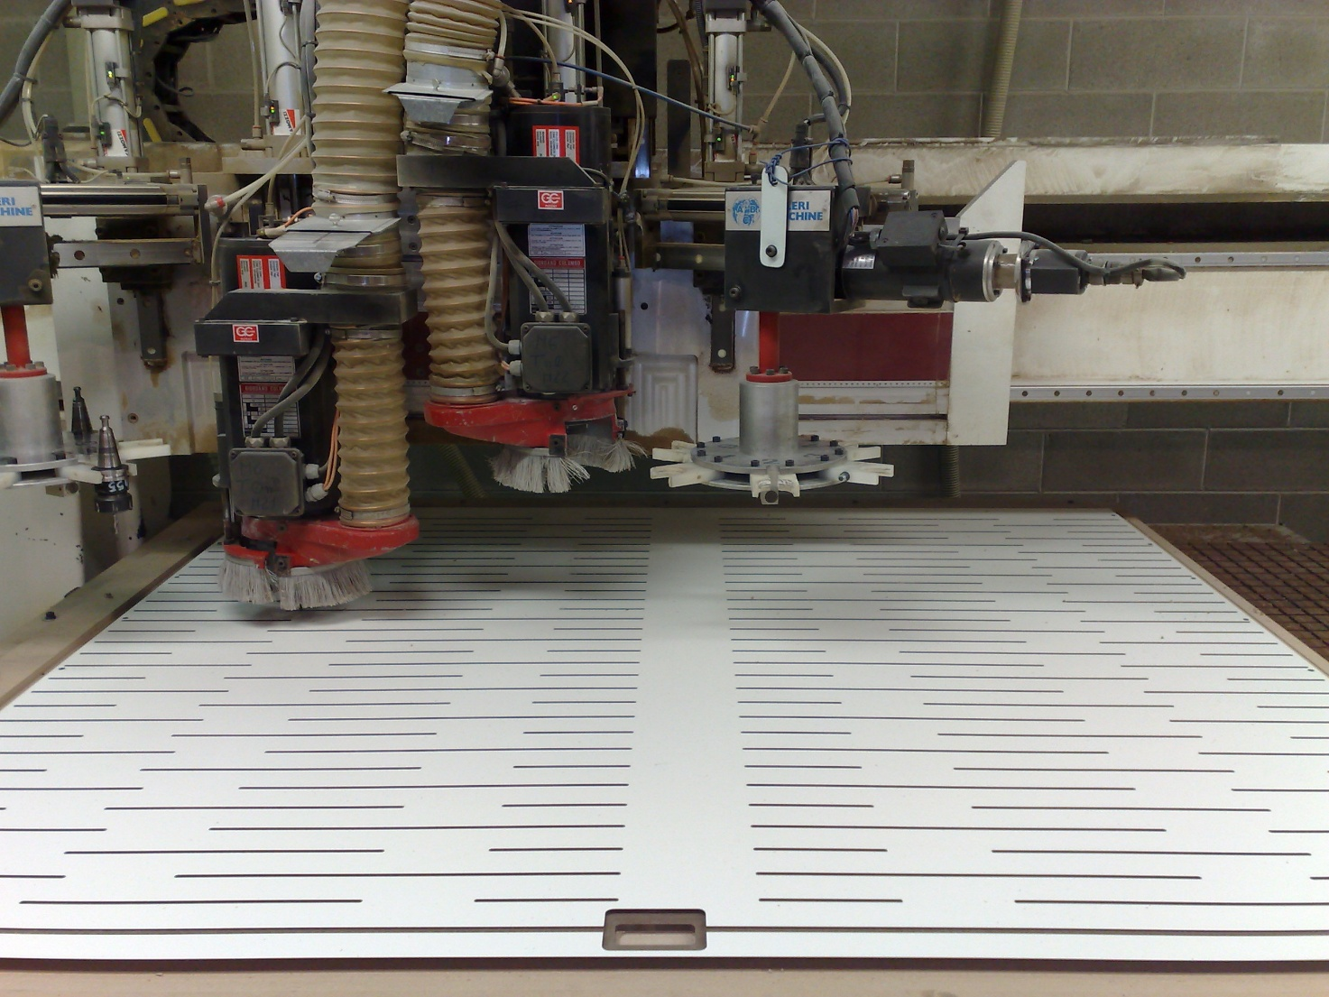
HPL manufacturing @ Teknemika (15)

Slide 19
HPL manufacturing @ Teknemika (16)
5. Quality Control and Finishing
o Immediate verification: Once cutting is completed, the piece is inspected visually or using measuring instruments to verify that tolerances and finishes comply with the required standards.
o Any finishing: If necessary, further processes can be applied to eliminate any imperfections on the edges or to prepare the piece for subsequent phases of assembly or use.
This process, combining the precision of the numerical control with the accuracy of the programming and the stability of the machine, allows us to obtain HPL sheets cut with high precision, reducing waste to a minimum and guaranteeing a high quality of the finished product.

Slide 20
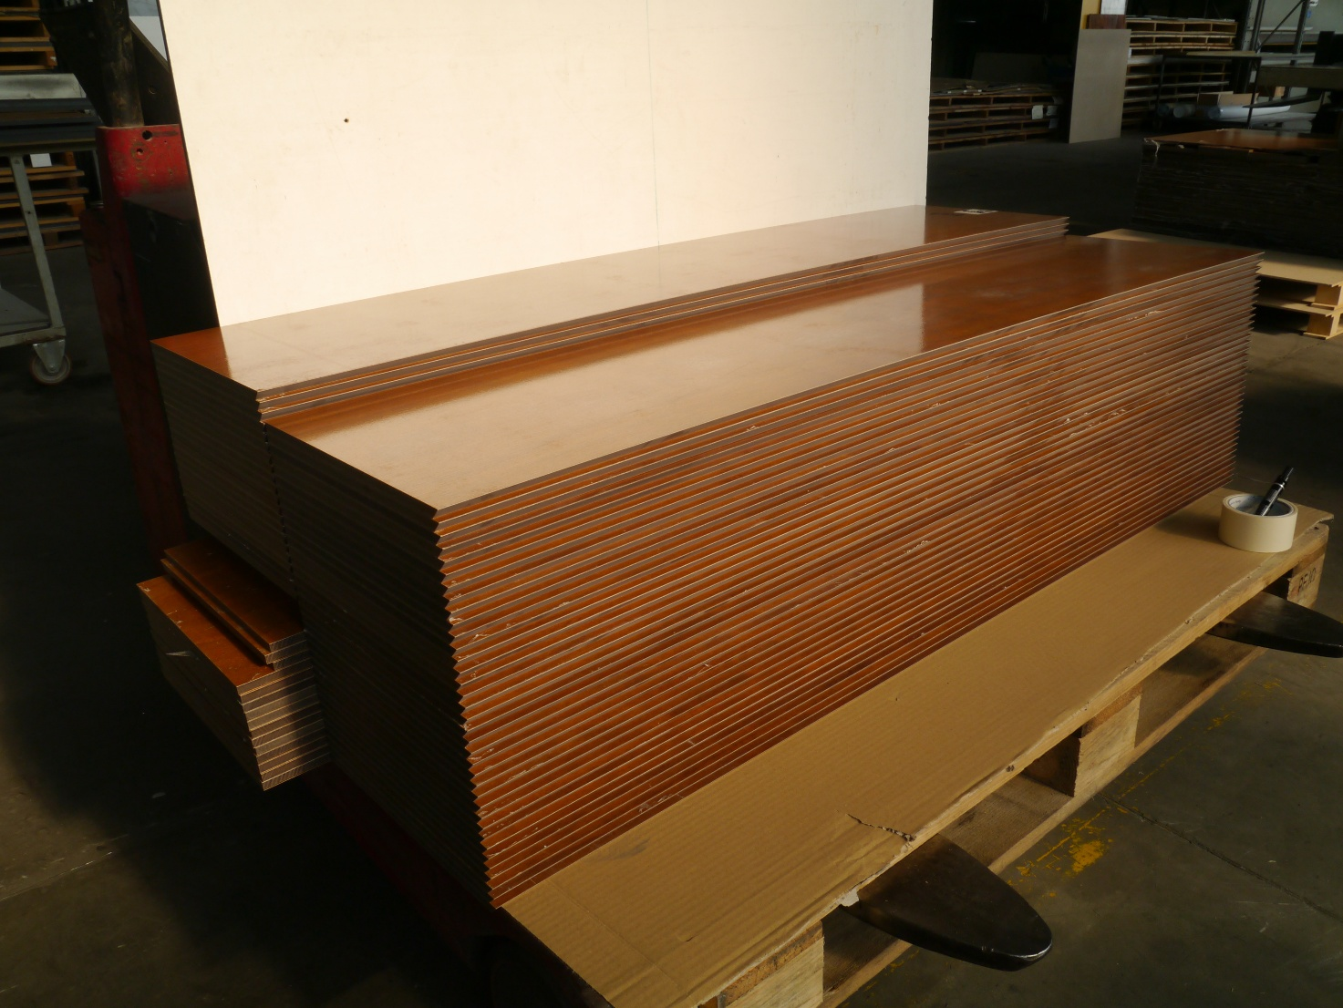
HPL manufacturing @ Teknemika (17)

Slide 21
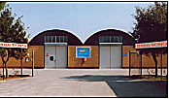

GENERAL TECNICA S.R.L.
General Tecnica S.r.l. is producing solutions and services since 1977 in Monte San Giovanni Campano (FR) Italy on a site of about 11.000 sqm of which 2.500 covered.
ORGANIZATIONAL STRUCTURE
Direction, Finance, Administration, Purchasing and Technical department;
Electrical and electronics workshop;
Mechanical and carpentry workshop;
Shop of varnishing, resin and special coating (epoxy powder, nitro, polyester, levasint, rilsan, Rack-o-plast, Teflon) with facilities for modelling and productions of die;
RPC Division.
Notes:
21

Slide 22
Production
Designing and building customized and dedicated automations to assemble, handle, check and perform functional tests;
Design and implementation of software for Industrial Automation;
Construction of mechanical parts;
Special metal Coating;
Cyclic scheduled or unscheduled maintenance of production facilities;
Resistive Plate Chambers.
Notes:
22

Slide 23
Fields of interest
Automotive;
Electric and electronic components;
Household appliances;
Military components;
R&D.
Notes:
23

Slide 24










customers
Notes:
24

Slide 25
30 Years of collaboration on rpc development
General Tecnica is an INFN industrial partner since 1985
The main purpose of this partnership was the construction of very large detectors that could hardly be carried out inside a research structure
The long collaboration with INFN concerned a number of crucial experiments :
EXPERIMENT | DATE | AREA m²
L3 (LEP) | 1985 | 1000
BaBar | 1992 | 2000
Atlas | 1999 | 7000
CMS | 1999 | 6000
Argo | 1999 | 6000
Alice | 2000 | 800
Opera | 2001 | 3000

Slide 26
RPC standardization (1)
The key element of this wide investment of R&D and serial production was a strong standardization of the RPC structure and materials which however could respect the specific requests of each experiment
  Electrodes of phenolic High Pressure Laminates 1.8-2.0 mm thick
  Electrode resistivity: about 3x10¹⁰ Ohm cm for the collider experiments; about 3x10¹¹ for Cosmic Ray or Underground Experiments
  2 mm gas gap with 100x100 mm² spacers array to kept uniformity over large areas
  Graphite electrodes, shielded by 190 micron PET film, to distribute the field all over the gas volume area
  Inner coating of a very well polymerized linseed oil film

Slide 27
RPC standardization (2)
Pick up strips panels on both gas volume faces (in most cases) with orthogonal strips for a 3D hit reconstruction. Only exception CMS with a single strip layer sandwiched between two gas volumes
Mechanical support panels, up to 5.5 m long, to fully preserve the stiffness and planarity of each chamber
Definition of adequate Quality Control tests to insure the integrity and functionality of each detector element
Specific QC tests defined and agreed with each experiments in case of special requests

Slide 28
Production facilities (1)
For the serial production a number of dedicated facilities were developed
  Graphite spraying machine
  Two hot melt coating machines to glue the PET film over the graphite electrode
  Spacers gluing machine with up to 12 chamber metering valves with high precision and exact repeatability of the dispensed volume
  Hot melt sealing system
  Strips milling machine
Notes:
28

Slide 29
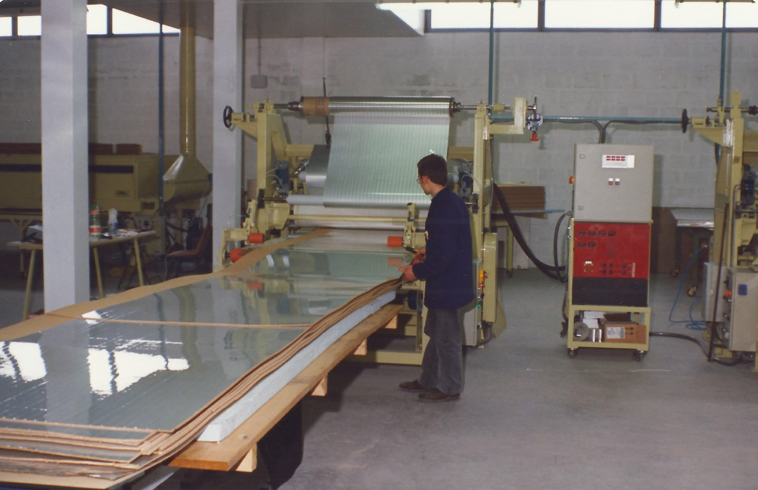
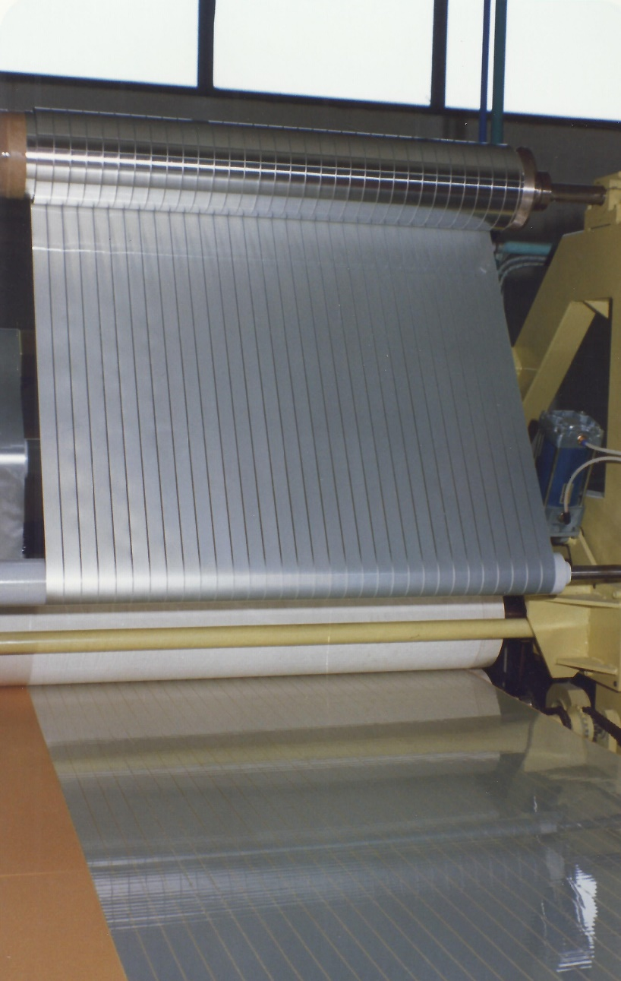
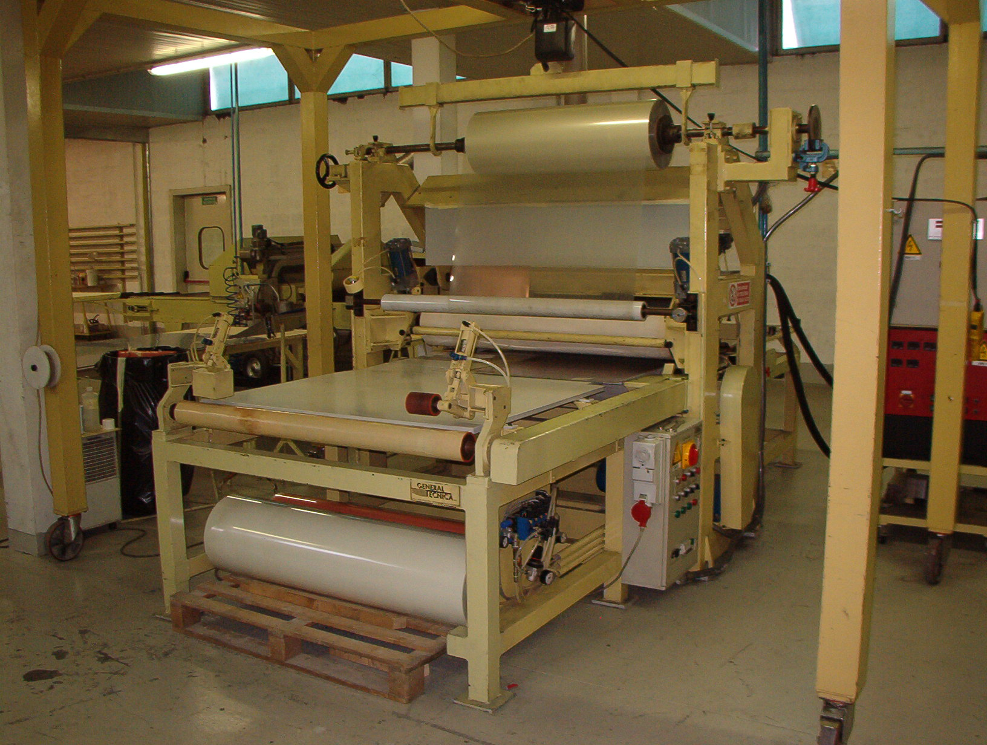
Production facilities (2)
Hot melt machine
Notes:
29

Slide 30
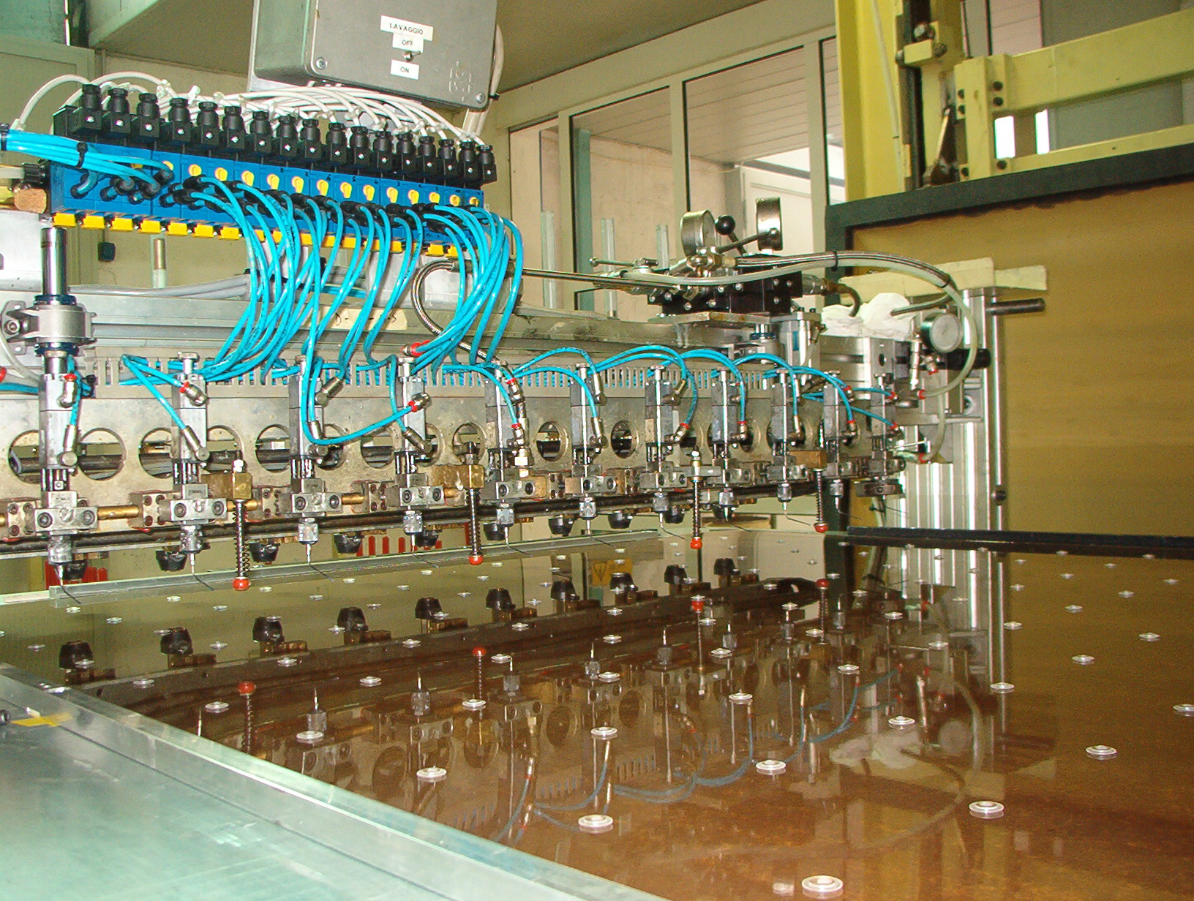
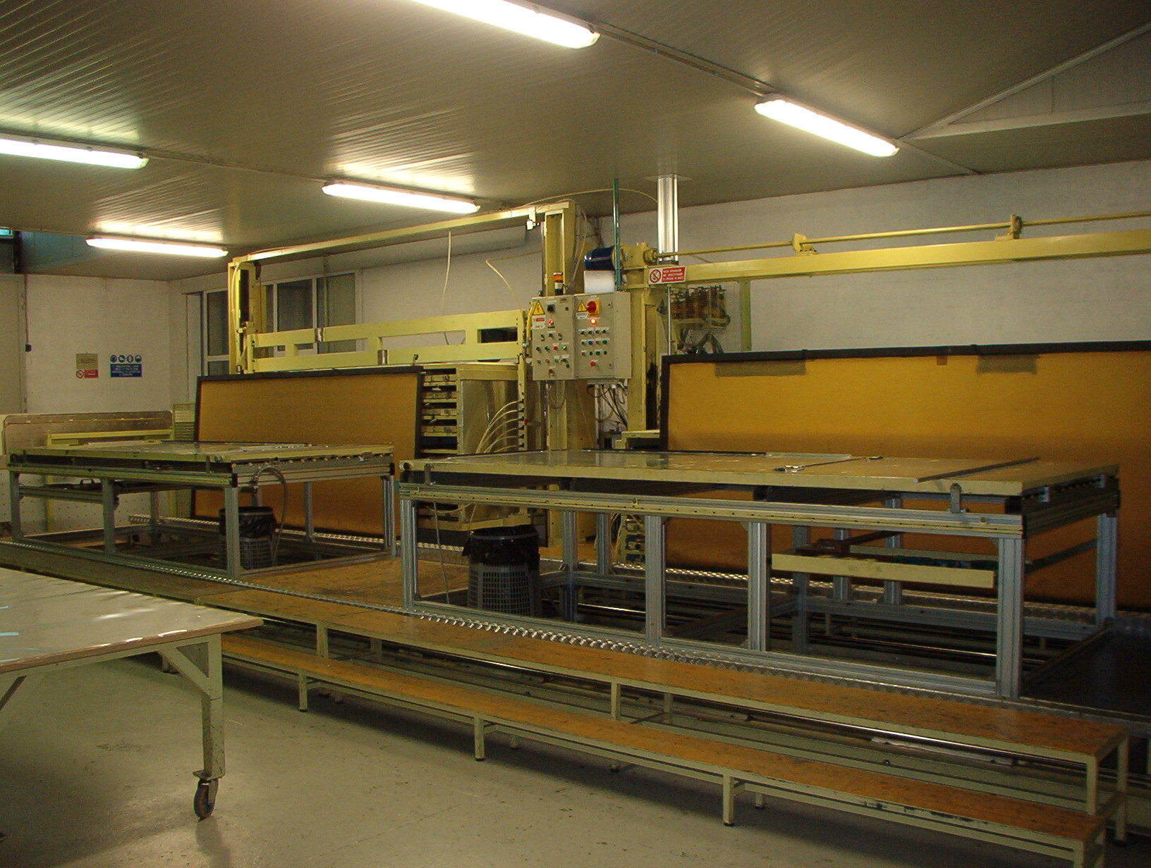
Production facilities (3)
Gluing spacers machine
Notes:
30

Slide 31
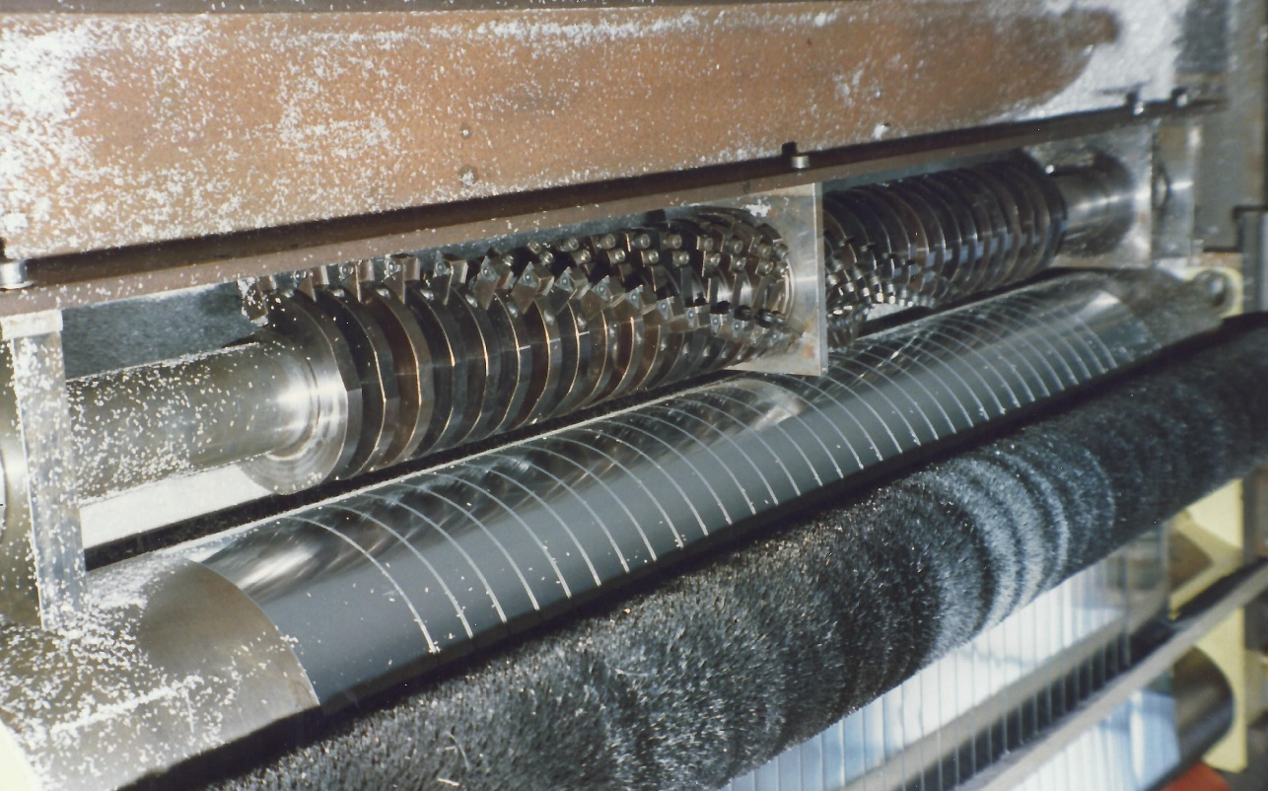
Production facilities (5)
Strips milling machine
Notes:
31

Slide 32
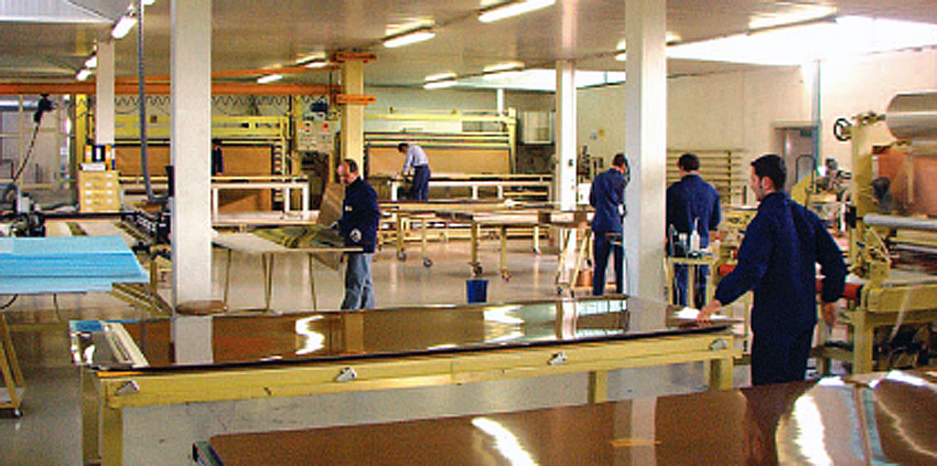
Production rate
The maximum production rate of 18 gas volumes/day , about 36 m²/day, was reached in 2001 when all the LHC detectors (Alice Trigger; Atlas and CMS) in addition to Argo and Opera were built in parallel
The QC tests followed punctually the serial production
Notes:
32

Slide 33
QC tests (1)
Tests carried out on the materials
  Resistivity measurement
  Check on the spacer thickness
  Check on the plate surface for spacer gluing
Tests carried out on the gas volumes
  Gas leaks
  Spacer integrity
  Dark current measurement

Slide 34
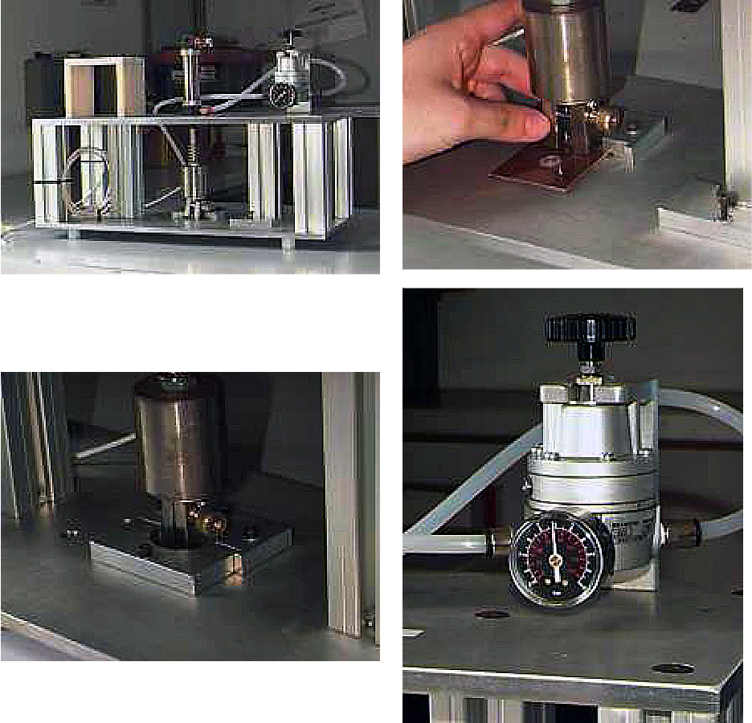
Qc tests (3)
Test to measure the gluing strength
Notes:
.

Slide 35
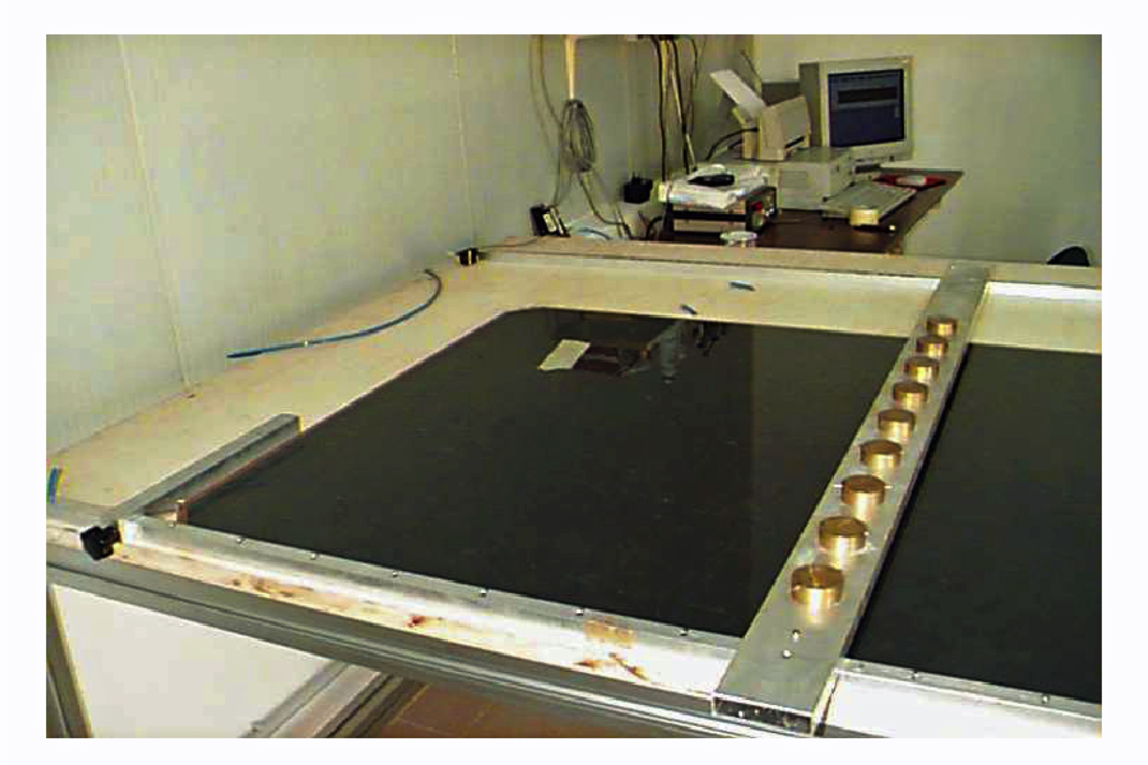
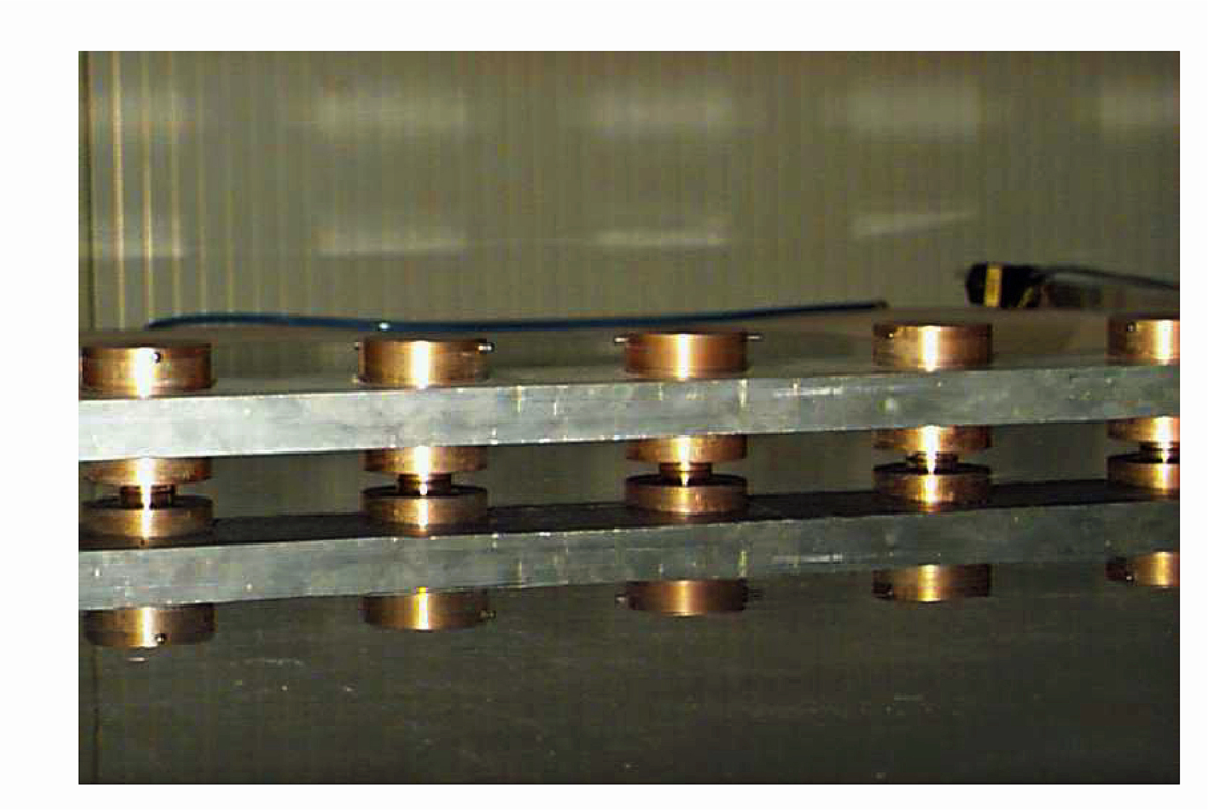
Qc tests (2)
Spacer integrity

Slide 36
Present activity
General Tecnica carried out a relevant activity of Research and Development in order to improve the RPC performance
The purpose was to fulfill the requirements of future accelerator and Cosmic Ray experiments with particular emphasis to the LHC detector upgrade: HL-LHC
This R&D concerned
  The search for new materials, particularly for the resistive electrodes but also for all other detector elements
  The gas gap size
  The electrode thickness
  The improvement of the gas distribution inside the gap
  The improvement of the gas inlets
Currently, the manufacturing of the gas volumes for the upgrade of the RPC system of the ATLAS experiment at CERN is in progress.

Slide 37
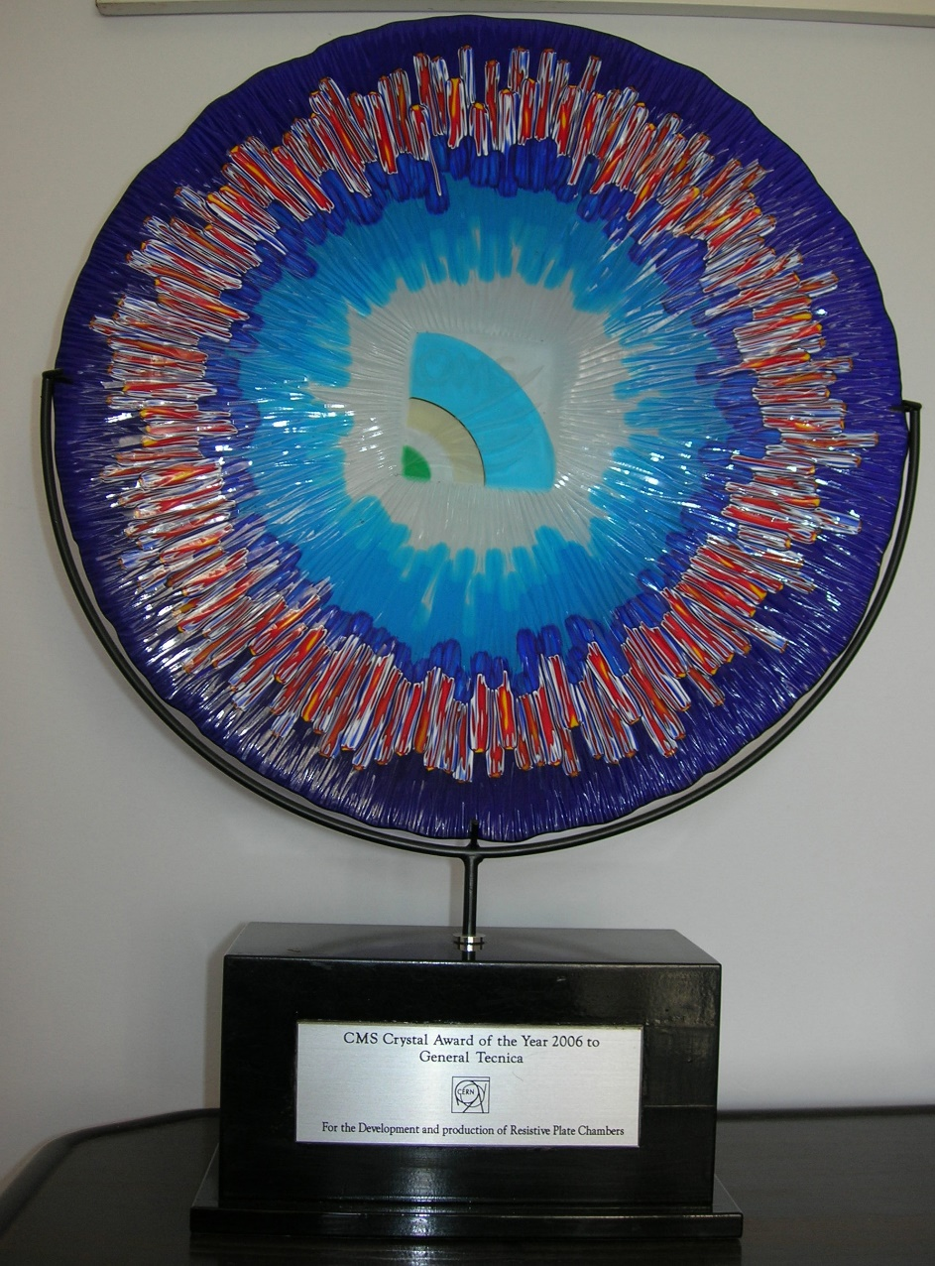
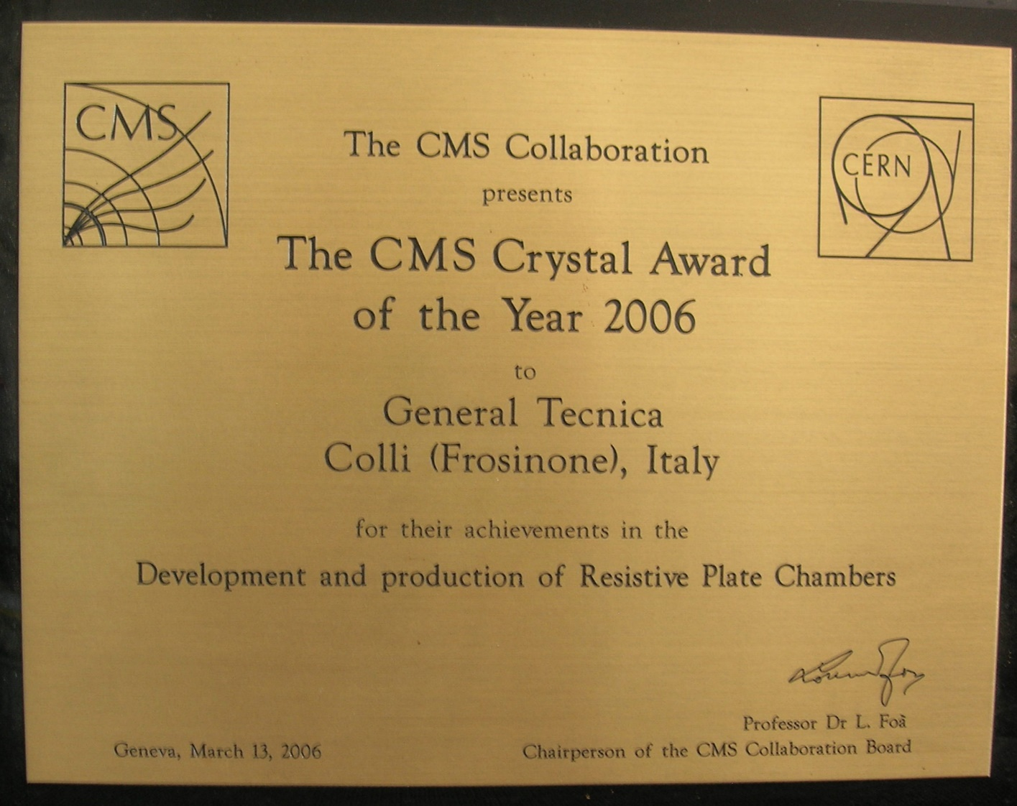
Awards (1)

Slide 38
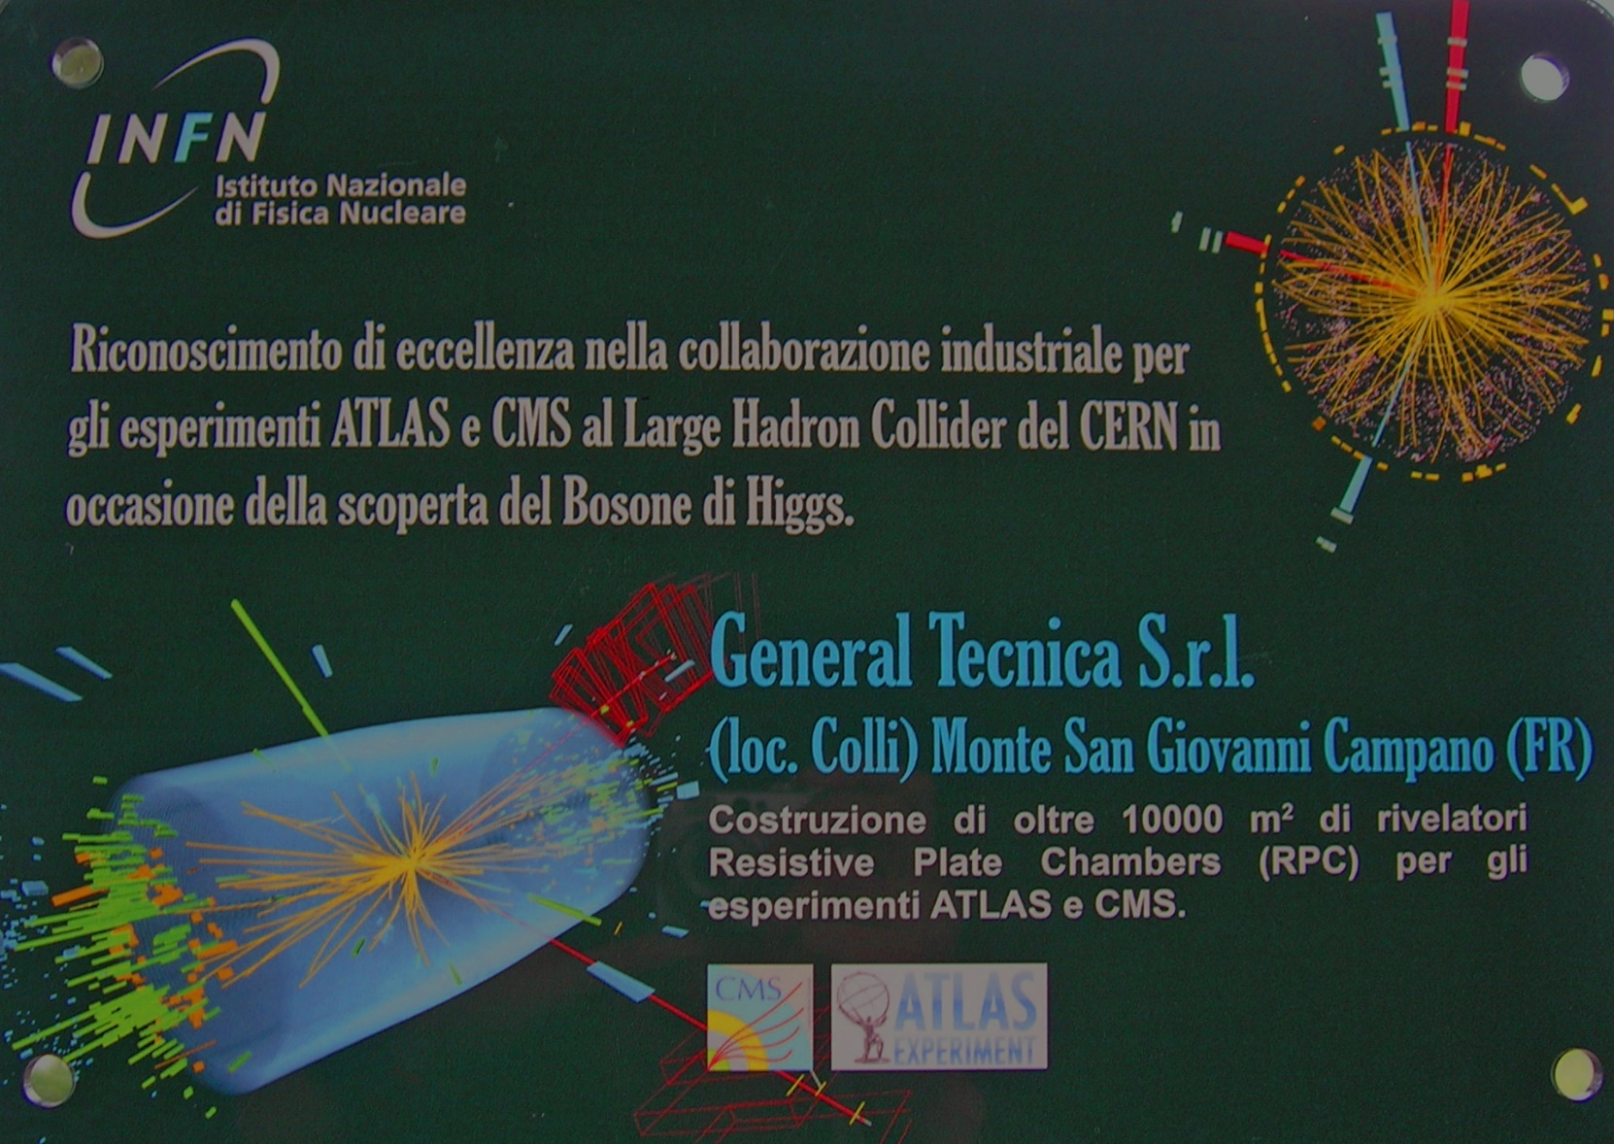
Awards (2)

