Slide 1

Status of RPC Facilities in Korea
Kyong Sei Lee (Korea University)
Minho Kang, Taejeong Kim, and Youngmin Jo (Hanyang University)
Giuseppe Iaselli, Dayron Ramos Lopez, Gabriella Pugliese, (Polytechnic of Bari)

Slide 2
Facilities and human resources for RPC production at KODEL will be preserved after the upgrade of CMS RPCs
Human resources for gas gap production, QC tests, and detector assembly
1 Ph.D (retired) + 2 Technicians (Hanyang University)
2. Facilities of phenolic and glass RPCs (WG6 of DRD1)
New lab for detector production and tests at Korea Basic Science Institute (KBSI), Korea University
Preparation of new lab for detector test at Dept. of Physics, Hanyang University
All RPC facilities will be transferred to Institute of Basic Science (IBS) in future
3. Utilizing dedicated facilities of company nearby Seoul for some processes (since 2020)
Washing electrode: Damia @Goyang city
Graphite coating: Damia @Goyang city
Insulator coating (PET): Yurim @Goyang city
So, the human resources and facilities are available for various R&Ds and detector productions for future experiments

Slide 3
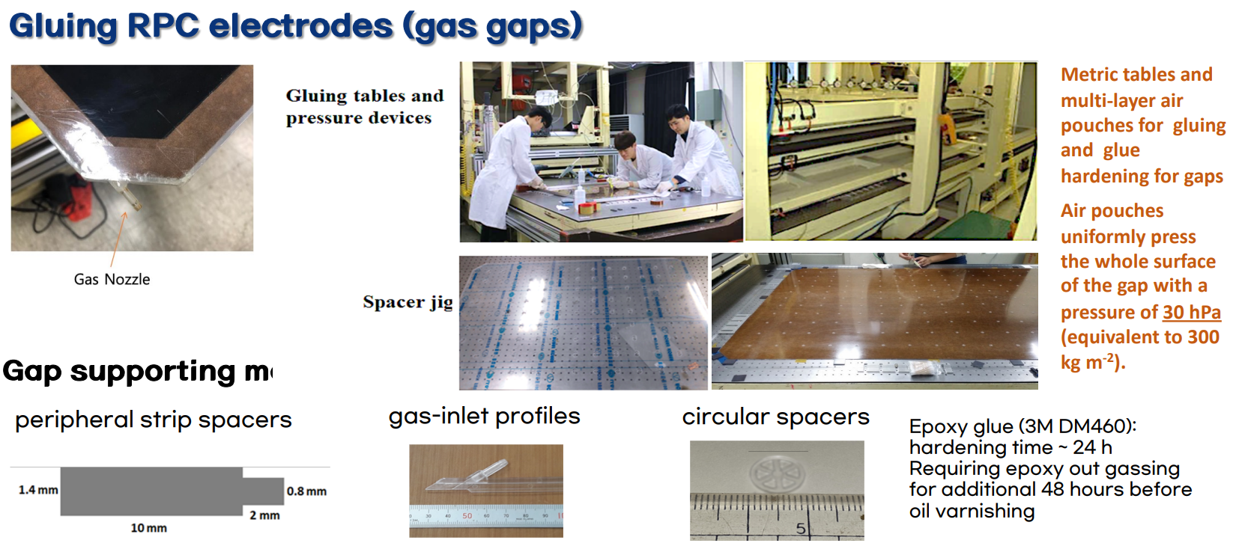
Detector production and test facilities for the CMS Endcap RPCs
at KBSI, Korea University
Gap supporting materials (molding)

Slide 4
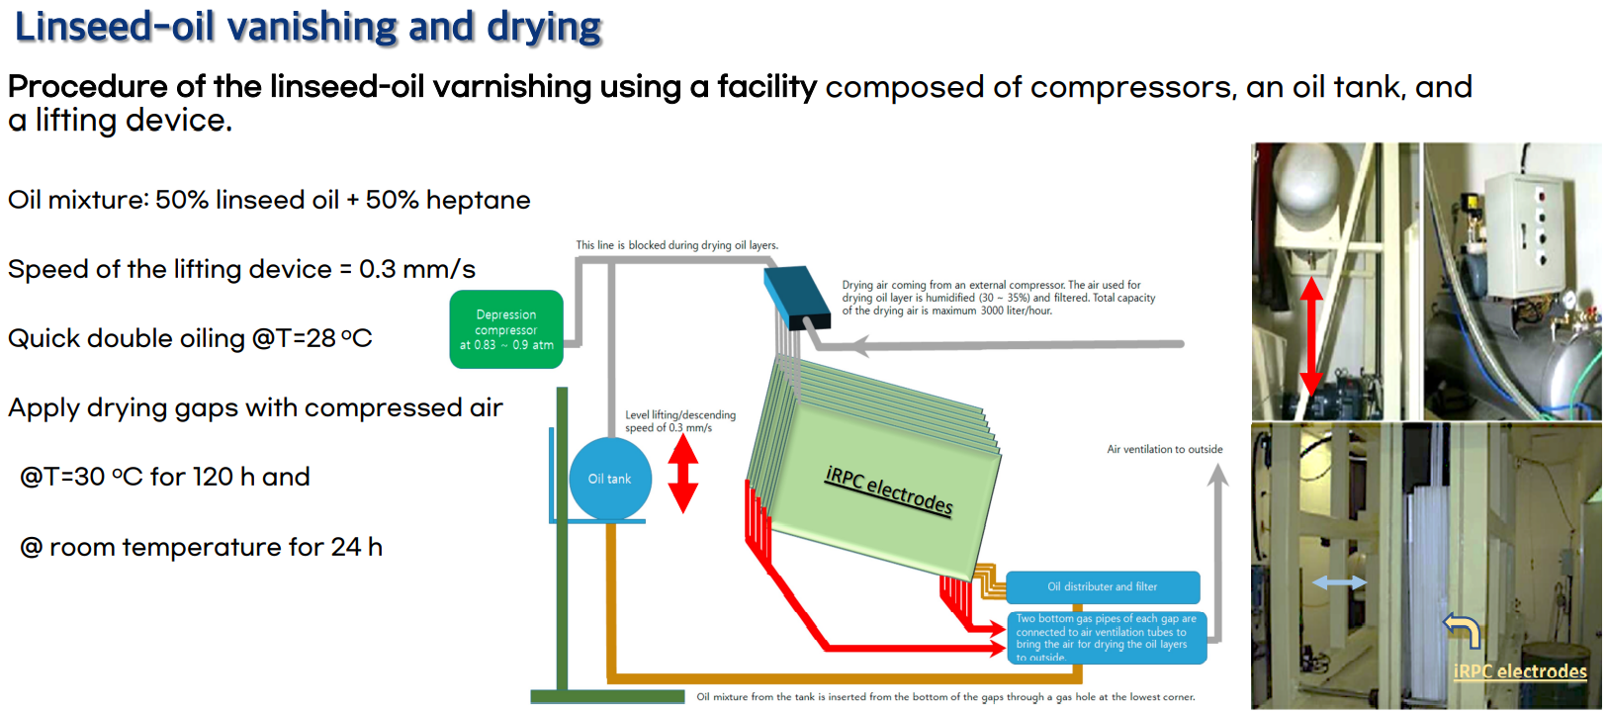
Detector production and test facilities for the CMS Endcap RPCs
at KBSI, Korea University

Slide 5
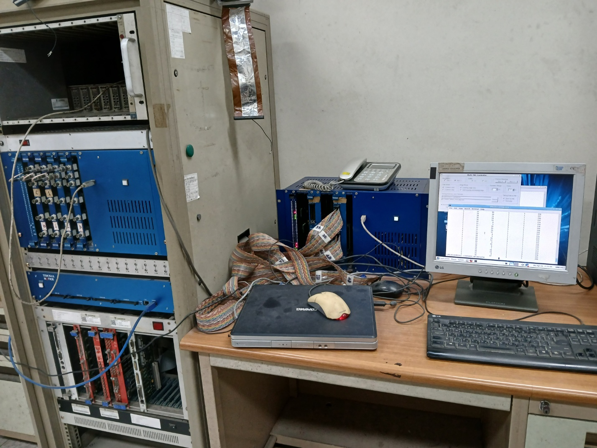
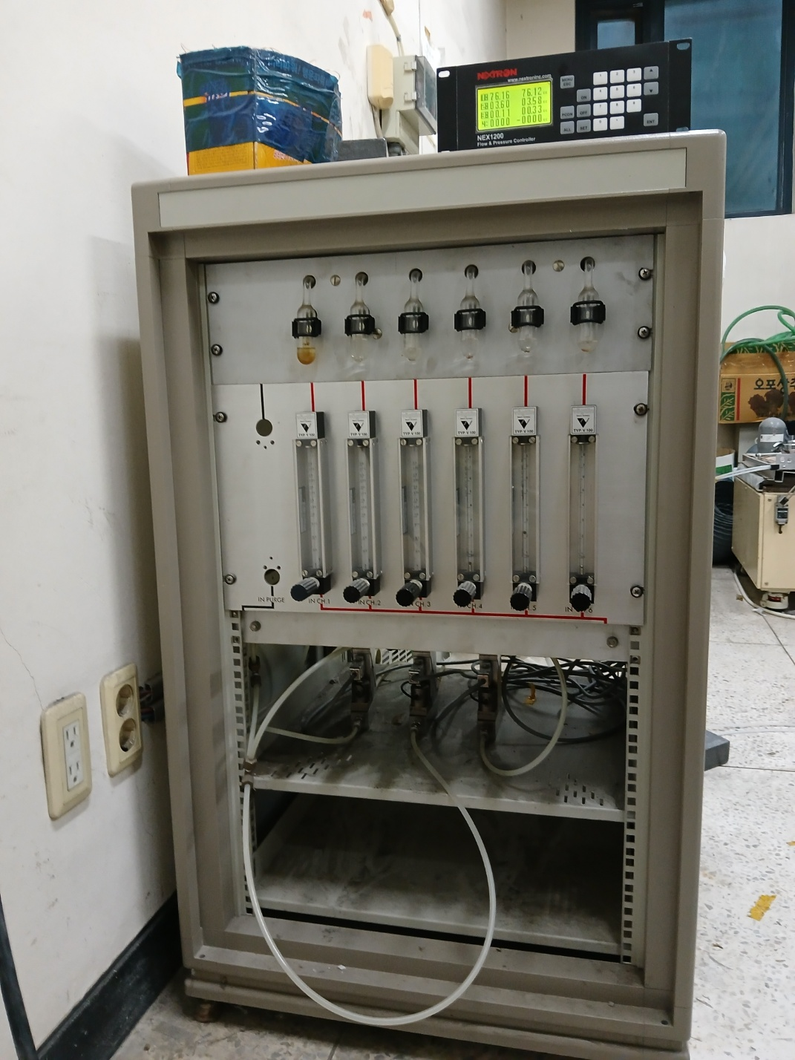
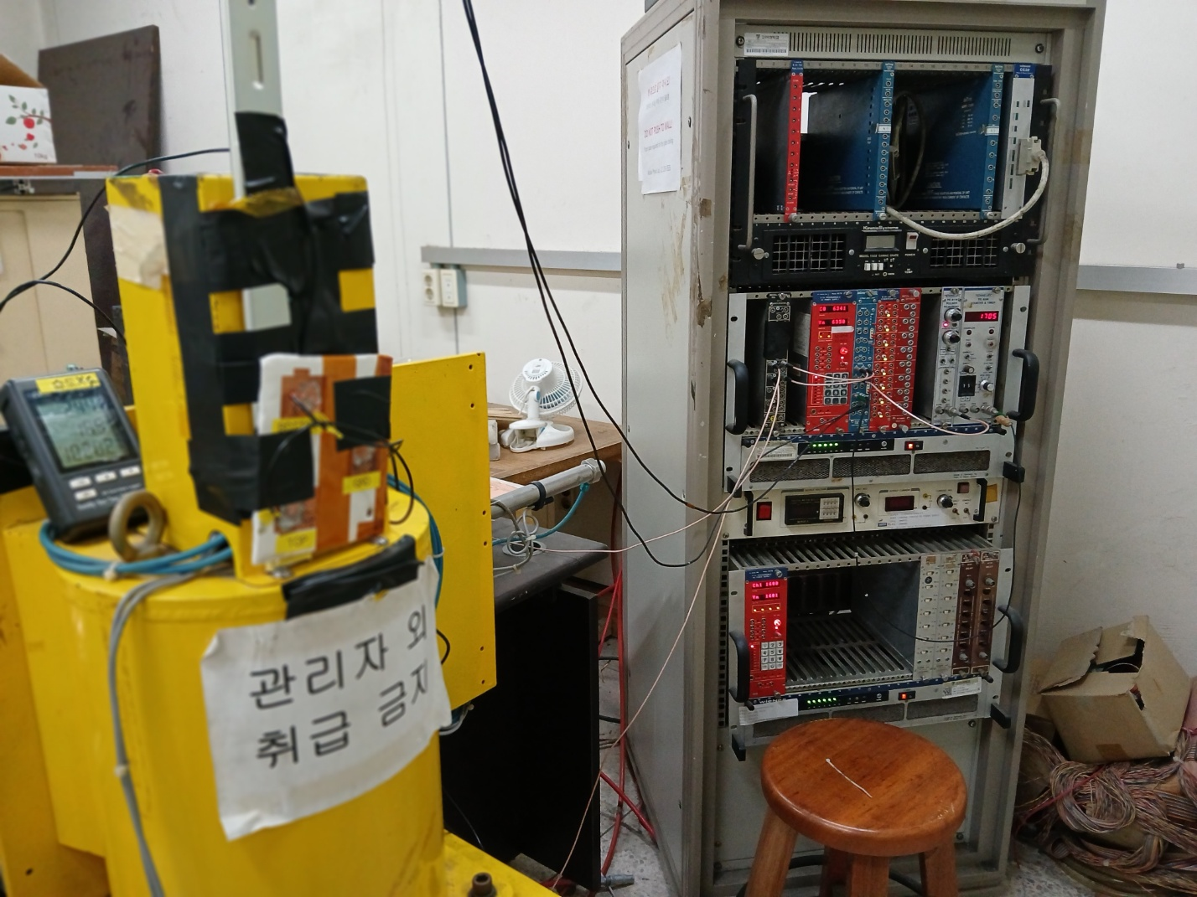
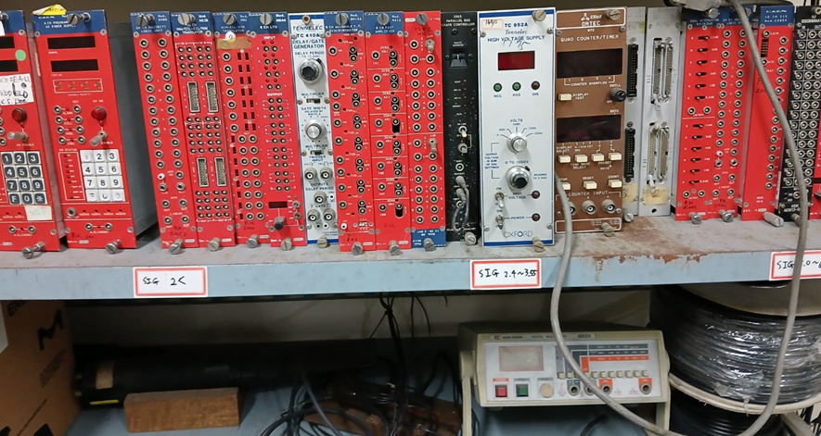
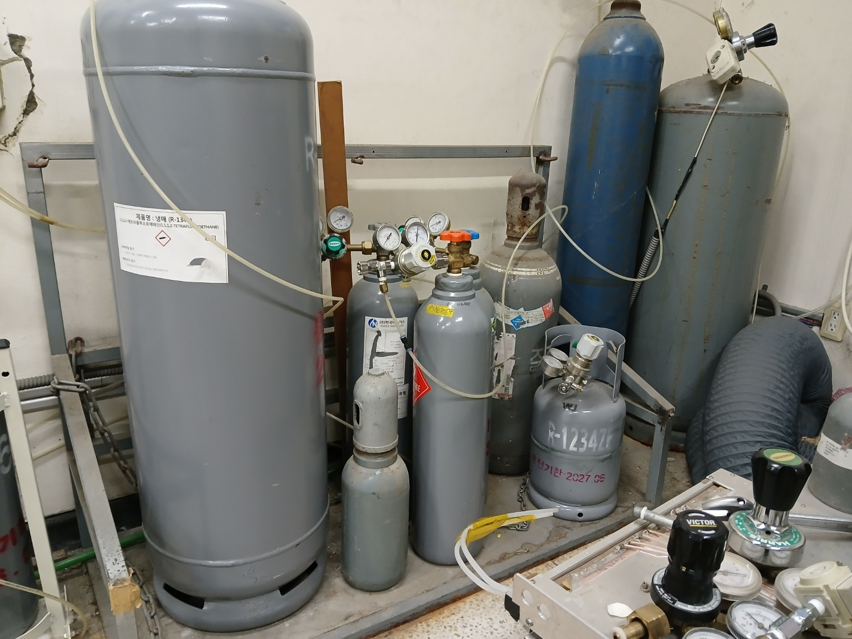
Preparation of new place for detector production at Korea Basic Science Institute (KBSI), Korea University + Test lab at Asan Science building
For construction and test of HPL and glass multi-gap RPCs
Test lab at Asan Science building
No picture yet.
Gap production tools are currently being rearranged at the KBSI place
Space @KBSI ~ 70 m²

Slide 6
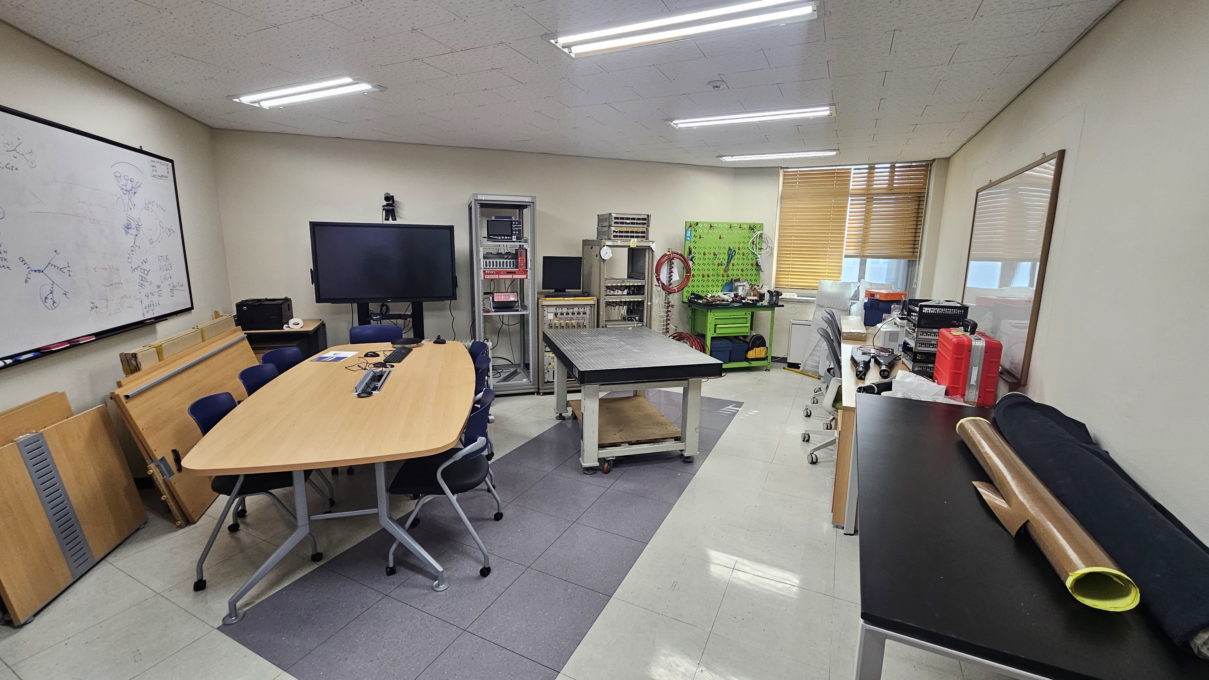
Preparation of a new lab for detector test at Dept. of Physics, Hanyang University
For construction and test of glass multi-gap RPCs
Space for test lab.~ 25 m²

Slide 7
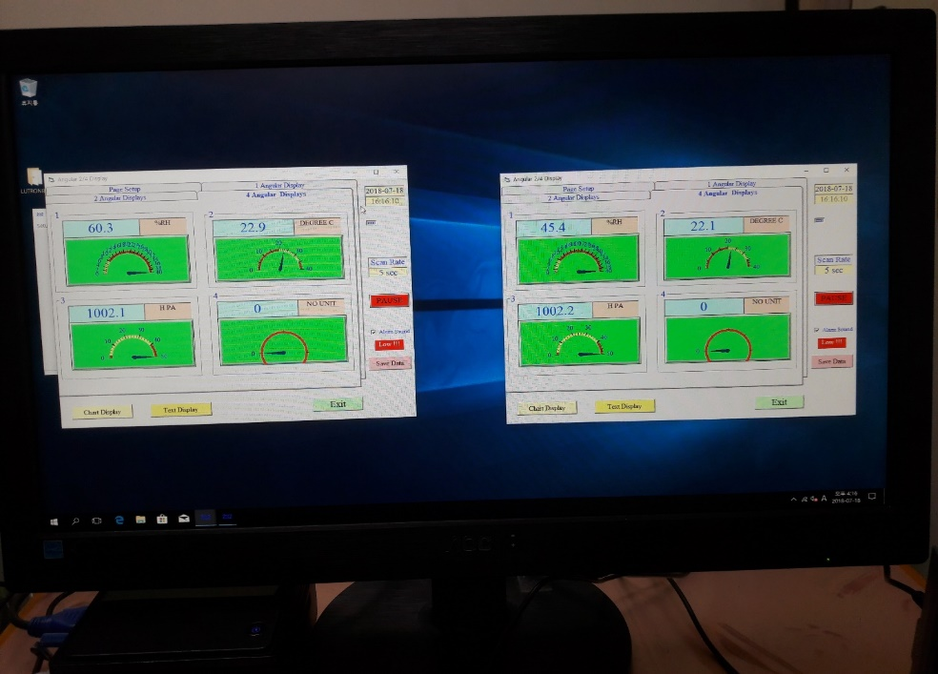
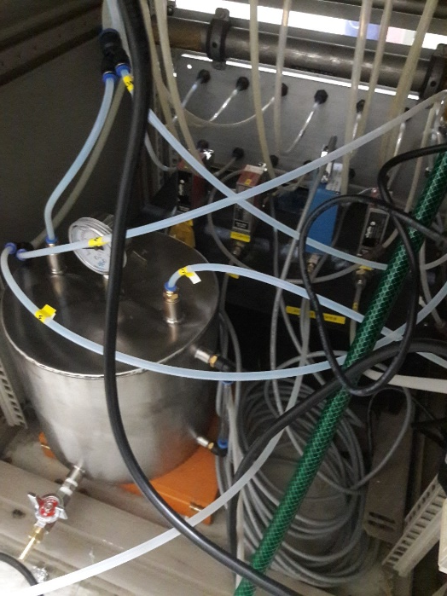
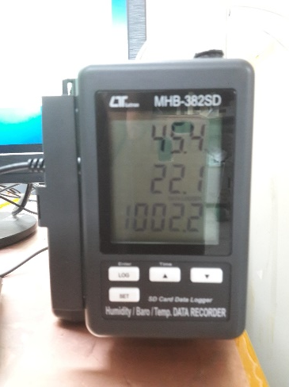
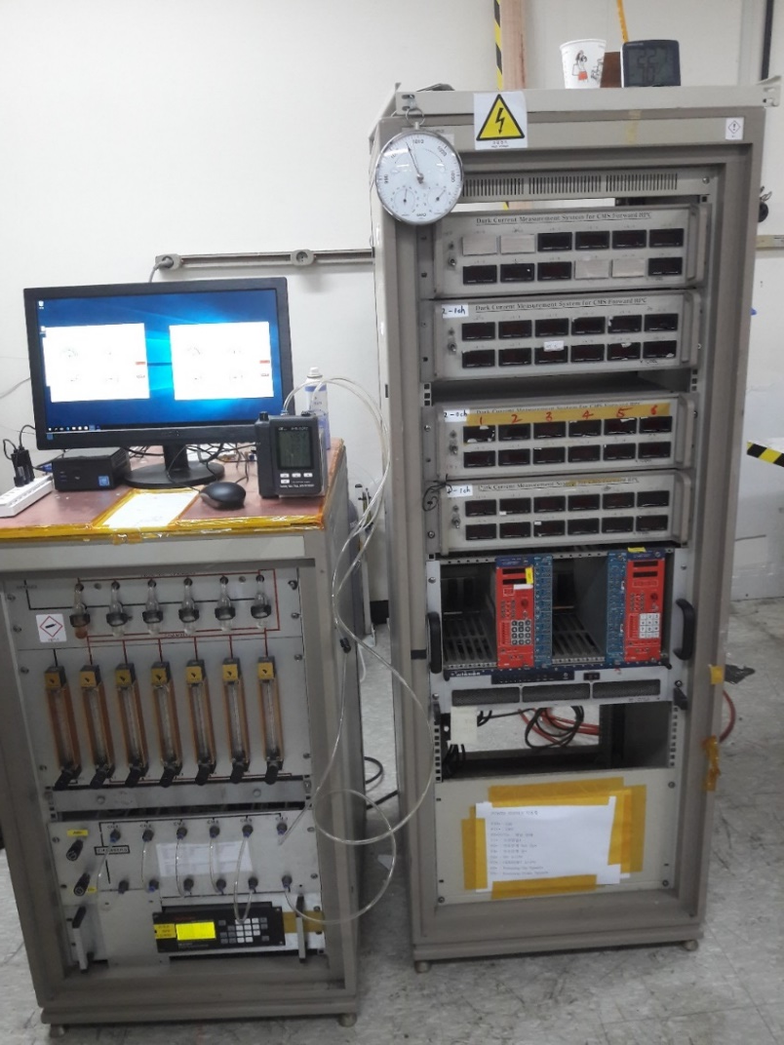
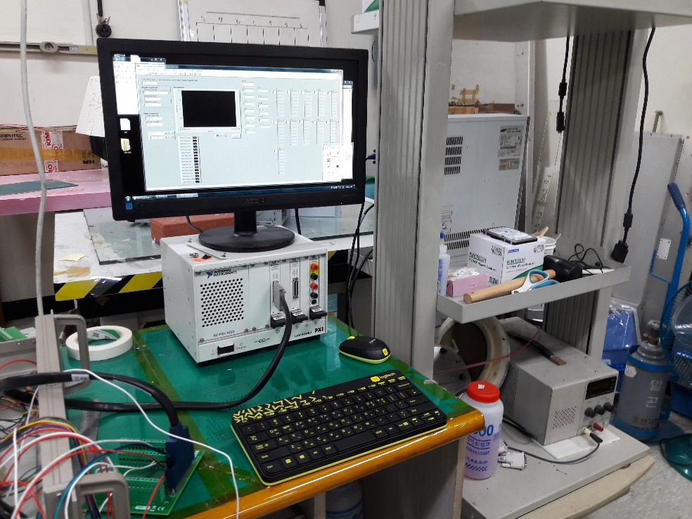
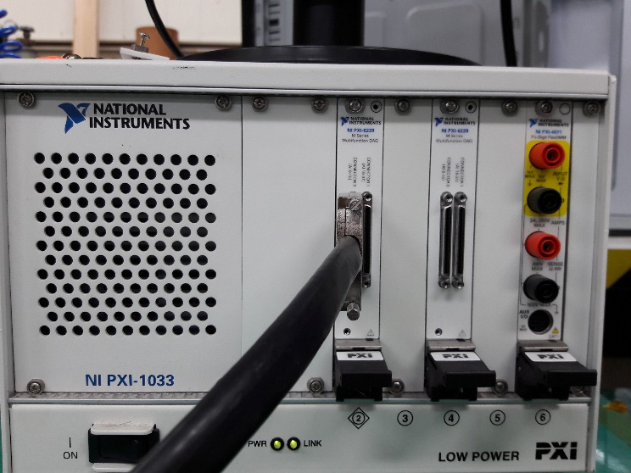
Test facilities for gaps
at Hanyang
For ambient
For test gas
Humidifier water tank
# of gaps in a single test batch: 24
Six gas channels
Gas rate: max 25 l/h
Gas
Monitoring P & T
Two 16 ch ADCs to read HVs and currents of gaps (National Instrument PXI-6229)
Monitoring HVs and currents

Slide 8
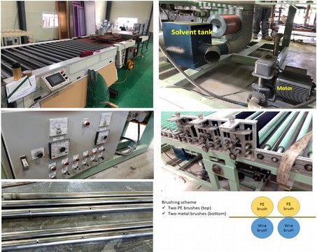
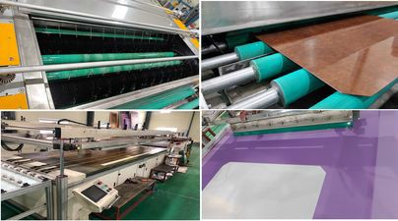
Damia Company at Goyang city for washing and graphite coating on HPL electrodes (resistive plates)
Outsourcing
Washing HPL surface with MEK to improve spacer bonding and oil adhesiveness
Graphite coating & inspection and measurement of
surface resistivity
100 kOhm/□ (RPCs) → 450 kOhm/□ (iRPCs)
3. Final visual inspection for HPL panels
Graphite coating
Washing
M A Shah, P2UG 20 Oct. 2021

Slide 9
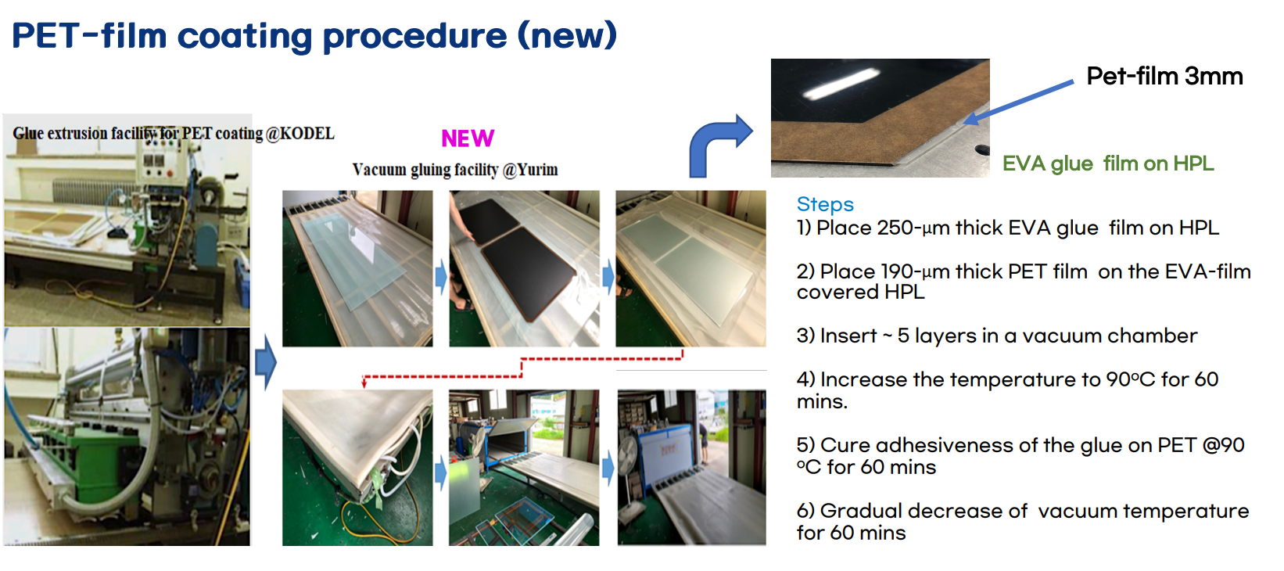
Outsourcing
Yurim Company at Goyang city for insulator coating on HPL electrodes

Slide 10

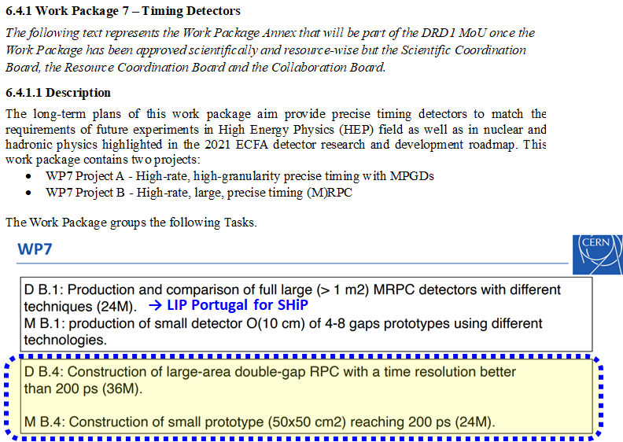
For R&D of thin double gap and multi-gap RPCs

Slide 11

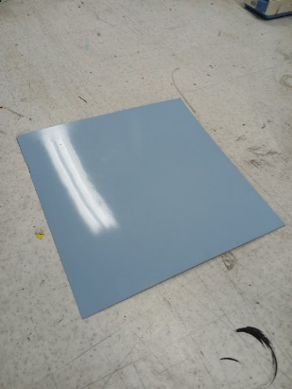
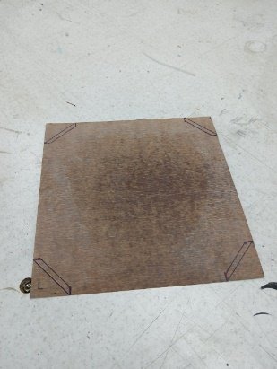
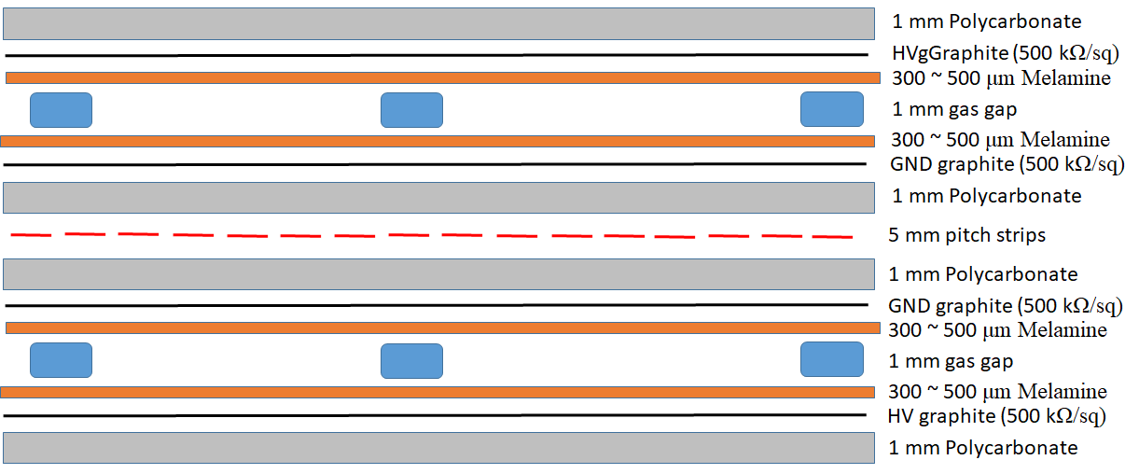
1. New melamine electrodes for high rate capability and more stable operation (ATLAS-like)
New HPL electrode material (0.2 mm melamine + 0.3 mm phenol):
Thinner gas gap volumes to achieve a better time resolution (~ 300 ps)
2 mm thick gas volume RPCs
→ 1 mm thick gas volume RPCs (0.5 mm?)
Thinner RPC electrode also looking for enhancement of rate capability
But, actually, the rate capability more depends on ρ and FEE sensitivity.
Thick melamine skin is better for aging.
Oil varnishing required for low noise and better longevity (aging)
Thin melamine + PC → better stiffness and then uniformity of gas gaps
ρ: resistivity of RPC electrodes
d: thickness of RPC electrodes
Thin melamine sheets (ρ ~ 1.5 ⅹ 10¹¹ Ω cm) and polycarbonate sheet to support the gas gaps
300 ~ 500 μm thick Melamine
+ Phenol
Glued to be one piece
Graphite coating on
a PC plate
0.5 mm or 1 mm thick Polycarbonate

Slide 12
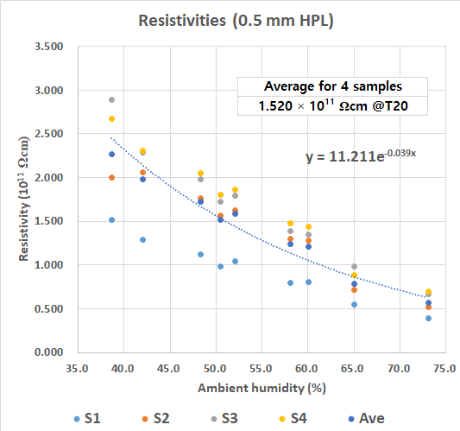
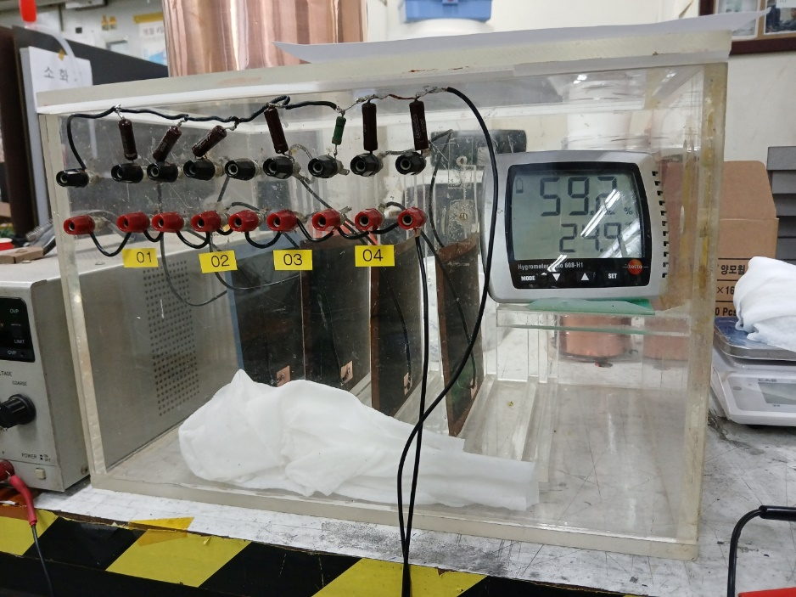
What else achievable with the electrodes composed of melamine + PC ?
Higher rigidity of the RPC electrodes made of thin melamine and PC
Enables to achieve thinner gas-gap RPCs for better time resolution:
2 or 1.4 mm gas-volume RPCs → 1 mm (or 0.5 mm) gas volume RPCs
The detector production becomes simpler due to use of PC plates.
No PET insulator coating (PC itself insulator)
No EVA shielding for preventing current leak along gap periphery
Resistivity of 500 μm-thick melamine
~ 1.5 × 10¹¹ Ωcm @T = 20 ºC and H=50%
Resistivities corrected for T=20ºC

Slide 13
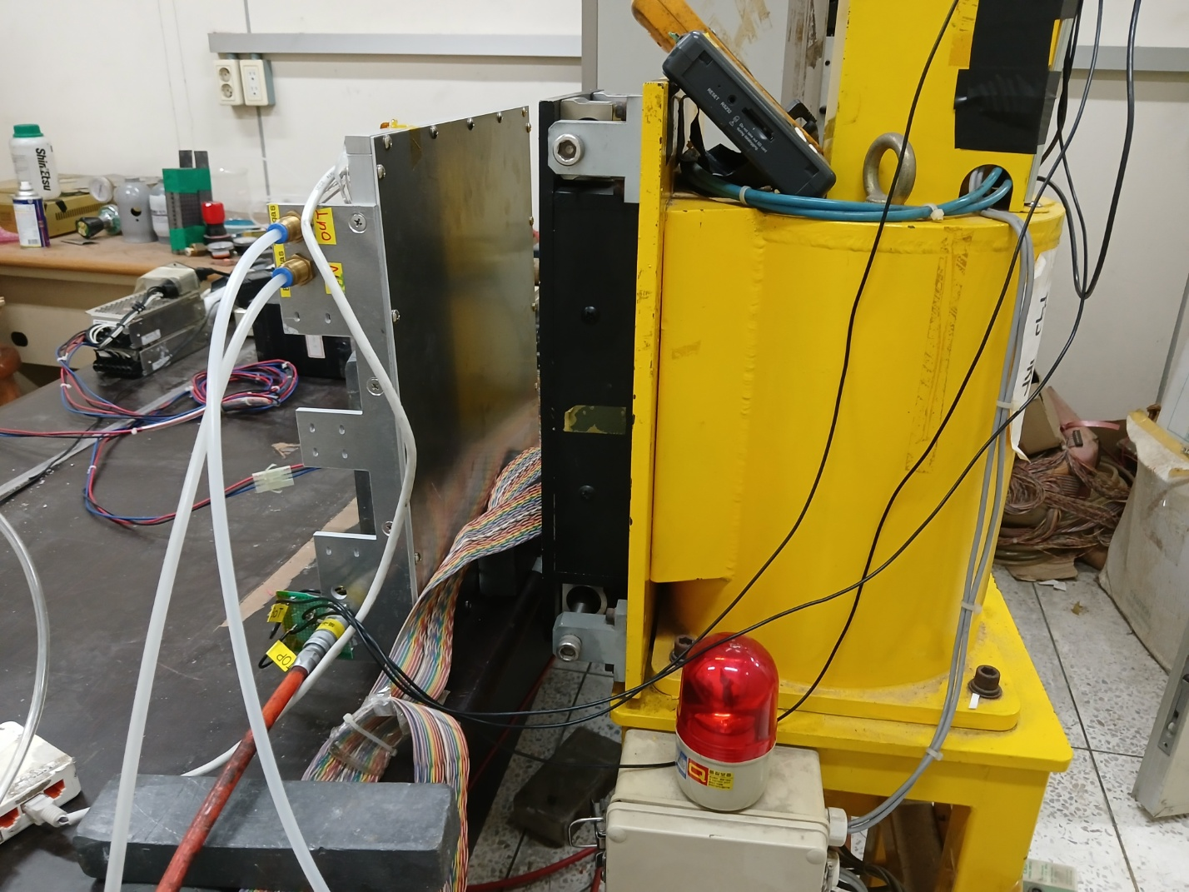
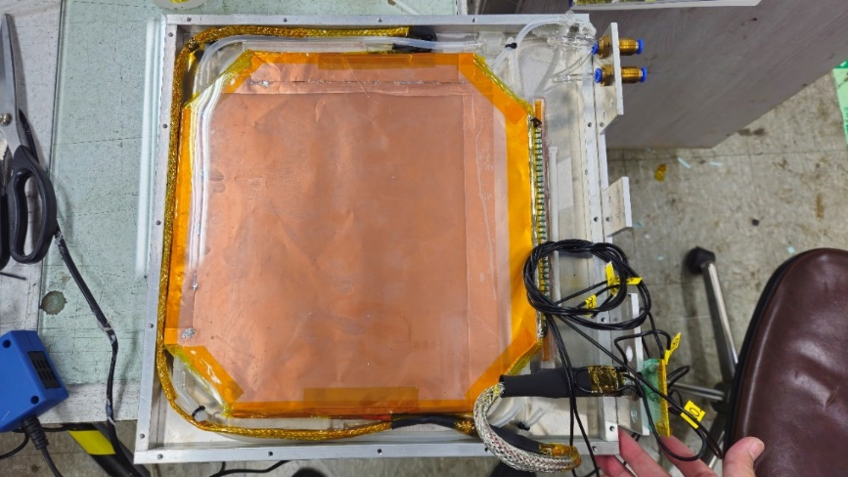
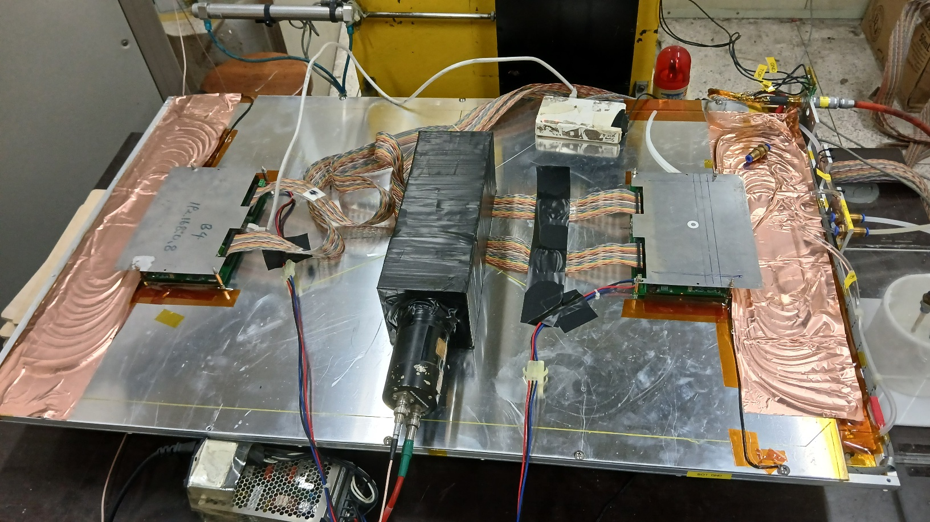
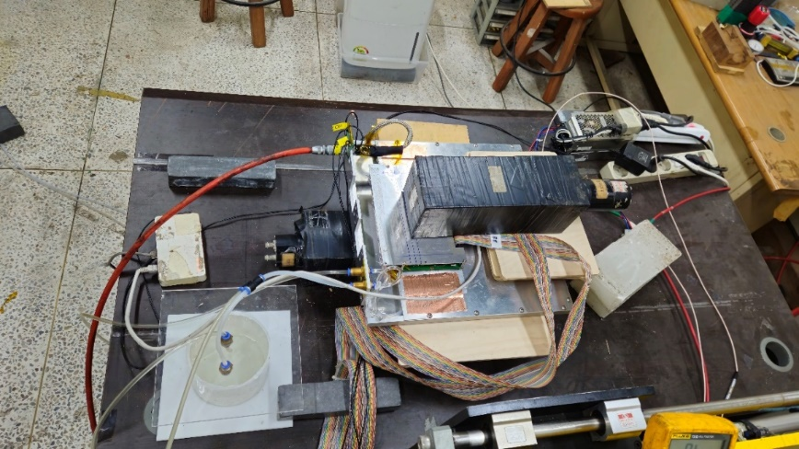
Small 1-mm thick gas-volume double-gap RPC made of 500 μm-thick melamine sheets
Active area of the detectors: 26.4 x 26.4 cm² and 1.0 x 0.56 m²
Strip pitches
5 mm to address ~ 2 mm position resolution
10 ~ 20 mm for typical RPC triggers
Surface resistivity of graphite ~ 400 kΩ/sq
Absence of good front-end-electronics with a time resolution ~ 50 ps
→ Unable to check the time characteristics of the detectors
½ sized prototype RPC (active = 1.0 m x 0.56 m)
Small prototype RPC (active = 0.26 m x 0.26 m)

Slide 14
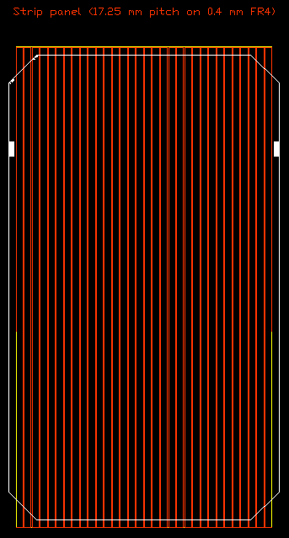
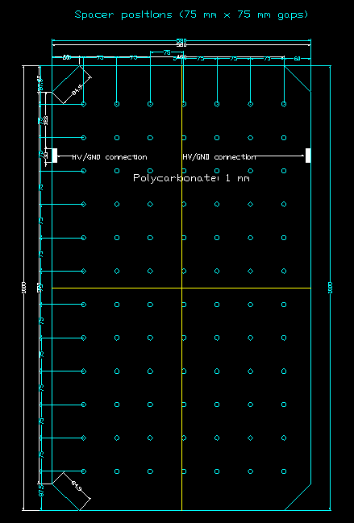
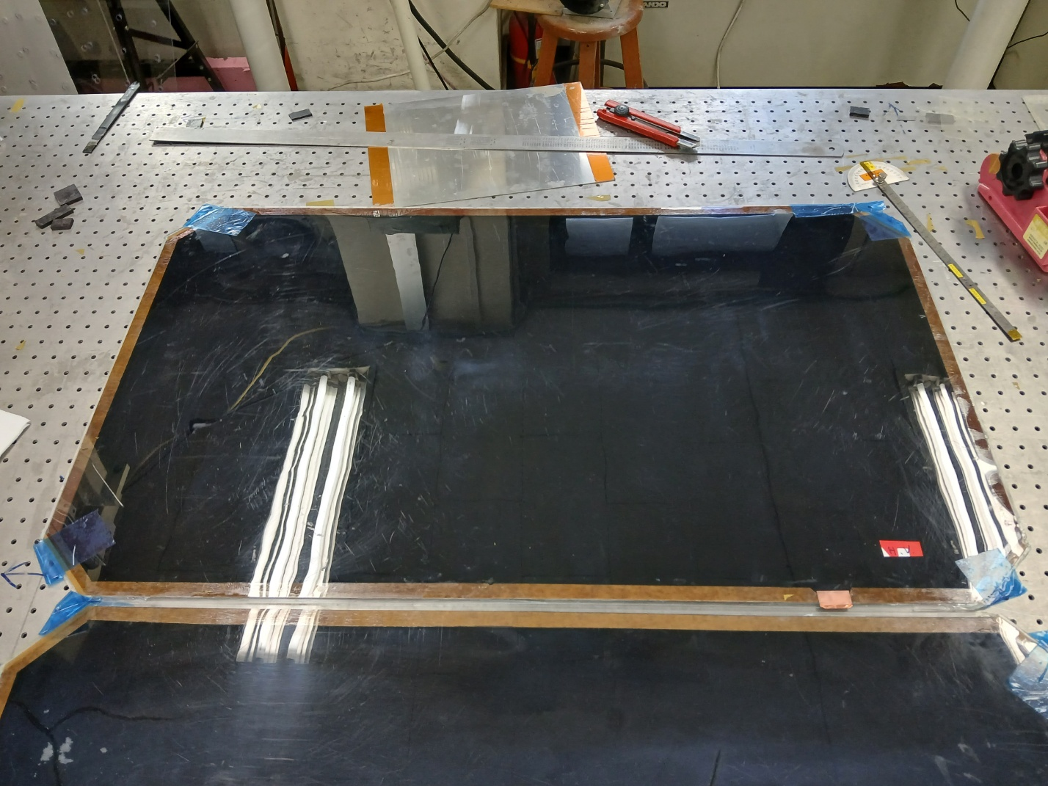
½ sized prototype RPC (active = 1.0 m x 0.56 m)
Thickness of melamined HPL = 0.52 mm
Single-gap thickness = 4.3 mm
Total thickness of two-gaps + strip panel +
copper grounds + PETs = 10.0 mm
Strip pitch = 20 mm
Spacer spacing = 75 mm x 75 mm

Slide 15
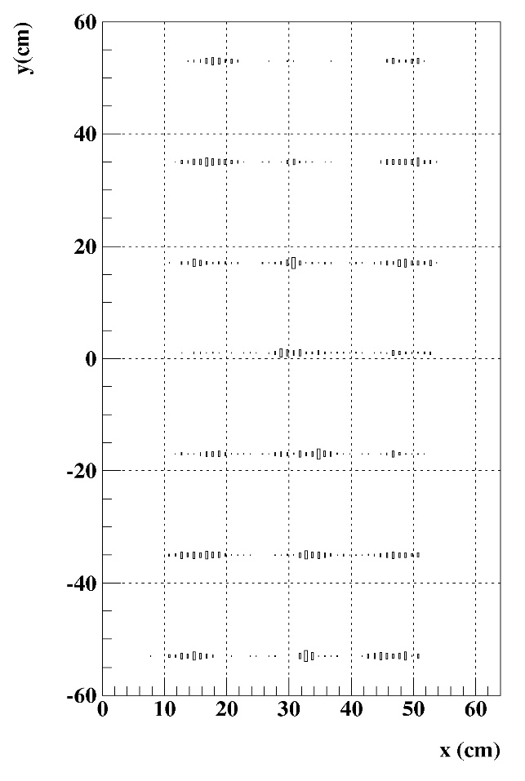
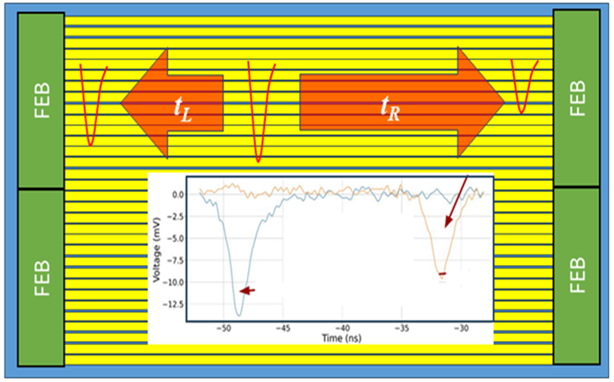
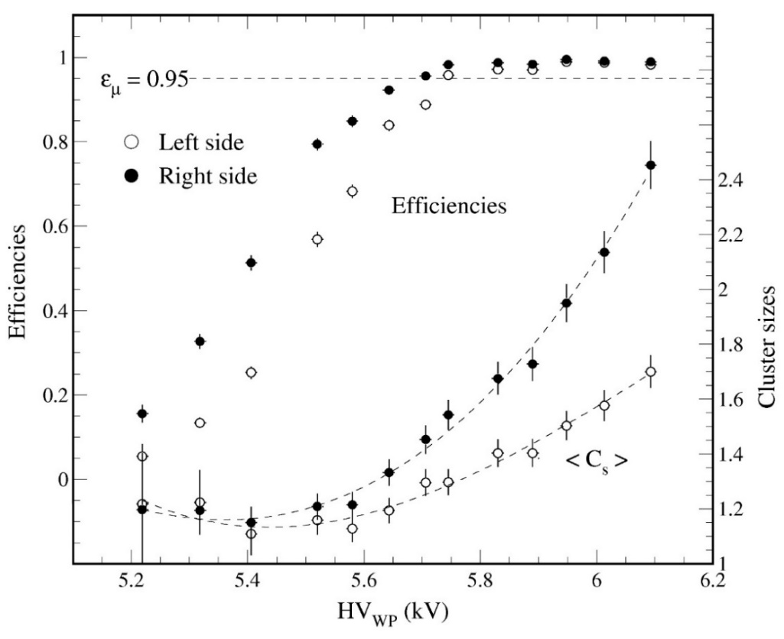
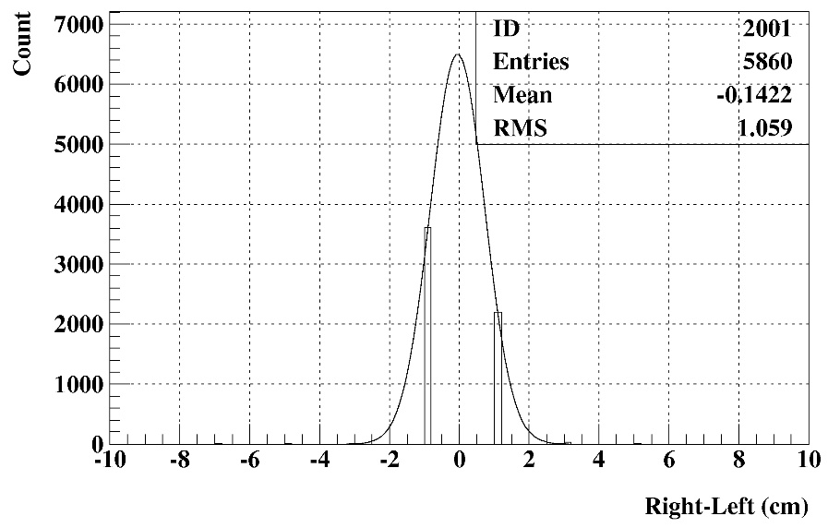
½ sized prototype RPC
(active = 1.0 m x 0.56 m)
y = (t_{L} – t_{R}) × 18 cm/ns
Active
20 mm pitch strips
Tested with a standard TFE gas for CMS RPCs
Digitization threshold = 0.50 mV (~ 65 fC)
FEB resolution ~ 1 ns
→ TDC data digitized by 1 ns
y
Up
Down
HV scan: Working point HV ~ 5.95 kV
x
y
HV ~ 6.06 kV
ε_{R} = 0.979, C_{sR} = 1.85
ε_{L} = 0.987, C_{sL} = 2.32
ε_{R} = 0.975, C_{sR} = 1.62
ε_{L} = 0.985, C_{sL} = 1.93
Up
ε_{R} = 0.992, C_{sR} = 1.91
ε_{L} = 0.993, C_{sL} = 2.39
Down
ε_{R} = 0.967, C_{sR} = 1.62
ε_{L} = 0.973, C_{sL} = 1.76
ε_{R} = 0.973, C_{sR} = 1.55
ε_{L} = 0.984, C_{sL} = 1.96
x
Up - Down (cm)

Slide 16
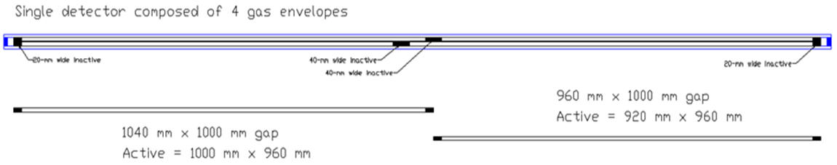
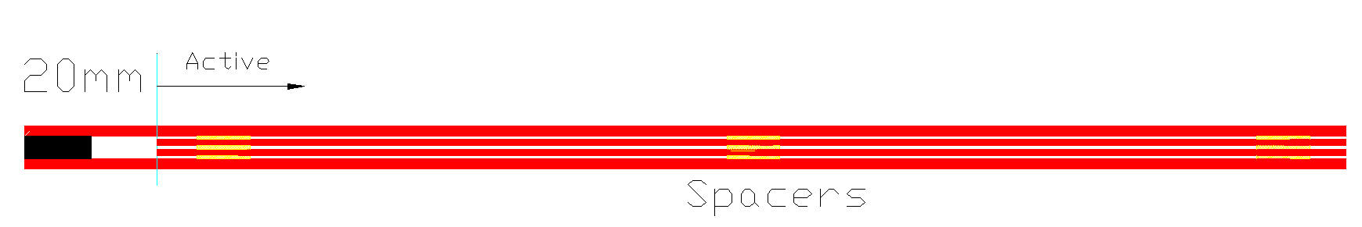
2. Glass RPCs for future FCC-ee
Time resolution ~ 200 ps
Position resolution
~ 1 mm transverse to strip direction
~ 10 mm along the strips
Maximum detector size: 1 m x 2 m
2D readout
Resistivity of soda-lime glass ~ 10¹² Ωcm
1) Thin double-gap RPCs
WP efficiency ~ 95%
Best position resolution ~ 1 mm
2) Thin multi-gap RPCs
WP efficiency ~ 98%
Best position resolution 1 ~ 2 mm
Multi-gap gas envelope → thin detectors
Double bi-gap RPCs (4-gap RPCs)
Double triple-gap RPCs (6-gap RPCs)

Slide 17
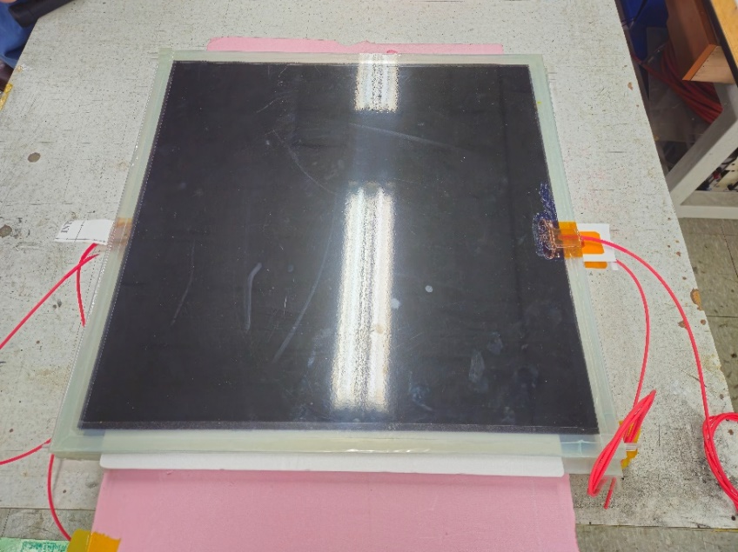
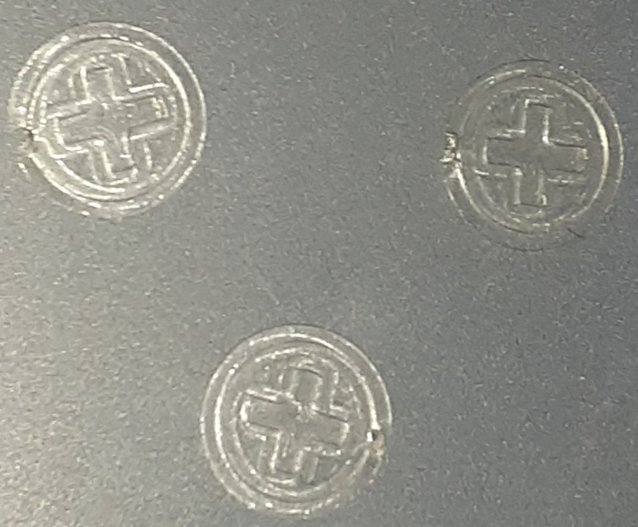
1st R&D items: 0.5 mm double-gap RPCs (2024)
Small 50 cm x 50 cm prototype gas gaps has been produced at Korea University
Gap thickness: 0.50 mm (intrinsic time resolution ~ 150 ps)
Glass thickness: 1.1 mm (resistivity ~ 7 × 10¹¹ Ωcm)
Surf resistivity of graphite ~ 200 kΩ/sq
So far, 4 gaps were constructed with ordinary soda-lime glass RPCs
Korea University: Thin-gap detectors
Bari Polytech: Electronics and tests at Bari and CERN
Rate capability (expected < 1 kHz cm⁻²) depends on the sensitivity of front-end electronics
Digitization threshold @FEE as low as ~ 10 fC
Time resolution for FEEs for digitization should be < 50 ps
Diameter = 8 mm
Thickness = 0.5 mm
Polycarbonate spacers can be produced with a molding method
Cost < 10 cents/spacer
Accuracy ~ 10 μm

Slide 18
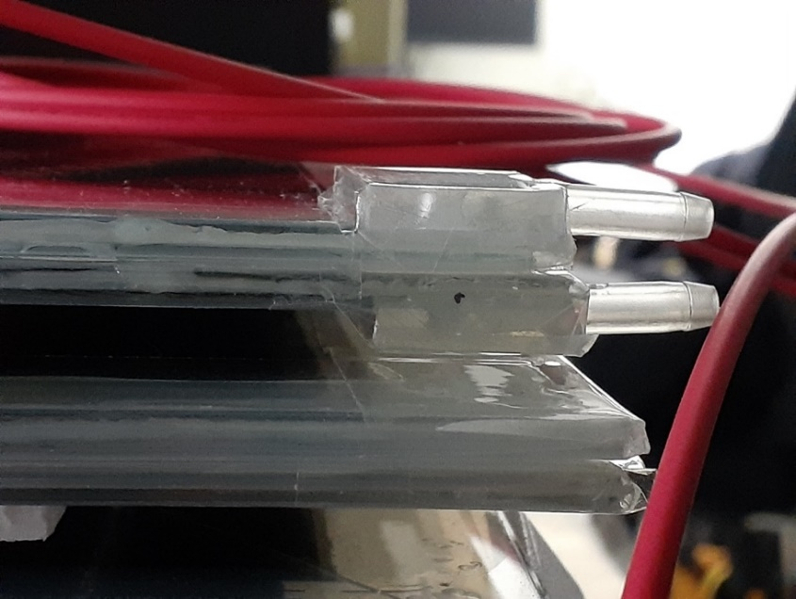
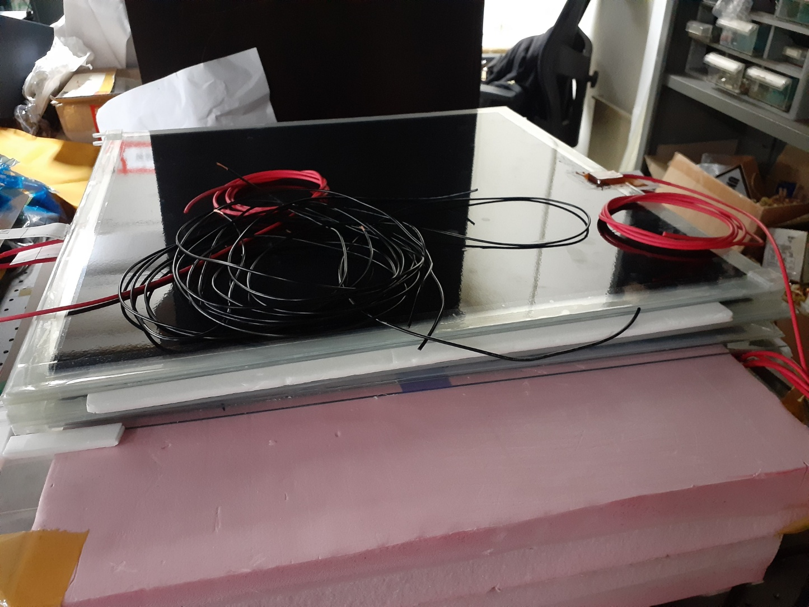
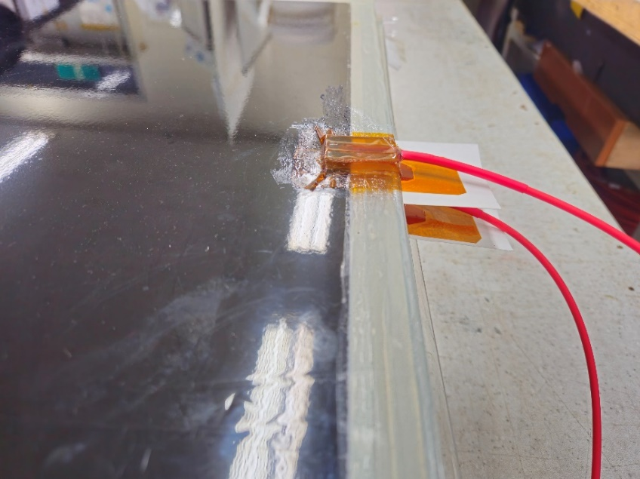
Thickness of a single gap = 3.0 mm

Slide 19
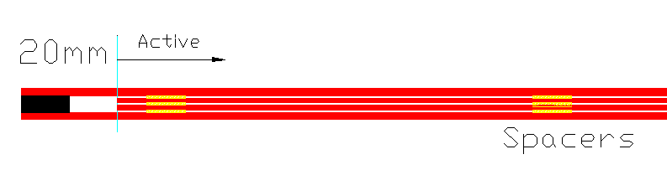
2nd R&D item: Thin multi-gap RPC composed of 2 layers of triple- or bi-gap gas envelopes
For proper gas circulation We use thin spacers (by a molding method) instead of fishing rod.
Intrinsic time resolution of gaps → with 0.30 mm (~ 100 ps) or 0.5 mm (~ 150 ps) thick spacers
Use of spacers instead of fishing rod for relevant gas circulation
Productivity of gluing gas-gap envelopes with spacers is high. but no way to repair inside
Strip panels are free from gas volumes
Surf resistivity of graphite: minimum 100 kΩ/sq and maximum 500 kΩ/sq
A spacer-position offset bet. top and bottom gas envelopes to get rid of dead regions due to spacers.
Maximum ~ 1 m long strips to allow dispersion of signals ~ 50 ps.
→ 1-m detector width will be maximum to get σ_{t} ~ 150 ps (0.30 mm gaps) and ~ 200 ps (0.5 mm gaps)
and so adequate for these large sized type MRPCs.
FEE
100 cm
A single detector composed of 4 triple-gap gas envelopes
Strips placed between top & bottom gas envelopes
200 cm
FEE

Slide 20
Summaries and Plans
We are working under a boundary of the DRD1 collaboration (G. Iaselli representing RPC group)
Polytechnic of Bari + Hanyang University + Korea University
WG6: Korean RPC facilities (Hanyang & Korea Universities)
WP7B: Proposed thin double and multi-gap RPC models for FCC-ee
1st prototype study for thin melamine RPCs at KODEL → quite satisfactory.
Fundamentals: Efficiency & operational voltage (well defined): well proven ☺
For the small prototype, HV_{WP} ~ 5.75 kV, Efficiency @HV_{WP} = 0.97, ε_{max} = 0.98 with a 11 mm strip pitch
For 1 m long prototype, HV_{WP} ~ 5.95 kV, Efficiency @HV_{WP} = 0.98, ε_{max} = 0.99 with a 20 mm strip pitch
No chance to study for rate capability and time resolution
Aging: tested up to ~ 50 mC cm⁻² / chamber: Δ
Confirmed the design and the detector production procedure are reliable for making large-size gaps ☺
Next steps
Thin glass multi-gap RPCs (small prototype: 50 cm x 50 cm)
Gas volumes & detectors -> Korea University (we already have some experience)
Electronics → Polytechnic of Bari
Detector tests at Korea university and then Polytechnic of Bari for development of electronics
Final test at GIF/CERN

Slide 21
Thank you for your attention

Slide 22
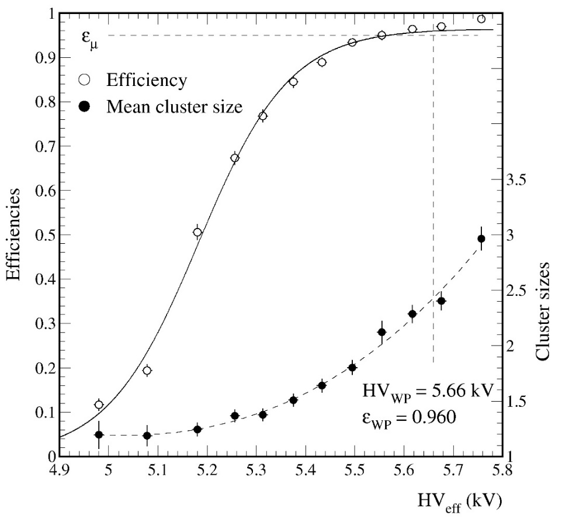
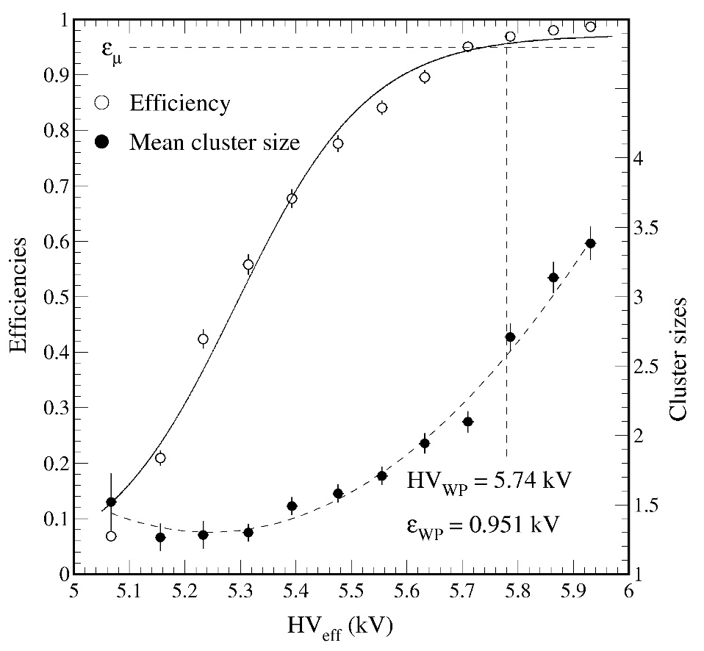
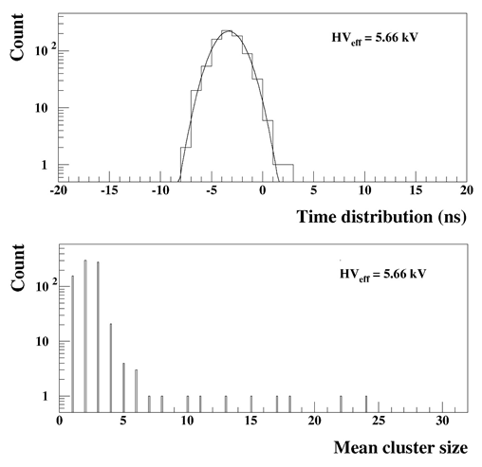
Small 11 mm strip pitch RPC
(read only 24 strip among 32 strips)
Digitization threshold = 0.35 mV (~ 50 fC)
Before irradiation no oil varnishing
HV_{WP} = HV(abs 95%) + 100 V = 5.71 kV
Efficiency @HV_{WP} = 0.970, ε_{max} ~ 0.990
Mean cluster size @WP ~ 2.5
Noise rate ~ 20 Hz cm² @ 23.1 ºC
Aft. Applying 50 mC cm⁻² and oil varnishing
HV_{WP} = HV(abs 95%) + 100 V = 5.79 kV
Efficiency @HV_{WP} = 0.969, ε_{max} ~ 0.986
Mean cluster size @WP ~ 2.7
Noise rate ~ 2.8 Hz cm² @ 18.3 ºC
Time resolution of the VME TPC ~ 800 ps (RMS)
Time resolution of FEE ~ 400 ps (RMS)
Scintillator trigger ~ 400 ps (sigma)
Overall time resolution = 1.13 ns (sigma)
HV_{WP} define by a sigmoidal fit
HV_{WP} define by a sigmoidal fit

