Slide 1
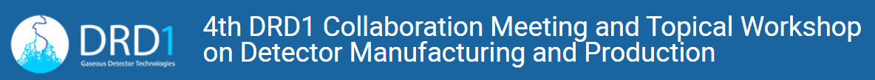
A recap of the gas-leak problem in the ATLAS legacy RPCs and its mitigation
P. Camarri
University of Roma «Tor Vergata» and INFN
February 28th, 2025

Slide 2
Outline
The ATLAS legacy RPC system
The reasons for the gas leaks
Procedures for mitigating the gas leaks

Slide 3

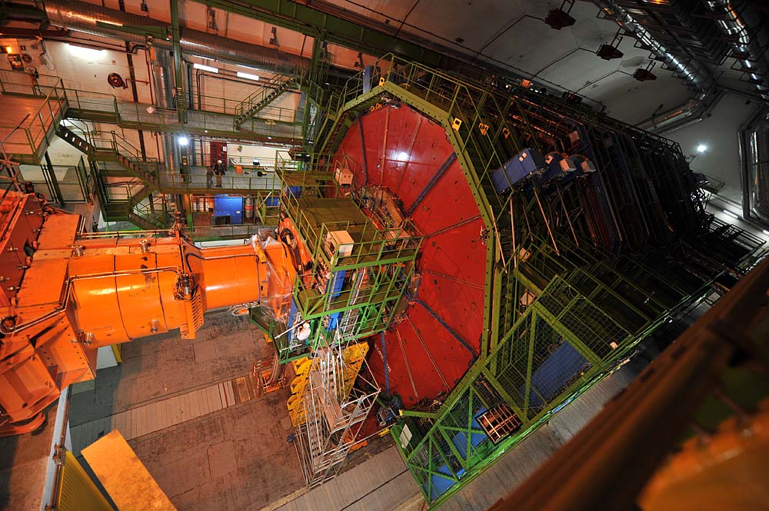
F-gases in ATLAS and CMS experiments
In ATLAS F-gases are used in the RPC system (Barrel only)
RPC gas mixture: C₂H₂F₄+iC₄H₁₀+SF₆ (94.7+5+0.3)%
In CMS F-gases are used in two muon detector systems: CSC (Endcap) and RPC (Barrel + Endcap)
CSC gas mixture: Ar+CO₂+CF₄ (40+50+10)%.
RPC gas mixture: C₂H₂F₄+iC₄H₁₀+SF₆ (95.2+4.5+0.3)%

Slide 4
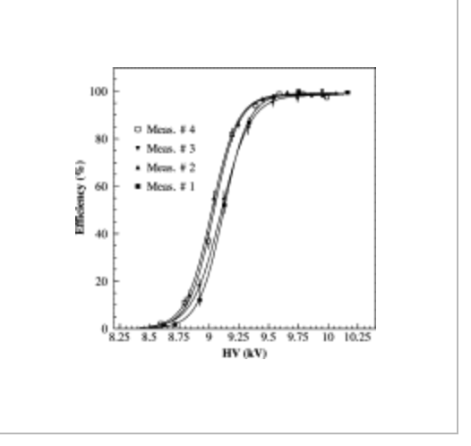
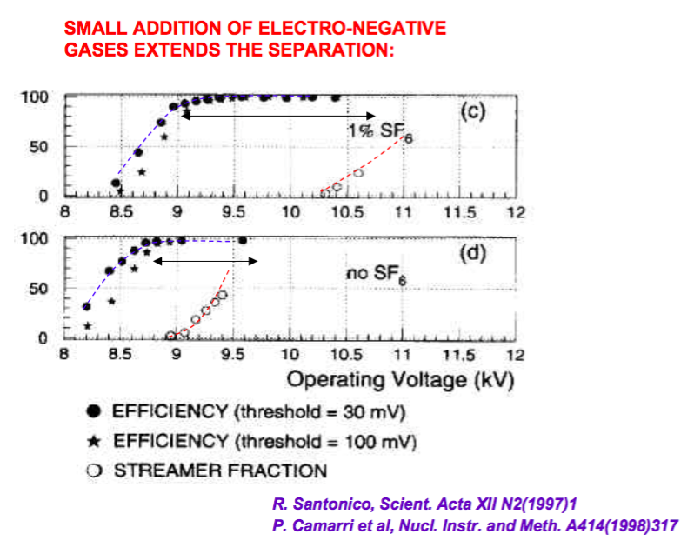
Why C2H2F4 and SF6 in RPC gas mixture?
In 2000s, ATLAS and CMS RPCs mixture was selected to guarantee:
  Stable detector performance (high efficiency, large avalanche stability plateau, prevention against ageing effects) for 10 years of LHC operation
  Aging study for resistive plate chambers of the CMS muon trigger detector, M. Abbrescia et al. https://doi.org/10.1016/j.nima.2003.09.021
  Easy procurement and stable price (C2H2F4 was the gas commonly used for refrigeration)
  Non Ozone-depleting (replacing the CF3Br, used in the RPC, that was banned in 1990s)

Slide 5
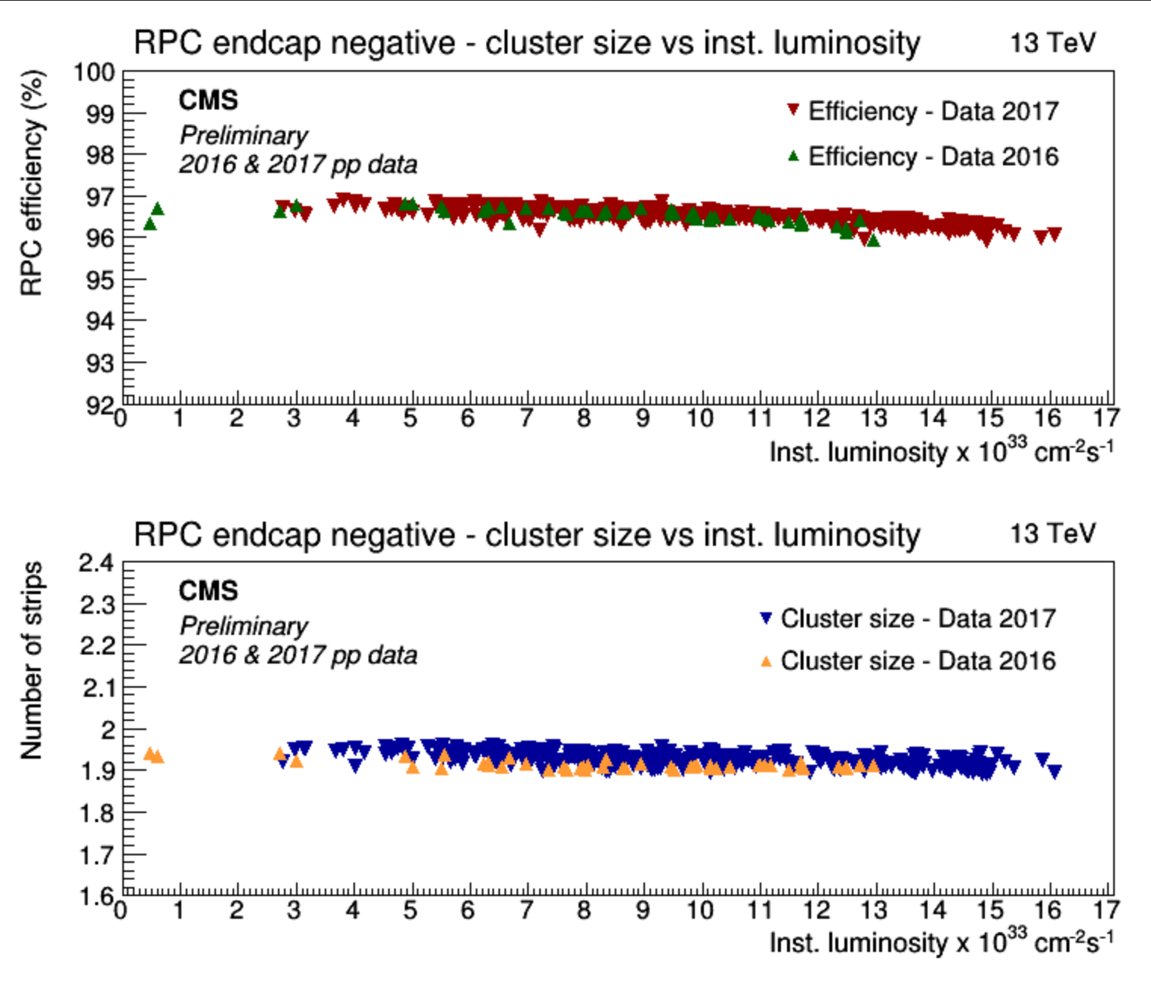
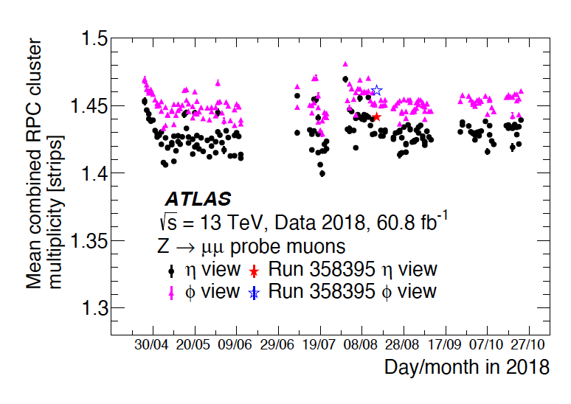
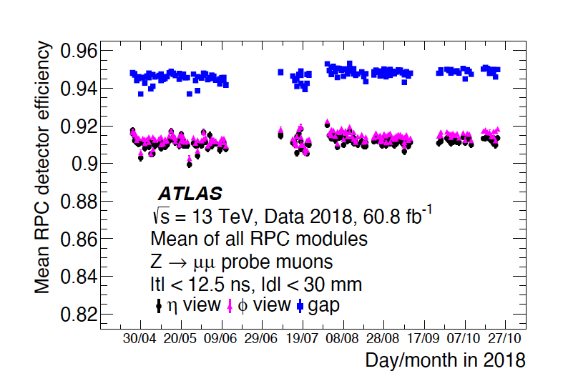
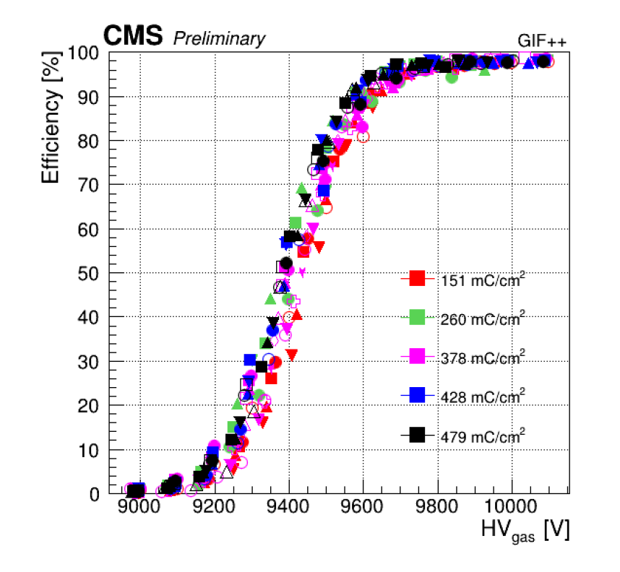
RPC System at LHC and expectation for HL-LHC
Since 2010, CMS and ATLAS RPC systems are in operation at LHC with stable performance
CMS RPC efficiency and Cluster size vs. instantaneous LHC Lumi.
Since 2016, a new RPC longevity test started in GIF++ to validate the RPCS for 3x HL-LHC operations.
Since 2013, CMS and ATLAS started an new R&D program to replace C2H2F4 (GWP = 1240) and SF4 (GWP = 12400) in RPC gas mixture.
Not easy to find a new gas mixture suitable for already installed chambers
(for recent results see the results presented at the RPC 2024 workshop)

Slide 6
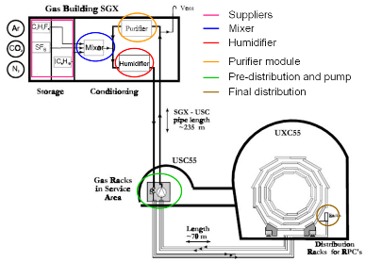
F-gases in ATLAS and CMS experiments
Closed loop gas system
New R&D carried out at GIF++ to lower the fraction of fresh gas and to reduce the F-gases emission
CMS and ATLAS are very large experiments:
CMS RPC system has detector volume ~13 m³
ATLAS RPC system has detector volume ~15 m³
CMS CSC system has detector volume ~70 m³
All systems were certified to work in closed-loop gas circulation mode with 10% of fresh gas replenishing rate
Since RUN2, CMS CSC system is equipped with a CF4 recuperation system with 40% of efficiency)
R&D ongoing in order to improve the recuperation efficiency and to reduce the F-gases emission

Slide 7
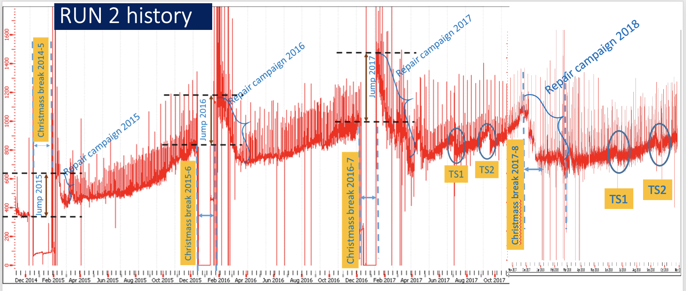
Detector gas tightness: ATLAS case
(2014-2019)
Leak rate increases at increasing speed during the run.
Year after year the leak rate increase vs time lowered showing a consolidated system
Disruptive events in 2015-16-17 YETS. This was caused by the start-up procedure of the gas system, in particular concerning the initial purge operation
Repair campaign performed during each Technical Stop with an increased capacity during each Technical Stop (more detail later).

Slide 8
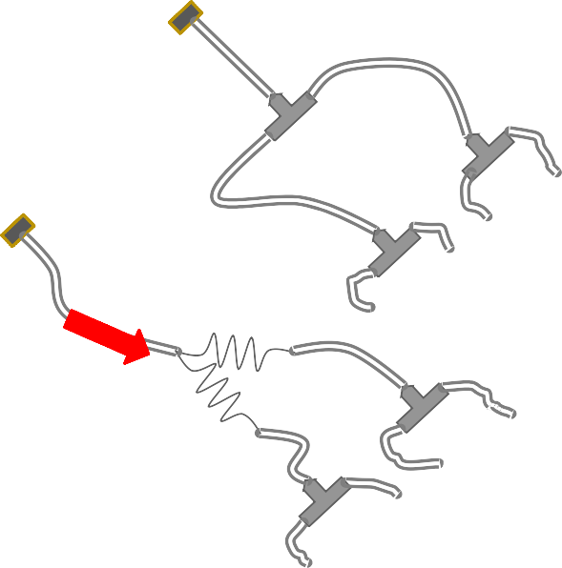
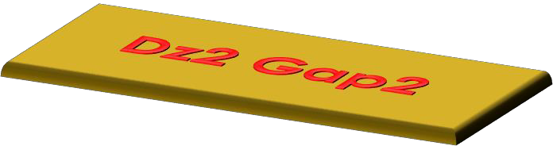
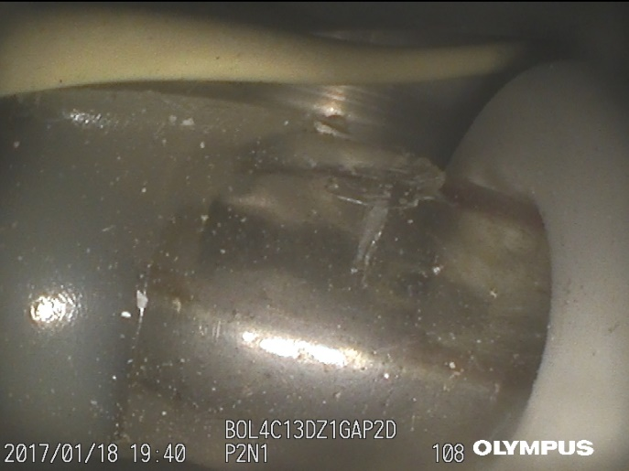
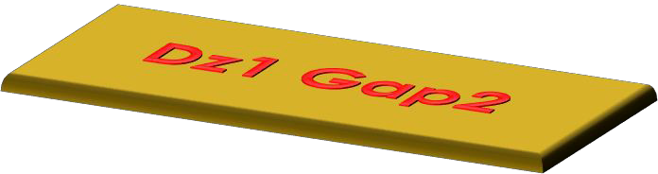
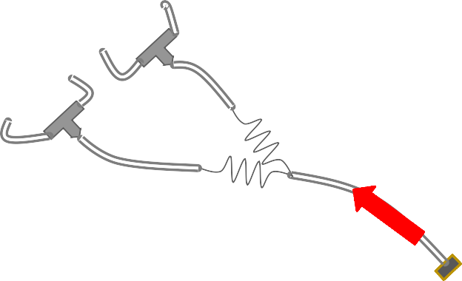


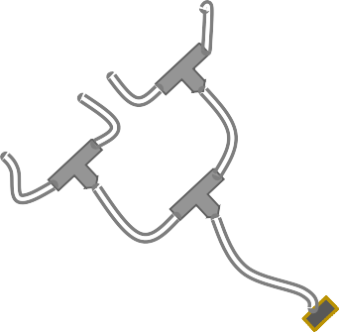
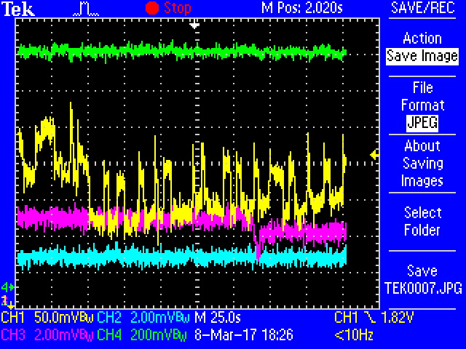
Causes of the leak in ATLAS RPC system
6
The ATLAS RPC leaks are concentrated in the gas inlets and outlets.
Outlet
1
2
2
1
2
1
2
1
2
1
Foto ? Camere ?
Typical new cracked inlet
2
1
2
1
2
1
Inlet
Interaction Point
The following main causes were found:
  A lower-than-expected quality in the original polycarbonate moulded inlet and outlet production: this material becomes very fragile after few years
  A stress applied to the gas inlets through the gas pipes
  The gas system is generating a constant stress in the form of fast propagating flow changes (about 1-2 %)
  The former purge procedure (happening at each YETS) was producing a very large shock with a consequent extensive system damage.
  However, it is crucial to stress that the inner serial gas connections between gas volumes inside the same chamber never got broken, showing that the leak problem related to the outer gas connectors is specific.

Slide 9
The technique of “Inserto tubo”, which consists in a total replacement of the broken inlets, has been improved a lot by the Russian teams and used extensively
From March 2021 a new type of glue (Dow Corning 3140) has been used which seems more elastic and resistant
Another additional technique uses expanded polyurethane, and will be mentioned later

Slide 10
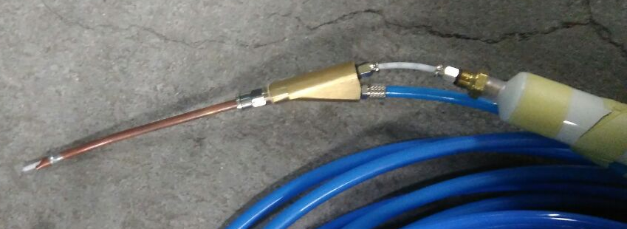
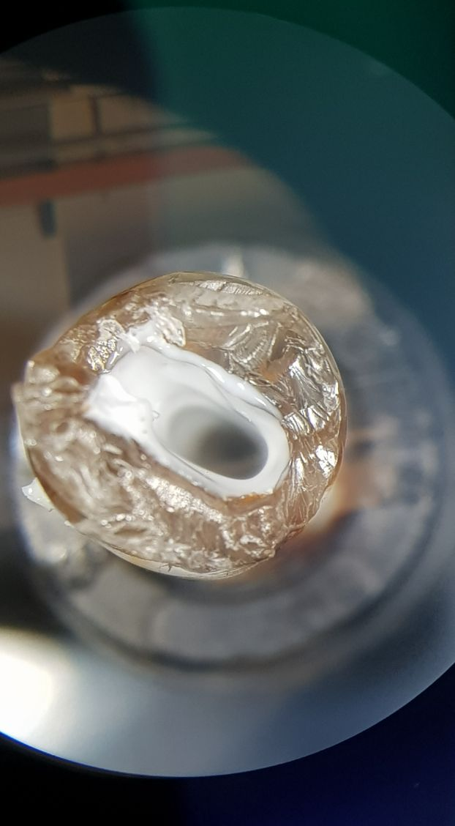
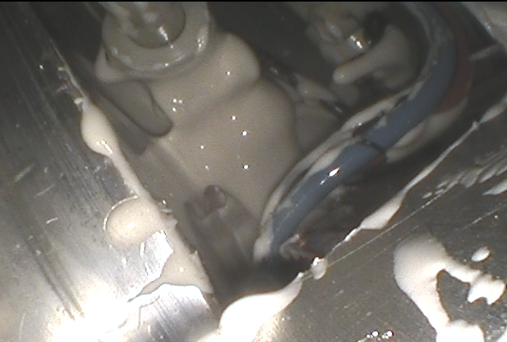
ATLAS RPC Leak repair technical R&D
R&D performed to develop the most efficient and fast repair technique. Repair interventions are strongly affected by limited access (space and time) and specialized person power availability, both for ATLAS and CMS.
In many cases the crack is unreachable so it must be repaired remotely:
  1. With the standard method the glue can be precisely sprayed with a special tool driven with Ultra-Thin wireless endoscope to completely cover the surface of the leaking inlet.
  The robustness of the reparations depends on glue characteristics; a lot of test were done to identify a better candidate, and Dow Corning 3140 seemed considerably stronger than the old 734
  We can deposit a thin sealant layer in the internal inlet surface (trough pipes) if the crack is not complete, to stop or prevent further degeneration
1
1
2

Slide 11
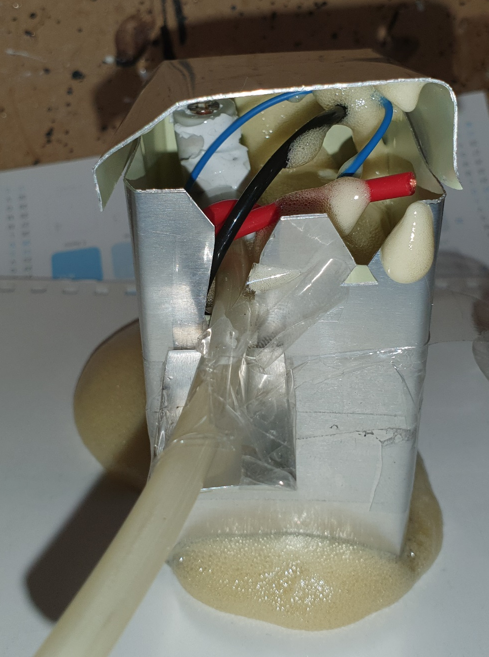
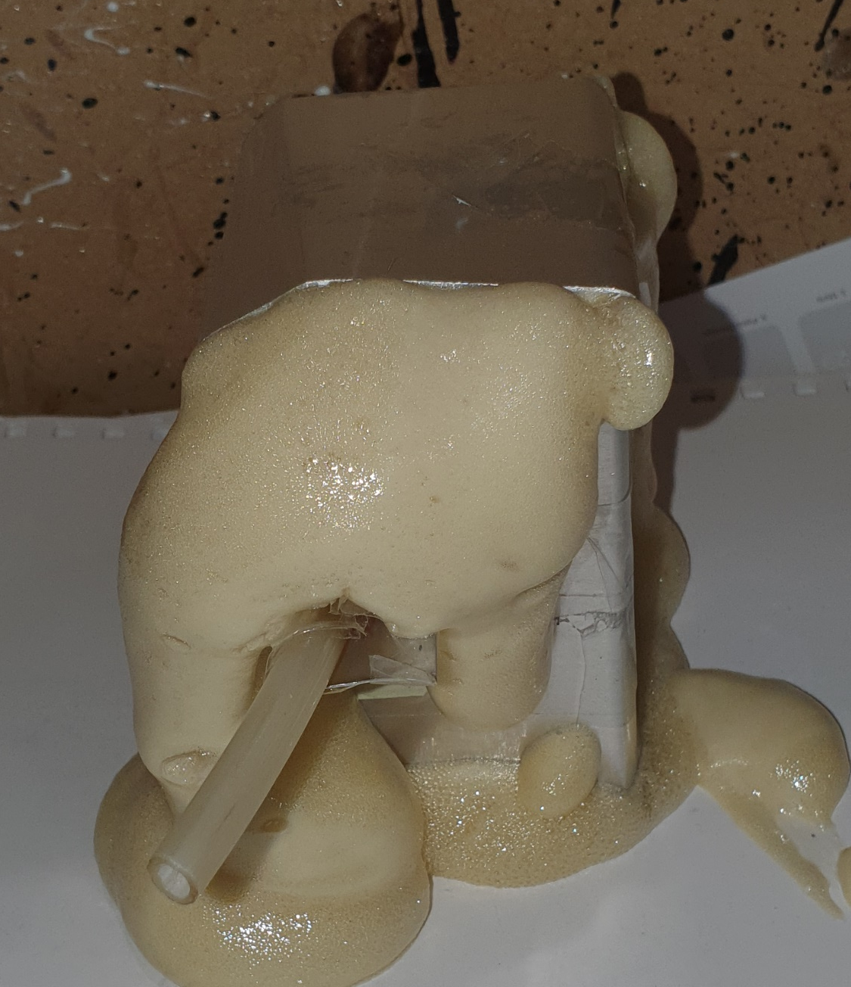
3. A more recent procedure consists in completely filling the service boxes using expanded polyurethane; this procedure is carried out in parallel with the standard one

Slide 12
Broken Gas Layers still to be Fixed
Now
 |  |  |  |  | 166 | 229 | 350 | 300 | 169 | 284
 | RUN1 LS1 | RUN2 |  |  |  | LS2 |  |  |  | RUN3
 | 0 | 2015 | 2016 | 2017 | 2018 | 2019 | 2020 | 2021 | 2022 | 2023
# Gas Layer Fixed* (tot=2136) | 251 | 18 | 55 | 127 | 102 | 270 | 94 | 231 | 242 | 165
*Gas layer is one or two RPC gas Gap in series
in each chamber there are 2 to 8 gas Layer
number gas layers to be repaired

Slide 13
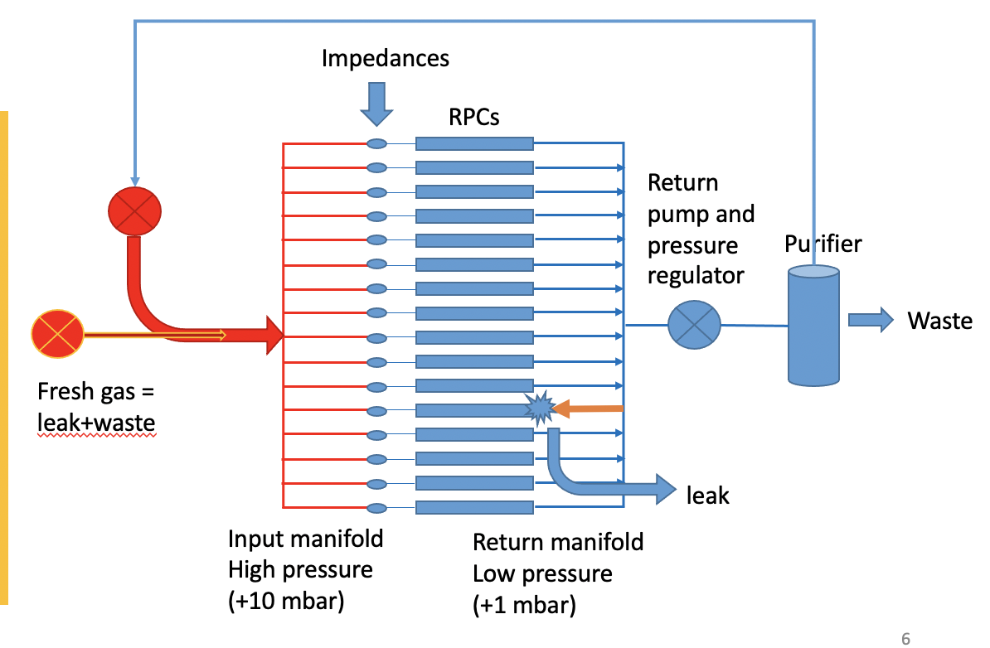
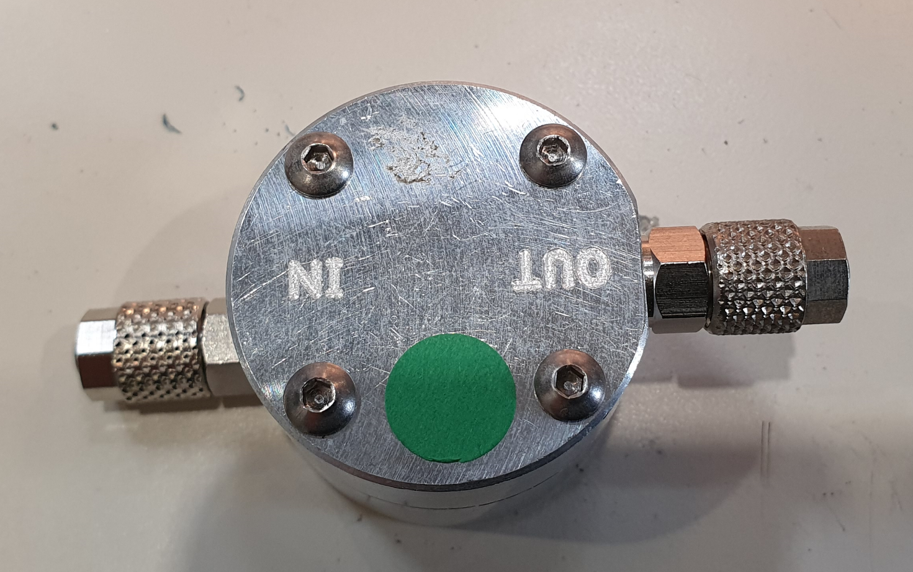
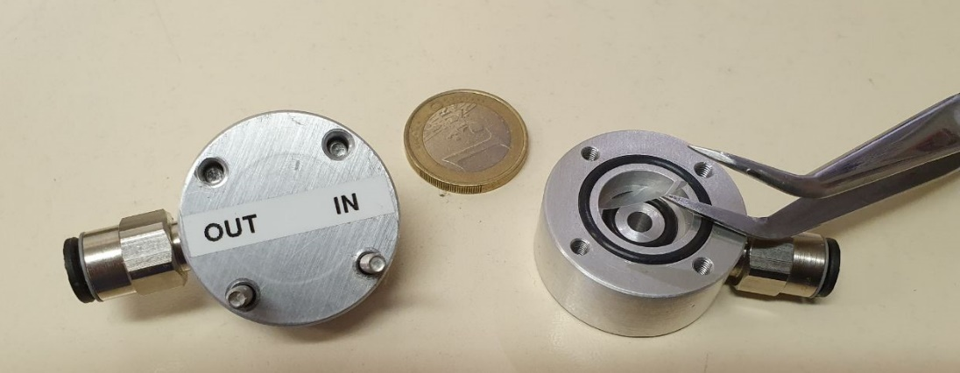
Mitigation of the effect of the leaks
A large fraction of gas is lost during the LHC runs due to new leaks appearing:
It can last months until the next TS (when access to the detector is possible)
Each of these leaks loss 10s of l/h
In Atlas up to 24 RPC gaps are connected in parallel to the same manifold line.
Non-return valve
This leak can be stopped by installing a non-return valve at the RPC output to close up with an overpressure of a fraction of a mbar
R&D done in Roma Tor Vergata to design, build and validate such new device which does not exist on the market.
The installation of 1200 valves was carried out in LS2

Slide 14
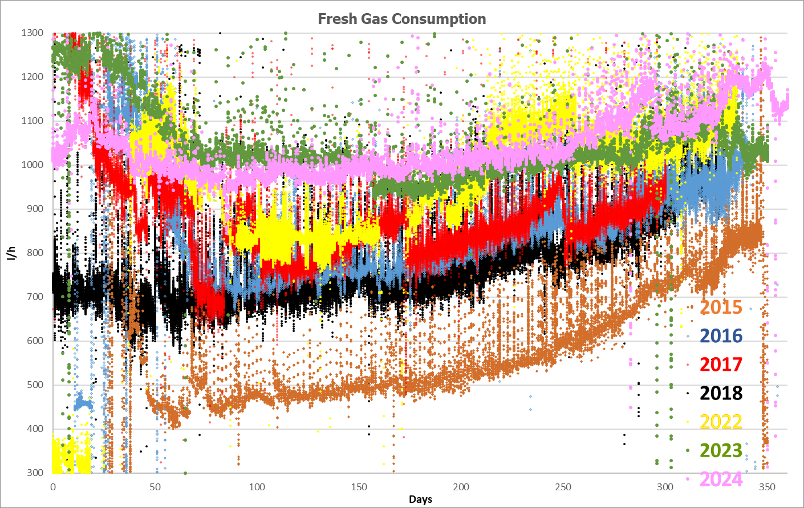
ATLAS RPC gas consumption
2015-2024 (except LS2)

Slide 15
Conclusions
Starting from 2015, 5 years after ATLAS started running and over 10 years after the gas gaps had been built, we became aware that the RPC system had a leak problem, due to both the quality of the inlet-outlet connectors and the yearly gas-purge procedure.
The ATLAS collaboration started repairing the broken gas connectors at first by replacing the broken inlets-outlets; starting from 2021, additional techniques were introduced, by spraying special glue, and by filling the service boxes with expanded polyurethane. In the first years the fixing proceeded with very good speed, then it slowed down due to the Covid lockdown.
At present, the fixings are proceeding regularly with all these techniques, and the overall gas leak in the RPC system is not increasing.

