Slide 1
Tracking with errors
random offset arc sextupoles in horizontal and vertical directions
dx,dy = standard deviation of Gaussian from where the offset of each sextupole is drawn
track for 5000 turns, with 1e3 macroparticles, with beambeam and beamstrahlung

Slide 2
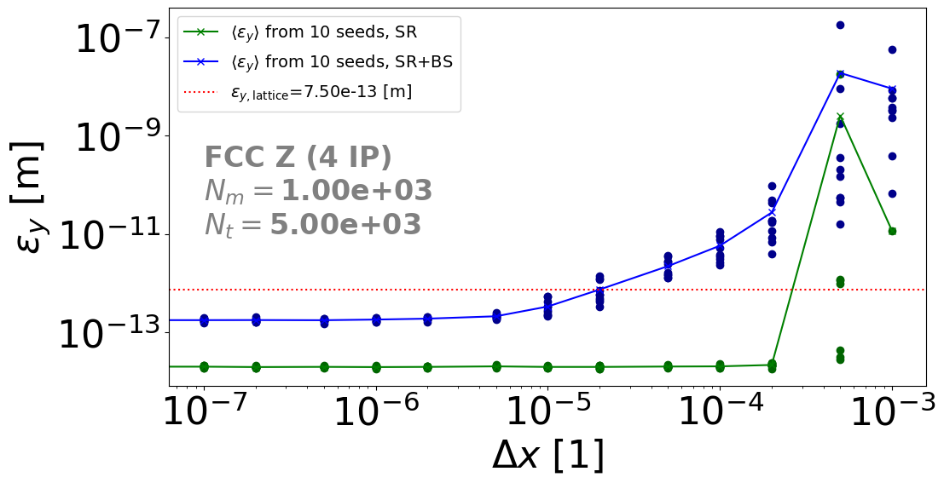
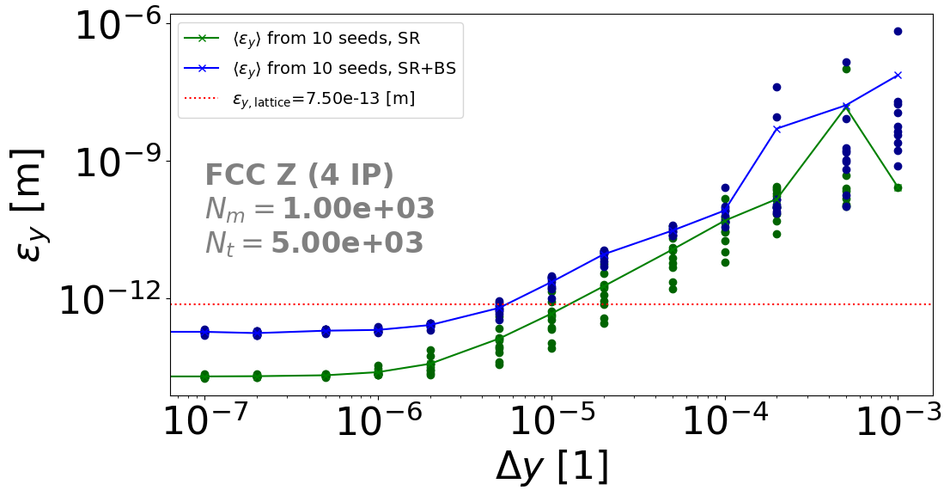
Vertical emittance

Slide 3
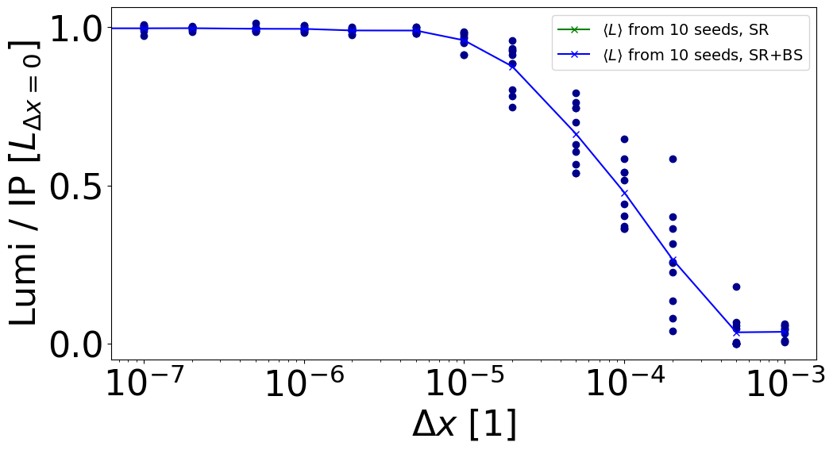
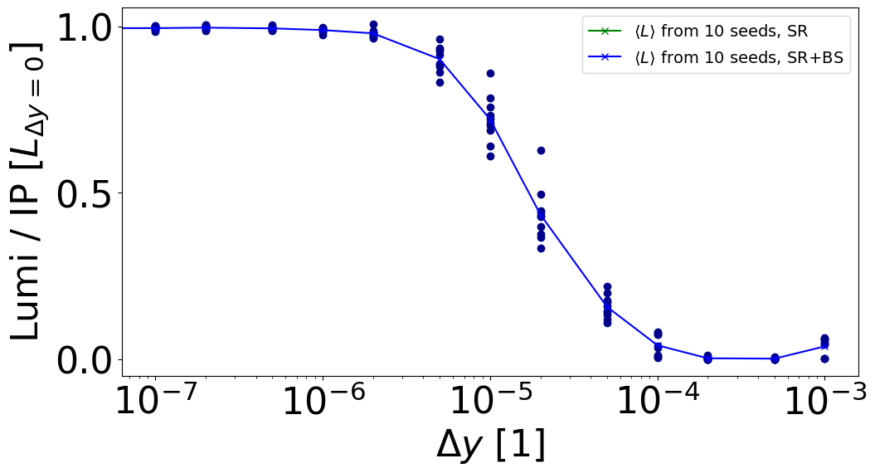
Luminosity / bunch crossing

Slide 4
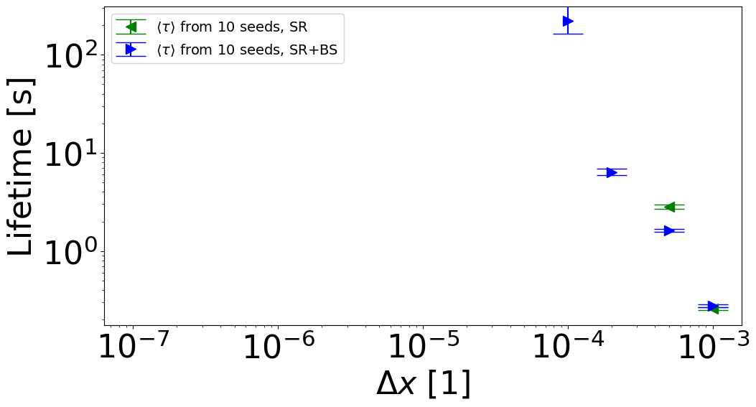
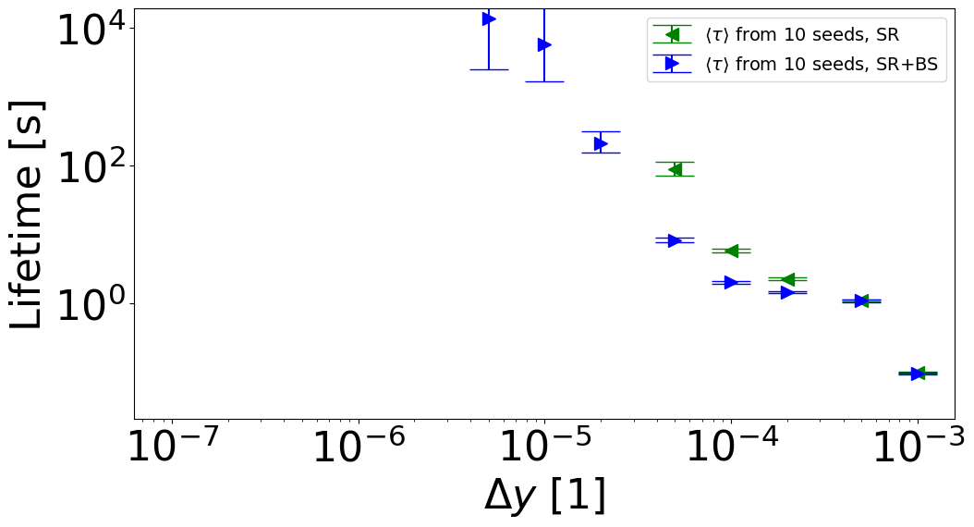
Beam lifetime
calculated from number the of lost particles

Slide 5
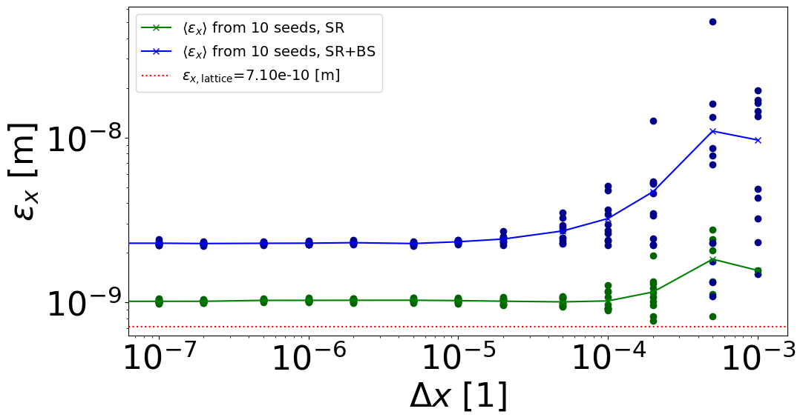
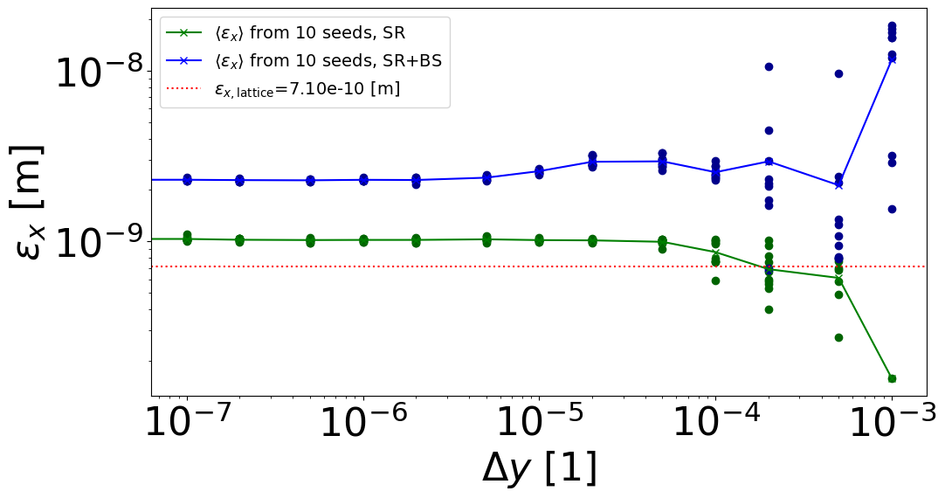
horizontal emittance
blowup due to bad location of tapering
simulation with tapering at RF ongoing

Slide 6
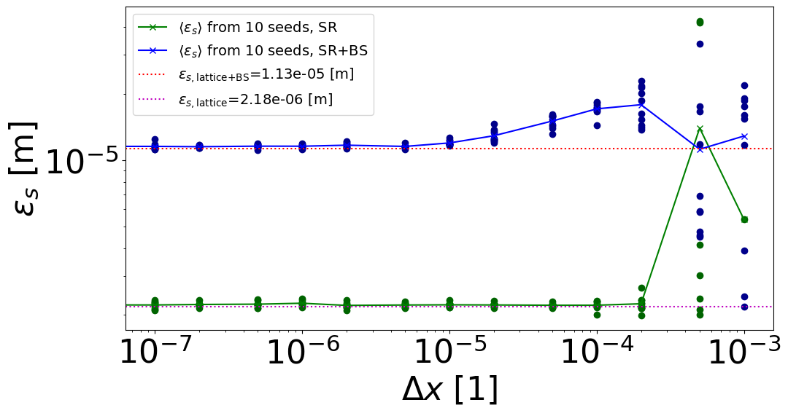
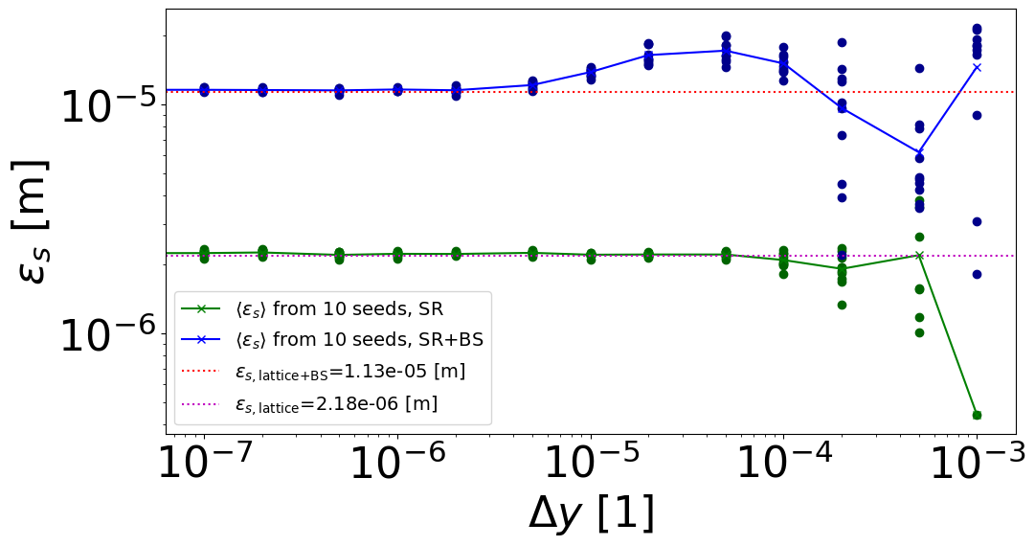
longitudinal emittance

