Slide 1
Impact of longitudinal wakefields on synchrotron detuning and TMCI

Slide 2
Impact of longitudinal wakefields on synchrotron detuning and TMCI
SUMMARY
Motivation: Implement longitudinal wakefields in BimBim based on the Circulant Matrix Model (CMM)
Synchrotron tune shift due to longitudinal impedance and non-linear Radio Frequency (RF) cavities
Theory benchmark with multiparticle tracking (xwakes)
  No Synchrotron Radiation (SR) compensation
  Synchrotron radiation compensation
Implementation in BimBim (based on CMM)
TMCI benchmark with multiparticle tracking (xwakes)
Conclusion and outlook

Slide 3
Impact of longitudinal wakefields on synchrotron detuning and TMCI
Motivation: Implement longitudinal wakefields in BimBim based on the Circulant Matrix Model (CMM)

Slide 4
Impact of longitudinal wakefields on synchrotron detuning and TMCI
Motivation: Implement longitudinal wakefields in BimBim based on the Circulant Matrix Model (CMM)
Linearized forces in the transverse plane applied to:

Slide 5
Impact of longitudinal wakefields on synchrotron detuning and TMCI
Motivation: Implement longitudinal wakefields in BimBim based on the Circulant Matrix Model (CMM)
Linear transfer matrix
Beam-beam force
Transverse impedance force
Space charge
Longitudinal impedance force
Linearized forces in the transverse plane applied to:

Slide 6
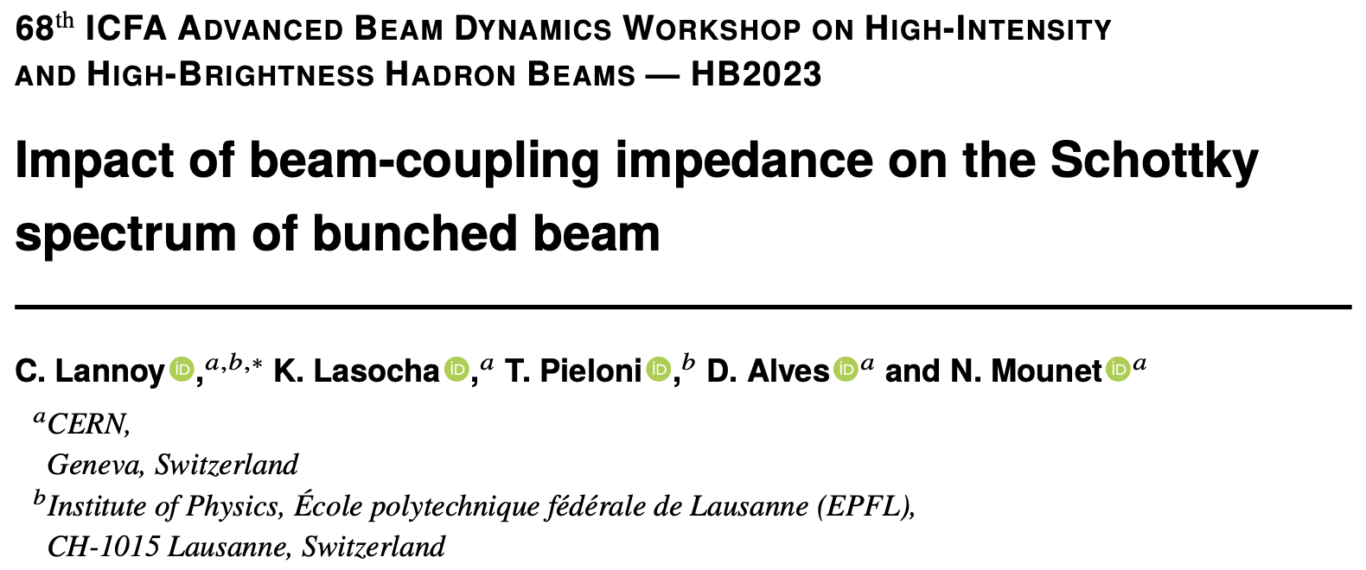
Impact of longitudinal wakefields on synchrotron detuning and TMCI
Synchrotron tune shift due to longitudinal impedance and non-linear Radio Frequency (RF) cavities
RF harmonic
https://doi.org/10.1088/1748-0221/19/03/P03017
RF phase
Slippage factor
Revolution frequency
Differential equation of the longitudinal motion in the RF bucket of a beam subjected to a force F_{imp :}
(1)
Nominal synchrotron frequency
energy
External force
Approximated form of the differential equation for small amplitudes :
(2)
Average current
Bunch spectrum
RF voltage
RF synchronous phase
Longitudinal impedance

Slide 7
Impact of longitudinal wakefields on synchrotron detuning and TMCI
Synchrotron tune shift due to longitudinal impedance and non-linear Radio Frequency (RF) cavities
RF harmonic
https://doi.org/10.1088/1748-0221/19/03/P03017
RF phase
Slippage factor
Revolution frequency
Differential equation of the longitudinal motion in the RF bucket of a beam subjected to a force F_{imp :}
(1)
Nominal synchrotron frequency
energy
External force
Approximated form of the differential equation for small amplitudes :
(2)
Known solution to the synchrotron tune shift for equation of the form (2)
Max phase amplitude
Average current
Bunch spectrum
RF voltage
RF synchronous phase
Longitudinal impedance

Slide 8
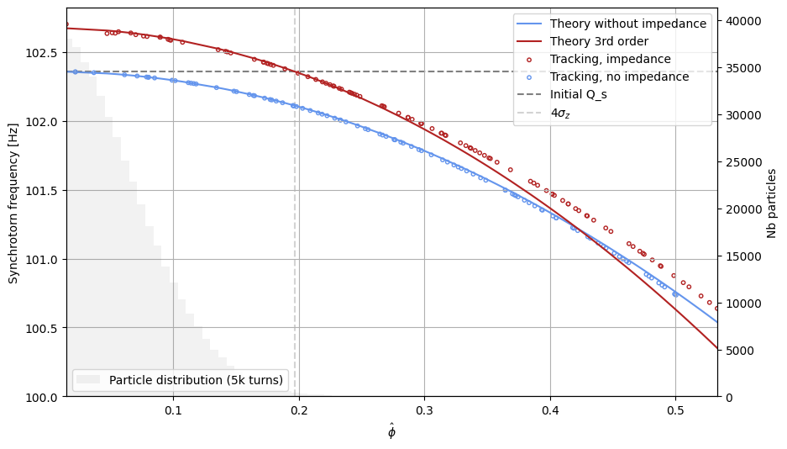
Impact of longitudinal wakefields on synchrotron detuning and TMCI
Theory benchmark with multiparticle tracking (xwakes)
  No Synchrotron Radiation (SR) compensation
Broad band resonnator wake case (FCC parameters)

Slide 9
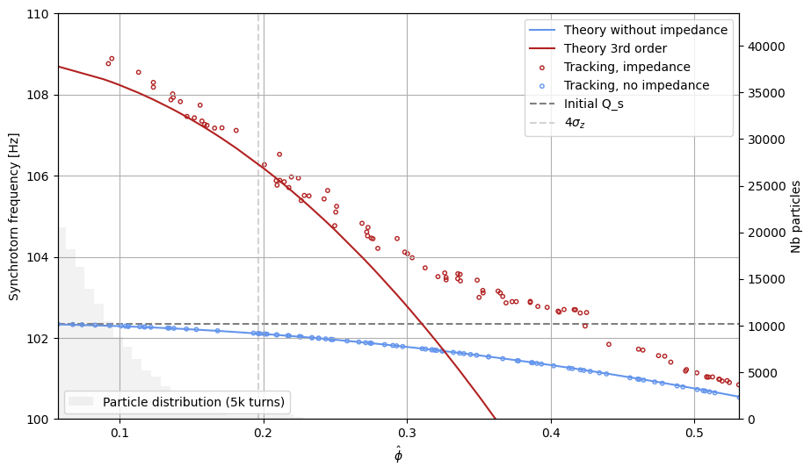
Impact of longitudinal wakefields on synchrotron detuning and TMCI
Theory benchmark with multiparticle tracking (xwakes)
  No Synchrotron Radiation (SR) compensation
Realistic wake case at high intensity (FCC parameters)

Slide 10
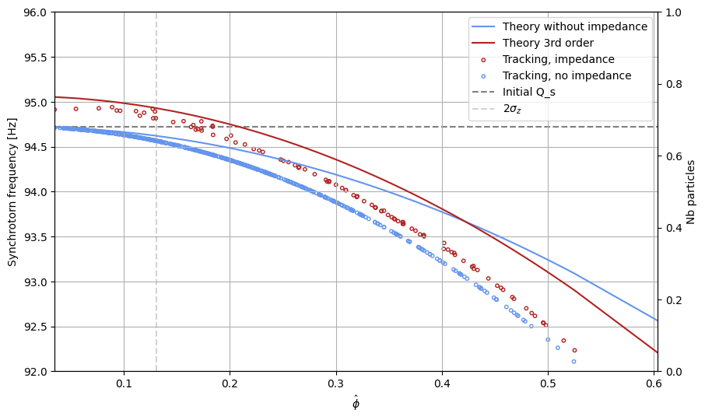
Impact of longitudinal wakefields on synchrotron detuning and TMCI
Theory benchmark with multiparticle tracking (xwakes)
  Synchrotron radiation compensation
Broad band resonnator wake case (FCC parameters)
Phase shift in the bucket
Reduced bucket size
REDUCED VALIDITY REGION

Slide 11
Impact of longitudinal wakefields on synchrotron detuning and TMCI
Implementation in BimBim (based on CMM)

Slide 12

Impact of longitudinal wakefields on synchrotron detuning and TMCI
Implementation in BimBim (based on CMM)
Full documentation and example of usage of the class LongitudinalImpedance will be available in the commit!
Z_ll = LongitudinalImpedance(impedance_path=‘/path/impedance_long.txt’, circumference=circumference)
actionSequence[0] = Transport(
phase_x = qx,
  phase_y = qy,
  beta_x = beta_x_avg,
  beta_y = beta_y_avg,
  # phase_z = qs, # should NOT be given
  chroma_y = chroma,
  longitudinal_wake_detuning = Z_ll,
  Vrf = RF_voltage,
  hRF = RF_harmonic,
  # fRF= frequency_RF, #EITHER fRF or hRF should be given
  slipFactor = slippage_factor,
)
Calculation done by LongitudinalImpedance class
Applied to the matrix in Transport class

Slide 13
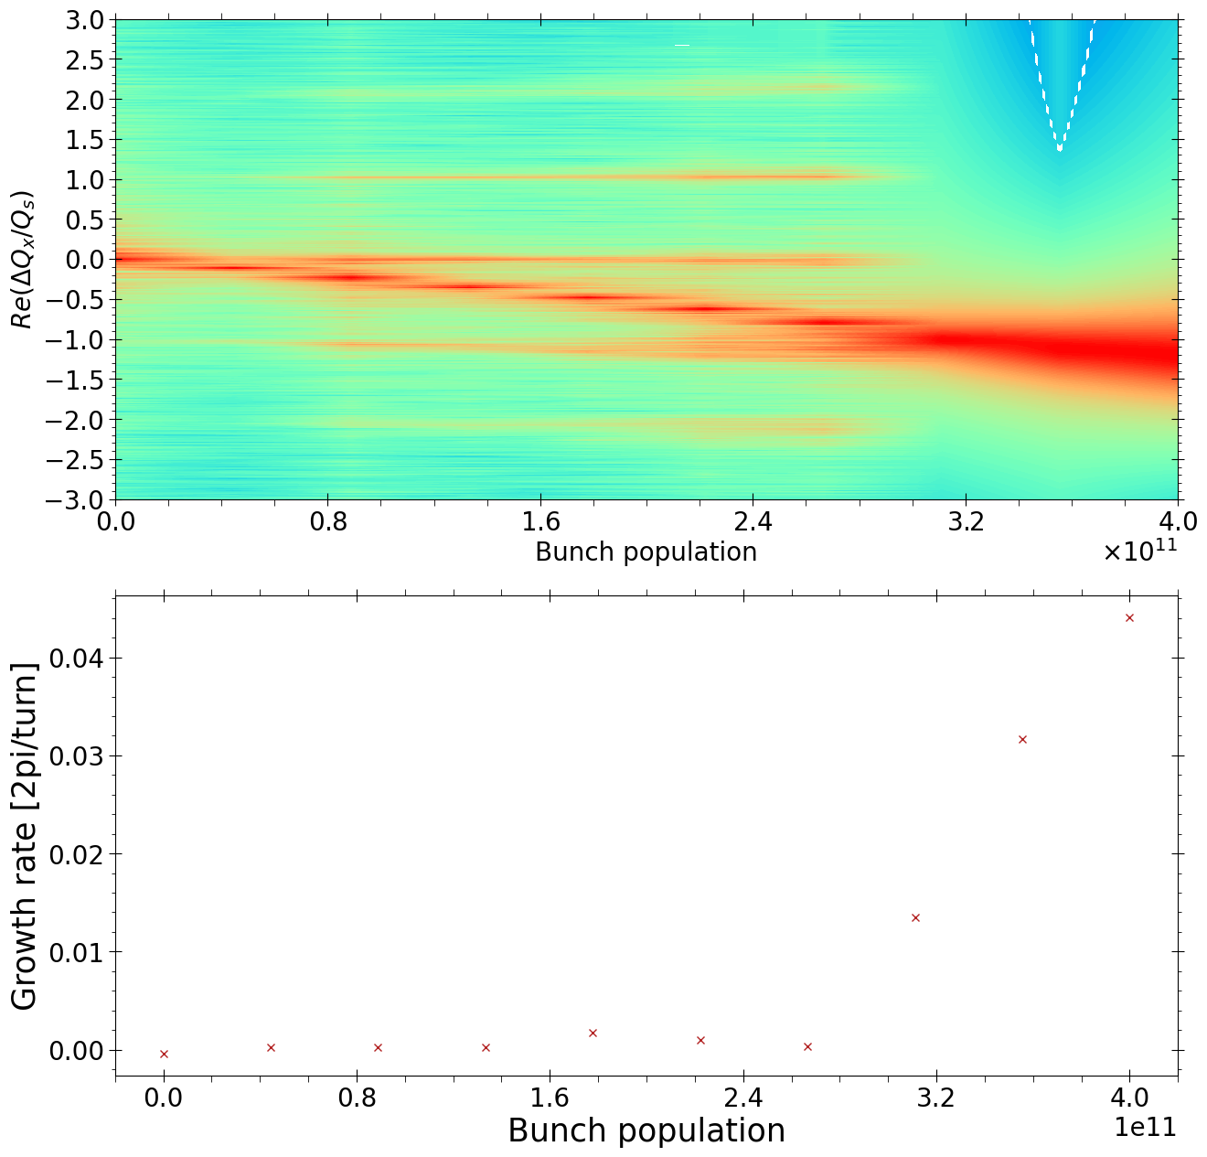
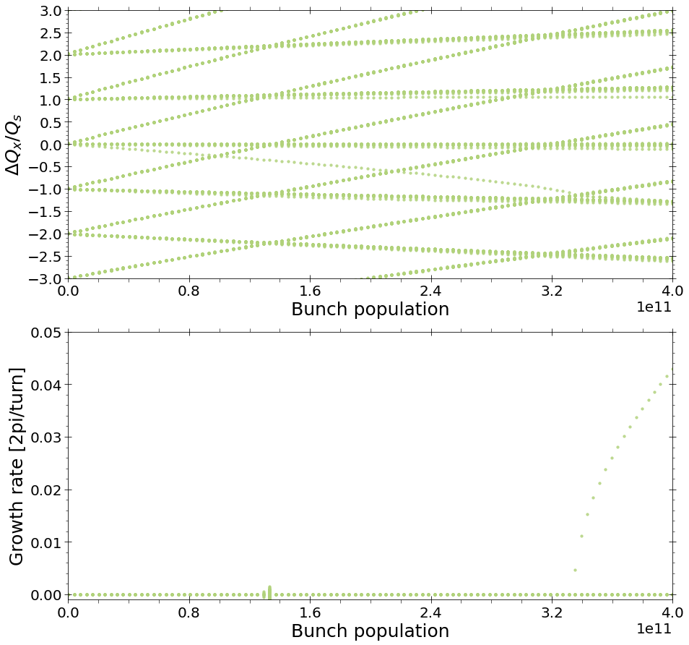
Impact of longitudinal wakefields on synchrotron detuning and TMCI
TMCI benchmark with multiparticle tracking (xwakes)

Slide 14
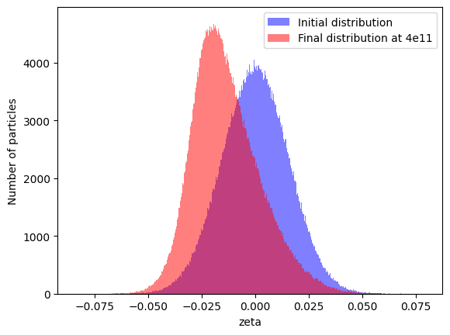
Impact of longitudinal wakefields on synchrotron detuning and TMCI
TMCI benchmark with multiparticle tracking (xwakes)
Potential Well Distortion has an effect on the dynamics and has to be implemented
TODO: Haissinski’s equation solver
Longitudinal impedance
distribution
initial rms size
energy
slippage factor
normalisation factor
circumference
normalisation factor given by:

Slide 15
Impact of longitudinal wakefields on synchrotron detuning and TMCI
Conclusion and outlook
An approximated representation of the longitudinal wakefield effects has been implemented in BimBim (CMM)
Documentation and examples are made available on the gitlab
Benchmark ongoing for the TMCI with tracking (xwakes)
Potential well distortion effects will be studied (Haissinski)
The effect of the longitudinal wakefields on transverse coherent instabilities (TMRI/TMCI, <x-z>) will be studied in the presence of beam-beam.

