Slide 1
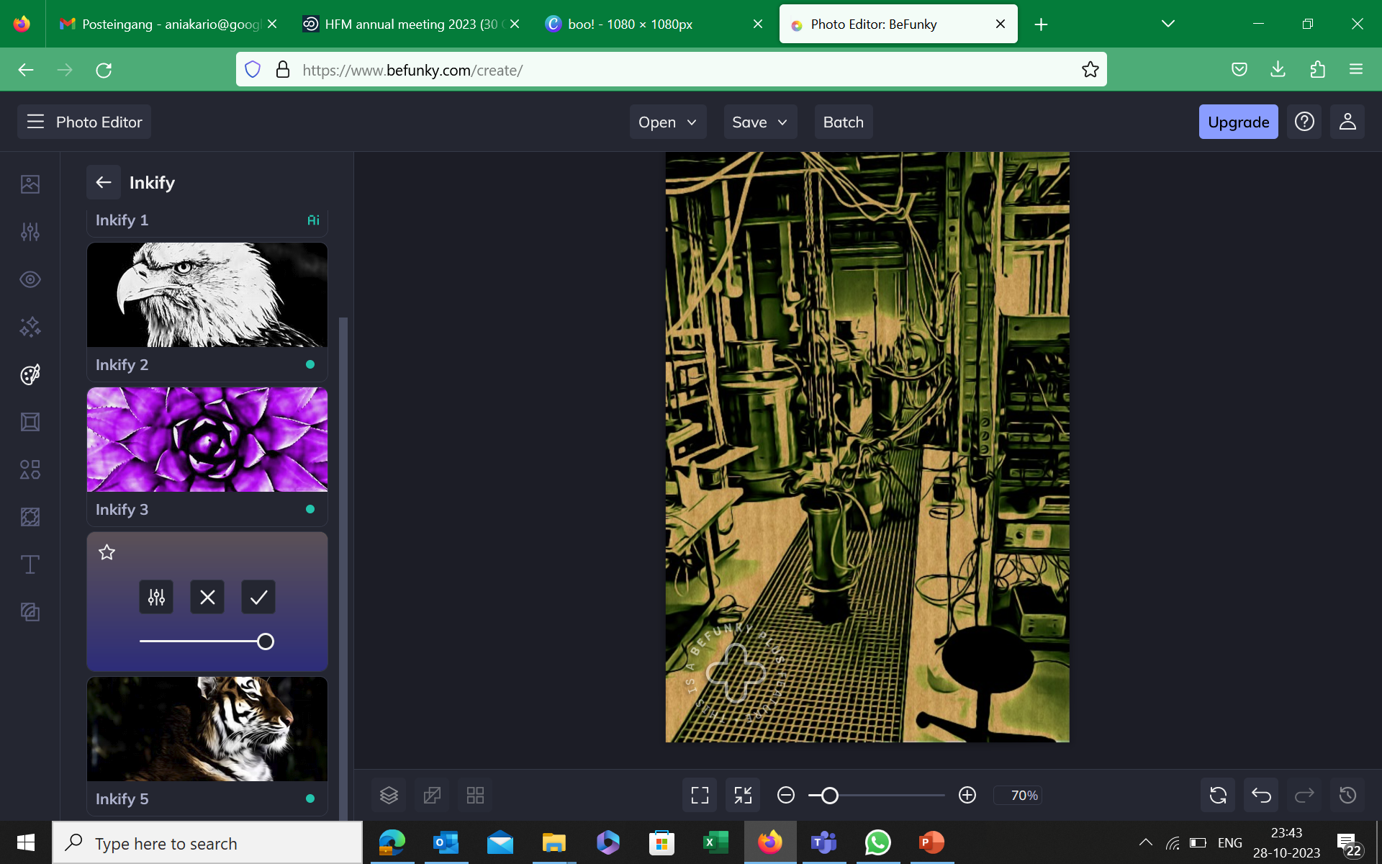

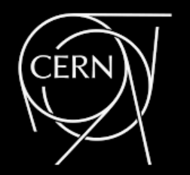
Electromechanical properties of ReBCO tapes, stack cables and coils
A. Kario, T. Nes, D. Velthuis, S. Wessel, J. Rietberg, A. Nijhuis, S. Otten, W. Huijskes, L. Rietkerk, C. Topaloglu, T. Hanhart, R. van Ingen, M. Goodwin, M. Dhalle, and H.H.J. ten Kate

Slide 2
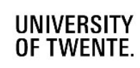
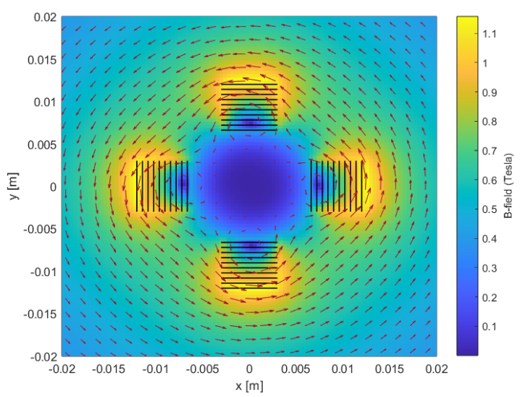
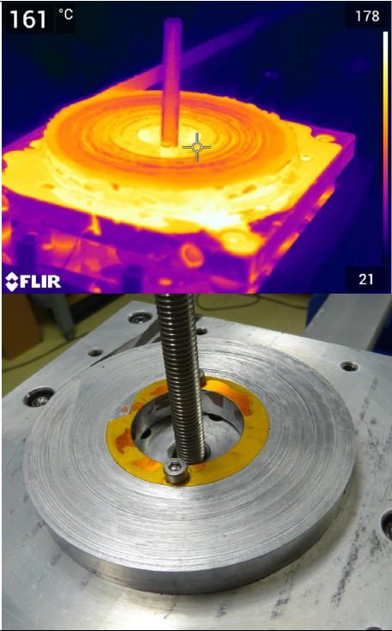
Outline
Single ReBCO tapes mechanical examinations
Transverse load
Axial tensile
ReBCO sub-stack cables
ReBCO demonstrator coils

Slide 3
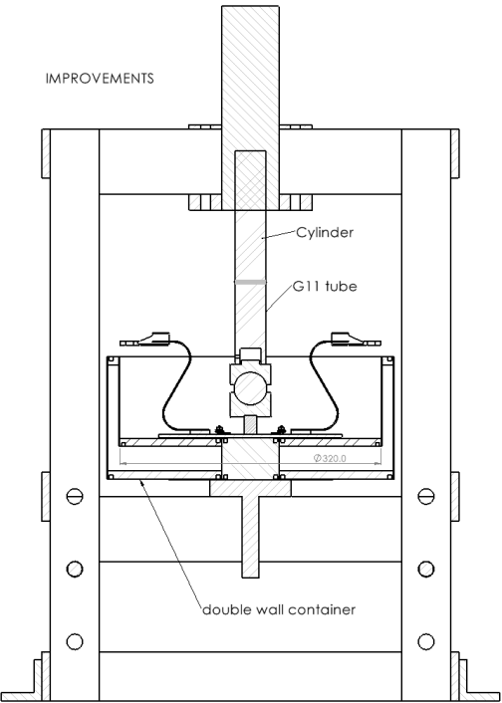
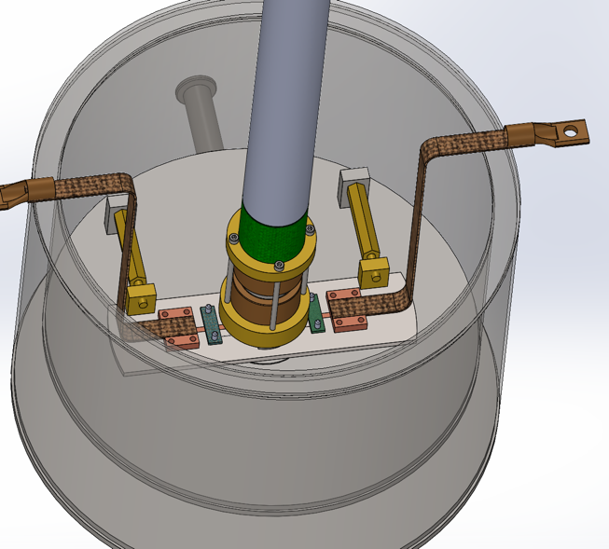
Transverse load setup - ReBCO tapes at 77 K
Cylinder press
Ball joint
Terminal
Pushing block
Ball joint
Ti-plate
Pushing block
Hydraulic press-based set-up, design and build for MuCOL related examinations.
Ball-joint alignment, titanium support, variable width, thickness, possible.

Slide 4
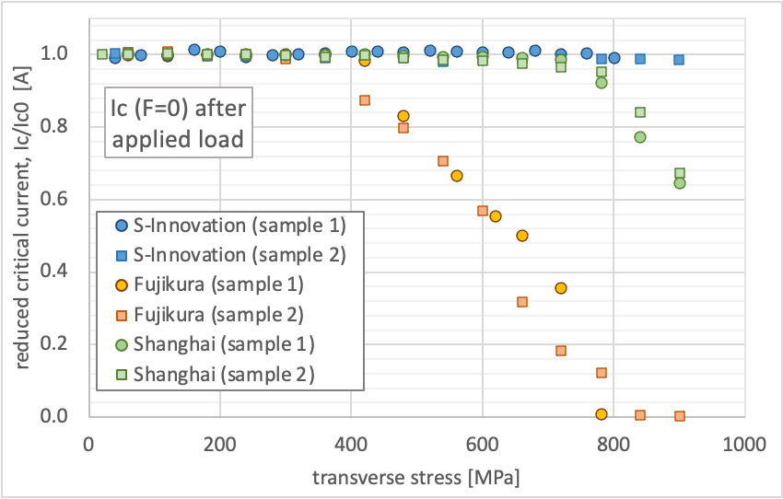
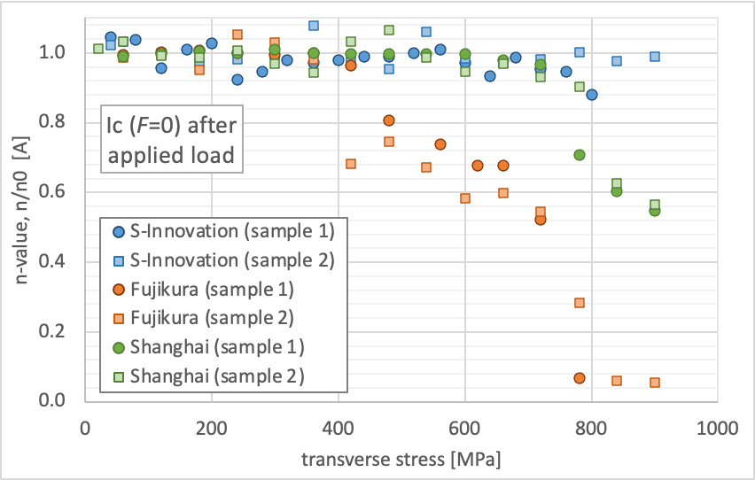
Critical current as function of transverse load @77 K
Tape | 𝜎_{irr} [MPa]
S-Innovation | > 900
Fujikura, 22-0012-09 | 400
SSCT, ST2903-105 | 750
Transverse load vary from 400 MPa to above 900 MPa for different manufacturers.
N-value follows the critical current degradation.
Transverse load limit is defined by substrate plastic deformation limit.

Slide 5
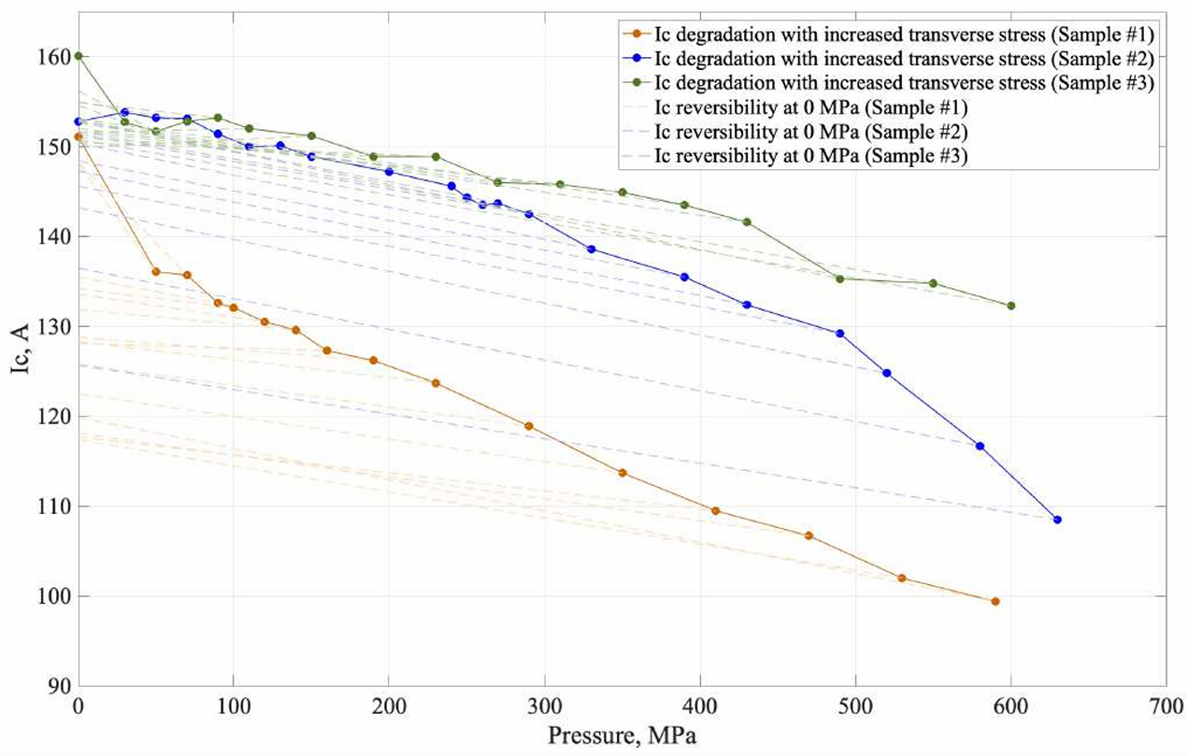
Misalignment of mechanical load = earlier degradation
ReBCO layer
Hastelloy substrate
ReBCO layer
Hastelloy substrate
Critical current decrease in the primary stage of loading.
Post-mortem analysis shows irregular positioning of the cracks in the ReBCO structure.
Focus Ion Beam cut, SEM images, examples of cracks.

Slide 6
platinum layer
ReBCO layer
buffer layers
crack
crack
cracks
substrate
Tape longitude section after transverse load up to 700 MPa
FIB cut shows damage by crack formation in ReBCO layer

Slide 7
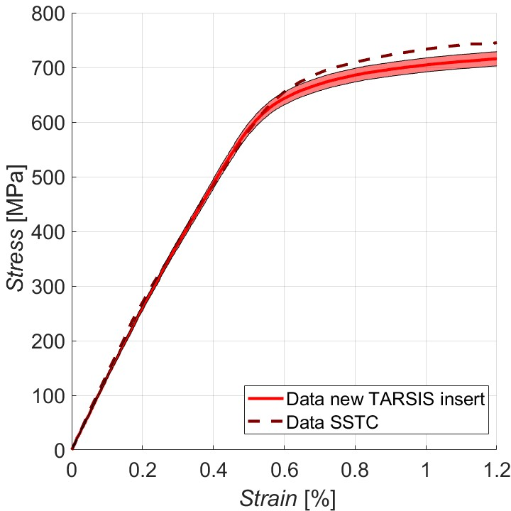
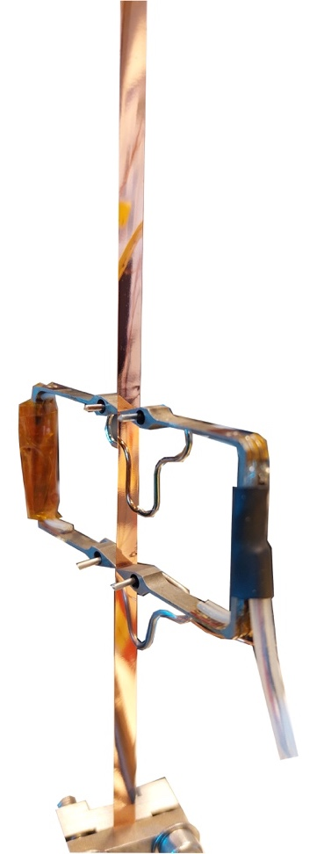
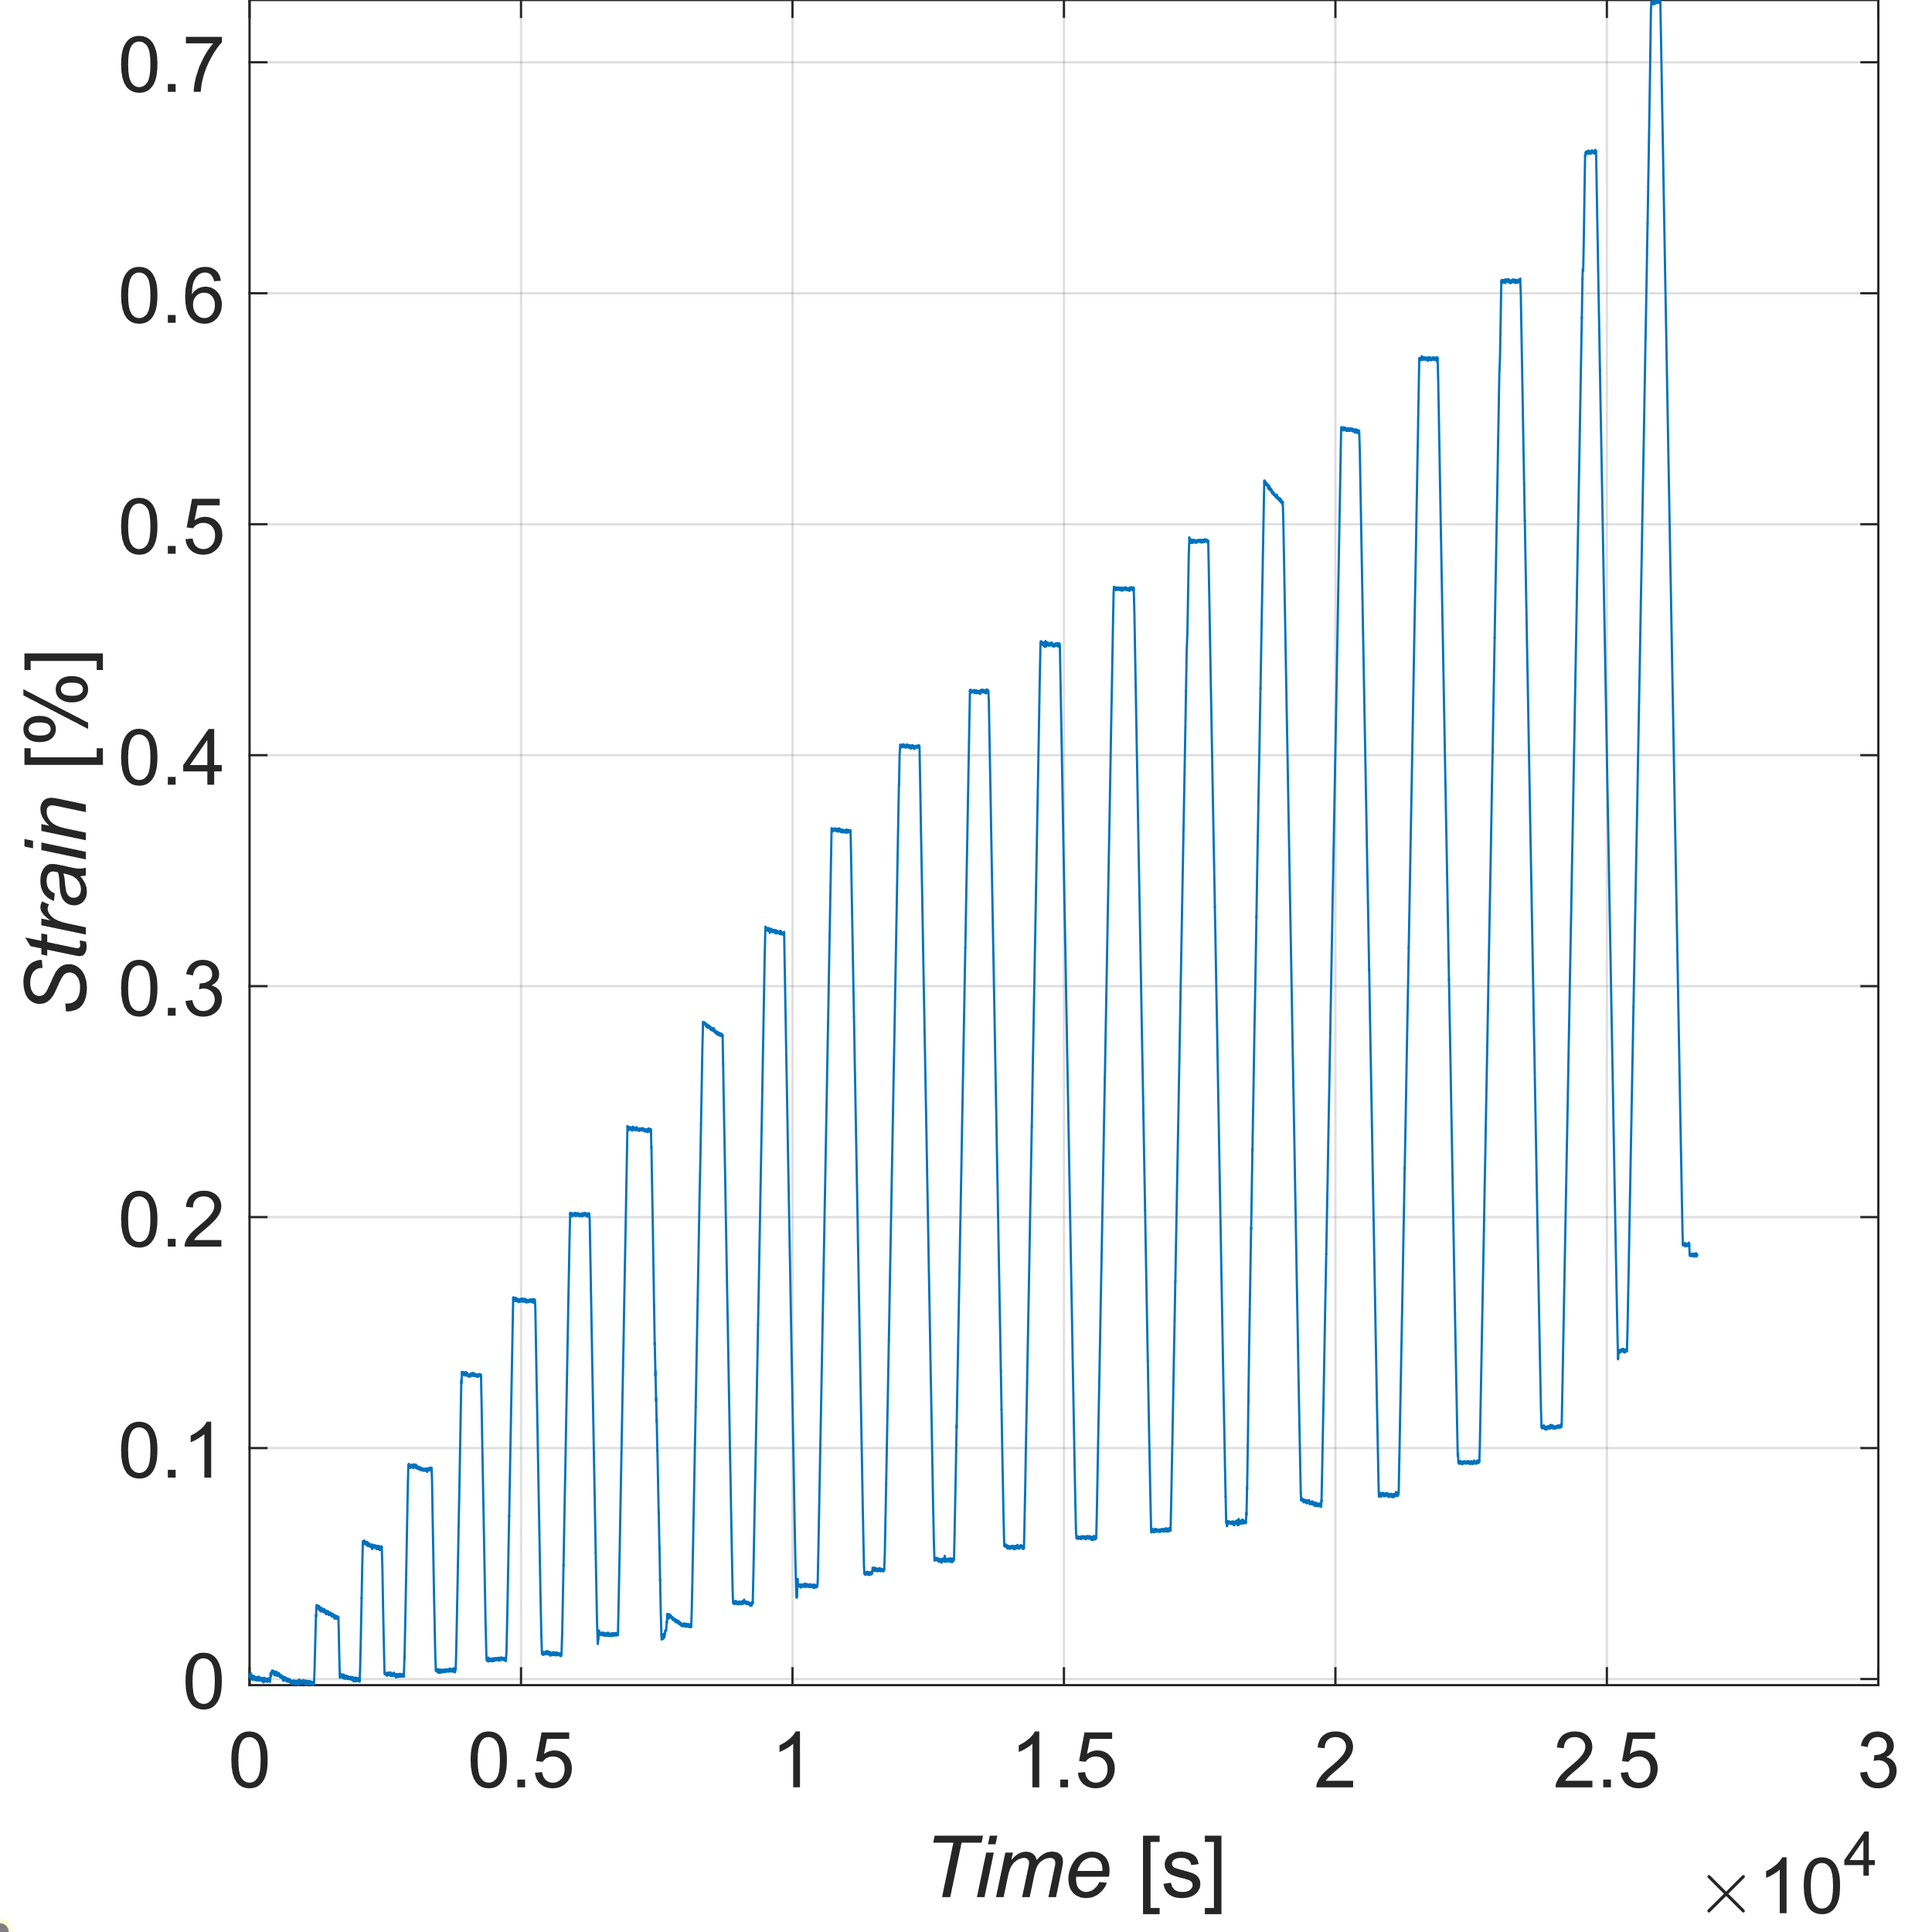
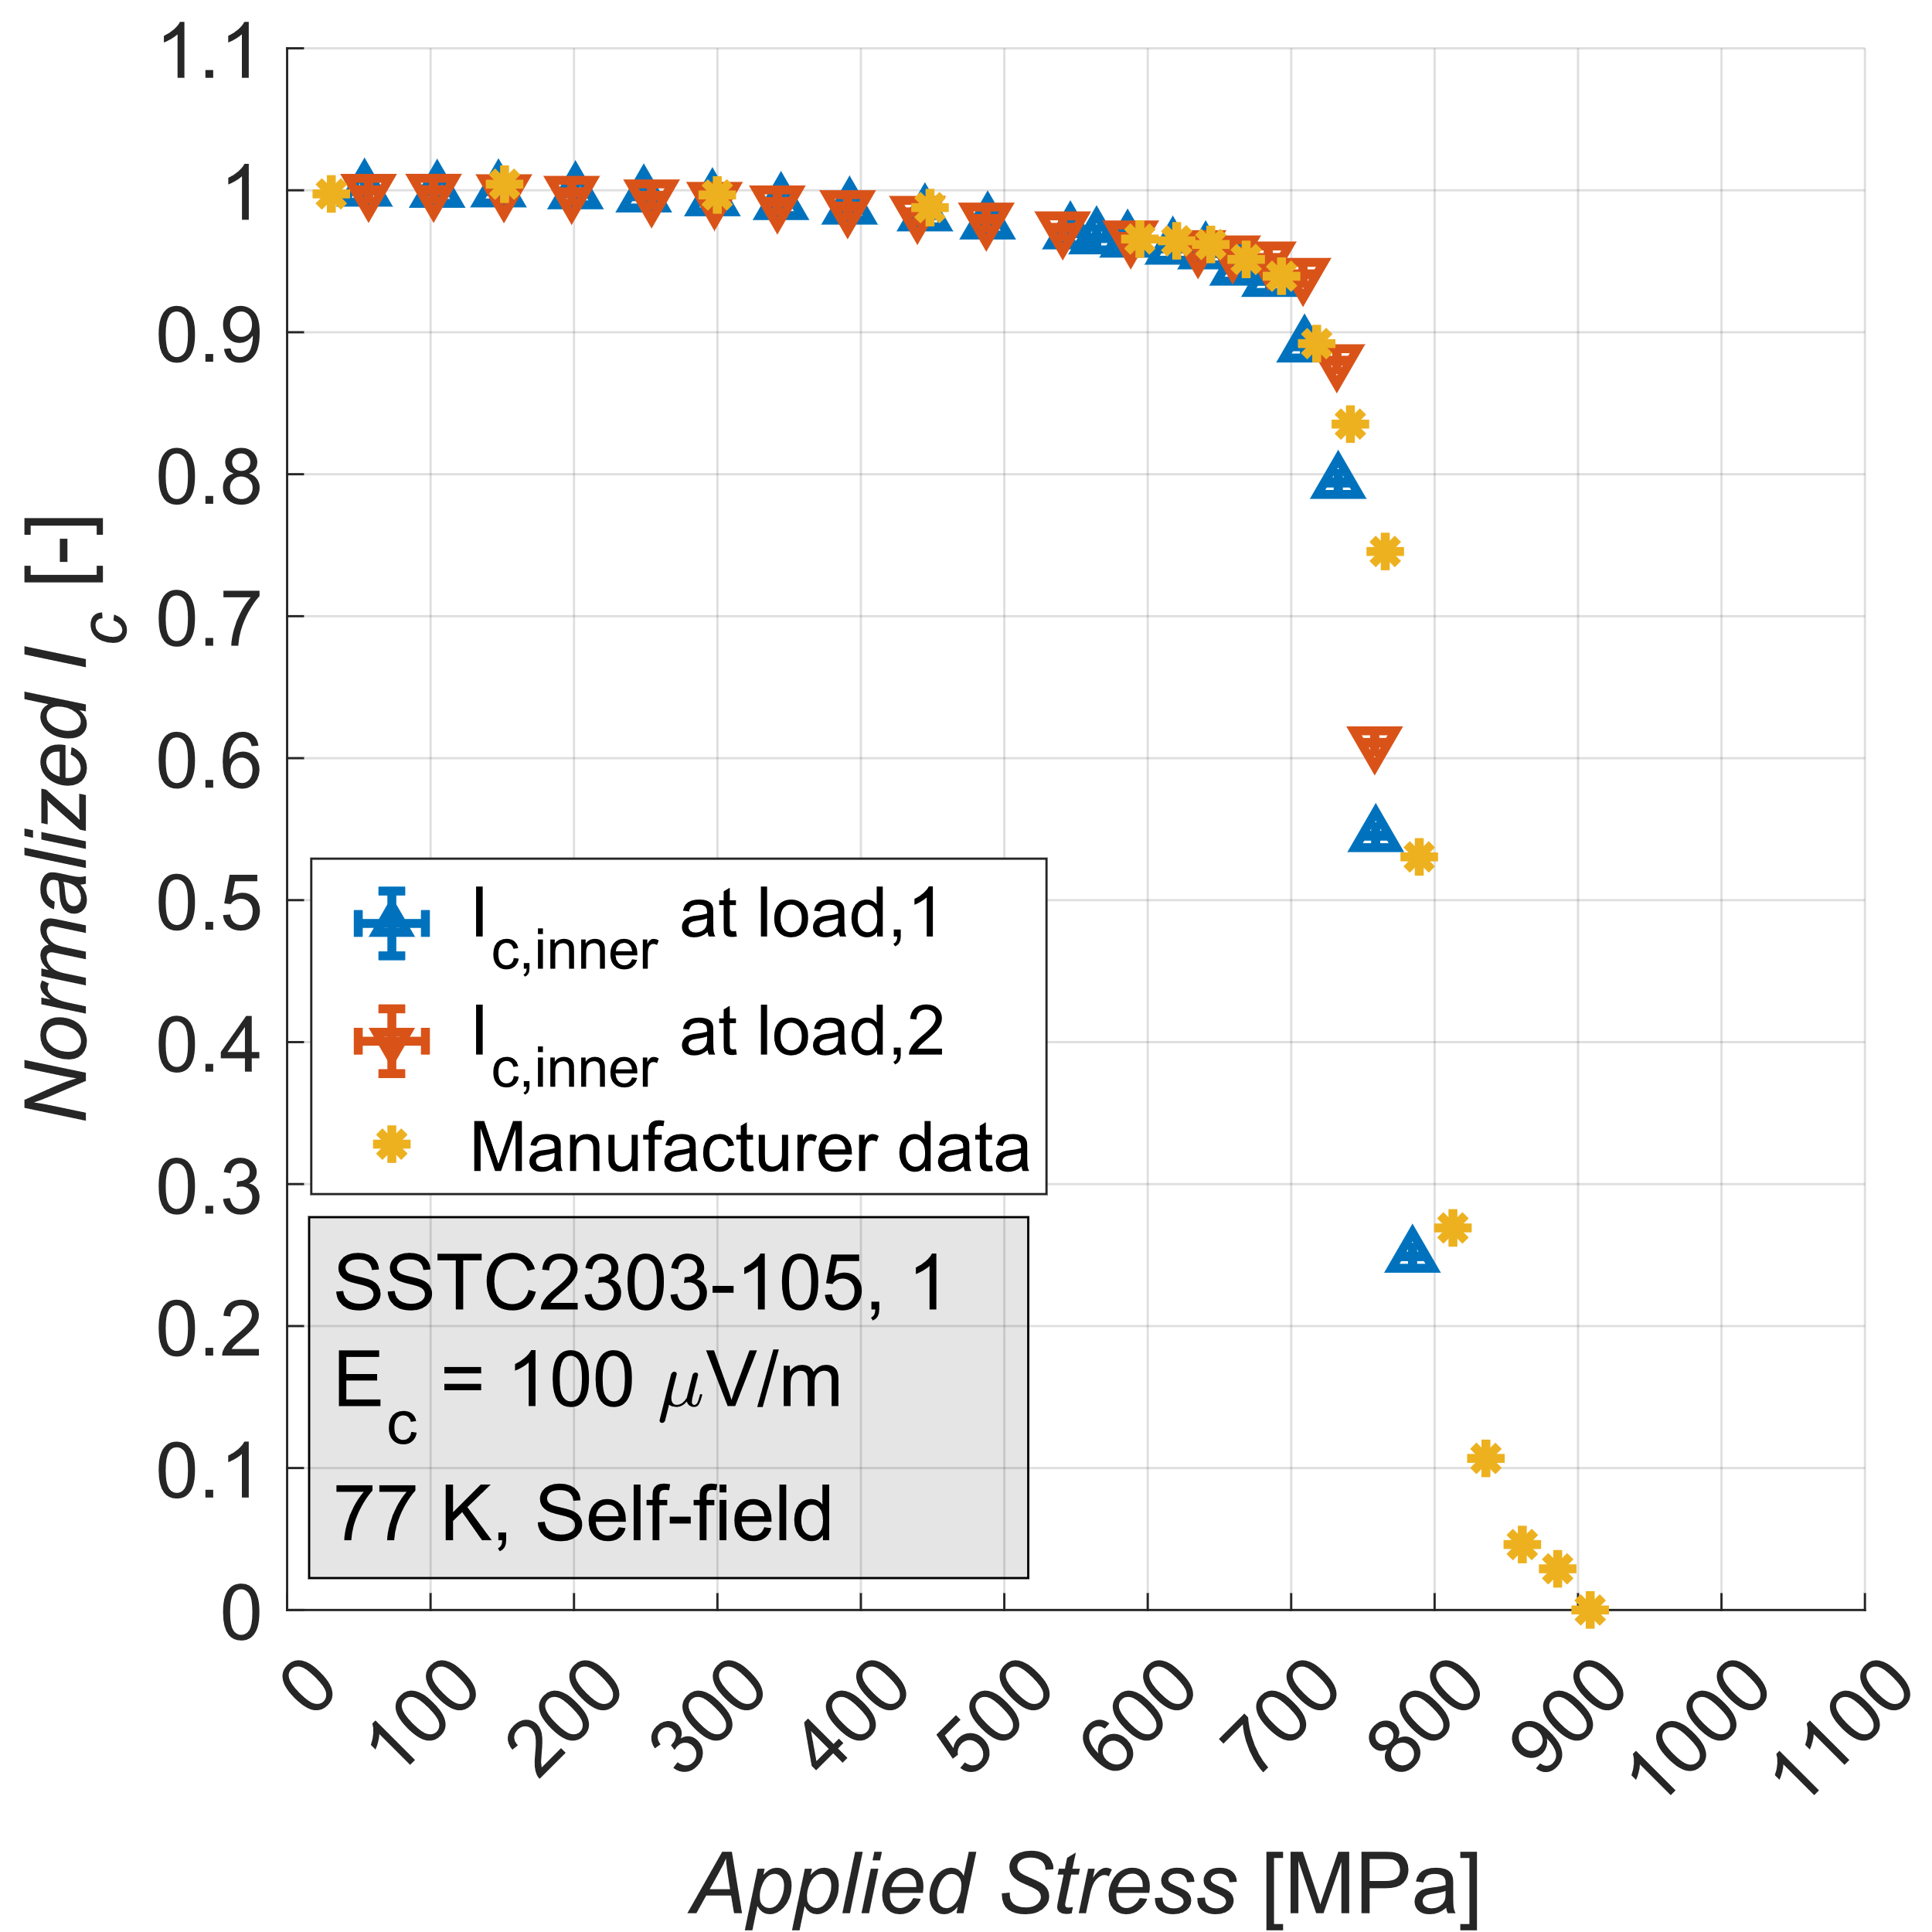
Axial tensile strain setup at 77 K
Tape | t_{Substrate} [𝜇m] | t_{Copper} [𝜇m] | I_{c} [A]
SSTC | 52 | 22 | 186
Fujikura | 49 | 25 | 204
Faraday | 39 | 13 | 162
Substrate : Hastelloy, width = 4 mm
Stress-strain properties, I_{c} & irreversibility limit for tensile axial strain.
5 MPa
7

Slide 8
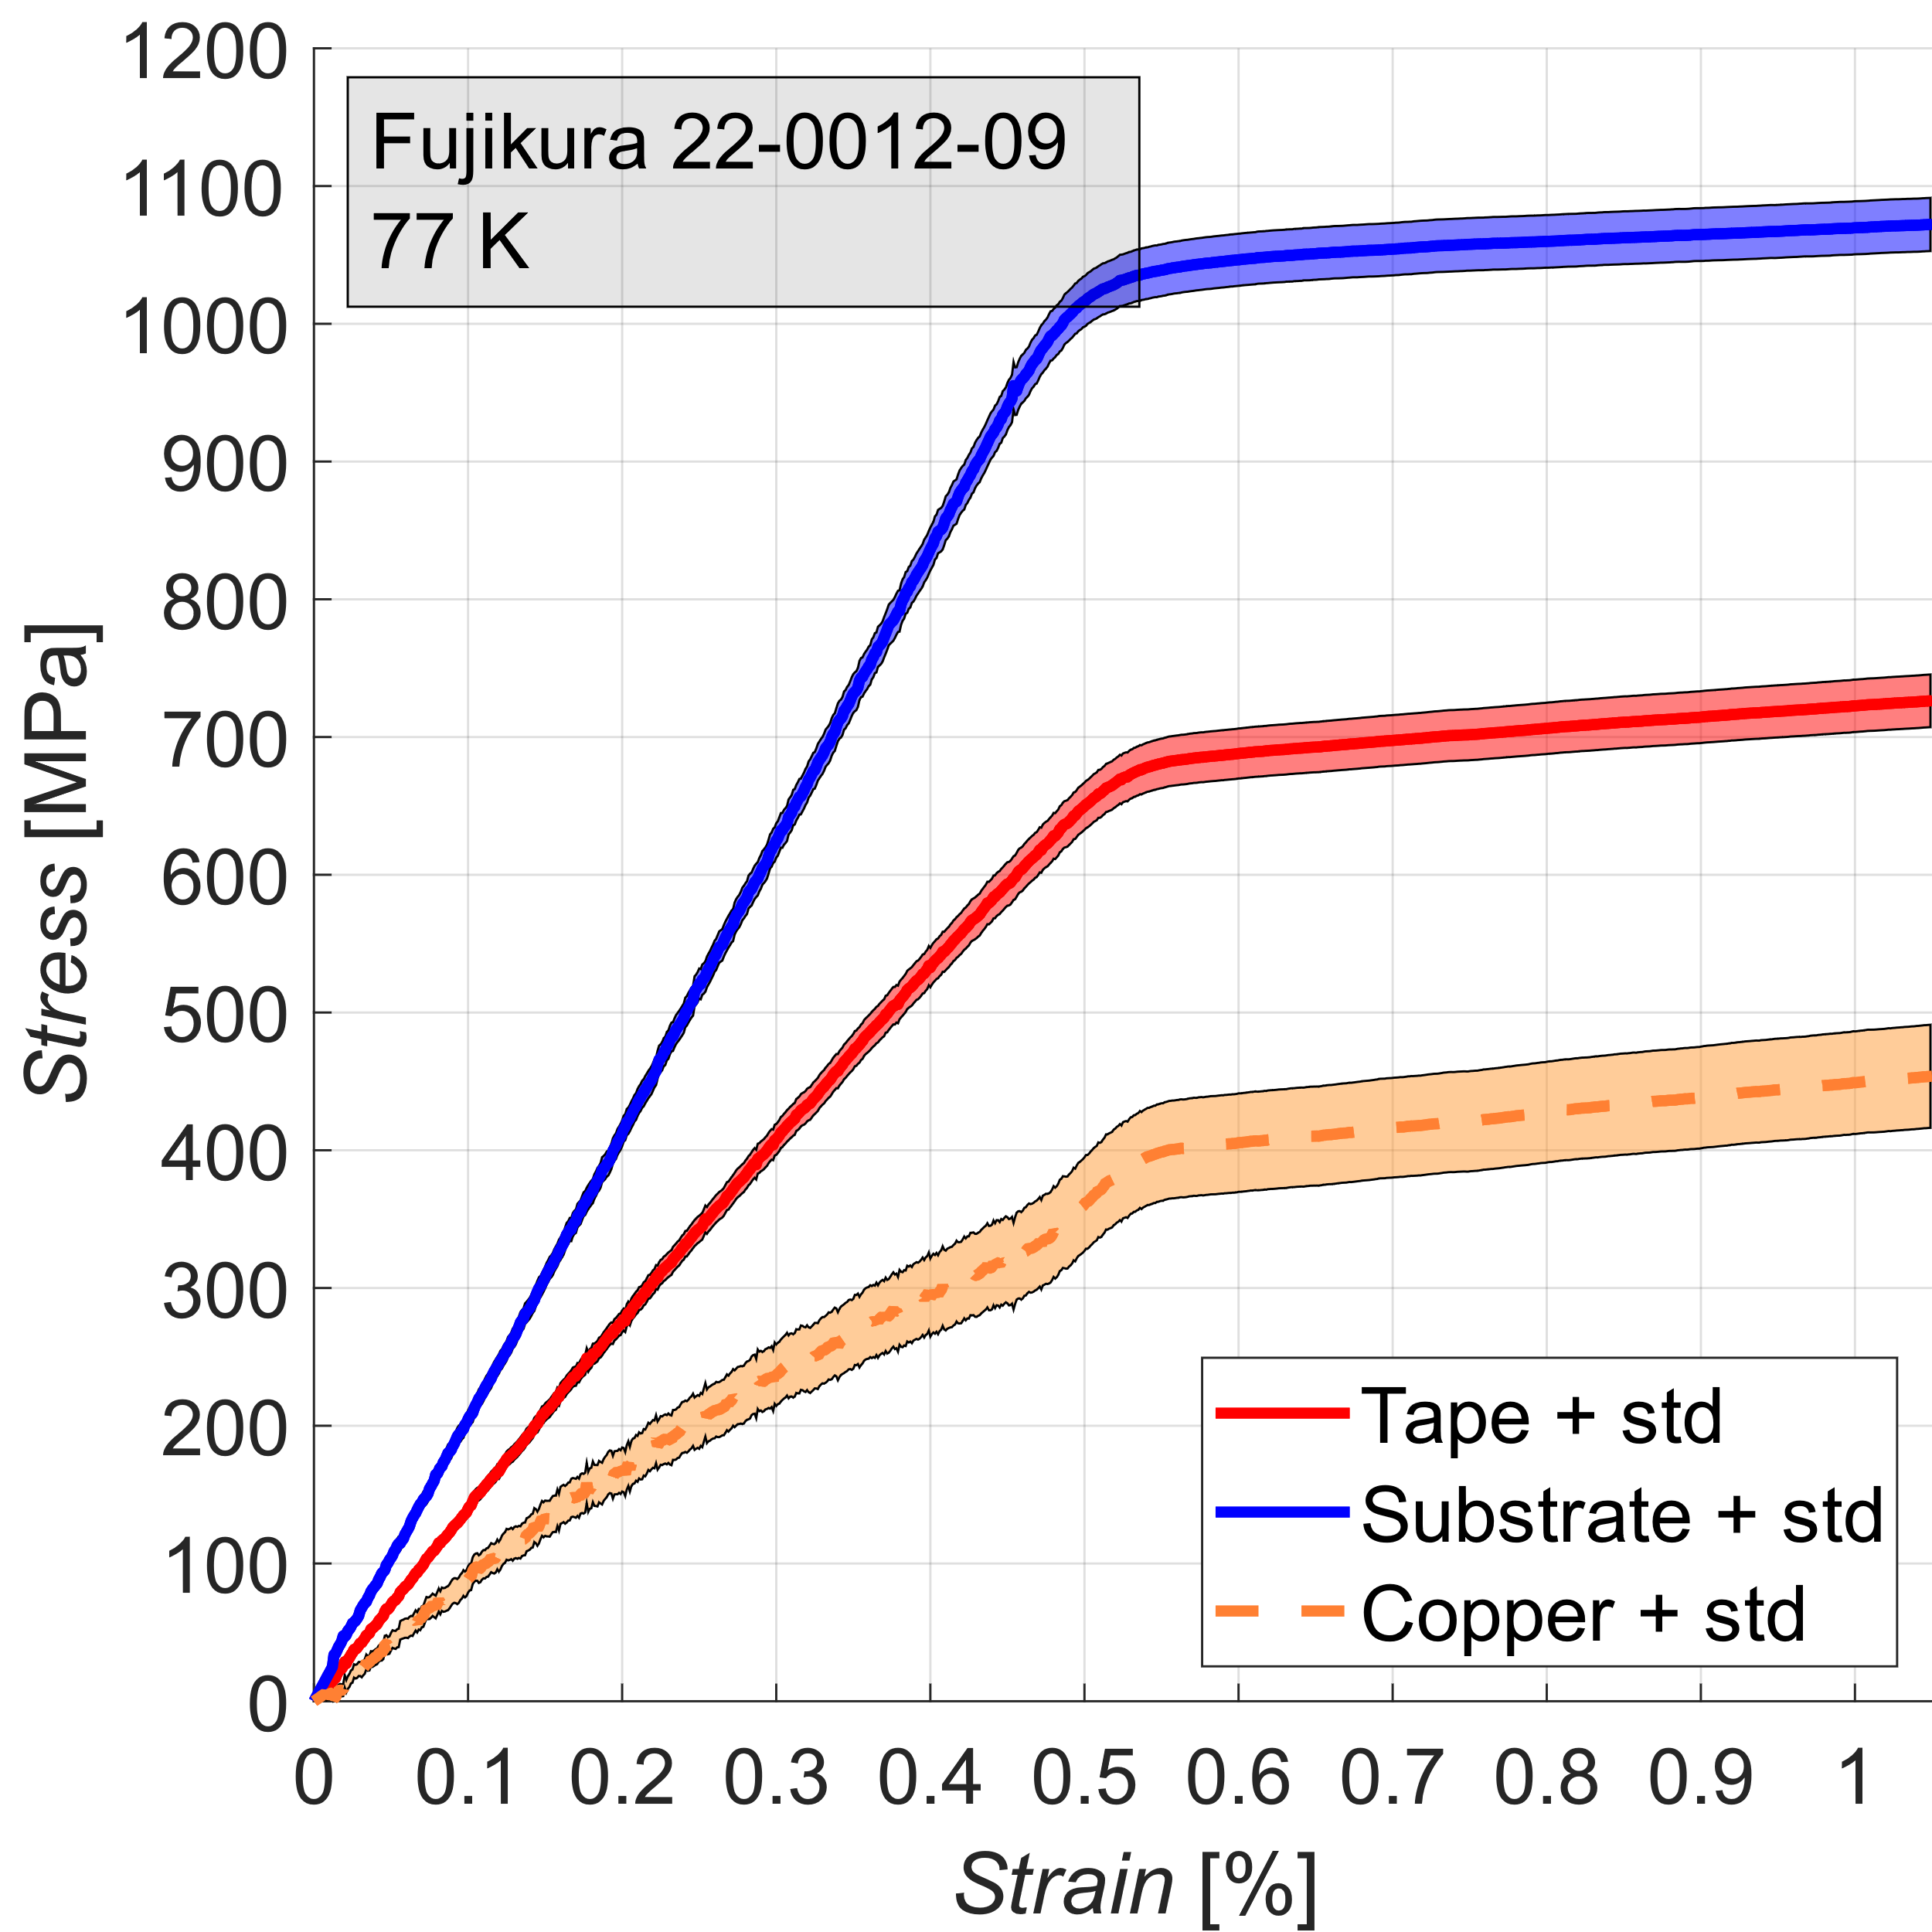
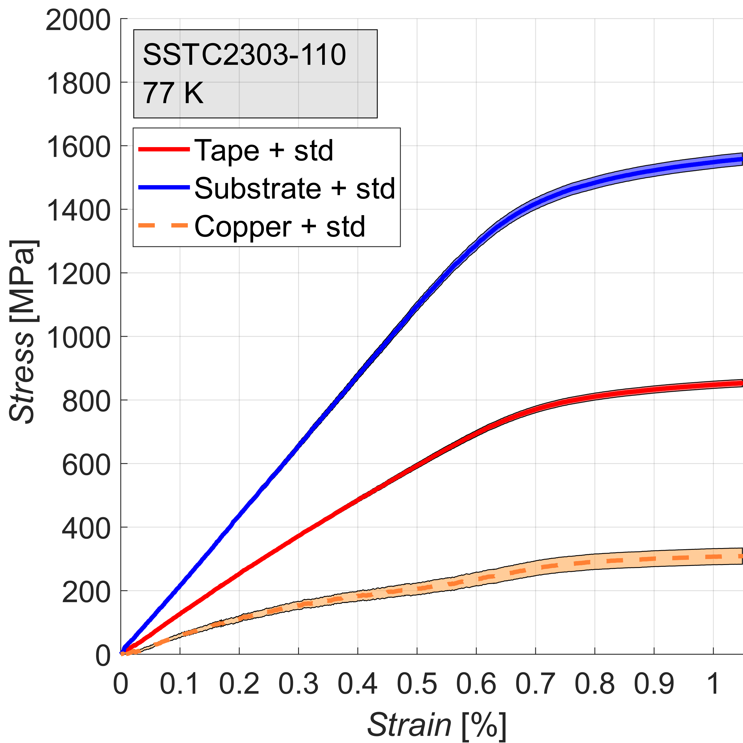
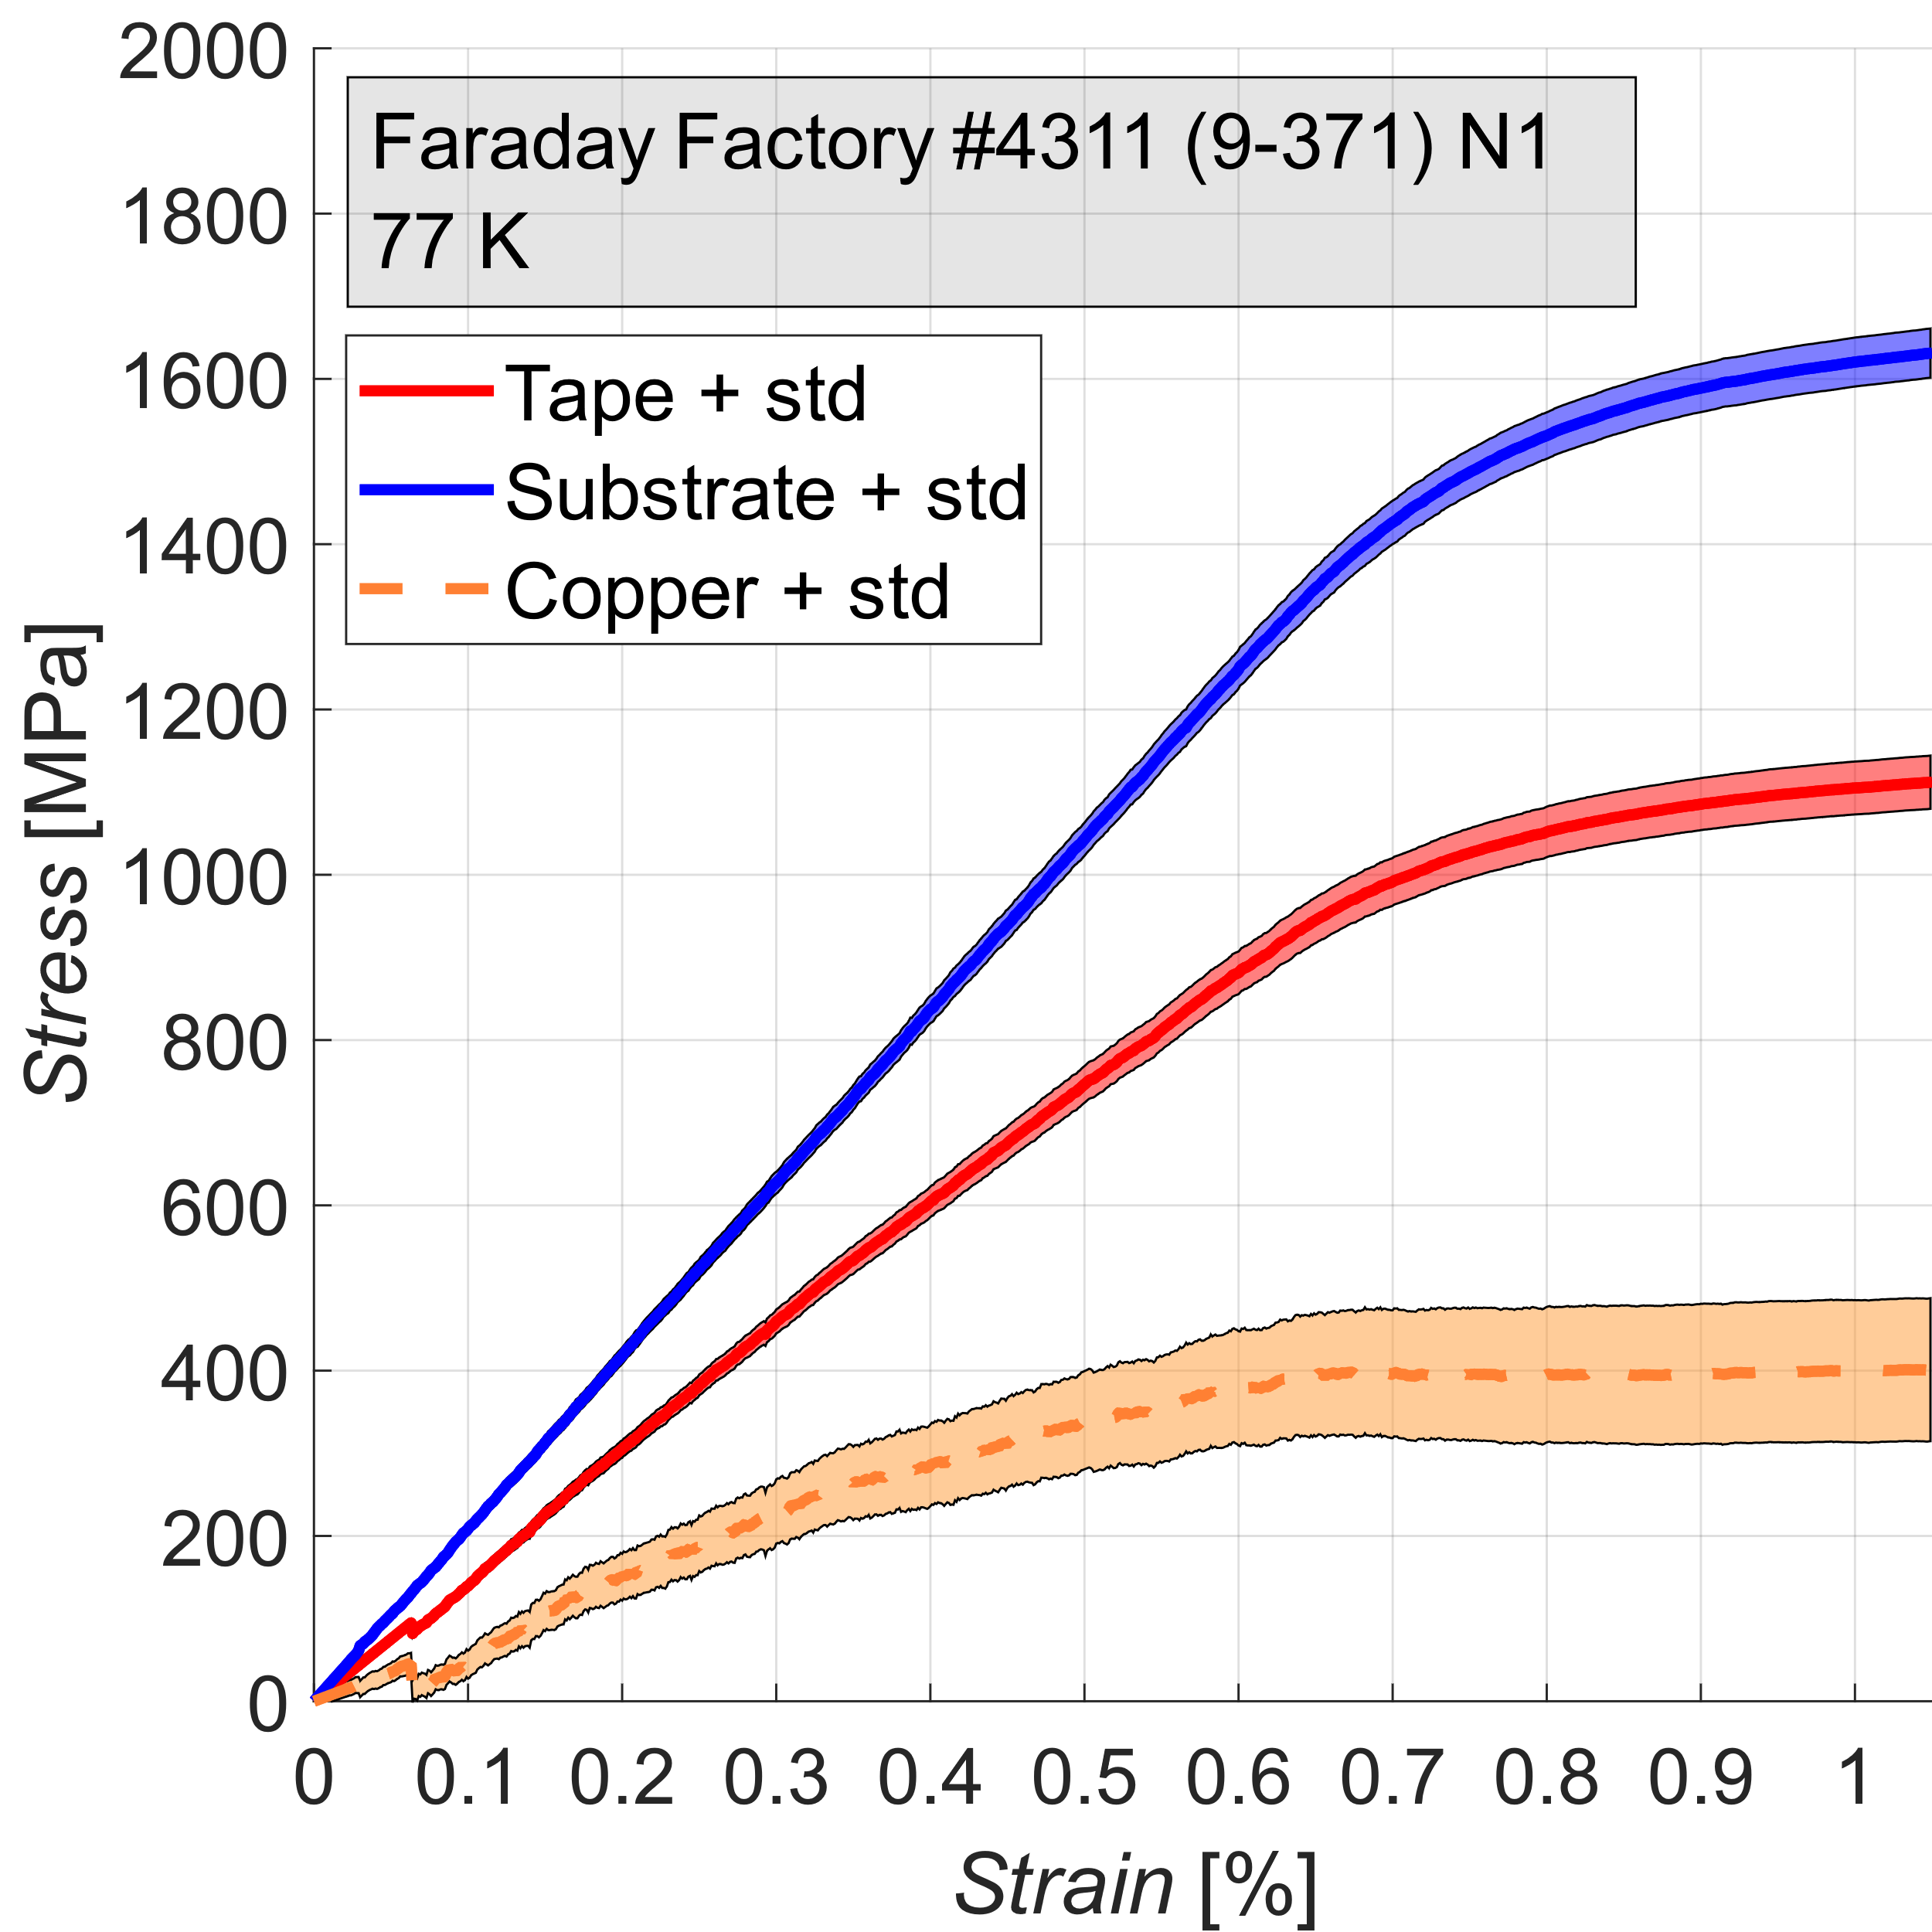
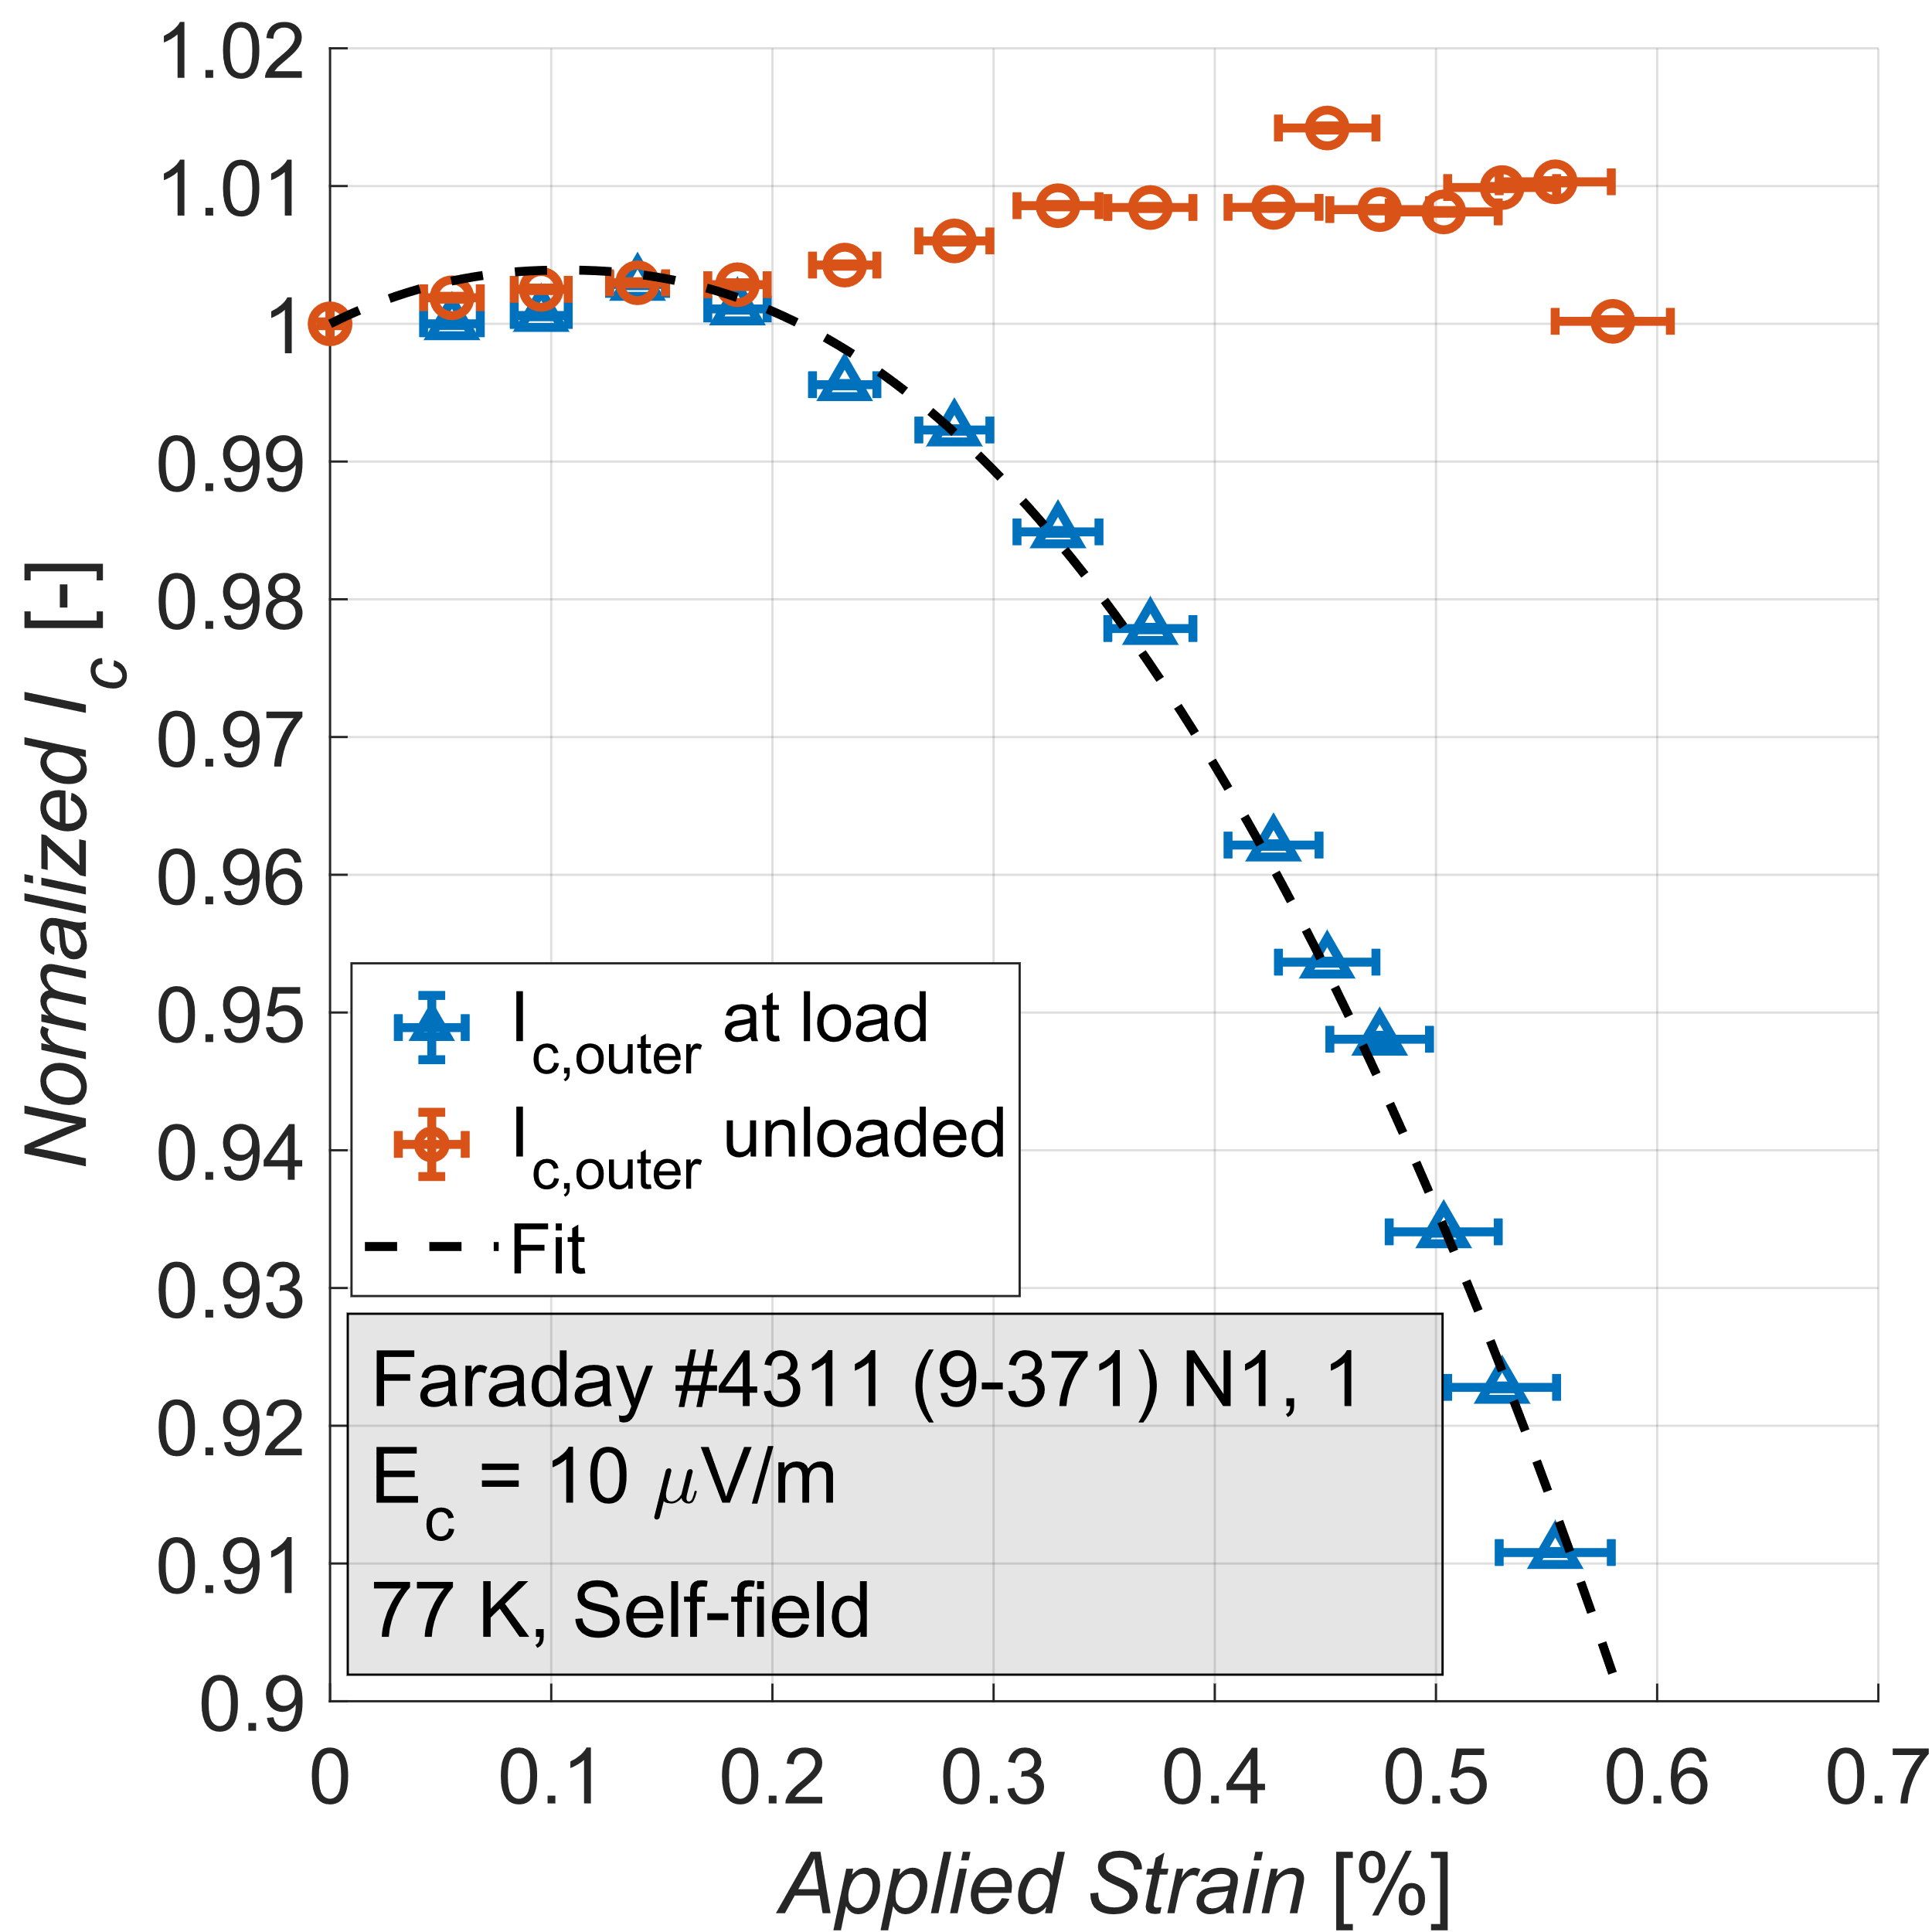
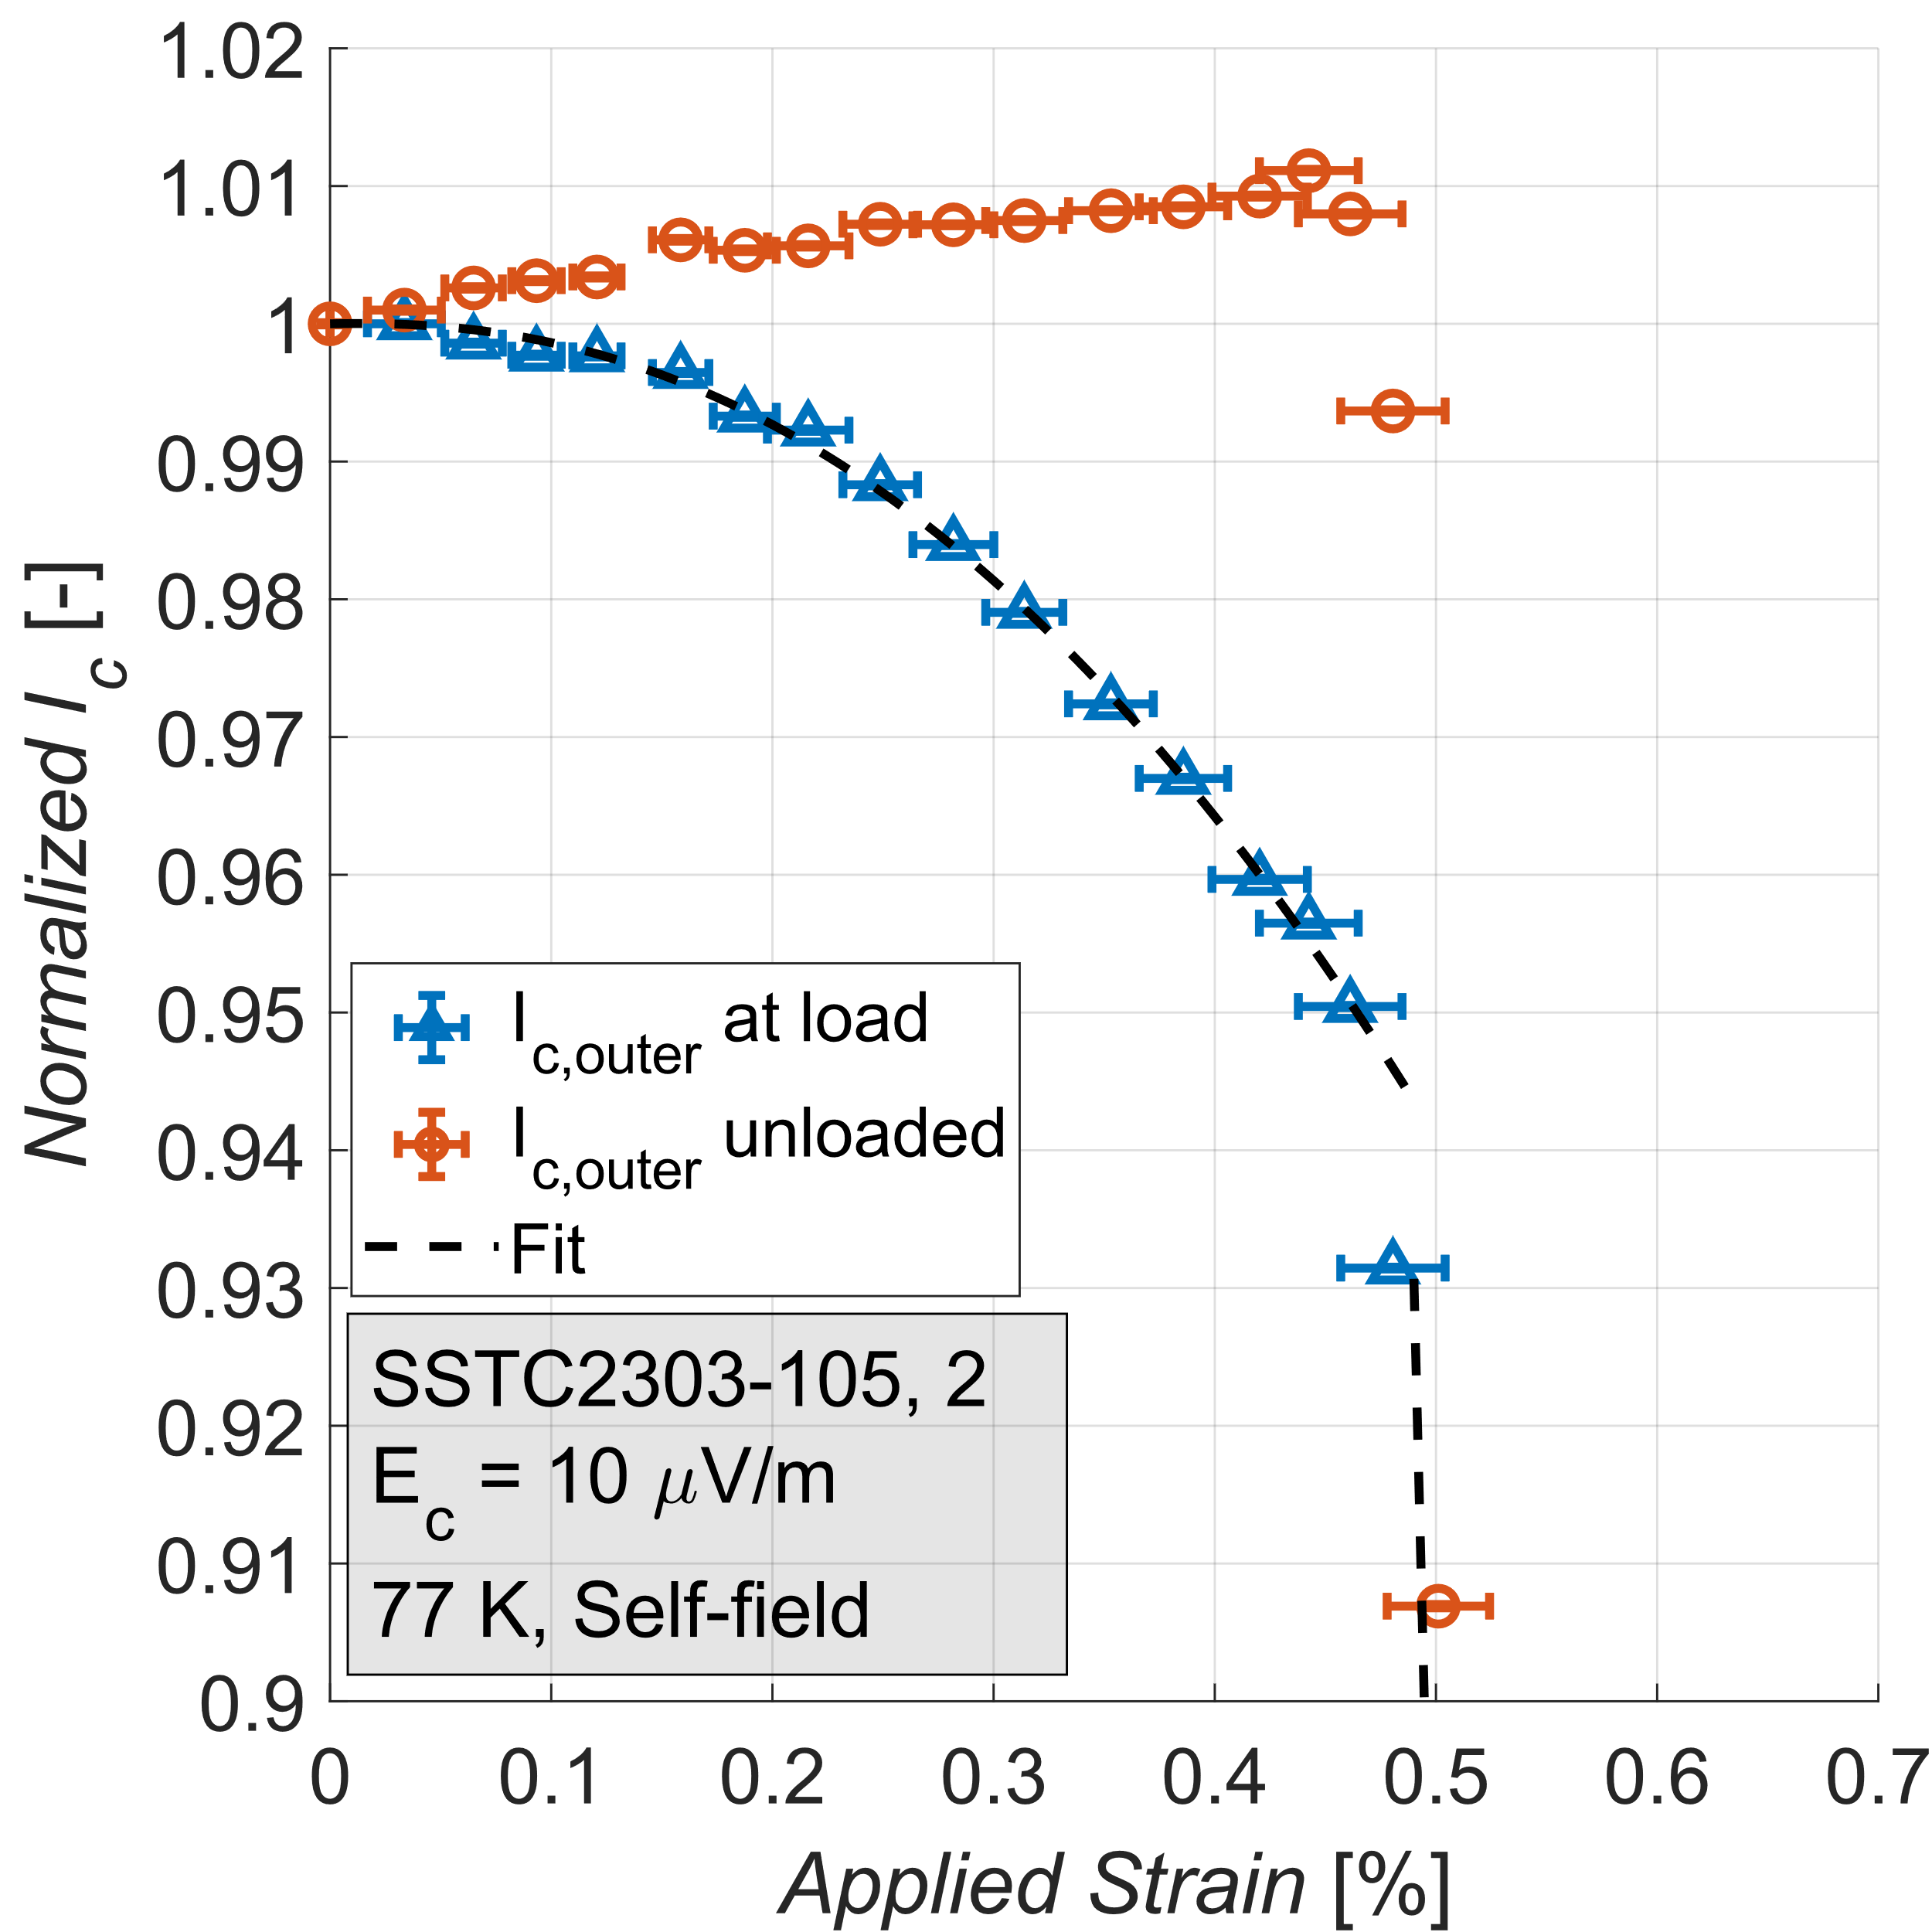
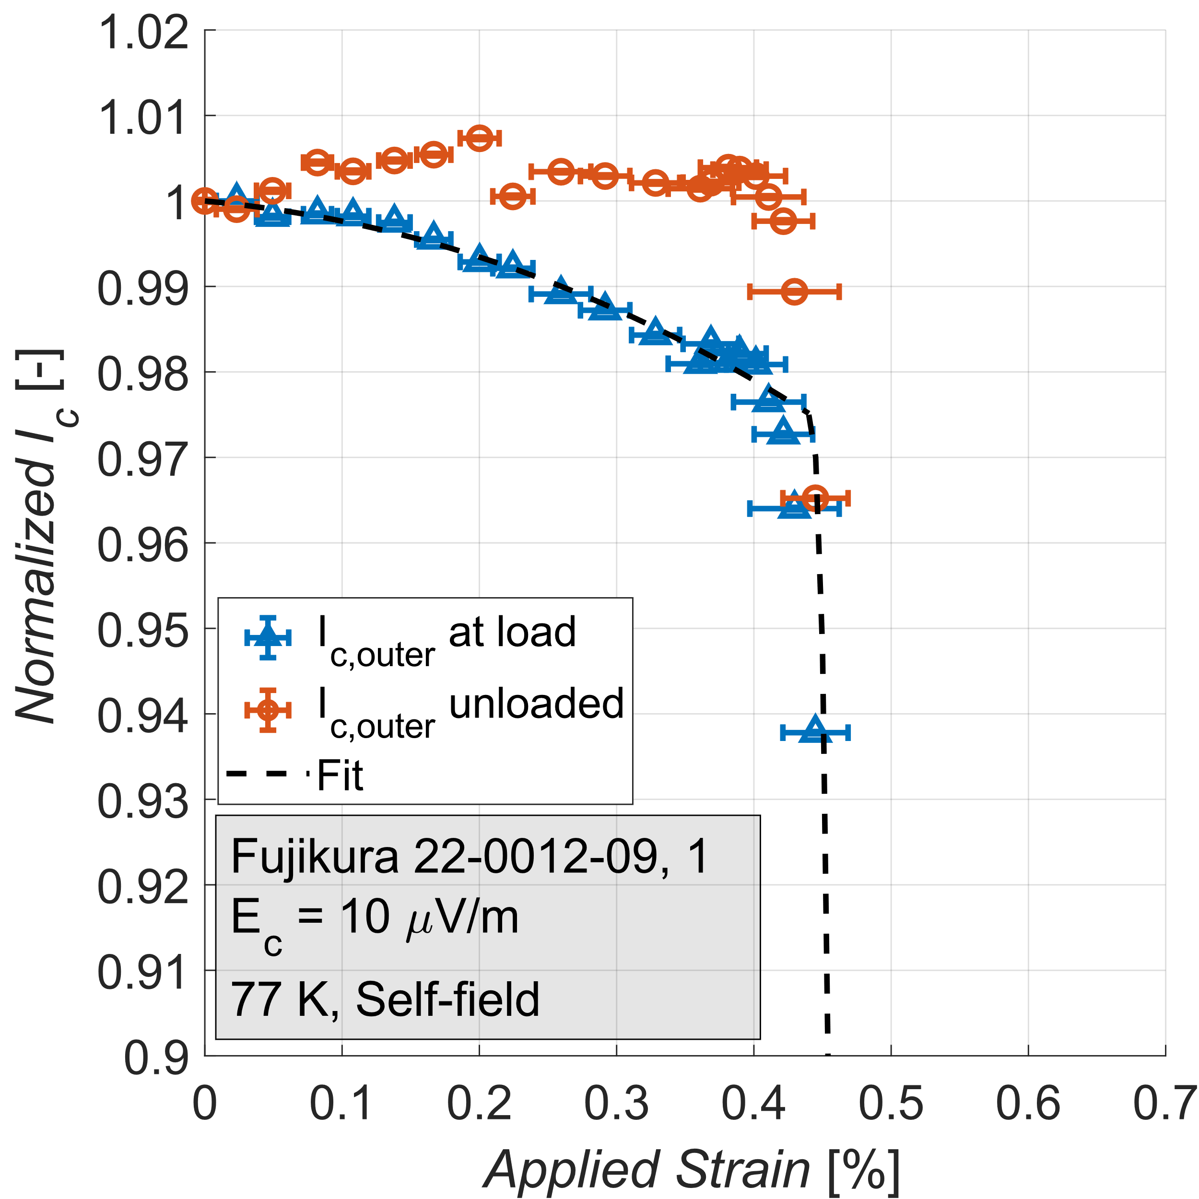
Axial tensile Stress-Strain curves & I_{c}(𝜖)
Tape | E [GPa] | 𝜎_{ys} [MPa]
SSTC | 125 | 600
Fujikura | 135 | 621
Faraday | 150 | 875
Tape | 𝜖_{irr}[%] | 𝜎_{irr} [MPa]
SSTC | 0.48 | 709
Fujikura | 0.43 | 626
Faraday | 0.58 | 900
8

Slide 9
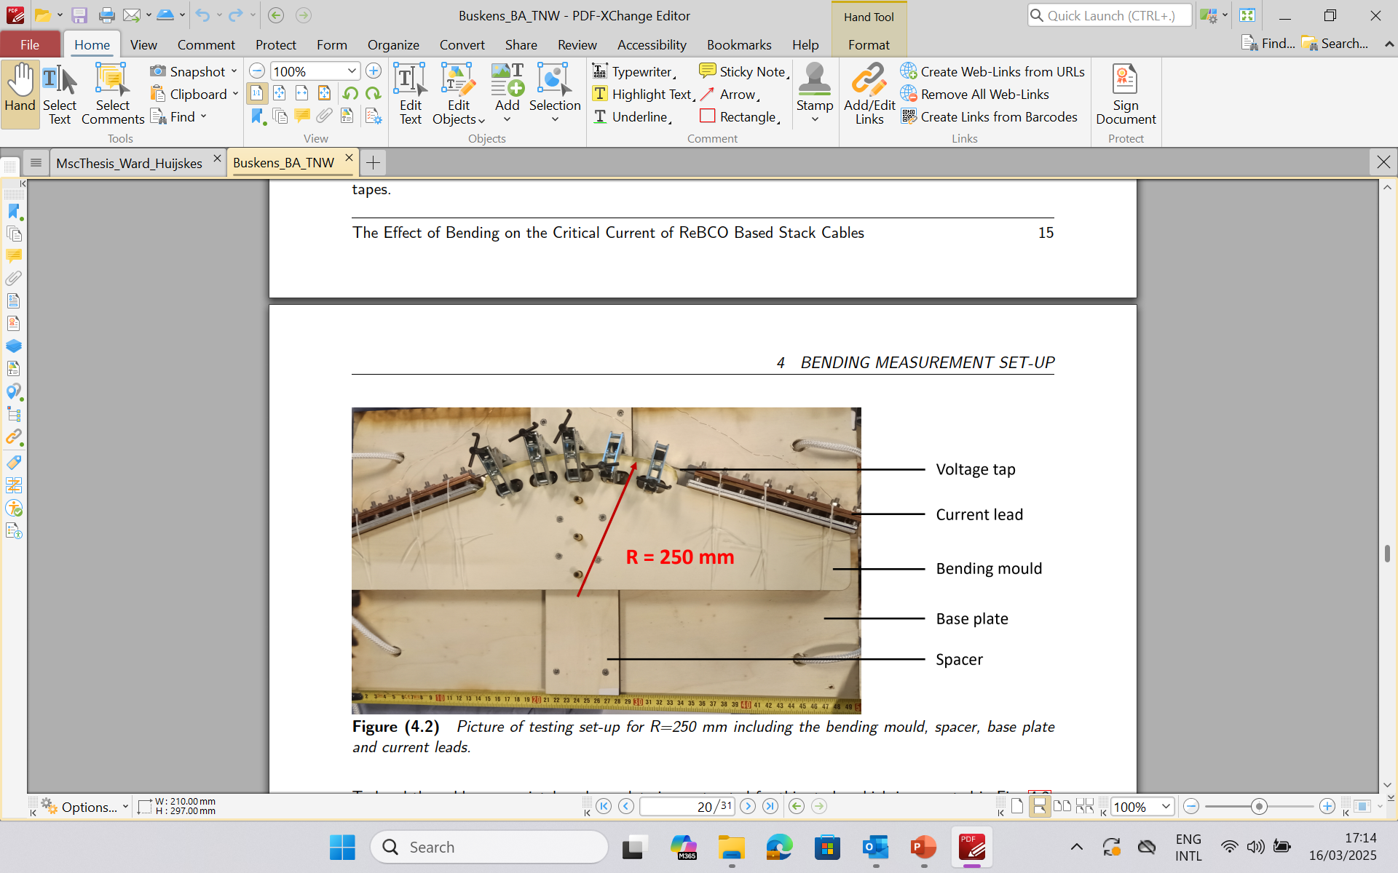
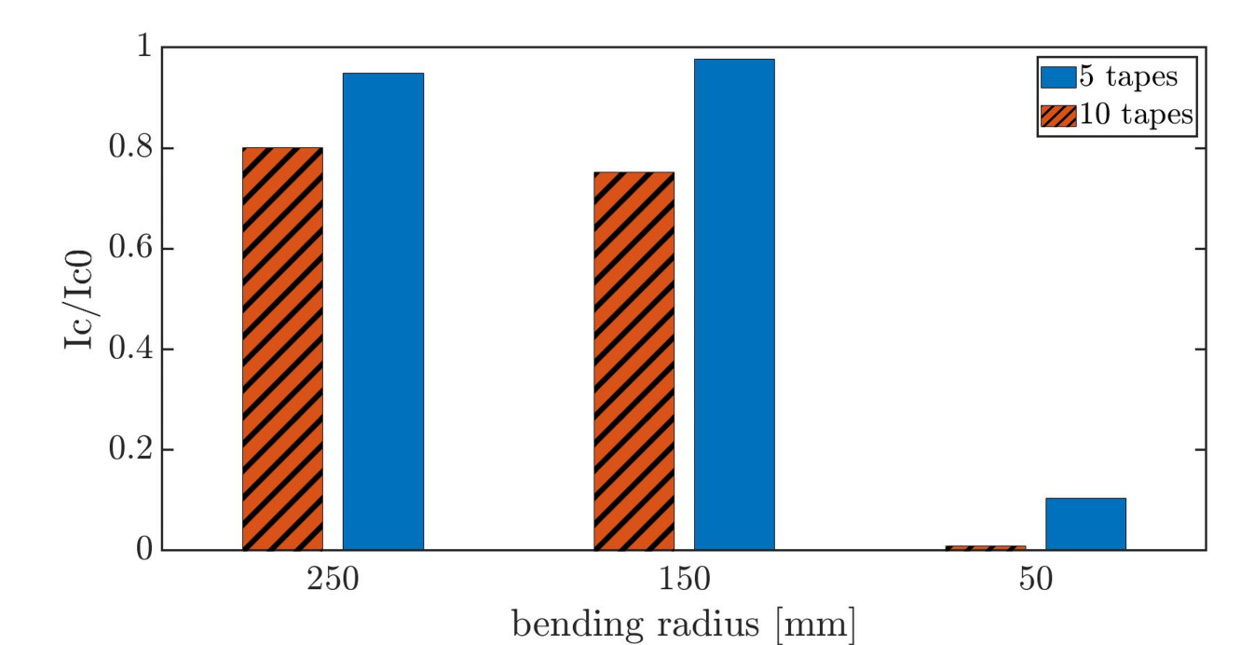
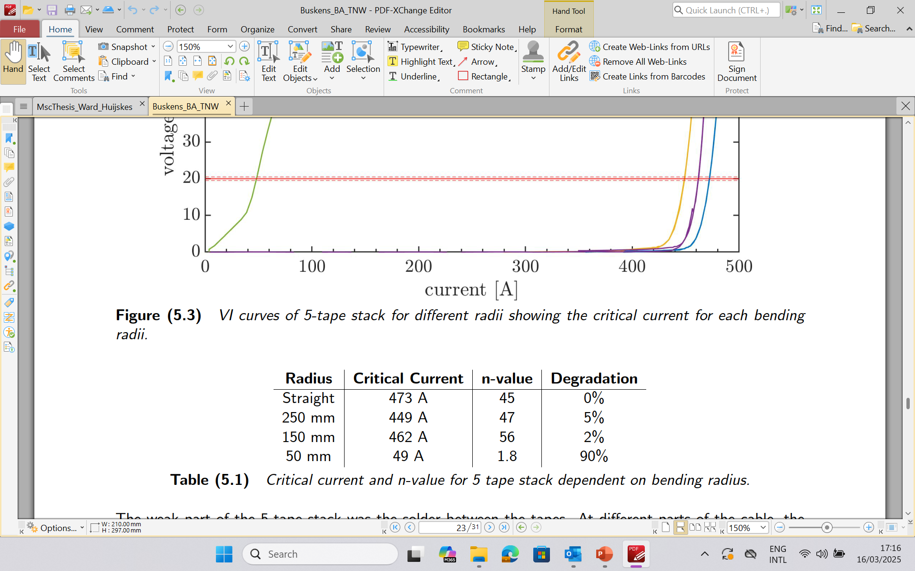
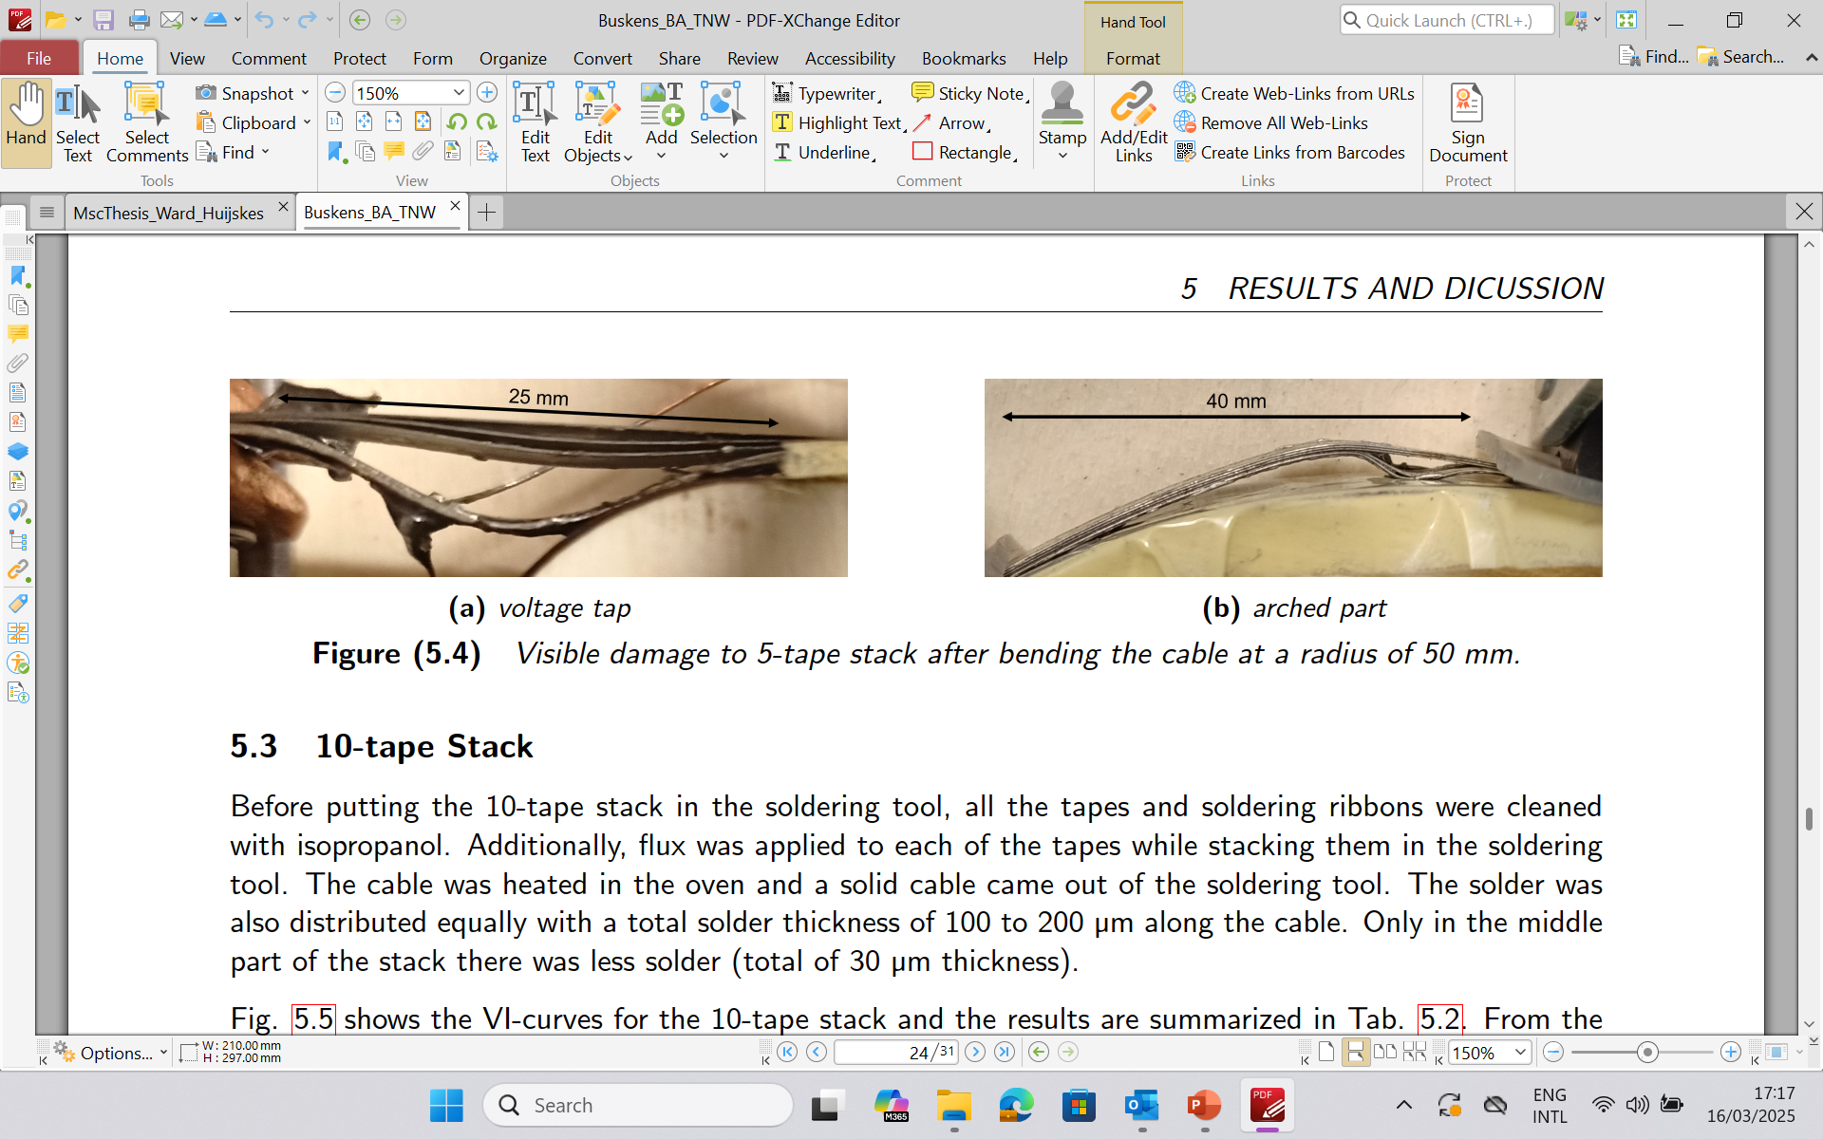
Bending of the soldered 5- and 10-tapes stack cables
Voltage tap
Voltage tap
Current lead
Critical current and n-value for 5- tape stack depended on bending radius
The 5-tape stack showed limited degradation (2-5%) for the bending radii of 250 mm and 150 mm.
The 10-tape stack had severe critical current degradation (20-25%) for the radii of 250 mm and 150 mm.
Bending at 50 mm caused detachment at the soldered interface and buckling to both cables.
9

Slide 10
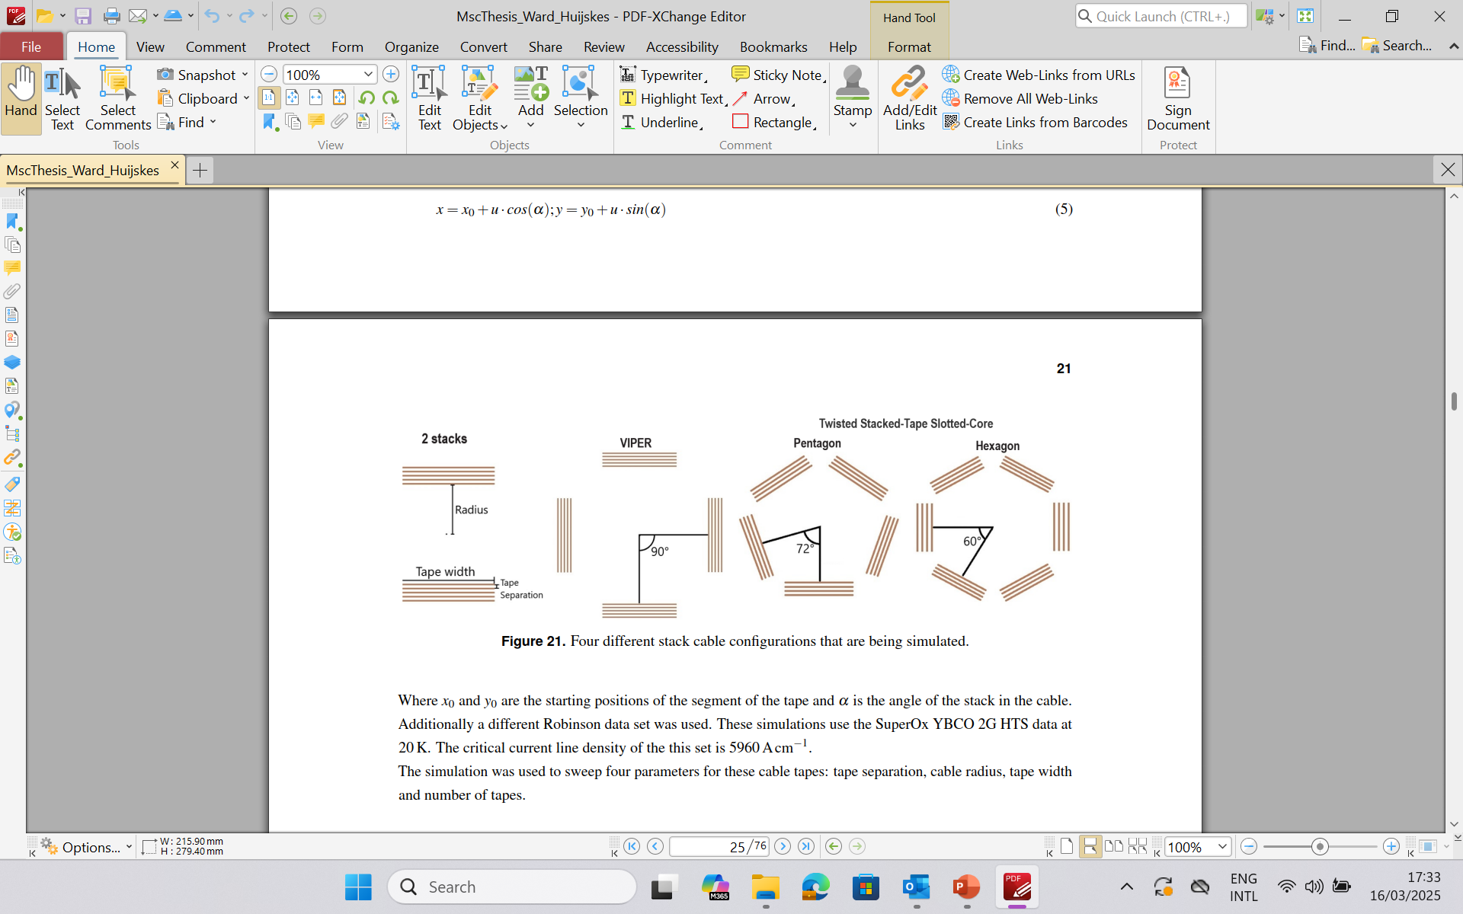
ReBCO stack cable critical current versus geometry
Two tapes stack
VIPER
Twisted Stack-Tape Slotted-Core
SuperOx YBCO 2G HTS data at 20 K from Robinson Inst. data base.
Tapes are assumed to be infinitesimally thick.
Length of the tapes can be neglected.
Example of the geometry with magnetic field map.
B-field (T)
10

Slide 11
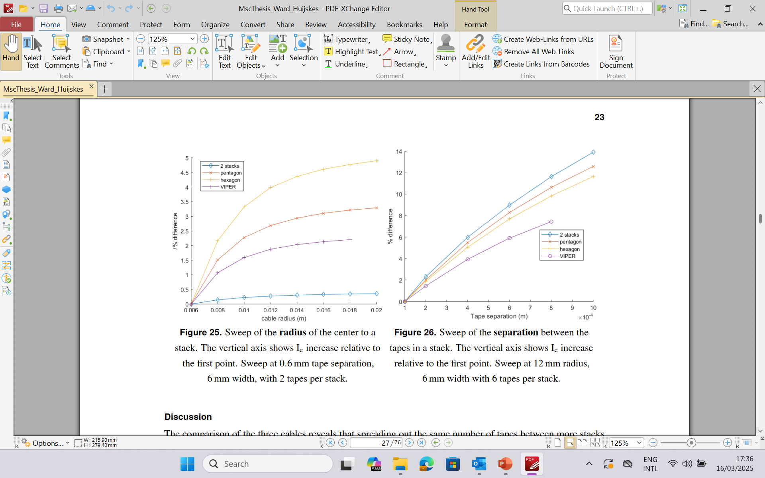
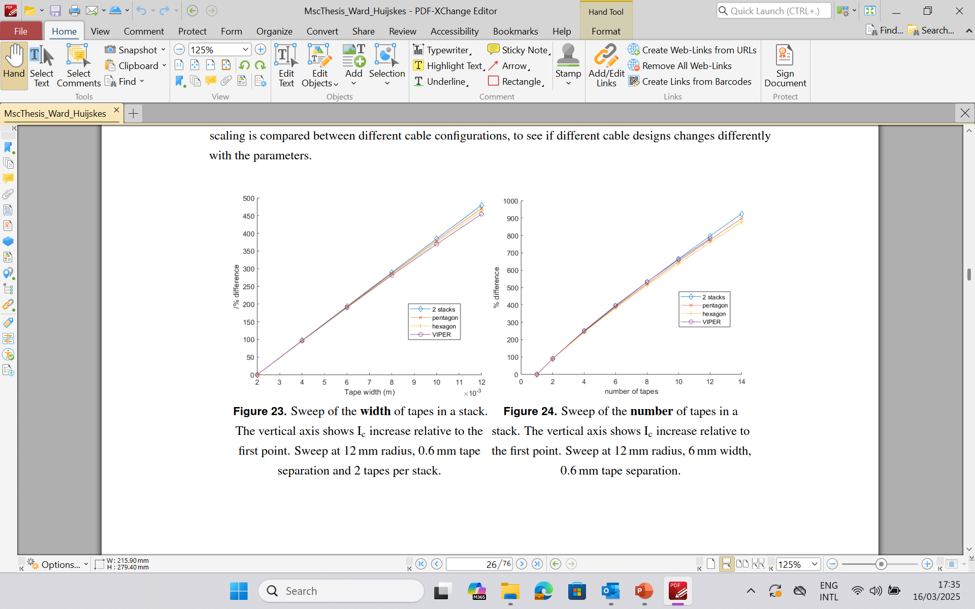
ReBCO stack cable critical current versus geometry
Tape width variation
Cable radius 12 mm
Tape separation 0.6 mm
2 tapes per stack
Cable radius variation
Cable radius 12 mm
Tape width 6 mm
2 tapes per stack
Separation between tapes
Cable radius 12 mm
Tape width 6 mm
6 tapes per stack
11

Slide 12
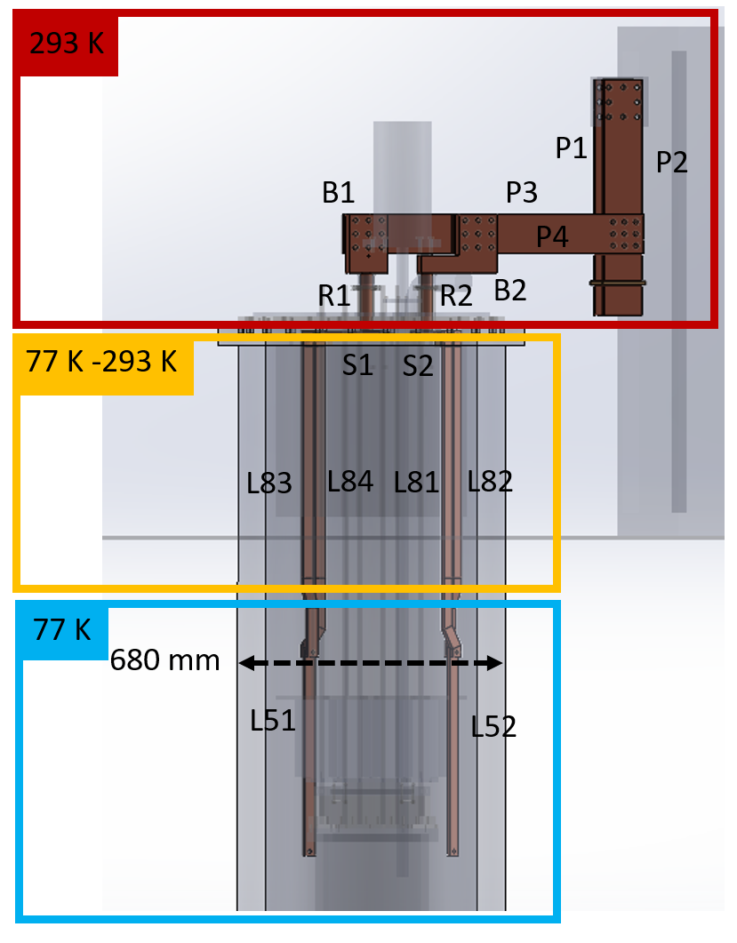
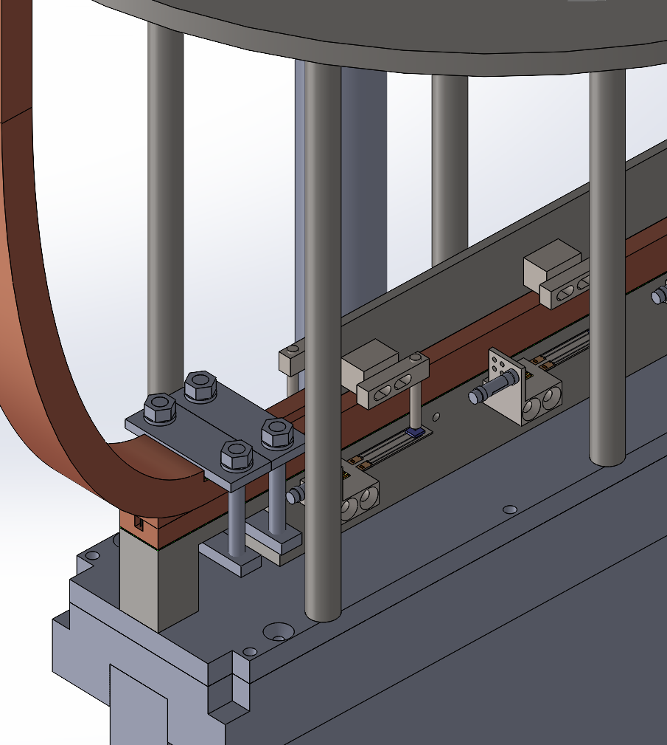
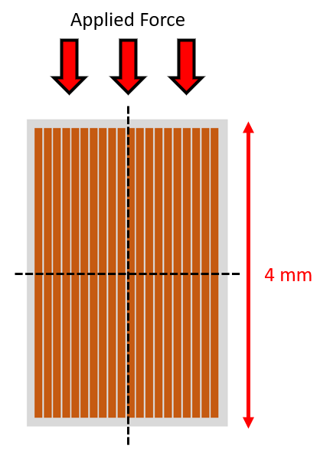
Twente cryogenic press for loading stack (sub)cables
Upgrade Twente cryogenic press: design and manufacturing of 4.5 kA current leads for stack test in LN₂
ReBCO stack cables for transverse load
Pressing Force
Pressing fin
ReBCO stack
Copper
stabilizer
20mm
12

Slide 13
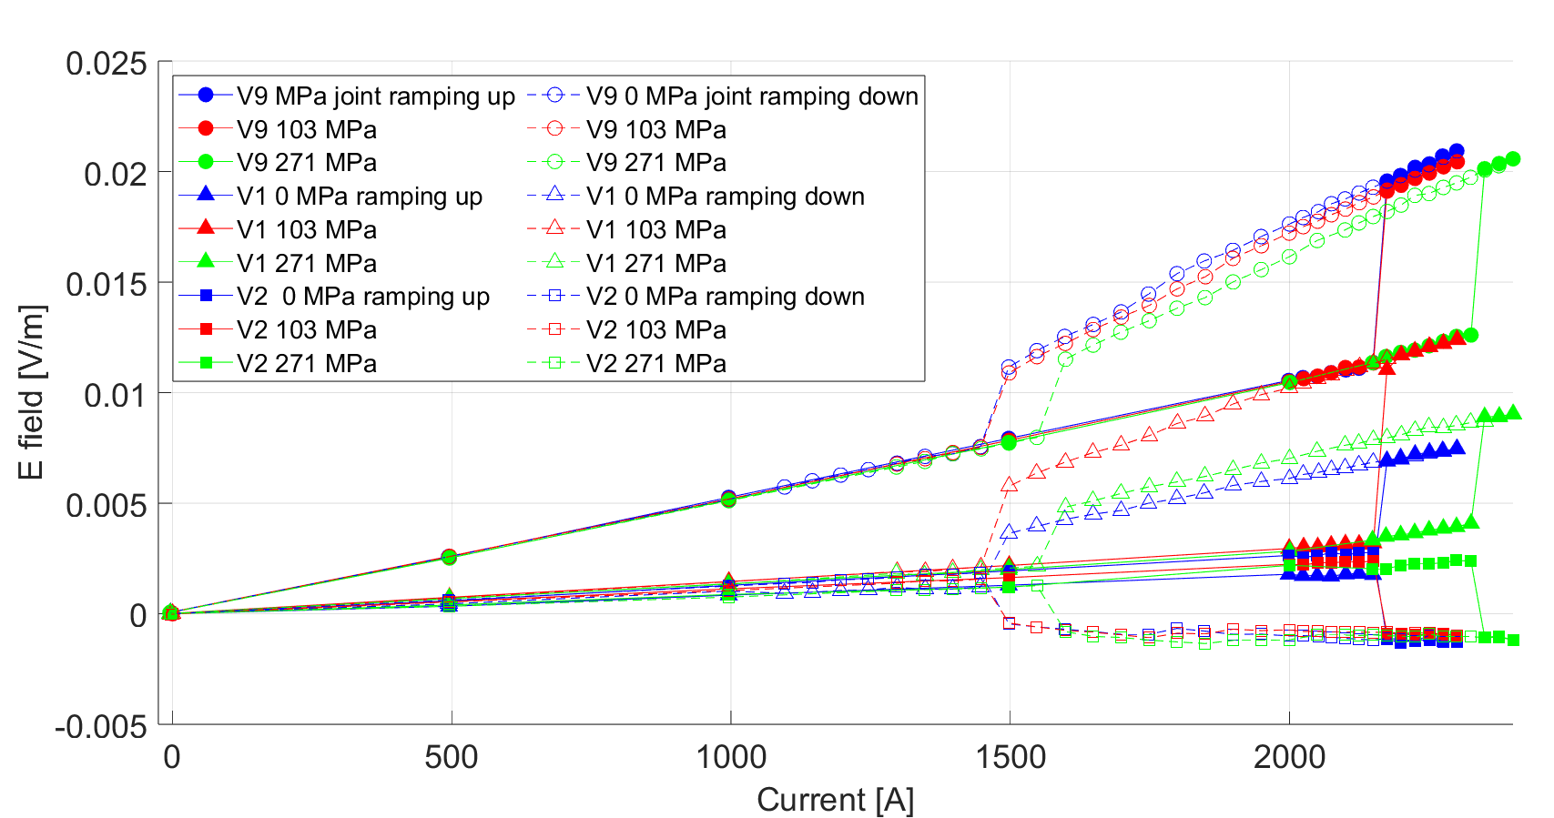
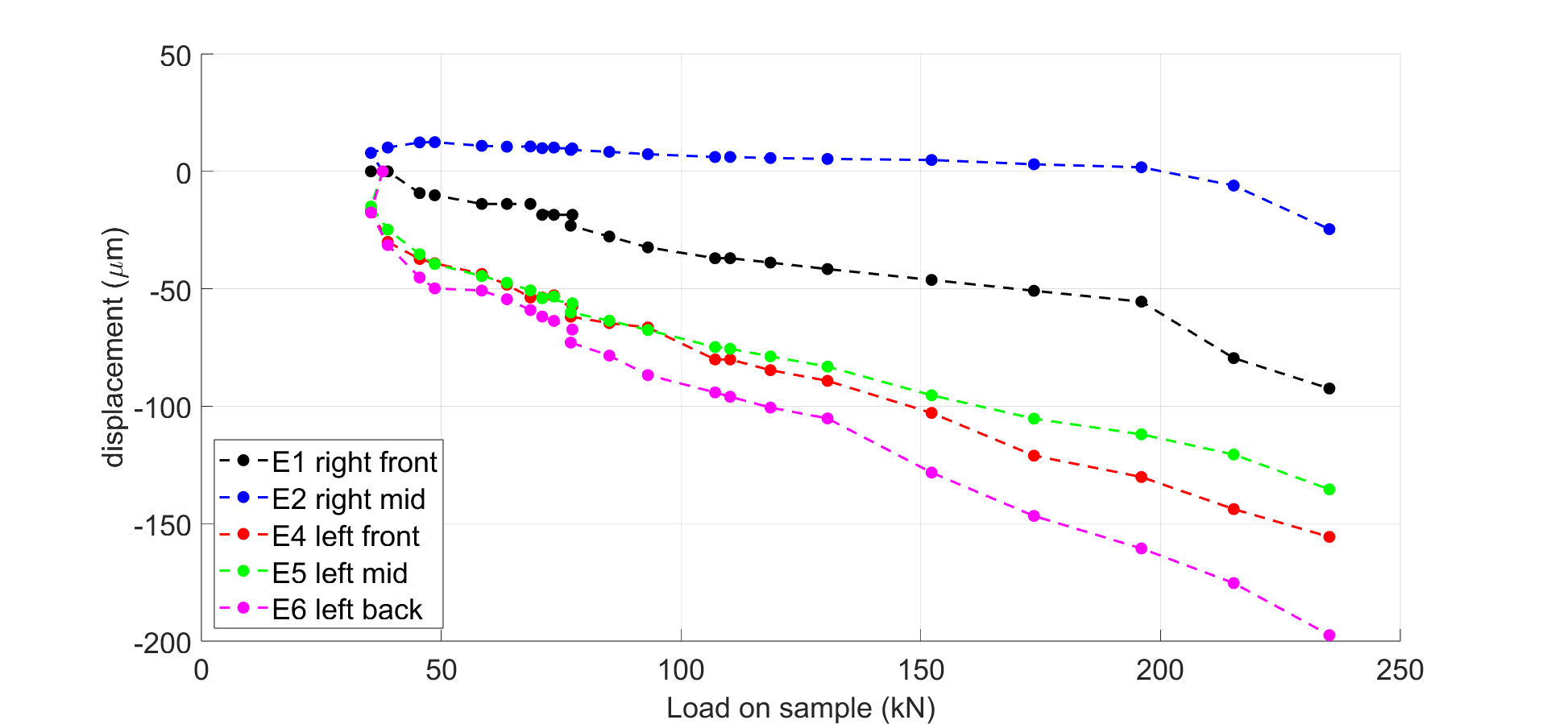
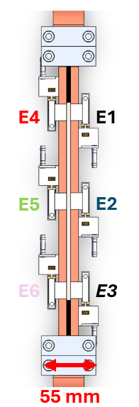
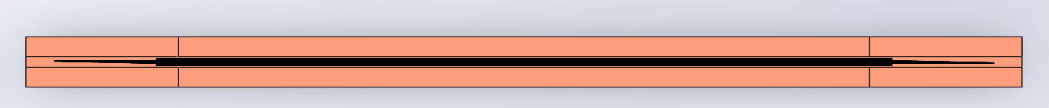
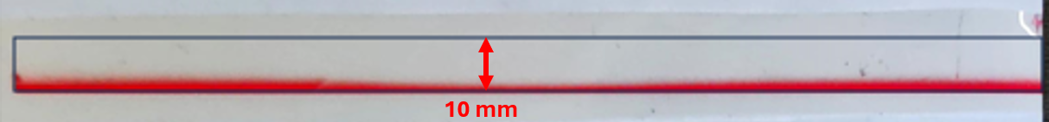
Transverse load test of dry-stack sub-cable at 77 K
V9
V1 V2
V1 V2
V9
Press bore was limiting cable length resulting in current shearing and lack of superconducting transition.
Press force distribution needs to be improved to perform measurements of transverse load in weak direction.

Slide 14
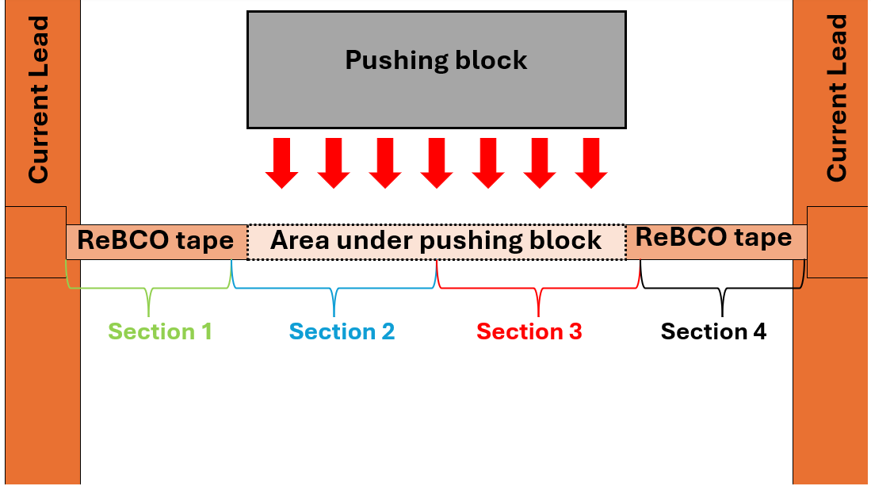
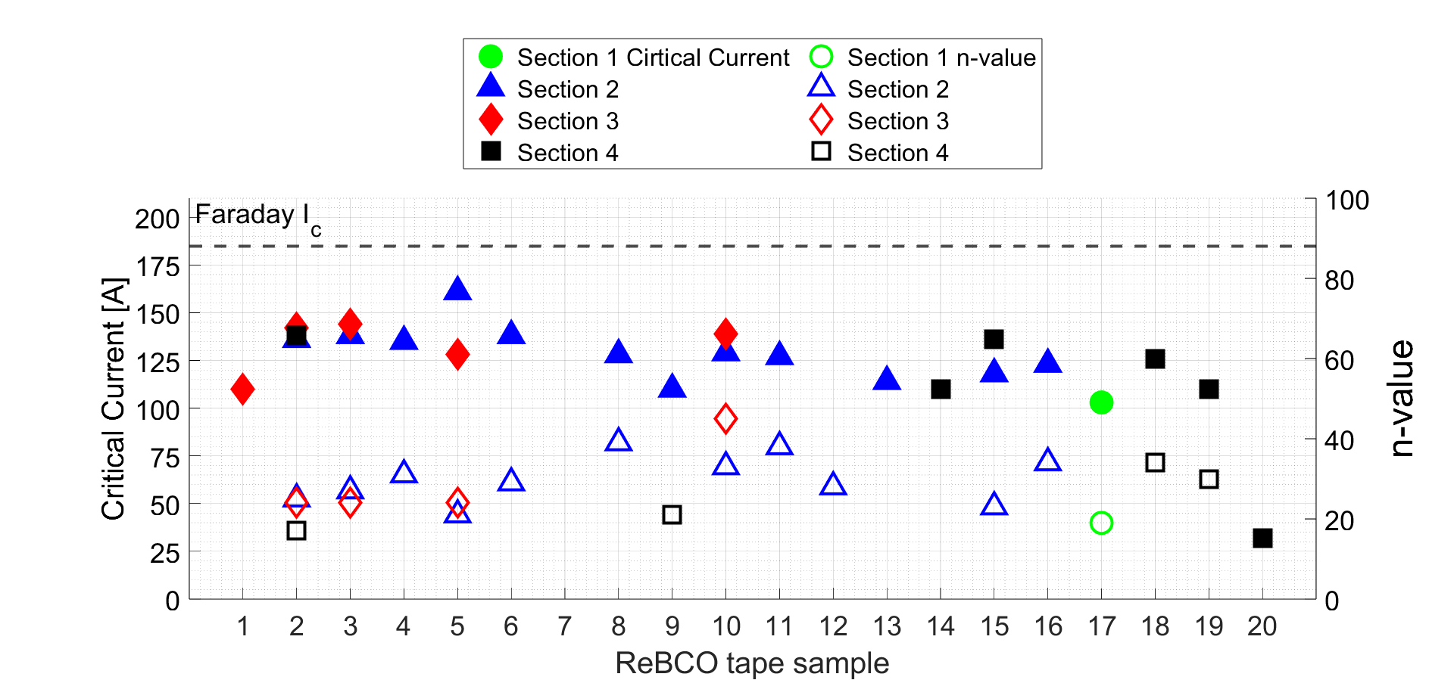
Tapes extracted from stack after loading to 275 MPa
Section 2 most degraded
Misalignment during loading of the stack.

Slide 15
Summary: mechanical properties of tapes and stacks
Transverse load varies from 400 to above 900 MPa for different manufacturers and is caused by plastic deformation of the substrate followed by cracks in the ReBCO layer.
Axial stress-strain also varies among different producers.
Bending of the soldered sub-stack at 50 mm radius caused detachment at the soldered interfaces and buckling in both 5 and 10 tapes cables.
Transverse load: existing bore is limiting the cable sample length causing current shearing and not seeing the superconducting transition.
Press force distribution needs to be improved to measure the transverse load effect in the weak direction.

Slide 16


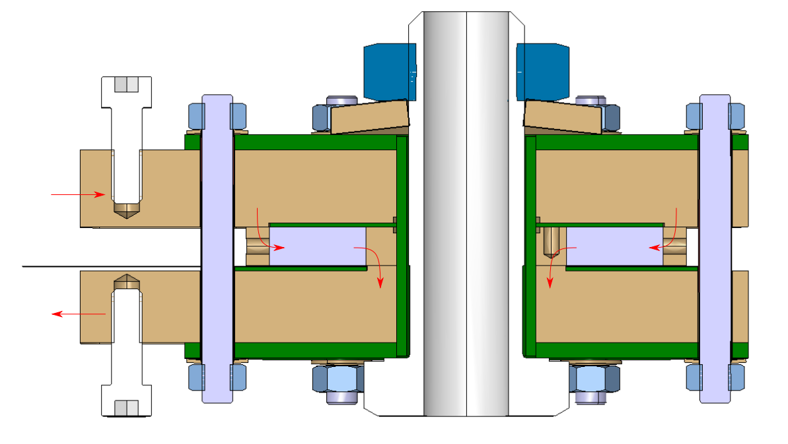
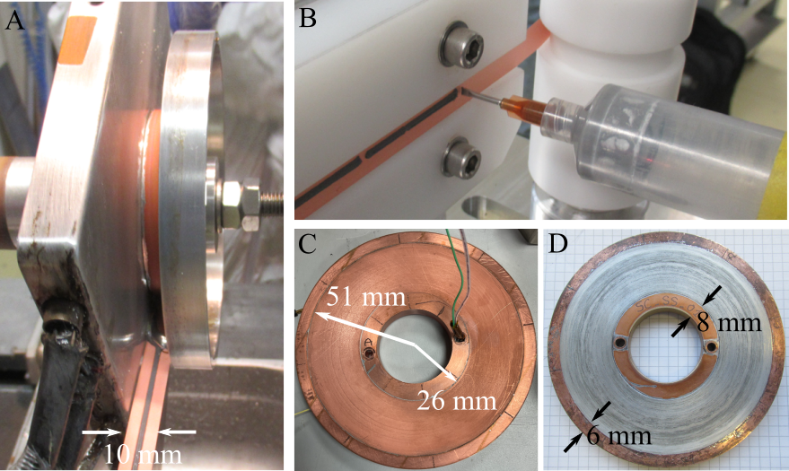
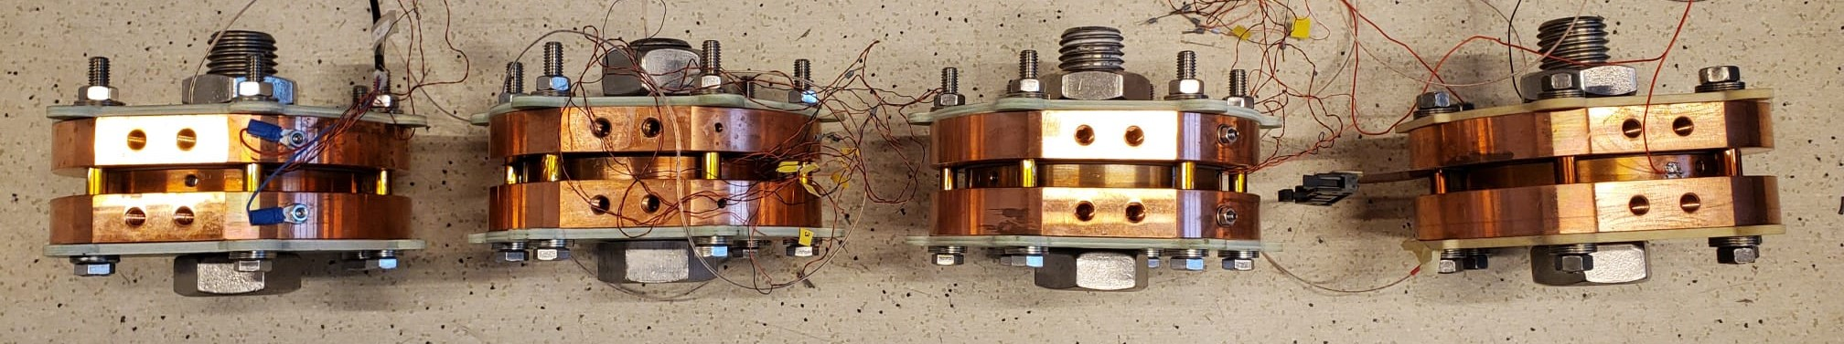
Non-insulated ReBCO coils: geometry & construction
Copper terminal plate
Clamping bolts
Current
in
52 mm
NI Coil-pack
Current out
I
NI dry-wound
NI soldered
102 mm
Outline:
Coil tests at 77K in self-field
Double tape dry-wound coil test at 4.2 K in background field.
Electro-magnetic and microstructural examination of extracted tape.
Time and temperature influence on tape critical current.
Double tape soldered coil test at 4.2 K in background field.
I
Attachment current leads
G10 insulation
146 mm
Dry-wound and soldered coils with single and double tape
T. H. Nes et al. 10.1109/TASC.2022.3148968
16
Notes:
Coil description & outline

Slide 17
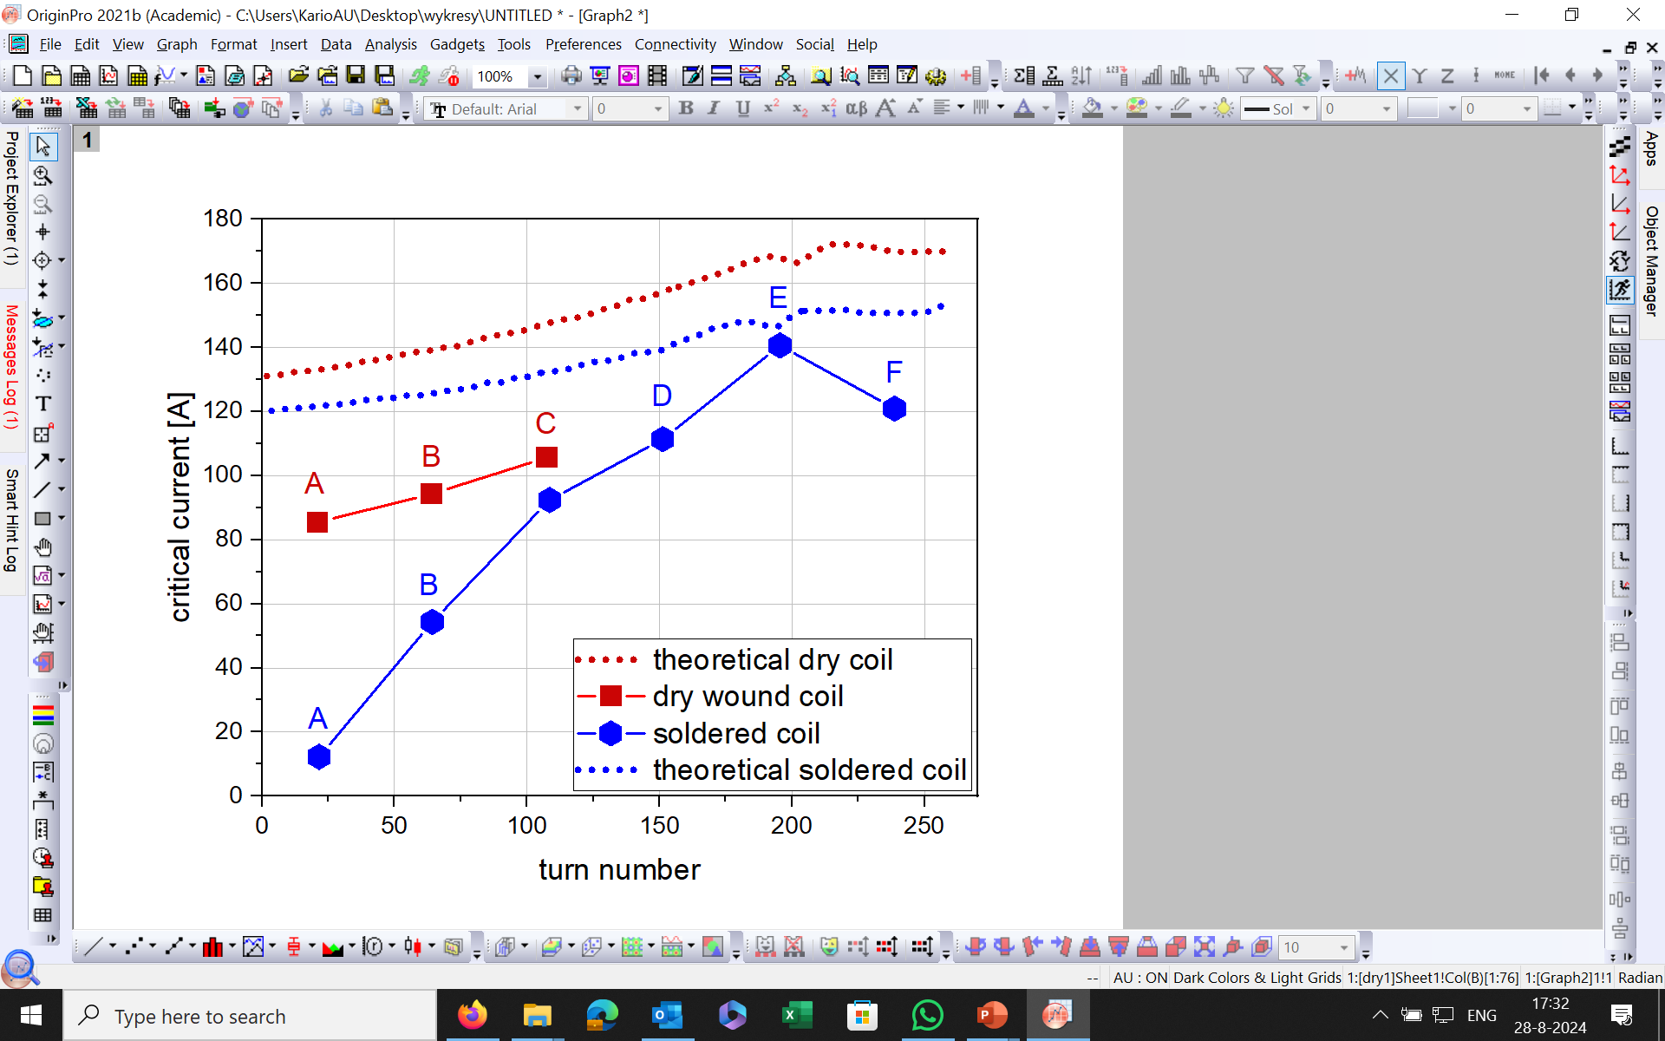
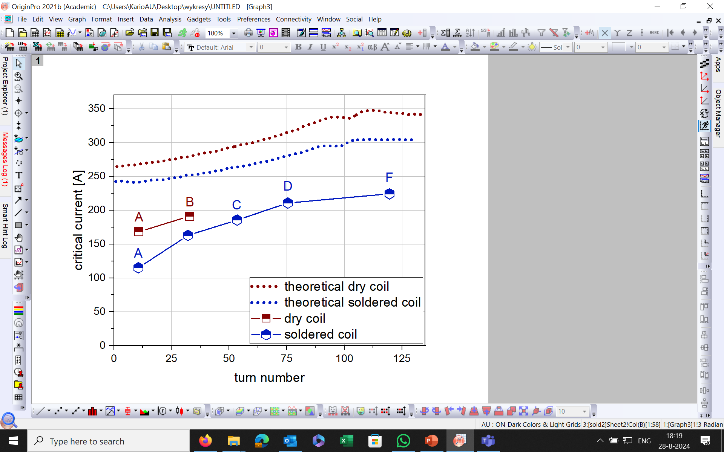
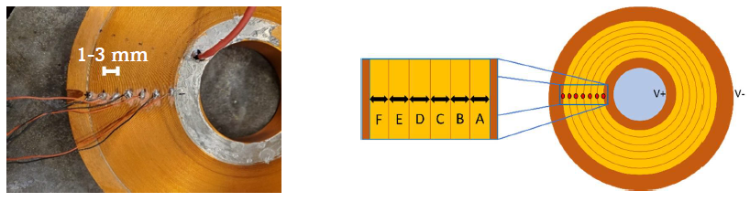
Non-insulated ReBCO coils: critical current at 77 K in self-field
Single tape coils
Double tape coils
Coil critical current = 95 A, quench current = 116 A
Coil critical current = 38 A, quench current > 400 A
Coil critical current = 180 A, quench current =194 A
Coil critical current = 163 A, quench current > 240 A
Two voltage criteria for both coils were used: 1 μV/m for soldered one and 10 μV/m for dry wound coil.
17
Notes:
-Ic (77K, s-f), as function of turn number, scheme of the coil, we see, single and double tape, where soldered-measured in all sectors and dry-inner only, quench current did not allow to measure all sectors (margin)

Slide 18
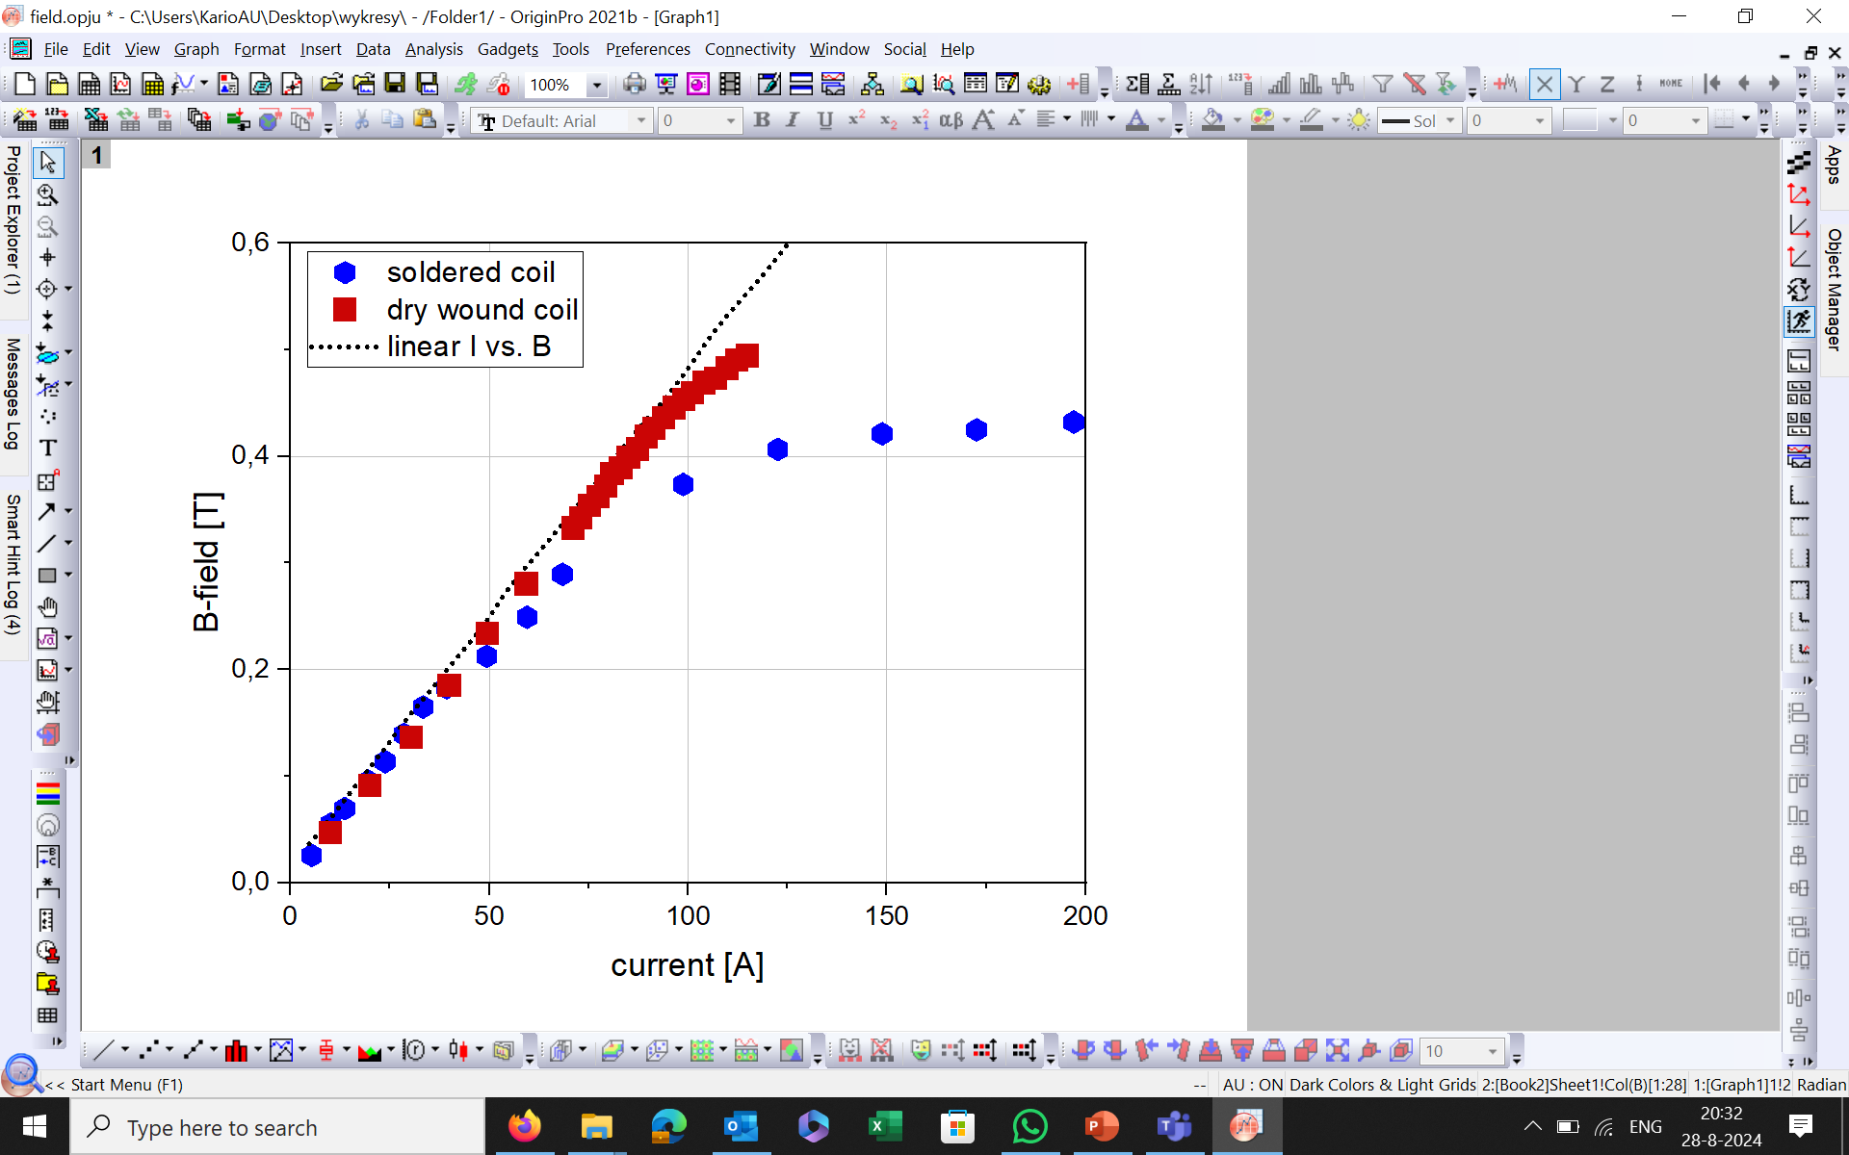
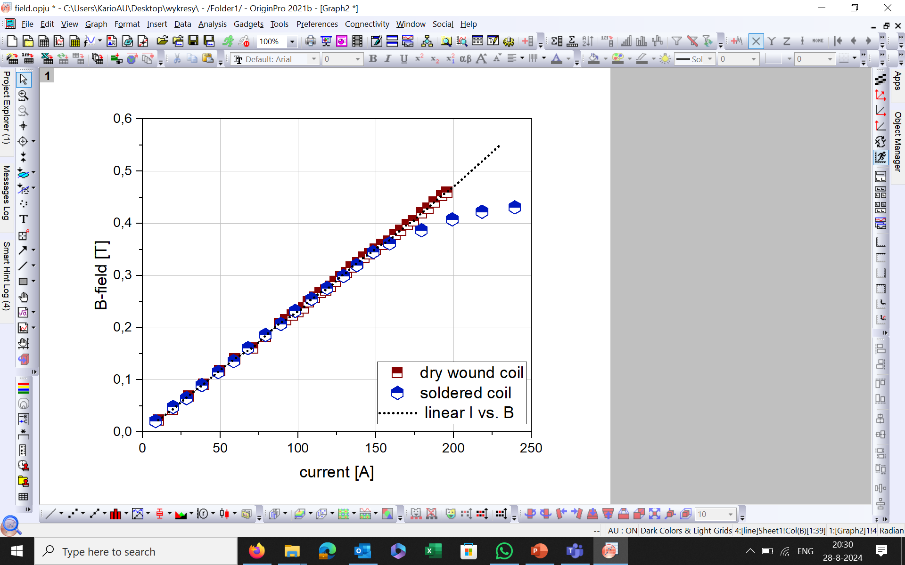
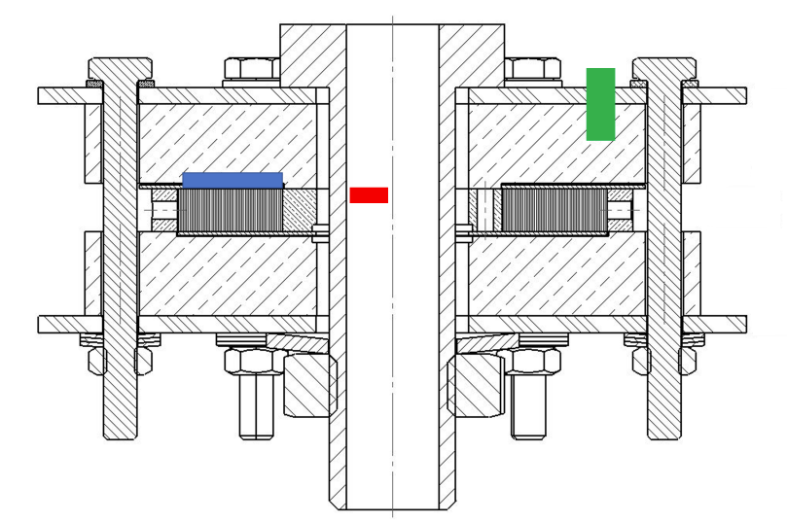
Non-insulated ReBCO coils: magnetic field in the coil center at 77 K in self-field
Single tape coils
Double tape coils
Hall probe
I_{c}=180 A
I_{c}=95 A
I_{c}=163 A
I_{c}=38 A
Magnetic field measurements in the center show saturation and current sharing especially in the case of soldered coils.
18
Notes:
-magnetic field was measured as well, in coil center, and in deviation from linearity we can nicely see the current sharing. Soldered: bigger saturation region, dry-only in single tape, the dry-wound double tape coil and soldered was chosen based on those measurements for Lhe test!

Slide 19
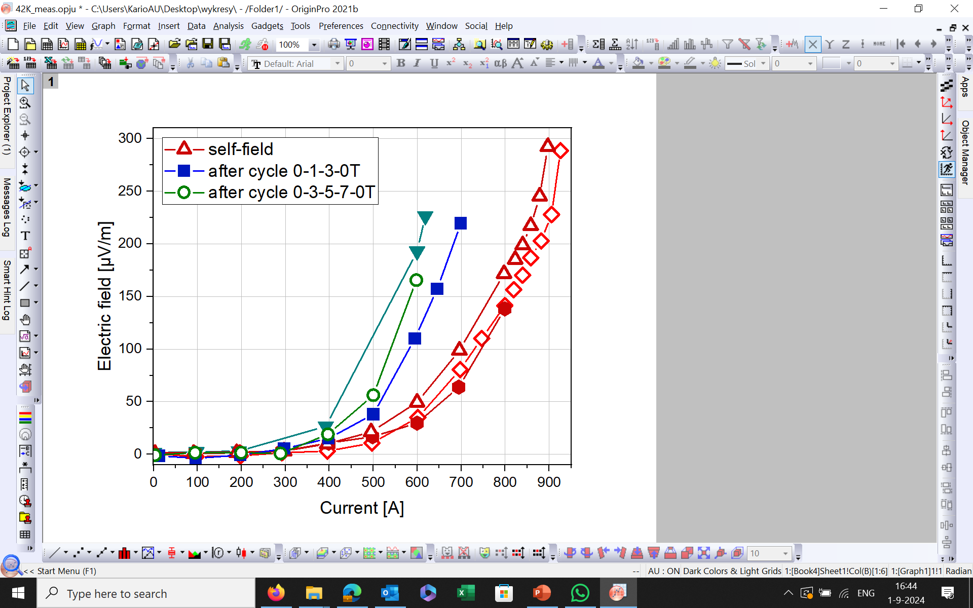
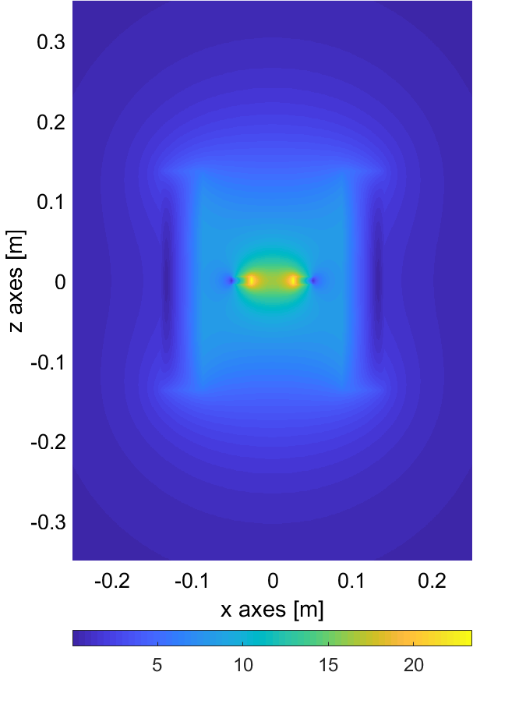
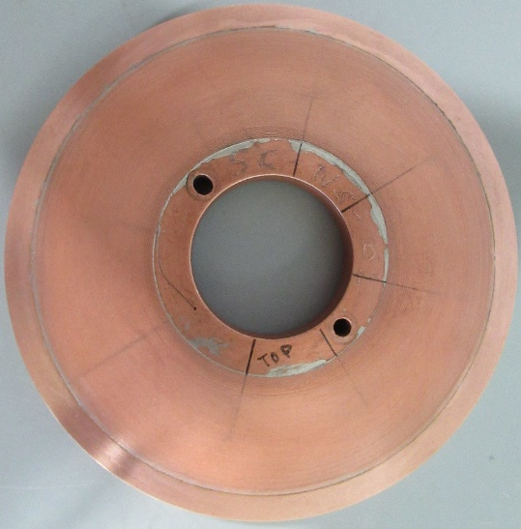
Dry wound double-tape coil: critical current at 4.2 K in background field
Magnetic field B [T]
Critical current of the coil as a function of cycling in self-field and in background magnetic field of up to 7 T.
Solenoid background magnet
Dry-wound 2-tape pancake coil
VI curves after cycling:
I_{c} reduced further to 530 A
Coil performance degraded by 30%.
Calculated critical current at 4.2 K and self-field: 2.4 kA
19
Notes:
Calculations of the Ic if the coil in external field show 2.4 kA of current for thise coil, coil was mounted in background magnet, instrumented, measured. Degradation in self-field, further degradation in background field, 30%

Slide 20
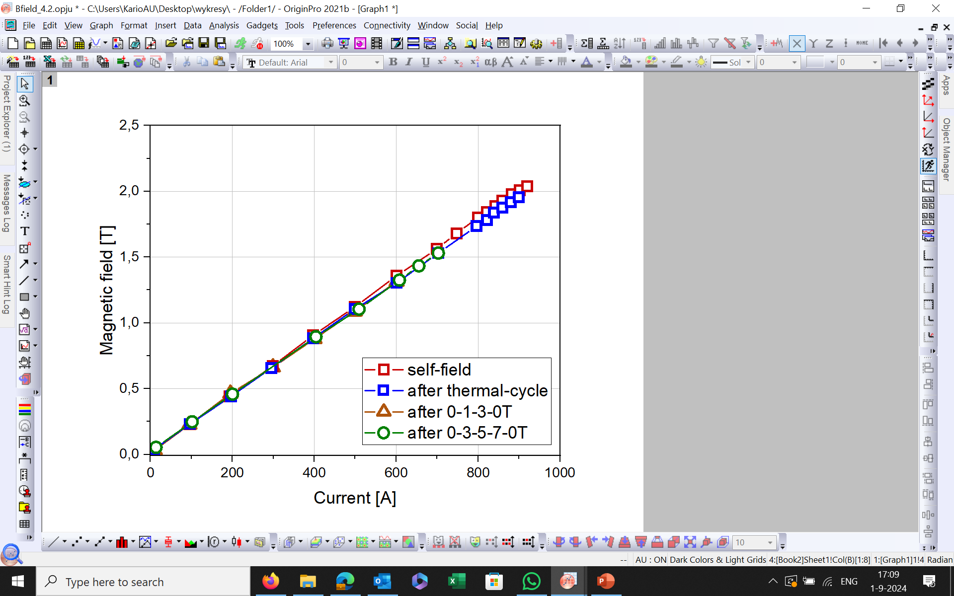

Dry wound double-tape coil: degradation of the coil
Magnetic field measurements in center of coil show degradation of the coil.
Coil measurements at 77 K in LN₂ and in self-field after LHe show severe critical current reduction.
T.H. Nes. PhD. Thesis, 2023
20
Notes:
In terms of magnetic field-degradation is noticeable also, by lower values of the field, saturation of the field is not observed, no signs of current sharing. The coil was measured in LN2, to look at the possible reversible effects and we see permanent degradation to few amps in the central windings, tape was unwound for further examinations and measured using reel-to-reel technique

Slide 21

Dry wound double-tape coil: degraded at 4.2K in LHe, postmortem analysis I_{c}@77K, self-field
end, 30 meter
beginning, 0 meter
Red dots: measured critical current
Orange arrows: lower bound of I_{c}
Original tape: I_{c} = 380A.
Reel-to-reel measurement of the ReBCO tape from an unwound pancake coil shows permanent degradation of the critical current of the tape.
21
Notes:
Ic(tape position), cricles Ic and triangles lower bonund of Ic, here only half-length of the tape measurement is shown, no correlation, a lot of defects limiting Ic to few or 10th of Amps, different type of defects were observed visually and examined microstructurally

Slide 22





Dry-wound double-tape coil: postmortem analysis, microstructure, blister type
Blisters
SEM, FIB cut
SEM, FIB cut
melting
End of crack
SEM, FIB, buffer layers
500 nm
SEM, top layers
delamination
CeO₂ ~ 200 nm
Cu ~ 20 microns
LaMnO₃ ~ 20 nm
MgO ~ 5 nm
Ag ~ 2 microns
Y₂O₃ ~ 20 nm
Al₂O₃ ~ 80 nm
10 μm
400 nm
Irreversible degradation of the tape; local defect of blister type; internal delamination of the tape structure, on Ag-ReBCO interface and in the ReBCO layer itself.
22
22
Notes:
Blister, cut in the center, delamination, cuts further away, melting of the ReBCO

Slide 23





Dry-wound double-tape coil: postmortem analysis, microstructure, meander type
Meander shape black spots
Confocal microscope, topology
SEM
Barium, Oxygen reaches layers on the surface
EDX: O map
EDX: Ba map
Optical microscope, tape surface
Irreversible degradation of the tape; local defect of the meander shape; out-diffusion of the barium to the surface of the tape.
23
23
Notes:
Meander shapes, visible on the tape structure, surface, analyzed by confocal microscopy, layer out-diffusion of barium

Slide 24


Soldered ReBCO pancake coils: degradation due to soldering time and temperature excluded
1h winding with 176°C Solder
V3
V1
V5
V2
Shanghai tape is like other fabricants tape, concerning heat treatment temperature and time.
Normalized I_{c} for 10 μV/cm vs heat treatment for 60 min.
24
Notes:
Beside ni-dry-wound coil, we analyzed the soldered doble tape coil as well. Since we noticed lower Ic of the tape in inner sectors side examination of the SST tape as function of temperature and time was done, and degradation due to that was excluded.

Slide 25


Non-insulated ReBCO coils: time constant
Dry wound coils
Soldered coils
Coil | τ [s] | Reduction factor
Single tape | 7.4 ± 0.1 | 1.2 ± 0.4
Double tape | 6.1 ± 0.1
Coil | τ [s] | Reduction factor
Single tape | 740 ± 12 | 3.3 ± 0.8
Double tape | 222 ± 2
Time constant τ [s]
Magnetic field [T]
Short time constant of 25 s in dry-wound coil at 4.2 K and 5 T background field was measured.
While long-time constants of 10 min in soldered coil at 4.2 K and 5T background field are present.
25
25
Notes:
Time constants, when we look at those coils, 77K and self-field, reduction of factor 4 expected, due to 1-2 tapes and coil inductance, dry wound non, soldered below. In a case LHe measurements….

Slide 26
Summary: ReBCO pancake coils experience
Dry-wound coils:
Small “self-protection” margin (~20 A at LN₂) and short time-constants (25 s at 4.2 K and 5 T background field).
Severe degradation of entire tape length after test at 4.2 K in LHe, caused by different visible defects reducing the tape I_{c}.
Soldered coils:
Relatively big “self-protection” margin (>200 A at 77 K, LN₂) but long-time constants (10 min at 4.2 K in LHe and 5 T background field).
Degradation of I_{c} due to temperature and time of soldering excluded.
Test at 77 K in self-field after LHe measurement should be done. No indication of degradation of the coil at 4.2 K in LHe was observed.
R.I.P.
NI-coils need to be studied using combination of multi-simulation tools (electromagnetic and mechanical) and extended experimental effort.
26

Slide 27
Summary
At University of Twente, torture LAB, we contribute to the development of accelerator type magnets, by investigating various tapes, - cables; and non-insulated and insulated small coils, mostly looking at electromagnetic and mechanical properties.
Few references:
Nienke Buskens (2023), bachelor thesis, The Effect of Bending on the Critical Current of ReBCO Based Stack Cables : High Magnetic Fields for Muon Collider, https://essay.utwente.nl/96263/.
Ward Maxim Huijskes (2024), master thesis, Preparations of transverse stress experiment of soldered TSTC for high-field magnets.
Lennard Rietkerk (2024), master thesis, Transverse stress tolerance of ReBCO superconducting dry-wound stack cables.
Jurgen Rietberg (2024), master thesis, Critical Current testing of ReBCO tapes under applied axial tensile stress and strain with new TARSIS setup.

