Slide 1
Local Heating in ReBCO Tape and Stack:
Summarizing the finding of the paper: DOI: 10.1109/TASC.2025.3548635
Hamed Milanchian, Tiina Salmi

Slide 2
Study of stress and strain in ReBCO tape due to a local hotspot temperature
During a quench the tape temperature can rise rapidly and very locally
Understanding the effect of these temperature peaks is important, for example when designing a safe quench protection system
  What kind of temperature profiles can lead to potentially too large thermal stress or strain?
In this study we simulate the mechanical effect of hotspot temperatures
  The end-temperature profile is an input (T_{max} = 300 K)
  We considered a single tapes and tape stacks. In a tape we simulate all material layers, but consider them glued together
This was a first step to see if we can identify critical temperature profiles
  Studies could be repeated with varying boundary conditions, including more analyses on tape layers interfaces to better estimate delamination risks
  Experimental measurements also planned at TAU
  Electromagnetic forces were excluded in this analysis, these could be considered in could be accounted in the next phase

Slide 3
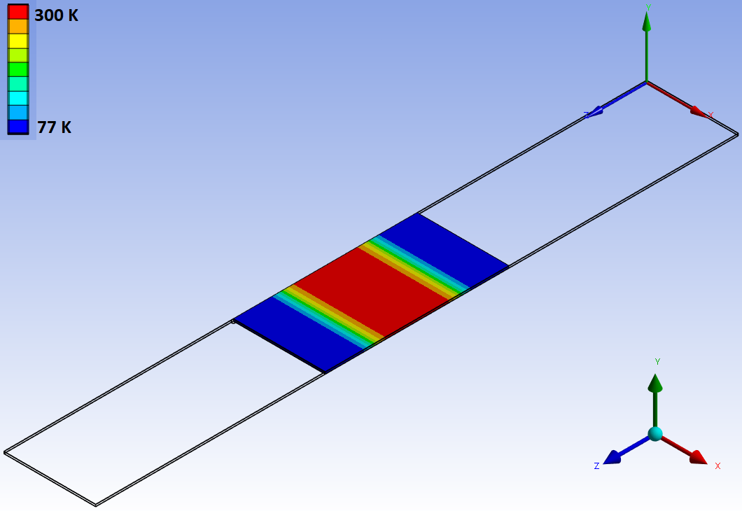
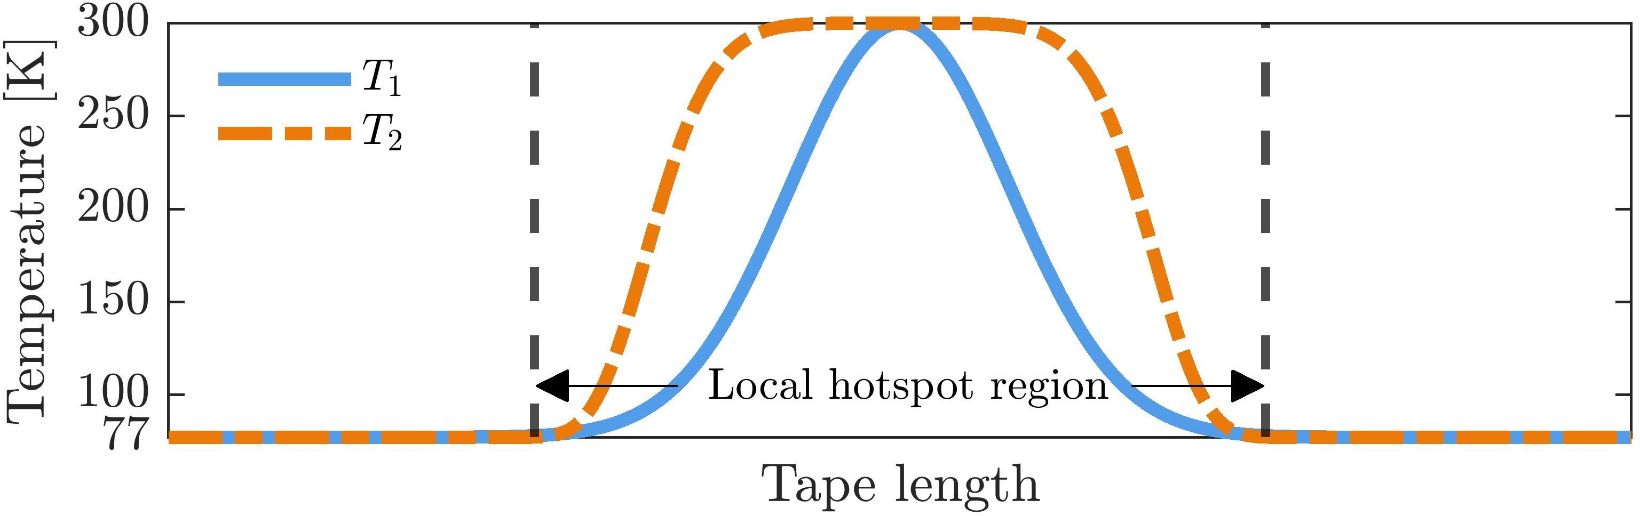
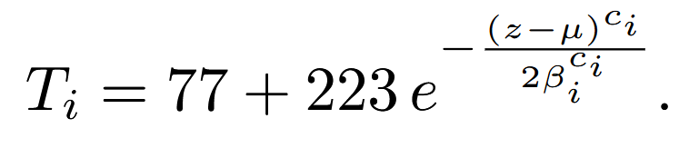
Local heating: hotpsots
The temperature profile is an input, which is not based on simulation
Three different hotspot region lengths 1 cm, 5 cm, 10 cm
Bell-shaped functions, two different widths of the peak (narrow peak, wide peak)
Uniform local heating in thickness and width

Slide 4
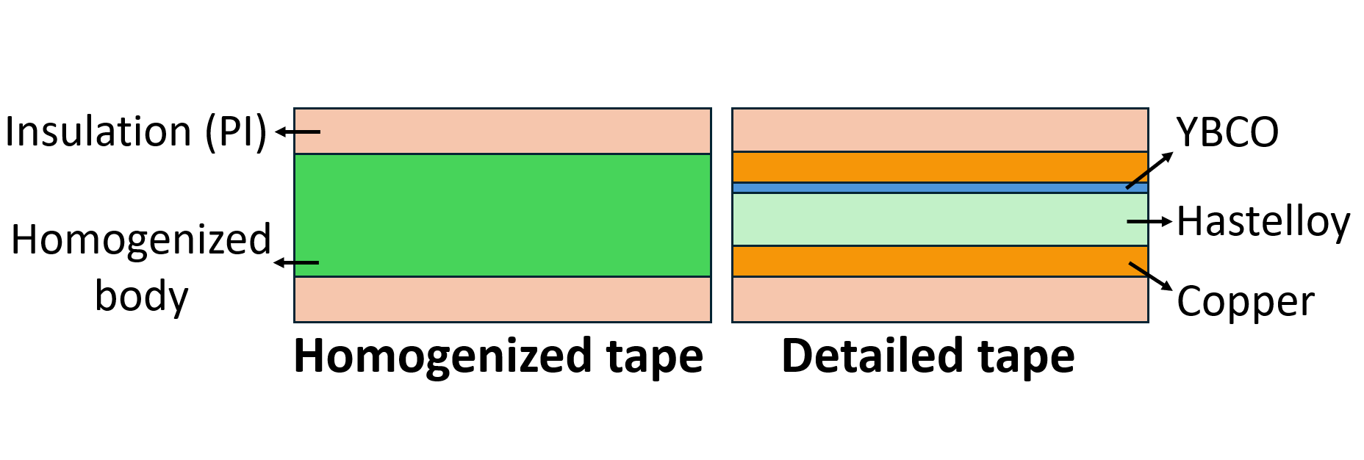
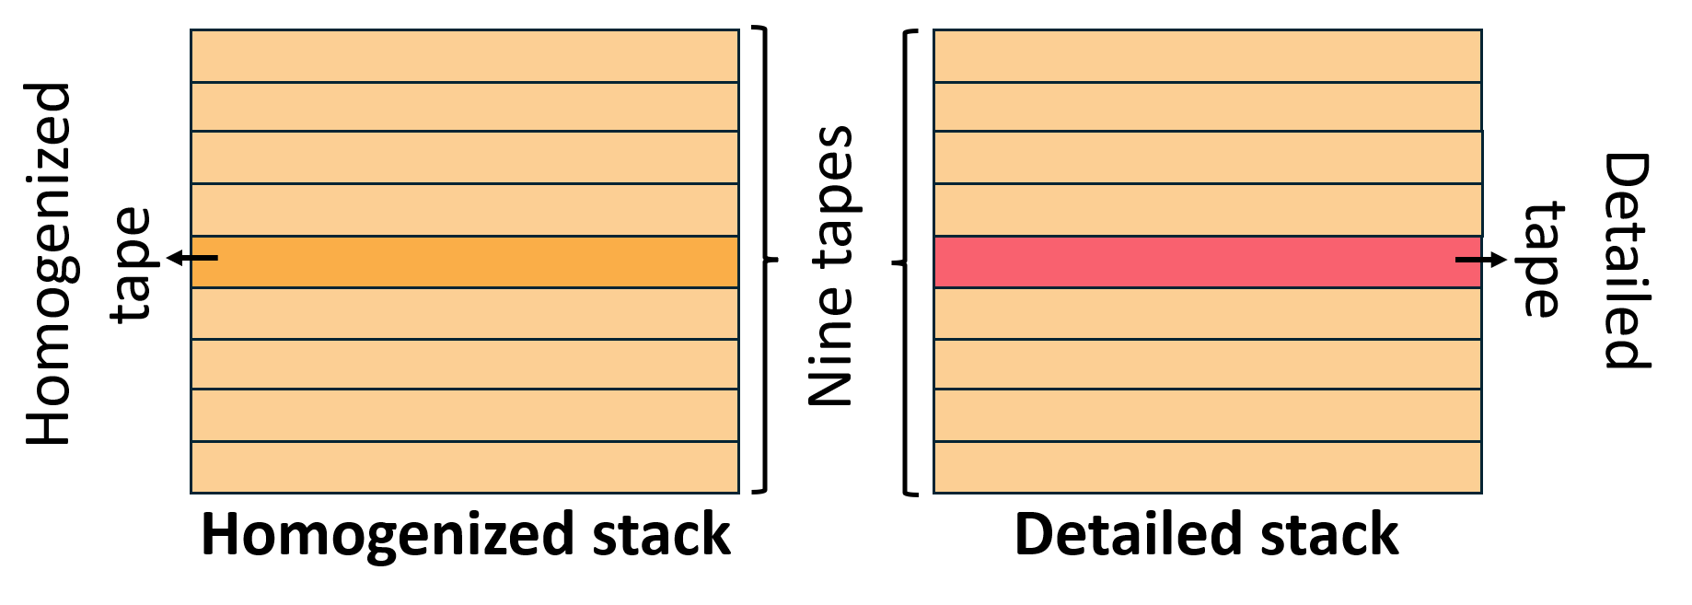
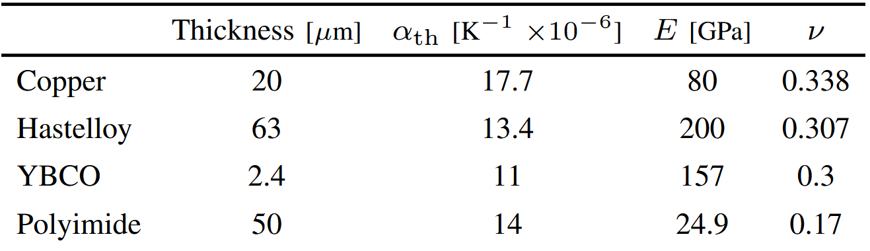
Tape and stack tape
Detailed and homogenized tape model
Detailed and homogenized stack model
All tape lengths 20 cm
Tape layer properties (SuperOx)

Slide 5
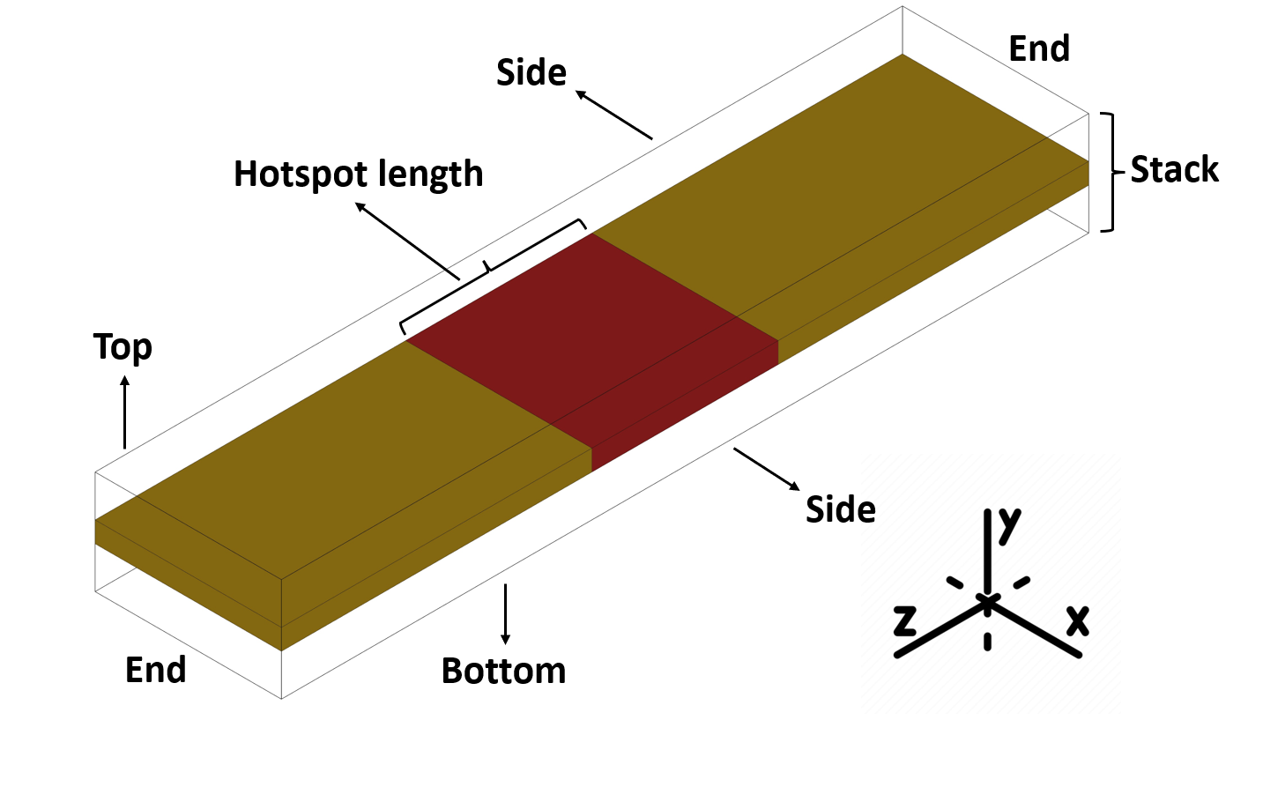


Mechanical model
Structural analysis (with thermal terms as inputs) with Ansys
No electromagnetic forces
Small deformation small strain assumption
Perfect bonding with tape internal interfaces
Frictional contact between tapes in tape stack (0.2)

Slide 6
Results
Axial strain and elastic limits
Axial strain and irreversible critical reduction
Interface analysis and delamination risks

Slide 7
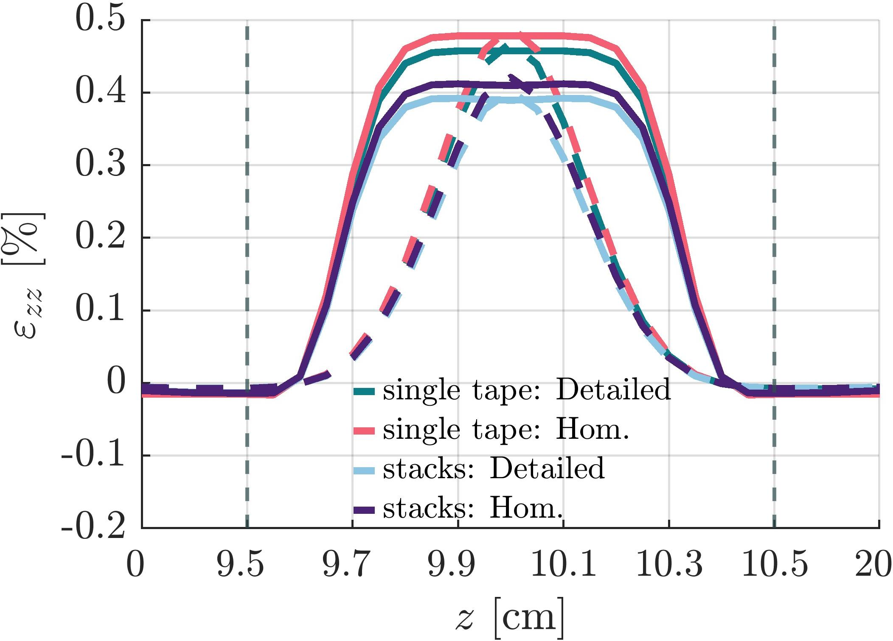
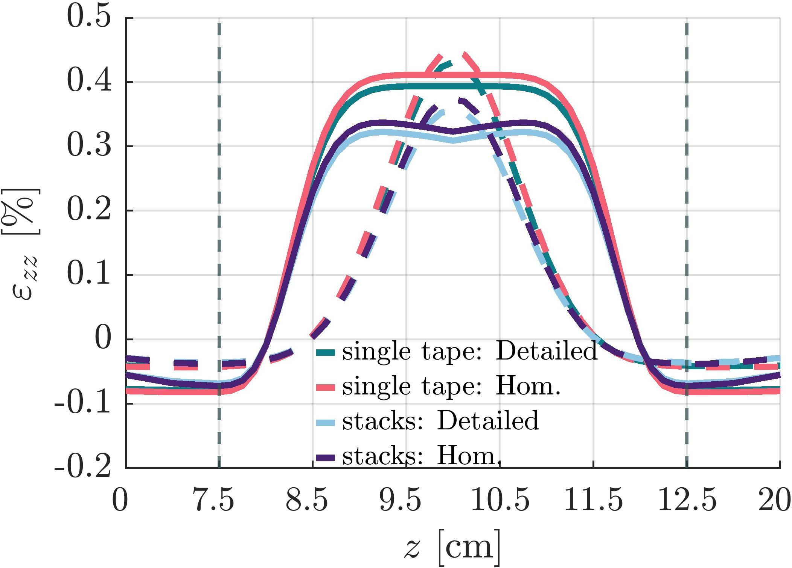
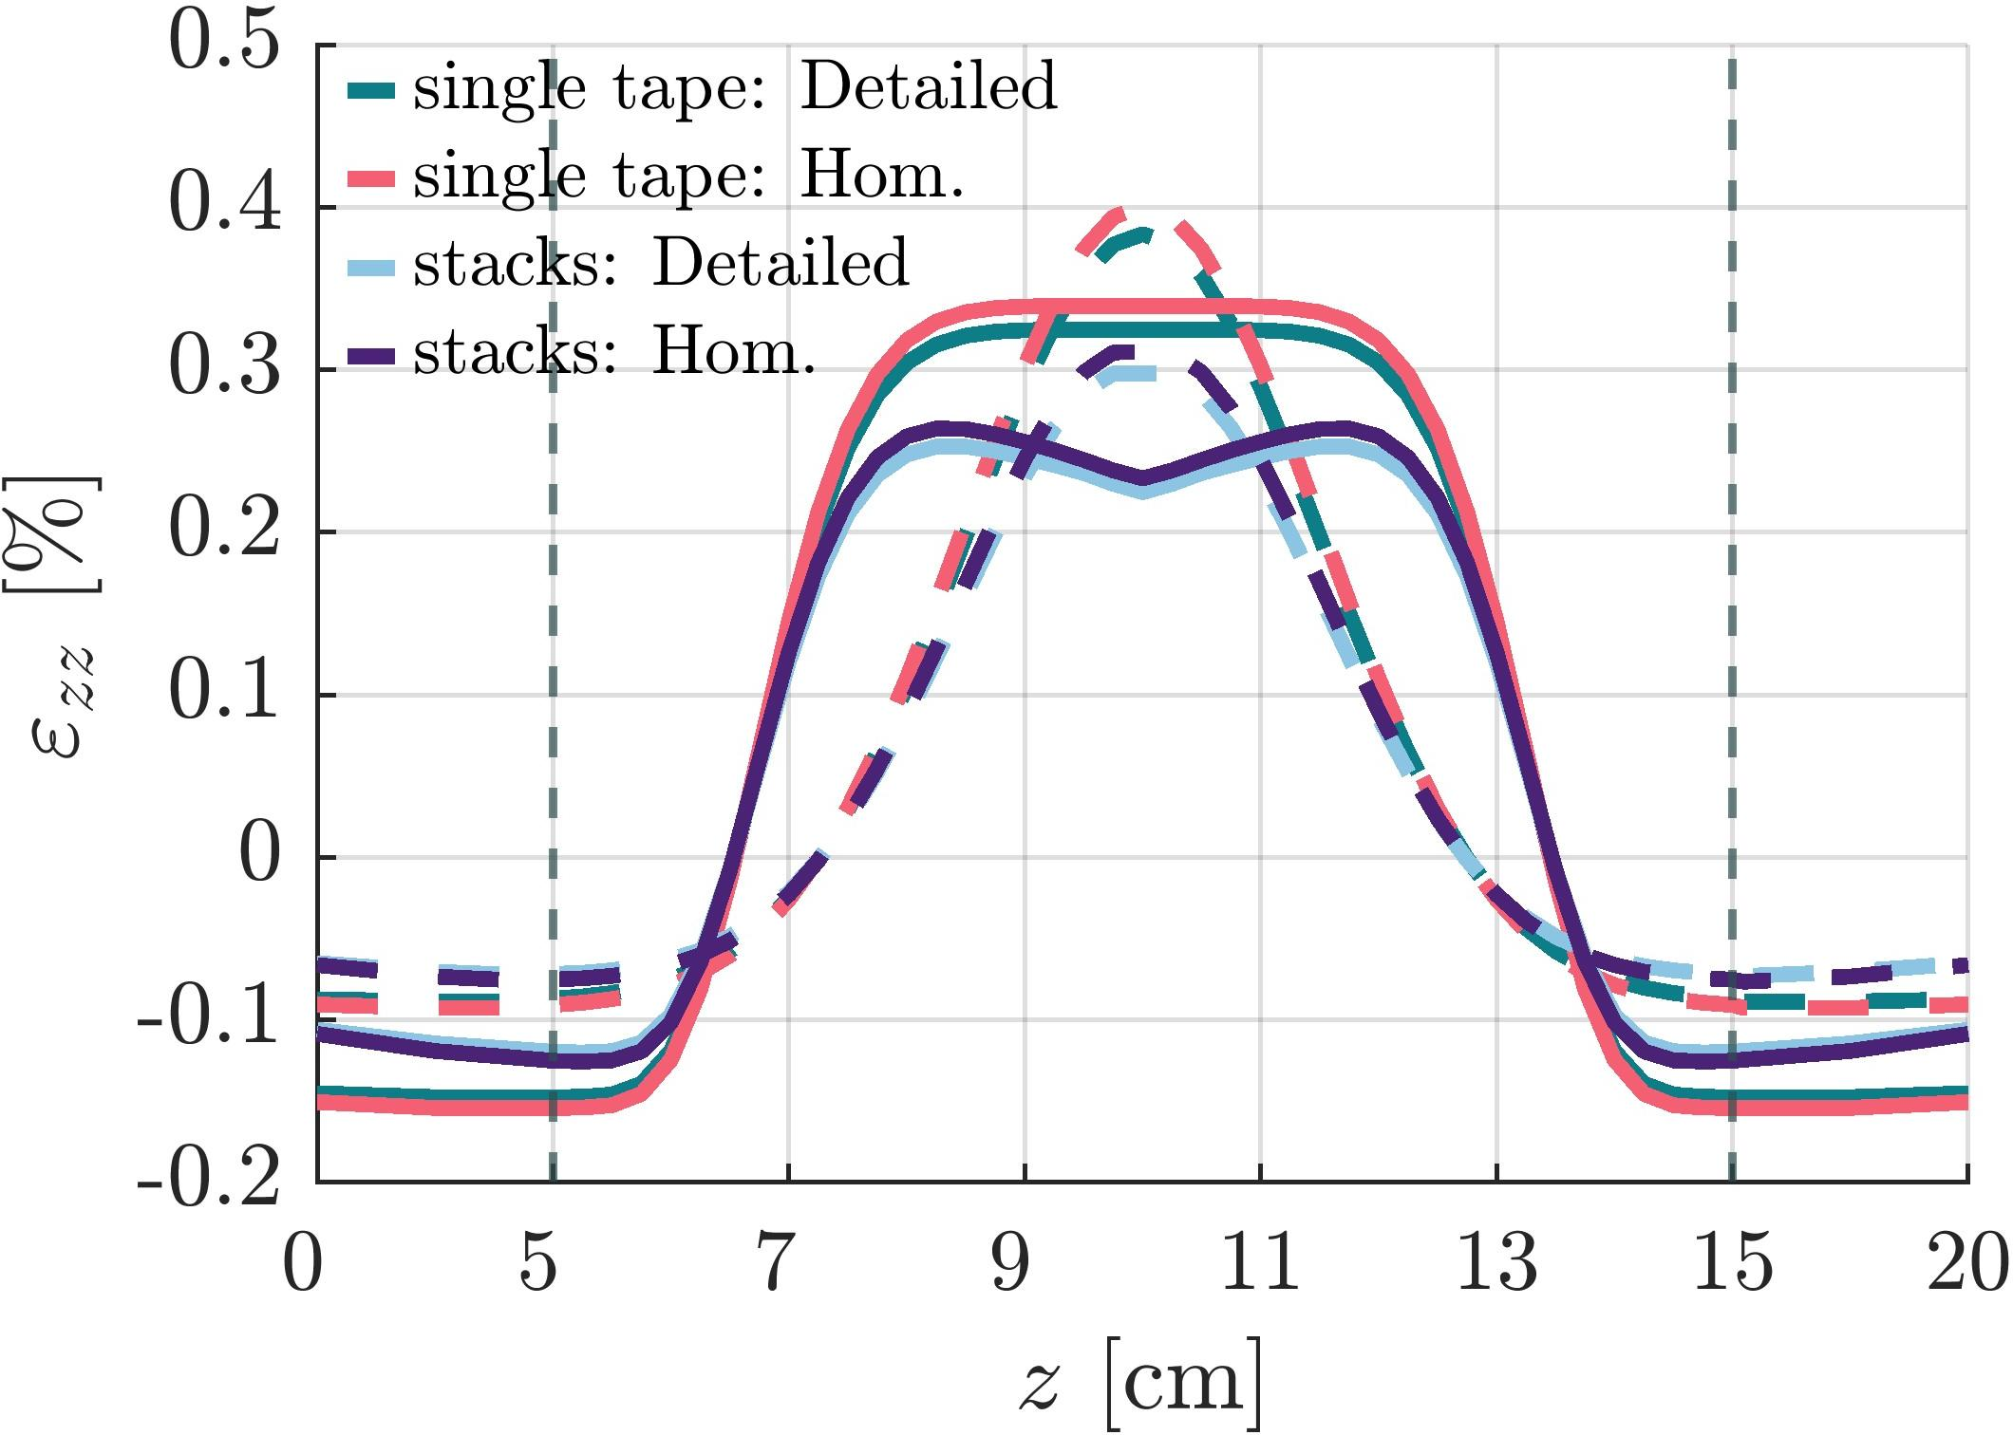
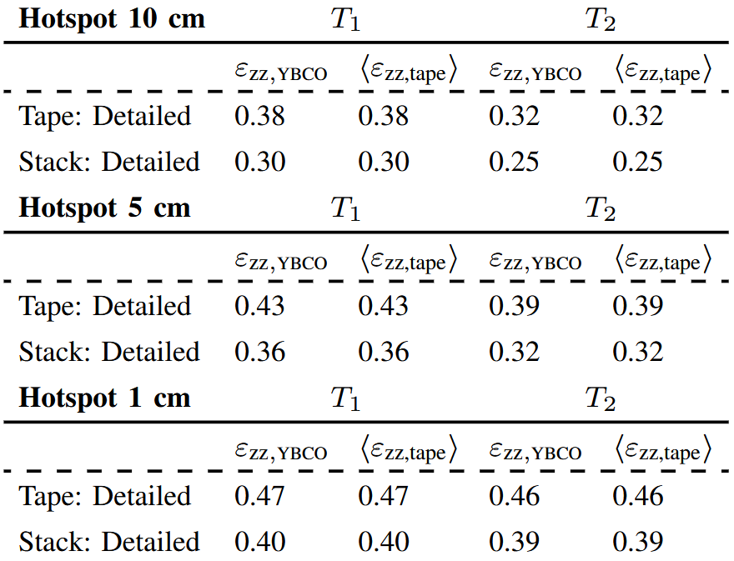
Results: Axial strain
Tmax = 300 K
-0.14%
Elastic limit
SCS4050: 0.44%
Irreversible critical current limit
SCS4050: 0.55–0.584% SAMRI: 0.434–0.453%

Slide 8
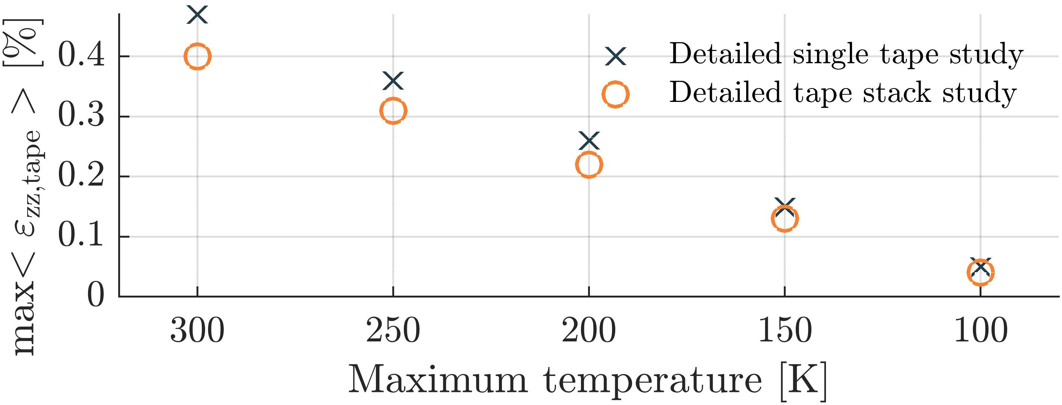
Results: Axial strain: Different max temperature
0.36%
minimum limit from literature
0.44%
1 cm hotspot (T₁)
Linear decrease of maximum strain with temperature
If T_{max} is above 250 K, the axial strain approaches the elastic limit

Slide 9
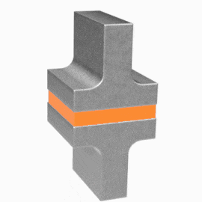
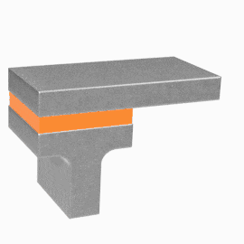
Results: Interface analysis and delamination risks
Mode I: Tensile delamination
Mode II: In-Plane shear delamination
Mixed-mode

Slide 10
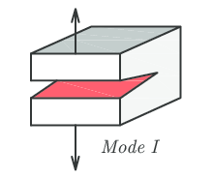

Results: Interface analysis
Delamination due to transverse tension
DOI: 10.1016/j.compstruct.2016.04.044
We checked all normal stress (σ_{n}) components at all interfaces (copper-Hastelloy, Hastelloy-YBCO and YBCO-copper) in 1 cm hotspot (T₁) and 10 cm (T₂) cases with both single tape and tape stack study.
max( )
Tape:
1 cm hotspot (T₁) → -184.7 MPa
10 cm hotspot (T₂): → -205.3 MPa
Tape stack (main tape):
1 cm hotspot (T₁): → -2.7 to 2.2 MPa
10 cm hotspot (T₂): → -2.3 to 1.0 MPa
SCS6050:
24.7 MPa (RT)
22.5 MPa (77 K)
Based on our simulations (and assumptions) no delamination should happen!

Slide 11
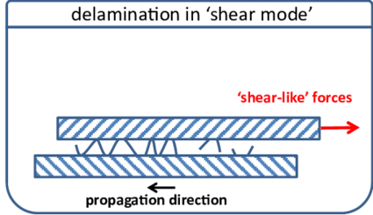

Results: Interface analysis
Pure shear delamination (Mode II)
DOI: 10.1016/j.atherosclerosis.2016.09.069
We checked all shear stress (τ) components at all interfaces (copper-Hastelloy, Hastelloy-YBCO and YBCO-copper) in 1 cm hotspot (T₁) and 10 cm (T₂) cases with both single tape and tape stack study.
All cases
Shear components below 1 MPa
SCS4050:
7.2 MPa (center) to 6.8 MPa (un-slit edge)
Based on our simulations (and assumptions) no delamination should happen!

Slide 12
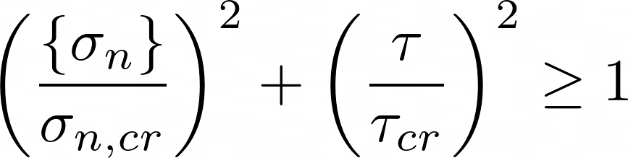

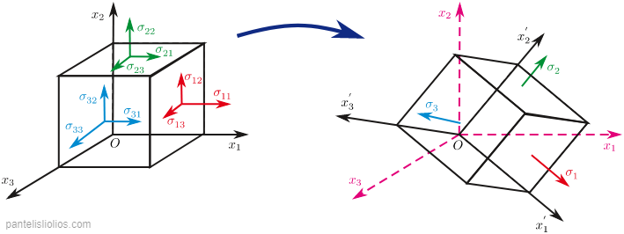
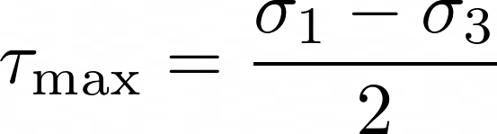

Results: Interface analysis – Mixed-mode
Quadratic nominal stress damage criterion
With this criterion and based on our simulations no delamination should happen!
Mohr-Coulomb shear stress
And there is a plane at an angle of 45° between v₁ and v₃ in which there is the maximum shear stress:
Principal planes in 3D

Slide 13
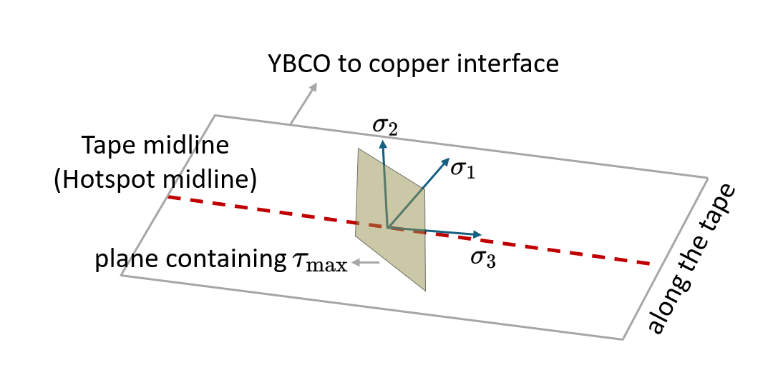
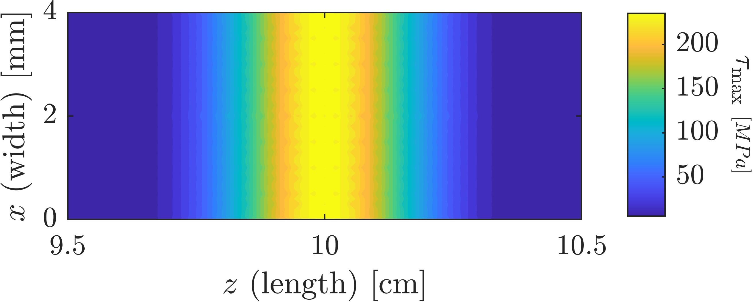
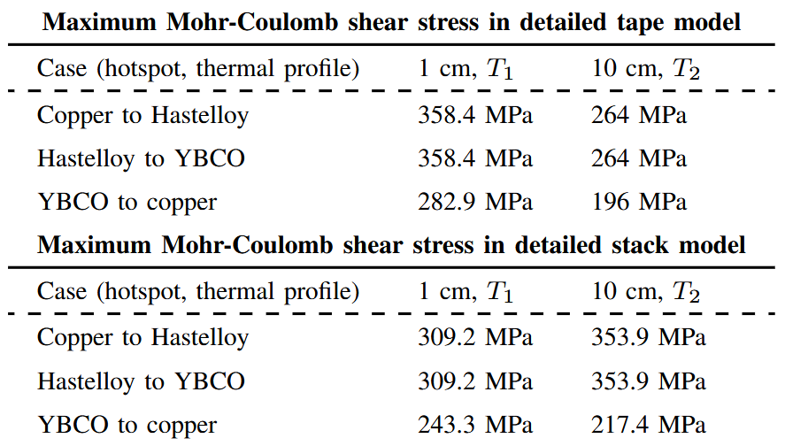
Results: Interface analysis – Mixed-mode
YBCO-to-copper interface : 1 cm hotspot (T₁)

Slide 14
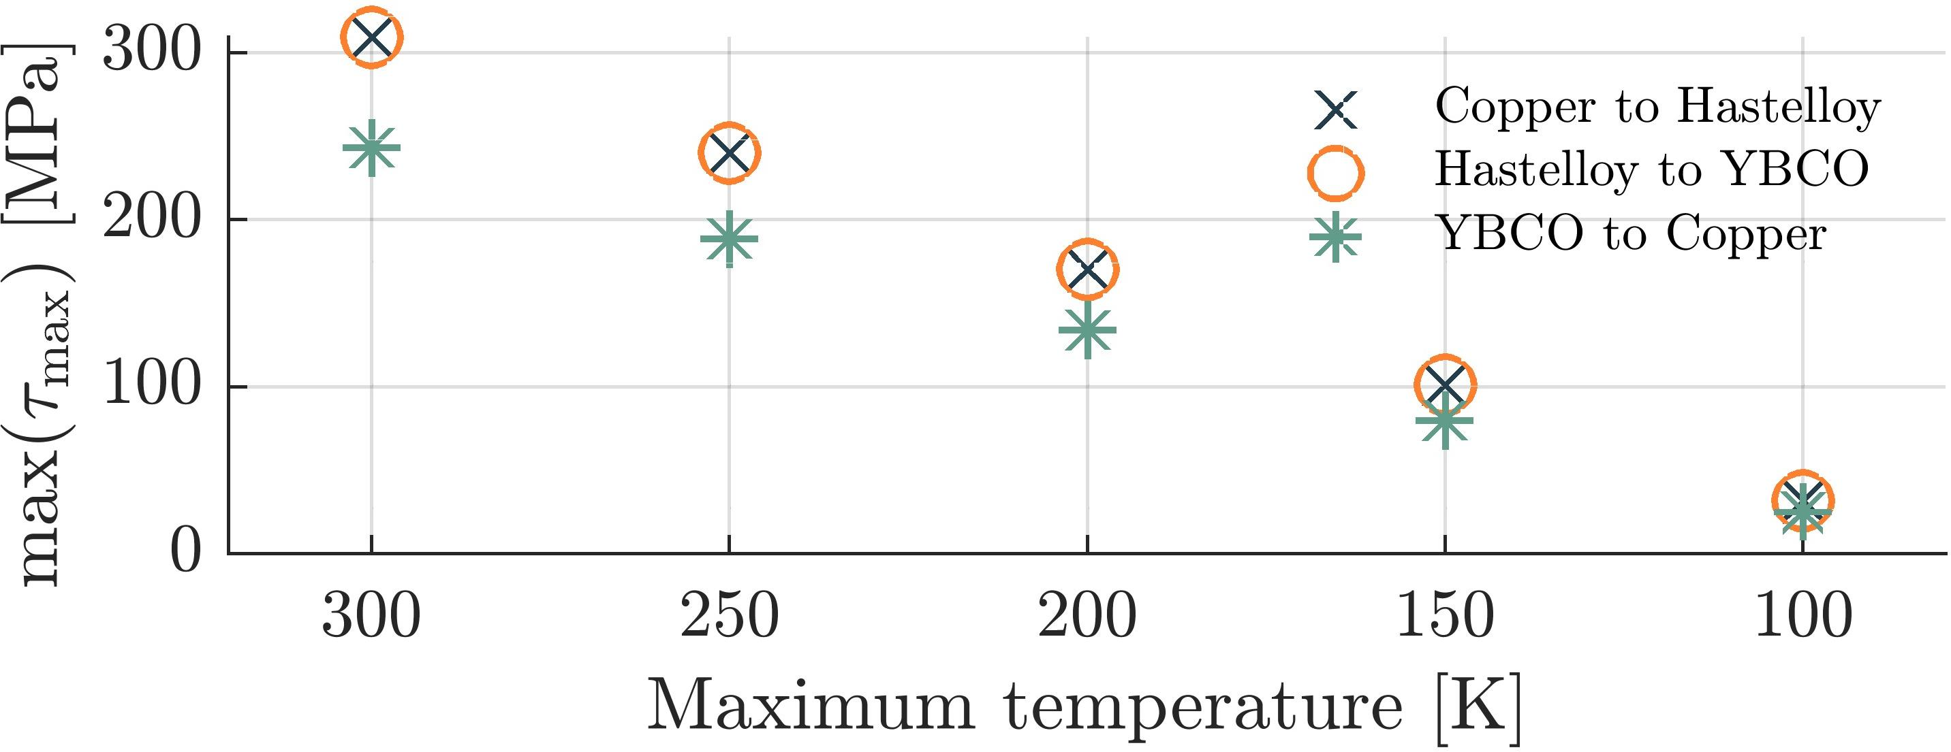
Results: Interface analysis and delamination risks
1 cm hotspot (T₁)
Tape stack model
Now the tape layers were bonded together. A proper interface analysis is needed to estimate delamination risks.
Next steps could include more detailed simulations using cohesive zone model (CZM), where an additional interface layer is modeled with associated critical normal stress, critical shear stress, and fracture energy.

Slide 15
Conclusions
Local heating (hotspots) generate considerable axial strain at the center of it.
Hotspots: Shorter length hotspots generate higher axial strain in hotpot region.
300 K maximum temperature rise can put tape in critical situation based on axial strain analysis (elastic limit and irreversible critical current).
With current boundary condition, pure mode-I and mode-II delamination seem not critical.
Mixed-mode delamination seems more critical, but it should be investigated experimentally and with simulations
Longer tapes are better investigated (1 m single tape with same BC tested already).
Looser and stricter boundary condition can be explored as well.

