Slide 1
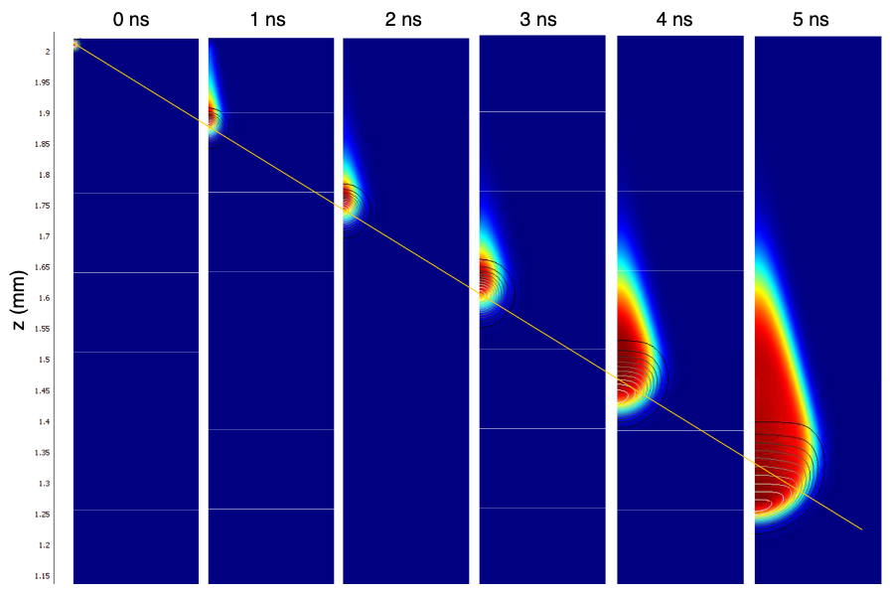
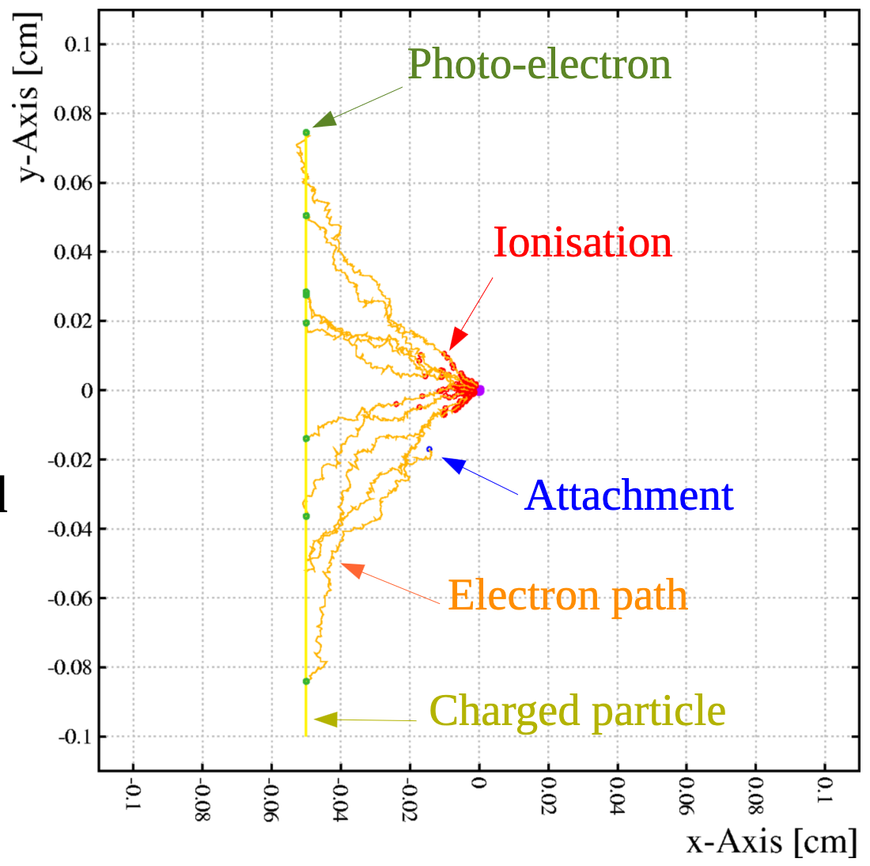
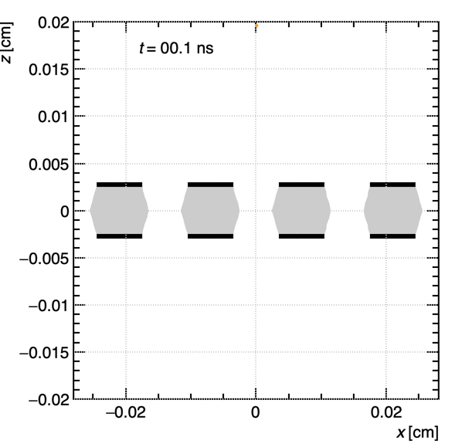
WG4 Working Meeting
Detector Physics Modelling and Simulation
Working meeting dedicated to
Software School & Documentation
P. Verwilligen – INFN Bari

Slide 2
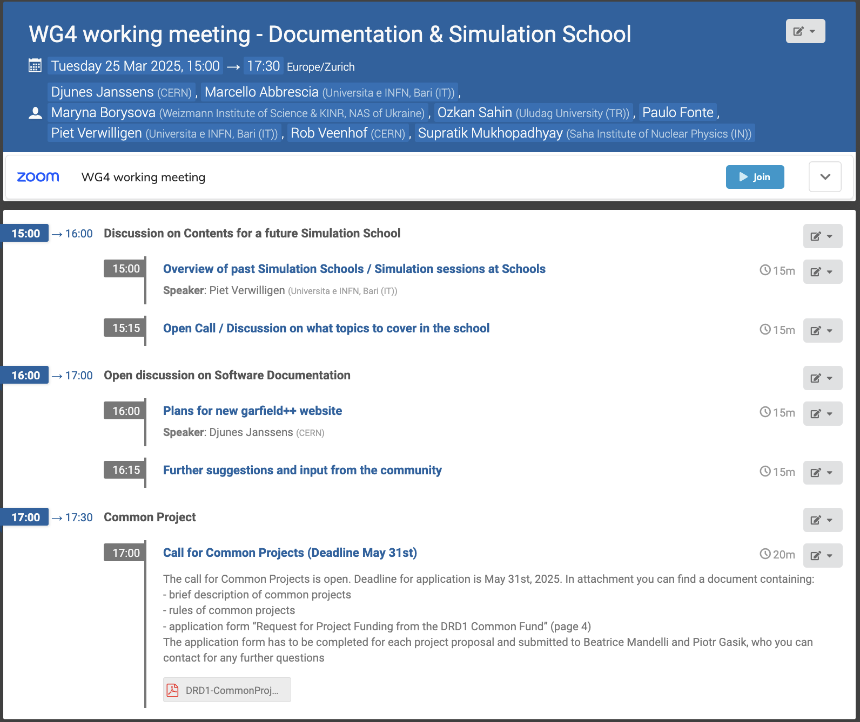
Meeting today

Slide 3
Meeting today
Idea for today is to have an open discussion
  Premise: we would like to organize a school where we teach our students the basics of GD simulation
  Why? – 2h theory + 4 or 8h exercises are not enough …
  When? – when we are ready – likely not ‘25 but ’26
  What? – to be discussed today – overview of the past
  Who? – anyone who has some experience – e.g. You!
  When to start the organization? Now!

Slide 4
Past Gaseous Detector SW Schools
RD51 Simulation School
  Jan 19-21, 2011 - https://indico.cern.ch/event/110634
RD51 Open Lectures
  Dec 11-15, 2017 - https://indico.cern.ch/event/676702
  June 22-26, 2020 - https://indico.cern.ch/event/911950
ESIPAP 2022 school
  Feb 4, 2022 - https://indico.cern.ch/event/1064512
TIPP 2023 school
  Aug 24 – Sep 1, 2023 - https://indico.tlabs.ac.za/event/121
RD51 MPGD School
  Nov 27 – Dec 1, 2023 - https://indico.cern.ch/event/1239595
DRD1 Gaseous Detector School
  Nov 27 – Dec 6, 2024 - https://indico.cern.ch/category/18473

Slide 5
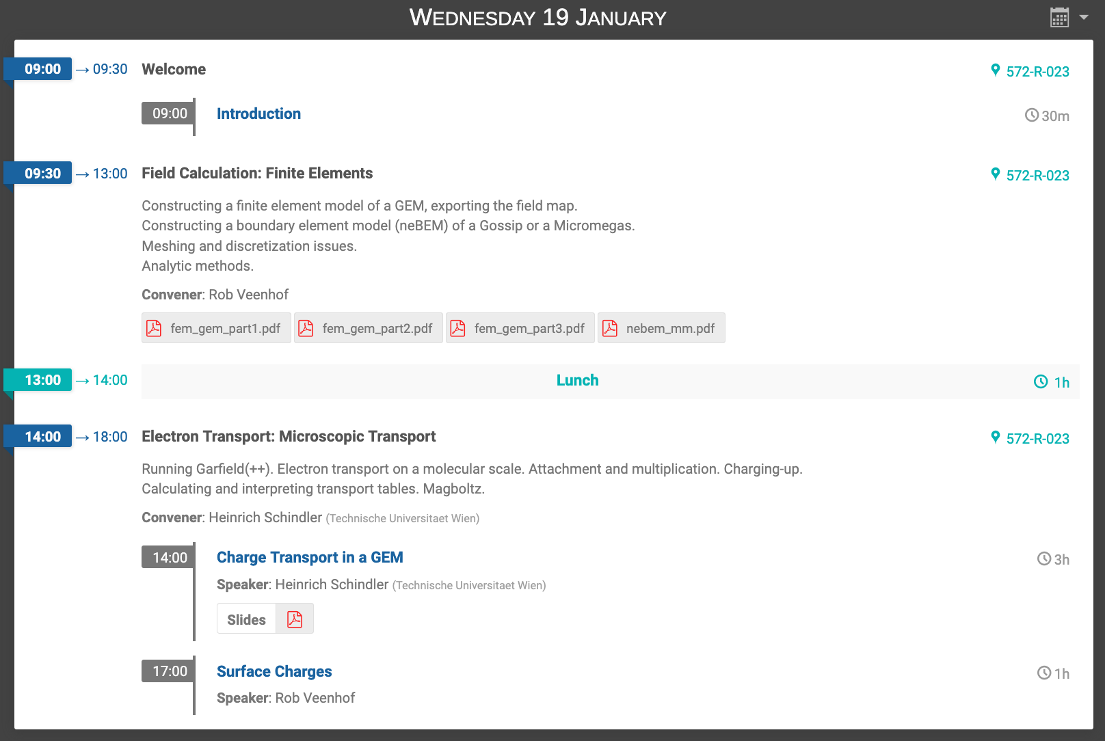
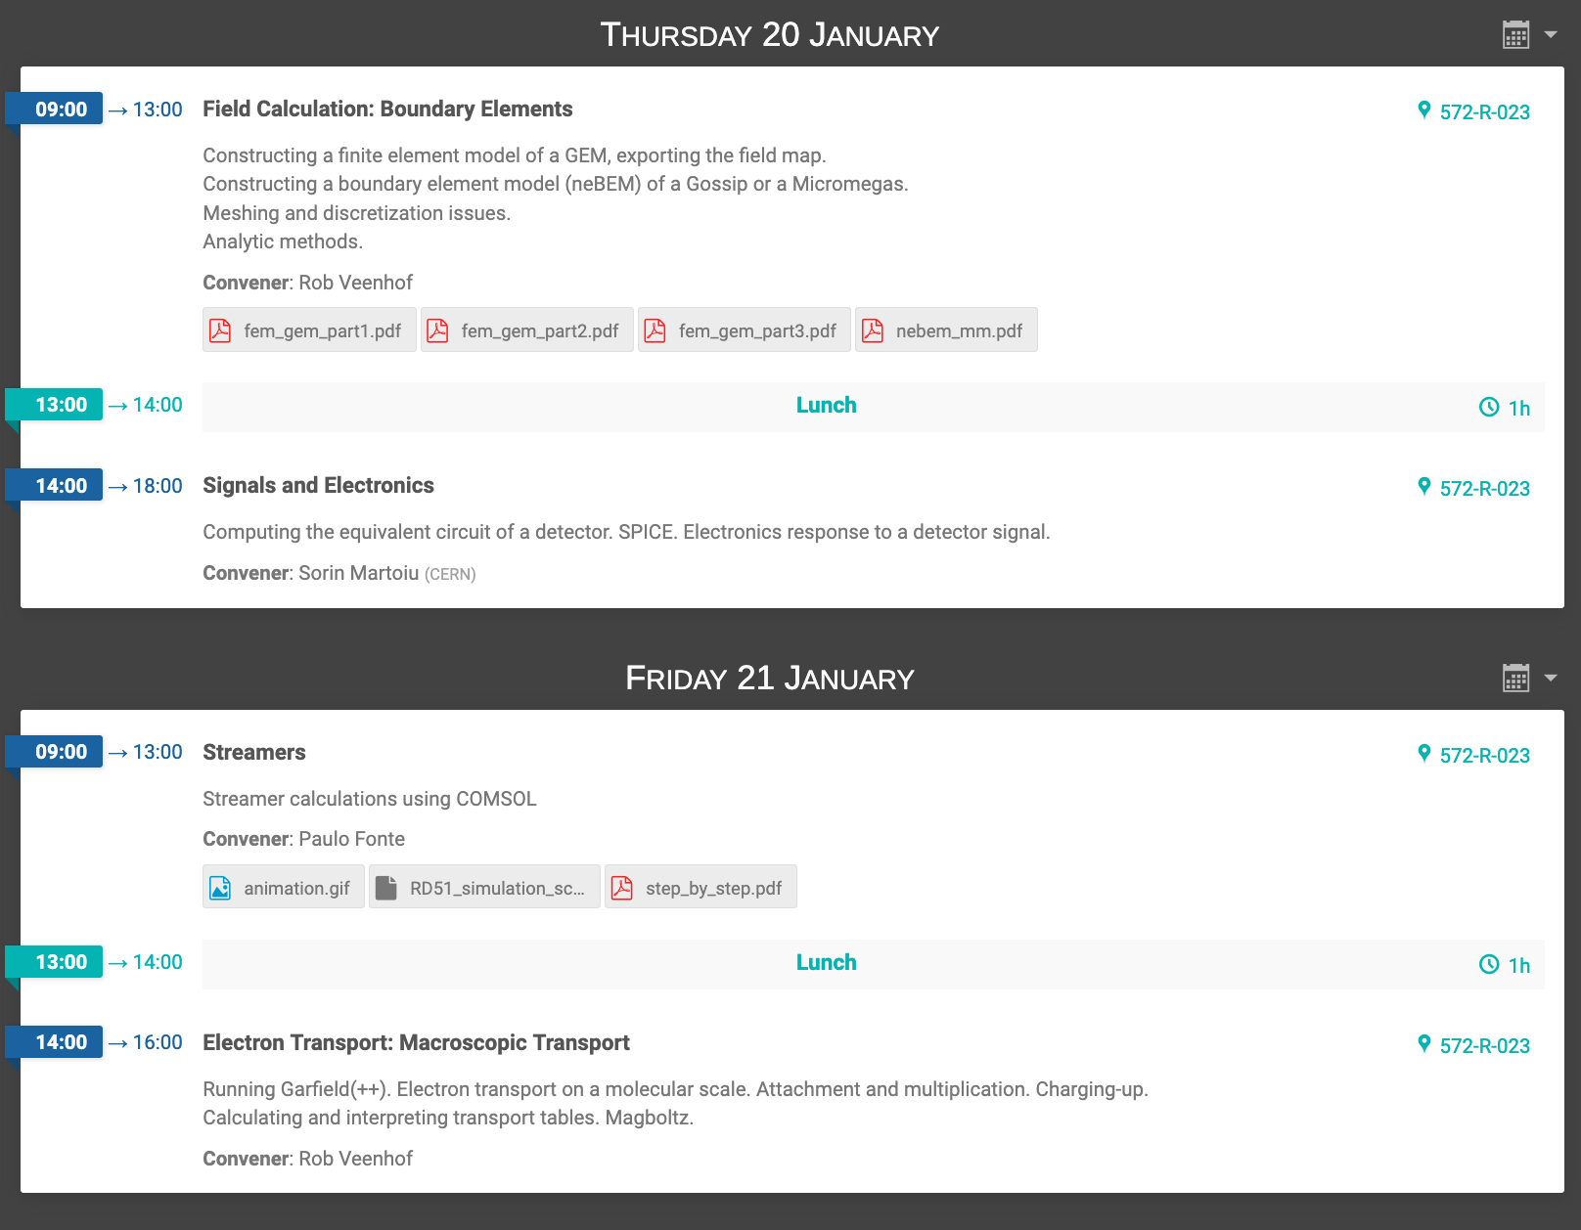
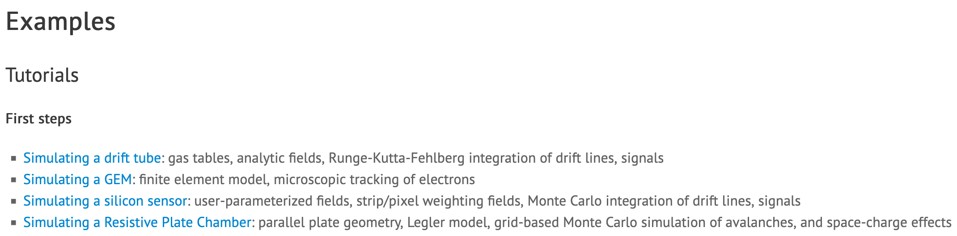
RD-51 Simulation School (2011) https://indico.cern.ch/event/110634/
3 Days – 6 blocks of 4 hours (24h) – 5 SW programs
Finite Element calculations with ANSYS (4h)
  Intro to ANSYS (by mouse)
  GEM with ANSYS (with script)
  Surface charges inside GEM hole
Boundary Element calculations with neBEM (4h)
Microscopic Transport with Garfield++ (4h)
  Electron & ion drift in GEM
  Electron multiplication in GEM
Equivalent circuit with SPICE (4h)
Hydrodynamic simulations with COMSOL (4h)
Macroscopic Transport with Garfield++ (4h)
  Gasfile, plots of electron & ion drift, …
  Charging up
School material lives on on the garfield++ website:
https://garfieldpp.web.cern.ch/garfieldpp/examples/
This is what we consider as our Reference / Starting point for the school – both in approach as in contents

Slide 6
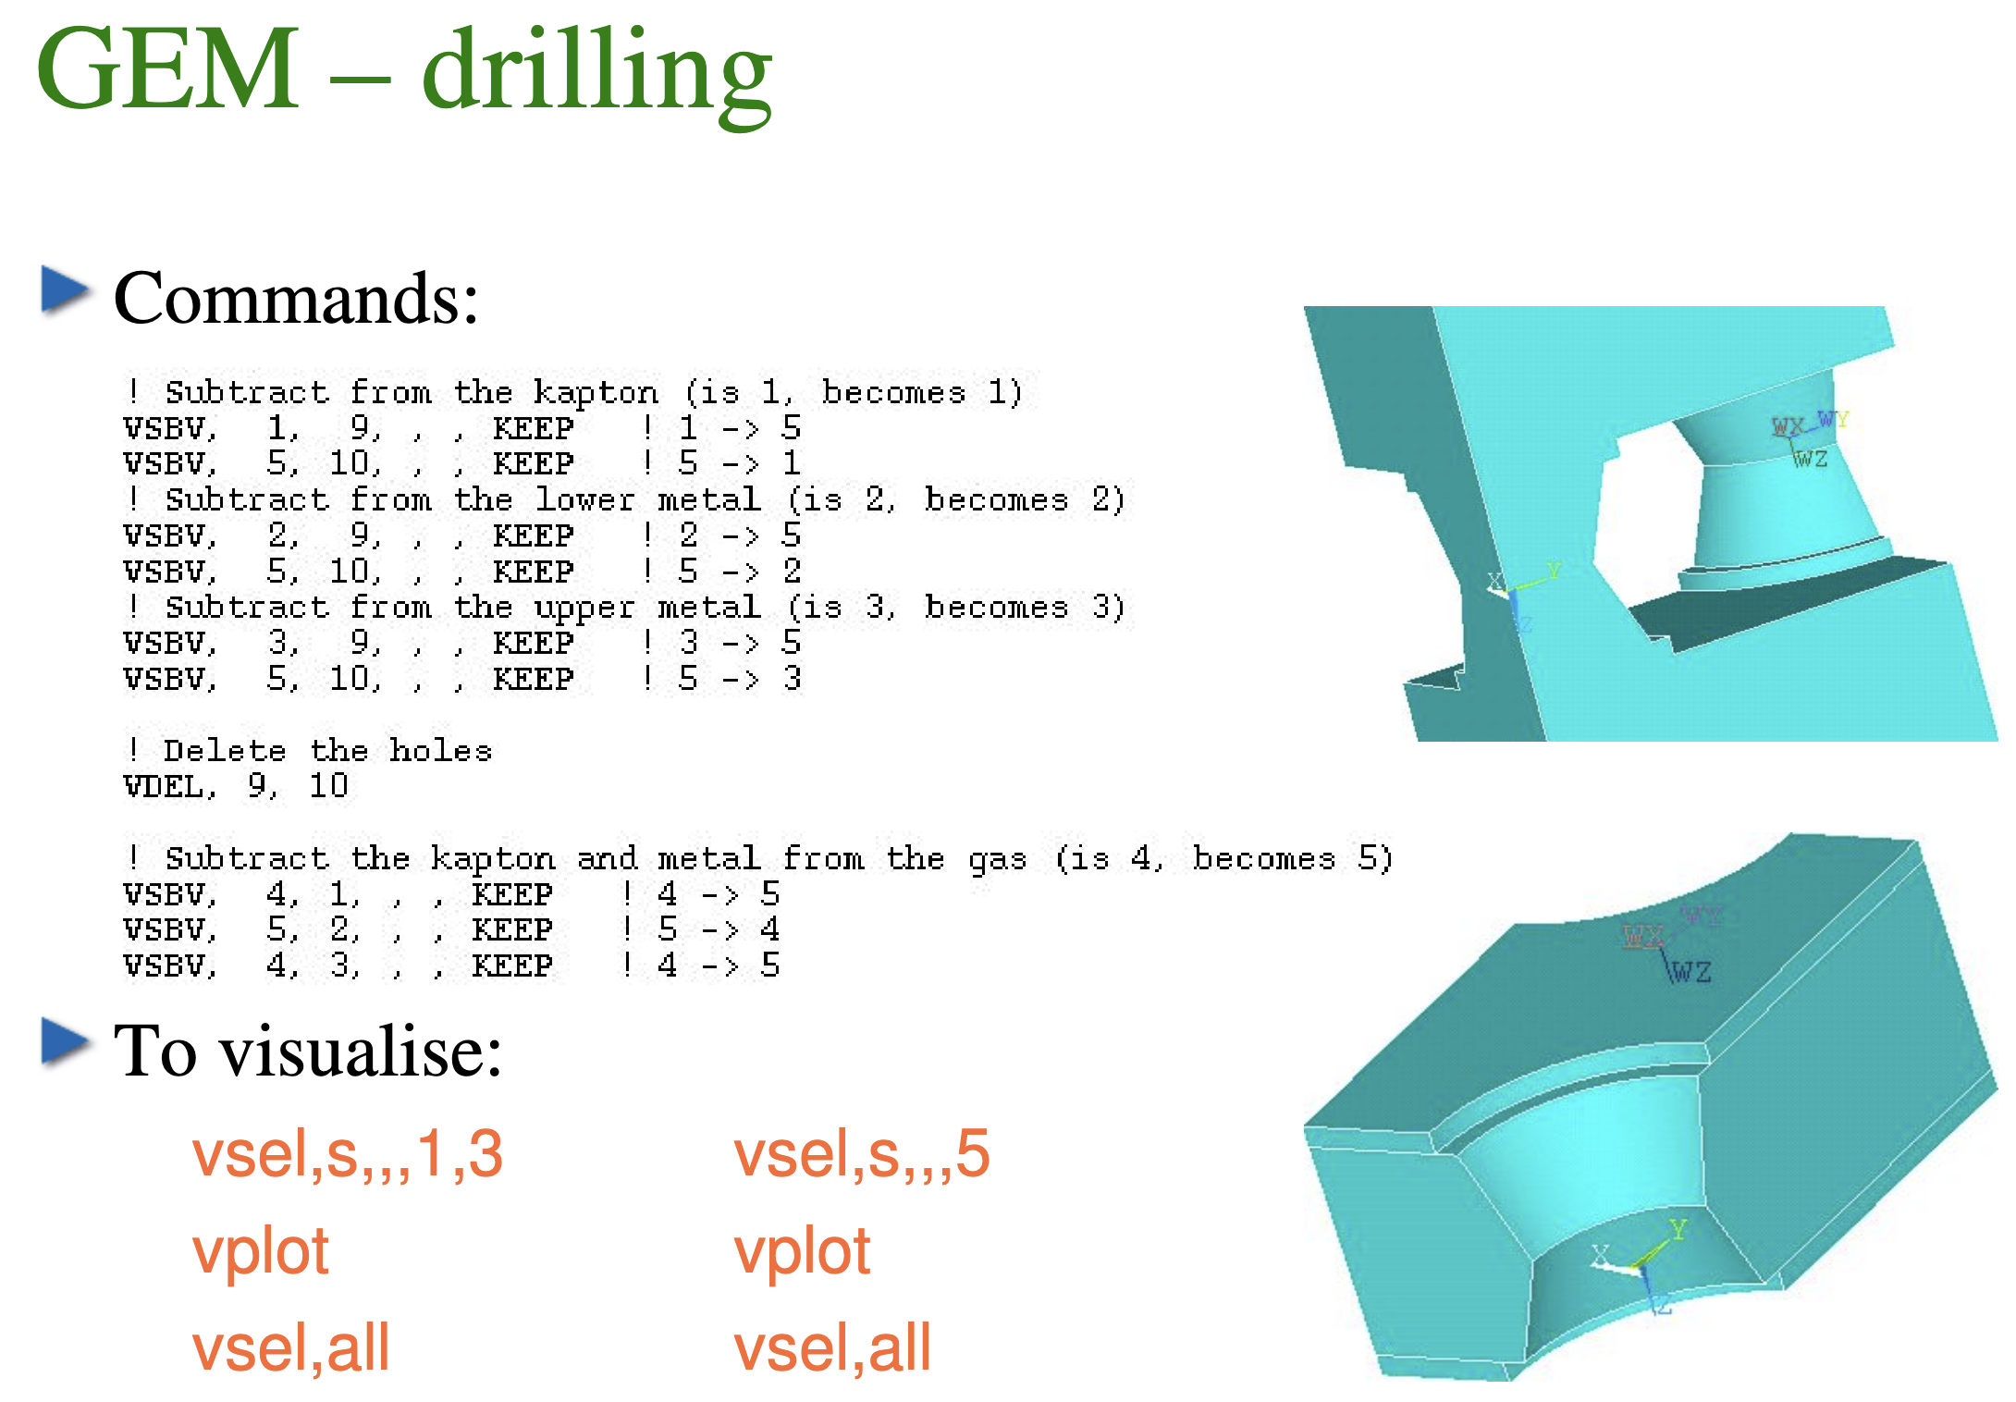
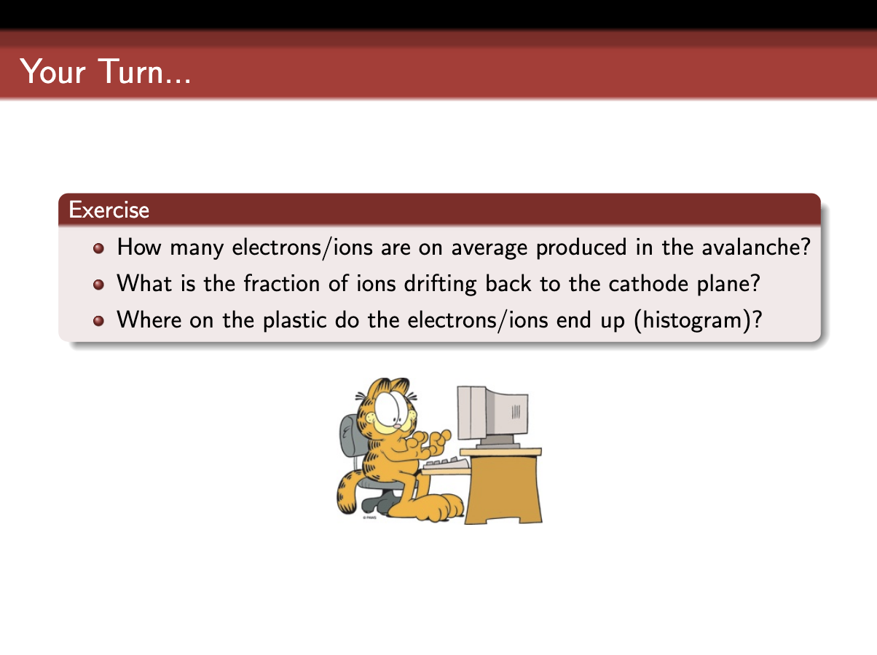
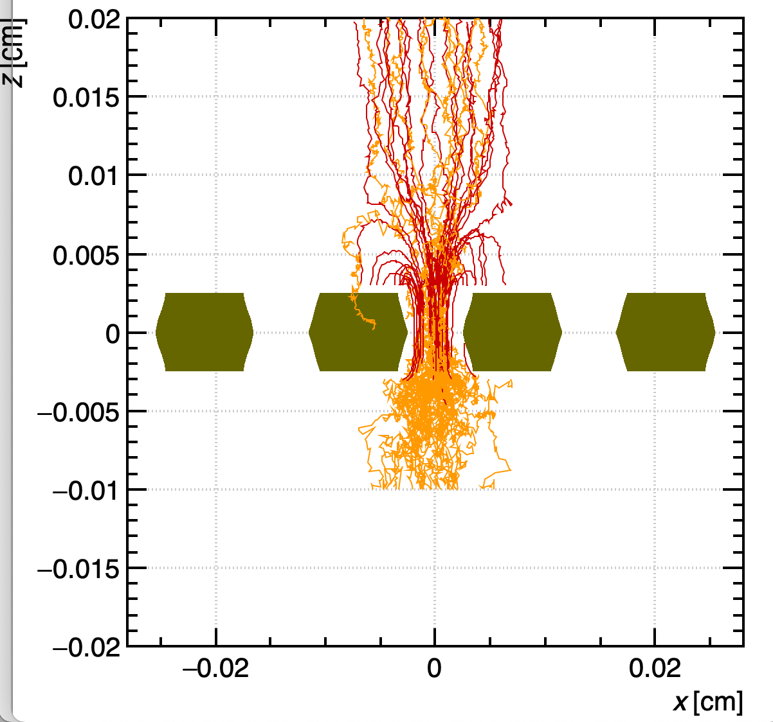
RD-51 Simulation School (2011) https://indico.cern.ch/event/110634/
Crucial for desemination of the use of ANSYS FEM code to calculte E-Field in MPGDs
R. Veenhof
H. Schindler

Slide 7
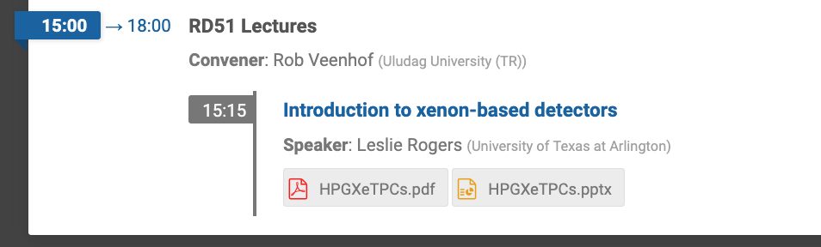
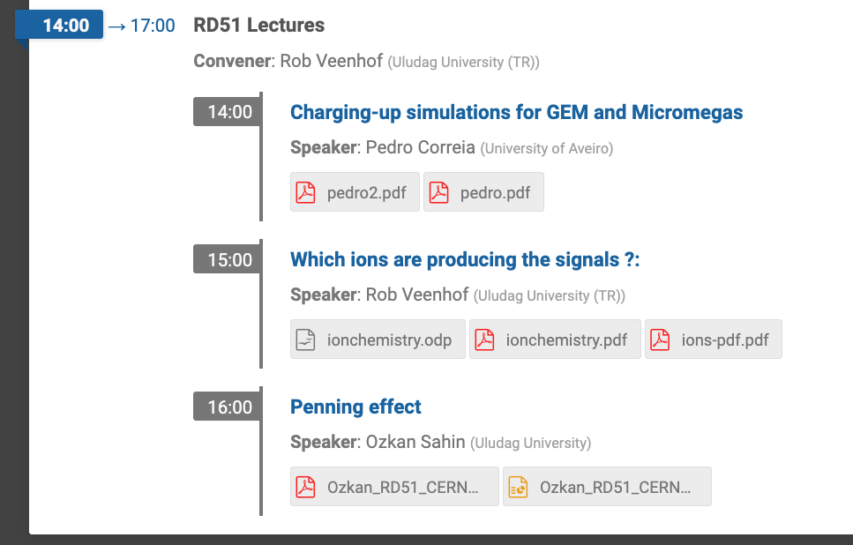
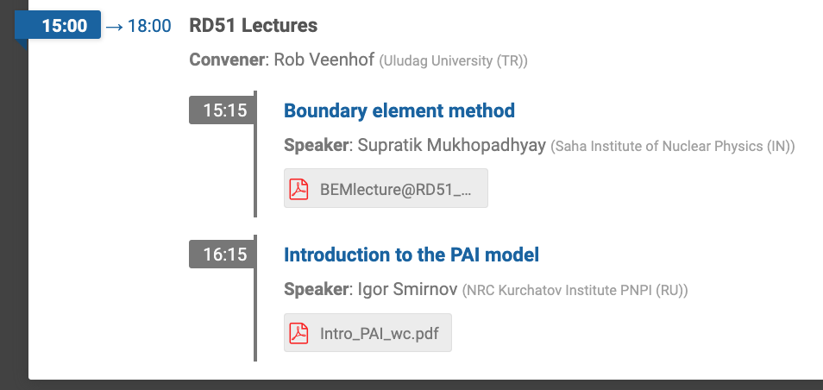
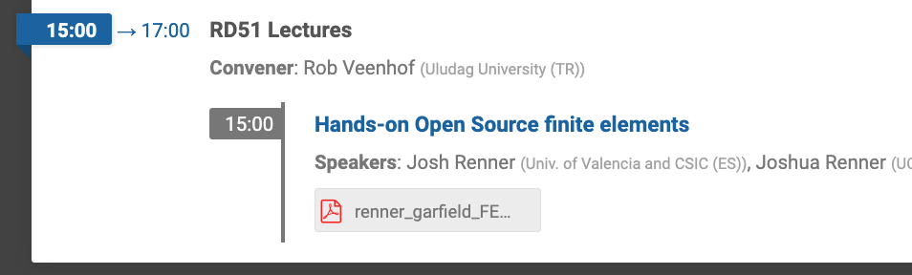
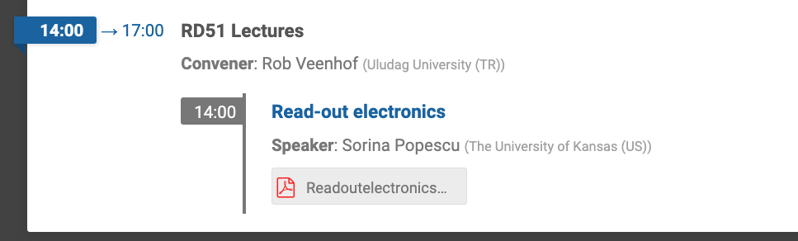
RD-51 Open Lectures (2020) https://indico.cern.ch/event/911950
Mostly theory - limited hands on
the lectures were ex-cathedra
(remote – 1st covid summer)

Slide 8
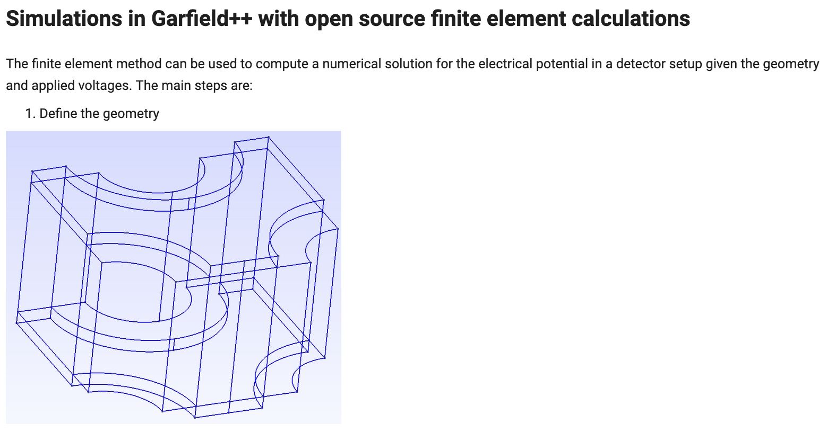
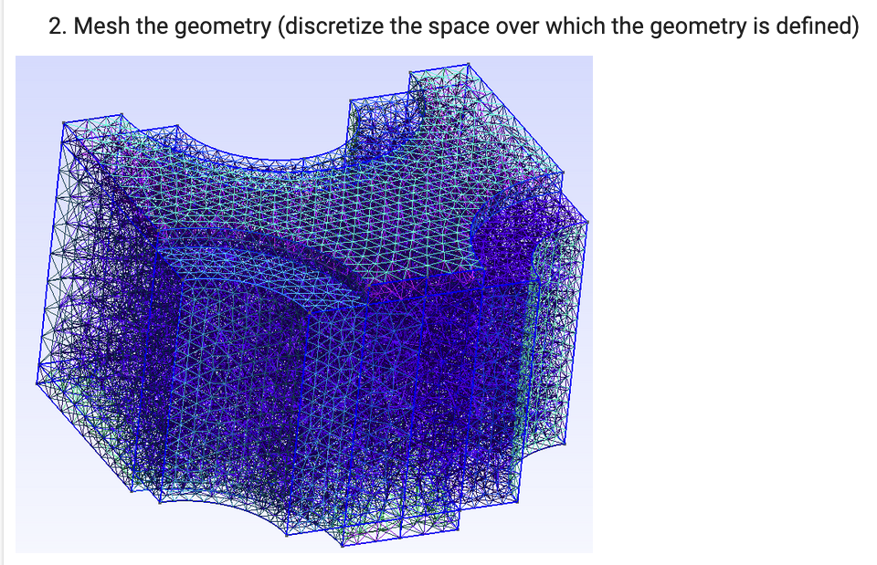
RD-51 Open Lectures (2020) https://indico.cern.ch/event/911950
Used also at ESIPAP 2022: https://colab.research.google.com/github/jerenner/
garfieldfem/blob/master/garfield_FEM.ipynb

Slide 9
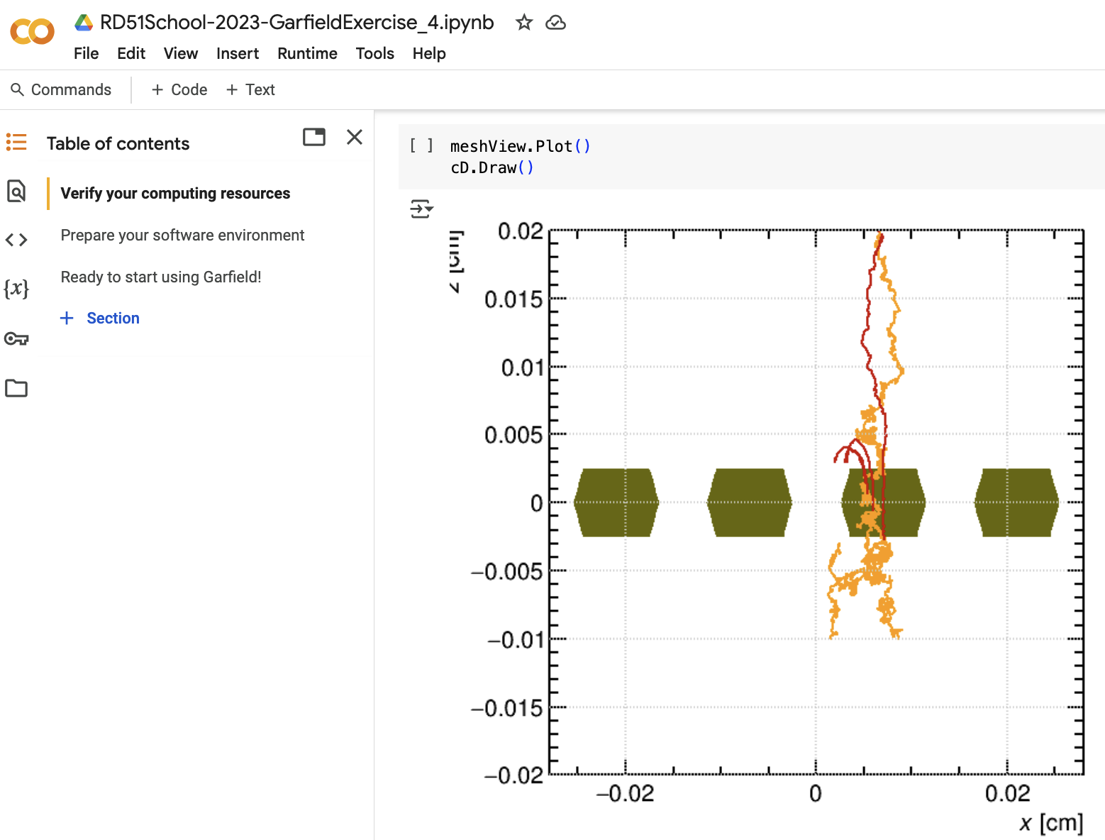
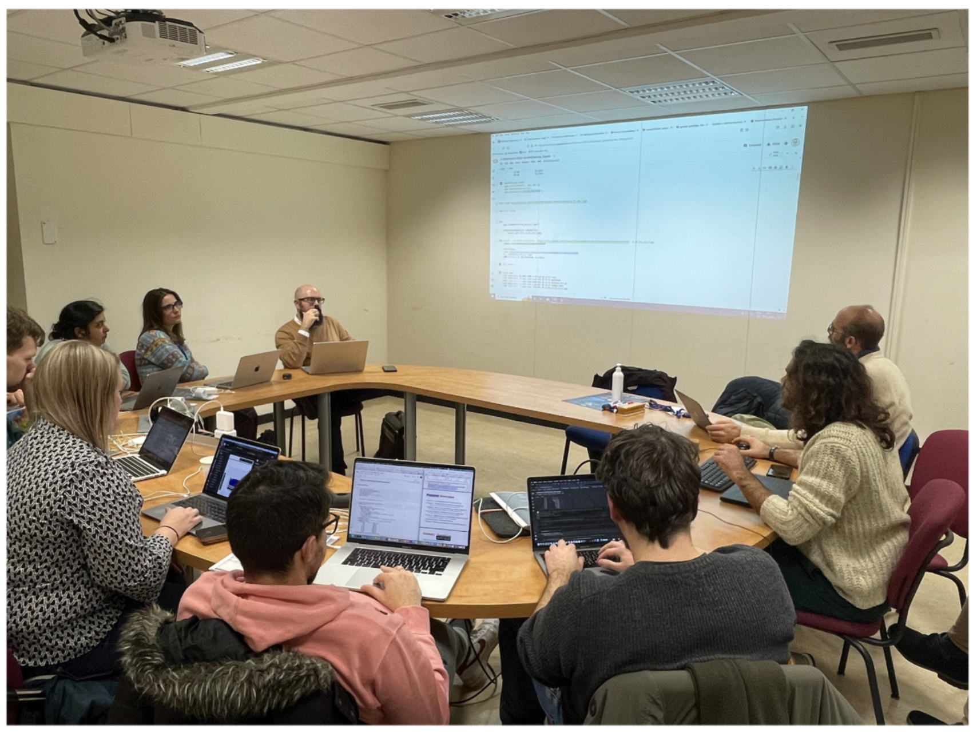
RD-51 MPGD School (2023) https://indico.cern.ch/event/110634/
2h of Theory (including signal induction)
4h of Lab Exercises
  Prepared 7 exercises – students could only do 3-4 ex.
  Exercises in google COLAB – [link]

Slide 10



Rise of Jupyter notebooks
Last decade: rise of Jupyter notebooks
  Interactive enfironment for code, data, plots – python based
  No need to install SW yourself - environment provided
CERN: SWAN (Service for Web-based Analysis)
  Software as a service
  Requires CERN computing account
  Advantage: uses CERN computing resources
  Advantage: integrated with CERN Linux
    E.g. easy to load latest nightly-build garfield
GOOGLE: COLAB
  Requires GOOGLE account
  Disadvantage: remote & limited resources
  Disadvantage: regular update Ubuntu
    Results in different version C++, python3, …
    Requires recompilation garfield++ from scratch
      Old notebooks not easily reusable

Slide 11

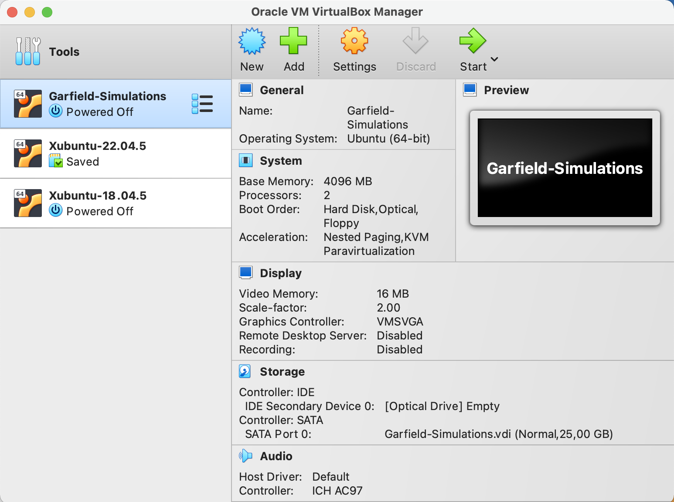
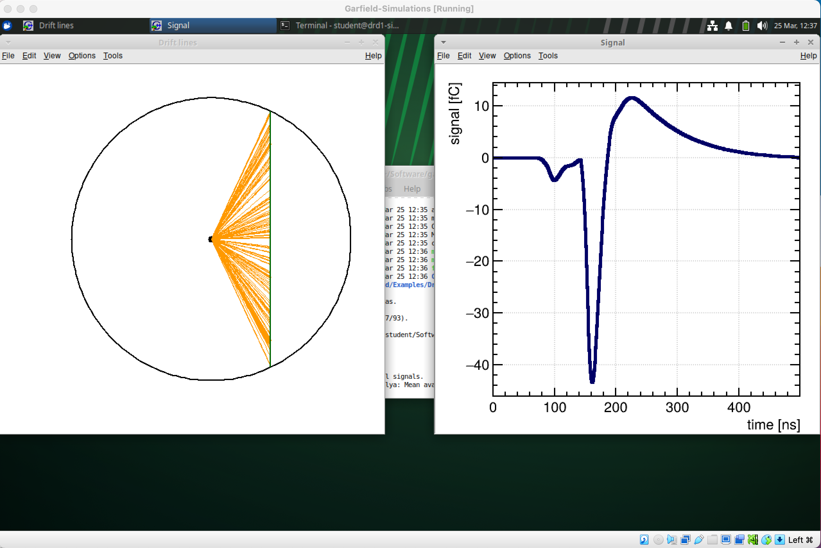
Rise of Virtual Machines
Already adopted by GEANT4, …
  Complete VM provided by tutors, students install
  Used by D.Janssens at TIPP 2023 school
  Used for DRD1 School 2024
Garfield++ Virtual machine
  Xubuntu 24.04 LTS (XFCE) + ROOT 6.32 + Garfield++

Slide 12
DRD1 Gaseous Det School (2024) https://indico.cern.ch/event/1384298
Improvements w.r.t. RD-51 School 2023:
  2h of Theory (excluding signal induction) + demo garfield++
2 x 4h of Lab Exercises
  1st session of 3-4 exercises on single items
  2nd session of ”big” exercise – Resistive MPGD or RPC (choice)
  Use of Garfield++ virtual machine [link]
Lessons learnt:
  Improvements w.r.t. RD-51 school OK
  Keep both basic & advanced exercises
  However: no time to let students simulate their own dets
    Requires simulation of the electric field – FEM / BEM

Slide 13
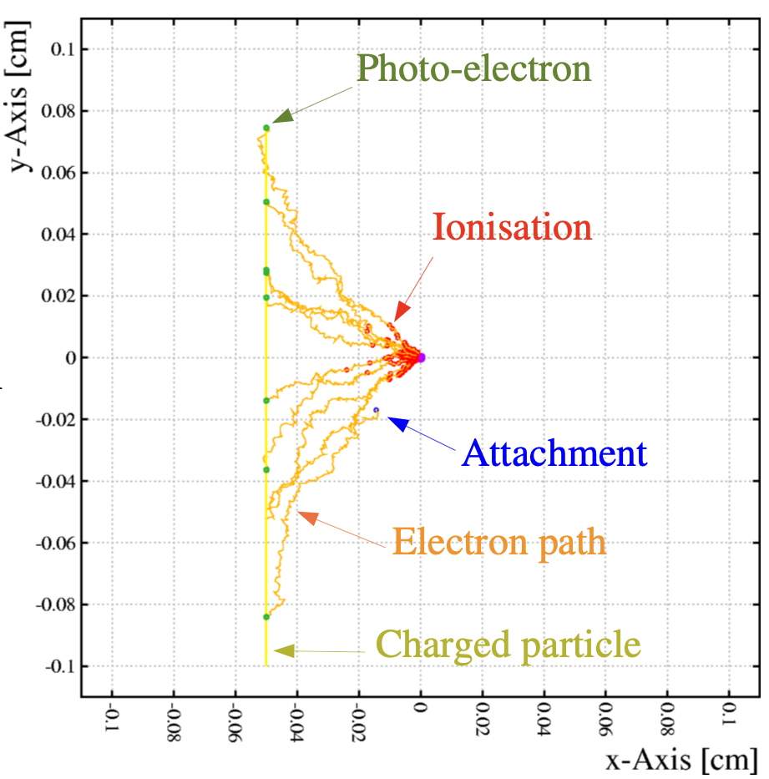

Whishlist of Topics what would we like our students learn at our school?
$$μ$$
1
Primary Ionization
Energy loss - gas
Cluster distribution
Your
gas
2
Your Detector
Geometry
Electric Fields
Anode Wire (-HV)
Charge transport
Drift & diffusion
Gas cross-sections
3
4
Your Detector (GND)
Charge Amplification
Townsend avalanche
Avalanche fluctuations
5
Signal Induction
Ramo-Shockley theorem
Signal processing

Slide 14
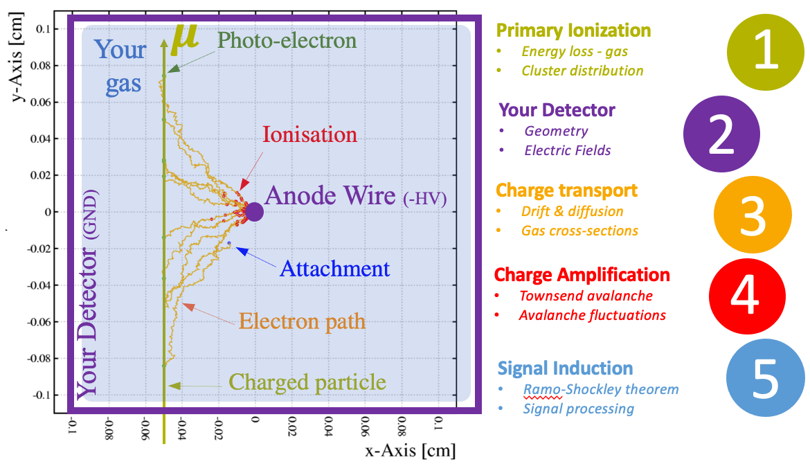
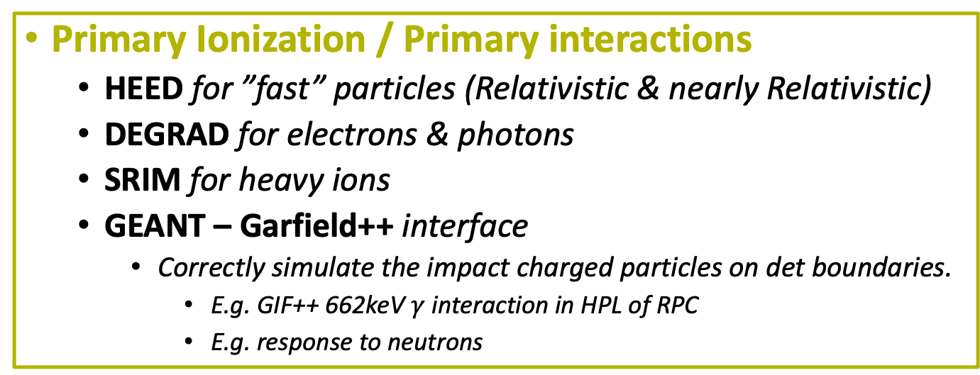
1
Primary Ionization / Primary interactions
  HEED for ”fast” particles (Relativistic & nearly Relativistic)
  DEGRAD for electrons & photons
  SRIM for heavy ions
  GEANT – Garfield++ interface
    Correctly simulate the impact charged particles on det boundaries.
      E.g. GIF++ 662keV $γ$ interaction in HPL of RPC
      E.g. response to neutrons

Slide 15
2
Detector Geometry & Electric Field
  Analytic (2D configuration with wires & planes)
  Finite Element Method (FEM)
    ANSYS, COMSOL, ELMER, AMReX/FEniCS, …
  Boundary Element Method (BEM)
    nearly-exact BEM (neBEM)
    Ouroboros-BEM

Slide 16
3
Charge Transport
  Macroscopic = Calculation & Study of SWARM parameters
    Magboltz, Pyboltz, Methes, Bolsig+, LXCAT database, literature …
    Garfield++ driftLineRKF, AvalanceMC
  Microscopic & Hybrid Methods
    Garfield ++ AvalancheMicroscopic, AvalancheGrid(SpaceCharge)
  Hydrodynamic
    COMSOL, Elmer: Coupled differential equations (q-Species & E-fields)
  Study: ideal gasmixture & environmental parameters for exp.

Slide 17
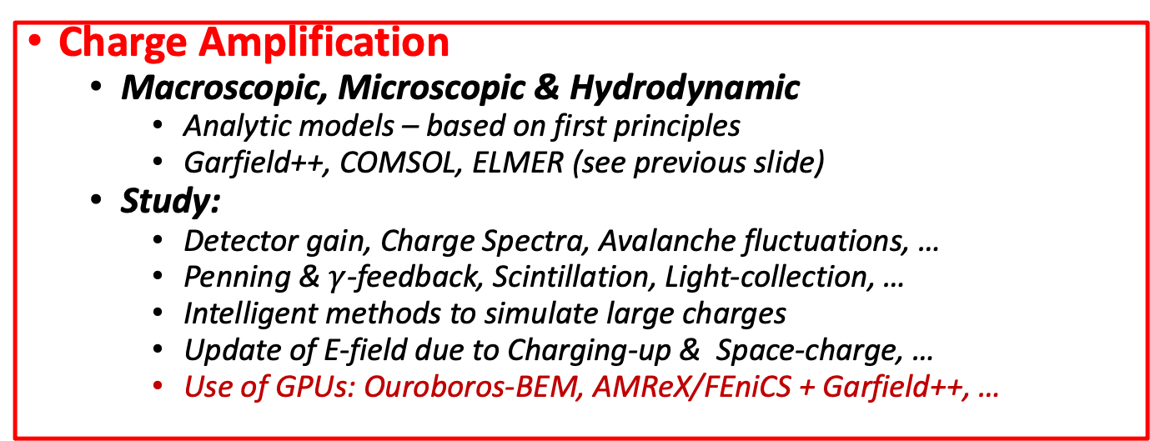
4
Charge Amplification
  Macroscopic, Microscopic & Hydrodynamic
    Analytic models – based on first principles
    Garfield++, COMSOL, ELMER (see previous slide)
  Study:
    Detector gain, Charge Spectra, Avalanche fluctuations, …
    Penning & $γ$-feedback, Scintillation, Light-collection, …
    Intelligent methods to simulate large charges
    Update of E-field due to Charging-up & Space-charge, …
    Use of GPUs: Ouroboros-BEM, AMReX/FEniCS + Garfield++, …

Slide 18
5
Signal Induction
  Ramo-Shockley theorem + Extension
    Signal induction in detectors with conductive elements
    Signal induction in detectors with resistive elements
      Charge spread – telegraph equation – time-dependent Weighting field
  Signal transmission, processing & Shaping
    Importance of the capacitance, equivalent RC-circuit, PSPICE
    Signal propagation on long strips, cross-talk, transmission line

Slide 19
Whishlist of Topics what would we like our students learn at our school?
Just to start the discussion
we would like
your input
What else?
  Maybe methodology?
    Being critical – search to confirm your results
    Cross check with different SW tools, compare to data
  Maybe some theoretical lectures?
    E.g. on Finite Element Methods & Boundary Element Methods?
    Understand theoretical limitations
  Maybe a “Big exercise” that puts everything together
    Selected by the organization – let students work on their own detector?
What did we forget? What will we select / prioritize?
  Doing everything is likely impossible
  This is likely already a 2 week program
Your input here
  We will update the slides

