Slide 1
Using Xsuite and Genetic Methods to Optimize FCC GHC Momentum Acceptance
Bernardo Abreu Figueiredo
Supervisor: G. Iadarola
Acknowledgements: K. Skoufaris

Slide 2
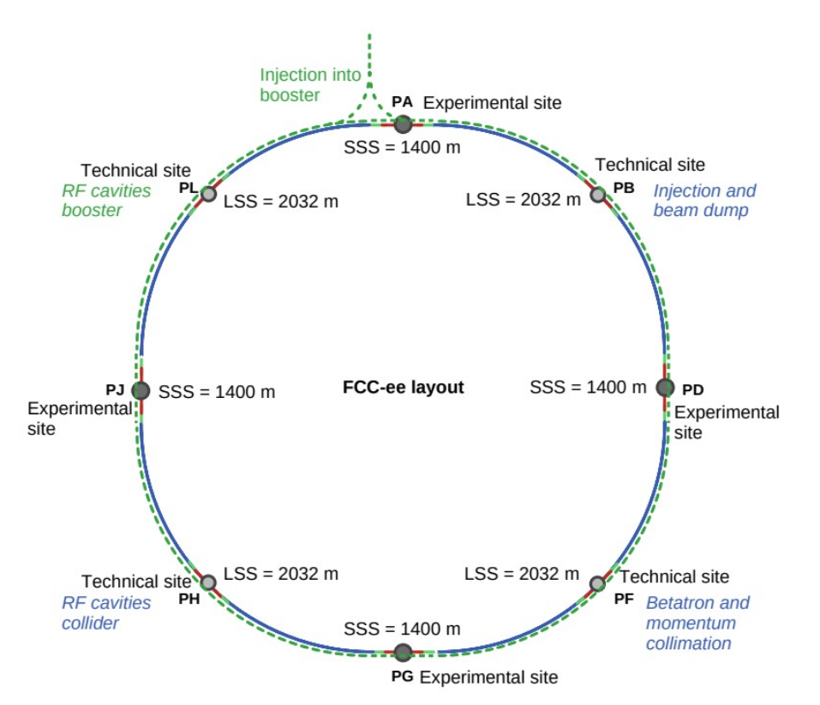
Future Circular Collider
FCC is among CERN’s most promising future accelerator project
Circumference of almost 100 km
Raises new challenges for beam optics
  How to get and maintain a stable beam?
Goals
  Lose as few particles as possible
  Minimize the bunch length at Interaction Points (IP)
Courtesy of J. Keintzel

Slide 3
What do we want to optimize?
We want to optimize three main quantities
  Minimize (Linear) Chromaticities
  Minimize W functions at IPs
  Maximize momentum acceptance
They are influenced particularly by Sextupole magnets
FCC GHC lattice contains 74 sextupole circuits
  GHC = Global Hybrid Correction
  Each circuit contains 2 sextupole magnets
  Distributed over the collider
Courtesy of J. Keintzel

Slide 4
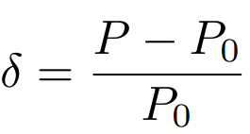
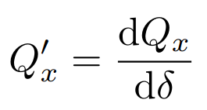
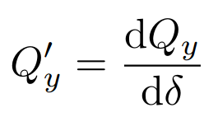
Chromaticity
Transverse tune is the number of oscillations per turn on one plane
  defined as Q_{x} and Q_{y} for the corresponding plane
𝛿 is the momentum (longitudinal) component
  Momentum ratio w.r.t. to reference particle
Chromaticity Q’ relates the transverse tune to the difference in momentum
  defined as the derivative of the tune to 𝛿
Q’ is the linear chromaticity
  Nonlinear chromaticities (Q’’, …) are the higher order derivatives w.r.t. 𝛿
We want to minimize chromaticities.
Ideally: Tune independent from momentum change

Slide 5

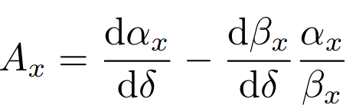
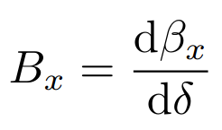
W Functions
The W function represents the sensitivity of optical functions to momentum changes
  Captures impact of chromatic aberrations
A quantifies change in alpha function
B quantifies change in beta function
We want to minimize W functions at interaction points
Ideally: Optical functions independent from momentum change

Slide 6
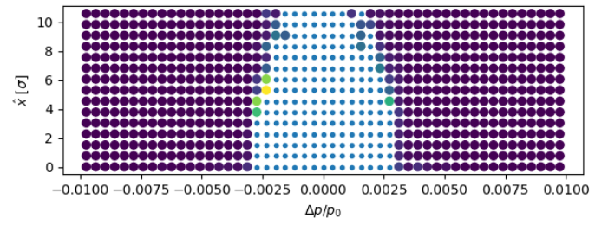
Momentum Acceptance
Momentum acceptance defines how much momentum deviation beam can be stably tolerated
Larger momentum deviations increase beam length
Small dot = Particle survived
Big dot = Particle lost
We want to maximize momentum acceptance to keep a stable beam even when dealing with high beam lengths (injection)

Slide 7
Optimization Strategy
Global Optimization of 74 Sextupole circuits to:
  Minimize chromaticities
  Minimize W functions at IPs
  Maximize momentum acceptance
Starting point obtained matching only chromaticities and W functions at IP
First optimization one circuit at a time using DiRECT optimization algorithm
After that, optimization of circuits together with evolutionary algorithm CMA-ES

Slide 8
General Structure
Each sextupole strengths is set as the sum of two knobs
  “Main” knob, used to optimize momentum acceptance
  “Correction” knob used to optimize chromaticity and W function
Main knobs are the free parameters of the momentum acceptance optimization
At each optimization step:
  Optimizer sets main knobs
  Correction knobs are used to correct chromaticity and chromatic functions at IP
    Calculated by using pseudo-inverse of a precomputed response matrix
Complex optimization: 74 sextupole circuits → high-dimensional parameter space

Slide 9
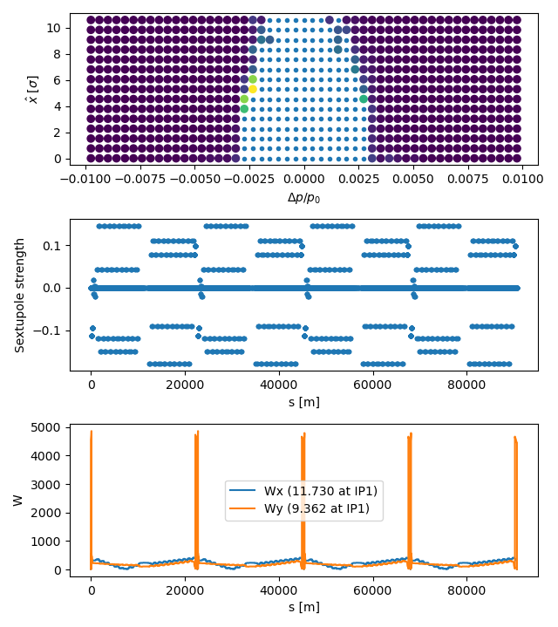
Initial State
Obtained matching chromaticity and chromatic functions at IP
Particles tracked for 1000 turns
Mean survival time: 249.79 turns
Sextupole strength interval low
W functions low at IP, but blow up directly after
  Goal is to reduce it as fast as possible

Slide 10
First Optimization: DiRECT
In a first round of optimization, DiRECT was used to solve the optimization problem
  Global optimization approach based on dividing hyperrectangles in the search space
Performed one by one, for each Sextupole circuit
  Bounds were set at (0.2x, 3x) for focusing and (3x, 0.2x) for decfocusing sextupoles
  x denotes the sextupole strength
To avoid biases/problems arising from the running order, the order is shuffled
Optimization executed on evaluating tracked particles for 100 turns
If an iteration didn’t provide an improvement, it is reverted and skipped
Took a few hours

Slide 11
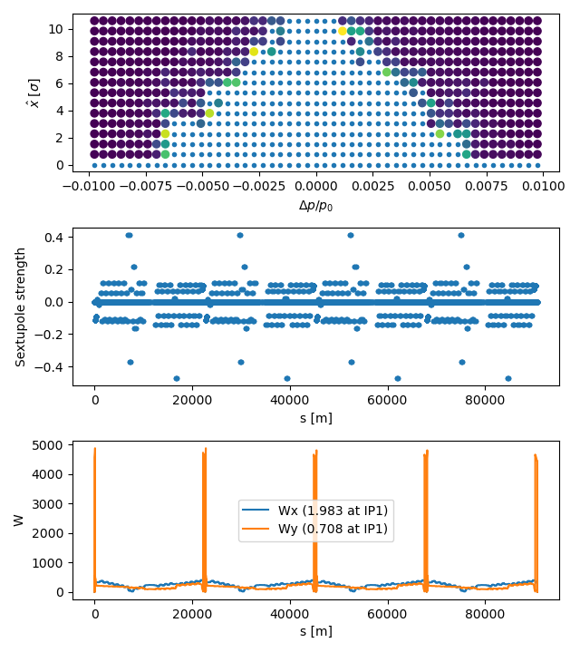
Results For First Optimization
Particles tracked for 1000 turns
Mean survival time: 249.79 → 470.076 turns
DiRECT

Slide 12
Second Optimization: Evolutionary Algorithm
After having a coarse solution, I tried several evolutionary algorithms to find more fine-grained results
Evolution strategies are based on
  Population: Evolves candidate solutions over generations
  Fitness evaluation: Evaluate each candidate based on objective function
  Selection: Choose a subset of candidates based on fitness
  Mutation and Recombination (Perturbations and weighted combinations of parent solutions)
CMA-ES: Covariance Matrix Adaptation Evolution Strategy
  Evolutionary algorithm, based on adapting the Covariance matrix
  Taking samples, if a step provides good results, increase the probability of this step/direction
  Using Covariance Matrix to direct the sampling
  Implemented in Pymoo library
Hansen, Nikolaus. "The CMA evolution strategy: A tutorial." arXiv preprint arXiv:1604.00772 (2016).

Slide 13
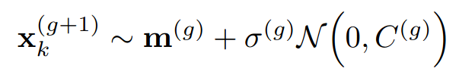
CMA-ES: Sampling
Starting point:
  Candidate solution provided by user
  Initial covariance matrix C is the identity matrix
  Step size σ (standard deviation) defaults to 0.1, can be set by user
Generate population of λ samples by sampling from (multivariate) normal distribution for k = 1, …, λ samples
x_{k}^{(g+1)} are the new candidate solutions (generation g + 1)
m^{(g)} is the weighted mean of the current search distribution (generation g)
σ^{(g)} is the current step size
C^{(g)} is the current covariance matrix

Slide 14
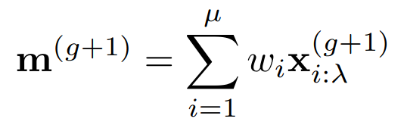
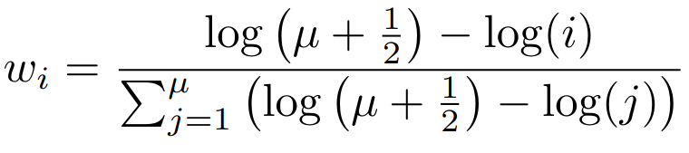
How to calculate the mean?
m is not just the mean of all candidates
Weighted mean of the best μ offsprings
x_{i:λ}^{(g+1)} is the i-th best offspring
μ is the number of selected points (usually λ / 2)
w_{i} is the weight coefficient for recombination
  Set in a way to give more weight to better points

Slide 15
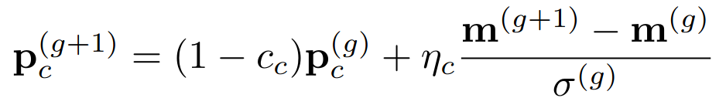

Covariance Matrix Adaptation: Rank-One Update
Update covariance matrix based on sum of selected steps
Approach uses evolution path p_{c}: Sequence of successive steps
  Expressed by sum of consecutive steps
Outer product is used for rank-one update
η_{c} is a normalization constant
c_{c} is a time horizon weight
c₁ is the learn rate for the rank-one update
Benefit: Faster convergence in optimal direction

Slide 16
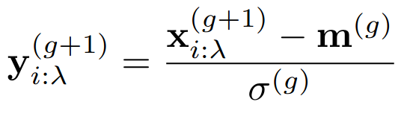
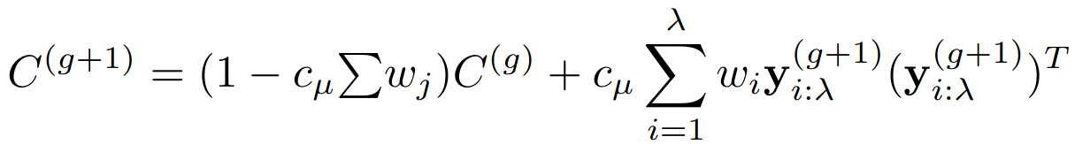
Covariance Matrix Adaptation: Rank-μ Update
Updating covariance matrix based on best μ parents from one step
Approach uses normalized step vectors y which
are added to the covariance matrix
c_{μ} is a learning rate for the rank-μ update
Benefit: More robust and stable search by considering multiple candidates

Slide 17

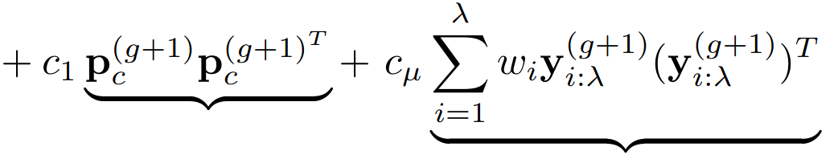
Covariance Matrix Adaptation: Putting it all Together
Covariance matrix adapts to guide
the search direction
Rank-one updates based on
successful steps for faster convergence
Rank-μ updates based on multiple
candidates for more robust search
  Balancing exploration and exploitation
Rank-one update
Rank-μ update

Slide 18
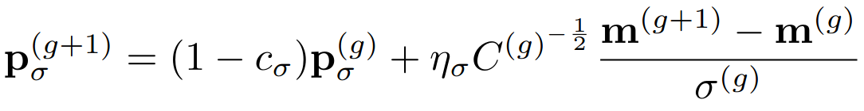
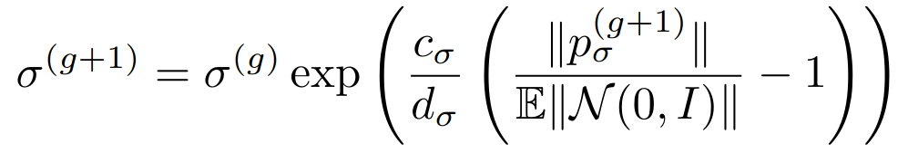
Controlling the Step Size
Now we know how C and m are calculated, but we still miss how the standard deviation for the distribution is controlled
Based on conjugate evolution path p_{σ} with
similar parameters (time horizon c_{σ}, normalization constant η_{σ})
Additional transformation C^{-½} that makes length of p independent of its direction (Rotation - Scaling - Rotation back)
d_{σ} is a damping parameter
Evolution path is normalized to expected
length of unit vector

Slide 19
Let’s take a deep breath… Short summary
Compute value of objective function for candidates
Select best candidates, calculate mean m^{(g+1)}
Compute new covariance matrix C^{(g+1)}
Update step size σ^{(g+1)}
Repeat until termination criterion is met (number of iterations/close enough to solution)

Slide 20
Second Optimization: CMA-ES
Momentum acceptance optimization was performed on particles tracked for 200 turns
Particle distribution is generated
Multiple runs of optimizations
Computationally expensive: Accumulated 18000 iterations (~125 hours)
  Create particle distribution and track it for each iteration

Slide 21
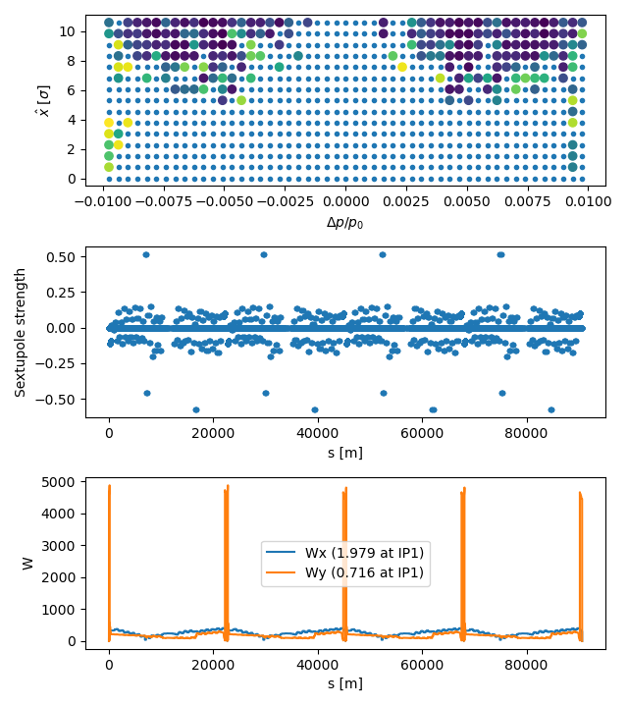
Results after 3500 Iterations of CMA-ES
Around 21 hours of calculation
Mean survival time: 470.076 → 801.665 turns
Bigger interval of Sextupole strengths
DiRECT
CMA-ES

Slide 22
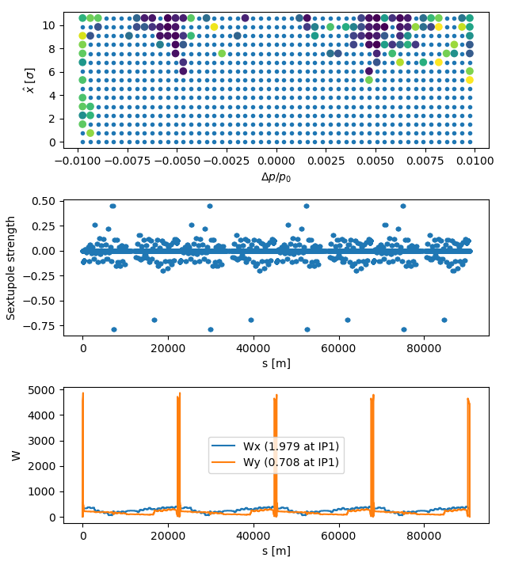
Results after 8000 Iterations of CMA-ES
Around 48 hours of calculation
Mean survival time: 801.665 → 912.933

Slide 23
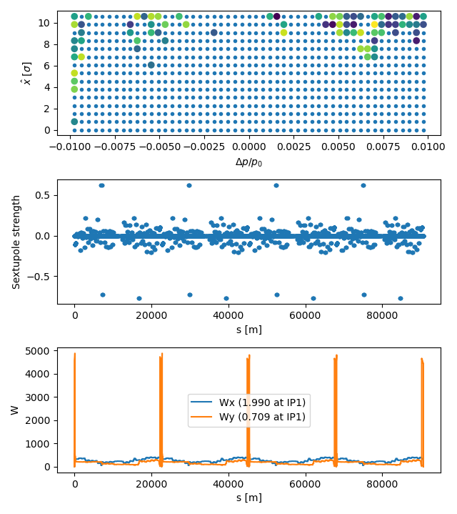
Final Results after 18000 Iterations
Final results after 8 runs, approx. 125 hours
18000 iterations cumulated
Mean survival time: 912.933 → 955.332

Slide 24
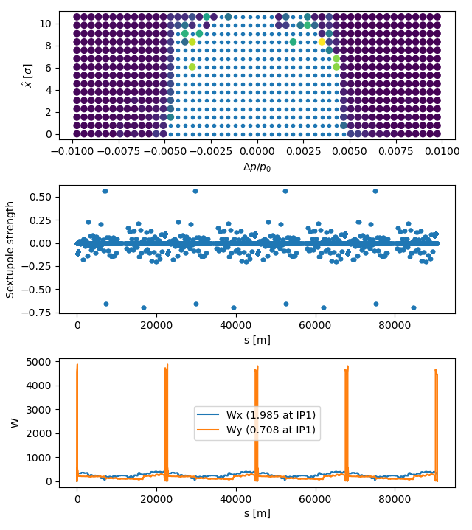
Damping high Sextupole Strengths
The strong sextupoles seem to have a major impact
Particular degradation when reducing them and optimizing W
This example is with reducing the strong sextupole strengths by 10%

Slide 25
Conclusion
Evolutionary Algorithms can deliver good results for momentum acceptance optimization
  Very strong improvements at the beginning (good results after 24 hours), gets less effective quickly
CMA-ES outperformed other algorithms when using the same number of iterations
  Also tried from the NSGA family, ISRES, Differential Evolution and Genetic Algorithm
  They also provided improvements, but not as much as CMA-ES
Challenge: Very time-consuming task
  Execution was only single-core (except for tracking)
  Especially when extending the idea to multiple lattices/configurations of the accelerator
  Best result came after more than five full days of calculation

