Slide 1
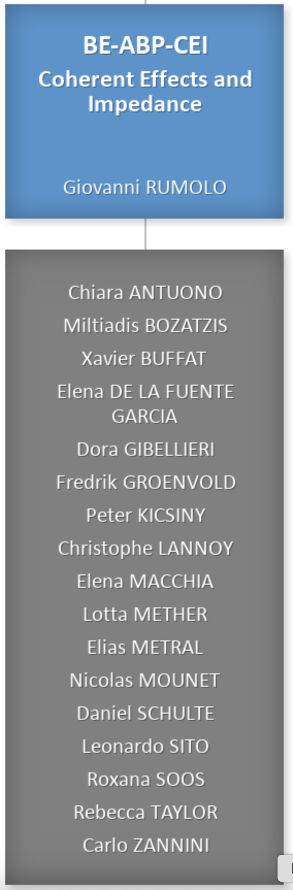
Coherent Effects and Impedances section (CEI) – general information
Giovanni Rumolo
CEI Section Meeting, 27/02/2025
Scientific secretary: Carlo Zannini
https://indico.cern.ch/event/1510134/

Slide 2
Some deadlines and events
Student committee TSC-2025-2 + QUEST
  Two TECH (impedance) and one DOCT (muons) approved at the departmental level, supervisors will receive on 1 April access to the folders for selection
  Two QUEST on muon colliders opening soon
70th ICFA Advanced Beam Dynamics Workshop eeFACT 2025 will take place next week (3-7 March, 2025) at the Tsukuba International Congress Center (EPOCHAL) in Japan
  This workshop will bring together experts to review and document the latest advancements in e⁺e⁻ factory design.
  Key objectives include drawing lessons from the commissioning of SuperKEKB and other existing factory machines, identifying challenges that degrade performance and exploring solutions. The workshop also includes design efforts for major projects such as FCC-ee, CEPC, STCF, and EIC.
  In addition, eeFACT2025 seeks to foster synergies and collaborations across different scientific communities, particularly with low-emittance light sources and other colliders, such as muon and linear colliders.
  From CEI Dora, Xavier, Peter and Roxana will participate
Notes:
STCF = Super Tau Charm Facility in China

Slide 3
Injectors schedule
Last week beam to PSB, yesterday beam to PS
Next week beam to PS-EA, ISOLDE and SPS expected
Following week
  start of physics in PS-EA and nTOF
  Probable start of SPS scrubbing run, planning and studies detailed by Lotta & Ingrid at SPS MPC meeting last Tuesday

Slide 4
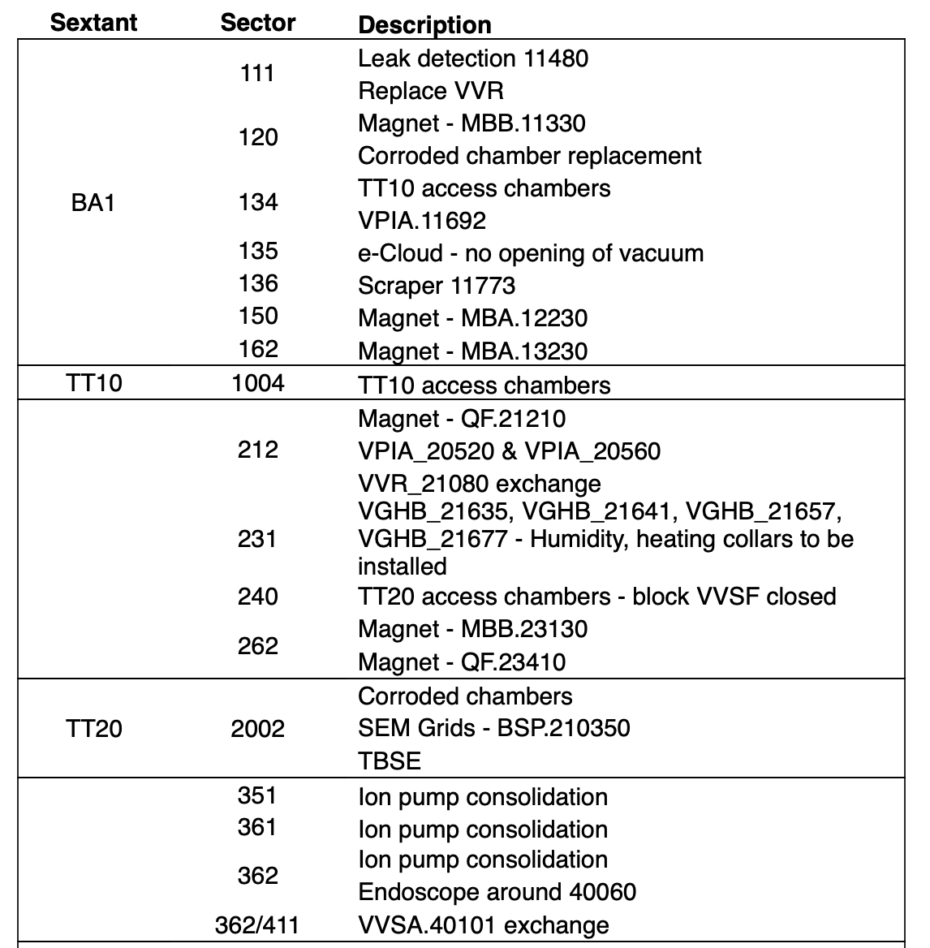
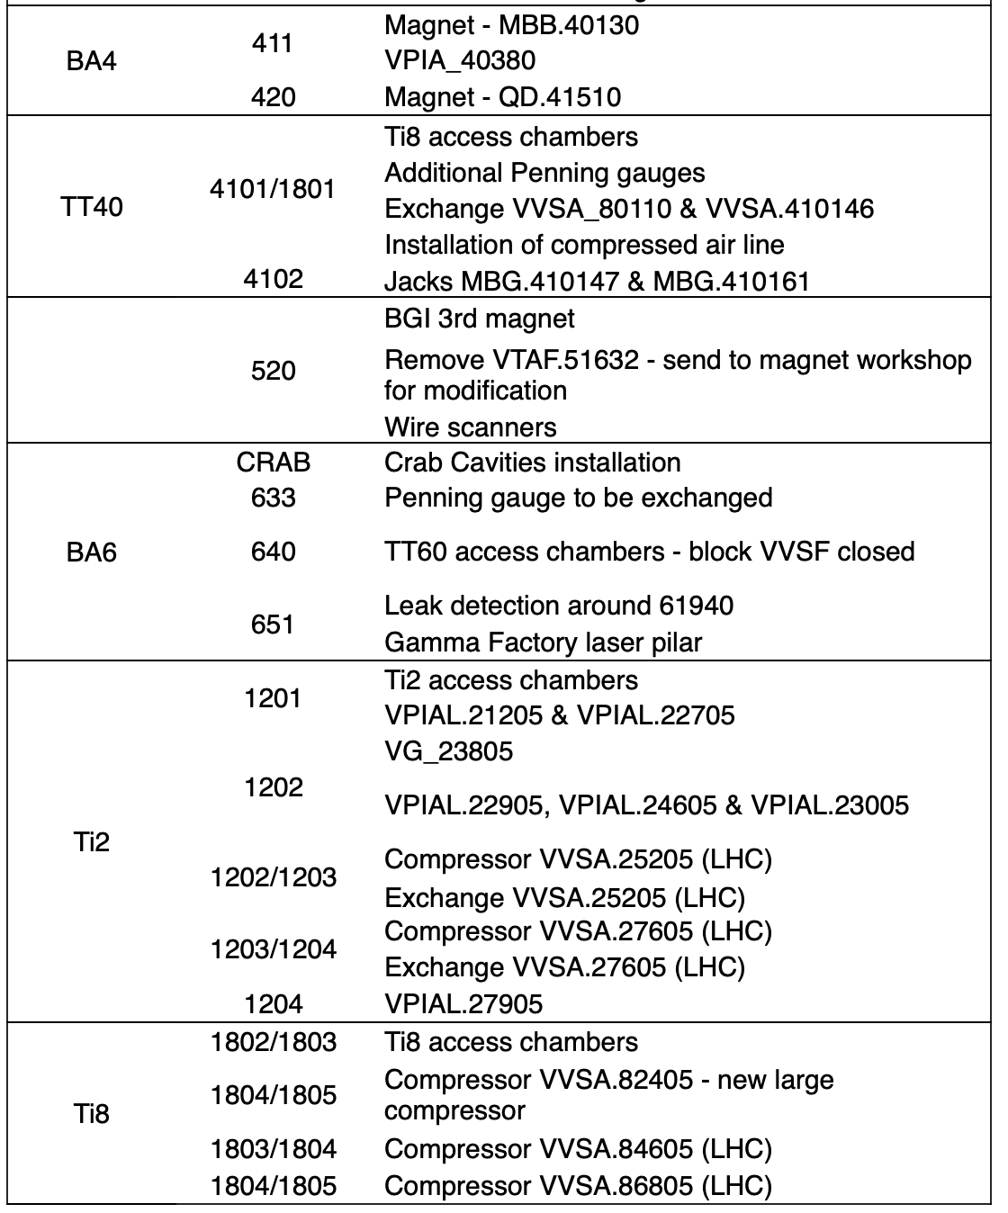
SPS scrubbing planning (Lotta)
Main objectives
  Condition newly installed devices and vented areas
Courtesy of Anthony Harrison, TE/VSC

Slide 5
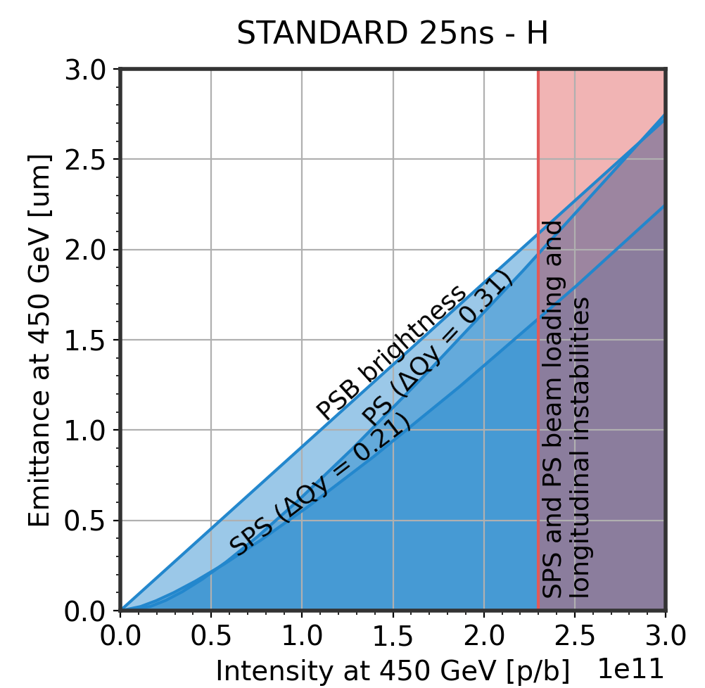
SPS scrubbing planning (Lotta)
Main objectives
  Condition newly installed devices and vented areas
Recover the standard LIU beam
  Recover 4x72b with 2.3e11 p/b and 1.65 ns ±10% at flat top
Work on further optimising the standard LIU beam
  Emittance/brightness characterisation and optimisation
  towards LIU target
  Tails?

Slide 6
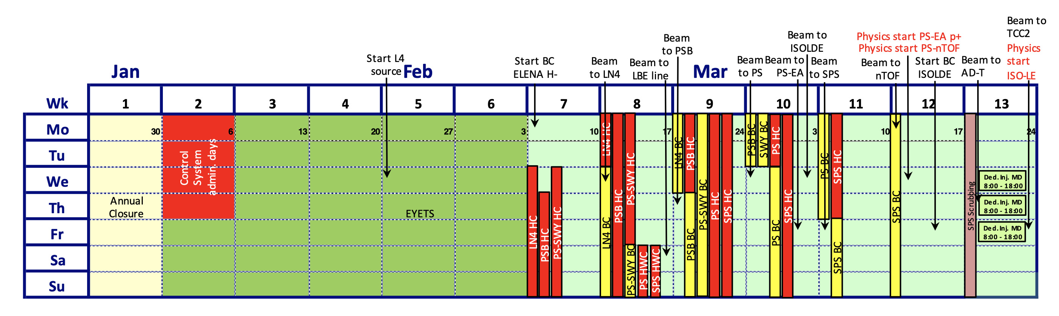
SPS scrubbing planning (Lotta)
Tentative planning
  Assume start already on Thursday prior to scrubbing week
  First four days ramp-up bunch intensity to 2.5-2.7e11 p/b with trains of
  4x72 bunches on long flat bottom cycle
  Ramp up bunch intensity to 2.3e11 p/b with nx72 bunches and gradually
  reduce bunch length at flat top down to 1.65 ns for the highest intensities
Possible limitations
  ZS sparking & pressure burst especially with SFTPRO in parallel
  Pressure spikes and amplifier breakage in RF cavities
  MKP-S heating

Slide 7
High intensity studies during scrubbing (Ingrid)
Consolidation of LIU intensity with standard beam, focusing on transverse and longitudinal optimization
Exploration of intensity margins – to be coordinated with IPP
MKP-S beam-induced heating mitigation test during night
  Offsetting the circulating beam towards the ground conductor is
  expected to be beneficial in terms of beam induced heating.
Monitor the SPS QD/QF current at different intensities
  Follow-up with SY/EPC regarding the current overshoot
  when applying Laslett.
Start investigation of the PS-SPS optics matching
  Repeat the same measurements as the ones done after LS2.
  Measurements can be done in parallel.

Slide 8
LHC schedule
Still in YETS, hardware commissioning expected to start in two weeks

