Slide 1
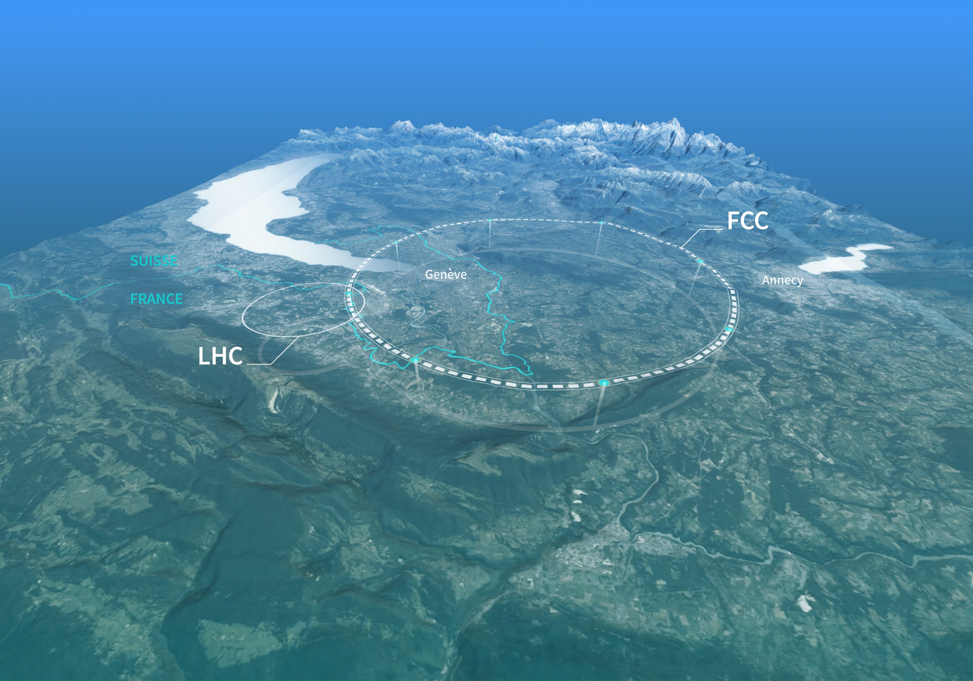





Impedance Budget and Single-Bunch instabilities at FCC-ee
- 70th ICFA Advanced Beam Dynamics Workshop on High-Luminosity Circular e⁺e⁻ Colliders
Dora Gibellieri^{1,2,3}, Carlo Zannini¹, Adnan Ghribi^{2,3}, Mauro Migliorati^{4,5} and Mikhail Zobov^{4,5}
¹CERN ²University of Caen Normandy ³GANIL ⁴Sapienza University of Rome ⁵INFN

Slide 2



Outline
Introduction
FCC-ee main ring Impedance Model
  Criticality of collimator model
  Effect on single-bunch instabilities
FCC-ee booster stability considerations
Conclusion and next steps
06.03.2025 | eeFACT 2025 | Dora Gibellieri

Slide 3
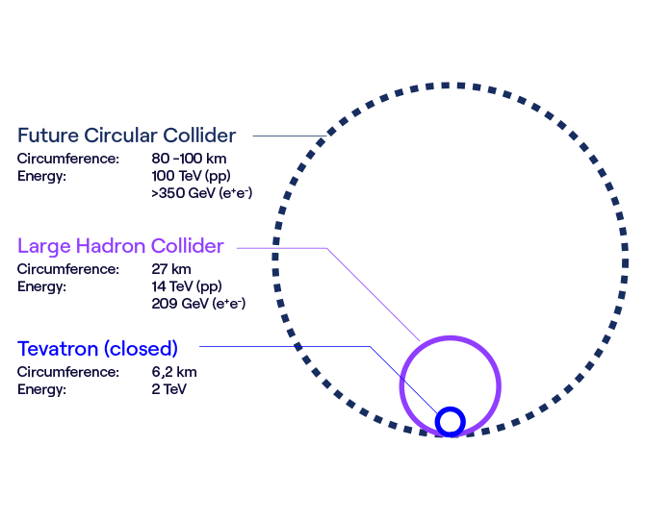
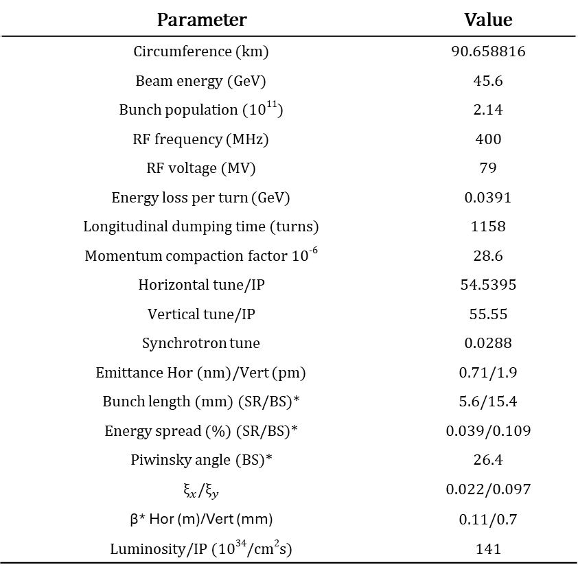
Introduction
FCC-ee main parameters for Z configuration
Parameter | Value
Circumference (km) | 90.658816
Beam energy (GeV) | 45.6
Bunch population (10¹¹) | 2.14
RF frequency (MHz) | 400
RF voltage (MV) | 79
Energy loss per turn (GeV) | 0.0391
Longitudinal dumping time (turns) | 1158
Momentum compaction factor 10⁻⁶ | 28.6
Horizontal tune/IP | 54.5395
Vertical tune/IP | 55.55
Synchrotron tune | 0.0288
Emittance Hor (nm)/Vert (pm) | 0.71/1.9
Bunch length (mm) (SR/BS)* | 5.6/15.4
Energy spread (%) (SR/BS)* | 0.039/0.109
Piwinsky angle (BS)* | 26.4
${\text{ξ}}_{x}$/${\text{ξ}}_{y}$ | 0.022/0.097
β* Hor (m)/Vert (mm) | 0.11/0.7
Luminosity/IP (10³⁴/cm²s) | 141
*SR: synchrotron radiation, BS: beamstrahlung
06.03.2025 | eeFACT 2025 | Dora Gibellieri

Slide 4
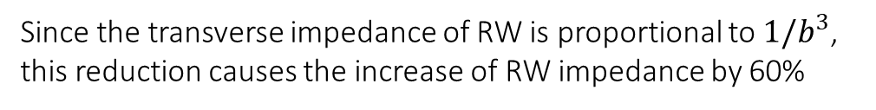
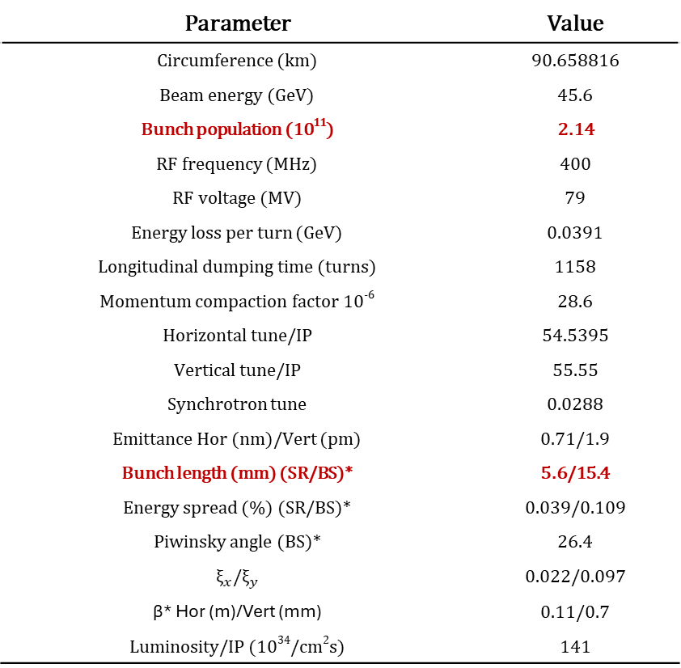
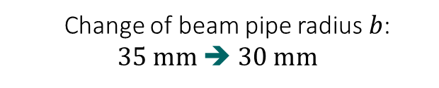
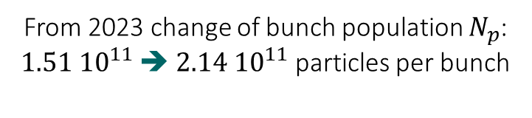
Introduction
FCC-ee main parameters for Z configuration
Parameter | Value
Circumference (km) | 90.658816
Beam energy (GeV) | 45.6
Bunch population (10¹¹) | 2.14
RF frequency (MHz) | 400
RF voltage (MV) | 79
Energy loss per turn (GeV) | 0.0391
Longitudinal dumping time (turns) | 1158
Momentum compaction factor 10⁻⁶ | 28.6
Horizontal tune/IP | 54.5395
Vertical tune/IP | 55.55
Synchrotron tune | 0.0288
Emittance Hor (nm)/Vert (pm) | 0.71/1.9
Bunch length (mm) (SR/BS)* | 5.6/15.4
Energy spread (%) (SR/BS)* | 0.039/0.109
Piwinsky angle (BS)* | 26.4
${\text{ξ}}_{x}$/${\text{ξ}}_{y}$ | 0.022/0.097
β* Hor (m)/Vert (mm) | 0.11/0.7
Luminosity/IP (10³⁴/cm²s) | 141
From 2023 change of bunch population $N_{p}$:
$1.51 {10}^{11}$➔ $2.14 {10}^{11}$ particles per bunch
  Change of beam pipe radius $b$:
    35 mm ➔ 30 mm
Since the transverse impedance of RW is proportional to ${1/b}^{3}$, this reduction causes the increase of RW impedance by 60%
Necessity of having a highly flexible model to account for all changes during the feasibility study development phase
*SR: synchrotron radiation, BS: beamstrahlung
06.03.2025 | eeFACT 2025 | Dora Gibellieri

Slide 5
FCC-ee main ring impedance model
Outline
Introduction
FCC-ee main ring Impedance Model
  Criticality of collimator model
  Effect on single-bunch instabilities
FCC-ee booster stability considerations
Conclusion and next steps
06.03.2025 | eeFACT 2025 | Dora Gibellieri

Slide 6
FCC-ee main ring impedance model
Beam coupling impedances studies
3D EM Simulations
(CST, Wakis, Echo3D etc.) and Analytical Model (equations, IW2D, etc.)
Identify main
impedance contributors:
Collimators
Resistive Wall etc.
Building I/W Model (Xwakes integration)
I/W Model for FCC-ee
Output:
Assessment of beam stability
Beam Dynamics Simulations (Xsuite) with feedback system
Goal: keep improving the Model
Constant I/W Model Optimization
Reminder: because of the short bunch, simulations are very challenging
06.03.2025 | eeFACT 2025 | Dora Gibellieri

Slide 7
FCC-ee main ring impedance model
Beam coupling impedances studies
3D EM Simulations
(CST, Wakis, Echo3D etc.) and Analytical Model (equations, IW2D, etc.)
Identify main
impedance contributors:
Collimators
Resistive Wall etc.
Building I/W Model (Xwakes integration)
I/W Model for FCC-ee
Output:
Assessment of beam stability
Beam Dynamics Simulations (Xsuite) with feedback system
06.03.2025 | eeFACT 2025 | Dora Gibellieri

Slide 8
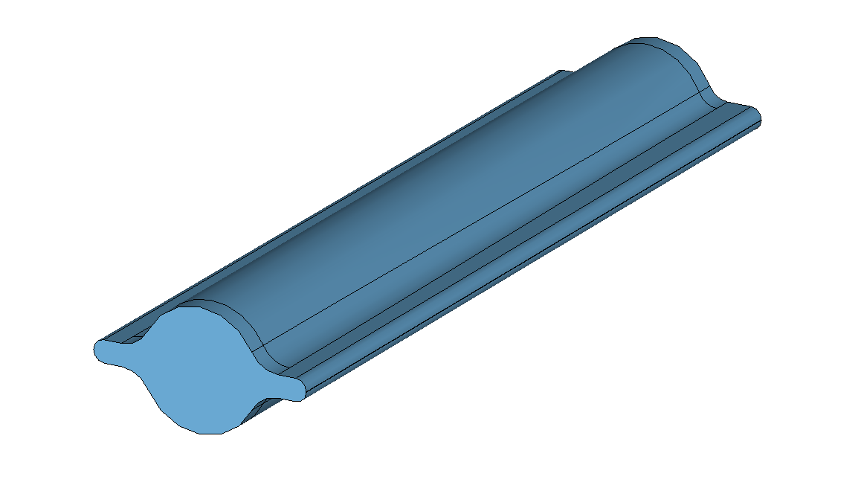
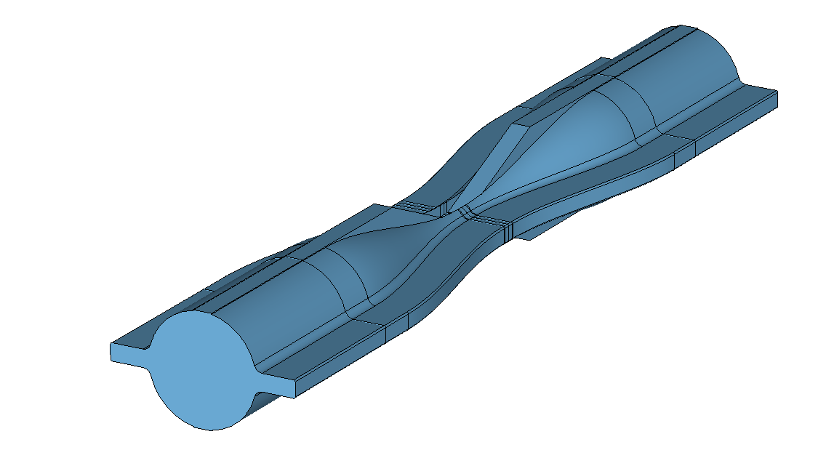
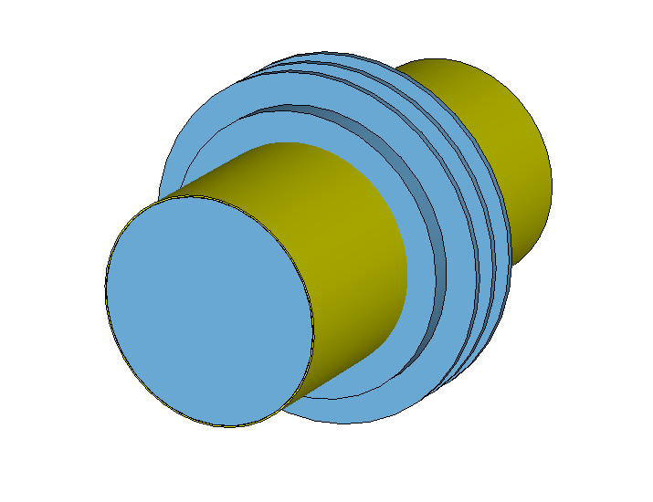
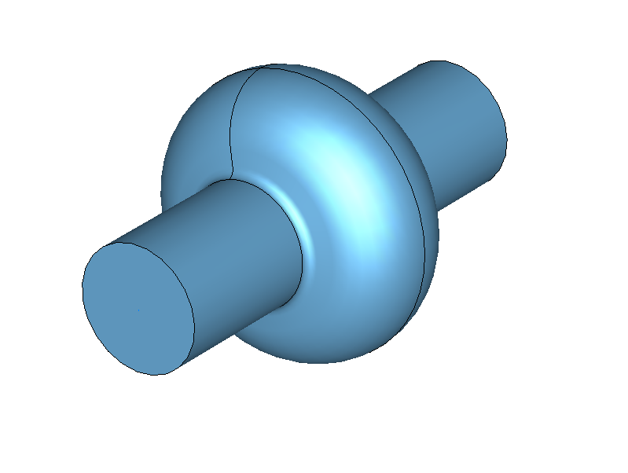
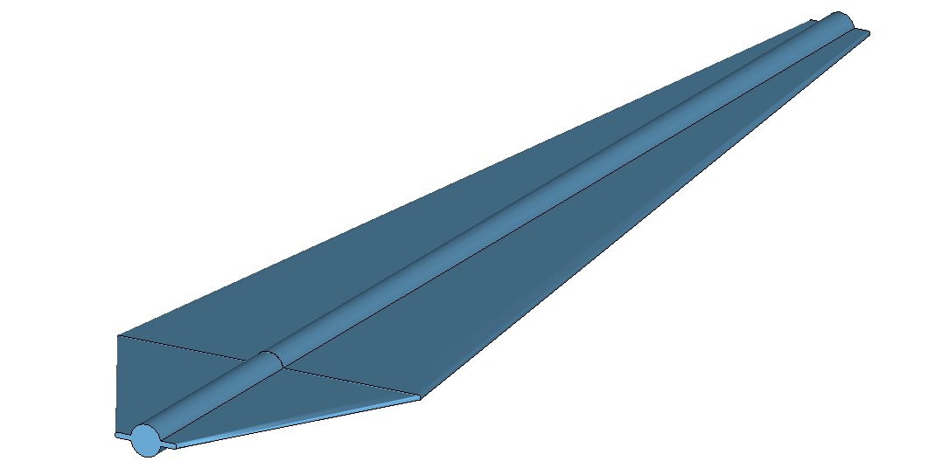
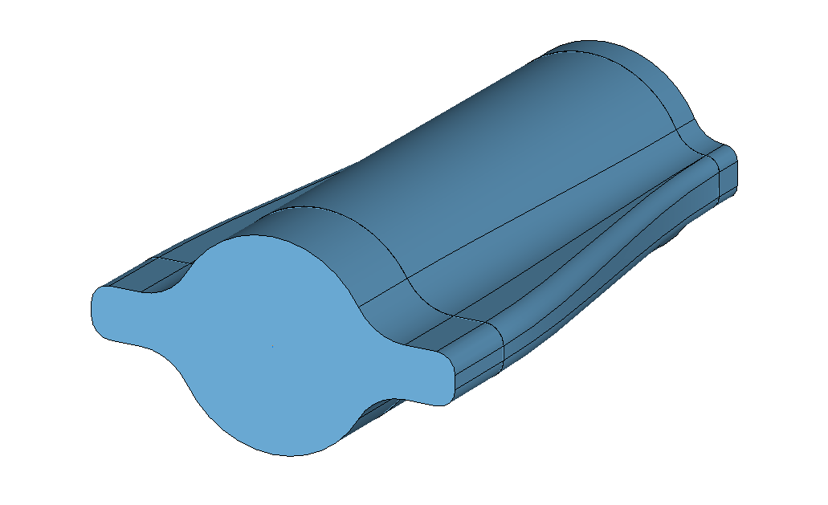
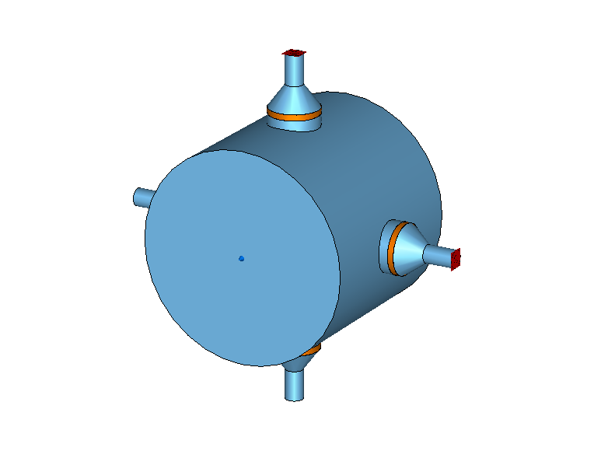
FCC-ee main ring impedance model
FCC-ee impedance model
What is the impedance model of a machine?
Is the collection of the impedance contributions of the different elements of the machine
06.03.2025 | eeFACT 2025 | Dora Gibellieri

Slide 9

FCC-ee main ring impedance model
Impedance elements studied
The beam pipe is evaluated with IW2D which considers a 90 km-long circular NEG-coated copper pipe. By incorporating numerical form factors, we account for the winglets shape.
06.03.2025 | eeFACT 2025 | Dora Gibellieri

Slide 10
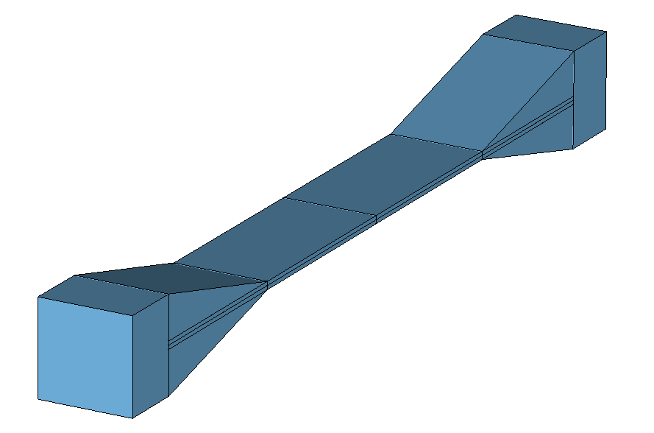
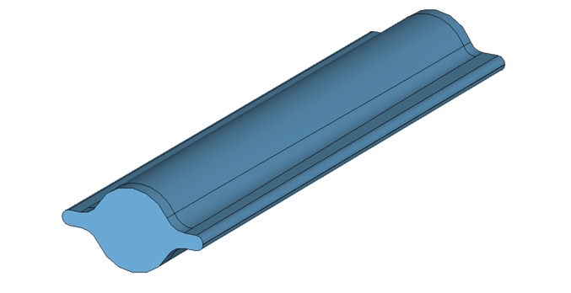
FCC-ee main ring impedance model
Impedance elements studied
Beam halo collimators and synchrotron radiation collimators evaluated with CST simulations.
06.03.2025 | eeFACT 2025 | Dora Gibellieri
Notes:
Tot CST simulations= Imp. Resistiva dovta al gap che puo essere calcolata analicamnete + geometrica . Dal imp taper.
Per convenienxa (metti formula)

Slide 11

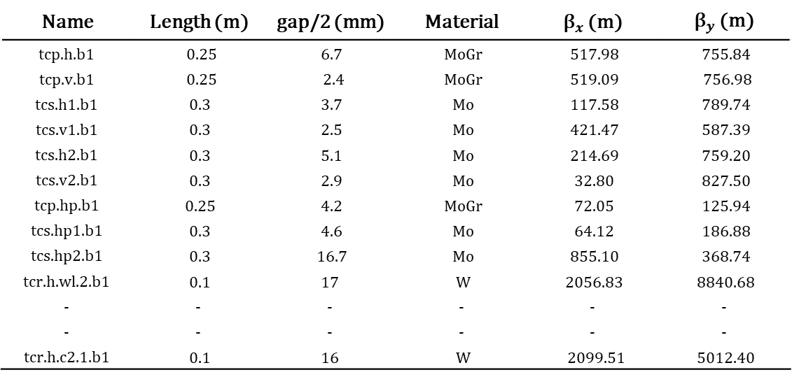
FCC-ee main ring impedance model
Impedance elements studied
Total collimator impedance obtained from CST simulations is considered as the sum of the resistive contribution associated with the collimator gap, which can be analytically evaluated using IW2D and the contribution related to the influence of the taper. From this point onward, we will refer to this as “geometric”.
Name | Length (m) | gap/2 (mm) | Material | ${\text{β}}_{x}$ (m) | ${\text{β}}_{y}$ (m)
tcp.h.b1 | 0.25 | 6.7 | MoGr | 517.98 | 755.84
tcp.v.b1 | 0.25 | 2.4 | MoGr | 519.09 | 756.98
tcs.h1.b1 | 0.3 | 3.7 | Mo | 117.58 | 789.74
tcs.v1.b1 | 0.3 | 2.5 | Mo | 421.47 | 587.39
tcs.h2.b1 | 0.3 | 5.1 | Mo | 214.69 | 759.20
tcs.v2.b1 | 0.3 | 2.9 | Mo | 32.80 | 827.50
tcp.hp.b1 | 0.25 | 4.2 | MoGr | 72.05 | 125.94
tcs.hp1.b1 | 0.3 | 4.6 | Mo | 64.12 | 186.88
tcs.hp2.b1 | 0.3 | 16.7 | Mo | 855.10 | 368.74
tcr.h.wl.2.b1 | 0.1 | 17 | W | 2056.83 | 8840.68
- | - | - | - | - | -
- | - | - | - | - | -
tcr.h.c2.1.b1 | 0.1 | 16 | W | 2099.51 | 5012.40
$$Z_{CST}^{coll}=Z_{RW}^{coll}+Z_{geom}^{coll}$$
06.03.2025 | eeFACT 2025 | Dora Gibellieri
Notes:
Tot CST simulations= Imp. Resistiva dovta al gap che puo essere calcolata analicamnete + geometrica . Dal imp taper.
Per convenienxa (metti formula)

Slide 12
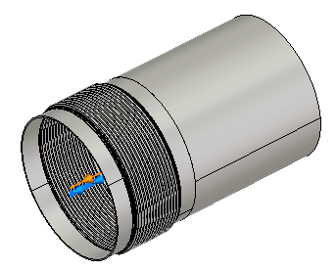
FCC-ee main ring impedance model
Impedance elements studied
Beam Pipe
Collimators
Polarimeter
RF fingers
RF cavities
BPMs
Photon stoppers
Bellows
It is essential to emphasize that the design of these elements is continuously evolving.
Developing a highly flexible model enables informed design decisions, to ensure beam stability.
06.03.2025 | eeFACT 2025 | Dora Gibellieri

Slide 13
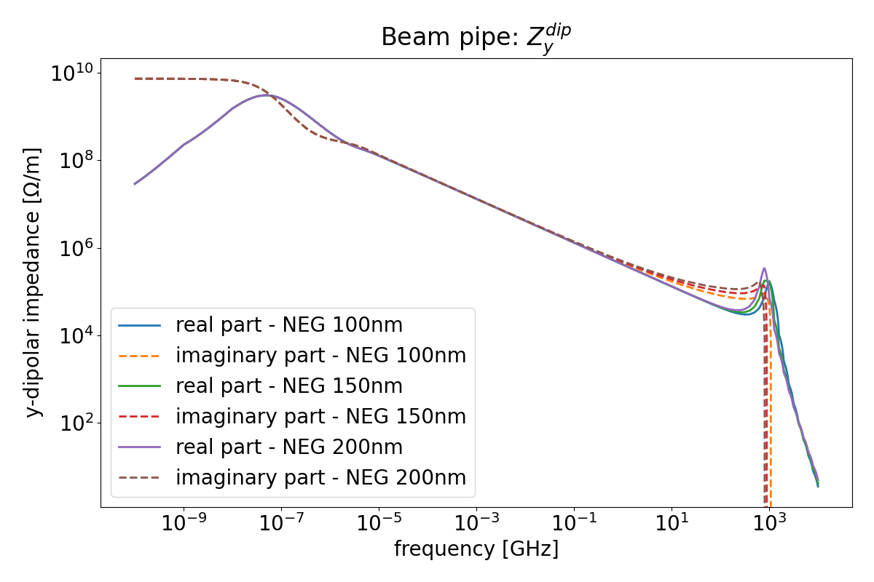
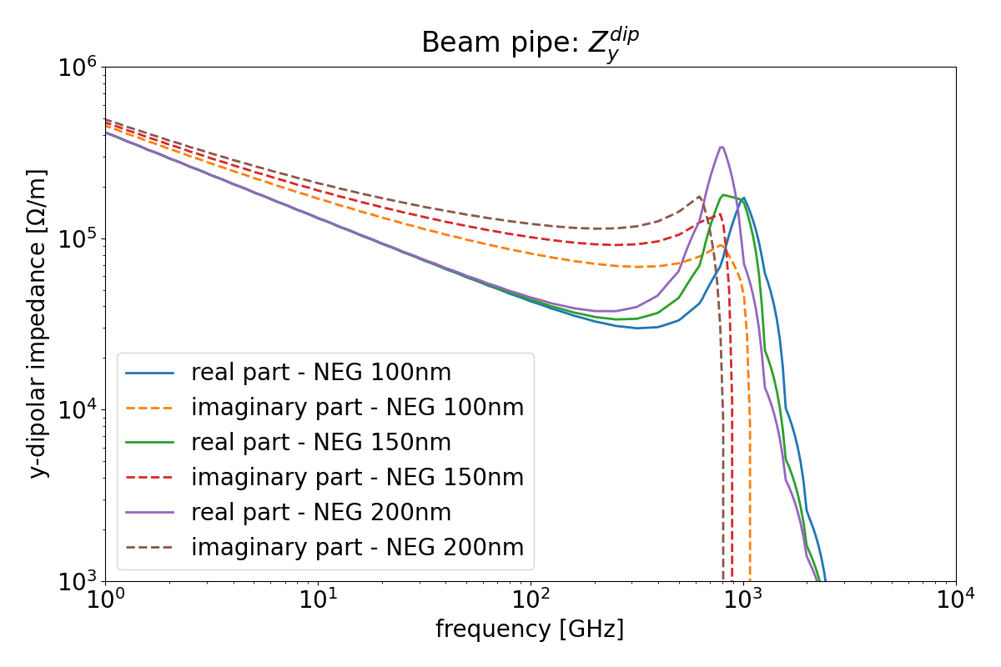
FCC-ee main ring impedance model
Highly flexible I/W model
The developed impedance model easily interfaces with IW2D, allowing us to quickly estimate the impedance by changing for example resistive parameters, such as the material type and, in this case, the thickness of the NEG coating.
High flexibility
Crucial when frequent updates are foreseen
06.03.2025 | eeFACT 2025 | Dora Gibellieri

Slide 14
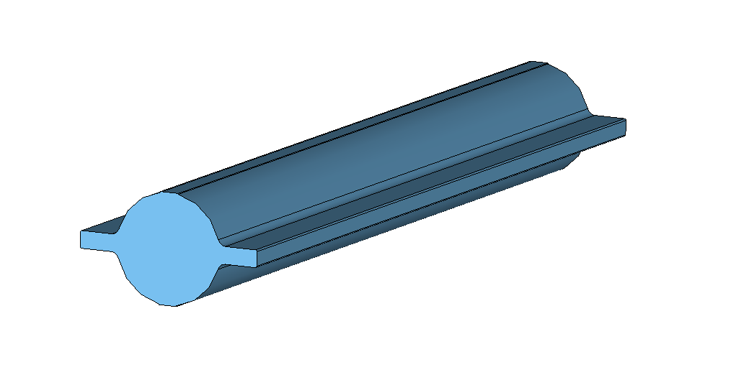
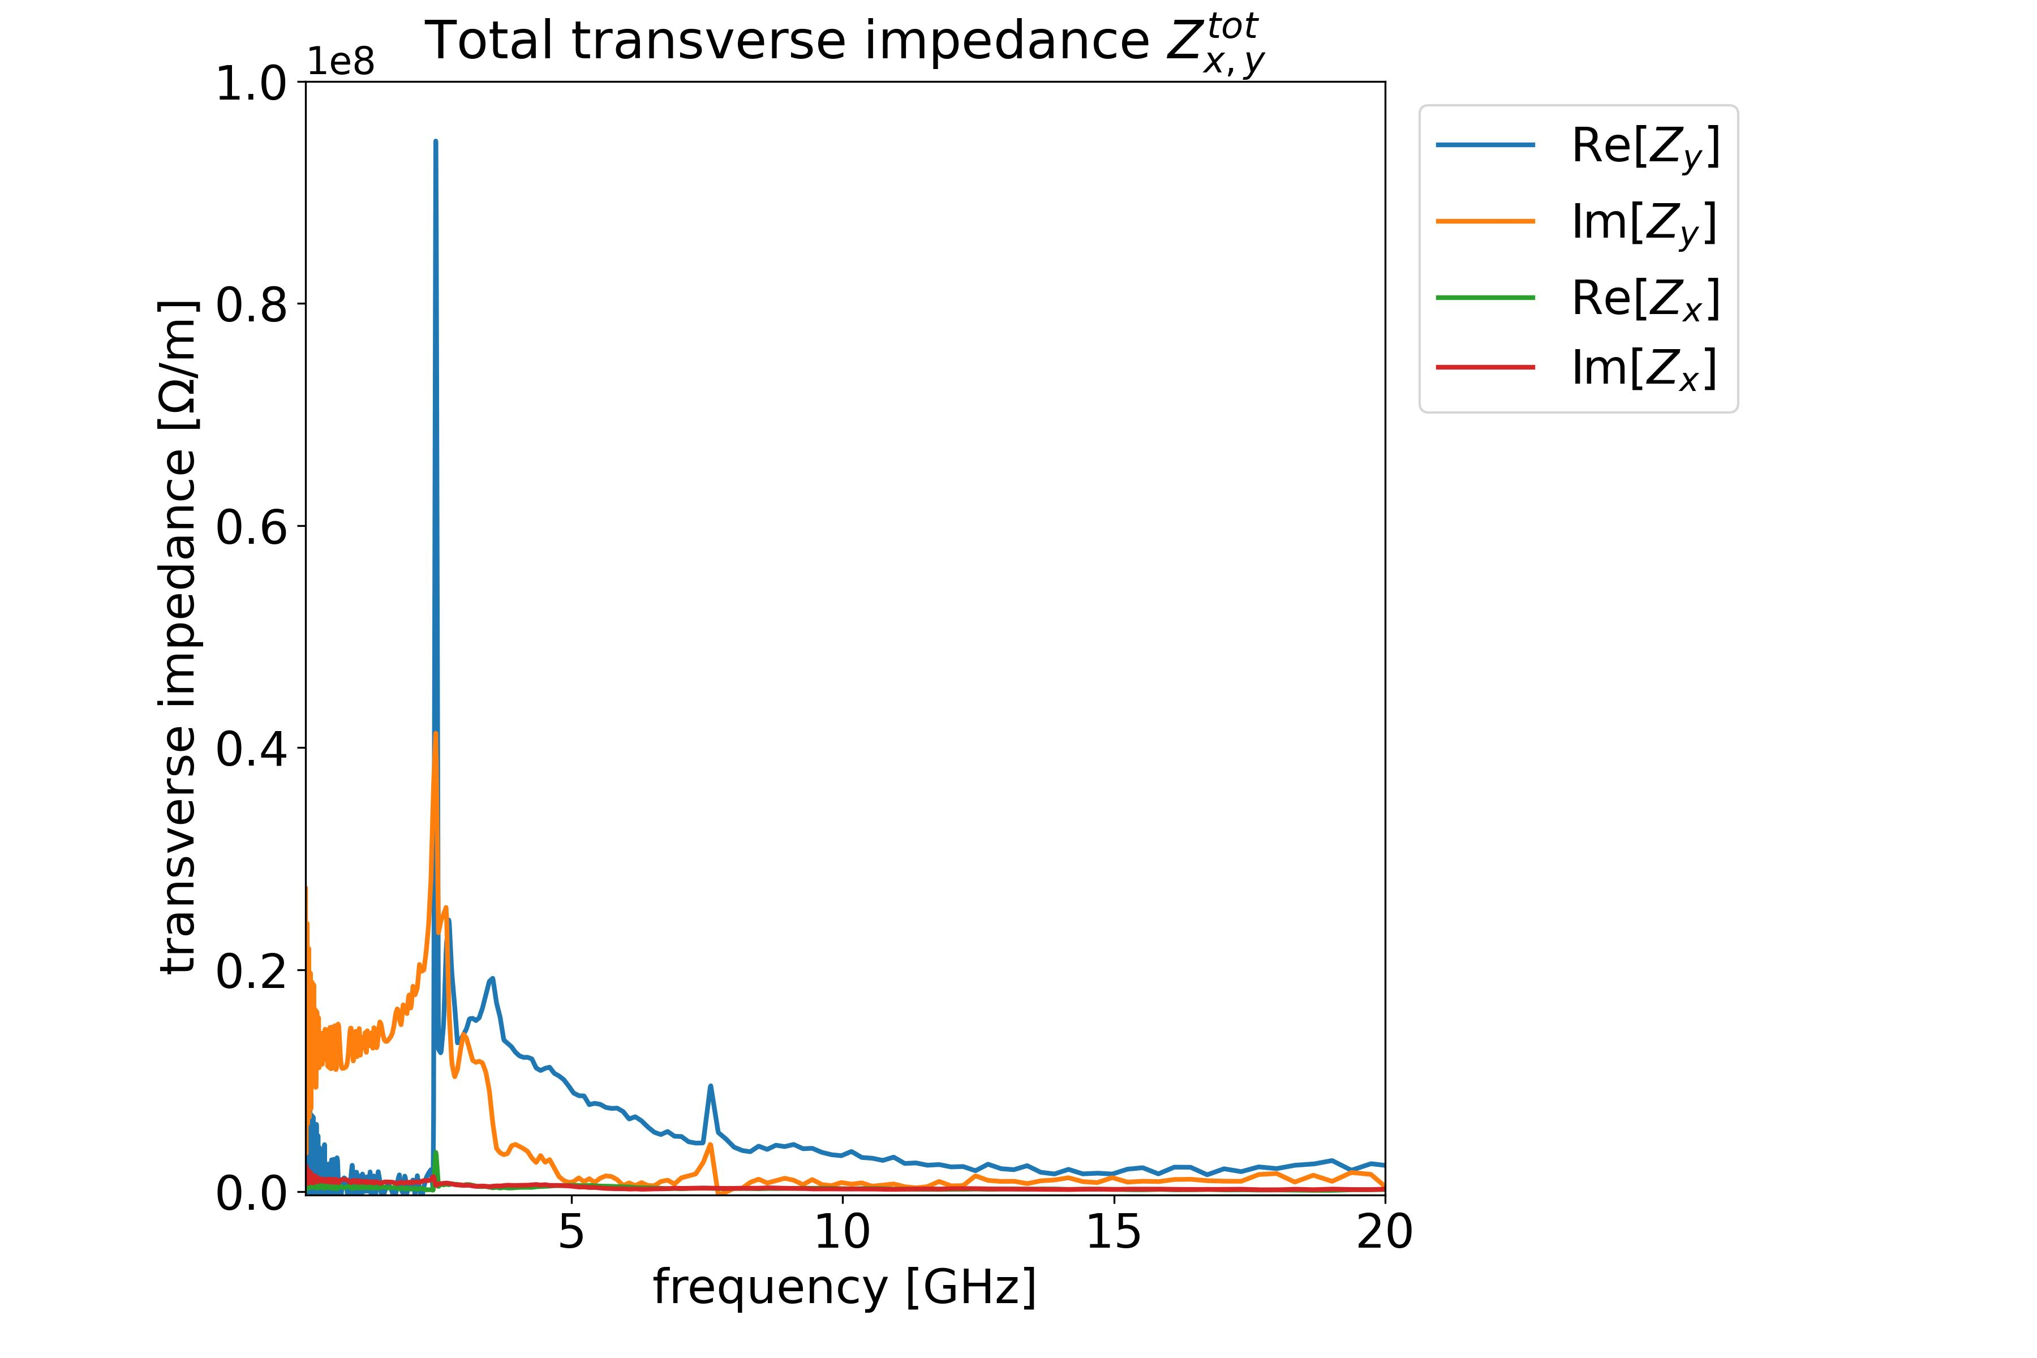
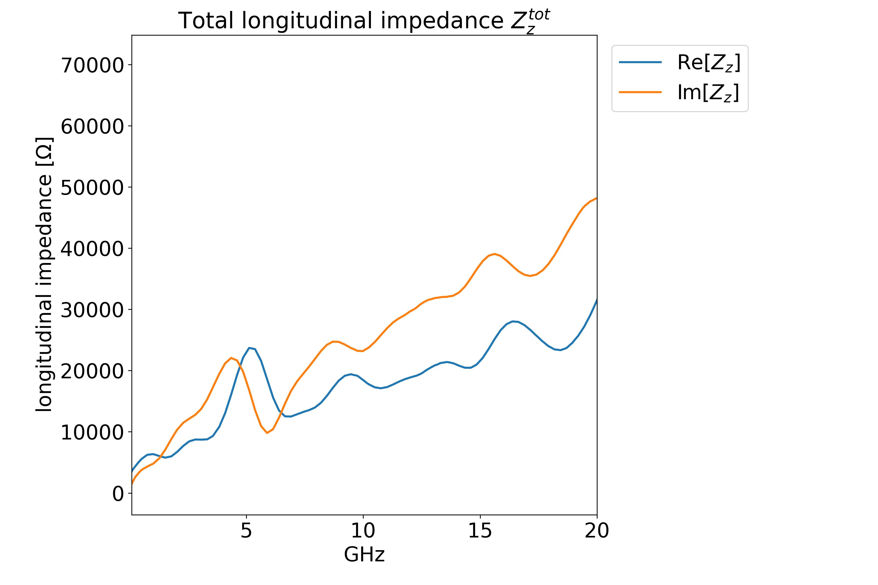
FCC-ee main ring impedance model
FCC-ee main ring impedance evaluation
Using the developed impedance model, the total transverse and longitudinal impedance contributions, including all considered elements, can be easily extrapolated.
06.03.2025 | eeFACT 2025 | Dora Gibellieri

Slide 15
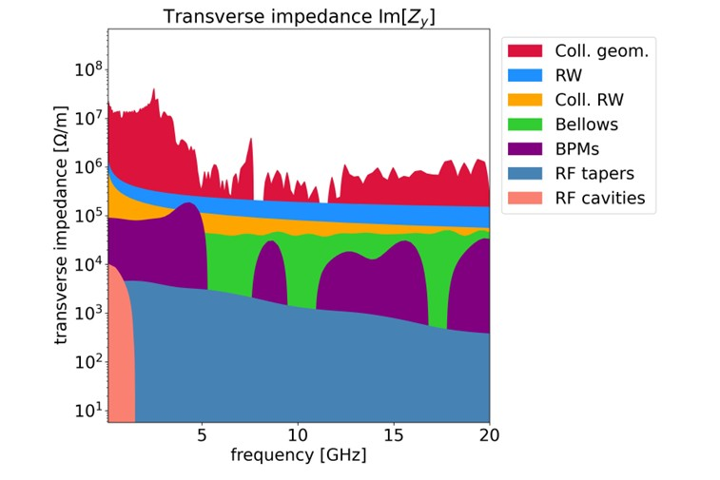
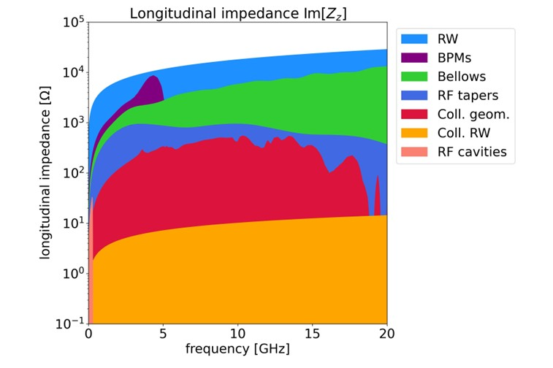
FCC-ee main ring impedance model
FCC-ee main ring impedance evaluation
The visualization of certain parameters, such as the imaginary part of the y-dipolar and longitudinal impedance of various contributors, enables the identification of the primary impedance sources.
06.03.2025 | eeFACT 2025 | Dora Gibellieri

Slide 16
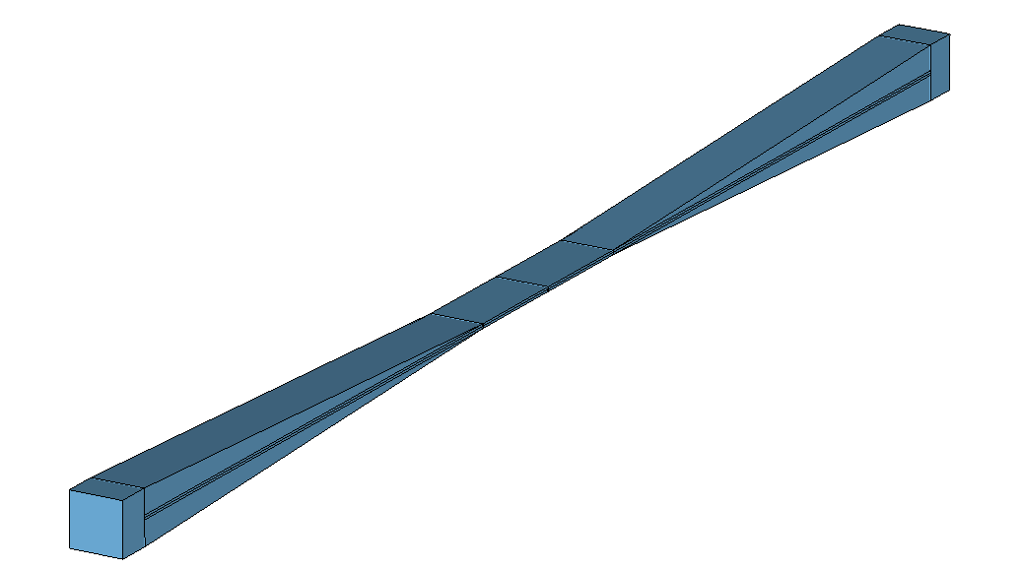
FCC-ee main ring impedance model
Criticality of the collimator model
Since the geometrical contribution of the collimators has been identified as the primary source of impedance, an optimization of the taper angle for all vertical collimators has been proposed, reducing it from the initially proposed 15 degrees to 2.5 degrees.
tcp.v.b1
Coll. length = 250 mm
Taper length = 630 mm
Taper angle = 2.5 degrees
tcp.v.b1
Coll. length = 250 mm
Taper length = 110mm
Taper angle = 15 degrees
06.03.2025 | eeFACT 2025 | Dora Gibellieri

Slide 17

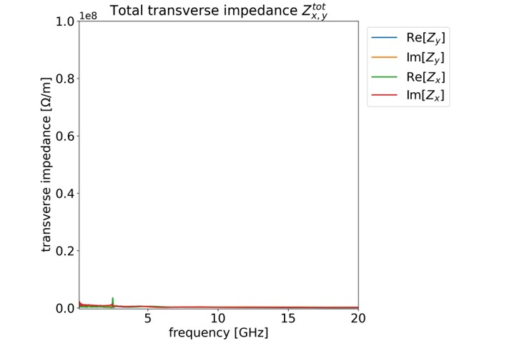
FCC-ee main ring impedance model
Criticality of the collimator model
Thanks to the optimization of the taper angle for all vertical collimators by reducing it from 15 degrees to 2.5 degrees, the y-transverse impedance drastically reduces.
Horizontal and vertical collimator taper angle of 15 degrees
Horizontal collimator taper angle of 15 degrees and vertical taper angle of 2.5 degrees
06.03.2025 | eeFACT 2025 | Dora Gibellieri

Slide 18
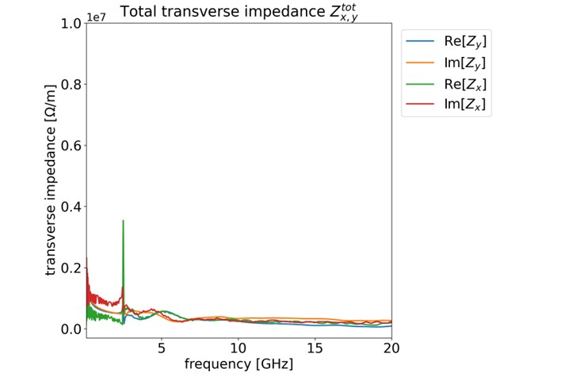
FCC-ee main ring impedance model
Criticality of the collimator model
Thanks to the optimization of the taper angle for all vertical collimators by reducing it from 15 degrees to 2.5 degrees, the y-transverse impedance drastically reduces.
Horizontal and vertical collimator taper angle of 15 degrees
Horizontal collimator taper angle of 15 degrees and vertical taper angle of 2.5 degrees
06.03.2025 | eeFACT 2025 | Dora Gibellieri

Slide 19

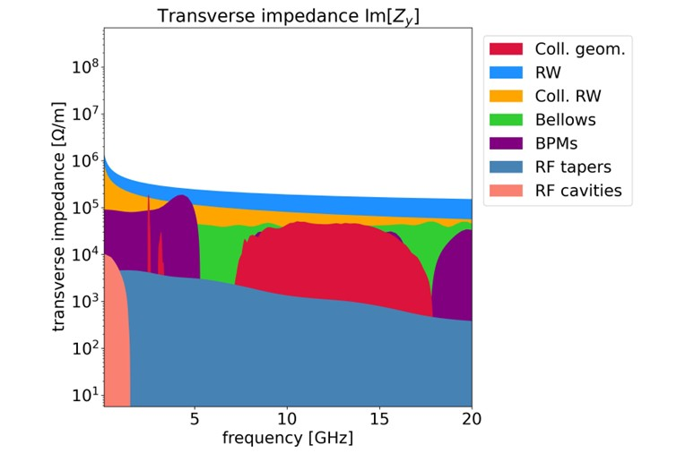
FCC-ee main ring impedance model
Criticality of the collimator model
Thanks to the optimization of the taper angle for all vertical collimators by reducing it from 15 degrees to 2.5 degrees, the y-transverse impedance drastically reduces.
Horizontal and vertical collimator taper angle of 15 degrees
Horizontal collimator taper angle of 15 degrees and vertical taper angle of 2.5 degrees
There is significant potential for optimizing collimators.
06.03.2025 | eeFACT 2025 | Dora Gibellieri

Slide 20
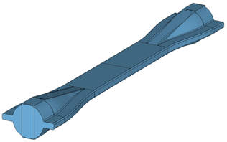
FCC-ee main ring impedance model
Continuous model updates
The design of various elements is constantly evolving. For example, one new proposal suggests using the KEK design for collimators.
The design of the vacuum chamber and the machine devices continue to evolve
The importance of a highly flexible model
06.03.2025 | eeFACT 2025 | Dora Gibellieri

Slide 21
FCC-ee main ring impedance model
Beam dynamic simulations and stability assessments
3D EM Simulations
(CST, Wakis, Echo3D etc.) and Analytical Model (equations, IW2D, etc.)
Identify main
impedance contributors:
Collimators
Resistive Wall etc.
Building I/W Model (Xwakes integration)
I/W Model for FCC-ee
Output:
Assessment of beam stability
Beam Dynamics Simulations (Xsuite) with feedback system
06.03.2025 | eeFACT 2025 | Dora Gibellieri

Slide 22
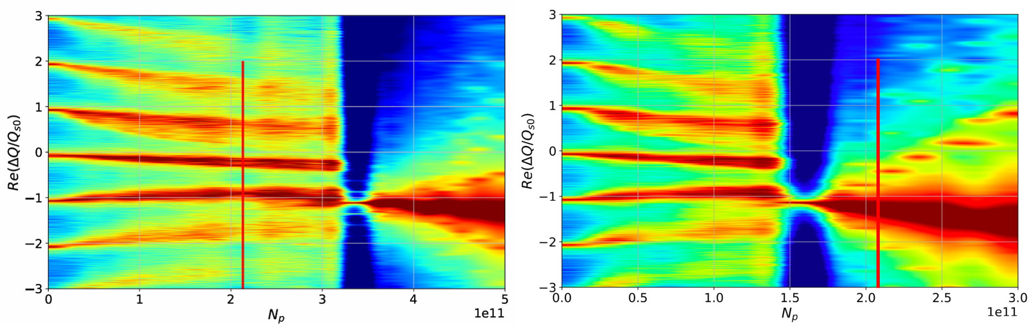
FCC-ee main ring impedance model
TMCI threshold
Without considering the geometric contribution of the collimators, we are already at the limit of stability. To stabilise we need a feedback system and chromaticity (left plot). If we double the total wake and impedance we have evaluated so far (right plot) despite feedback and chromaticity, the TMCI threshold will be below the nominal intensity. It is therefore essential to optimise the geometric impedance of the collimators and assess its impact on the beam dynamics.
Feedback, chroma 5
Feedback, chroma 5 with double wake
More details in: M. Migliorati et al., FCC-ee single beam collective effects - FCC week 2024
06.03.2025 | eeFACT 2025 | Dora Gibellieri
Notes:
Individuare iol mardine da utilizzare (deve essere inferior a un fattore 2)

Slide 23
FCC-ee booster stability considerations
Outline
Introduction
FCC-ee main ring Impedance Model
  Criticality of collimator model
  Effect on single-bunch instabilities
FCC-ee booster stability considerations
Conclusion and next steps
06.03.2025 | eeFACT 2025 | Dora Gibellieri

Slide 24
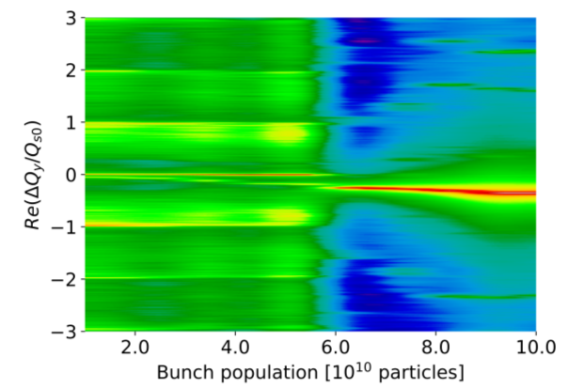
FCC-ee booster stability considerations
High Energy Booster impedance induced effects
Challenges in HEB PA31.0 (2023) Design
  Microwave instabilities
  Transverse mode coupling instabilities
  Transverse coupled bunch instabilities
HEB PA31.3 (2024) Design Enhancements and Solutions
  Change of pipe diameter
    25 mm ➔ 30 mm
  Change of pipe material
    Stainless steel ➔ copper
  Change of momentum compaction factor
More details in: A. Ghribi et al., FCCee high energy booster - FCC week 2024
06.03.2025 | eeFACT 2025 | Dora Gibellieri

Slide 25
FCC-ee booster stability considerations
High Energy Booster impedance induced effects
Challenges in HEB PA31.0 (2023) Design
  Microwave instabilities
  Transverse mode coupling instabilities
  Transverse coupled bunch instabilities
HEB PA31.3 (2024) Design Enhancements and Solutions
  Change of pipe diameter
    25 mm ➔ 30 mm
  Change of pipe material
    Stainless steel ➔ copper
  Change of momentum compaction factor
  Transverse feedback
    310 turns
More details in: A. Ghribi et al., FCCee high energy booster - FCC week 2024
06.03.2025 | eeFACT 2025 | Dora Gibellieri

Slide 26
Conclusion and next steps
Outline
Introduction
FCC-ee main ring Impedance Model
  Criticality of collimator model
  Effect on single-bunch instabilities
FCC-ee booster stability considerations
Conclusion and next steps
06.03.2025 | eeFACT 2025 | Dora Gibellieri

Slide 27





Conclusion and next steps
Status updates: tools, models, and resources
Simulations made on Xsuite and PyHEADTAIL
FCC-ee Impedance Model available on GitHub
Codes for the booster available on CERN gitlab
Impedance budget space (common to booster and collider) on CERN gitlab
Calculations made on several computing clusters : LXPLUS (CERN), FEYNMAN (CEA), and with dedicated computing resources on Jean-Zay (IDRIS) and CC IN2P3
Dedicated chat spaces for the high energy booster and the collective effects studies on mattermost
06.03.2025 | eeFACT 2025 | Dora Gibellieri

Slide 28
Conclusion and next steps
Conclusion
🔹 Impedance/Wake Model Development for Critical Design Decisions:
  The extremely short bunch length makes impedance and wakefield simulations highly challenging.
  Wall Model: Numerical form factors have been incorporated into the model for both driving and detuning impedance, accounting for vacuum chamber shape.
  Collimators: A step-by-step approach is being adopted to explore computational limits and propose optimized impedance solutions.
  Updated of impedance and wakefield models in Xwakes.
  Ensured model flexibility to facilitate updates in optics, material choices, coating thickness, geometries, and new machine elements.
  Enabled impedance assessments of different scenarios.
🔹 Beam Dynamics Simulations (Xsuite/PyHEADTAIL):
  Single-bunch beam dynamics simulations.
    Single-bunch TMCI threshold evaluation and impact of machine settings as a key impedance figure of merit.
🔹 Booster Studies:
  Significant design enhancements and solutions strategies have been adopted.
06.03.2025 | eeFACT 2025 | Dora Gibellieri

Slide 29
Conclusion and next steps
Next steps and ongoing activities
🔹 Model Updates & Implementation:
  Continuous update of impedance and wakefield models in Xwakes
  Ensure model flexibility
  Final assessments for different scenarios
🔹 Beam Dynamics Simulations (Xsuite):
  Ongoing benchmark studies between PyHEADTAIL and Xsuite, moving toward a full transition to Xsuite
  Multi-bunch feedback system simulations to assess machine configuration effects
  Integration of advanced feedback features from PyHEADTAIL multi-bunch into Xsuite
  Investigating the impact of nonlinear impedance terms
🔹 Booster Studies:
  Complete impedance model development
  Further investigations into impedance effects and potential mitigation strategies
06.03.2025 | eeFACT 2025 | Dora Gibellieri

Slide 30
Thank you for your attention ☺
- 70th ICFA Advanced Beam Dynamics Workshop on High-Luminosity Circular e⁺e⁻ Colliders
Tsukuba International Congress Center (EPOCHAL)
Tsukuba, Japan

Slide 31
Backup
- 70th ICFA Advanced Beam Dynamics Workshop on High-Luminosity Circular e⁺e⁻ Colliders

Slide 32
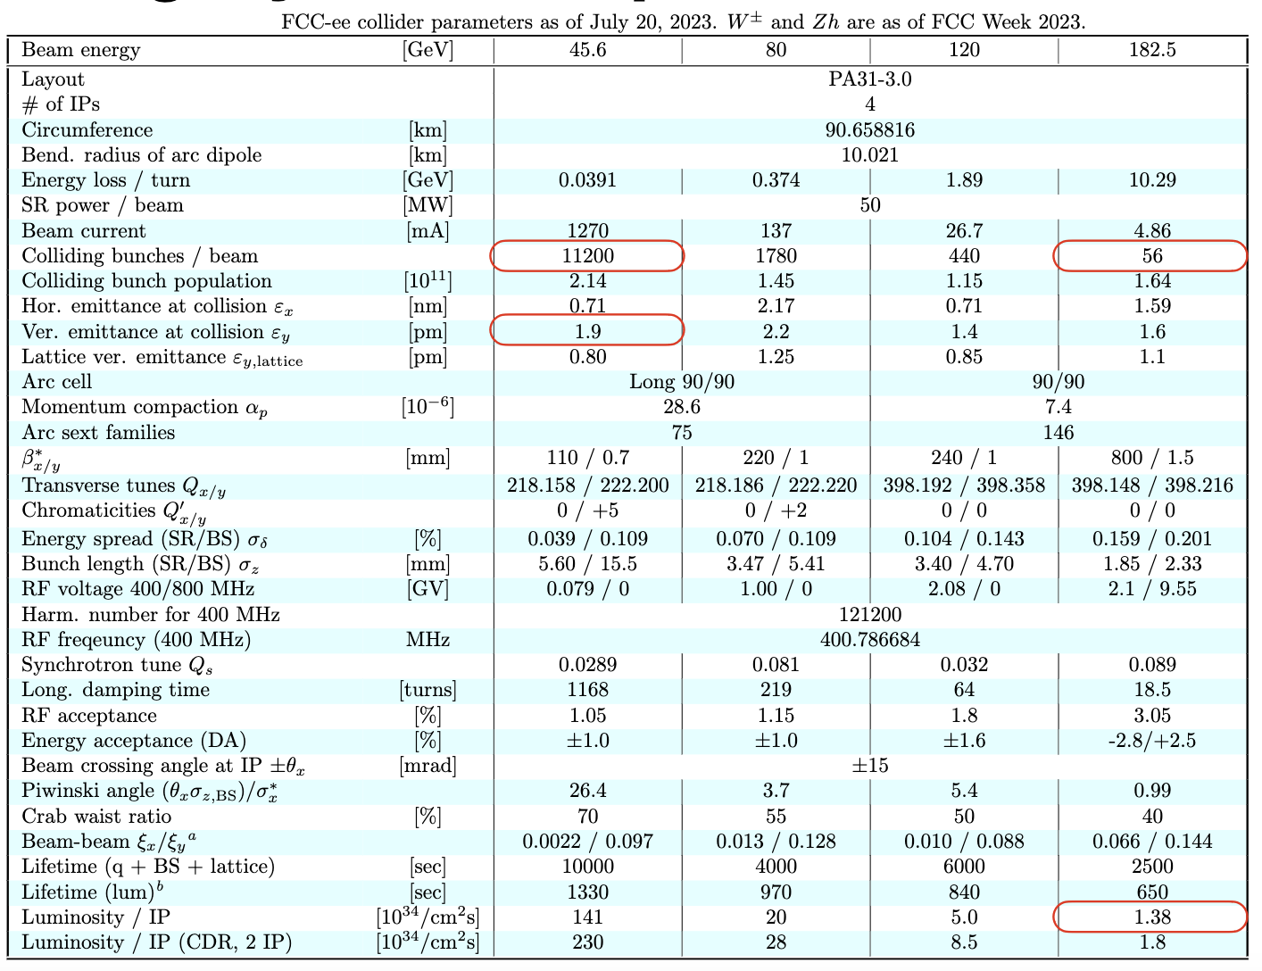
FCC-ee collider parameters
The Z configuration has been investigated due to the largest number of bunches (smallest bunch spacing)
From K.Oide presentation at the FCC-ee Optics Design Meeting
06.03.2025 | eeFACT 2025 | Dora Gibellieri

Slide 33
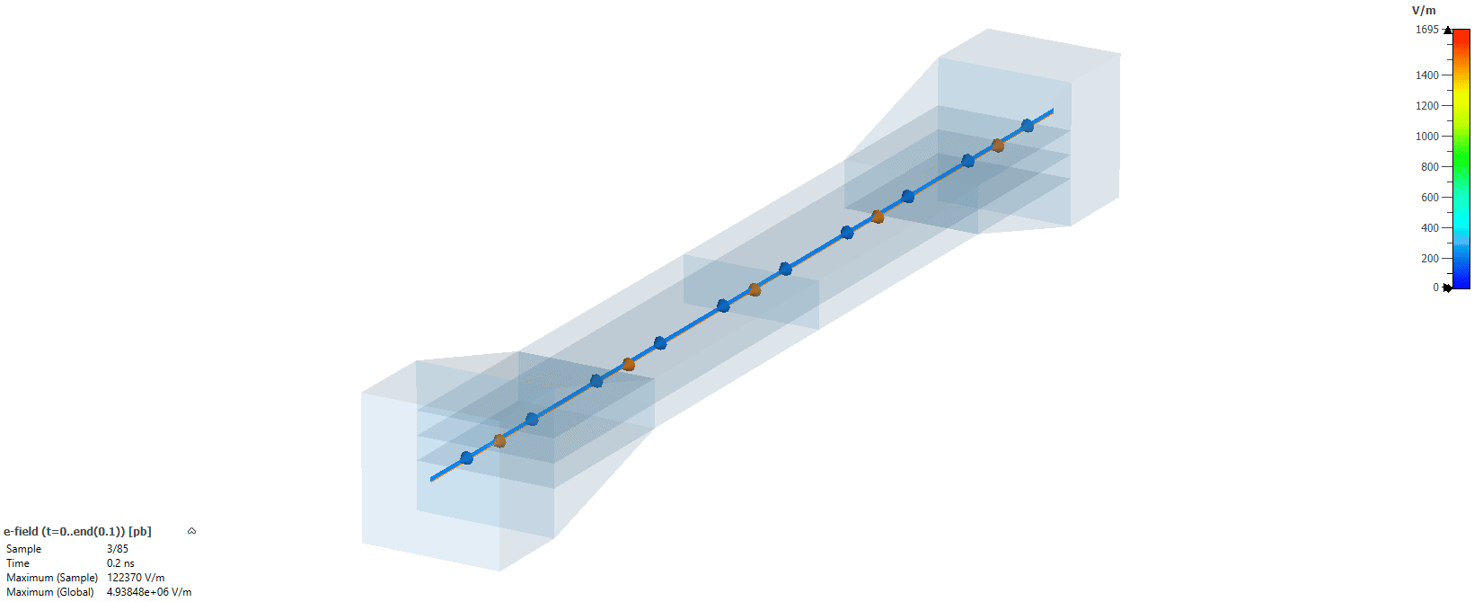
Resonance study
Resonating modes in the jaws due to impedance mismatch
Dumping mechanisms: propagation losses (taper angle) and resistive losses (conductivity)
06.03.2025 | eeFACT 2025 | Dora Gibellieri

Slide 34
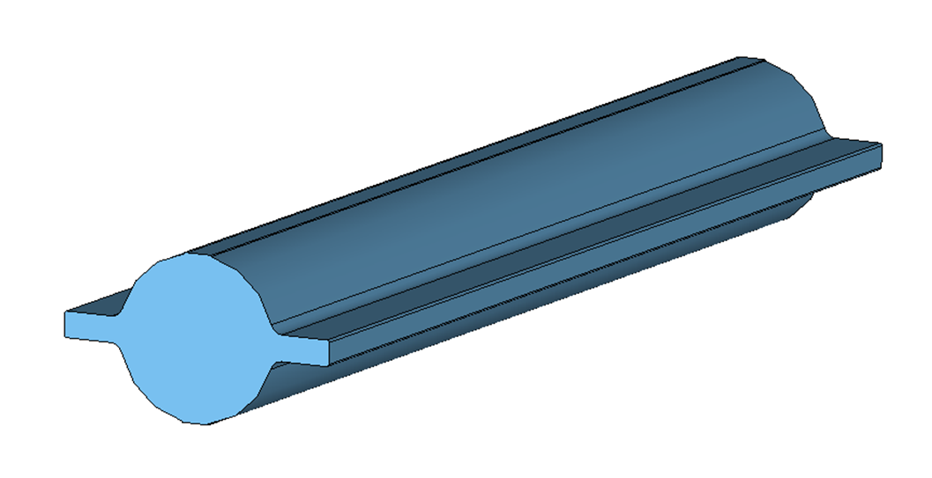
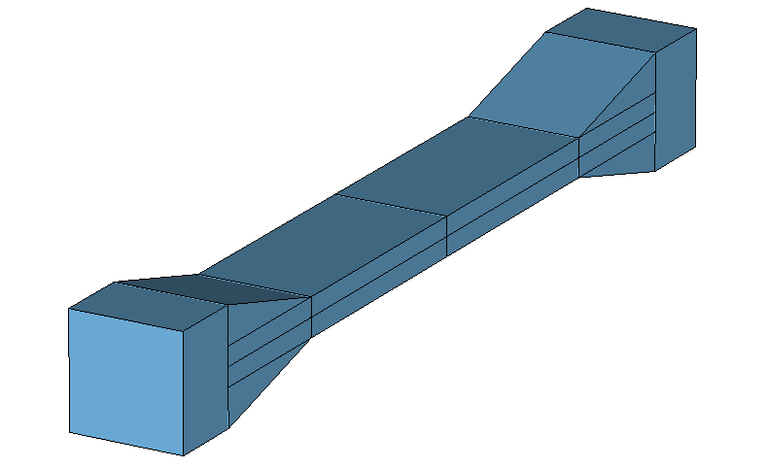

I/W Model with Xwakes
Provides generic tools to build a Machine Impedance Model
A Model represents the impedance of an accelerator by combining all its elements, while preserving the individual knowledge of each contribution
Wake
Impedance
Wake
Impedance
ABP-CEI Section Meeting (28 November 2024) · Indico
06.03.2025 | eeFACT 2025 | Dora Gibellieri

Slide 35
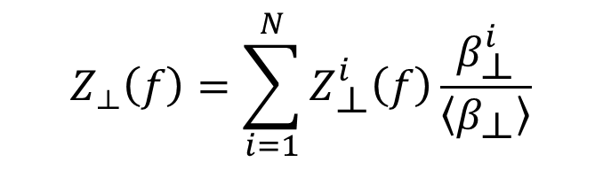
I/W Model with Xwakes
The model contains a list of elements
How is the total Impedance of the Model computed?
The total transverse impedance is calculated as follows:
$$Z_{⟂}\left(f\right)=\sum_{i=1}^{N}{Z_{\text{⟂}}^{i}\left(f\right)\frac{β_{\text{⟂}}^{i}}{\left\langle β_{\text{⟂}}\right\rangle }}$$
Where $β_{\text{⟂}}^{i}$ is the beta function of the $i^{th}$ element, $\left\langle β_{\text{⟂}}\right\rangle$ is the average beta function of the ring and $Z_{\text{⟂}}^{i}$ is the transverse impedance of the $i^{th}$ element
Note that the individual elements can still be accessed through the model
06.03.2025 | eeFACT 2025 | Dora Gibellieri

Slide 36
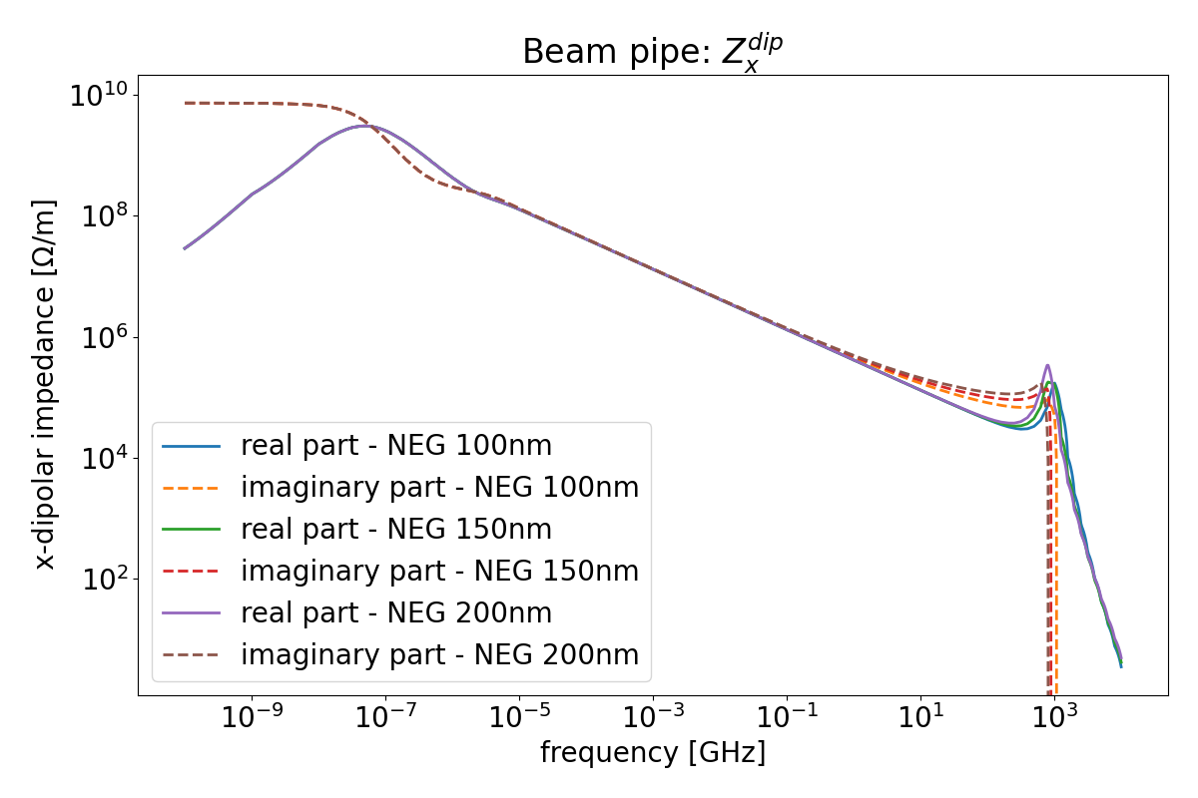

NEG thickness comparison
06.03.2025 | eeFACT 2025 | Dora Gibellieri

Slide 37
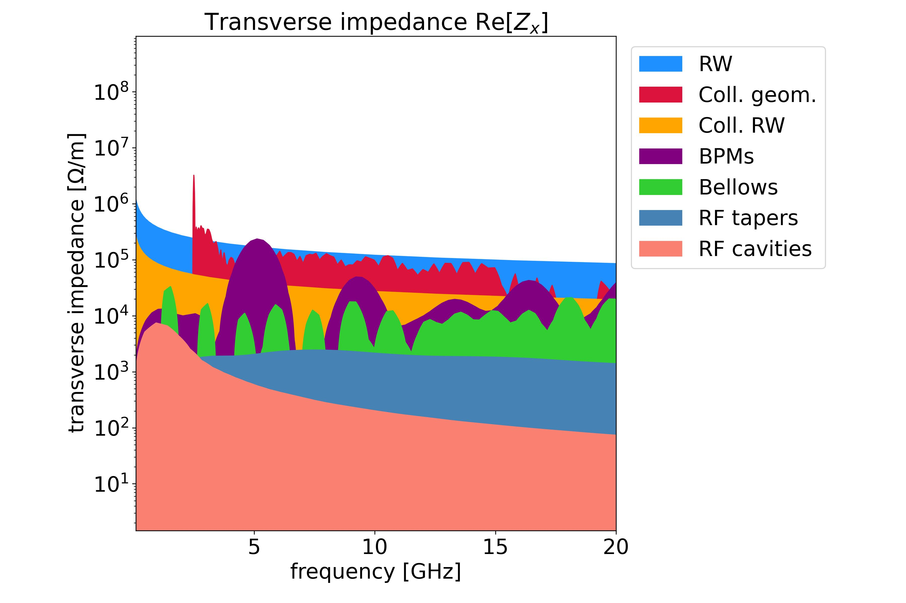
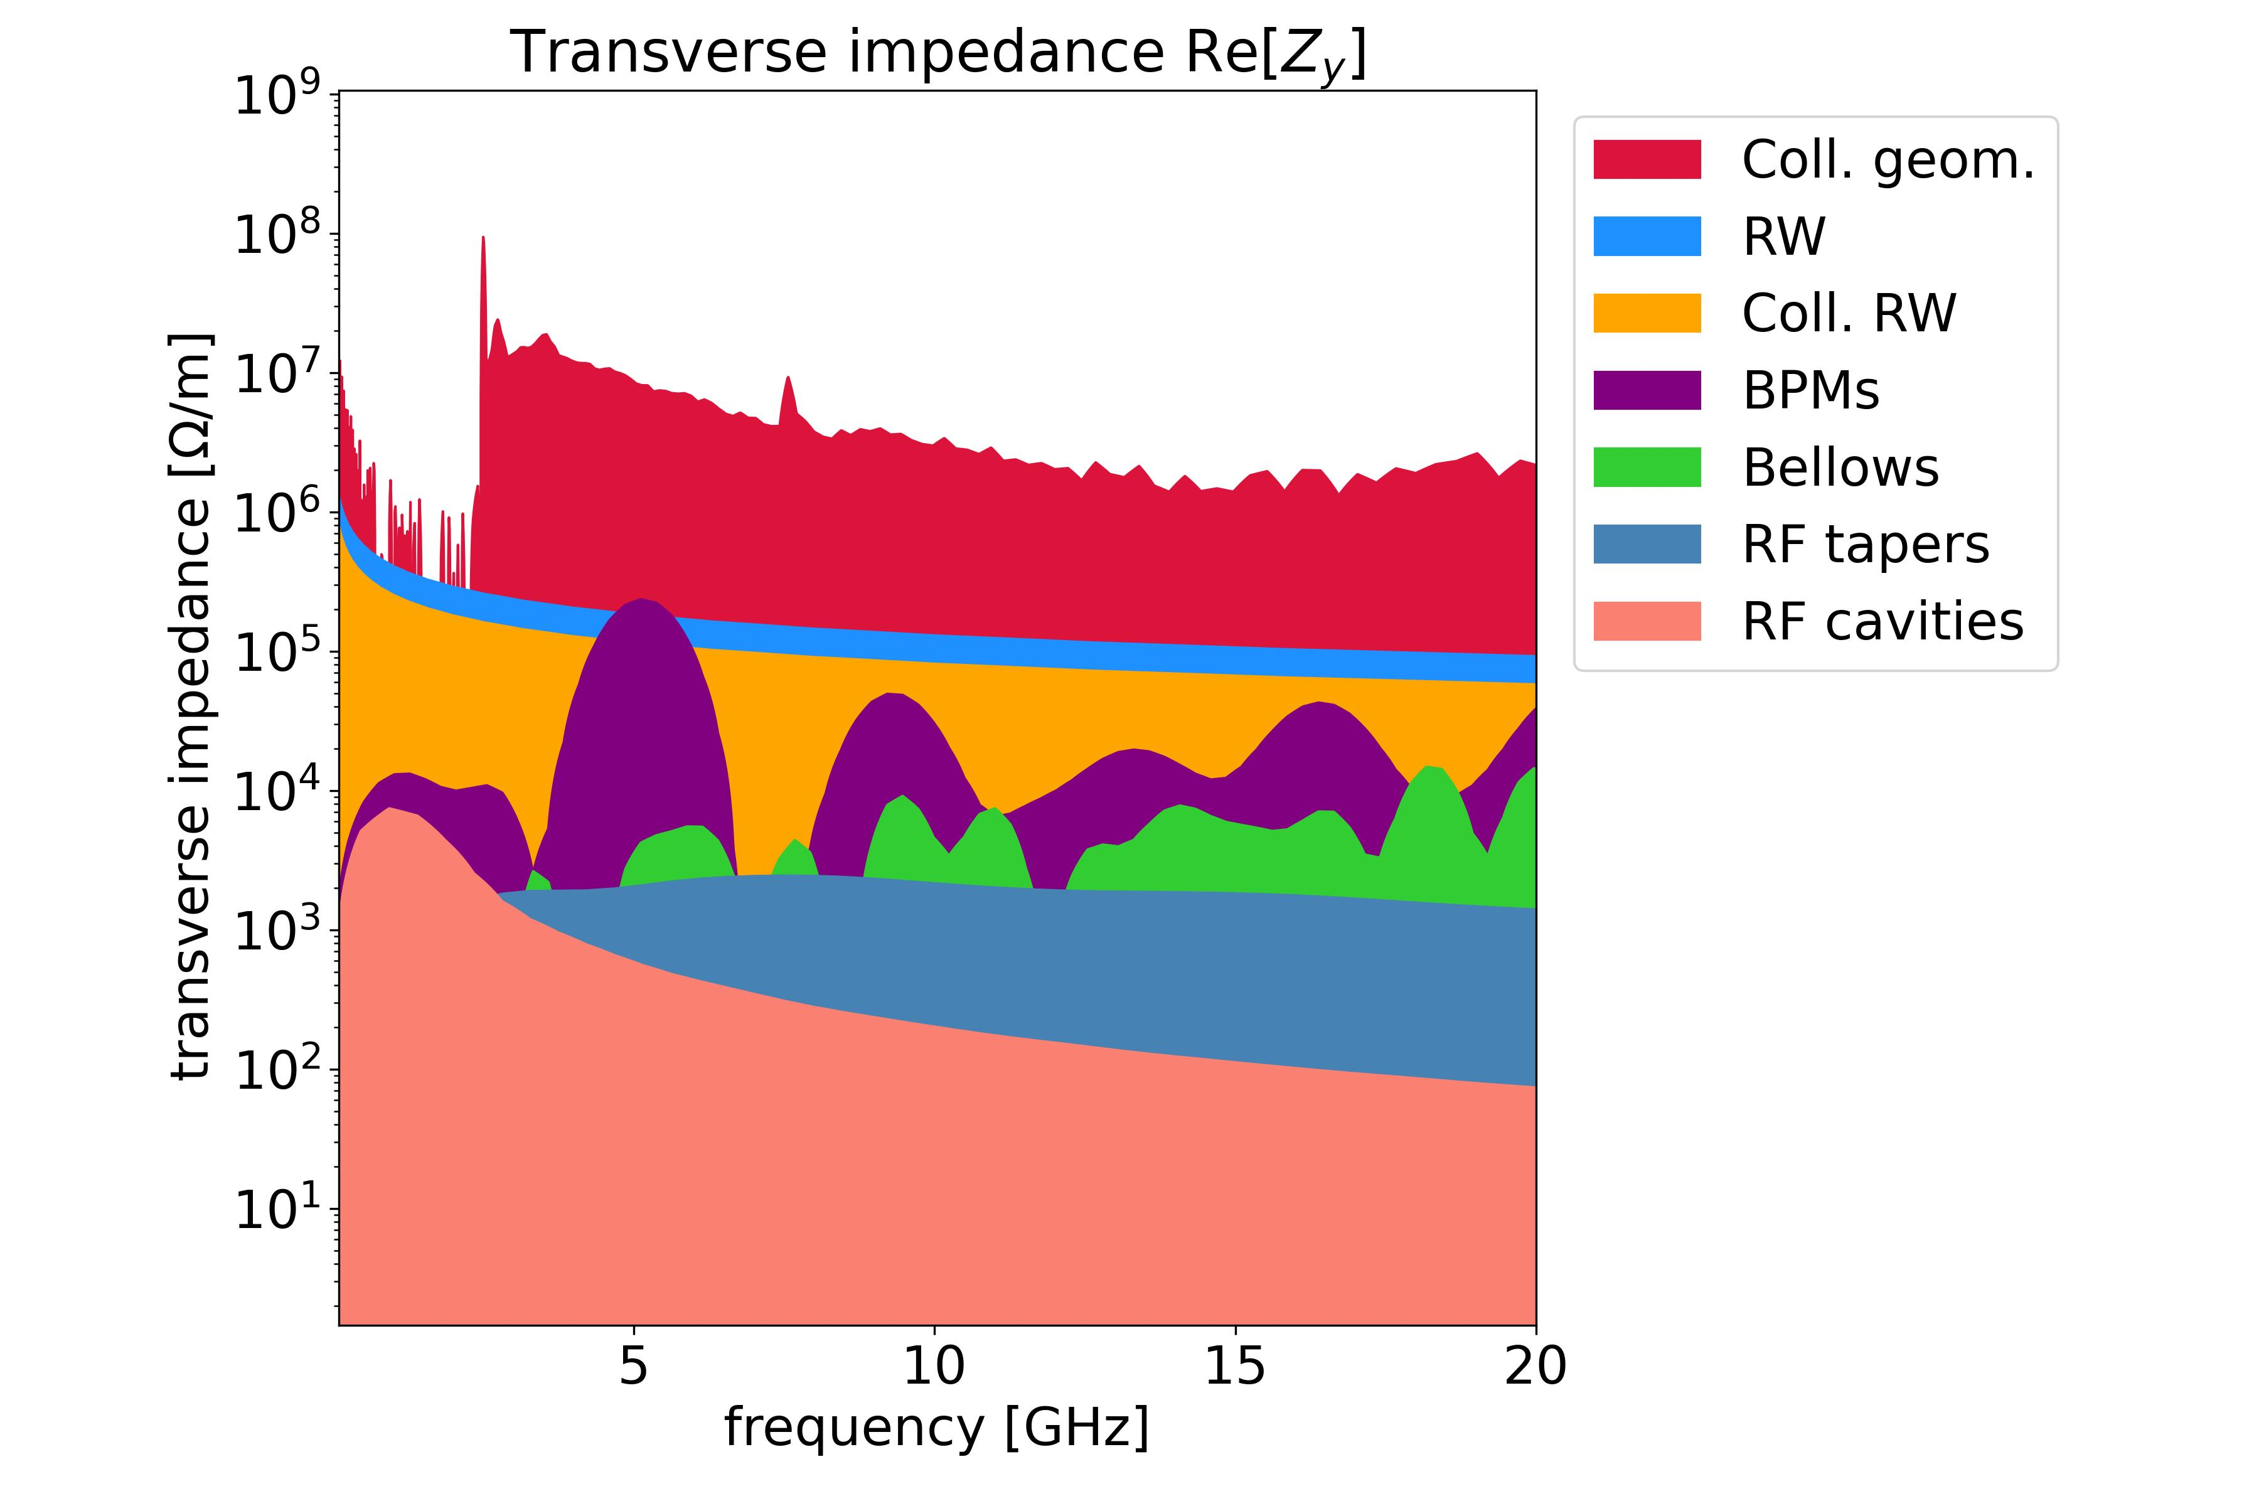
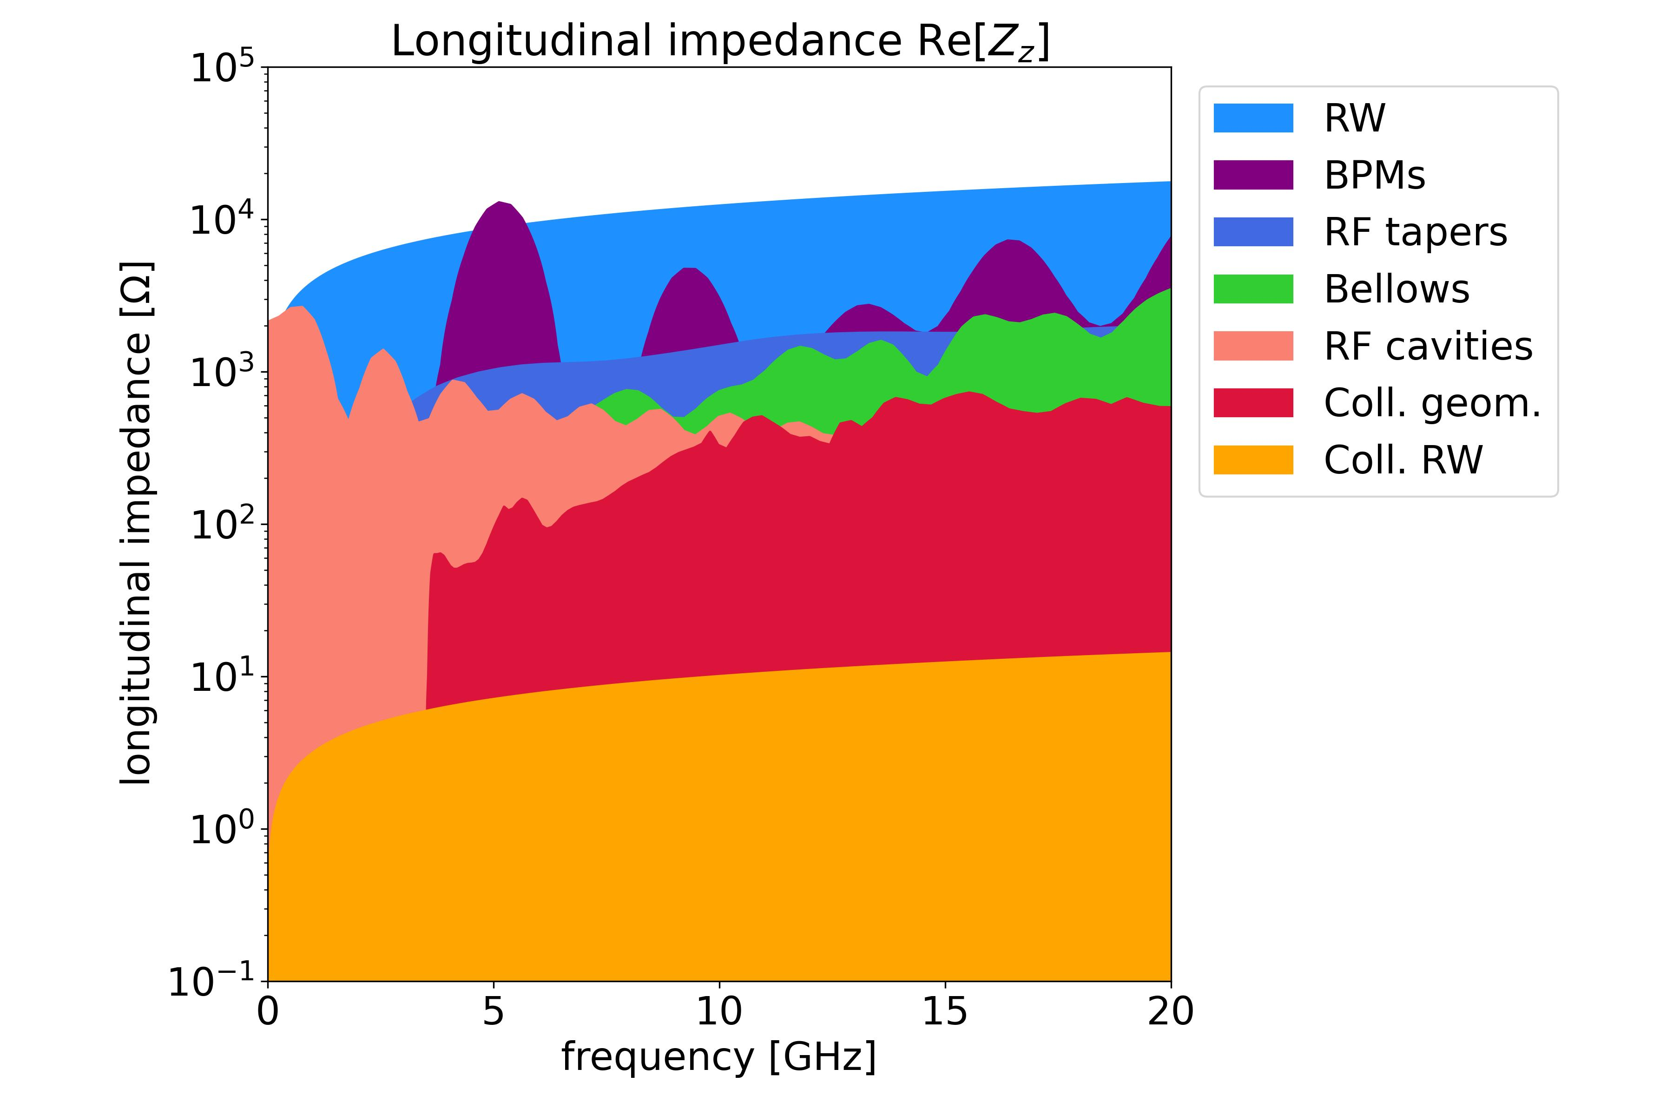
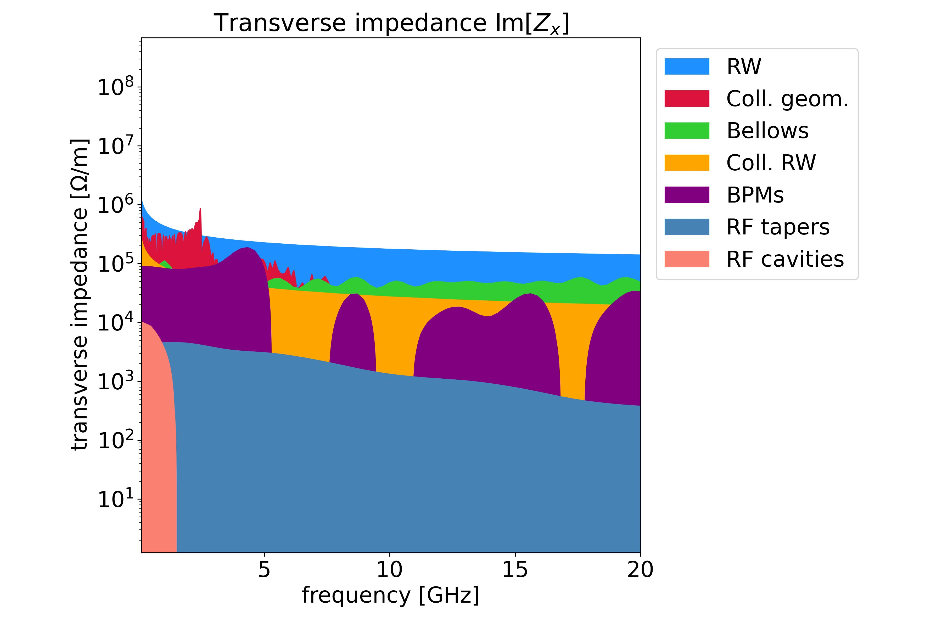


FCC-ee main ring impedance model
Impedance contributions considering a collimators’ taper angle of 15 degrees
06.03.2025 | eeFACT 2025 | Dora Gibellieri

Slide 38
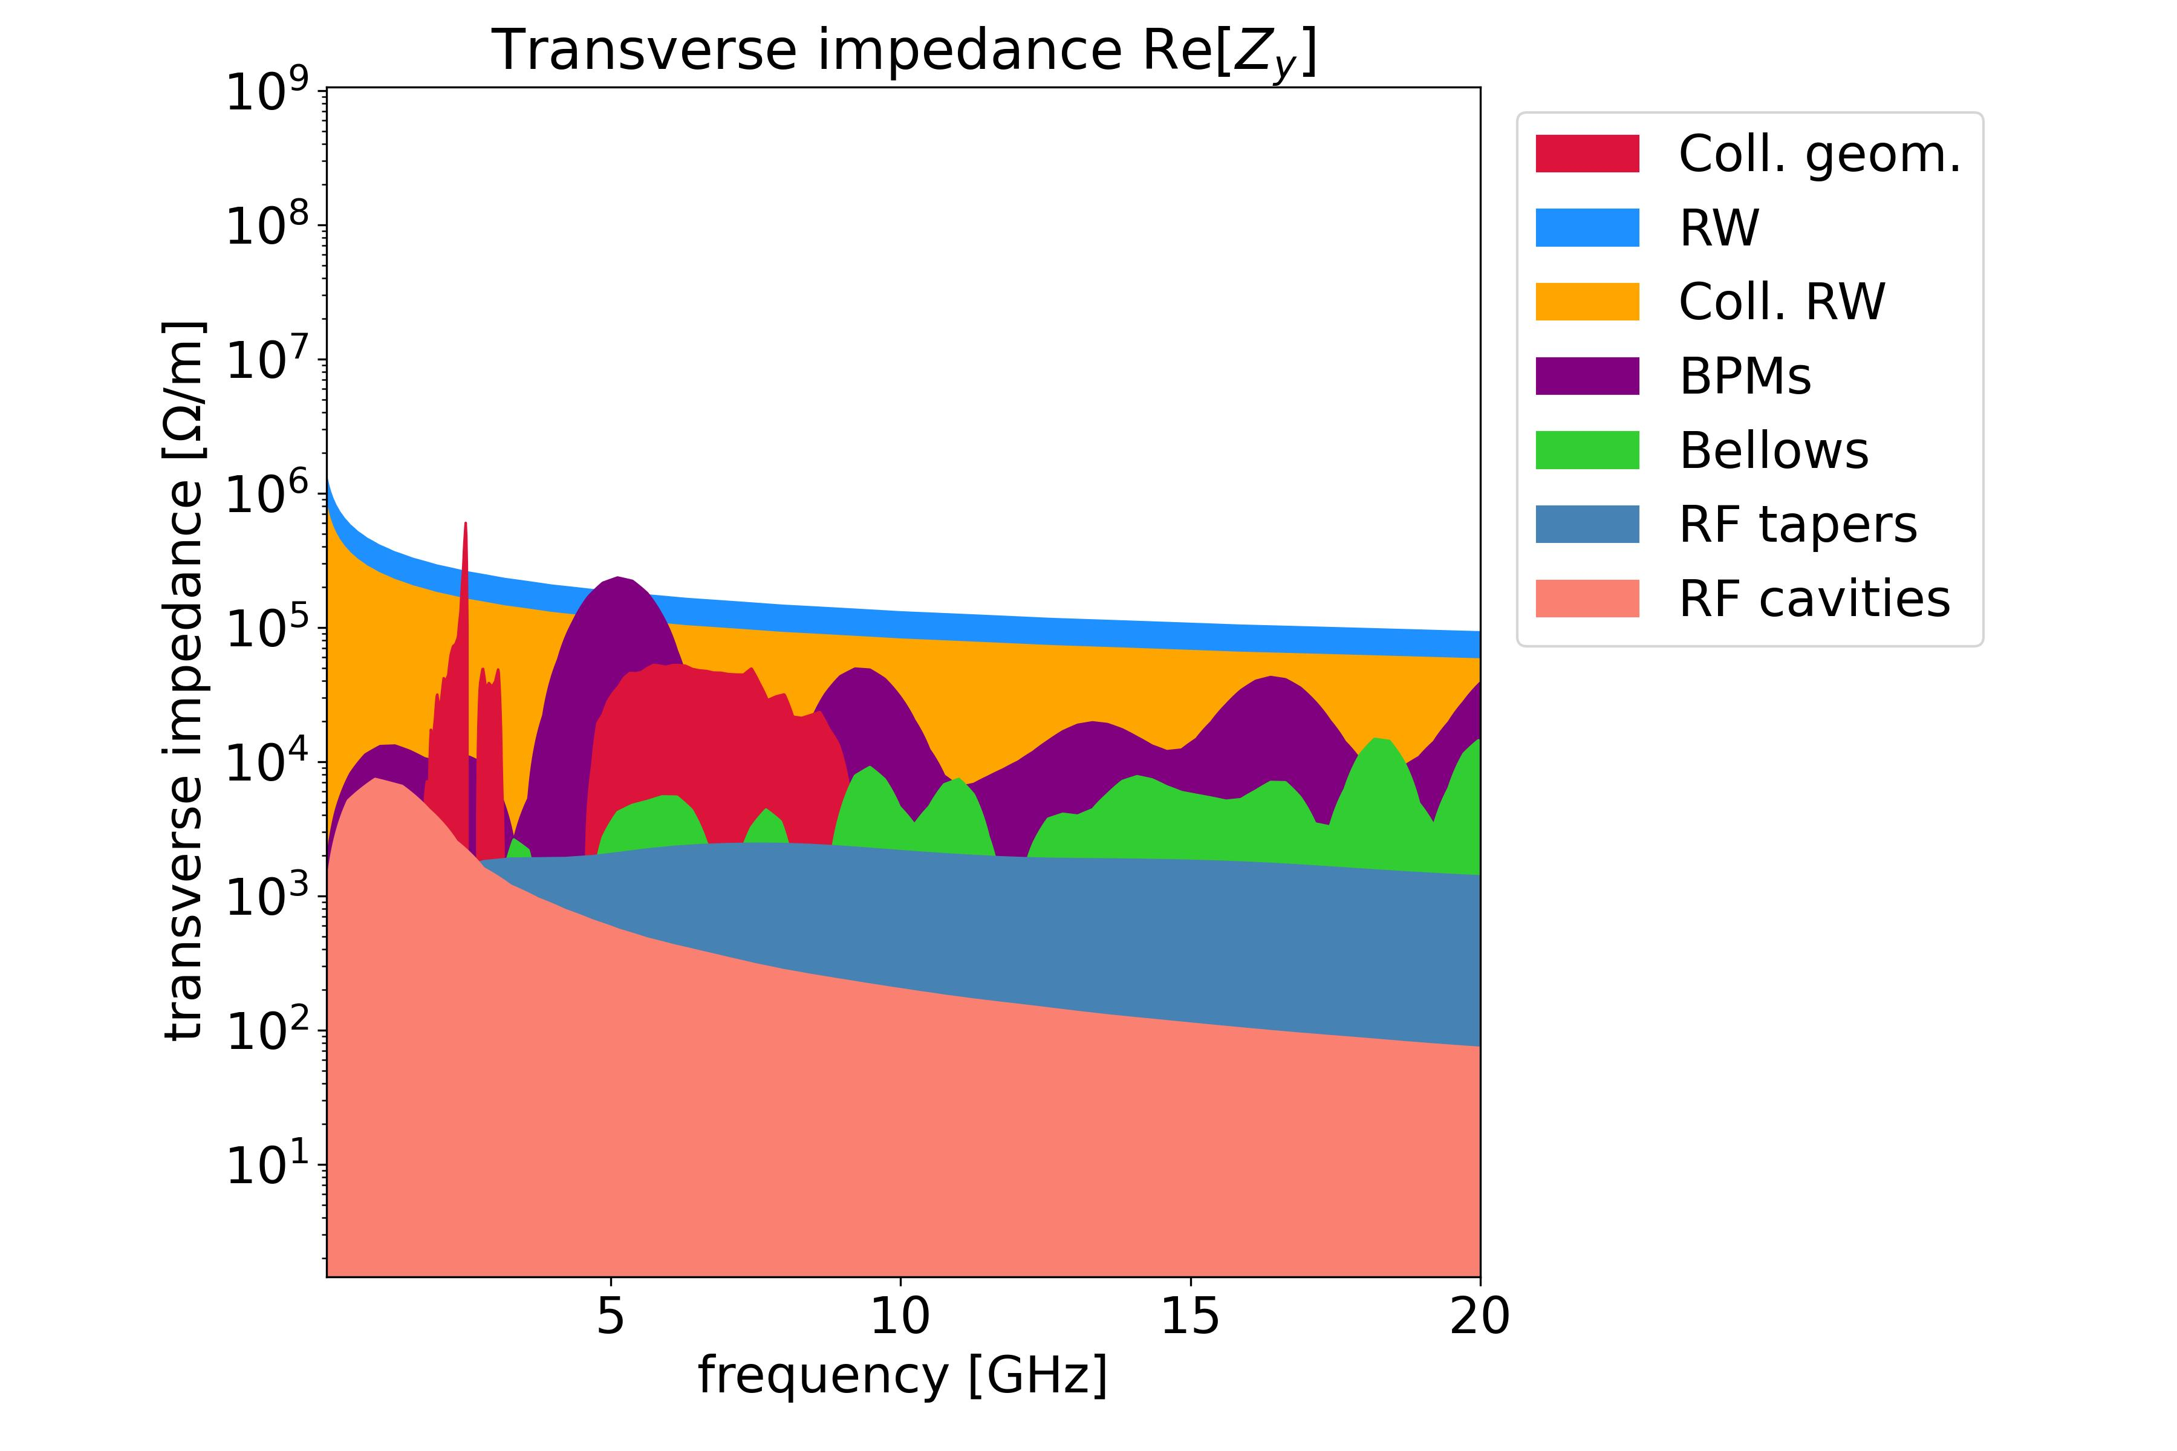

FCC-ee main ring impedance model
Impedance contributions considering a collimators' taper angle of 15 degrees for horizontal collimators and 2.5 degrees for vertical collimators
06.03.2025 | eeFACT 2025 | Dora Gibellieri

