Slide 1
J_{c} Scaling and Data Fitting for Nb₃Sn Wires
Simon C. Hopkins
HFM-MDP Forum, 20 February 2025

Slide 2

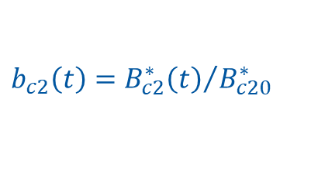

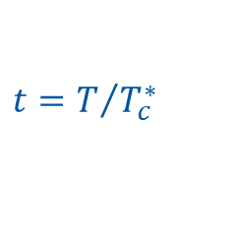

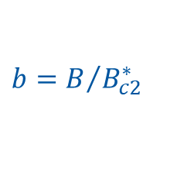
Scaling Laws for Nb₃Sn
Nb₃Sn shows a consistent scaling behaviour of flux pinning force F_{p} or critical current I_{c} with field, temperature and strain
There are many alternative parameterisations, but many can be reduced to the separable form:
  with
In this presentation, I omit the strain scaling for simplicity
$$F_{p}=Cg\left(ε_{0}\right)h\left(t\right)f\left(b\right)$$
$$f\left(b\right)=b^{p}{\left(1−b\right)}^{q}$$
$$b=B/{B_{c2}^{∗}}$$
$$b_{c2}\left(t\right)={B_{c2}^{∗}\left(t\right)}/{B_{c20}^{∗}}$$
$$h\left(t\right)={\left(1−t^{ν}\right)}^{η−μ}{\left(1−t^{2}\right)}^{μ}$$
$$t=T/{T_{c}^{∗}}$$

Slide 3

Field Dependence, f(b)
The pinning force density F_{p} scales with temperature, but has a fixed shape f(b) vs. reduced field (for a certain wire)
The classic pinning theories give:
  where p and q depend on the pinning mechanism
  For conventional Nb₃Sn wires we
  expect p = 0.5 and q = 2 for grain
  boundary pinning
  → F_{p,max} at b = 0.2
  For point pinning, we expect
  p = 1 and q = 2 pinning
  → F_{p,max} at b = 0.33
$$f\left(b\right)=b^{p}{\left(1−b\right)}^{q}$$

Slide 4


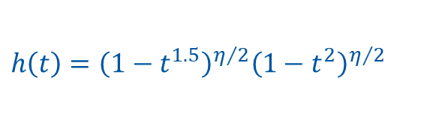
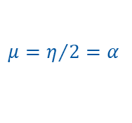

Temperature Dependence, h(t)
For the temperature scaling term:
  several parameterisations have been proposed, e.g.
  ‘Hybrid2’, ‘HFM’…
  Godeke, Bottura…
ν = 1.52 arises from an approximation to Maki-DeGennes; Ekin et al. found 1.50 ± 0.04
For fits to a variety of data, Ekin et al. found η to be 2–2.4, not necessarily completely independent of wire type
$$h\left(t\right)={\left(1−t^{ν}\right)}^{η−μ}{\left(1−t^{2}\right)}^{μ}$$
$$μ=η/{2=α}$$
$$h\left(t\right)={\left(1−t^{1.5}\right)}^{η/2}{\left(1−t^{2}\right)}^{η/2}$$
$$η=2, μ=1$$
$$h\left(t\right)=\left(1−t^{1.52}\right)\left(1−t^{2}\right)$$

Slide 5
Fitting Methodologies
Ekin distinguishes ‘raw scaling data’ from ‘global-fit-model’ values
  Raw scaling:
    separately scale f(b) at each T (and ε) → B_{c2}* and F_{pmax}
      note: relatively insensitive to the shape of f(b)
    analyse their T and ε scaling → b_{c2}(t), h(t) etc. (a few parameters at a time)
    globally fit only the remaining parameters (e.g. the overall constant C) to the full I_{c} data set
  Global fit:
    assume a scaling model and simultaneously fit all parameters to the I_{c} data set
  The two can yield significantly different estimates of b_{c2}(t) etc., and the former is expected to be better suited to extrapolation
Methods and minimum data sets extensively explored for ‘Extrapolative Scaling Expression (ESE)’ expression:
  Topical reviews by Ekin et al.: Supercond. Sci. Technol. 23 083001, 29 123002, 30 033005
  Combinations with magnetisation data by Pong et al.: Supercond. Sci. Technol. 35 095006

Slide 6
Fitting Considerations: F_{p}, I_{c}, J_{c}
Ekin’s formulation was expressed as a scaling of pinning force F_{p} (per length)
  When fitting I_{c} data, a modest reduction in error has been reported by converting to F_{p} for fitting
This can be equivalently formulated for a volumetric pinning force density F_{p} and J_{c}
  Straightforward conversion, but it must be clear which J_{c} – e.g. non-Cu or layer J_{c} – is meant
  For large data sets, there may be a small distinction between fitting J_{c} calculated per sample (from its measured Cu/non-Cu) and fitting I_{c} with a subsequent conversion

Slide 7
Fitting of Transport I_{c}
At CERN, transport I_{c} measurements are performed systematically for wire and cable acceptance
Some challenges for the available parameter ranges:
  Limited maximum current and field: at CERN, currently 15 T, ~2000 A
  Limited temperature range: at CERN, currently only ~1.9 K and ~4.2 K
  Routine testing covers a limited field range (depending on wire type, typically 12–15 T)
  At ‘low’ fields, limitations from magnetothermal stability as well as the current limit
The sample/test configuration and any subsequent data processing have a significant effect, and should be reported with the fit:
  Fits ‘work’ with or without self-field correction, but don’t yield the same result for f(b)
    When implemented in Roxie, a self-field flag must be set accordingly
  The strain state also depends on the sample configuration, and should be reported and/or (approximately) corrected to a zero (or defined) state
    Transport measurements at CERN are on Ti-Al-V barrels

Slide 8
Fitting of Magnetisation Data
Magnetisation measurements typically allow measurements over a broad range of temperature
  VTI from 1.9 K to >> T_{c} for the VSM at CERN
Some very high field facilities exist, but field range is typically more limited:
  10.5 T at CERN; 5–7 T is common
  Often little overlap with transport data
At low field, flux jumps complicate the interpretation
Again, the sample/test configuration can be influential – in addition:
  Dependence on sample length – preferable to favour ‘long’ samples:
    Relative to the twist pitch, and
    More representative average, lower noise, reduced error contribution from end preparation etc.
  At CERN, constrained to ~6 mm diameter sample space: small ‘coils’ tested whenever possible

Slide 9
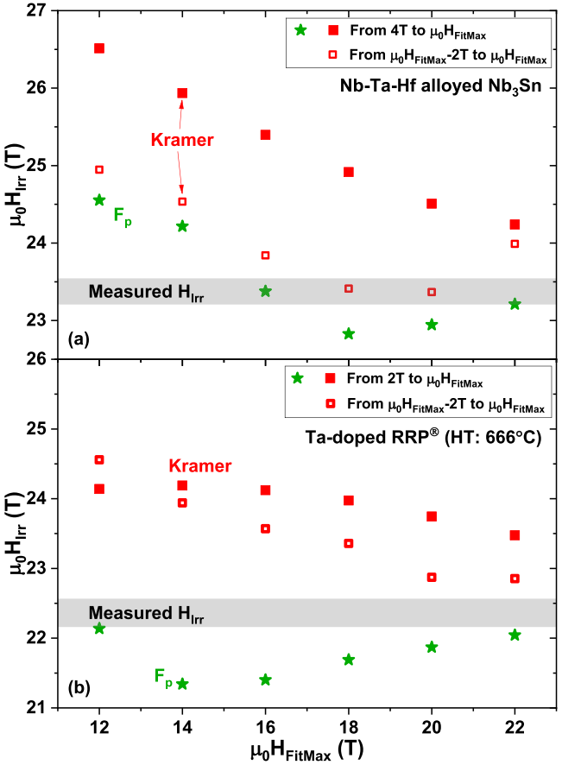
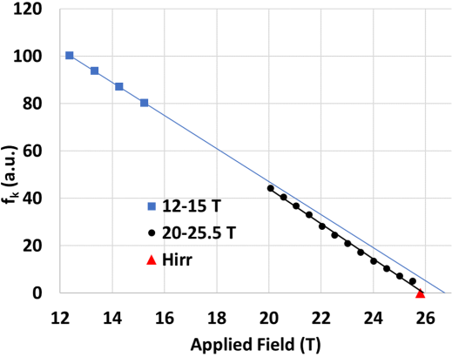
Determination of B_{c2}*(T)
Determining B_{c2}* over the full temperature range is not straightforward from a single method:
  Transport data are often available only at low temperature, for which B_{c2}* is larger than the maximum test field
  Magnetisation data allow B_{c2}* to be found directly (only) at high temperature
There have been reports of significant errors in extrapolation to high field both for transport and magnetisation data
  Transport
  Segal et al., J. Phys. Conf. Ser. 1559 12062
  Magnetisation
  Tarantini et al., Supercond. Sci. Technol. 32 124003

Slide 10
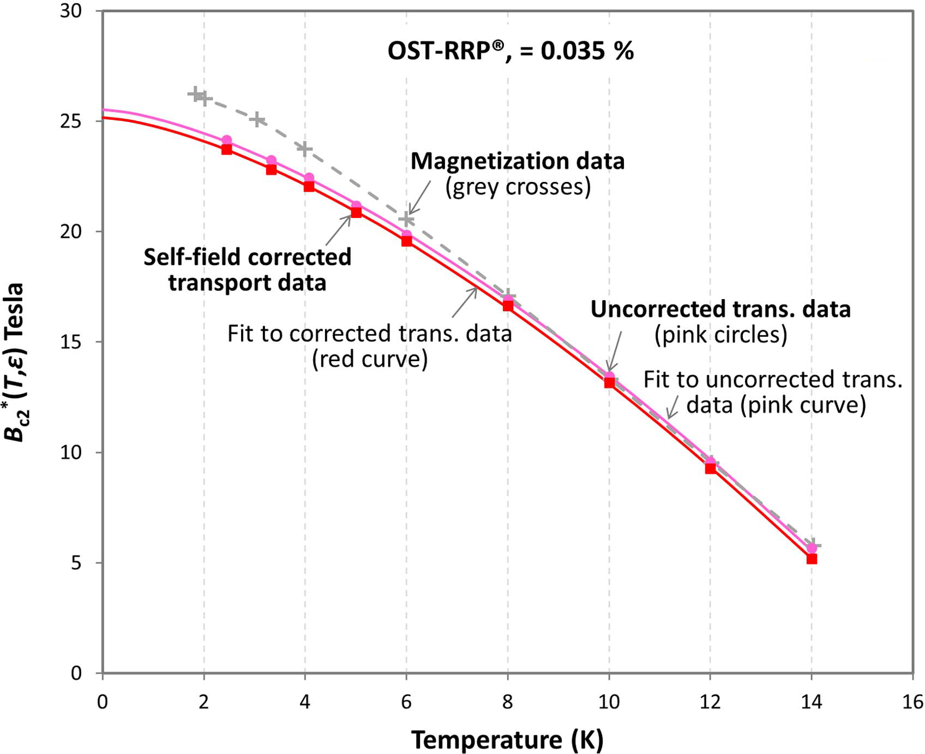
Determination of B_{c2}*(T)
A divergence between values determined from transport and magnetisation data has also been found at low temperature
Inhomogeneity is one possible contributor:
  A radial dependence of both composition (Sn at%) and microstructure is often found in Nb₃Sn filaments/sub-elements
  This corresponds to a radial profile of T_{c} and I_{c}, with a form depending on the conductor type/design and its heat treatment.
Procedural approaches to address limited data, e.g. Pong et al.:
  B_{c2}*(T) from magnetisation reasonably reliable at high temperature (~10 K); T_{c}* fit may benefit from allowing fitting of ν
  Ekin et al., Supercond. Sci. Technol. 29 123002

Slide 11
Sampling and Scope
The sampling and heat treatment cycle should also be reported with the fitting parameters:
  Generally B_{c2} etc. depend on the heat treatment cycle, not just F_{pmax}
  Must be clear whether the fit represents a particular spool/cable/coil, the procurement specification, or some statistic of the performance distribution achieved in production
    All are useful: witness reports to evaluate coil performance, magnet design, etc.
    Important to note that small-scale orders for R&D activities may not accurately reflect the performance distribution obtained in large-scale procurement
Care is needed to avoid biasing the fit, e.g.:
  More tests at 4.2 K than 1.9 K – consider including only samples for which both are available
  If fitting by minimising errors, the error contributions could be weighted to correct various biases:
    Different numbers of data points vs. T and B
    Proportionally larger errors at low currents; larger absolute contributions at high current

Slide 12



Non-Cu J_{c}(B,T) for Current Wires
For reference fits to current wire in HFM, I have used this form:
  Implemented in Roxie as ‘11. CERN High Field Nb₃Sn’
  Consistent in form with witness reports
  Matches Hybrid2 presented earlier
    …but with ν adjustable, and terminology aligned
  B_{p} implies peak field on conductor: fits made with self-field correction
For initial fits, I have fixed several parameters
  α and ν at typical and nominal values – could be fitted later
  if sufficient data to justify differences
  p and q as expected for grain boundary pinning – not suitable for
  APCs/internal oxidation
$J_{c}\left(B,T\right)=\frac{C_{0}}{B_{p}}{\left(1−t^{ν}\right)}^{α}{\left(1−t^{2}\right)}^{α}b^{p}{\left(1−b\right)}^{q}$
$$b=\frac{B_{p}}{B_{c20}\left(1−t^{ν}\right)}$$
$$t=\frac{T}{T_{c0}}$$
α | 1
ν | 1.52
p | 0.5
q | 2

Slide 13
Data for Fitting
Extensive transport I_{c} data are available from wire verification and cable qualification
  Only round wire (not rolled/cabled) considered
  Each fit for a single heat treatment cycle
  However, most data for a limited field range, with much lower sampling at 1.9 K than 4.2 K
    Wire from R&D procurement not initially characterised at 1.9 K
Very limited magnetisation data currently available:
  T_{c0} has been obtained from B_{c2}(T) magnetisation data for the MQXF wire
  The same T_{c0} value is temporarily assumed for other RRP wires, with B_{c20} fitted from transport data
  Further tests are planned in the coming weeks

Slide 14
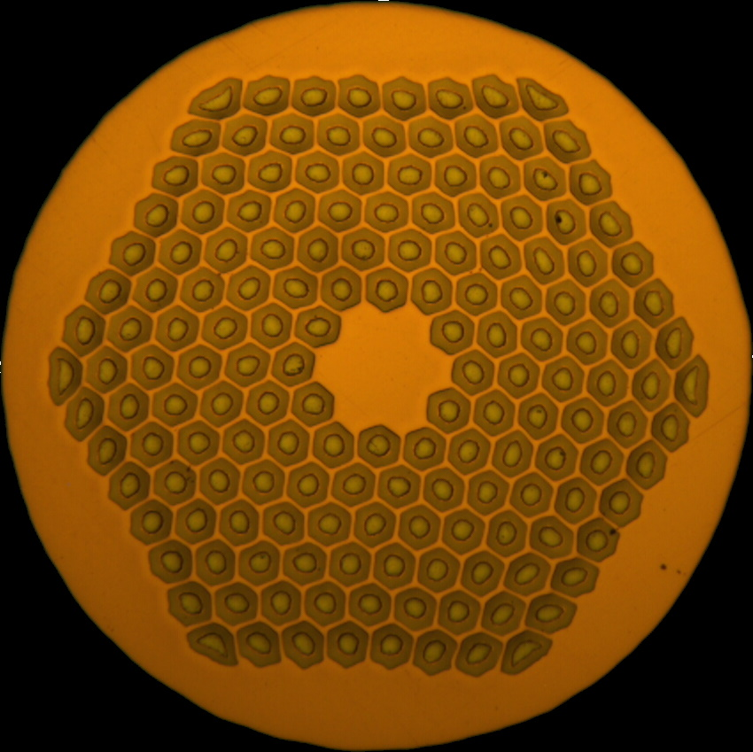
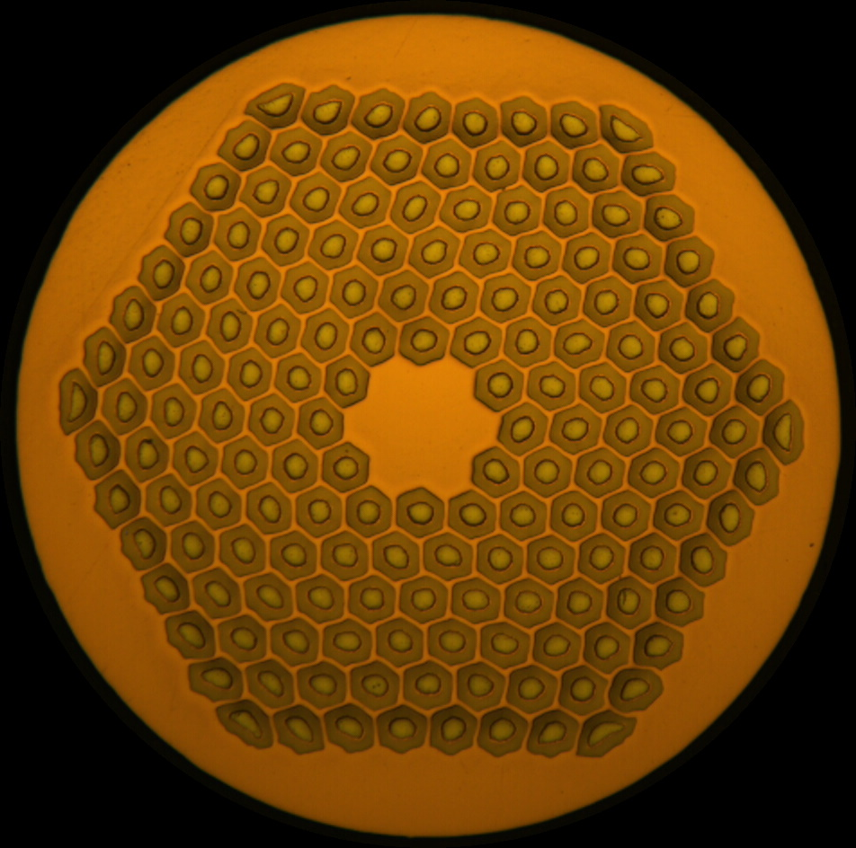
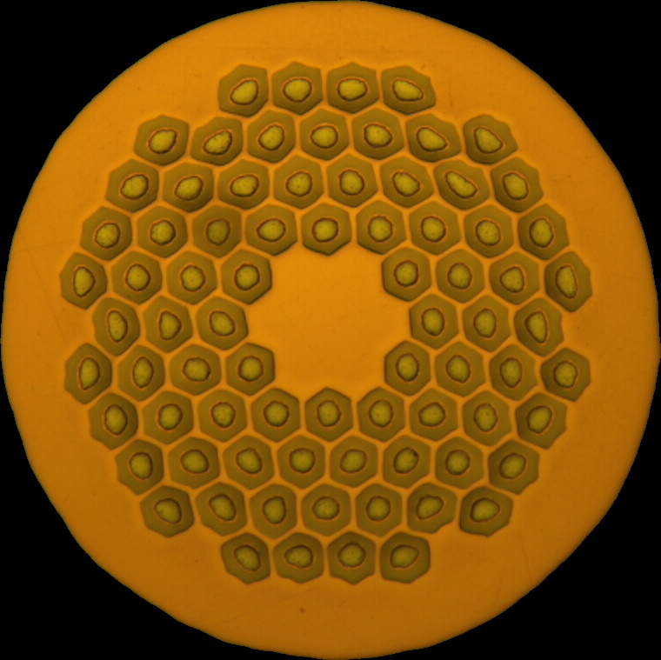
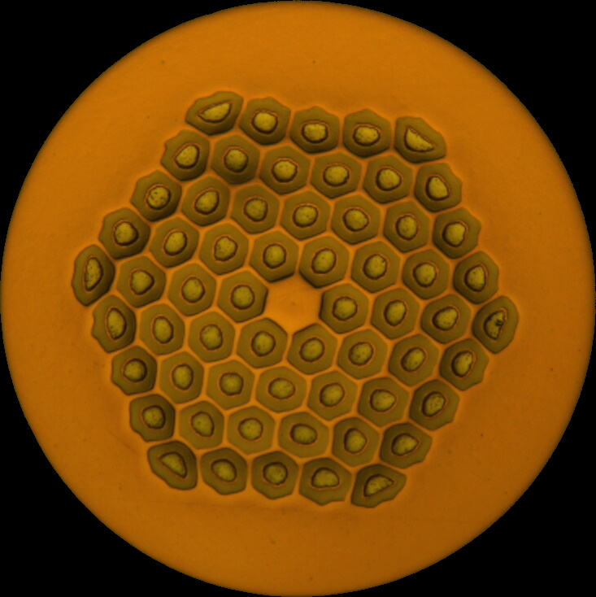
Wire Types
HFM low field coils
HL-LHC ref.
HFM high field coils (or ungraded)
 | DEM-0.7 | ERMC-0.7 | MQXF | ERMC-1 | DEM-1.1
d (mm) | 0.7 |  | 0.85 | 1.0 | 1.1
Layout | 60/91 | 78/91 | 108/127 | 162/169
d_{s} (µm) | 54 |  |  | 58 | 64
Cu/non-Cu | 1.8 (≥ 1.6) | 1.2 ± 0.2 | 1.2 ± 0.1 | 0.9 ± 0.2
Nb:Sn | 3.6 (reduced Sn) |  |  | 3.4 (standard Sn)
Heat treatment | 665 °C 50 h |  |  | 650 °C 50 h | 665 °C 50 h

Slide 15
Heat Treatments
In the previous slide, heat treatment cycles are the manufacturer’s recommendations
  Established baseline for MQXF
Other cycles are in current use:
  To improve magnetothermal stability of ERMC-1 and DEM-1.1:
  650 °C with 30 h or 50 h duration
  For graded designs with simultaneous reaction of conductors for which suggested HT cycles may differ (R2D2)

Slide 16
MQXF and DEM-1.1
Fitting parameters for MQXF and DEM-1.1 wire are shown below for the HTs in current use
  Using 665 °C 50 h for DEM-1.1 increase B_{c20} by ~0.5 T
 | MQXF | DEM-1.1
Heat treatment | 665 °C 50 h 3_665_B | 650 °C 50 h 3_650_A | 650 °C 30 h 3_650_I
Scope | Mean | Typical¹ | Low²
B_{c20} (T) | 29.56 | 29.66 | 28.77
C₀ (T·A/mm²) | 220303 | 240652 | 239814
T_{c0} (K) | 16.25
¹ Sampling representative of one cable qualification
² Spool at the low end of the I_{c} distribution

Slide 17
MQXF and DEM-1.1
Non-Cu J_{c}(B) at 4.2 K and 1.9 K
1.9 K
4.2 K

Slide 18
Next Steps
Currently compiling more complete data sets for each wire layout
  Transport I_{c} measurements and stability tests continuing for improved statistics as cables are qualified
  Comparison of alternative heat treatment cycles
  Magnetisation measurements resuming shortly for more robust temperature-dependent and low-field data
Propose to create an EDMS document for each wire design and reference fit, which can be updated (version controlled) as new data become available

