Slide 1
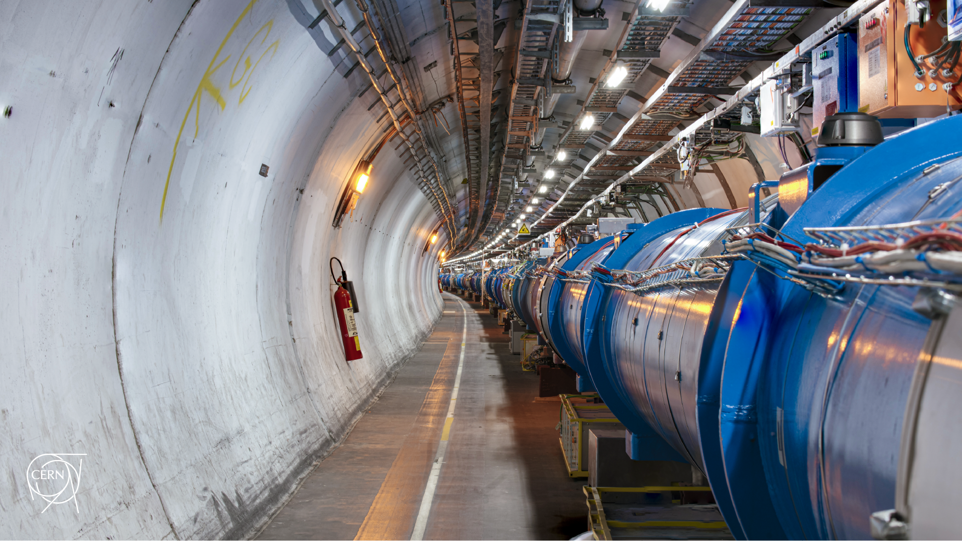
207th HL-LHC TCC follow-up on crystal collimation
D. Mirarchi on behalf of BE-ABP-NDC, BE-CEM-MRO, BE-OP-LHC, SY-STI-TCD teams
208th HL-LHC Technical Coordination Committee

Slide 2
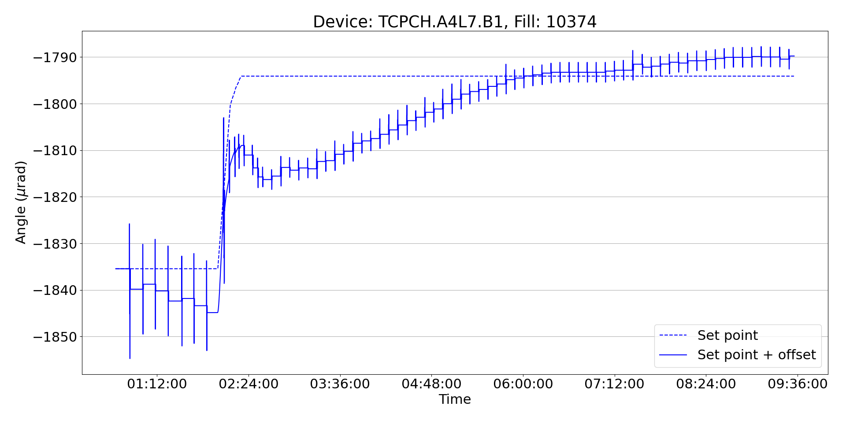
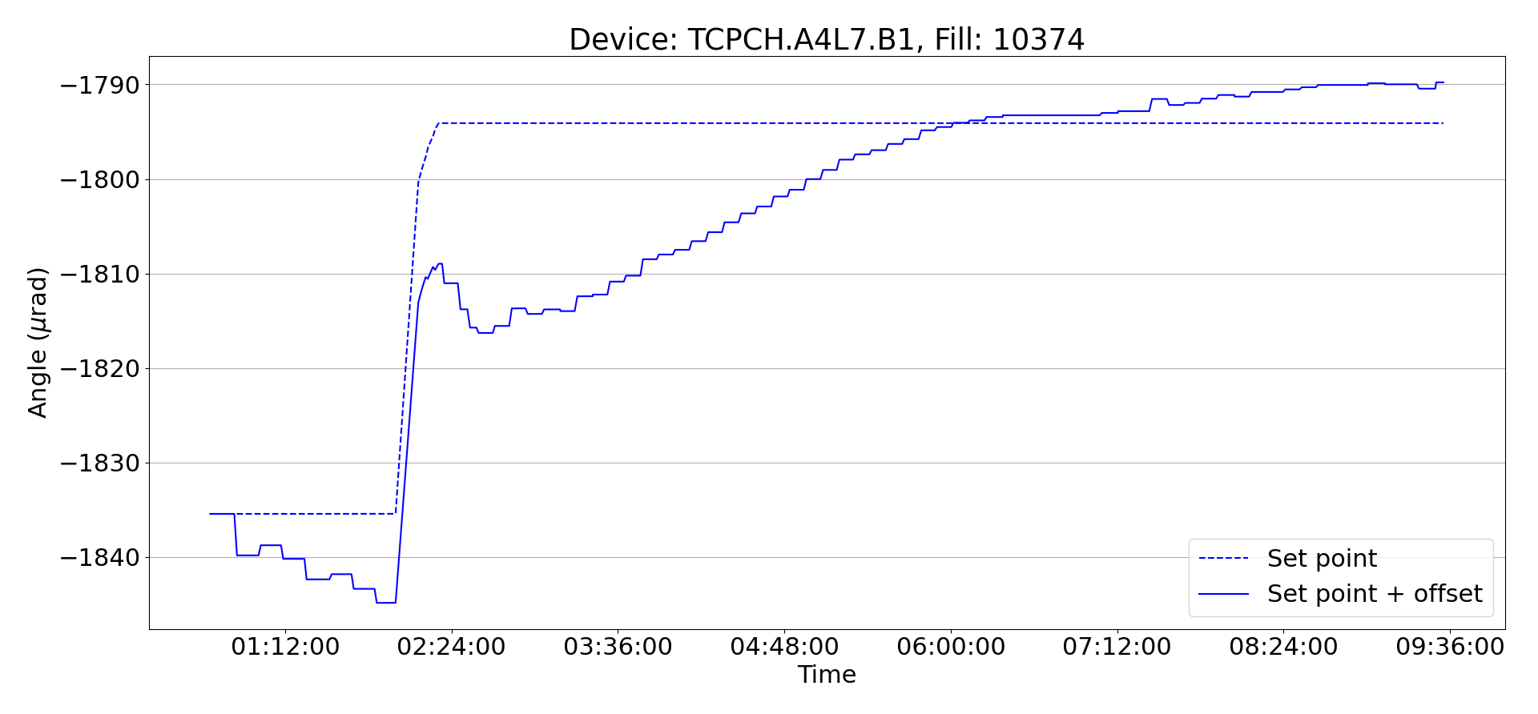
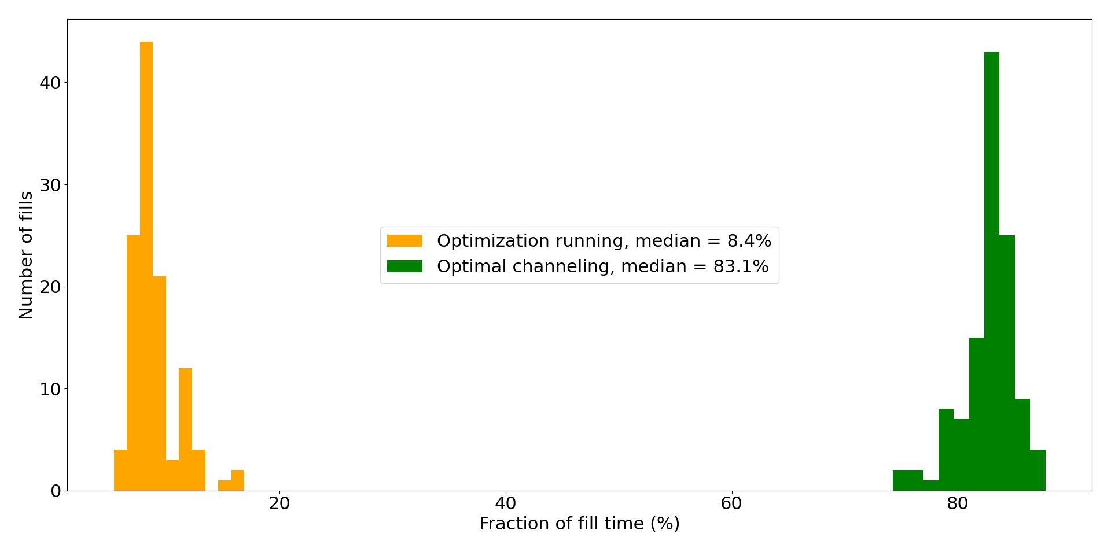
Autopilot performance
On-line angle
Main parameter to define performance:
How much time do we spend optimising
w.r.t. time spent in optimal channeling?
After optimization removal
for off-line analysis
Valid for each device individually
(sequential optimizations)
Some room for improvements (still to be quantified):
ML aided optimization
Adaptive time between optimizations
Can we accept that for ~8% of the time each plane cannot guarantee target cleaning performance?
To be balanced with efforts needed to understand and fix root cause – strong synergy with PBC studies

Slide 3
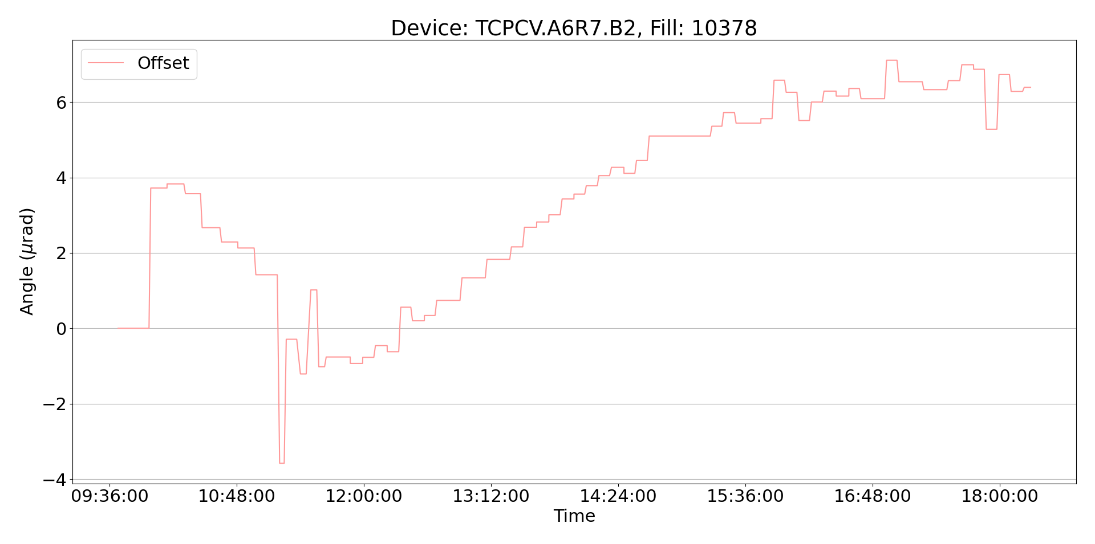
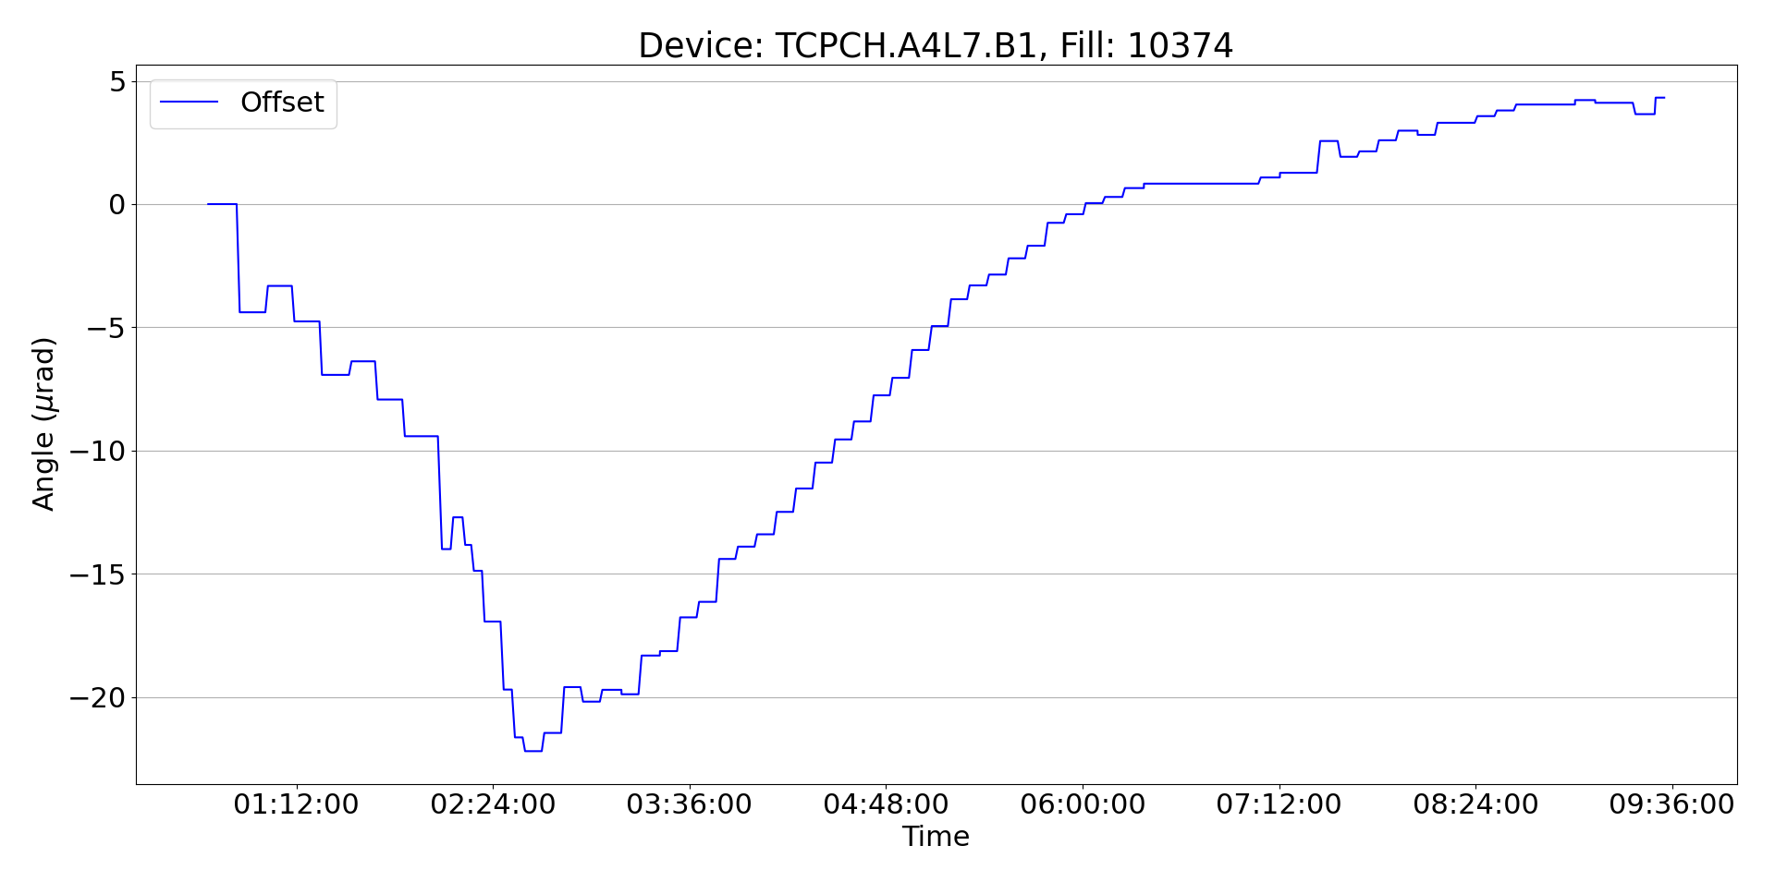
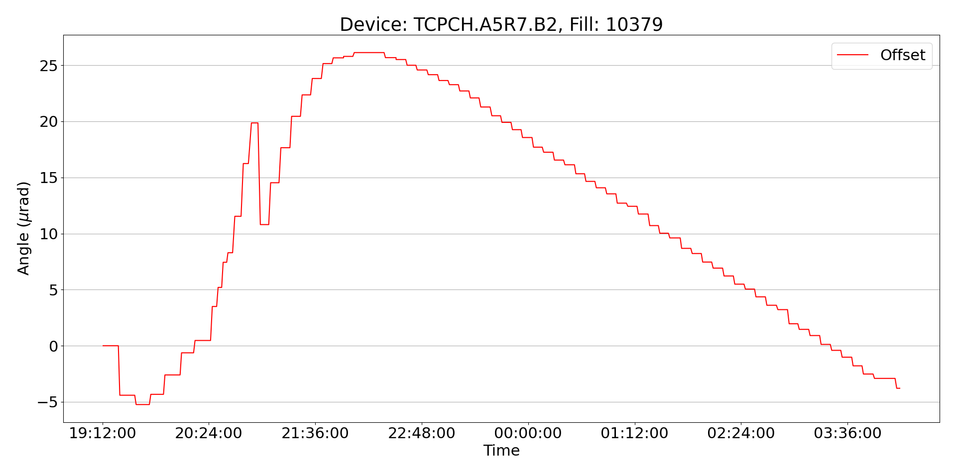
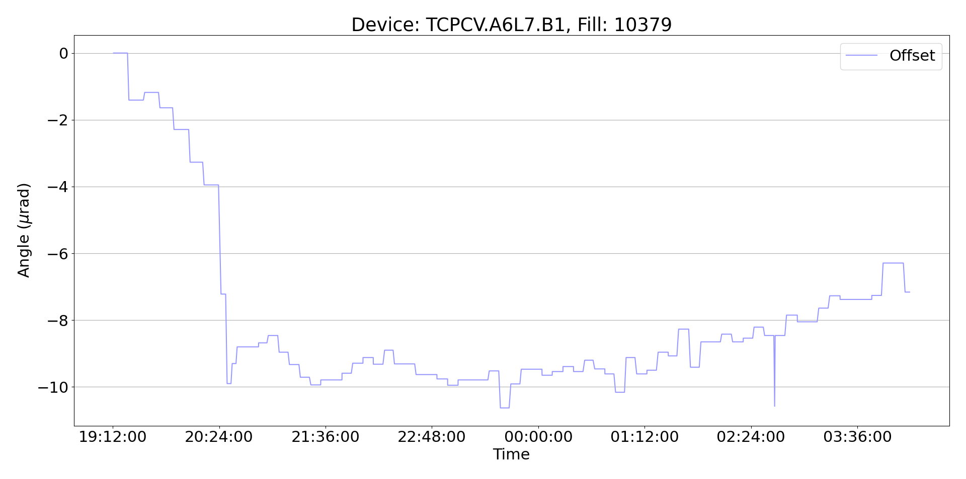
Offset trend overview
Quantitative assessments
at CWG #286
B1H
B2H
B1V
B2V
Main qualitative considerations:
All devices show a trend compatible with a warm-up ➔ cool-down process, as observed in 2023

