Slide 1

Design review for the LHC-BGI magnets
D Bodart
05/02/2025

Slide 2
Introduction
The Beam Gas Ionization (BGI) monitor is a non-invasive instrument for measuring transverse beam profiles. Building on the success of BGI devices currently operational in the PS and tested in the SPS, the high potential of this technology has been well demonstrated. In the 2022 review, BGI was selected as the baseline profile monitor for the High Luminosity LHC (HL-LHC).
To meet the stringent operational requirements—achieving a transverse profile measurement accuracy within 2.5% and an emittance error below 5%—the new Timepix-based BGI requires a magnetic field of 0.6T. This marks a significant improvement over the older MCP-camera-based BGI, which operated at only 0.2T, making the reuse of existing magnets unfeasible.
With the increased magnetic field, operational considerations necessitate an integrated B-field of zero to maintain a closed orbit and avoid transverse offsets. To achieve this, a triplet configuration was chosen, consisting of one main magnet and two trims.
Working within a constrained budget, the project has prioritized cost optimization by recycling existing power converters, magnets, and infrastructure wherever possible. Alternatives, including permanent magnets 3 in 1 magnet and MDX doublet configuration, were thoroughly evaluated before finalizing the triplet configuration, which requires a new main magnet for each instrument.
In total, four instruments will be deployed—one for each transverse plane of the two LHC beams—ensuring precise and reliable beam profile monitoring for the HL-LHC.

Slide 3
BGI-LHC Technical requirements
4 Beam Gas Ionization detectors in total are located in Point 5: 2 in 5R4, 2 in 5L4.
2 configuration are used: One with a horizontal field and one with a vertical field per beam.
A setup consist of 1 BGI magnet and 2 “field cancelling” trim magnets located 1 upstream and 1 downstream of the BGI magnet so they cancel the B field between the three magnets together. The upstream and downstream magnets provide each of them half of the integrated B field of the BGI magnet.
The requested B Field in the detector gap is 0,6 T, the Good Field Region is defined as a volume within the magnet center of X,Y,Z: 30 x 50 x 30 mm with Y offset of 1,5 mm.
The field quality is defined as DB/B <1 e⁻³ in the defined volume above.
The magnet gap is 140 mm as a result of the instrument size and related vacuum chamber and assembly clearance (see Fig. 1, 2 and 3).
The magnet design shall accommodates with the environment constraints defined by the machine layout, where basically the adjacent beam pipe and the QRL limits the transverse space (see fig. 4 to 7).
Easy access to the detector is needed requesting the BGI magnet to be movable in the longitudinal axis of 210mm + clearance= minimum 300 mm.
Operating power converter parameters:
  BGI magnet converter: 600A, 40V, 1 unit per BGI magnet, already available.
  Trim magnets converters: 4 units available of 125A and 125V, presently in operation.
Available cooling water: P=11 bars, DP 8 bars, inlet temp= 27 °C. (1/2” piping)

Slide 4
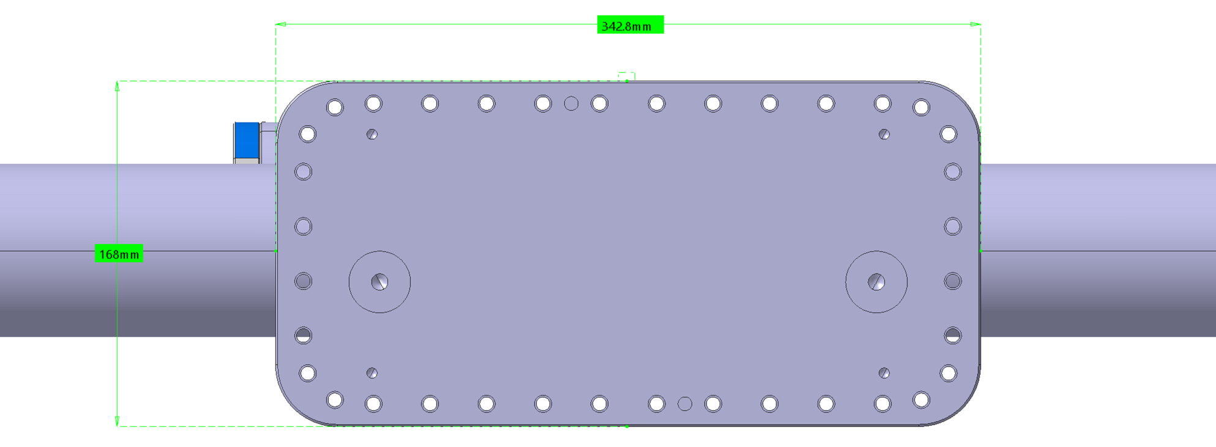
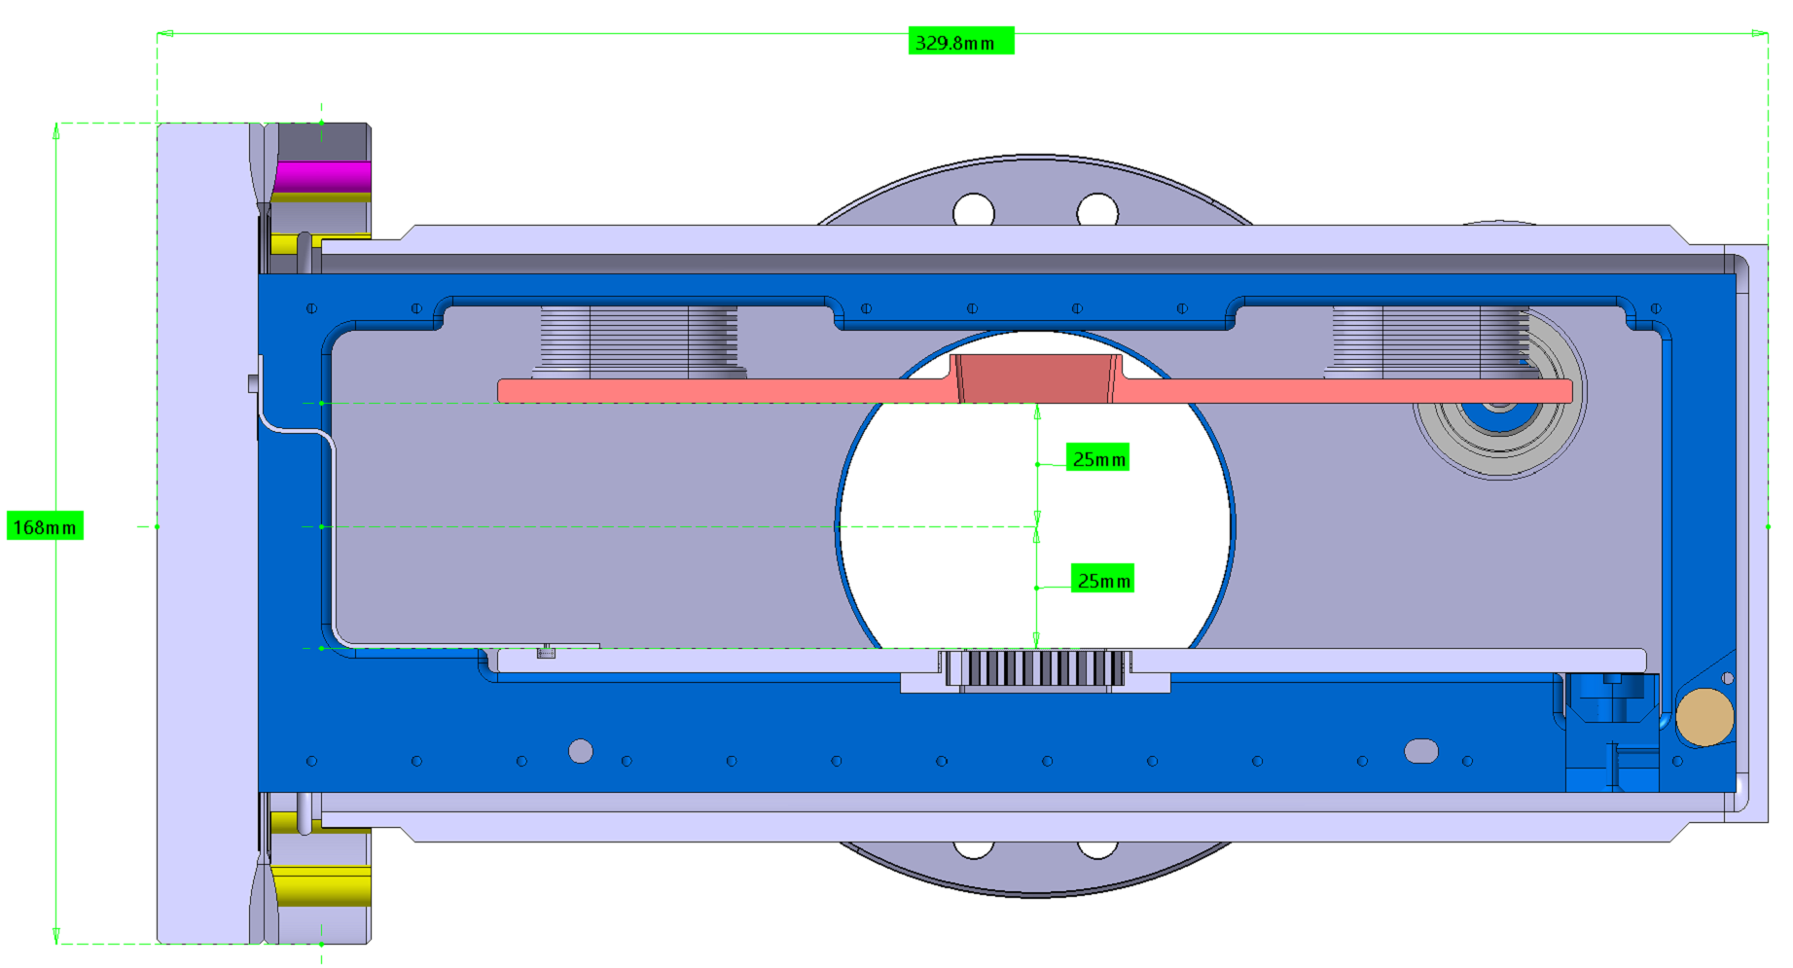
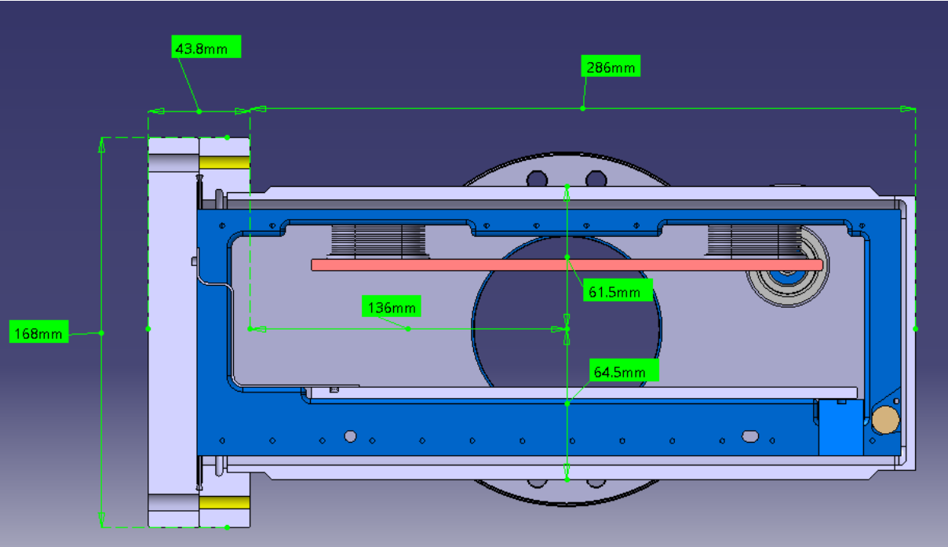
Designs overview
OPTION 4: LHC-BGI RECT INSTR & RECT CHAMBER ASSBLY - TPX3
BGI-LHC Technical requirements
ST1904954
Detector: TPX3
Envelope ~ 180 mm x 352 mm x 355 mm RF requirements:
  SPS-BGI type
Beam vertical offset +1,5 mm
Fig.1 instrument chamber size side view
Fig.2 & 3 instrument chamber size cross section

Slide 5
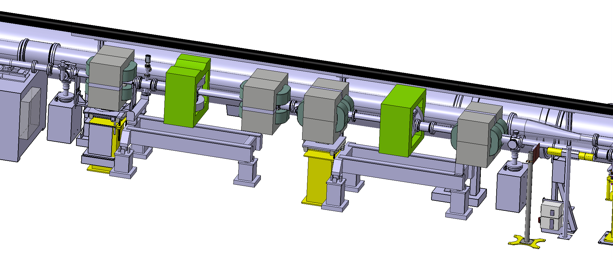
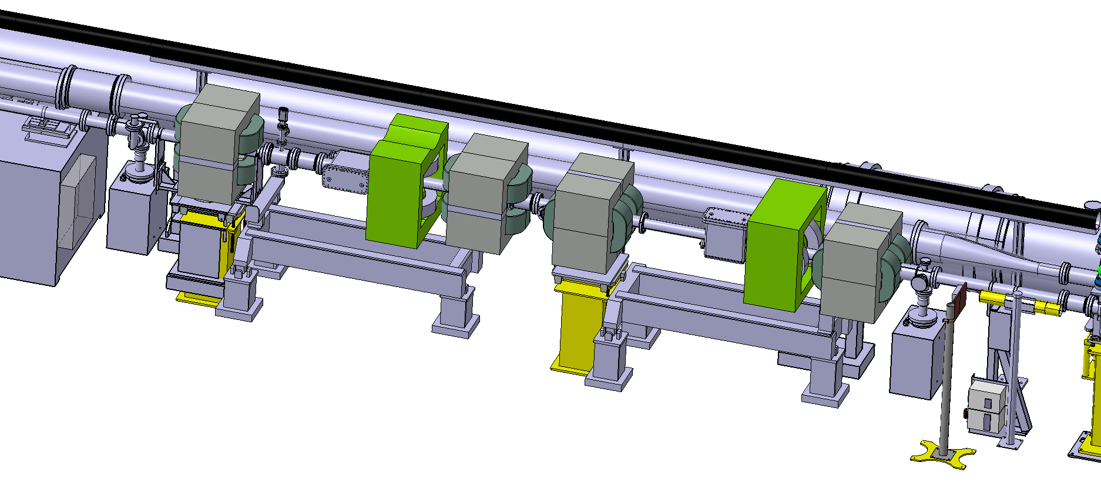
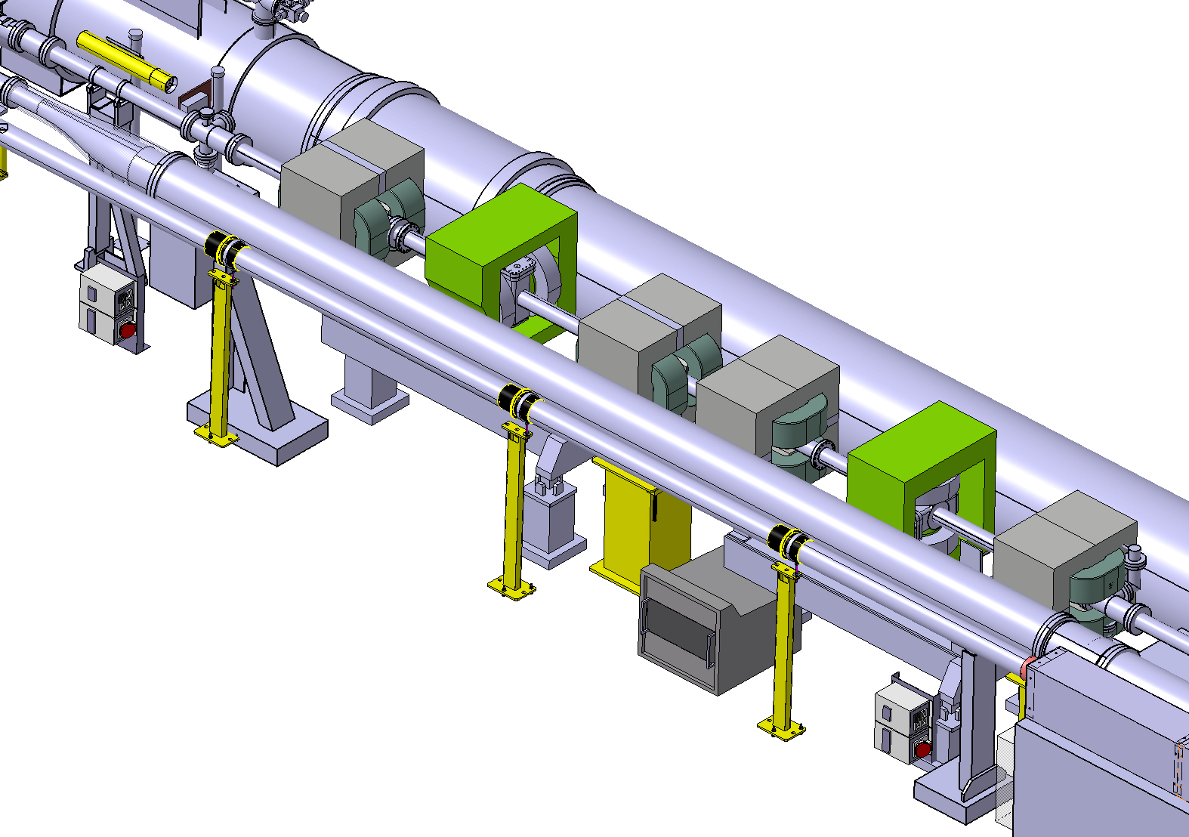
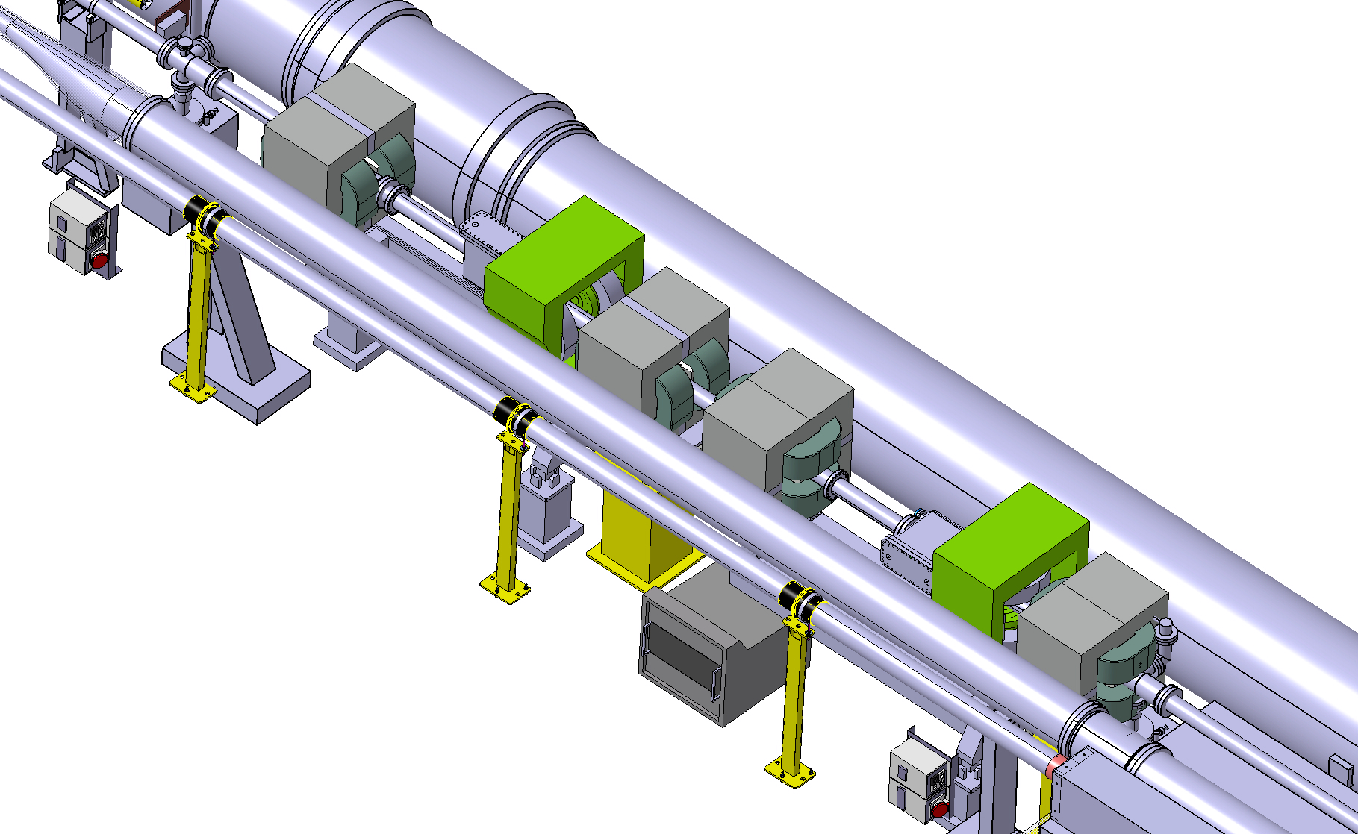
Magnet integration and layout
The configuration of the magnets is the following: 2 MDX magnets (in grey) are set on each side of the BGI magnet (in green). Identical distance between each magnet during operation is ensured for symmetry purposes. To access the instrument the BGI magnet is slided longitudinaly thanks to movable supporting devices recovered from the previous setup and to be adapted especially for the downstream MDX magnet.
5L4 configuration top view:
Fig.4 Operating configuration
Fig.5 Instrument access configuration
5R4 configuration top view
Fig.6 Operating configuration
Fig.7 Instrument access configuration

Slide 6
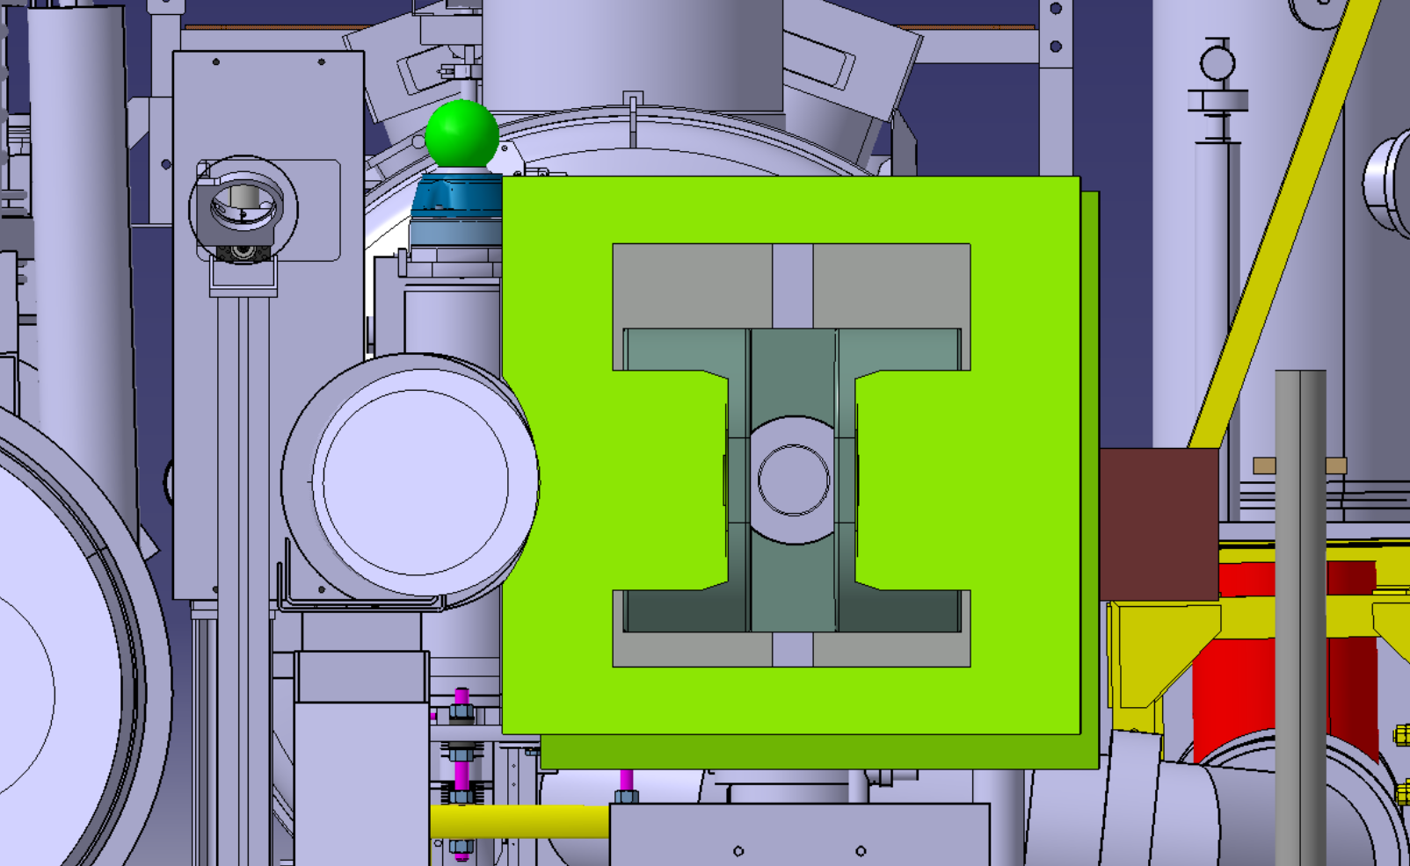
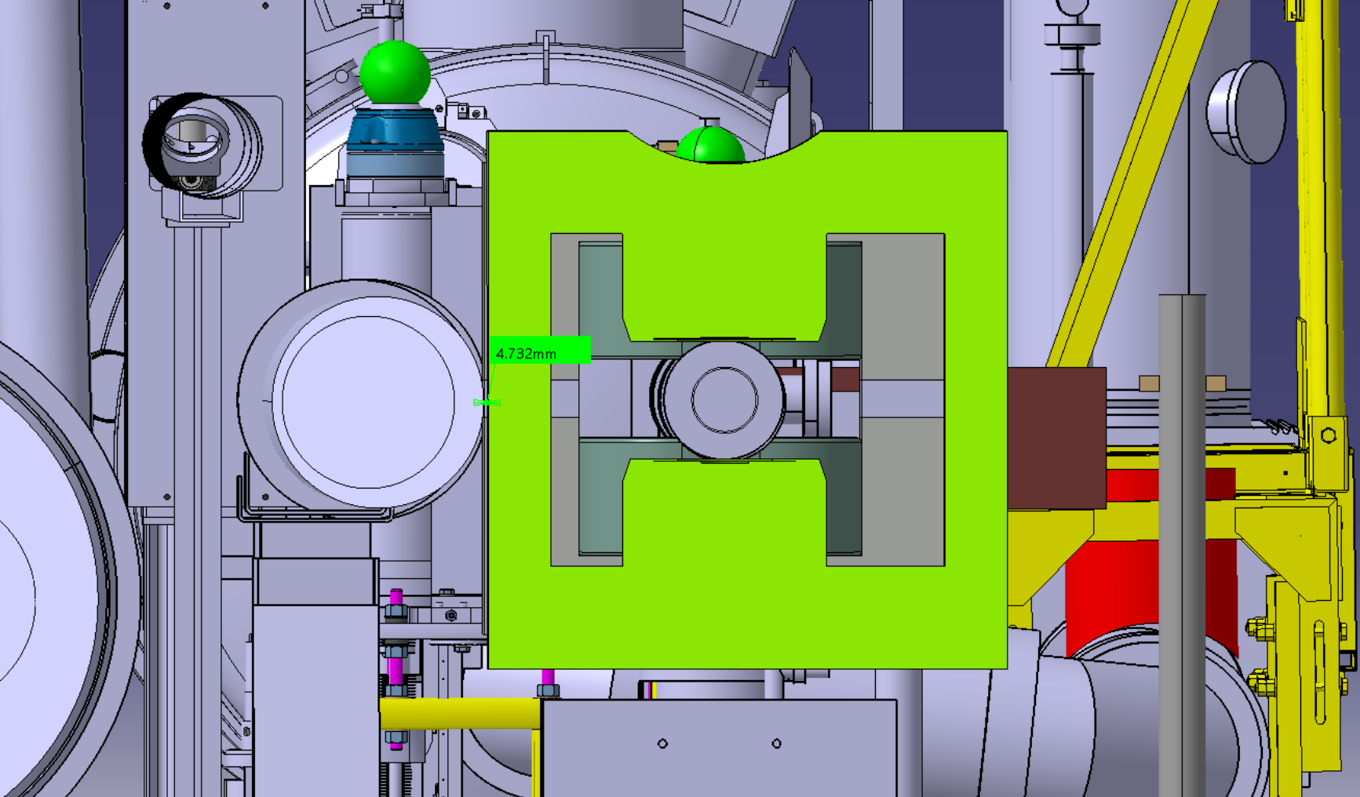
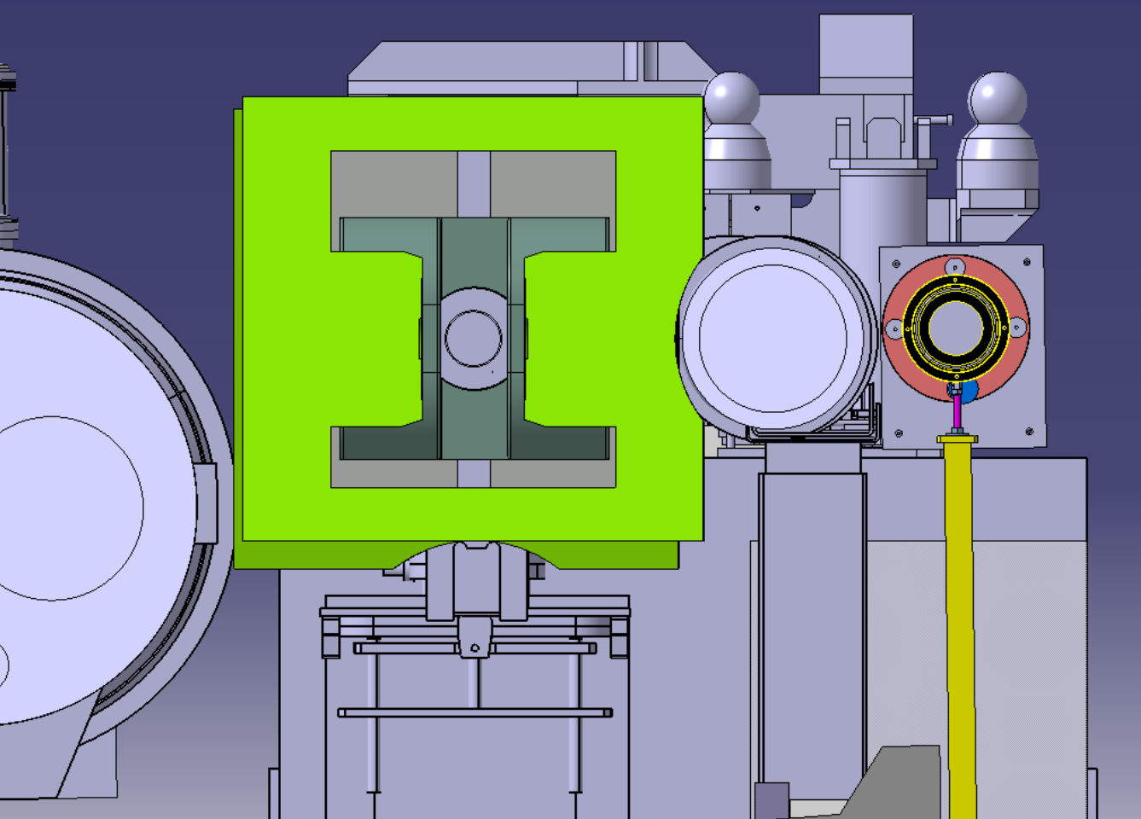
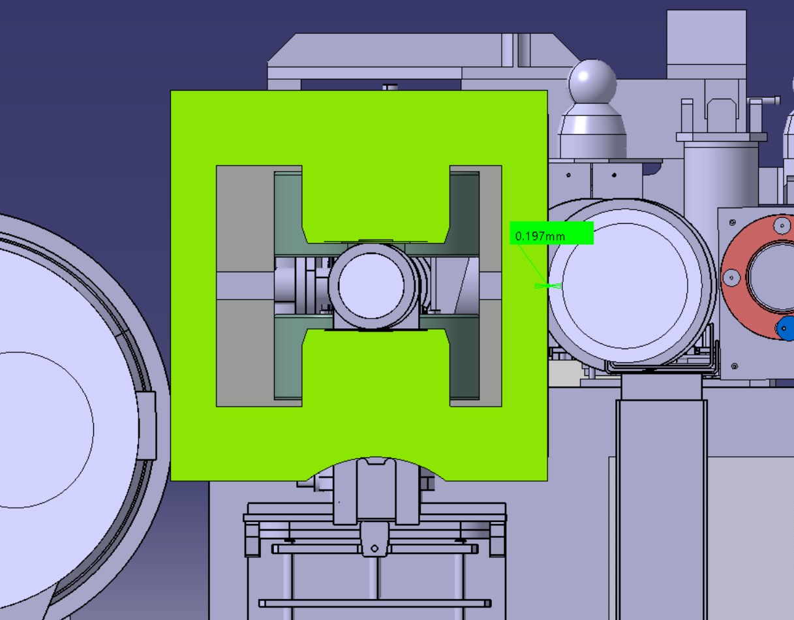
Magnet integration and layout
The BGI magnet yokes are shaped so that they do not interfer with the adjacent equipment. It allows installation / removal with vertical lifting devices such as crane.
5L4 configuration top view:
Fig.8 Horizontal field configuration
Fig.9 Vertical field configuration
5R4 configuration top view
Fig. 10 Horizontal field configuration
Fig.11 Vertical field configuration

Slide 7
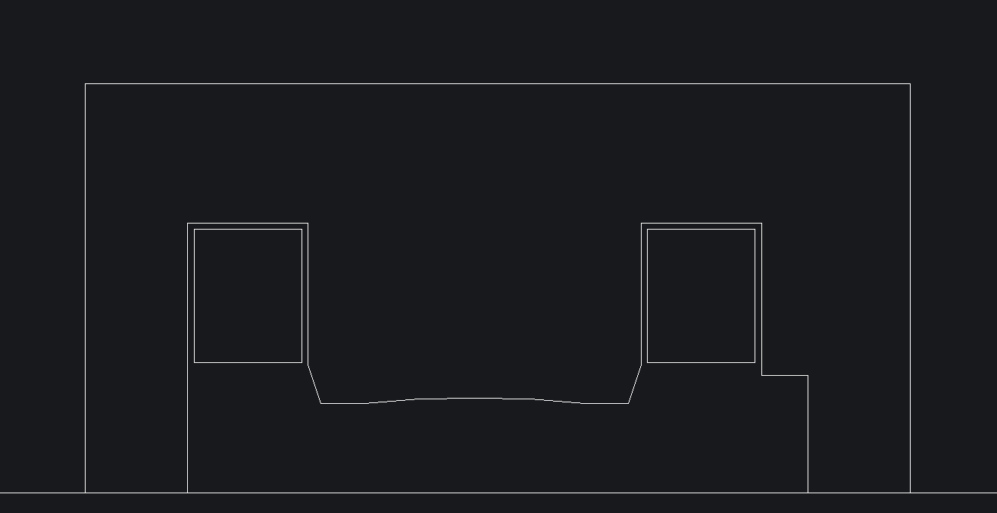
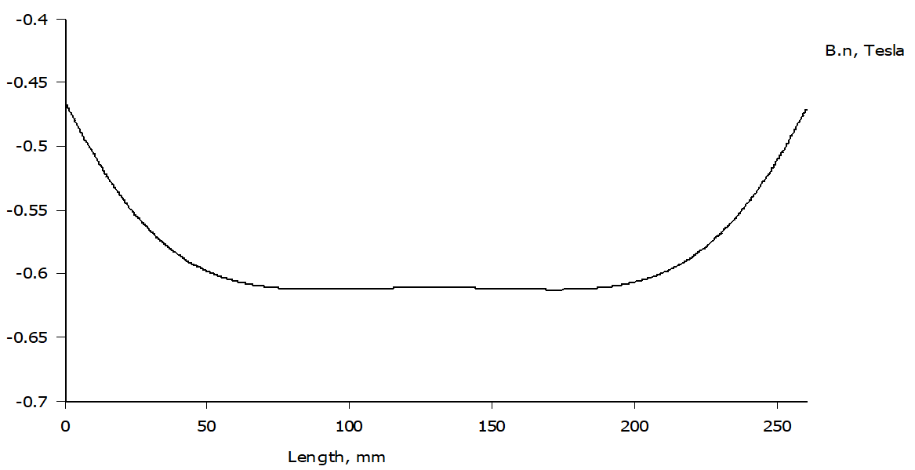
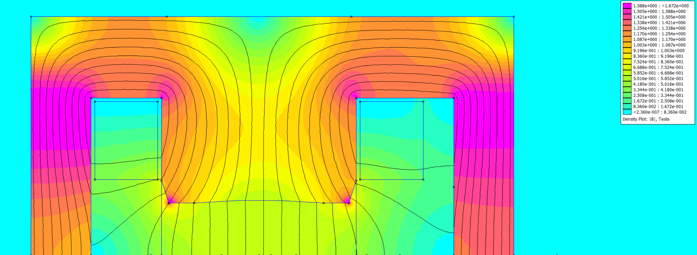
BGI magnet design proposal
The BGI magnet used to generate the B field to the beam instrumentation is a H window solid yoke with cylindrical pole shape made of ARMCO ©. The magnet design fits to the 4 configurations. 2 ring like coils are used to optimize the electrical resistance w.r.t. the converter performances. The optimization of the pole profile is tapered on the last 30 mm and has a radius of 1000 mm on the pole tip corresponding to the best field homogeneity in the defined Good Field Region. The pole offset is 4 mm due to the R 1000 mm radius. 70562 amperes turns provides 0,6T in the magnet gap at 485 amperes. The magnetic efficiency is 94,7%. The return yokes are asymmetrical due to space constraints mainly due to the detector instrumentation supply and measurement cables.
Fig.12 2D drawing with instrument integration
Fig.14 B field in transverse axis
Fig.13 2D FEMM magnetic simulation

Slide 8
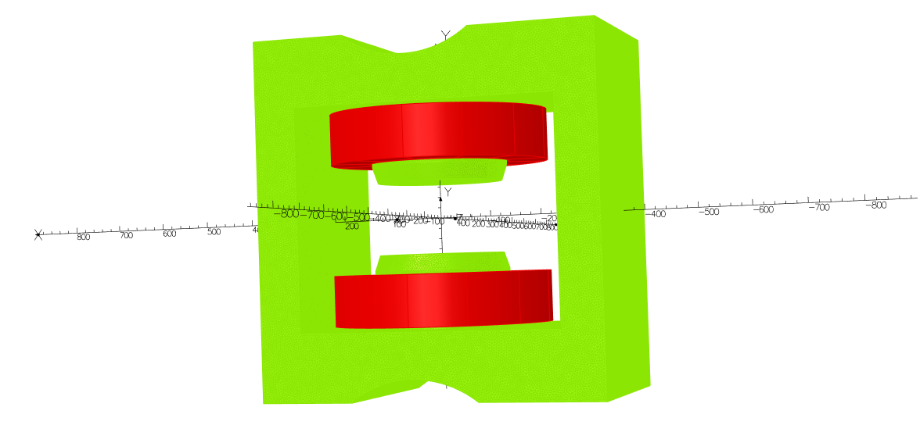
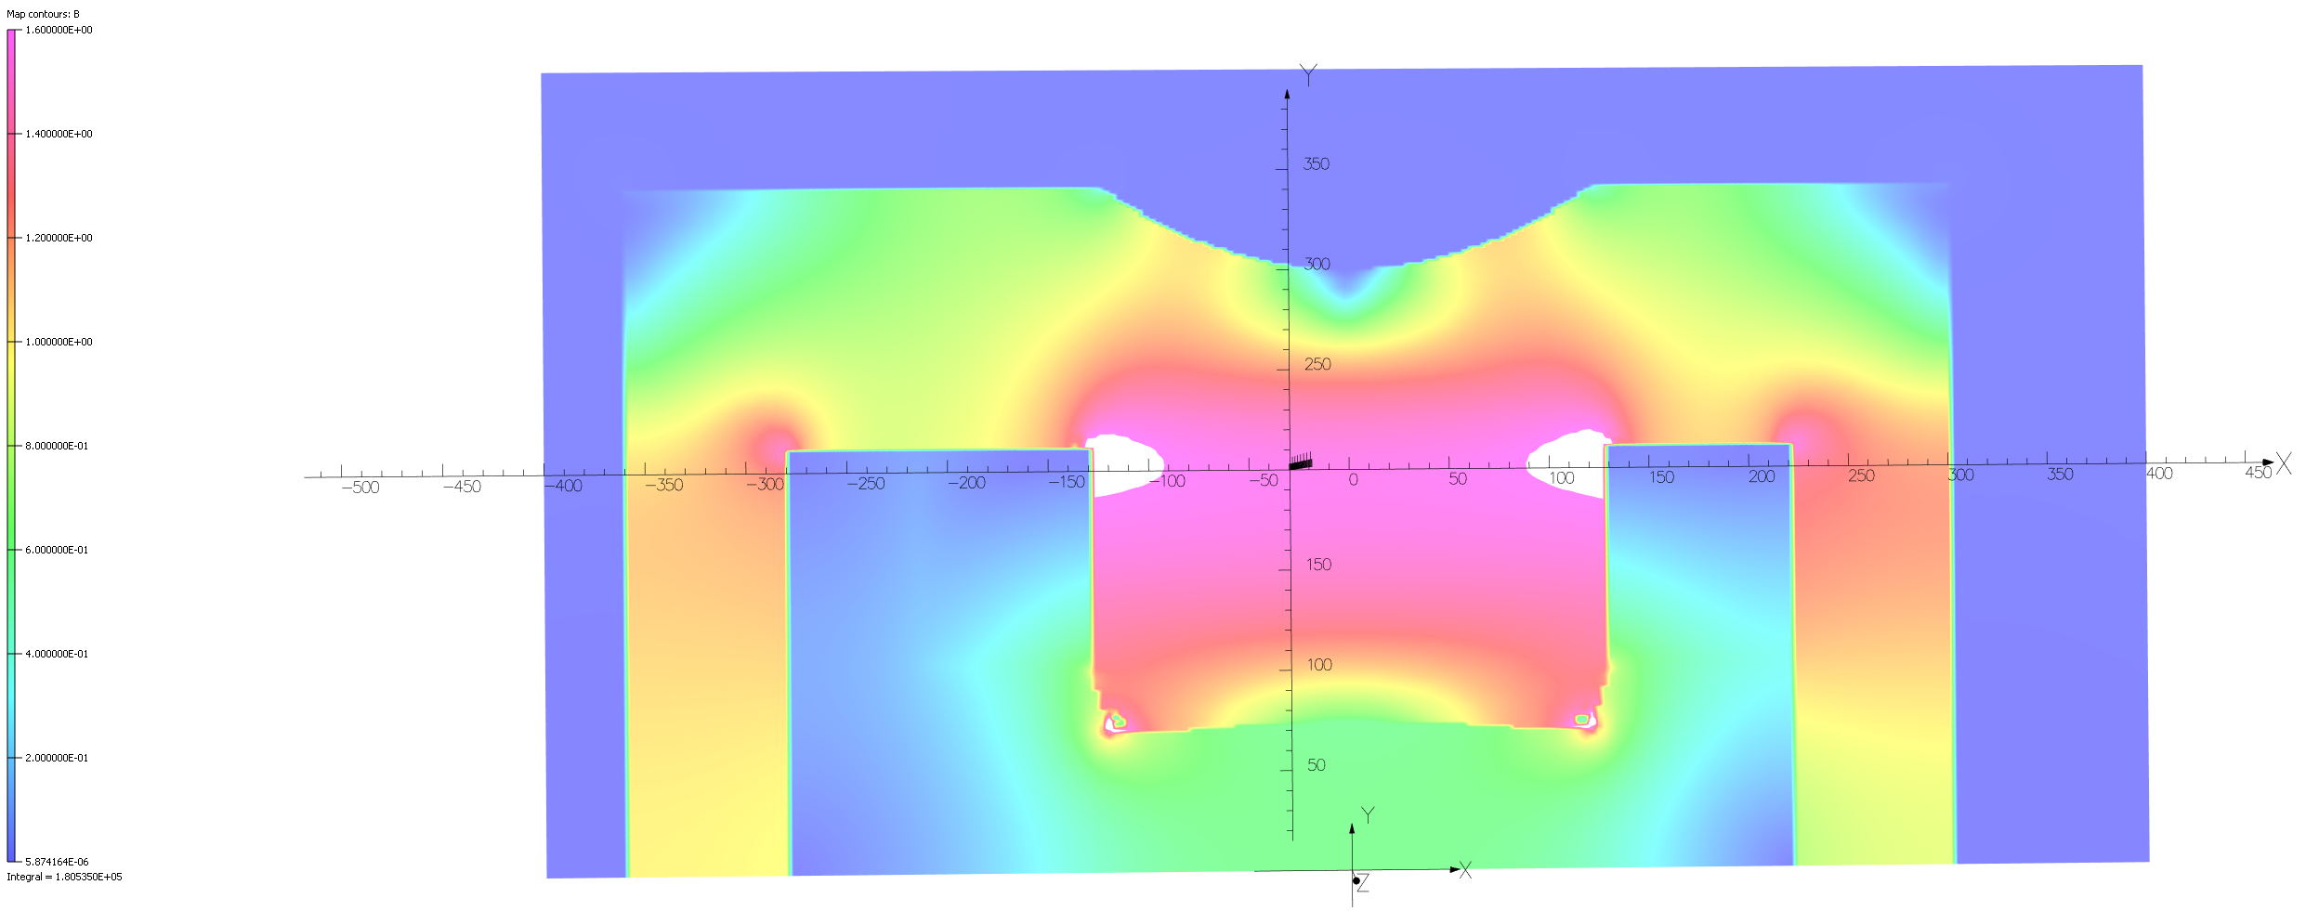
BGI magnet design proposal
The pole outer radius is 130 mm. The yoke length is larger than the pole tip by 60 mm en each side to reduce iron saturation by 120 mm. Small area on the yoke has a magnetic field of 1,6T (see Fig.17). The field homogeneity is dependent of the vertical position By (see Fig.16). The optimization of the pole tip with a 1000 mm radius allowing the By field to be 4 e⁻⁴ and 6,5 e⁻⁴ within the 1 e⁻³ in the defined volume of x=30, y=56 (including the offset), z=30 mm.
Fig.15 3D model of the BGI magnet
Fig.16 3D model of the BGI magnet
Fig.17 3D Field intensity in the yoke (transverse view)

Slide 9
BGI magnet performances
The following information stand for the non-symetrical yoke model:
The ʃ B.dl = 0,211 Tm at 0,6T.
Normalized harmonic values R=30 mm L= 2 m
Table 1: Harmonics
Table 2: Coils data
 | Absolute values | Relative values
B1 [Tm] | 0,214
B2 [units] | 0,033 | 3,08
B3 [units] | 0,213 | 19,85
B4 [units] | 4,98e-4 | 2.18E-03
B5 [units] | 0,00269 | -4.79E-01
B6 [units] | 5,25e-5 | -1.40E-04
B7 [units] | 0,223e-3 | -2.28E-01
B8 [units] | 6,22e-5 | 3.60E-04
Coils data
# of Turns/coil | 72
Conductor size | 10x10x4 mm
I density | 5,66 A/mm²
Cooling circuits | 2/coil
Water velocity | 2,5 m/s
Water flow/coil | 7,5 l/min
Total dissipated power | 9,19 kW
R magnet | 0,039 Ω
Temperature increase | 18 degC

Slide 10
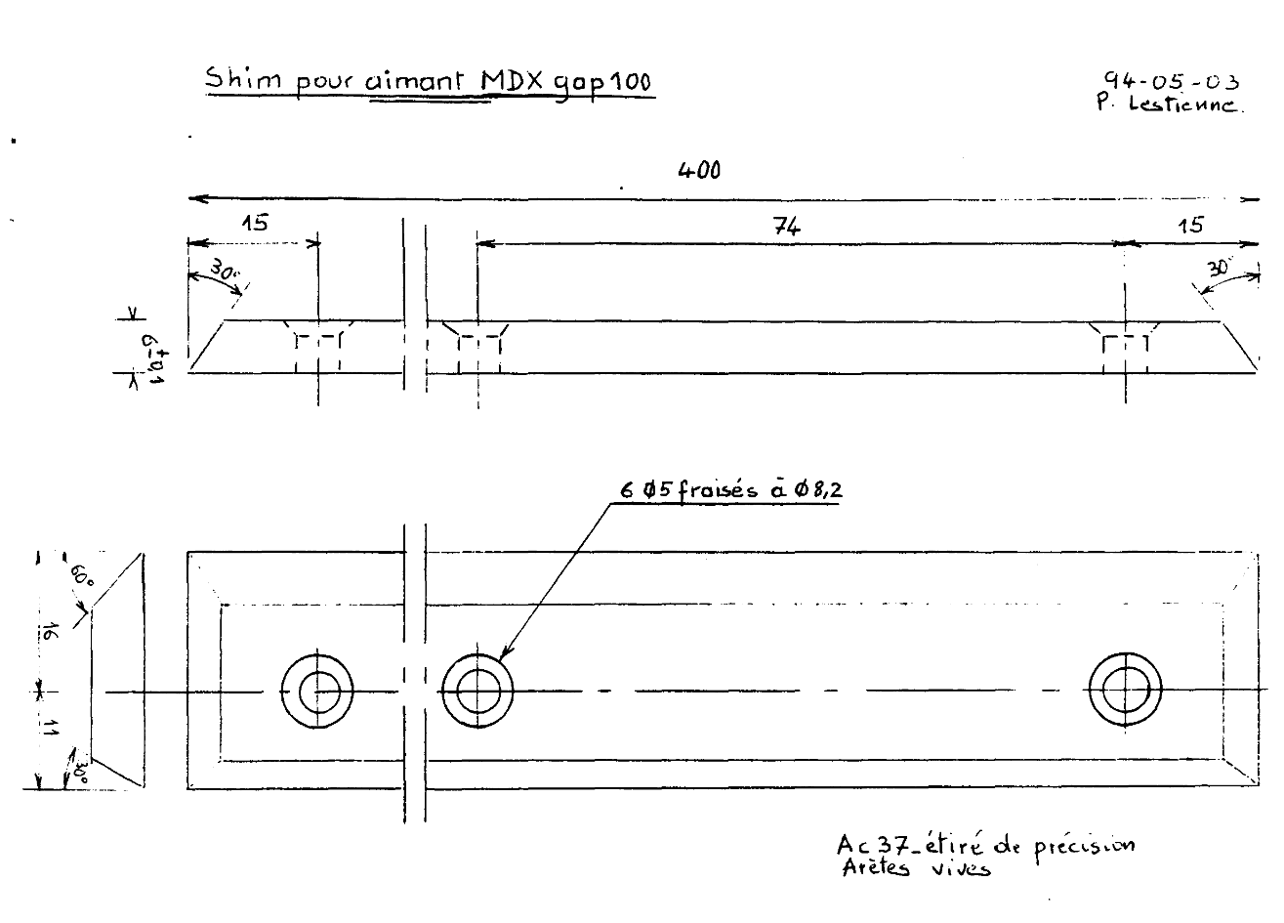
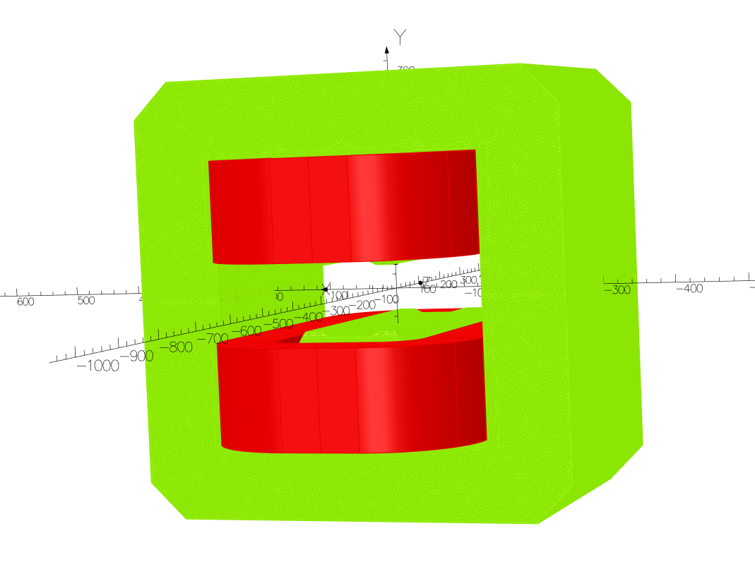
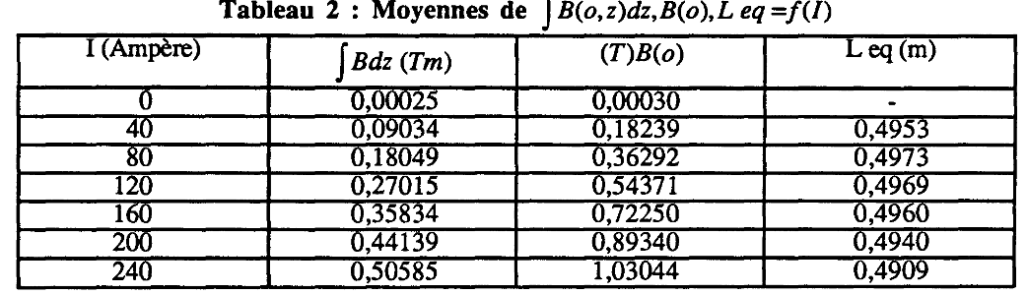
MDX magnet
The MDX magnet is a H type bending solid yoke magnet with adjustable aperture. The integration of this magnet type does not requires any yoke modification appart from the supporting structure. In our case the aperture is 100 mm for a vacuum chamber of 85 mm outer diameter. The magnet yoke dimensions are 600 x 600 x 400 mm. B field cancelling by upstream and downstream MDX B field= 0,002120 Tm/A. 0,211 x 0,002120/2= 44,4 A (30% lower than previous design with rectangular pole shape). Specific shim made experimentaly are designed. The connections are to be moved to the top of the magnet for the 5R4 location due to space constraints.
edms 966185 v.1
Fig.19: 100 mm gap MDX magnetic shims
Table 3: Transfer function of the 100 mm gap MDX (archive)
Fig.18: MDX magnetic model

Slide 11
MDX magnet performances
Table 4: Harmonics
Table 5: Coils data
 | Absolute values | Relative values
B1 [Tm] | 57.44
B2 [units] | -5.48E-14 | -9.54E-12
B3 [units] | 0.115 | 2.00E+01
B4 [units] | -2.24E-14 | -3.89E-12
B5 [units] | -0.268 | -4.67E+01
B6 [units] | 4.19E-15 | 7.30E-13
B7 [units] | 0.05973 | 1.04E+01
B8 [units] | -2.13E-15 | -3.71E-13
Coils data
# of Turns/coil | 180
Conductor size | 6,5x6,5x3,5 mm
I density | 1,4 A/mm²
Cooling circuits | 4/coil
Water velocity | 2,35 m/s
Water flow/coil | 710 l/min
Total dissipated power | 0,38 kW
R magnet | 0,1936 Ω
Temperature increase | 0,5 degC
The magnet configuration made of 2 MDX and one BGI generates a B field = 0 Tm when the operating current is set to self cancelling. The self cancelling effect is independent of the particle energy. For information the BGI magnets produces a beam deflection angle of 0,148 and 0,010 mrad at a Ek of 450 and 7000 GeV respectively.

Slide 12
Operating voltages
The following tables shows the total requested voltage per circuit. It includes the magnets and the supply cables.
Table 6: BGI magnet operating voltage
Total voltage drop of the BGI magnet + supply cables
Magnet ID | BGIV.A5L4 | BGICV.A5L4 | BGIH.A5L4 | BGICH.A5L4 | BGIV.A5R4 | BGICV.A5R4 | BGIH.A5R4 | BGICH.A5R4
Length PC to M [m] | 64 | 73 | 62 | 70 | 64 | 73 | 59 | 67
Total cable length [m] | 128 | 146 | 124 | 140 | 128 | 146 | 118 | 134
Cable cross section [mm2] | 480 | 480 | 480 | 480 | 480 | 480 | 480 | 480
Rho copper | 1,72E-08
Cable R [ohm] | 0,009 | 0,010 | 0,009 | 0,010 | 0,009 | 0,010 | 0,008 | 0,010
Operating voltage magnet + cables [V] | 23,2 | 23,9 | 23,1 | 23,7 | 23,2 | 23,9 | 22,9 | 23,5
Table 2: Coils data
Table 7: MDX magnets operating voltage
Total voltage drop of 2 MDX magnets + supply cables
Magnet ID | BGIV.A5L4 | BGICV.A5L4 | BGIH.A5L4 | BGICH.A5L4 | BGIV.A5R4 | BGICV.A5R4 | BGIH.A5R4 | BGICH.A5R4
Length [m] | 64 | 73 | 62 | 70 | 64 | 73 | 59 | 67
Total cable length [m] | 128 | 146 | 124 | 140 | 128 | 146 | 118 | 134
Cable cross section [mm2] | 95 | 95 | 95 | 95 | 95 | 95 | 95 | 95
Rho copper | 1,72E-08
Cable R [ohm] | 0,046 | 0,053 | 0,045 | 0,051 | 0,046 | 0,053 | 0,043 | 0,049
Operating voltage magnet + cables [V] | 36,0 | 37,0 | 35,8 | 36,6 | 36,0 | 37,0 | 35,4 | 36,3
The maximum operating voltage for the BGI 23.9V is well below the 40V limit,and for the 2 MDX 37V below the 125V.
The BGI operating current is 490 A for a I max of 600A, the MDX magnets connected in serie by two are operated at 44.4 A for a I max of 125A.

Slide 13
Cost / Planning
The cost estimation for the procurement of the magnets is detailed as follow:
One pre-serie magnet for magnetic measurements / optimization: 75 kCHF, lead time 9 months.
Series production of three magnets: 150 kCHF Lead time 1 year if the magnets are similar to the pre-serie unit.
One spare coil set: 20 kCHF
Renovation and configuration (vertical versions) of 8 +2 spares MDX magnets: 100 kCHF
Magnet support structures: BGI magnets table modification: 20 kCHF
Supporting posts for MDX magnets: 12 kCHF
Total: 377 kCHF
Procurement lead time is 3 years from the design validation to commissioning.

Slide 14
Conclusions
The magnetic model of the BGI-LHC magnets provides the requested B field of 0.6 Tesla with the required field quality of 10e⁻³ in the defined Good Field Region.
The MDX magnet used as trim magnets operate as field canceling magnets and ensure the beam is set back to its orbit. As those magnets are available they reduce procurement costs.
The magnets are compatible with the available space, the power and cooling constraints, using available power converters for all magnets and power cables for trims only.

